Slide 1
Review of BI specs for TT21/22/23/24/25
F.M. Velotti, V. Kain, Y. Dutheil, M. Fraser

Slide 2
Previous documents and specs
Initial specifications for TT20 and other primary lines covered already a large part of the new instrumentation needed
After 2021 startup, and in the context of the review of the issues had, it was decided to review our requests
  Original request: https://edms.cern.ch/document/2113420/0.1
  This document was discussed already in the context of the SLAWG with BI colleagues – proposed changes included already feedback on what could be done and to not explode in terms of cost
We are now summarising all the changes that ideally we would do to these lines

Slide 3
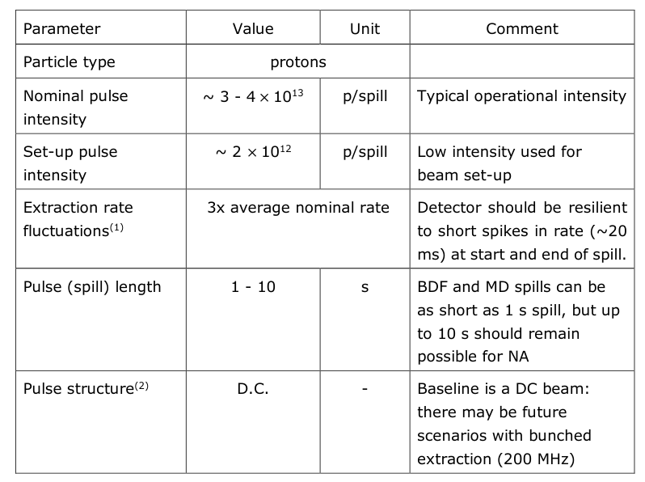
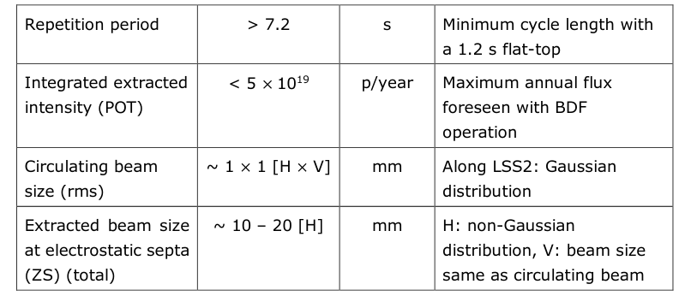
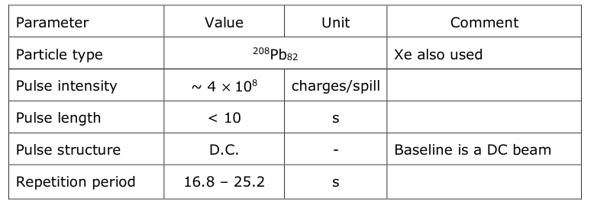
Beam parameters assumed
For the specification we have used the assumptions in the tables on the side
It was agreed in the NA meetings that clear numbers taking into account also possible future projects, should be provided – they are not these ones!
Brennan and Gianluigi will follow this up

Slide 4
Changes already in place
The different monitors in the TT20 lines are now PPM
We access to data on the different BSPs, BSGs and BSIs in time along the spill with sampling rate of 20 ms
Six additional BLMs have been installed along TT20 during YETS 17/18
Two new diamond BLMs have been installed in LSS2 and start of TT20, although they have not been commissioned yet
A longitudinal BLM has been installed (refurbished) but it is not been commissioned yet

Slide 5
Requests for new instrumentation - position
Available BSPs in TT20 lines are very difficult to use for any optics measurements
  Position measurement becomes unreliable as soon too far off from center
  Not reliable for non-symmetric distribution
Requests to have devices to measure accurately position at all locations of BSPs => replace BSPs with BPMs or BSGs or equivalent
  Are BPMs an option? 200 MHz and 40 kHz still present in the first part of the extraction – could this be used for BPM?
  We could define an operational scenario with RF on, like move to amplitude extraction to be able to extract bunched beams with not too high losses
  Exhange should be performed in TT21/22/23/24/25
  Higher priority for TT22/23/24/25
Line | Number or BSPs
TT21 | 19
TT22 | 3
TT23 | 4
TT24 | 4
TT25 | 5

Slide 6
Requests for new instrumentation – beam size
Large coverage with BSG provided already in vertical, but quite a few key locations missing in horizontal
We need to increase the horizontal coverage especially after the splitters and before the targets
  Request to have at least 3 BSG per plane per line (see table for what is missing)
Replace 3 BSPs with BSGs as in specification document (see also here) for TT21
Refurbish BTVs in 2116 (~ 20 m upstream first MSSB), 2117 (~20 m downstream first MSSB) and 2204 (~20 m upstream of second MSSB) and provide resolution of 1-2 mm
Single-shot beam profiles before and after the extraction septa (ZS, MST, MSE) are requested with a resolution approaching 0.1 − 0.2 mm
If possible, add FISKs in the line for accurate beam profile measurements and time-resolved
Line | Number of BSGHs to add | Number of BSGVs to add
TT22 | 2 | -
TT23 | 2 | -
TT24 | 2 | 1
TT25 | - | -

Slide 7
Requests for new instrumentation – intensity
BCT exploiting remanent harmonics in spill? Or again exploit special operation mode to allow extraction of bunched beam for calibration
High-bandwidth spill monitor needed to assess harmonic content of extracted spill
  It is needed to be able to resolve 43 kHz (revolution frequency) and twice that (86 kHz as 2 batches)
  Up to 200 MHz (RF frequency) would be ideal for accurate measurements of spill quality
  Ensure low noise first BSI in TT20 for accurate noise compensation (high BW not needed for this)
  Future experiments are requesting knowledge of the beam harmonics up to 10 GHz
  Spill monitor should be sensitive enough to allow measurements with ions too
For long term prospects (post-LS3), it was proposed to investigate a possibility to measure beam intensity at %-level
For now, working on procedure to calibrate BSIs in TT20

Slide 8
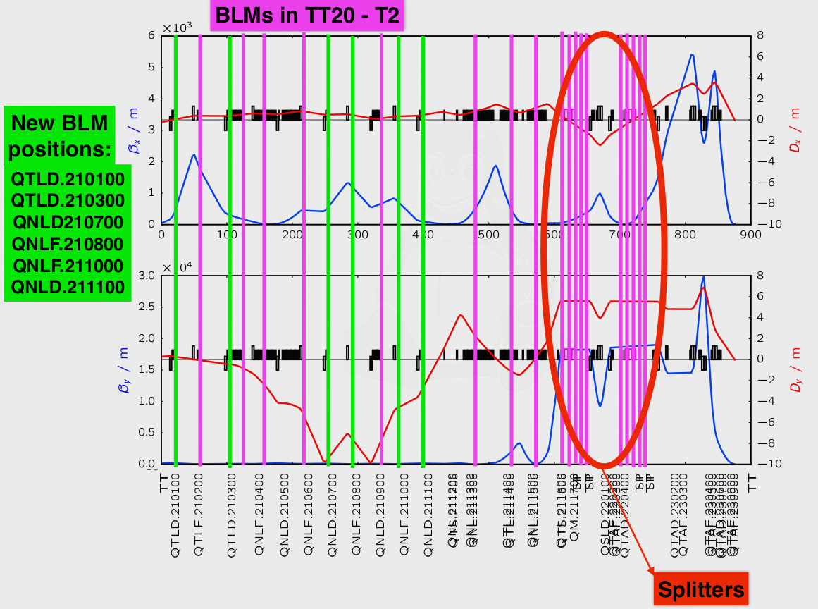
Requests for new instrumentation – losses
TT23/24/25 not equipped with BLMs: request to add 1 BLM per quadrupole in these 3 lines (lines from splitters to primary targets)
LHC BLMs available in LSS2, but in non-PPM mode: request to have them in the SPS timing system to be able to simplify readings and integrate with standard tools

Slide 9
Summary
Specification for primary line to NA completed with all unrestrained desires
ASAP:
  High BW spill monitor and low noise spill monitor
Highest priority items:
  Add BSGs in TT22/23/24 to achieve at least 3 BSG per plane per line
  Replace all BSPs with BPMs/BSGs or any other position device to improve measurement quality and range
  Refurbish BTVs at splitter location for real beam size measurements
  Add 1 BLM per quadrupole in TT23/24/25

