Slide 1
ISRS Workshop 6 January 2022
Development Plan for the ISRS CCT
Davide Tommasini with Matthias Bonora, Ariel Haziot, Glyn Kirby, Melvin Liebsch, Diego Perini, Carlo Petrone, Stephan Russenschuck, Gerard Willering

Slide 2
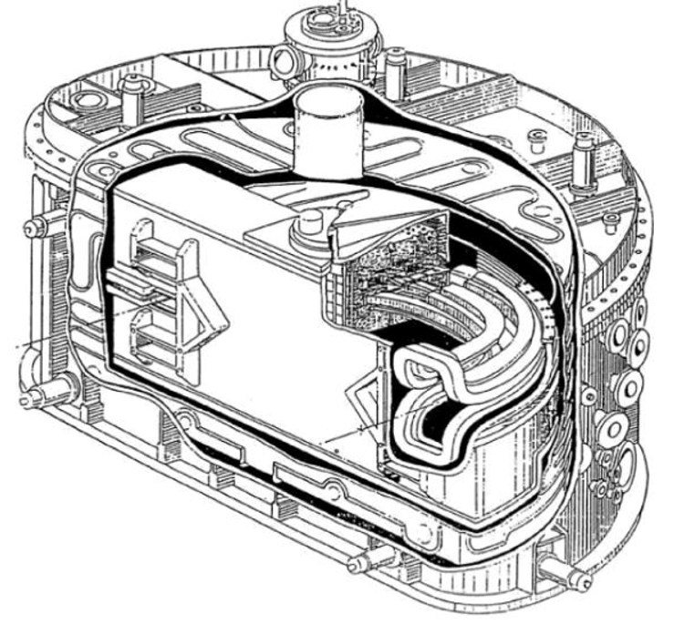
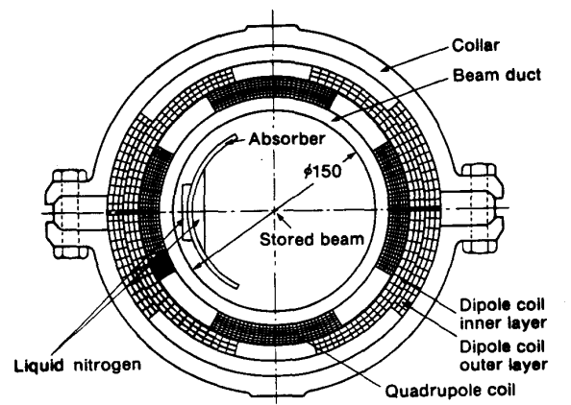
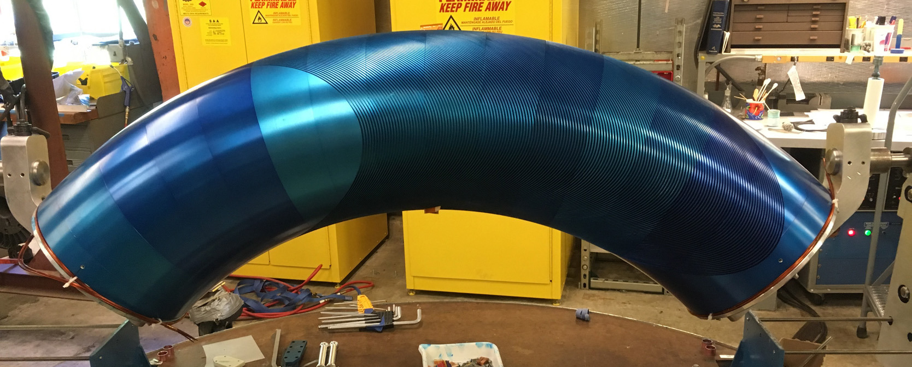
Scope
Design, manufacture and tests (cold tests and magnetic measurements) of a demonstrator for the ISR Project:
4 T peak field CCT, 90° angle, 1-m radius, 250 mm aperture
In addition to a dipole field of 2.2 T, the magnet shall also provide alternated focusing FDF (13 T/m) over its length.
The closest magnet to these specifications is a CCT built at LBNL in 2019, producing a 2.4 T dipole field in a 290 mm clear bore diameter, with a bending radius of 0.9 meters over a bending angle of 50°, no alternated function.
Also references are bending magnets for lithography :
700 MeV compact synchrotron Helios (Oxford Instruments, 1989), bending angle 180°, bending field 4.5 T with gradient of 1.8 T/m, bending radius 0.5 meters
600 MeV compact synchrotron Niji 3 (Sumitomo, 1991), bending angle 90°, bending field 4.0 T with gradient of 4.0 T/m, bending radius 0.5 meters, aperture 150 mm.

Slide 3
Milestones and deliverables
ID | Description | Time
M1 | Setting up of design tools | T₀+6
M2 | Completion of winding tests (different conductors and formers) | T₀+9
D1 | Test of a small scale straight CCT with gradient | T₀+12
D2 | Preliminary conceptual design report of the demonstrator | T₀+15
M3 | Setting up of magnetic measurement tools for bent magnet | T₀+17
D3 | Test of a small scale bent CCT with gradient | T₀+18
D4 | Test (magnetic measurements) of a Cu dummy demonstrator | T₀+20
D5 | Test of the demonstrator | T₀+24
https://indico.cern.ch/category/14538

Slide 4
Setting-up of design tools
ID | Description | Time
M1 | Setting up of design tools | T₀+6
Making the CERN version of Field operational for the base development
Identify strategies for integration with Opera/Roxie
Identify strategies for the drawing of the formers
On a longer term it is desirable to develop a “reference design tool” for CCTs, but this is NOT within the scope of this specific activity.
Ariel + Matthias with support from Glyn

Slide 5
Winding tests
ID | Description | Time
M2 | Completion of winding tests | T₀+9
Definition of allowed configurations of conductors and of channels geometries
Exploration of materials for the former
Exploration of machining/forming techniques
Ariel + Diego with support from Glyn

Slide 6
Straight small scale CCT with gradient
ID | Description | Time
D1 | Test of a small scale straight CCT with gradient | T₀+12
Conceptual and engineering design
Manufacture
Test & magnetic measurements
Ariel + Carlo + Gerard with support from Diego and Glyn

Slide 7
Conceptual design of the demonstrator
ID | Description | Time
D2 | Preliminary conceptual design report of the demonstrator | T₀+15
Based on winding tests and experience from the straight small scale CCT
Ariel with support from Glyn

Slide 8
Setting-up of magnetic measurements tools
ID | Description | Time
M3 | Setting up of magnetic measurement tools for bent magnet | T₀+17
Definition and analysis of measurables
Setting up the tools for magnetic measurement at ambient temperature
Magnetic measurements at cold ?
Carlo and Melvin with support from Stephan and Glyn

Slide 9
Bent small scale CCT with gradient
ID | Description | Time
D3 | Test of a small scale bent CCT with gradient | T₀+18
Conceptual and engineering design
Manufacture
Test & magnetic measurements
Ariel + Carlo + Gerard with support from Diego and Glyn

Slide 10
Cu dummy demonstrator
ID | Description | Time
D4 | Test (magnetic measurements) of a Cu dummy demonstrator | T₀+20
Conceptual and engineering design
Manufacture
Test & magnetic measurements
Ariel + Carlo + Gerard with support from Diego and Glyn

Slide 11
CCT demonstrator
ID | Description | Time
D5 | Test of the demonstrator | T₀+24
Engineering design
Manufacture
Test & magnetic measurements
Ariel + Carlo + Gerard with support from Diego and Glyn

