Slide 1
ISRS Workshop 6 January 2022
Ressources and budget
Diego Perini with Davide Tommasini, Ariel Haziot, Glyn Kirby, Diego Perini, Stephan Russenschuck, G. Riddone

Slide 2
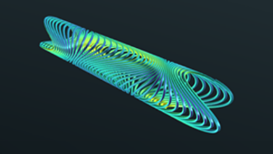
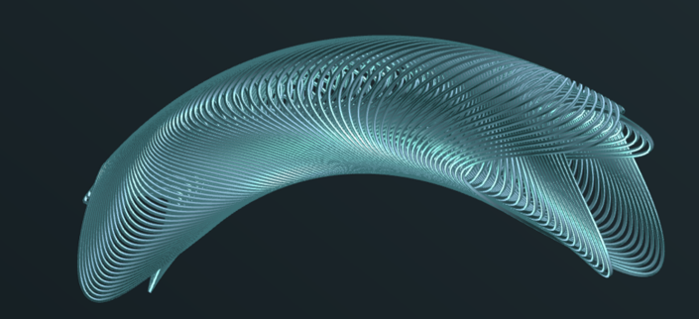
Scope, deliverables and milestones
Design, manufacture and tests (cold tests and magnetic measurements) of a demonstrator for the ISR Project.
4 T peak field CCT, 90° angle, 1-m radius, 250 mm aperture (see Davide’s talk)
Programme spanning over 2 years
  Hardware deliverable:
    Small scale straight model, T₀ + 12 m
    Small scale curved model, T₀ + 18 m
    Curved dummy copper, T₀ + 20 m
    Curved demonstrator, T₀ + 24 m
To do all this we need as well:
  Former production tests
  Measuring tools and procedures (see Stephan's talk)
We are at the beginning. Certain estimations correspond to what we know today.

Slide 3
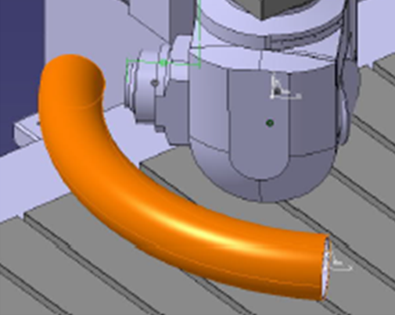
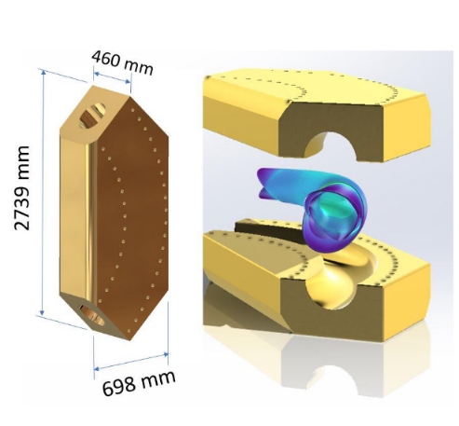
Tests |  | T₀ + 9
Former manufacturing tests | 20000
Former material tests | 50000
Design office | 10000
Small scale straight model with gradient |  | T₀ + 12
Former | 20000
External structure | 20000
Design office | 10000
+ Cable | 8000
Small scale curved model with gradient |  | T₀ + 18
Former | 20000
External structure | 20000
Design office | 10000
+ Cable | 8000
Curved dummy copper |  | T₀ + 20
Former | 30000
Design office | 10000
Curved demonstrator |  | T₀ + 24
Former | 30000
External structure | 70000
Assembly tools | 50000
Design office | 15000
+ Cable | 15000
1 FSU equivalent for a period of two years | 180000
Material costs
Total 596000 CHF

Slide 4
Manpower for design and manufacturing
Manpower (per year, over two years)
Fellow | 1
Engineering (Glyn) | 0.2
Other engineering | 0.3
CERN technicians | 0.5
110000/year

Slide 5
Measurements
Further evaluations and studies have to be carried out.
At the moment there are different possibilities. The cost and the necessary resources could stay in the following windows:
Materials from 50000 to 250000 CHF
Manpower from 0.1 to 0.5 Engineer
from 0.5 to 2 Student

Slide 6
Summary
Materials for magnets
  596000 (including 180000 for a FSU equivalent)
Manpower for design and manufacturing
  220000 (fellow 2 years)
  1 FTE per year for two years
Measurements
Materials from 50000 to 250000 CHF
Manpower from 0.1 to 0.5 Engineer, from 0.5 to 2 Student.

