Slide 1
Beamstrahlung and GUINEA-PIG
Daniel Schulte

Slide 2
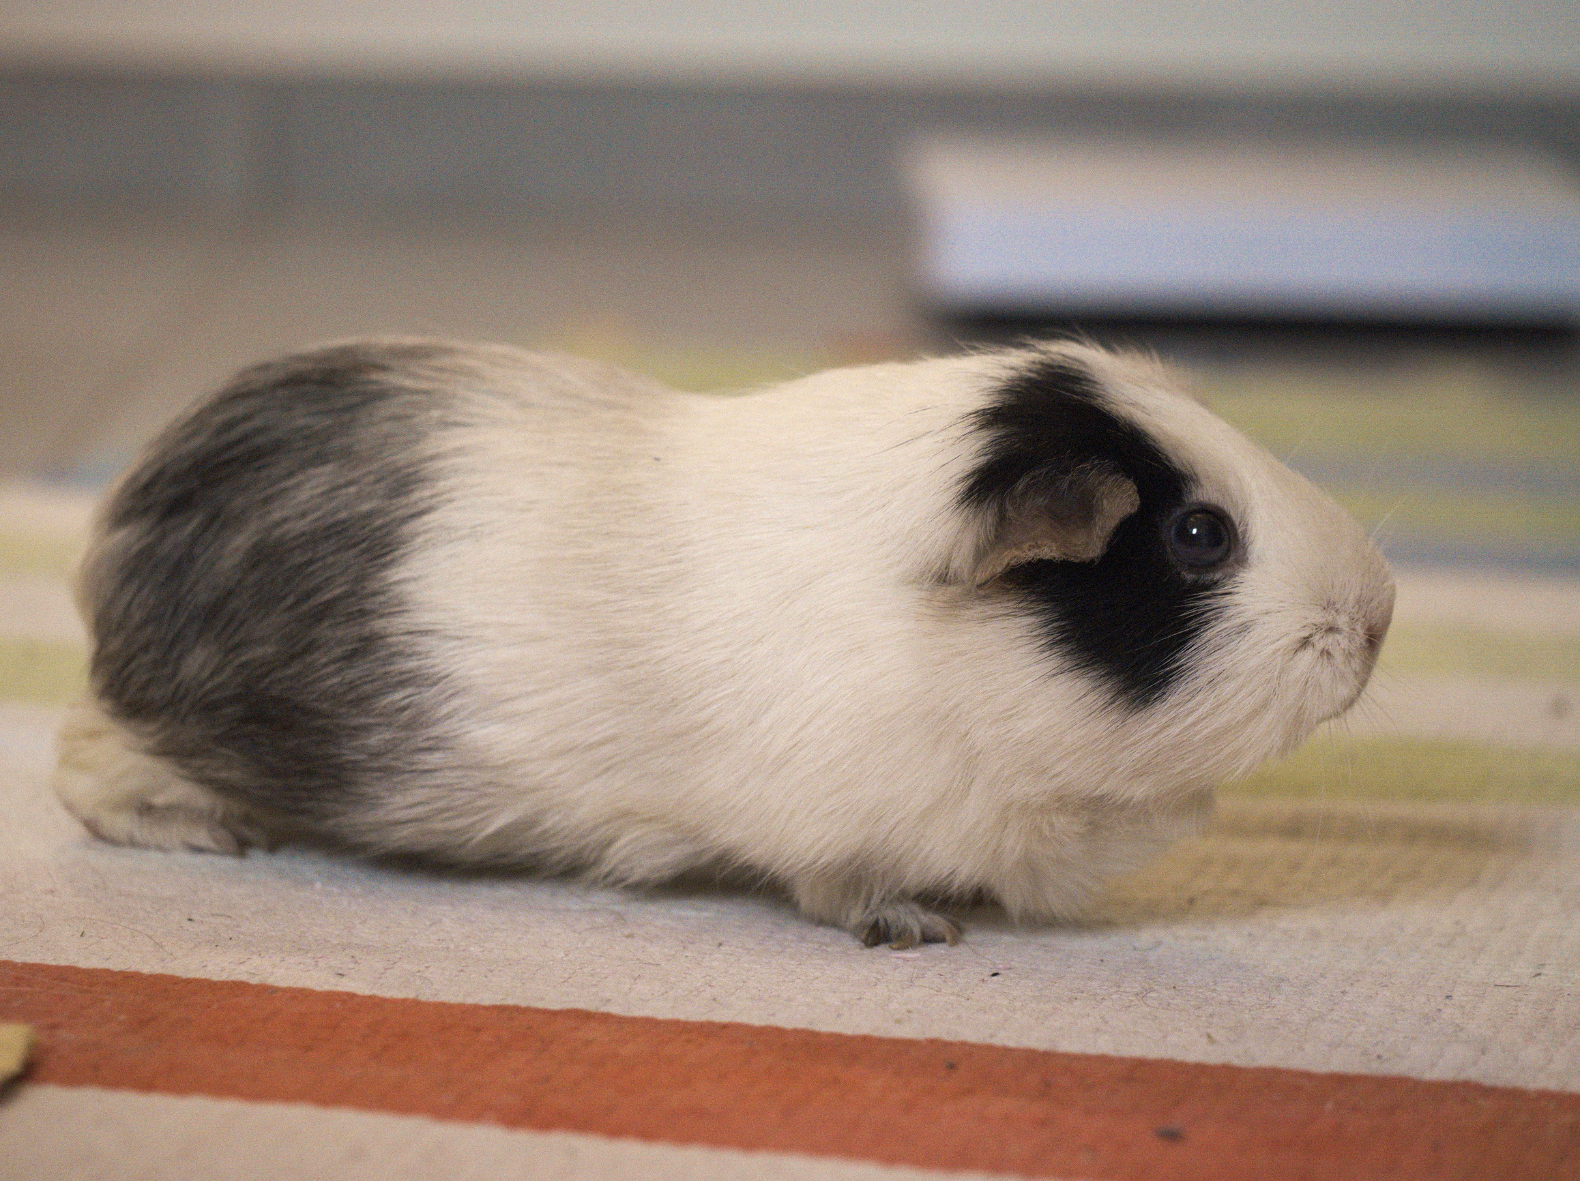
Introduction
GUINEA-PIG:
Generator of Unwanted Interactions for Numerical Experiment Analysis – Programme Interfaced to GEANT
GUINEA-PIG written in C as PhD project at DESY (first version 1994)
Mainly a tool for detector and physics studies for TESLA
focus on single passage
GUINEA-PIG++:
Translation into C++ at LAL (written in 2007) some additions like polarisation,
Should now have stabilised
Guy Le Meur, B. Dalena, J. Esberg, C. Rimbault, J. Snuverink
https://gitlab.cern.ch/clic-software/guinea-pig
New fellow starting now to work on the code
Recently modified for muon collider

Slide 3
Physics
GUINEA-PIG simulates the interaction of two colliding ultra-relativistic beams containing electrons, positrons and photons (others can be approximated using tricks)
Made for single collisions, can be used for repeated collisions at some level but with care
Can load electron, positron and gamma beams, typically required because complex energy profile exists, also for gamma-gamma collider
It includes:
Pinching of the beams
Emission of beamstrahlung
Initial state radiation
Production of incoherent pair background
Bremsstrahlung
Beam size effect
Production of coherent pair background
Production of hadronic background (also minijets)
GUINEA-PIG++ also includes
Beam polarisation
Trident cascade process
now also hadrons

Slide 4
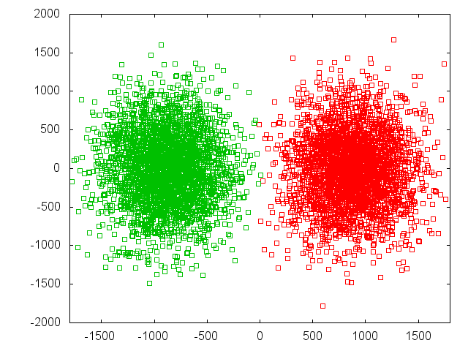
Pinch Effect
Need strong-strong code
CAIN (K. Yokoya et al.)
GUINEA-PIG (D. Schulte et al.)
Beams => macro particles
Beams => slices
Slices => cells
The simulation is performed in a number of time steps in each of them
The macro-particle charges are distributed over the cells
  The forces at the cell locations are calculated
  The forces are applied to the macro particles
  The particles are advanced
X direction
ILC
Z direction
All simulation performed with GUINEA-PIG
Predicted focal points
(for beam centre)

Slide 5
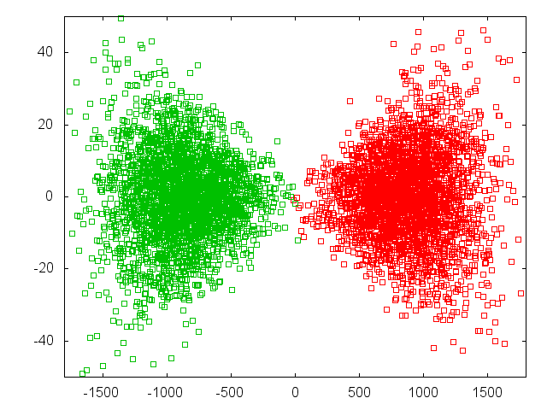
Pinch Effect
Beam-beam force switched off
Need strong-strong code
CAIN (K. Yokoya et al.)
GUINEA-PIG (D. Schulte et al.)
Beams => macro particles
Beams => slices
Slices => cells
The simulation is performed in a number of time steps in each of them
The macro-particle charges are distributed over the cells
  The forces at the cell locations are calculated
  The forces are applied to the macro particles
  The particles are advanced
Y direction
Z direction

Slide 6
Overview
Modelling of beam-beam interaction
  based on known physics
  Total luminosity increase estimate of GUINEA-PIG has been benchmarked at SLC
Beamstrahlung generator
  known physics for circular orbit
  some constraints on beam parameters for validity have to be checked
Design phase space of colliding beams is complex
  toss a coin to your local accelerator physicist and get files with input distributions
Modelling of luminosity spectrum with fits (e.g. CIRCE)
  seems OK if correlation can be handled
Phase space of actual beam differs from design and is not fully known
  static imperfections
  dynamic imperfections
Some comment on initial state radiation, bremsstrahlung and incoherent pairs

Slide 7
Correct Use
Fast estimates by defining beam parameters in the acc.dat file
  allows to define beam size, emittance, beta-function, bunch length, energy spread (Gaussian or rectangular), waist shift, offsets, …
Better estimates by using input files from tracking codes
  linear colliders contain correlations in the beam
    tracking includes these correlations in the input files
  beam shape in FCC-ee is formed by interaction over many turns
    special code developed (X. Buffat et al.) to simulate this
  parameters are an approximation
  beams vary with time
    your local accelerator expert can tell about wanted and unwanted changes
The specific question can require more or less detail

Slide 8
Beamstrahlung Generator
Assume a locally circular orbit
The radiation forms while particle trajectory is bend by angle of O(1/γ)
Need to see field of many particles in the opposite beam over this length
=> Is the case in all practical parameter set
Note: typically one single particle dominates field seen at any given position in beam but averages out over distance of photon emission
Need to bend particles by several times 1/γ
=> typically the case, η has to be several, but much smaller than N
Typically emit O(1) photon per beam particle
Need a generator to produce individual photons with the correct probability

Slide 9
Beamstrahlung
Power
[a.u.]
Classical regime
ILC (0.06), CLIC at 380GeV (0.17)
Quantum regime
CLIC at 3TeV Υ=5
The spectrum is given by
Sokolov-Ternov Spectrum
With modified Bessel functions
and
Nice numerical method by K. Yokoya implemented (KEK-Report 85-9)

Slide 10
Example: Beam Energy Spread
Beam has an uncorrelated energy spread from the damping ring (and the positron production in ILC)
But it also has a correlated energy spread from the acceleration
Cause are wakefields:
early particles take energy from the cavity so later particles are accelerated less
Some trick with RF phase reduces the effect but does not fully eliminate it
More important in CLIC than ILC
Final energy spread is a key parameter for the beam parameters, efficiency and luminosity
  more spread is higher efficiency and more luminosity but limited by energy acceptance of BDS

Slide 11
Example: Beam Energy Spread
Loaded gradient seen by a single bunch for on-crest acceleration:
2% full gradient spread
0.7% RMS gradient spread
Loaded gradient seen by a single bunch for off-crest acceleration (12°):
1% full gradient spread
0.35% RMS gradient spread
Loose about 2% in gradient

Slide 12
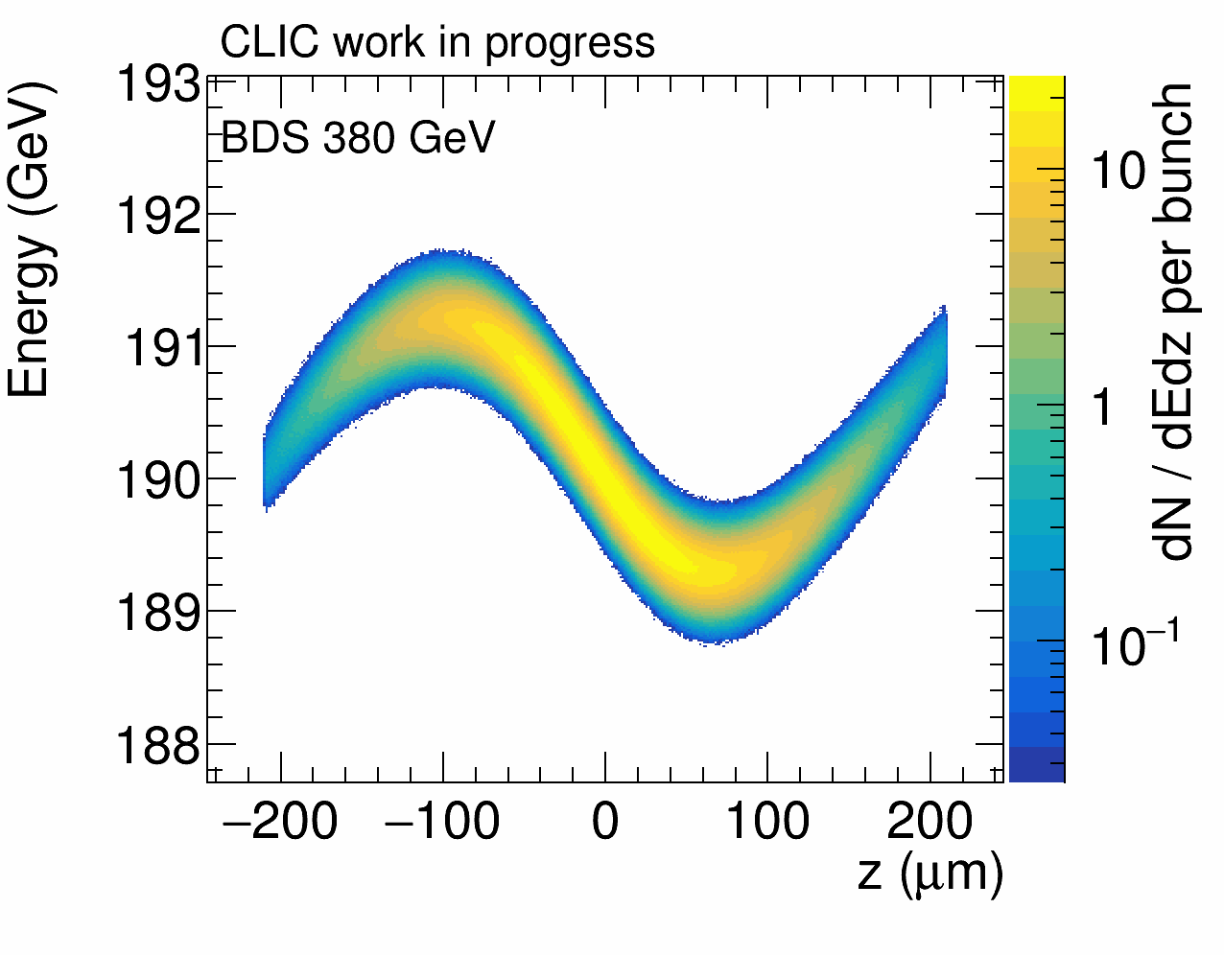
Energy Correlation
Late particles often see particles that lost energy in other beam
But other bunch has pinched
Early particles see full energy in other beam
But other bunch has not yet pinched
CLIC at 380 GeV is shown
Full energy difference is 1%
Note: CLIC studies take these correlations fully into account
Dominique Aromski

Slide 13
Example Correlation
CLIC 3 TeV
no beamstrahlung
Particles in head (higher energy) collide more on far side
In centre both beams always have the same energy
(but collision energy changes)

Slide 14
Example Correlation
CLIC 3 TeV with beamstrahlung
Still a correlation of energy difference and longitudinal position close to nominal centre-of-mass energy

Slide 15
Modelling Beam Spectrum 3TeV
J-J. Blaising, LAPP/IN2P3
Left: dN/dEe distribution Guineapig events (blue) and Circe2 generated events using a Power function mapping (red); 20 GeV bins.
Right: zoom in the high energy region; 1 GeV bins/
Good agreement with Guineapig events in the whole E range.

Slide 16
Modelling Beam Spectrum 3TeV
J-J. Blaising, LAPP/IN2P3
Left: dN/d√s distribution Guineapig events (blue) and Circe2 generated events using a power function mapping (red); 20 GeV bins.
Right: zoom into the high √s region; 1 GeV bins; looks good.
Check the distribution ratios.

Slide 17
Beam Emittance
Imperfections are main source of final vertical emittance
Require 90% likelihood to meet static emittance growth target
Damping ring main source of horizontal emittance
But value is OK, as we will see
 | Δε_{x} [nm] | Δε_{y} [nm]
 | Total contribution | Design limits | Static imperf. | Dynamic imperf.
Damping ring exit | 700 | 5 | 0 | 0
End of RTML | 150 | 1 | 2 | 2
End of main linac | 50 | 0 | 5 | 5
Interaction point | 50 | 0 | 5 | 5
sum | 950 | 6 | 12 | 12
Total emittance: 30 nm
Not very Gaussian
Can be smaller

Slide 18
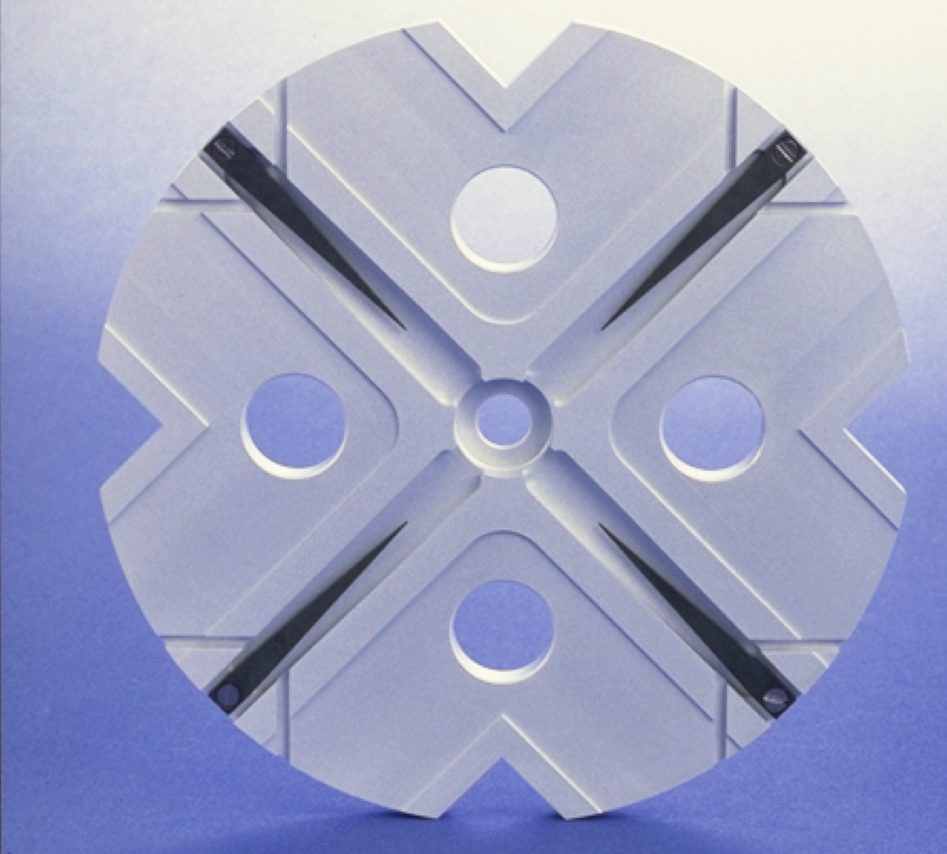
Example Imperfection: Wakefields
Wakefields can lead to instability/emittance growth
This effect is larger in higher frequency structures, hence N=2x10¹⁰ vs. N=4x10⁹

Slide 19
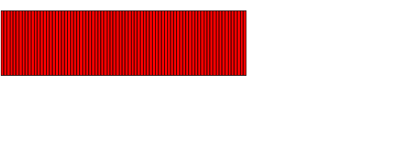
Example: Bunch in Main Linac
Head performs simple betatron oscillation
Tail still flaps
Centre of bunch is much more stable
Direction of motion

Slide 20
The Banana Effect
a) Wakefields+dispersion can create banana-shaped bunch in main linac
b) Do not model with projected emittance
c) The correct shape should be used
For large disruption (ILC) banana can reduce luminosity
Study for TESLA
Similar disruption as ILC

Slide 21
The Banana Effect
a) Wakefields+dispersion can create banana-shaped bunch in main linac
b) Do not model with projected emittance
c) The correct shape should be used
For large disruption (ILC) banana can reduce luminosity
Introduce offset to maximise luminosity
Introduce angle to maximise luminosity
Study for TESLA
Similar disruption as ILC
But still some change in luminosity spectrum

Slide 22
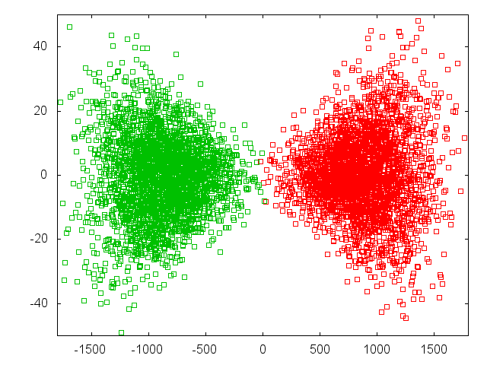
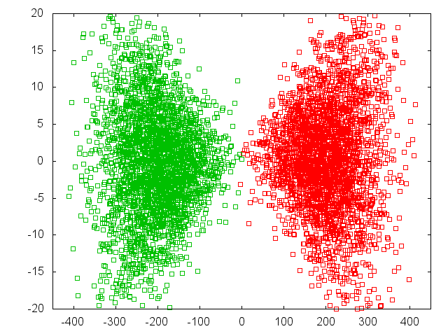
Luminosity and Offset
Luminosity loss for beam offsets depends strongly on disruption parameter
Δy = 0.4 σ_{y}
L = 0.71 L₀ D_{y}~24
L = 0.92 L₀ D_{y}~12
Will potentially impact spectrum
92%
71%
ILC
CLIC

Slide 23
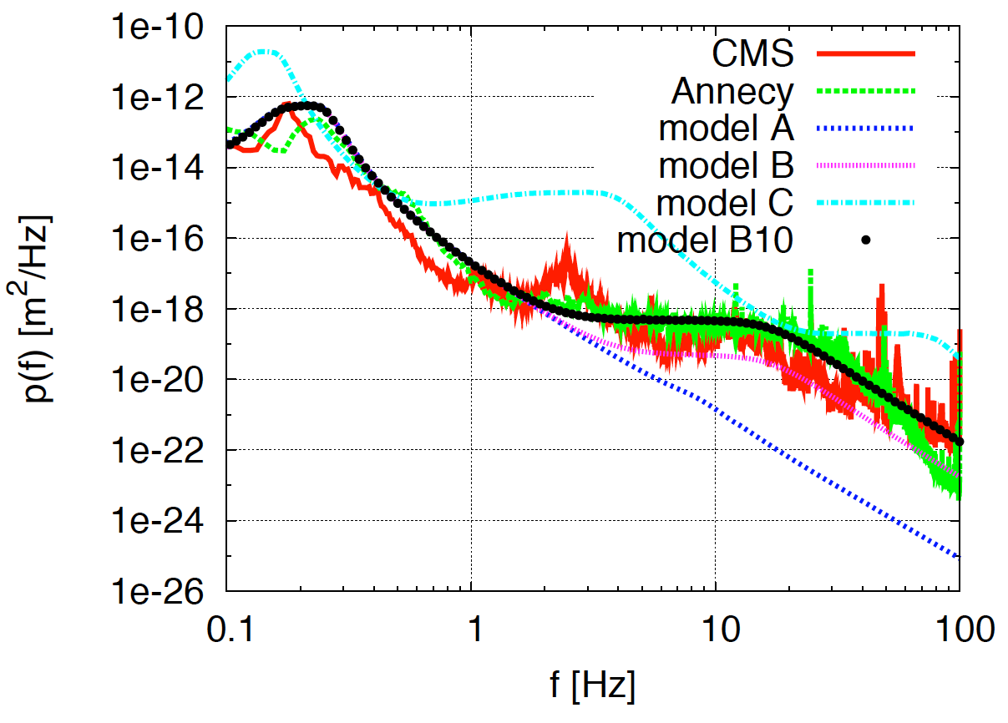
Dynamic Variations
Many sources of variations
ground motion
vibration of components
damping ring extraction kickers
RF phase and amplitude jitters
timing system jitters
…
Leads to some modification of the spectrum
(CLIC 3 TeV example)
Typically try to keep these effects small
but some variation with time will be present
For FCC-ee one needs to consider injection of fresh beam in top-up
will affect circulating beam to some extend

Slide 24
Note: Benefit of Beamstrahlung
If beams collider with vertical offset, beamstrahlung is increased
If one beam is vertically larger it emits more radiation
the other beam will emit less
Can use beamstrahlung to tune the beams
e.g. tune vertical knobs on the beam that emits more to reduce its beamstrahlung and increase the one of the other beam
We found this allows to effectively tune luminosity

Slide 25
Luminosity Spectrum Uncertainty
Main uncertainties arise from limited knowledge of colliding beams
You will typically receive a relevant example of beams
But actual beams in the collider can differ
Main implications
Need to measure luminosity spectrum
  Challenge is that Bhabha events allow to measure E1 / E2 but not directly E1 x E2
  Bhabha particles are deflected by beam so total of transverse momentum of final pair is not not zero
  Can be simulated with GUINEA-PIG++
In FCC-ee calibration of energy at Z-pole could be performed using non-colliding circulating beams, but need to understand error of estimate for colliding beams

Slide 26
Use for Luminosity Files
Have to use some switches in master input file acc.dat
do_lumi=7; Switches all luminosity calculations on
num_lumi=1000000; Will store up to 1000,000 samples
electron_ratio=1.0; Default is 0.0, which leads to no files, probability to use each beam particle for luminosity calculation per step
photon_ratio=1.0;
lumi_p=1e-20; Or some other value that is large enough, collisions are stored with probability lumi_p x “single collision luminosity”
Load beams if you received the associated files
load_beam=3; For historical reasons, the best solution is option 3
This will load electron.ini and positron.ini, with each line containing
Energy [GeV], x, y, z [in μm at s=0], vx, vy [in μradian]
Make sure that n_macro is set to the number of particles in each file
https://gitlab.cern.ch/clic-software/guinea-pig and TESLA-97-08

Slide 27
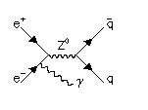
Note: Initial State Radiation
Can be switched on, if required
default is off
i.e. do_isr=0;
Uses simple model
It probably is best to do it separately in the physics generator
Example with no beamstrahlung and monochromatic beam

Slide 28
Note: Bremsstrahlung
Modeled as Compton scattering on virtual photons
Beam size effect is taken into account as displacement of virtual photon from original particle
The beam size can have a significant impact on the bremsstrahlung cross section
For actual luminosity measurements careful benchmarking will be required
In principle beam size effect should impact all processes
but should play a small role for reasonably hard processes
Old TESLA results

Slide 29
Lepton Pair Production
Colliding Photons can produce electron-positron pairs (incoherent pair production)
O(10⁵) per bunch crossing
Beamstrahlung photons can turn into pair in strong field
(coherent pair production)
O(1-10⁸) per bunch crossing
Trident cascade

Slide 30
Electron-Positron Pair Production
Colliding photons can produce electron-positron pairs (incoherent pair production)
O(10⁵) per bunch crossing
Virtual photon approximation used (beam size and external field effect can be included)
GUINEA-PIG benchmarked to Vermaseren Monte Carlo
(for Landau-Lifshitz process)
ϑ₀
r B_{z}

Slide 31
Virtual Photon Approximation
Choice of maximum virtuality Q is somewhat uncertain
Model: full cross section below cut, zero above
Impact on spectrum of pairs is limited
But impact on transverse distribution can matter
At the time important difference with respect to ABEL

Slide 32
Beamsize and Pairs
Old TESLA results
Significant change of cross section
Typically try to be conservative and ignore effect

Slide 33
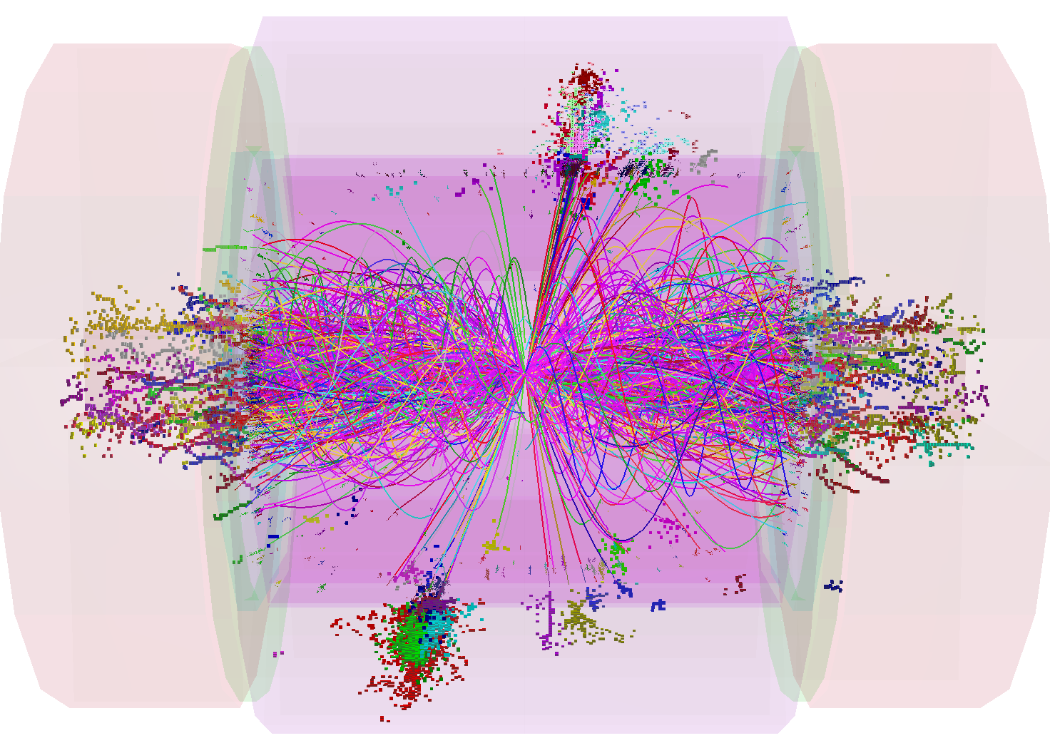
Hadronic Background
Two colliding photons can also produce hadrons
(photons look like part-time like a hadron)
Two implementations in GUINEA-PIG:
Total cross section parametrisation
In particular PYTHIA cross section
stored initial states can be then be turned to events with PYTHIA
Easily modified to include any other cross section
Includes limits on virtual photons
  different cuts in virtuality
Direct calculation of parton-parton scattering, based on parametrisations
of Glück, Reya and Vogt
or Drees and Grassie
Works only for hard scattering
Fragment with JETSET

Slide 34
Conclusion
Main uncertainties arise from missing knowledge of actual input distribution
Can provide representative examples for physics studies
But they are not the ones in the actual machine
Need reconstruction of spectrum with measurement
Should be able to improve this by using information from the simulation
  but check for robustness with varying initial beams

Slide 35
Reserve

Slide 36
Physics
GUINEA-PIG simulates the interaction of two colliding ultra-relativistic beams containing electrons, positrons and photons (others can be approximated using tricks)
Made for single collisions, can be used for repeated collisions at some level but with care
Can load electron, positron and gamma beams, typically required because complex energy profile exists, also for gamma-gamma collider
It includes:
Pinching of the beams
Emission of beamstrahlung
Initial state radiation
Production of incoherent pair background
Bremsstrahlung
Beam size effect
Production of coherent pair background
Production of hadronic background (also minijets)
GUINEA-PIG++ also includes
Beam polarisation
Trident cascade process
but no hadrons

Slide 37
Pinch Effect
Need strong-strong code
CAIN (K. Yokoya et al.)
GUINEA-PIG (D. Schulte et al.)
Beams => macro particles
Beams => slices
Slices => cells
The simulation is performed in a number of time steps in each of them
The macro-particle charges are distributed over the cells
  The forces at the cell locations are calculated
  The forces are applied to the macro particles
  The particles are advanced
X direction
ILC
Z direction
All simulation performed with GUINEA-PIG
Predicted focal points
(for beam centre)

Slide 38
Pinch Effect
Beam-beam force switched off
Need strong-strong code
CAIN (K. Yokoya et al.)
GUINEA-PIG (D. Schulte et al.)
Beams => macro particles
Beams => slices
Slices => cells
The simulation is performed in a number of time steps in each of them
The macro-particle charges are distributed over the cells
  The forces at the cell locations are calculated
  The forces are applied to the macro particles
  The particles are advanced
Y direction
Z direction

Slide 39
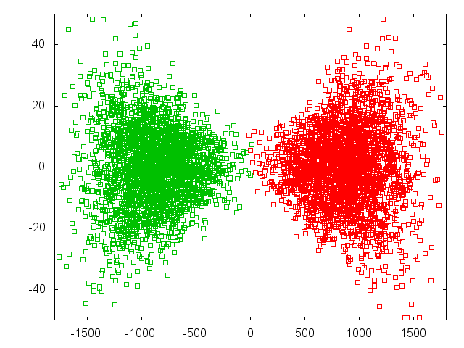
Pinch Effect
Beam-beam force switched off
Need strong-strong code
CAIN (K. Yokoya et al.)
GUINEA-PIG (D. Schulte et al.)
Beams => macro particles
Beams => slices
Slices => cells
The simulation is performed in a number of time steps in each of them
The macro-particle charges are distributed over the cells
  The forces at the cell locations are calculated
  The forces are applied to the macro particles
  The particles are advanced
Y direction
Note: Luminosity increase has been benchmarked to SLC (F. Zimmermann et al.)
Z direction

Slide 40
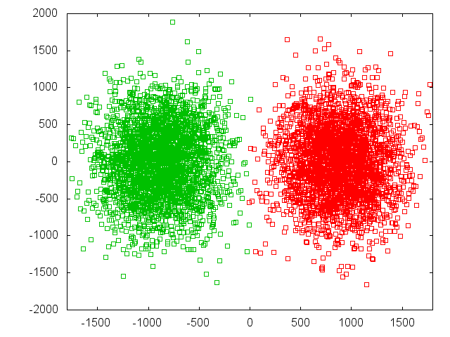
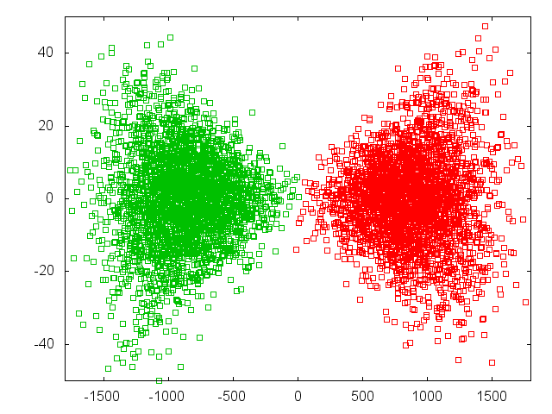
Photon Production
Horizontal plane
Vertical plane

Slide 41
Note: Initial State Radiation
Can be switched on, if required
default is off
Uses simple model
It probably is best to do it separately in the physics generator

Slide 42
Example: Top Production at Threshold
K. Seidel et al. arXiv:1303.3758
Top production at threshold is strongly affected by beam energy spread and beamstrahlung
For L_{0.01} > 0.6 L impact of beamstrahlung is comparable to ISR
But depends on physics

Slide 43
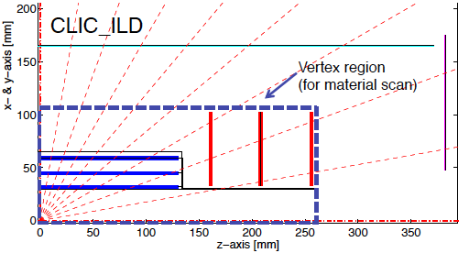
Impact on Detector Design
CLICdp
A. Sailer
Background limits vertex detector
Defines forward detector design

Slide 44
Hadronic Background
Two colliding photons can also produce hadrons
(photons look like part-time like a hadron)
Two implementations in GUINEA-PIG:
Total cross section parametrisation
In particular PYTHIA cross section
stored initial states can be then be turned to events with PYTHIA
Easily modified to include any other cross section
Includes limits on virtual photons
  different cuts in virtuality
Direct calculation of parton-parton scattering, based on parametrisations
of Glück, Reya and Vogt
or Drees and Grassie
Works only for hard scattering
Fragment with JETSET

Slide 45
How to Run
GUINEA-PIG is steered using a database and potentially some input files
Beam (electrons, positrons, photons) is described by charge, emittance, beta-function, bunch length, energy and energy spread
Or can be loaded from a file (format corresponds to our main tracking code PLACET)
Processes can be switched on or off setting variable in database
Computational parameters can be chosen
number of macro-particles (O(10⁵) or more)
number of slices (O(30))
grid size and number of cells (64x64 or more)
Cut-off for Weizäcker-Williams method (electron mass, photon collision energy, transverse momentum of final state)
beam size effect (incoherent pairs, hadrons, bremsstrahlung)
hadronic cross section/parton model
…
Be careful when choosing and confirm convergence and stability of results

Slide 46
Output
Different results and spectra in main output file, e.g.
luminosity
luminosity spectrum for all particle combinations
number and energy of beamstrahlung photons produced
…
Specialised files
Luminosity weighted collisions (electron-positron, electron-photon, photon-photon, …)
  3x3 matrix of options
Cross section weighed collisions producing hadronic events (with real and virtual photons)
Spent beam (in tracking format for PLACET), photons, coherent/trident pairs
Incoherent pairs before/after tracking though beam fields
All files have trivial format: e.g. one line, one particle or one collision
Note: Cross section for collision files is adjusted on the fly to avoid overflow if initial cross section is too large

Slide 47
Code Implementation
GUINEA-PIG
Written in C (my C++ compiler was broken)
Mainly functional, some object oriented methods
Requires C compiler, GCC is a great choice
Advisable (but not required) to use FFTW2 or FFTW3
Can use input from beam tracking (e.g. PLACET)
Some output can be used in physics tools (e.g. PYTHIA, CIRCE, CALYPSO)
No parallelisation in public version
  as always not simple to switch between grid and tracking
GUINEA-PIG++
Translation of GUINEA-PIG to C++
Was originally meant to be parallel
Can be found on the web, e.g. https://gitlab.cern.ch/clic-software/guinea-pig
Some documentation is available
Normally, I manage to answer questions, Barbara Dalena (CEA FR) can also help

Slide 48
Performance
The performance is adequate for many applications
Has been the basis for a large set of linear collider studies for the machine and for the detector
Ran originally on i486
Can run many cases in parallel
Sequential runs in same directory can hand over random number generator status to have different sequence each time
In different directories need to use the proper random number generator (sorry, in the code, could be made public if demand exists)
Could imagine to use more advanced generator
For some applications a speed-up of single run would be useful
Simulation of dynamic effects in linear colliders (many subsequent collisions)
Circular colliders (many turns)
Best to fill results into reference data base
More convenient to use
Can be used to verify results
It is not fully straightforward to correctly model the machine

Slide 49
Conclusion
GUINEA-PIG simulates beam-beam interaction in lepton colliders
Strong-strong beam dynamics
Production of secondaries
Core tool for linear colliders
Machine studies
Detector design
Physics performance prediction
Code(s) are publicly available
Limited maintenance
But at the same level as the past 20+ years
Will have a new fellow in January
Will consider to upgrade to muons
  some first results are based on
An effort to develop general purpose code for all types of particles and multiple turns is ongoing

Slide 50
Reserve

Slide 51
Coherent Pair Creation
Beam fields in the rest system of a photon can reach the Schwinger Critical Field
The quantum electrodynamics becomes non-linear
A photon in a very strong field can form an electron-positron pair
Coherent pair creation
Produce 6.8x10⁸ pairs
Average particle energy 0.3TeV

Slide 52
Computational Model
The beam is represented by macro-particles (typically O(>10⁵))
Can be generated on the fly or loaded from files
The beams are sliced, slices interact pairwise (typically O(30))
Slice interactions are using grids (typically O(64x64) cells)
Beam particles are distributed
Transverse fields use clouds-in-cell model and FFT for the convolution
Generation of
  Beamstrahlung photons
  Coherent pairs
  (Trident cascade)
Virtual photons are created at each step and also distributed on the grid
Particles in the same cell can collide and produce secondaries
  Hadrons are stored
  Pairs are tracked further
Stepping of particles
Note: Larger grids are used for low energy background

Slide 53
Spent Beam Content
Spent beam particles
Beamstrahlung
Coherent pairs
Trident cascade pairs
Incoherent pairs
Hadrons
…
J. Esberg

Slide 54
Generic Linear Collider
Power
Physics
Power
Can reach high electron-positron centre-of-mass energies
almost no synchrotron radiation
Single pass, hence two main challenges
gradient
luminosity

Slide 55
ILC and CLIC Main Parameters
Parameter | Symbol [unit] | SLC | ILC | CLIC | CLIC
Centre of mass energy | E_{cm} [GeV] | 92 | 500 | 380 | 3000
Geometric luminosity | L_{geom} [10³⁴cm⁻²s⁻¹] | 0.00015 | 0.75 | 0.8 | 4.3
Total luminosity | L [10³⁴cm⁻²s⁻¹] | 0.0003 | 1.8 | 1.5 | 6
Luminosity in peak | L_{0.01} [10³⁴cm⁻²s⁻¹] | 0.0003 | 1 | 0.9 | 2
Gradient | G [MV/m] | 20 | 31.5 | 72 | 100
Particles per bunch | N [10⁹] | 37 | 20 | 5.2 | 3.72
Bunch length | σ_{z} [μm] | 1000 | 300 | 70 | 44
Collision beam size | σ_{x,y} [nm/nm] | 1700/600 | 474/5.9 | 149/2.9 | 40/1
Emittance | ε_{x,y} [μm/nm] | ~3/3000 | 10/35 | 0.95/30 | 0.66/20
Betafunction | β_{x,y} [mm/mm] | ~100/10 | 11/0.48 | 8.2/0.1 | 6/0.07
Bunches per pulse | n_{b} | 1 | 1312 | 352 | 312
Distance between bunches | Δz [ns] | - | 554 | 0.5 | 0.5
Repetition rate | f_{r} [Hz] | 120 | 5 | 50 | 50
There are more parameter sets for ILC and CLIC at different energies
CLIC at 3TeV has higher order optics and radiation effects

Slide 56
Beam-beam Effect
Bunches are squeezed strongly to maximise luminosity
Electron magnetic fields are very strong
CLIC at 3TeV
Beam particles travel on curved trajectories
They emit photons (O(1)) (beamstrahlung)
L_{0.01}
They collide with less than nominal energy
L
Request from physics
L_{0.01}/L>0.6 below 500GeV
L_{0.01}/L>0.3 at 3TeV

Slide 57
Beam Focusing
Beam have linear focusing force
Very flat beam
We define the disruption parameters to compare the bunch length to the focal length
Typically smaller than 1
Typically much larger than 1
Parameter | Symbol [unit] | SLC | ILC | CLIC | CLIC
Horizontal disruption | D_{x} | 0.6 | 0.3 | 0.24 | 0.2
Vertical disruption | D_{y} | 1.7 | 24.3 | 12.5 | 7.6

Slide 58
Luminosity Spectrum
The total luminosity L varies strongly with beta-function
So tend to use L_{0.01}/L=60% as criterion
i.e. typically n_{γ}=1.5-2
Reasonable compromise for most physics studies
But L_{0.01} does not change so much

Slide 59
Hourglass and Beam-beam Effects
Including pinch effect
There is an optimum value for beta
For smaller beta-function the geometric luminosity increases but the enhancement is reduced
Small beta-functions lead to
High chromaticity
Optics is difficult
Large divergence
Quadrupole aperture is limited
ILC choice
CLIC choice

Slide 60
Luminosity and Offset
Luminosity loss for beam offsets depends strongly on disruption parameter
Δy = 0.4 σ_{y}
L = 0.71 L₀ D_{y}~24
L = 0.92 L₀ D_{y}~12

Slide 61
Luminosity and Offset
Luminosity loss for beam offsets depends strongly on disruption parameter
Δy = 0.4 σ_{y}
L = 0.71 L₀ D_{y}~24
L = 0.92 L₀ D_{y}~12
92%
71%
ILC
CLIC

Slide 62
Note: The Banana Effect
a) Wakefields+dispersion can create banana-shaped bunch in main linac
b) Do not model with projected emittance
c) The correct shape should be used
For large disruption (ILC) banana can reduce luminosity
Study done for TESLA
Similar disruption as ILC

Slide 63
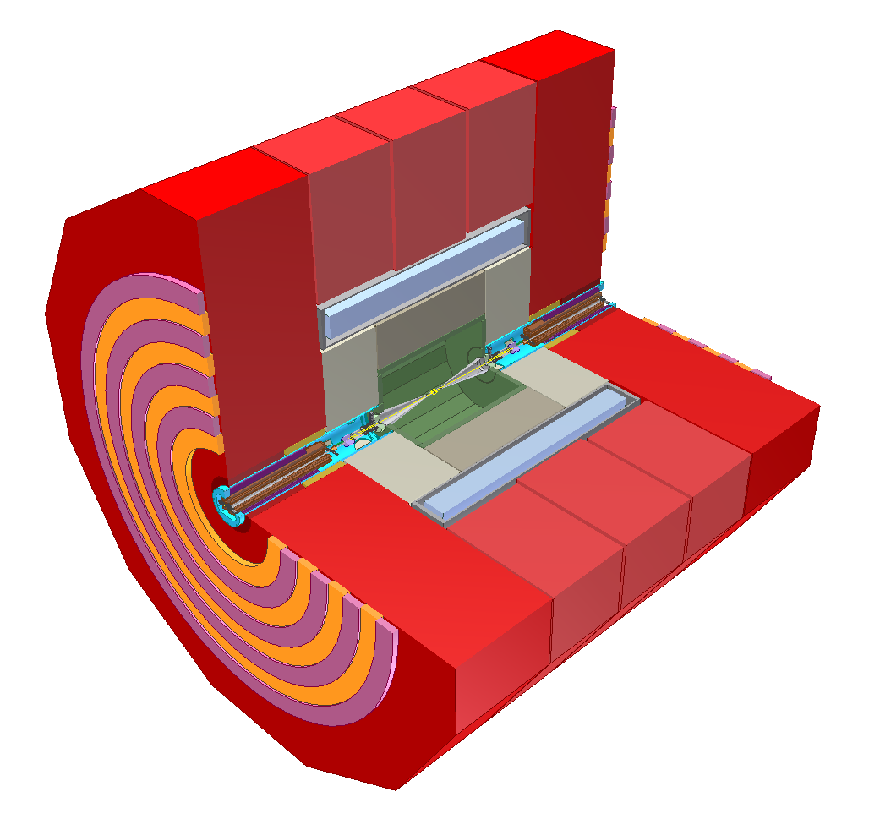
Linear Collider Experiment
10⁹ readout cells
Field return and muon particle identification
Final steering
of nm-size beams
B-field for momentum and charge measurement
Energy measurement of (charged and) neutral particles
6 m
Measure momentum
and charge of charged particles
Measure vertex and
Short-lived particles
L. Linssen

Slide 64
Spent Beam Divergence
Beam particles are focused by oncoming beam
Photons are radiated into direction of beam particles
Coherent pair particles can be focused or defocused by the beams but deflection limited due to their high energy
-> Extraction hole angle should be significantly larger than 6mradian
We chose 10mradian for CLIC
-> 20mradian crossing angle
ILC requires 14mradian crossing angle
CLIC

Slide 65
GUINEA-PIG Impact on CERN Studies
GUINEA-PIG is central for linear collider machine, detector and physics studies
Used on TESLA, SLC, SBLC, JLC, VLEPP, CLIC, ILC, plasma-based collider, …
Luminosity estimates
  Including imperfections
Produces luminosity spectrum for physics analysis
  Actually used in optimisation of machine for physics
  Used for estimation of physics performance
Produces background data for detector design
  E.g. pair background defines vertex detector
  Used for estimation of physics performance
LHeC and FCC-he
Prediction of luminosity
Impact of electron beam on proton beam emittance
FCC-ee, LEP3
Some simulations of beam-beam and particle energy loss

Slide 66
Reserve

Slide 67
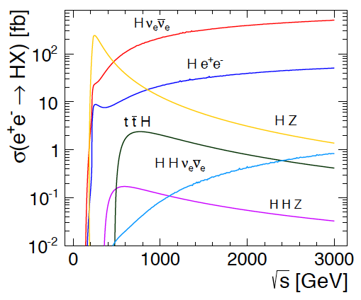
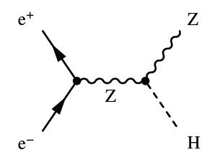
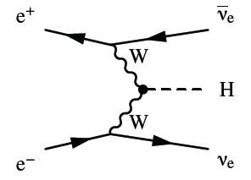
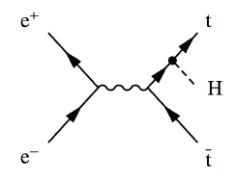
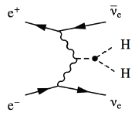

Higgs Physics in e+e- Collisions
Precision Higgs measurements
Model-independent
  Higgs couplings
  Higgs mass
Large energy span of linear colliders allows to collect a maximum of information:
  ILC: 500 GeV (1 TeV)
  CLIC: ~350 GeV – 3 TeV

Slide 68
Invisible Higgs Decays
Can we check that the Higgs does not decay into something invisible, e.g. neutrinos?
Yes, missing mass (or recoil mass) analysis:
1) Measure the Z, e.g. from produced jets
2) Subtract Z momentum from initial state
(E_{cm},0,0,0)-(E_{Z}, P_{Z,x}, P_{Z,y}, P_{Z,z})=(E_{H}, P_{H,x}, P_{H,y}, P_{H,z})
3) Result is mass and momentum of other particle
Even if we do not see it
So we know the missing particle

Slide 69
Automatic Parameter Determination
Structure design fixed by few parameters
a₁,a₂,d₁,d₂,N_{c},φ,G
Beam parameters derived automatically to reach specific energy and luminosity
Consistency of structure with RF constraints is checked
Repeat for 1.7 billion cases
Design choices and specific studies
Use 50Hz operation for beam stability
Scale horizontal emittance with charge to keep the same risk in damping ring
Scale for constant local stability in main linac, i.e. tolerances vary but stay above CDR values
BDS design similar to CDR, use improved β_{x}-reach as reserve
…

Slide 70
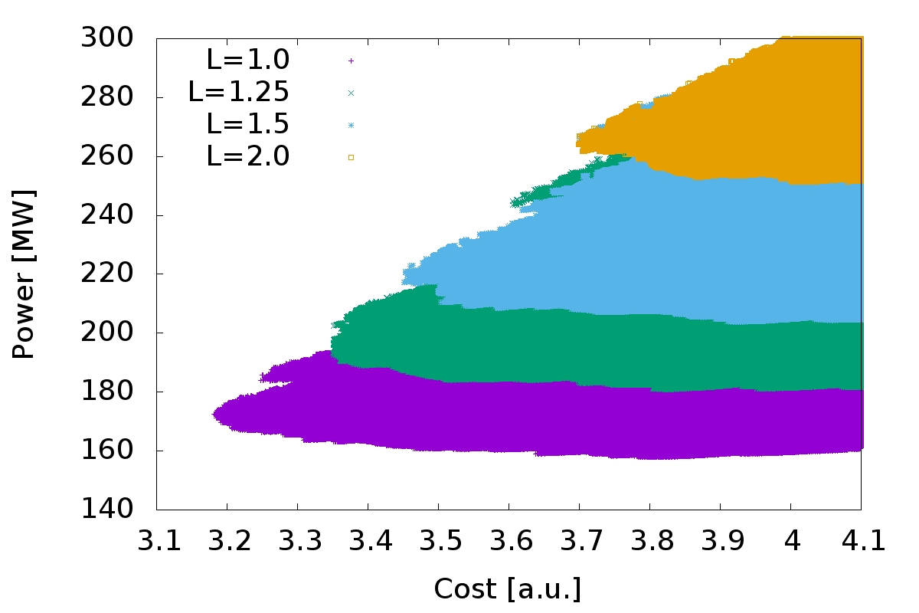
Optimisation at 380GeV
S=1.1
L=1.0x10³⁴cm⁻²s⁻¹
L=1.25x10³⁴cm⁻²s⁻¹
L=1.5x10³⁴cm⁻²s⁻¹
L=2.0x10³⁴cm⁻²s⁻¹
Many thanks to the rebaselining team that provided the models that are integrated in the code
Luminosity goal significantly impact minimum cost
For L=1x10³⁴cm⁻²s⁻¹ to L=2x10³⁴cm⁻²s⁻¹ :
Costs 0.5 a.u.
And O(100MW)
Cheapest machine is close to lowest power consumption => small potential for trade-off

Slide 71
Note: Luminosity Enhancement
Parameter | Symbol [unit] | ILC | CLIC | CLIC
Centre of mass energy | E_{cm} [GeV] | 500 | 380 | 3000
Total luminosity | L [10³⁴cm⁻²s⁻¹] | 1.8 | 1.5 | 6
Luminosity in peak | L_{0.01} [10³⁴cm⁻²s⁻¹] | 1 | 0.9 | 2
Particles per bunch | N [10⁹] | 20 | 5.2 | 3.72
Bunch length | σ_{z} [μm] | 300 | 70 | 44
Collision beam size | σ_{x,y} [nm/nm] | 474/5.9 | 149/2.9 | 40/1
Vertical emittance | ε_{x,y} [nm] | 35 | 40 | 20
Geometric luminosity | L_{geom} [10³⁴cm⁻²s⁻¹] | 0.75 | 0.8 | 4.3
Enhancement factor | H_{D} | 2.4 | 1.9 | 1.5

Slide 72
Note: Travelling Focus
Travelling focus (Balakin):
We focus each slice of the beam on one point of the oncoming beam, e.g. 2σ_{z} before the centre
The beam-beam forces keep the beam small
Additional gain of 10% in luminosity

Slide 73
Note: ILC with β_{y}=0.24mm
Even stronger offset dependence for smaller beta-function
So in practice less gain than expected

Slide 74
Generic Linear Collider
Single pass poses luminosity challenge
Low emittances are produced in the damping rings
They must be maintained with limited degradation
The beam delivery system (BDS) squeezes the beam as much as possible

Slide 75
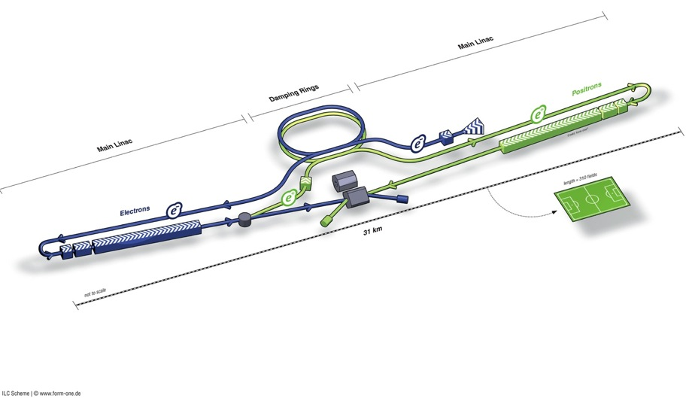
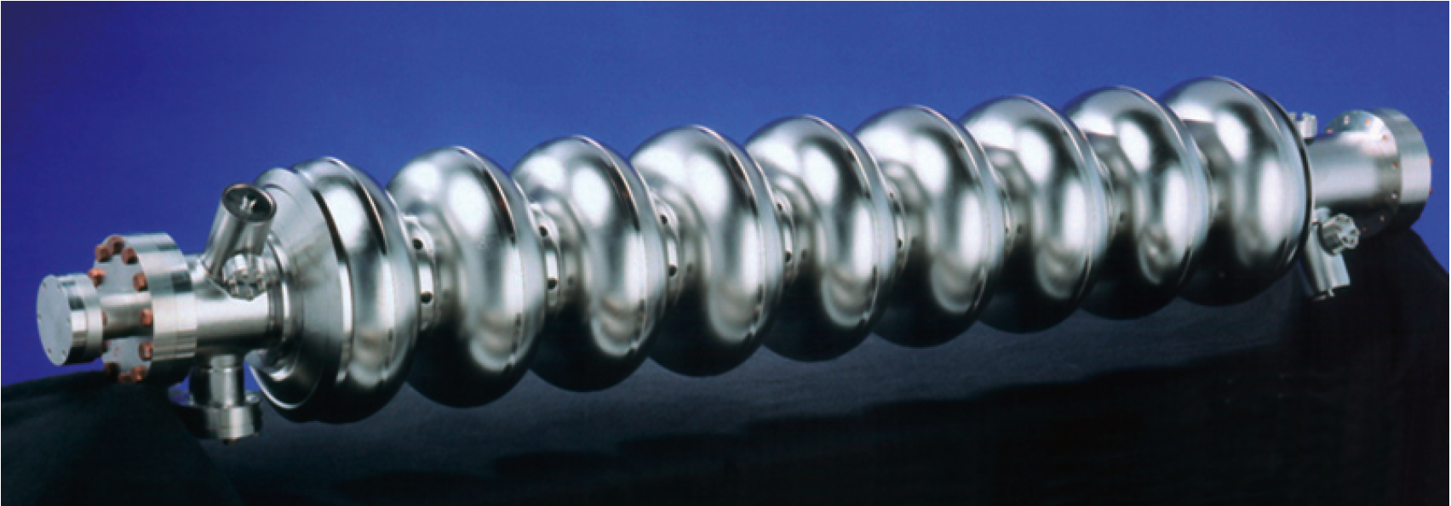
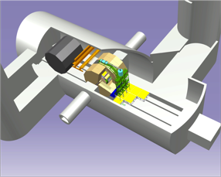
ILC
Damping Rings
BDS (beam delivery system)
Ring to Main Linac (RTML)
(w. bunch compressors)
e+ Main Linac
e- Main Linac
E+ source
Parameters | Value
C.M. Energy | 500 GeV
Peak luminosity | 1.8 x10³⁴ cm⁻²s⁻¹
Beam Rep. rate | 5 Hz
Pulse duration | 0.73 ms
Average current | 5.8 mA (in pulse)
E gradient in SCRF acc. cavity | 31.5 MV/m +/-20% Q₀ = 1E10

Slide 76
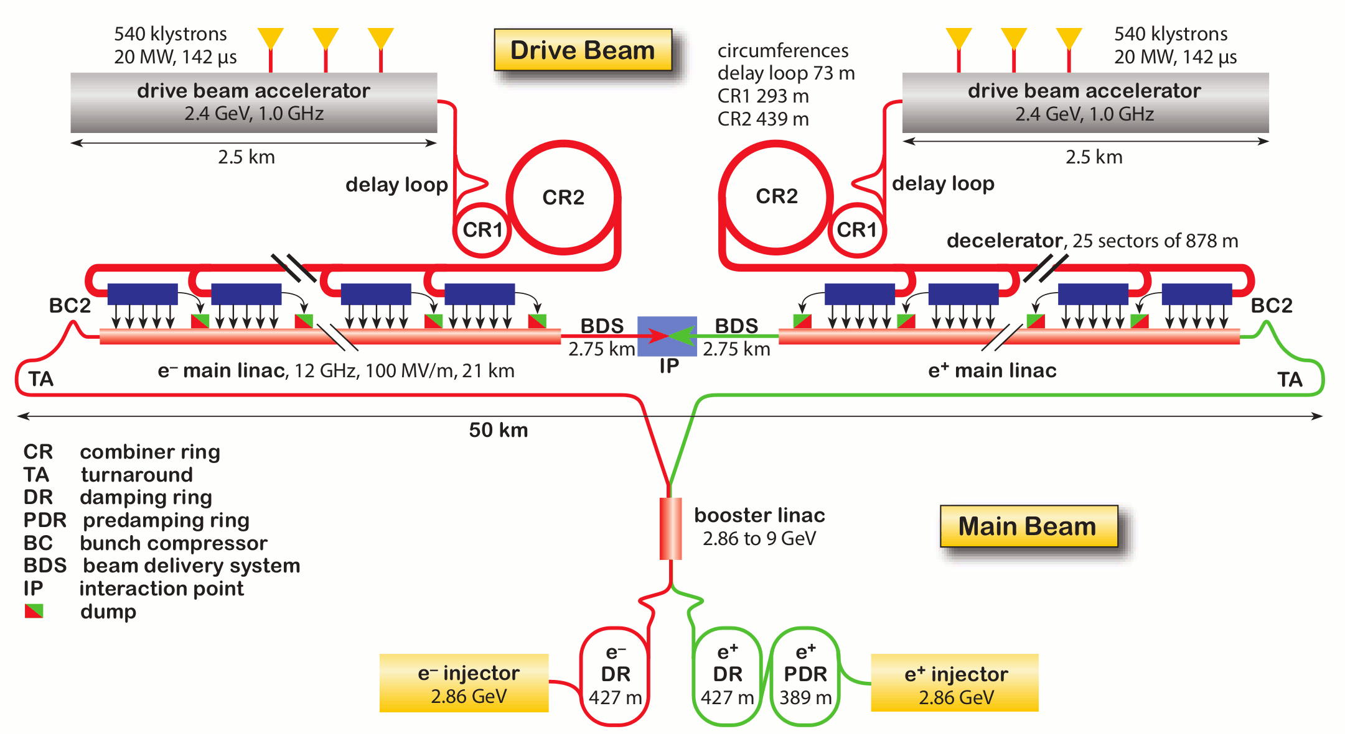
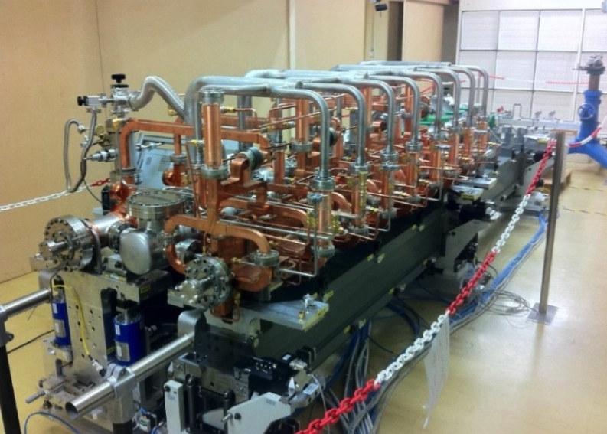
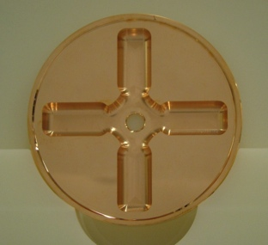
CLIC (at 3TeV)
Drive beam time structure - initial
Drive beam time structure - final
240 ns
240 ns
5.8 μs
140 μs train length - 24 × 24 sub-pulses
4.2 A - 2.4 GeV – 60 cm between bunches
24 pulses – 101 A – 2.5 cm between bunches

Slide 77
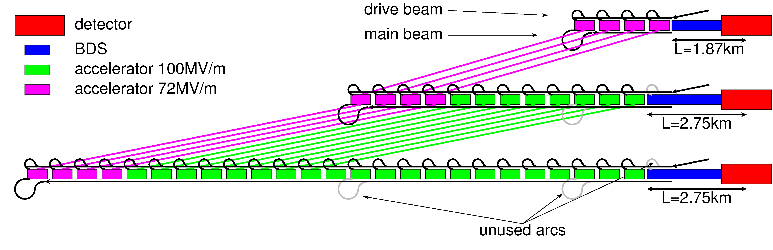
CLIC Staged Approach
  First stage: E_{cms}=380Gev, L=1.5x10³⁴cm⁻²s⁻¹, L_{0.01}/L>0.6
Second stage: E_{cms}=O(1.5TeV)
Final stage: E_{cms}=3TeV, L_{0.01}=2x10³⁴cm⁻²s⁻¹, L_{0.01}/L>0.3

Slide 78
Note: ILC TDR
http://www.linearcollider.org/ILC/Publications/Technical-Design-Report

Slide 79
Note: CLIC CDR
Vol 1: The CLIC accelerator and site facilities
- CLIC concept with exploration over multi-TeV energy range up to 3 TeV
- Feasibility study of CLIC parameters optimized at 3 TeV (most demanding)
- Consider also 500 GeV, and intermediate energy range
- https://edms.cern.ch/document/1234244/
Vol 2: Physics and detectors at CLIC
- Physics at a multi-TeV CLIC machine can be measured with high precision, despite challenging background conditions
- External review procedure in October 2011
- http://arxiv.org/pdf/1202.5940v1
Vol 3: “CLIC study summary”
- Summary and available for the European Strategy process, including possible implementation stages for a CLIC machine as well as costing and cost-drives
- Proposing objectives and work plan of post CDR phase (2012-16)
- http://arxiv.org/pdf/1209.2543v1
In addition a shorter overview document was submitted as input to the European Strategy update, available at:
http://arxiv.org/pdf/1208.1402v1
Input documents to Snowmass 2013 has also been submitted:
http://arxiv.org/abs/1305.5766 and
http://arxiv.org/abs/1307.5288
ILC costing 500 GeV
CLIC costing 500 GeV
79

Slide 80
Luminosity and Parameter Drivers
Can re-write normal luminosity formula
(note: no crossing angle assumed)
Beam power
Luminosity
spectrum
Beam Quality
(+bunch length)
Somewhat simplified view

Slide 81
Note: Crossing Angle
Have crossing angles
ILC: 14mradian
CLIC: 20mradian
to reduce effects of parasitic crossings
to extract the spent beam cleanly
Luminosity with crossing angle
0.1-0.2
Use crab cavities:
Can ignore crossing angle for beam-beam calculation
But not in detector design

Slide 82
Vertical Beamsize
Using the naïve luminosity calculation with beta-function at the IP we find that the luminosity can be increased by reducing β_{y}
There are two limits:
The lattice design tends to find a practical lower limit a bit below β_{y}=100 μm
CLIC at 3TeV has β_{y}=70 μm but strong geometric aberrations
Not excluded that this can be improved but people worked on it for years
Luminosity actually increases not as predicted

Slide 83
Hourglass Effect
Taking into account hourglass effect
Luminosity does not improve much below β_{y} < σ_{z}
For flat beams, the optimum is around β_{y} = 0.25 x σ_{z}
Note: This is different for round beams

Slide 84
Luminosity and Offset
Luminosity loss for rigid bunches with offset
Actual loss depends strongly on disruption
Note: the simulations suffer from noise (use of macroparticles)
Need to enforce symmetric charge distribution to simulate high disruption
Can you trust the results in real life?

Slide 85
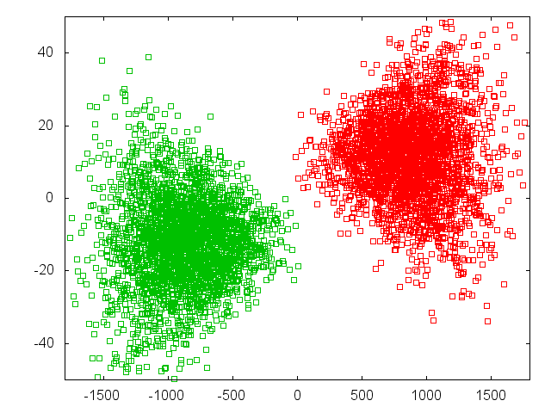
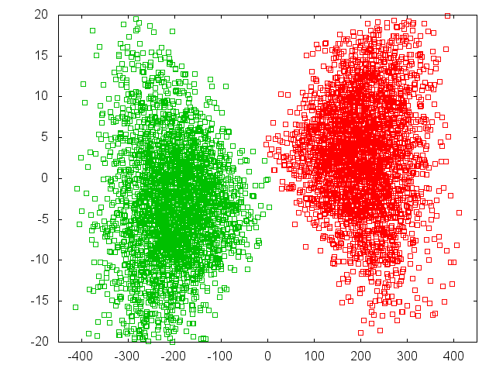
Luminosity and Offset
Luminosity loss for beam offsets depends strongly on disruption parameter
Δy = 2 σ_{y}
L = 0.38 L₀
L = 0.59 L₀
59%
38%
ILC
CLIC at 380GeV

Slide 86
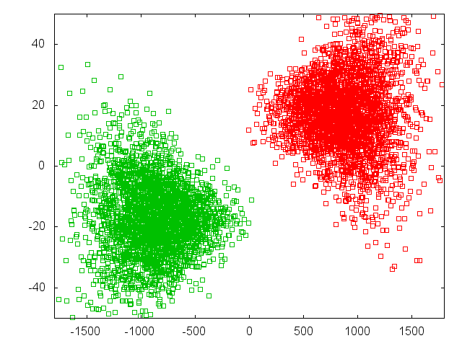
Luminosity and Offset
Luminosity loss for beam offsets depends strongly on disruption parameter
Δy = 4 σ_{y}
L = 0.26 L₀
26%
ILC

Slide 87
Note: ILC Full Optimisation
For ILC could consider smaller vertical beta-functions
Smaller beta-functions profit more from waist shift
0.24mm seems best
Would gain 15% luminosity
But still more difficult to produce (larger divergence)
And tolerances become tighter

Slide 88
Beam-beam Deflection
Strong deflection allows to easily measure and correct offset
In CLIC an offset Δ_{y} = 0.1σ_{y} = 0.1nm
3m downstream of IP 40μm beam offset
Get great signals for the BPMs

Slide 89
Impact on Vertex Detector
To vertex detector can identify particles originating from decays of other particles
Secondary particles
B-meson
Need a certain angular coverage
Hit density from pairs depends on radius and field
Edge is due to beam-beam deflection
Limit O(1mm⁻²)
e⁺
e⁻

Slide 90
CLIC Inner Detector Layout
The last focusing magnet of the machine is inside of the detector
A. Seiler

Slide 91
CLIC Inner Detector Layout
Increased ratio x/s
10mradian
For the beam
10mradian
To fit the quadrupole

Slide 92
ILC and CLIC Main Parameters
Parameter | Symbol [unit] | ILC | CLIC | CLIC
Centre of mass energy | E_{cm} [GeV] | 500 | 380 | 3000
Total luminosity | L [10³⁴cm⁻²s⁻¹] | 1.8 | 1.5 | 6
Luminosity in peak | L_{0.01} [10³⁴cm⁻²s⁻¹] | 1 | 0.9 | 2
Particles per bunch | N [10⁹] | 20 | 5.2 | 3.72
Bunch length | σ_{z} [μm] | 300 | 70 | 44
Collision beam size | σ_{x,y} [nm/nm] | 474/5.9 | 149/2.9 | 40/1
Vertical emittance | ε_{x,y} [nm] | 35 | 40 | 20
Photons per beam particle | n_{γ} | 1.9 | 1.5 | 2.1
Average photon energy | <E_{γ}/E₀> [%] | 2.4 | 4.5 | 13
Coherent pairs | N_{coh} | - | - | 6.8x10⁸
Their energy | E_{coh} [TeV] | - | - | 2.1x10⁸
Incoherent pairs | N_{incoh} | 196x10³ | 58x10³ | 300x10³
Their energy | E_{incoh} [TeV] | 484 | 187 | 2.3x10⁴

Slide 93
The Spent Beam
Particles move little in the horizontal plane
Can see the field profile
They start to oscillate in the vertical plane
=> Final angle depends also on the phase that they happen to have at the end of the collision

Slide 94
CLIC 3TeV Beamstrahlung
Goal is to maximise L_{0.01}
And L_{0.01}/L > 0.3
CLIC parameter choice

Slide 95
Waist Shift
Focusing before IP leads to more luminosity (D.S.)
For CLIC and ILC ~10% luminosity gain

Slide 96
FCC-eh
Do the electron and proton transverse beam sizes have to be matched?
In LHeC the sizes are not matched along the collision
Strong pinching of electrons
Not obvious why beam sizes do need to match
Scan for optimum electron beam size and waist position
Electron beam shrinks during collision
Increases beam-beam tune shift for protons

