Slide 1
Beamstrahlung in CAIN
Kaoru Yokoya
2022.01.12
ICFA Higgs Factories
Focus Meeting: Beamstrahlung
https://indico.cern.ch/event/1100734/

Slide 2
CAIN Versions
Started in 1984, named ABEL, for beam-beam interaction in JLC
  Pinch effect
  Beamstrahlung
Later, renamed to CAIN when beam-laser interaction was included for gamma-gamma colliders
Latest version: not clear.
  Perhaps, CAIN2.44b, but a beta version
  CAIN2.43 is better
Code
  Written in FORTRAN90 since recursive calls were included
  Windows version and UNIX version
  I have almost stopped revising the code.
  Ask Tauchi san for UNIX version and compilation
Manual available.
Possible bugs
  Sometimes a strange phenomena when too many macroparticles are used
  There can be lots of bugs in the routines which are used only rarely

Slide 3
Structure of the Code
All the particles (electron, positron, photon) are in one big array, containing the info of the space-time, energy-momentum, polarization, etc.
Fields
  Beam-beam field
  External field (constant field, quadrupole field, laser field)

Slide 4
Commands
Input data is a sequence of “commands”
Interaction control
  BBFIELD beam-beam field
  LASERQED
  CFQED
    beamstrahlung
    coherent pair creation,
  LUMINOSITY
  PPINT (incoherent pair)
Beamline definition
  MAGNET, BEAMLINE, BLOPTICS, MATCHING
Execution commands
  PUSH, ENDPUSH
  DRIFT
  LORENTZ
  TRANSPORT, ENDTRANSPORT
Math expression
  SET, ARRAY
Control :
  DO, CYCLE, EXIT, ENDDO,
  IF, ELSEIF, ELSE, ENDIF
Output
  WRITE, PRINT
  PLOT (use very old software TOPDRAWER)
Beam definition
  BEAM
  LASER

Slide 5
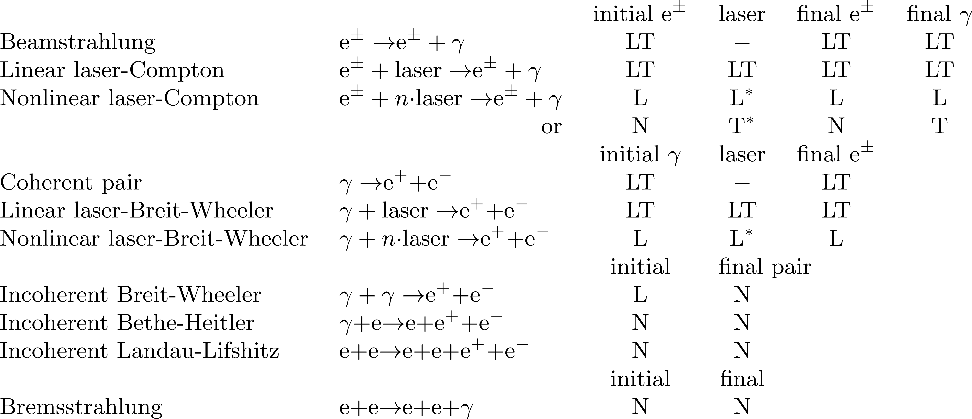
Polarization
Spin of electron/positron and Stokes parameters of photons
Treated as density matrix
But not for all the interactions
L : Longitudinal spin of electron/positron (or circular polarization of photon).
T : Transverse spin of electron/positron (or linear polarization of photon).
* : 100% polarization only
N : Not computed. (No change for existing particles, zero for created particles)
- : Irrelevant

Slide 6
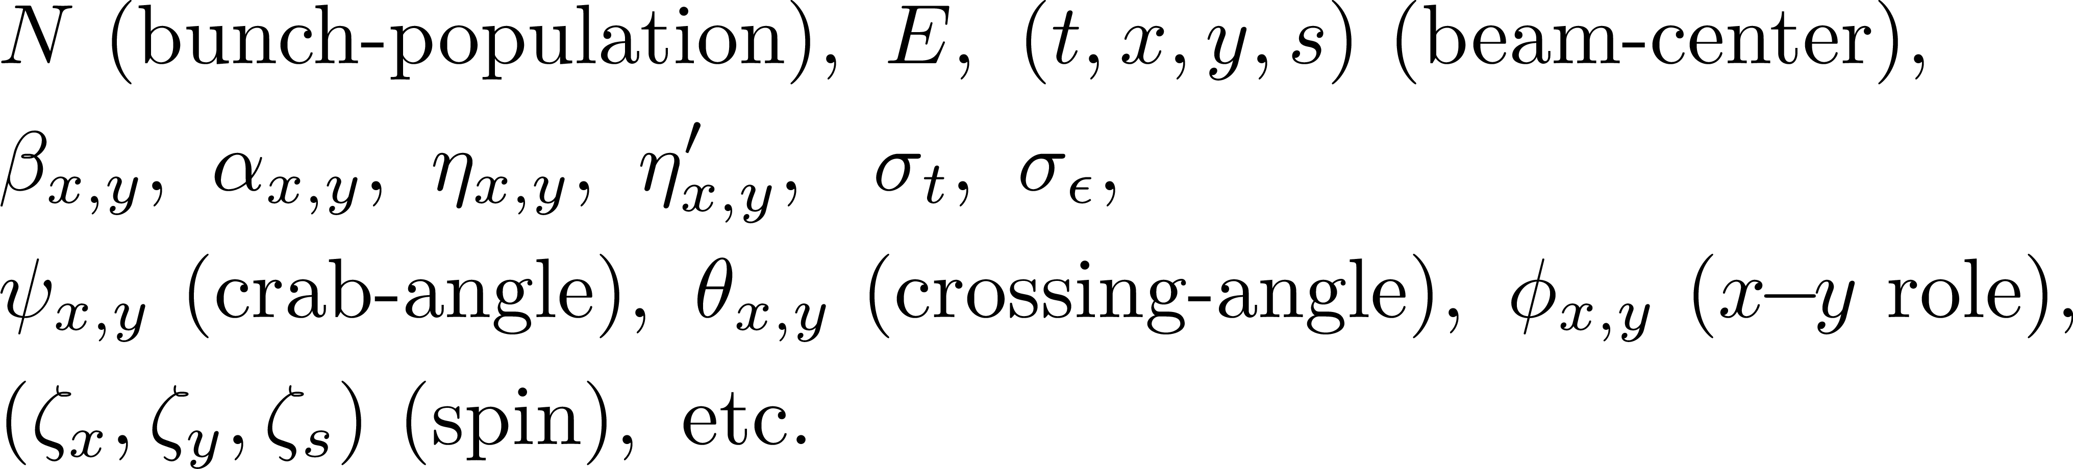
Beam Definition
Courant-Snyder parameters: Following parameters can be used
Beam data can also be read from files
  CAIN standard format, MATHEMATICA format, FORTRAN NAMELIST)
  Or, user-defined format (see Sec.3.5.2 of the manual)

Slide 7
Beam-Beam Field
Longitudinal slices
  No interaction between different slices (Lorentz contraction)
  Longitudinal mesh size must be defined by the user
Interaction within each slice (2D)
  Main part
    Equal-space, rectangular mesh
    Kernel potential averaged over each mesh
    Fast computation by FFT
    Size of the “main part” and the mesh size are decided by the input data, not automatically

Slide 8
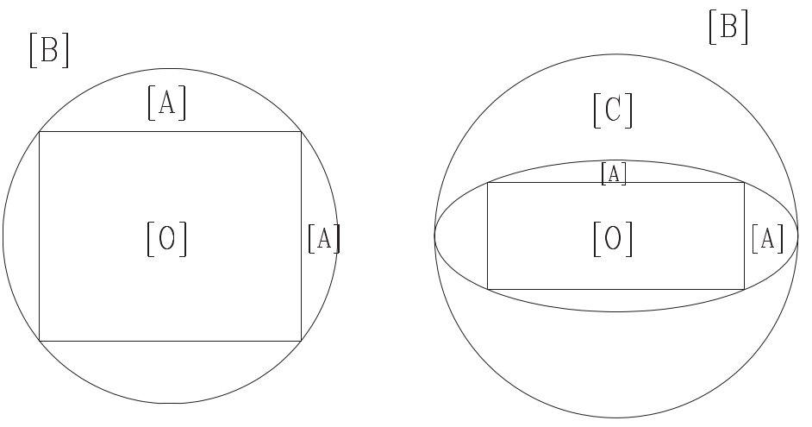
Beam-Beam Field (continued)
  Outside region
    Ignore the contribution of the particles outside the mesh region
    But the force from the main part to outside particles is included by
      either direct Coulomb force
      or by harmonic expansion
[O] mesh region
[A] Direct Coulomb field
[B] Harmonic expansion in polar coordinate
[C] Harmonic expansion in elliptic coordinate
Square (more or less) case
Very flat case

Slide 9
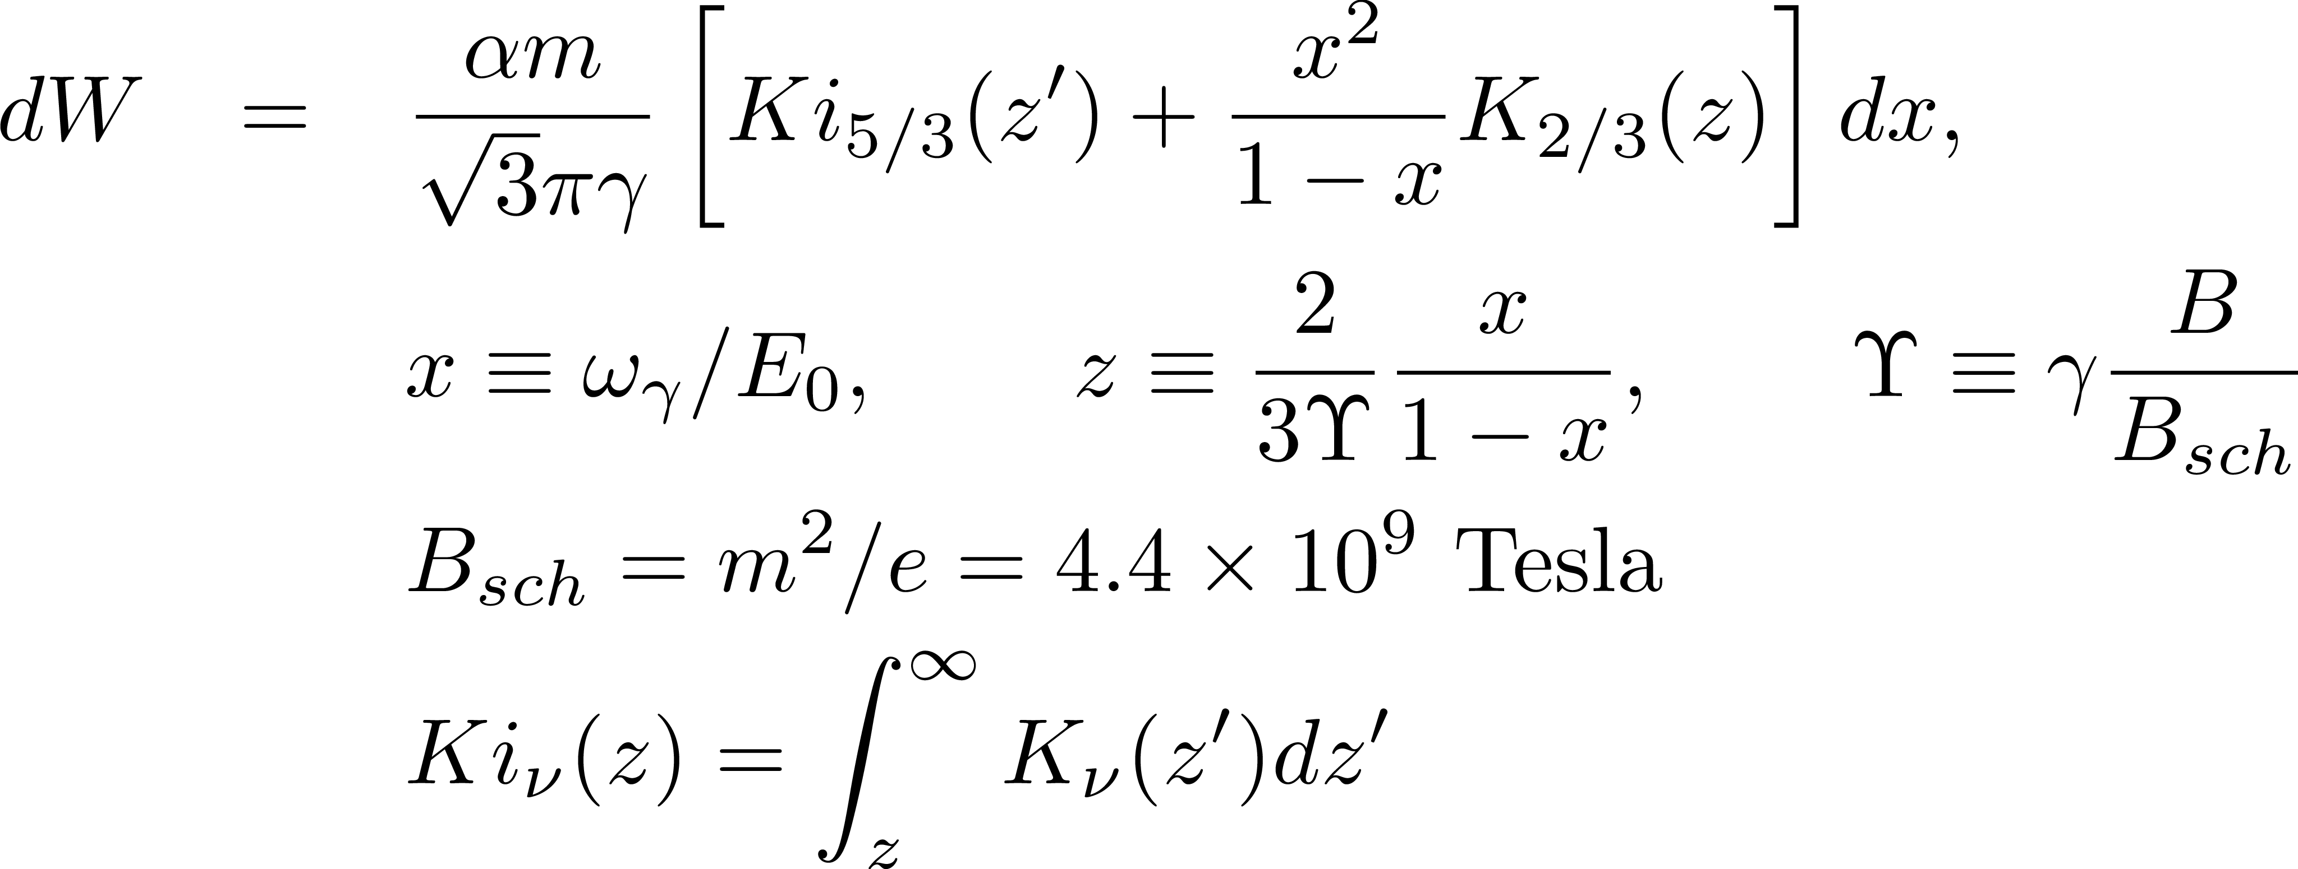
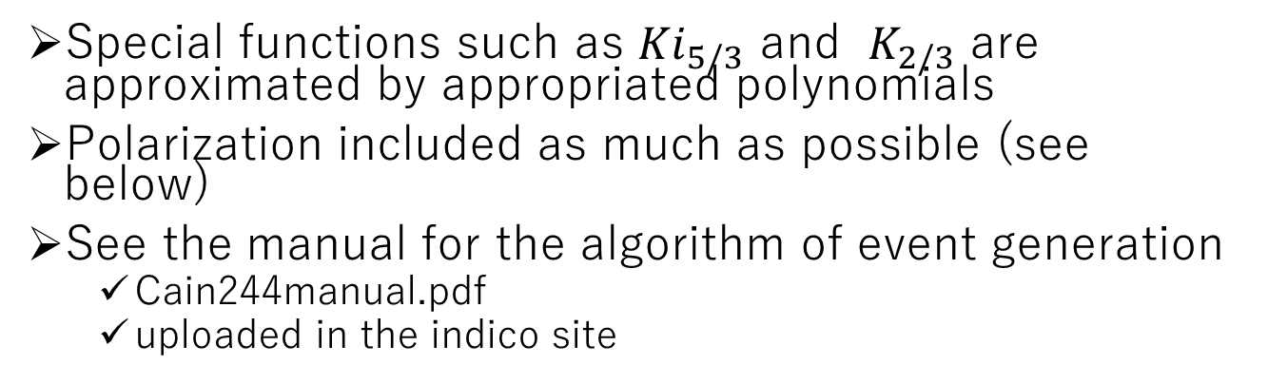
Beamstrahlung
Use the formula in constant (within the slice) magnetic field
Special functions such as ${Ki}_{5/3}$ and $K_{2/3}$ are approximated by appropriated polynomials
Polarization included as much as possible (see below)
See the manual for the algorithm of event generation
  Cain244manual.pdf
  uploaded in the indico site

Slide 10
Beamstrahlung (continued)
Emission angle is not taken into account
  Effects of the angle is not large during the collision
  Emission angle causes 1-2 mm displacement at the beam dump window
  Vertical angle should at least be included
  Horizontal angle cannot be consistently included in the “Constant Field Approximation”
  I do not have a complete formula including the angle and polarization effect

Slide 11
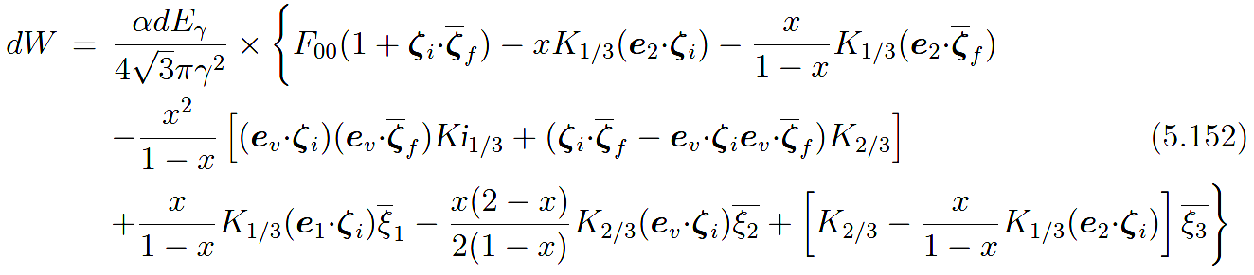
Polarization Effects
Electron/positron polarization can be tracked during beam-beam interaction, including the precession and the spin-flip beamstrahlung
Initial and final electron polarization (longitudinal and transverse) and the Stokes parameter of the final photon are included
Included terms
ζ: electron polarization vector,
ξ: photon Stokes parameter
suffix i/f : initial/final
Terms involving 3 polarization operators are ignored

Slide 12
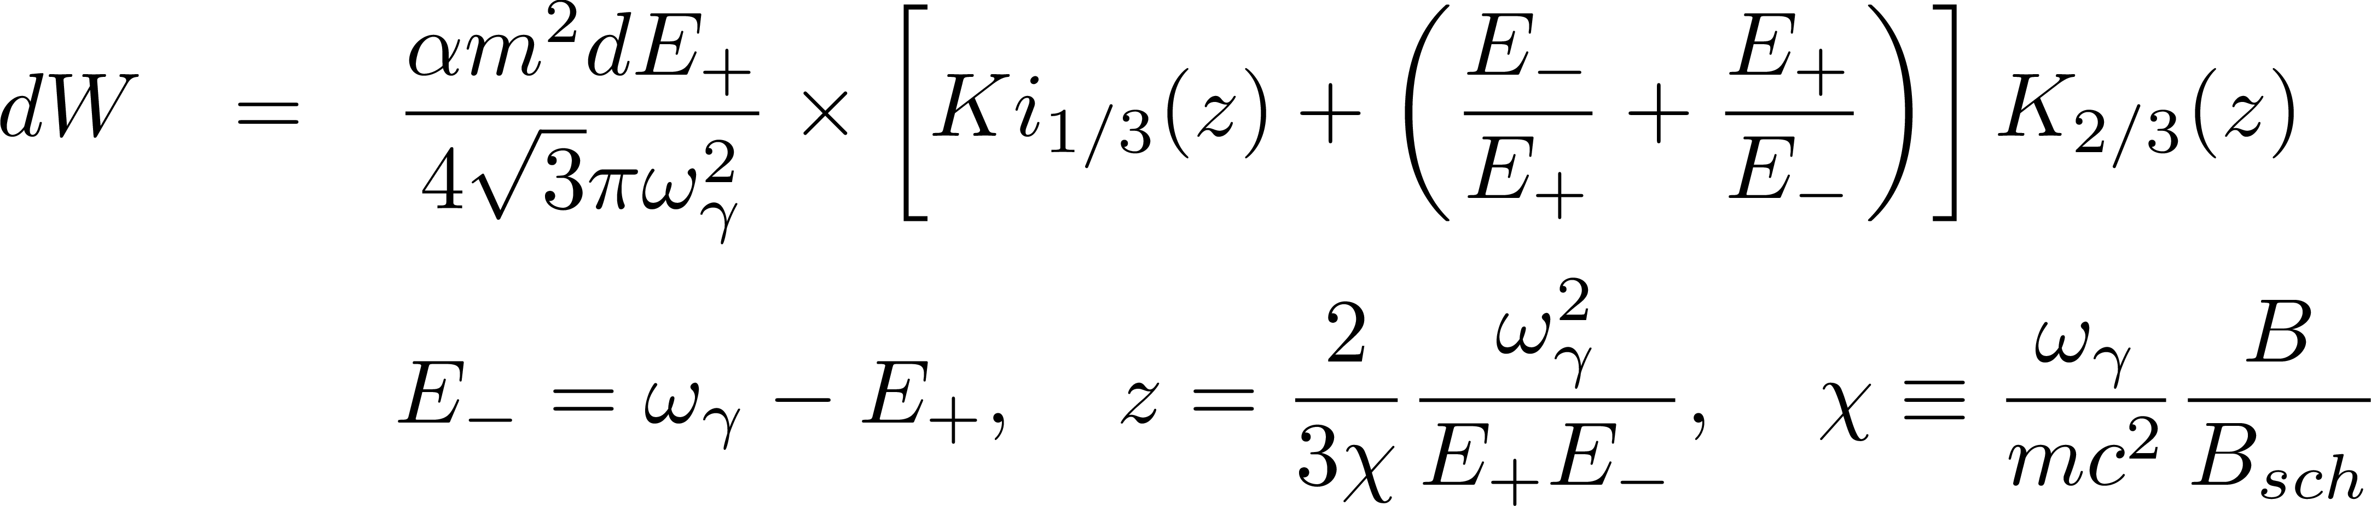
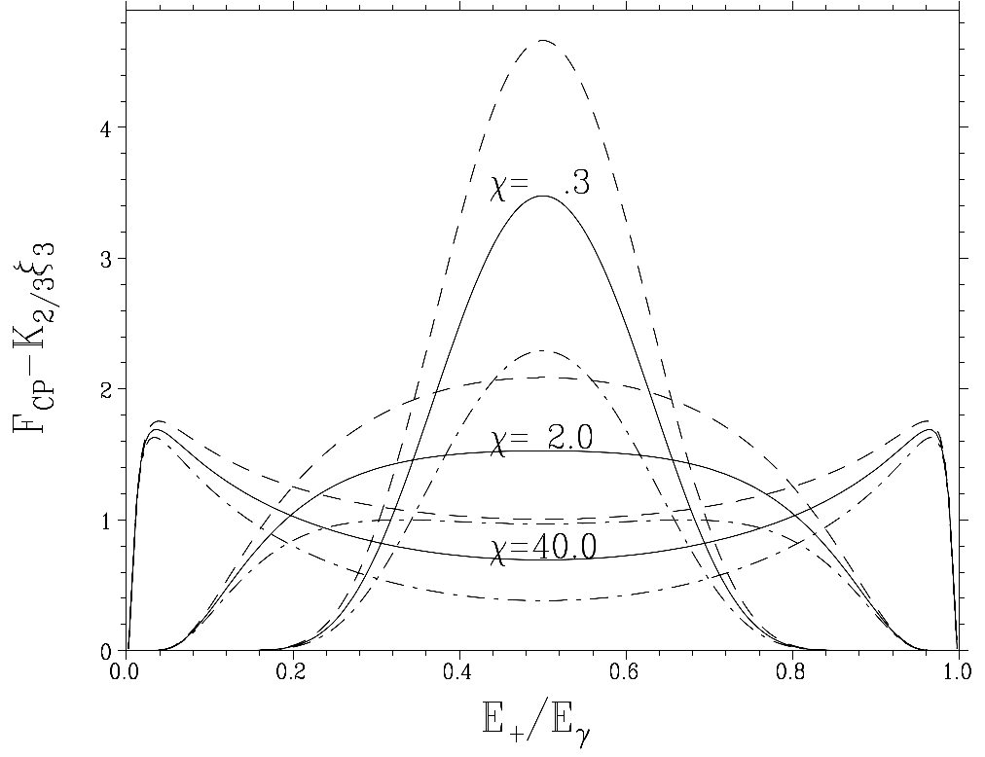
Coherent Pair Creation
Constant field formula
Polarization of (e⁺, e⁻, γ) is included
  The formula is much more complex than above
Creation angle ignored
The algorithm is inefficient for large χ (>~ 1000)

Slide 13
Application to ILC
Characteristics of the beam-beam interaction in ILC
  Very large disruption parameter
    Dy = 25 – 35
    Accurate simulation is hard
    Luminosity fluctuation a few % with 400k particles
  Beamstrahlung is moderate (compared with CLIC)
    n_{γ} ~ 2.0, δ_{E} = 2.5 (Z-pole, 500GeV) ~ 10 (1TeV)%

Slide 14
Parameters used here
(*) CLIC parameters here are based on CDR but not exactly the same because
the beam deformation in the BDS is included in the CDR

Slide 15
(Only one random number set was used for each. For demonstration only)

Slide 16
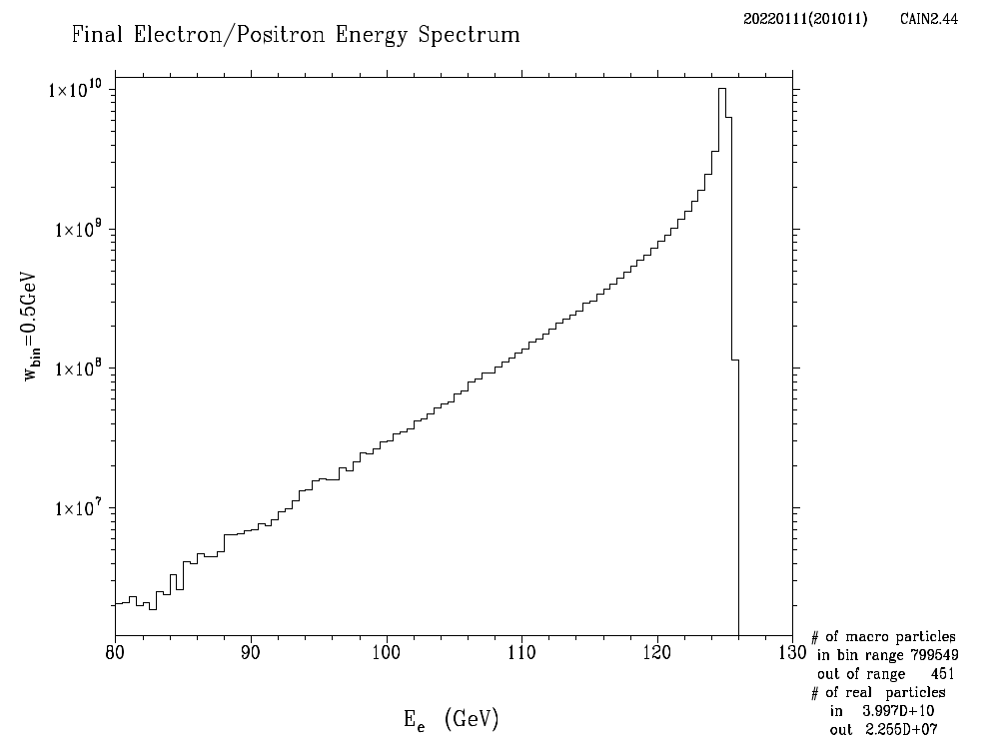
Final Electron/Positron Energy Spectrum
E_{CM}=250GeV

Slide 17
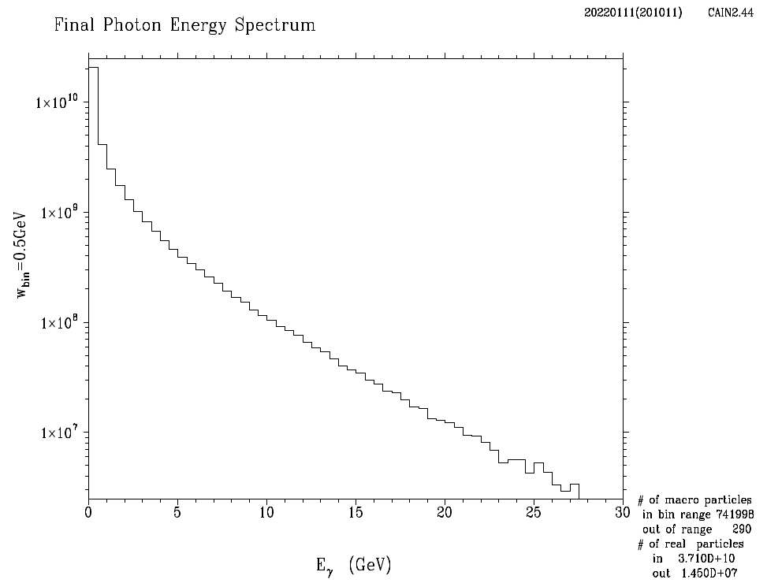
Photon Energy Spectrum
E_{CM}=250GeV

Slide 18
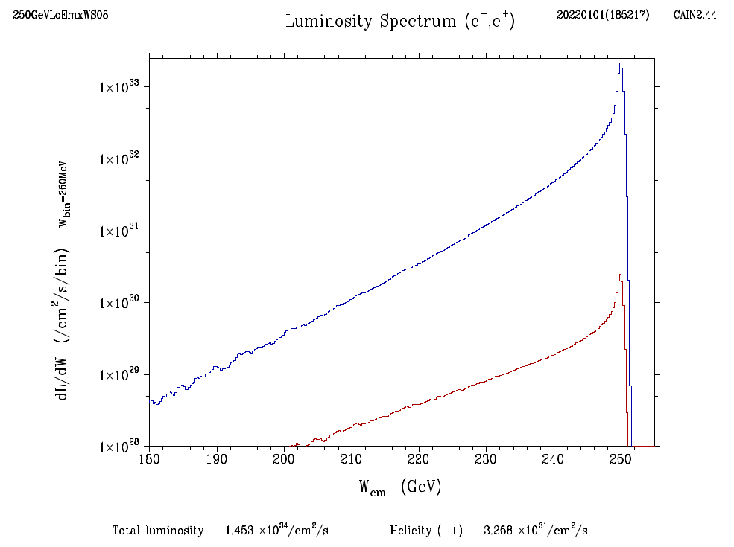
Luminosity Spectrum
E_{CM}=250GeV
total
wrong helicity

Slide 19
Summary
CAIN has been used since mid 1980’s for beam-beam interaction in linear colliders
Beamstrahlung has been included since the first version
Angle of photon emission is not included
Polarization effects due to both the precession and the spin-flip beamstrahlung are included

