Slide 1




Associated production of
vector bosons with heavy
flavours
J. Huston
Michigan State University,
for the ATLAS, CMS and LHCB experiments
…will concentrate on most recent results
1

Slide 2
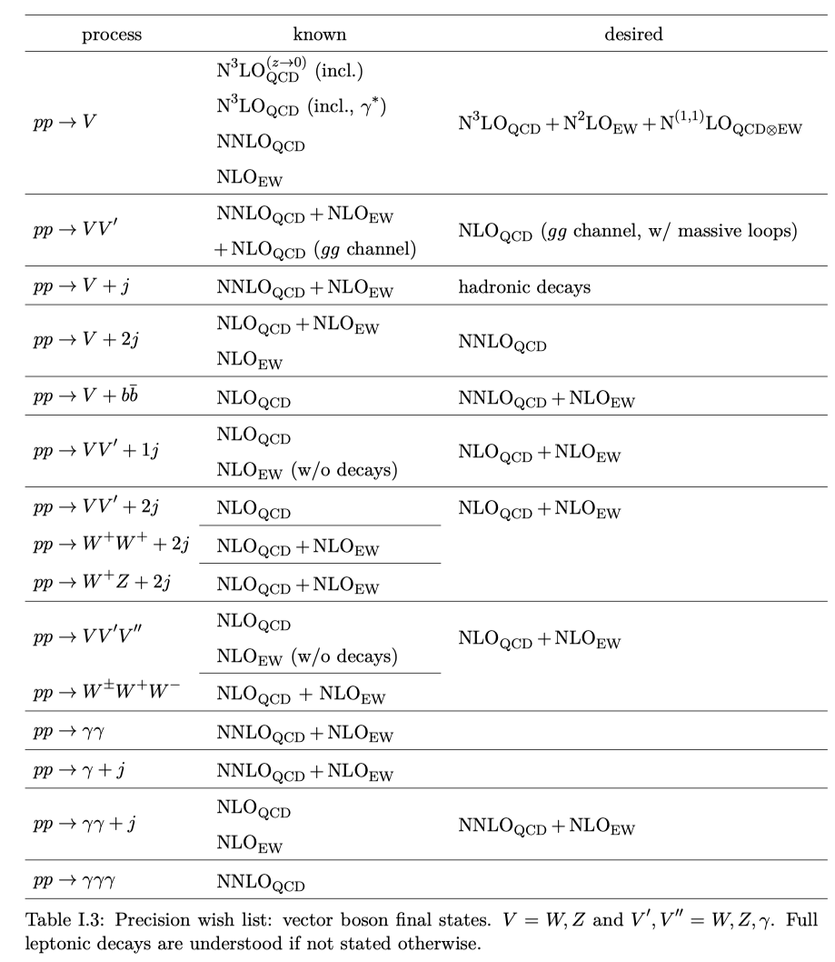
Background
Associated production of vector bosons with heavy flavour is an important precision test of pQCD in the presence of two mass scales, and can also provide critical information on heavy quark PDFs such as the charm and strange distributions; N.B. NNLO calculations needed for PDF fits
Can also serve as a background to new physics
Les Houches 2019 precision wishlist (2003.01700)
2021 wishlist in preparation
VbB has been
known at NLO
for some time,
and matched to
parton showers.
WbB known at
NLO with up to
3 extra jets.
Recently, the
two-loop
corrections to the
WbB amplitude have been
calculated
(PRL127.012001)
Non-planar master integrals still to be calculated.
will add γ+c/b
2

Slide 3
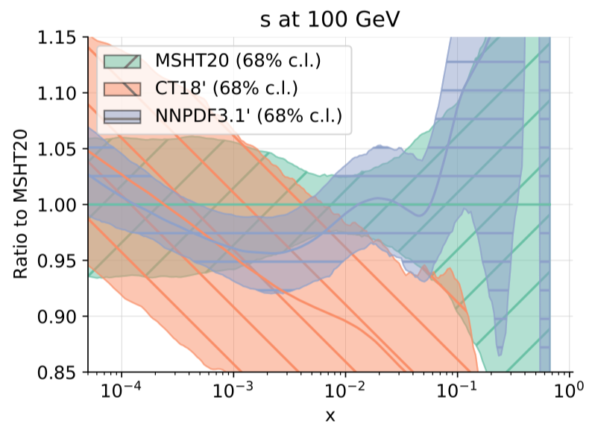
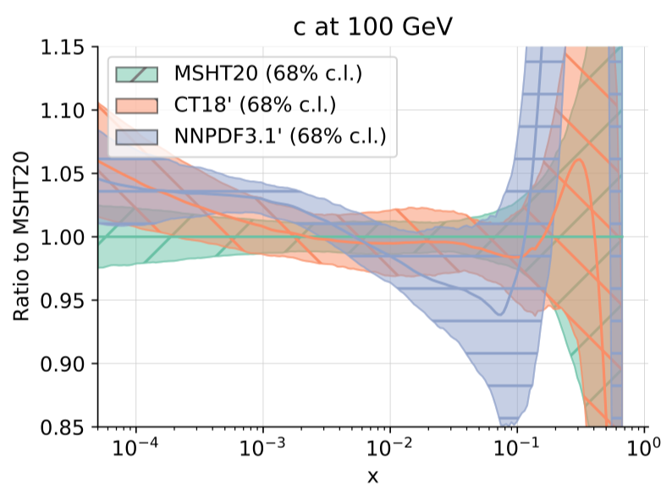
Strange/charm PDFs
Consider the strange quark PDF
There is a large difference between CT18 and CT18A/MSHT20/NNPDF3.1 due almost entirely to the ATLAS 7 TeV W/Z data
The difference between the W and Z cross sections requires a larger strange quark (s-sbar->Z)
All 3 groups fit the ATLAS W/Z data equally poorly
Because of its fitting criteria, CT18 does not use the 7 TeV W/Z data for its main fit (but it is in CT18A)
W+c data offer another window on the strange quark distribution
NNPDF3.1 has a different charm distribution then CT18/MSHT20, due to its fitting the charm distribution as a free parameter, rather then generating perturbatively through gluon splitting; an intrinsic charm component may be present at high x
CT has published PDF sets in which an intrinsic component of charm is modeled. The addition of this intrinsic component leads to a small, but noticeable, reduction in global χ²
Z+c/γ+c offers another window on the charm quark
PDF4LHC21: arXiv:2203.05506
3

Slide 4
Charm and b quark distributions
Perturbative view is that c and b quarks are not present in the proton at scales lower then their masses
They can be produced in the initial state at scales higher then their masses through gluon splitting into quark-antiquark pairs (thus primarily at lower x)
  only things that drive production (besides the gluon distribution) are the heavy quark mass and the value of α_{s}(m_{Z})
But the proton can also have an intrinsic charm (and bottom for that matter) component through a |uudcc> Fock state, primarily at higher x
  there are models (BHPS, incorporated by the CTEQ group), and increasingly, predictions from lattice gauge theory
In PDF fits, heavy quarks can be produced through QCD evolution, or through QCD evolution + an intrinsic component through a model (CTEQ), or through a free fit to the heavy quark PDF in a similar manner as for the lighter quarks (NNPDF)
4

Slide 5
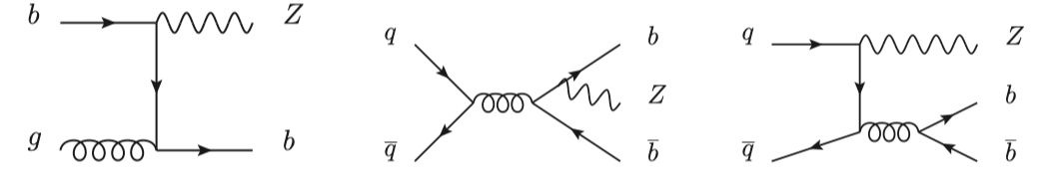
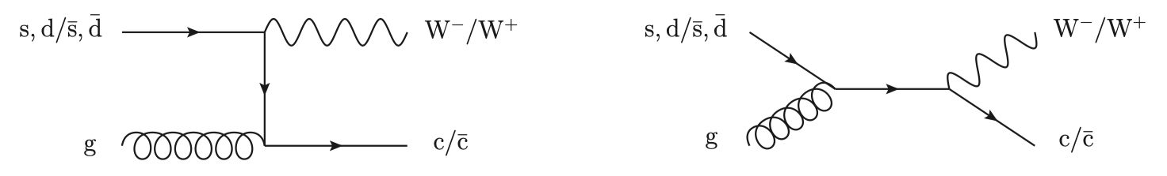
V+HF
A heavy flavor quark can be present in the initial state or produced through gluon splitting
The calculation can be performed in a scheme where there are only 4 parton flavours (4FNS) or in which the b-quark is included (5-FNS)
The kinematics can drive the subprocess for the production, as for example, whether the final state heavy quark (jet) has to pass only some minimum p_{T} requirement, or whether it has to roughly balance the boson transverse momentum
If it’s the former, then the final state c or b quark is likely to arise through gluon splitting, especially given the additional gluon splittings that may occur in a parton shower (JHEP 02 (2018) 059)
  this effect is more pronounced if there is a hierarchy of scales, i.e. p_{T}^{jet}>>p_{T}^{charm} (would be useful to measure differentially in p_{T}^{jet})
5
Notes:
Require jets to have pT>25GeV

Slide 6
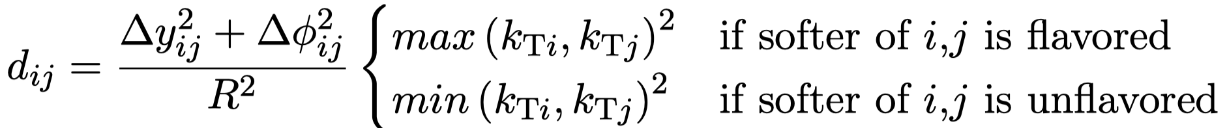
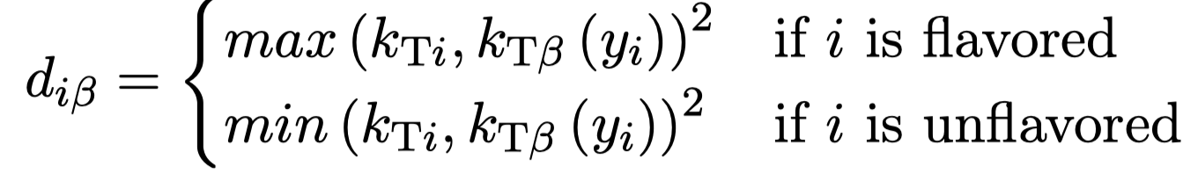
Jet tagging
There is also the issue of how the heavy flavor jet is tagged; the theory predictions use a flavor tagging k_{T} jet algorithm in which the distance between pseudo-jets i and j (d_{ij}) are dependent on the flavour of the considered partons
  the distance to the beam is also flavour-dependent
The experimental measurements typically use the anti-k_{T} jet algorithm with later flavor identification (Eur.Phys.J.C 47 (2006) 113)
The difference between the two may not be small (10-15%)
6

Slide 7
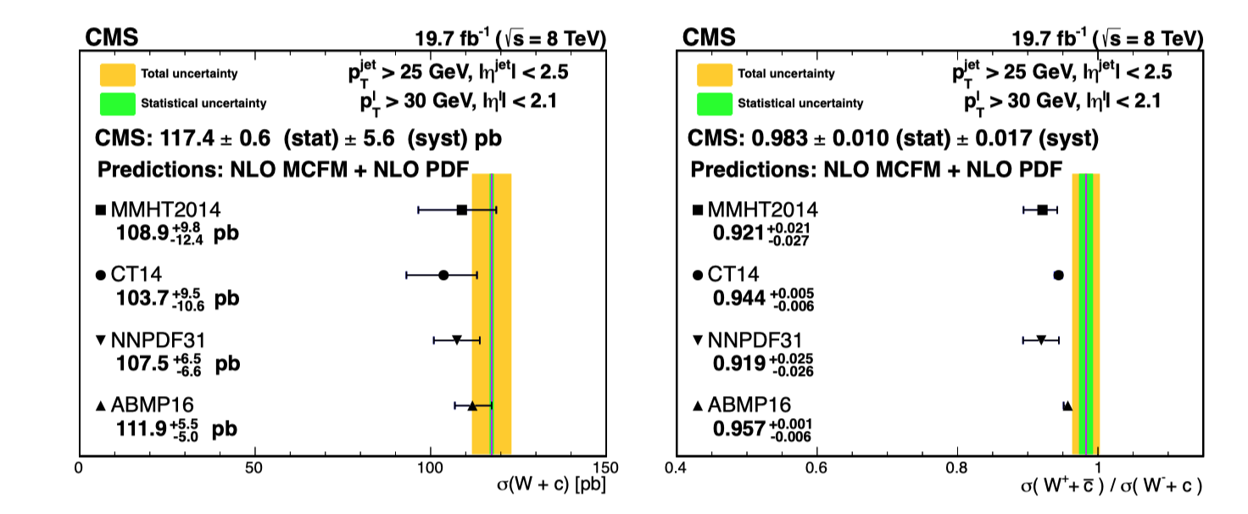
W+c jets
Measurement carried out inclusively, and differentially as function of p_{T} and η of lepton
Note: W and c quark should
be of opposite sign; SS-OS
suppresses contributions from
gluon splitting
arXiv:2112.00895 (submitted to EPJC)
no strange
quark asymmetry
7

Slide 8
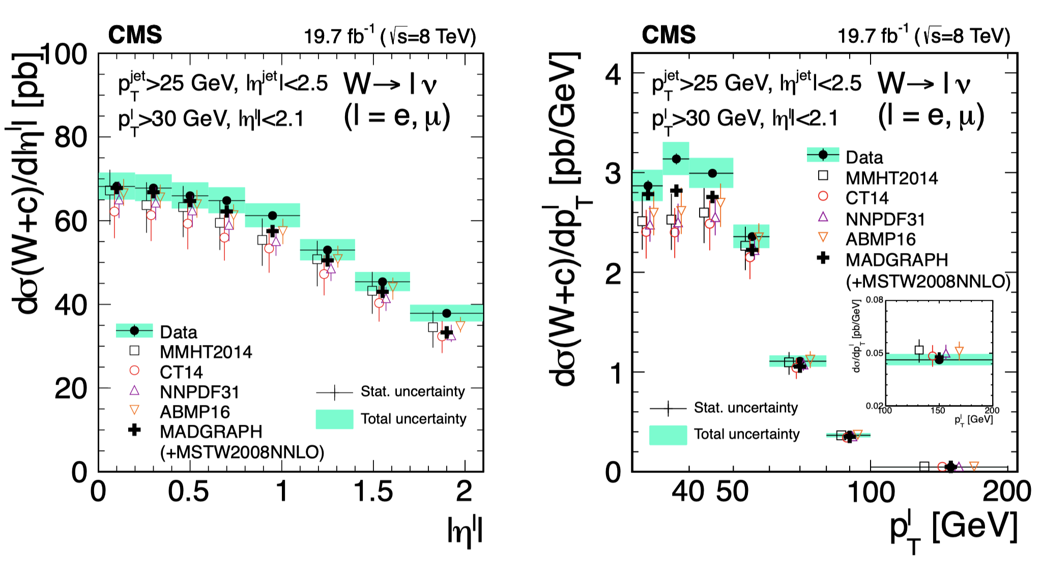
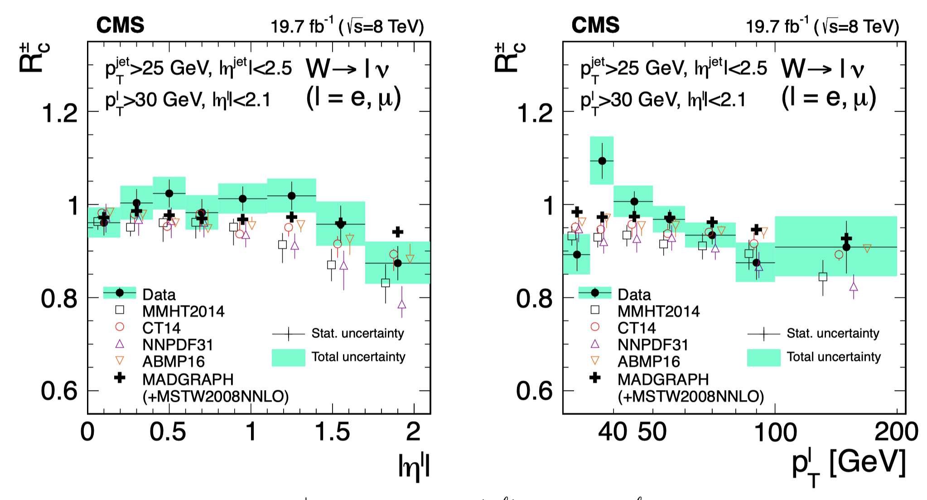
Differential cross sections
Require an isolated lepton (e or μ) with p_{T}>30 GeV and |η|<2.1
Require a jet with p_{T}>25 GeV with |η_{jet}|<2.5. Jets not selected if ΔR(jet,l)<0.5
Data are larger then (NLO+PS) predictions for lepton p_{T} less then 65 GeV, but compatible within uncertainties
NNLO corrections for W+c predicted to be on the order of 5% for lepton p_{T} less then 60 GeV and about 1% for larger p_{T} values
  JHEP 06 (2021) 100
This would improve the level of agreement with the data
arXiv:2112.00895 (submitted to EPJC)
cross section ratio
8
Notes:
More on flavor kT tagging

Slide 9
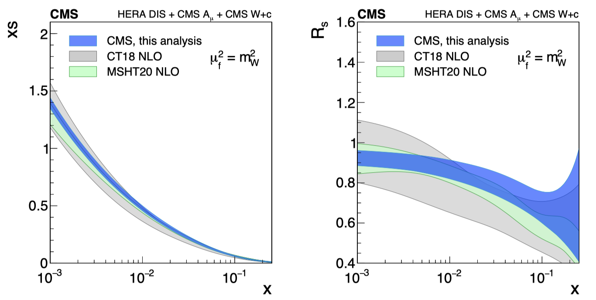
(W+c) strange quark PDF
Derived CMS strange quark consistent with that obtained by CT18 and MSHT20 for x<0.01; somewhat larger at higher x
  NB: MSHT20 includes ATLAS 7 TeV W/Z data
strangeness suppression factor
arXiv:2112.00895 (submitted to EPJC)
9

Slide 10
(W+c) strange quark PDF
Derived CMS strange quark consistent with that obtained by CT18 and MSHT20 for x<0.01; somewhat larger at higher x
  NB: MSHT20 includes ATLAS 7 TeV W/Z data
Compare to results from ATLAS PDF21 fit
  CT18 does not include ATLAS 7 TeV W/Z data, CT18A does
strangeness suppression factor
perhaps more consistency between
ATLAS and CMS determinations of s
thanks to Francesco Giuli for making
the ATLAS plots
arXiv:2112.00895 (submitted to EPJC)
9

Slide 11
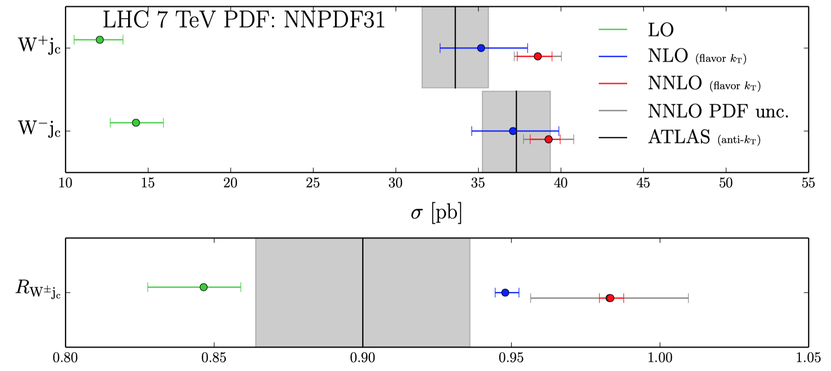
NNLO W+c-jet cross section calculation
Large reduction in uncertainties from NLO->NNLO
NNLO scale uncertainties smaller then PDF uncertainties
NB: the NNLO calculation used flavor tagging for the charm jet; the experimental measurement used the antikT algorithm with later flavor identification; NNLO corrections to subleading CKM-mediated processes not included in this calculation (but are now available)
  JHEP 06 (2021) 100
sizeable difference for NNLO
compared to data
10

Slide 12
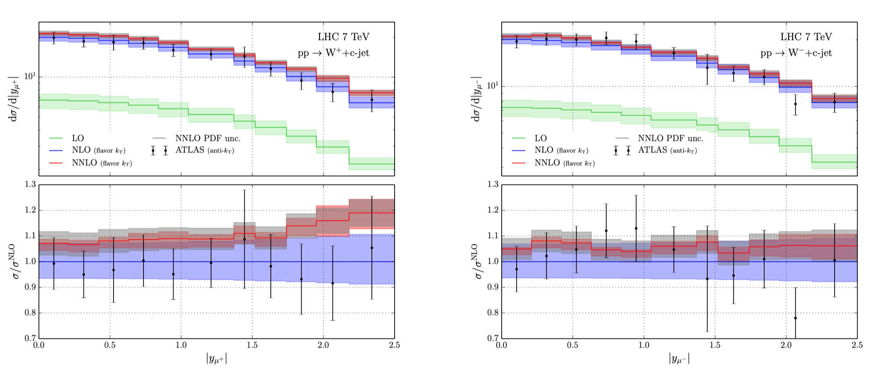
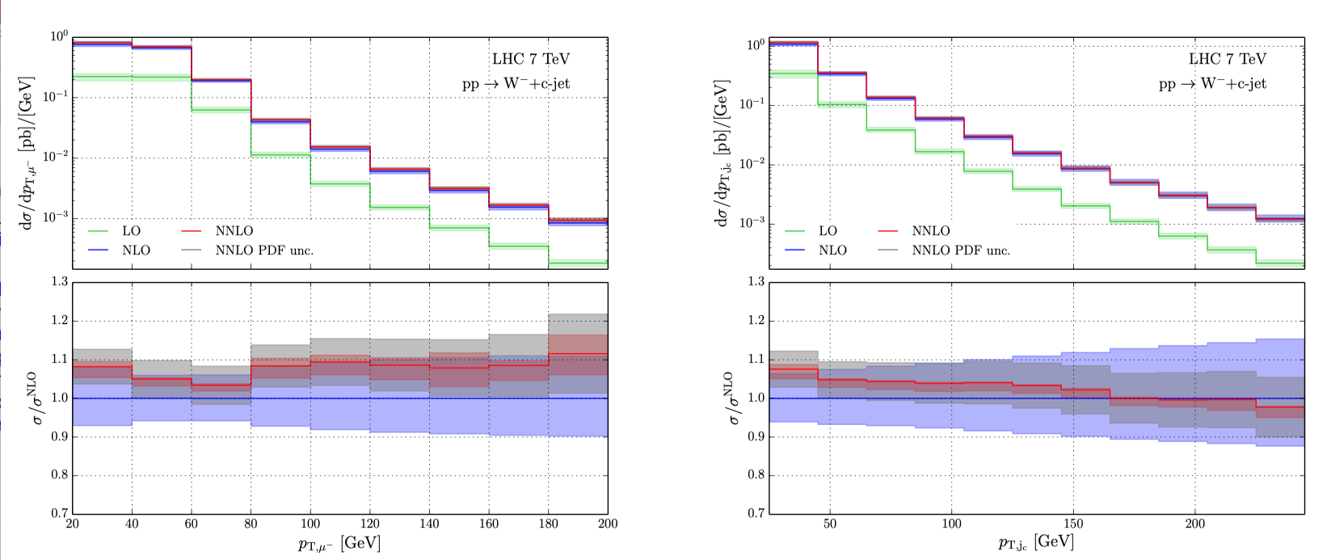
W+c at NNLO-differential
  JHEP 06 (2021) 100
no comparison
to data yet
(that I know of)
11

Slide 13
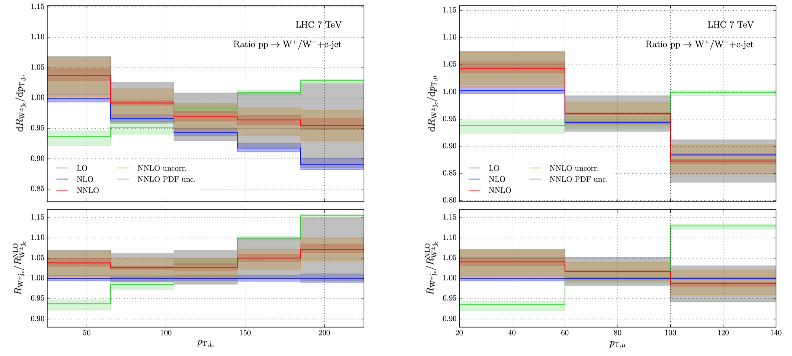
W+c at NNLO
Ratio plots sensitive to s-s asymmetry
  JHEP 06 (2021) 100
NNLO uncertainties very small; potential for constraining asymmetry
12

Slide 14
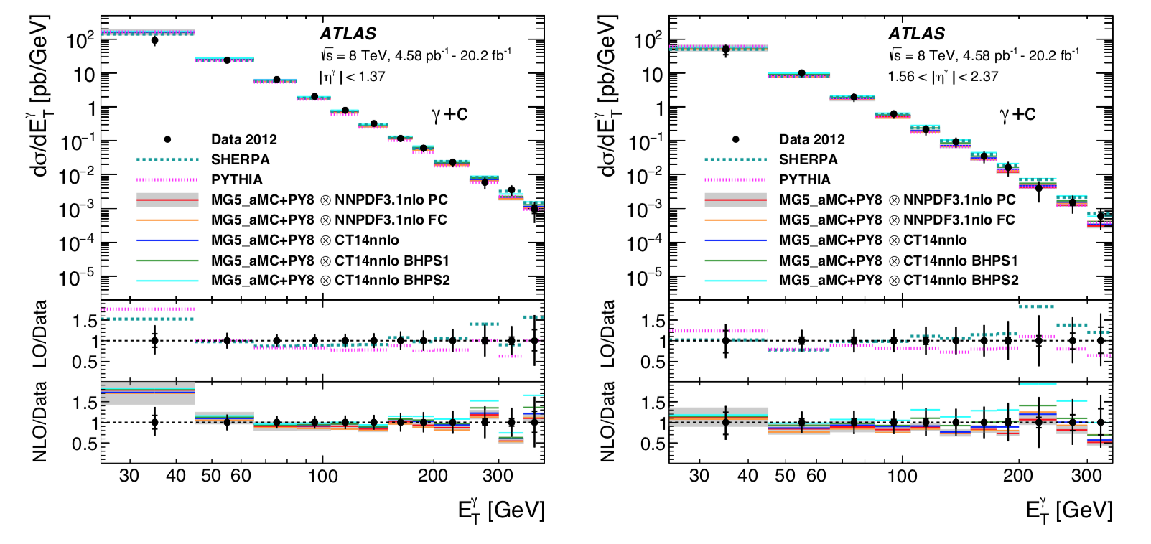
Photon+charm jets
Photons measured in central and forward rapidity
Jets are defined with antikT algorithm, R=0.4; p_{T}^{jet}>20 GeV
  if jet contains a b-hadron with p_{T}>5 GeV within ΔR=0.3 of jet, then it is assigned as a b-jet; if there is no b-hadron, but there is a charm hadron, it is assigned as a c-jet
All predictions agree reasonably well with data (relatively large uncertainties)
There are differences at high E_{T} when intrinsic charm included in predictions of similar size to uncertainties
NNLO predictions would be very useful (have to deal with photon isolation)
Phys.Lett.B776(2018) 295
see talk of
Hofer on
Monday
13

Slide 15
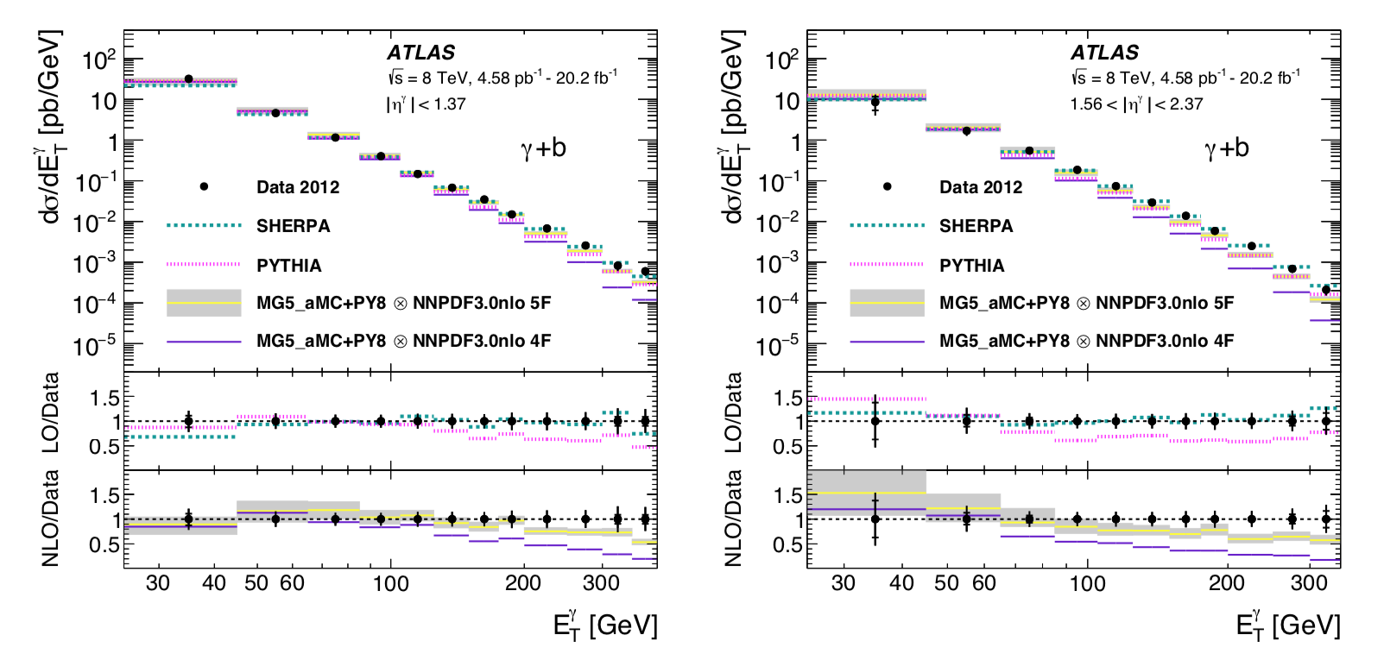
Photon+b jets
5FNS scheme works better then 4FNS scheme
Best description of the data provided by Sherpa with up to 3 additional partons included in 5FNS scheme
Again, NNLO would be useful
Phys.Lett.B776(2018) 295
14

Slide 16
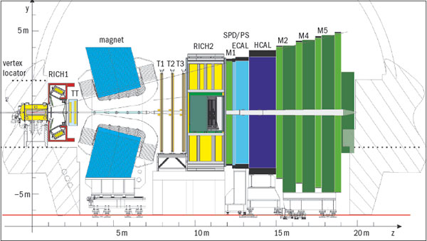
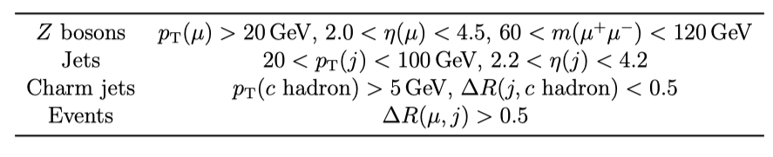
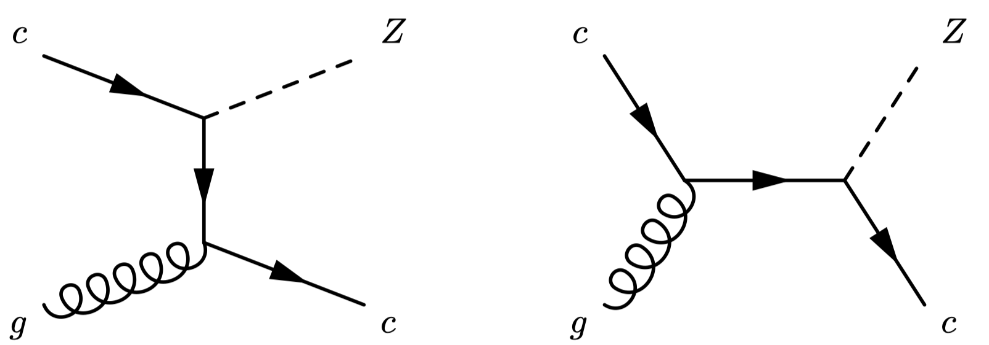
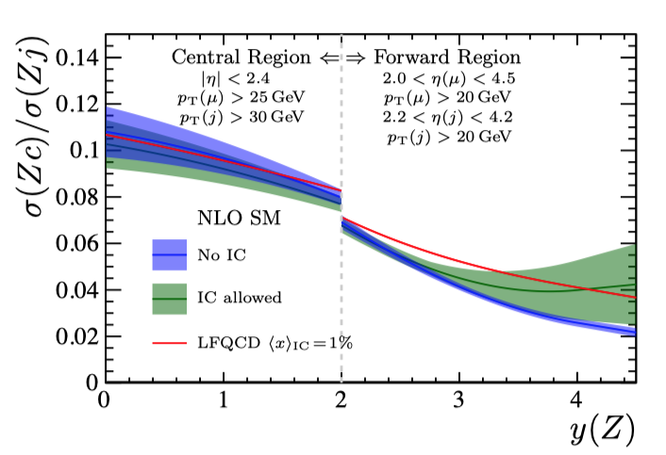
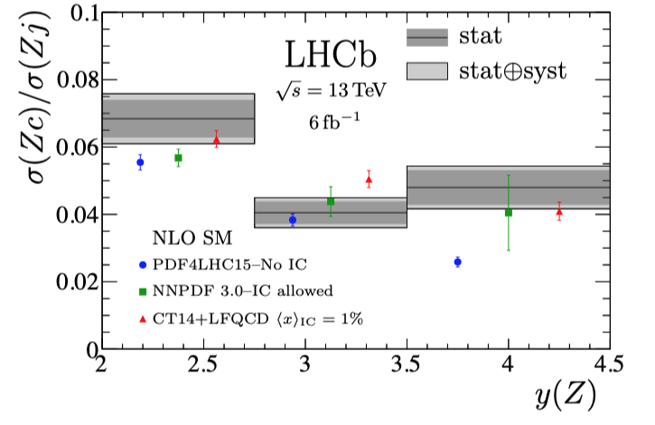
Z+c jets (arXiv:2109.08084)
The forward layout of LHCb makes it particularly sensitive to the presence of any charm component at high x
For greater sensitivity, measure the ratio of
Zc to Zj
c
c
fiducial region for
LHCb measurement
excess over no
intrinsic charm
predictions from PRD93 074008
summed over 3 jet bins (20-100 GeV)
15
Notes:
It would be interesting to examine the ratio separately for each jet pT bin.

Slide 17
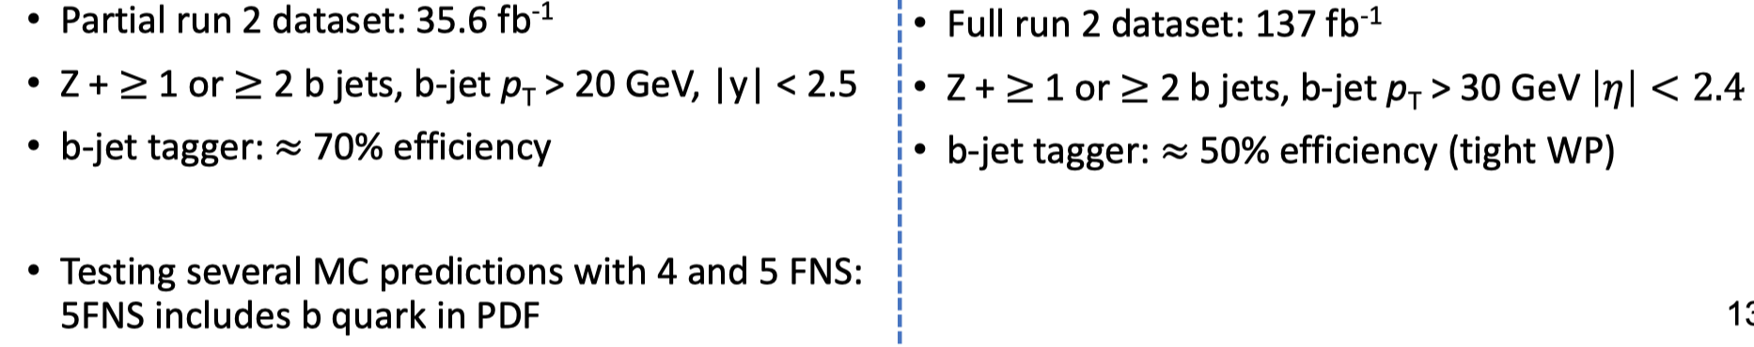
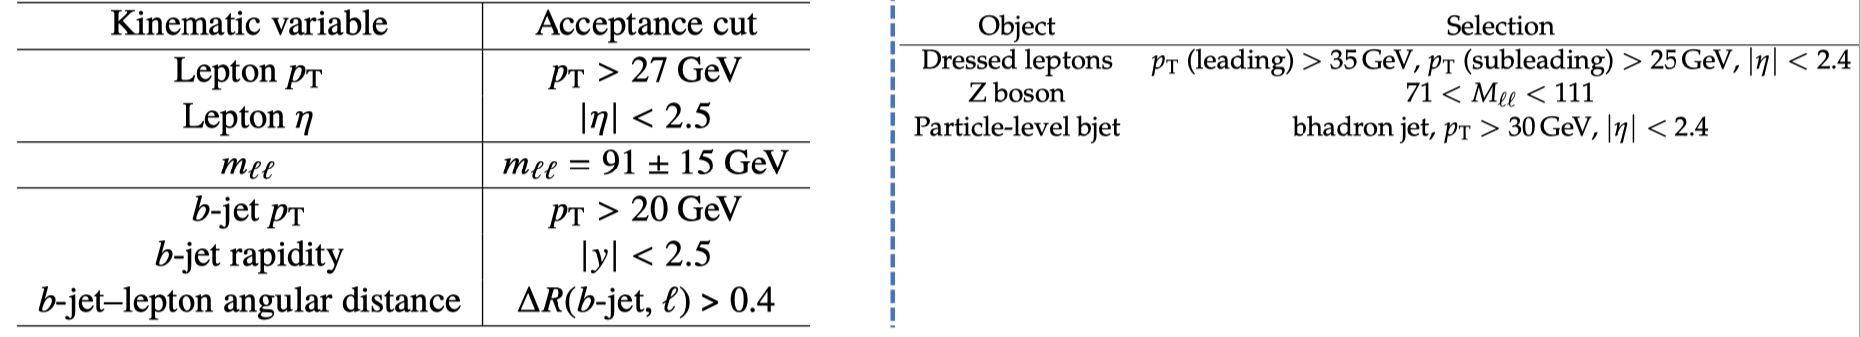
Z+b jets
The b quark is treated as perturbatively produced by all PDF fitting groups; i.e. inside the proton, at higher Q² scales, only things that drive it are the b-quark mass and the value of α_{s}(m_{Z})
Also sensitive to final state gluon splitting
Calculation can be performed either in 4FNS or 5FNS
ATLAS JHEP 07 (2020) 44
CMS-SMP-20-015 arxiv:2112.09659
16

Slide 18
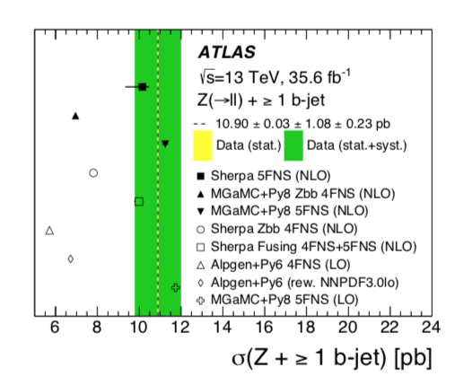
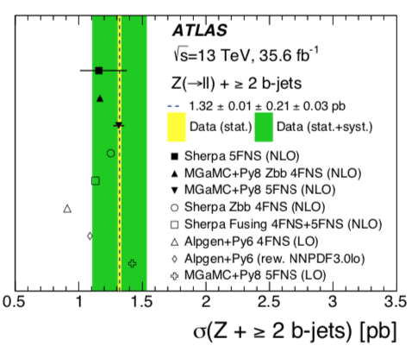
Z+b jet
The b quark is treated as perturbatively produced by all PDF fitting groups; i.e. inside the proton, at higher Q² scales only things that drive the PDF are the b-quark mass and the value of α_{s}(m_{Z})
Also sensitive to gluon splitting (and multiplicative factor of parton shower)
Calculation can be performed either in 4FNS or 5FNS
  4FNS underestimates cross section; better agreement with5FNS
ATLAS JHEP 07 (2020) 44
note Fusing prediction
of 4FNS+5FNS
schemes
Monte Carlo
equivalent of FONLL/
ACOT
17

Slide 19
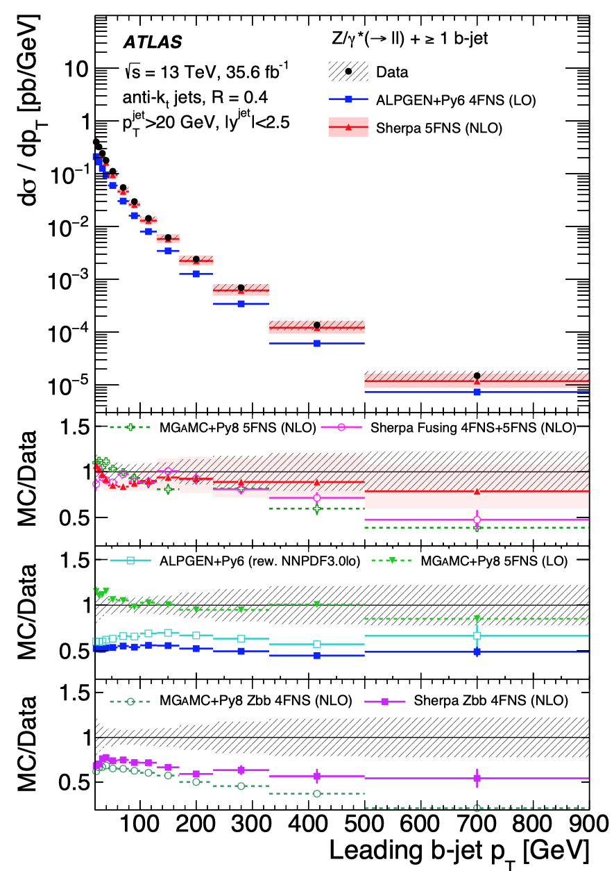
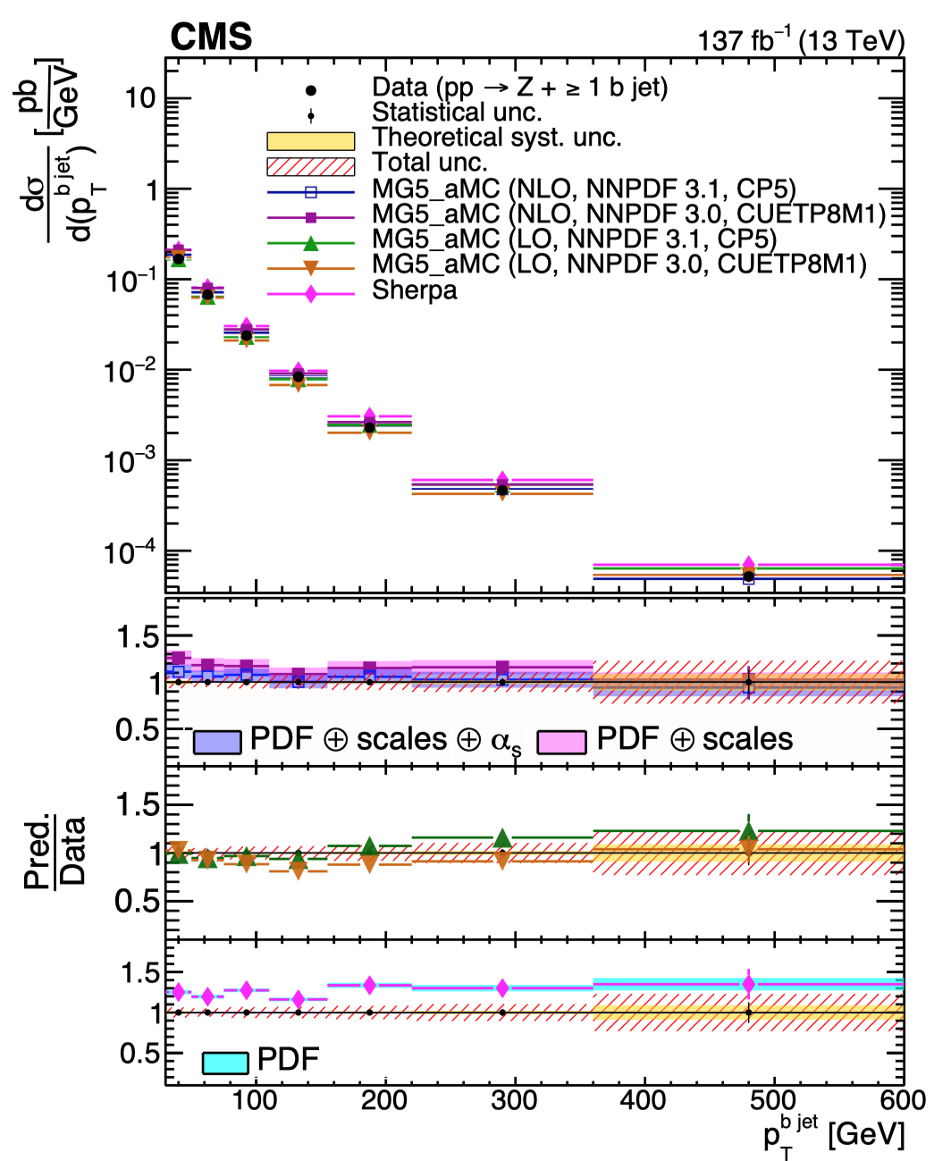
Most important information comes from differential distributions, though
NNPDF3.1 PDF is the most up-to-date of the PDFs shown; would be nice to have comparisons of more modern PDFs as well (CT18, MSHT20, NNPDF4.0 (NNPDF3.1’)
arxiv:2112.09659 CMS-SMP-20-015
ATLAS JHEP 07 (2020) 44
sizeable
difference
depending on
whether
massless or
massive
NLO+PS
prediction used
18

Slide 20
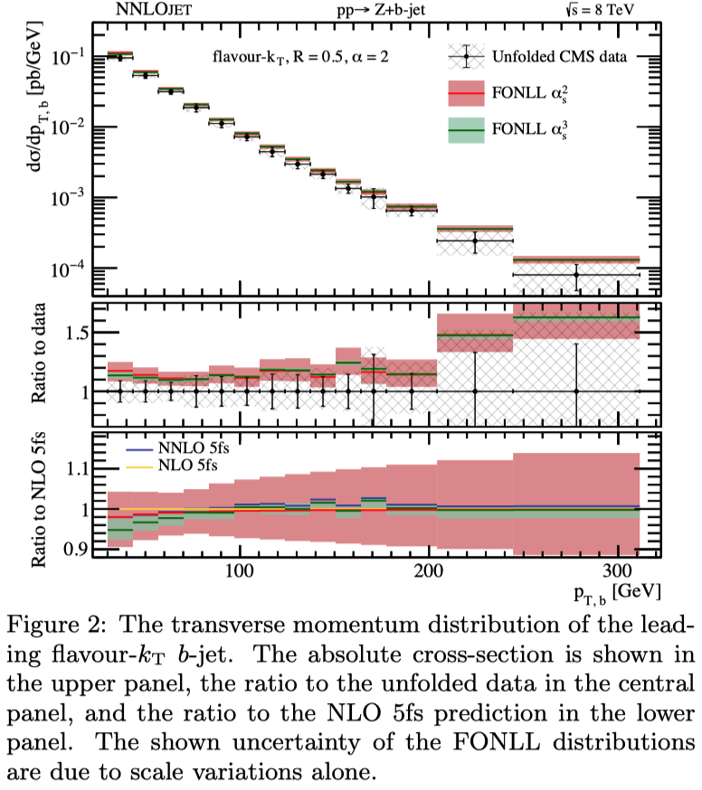
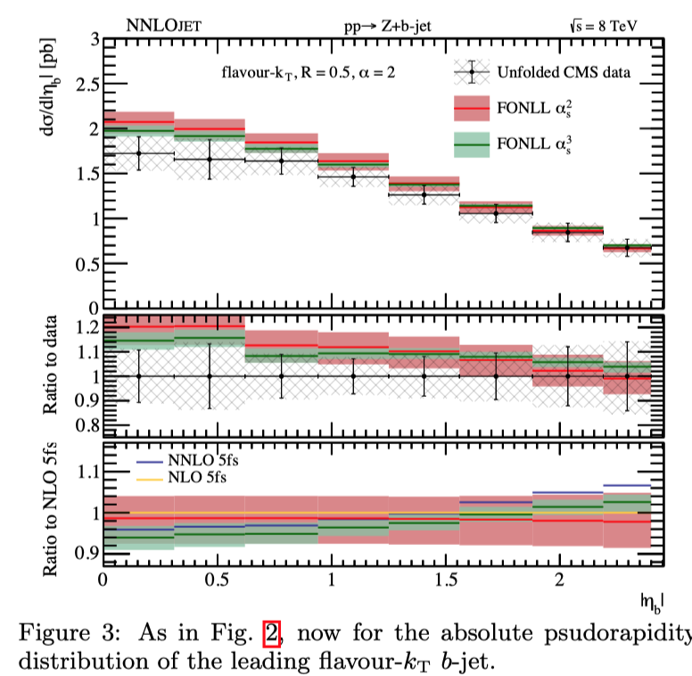
Z+b at NNLO prediction
Carried out by combining a massless NNLO and a massive NLO computation at order (α_{s}³)
  initial state b-quarks from gluon splitting resummed by PDF evolution; finite b-quark mass effects also incorporated (presumably same could be done for Z+c)
  note: massless calculation means IR-safe definition of jet flavour must be used; not consistent with experimental choice
  desired to have data unfolded to level of partonic flavour-kT jets
(arXiv:2005.03016)
large reduction
in uncertainty in
going from NLO
to NNLO
reasonable
agreement with
data
19

Slide 21
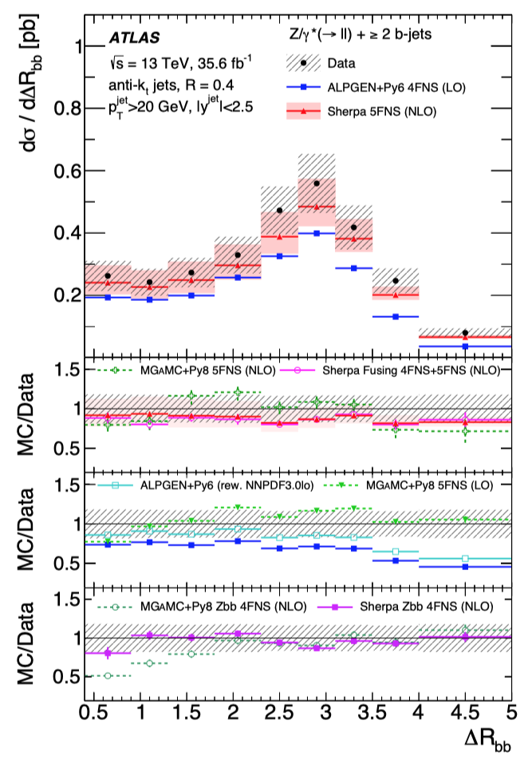
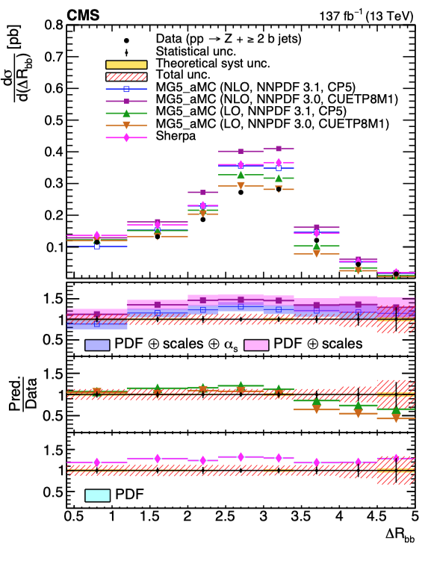
Z+>=2 b jets (ΔR_{bb})
Require at least two b jets
Small values of ΔR_{bb} sensitive to gluon splitting
JHEP 07 (2020) 44
arxiv:2112.09659 CMS-SMP-20-015
20

Slide 22
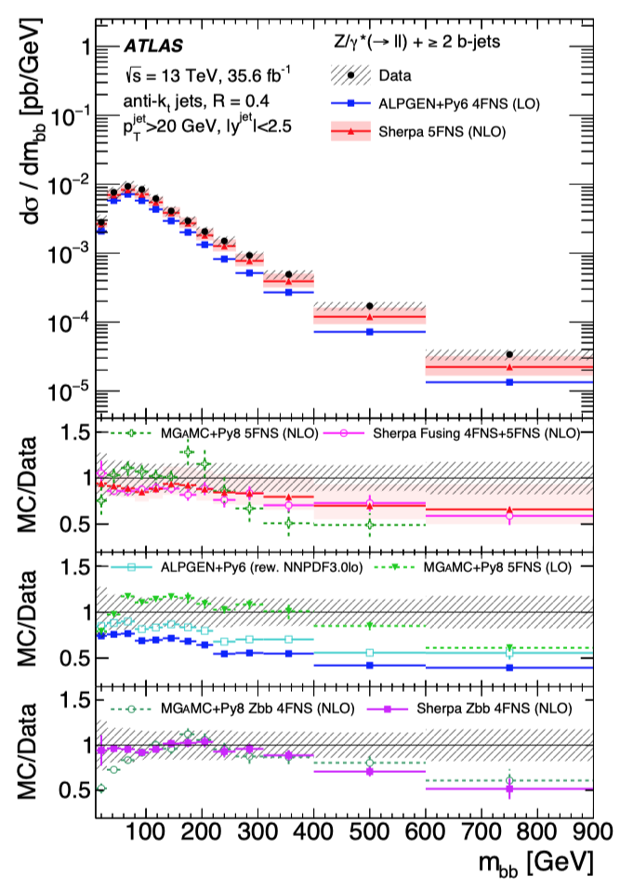
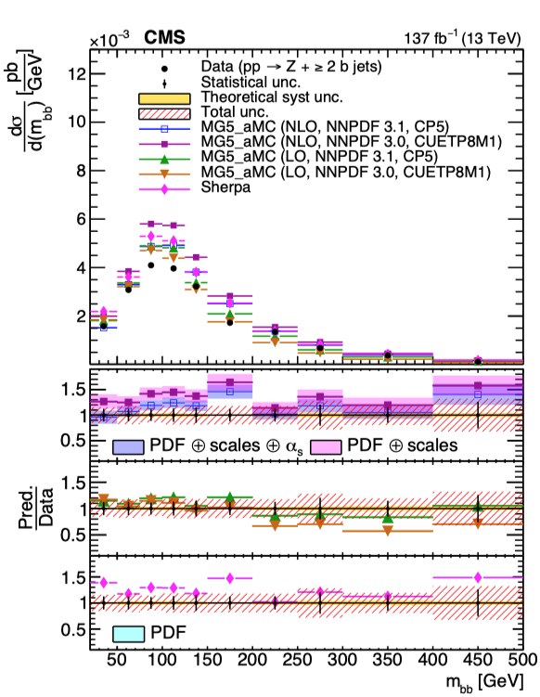
Z+>=2 b jets (m_{bb})
For ATLAS, no MC in agreement for m_{bb}>300 GeV
For CMS, shapes best described by MG5 NLO
JHEP 07 (2020) 44
arxiv:2112.09659 CMS-SMP-20-015
21

Slide 23
Summary
V+heavy flavor production is a source of very interesting physics at the LHC, with crucial information for heavy flavour PDFs such as strange and charm
Precision predictions are starting to become available at NNLO, but there is a mis-match between theoretical and experimental jet definitions that needs to be resolved
Need NNLO predictions for photon+HF (with isolation prescription for the photons)
Greatest precision of V+HF theory achieved at NNLO, but kinematic cuts make matching to parton showers possibly necessary
  this is an extremely complex problem, V+j resummation with an extra mass scale thrown in for fun
NNLO V+HF predictions with fragmentation functions on the way
  see talk by Czakon earlier today
Would be nice to have comparisons with more modern PDFs
We have only just begun to tap the data taken at 13 TeV (->13.6 TeV), and the comparison to precision predictions
22

Slide 25
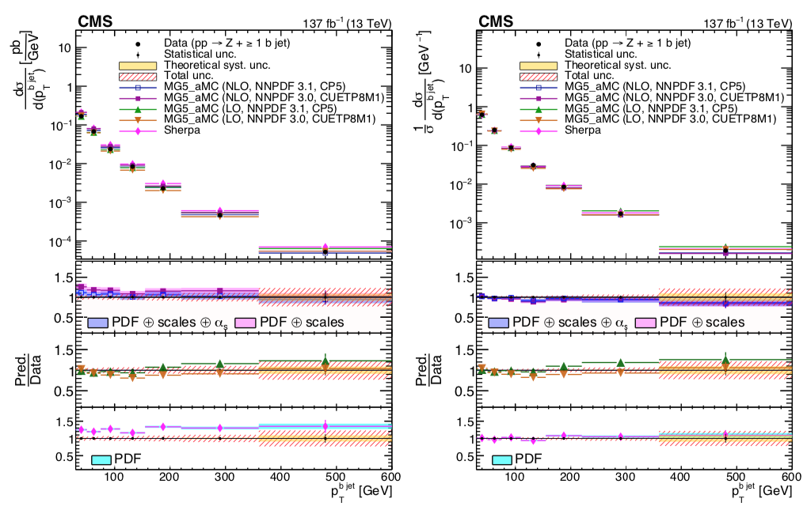
Z+b
Ignore LO predictions; NNPDF3.1 PDF is the most up-to-date of the two PDFs shown; would be nice to have comparisons of more modern PDFs as well (CT18, MSHT20, NNPDF4.0 (NNPDF3.1’)
arxiv:2112.09659 CMS-SMP-20-015
normalized
Notes:
Talk about dynamics of Zbb

Slide 26
