Slide 1


X-band design activities
Ping Wang, Alexej Grudiev
CERN, European Organization for Nuclear Research
CLIC Project Meeting- 14.12.2021

Slide 2
Outline
Introduction
CLIC-K with bended damping waveguides
X-band BOC pulse compressor for klystron-based CLIC
Summary
CLIC Project Meeting- 14.12.2021

Slide 3
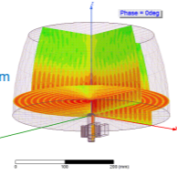
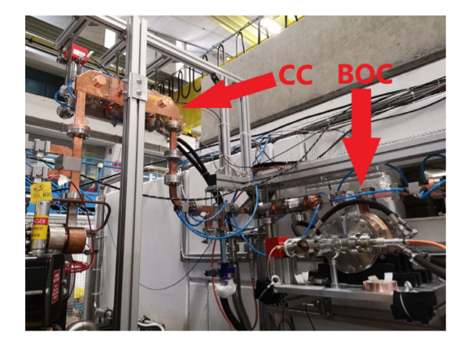
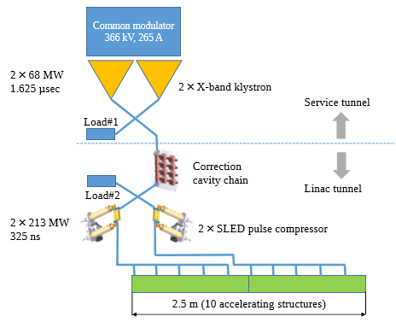
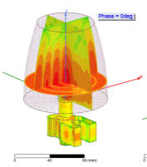
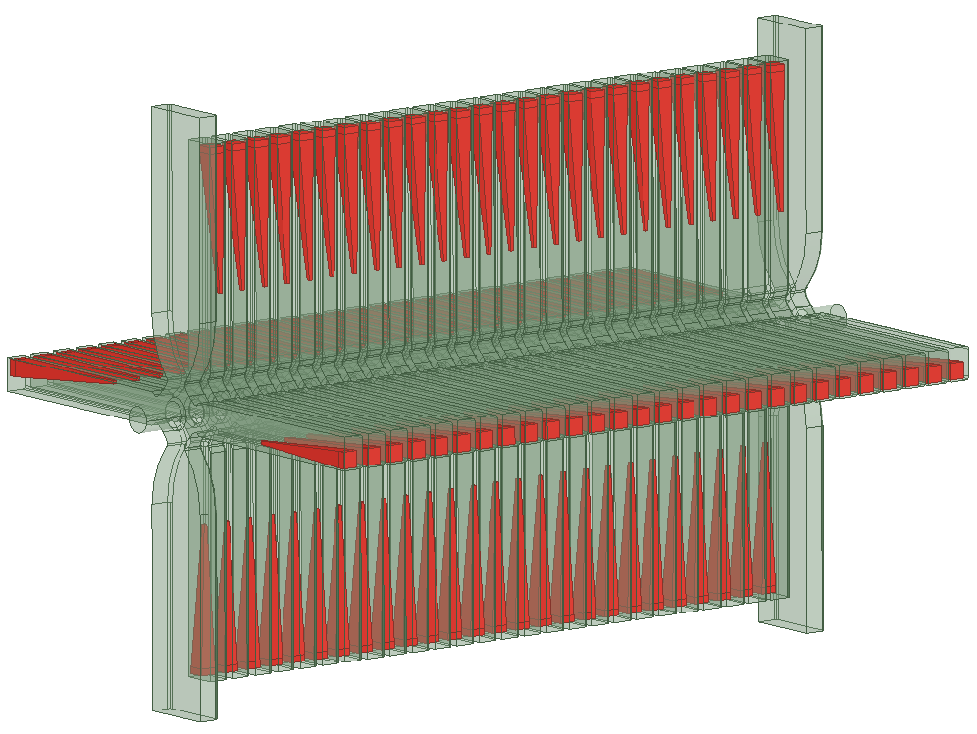
Introduction
[2] Yuliang Jiang et al., Demonstration of a cavity-based pulse compression system for pulse shape correction, Phys. Rev. Accel. Beams 22, 082001
[3] Xiaowei Wu and Alexej Grudiev, Novel open cavity design for rotating mode rf pulse compressors, Phys. Rev. Accel. Beams 24, 112001
CLIC-K
[1] Updated baseline for a staged Compact Linear Collider, edited by P.N. Burrows, P. Lebrun, L. Linssen, D. Schulte, E. Sicking, S. Stapnes, M.A. Thomson, CERN–2016–004 (CERN, Geneva, 2016),
[4] Jiayang Liu, Alexej Grudiev, CERN-ACC-2018-0034
CLIC Project Meeting- 14.12.2021

Slide 4
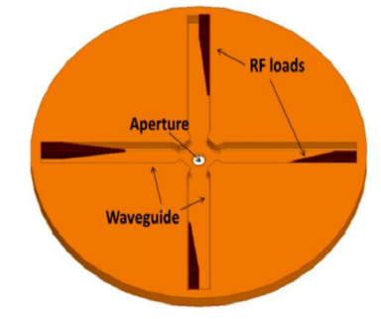
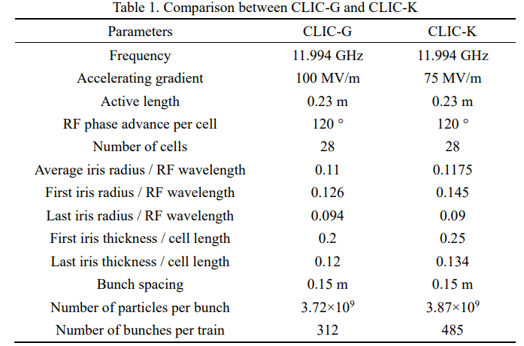
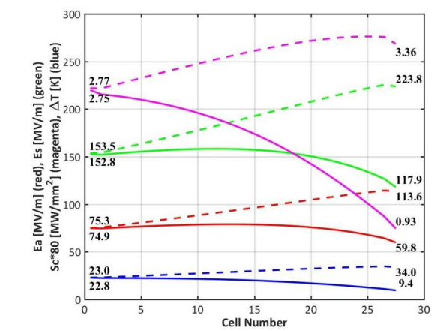
CLIC-K with straight damping waveguides
Jiayang Liu, Alexej Grudiev, CERN-ACC-2018-0034
CLIC Project Meeting- 14.12.2021

Slide 5
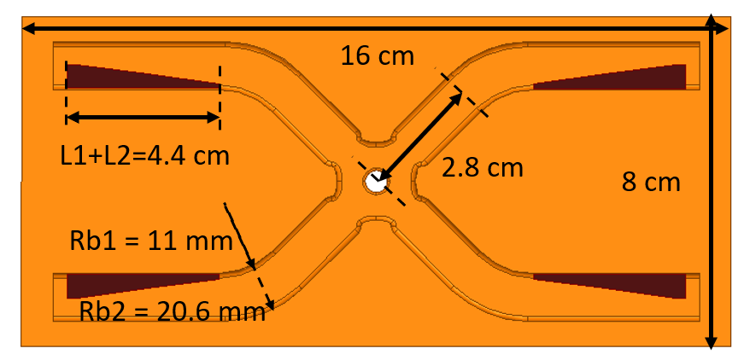
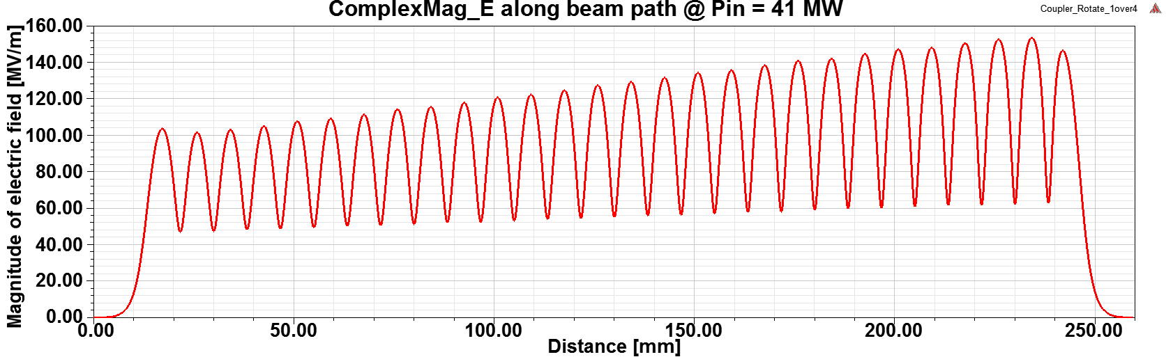
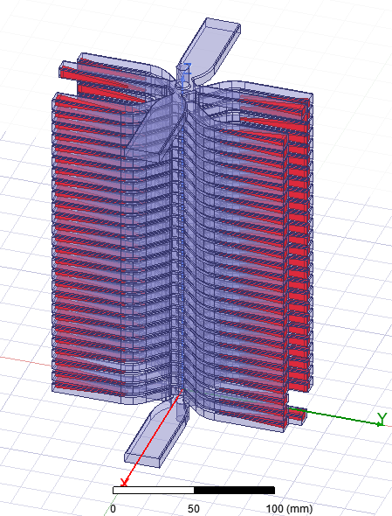
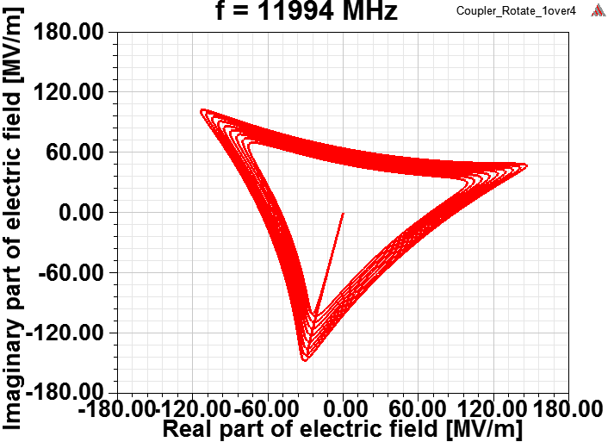
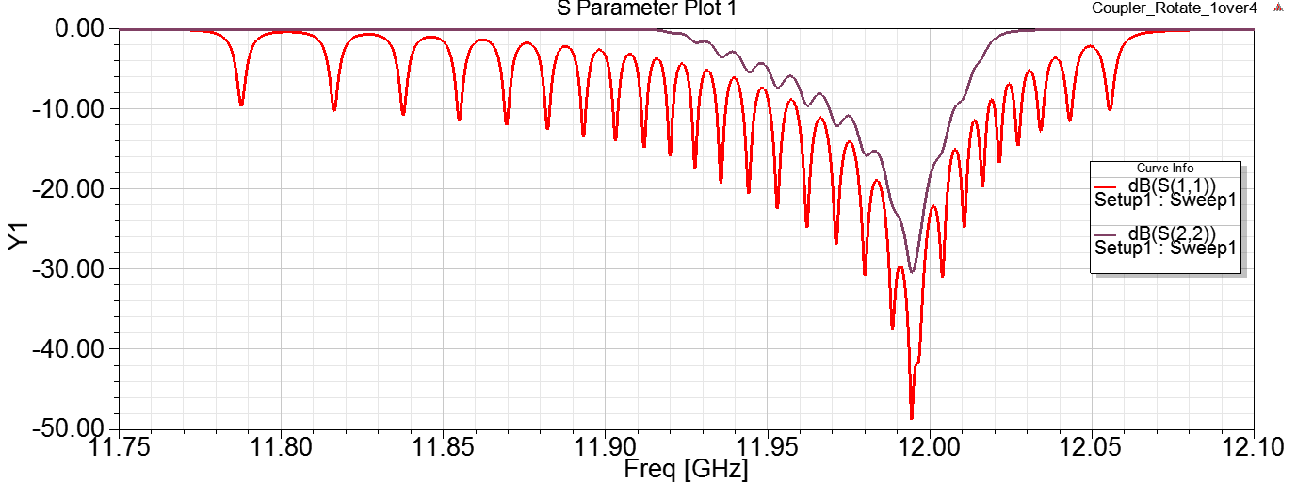
RF design of CLIC-K with bended damping waveguides
CLIC-K with bended damping waveguides is more compact.
CLIC Project Meeting- 14.12.2021

Slide 6
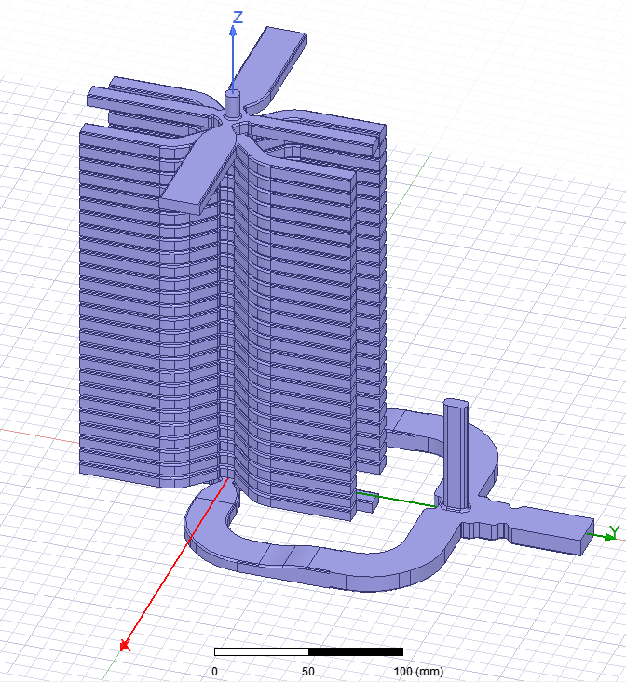
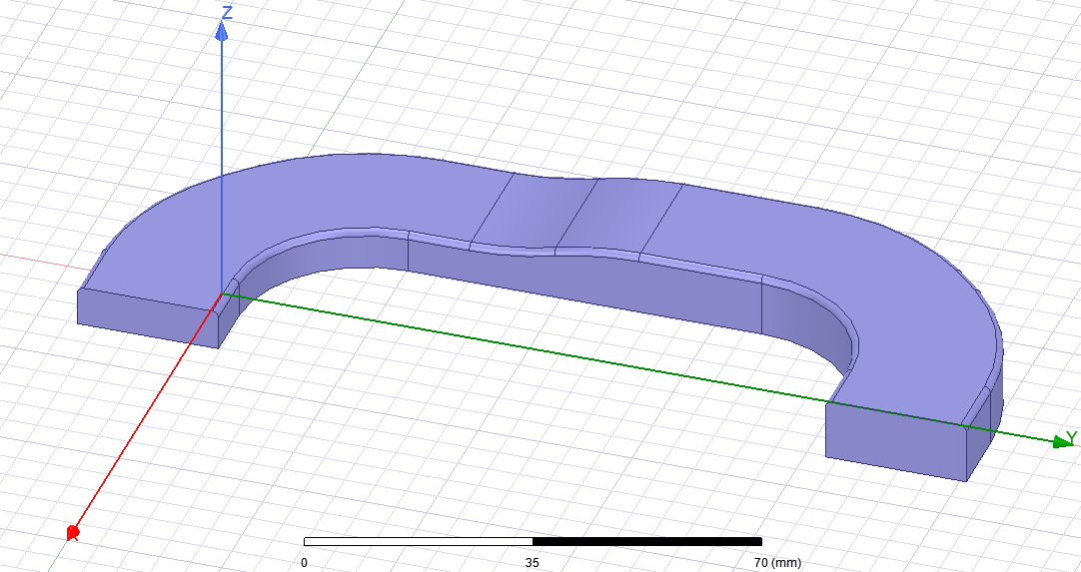
RF design of the distribution network around the CLIC-K
HOM Magic-T
Novel bending waveguides
Compact taper
Position of flanges
HOMagic-T
Bend2
The length of the straight parts can be changed if necessary.
Taper
Bend1
CLIC Project Meeting- 14.12.2021

Slide 7
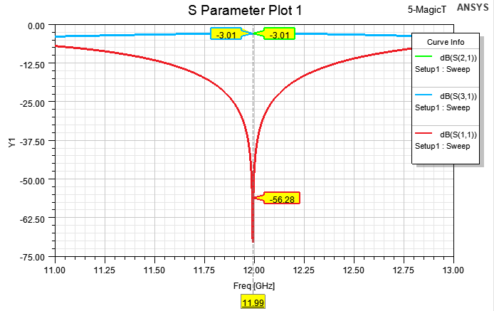
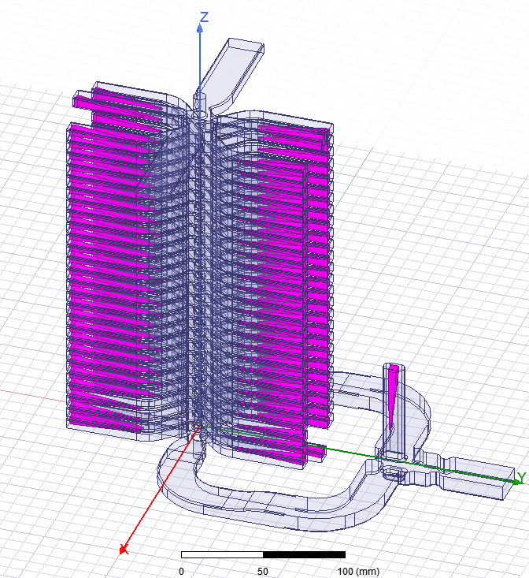
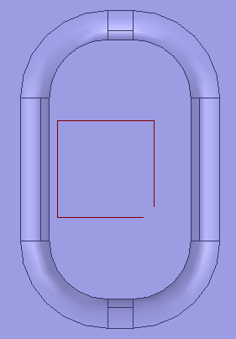
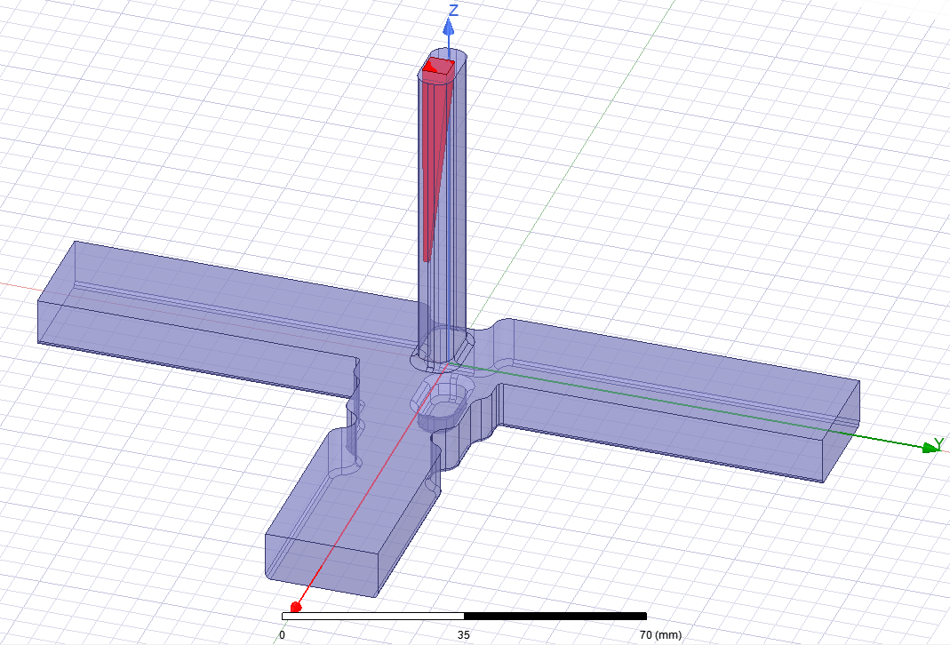
Application of the HOM Magic-T
The load of HOMagic-T is the same as that of a damping waveguide
0.4 mm
4.2mm
4.2 mm
65 mm
Port2
Port3
Port1
CLIC Project Meeting- 14.12.2021

Slide 8
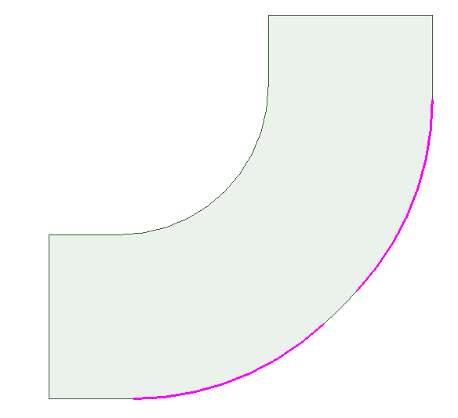
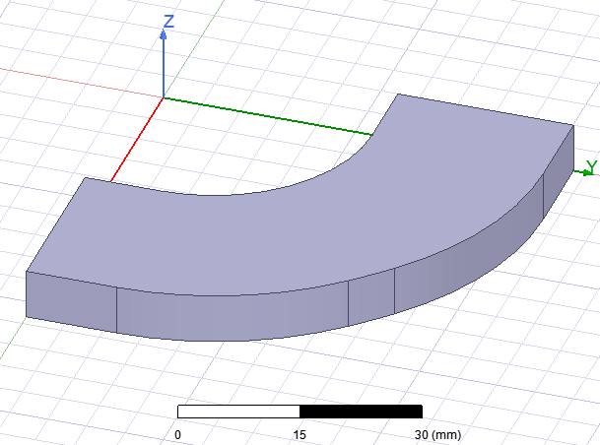
Geometry of the bending waveguides
Bend 1 and bend 2
Two bends have different height (wgb) of 10.16 mm and 6.66 mm
wga | 22.86 mm
wgb | 10.16/6.66 mm
R1 | 92.875 mm
R2 | 39.000 mm
R3 | 20.600 mm
alpha | 4 deg
L | >= 10.0 mm
R₃
L
R₁
R₂
wga
wgb
alpha
R₁ = (wga-R₃*cos(45deg)-wga*cos(45deg) +R₃-R₂+R₂*cos((90deg-alpha)/2))/(cos((90deg-alpha)/2)-cos(45deg))
CLIC Project Meeting- 14.12.2021

Slide 9
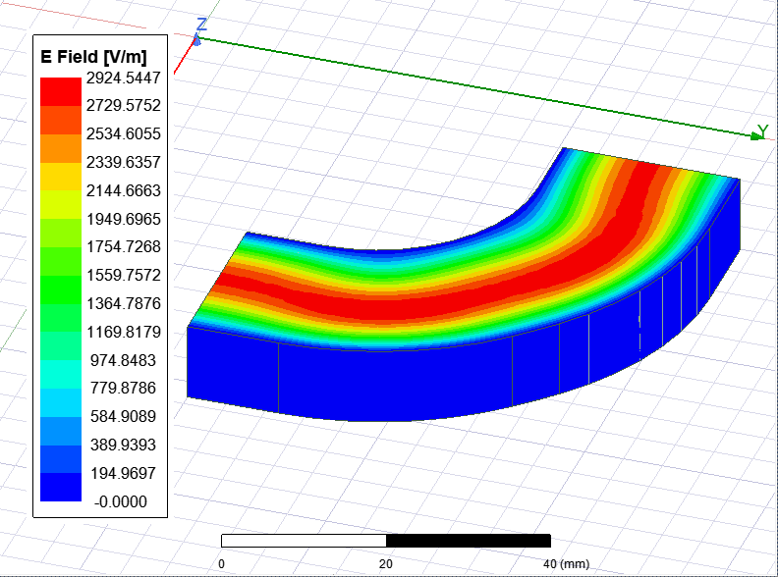
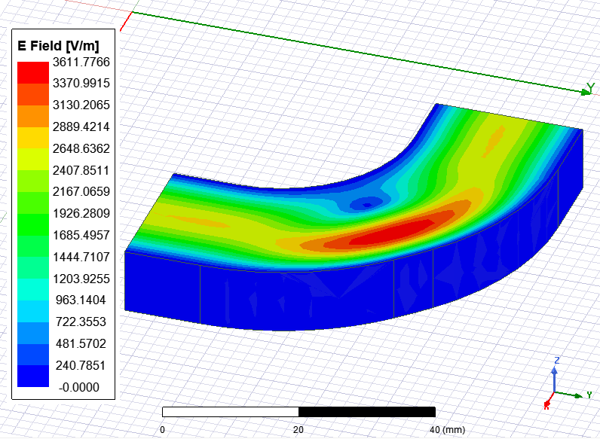
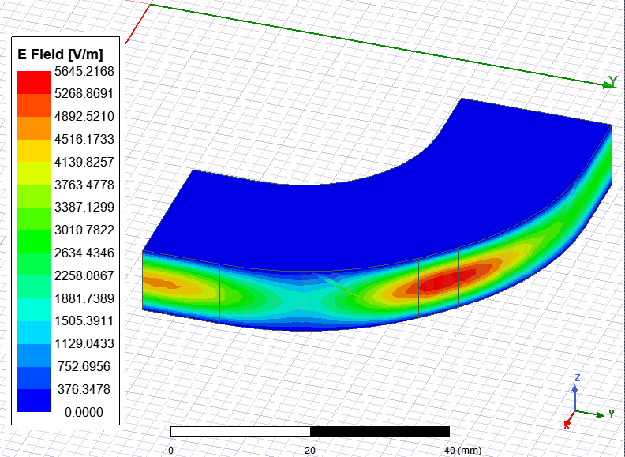
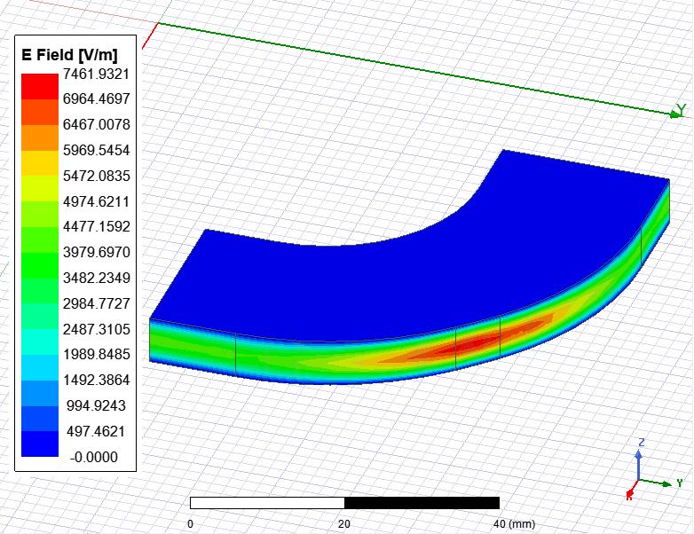
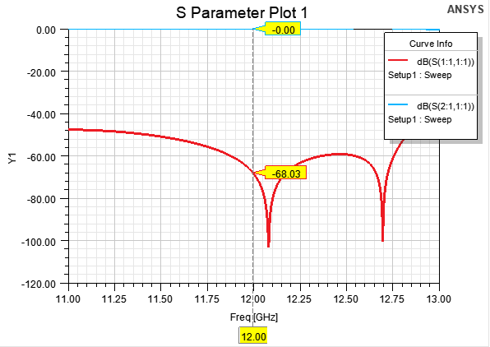
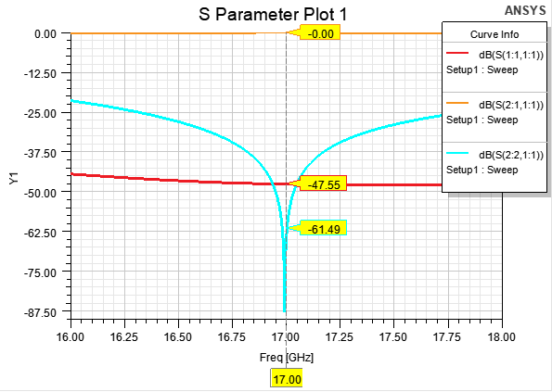
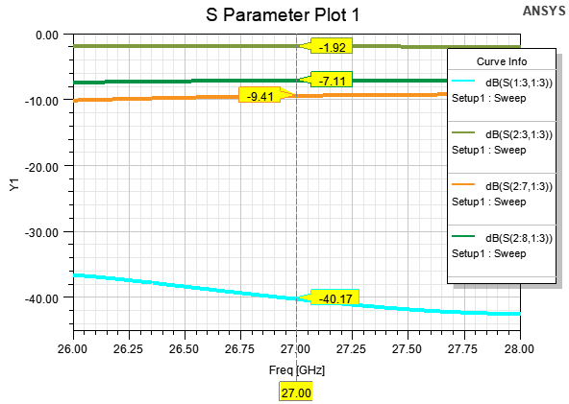
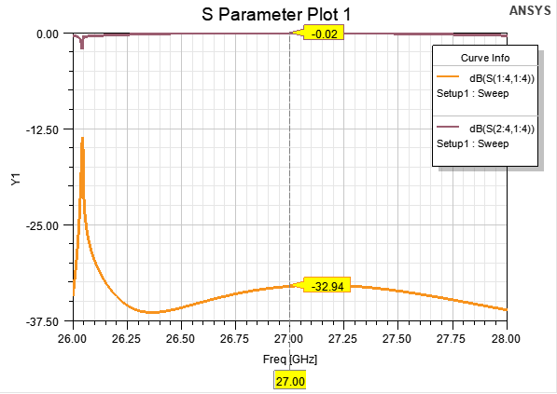
RF simulation of the bending waveguides
The RF performance of the two bending waveguides are very similar in the first two pass bands with center frequency of 12 GHz and 17 GHz.
Bend2: wgb = 6.66 mm
TE₁₀ mode
TE₁₀ mode
TE₀₁mode
TE₀₁mode
5 modes
10 modes
10 modes
Couplings to other modes below -15 dB are not shown in the figure
Couplings to other modes below -28 dB are not shown in the figure
Coupling to other modes below -50 dB are not shown in the figure
CLIC Project Meeting- 14.12.2021

Slide 10
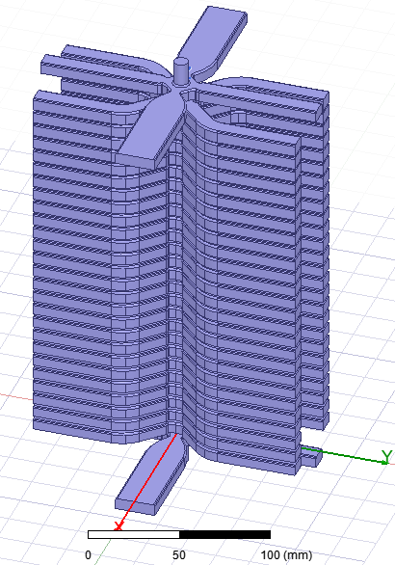
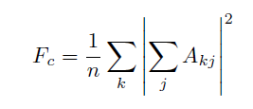

Wakefield calculation of the CLIC-K
PML
PML
CLIC-K with bended damping waveguides can suppress the transverse wakefield very well.
Loads
PML on input coupler and damping waveguides (PIC-PDw)
PML on input couplersand Loads in damping waveguides (PIC-LDw)
485 bunches | Fc | Frms | Fworst
PIC-PDw-x | 1.0020 | 1.1749 | 2.9619
PIC-PDw-y | 1.0011 | 1.1066 | 2.2825
PIC-LDw-x | 1.0021 | 1.1623 | 3.0745
PIC-LDw-y | 1.0011 | 1.0690 | 2.2665
Requirements |  | < 2 | < 5
[1] D. Schulte, Multi-bunch calculations in the CLIC main linac, Proceedings of PAC09, Vancouver, BC, Canada, 2009.
CLIC Project Meeting- 14.12.2021

Slide 11
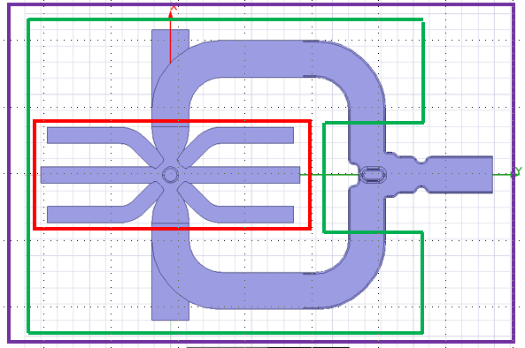
Wakefield calculation of the CLIC-K
HOM Magic-T is necessary to suppress the wakefield in the input coupler
PML on input coupler and Loads in damping waveguides (PIC-LDw)
Shorted Bends on input coupler and Loads in damping waveguides (SFIC-LDw)
HOMMagic-T on input coupler and Loads in damping waveguides (MTIC-LDw)
485 bunches | Fc | Frms | Fworst
PIC-LDw-x | 1.0021 | 1.1623 | 3.0745
PIC-LDw-y | 1.0011 | 1.0690 | 2.2665
SFIC-LDw-x | 1.0044 | 1.2392 | 64.366
SFIC-LDw-y | 1.0011 | 1.0687 | 2.2460
MTIC-LDw-x | 1.0020 | 1.1577 | 3.5042
MTIC-LDw-y | 1.0011 | 1.0692 | 2.2577
CLIC Project Meeting- 14.12.2021

Slide 12
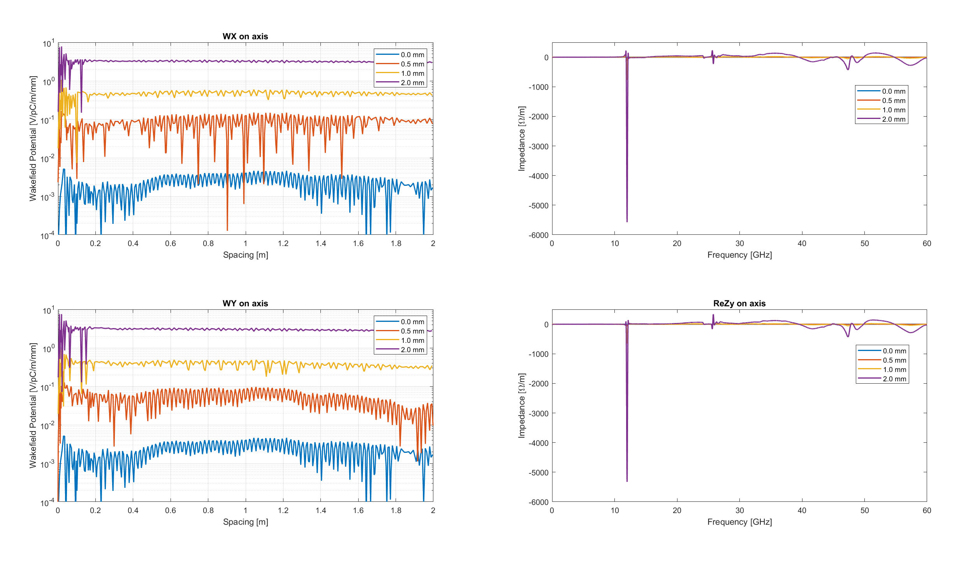
A monopole wakefield and transverse kicks
PML
Position of wakefield integration (x , y )
(0.0,0.0)
(0.5.0.0)
(1.0,0.0)
(2.0,0.0)
Loads
(0.0,0.0)
(0.0,0.5)
(0.0,1.0)
(0.0,2.0)
Mag
Mag
Charge

Slide 13
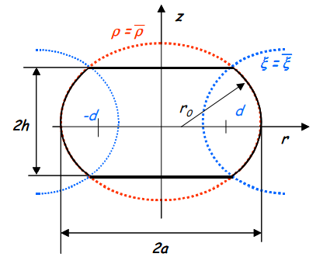
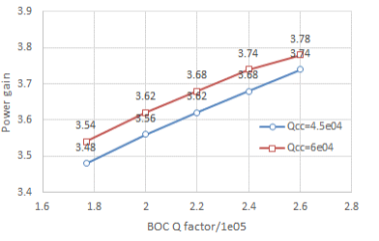
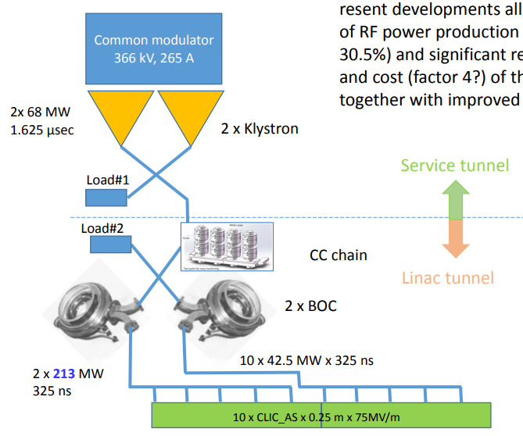
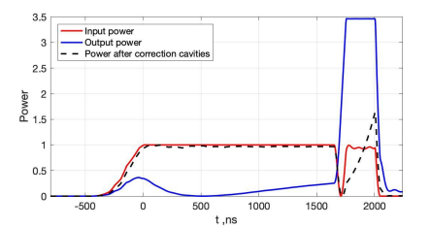
X-band BOC pulse compressor for klystron-based CLIC
BOC has large unloaded quality factor and good suppression of other parasitic modes
[1] Igor Syratchev, CLIC Klystron based. Updates 2017. CLIC WS, CERN, March 2017
[2] Jinchi Cai and Igor Syratchev, CERN-ACC-2020-0031
[3] Igor Syratchev, CERN/PS 2002-008 (RF)
CLIC Project Meeting- 14.12.2021

Slide 14
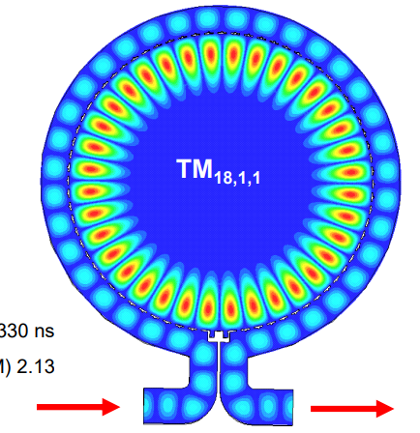


X-band BOC pulse compressor for klystron-based CLIC
Targeted Parameters
Q₀ = 240000
Beta = 7.0
To be calculated geometry Parameters
Radius of the cavity
Width of the waveguide around the cavity
One lambda
Q₀ = 150000
Mode: TM_{18,1,1}
Mode: TM_{32,1,1}
H face
Quarter lambda model
E face
[1] Riccardo Zennaro, BOC production at PSI, RF meeting, 2021

Slide 15
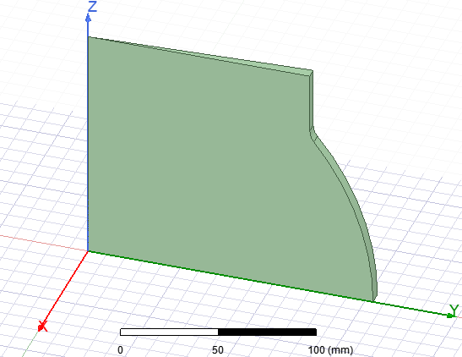
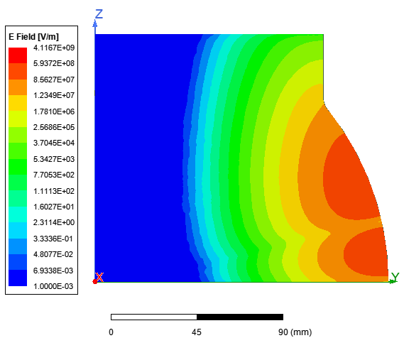


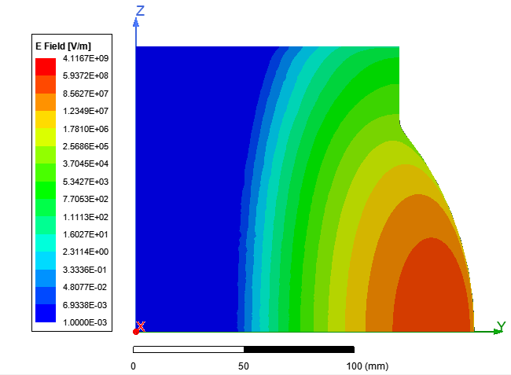
Cavity outer wall optimization
Quarter Lambda Model for cavity without coupling hole: Preliminary Radius of cavity
120 mm
Mode: TM_{32,1,1}
a
130 mm
Cd
PerfE
PerfH
PerfH
CLIC Project Meeting- 14.12.2021

Slide 16
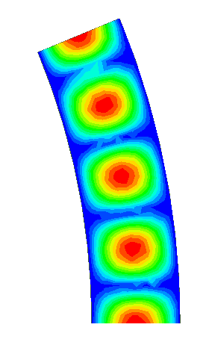
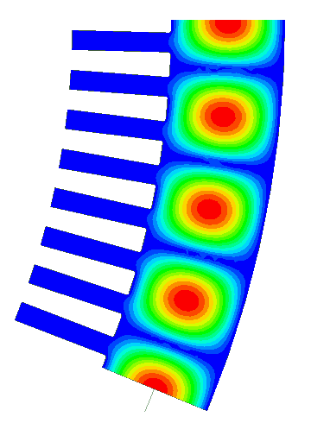
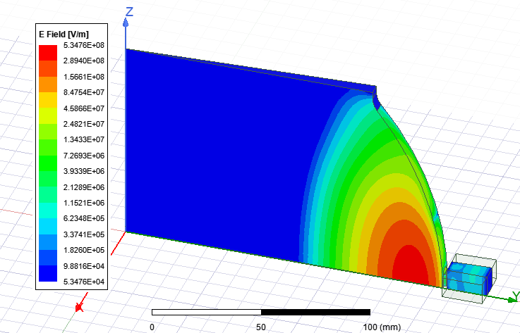
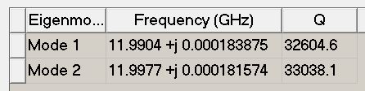

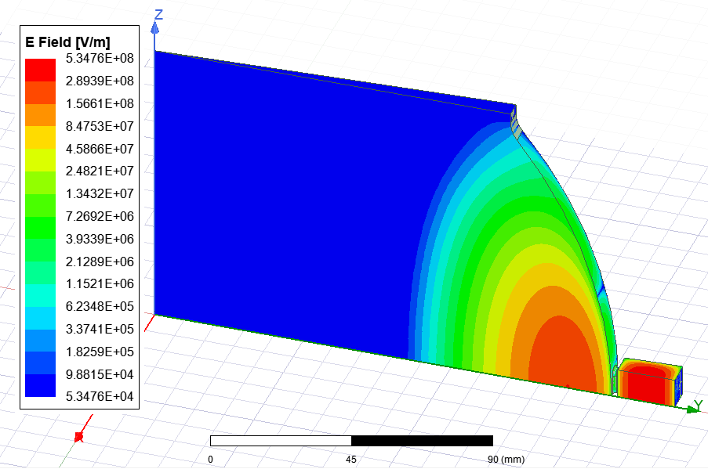
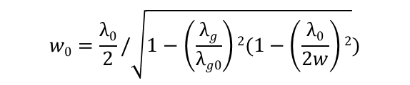

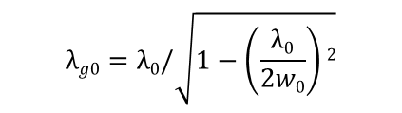
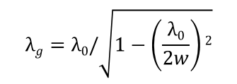

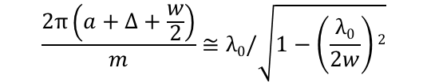


Calculation of the Width of the waveguide around the BOC
a: Radius of resonant cavity
$Δ:Thickness of wall between resonant cavity and waveguide$
w₀
w = 19.50 mm
$$Δ$$
w
$$\frac{2π\left(a+Δ+\frac{w}{2}\right)}{m}≅λ0/\sqrt{1−\left(\frac{λ0}{2w}\right)2}$$
w₀
a
Coupling hole
$$λg=λ0/\sqrt{1−\left(\frac{λ0}{2w}\right)2}$$
$$λg0=λ0/\sqrt{1−\left(\frac{λ0}{2w0}\right)2}$$
$$w0=\frac{λ0}{2}/\sqrt{1−\left(\frac{λg}{λg0}\right)2(1−\left(\frac{λ0}{2w}\right)2})$$
$$λg0=32.50 mm$$
$$λg=32.32 mm$$
Method1:w0 = 19.301 mm
Method2: 19.308 mm
Two coupled cavities should have the same frequencies
CLIC Project Meeting- 14.12.2021

Slide 17






Novel coupler for BOC
Double height waveguide can reduce the loss and surface field of the waveguide.
New coupler can avoid the thin wall between the input and output waveguides, which ease the machining.
Port3
Port2
Port4
Port1
CLIC Project Meeting- 14.12.2021

Slide 18








Eig mode simulation of the X-band BOC
E face:
Q₀ = 23.4e5
Beta = 7.38
H face:
Q₀ = 23.4e5
Beta = 7.01
E face
H face
E face
H face

Slide 19


Full geometry of the new X-band BOC pulse compressor
Double height waveguide
No fake coupling holes
No thin wall between waveguides
Outer radius of the waveguide: 351 mm
Height of the BOC: 200mm
CLIC Project Meeting- 14.12.2021

Slide 20
Summary
RF design of the CLIC-K with bended damping waveguides was completed and the mechanical design is in progress.
Preliminary RF design of the BOC pulse compressor was finished and the mechanical design will be discussed in the next step

Slide 21
Thanks for your attention!!!

