Slide 1
Short Introduction to CERN and GM group
Jean-Christophe Gayde
28/11/2021

Slide 2
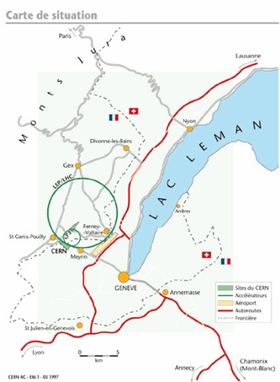
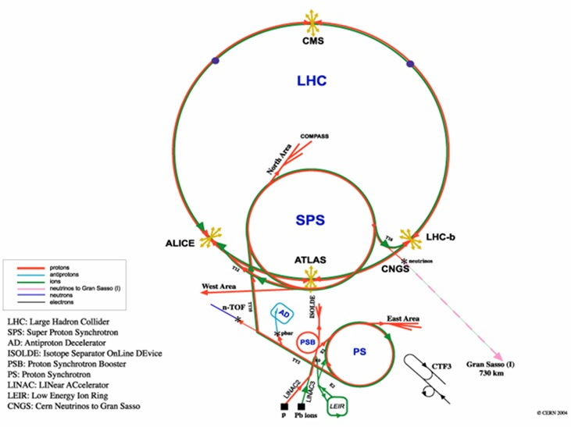
CERN
Organisation européenne pour la recherche nucléaire
  Born in 1954
  1st accelerator in 1959
  23 members states
  Thousands of users worldwide
  As of 2017, more than 17 500 people from around the world work together
  2500 staff members
  12200 scientists
  Of 110 nationalities
  From institutes in more than 70 countries
  What the universe is made of and how it works

Slide 3
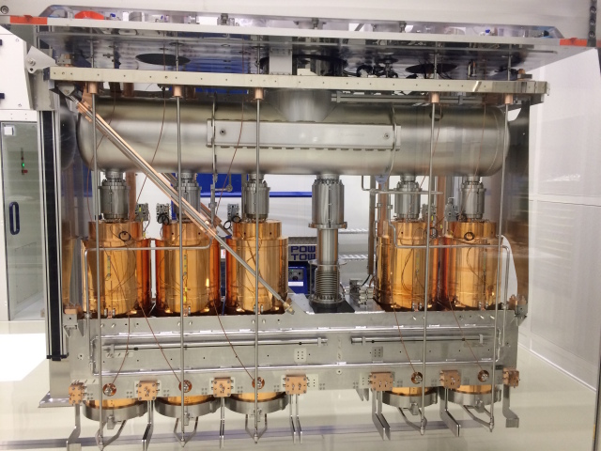
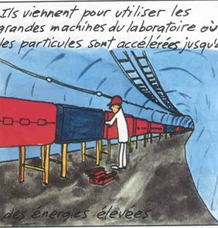
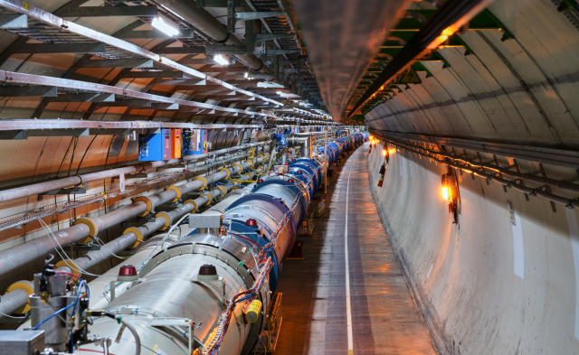
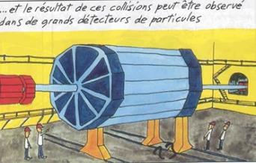
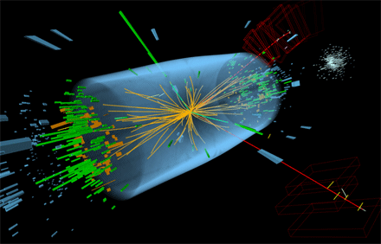
Accelerators and Physics Detectors
The only way to recreate the conditions that existed just after the big bang is to use a particle accelerators
Collisions are studied in experimental detectors

Slide 4
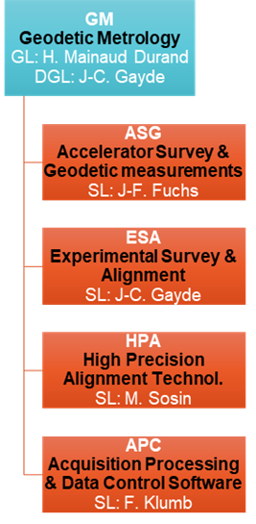
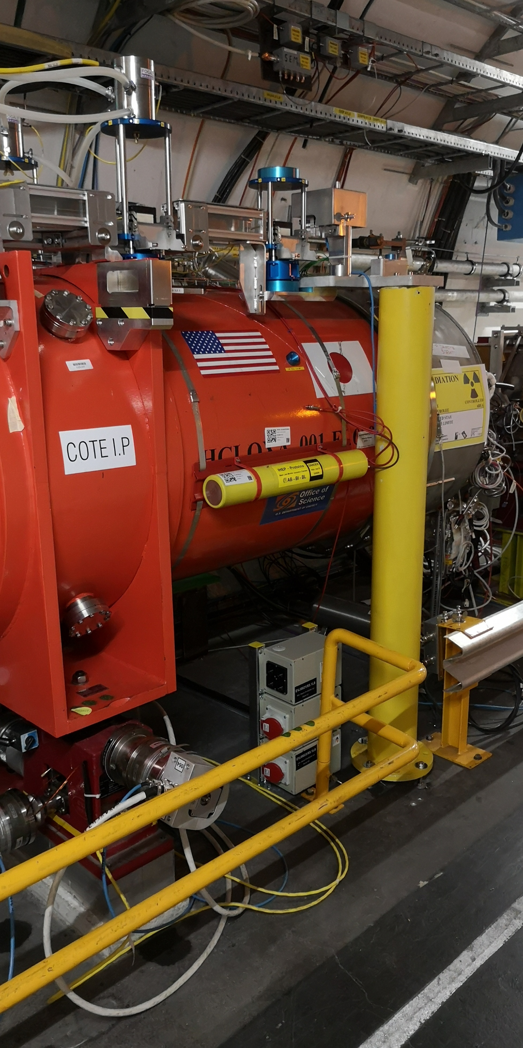
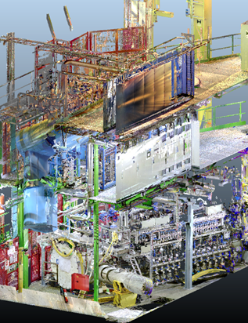


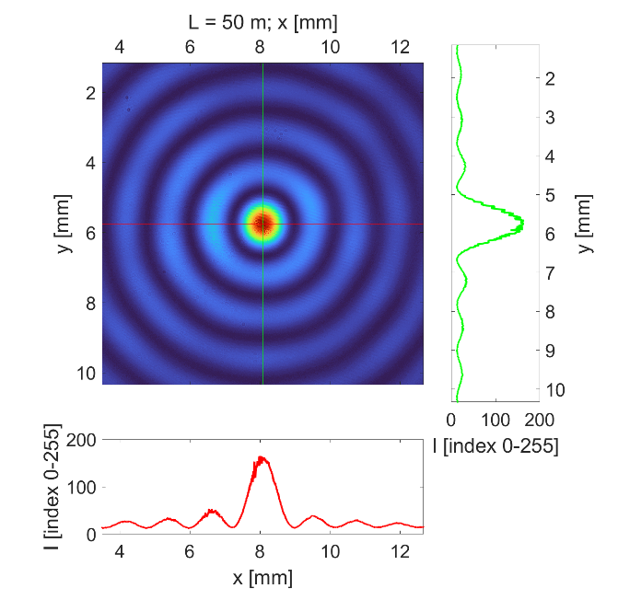

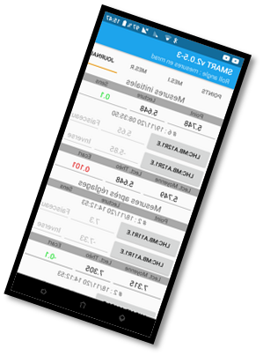
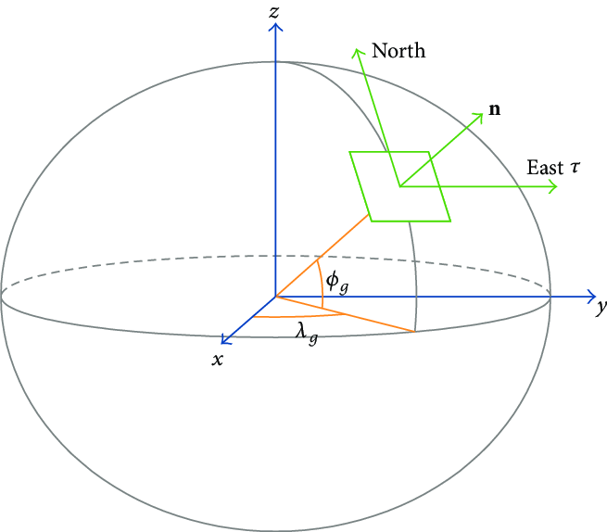

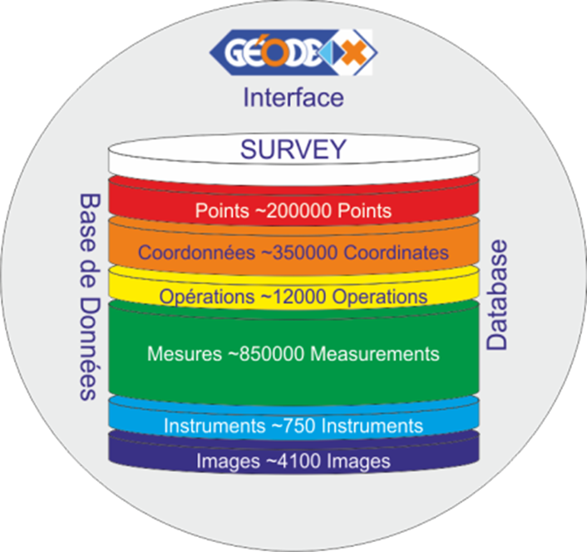

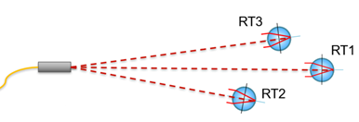
The GM Group – Geodetic Metrology
The GM group provides metrology and alignment for components installed in the accelerators, beam transfer lines and physics experiments throughout the CERN.
  ̴ 60 km beam lines
  ̴ 7500 componants
  20 experiments
  Thousands of sub-detectors
Geodetic aspects
R&D
Permanent monitoring
Geo-referenced 3D scans
Database and software

Slide 5
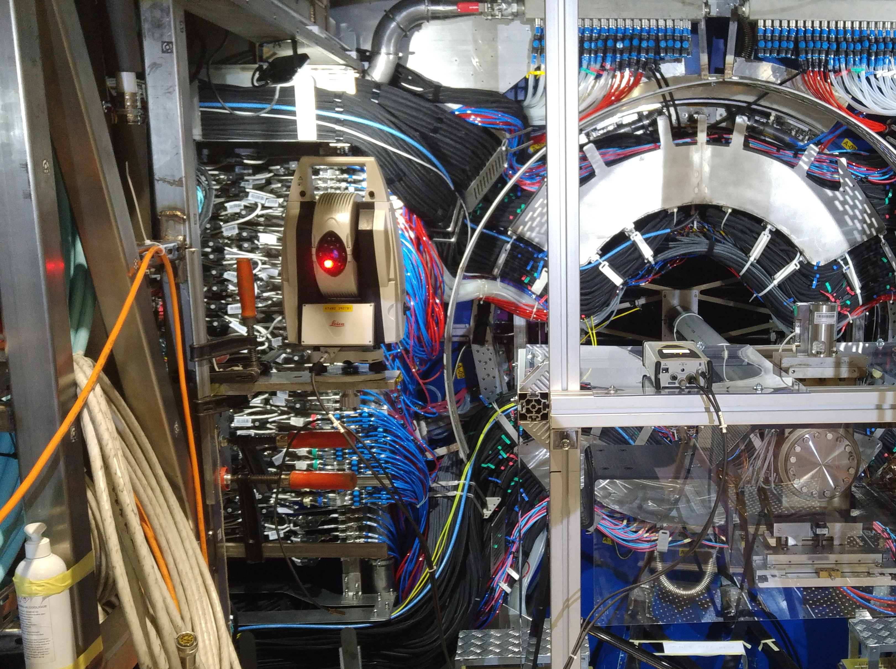
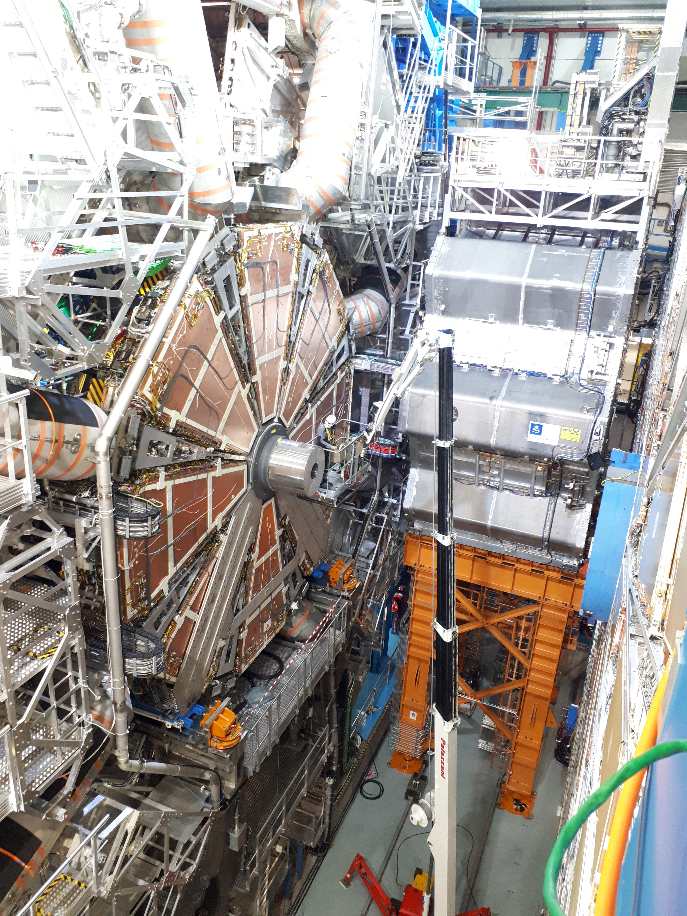
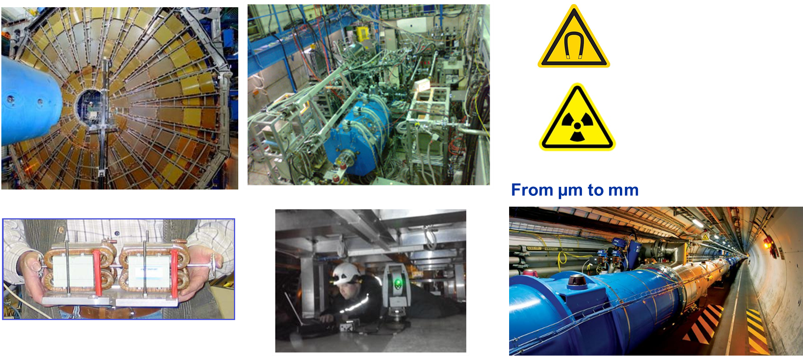
Daily challenges
Scale
Size of components
Congested area
Difficult configuration:
Narrow and straight
Underground
Environment
Meas. uncertainties

Slide 6
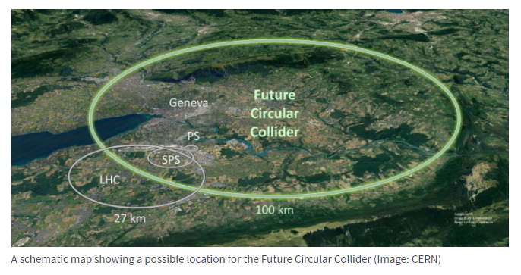
Future challenges
A few challenges from the Geodetic Metrology point of view:
Geodetic aspects:
  FCC 10 times larger than LHC
  Reference frames and infrastructure go back to LEP (80s)
  The installation of components will start before the final completion of the whole tunnel ring
  Very important to setup ASAP adapted geodetic reference systems: coordinate reference systems, coordinate reference frames and their corresponding software tools, technical documentation and control baselines.
Alignment aspects:
  Thousands of components to fiducialise, alignment, at tighter tolerances than in the LHC:
    To propose affordable and sustainable solutions (less cables, less space, very robust).
    Automated solutions to determine the position of components and to adjust them.
Future Circular Collider (FCC) WEBSITE
Circumference of ̴ 100 km, depth of ̴ 400 m
At the stage of the feasibility study and intensified R&D
2 stages: FCC-ee -- > FCC-hh over 50 years

Slide 7
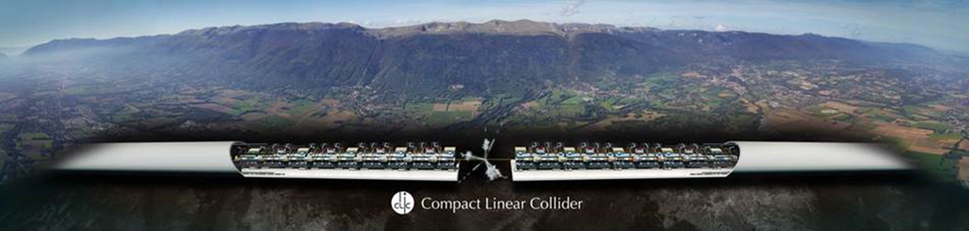
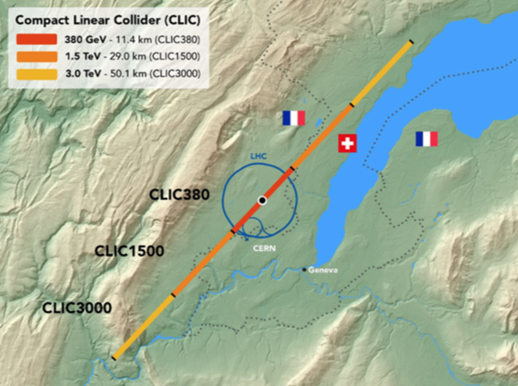
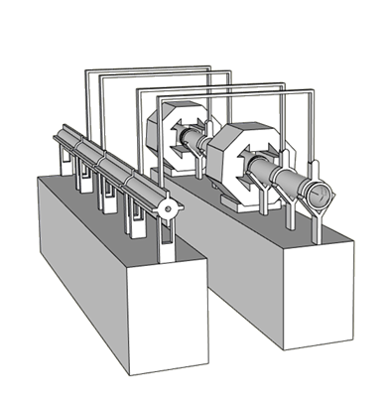
Future challenges
WEBSITE
Compact LInear Collider (CLIC).
For a 3 TeV configuration: 20 000 modules.
Considering the number of components to be aligned, ground motion and tight tolerances of alignment (micron level) – > active pre-alignment
Active pre-alignment means:
  Continuous determination of the position of all components using alignment sensors
  Remote adjustment (when the position is above thresholds) using actuators.
Different methods already developed:
  To pre-align the components on a girder
  To align the girders over hundreds of meters within a micrometric accuracy.
  See interesting links here: LINK1, LINK2, PACMAN

Slide 8
Thank you for your attention!

