Slide 1
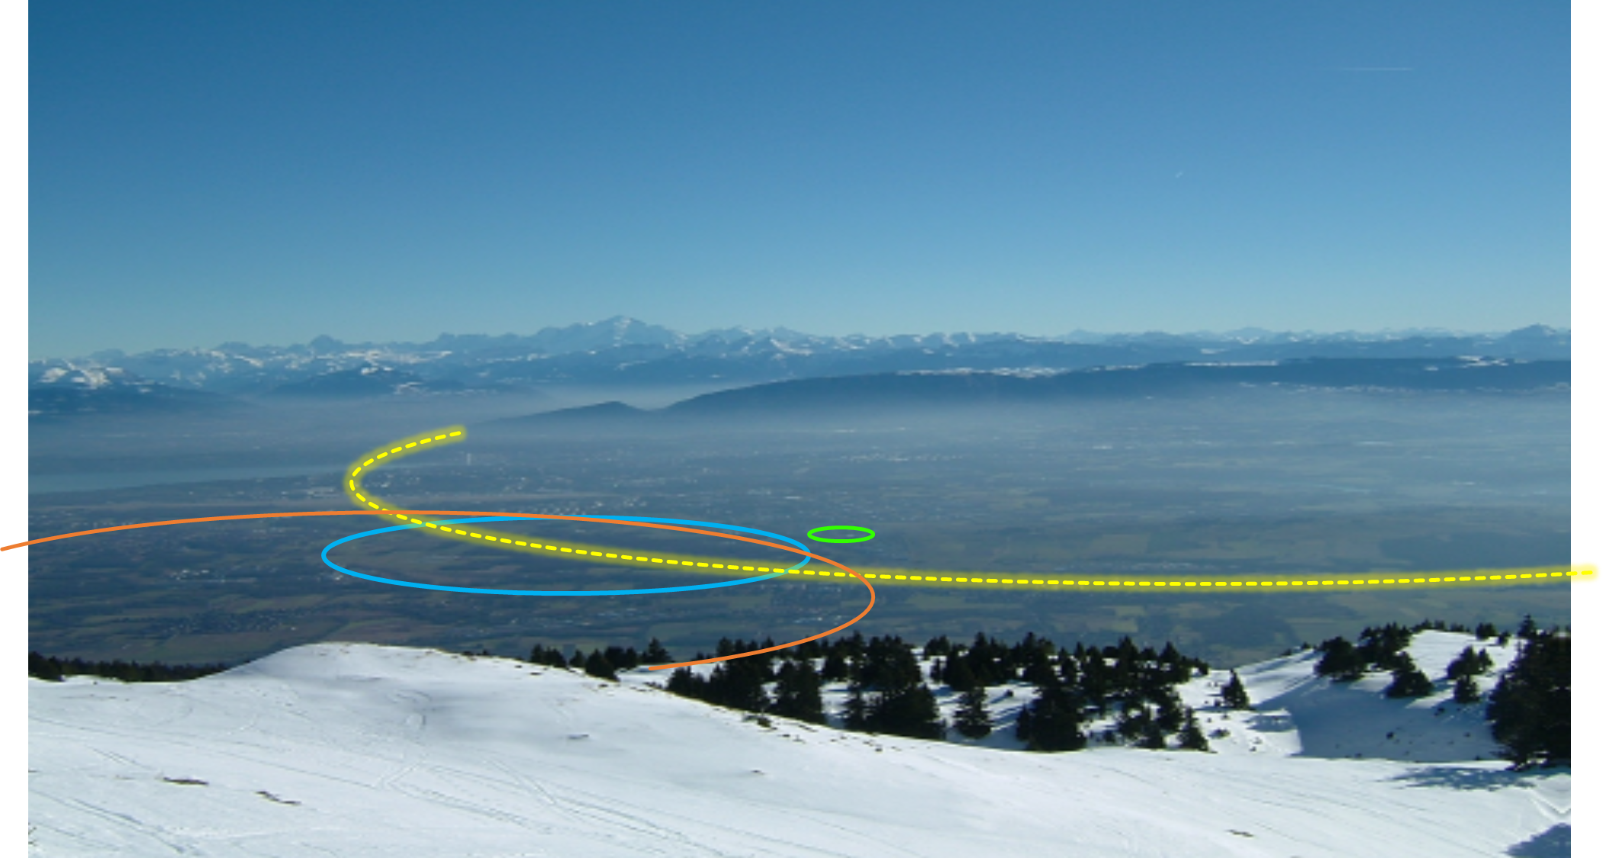
The Future Circular Collider at CERN
Emmanuel Tsesmelis
CERN
Head of Associate Member State and Non-Member State Relations
Convenor of FCC Global Collaboration Working Group
7 December 2021
PS
LHC
FCC
SPS
Work supported by the European Commission under the HORIZON 2020 projects EuroCirCol, grant agreement 654305; EASITrain, grant agreement no. 764879; ARIES, grant agreement 730871, FCCIS, grant agreement 951754, and E-JADE, contract no. 645479
Photo: J. Wenninger

Slide 2

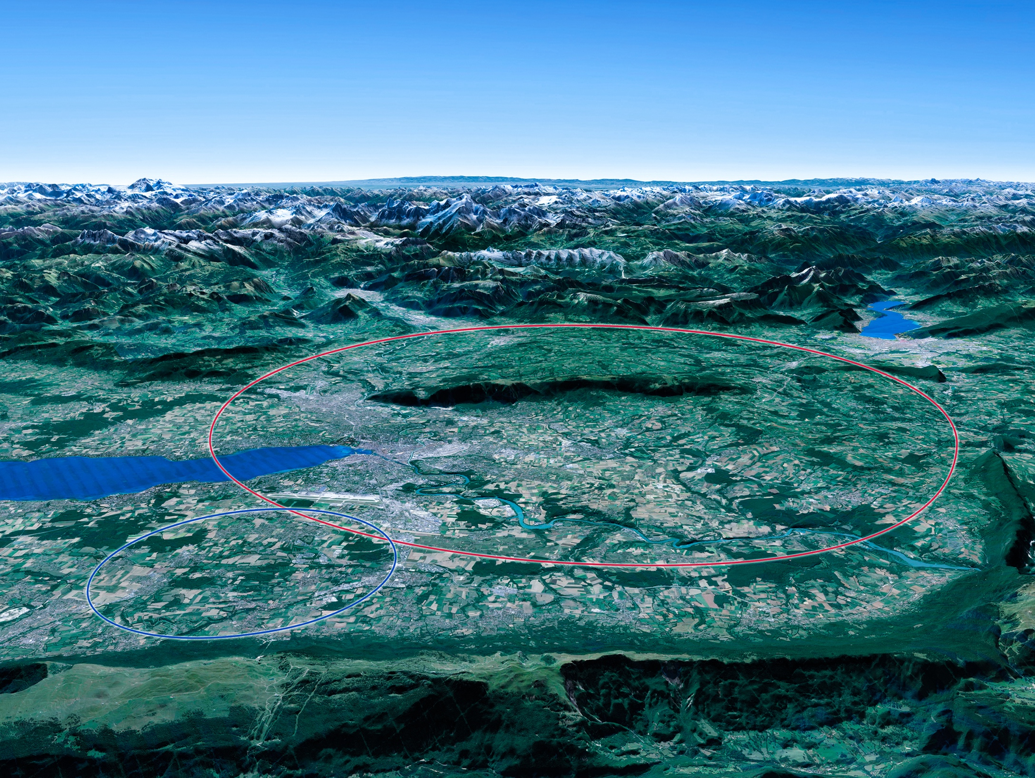

CERN Scientific Priorities for the Future
Implementation of the recommendations
of the 2020 Update of the European Strategy for Particle Physics:
Fully exploit the LHC & HL-LHC.
Build a Higgs factory to further understand this unique particle.
Investigate the technical and financial feasibility of a future energy-frontier 100 km collider at CERN.
Ramp up relevant R&D.
Continue supporting other projects around the world.
LHC
Notes:
For information, the ESPPU recommendations in more detail:
Full exploitation of the HL-LHC
An electron-positron Higgs factory is the highest priority after the LHC
Ramp up R&D efforts for advanced accelerator technologies
Support long-baseline neutrino projects in Japan and US
Investigation of feasibility of a future 100 TeV hadron collider at CERN
THIS IS THE LAST SLIDE IN THE “RESEARCH” SECTION

Slide 3

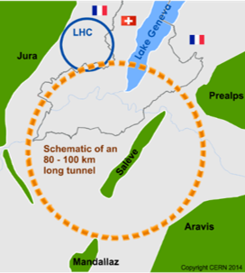
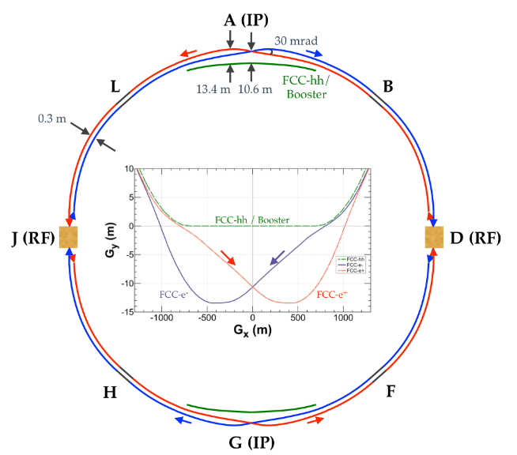
The FCC Integrated Programme
Inspired by successful LEP – LHC Programmes at CERN
Complementary physics, common civil engineering and technical infrastructures, building on and reusing CERN’s existing infrastructure, FCC integrated project allows seamless continuation of HEP after HL-LHC
Phase 1 : FCC-ee
electron – positron Collider
Higgs, Z, W, ttbar Factory at highest lumi
Phase 2 : FCC-hh
proton – proton Collider
High-energy frontier (pp,ion,eh)
FCC-hh
FCC-ee
2020 - 2040
2040 - 2055
2060 - 2090

Slide 4


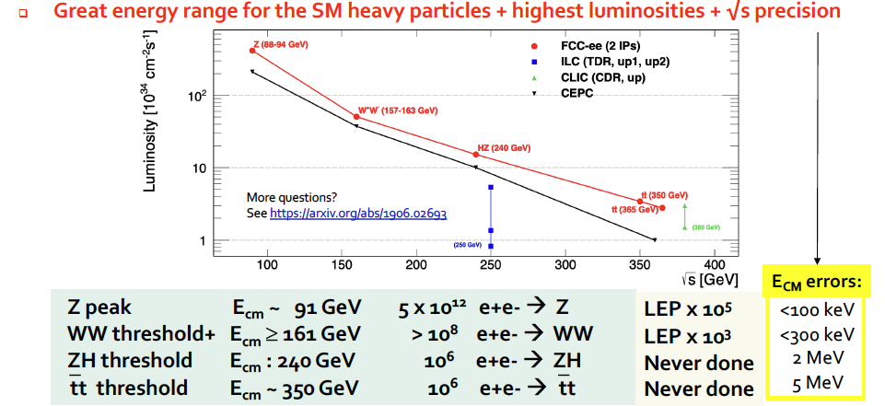
FCC-ee Higgs and Electroweak Factory
Increasing international collaboration as a prerequisite for success:
links with science, research & development and high-tech industry will be essential to further advance and prepare the implementation of FCC
P. Janot

Slide 5
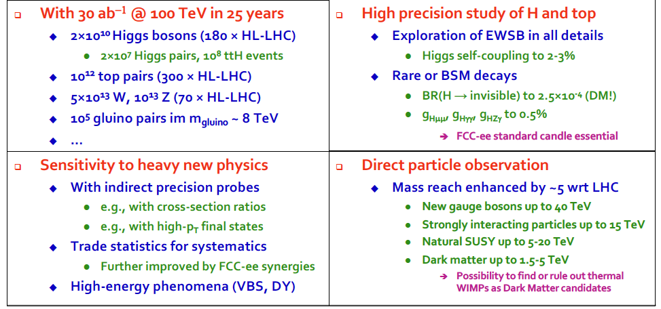
Physics Opportunities with FCC-hh
Increasing international collaboration as a prerequisite for success:
links with science, research & development and high-tech industry will be essential to further advance and prepare the implementation of FCC
P. Janot

Slide 6
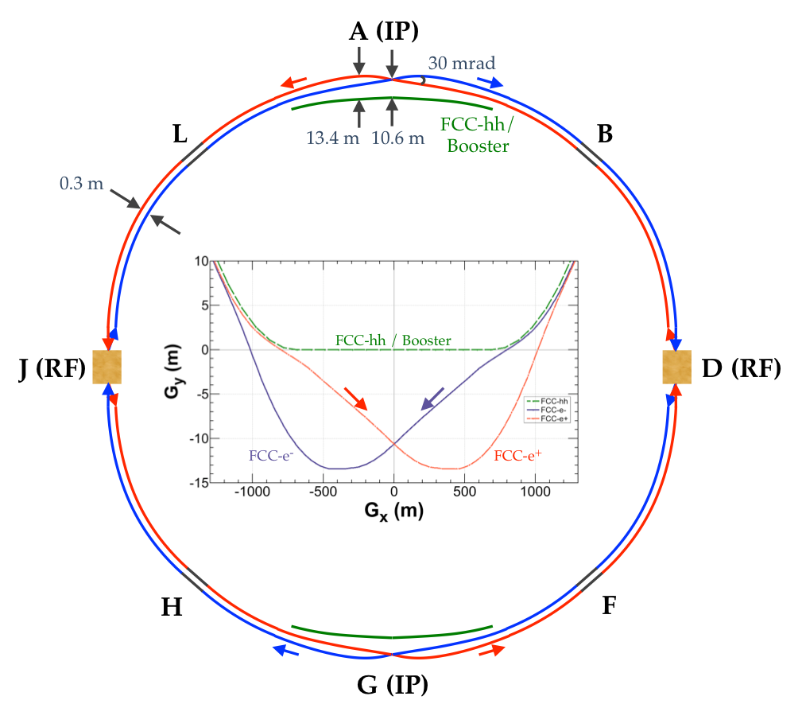
FCC-ee Basic Design Choices
Double ring e+ e- collider
Common footprint with FCC-hh, except around IPs
Asymmetric IR layout and optics to limit synchrotron radiation towards the detector
2 IPs, large horizontal crossing angle 30 mrad, crab-waist collision optics (alternative layouts with 4 IPs under study now)
Synchrotron radiation power 50 MW/beam at all beam energies
Top-up injection scheme for high luminosity Requires booster synchrotron in collider tunnel

Slide 7
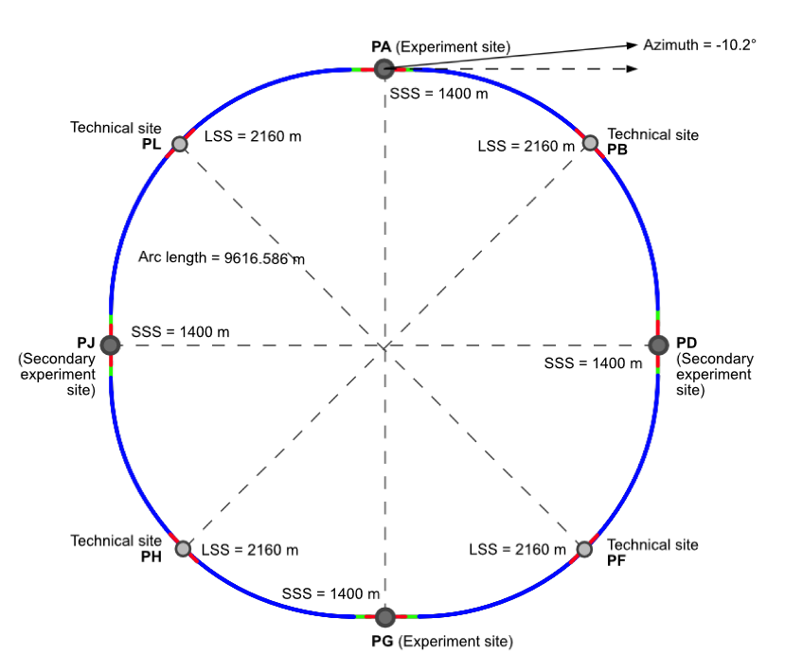
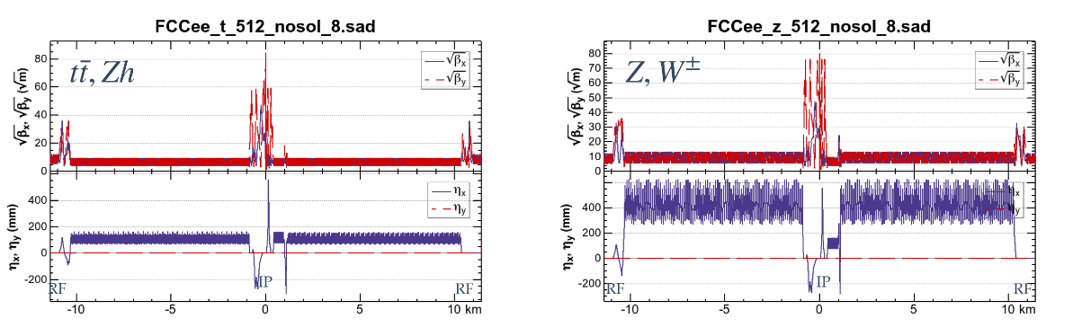
New “lowest risk” Placement/Optics Allows 4 Experiments
C=91 km
J. Gutleber
perfect symmetry
and
perfect 4-fold superperiodicity
FCC-ee beam optics for ¼ ring
K. Oide
8 surface sites

Slide 8
FCC-ee Collider Parameters (Stage 1)
Parameter [4 IPs, 91.2 km circumference] | Z | WW | H (ZH) | ttbar
beam energy [GeV] | 45 | 80 | 120 | 182.5
beam current [mA] | 1400 | 135 | 26.7 | 5.0
no. bunches/beam | 8800 | 1120 | 336 | 42
bunch intensity [10¹¹] | 2.76 | 2.29 | 1.51 | 2.26
SR energy loss / turn [GeV] | 0.0391 | 0.37 | 1.869 | 10.0
total RF voltage 400/800 MHz [GV] | 0.120/0 | 1.0/0 | 2.48/0 | 4.0/7.67
long. damping time [turns] | 1170 | 216 | 64.5 | 18.5
horizontal beta* [m] | 0.15 | 0.2 | 0.3 | 1
vertical beta* [mm] | 0.8 | 1 | 1 | 1.6
horiz. geometric emittance [nm] | 0.71 | 0.28 | 0.64 | 1.49
vert. geom. emittance [pm] | 1.42 | 4.34 | 1.29 | 2.98
bunch length with SR / BS [mm] | 4.32 / 15.2 | 3.55 / 7.02 | 2.5 / 4.45 | 1.67 / 2.54
luminosity per IP [10³⁴ cm⁻²s⁻¹] | 181 | 17.3 | 7.2 | 1.25
beam lifetime rad Bhabha / BS [min] | 19 / - | 20 / - | 10 / 19 | 12 / 46
Preliminary - for new layout & with 4 IPs

Slide 9
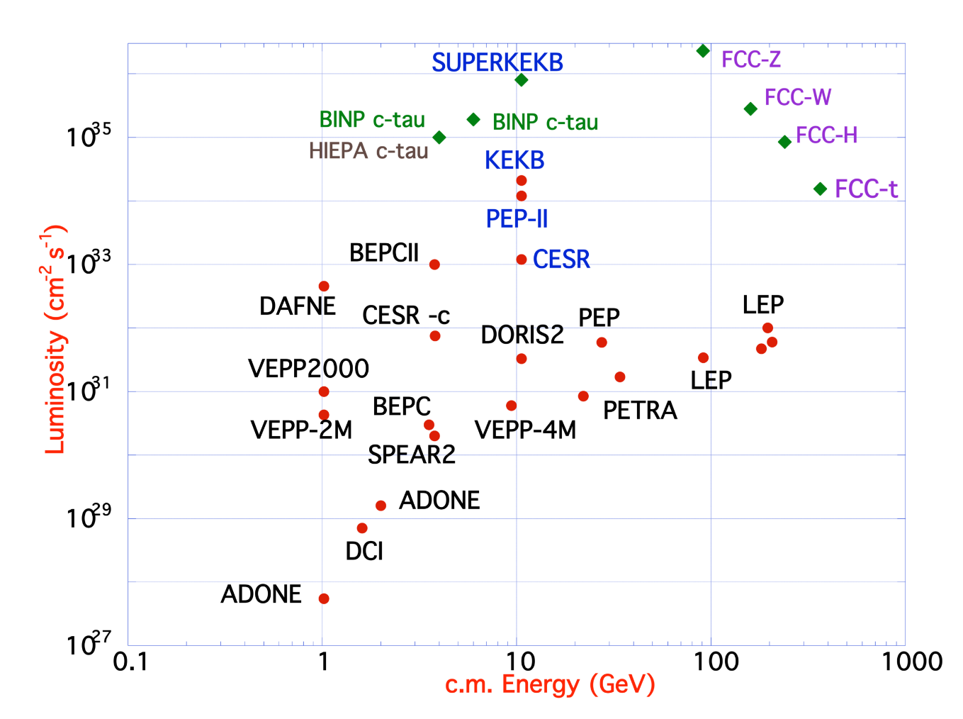
FCC-ee Design Concept
based on lessons and techniques from past colliders (last 40 years)
B-factories: KEKB & PEP-II:
double-ring lepton colliders,
high beam currents,
top-up injection
DAFNE: crab waist, double ring
S-KEKB: low β_{y}*, crab waist
LEP: high energy, SR effects
VEPP-4M, LEP: precision E calibration
KEKB: e⁺ source
HERA, LEP, RHIC: spin gymnastics
Marica Biagini
Marica Biagini
combining successful ingredients of several recent colliders → highest luminosities & energies

Slide 10
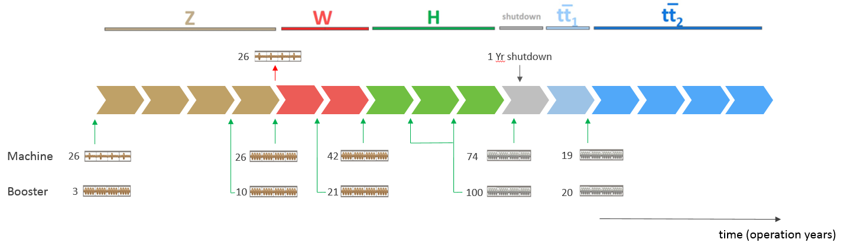
FCC-ee RF Staging Scenario
“Ampere-class” machine
three sets of RF cavities to cover all options for FCC-ee & booster:
high intensity (Z, FCC-hh): 400 MHz mono-cell cavities (4/cryom.)
higher energy (W, H, t): 400 MHz four-cell cavities (4/cryomodule)
ttbar machine complement: 800 MHz five-cell cavities (4/cryom.)
installation sequence comparable to LEP ( ≈ 30 CM/shutdown)
WP | V_{rf} [GV] | #bunches | I_{beam} [mA]
Z | 0.1 | 16640 | 1390
W | 0.44 | 2000 | 147
H | 2.0 | 393 | 29
ttbar | 10.9 | 48 | 5.4
“high-gradient” machine
Notes:
“Continuous flow” operation: succession of 8 months operation, 4 months installation shutdown (LEP-like)
Three sets of cavities to cover all options (+ booster):
high intensity (Z, FCC_hh): 400 MHz mono-cell cavities, ≈1MW RF source
high energy (H, t): 400 MHz four-cell cavities -> will be used for the W machine
booster and t machine complement: 800 MHz four-cell cavities (400 MHz would do the job as well)
High energy set for the W-machine not optimal (20-30% reduction of beam current) – building & installing 48 specialized CM would impact more (>>1 year delay)
Optimize the re-use of the 100MW, 400MHz RF power & controls hardware installed for the ‘Z-machine’
design an easily adaptable and modular RF power distribution system

Slide 11
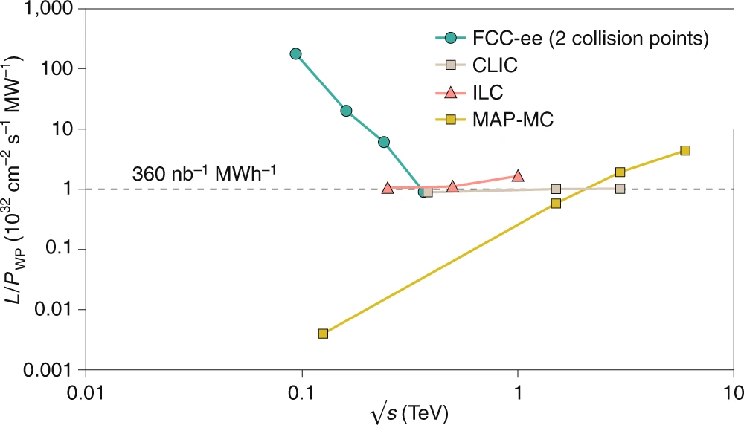
FCC-ee Figures of Merit
Luminosity vs. capital cost
for the H running, with 5 ab⁻¹ accumulated over 3 years and 10⁶ H produced, the total investment cost (~10 BCHF) corresponds to → 10 kCHF per produced Higgs boson
for the Z running with 150 ab⁻¹ accumulated over 4 years and 5x10¹² Z produced, the total investment cost corresponds to → 10 kCHF per 5×10⁶ Z bosons
This it the number of Z bosons collected by each experiment during the entire LEP programme !
Luminosity vs. electricity consumption
Due to twin-aperture magnets,
thin-film SRF, efficient RF power
sources, top-up injection
Capital cost per luminosity dramatically
decreased compared with LEP !
Highest lumi/power of all H fact proposals
Electricity cost ~200 CHF per Higgs boson

Slide 12
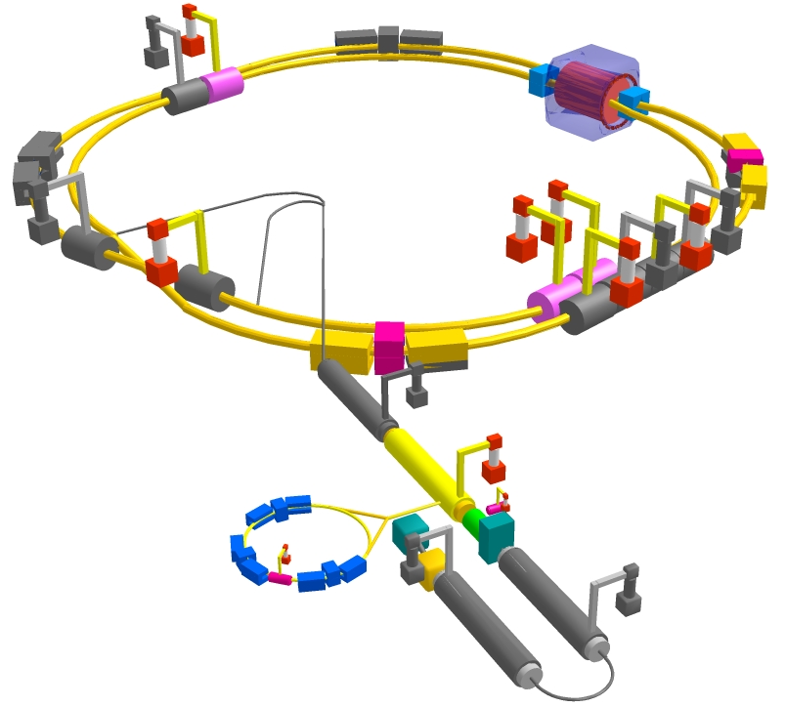
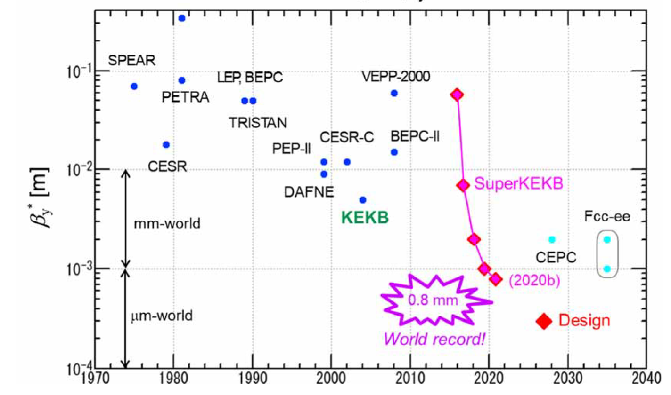
SuperKEKB – Pushing Luminosity and β*
Design: double ring e⁺e⁻ collider as B-factory at 7(e⁻) & 4(e⁺) GeV; design luminosity $\sim$8 x 10³⁵ cm⁻²s⁻¹; β_{y}* $\sim$0.3 mm;
nano-beam – large crossing angle collision scheme (crab waist w/o sextupoles); beam lifetime$\sim$5 minutes; top-up injection;
e⁺ rate up to $\sim$ 2.5 10¹² /s
M. Tobiyama, K. Oide
SuperKEKB is demonstrating FCC-ee key concepts
β_{y}* = 0.8 mm achieved in both rings – using the
FCC-ee-style “virtual” crab-waist collision scheme
Y. Funakoshi, Y. Ohnishi, K. Oide

Slide 13
NSLS-II, EIC & FCC-ee beam parameters
Potential EIC – FCC collaboration
 | NSLS-II | EIC | FCC-ee-Z
Beam energy [GeV] | 3 | 10 (20) | 45.6
Bunch population [10¹¹] | 0.08 | 1.7 | 1.7
Bunch spacing [ns] | 2 | 10 | 15, 17.5 or 20
Rms bunch length [mm] | 4.5 - 9 | 2 | 3.5 (SR)
Beam current [A] | 0.5 | 2.5 (0.27) | 1.39
RF frequency [MHz] | 500 | 591 | 400
Similarity of several parameters strongly suggests collaboration to exploit synergies in areas such as beam instrumentation, SRF, vacuum system with SR handling, etc.

Slide 14
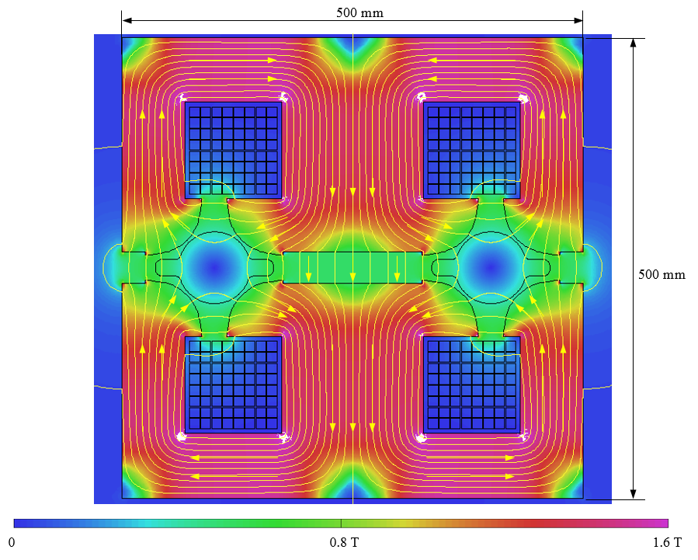
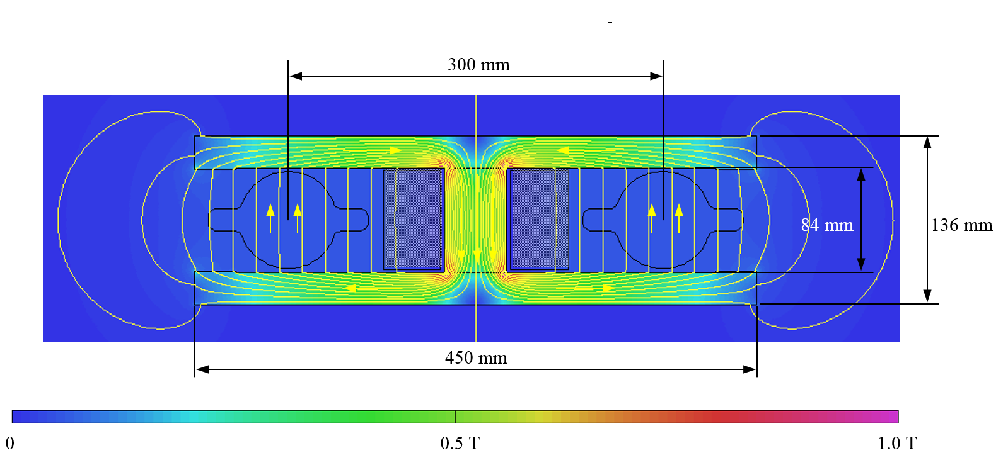
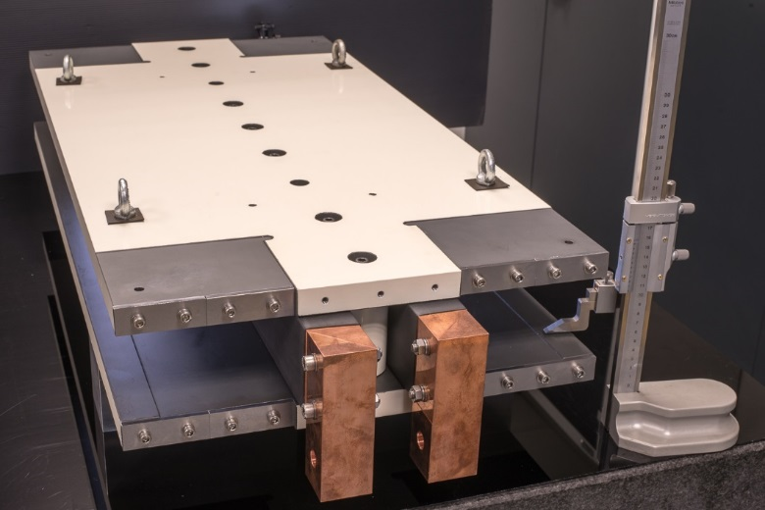
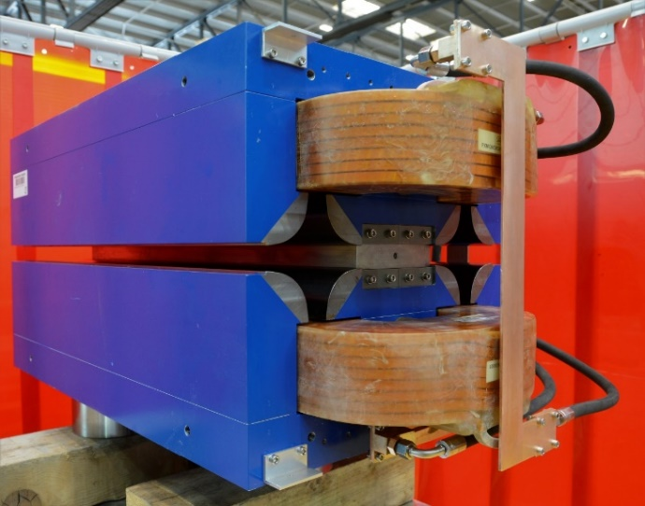
Prototypes of FCC-ee Low-power Magnets
Twin-dipole design with 2× power saving
16 MW (at 175 GeV), with Al busbars
Twin F/D arc quad design with 2× power saving
25 MW (at 175 GeV), with Cu conductor
prototype
prototype

Slide 15
FCC-hh Basic Design Choices
dual aperture superconducting magnets
two high-luminosity experiments (A & G)
two other experiments (L & B) combined with injection upstream of experiments
two collimation insertions
  betatron cleaning (J)
  momentum cleaning (F)
extraction/dump insertion (D)
RF insertion (H)
Injection from LHC (~3 TeV) or scSPS (~1.2 TeV)
Alternative layouts under study

Slide 16
FCC-hh (pp) Collider Parameters (Stage 2)
parameter | FCC-hh |  | HL-LHC | LHC
collision energy cms [TeV] | 100 |  | 14 | 14
dipole field [T] | 16-17 |  | 8.33 | 8.33
circumference [km] | 91.2 |  | 26.7 | 26.7
beam current [A] | 0.5 |  | 1.1 | 0.58
bunch intensity [10¹¹] | 1 | 1 | 2.2 | 1.15
bunch spacing [ns] | 25 | 25 | 25 | 25
synchr. rad. power / ring [kW] | 2700 |  | 7.3 | 3.6
SR power / length [W/m/ap.] | 32.1 |  | 0.33 | 0.17
long. emit. damping time [h] | 0.45 |  | 12.9 | 12.9
beta* [m] | 1.1 | 0.3 | 0.15 (min.) | 0.55
normalized emittance [μm] | 2.2 |  | 2.5 | 3.75
peak luminosity [10³⁴ cm⁻²s⁻¹] | 5 | 30 | 5 (lev.) | 1
events/bunch crossing | 170 | 1000 | 132 | 27
stored energy/beam [GJ] | 7.8 |  | 0.7 | 0.36
Preliminary - for new layout

Slide 17
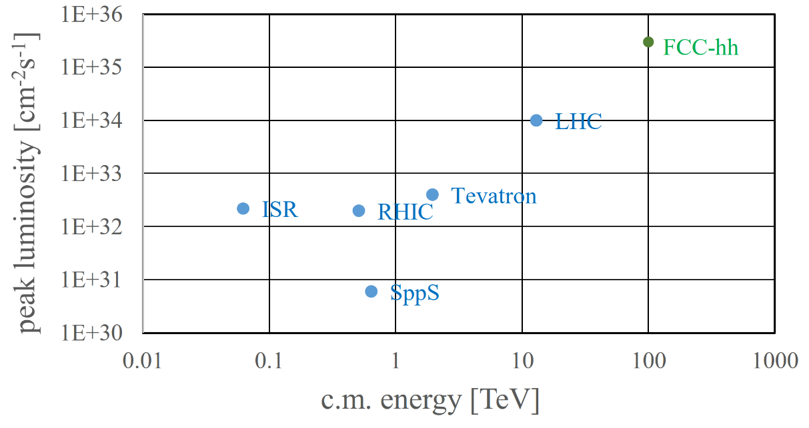
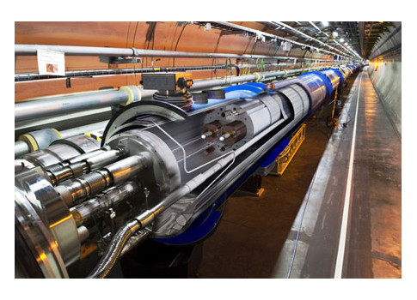
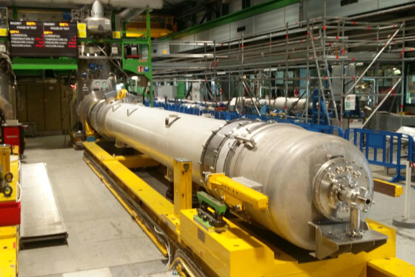
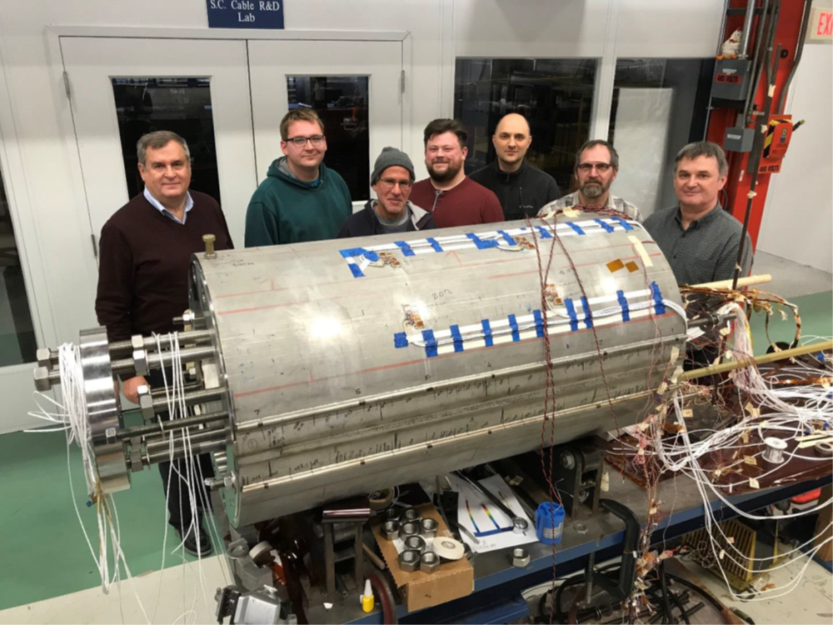
FCC-hh: Highest Collision Energies
order of magnitude performance increase in both energy & luminosity
100 TeV cm collision energy (vs 14 TeV for LHC)
20 ab⁻¹ per experiment collected over 25 years of operation (vs 3 ab⁻¹ for LHC)
similar performance increase as from Tevatron to LHC
key technology: high-field magnets
from
LHC technology
8.3 T NbTi dipole
via
HL-LHC technology
12 T Nb₃Sn quadrupole
FNAL dipole demonstrator
14.5 T Nb₃Sn

Slide 18
World-wide FCC Nb₃Sn Programme
Main development goal is wire performance increase:
J_{c} (16T, 4.2K) > 1500 A/mm² →50% increase wrt HL-LHC wire
Reduction of coil & magnet cross-section
5400 mm²
3150 mm²
~1.7 times less SC
After 1-2 years development, prototype Nb₃Sn wires from several new industrial FCC partners already achieve HL-LHC J_{c} performance
~10% margin
HL-LHC
~10% margin
FCC ultimate
FCC conductor development collaboration:
Bochvar Institute (production at TVEL), Russia
Bruker, Germany, Luvata Pori, Finland
KEK (Jastec and Furukawa), Japan
KAT, Korea, Columbus, Italy
University of Geneva, Switzerland
Technical University of Vienna, Austria
SPIN, Italy, University of Freiberg, Germany
2019/20 results from US, meeting FCC J_{c} specs:
Florida State University: high-J_{c} Nb₃Sn via Hf addition
Hyper Tech /Ohio SU/FNAL: high-J_{c} Nb₃Sn via artificial pinning centres based on Zr oxide.

Slide 19

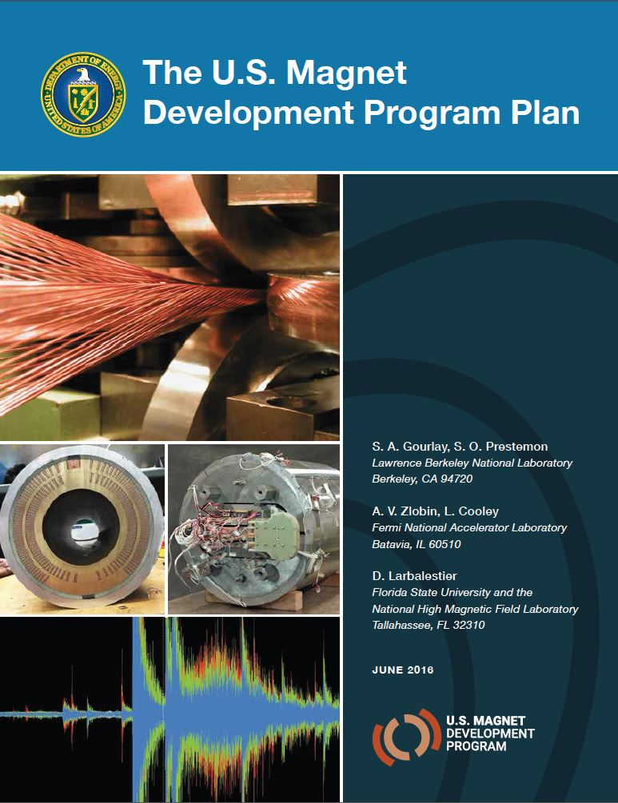
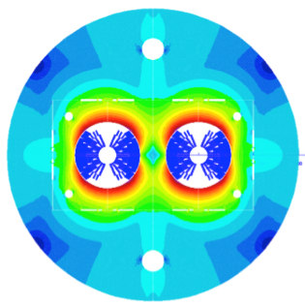
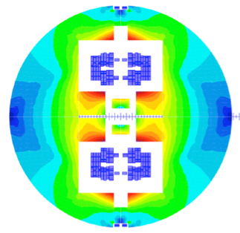

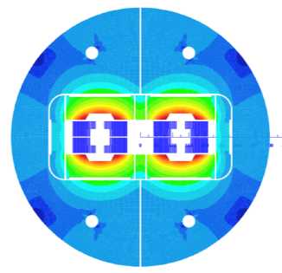
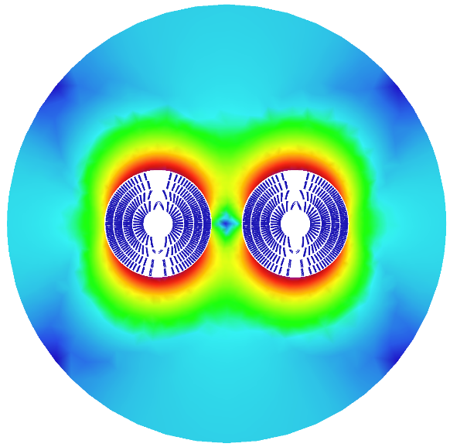
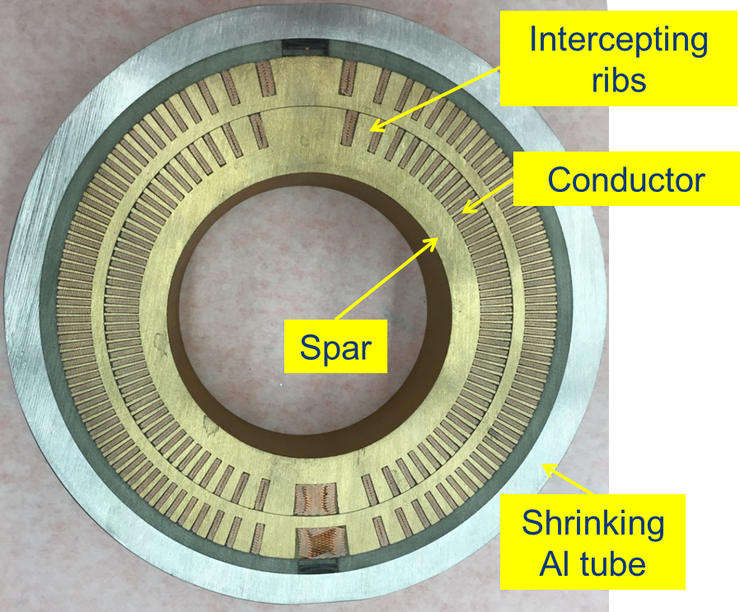
16 T Dipole Design Activities and Options
H2020
Swiss contribution
Cos-theta
Common coils
Canted
Cos-theta
Blocks
INFN
CIEMAT
LBNL
CEA
PSI
FNAL
Short model magnets (1.5 m lengths) will be built until 2025

Slide 20
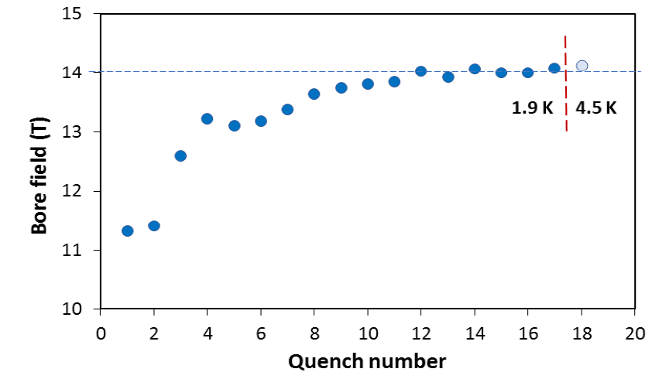
US – MDP: 14.5 T Magnet Tested at FNAL
84% on the laodline at 1.9 K
92% on the loadline at 4.2 K
60-mm aperture
4-layer graded coil
15 T dipole demonstrator
Staged approach: In first step pre-stressed for 14 T
Second test in June 2020 with additional pre-stress reached 14.5 T

Slide 21
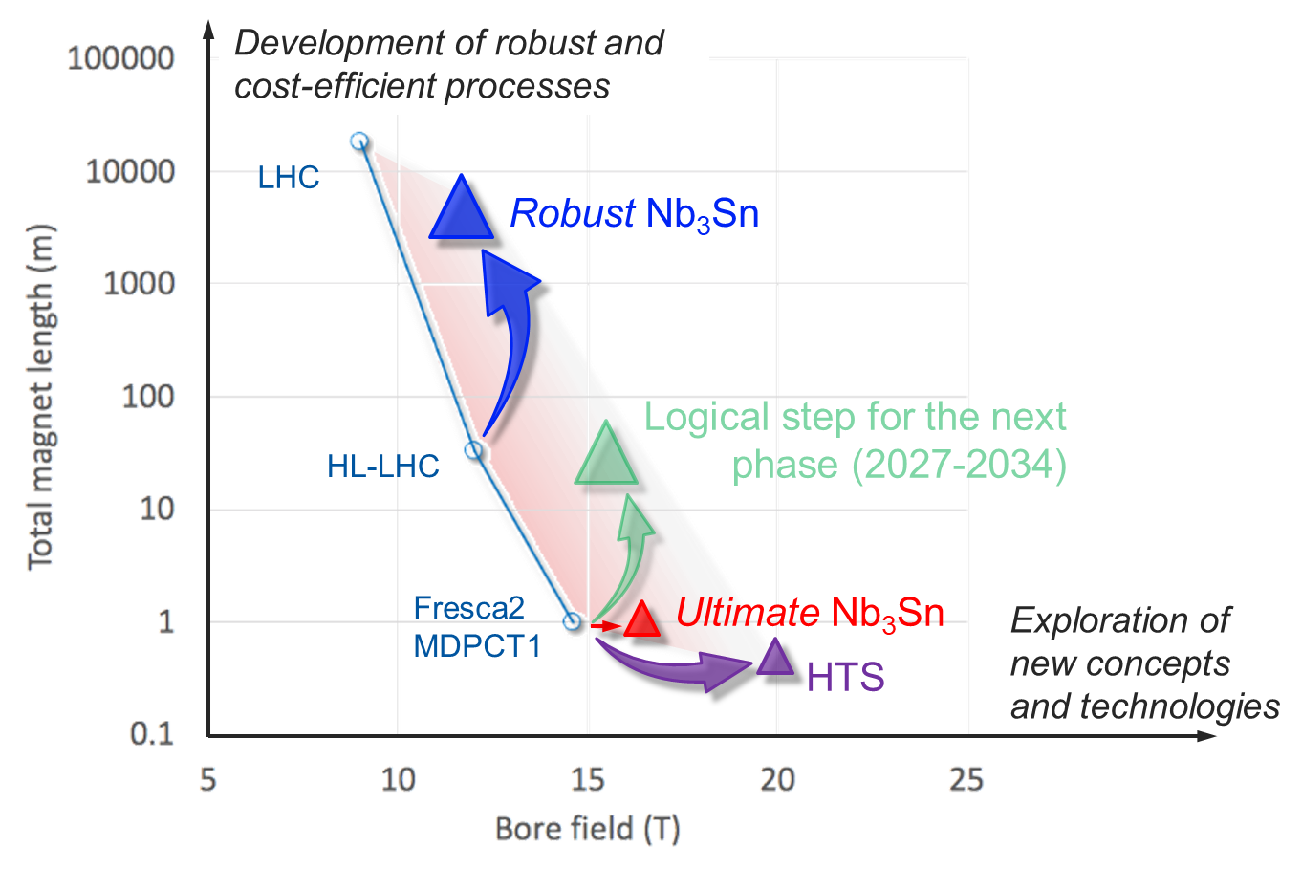
High Field Magnet Programme
Goals until 2027
L. Bottura
    1. Develop Nb₃Sn magnets for collider-scale production, through robust design, industrial processes and cost reduction
    2. Demonstrate Nb₃Sn full potential in terms of ultimate performance
  3. Provide a proof-of-principle for HTS magnet technology

Slide 22
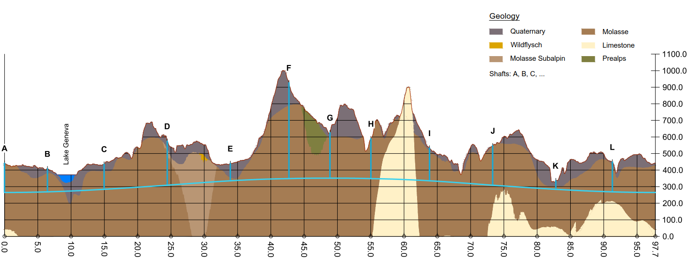
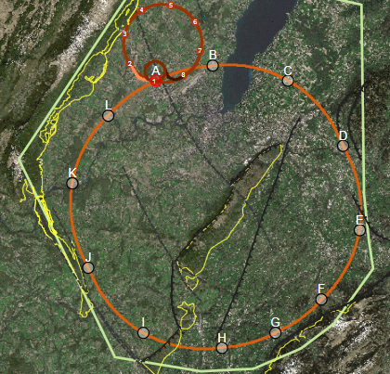
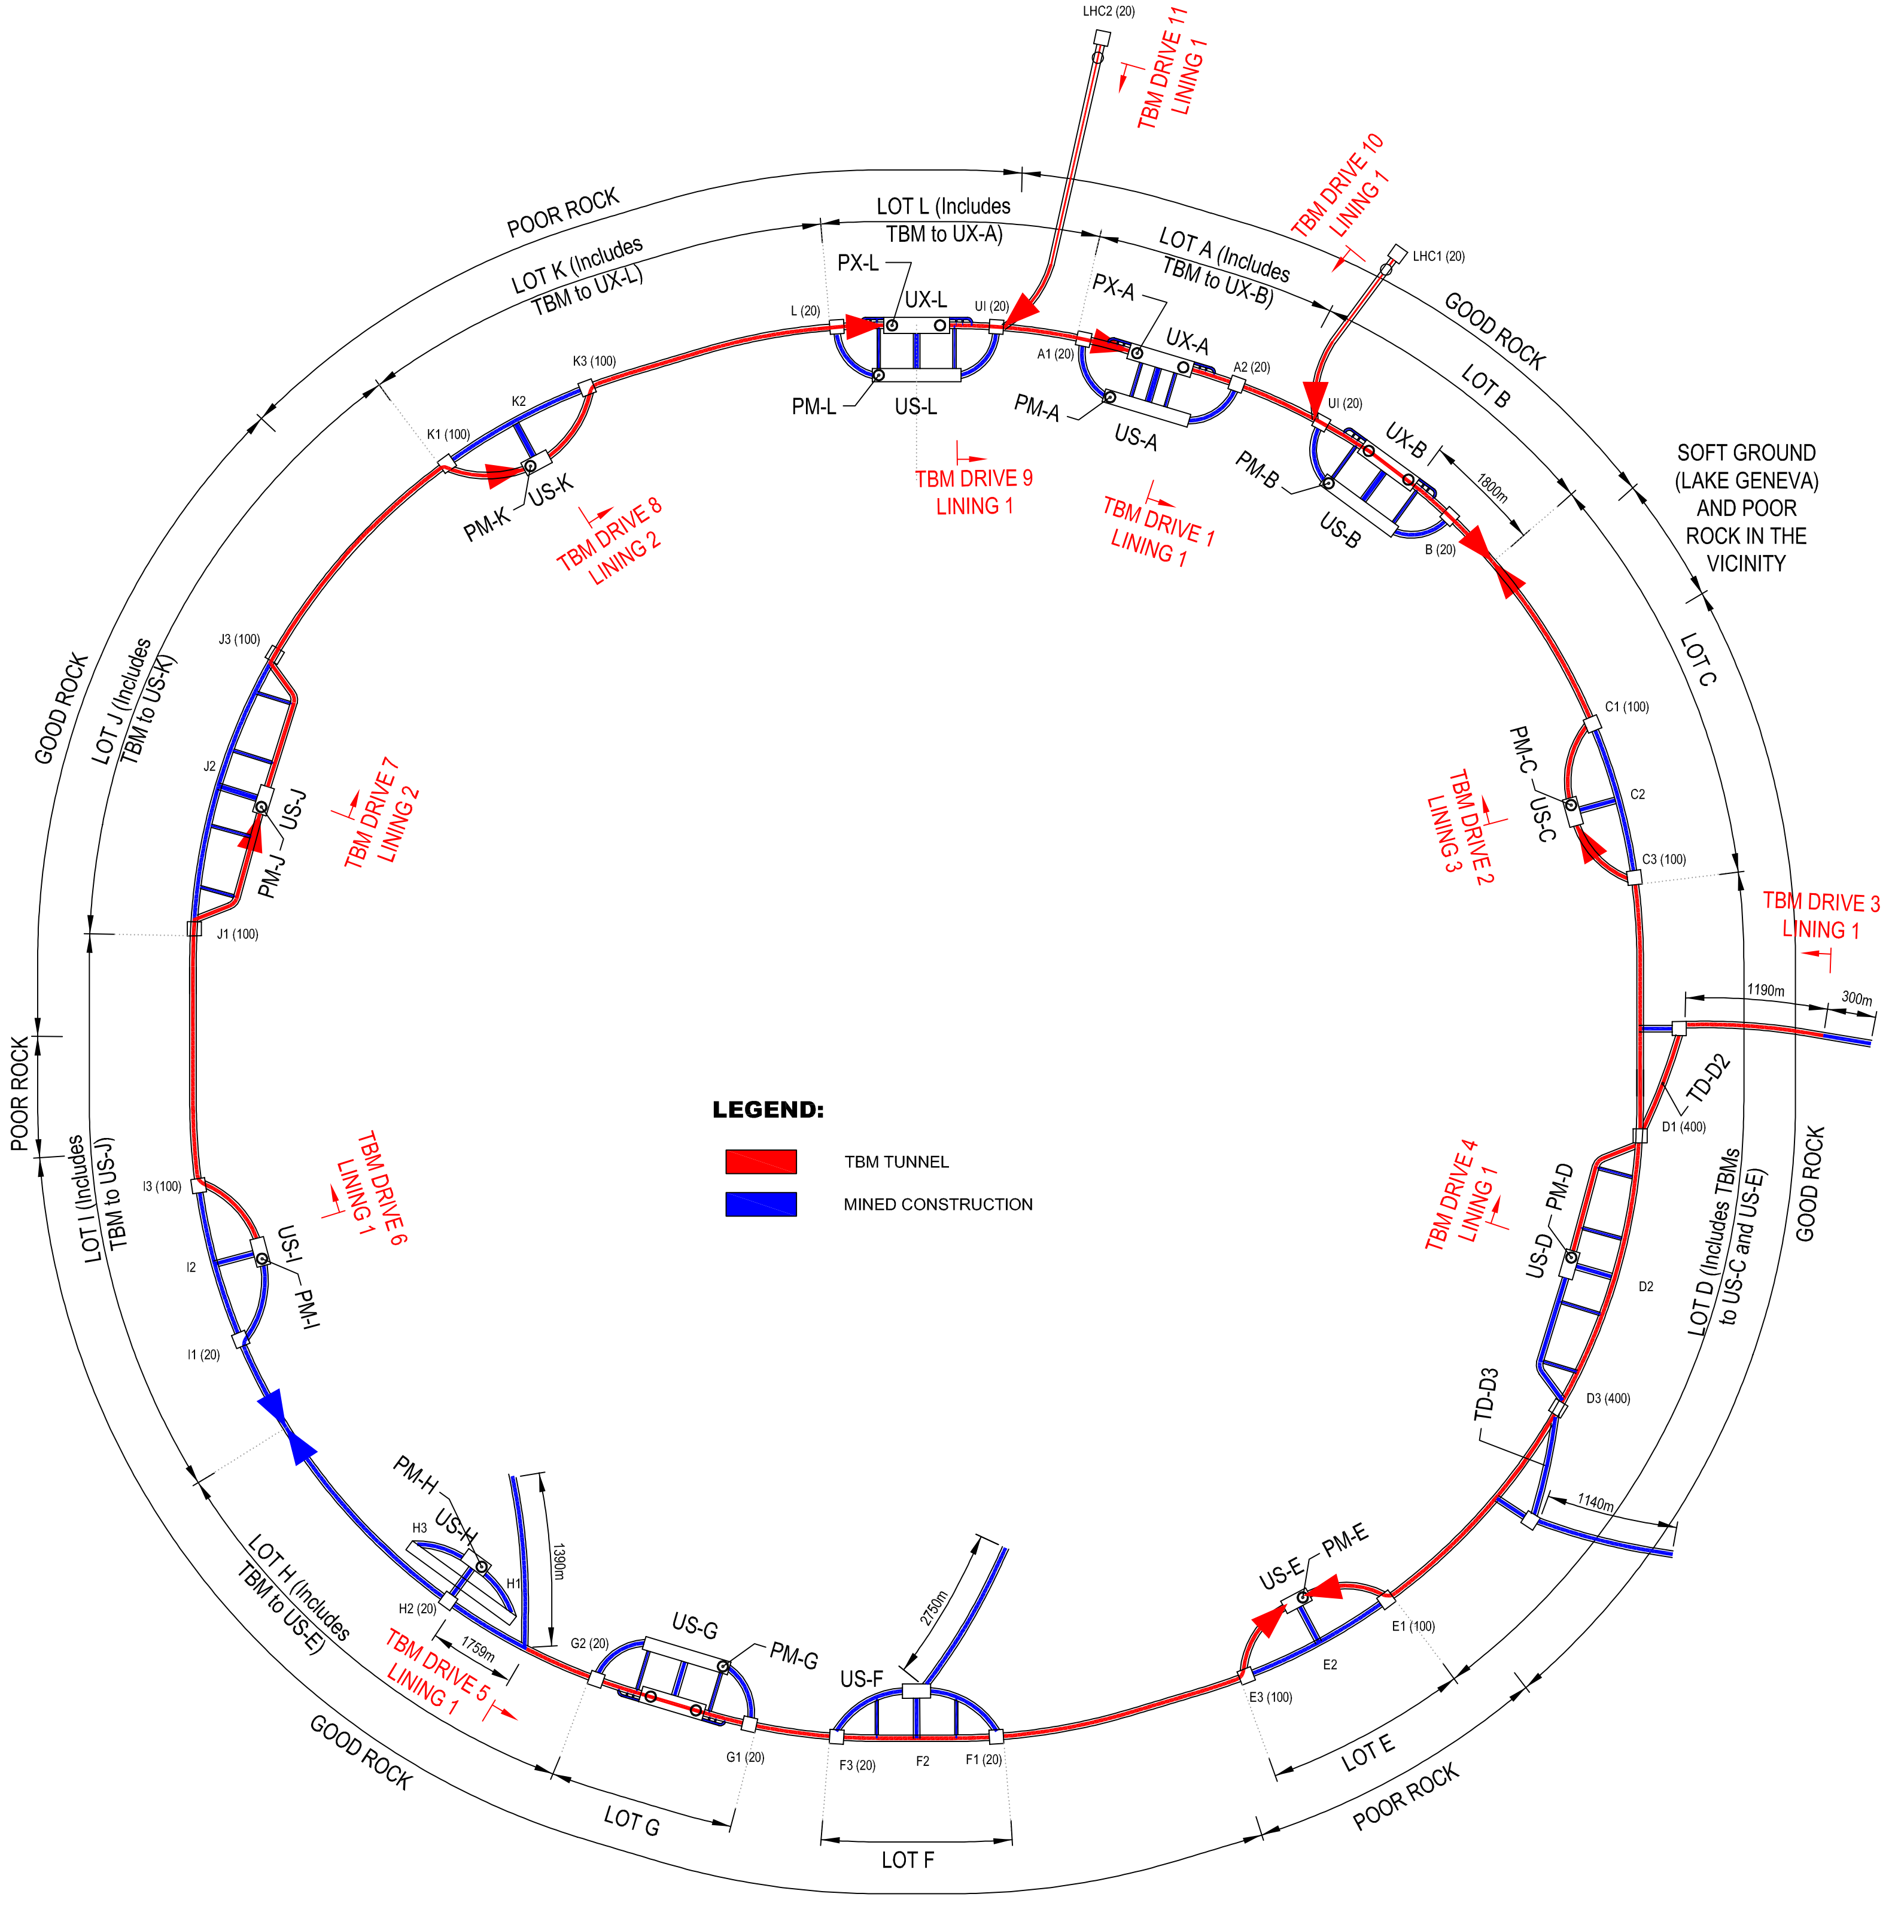
FCC Implementation - Footprint Baseline
Present baseline position was established considering:
lowest risk for construction, fastest and cheapest construction
Molasse rock preferred for tunnelling, avoid limestone with karstic structures
90 – 100 km circumference
12 surface sites with few ha area each

Slide 23
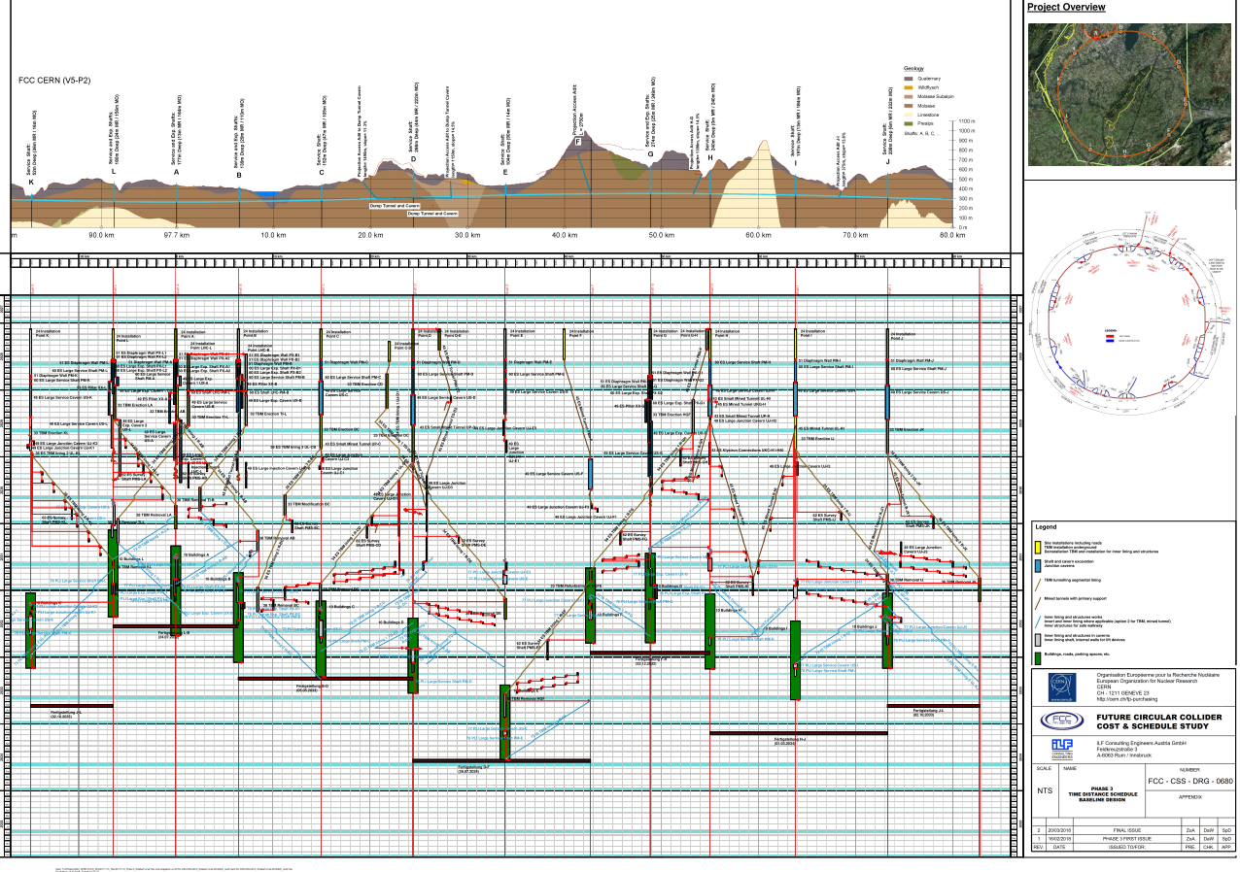
Civil Engineering Construction Schedule
4.5yrs
6.5yrs
Total construction duration 7 years
First sectors ready after 4.5 years

Slide 24
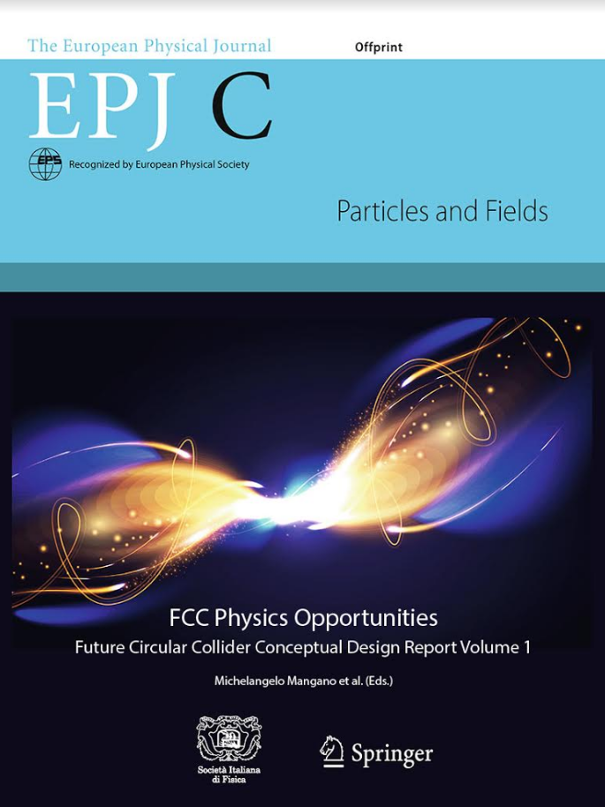
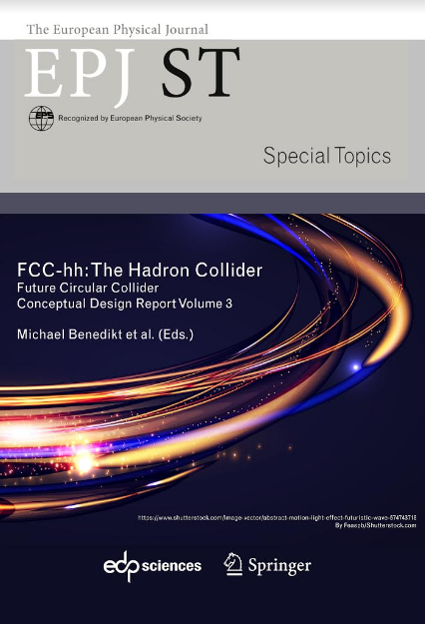
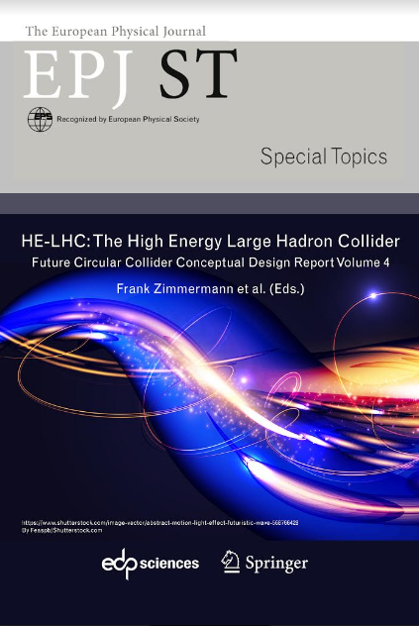
FCC CDR and Study Documentation
FCC-Conceptual Design Reports:
  Vol 1 Physics, Vol 2 FCC-ee, Vol 3 FCC-hh, Vol 4 HE-LHC
  CDRs published in European Physical Journal C (Vol 1) and ST (Vol 2 – 4)
  EPJ C 79, 6 (2019) 474 , EPJ ST 228, 2 (2019) 261-623 ,
  EPJ ST 228, 4 (2019) 755-1107 , EPJ ST 228, 5 (2019) 1109-1382
Summary documents provided to EPPSU SG
  FCC-integral, FCC-ee, FCC-hh, HE-LHC
  Accessible on http://fcc-cdr.web.cern.ch/
>1350 contributors from > 350 institutes,
a truly global effort as suggested by EPPSU 2013

Slide 25
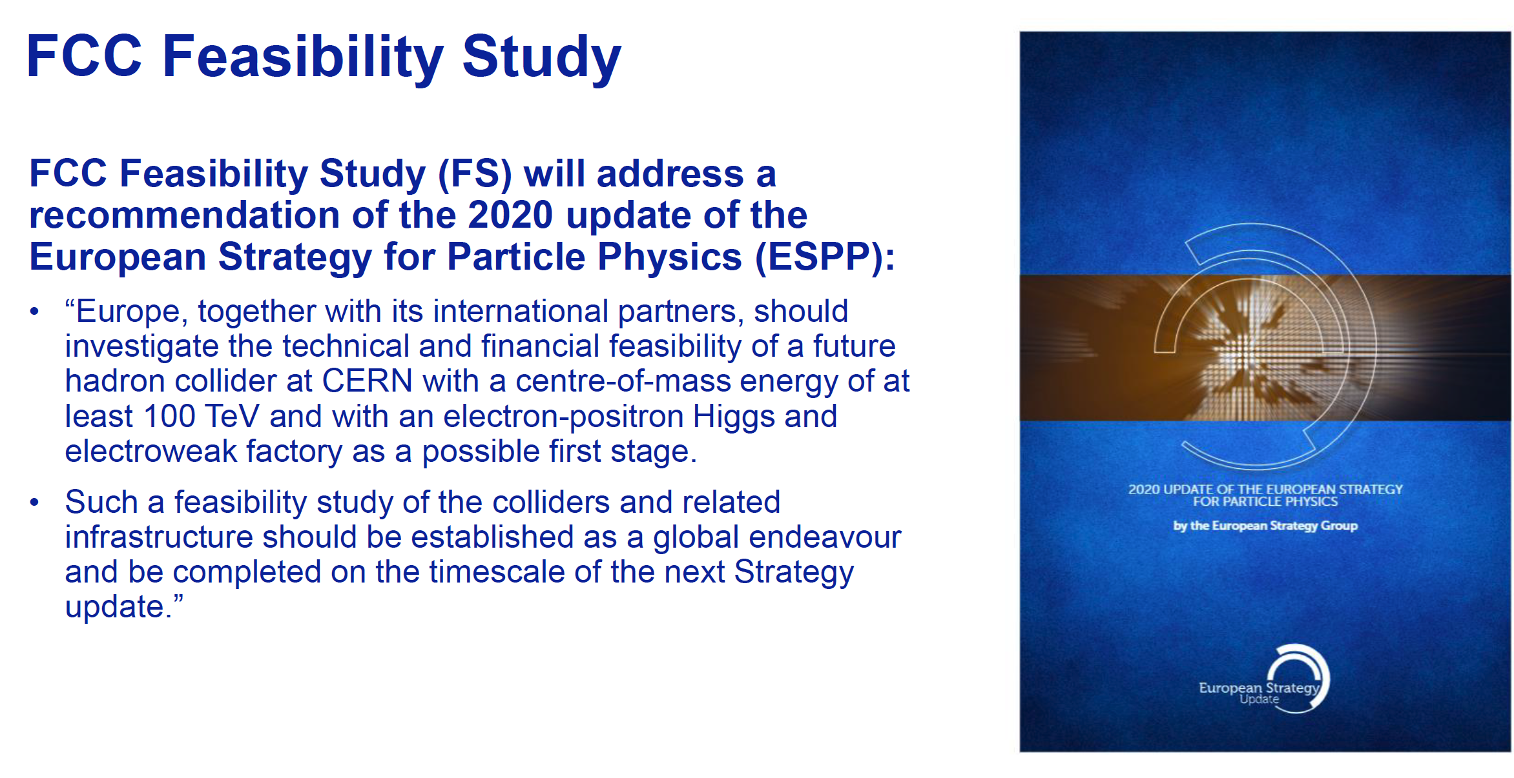
FCC Feasibility Study
Increasing international collaboration as a prerequisite for success:
links with science, research & development and high-tech industry will be essential to further advance and prepare the implementation of FCC

Slide 26
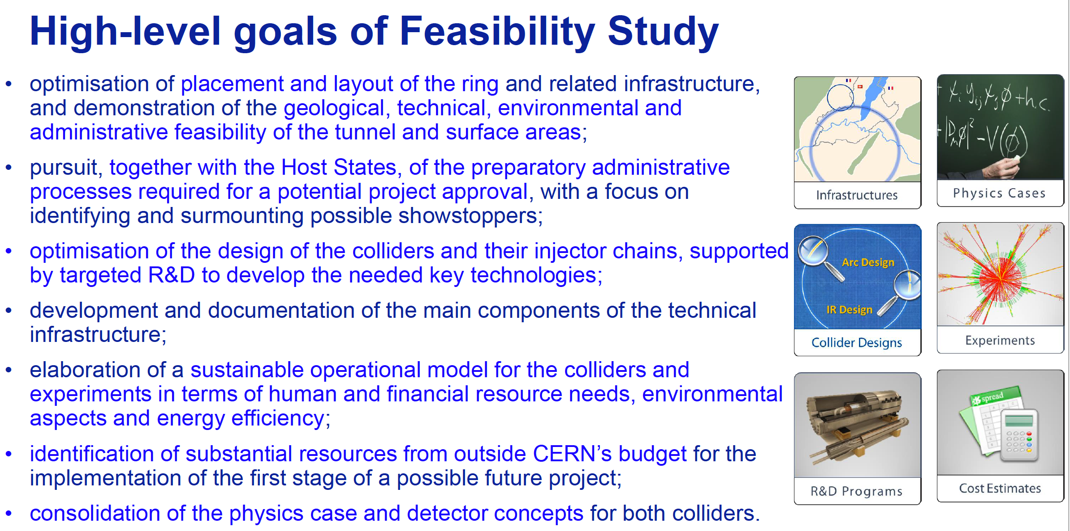
High-level Goals of Feasibility Study
Increasing international collaboration as a prerequisite for success:
links with science, research & development and high-tech industry will be essential to further advance and prepare the implementation of FCC

Slide 27
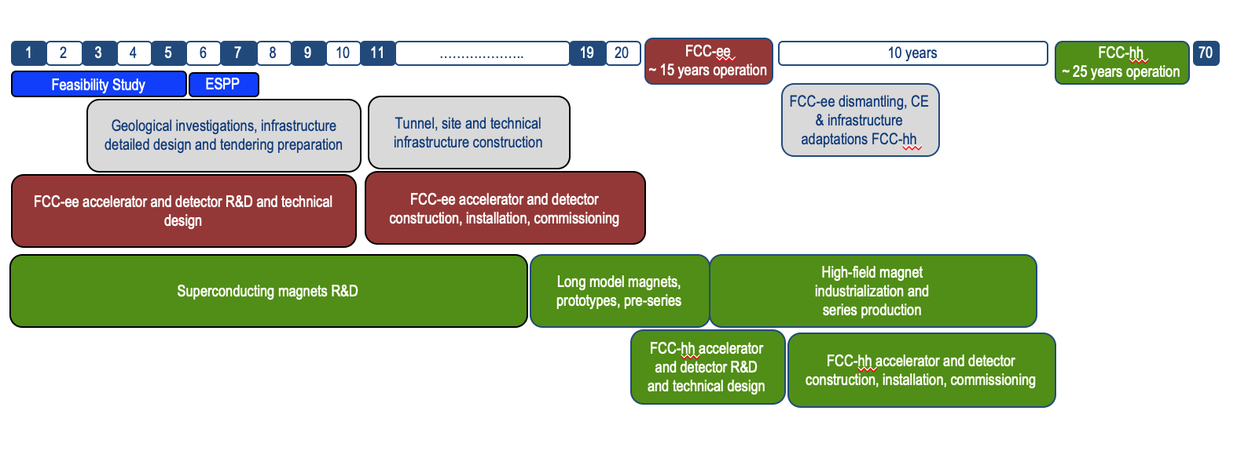
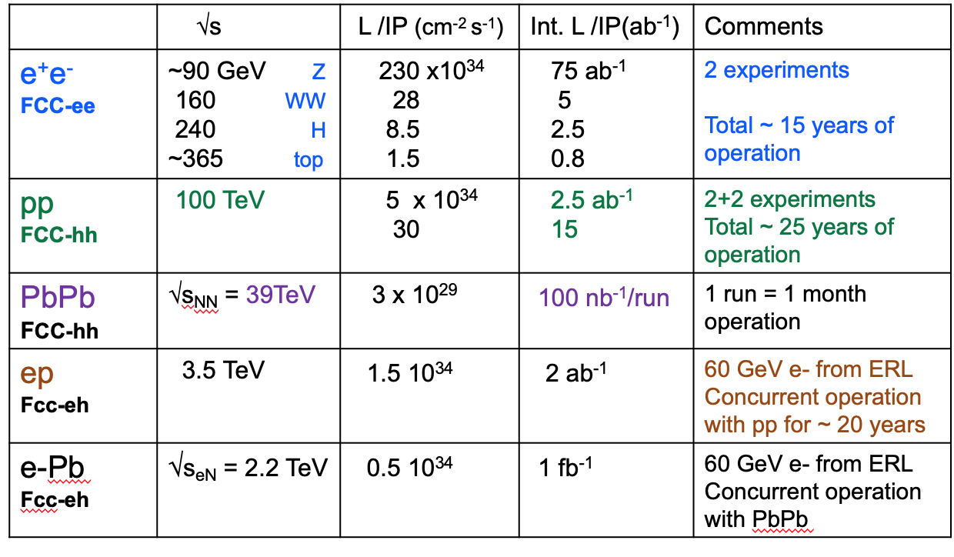
Timeline of the FCC Integrated Programme
Technical
schedule
2-4 experiments
20-30
Feasibility Study: 2021-2025
If project approved before end of
decade → construction can start
beginning 2030s
FCC-ee operation ~2045-2060
FCC-hh operation 2070-2090++
F. Gianotti

Slide 28



Feasibility Study Timeline
2021 |  |  |  | 2022 |  |  |  | 2023 |  |  |  | 2024 |  |  |  | 2025
Q1 | Q2 | Q3 | Q4 | Q1 | Q2 | Q3 | Q4 | Q1 | Q2 | Q3 | Q4 | Q1 | Q2 | Q3 | Q4 | Q1 | Q2 | Q3 | Q4
CDR baseline design adaptations for
new implementation scenario
Status reports &
study planning ,
FCC Week & Review : implementation, baseline design, organisation, communication
high-risk areas site investigations, environmental evaluation & impact study with host states
FCCW & mid-term review:
general coherency, CDR cost update
detailed design towards CDR
FCC Week & Review: key technology R&D programs
FS Report
Release FSR
Project cost update

Slide 29
Beneficiaries
H2020 DS FCC Innovation Study 2020-24
Topic | INFRADEV-01-2019-2020
Grant Agreement | FCCIS 951754
Duration | 48 months
From-to | 2 Nov 2020 – 1 Nov 2024
Project cost | 7 435 865 €
EU contribution | 2 999 850 €
Beneficiaries | 16
Partners | 6
Beneficiaries
Partners

Slide 30
Beneficiaries
Objectives of FCCIS (Description of Action)
O1: Design a circular luminosity frontier particle collider with a research programme to remain at the forefront of research
O2: Demonstrate the technical and organizational feasibility of a 100 km long, circular particle collider
O3: Develop an innovation plan for a long-term sustainable research infrastructure that is seamlessly integrated in the European research landscape
O4: Engage stakeholders from different sectors of the society
O5: Demonstrate the role and impact of the research infrastructure in the innovation chain, focusing on responsible resource use and managing environmental impacts

Slide 31
Beneficiaries
FCCIS Work Packages
WP1: study management
WP4: impact & sustainability
Develop the financial roadmap of the infrastructure project, including the analysis of socio-economic impacts.
WP2: collider design
Deliver a performance optimised machine design, integrated with the territorial requirements and constraints, considering cost, long-term sustainability, operational efficiency and design-for- socio-economic impact generation.
WP5: leverage & engage
Engage stakeholders in the preparation of a new research infrastructure. Communicate the project rationale, objectives and progress. Create lasting impact by building theoretical and experimental physics communities, creating awareness of the technical feasibility and financial sustainability, forging a project preparation plan with the host states (France, Switzerland).
WP3: integrate Europe
Develop a feasible project scenario compatible with local – territorial constraints while guaranteeing the required physics performance.

Slide 32
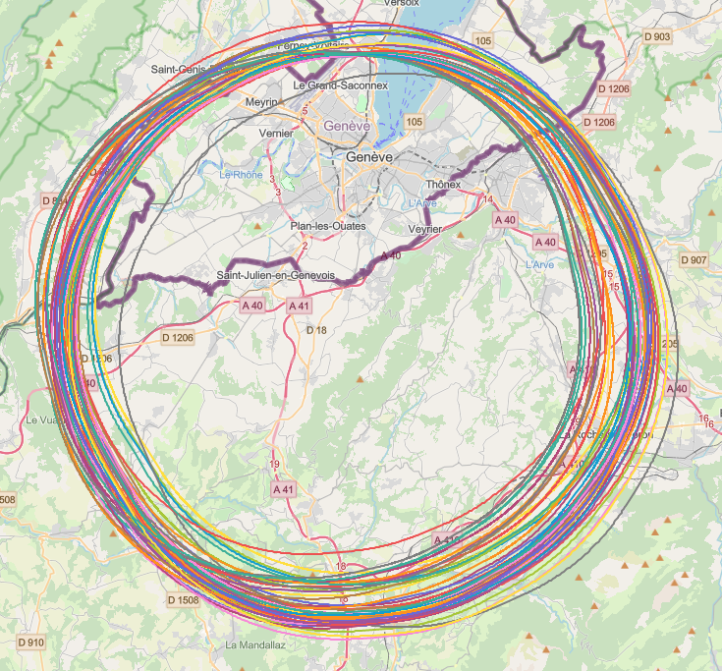
Collider Placement Optimisation
An overall layout and placement optimisation process across both host states that follows the "avoid-reduce-compensate" directive according to European and French regulatory frameworks.
Process integrates a diverse set of requirements and constraints, such as
  performance for the scientific research to be competitive at international scale
  civil engineering technical feasibility and subsurface constraints
  territorial constraints at surface and subsurface
  nature, accessibility, technical infrastructure and resource needs and constraints
  economic factors including the development of benefits for and synergies with the regional developments
Work takes place as a collaborative effort by technical experts at CERN, consultancy companies and government notified bodies

Slide 33
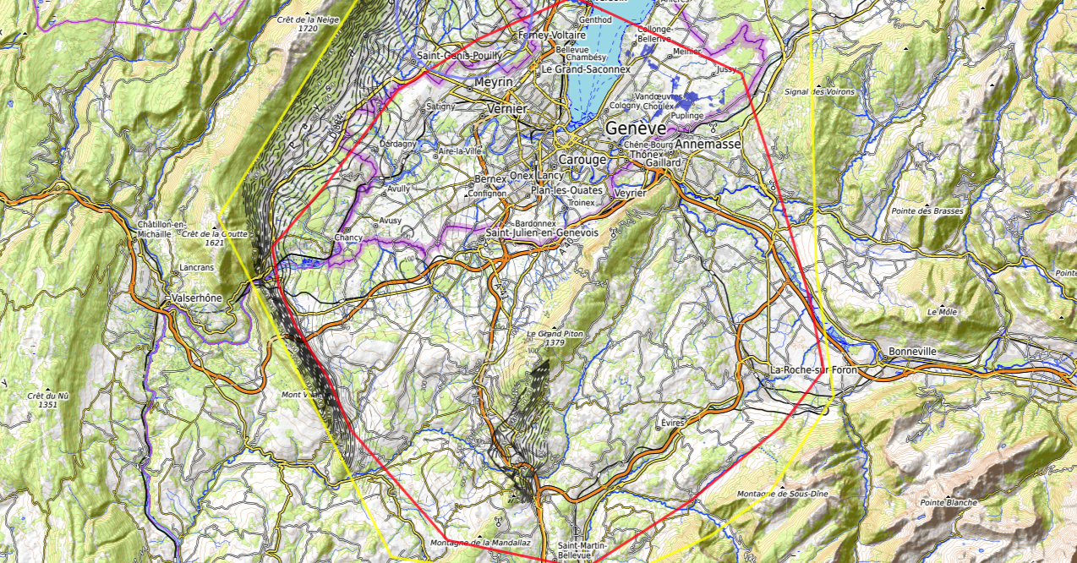
Constraints
Placement Studies (I)
J. Gutleber, V. Mertens
Discouraged due
to likely oppositions
Densely urbanized
and agriculture/nature
Strict landscape protection
and re-naturalization areas
Jura limestone
Protected forest
Densely urbanized
and emerging areas
Densely urbanized
Clustered residential
areas and farm areas
Terrain difficult to
access and water
reservoirs
Known water reservoirs and
protected nature in CH
(legal + technical reasons)
Water protection and
natural zones without
developed access
Densely urbanized
and emerging areas
(some spots possible)
Water protection zones,
landscape protection zones,
altitudes
High mountains (900 m)
north of Fillière river valley
Vuache limestone
and faults
Likely major opposition:
local urbanistic planning
for traffic calming &
nature protection
High altitudes
Densely populated

Slide 34
Placement Studies (II)
J. Gutleber, V. Mertens
CERN Prevessin
SPS BA4
LHC Pt8 area
GE public plot in Bellevue
GE public plot in Pallanterie
Target Areas
GE public plot in Présinge
Challex area south of D884
Permit north of D884, east of
water bearing layer zone.
Permit entering swiss territory
conntected by access tunnel
CERN
Meyrin site
Selected plots south of
Cranves-Salves
Selected plots south of
Bonne
West of A40 at Arve
Charvonnex, Villy
Between A41,
railroad and
route d’Annecy.
South of A410
Some plots in Contamine
sur Arve
Vulbens south of water
Protection zone until A40
North & south of
A410 at selected
Places to be
analysed
individually
Some plots in Arenthon
North of Roche-s.-Foron,
industrial area and Etaux
Dingy north up to A40,
except water protection
zones
700 m altitude line at
Roche-s.-Foron railroard
Minzier area outside
forests, which are
Inaccessible on mountains
One 3 ha unprotected location
at D2 in Fillière valley
North-east of
Choisy
North of Ollières, few selected locations

Slide 35
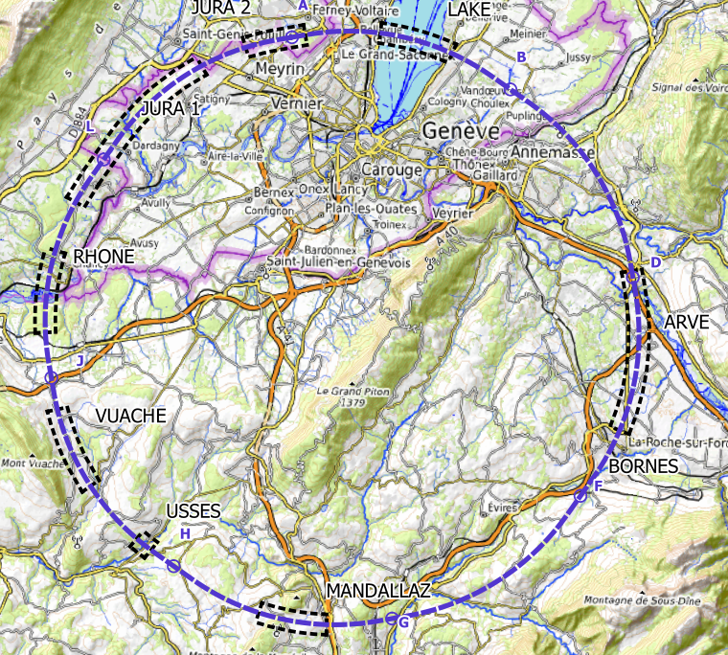
Plans for High-risk Site Investigations
  Jura, Vuache (3 Areas)
  Top of limestone
  Karstification and filling-in at the tunnel depth
  Water pressure
  Lake, Rhône, Arve and Usses Valley (4 Areas)
  Top of the molasse
  Quaternary soft grounds, water bearing layers
  Mandallaz (1 Areas)
  Water pressure at the tunnel level
  Karstification
  Bornes (1 Area)
  High overburden molasse properties
  Thrust zones
  Site investigations planned for mid 2023 – mid 2025:
  ~40-50 drillings, 100 km of seismic lines

Slide 36
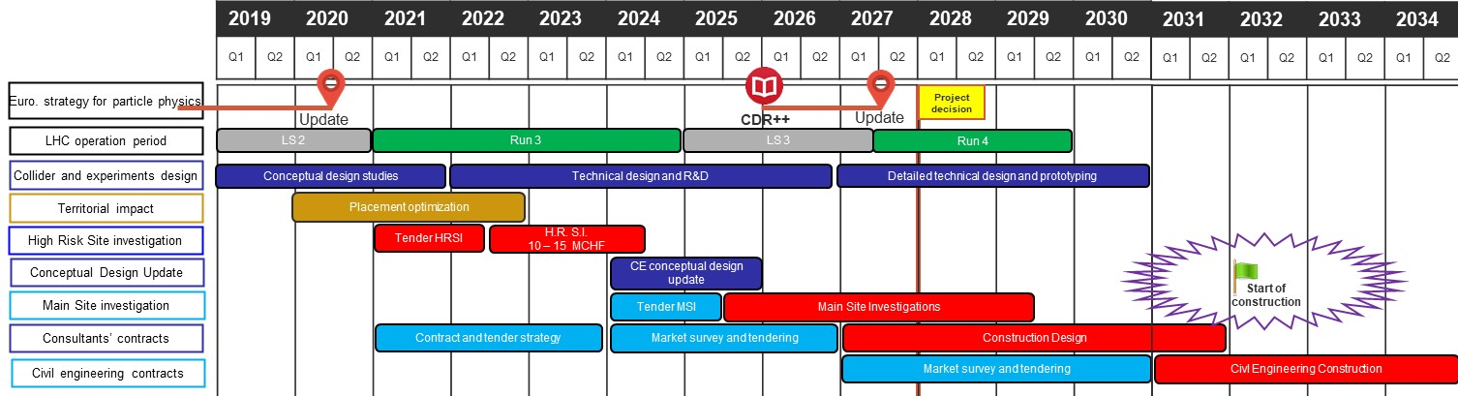
CE Preparatory Activities 2020 - 2030
Technical schedule of main processes leading to start of construction begin 2030s
For proof of principle feasibility: High risk area site investigations, 2022 – 2024
Followed by update of civil engineering conceptual design and CE cost estimate 2025

Slide 37
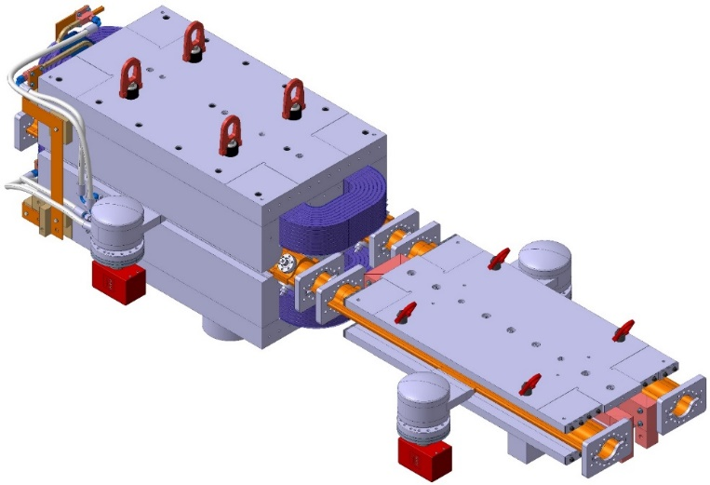
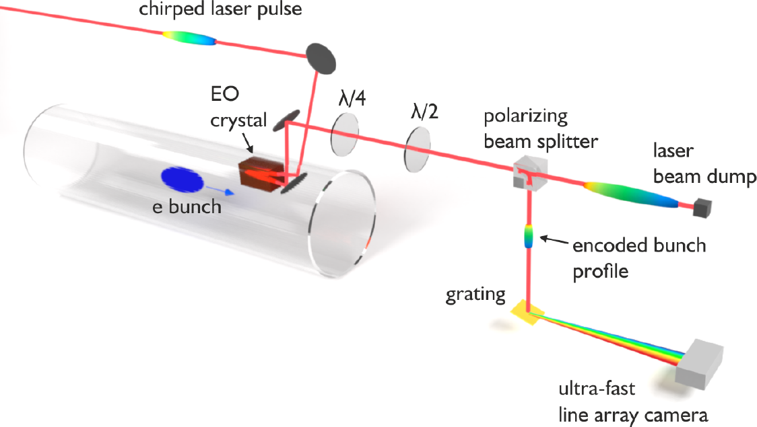
FCC Key Deliverables: Prototypes by 2025
FCC-ee complete arc half-cell mock-up
including girder, vacuum system with antechamber + pumps, dipole, quadrupole + sext. magnets, BPMs, cooling + alignment systems, technical infrastructure interfaces.
Key beam diagnostics elements
bunch-by-bunch turn-by-turn longitudinal charge density profiles based on electro-optical spectral decoding (beam tests at KIT/KARA) ; ultra-low emittance measurement (X-ray interferometer tests at SuperKEKB, ALBA) ; beam-loss monitors (IJCLab/KEK?) ;
beamstrahlung monitor (KEK); polarimeter ; luminometer

Slide 38
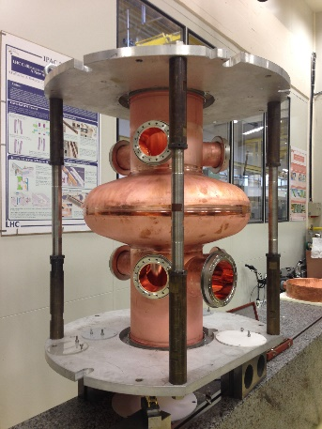
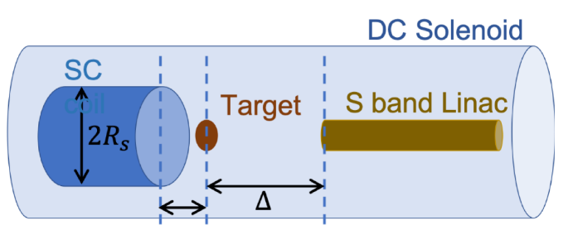
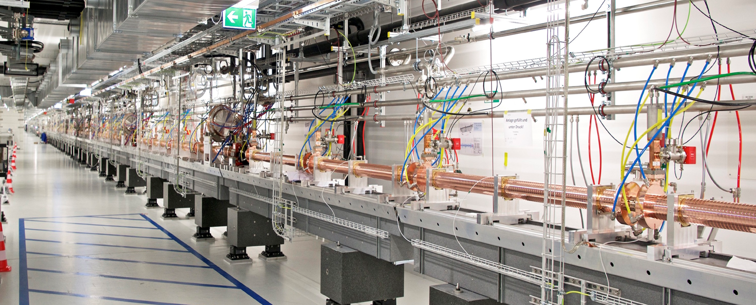

FCC Key Deliverables: Prototypes by 2025
High-yield positron source
target with DC SC solenoid or flux
concentrator
400 MHz SRF cryomodule,
+ prototype multi-cell cavities for FCC ZH operation
High-efficiency RF power sources
Beam test of e⁺ source & capture linac at SwissFEL – yield measurement
Positron capture linac
large aperture S-band linac
SwissFEL linac
Strong support from Switzerland via CHART II programme 2019 – 2024 for FCC-ee injector, HFM, beam optics developments, geology and geodesy activities.

Slide 39

FCC-ee Machine Detector Interface
Increasing international collaboration as a prerequisite for success:
links with science, research & development and high-tech industry will be essential to further advance and prepare the implementation of FCC

Slide 40

FCC-hh Detector – A Formidable Challenge
Increasing international collaboration as a prerequisite for success:
links with science, research & development and high-tech industry will be essential to further advance and prepare the implementation of FCC
P. Janot

Slide 41


FCC FS Council Documents, June 2021
Organisational Structure of the FCC Feasibility Study
http://cds.cern.ch/record/2774006/files/English.pdf
Main Deliverables and Timeline of the FCC Feasibility Study
http://cds.cern.ch/record/2774007/files/English.pdf

Slide 42

FCC Feasibility Study Organisational Structure
FCC Organisational Structure
  Ownership of the Feasibility Study by the Council.
  Effective and timely supervision.
  Integration of scientific and technical advice.
  Participation of stakeholders that can potentially make significant financial and technical contributions to a possible future project.
  Execution of Feasibility Study.

Slide 43

Status of Global FCC Collaboration
Increasing international collaboration as a prerequisite for success:
links with science, research & development and high-tech industry will be essential to further advance and prepare the implementation of FCC
147
Institutes
30
Companies
34
Countries
EC
H2020

Slide 44




FCC Physics Workshop 7-11 February 2022
Liverpool, UK
number of in-person participants limited to ~160 (first come -- first served)
- registration fee: 300£
- broadcast on zoom

Slide 45

FCC Week 2022
In Paris 30 May to 3 June 2022
We are looking forward
to seeing you there !

Slide 46

Summary
The European Strategy Update in 2020 issued the request for a feasibility study of the FCC integrated programme to be delivered by end 2025.
The main activities of the FCC Feasibility Study are:
  Local/regional implementation scenario in collaboration with Host State authorities.
  Accompanied by machine optimisation, physics studies and technology R&D.
  Performed via global collaboration and supported by EC H2020 Design Study FCCIS.
  In parallel High-Field Magnet R&D programme as separate line, to prepare for FCC-hh.
Long term goal: world-leading HEP infrastructure for 21st century to push the particle-physics precision and energy frontiers far beyond present limits.
Success of FCC relies on strong global participation. Everybody interested is warmly welcome to join the effort!

Slide 47

Thank you

