Slide 1
Space Gravitational Wave Antenna
DECIGO
Seiji Kawamura (Nagoya University) and DECIGO working group
Physics in LHC and Beyond
May 15, 2022 @Matsue, Japan

Slide 2
Outline
Introduction
DECIGO
  Design and Science
  Update of design
B-DECIGO
  Design and Science
Summary

Slide 3
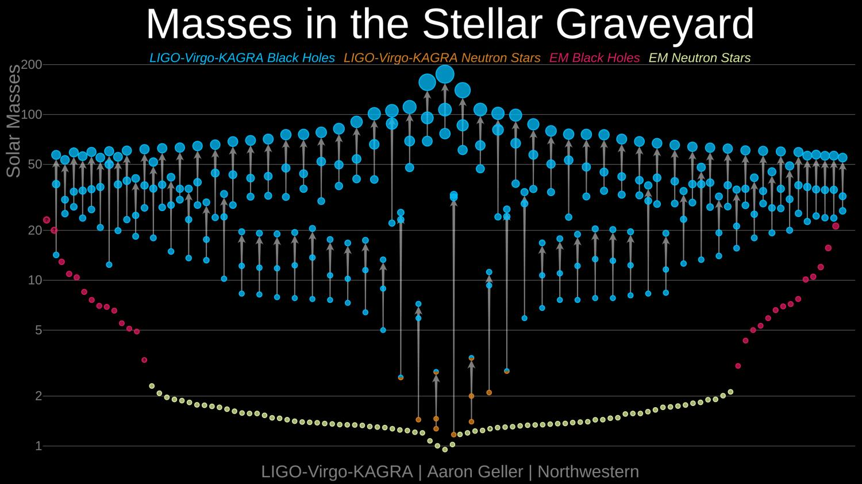
Establishment of gravitational wave astronomy

Slide 4
GW detector in space
Arm length: much longer than ground-based detectors (GBD).
Signal increases at low frequencies
－Longer interaction between GW and light
Noise decreases at low frequencies
－No seismic noise and less Newtonian noise
Sensitivity improves at low frequencies
Furthermore, expected GW signals larger

Slide 5
Laser Interferometer Space Antenna (LISA)
LISA project

Slide 6
What is DECIGO?
Deci-hertz Interferometer Gravitational Wave Observatory
Bridges the gap between LISA and GBDs
  Follow-up for LISA, Predictor for ground-based detectors
Low confusion noise -> Extremely high sensitivity
10⁻¹⁸
Moving above
LISA band
LISA
10⁻²⁰
Moving into
GBD band
Strain [Hz^{-1/2}]
GBDs
DECIGO
10⁻²²
Confusion limiting noise
10⁻²⁴
10⁻⁴
10⁻²
10⁰
10²
10⁴
  Seto, Kawamura, Nakamura, PRL, 2001
  Kawamura et al., PTEP 2021
Frequency [Hz]

Slide 7
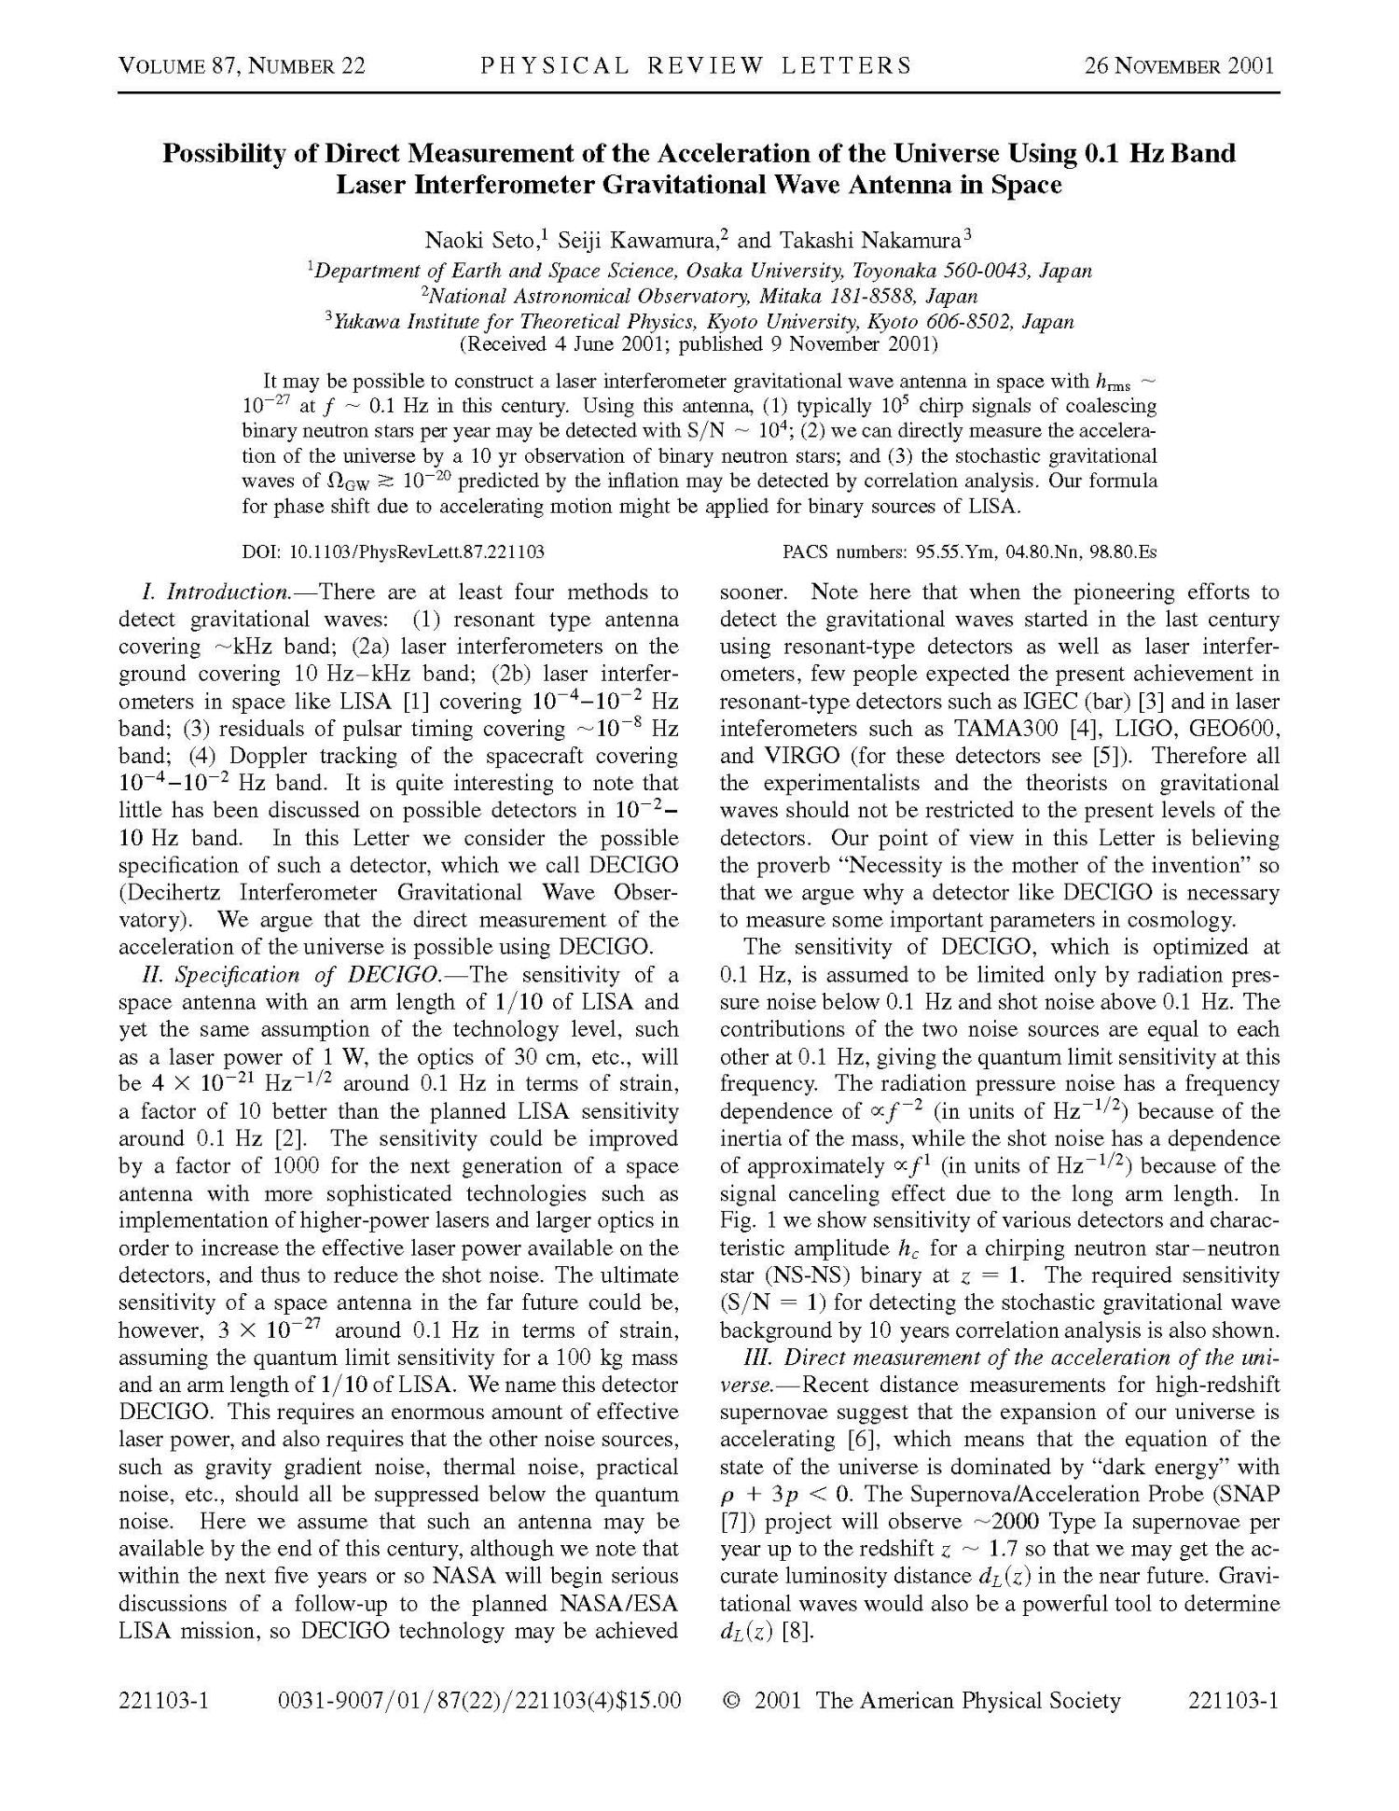

Slide 8
Pre-conceptual design
Mirror
d: 1 m
M: 100 kg
1,000 km
FP cavity
Thruster
Laser
P: 10 W
λ: 0.515 μm
Drag-free spacecraft

Slide 9
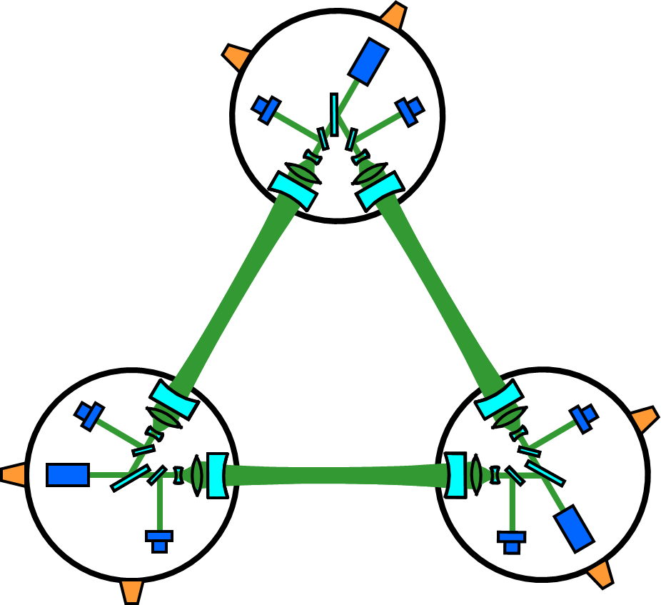
Orbit and constellation (preliminary)
Earth
Correlation for primordial GW
Record disk
Sun
Increase angular resolution

Slide 10
Target sensitivity and science
10⁻¹⁹
10⁻²⁰
10⁻²¹
10⁻²²
10⁻²³
10⁻²⁴
10⁻²⁵
10⁻²⁶
Intermediate-mass BH
PBH related
Dark Matter
(1000 M z=10)
BH-BH
Coalescence
  Saito, Yokoyama 2009, 2011
5 years
3 months
BH-NS
(10 M z=1)
1 cluster
General relativity
Prediction of BNS coalescence
Strain [Hz^{-1/2}]
NS-NS (z=1)
  Takahashi, Nakamura 2003
PGW (Ω_{GW}~2×10⁻¹⁵)
  Yagi, Tanaka 2010
PGW (Ω_{GW}~1×10⁻¹⁶)
Correlation
(3 years)
Acceleration of expansion of Universe
Primordial GW
10⁻³ 10⁻² 10⁻¹ 1 10 10² 10³
  Design parameters:
  under optimization for PGW
Frequency [Hz]
  Seto, Kawamura, Nakamura 2001

Slide 11
Primordial GW
Direct observation of primordial GWs from inflation
  Whether Inflation really happened?
  Which inflation model is correct?
  Parity violation?（Clockwise and counterclockwise GW）
    Seto 2007
  Separation of Tensor, Vector, scalar mode
    Nishizawa, Taruya, Kawamura 2010

Slide 12
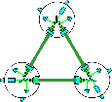
Acceleration of Expansion of the Universe
Expansion
＋Acceleration
DECIGO
GW
NS-NS (z～1)
Output
GW (No Acceleration)
Strain
GW (with Acceleration)
Phase Delay～1sec (10 years)
Time
Seto, Kawamura, Nakamura, PRL 87, 221103 (2001)

Slide 13
DECIGO and gamma-ray burst (GRB)
Prediction of NS-NS coalescence
  z<5; 5 years before coalescence
  Expected event rate: 10⁶ /year (300 /day)
  Angular accuracy：1 arcsec
Assuming short GRB comes from NS-NS coalescence
  Assuming 1/30 of short GRB can be detected (beaming effect)
  Expected event rate: 10 /day
Frequent and detailed observation of GRB by electro-magnetic waves

Slide 14
Gravitational waves as a probe of extended scalar sectors
GW expected from strongly first order phase transition at the electroweak symmetry breaking
α: related to amplitude of GW
β: related to peak frequency
N: Number of additional scalar fields
m_{s}: Mass of scalar field
1/Phase transition time
Kakizaki, Kanemura, Matsui, PRD 92 (2015) 115007; modified by Kanemura
Latent heat

Slide 15
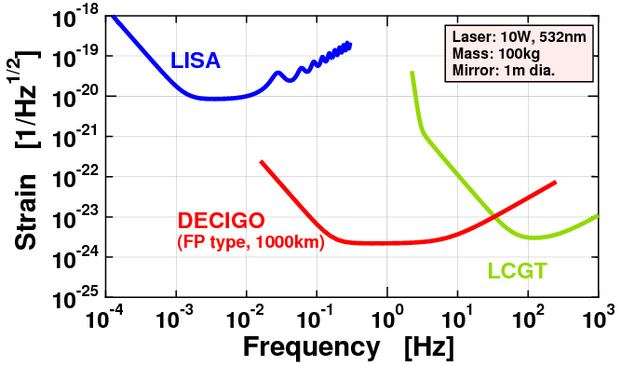
Requirements
Force noise: 25 times more stringent than LISA
  Comparable in terms of strain; distance: 1/2500, mirror mass: 100
Sensor noise: 30 times looser than KAGRA
  Comparable in terms of strain; storage time: 30
KAGRA

Slide 16
Update of PGW
10⁻¹⁹
10⁻²⁰
10⁻²¹
10⁻²²
10⁻²³
10⁻²⁴
10⁻²⁵
10⁻²⁶
The upper limit of PGW has been reduced by the Planck observations.
The target sensitivity of DECIGO should be improved to enhance the possibility of detection of PGW.
1 cluster
Strain [Hz^{-1/2}]
PGW (Ω_{GW}~2×10⁻¹⁵)
PGW (Ω_{GW}~1×10⁻¹⁶)
Correlation
(3 years)
10⁻³ 10⁻² 10⁻¹ 1 10 10² 10³
Frequency [Hz]

Slide 17
Procedure of update of design
Step 1
  Optimization considering only quantum noise
Step 2
  Optimization including other noise sources
    Thermal noise
    Confusion limiting noise by GWs from double white dwarf (DWD) binaries
Step 3
  Optimization considering practical constraints

Slide 18

Step 1: Optimization with quantum noise
Constant mirror mass is assumed
The following parameters are optimized for the best SNR for a given mirror radius
  Cavity length
  Reflectivity of mirror
  Laser power (up to 100 W)
Considering only quantum noise
$$SNR= \frac{3{H_{0}}^{2}}{10π^{2}}\sqrt{T}{\left[\int_{0.1}^{1}{\frac{2γ^{2}\left(f\right)Ω_{gw}^{2}\left(f\right)}{f^{6}P_{1}\left(f\right)P_{2}\left(f\right)}df}\right]}^{1/2}$$
Iwaguchi, et al., Galaxies 9 (2021) 9010009
Ishikawa, et al., Galaxies 9 (2021) 9010014

Slide 19
Step 2: Optimization with thermal noise and DWD noise
Design parameters
For a given radius,
optimize the other parameters
Parameter | Range
Mirror radius | 0～1 m
reflectivity | 0～1
Laser power | 0～100 W
Arm length | No limit
Values/type for each model: 2³ in total
Parameter | Value
Cut-off frequency | 0.07 Hz / 0.1 Hz
Pressure inside spacecraft | 10⁻⁸ Pa / 10⁻⁹ Pa
Mirror model | Constant mass (100 kg) / Constant thickness (0.5 m, 100 kg)

Slide 20
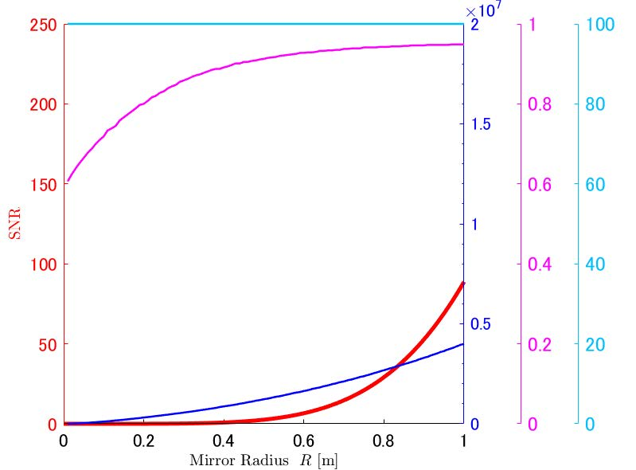
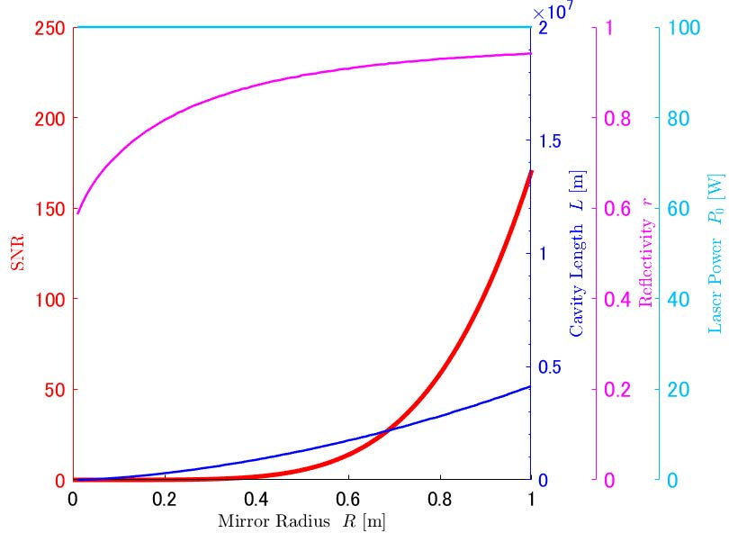
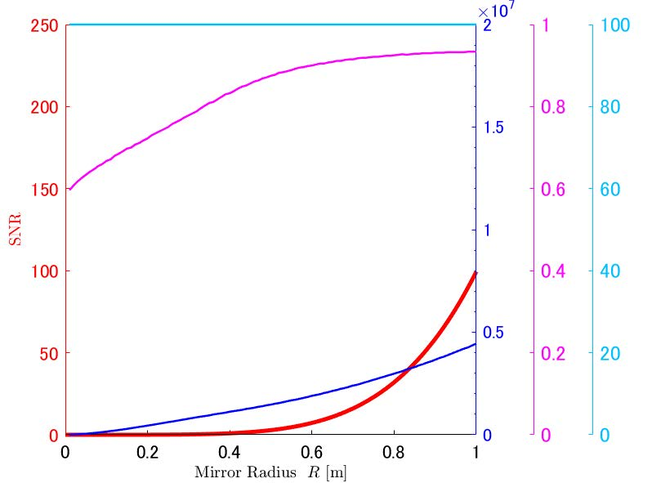
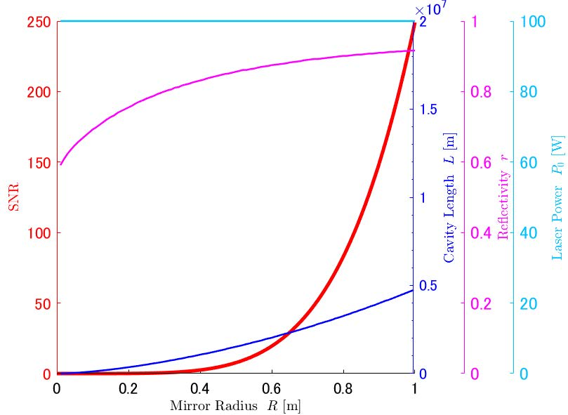
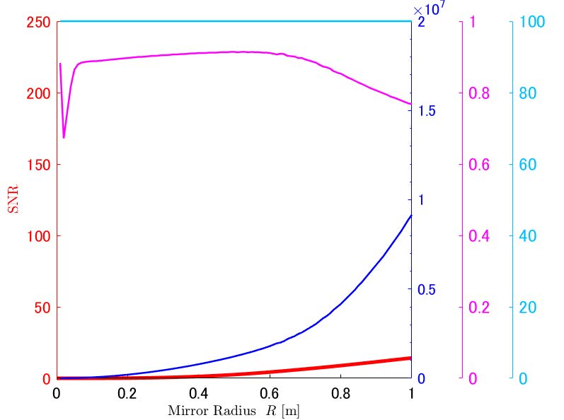
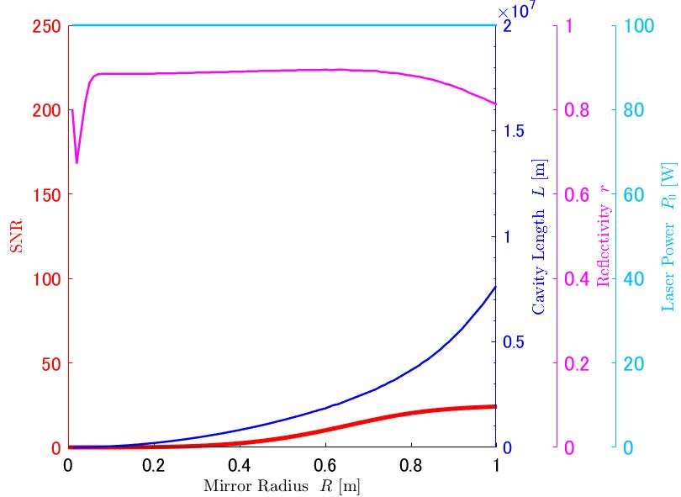
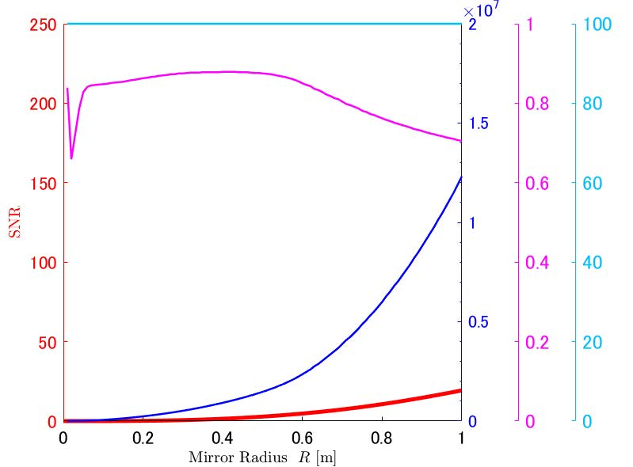
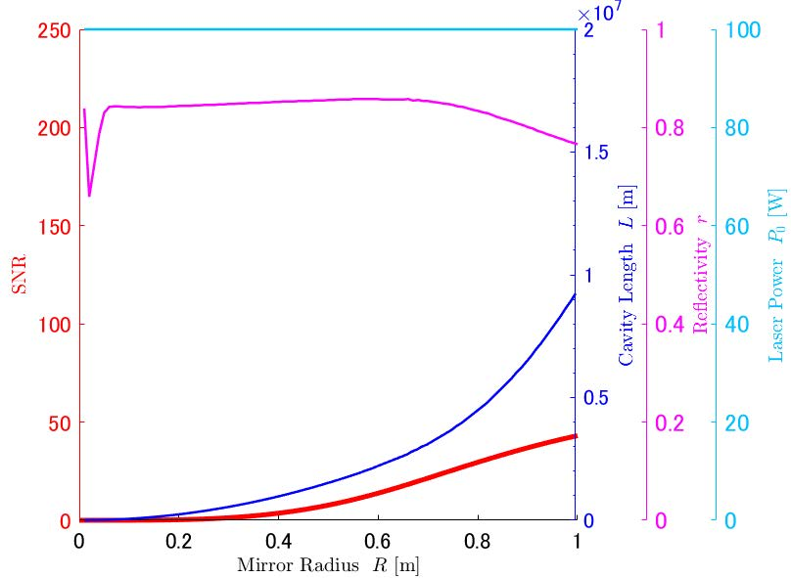
Results
10⁻⁸ Pa
10⁻⁹ Pa
10⁻⁸ Pa
10⁻⁹ Pa
Constant thickness
Cut-off frequency: 0.1Hz Cut-off frequency: 0.07Hz
Constant mass
Kawasaki, et al., Galaxies 10 (2022) 10010025

Slide 21
Step 3: Optimization with practical constraints
A dedicated team of experts inside the DECIGO working group is now being convened.
The team will soon start the final optimization, using the framework that was created in step 2.

Slide 22
B-DECIGO: scientific pathfinder
Orbit: TBD
(Heliocentric orbit)
# of clusters: 1 (4)
Aim to launch in 2034
Mirror
d: 0.3 m (1 m)
M: 30 kg (100 kg)
100 km
(1,000 km)
FP cavity
* (for DECIGO)
Thruster
Laser
P: 1 W (10 W)
λ: 0.515 μm
Drag-free spacecraft

Slide 23
B-DECIGO: Target sensitivity and objectives
10⁻¹⁹
10⁻²⁰
10⁻²¹
10⁻²²
10⁻²³
10⁻²⁴
10⁻²⁵
10⁻²⁶
Observation of NS-NS (BH) binary
  Prediction of timing of NS-NS (BH) coalescence
  100 /year
Revelation of origin of ~30 M BBH (Nakamura+ 2016)
Much better parameter estimation of binaries
(Isoyama+ 2018)
Removal of foreground for DECIGO
Verification of technologies for DECIGO
PBH related
(1000 M z=10)
BH-BH
Coalescence
BH-NS
(10 M z=1)
1 cluster
Strain [Hz^{-1/2}]
5 years
3 months
PGW (Ω_{GW}~1×10⁻¹⁶)
NS-NS
(z=1)
Coalescence
10⁻³ 10⁻² 10⁻¹ 1 10 10² 10³
Frequency [Hz]

Slide 24
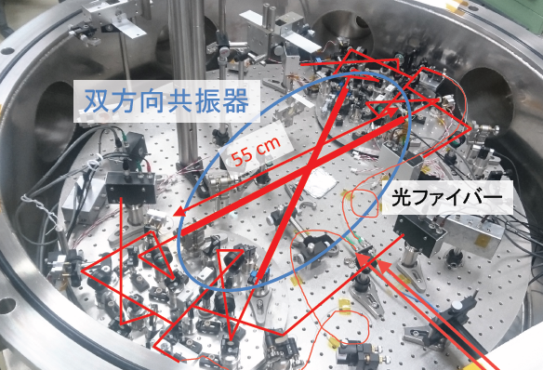
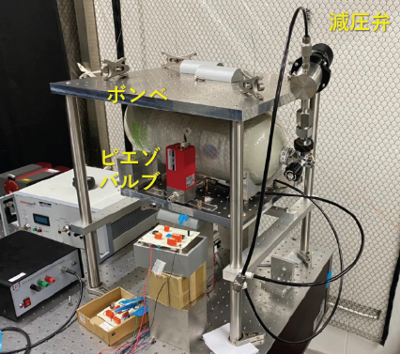
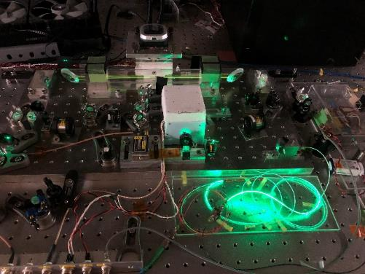
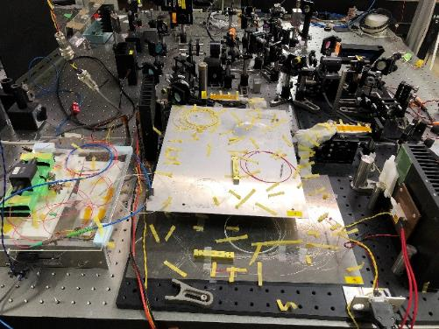
Progress on technologies for B-DECIGO
Bi-directional interferometer Low-noise thruster
High-power stabilized laser

Slide 25
Related mission: SILVIA
Space Interferometer Laboratory Voyaging towards Innovative Applications
Small satellite mission by formation flight official WG at ISAS/JAXA in collaboration with DECIGO team and infrared interferometer team (and possibly X-ray interferometer team)
Objectives and scope
  Demonstration of the formation flying technologies
Recent progress
  Feb. 2020: SILVIA mission proposed to ISAS
  Aug. 2020: Approved to proceed to Pre-Phase A1b (Idea implementation process)
  Only SILVIA selected among seven missions that applied
Next step
  Review to judge for Pre-phase A2 (Mission definition)
  If approved, will become a candidate mission for the 5th or 6th small satellite mission

Slide 26
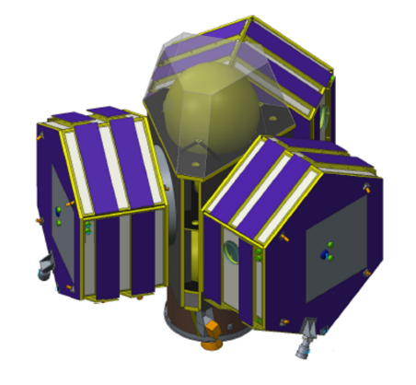
Summary
Image of
B-DECIGO
©NEC
DECIGO will accomplish a variety of amazing science including direct observation of primordial GW to reveal the secret of the birth of the Universe.
B-DECIGO will verify technologies for DECIGO as well as accomplish a variety of fruitful science including prediction of NS-NS coalescence to reveal its mechanism.
SILVIA will establish the essential technologies for B-DECIGO and DECIGO.

