Slide 1
RFQ3 beam dynamics design
Questions
Alessandra Lombardi
6/5/2021
Skip to slide 7 for update 15/7/2021
Skip to slide 13 for update 14/10/2021
Skip to slide 23 for update 4/11/2021
Skip to slide 25 for update 27/01/2022

Slide 2
Some improvements that will try
Smoother rms :
  to ease the matching from the LEBT
  to aloow for more space between the last solenoid and the rfq
Output rms :
  to simmetrise the beam before exiting the RFQ
  Entails readjustment of the MEBT

Slide 3
Source
Forget about the 80mA, lets fix 50mA peak current?
Extraction energy : lower / higher : what is the acceptable range

Slide 4
Transverse acceptance
Higher acceptance? Is this a good idea? We need to consider the next bottleneck in the linac/PSB transfer
95% transmission ?

Slide 5
Maximum electric field on the vanetip
This is an input to the beam dynamics design currently 33MV/m
What shall we take?
Constant along the vanes or concentrated in one point?
Shall we avoid max efield in loss area? Is there a correlation?

Slide 6
Meeting 1 -6/5/2021
Summary:
  Ok for 50 mA as limit
  No particular feedback on input energy
  No more than 35MV/m

Slide 7
RFQ3 beam dynamics design
Update and first draft
Alessandra Lombardi
15/7/2021
File in directory D:\352RFQreprise2021\designthecapturefirst

Slide 8
Fixed parameters :
  35MV/m max field on vanetip
  Current 60mA and emit=0.4 rms norm mm mrad
  Energy from 35 to 55 kV
  Rho/ro = 0.75 no room to furthere reduce Emax-what I quote in the next slides is already minimized
Divide capture and acceleration-design capture choose together and then optimize acceleration that goes with it
LINAC4 present RFQ:
  Designed for 80mA , 0.25 mm mrad T=93%
  Capture 45keV to 400KeV length =118cm + 182 cm acceleration
  V=78KV, emax 35 MV/m
  At the time of design we were not considering emittances bigger than 0.25 mm mrad, we had the acceptance =1.5 emittance that is 0.375 mm mrad

Slide 9
Version 1- 35keV
First design the capture (to about 0.4 MeV) then worry about acceleration to the final energy
Start at 35keV to 400kV
V kV Emax MV/m | Min a // B | L | T (%) 60mA 0.4mmmrad | T (%) 60 mA 0.3 mm mard | filename
75 | 1.9// 6.11 | 76cm | 84% | 87% | RFQ1.in
75 //33MV/m | 2.1 // 5.99 | 80cm | 81% | 85% | RFQ2.in | Parametric res see losses and phase ramps
70/29MV/m
Losses correspond to too fast phase ramp - smooth the phase from 30 to 40

Slide 10
Version 2
Higher long emittance but we have margin in the DTL
Increase the energy
Start at 58keV
Bunch and capture to 350keV
V Emax | Min a // B | L | T 60mA 0.4mmmrad | T 60 mA 0.3 mm mard | filename
70//29 MV/m | 2.3//5.7 | 98cm | 93% | 96% | RFQ3.in | Higher long emittance but we have margin in the DTL
75 |  |  |  |  | RFQ4.in

Slide 11
Version 3
This is similar to the existing linac4 RFQ with a tradeoff between transverse acceptance and longitudinal emittance delivered to the DTL and a lower voltage
Stay at 45 kev
Bunching to 350 keV
V Emax | Min a // B | L | T 60mA 0.4mmmrad | T 60 mA 0.3 mm mard | filename
70//29 | 2.3 //5.7 | 171 cm | 96% | 97% | RFQ5.in
75//29?? | // 5.1 | 120 | 88% | 91.% | RFQ6.in

Slide 12
Next steps
Accelerate to 3 MeV (forego exact length of 3 m for the moment)
Track into and through the DTL
Emittance measurement at the new source at 35 and 45 keV
Track particles from measurements
Check point with this group beginning September 2
Switch to sinusoidal
Track with higher than nominal voltage

Slide 13
RFQ3 beam dynamics design
Update
Alessandra Lombardi
14/10/2021

Slide 14
Bring to the final energy after efficient capture-continue what presented in July
RFQ7.in

Slide 15
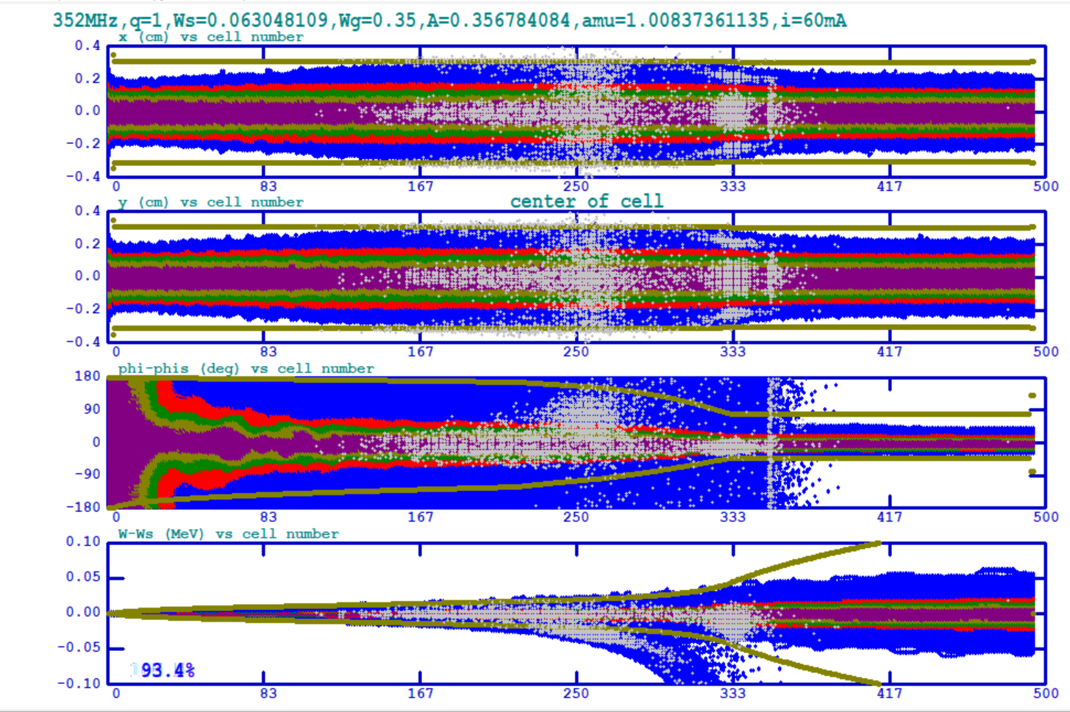
V=70kV
Emax= 29 MV/m
L=5.6 m
I =70mA
Emit=0.4 mm mrad
redo
soft and safe but 5.5 m long (can be optimised but 5 m absolute minimum)

Slide 16
Take another approach
LINAC4 RFQ
  78 kV nominal Voltage / 35MV/m maximum field
  Bfactor=5.585 , min aperture = 1.77
  Transmission
    93% 70mA emit=0.25 mm mrad
    80% 70mA emit=0.5 mm mrad
Higher voltage : V=85 kV but keep Emax=35MV/m
Lets aim at increasing min aperture but keep B factor
Lets design for I=70mA and emit=0.5 pi mm mrad aiming at T>90%

Slide 17
Iteration 1 – keep length and max field
V (kV) | E_max | L cm | B | Min a (mm) | T (70mA , E=0.25) | T (70mA , E=0.5) | Filename
81 | 34 | 300 |  | 1.85 | 94% | 83%
85 | 35 | 300 | 5.4 | 1.92 | 95% | 85%
85 | 35 | 300 | 5.7 | 1.94 |  | 80%
85 | 35 | 300 | 5.8 | 1.89 |  | 87%
85 | 35 | 300 | 5.9 | 1.87 |  | 88.5%
85 | 35 | 300 | 6.0 | 1.86 | 95.4% | 89% | RFQ9.IN
Remnant losses are due to the fact that we keep the length and the modulation in the final part is too high

Slide 18
Iteration 2 – reduce final modulation and allow length above 3 m
B | Final m | L | T (70mA , E=0.25) | T (70mA , E=0.5)
6 | 2.1 | 301 |  | 90%
6 | 1.9 | 310 |  | 90.4% |  | RFQ10.IN
6 | 1.82 | 325 | 96.7% | 91.6% |  | RFQ11.IN
6 | 1.72 | 342 | 96.9% | 92.3% |  | RFQ12.IN
6 | 1.72 | 343 | 96.9 | 93.6 |  | RFQ13.in matching and longer rms
We are left with 3% longitudinal losses and 3 % transverse losses

Slide 19
Evolution from iteration 1 to iteration 2

Slide 20
Evolution from iteration 1 to iteration 2

Slide 21
Details of the last iteration
Ro=0.3306 cm
For rho/ro=0.75 , rho=0.2479 cm Emax = 34.25 MV/m
For rho/ro=0.85 , rho=0.2810 cm Emax = 35MV/m
LINAC4 RO=0.3256 ;rho=0.2768 cm

Slide 22
Summary
 | V (kV) | L (cm) | Emax (MV/m) | T (70mA, 0.5mm mrad) | Power
LINAC4 | 78 | 300 | 35 | 80%
Redesign 1 (conservative field) | 70 | 550 | 29 | 94 | +34%
Redesign 2 | 85 | 343 | 35 | 94 | +20%
Next steps :
concentrate on redesign 2 for further optimisation (1month)
Start RF design by end of October (fix Ro, rho and length)
try more radical approach ( 2 RFQs ….)

Slide 23
RFQ3 beam dynamics design
Update
Alessandra Lombardi
4/11/2021

Slide 24
Fix parameters for RF design
R0=0.33 cm
Rho=0.28 cm
L=352 cm
V=85 kV
Sinusoisal modulation profile
Give most critical cell (higher Efield) – max efield along the vanes
Questions :
One or 2 rf tanks?

Slide 25
RFQ3 beam dynamics design
Update
Alessandra Lombardi (soon to be joined by S. Kumar)
27/01/2021

Slide 26
Since the last time we met formally
R0=0.33 cm
Rho=0.28 cm
L=345 cm
V=85 kV
All the above constant
Just relatively small changes to the geometry
Few exchanges with Alexej/Hermann on geometry
  Sinusoidal vs 2TERM potential
  Ending of the RFQ electrodes and radius of curvature
Set up a cern box with reference files :
Created a 3d field map for accurate tracking including vane profile

Slide 27
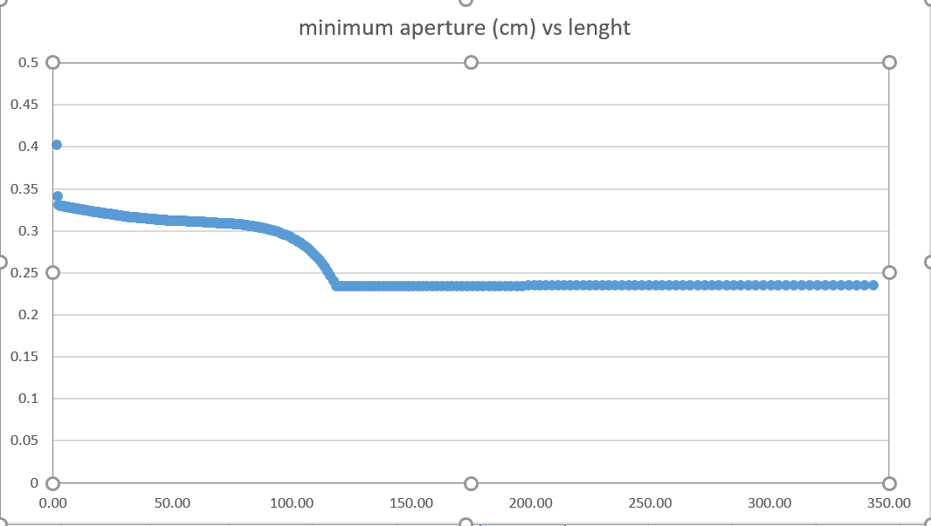
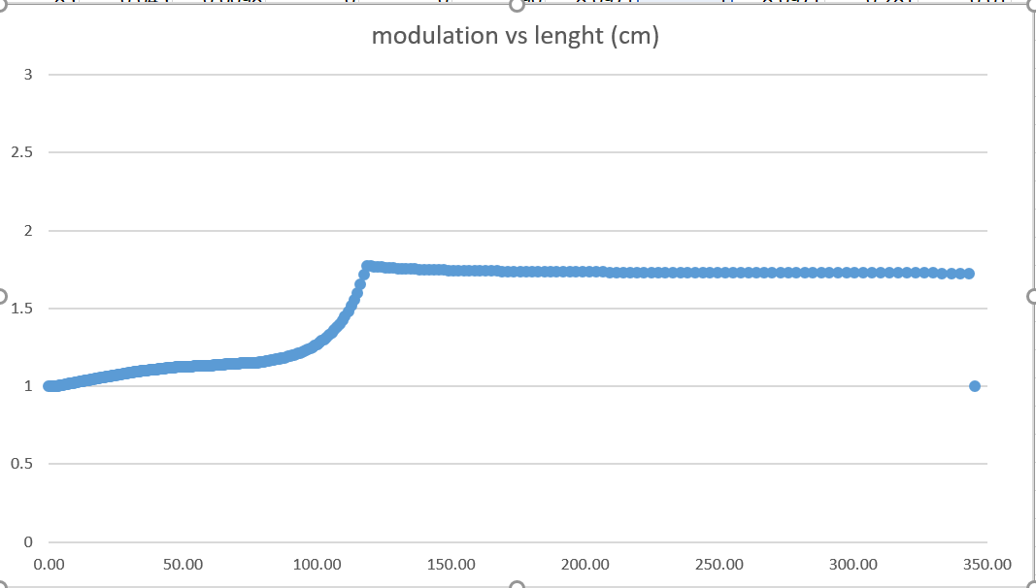
Final-draft geometry : minimum aperture and modulation
Guideline design principle (wrt RFQ1):
-easy on the modulation and bigger aperture
-higher vane voltage , same surface field, longer RFQ
resulting in
more transverse focusing i.e. higher transverse acceptance
For reference min aperture RFQ1 is 0.18

Slide 28
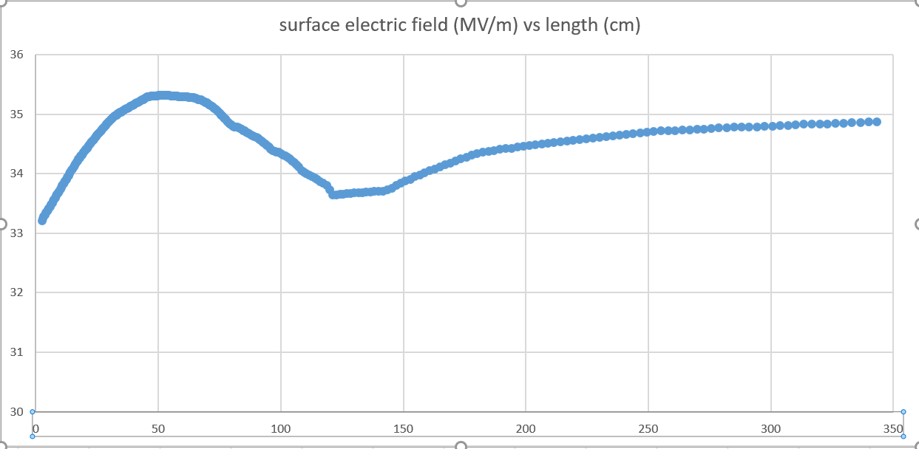
Final-draft geometry : max electric field

Slide 29
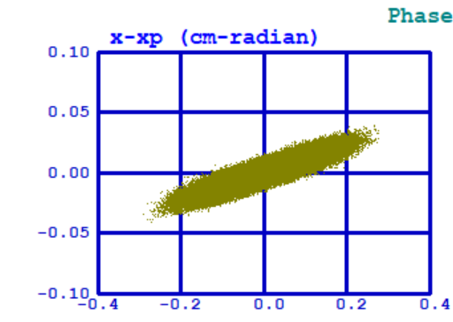
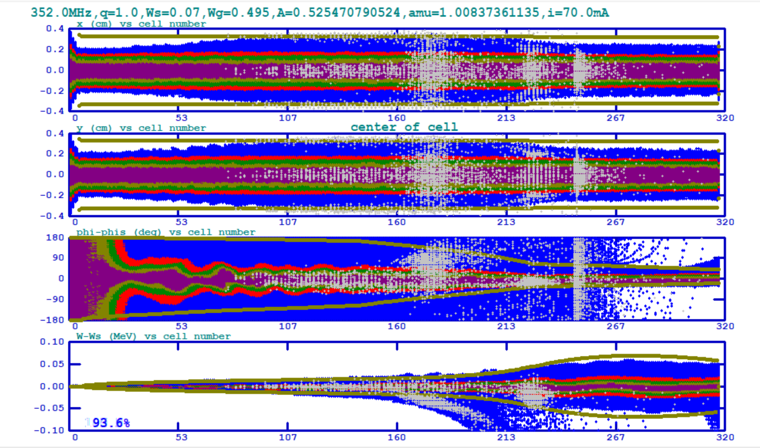
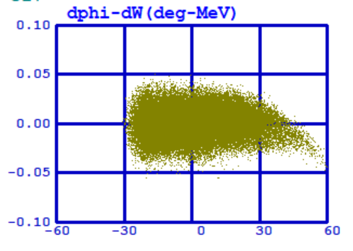
Beam dynamics – 70mA emit =0.5mm mrad
Transverse (x, y top) and longitudinal planes (phase, energy spread) along the RFQ
Beam at the RFQ output plane

Slide 30
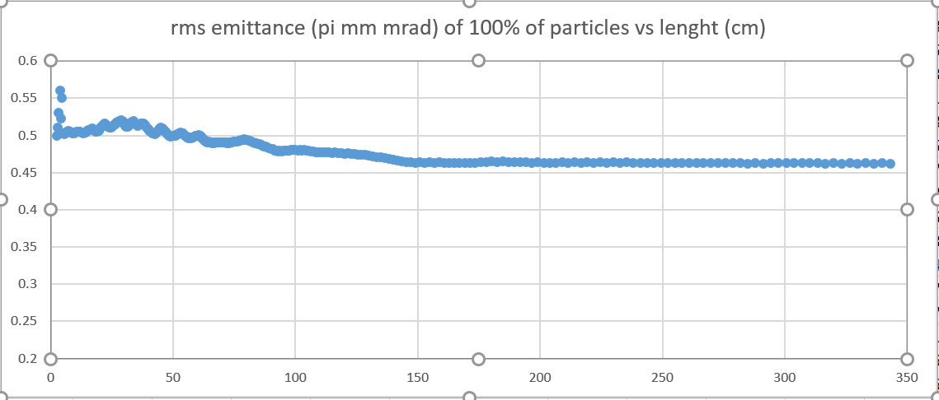
Emittance along the RFQ (70mA , 0.5 mm mrad)

Slide 31
Next steps
Generate field map for the latest version and run with the particle distribution measured at the test stand
Error studies (I do not expect big difference with RFQ1)
  field flatness - tuning
  field jitter – klystron regulation
  Alignment between sections
  Machining accuracy needed

