Slide 1
Update on rf design of Linac4-RFQ3, estimate of mode spectrum
Hermann Pommerenke (SY-RF-MKS)
27 Jan 2022

Slide 2
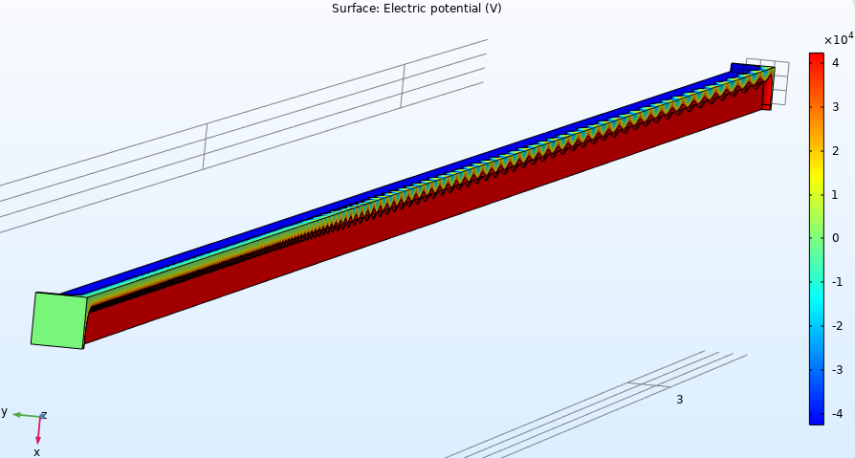
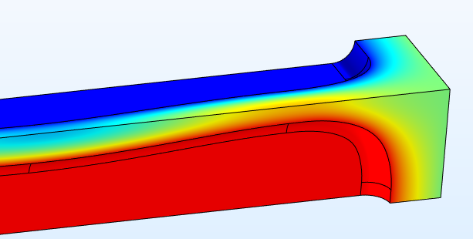
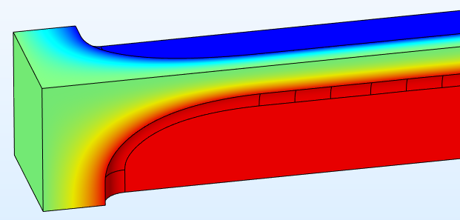
(Quasi)electrostatic simulation of vane
COMSOL electrostatic solver
produces a 3D fieldmap for V₀ = const.
could use this for tracking (RF-Track…) to confirm beam dynamics design

Slide 3
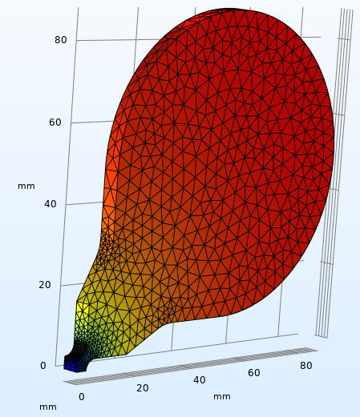
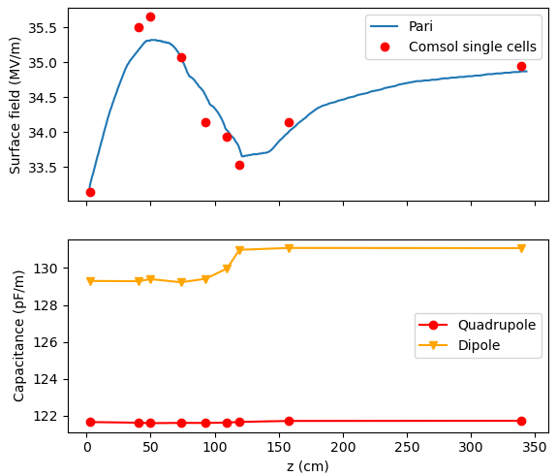
rf simulation of individual cells / E_{s,max}
COMSOL electromagnetic eigenmode solver
confirm maximum surface field values given by PARI → very good agreement!
gives Q-factor, quadrupole/dipole capacitance → spectrum & power

Slide 4
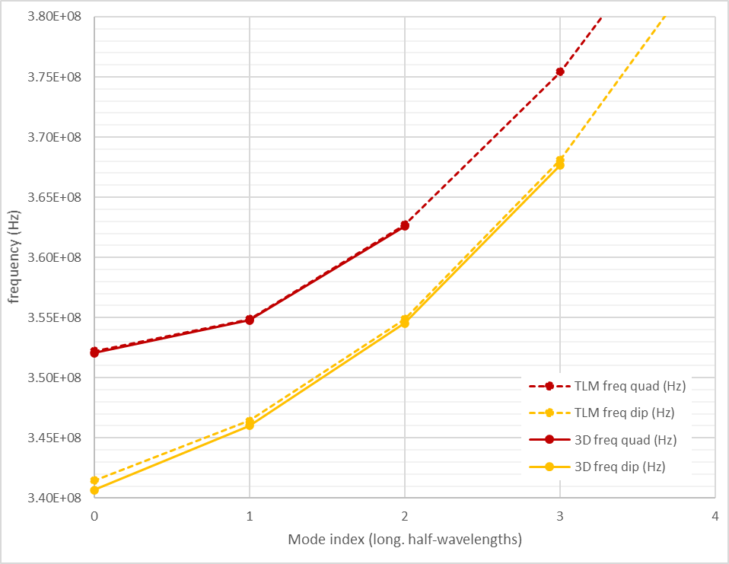
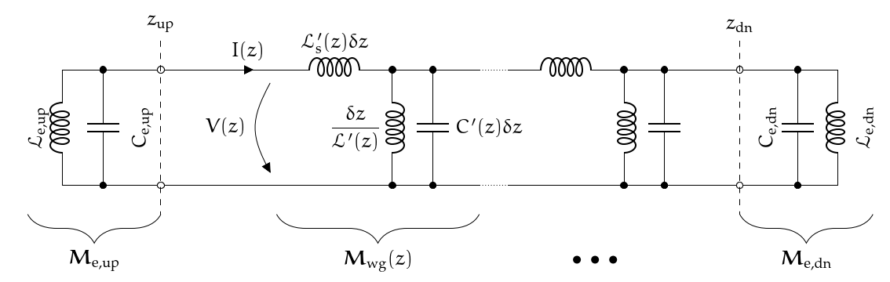
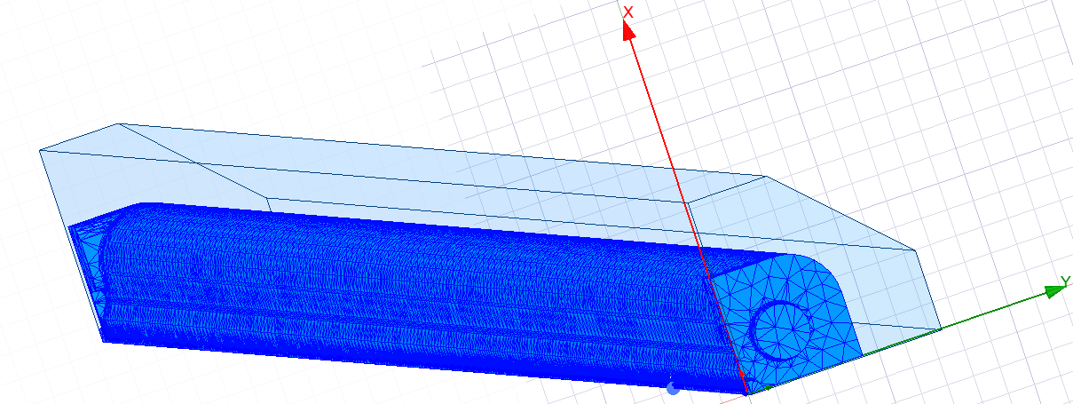
RFQ spectrum
preliminary 3D design of RFQ ends required
Transmission line model (TLM) for rapid estimate, full 3D simulation to validate spectrum
margins for current vane design: Quad: 2.7 MHz, Dip: 2.5 MHz
closest quadrupole
(+ 2.7 MHz)
operating mode
closest dipole, most dangerous
(+ 2.5 MHz)

Slide 5
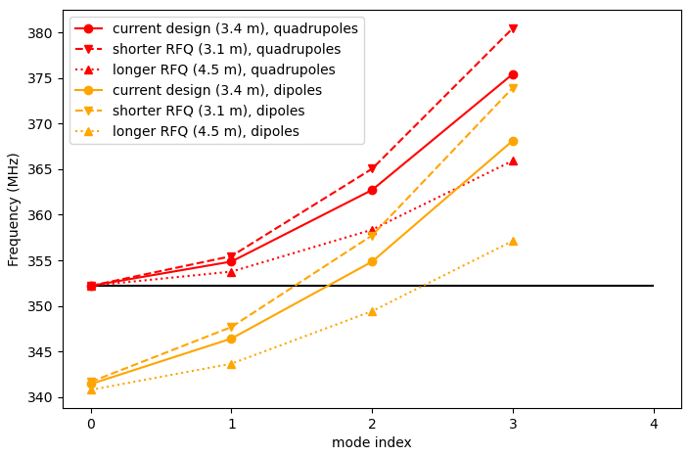
Mode detuning by length adjustment
various techniques exist to move (dipole) modes; e.g., RFQ1/2 use dipole rods
we can move higher-order modes by changing total RFQ length, without additional features
assuming everything else (especially r₀ and ϱ, i.e. capacitance) stays the same:
  shorter RFQ: 3.1 m (- 9 %, 9 cells*)
  longer RFQ: > 4.5 m (+ 30 %, 33 cells*)
*length of the last 3 MeV cell: 3.3 cm

