Slide 1
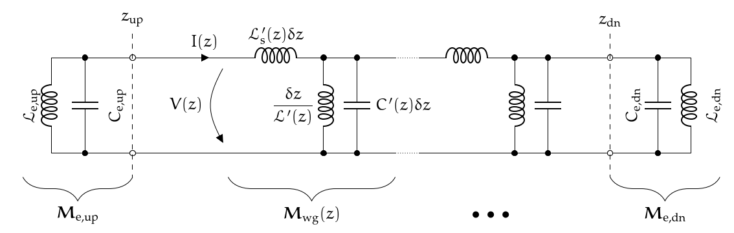
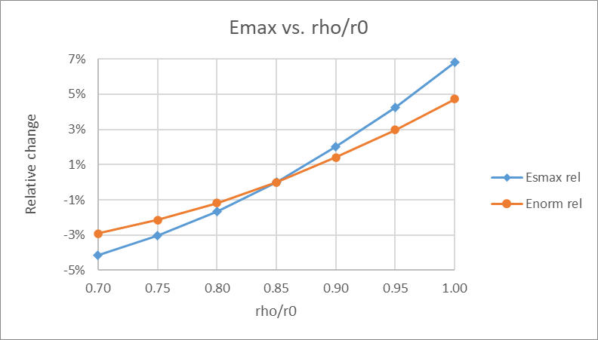
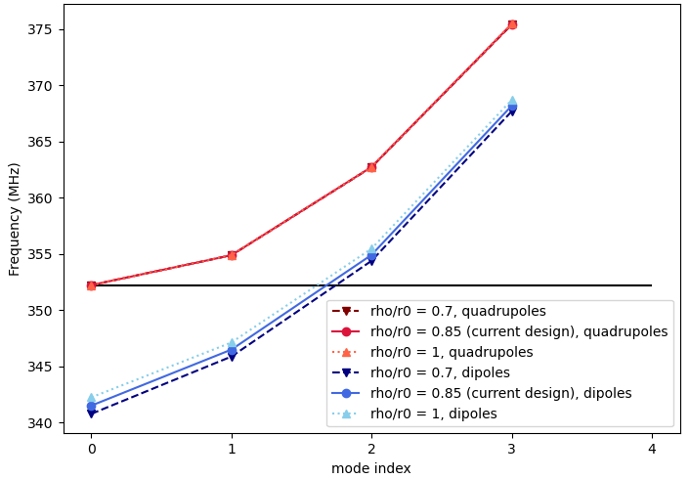
Mode detuning, Emax with ϱ/r₀
Improvement is marginal: with 0.7 < ϱ/r₀ < 1.0 we can move critical dipole HOM by only +/- 0.5 MHz
ϱ/r0 has strong effect on maximum surface field! (larger ϱ/r0, larger field)
relative change wrt. ϱ/r0 in 2D cross-section
gap scaling: $E_{norm}=E_{s}^{p}V_{0}^{1−p}⋅\frac{d_{DC}^{p}}{V_{DC}}$

Slide 2
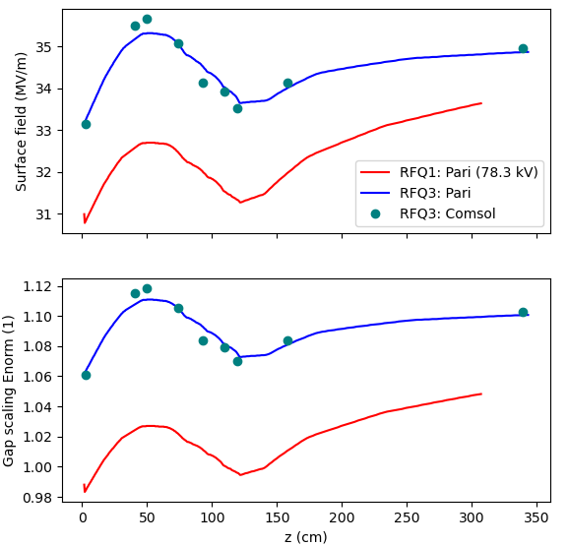
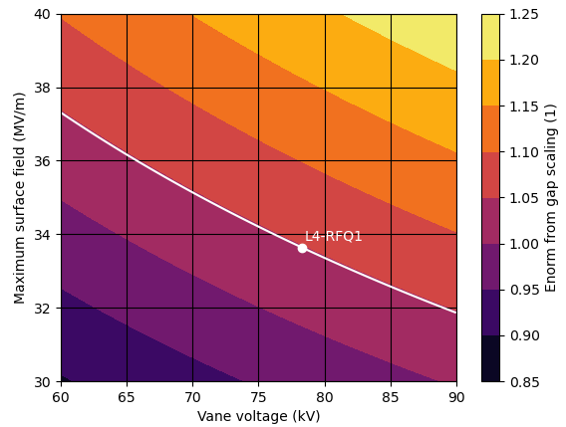

E_{s}/gap scaling in RFQ1 and RFQ3
$$E_{norm}=\frac{V_{0}}{V_{DC}}⋅{\left(\frac{d_{DC}}{d}\right)}^{p}=E_{s}^{p}V_{0}^{1−p}⋅\frac{d_{DC}^{p}}{V_{DC}}$$
where V₀ = vane voltage, V_{DC} = 7747 V,
d_{DC} = 100 um, p = 0.72,
E_{s} = maximum surface field, d = V₀/E_{s}
Gap scaling normalized E-field calculation for RFQ:
values in current 3D vane design
illustration of gap scaling
safer if we stay below the RFQ1-line

