Slide 1
Analysis of simulations and measurements to predict the magnetic field for the operation of accelerator magnets
TE – MSC Seminar, 9 December 2021

Slide 2
Outline
Introduction
  Electromagnetic simulations
  Magnetic measurements
  FiDeL model
  Limitations of the existing tools
Proposed approach
  “PyMagAnalysis”
    Examples: ROXIE, Measurement, FiDeL inputs
    Updates of the numerical models
    Design of the experimental cycles
Case study
  Luminosity calibrations for ATLAS experiment
Summary

Slide 3
Introduction

Slide 4
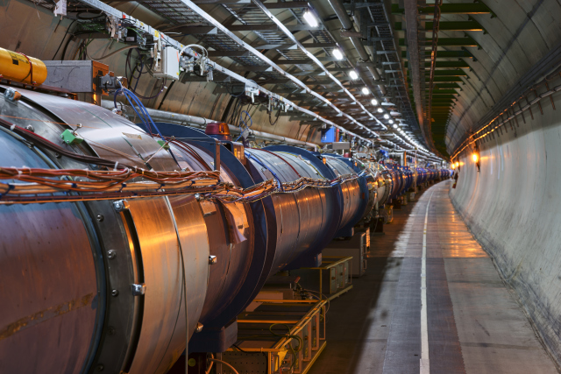

Motivation
How to study the behavior of the magnet?
Numerical
simulations
Magnetic
measurements
For a superconducting accelerator magnet, a suitable magnetic model must be developed in order to know how to use the magnet in the operation.

Slide 5
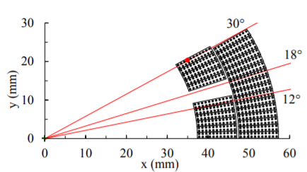
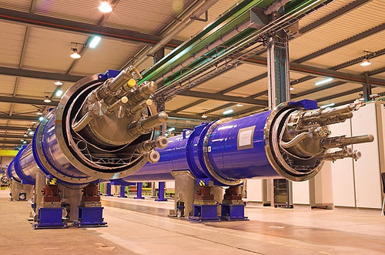

Long path ahead
How to study the behavior of the magnet?
Design phase
(selection of materials,
geometry, parameters)
Prototyping
(acceptance tests, feedback to the
design engineer)
Interventions throughout the lifetime
(repairs, using magnet differently then originally intended)
Final model for the operation
Scaled-down models (validation of the design choices)
Series production
(detailed magnetic
characterization)
→ Long chain of validations between simulations and measurements.

Slide 6
Electromagnetic simulations
Advantages:
  Various predictions with no need of building a real device
  Relatively quick
  Inexpensive in comparison with measurements
Limitations:
  Coupling phenomena (magnetic, thermal, mechanical)
  Discretization errors (meshing of FEM elements)
  Numerical sub-models (persistent current modelling)
  Geometry of components
  2D/3D effects
  Uncertainties on material properties:
    Jc-critical current density fit formula and parametrization
    Permeability (saturation)

Slide 7
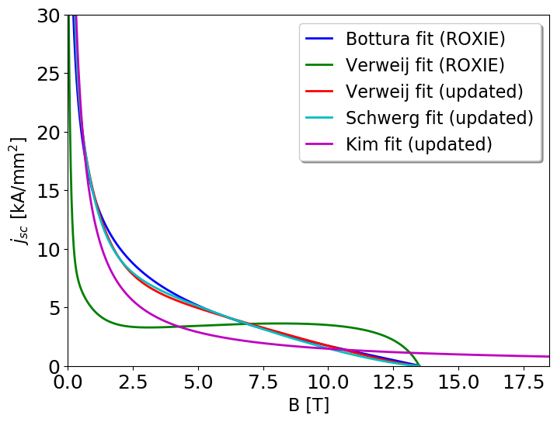

Example: $J_{c}$- fit formula
Selection of the critical current density fit function may impact the results, especially at low field due to persistent currents.
In ROXIE, there is a link to the bibliography with different fit formulas. Unfortunately, some of the references include outdated fitting parameters. In addition, the fitting formulas are implemented in such a way, that they have inconsistent units.
Reverse Engineering:
Analysis of the implementation of the fit functions.
Change of the Jc-fit parametrization
using up-to-date sources.
Nb-Ti @1.9K
Comparison of different Jc-fit functions for Nb-Ti with the fitting parameters from the original ROXIE bibliography or updated.
→ Developed SWAN repository with different fit functions.

Slide 8
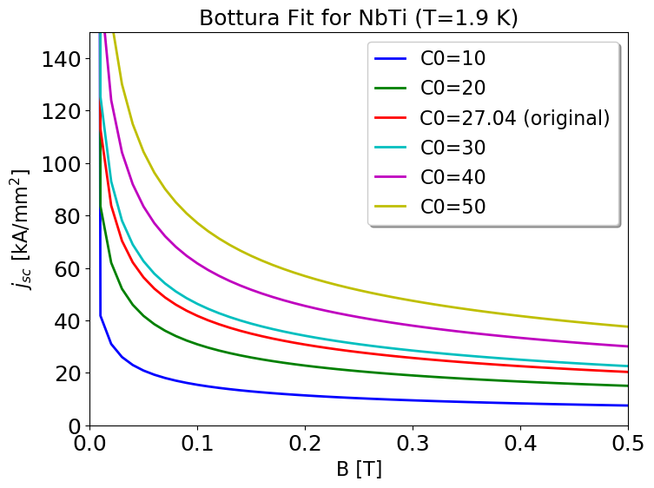
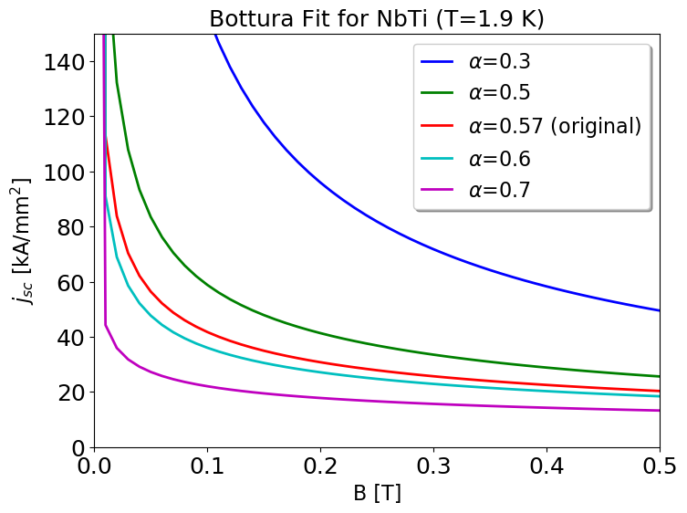
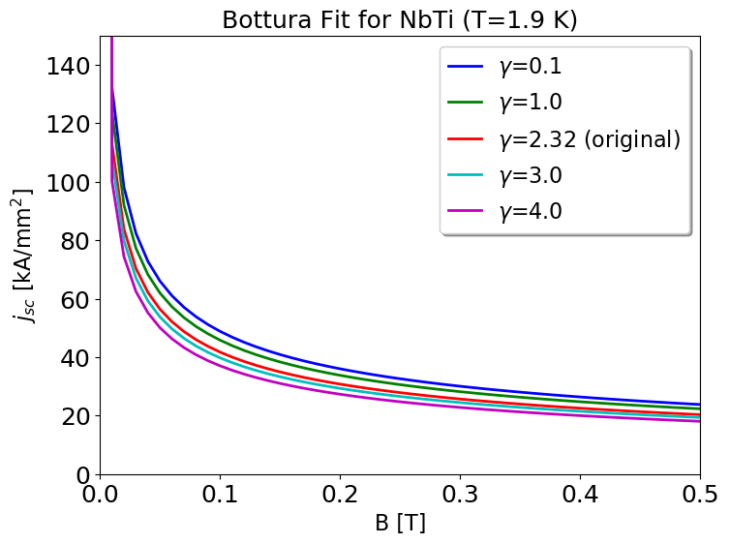
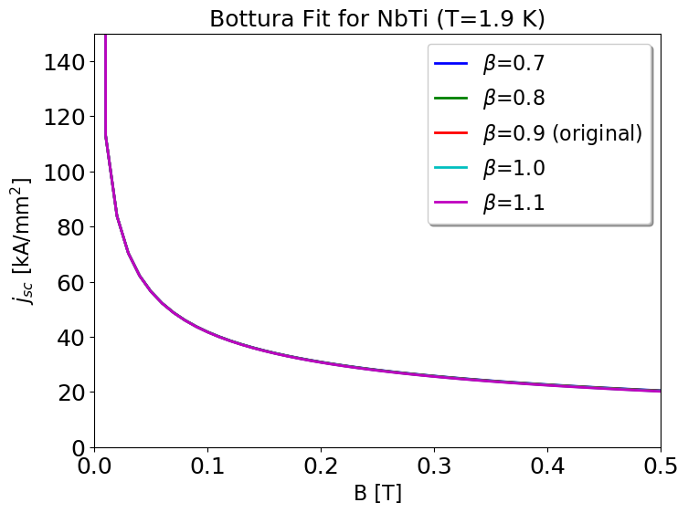

Example: $J_{c}$- parametrization
→ Sensitivity analysis to different fitting parameters is important.

Slide 9
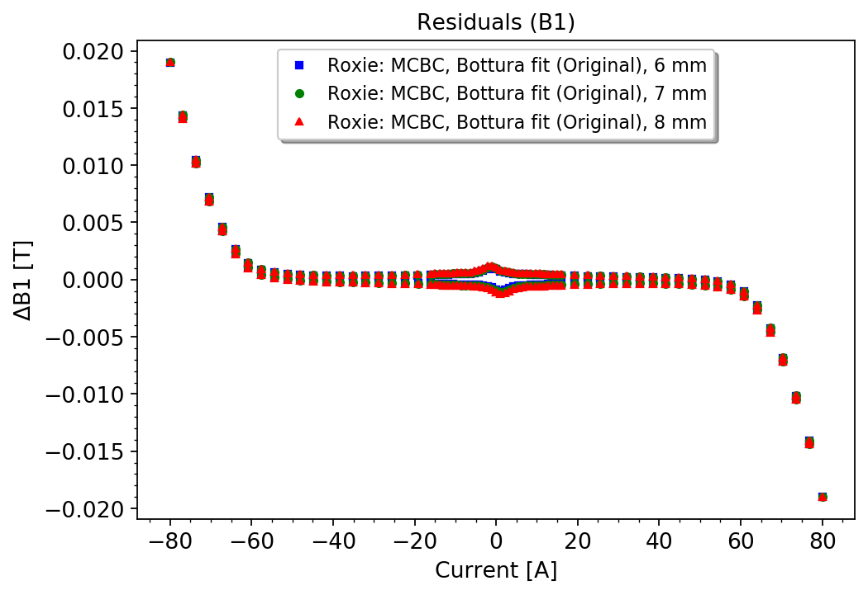
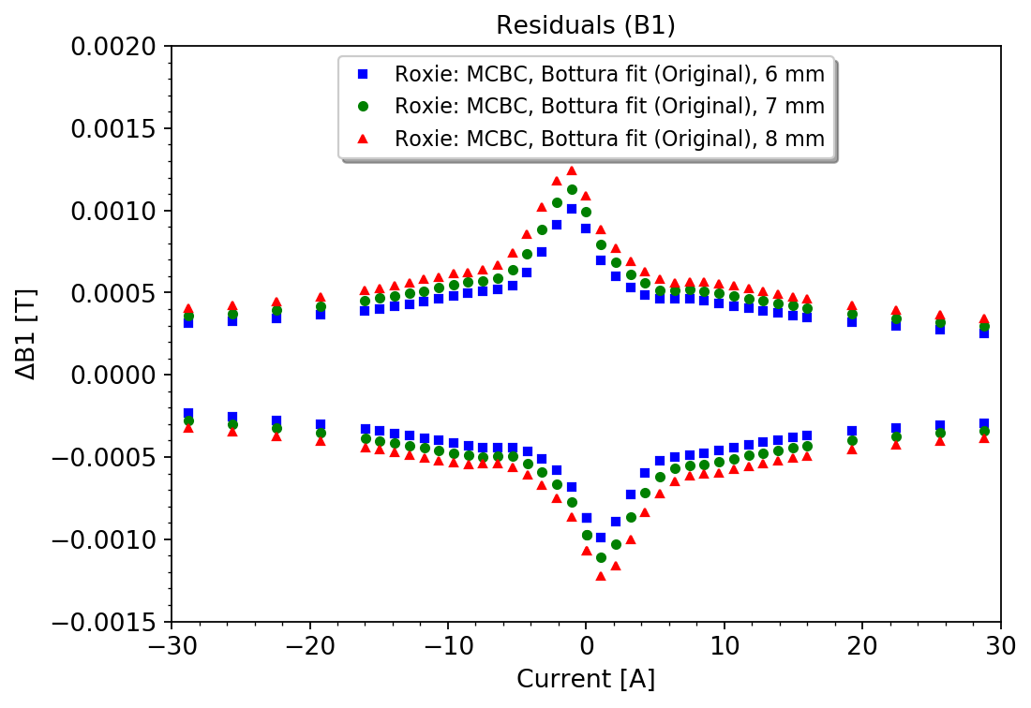
Example: Filament diameter
→ The change of the filament cross-section, for example due to deformation,
may affect the results.

Slide 10
Magnetic measurements
The validation of the superconducting magnet performance is conducted at different phases of its development→ wide range of available techniques.
 | Volume | TF | Homogeneity | Angle | Axis | Bandwidth | Temperature | Accuracy
Hall probes | ∼mm³ | local | - | - | - | ∼kHz | ambient cryogenic | <10⁻³
NMR probes | ∼cm³ | local | - | - | - | <1 Hz | ambient | <10⁻⁶
Static coils | 10 mm² 0.1 to 1 m | local integral | - | - | - | ∼kHz | ambient cryogenic | <10⁻³
Rotating coils | ⌀ > 30 mm L = 0.1 to 1 m | local integral | multipoles | if calibrated | if rotation axis is known | <10 Hz | ambient cryogenic | 10⁻⁴ on main field 10⁻⁶ on multipoles < 0.1 mm on axis
AC mole | ⌀ > 30 mm L = 0.1 m | - | - | - | local | - | ambient | <0.1 mm
SSW | ⌀ > 30 mm L = 0.5 to 15 m | integral | - | integral | integral | DC | ambient | < 10⁻⁴ on main field < 0.05 mm on axis < 0.1 mrad on angle
Courtesy of L. Fiscarelli
For superconducting accelerator magnets, a harmonic description of the field is used, both for characterizing field quality and particle tracking simulations
→ necessity to perform rotating coils measurements.

Slide 11
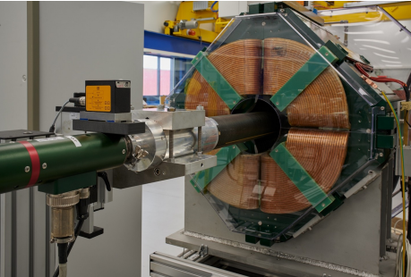
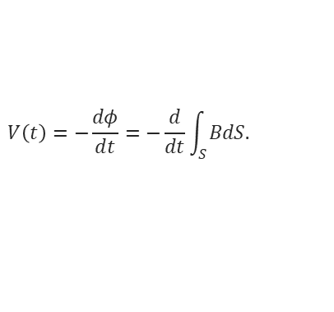


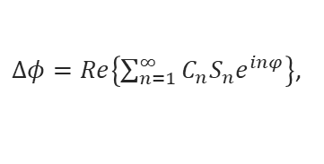
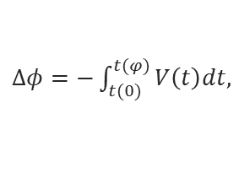
Rotating-coil measurements
Advantages:
  Provides directly integrated field in the form of harmonic components
  (as required by beam operation),
  High precision:
    10⁻⁴ on main field,
    10⁻⁶ on multipoles.
Limitation:
  Not commercially available,
  Magnet specific dimensions,
  Uncertainties in measurements:
    Calibration (impact on accuracy),
    Other effects (thermal contraction, and mechanical vibrations).
Principle:
Faraday’s law:
$$V\left(t\right)=−\frac{dφ}{dt}=−\frac{d}{dt}\int_{S}^{ }{BdS.}$$
The change in flux:
$Δφ=−\int_{t(0)}^{t(φ)}{V\left(t\right)dt,}$
$Δφ=Re\left\{\sum_{n=1}^{∞}{C_{n}S_{n}e^{inφ}}\right\}$,
where:
$C_{n}= B_{n}+{iA}_{n}$ at reference radius $r_{0,}$
$S_{n}−$complex sensitivity factors.

Slide 12
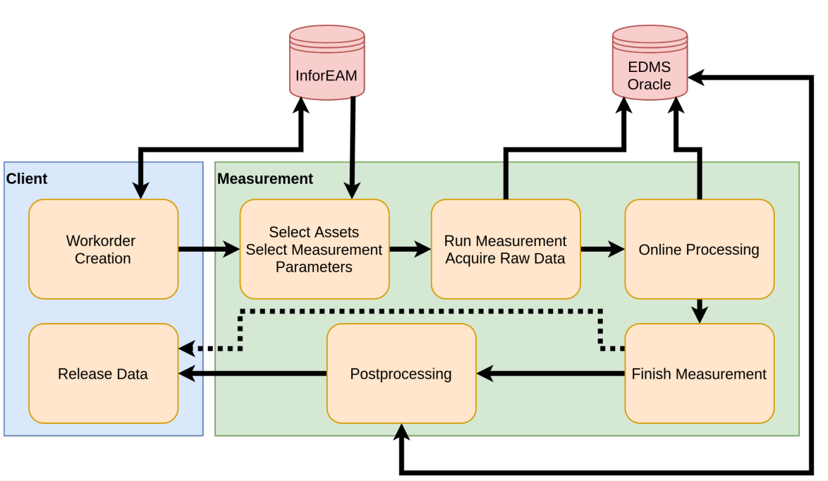
Measurement work-flow
The change in flux:
Courtesy of M. Bonora
Advanced analysis and developing model for the operation (FiDeL)

Slide 13
FiDeL: What is it?
LHC operation requires a prediction of the current of the magnet circuits. These settings are based on parametric model, whose coefficients are obtained from a synthesis of information available from the magnetic field measurements (warm and cold).
These equations together with the fitting coefficients are the Field Description of the LHC (FiDeL) [1].
The aim is to provide integral transfer function for each LHC circuit.
The model uses several levels of approximations, starting from linear dependance on current (ideal magnet) and adding correction terms (depends on magnet type and function) to describe non-linear effects.
The prediction of the field is based on static (current, ramp-direction dependent) and dynamic (time, ramp-rate dependent) components.

Slide 14



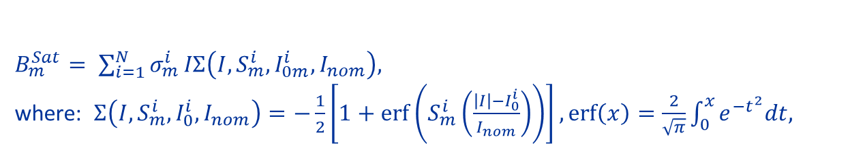
FiDeL: Static components
Among static static components, the following terms are distinguished [1]:
Geometric (linear term):
DC magnetization (hysteresis due to persistent currents):
Saturation (due to iron yoke):
Residual magnetization:
$$B_{m}^{Geo}= γ_{m}^{Geo}I,$$
$B_{m}^{DC_Mag}= μ_{m}^{ }\left|I\right|{\left(\frac{I_{inj}}{\left|I\right|}\right)}^{2−p_{m}}{\left(\frac{I_{c}−\left|I\right|}{I_{c}−I_{inj}}\right)}^{q_{m}}$ ${\left(\frac{{T_{c0}}^{1.7}−{T_{ }}^{1.7}}{{T_{c0}}^{1.7}−{T_{meas}}^{1.7}}\right)}^{h_{m}},$
$B_{m}^{Sat}= \sum_{i=1}^{N}{σ_{m}^{i}}IΣ\left(I, S_{m}^{i},I_{0m}^{i},I_{nom}\right),$
where: $Σ\left(I,S_{m}^{i},I_{0}^{i},I_{nom}\right)=−\frac{1}{2}\left[1+\operatorname{erf}\left(S_{m}^{i}\left(\frac{\left|I\right|−I_{0}^{i}}{I_{nom}}\right)\right)\right],\operatorname{erf}\left(x\right)=\frac{2}{\sqrt{π}}\int_{0}^{x}{e^{−t^{2}}dt,}$
$B_{m}^{Res}= ρ_{m}^{ }\left|I\right|{\left(\frac{I_{inj}}{\left|I\right|}\right)}^{r_{m}}$.

Slide 15
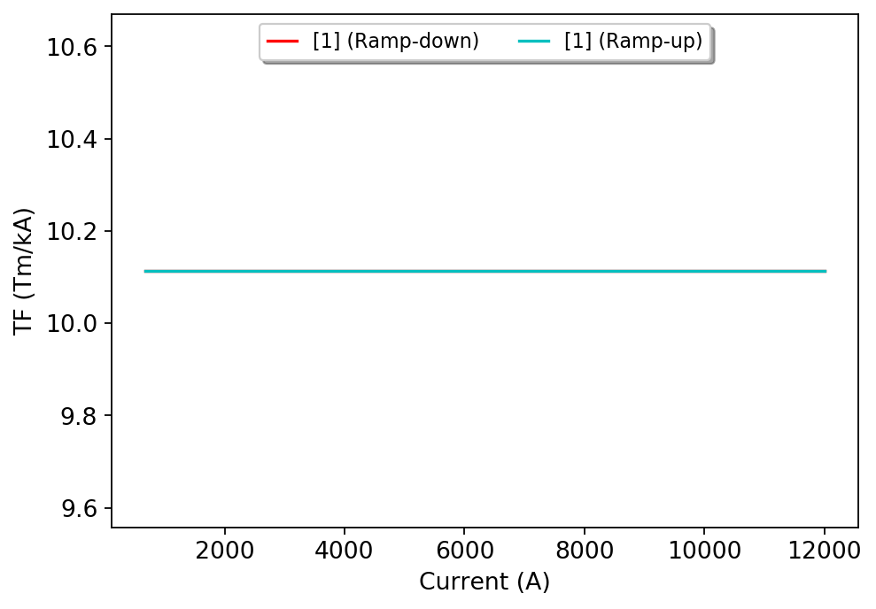
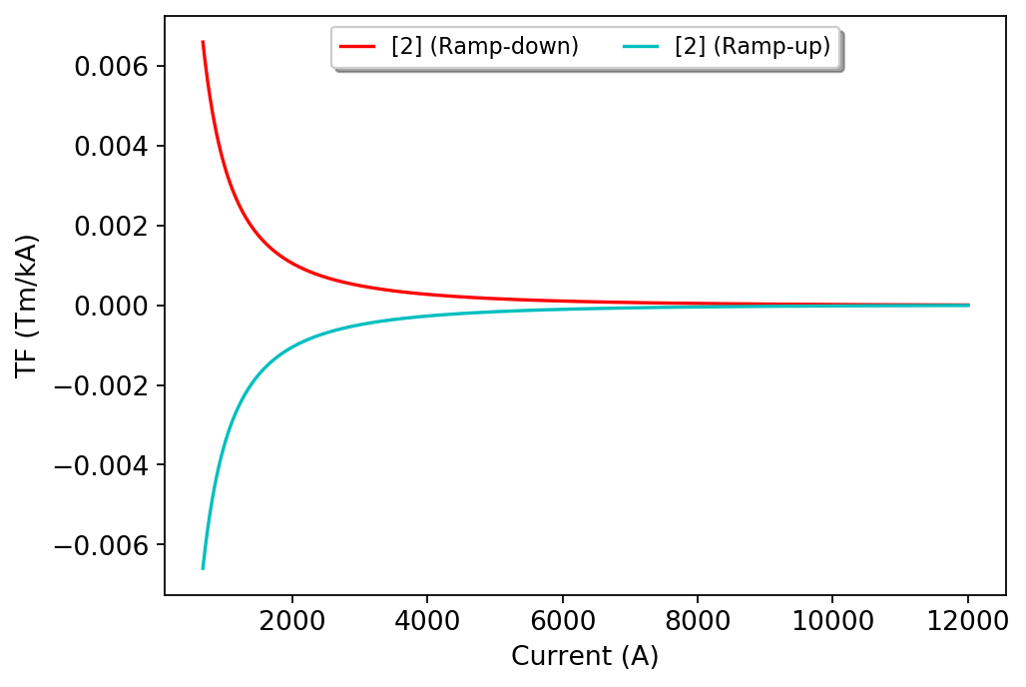
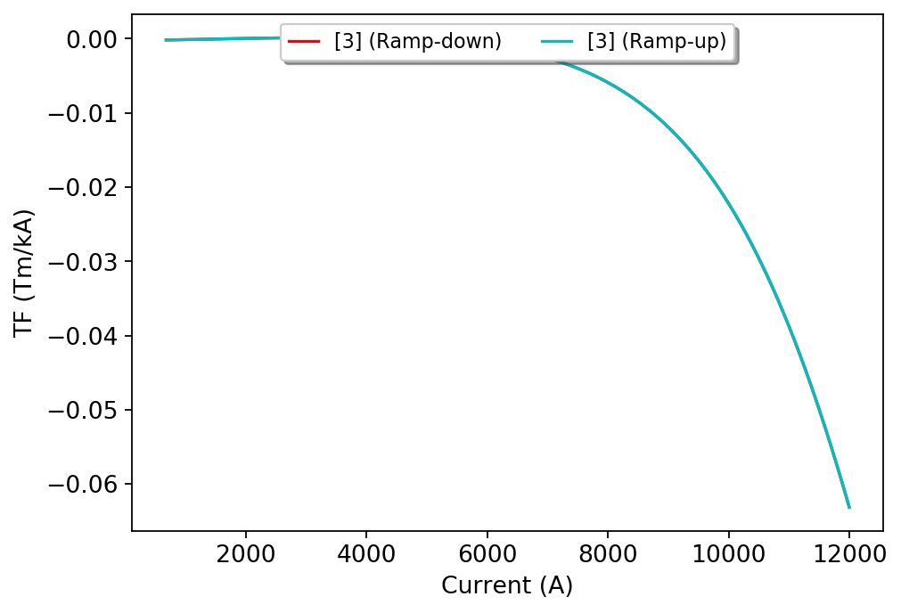
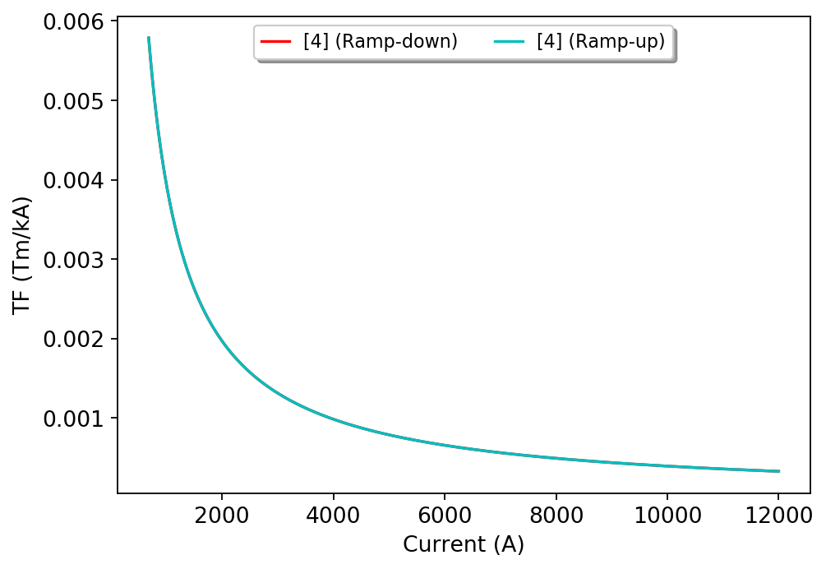
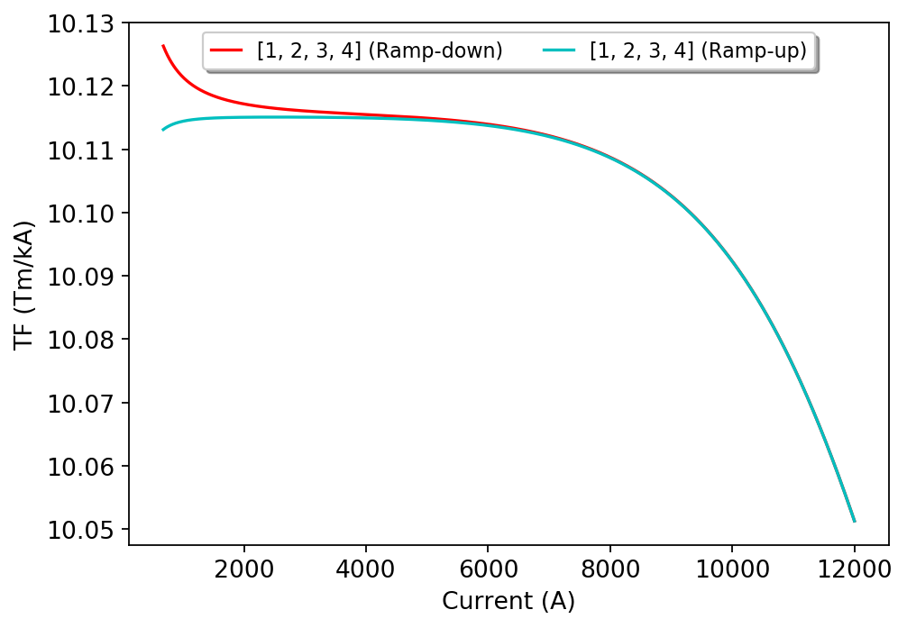
FiDeL: Example
  Transfer function including static components for LHC main dipoles [2].
Geometric
DC magnetization
Saturation
+
+
Residual magnetization
Total field
+
-=

Slide 16
FiDeL: Remarks
FiDeL is the field forecast system for the superconducting accelerator magnets: it is an integral part of the LHC controls (LSA).
Beyond the model:
  Persistent current effects and hysteresis modelling for non-standard
  operational cycles (when filaments are not fully penetrated):
  → Necessity to perform additional special test cycles to support operation
  (drawbacks: cost, time, amount of requests),
  → Great opportunity to fill the gap and analyse effects for non-standard
  cycles by performing ROXIE simulations.

Slide 17
Limitations of the existing tools
ROXIE:
  No possibility to easily compare several simulations at once,
  Lack of application programming interface (API),
  Difficulties with data analysis (no zoom or plot adjustment options).
Magnetic measurements:
  Limited number of points for a small set of powering cycles
FiDeL:
  No automated scripts to generate the model or reproduce the results
  for the existing magnets,
  Until now, the analysis was performed offline, after the measurement campaign, excluding the option to acquire additional experimental data if necessary.
→ No systematic integration between simulation software packages,
measurement acquisition systems and FiDeL analysis to easily access and
compare results.

Slide 18
Proposed approach

Slide 19

Concept
PyMagAnalysis – Python based Analysis of the Superconducting Magnets. New software for parallel and uniform analysis of simulation and measurement results, as well as for field forecasting.
https://gitlab.cern.ch/agchmiel/pymaganalysis

Slide 20
Benefits
Comparison of different data sources.
Improvement of the numerical models:
    data-driven updates,
    parametric analysis.
Increased efficiency and quality of the measurements:
    cross-check and validation of the results,
    design of experiments.
Field forecast based on the best available knowledge:
    prediction for the operations,
    beyond standard operation cycles.
Reproducibility and traceability of the analyses and the results
(via Gitlab, SWAN and Jupyter Notebooks).

Slide 21
PyMagAnalysis: General overview
Filtering:
- Time,
- Current,
- Ramp-rate.
FiDeL Fit
Modelling fit
Analyzer
Data input
Multipole inputs:
- ROXIE input,
- Measurement input,
- FiDeL input.
Advanced analysis:
- current vs. time,
- multipole vs. time,
- multipole vs. current,
- linear fit,
- residuals vs. current,
- and many more…
Plotter
Presenting results:
- custom labels,
- zoom,
- plot types,
- and many more…
ROXIE files
FiDeL reports (EDMS)
Magnetic
Measurement DB

Slide 22
PyMagAnalysis: Data input
Data input
Abstract methods: Derived methods:
- Current - Phase
- Multipole - Nominal field
- Time - Nominal current
ROXIE input
Measurements
FiDeL input
Measurement input
Constructor:
fit
currents
Implementation of DataInput methods
Constructor:
file path
hCoil
blockNr
secondaryBlockNr
scalingFactor
Parsing .data, .output
Implementation of DataInput methods
Filtering
Constructor:
edmsId/magnetName
cycleName
apertureNr
currentNr
secondaryCurrentNr
rampDirections
Reading from DB
Implementation of DataInput methods
Filtering

Slide 23
PyMagAnalysis: Analyzer and Plotter
Data input
Analyzer
Plotter
Data Inputs
timeVsMultipole(multipole="B3")
timeVsCurrent()
currentVsMultipole(multipole="A5", separate_branches=True)
currentVsTransferFunction(multipole="B1", offsets=[-3.433])
linearFit(multipole="B1", decimals=5)
residuals(multipole="B1", decimals=None, references=None)
currentVsMagnetizationData(self, name="BSTR", strands=[102])
circularFit(multipole="C1", angleType="current")
timeVsAngle(angleAnalysis="field", multipole="C1")
angleVsMultipole(multipole="C1", angleType="current")
xZoom=[-20,20],
yZoom=[-80,60],
annotation=False,
startColorIdx=0,
differentMarkers=True,
label="My plot XYZ“

Slide 24
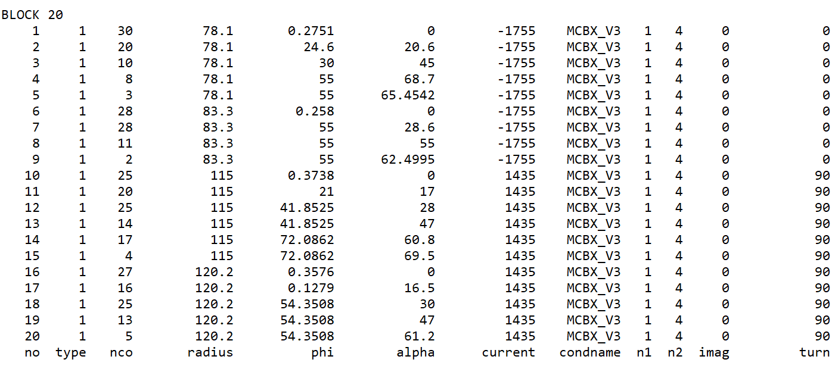
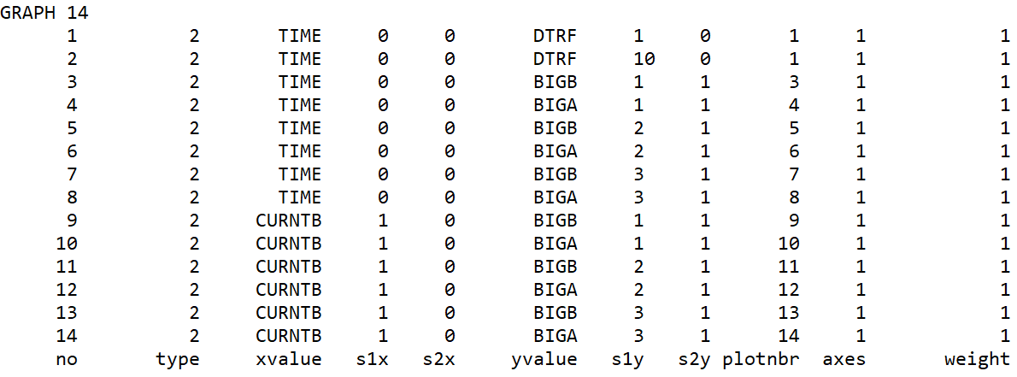
Roxie Input: parsing .data file
Example of ROXIE .data file (MCBXF magnet).
Notation:
DTRF – current factor in block
CURNTB – current in block
Hcoil – harmonic coil
How to read B3 for Hcoil 1?
- BIGB3 (y value in Graph 7)
How to find secondary current for Hcoil 1 and Block 10?
- DTRF (y value in Graph 2)
x nom. current for Block 10
How to find primary current
for Hcoil 1 and Block 1?
- CURNTB (x value in Graphs 9-14)
Where to find x and y values of the selected graphs?

Slide 25
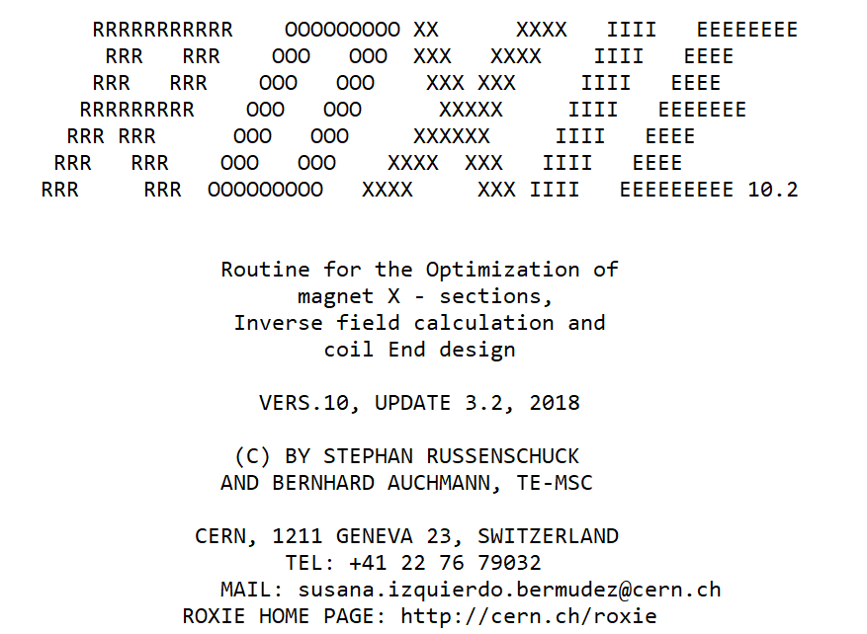
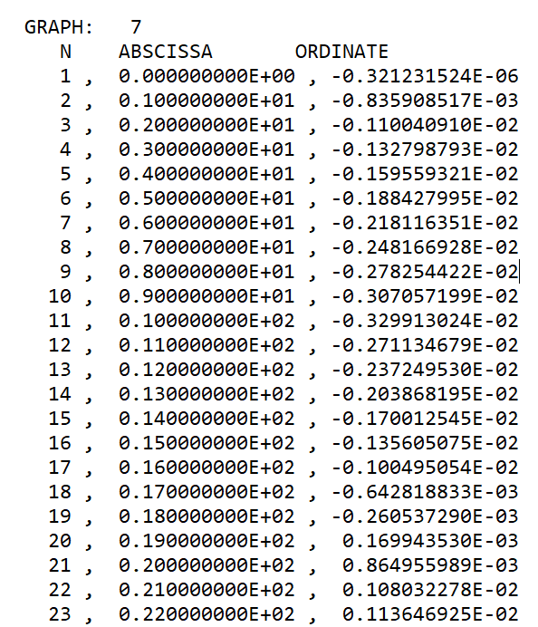
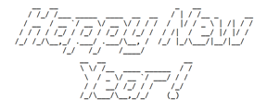
Roxie Input: parsing .output file
Example of ROXIE .output file.
Data input
Go to the selected graph and column:
B3 for Hcoil 1.
→ Implemented automatic parsing of custom ROXIE .data and .output files.

Slide 26
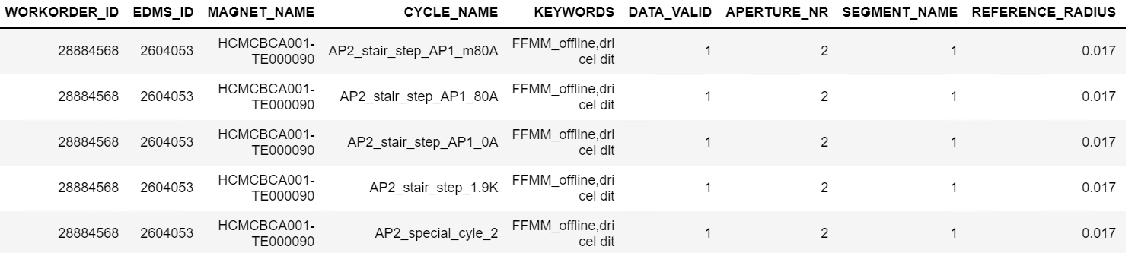
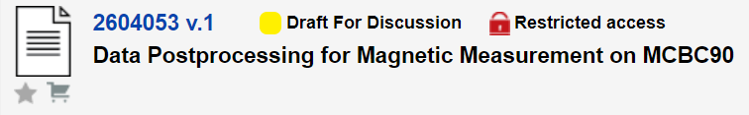
Measurement Input: reading from DB
Screenshot of the Magnetic Measurement Database:
EDMS document:
→ Implemented reading from the Magnetic Measurement Database.

Slide 27
PyMagAnalysis: Use case 1
Simulation of a standard current cycle in ROXIE and analysis of B1 residuals.
Filtering:
- Time,
- Current,
- Ramp-rate.
FiDeL Fit
Modelling fit
Analyzer
Data input
Multipole inputs:
- ROXIE input,
- Measurement input,
- FiDeL input.
Advanced analysis:
- current vs. time,
- multipole vs. time,
- multipole vs. current,
- linear fit,
- residuals vs. current,
- and many more…
Plotter
Presenting results:
- custom labels,
- zoom,
- plot types,
- and many more…
ROXIE files
FiDeL reports (EDMS)
Magnetic
Measurement DB

Slide 28
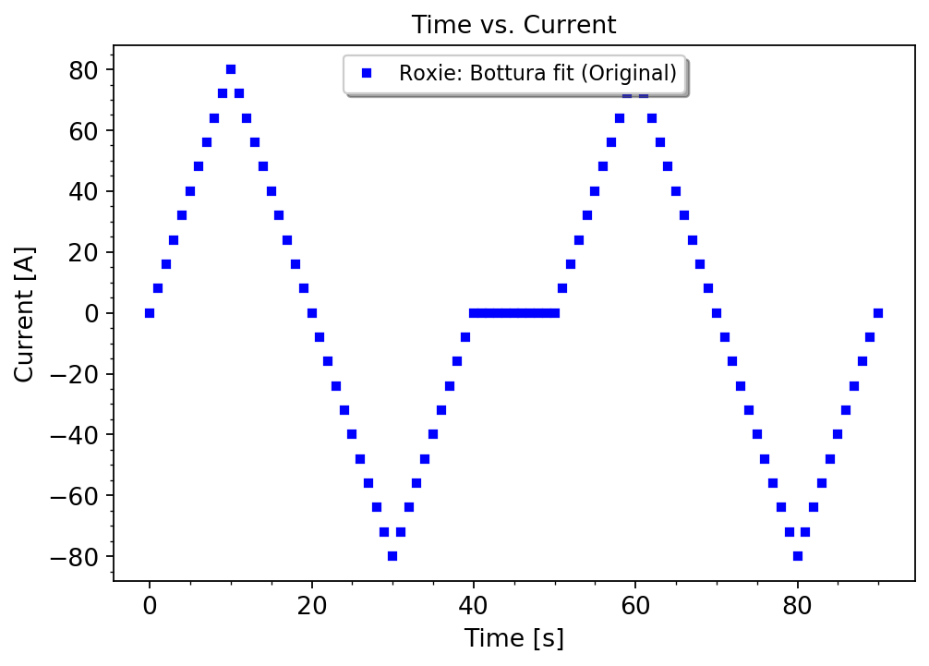
Roxie Input (use case 1)
Standard reference cycle with a pre-cycle up to nominal current.
Remark: The code is attached below to show the logic and simplicity of the program, as well as several discussed functionalities - do not be afraid!

Slide 29
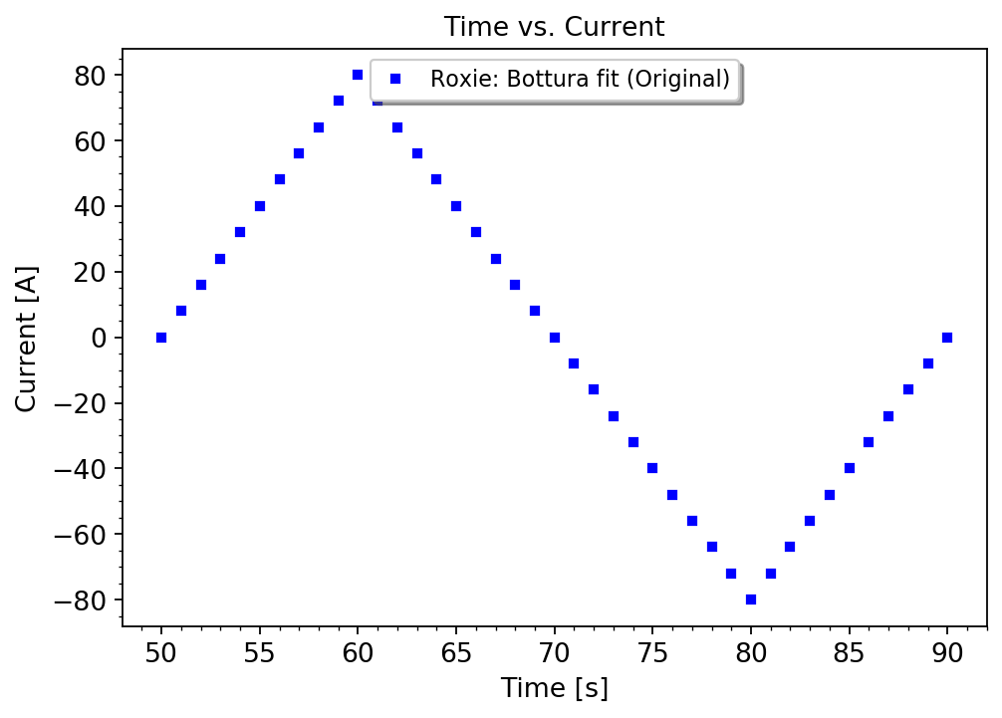
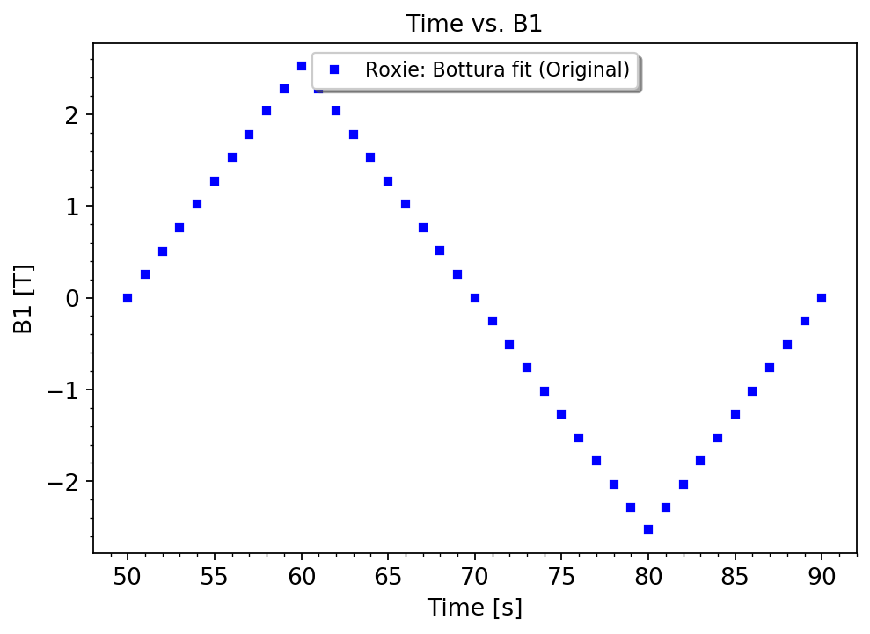
Roxie Input (use case 1)
→ Filtering of the timestamps
→ Analysis of the main field

Slide 30
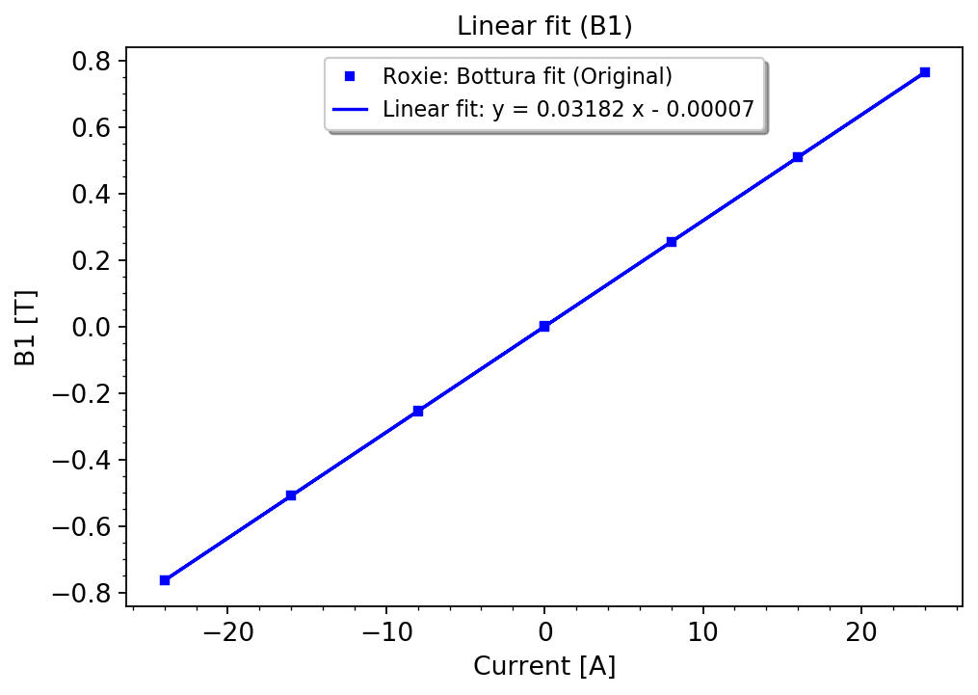
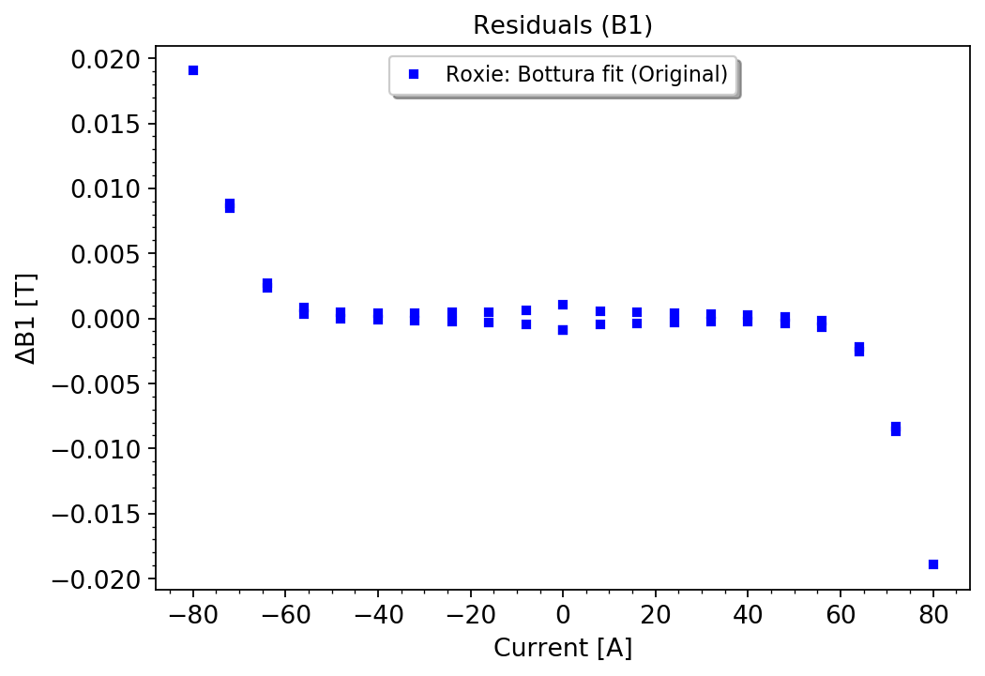
Roxie Input (use case 1)
→ Filtering of the timestamps
→ Filtering of the current
→ Linear fit
→ Residuals (B1)

Slide 31
PyMagAnalysis: Use case 2
Measurement of a standard current cycle and analysis of B1 residuals and
transfer function, with an additional distinction of ramp directions.
Filtering:
- Time,
- Current,
- Ramp-rate.
FiDeL Fit
Modelling fit
Analyzer
Data input
Multipole inputs:
- ROXIE input,
- Measurement input,
- FiDeL input.
Advanced analysis:
- current vs. time,
- multipole vs. time,
- multipole vs. current,
- linear fit,
- residuals vs. current,
- transfer function vs.
current,
- and many more…
Plotter
Presenting results:
- custom labels,
- zoom,
- plot types,
- and many more…
ROXIE files
FiDeL reports (EDMS)
Magnetic
Measurement DB

Slide 32
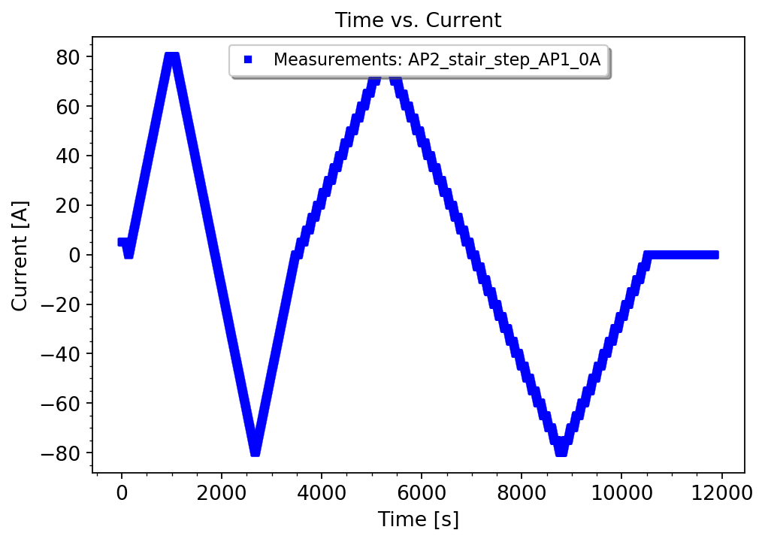
Measurement Input (use case 2)
Standard reference cycle including pre-cycle up to nominal current followed by a stair-step profile. The magnetic field is measured at the plateaus with high accuracy.
The original cycle loaded from DB may include imperfections.
We are interested in analyzing data points
at the plateaus.
Opportunity to cross-check the results (feedback for test engineers).

Slide 33
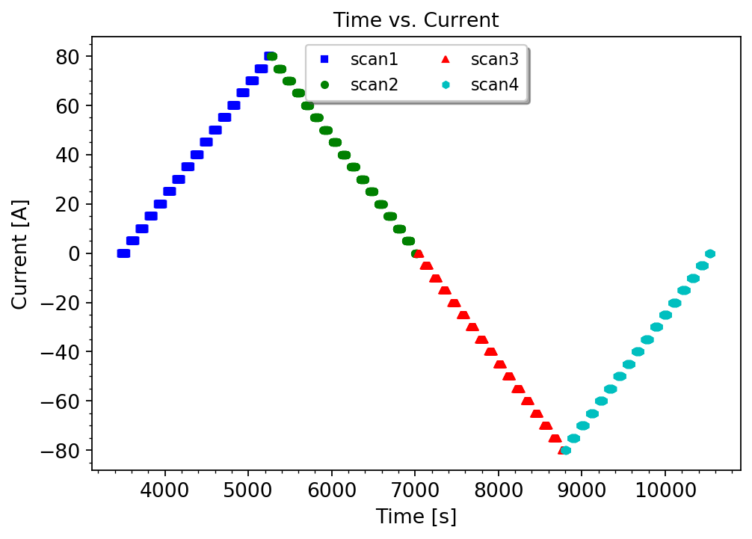
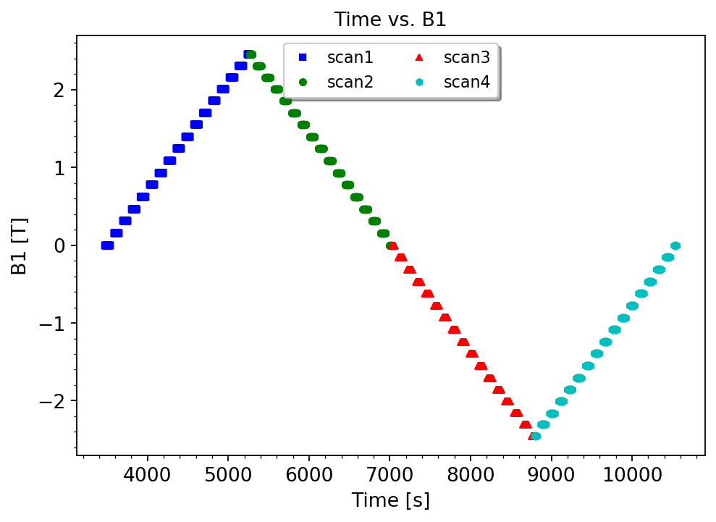
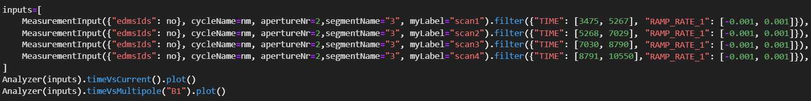
Measurement Input (use case 2)
Data input
→ Filtering of the timestamps
→ Filtering of the ramp-rates
→ Possibility to split one signal
→ Analysis of the main field (B1)

Slide 34
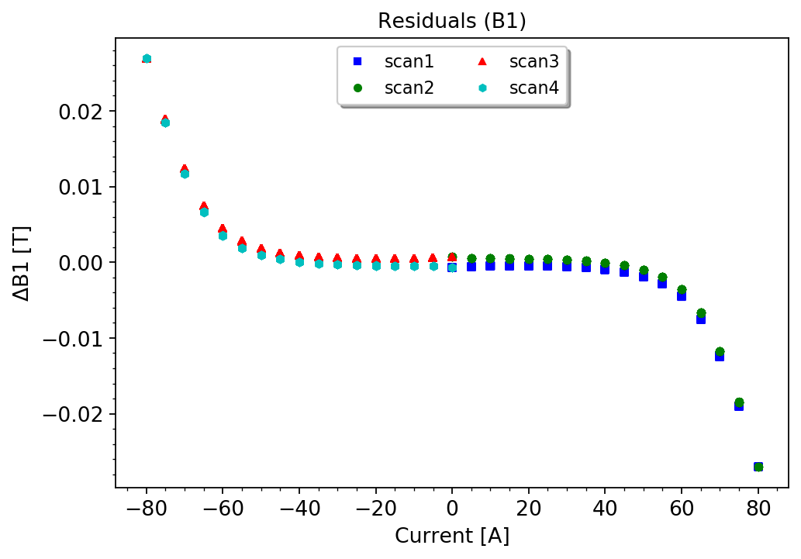
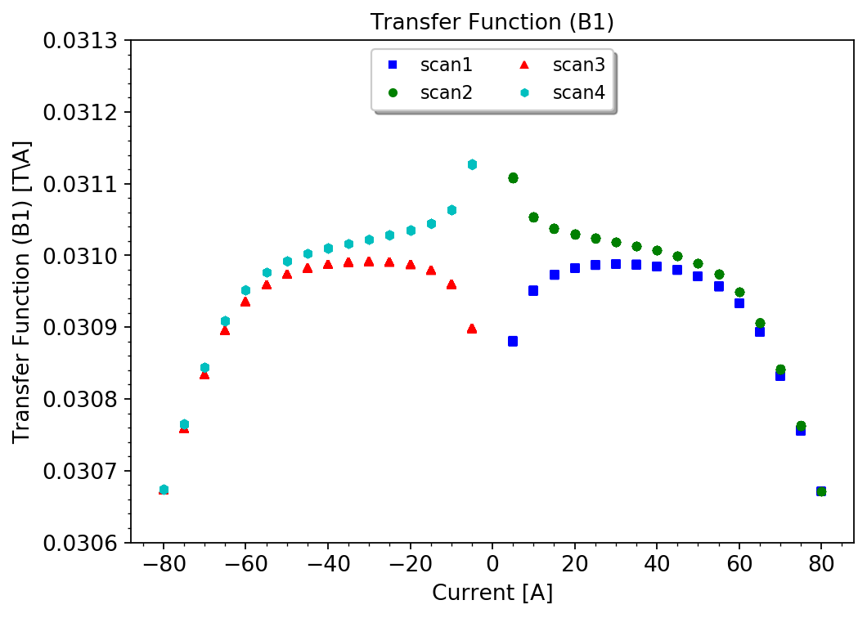
Measurement Input (use case 2)
Data input
→ Residuals (B1)
→ Transfer function (B1)

Slide 35
PyMagAnalysis: Use case 3
Reconstruction of the MCBC FiDeL model from 2009 [3].
Filtering:
- Time,
- Current
- Ramp-rate
FiDeL Fit
Modelling fit
Analyzer
Data input
Multipole inputs:
- ROXIE input
- Measurement input
- FiDeL input
Advanced analysis:
- current vs. time,
- multipole vs. time,
- multipole vs. current,
- linear fit,
- residuals vs. current,
- and many more…
Plotter
Presenting results:
- custom labels,
- zoom,
- plot types,
- and many more…
ROXIE files
FiDeL reports (EDMS)
ROXIE files
Magnetic
Measurement DB

Slide 36
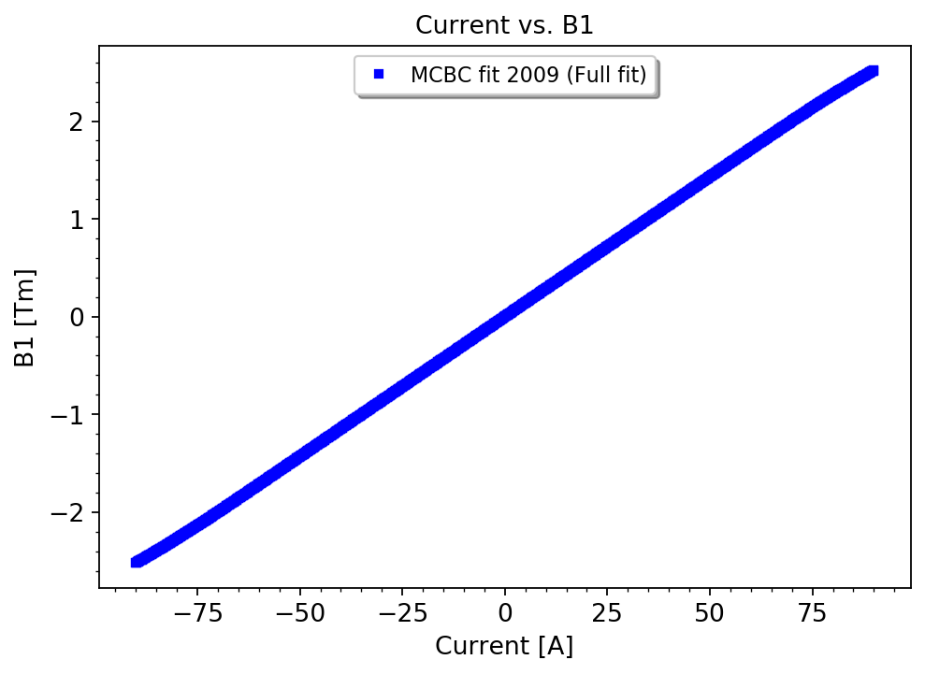
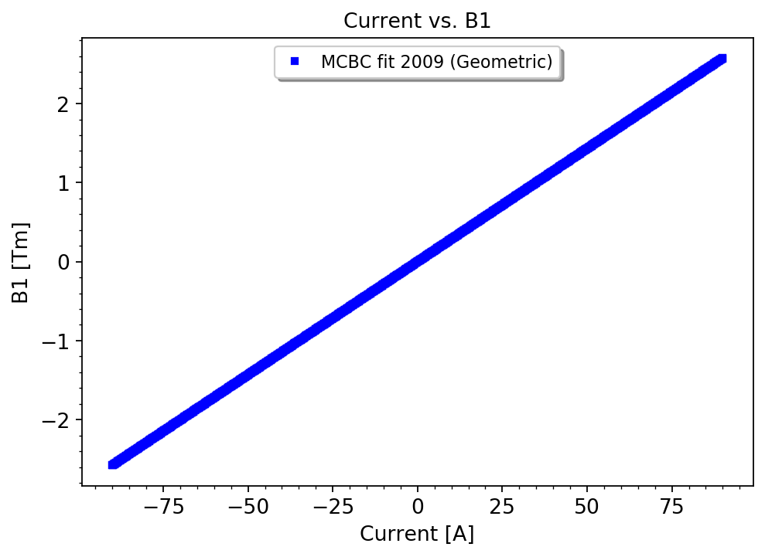
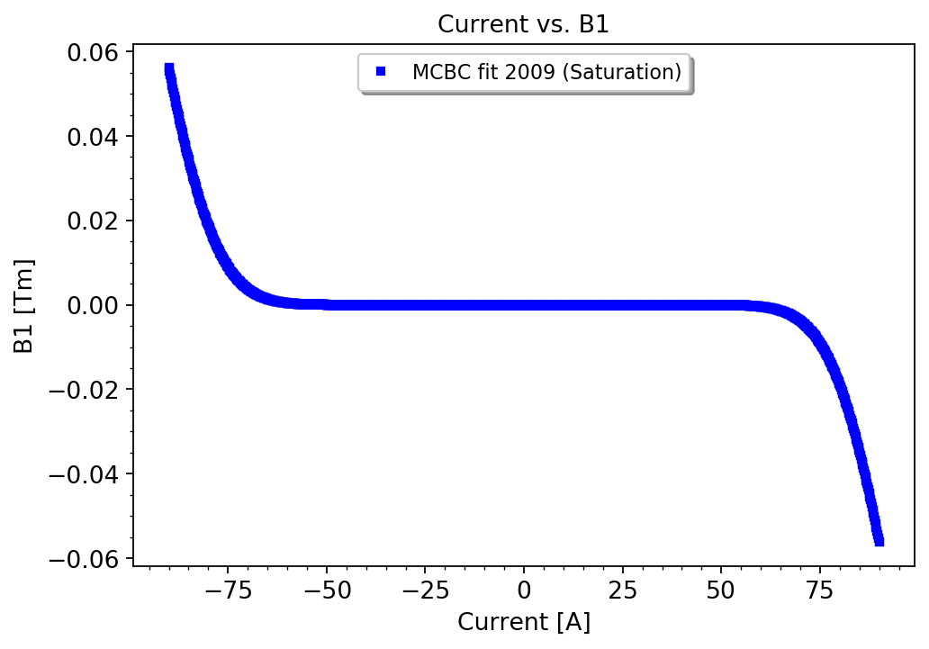
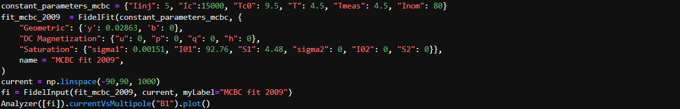
FiDeL Input (use case 3)
Analysis of the provided fitting parameters for a given magnet.
→ Full fit
→ Geometric term
→ Saturation term

Slide 37
PyMagAnalysis: Use case 4
Developing a new FiDeL model based on magnetic measurements.
Filtering:
- Time,
- Current,
- Ramp-rate.
FiDeL Fit
Modelling fit
Analyzer
(see next slide)
Data input
Multipole inputs:
- ROXIE input
- Measurement input
- FiDeL input
Advanced analysis:
- current vs. time,
- multipole vs. time,
- multipole vs. current,
- linear fit,
- residuals vs. current,
- and many more…
Plotter
Presenting results:
- custom labels,
- zoom,
- plot types,
- table generation,
- and many more…
ROXIE files
FiDeL reports (EDMS)
ROXIE files
Magnetic
Measurement DB

Slide 38
FiDeL Modelling (use case 4)
Implementation of the FiDeL fit functions (see slide 15),
Curve fitting using SciPy Python library and finding solutions via
non-linear least squares method,
Algorithm:
  Specify constant parameters,
  Fit geometric component in the specified linear range,
  Calculate residuals,
  Calculate absolute value of the magnetization,
  Fit DC magnetization component,
  Calculate further residuals,
  Fit saturation component (single or double-term),
Estimate relative error.

Slide 39
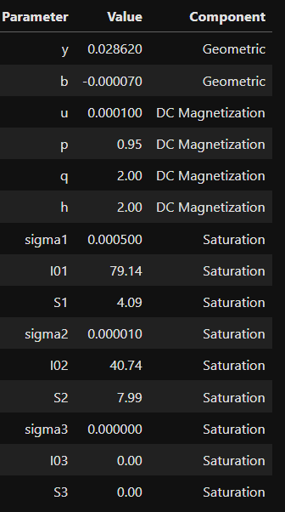
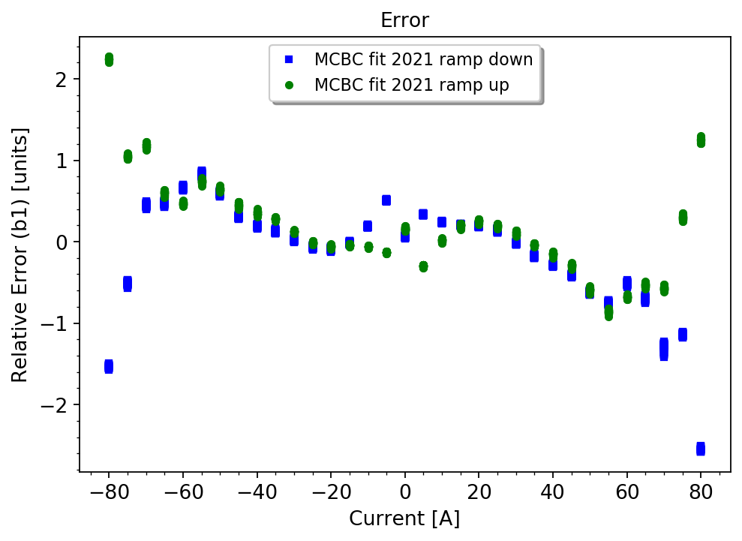
FiDeL Modelling (use case 4)
→ Evaluation of the relative error
→ Generation of the table
with the fitting parameters

Slide 40
PyMagAnalysis: Use case 5
Comparison of ROXIE, Measurement and FiDeL input.
Filtering:
- Time,
- Current,
- Ramp-rate.
FiDeL Fit
Modelling fit
Analyzer
Data input
Multipole inputs:
- ROXIE input,
- Measurement input,
- FiDeL input.
Advanced analysis:
- current vs. time,
- multipole vs. time,
- multipole vs. current,
- linear fit,
- residuals vs. current,
- and many more…
Plotter
Presenting results:
- custom labels,
- zoom,
- plot types,
- and many more…
ROXIE files
FiDeL reports (EDMS)
FiDeL reports (EDMS)
ROXIE files
Magnetic
Measurement DB

Slide 41
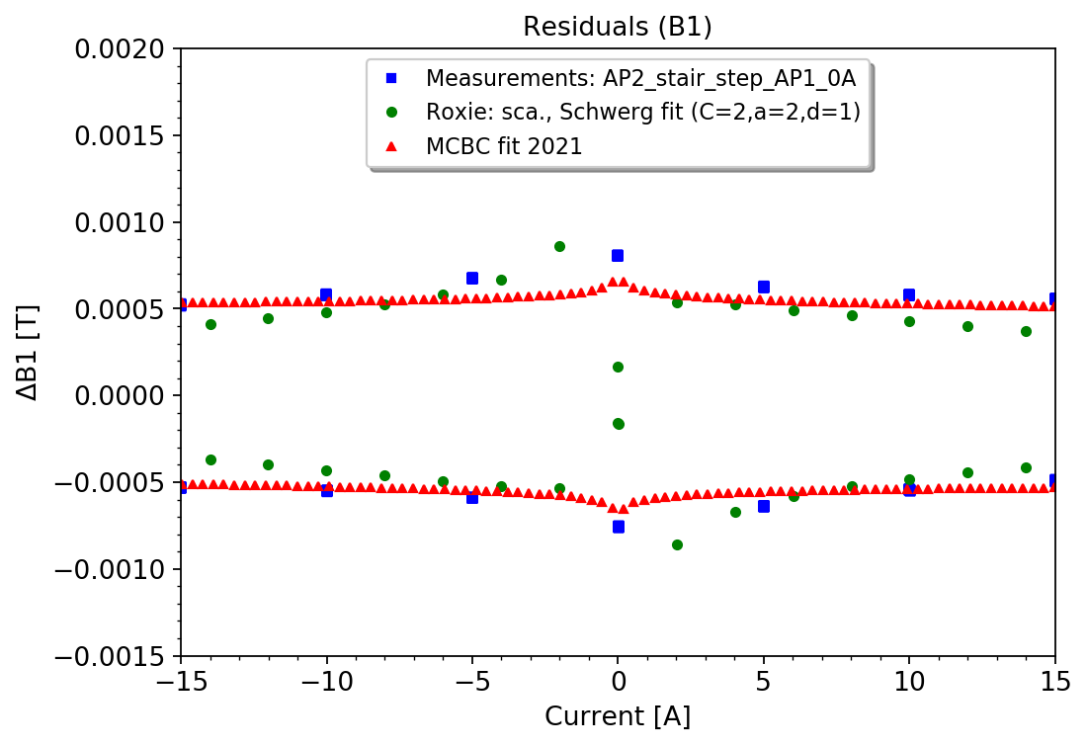
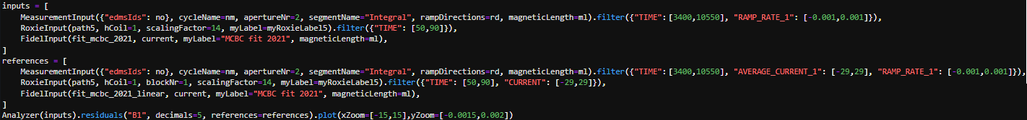
Comparison of different inputs (use case 5)
Data input
→ Residuals (B1)

Slide 42
PyMagAnalysis: Use case 6
Data-driven update of the ROXIE model and design of the experiments.
Filtering:
- Time,
- Current,
- Ramp-rate.
FiDeL Fit
Modelling fit
Analyzer
Data input
Multipole inputs:
- ROXIE input,
- Measurement input,
- FiDeL input.
Advanced analysis:
- current vs. time,
- multipole vs. time,
- multipole vs. current,
- linear fit,
- residuals vs. current,
- and many more…
Plotter
Presenting results:
- custom labels,
- zoom,
- plot types,
- and many more…
ROXIE files
FiDeL reports (EDMS)
FiDeL reports (EDMS)
ROXIE files
Magnetic
Measurement DB
Update of the model
Design of the experiments

Slide 43
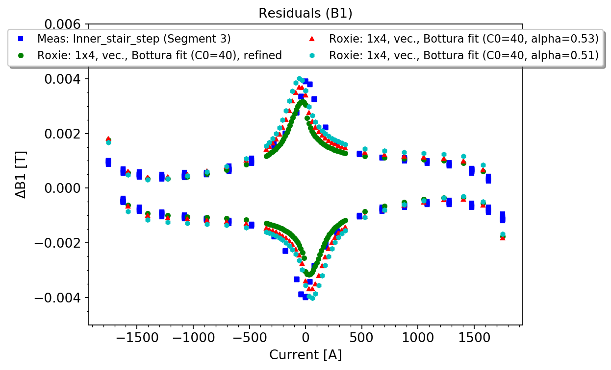
Data-driven update of the model
Data input
Example:
  Modification of Jc-fit formula or fitting parameters,
  Comparison of numerical methods (scalar vs. vector model),
  Increase of resolution within specific range.
→ Measurement-based update allows to develop a numerical model, which
resembles closer a real device.
→ Potential to use simulations for analysis of complex cycles performed in
operation.

Slide 44
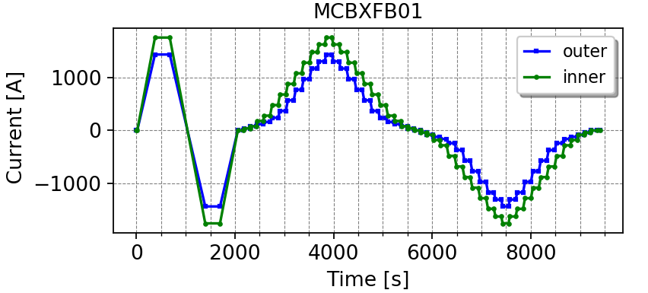
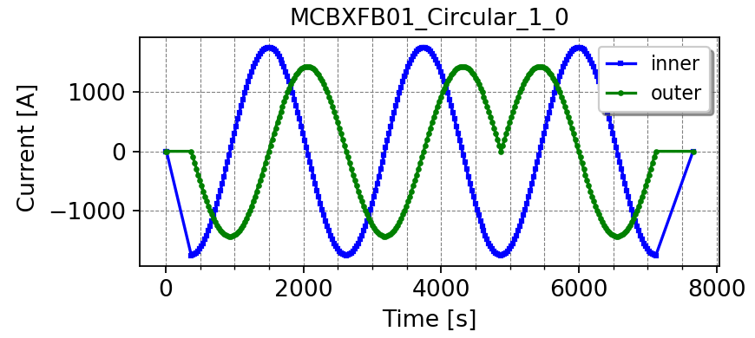
Design of experiments
Different types of cycles:
  Standard cycles with equally distributed plateaus at different levels,
  Standard cycles with increased number of points in the specific range, (relevant for magnetic hysteresis investigation in all magnets),
  Operational cycles (e.g., MCBC/MCBY orbit correctors),
  Circular cycles (e.g., for MCBXF magnet, vector-hysteresis model).
→ Developed automated scripts to generate powering cycles with ensured
compatibility with power generators (file format, nb. of points, max. ramp-rate).
Examples:
Standard test cycles with increased number of points
at low current to investigate hysteresis effects.
Circular cycles up to nominal current to benchmark vector-hysteresis model.

Slide 45
Case Study: Luminosity calibrations for ATLAS experiment

Slide 46







Van der Meer Scans
Instantaneous luminosity [4]:
$$ℒ_{0}=\frac{n_{1}n_{2}fN_{b}}{2π\sqrt{{(σ}_{1x}^{2}+σ_{2x}^{2})(σ_{1y}^{2}+σ_{2y}^{2})}}= \frac{\dot{N}}{σ}$$
$n_{1}{,n}_{2}$ – bunch intensities
$N_{b}$ – number of bunches per beam
$σ_{ix}^{2},{ σ}_{iy}^{2}$ – effective transverse beam size
$\dot{N}$ – event rate
$σ$ – cross-section of the process
Van der Meer (vdM) scans [4]:
The size and shape of the interaction region is measured by recording interaction rates as a function of transverse beam separation $(∆X):$
$ℒ_{0}(d)=ℒ_{0}exp\left(\frac{−∆X}{{2σ}_{d}^{2}}\right)$,
Visible number of interactions per bunch charge product as a function of the beam separation [5].
$σ_{d}^{ }= \sqrt{σ_{1i}^{2}+σ_{2i}^{2}}$ for $i=x,y.$

Slide 47

MCBC/MCBY magnets
In the LHC, MCBC/MCBY magnets are used to provide beam separation during vdM scans.
MCBY
Magnet configuration around
the interaction point (IP) [6].
MCBC
→ Non-linearities and lack of repeatability during vdM scans [7, 8] triggered the
necessity to review the hysteretic behaviour of MCBC/MCBY magnets [9-11].

Slide 48

Analysis of the operational cycles
Injection
vdM, LSC scans + collisions
Pre-cycle
Selection of the most representative powering schemes during horizontal and vertical scans.

Slide 49




Design of the experiments
Extraction of the most relevant features, i.e.:
pre-cycle
injection,
ramp,
high oscillations,
vdM scans,
current drops.
Example: Special cycle “MCBCV.5R1.B2” (AP1) / Special cycle “MCBCH.5R1.B1” (AP2).

Slide 50
Specification of the test program
Test program at 4.5K for MCBC:
Standard test cycles:
  Standard cycle in AP2, no current in AP1 (2h) [Reference]
  Standard cycle in AP2, nominal current in AP1 (2h)
  Standard cycle in AP2, negative nominal current in AP1 (2h)
Special test cycles:
  Special cycle “MCBCV.5R1.B2” in AP1, special cycle “MCBCH.5R1.B1” in AP2 (4h) [6016]
  Special cycle “MCBCV.6R1.B1” in AP1, special cycle “MCBCH.6R1.B2” in AP2 (4h) [6016]
Special cycles for the validation of the ROXIE model:
  Special cycle “ROXIE1” in AP2 (2h)
  Special cycle “ROXIE2” in AP2 (2h)
→ 7 different test cycles performed for MCBC magnet.
→ Analogical test cycles performed for MCBY magnet.

Slide 51


Magnetic measurements
Magnetic measurements in SM18.

Slide 52


Investigation of the effect of cross-talk
→ The problems in vdM scans cannot be attributed to the effect of cross-talk.

Slide 53


Reproducibility of the field for consecutive scans
Example: MCBC special cycle 2.
vdM scans: 1,2,4,5
other scans: 3,6,7
→ Very good reproducibility of the measurement results for vdM scans.
→ A non-linearity due to the change of magnetization branch is observed,
which depends on the current profile.

Slide 54


Comparison with standard cycles
→ The transition from one branch to the other for the vdM cycles is the main
source of non-linearity (“minor magnetization loops”).

Slide 55


Design of the special test cycles
Analysis of the results.
Example:
Special cycle ROXIE1 (MCBY).
→ Thanks to automated analysis, we can easily analyze minor magnetization loops.
→ Possibility to develop fitted-parameter models for the operation (future R&D).

Slide 56




Comparison with ROXIE
Example: Special cycle ROXIE1 (MCBC).
→ Using data-driven updates of the ROXIE models, we can analyze complex
powering schemes, without the need of performing many measurements.

Slide 57

Final contribution
Courtesy of M. Hostettler
→ The studies show that beam-based simulations with our input data (red dots)
are consistent with ATLAS observations (black dots) [12].
→ Important contribution for machine operation.

Slide 58

Documentation and traceability
SWAN/Jupyter Notebooks with the entire analysis for each magnet.
https://gitlab.cern.ch/agchmiel/pymaganalysis
→ Thanks to integrated tools, we can easily reproduce all the results.

Slide 59
Summary
A substantial progress has been made to synchronize different activities (simulations, measurements, calibration curves for operations).
PyMagAnalysis has been developed for the combined analysis of numerical and experimental data, as well as to build the FiDeL model for the operation.
The integration of the tools is essential to improve the numerical models, as well as to increase the efficiency and quality of the measurements.
The full potential of the automated tools is demonstrated by investigation of MCBC/MCBY hysteresis. Despite of the complexity of this topic, ranging from analysis of complex operations cycles, through simulations, to measurements, very good agreement has been achieved with beam observations.

Slide 60
References (1)
FiDeL Website, “FIDEL - The Field Description for the LHC”, available online: https://lhc-div-mms.web.cern.ch/tests/MAG/FiDeL/Documentation/LHC-C-ES-0012-20-00.pdf
N. J. Sammut, “The field description for the Large Hadron Collider”, Doctoral Dissertation, Malta University, 2006.
V. Remondino “Magnetic model of the orbit corrector dipoles MCBC and MCBY”, CERN, EDMS 2459091, 2006.
N. White et al., “Luminosity Optimization and Calibration in the LHC”, available online: https://accelconf.web.cern.ch/pac2009/papers/we6pfp015.pdf
ATLAS Website, https://atlas.cern/updates/briefing/new-luminosity-measurement
N. Sammut et al., “Measurement and effects of the magnetic hysteresis on the LHC crossing angle and separation bumps”, available online: https://www.researchgate.net/publication/42854360_Measurement_and_Effects_of_the_Magnetic_Hysteresis_on_the_LHC_Crossing_Angle_and_Separation_Bumps
M. Hostettler et al., “MCBC/Y magnetic non-linearities in fill 6016”, LLCMWG Meeting, 16 November 2020, https://indico.cern.ch/event/975528/contributions/4108151/attachments/2143174/3612702/20201116_LLCMWG_VdM_mag_hyst.pdf

Slide 61
References (2)
E. Todesco et al., “Hysteretic components of transfer function in mcbc mcby that could affect vdm scans”, LLCMWG Meeting, 16 November 2020, https://indico.cern.ch/event/975528/contributions/4108149/attachments/2143811/3612938/20-11-16_MCBC_MCBY.pdf
A. Chmielinska, L. Fiscarelli, “Plan for magnetic measurements of MCBC and MCBY”, LLCMWG Meeting, 23 November 2020, https://indico.cern.ch/event/976037/contributions/4110709/attachments/2148407/3621784/LLCMWG_MCBC_MCBY_cycles_v2.pdf
A. Chmielinska, L. Fiscarelli, E. Todesco, “Magnetic measurements of MCBC corrector magnet”, LLCMWG Meeting, 01 March 2021, https://indico.cern.ch/event/976037/contributions/4110709/attachments/2148407/3621784/LLCMWG_MCBC_MCBY_cycles_v2.pdf
A. Chmielinska, L. Fiscarelli, E. Todesco, “Magnetic measurements of
MCBY corrector magnet”, LLCMWG Meeting, 29 March 2021, https://indico.cern.ch/event/976037/contributions/4110709/attachments/2148407/3621784/LLCMWG_MCBC_MCBY_cycles_v2.pdf

Slide 62
References (3)
M. Hostettler et al., “Simulated impact of magnetic-measurement results on ATLAS length-scale calibration scans”, LLCMWG Meeting, 15 November 2021, https://indico.cern.ch/event/975528/contributions/4108151/attachments/2143174/3612702/20201116_LLCMWG_VdM_mag_hyst.pdf

Slide 63
Thank you for your attention.

Slide 64
Spare slides

Slide 65
PyMagAnalysis: Use case 6
Data-driven update of the ROXIE model.
Filtering:
- Time,
- Current,
- Ramp-rate.
FiDeL Fit
Modelling fit
Analyzer
Data input
Multipole inputs:
- ROXIE input,
- Measurement input,
- FiDeL input.
Advanced analysis:
- current vs. time,
- multipole vs. time,
- multipole vs. current,
- linear fit,
- residuals vs. current,
- and many more…
Plotter
Presenting results:
- custom labels,
- zoom,
- plot types,
- and many more…
ROXIE files
FiDeL reports (EDMS)
FiDeL reports (EDMS)
ROXIE files
Magnetic
Measurement DB
Update of the model

Slide 66
PyMagAnalysis: Use case 7
Design of the experimental cycles.
Filtering:
- Time,
- Current,
- Ramp-rate.
FiDeL Fit
Modelling fit
Analyzer
Data input
Multipole inputs:
- ROXIE input,
- Measurement input,
- FiDeL input.
Advanced analysis:
- current vs. time,
- multipole vs. time,
- multipole vs. current,
- linear fit,
- residuals vs. current,
- and many more…
Plotter
Presenting results:
- custom labels,
- zoom,
- plot types,
- and many more…
ROXIE files
FiDeL reports (EDMS)
FiDeL reports (EDMS)
ROXIE files
Magnetic
Measurement DB
Design of the experiments

Slide 67
Design of experiments (1)
Different types of cycles:
  Standard cycles (with equally distributed plateaus at different levels),
  Cycles with increased number of data points in the specific range, (relevant for magnetic hysteresis investigation in all magnets),
  Operational cycles (e.g., MCBC/MCBY orbit correctors),
  Circular cycles (e.g., for MCBXF magnet, vector-hysteresis model).
Compatibility with the power generators must be guaranteed:
  File format
  Number of points
  Ramp-rates
All cycles must be in accordance with time limits and available recourses.
→ Developed automated scripts to generate special & standard test cycles.

Slide 68
Design of experiments (2)
Example: Standard and circular cycles for MCBXFB01.
Standard test cycles with increased number of points
at low current to investigate DC magnetization effects.
Circular cycles up to nominal current to benchmark the vector-hysteresis model.
→ Developed automated scripts to generate special & standard test cycles.

