Slide 1
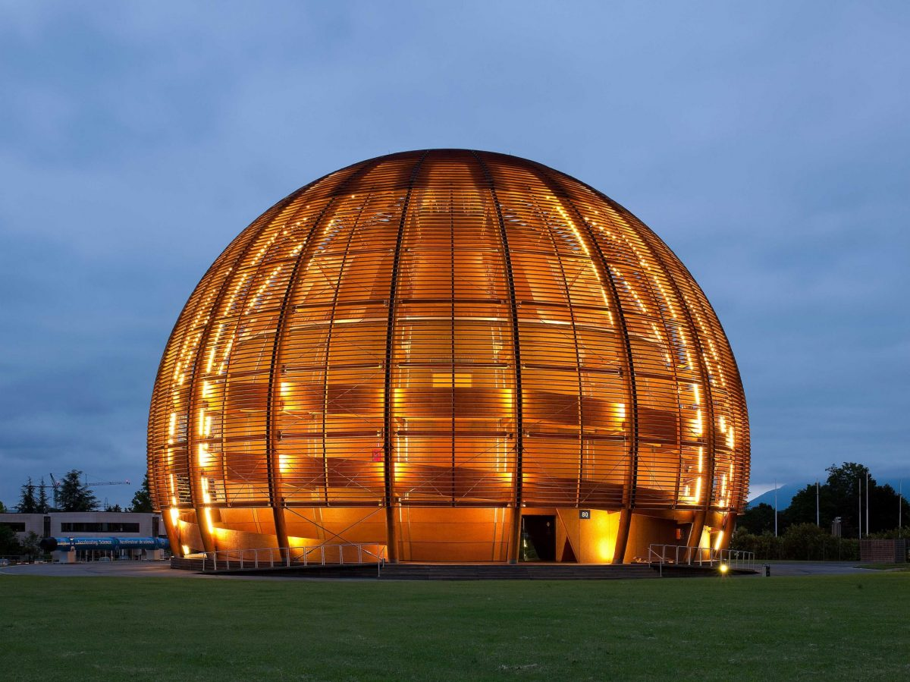
ITP – Italian Teacher Programme
CERN, 18 November 2022
Maurizio Bona
Vice-Chair of the IYBSSD Steering Committee
CERN, SESAME and SEEIIST: scientific research
as promoter of intercultural dialogue and peace
M. Bona – ITP, CERN, Nov 2022

Slide 2
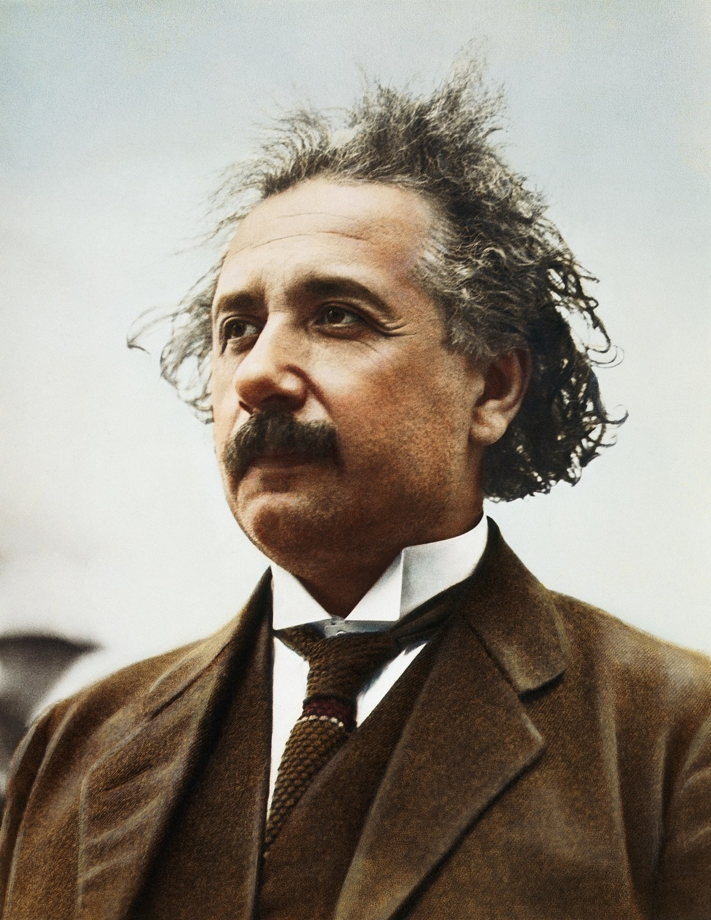

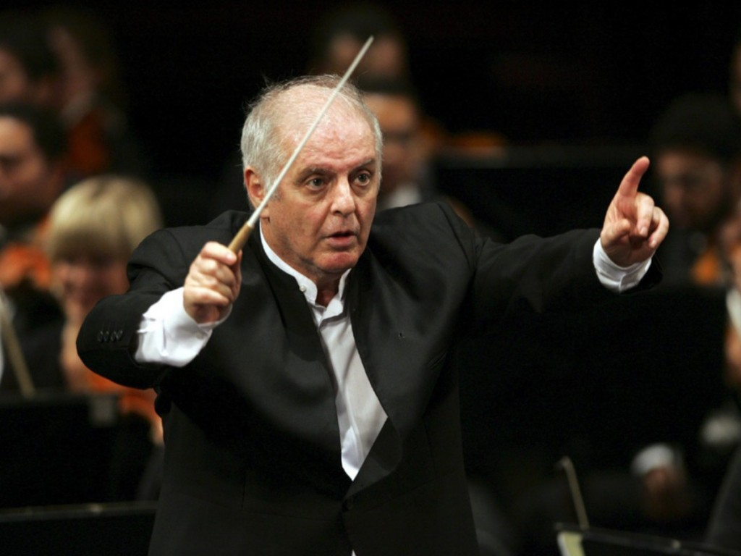
M. Bona – ITP, CERN, Nov 2022

Slide 3
CERN - Science for dialogue and peace
M. Bona – ITP, CERN, Nov 2022

Slide 4
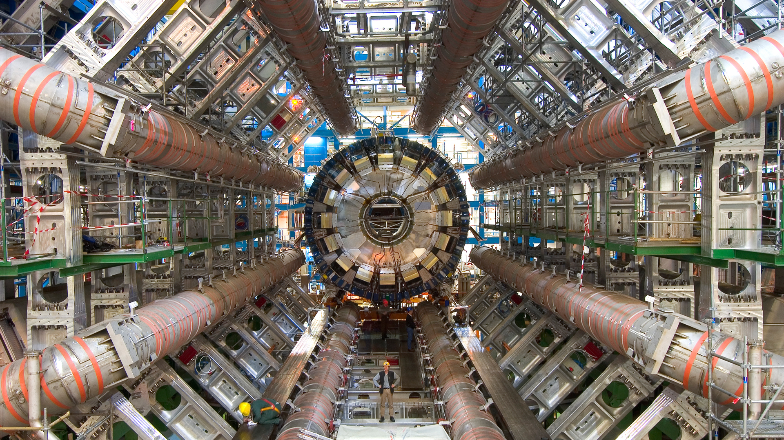
.
M. Bona – ITP, CERN, Nov 2022

Slide 5
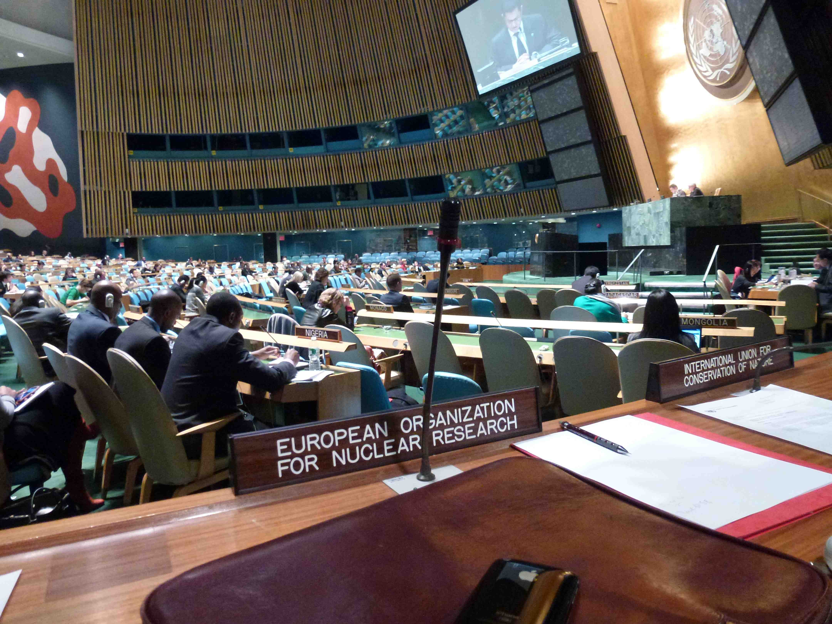
M. Bona – ITP, CERN, Nov 2022

Slide 6
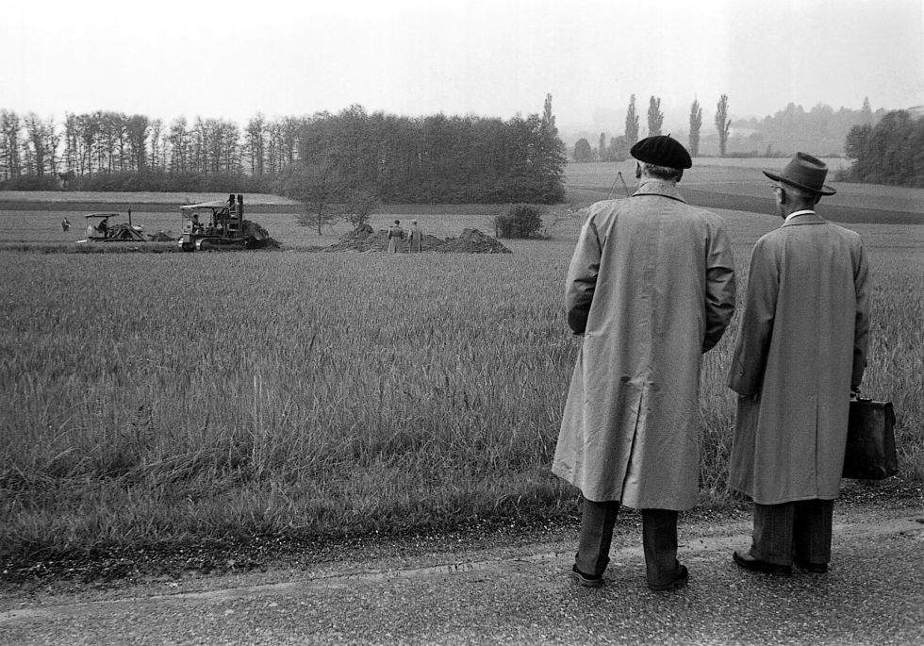
CERN – The very beginning
M. Bona – ITP, CERN, Nov 2022

Slide 7
• The CERN “parents”
A group of far-sighted scientists, politicians, diplomats,
intellectuals
• CERN’s main objectives
O. Carry out scientific programmes.
. Resume the dialogue after World War II among former belligerent
European Countries, and beyond.
• The CERN Convention (signed in 1953)
“The Organization shall have no concern with work for military
requirements and the results of its experimental and theoretical work
shall be published or otherwise made generally available” Org
M. Bona – ITP, CERN, Nov 2022

Slide 8
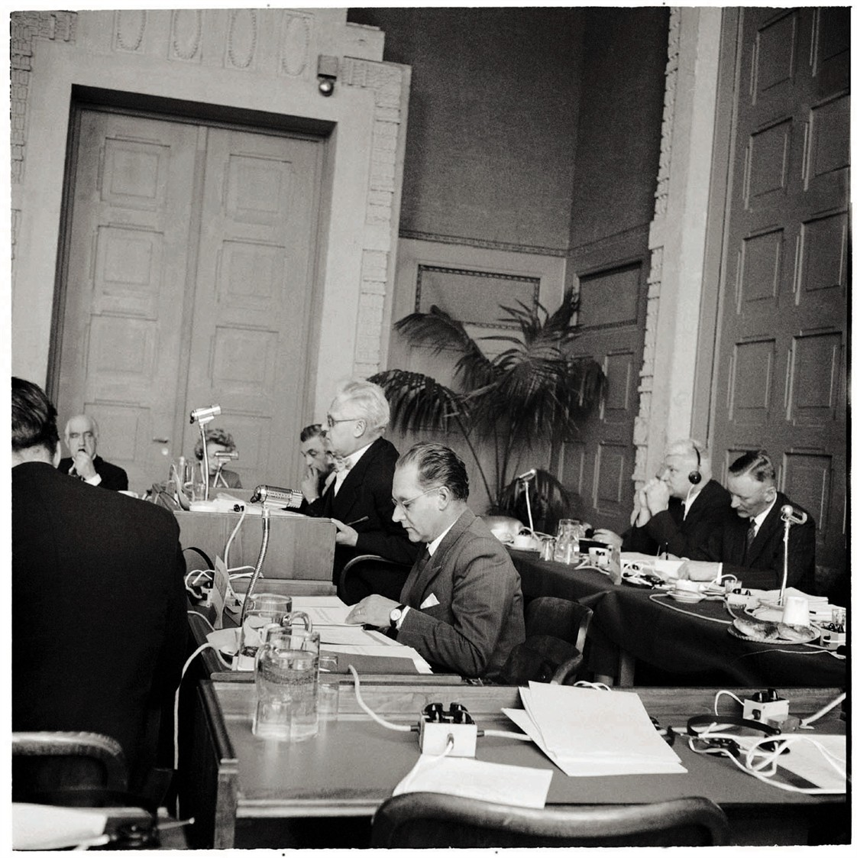
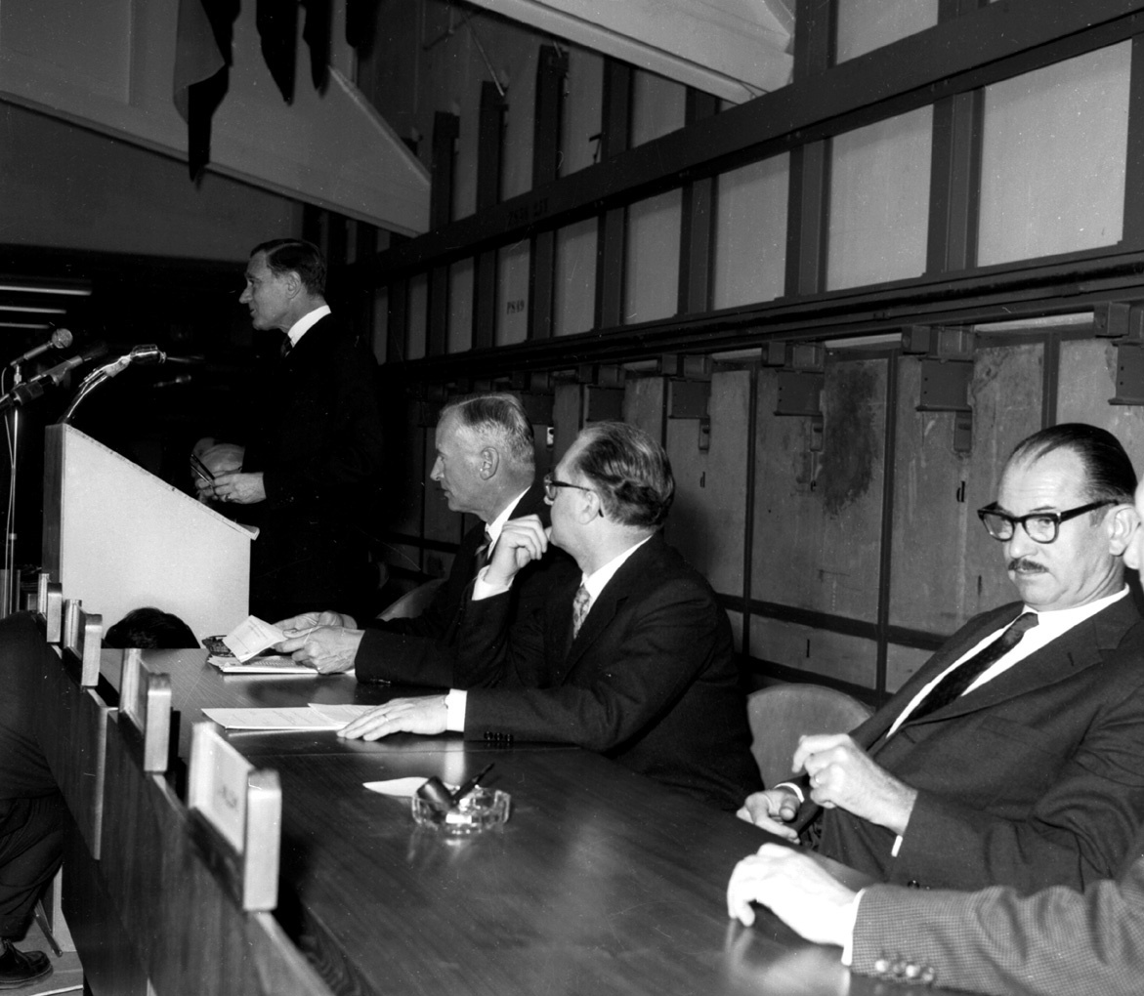
< First meeting of the provisional CERN Council, Feb 1952
“The only way to define Europe is to build it, not so much in time and space, but rather by continuing to refresh its own, universal, genius”.
Denis de Rougemont
F. de Rose at the inaguration of PS accelerator , 1960
M. Bona – ITP, CERN, Nov 2022

Slide 9
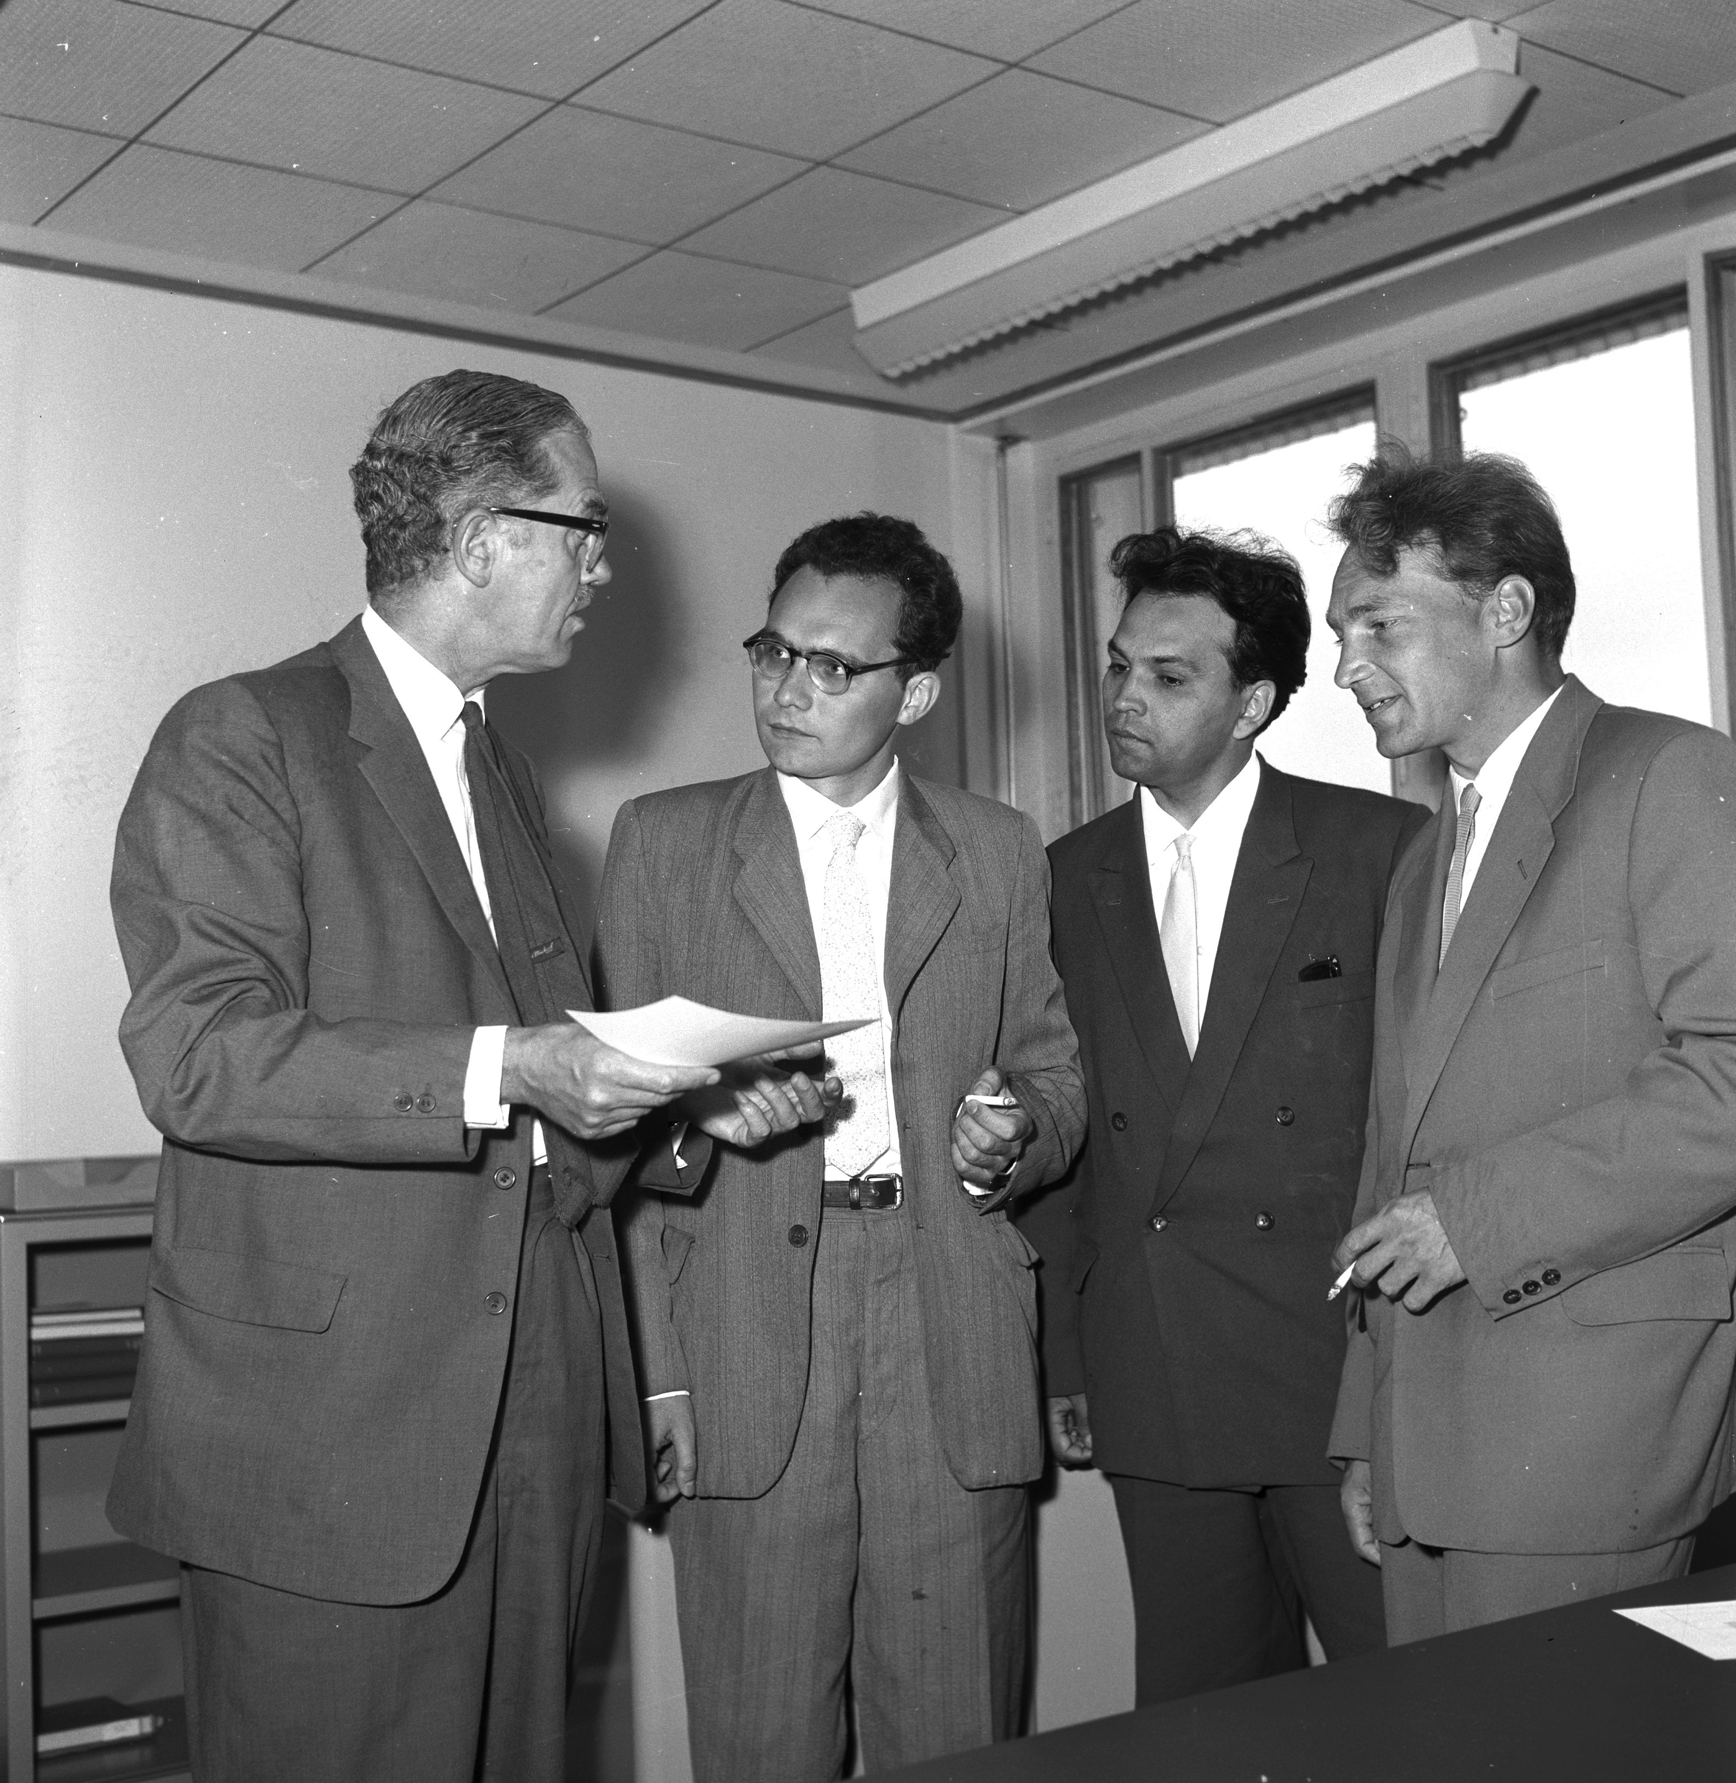
“Following CERN’s decision in 1959 to welcome Soviet scientists, the first long-term visitors from beyond the iron curtain arrived on 18 July 1960 for a stay of six months.”
CERN Courier Volume 1,
Number 12, July 1960
M. Bona – ITP, CERN, Nov 2022

Slide 10
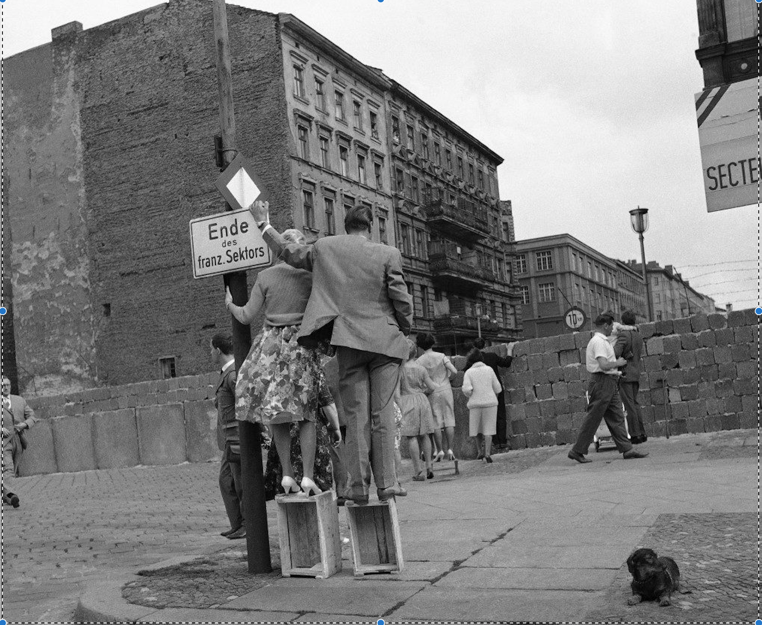
Berlin, 1961
(AP Photo/Worth) PA-9275541
M. Bona – ITP, CERN, Nov 2022

Slide 11
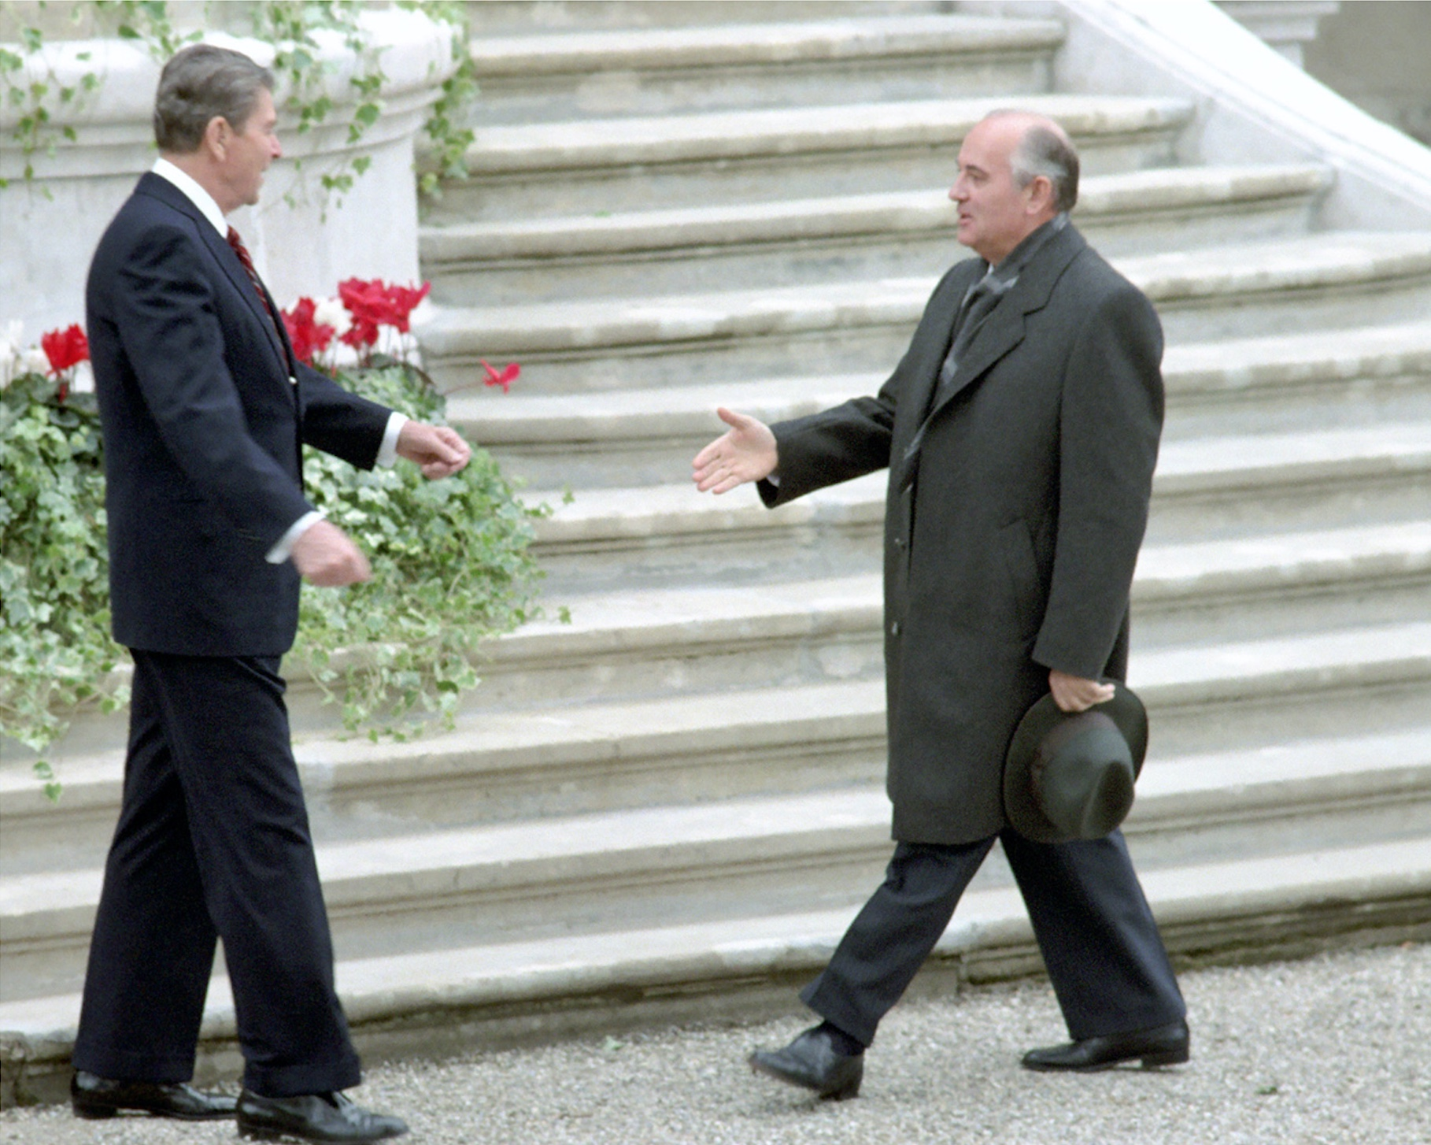
Ronald Reagan Presidential Library, C32042-10
Reagan - Gorbachev first meeting, Geneva 1985
M. Bona – ITP, CERN, Nov 2022

Slide 12
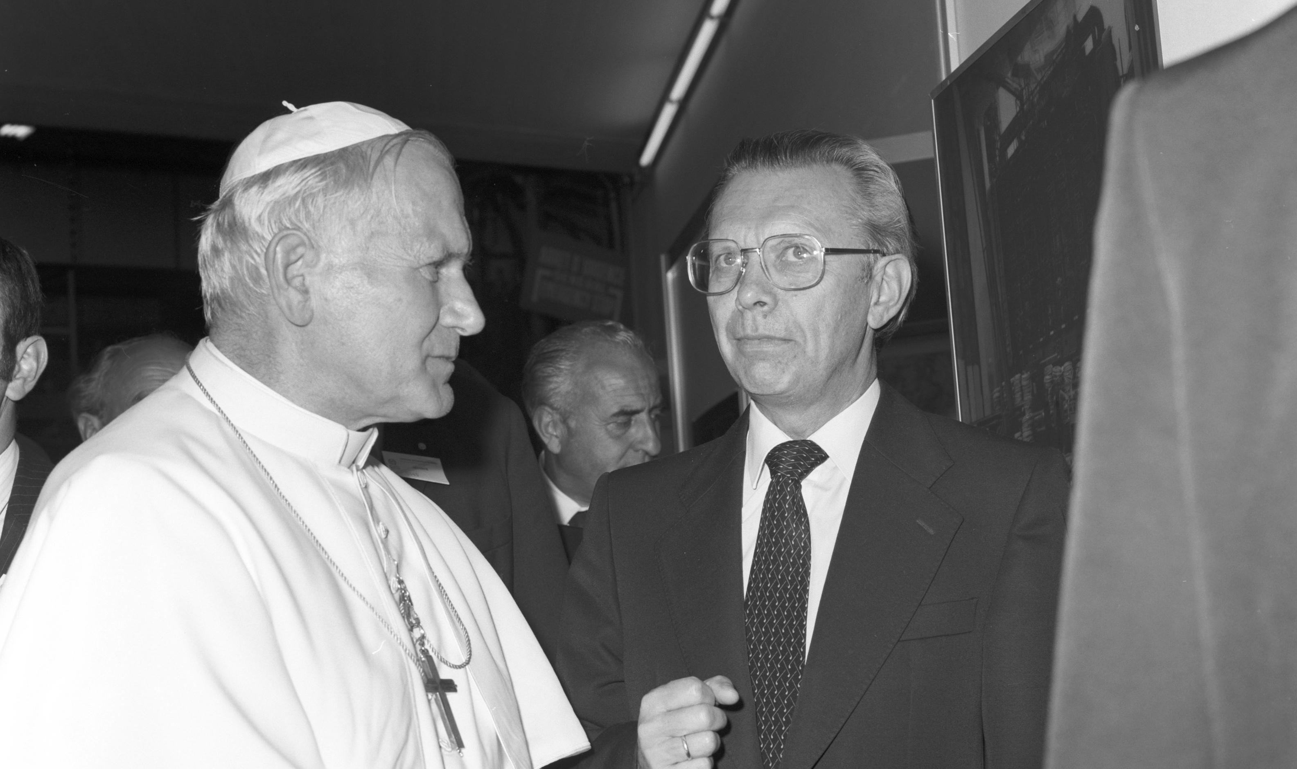
Pope J-P II and DG Schopper, CERN, Jun 1982
M. Bona – ITP, CERN, Nov 2022

Slide 13
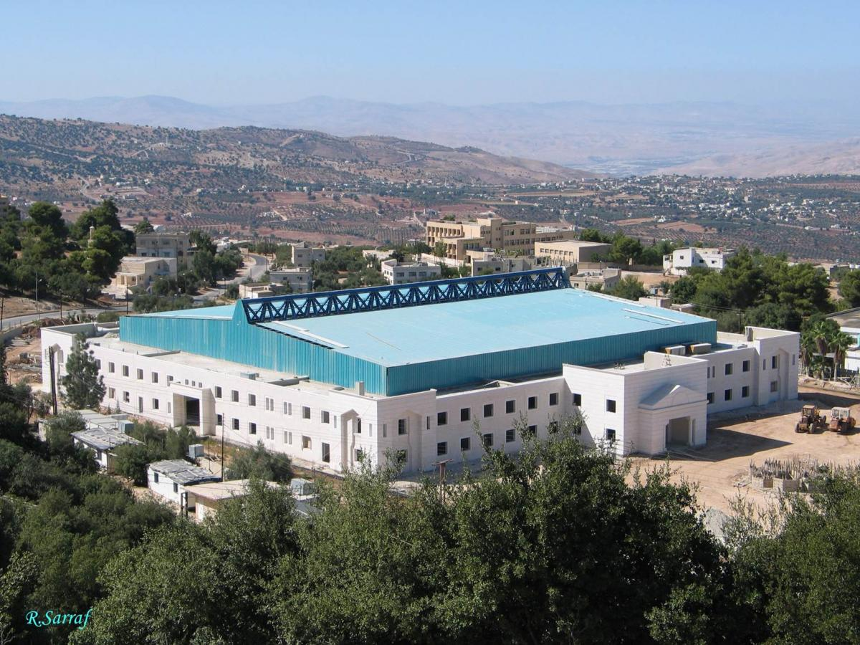
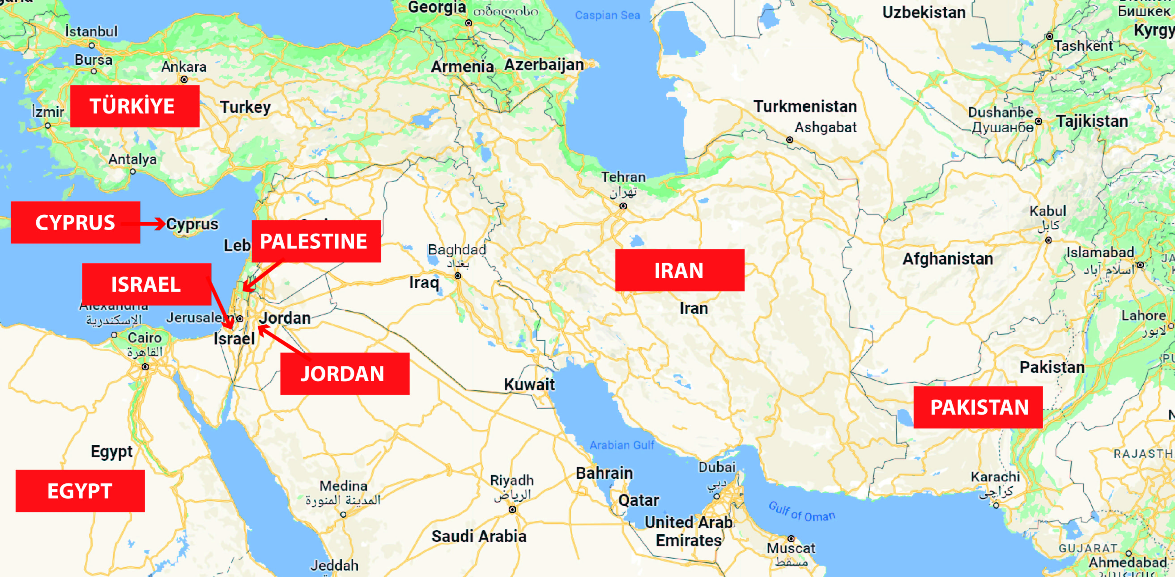
SESAME – Synchrotron-light
for Experimental Science and
Applications in the Middle East
Amman, Jordan
M. Bona
ITP, CERN, Nov 2022
Members (2017)

Slide 14
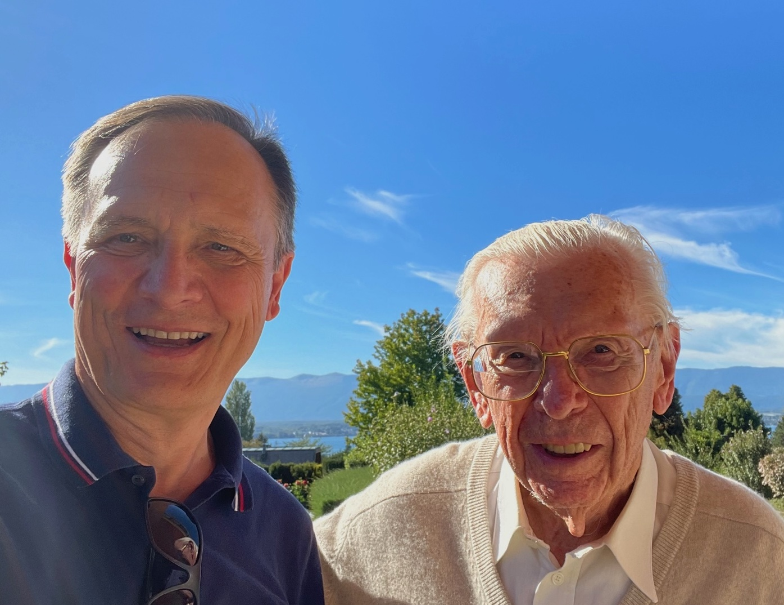
Prof. H. Schopper, Geneva, Sept 2022
M. Bona – ITP, CERN, Nov 2022

Slide 15
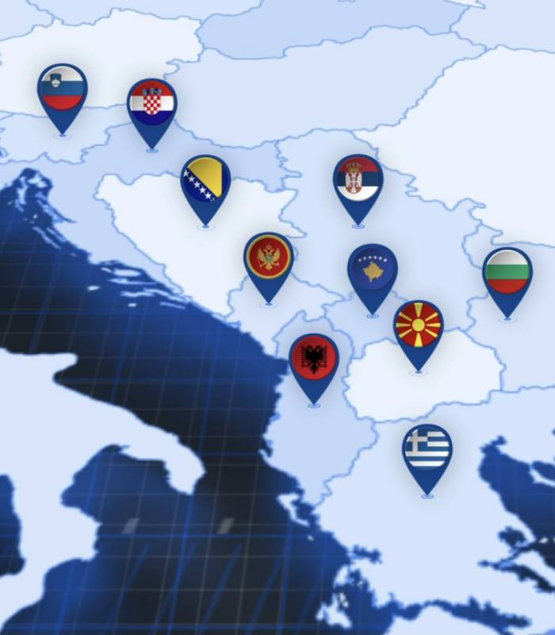
SEEIIST
South East
International Institute for
Sustainable Technologies
M. Bona – ITP, CERN, Nov 2022

Slide 16
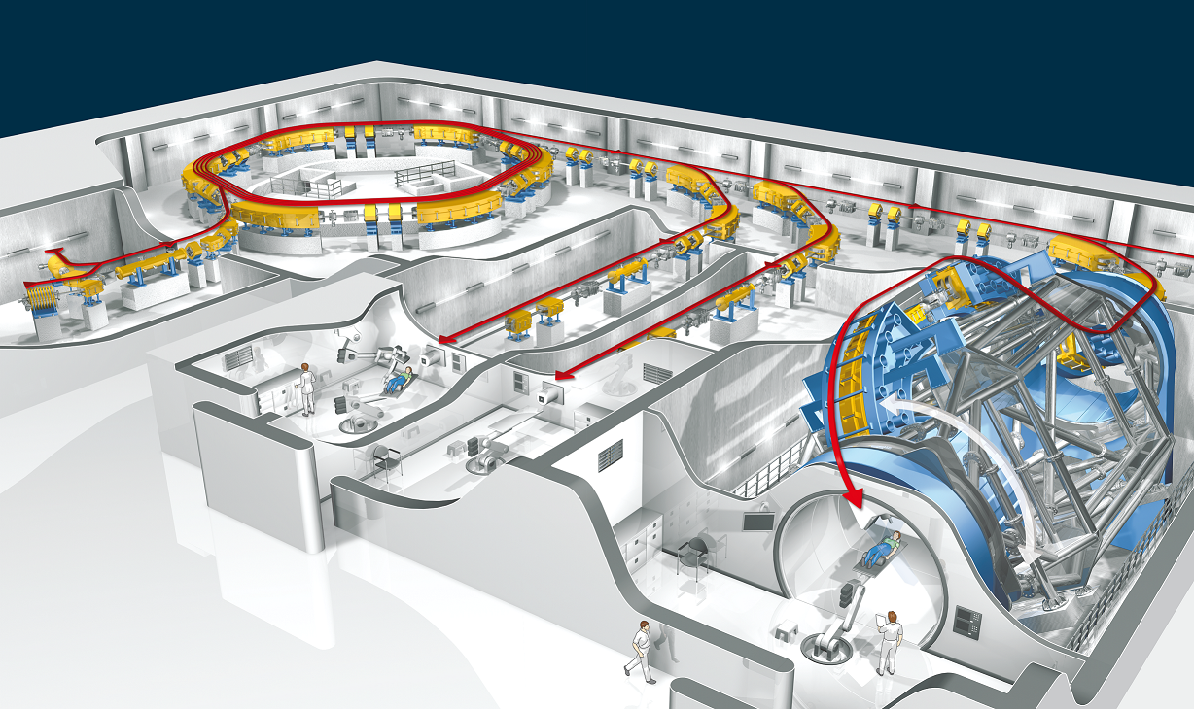
SEEIIST: Facility for Tumor Therapy and Biomedical Research with protons and heavier ions
About 500 patients per year to be treated as needed for a population of 20M.
In parallel, 50% of the beam time dedicated to biomedical research with multi-ion sources from H to Ne, making the SEEIIST project unique in the world. Capacity for about 1000 researchers, including a major number from Western Europe.
M. Bona – ITP, CERN, Nov 2022

Slide 17
SEEIIST Timeline to date
- 2016 Initial idea proposed by Herwig Schopper et al.
- 2017 Declaration of intent signed at CERN; kick-off
of the design phase (Oct)
- 2018 First contacts with Switzerland to get its neutral support
- 2021 . High-level political roundtable in Bern (Sept)
. Establishment of the WG on the Legal Framework
. Establishment of the WG on the Site Selection
- 2022 First in-person meeting of the WGs in Greece (Apr)
M. Bona – ITP, CERN, Nov 2022

Slide 18
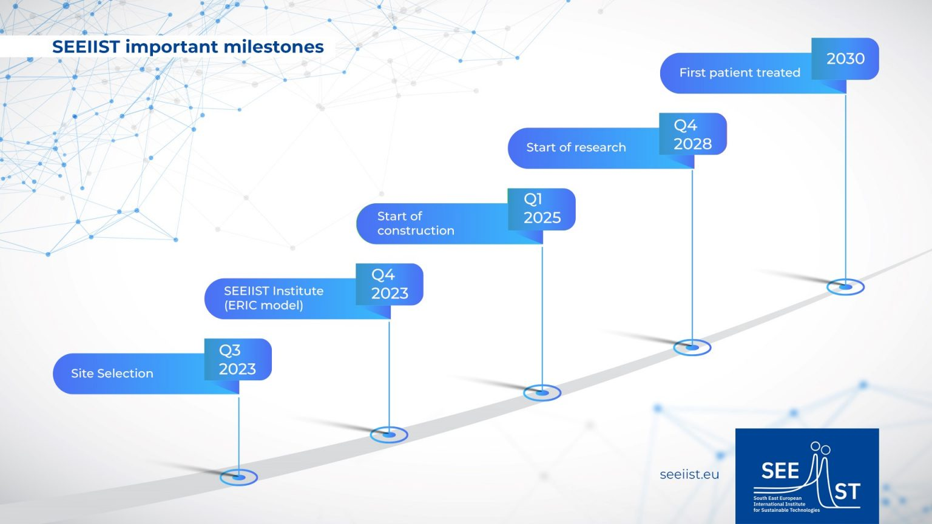
SEEIIST estimated cost: up to 200 MEUR. Multiple sources of financing necessary: EU Structural and cohesion funds, IPA funds, contributions from member-states, other investment funds … (source: Swiss DFAE)
M. Bona – ITP, CERN, Nov 2022

Slide 19
Science and peace
. How can science contribute to the intercultural
dialogue and to peace ?
M. Bona – ITP, CERN, Nov 2022

Slide 20
founded by Daniel Barenboim - Edward Said, 1999
“The West-Eastern Divan Orchestra ….. has bee
n sometimes described in a very flattering way for us as an “orchestra for peace”. Let me tell you something: this is not going to bring peace. What it can bring is understanding, the patience, the courage, and the curiosity to listen to the narrative of the other”
“… Let me tell you something: this is not going to bring peace. What it can bring is understanding, the patience, the courage, and the curiosity to listen to the narrative of the other”
Daniel Barenboim, Ramallah concert, August 2005.
M. Bona – UNIGE, Apr 2022
M. Bona – ITP, CERN, Nov 2022

Slide 21
Thank you for your attention !
M. Bona – ITP, CERN, Nov 2022

Slide 22
Reserve
In case of questions
M. Bona – ITP, CERN, Nov 2022

Slide 23
“Science diplomacy”
M. Bona – ITP, CERN, Nov 2022

Slide 24
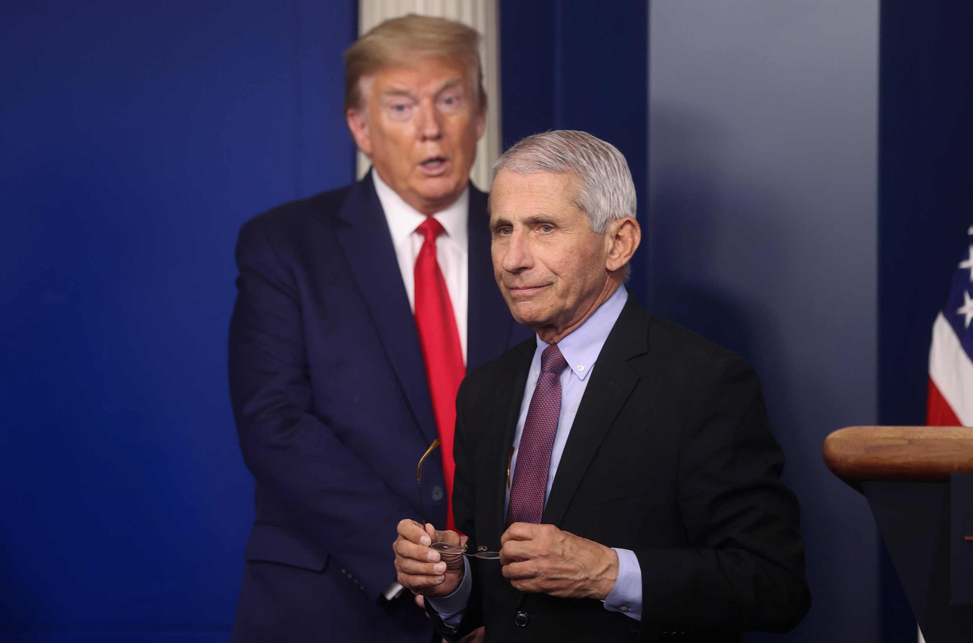
Jonathan Ernst, Reuters
M. Bona – ITP, CERN, Nov 2022

Slide 25
Science and diplomacy
Definitions of science diplomacy (from AAAS and Royal Society, 2010)
. Facilitating international science cooperation
Diplomacy for science
. Use science cooperation to improve international relations
between countries
Science for diplomacy
. Informing foreign policy objectives with scientific advice
Science in diplomacy
M. Bona – ITP, CERN, Nov 2022

Slide 26
Science and diplomacy
Definitions of science diplomacy (from AAAS and Royal Society, 2010)
. Facilitating international science cooperation
Diplomacy for science
. Use science cooperation to improve international relations
between countries
Science for diplomacy
. Informing foreign policy objectives with scientific advice
Science in diplomacy
M. Bona – ITP, CERN, Nov 2022

Slide 27
Extra slides
M. Bona – ITP, CERN, Nov 2022

Slide 28
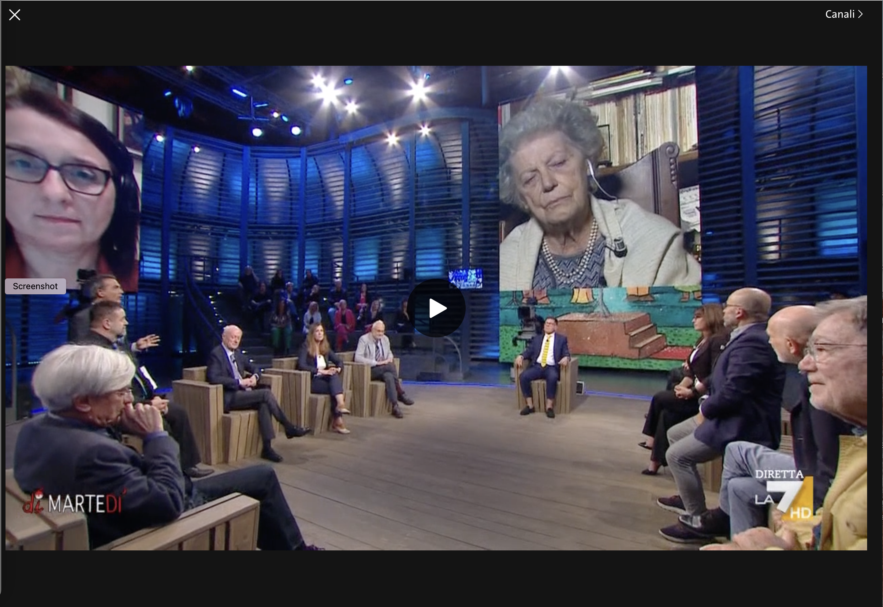
Dimartedì 4.10.2022
M. Bona – ITP, CERN, Nov 2022

Slide 29
July 1960
“Following CERN’s decision in 1959 to welcome Soviet scientists, the first long-term visitors from beyond the iron curtain arrived on 18 July 1960 for a stay of six months.”
17 June 2022
CERN Council statement
“At its 208th meeting yesterday, the CERN Council …. declared that it intends to terminate CERN’s International Cooperation Agreements (ICAs) with the Russian Federation and the Republic of Belarus at their expiration dates in 2024.” …
M. Bona – ITP, CERN, Nov 2022

Slide 30

https://www.iybssd2022.org/en/home/
M. Bona – ITP, CERN, Nov 2022

