Slide 1

HITRIplus overview and
CNAO experience and opportunities
Sandro Rossi
Director General - CNAO Foundation
HITRIplus Coordinator
SC SEEIIST – Thessaloniki 4 April 2022

Slide 2





















SEEIIST
(Courtesy of Sanja Damjanovic – Budva 18/9/2019)
HITRI – Hadron Ion Therapy Research Infrastructure
Design Study Proposal – EU H2020 INFRADEV-01-2019-2020 call
TIARA prepared
to give advice
HITRI Consortium
Several beneficiaries from SEE Region through SEEIIST

Slide 3
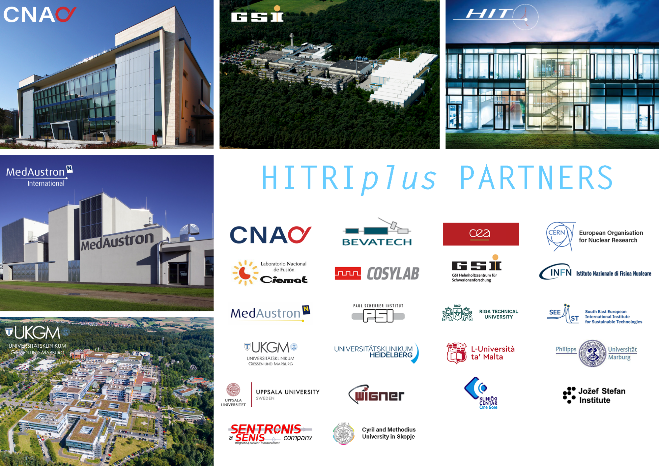

Slide 4
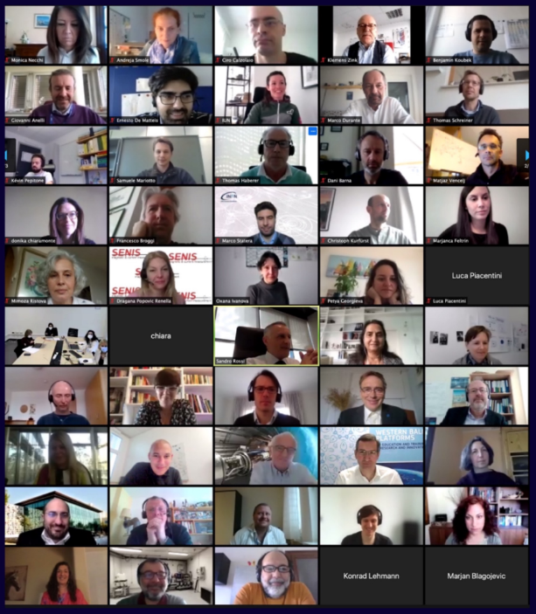

Duration: 4 years
Funded 5 mEuro

Slide 5
HITRIplus Objectives
1. To integrate, open up and broaden the leading European Research Infrastructure for the treatment of cancer with beams of ions, ranging from helium to carbon and to heavier ions.
2. To coordinate and strengthen the research programmes on heavy ion therapy of different European institutions, by promoting synergies, collaborations, innovation, knowledge transfer, new initiatives and sharing of tools and data.
3. To develop in a joint and coordinated way novel technologies to improve the accelerators and their ancillary systems that provide particle beams to this scientific community. These technologies will improve the present generation of facilities and will be the foundation for a next generation European design for ion therapy facilities.
4. To establish a European multidisciplinary community for heavy ion therapy research, aiming at improving treatment strategies and modalities by connecting physics and engineering with medicine, biology and biophysics, and to extend this community towards emerging European regions, addressing in particular new initiatives in South East Europe.
5. To define the main technical features and the scientific programme of a future pan-European Research Infrastructure for medical and radiobiological research with heavy ion beams, to be built in South East Europe or in another European region.

Slide 6
General Assembly
SEEIIST (Chair: S. Damjanovic)
1 representative per Party
PROJECT MANAGEMENT
(WP1+WP13)
External Scientific Advisory Board
Advisory Board for ethical/legal/industrial issues
Coordinator
Sandro Rossi (CNAO)
Deputy Coordinator
Maurizio Vretenar (CERN)
Central Project Office
A. Facoetti (CNAO)
Technical Project Board (coordinator + pillar coordinators)
NA: M. Dosanjh (SEEIIST) – TNA: M. Durante (GSI) – JRA: M. Vretenar (CERN)
Network Activities
Transnational Access
Joint Research Activities

Slide 7
SEEIIST’s role in HITRIplus
WP1 - Project Management (Manjit Dosanjh , Petya Georgieva)
Task 1.2: Scientific and Technical Management
Task 1.3: Coordination of Participants, Communication and Meeting Organisation
WP2 - NA1 - Networking and communication, dissemination and outreach (leader) (Manjit Dosanjh, Petya Georgieva)
Task 2.1: Coordination of Communication tools
Task 2.2: Building the user community
Task 2.3. Dissemination and outreach
WP5 - NA4 - Education and training (Manjit Dosanjh , Petya Georgieva, UKIM and CMSM as collaborating Institutes (Mimoza Ristova, Sanja Damjanovic))
Task 5.1: Specialised courses on heavy ion therapy research and infrastructure
Task 5.3: Provide e-learning course material on heavy ion therapy
WP7 - JRA1- Advanced accelerator and gantry design (Elena Benedetto, Marius Sapinsky)
Task 7.1: Coordination and Communication
Task 7.2: Synchrotron and Advanced Components Design
Task 7.3: Operational modes, beam transport and instrumentation
Task 7.4: Injector Linac Design
Task 7.5: Integration of an innovative superconducting gantry: optics, mechanics, beam delivery
WP8 - JRA2 - Superconducting magnet design (Sentronis as collaborating Institute)
Task 8.4: Construction of a small size magnet demonstrator for accelerator and gantry
WP11 - JRA5 - Controls and Safety (Jožef Stefan Institute as collaborating Institute)
Task 11.2: Machine controls
SEEIIST beneficiary and responsible of 17% of the HITRIplus budget (845 kEuro)

Slide 8
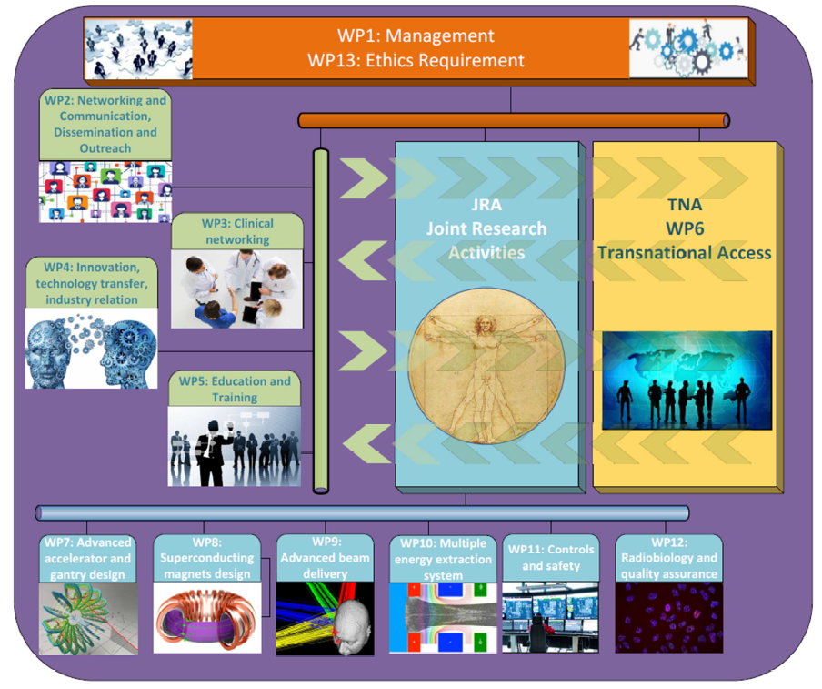
Notes:
Maximum

Slide 9
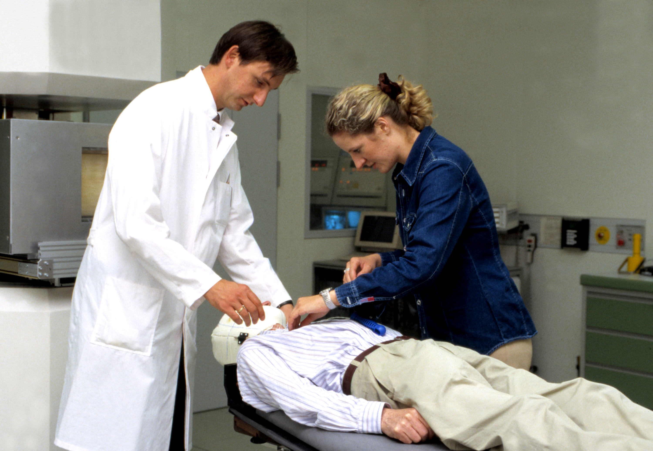
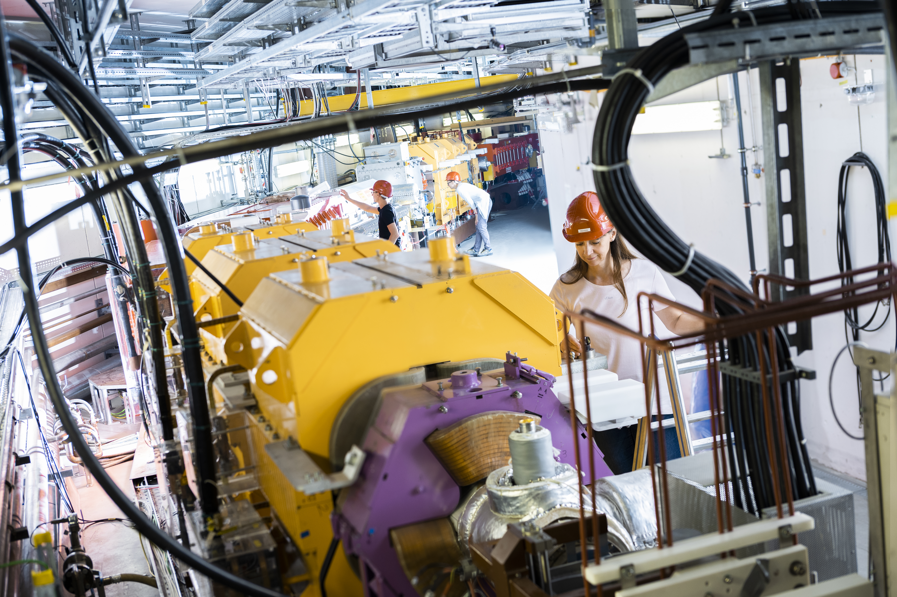
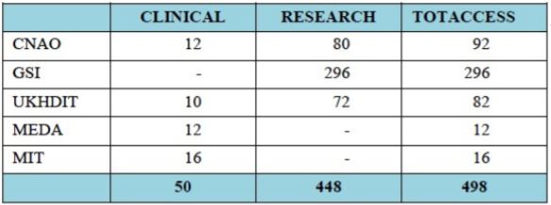
WP6: Transnational Access
The Clinical Access gives the opportunity to clinicians/medical physicists/technicians referring patients to the hadrontherapy facilities to personally follow patient’s treatment and follow up.
The Research Access will attract universities, research centres, and hospitals, which will connect all the groups to perform research activities with carbon ion beams. Industrial partners are also encouraged to take part in the research programme, to be involved in the development of new clinical procedures and new medical devices.
Available and effective
Capacity Building
in SEE Countries
for Clinicians and Researchers
www.hitriplus.eu
Big opportunity for SEEIIST Members!!!
62 hours of Research Access used !

Slide 10
Networking Activities: communication, dissemination and outreach, clinical networking, innovation technology transfer and industry relations, education and training;
Transnational Access: to promote the access to the existing facilities of the research and clinical communities;
Joint Research Activities: improved accelerator and gantry design, superconducting magnet design, advanced beam delivery, multiple energy extraction system, controls and safety, radiobiological dosimetry and Quality Assurance.

Slide 11
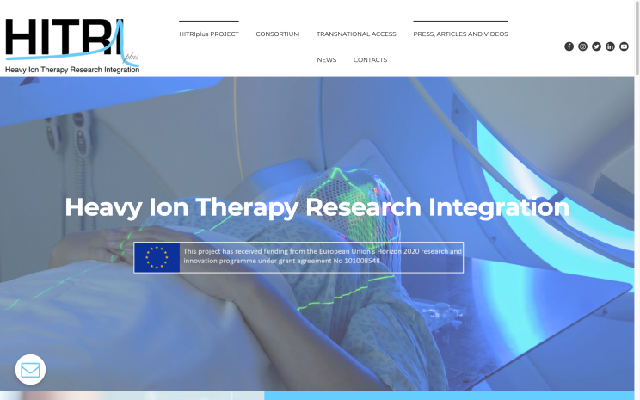

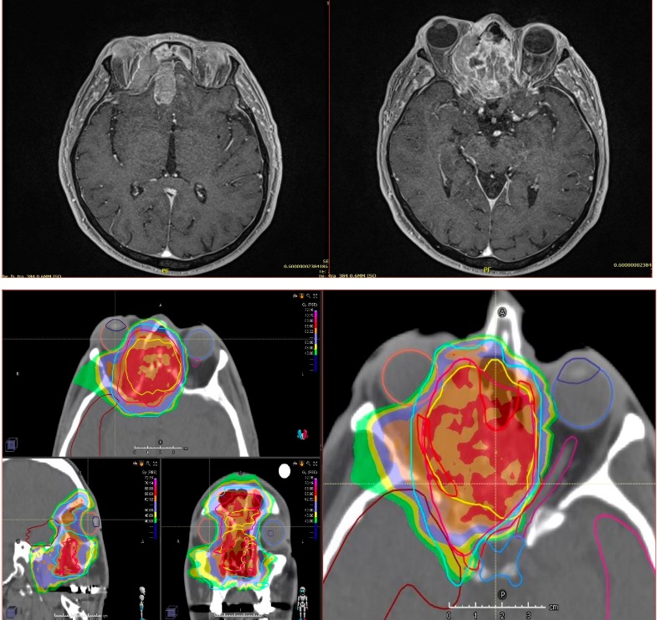
WP2: Network and Communication
Dissemination and Outreach
HITRIplus monthly seminars
WP3: Clinical networking
Design one trial as a template for bringing innovative heavy ion therapy approaches in the clinics
Set up a European registry to collect data on rare cancers treated with heavy ion therapy
Review existing data on OARs dose costraints in use in the clinical facilities
11

Slide 12
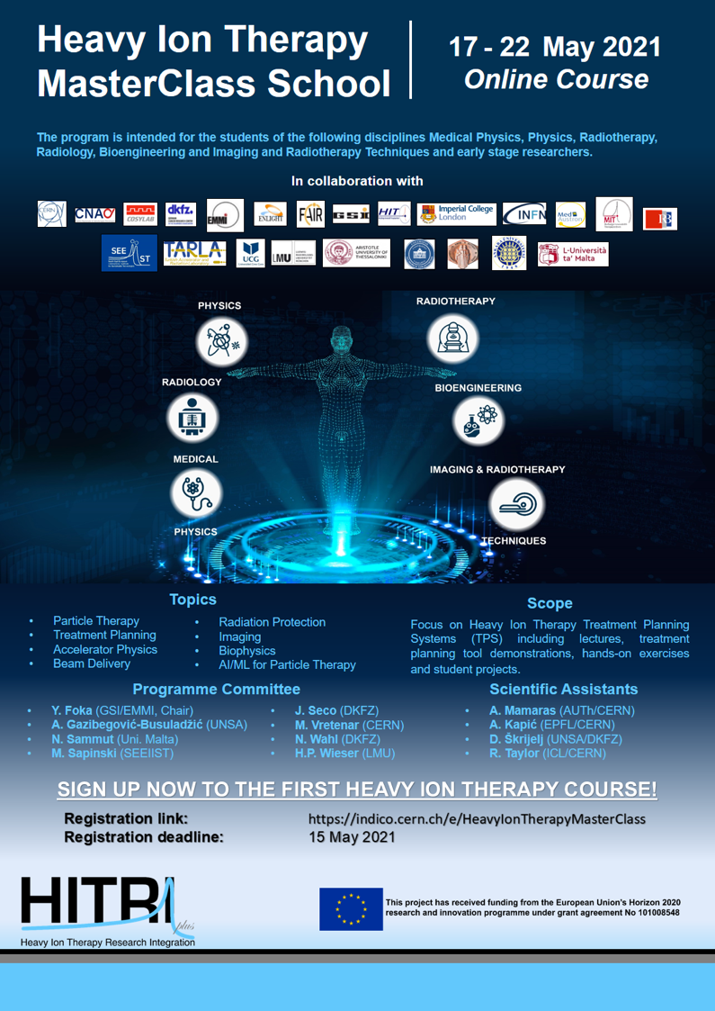
WP4: Innovation, technology transfer, industry relation
WP5: Education and training
Secondments & Internships
Postgraduate students, postdocs, academic researchers, industrial researchers, oncology practitioners
Provide first-class unique scientific opportunity to join day-to-day work of research teams and participate in experiments to learn best practices
Enable participants to become facility users
45 weeks of grants
3+2 positions starting soon
1050 registrants
600 avg attendes/day

Slide 13
Networking Activities: communication, dissemination and outreach, clinical networking, innovation technology transfer and industry relations, education and training;
Transnational Access: to promote the access to the existing facilities of the research and clinical communities;
Joint Research Activities: improved accelerator and gantry design, superconducting magnet design, advanced beam delivery, multiple energy extraction system, controls and safety, radiobiological dosimetry and Quality Assurance.

Slide 14
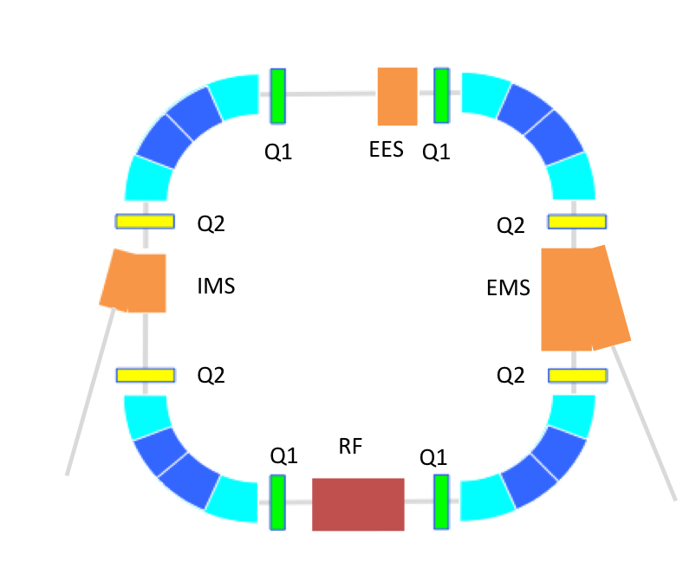
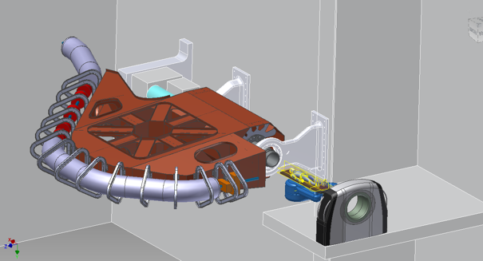
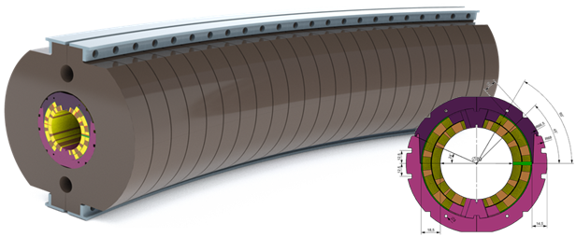
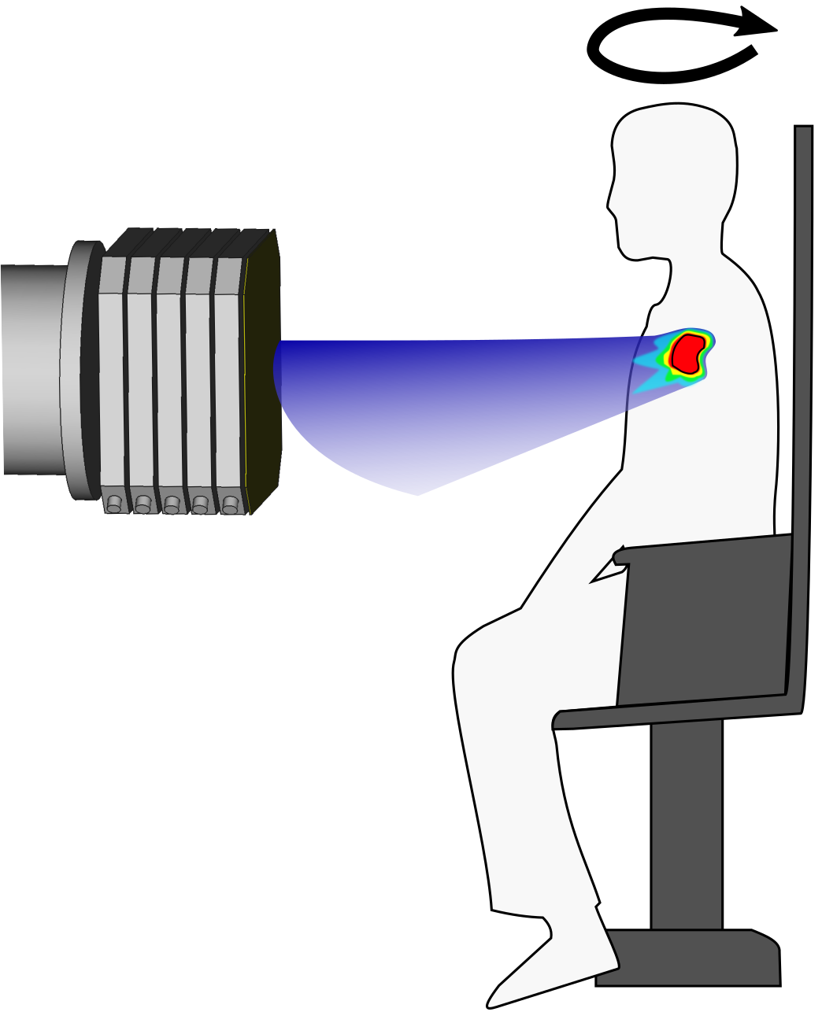
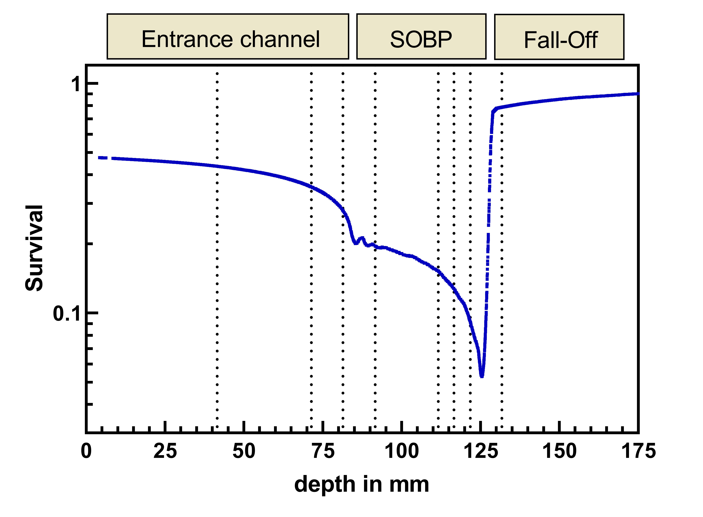
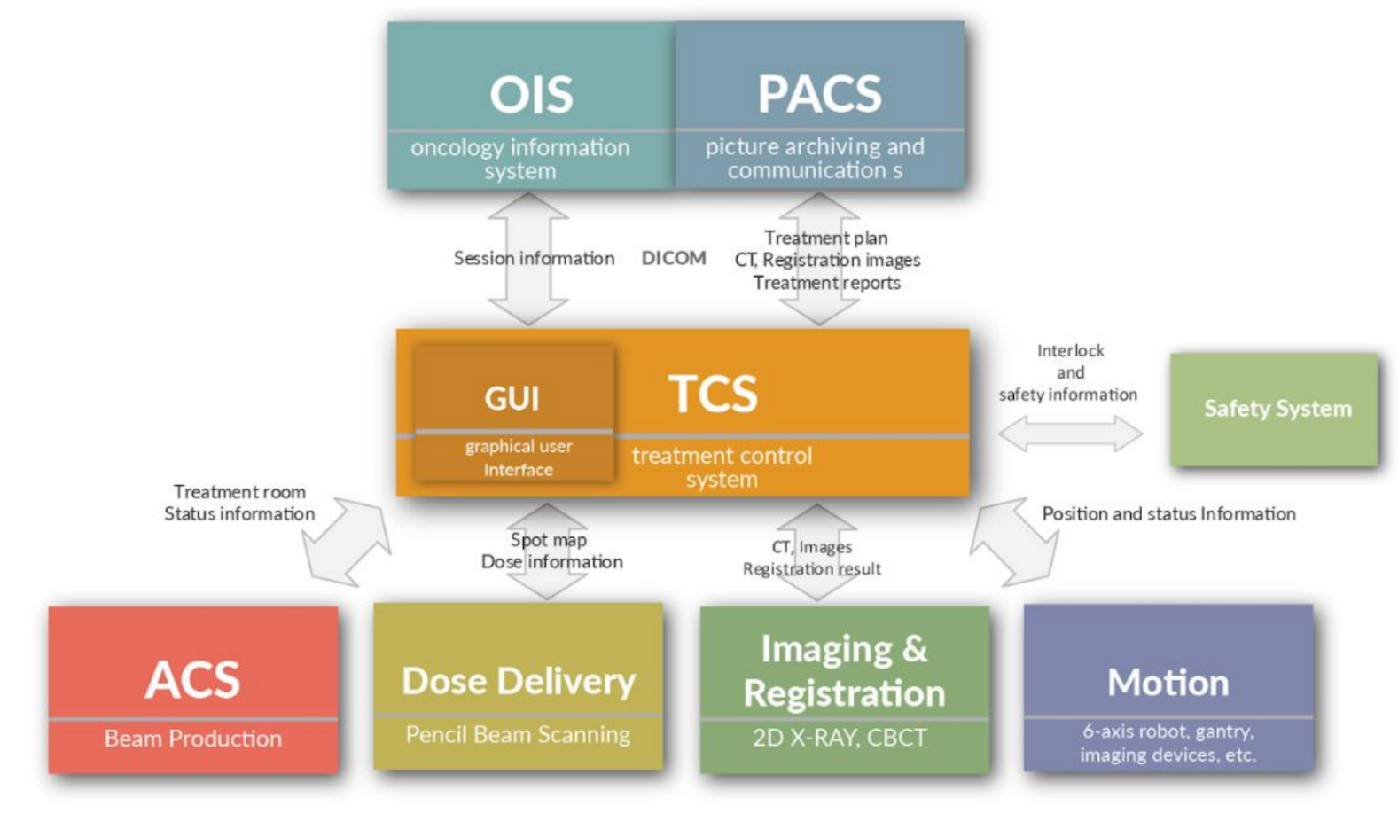
WP8
WP7
HITRIplus
JRA
WP9
WP12
WP11
WP10

Slide 15
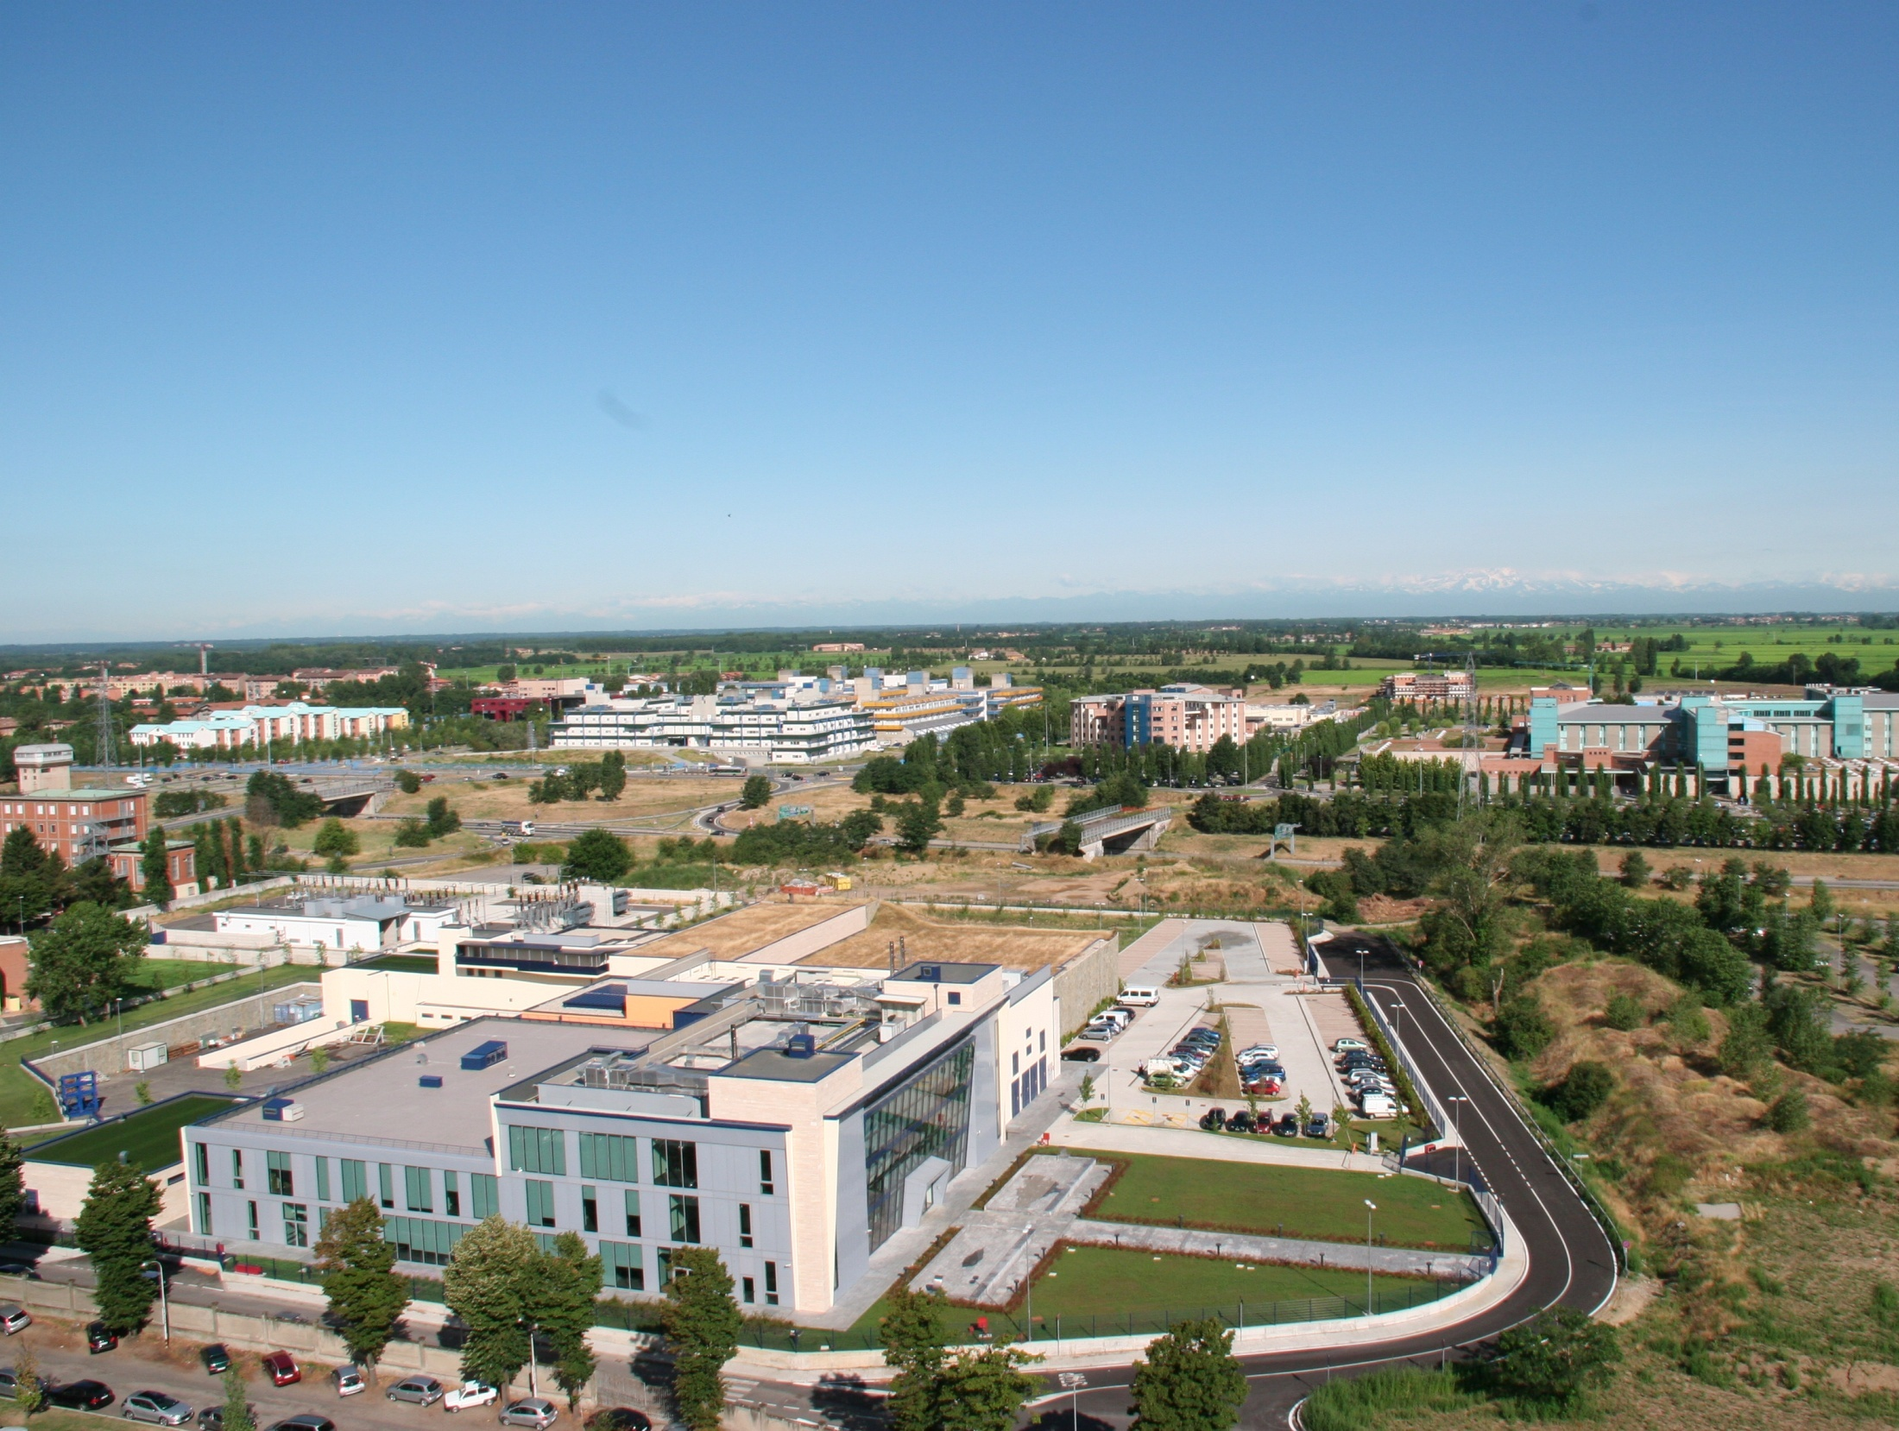
Not-for-profit private Foundation
Created by the Italian Ministry of Health in 2001
with the purpose to build and run a hadrontherapy Centre
7 Novembre 2005

Slide 16
From 1996 to 1999 at CERN
PIMMS (Proton-Ions Medical Machine Study)
CERN-GSI-MedAUSTRON-Oncology2000-TERA
PL: P. Bryant (CERN+experts)
PAC: G. Brianti chairman
TERA: 25 man×yrs
MedA.: 10 man×yrs
O2000: 3 man×yrs
GSI: experts advices
Objective: define the optimal hadrontherapy centre without constraints

Slide 17
Collaboration agreements: fundamental contracts for construction and presently for technology R&D
NATIONAL
TERA Foundation: final design and high tech specifications
INFN: technical issues, radiobiology, research, formation
University of Milan: medical coordination and formation
University of Pavia: technical issues, radiobiology, formation
Polytechnic of Milan: patient positioning, radioprotection, authorisations
INTERNATIONAL
CERN (Geneva): technical tasks, PIMMS
GSI (Darmstadt): linac and special components
LPSC (Grenoble): technical tasks
NIRS (Chiba): medical activities, radiobiology, formation

Slide 18
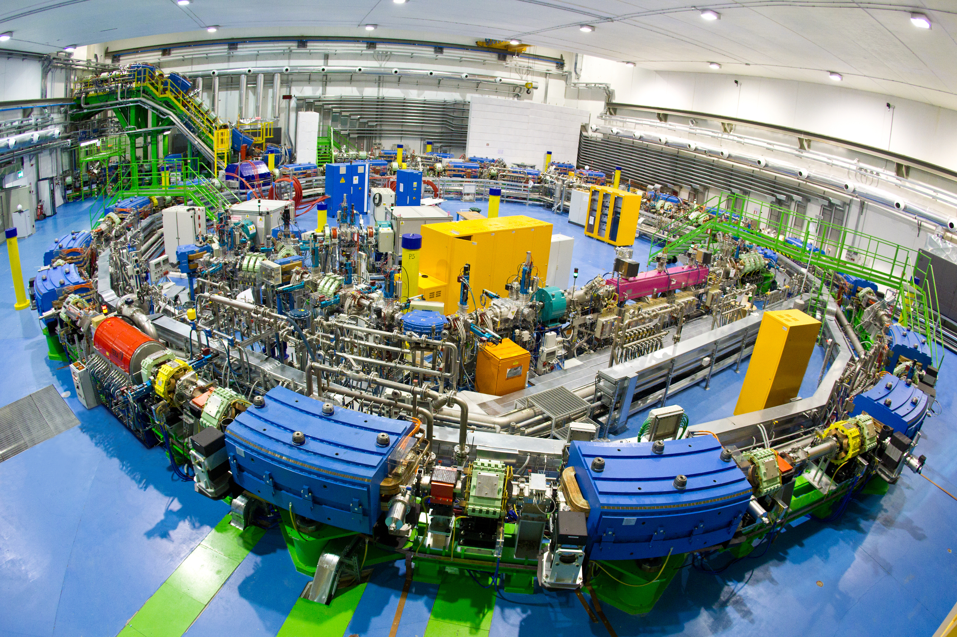
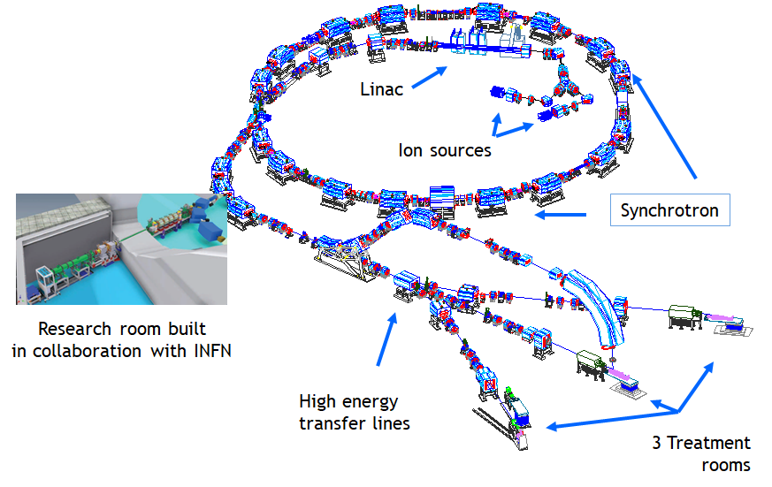
Sources
to generate
Linac
to pre-accelerate
1 RF cavity
to accelerate
16 Dipoles
to bend
20 Correctors
to steer
24 Quadrupoles
to focus

Slide 19
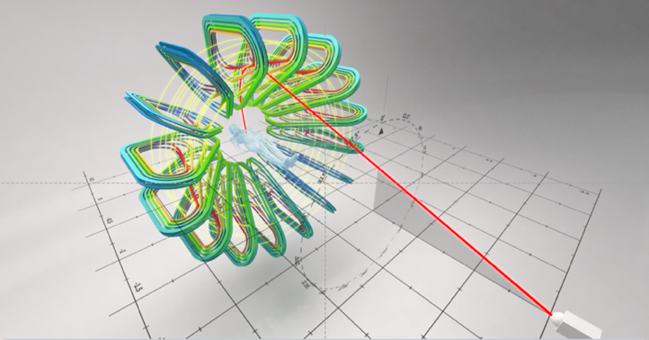

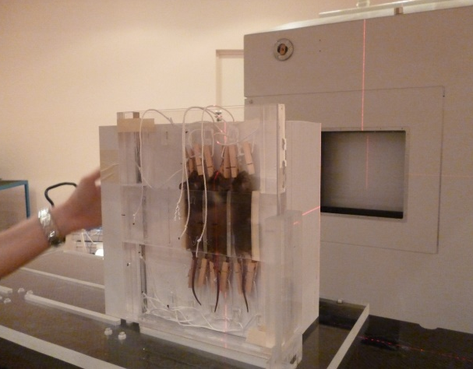

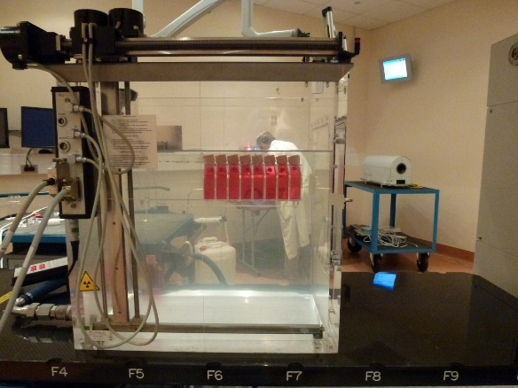
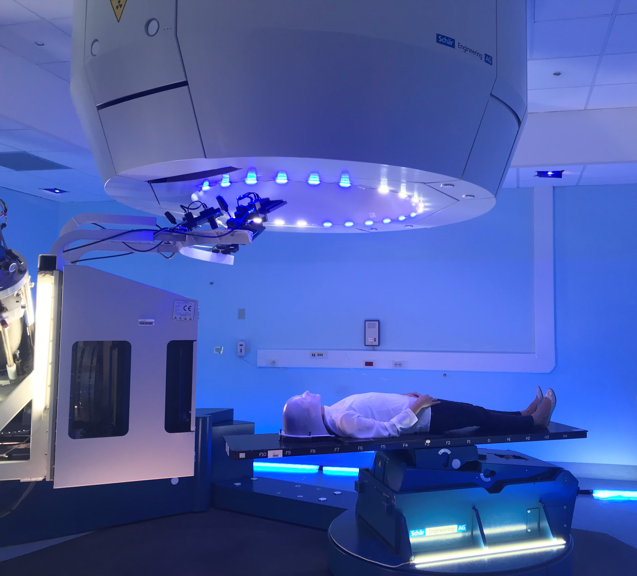
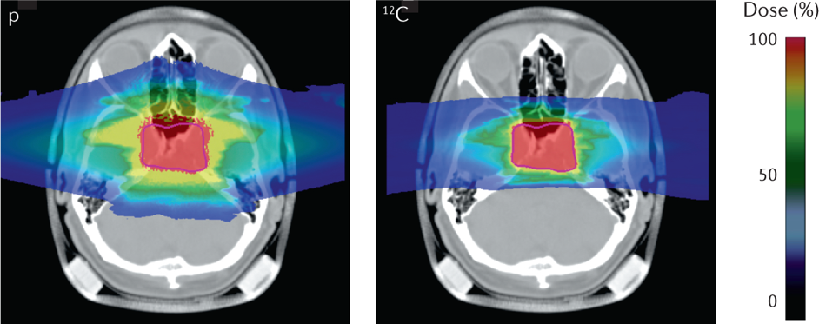
Medicine and Biology
The Hadron School
(PhD Courses IUSS-CNAO)
Risk and complexity in high-tech medical innovation
Physics and Engineering
Management and Innovation
Research
Post-graduate Education
Clinical Activities

Slide 20
Patients treated at CNAO: 3900
55% carbons – 45% protons
CE clinical trials
2020
2019
2021
Patients per year

Slide 21
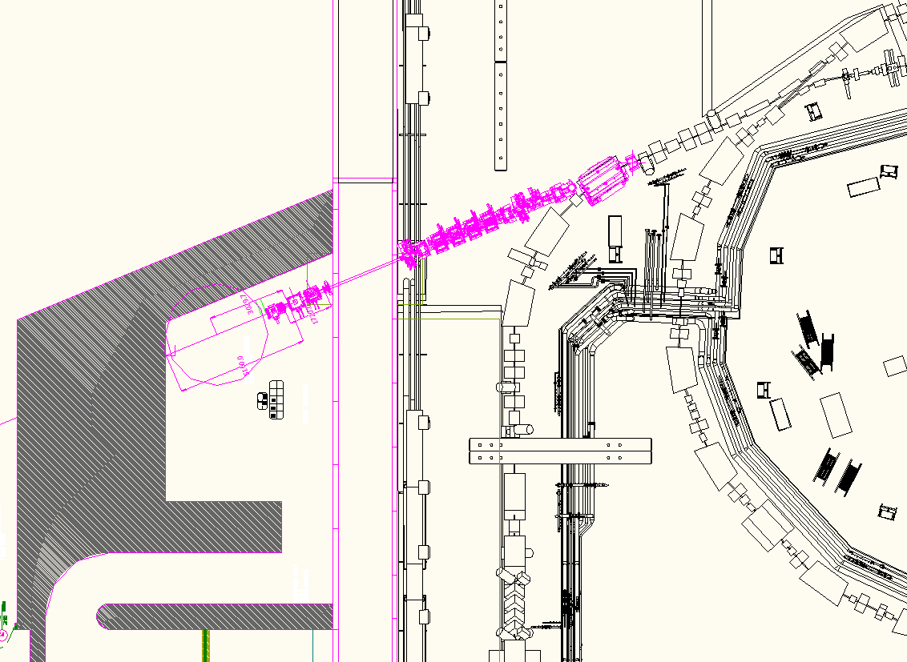
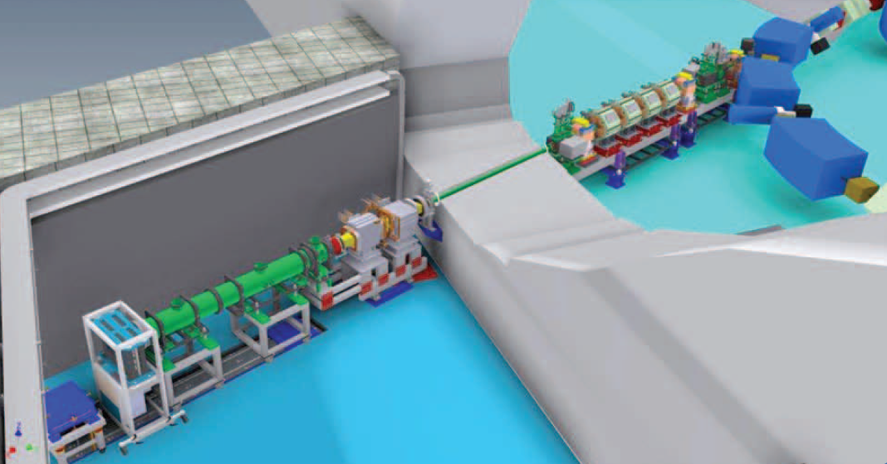
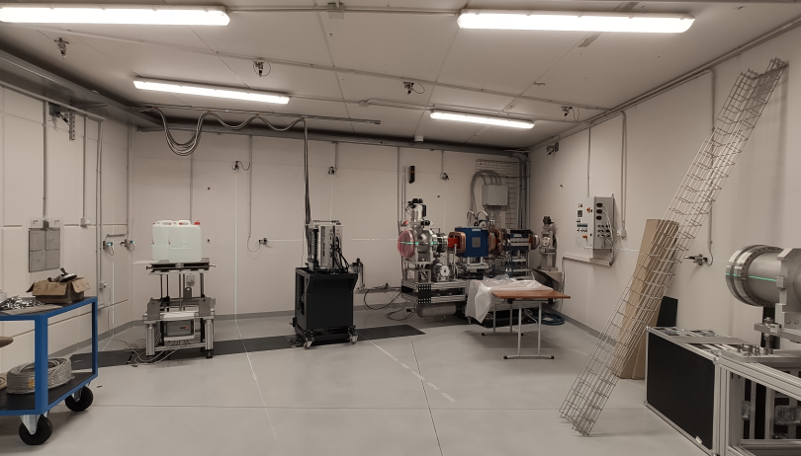
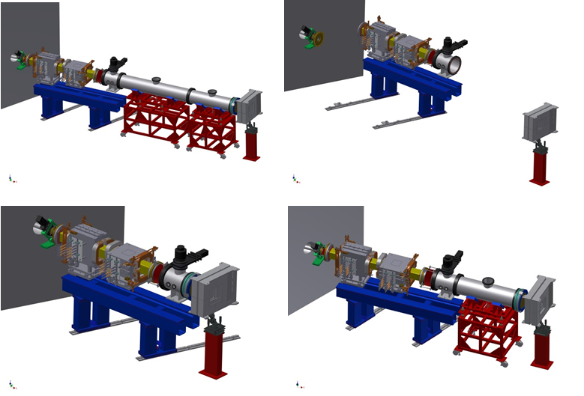
Experimental programmes
(besides clinical trials)
Radiobiology: pre-clinical radiobiology is an essential tool to support new therapy solutions, such as the novel combined use of particle therapy with immunotherapy and radio-genomics for patient selection and personalized medicine. Basic radiobiology studies are also important for space radiation protection.
Animal Studies: the majority of the radiobiology studies need animal models, generally rodents, including genetically modified animals. In collaboration with UniPv, CNAO will provide on-site state-of-the-art animal facilities and tools to enable modern radiobiological research.
Medical Physics: ultra-fast dose delivery methods will extend ion therapy to the very promising group of moving organs, while new synchrotron extractions and delivery systems will allow FLASH irradiations. Tomography with helium ions – possibly extracted together with C-ions – together with ion-acoustic imaging promise to reduce range uncertainties. Moreover, real-time techniques generate information and pave the way to adaptive treatments.
Material science: the beams available at CNAO give the opportunity for testing radiation hardness of shielding materials, space microelectronics, and production of nanotubes.

Slide 22
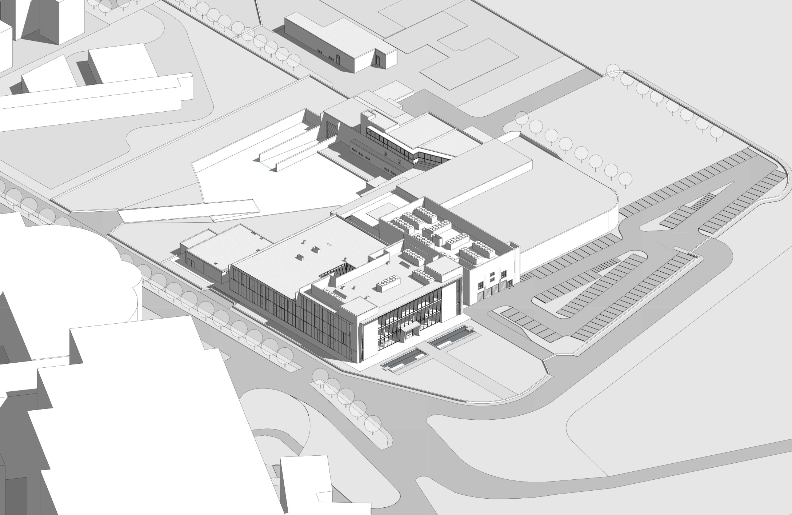
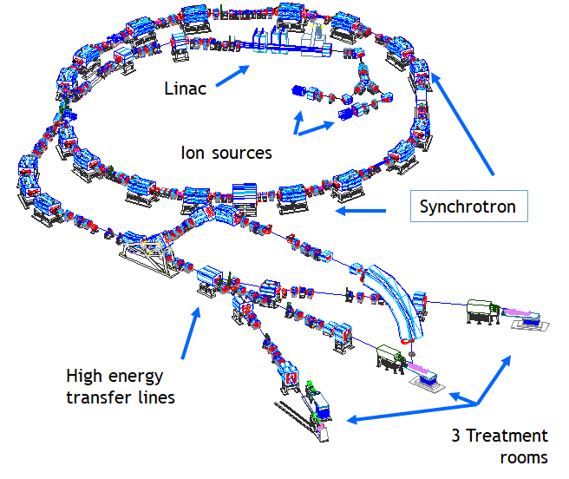
Present layout
Expansion area
Synchrotron vault
Hospital building

Slide 23
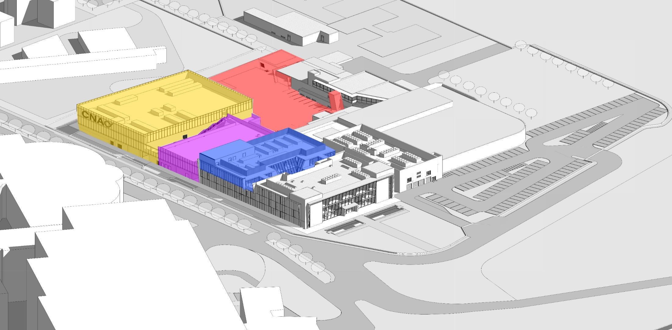
Layout end 2023
NEW BUILDING FOR HIGH TECH
NEW BUILDING
FOR RESEARCH
NEW 2ND FLOOR IN
CLINICAL INFRASTRUCTURE
Synchrotron vault

Slide 24
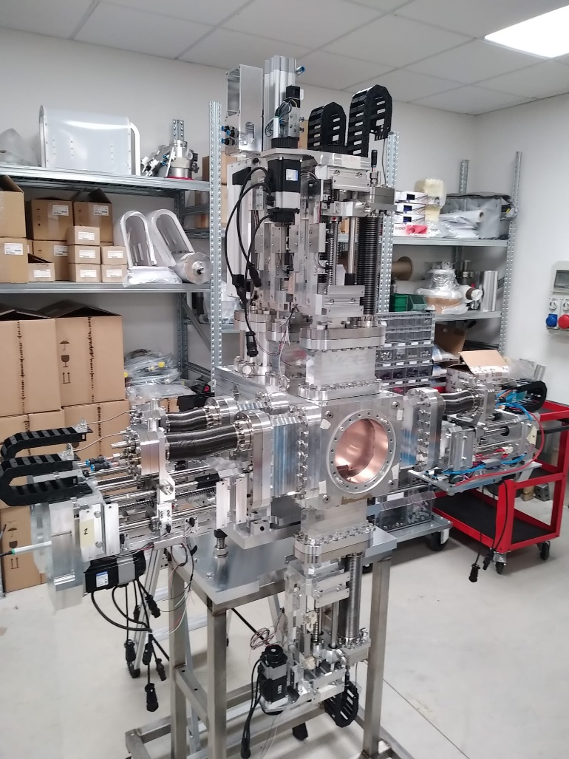
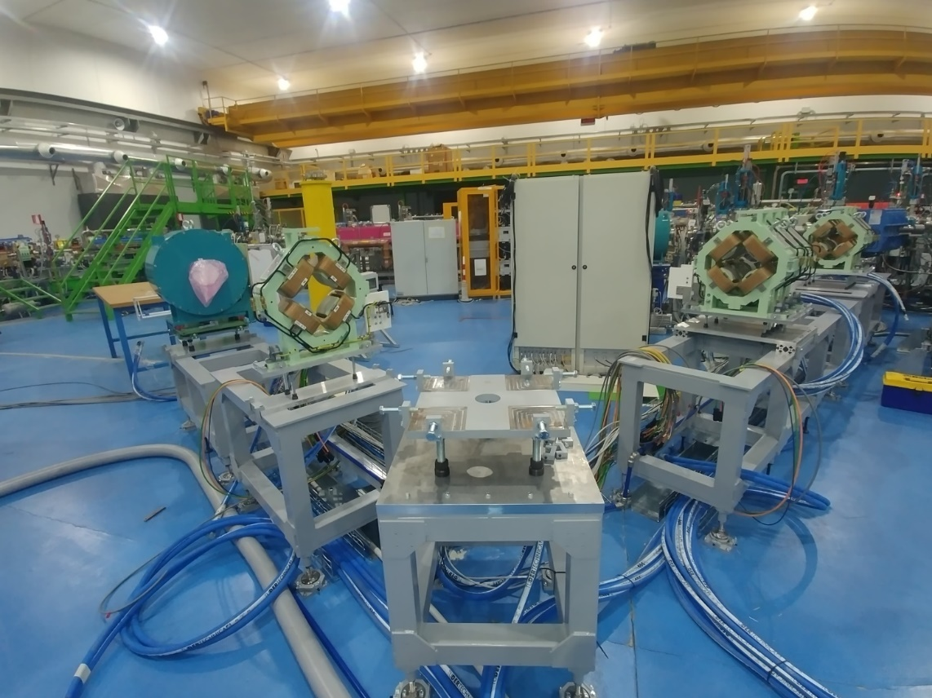
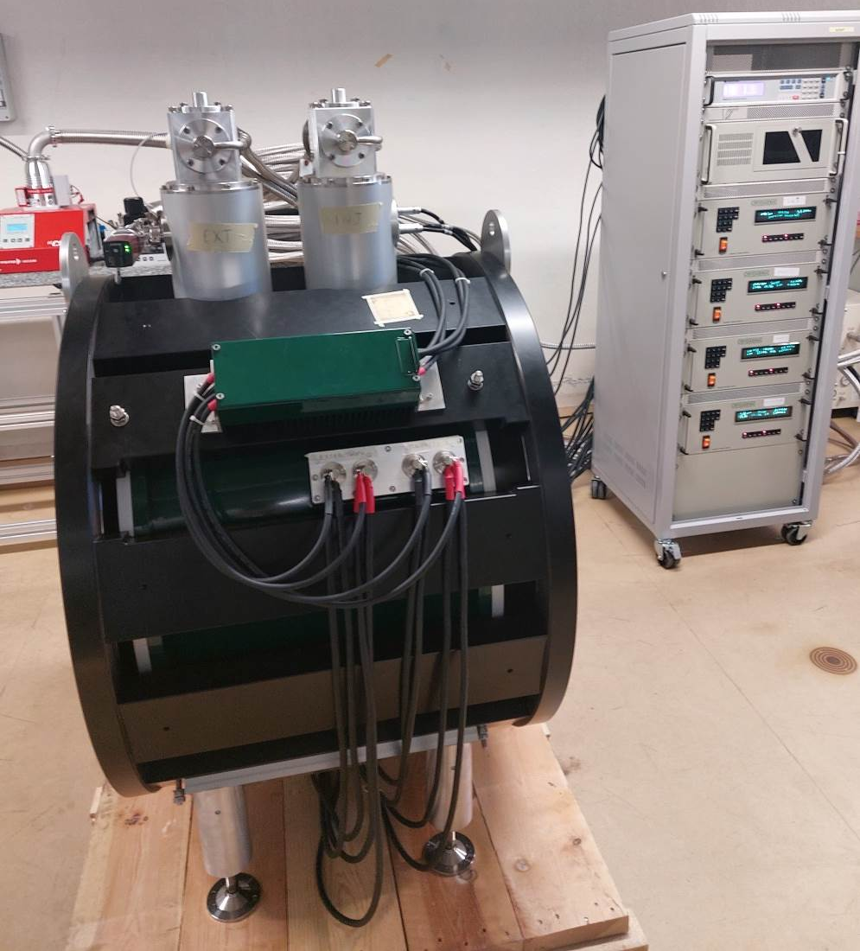
Beam diagnostics
INSpIRIT: new Ion Species
Collaboration CNAO-INFN-HiFuture
Mechanics in synchrotron room
Status: on-time
Deadline: end 2022
Superconducting magnet

Slide 25
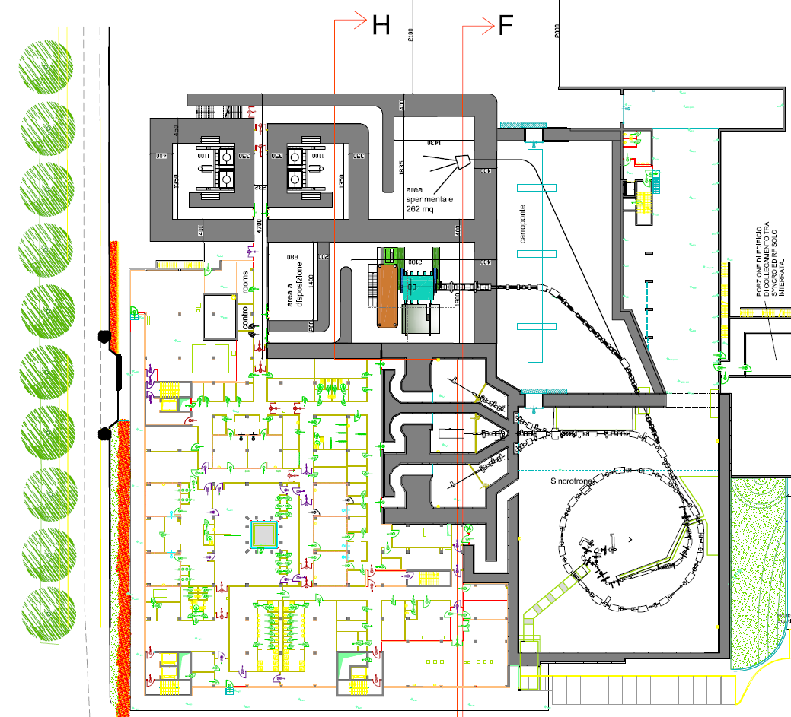
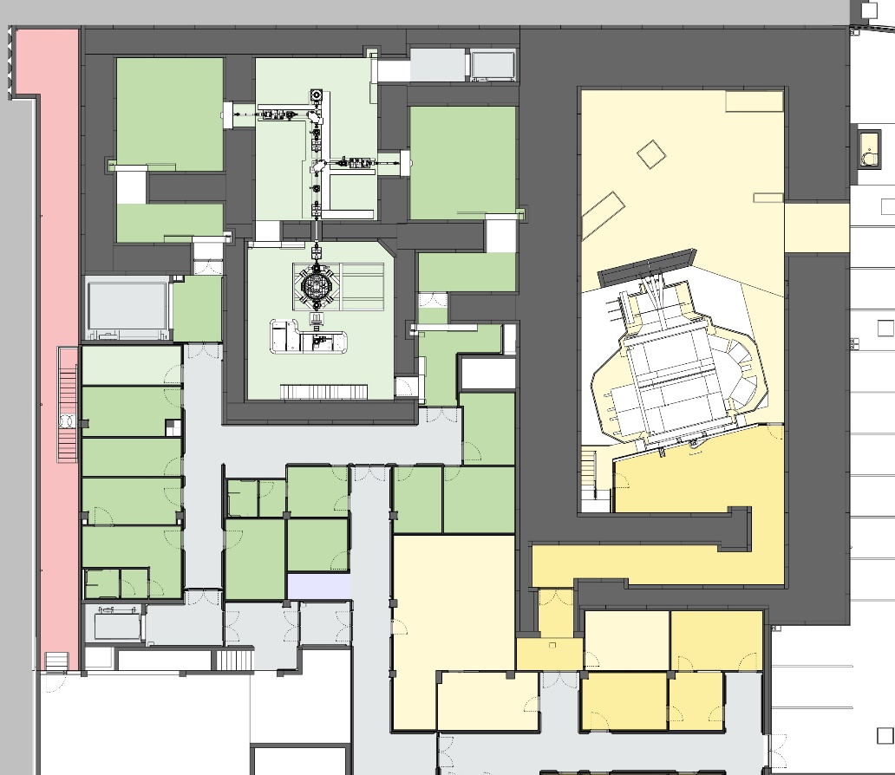
Expansion Project: Level -1
BNCT
+
PROTONTHERAPY

Slide 26
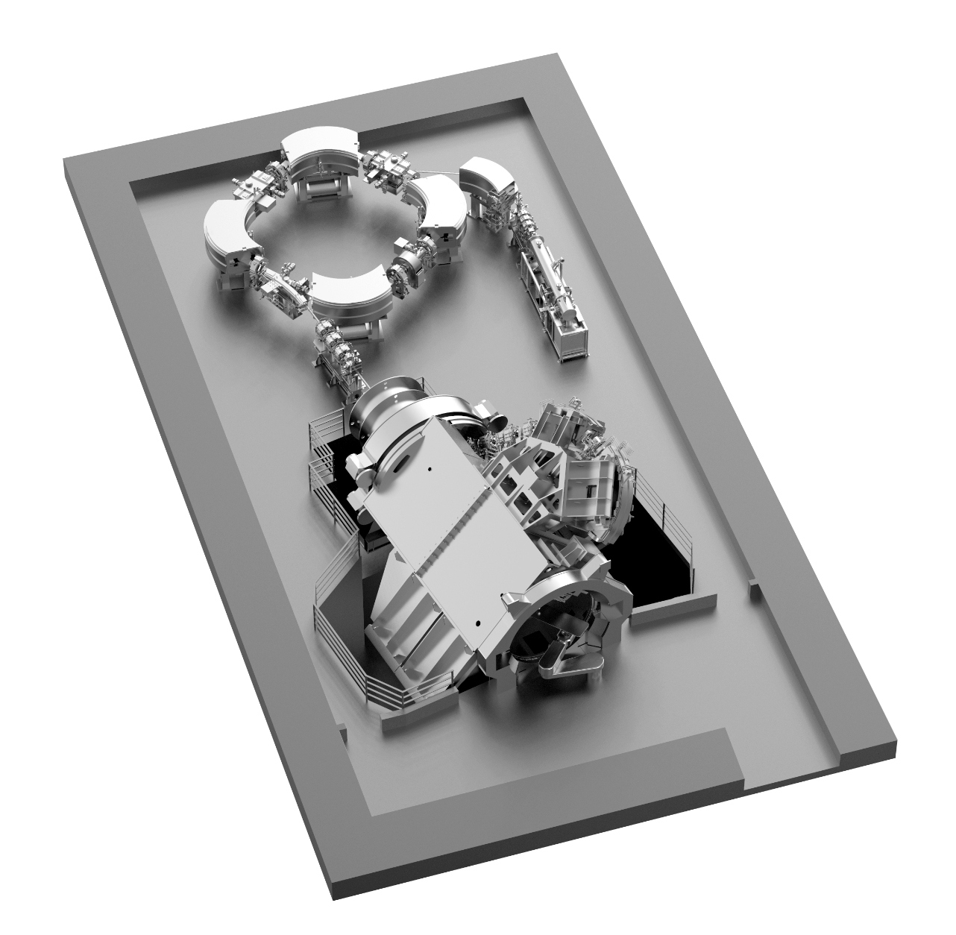
New Protontherapy @ CNAO
Main features:
synchrotron, 5.7 m diameter;
70-230 MeV energy range;
active pencil beam scanning;
organ motion management functionality;
large irradiation field (30 x 40) cm²; for paediatric patients, to ease cranio-spinal irradiations reducing to a minimum the required field patching;
360 deg rotating gantry, 6 dof robotic couch;
possibilities of treatments in anaesthesia.
Hitachi PT systems have been used by 32 centres worldwide to treat more than 80,000 cancer patients

Slide 27
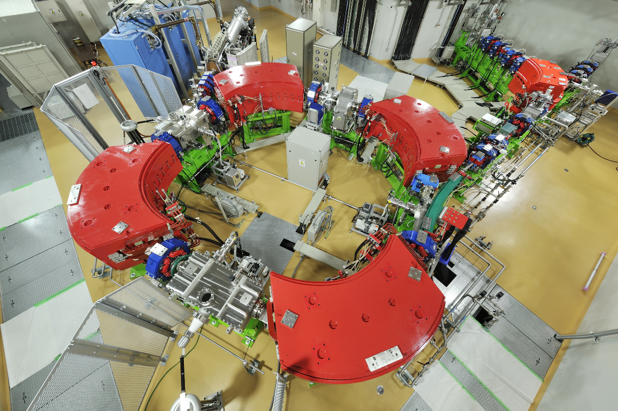
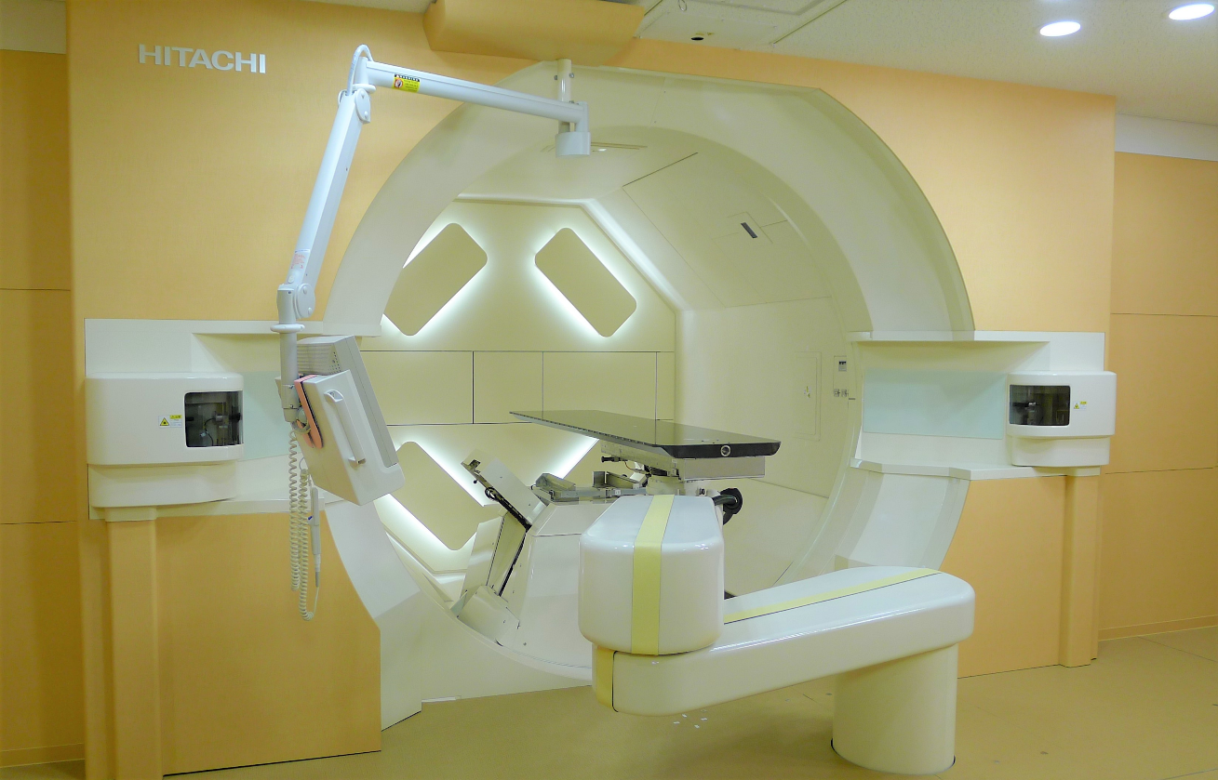
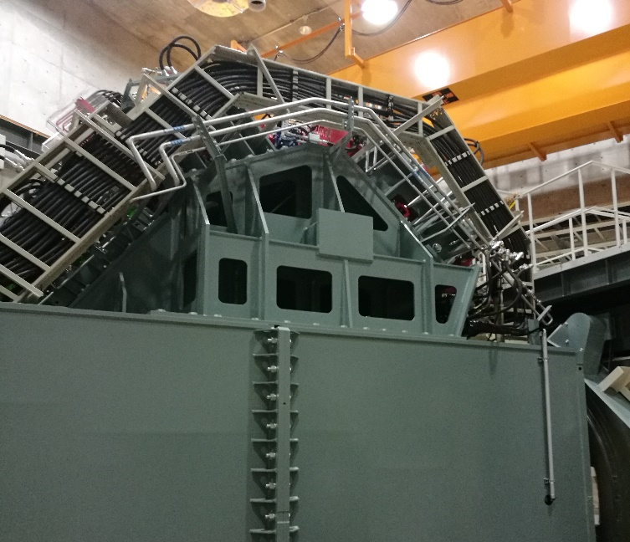
New single-room for protons
Synchrotron room
Contract signed with Hitachi:
December 5th, 2019
Start installation end 2023
Treatment room
360°isocentric gantry
(Field size: 30x40 cm²)

Slide 28
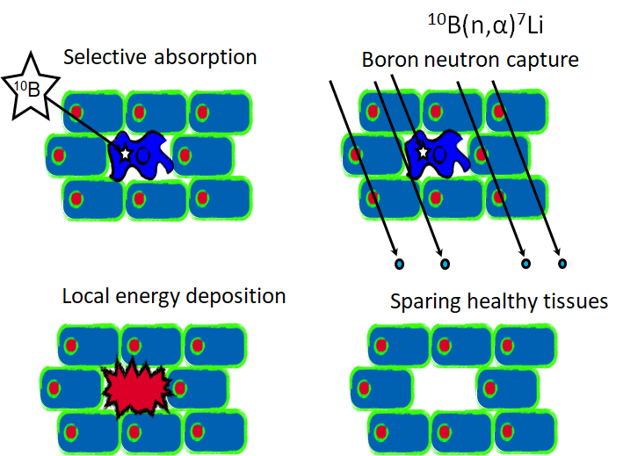
BNCT: Boron Neutron Capture Therapy
2-steps research approach for metastasized tumours
Boronated drug that selectively reaches the tumour cells and avoids the healthy tissues
Accelerator driven neutron production

Slide 29
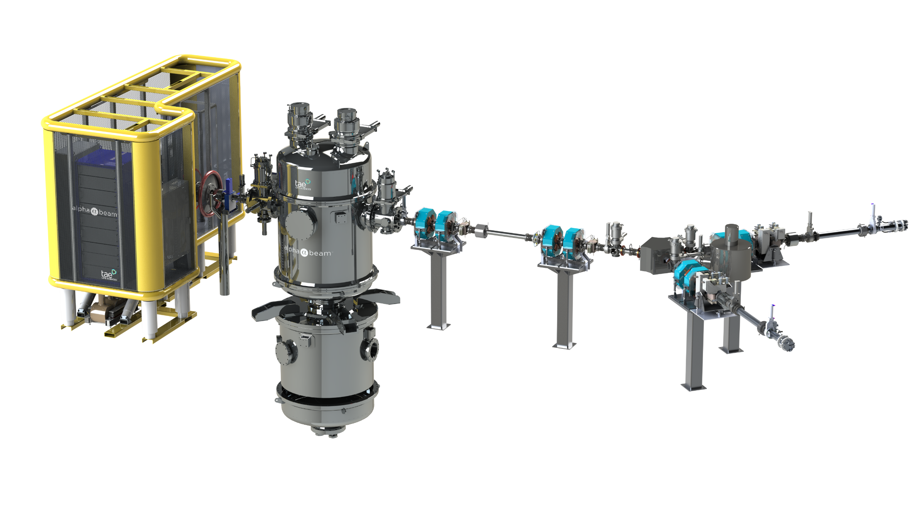

BNCT: proton tandem accelerator
Collaboration agreement with TLS signed November 2020
Start installation end 2023
Proton energy 2.5 MeV
Intensity 10-15 mA
p-Li reaction

Slide 30


CNAO is ready and willing to continue sharing and collaborating with SEEIIST
THANK YOU!
https://www.hitriplus.eu/

