Slide 1
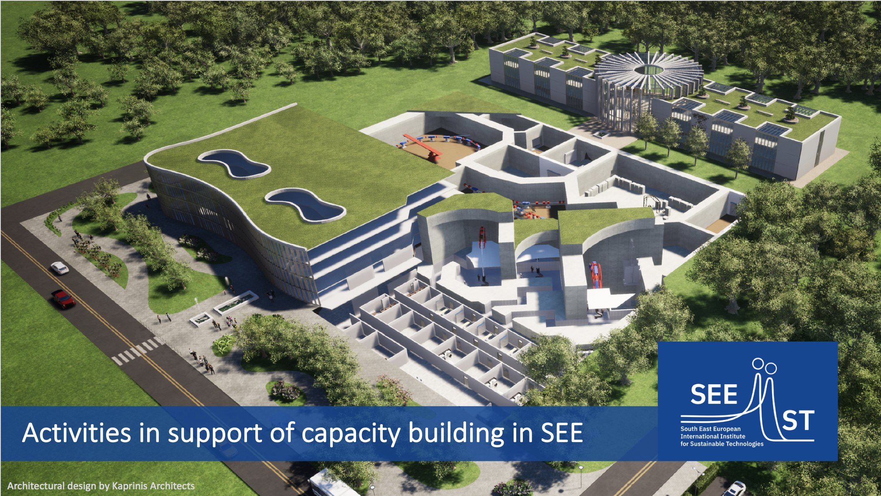
Yiota Foka (GSI)
4 Arpil 2022, SEEIIST SC Open Session

Slide 2
Outline
Some selected ongoing activities as means to support capacity building in SEE
complementary and in coordination with HITRIplus
Particle Therapy MasterClasses (PTMC); addressing high-school students
New lab “ion source” test bench project; for training and accelerator technology testing
Training at CERN, Ljubljana Uni, Cosylab, i-Tech; of uni students and personnel
SEEIIST meets Industry; academia-research-industry workshop
Information events; for scientific/medical communities
Radio-isotope production exploratory project; SEE/WE experts groups

Slide 3
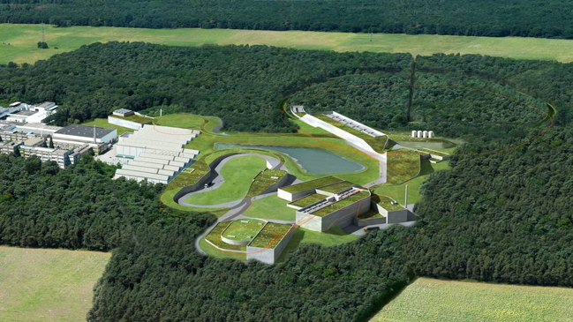
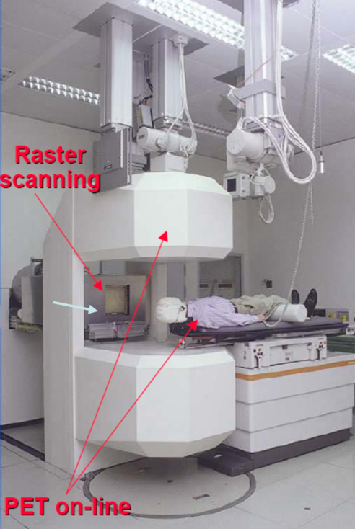
Heavy-ion research and heavy-ion therapy at GSI
Pioneered heavy-ion (carbon) therapy for cancer tumours in Europe (90s)
Mission and mandate of research institutes: fundamental research
Developed technologies and acquired knowledge find applications for society

Slide 4
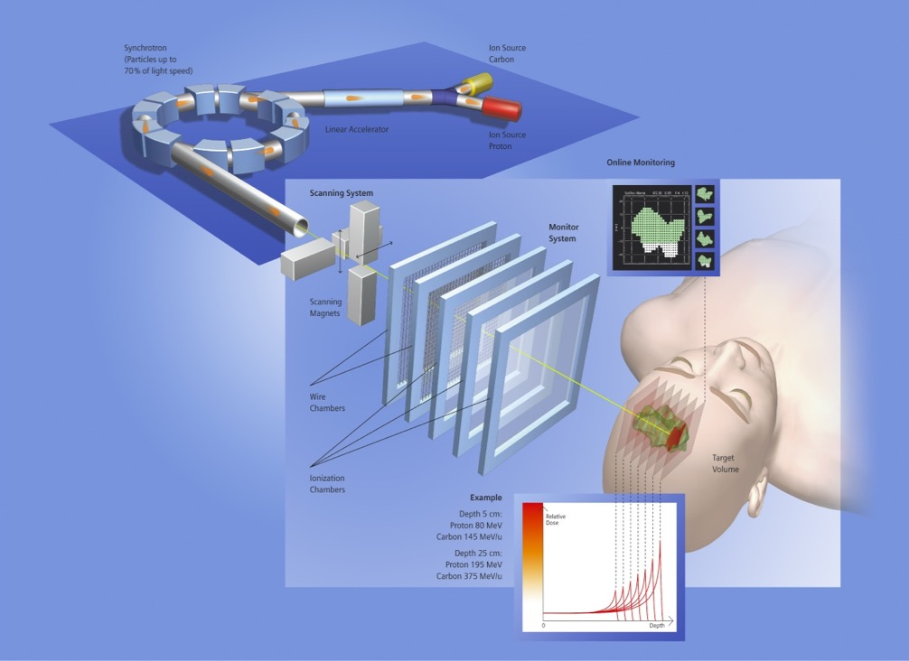
Heavy-ion research and heavy-ion therapy at GSI
Rasterscan Method
Haberer et al., NIM A , 1993
  Implemented in the Heidelberg and Marburg Ion Treatment centers
  (HIT and MIT) in Germany
Haberer et al., NIM A , 1993
Notes:
4

Slide 5
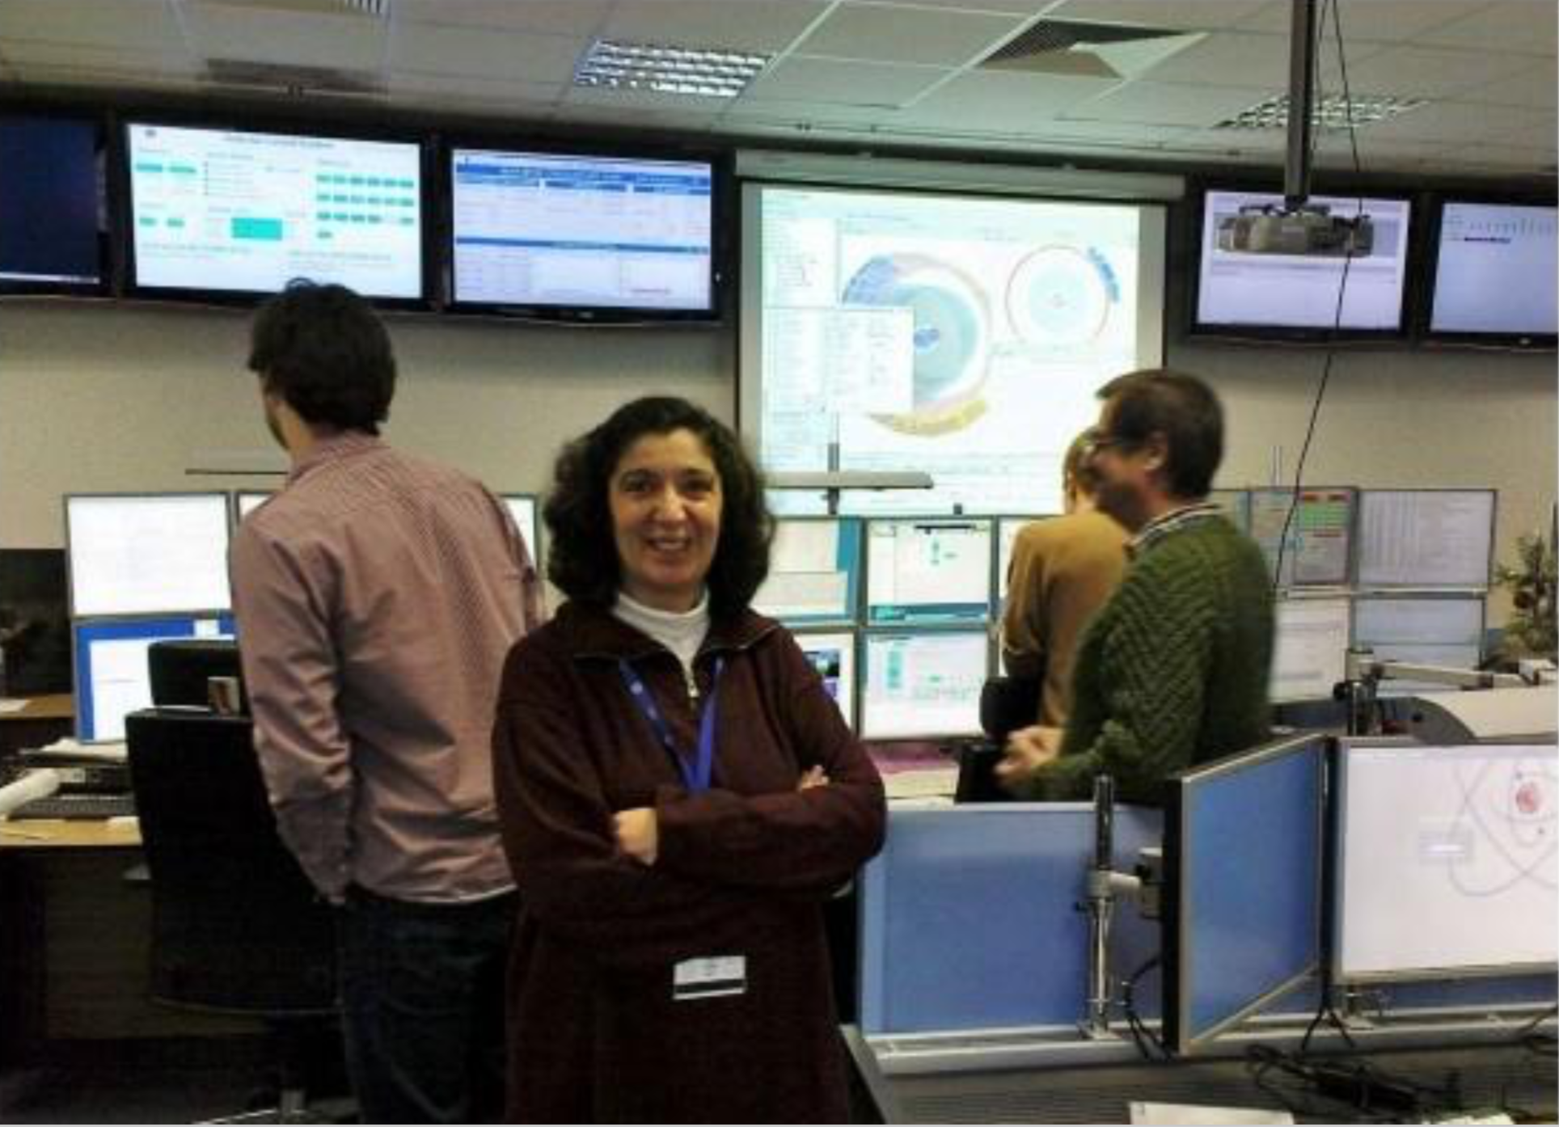
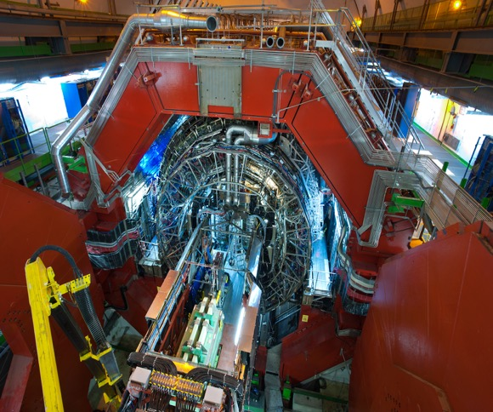
From heavy-ion research to heavy-ion therapy
Heavy-ion physicist, involved with medical applications of heavy-ions for cancer therapy
Control Room of ALICE at CERN
ALICE at the CERN LHC

Slide 6
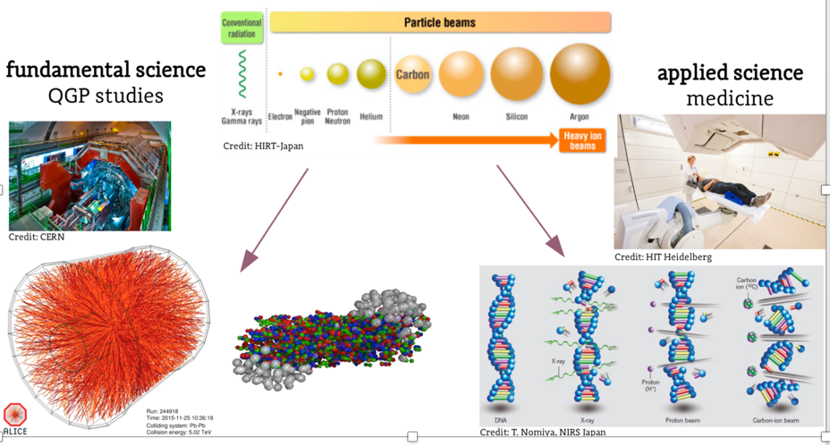
Heavy-ion research and heavy-ion therapy
Pb-Pb at 5.5 TeV
pp at 14 TeV
88-430 MeV/u carbon
50-221 MeV/u protons

Slide 7
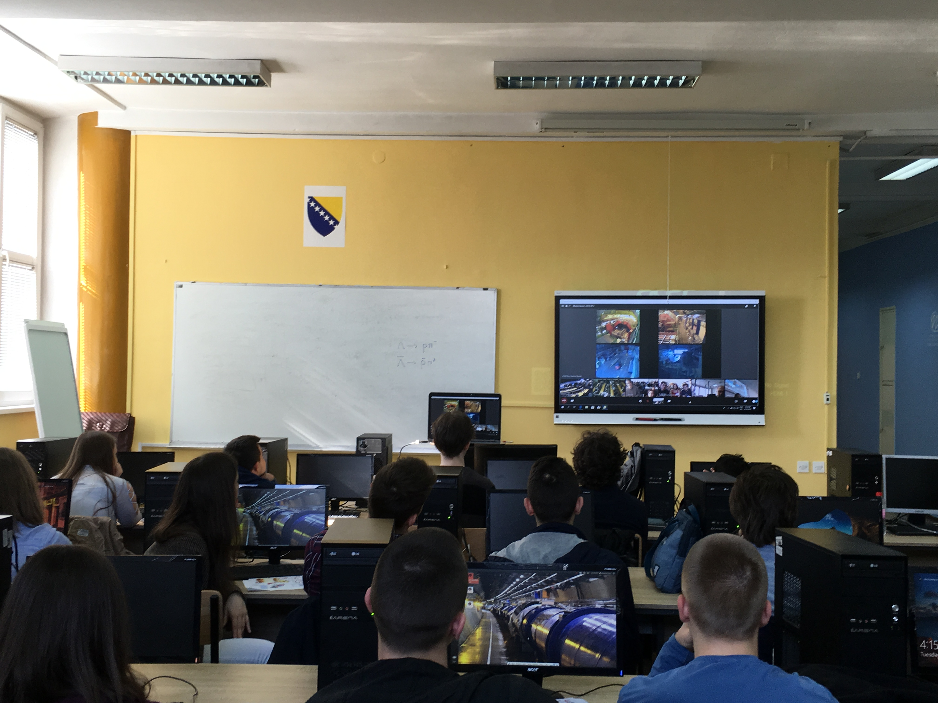
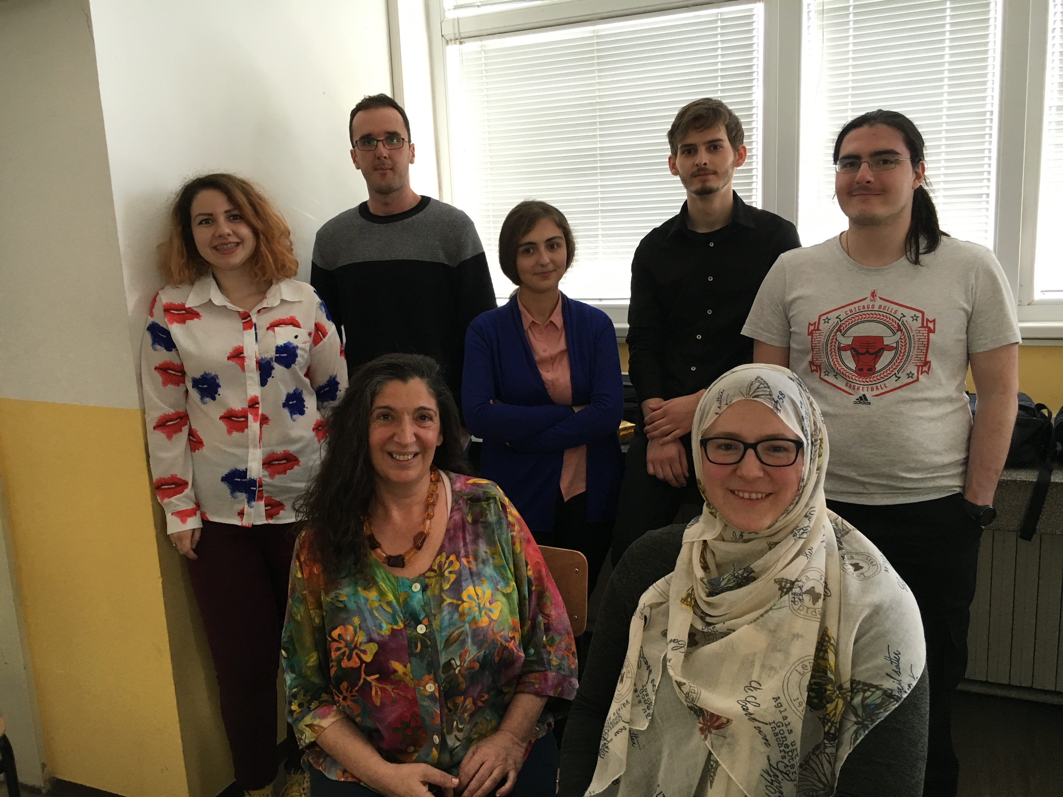
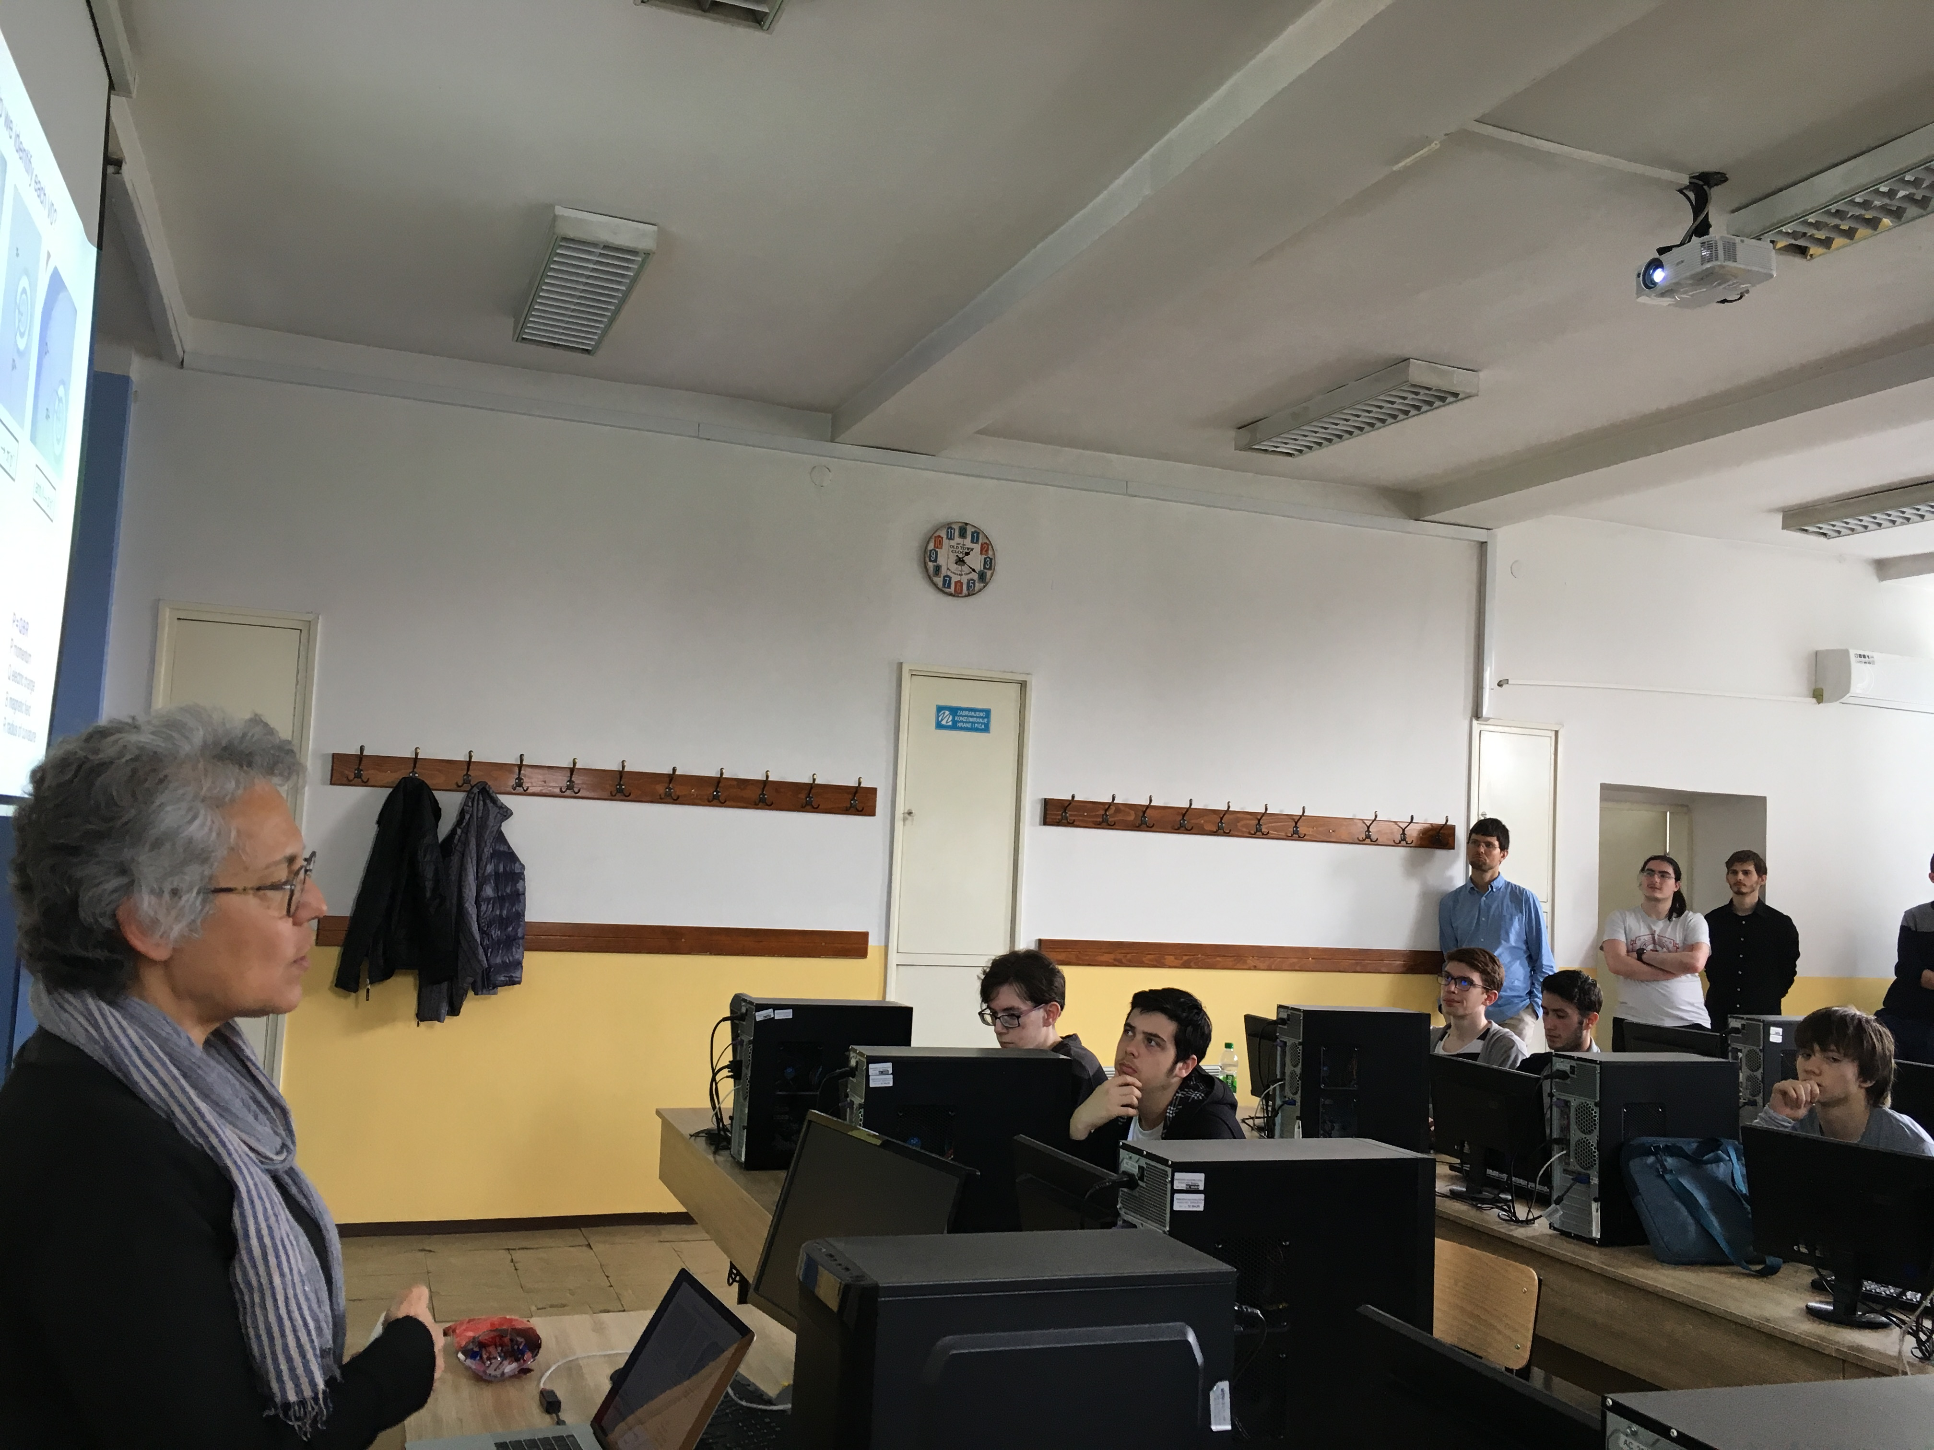
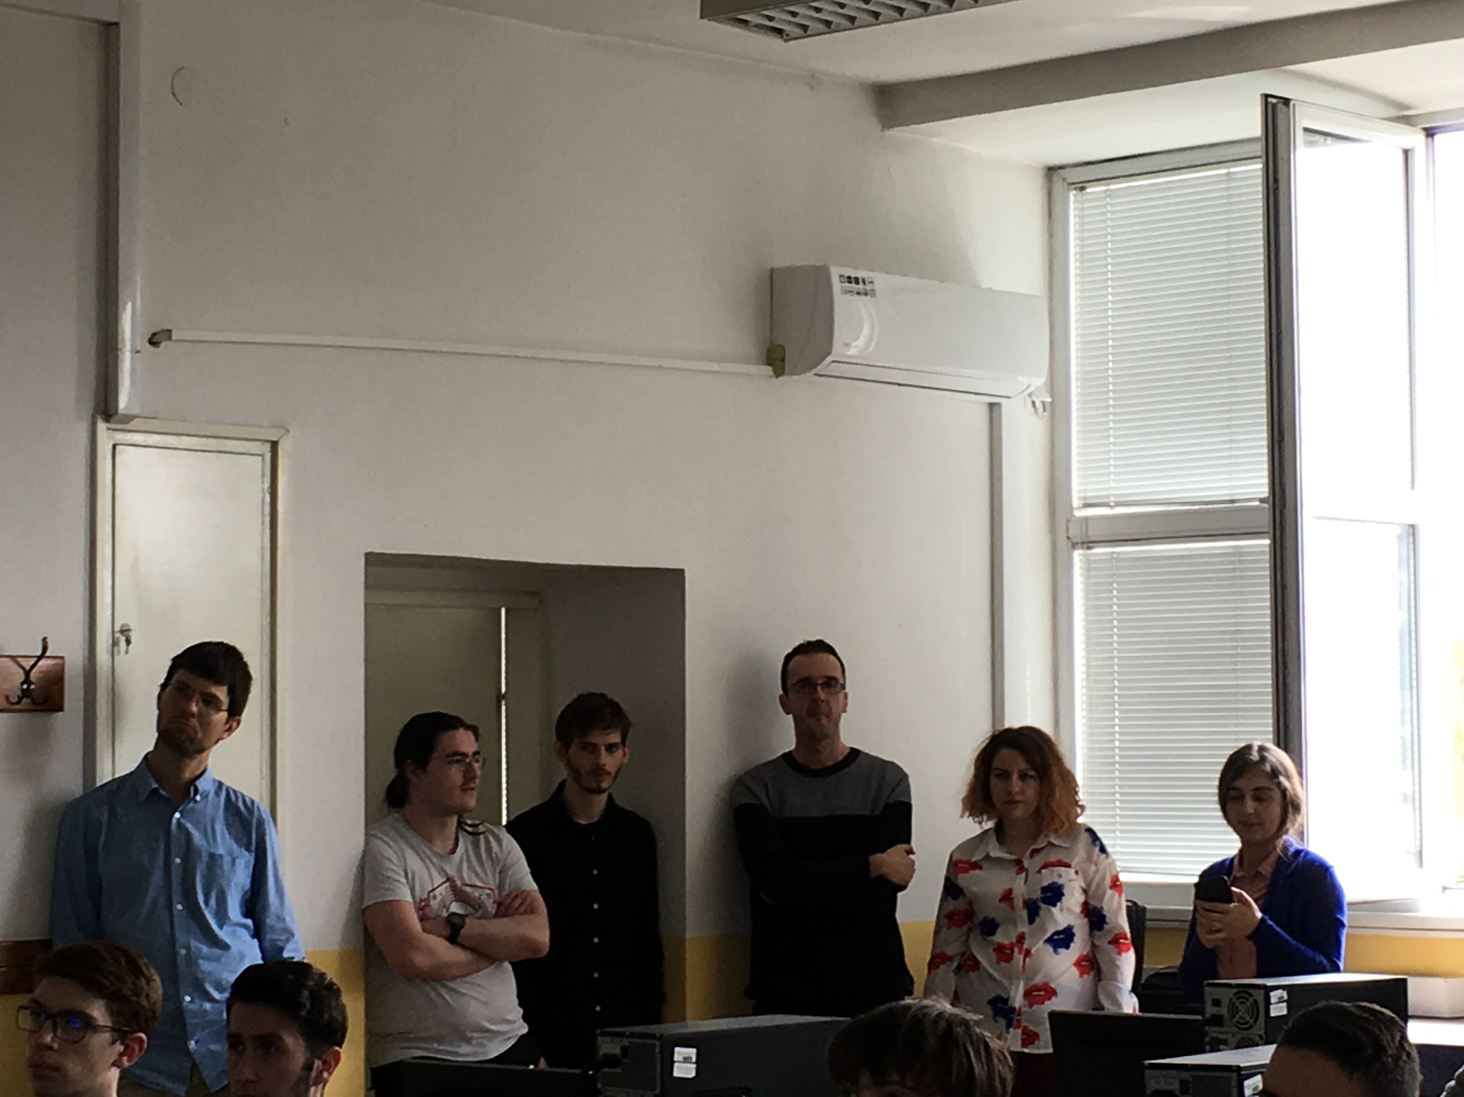
From first MasterClasses at UNSA/Sarajevo in 2019 to hundreds of students
Sponsored by “Three Physicists Foundation”: Origin of New Projects

Slide 8
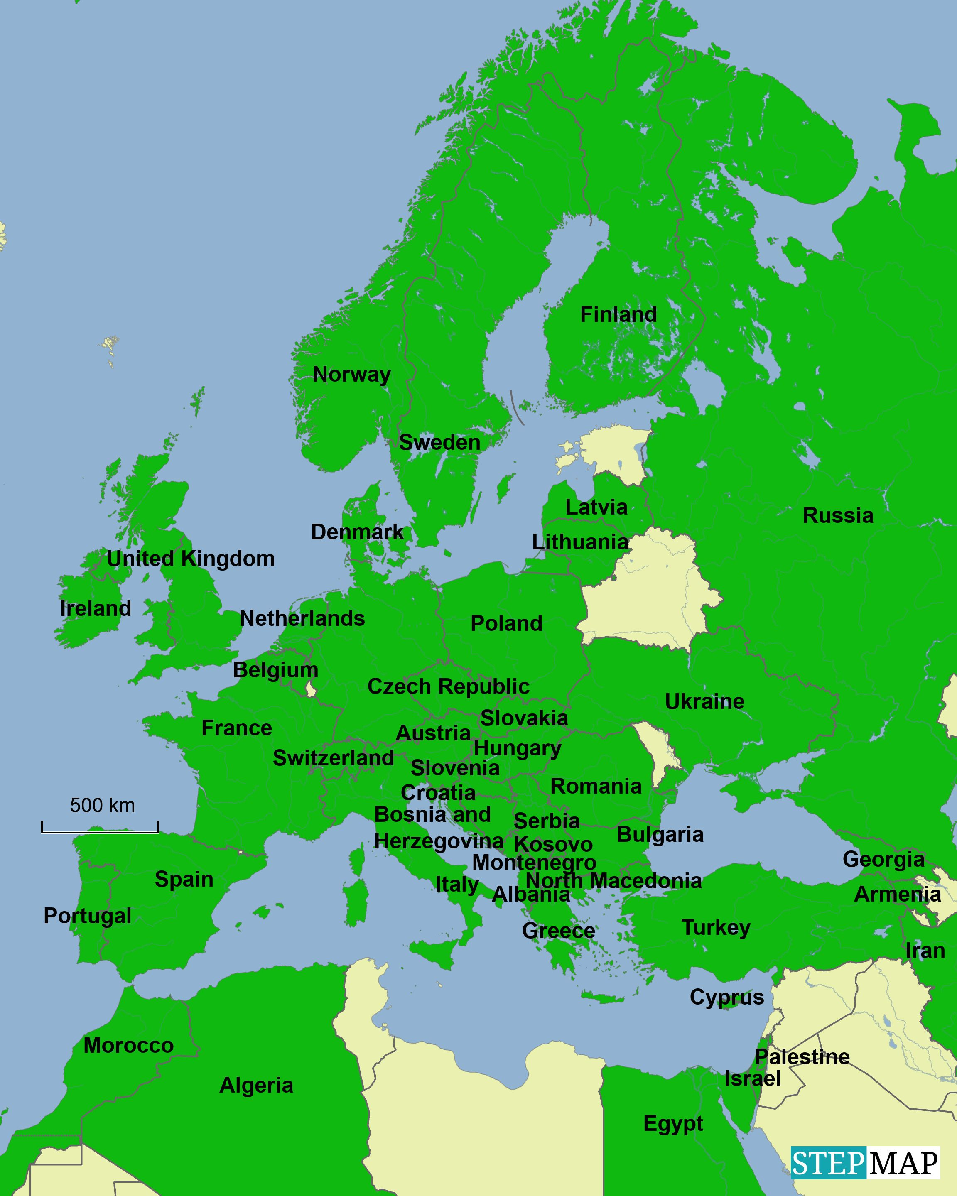
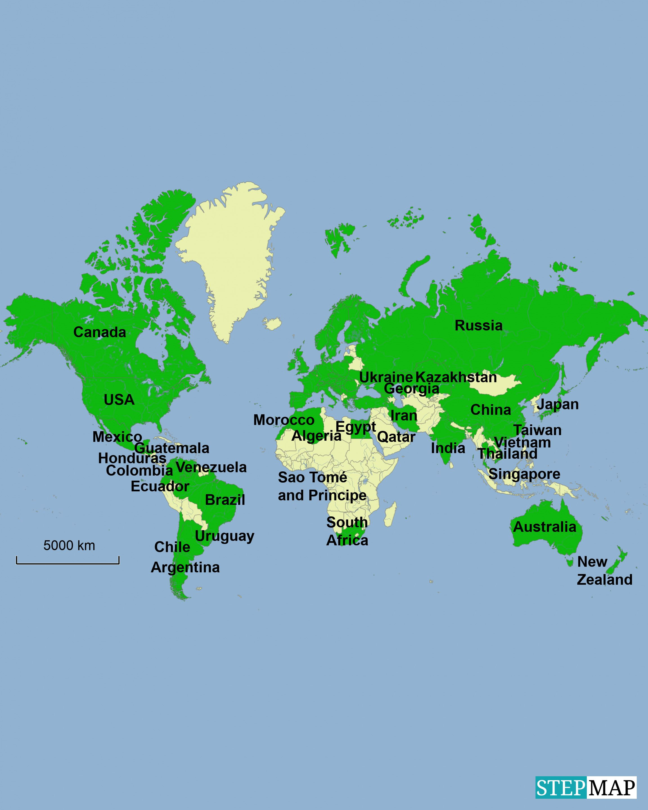
International MasterClasses Statistics
Motivate the next generations of scientists !
60 countries
255 institutes
15 000 students
IMC 2022 :
11.2.2022 – 9.4.2022
Brings scientific methods and real data to schools!
Coordination QuarkNet / TU Dresden
188 institutes (177)
266 LHC Masterclasses (257)
  30 ATLAS W (35)
  101 ATLAS Z (104)
  64 CMS (58)
  41 LHCb (39)
  27 ALICE SP (18)
  3 ALICE R_AA (3)
51 institutes (48)
54 LHC Masterclasses (50)
  22 ATLAS (19)
  32 CMS (31)
(Incl. TRIUMF program)
12 MINERvA Masterclasses
Flagship project of IPPOG, the International Particle Physics Outreach Group

Slide 9
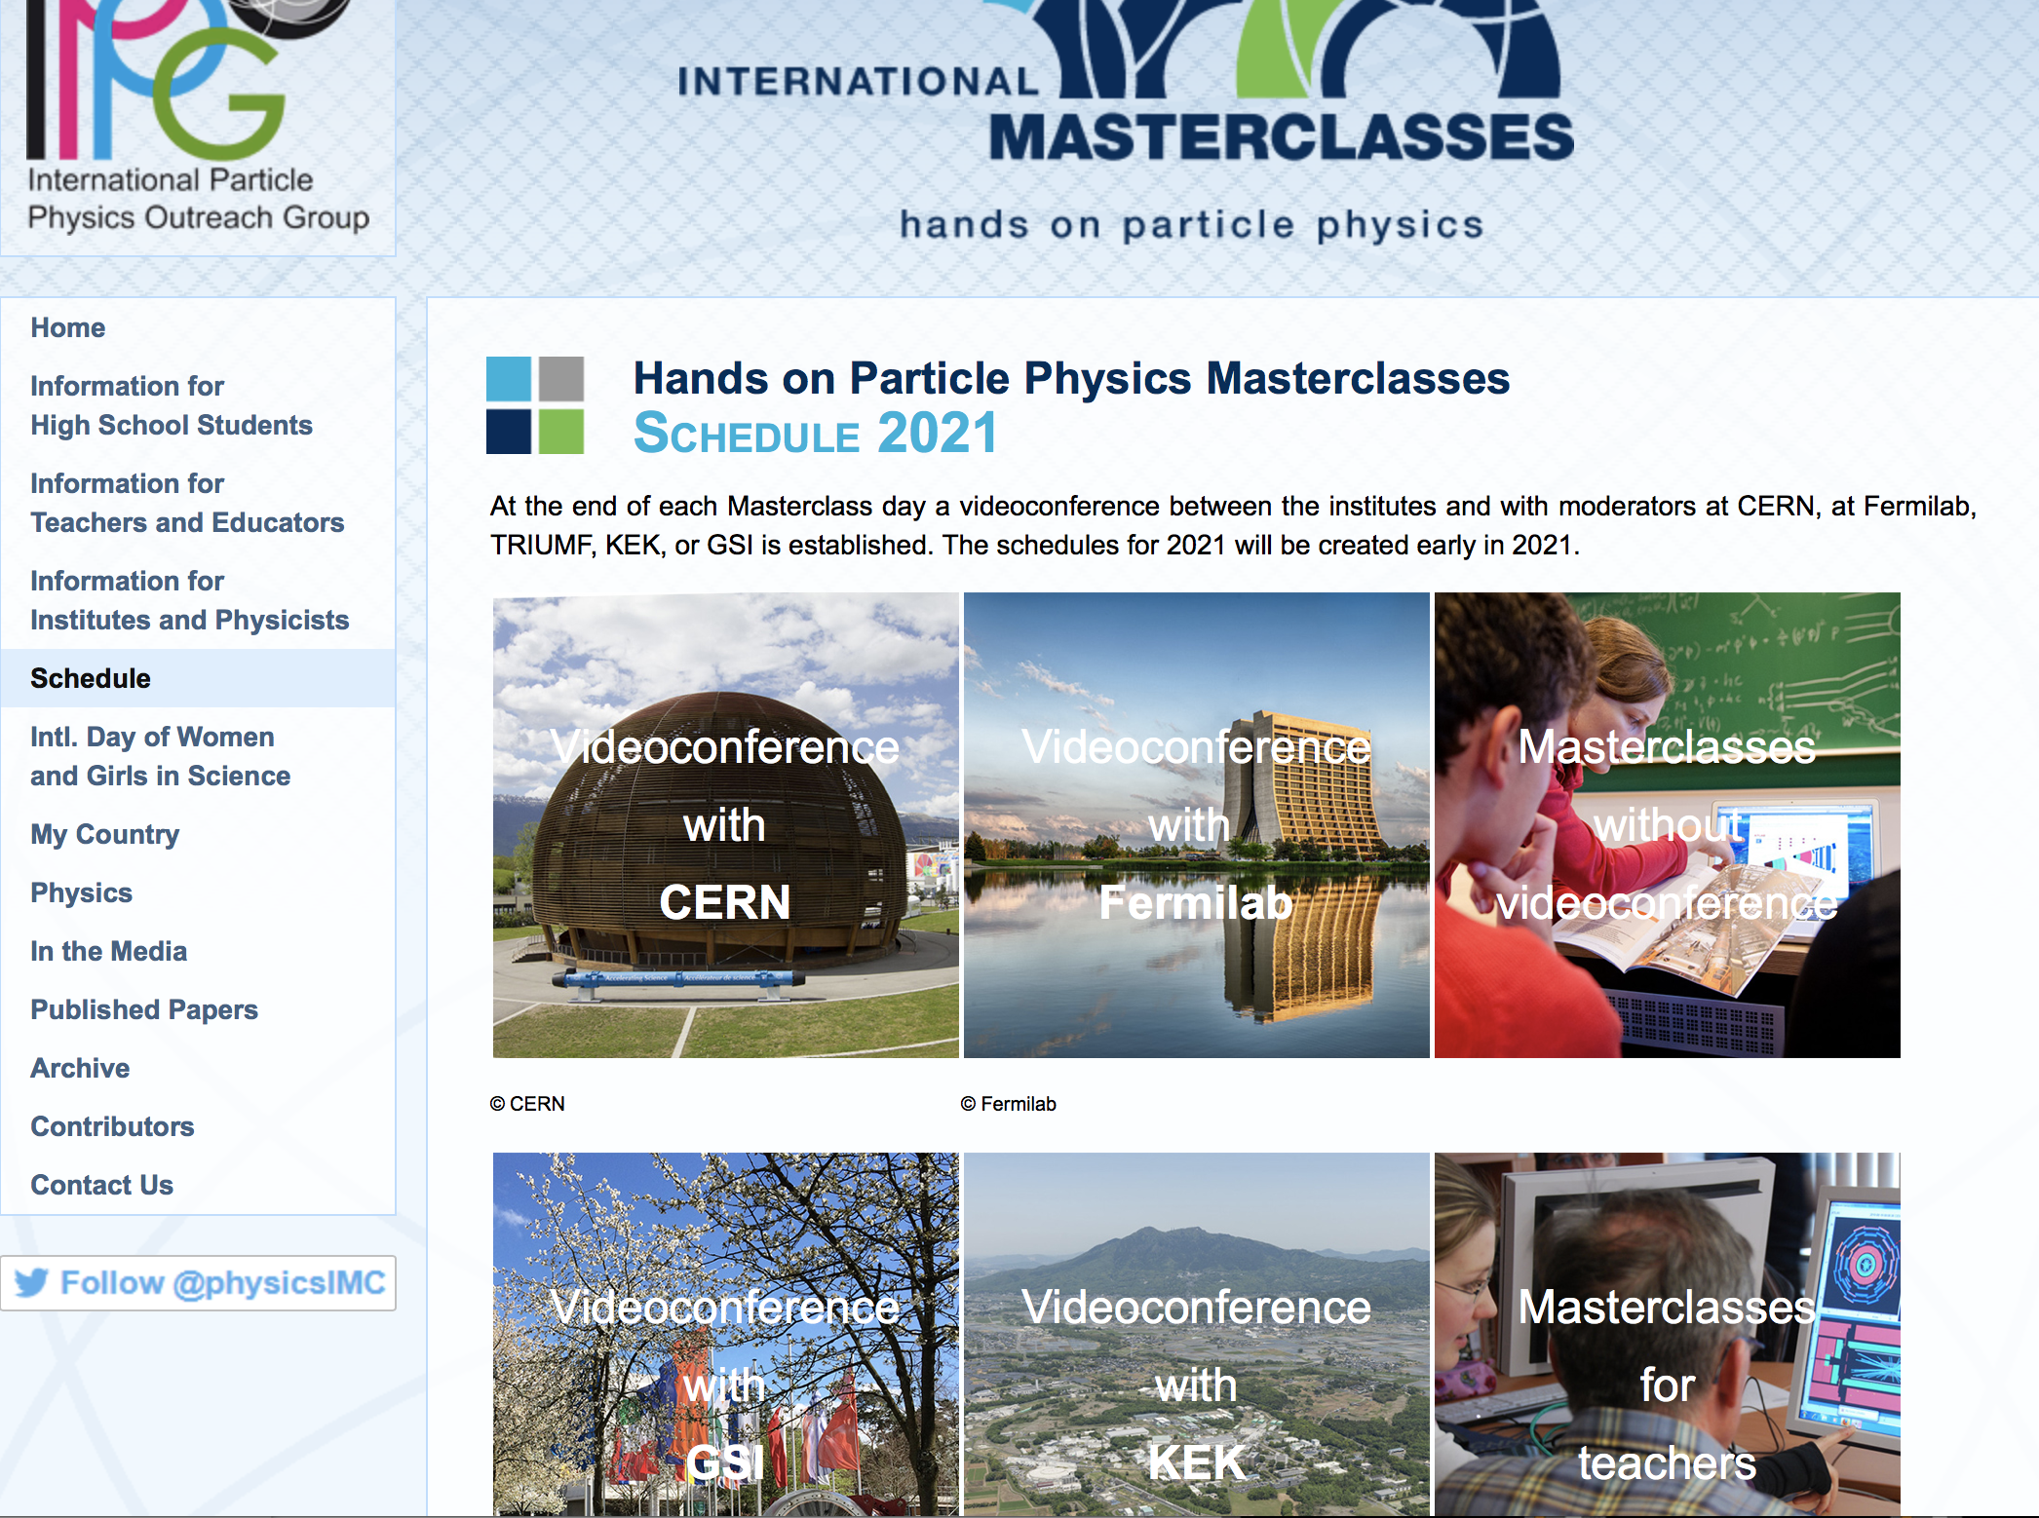
https://physicsmasterclasses.org/
PTMC: https://indico.cern.ch/event/840212/

Slide 10
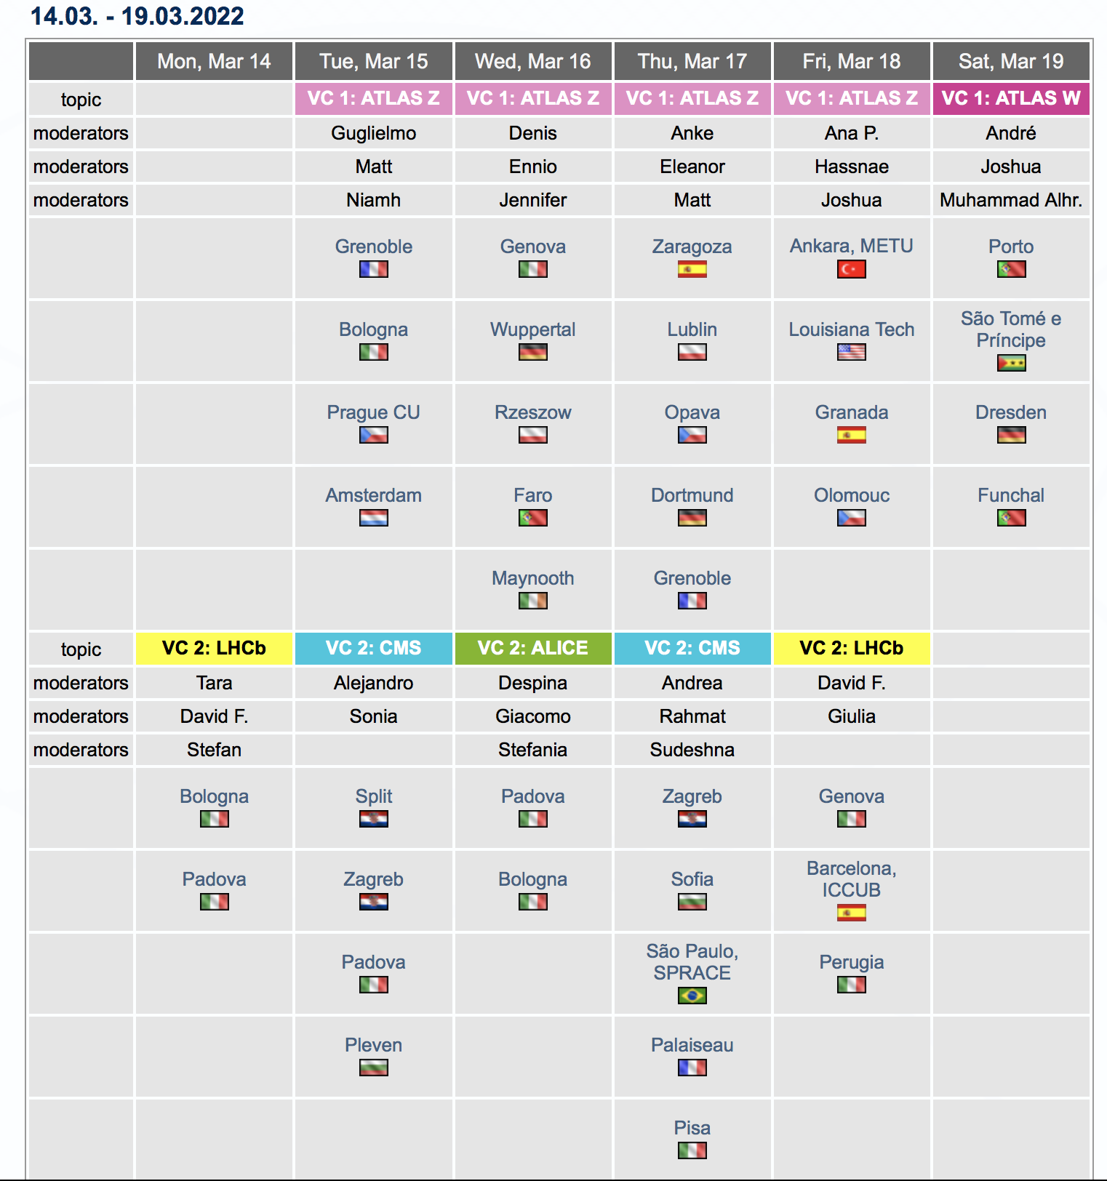
https://physicsmasterclasses.org/
moderators
institutes

Slide 11
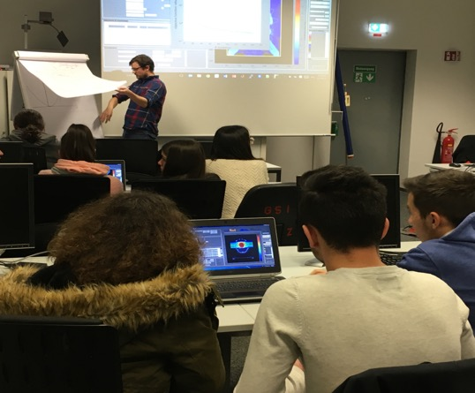
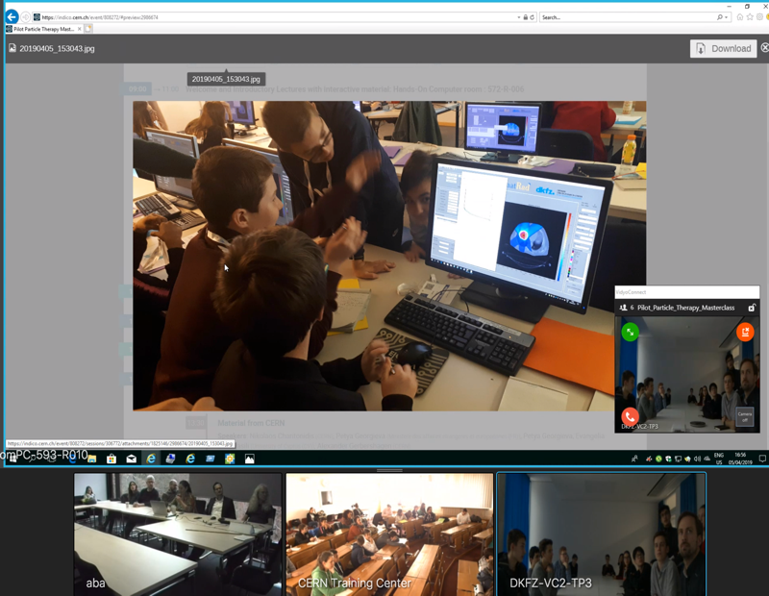
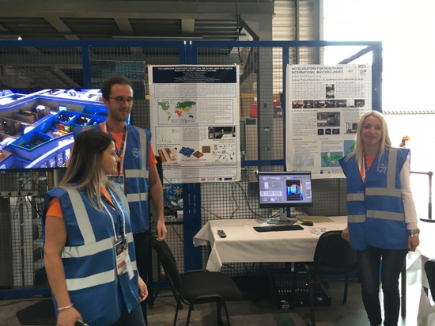
New PTMC and Treatment Planning
matRad open source Treatment Planning toolkit: DKFZ German Cancer Research Centre
First Local Test: GSI Feb 2019
International Pilot: CERN, GSI, DKFZ April 2019
CERN Open days
First tests positive feedback:
“motivation to contribute to the fight against cancer”
IMC Steering Group Approval: GSI May 2019
web pages: Sarajevo Uni students Aug 2019 at CERN

Slide 12
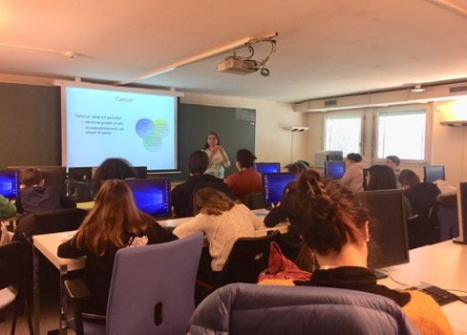
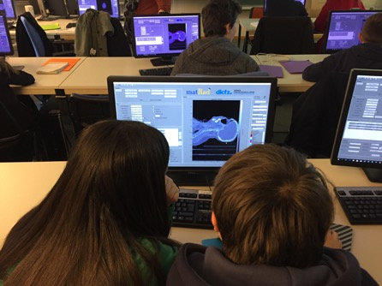
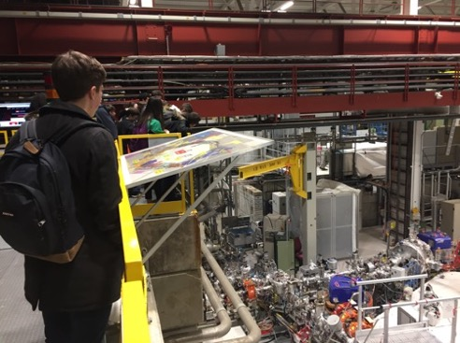
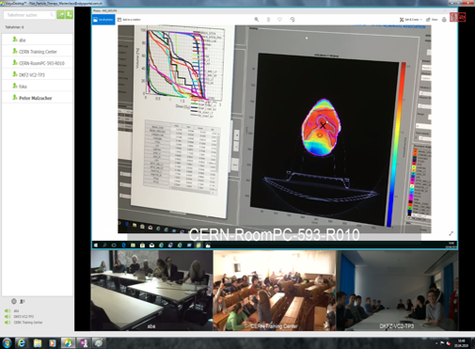
PTMC: Typical MasterClass Day Agenda
Scientists for a day !!
Adapted online/zoom due to covid
Local: Morning Presentations
Local: Afternoon Hands-on
Every year, during the months of
February-March
school-children (15-19 year old)
are invited at/by an institute of their area.
2-5 institutes per day performing
the same programme
LOCAL TIME: ACTIVITY
8:30 - 9:00 Registration and Welcome
9:00 - 10:00 Introductory lectures
10:30 - 11:30 Visit of a lab or experiment
12:00 - 13:00 Lunch
13:00 - 15:00 Hands-on session
15:00 - 16:00 Discuss results locally
16:00 - 17:00 Common Video Conference
Common: Afternoon at 16:00
Video-Conference
Local: Morning Visits

Slide 13
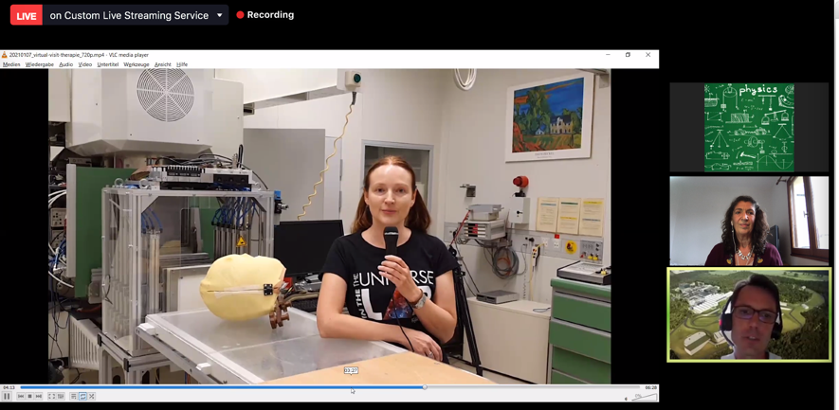
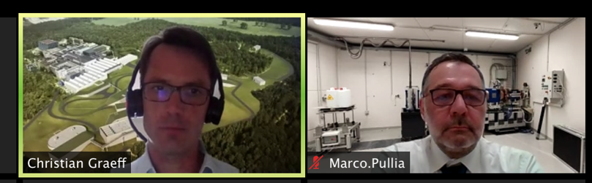
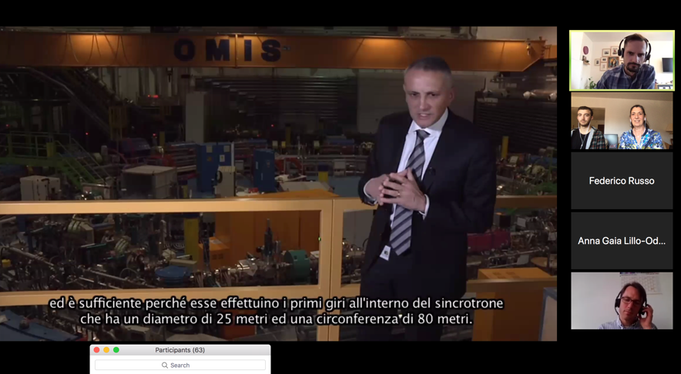
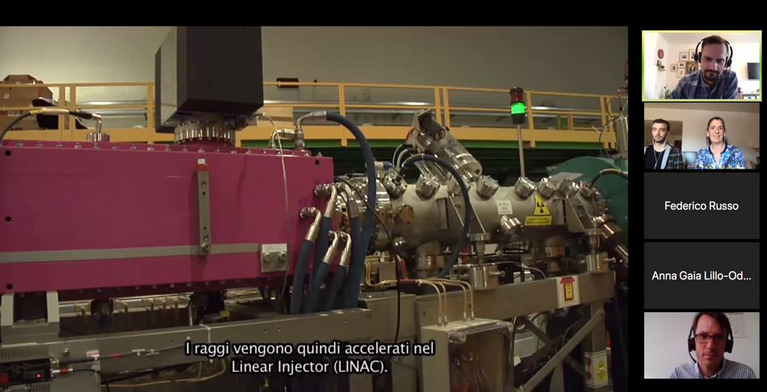
PTMC: Typical MasterClass Day Agenda
Virtual visits during video-conference: GSI research institute, CNAO, MedAustron therapy centers
GSI moderator
CNAO moderator

Slide 14
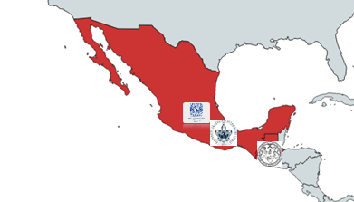
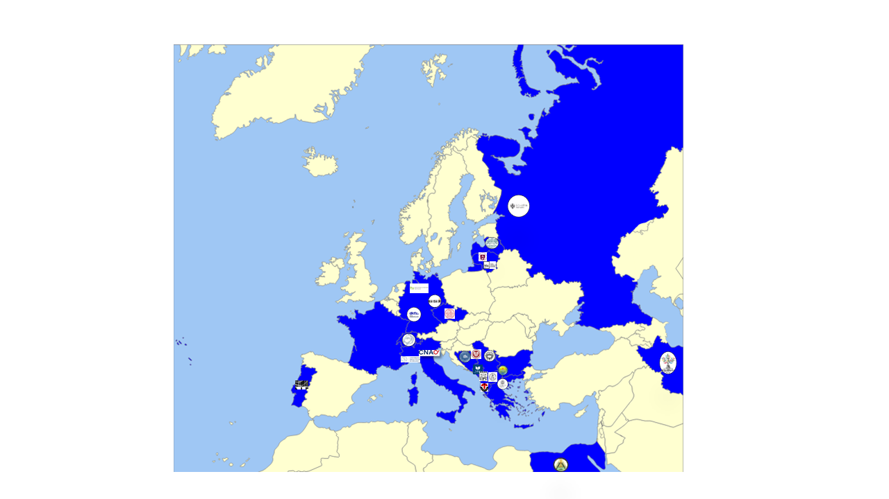
Participants of online PTMC in IMC2021
PTMC: https://indico.cern.ch/event/840212/
PTMC2021 online:
more than 1500 students participated
from 20 countries and 37 institutes during 6 sessions

Slide 15
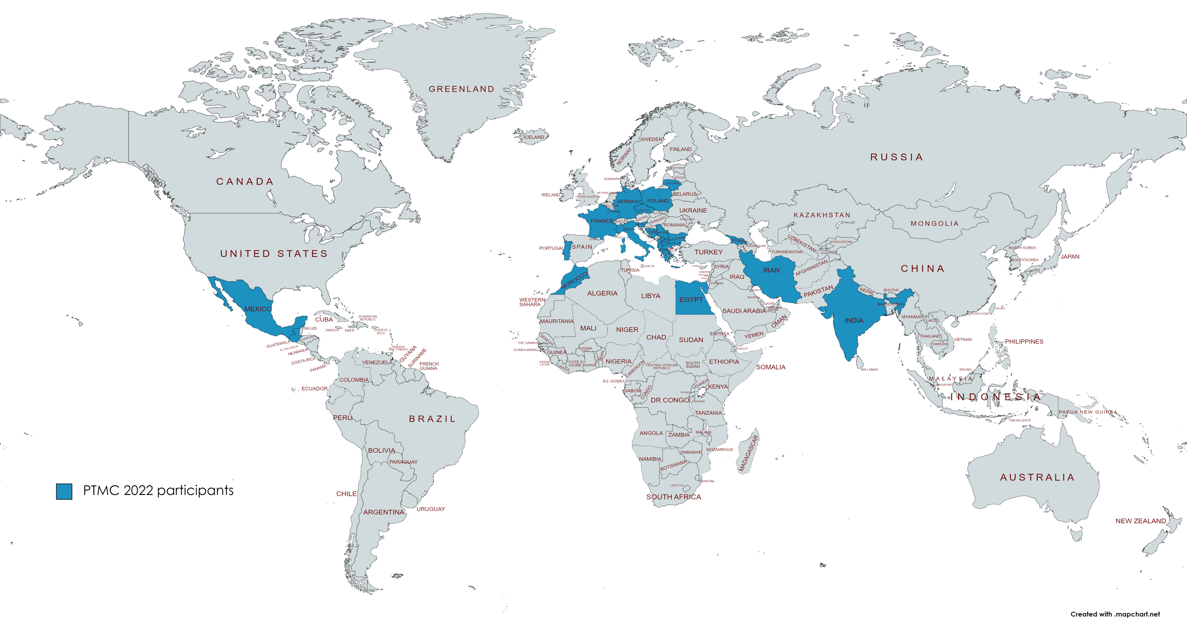
Participants of online PTMC in IMC2022
PTMC: https://indico.cern.ch/event/840212/
PTMC2022 online:
ongoing: 4 sessions online and in-person participation
from 22 countries and 37 institutes during 6 sessions
web pages with agendas of every institute with material
in different languages, publicly available for future events
Interest of students, motivation of tutors (voluntary work), potential impact

Slide 16
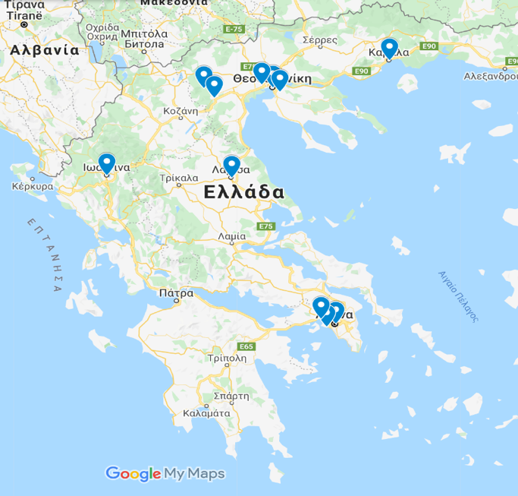
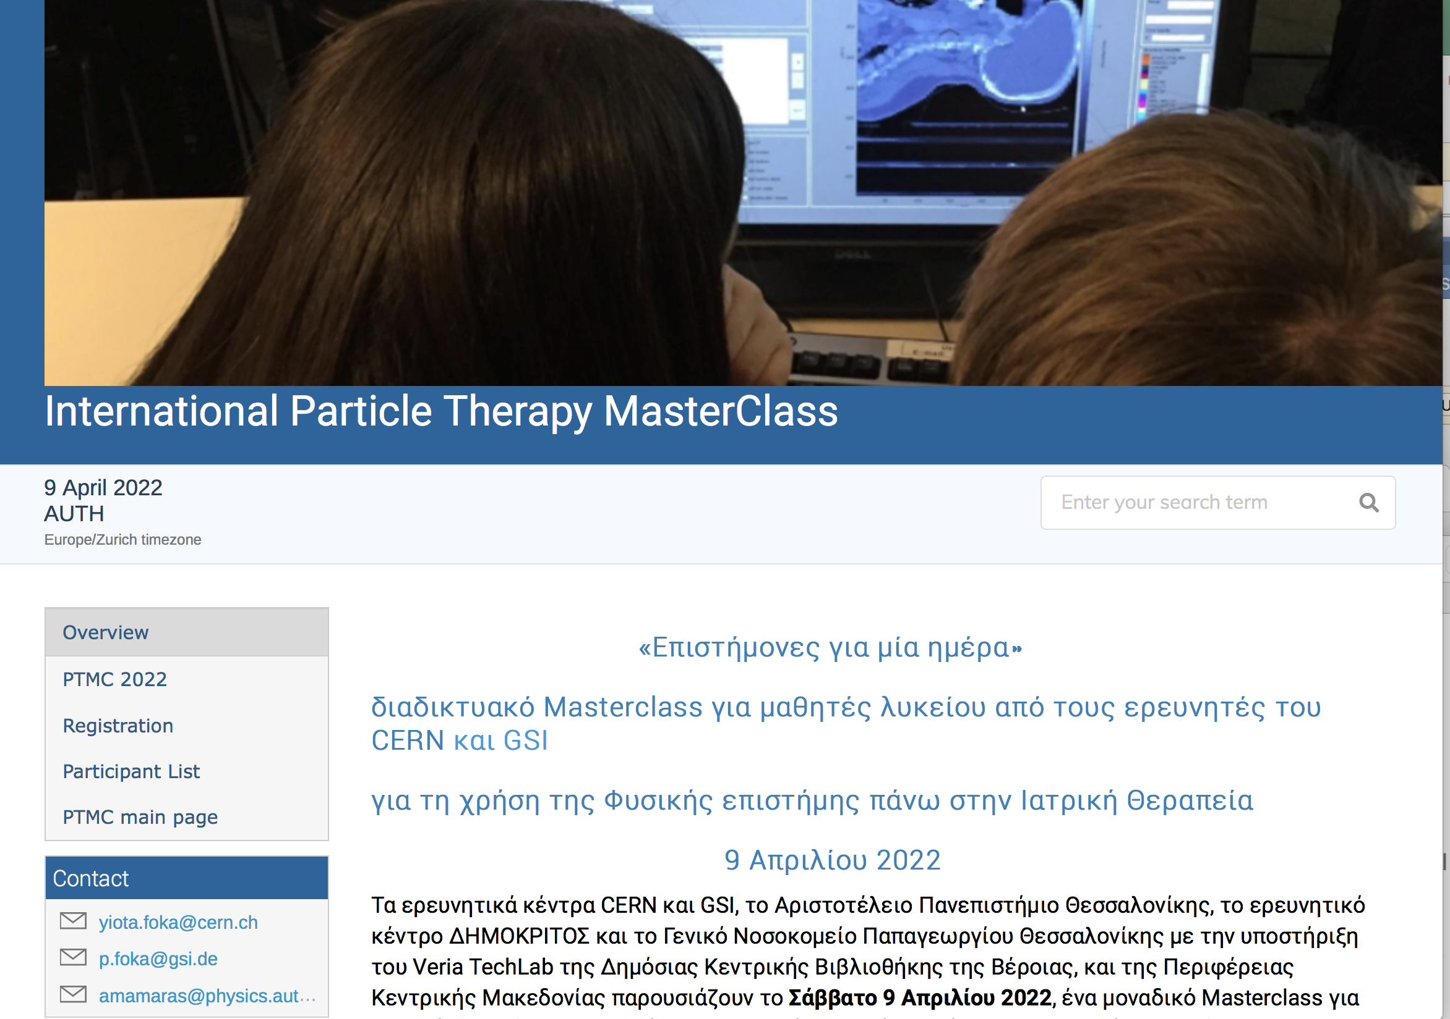

PTMC in Greece
PTMC2021 online: through Library of Veroia
PTMC2022 online: more than 250 registrants
AUTH uni, Dimokritos research centre, Papageorgiou Hospital, Technopolis.
Publicity: Library of Veroia extended networks and national press
Total of 366 live views
from at least 20 major regions of Greece
Press Release published in nation-wide media
Post on Facebook resonated with 3,600 people
Announcement viewed 941 times on website

Slide 17
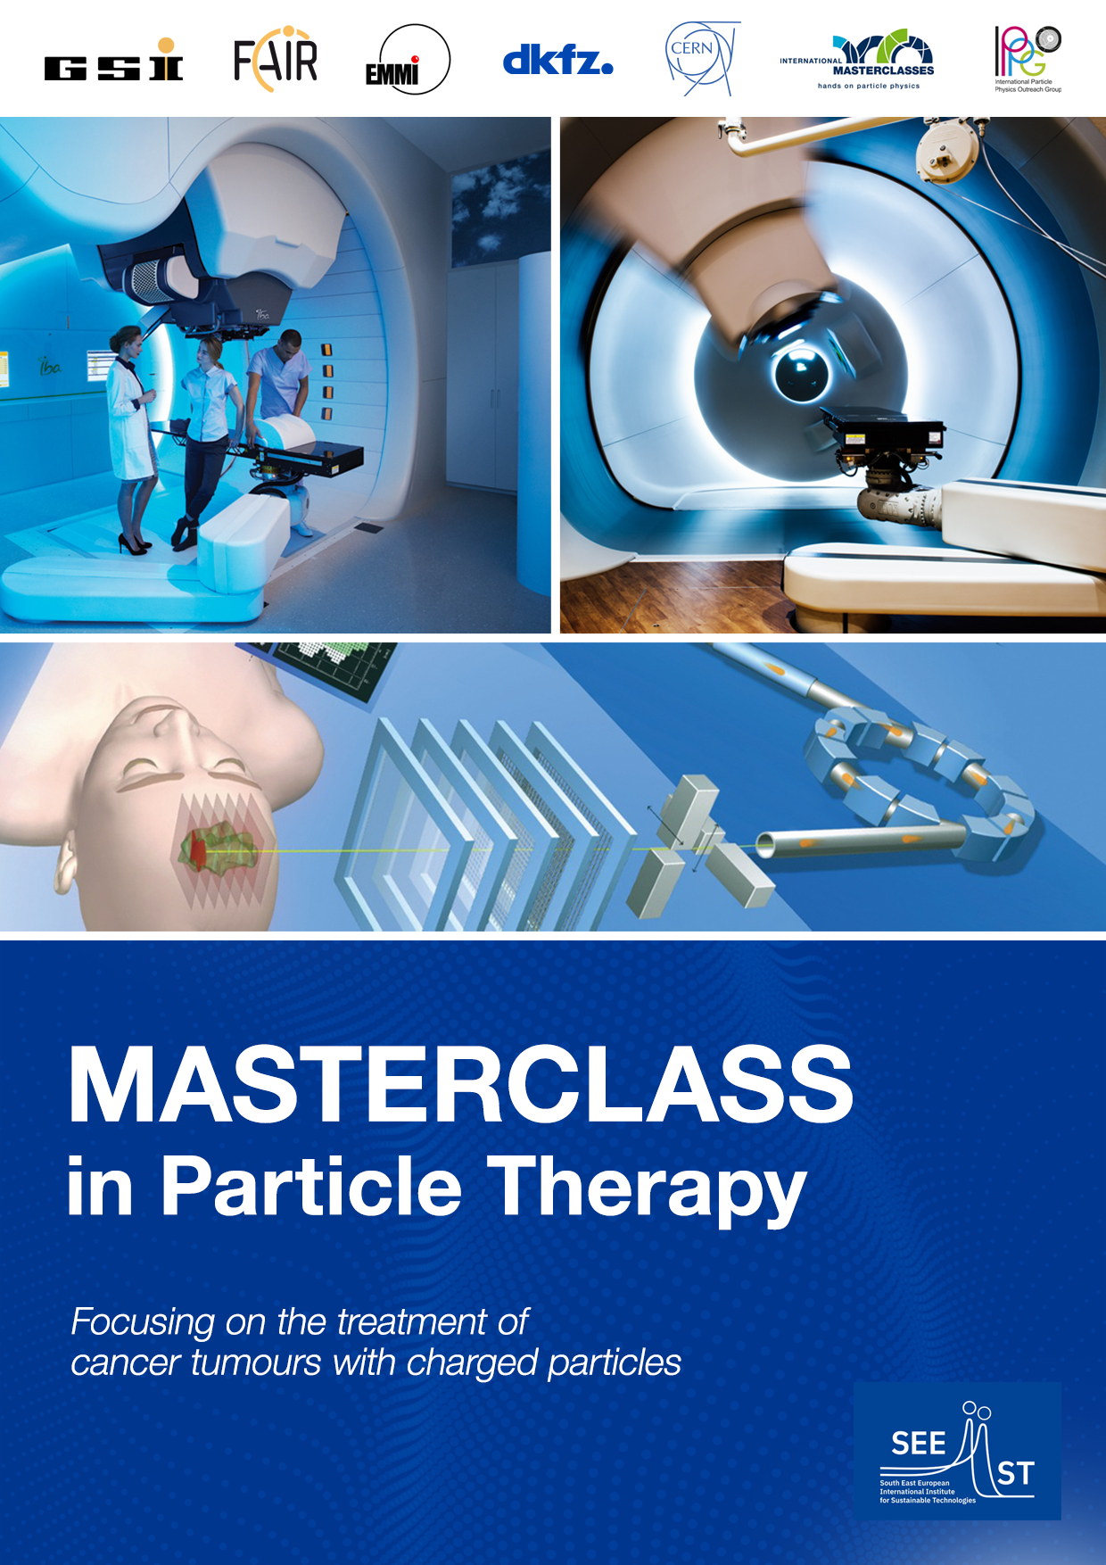
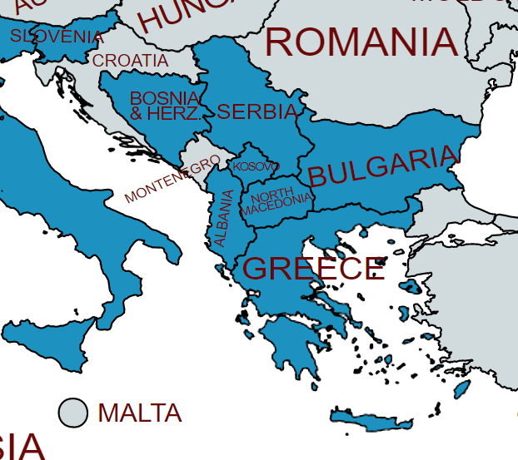
PTMC in SEE countries
Use PTMC to support capacity building in SEE
Promotion through the SEEIIST PR team
Almost all SEEIIST members in PTMC2021
and more in PTMC2022
Upcoming PTMC 8 and 9 april: among moderators, Ugo Amalid the father of CNAO therapy centre

Slide 18
PTMC in SEE countries
Use PTMC to support capacity building in SEE
Promotion through the SEEIIST PR team
Almost all SEEIIST members in PTMC2021
and more in PTMC2022
Aims:
establish (national) networks via SEEIIST SC members
(i.e. Slovenia…)
involve host institutes, medical communities….
complement current bottom-up with top-down approach
involving relevant education/science ministries/channels
(i.e. Montenegro….)
international event:
bring in contact students around the world,
highlight benefits of international collaborations ….

Slide 19
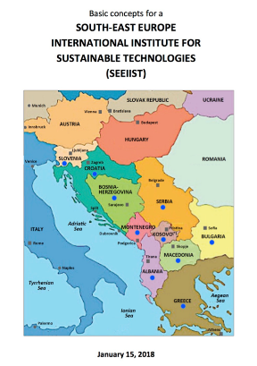
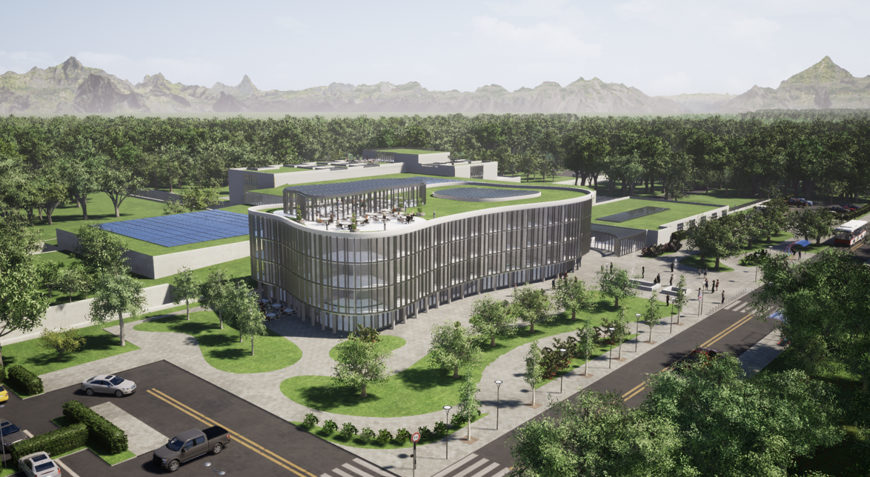
SEEIIST: Next generation facility for cancer tumour
therapy and research with heavy-ion beams
Δ. Καπρινης
Motivate young generations:
contributions to common projects for common progress and benefits

Slide 20
Aims and expectations
Attract school-children to STEM at early stages: decide future studies/career
Cultivate confidence through the hands-on (I can do it!)
and “demystify the difficulty” of physics, math….
NOTE: a Master thesis survey/study has shown that students do learn!
Support female students (i.e. 11 Feb, 8 March sessions) handle prejudices (i.e. MSc/PhD in Mexico)
Create groups of Uni assistants/tutors that learn better in order to teach
Demonstrate a return to society from investment in fundamental research
Enhance awareness of broader public
extended reach to family, friends, personal environment
Prepare future generations aware of importance of fundamental research and its applications:
  favourable politicians,
  evidence-based decision-making society

Slide 21






Acknowledgements PTMC
matRad Developers
Wahl, Niklas
Bangert, Mark
Hans-Peter Wieser
DKFZ Heidelberg
LoC: Wahl, Niklas
Katrin Platzer, Malte Ellerbrock
Noa Homolka Amit Ben Antony Bennan
GSI
LoC: Yiota Foka
GSI Biophysics:
Christian Graeff, Radek Pleskac
GSI ALICE, EMMI :
Ralf Averbeck, Malzacher, Peter
GSI IT :
Thorsten Kollegger, Behnert, Katharina
Osdoba, Sascha
CERN (staff and users)
CERN: tutors
Loc Org: Nikolaos Charitonidis
Alexander Gerbershagen
Evangelia Dimovasili
Elena Benedetto
CERN/ARIES: Maurizio Vretenar, Valerie Brunner
CERN/ENLIGHT: Manjit Dosanjh Petya Georgieva
CERN/KT: Manuela Cirilli Anais Rassat Rita Ferreira Giovanni Porcellana
CERN: Visits Service Erwan Harrouch Francois Butin
CERN: Training Centre: Eric Bonnefoy M-L LECOQ
Uni Sarajevo: web pages
Amila Avdic
Amra Ibrahimovic
Mirsad Tunja
Damir Skrijelj
Online mode, web pages, training
Sponsors : Edmond Offermann
Aris Mamaras (AUTH), Damir Skrijelj (UNSA)
General Coordination :
p.foka@gsi.de
yiota.foka@cern.ch

Slide 22
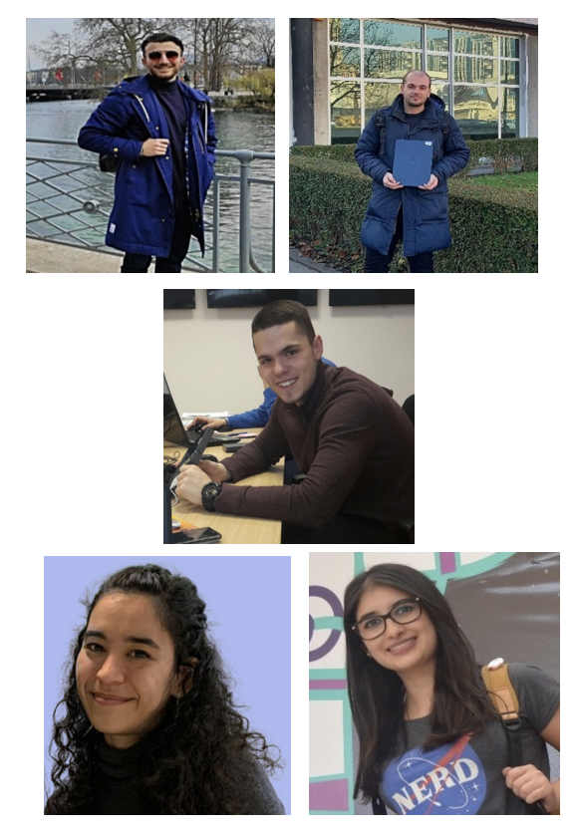
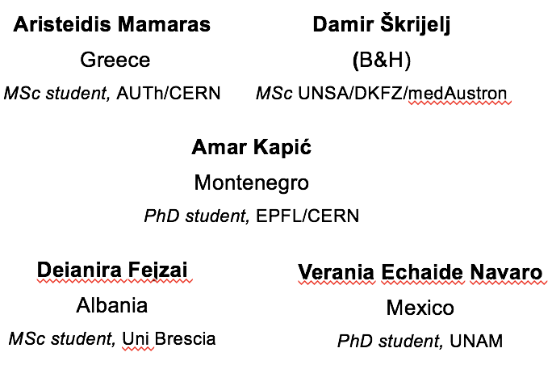
Acknowledgements PTMC
PTMC2022 core team
matRad Developers
Wahl, Niklas
Bangert, Mark
Hans-Peter Wieser
DKFZ Heidelberg
LoC: Wahl, Niklas
Katrin Platzer, Malte Ellerbrock
Noa Homolka Amit Ben Antony Bennan
GSI
LoC: Yiota Foka
GSI Biophysics:
Christian Graeff, Radek Pleskac
GSI ALICE, EMMI :
Ralf Averbeck, Malzacher, Peter
GSI IT :
Thorsten Kollegger, Behnert, Katharina
Osdoba, Sascha
CERN (staff and users)
CERN: tutors
Loc Org: Nikolaos Charitonidis
Alexander Gerbershagen
Evangelia Dimovasili
Elena Benedetto
CERN/ARIES: Maurizio Vretenar, Valerie Brunner
CERN/ENLIGHT: Manjit Dosanjh Petya Georgieva
CERN/KT: Manuela Cirilli Anais Rassat Rita Ferreira Giovanni Porcellana
CERN: Visits Service Erwan Harrouch Francois Butin
CERN: Training Centre: Eric Bonnefoy M-L LECOQ
Uni Sarajevo: web pages
Amila Avdic
Amra Ibrahimovic
Mirsad Tunja
Damir Skrijelj
Online mode, web pages, training
Sponsors : Edmond Offermann
Aris Mamaras (AUTH), Damir Skrijelj (UNSA)
General Coordination :
p.foka@gsi.de
yiota.foka@cern.ch

Slide 23
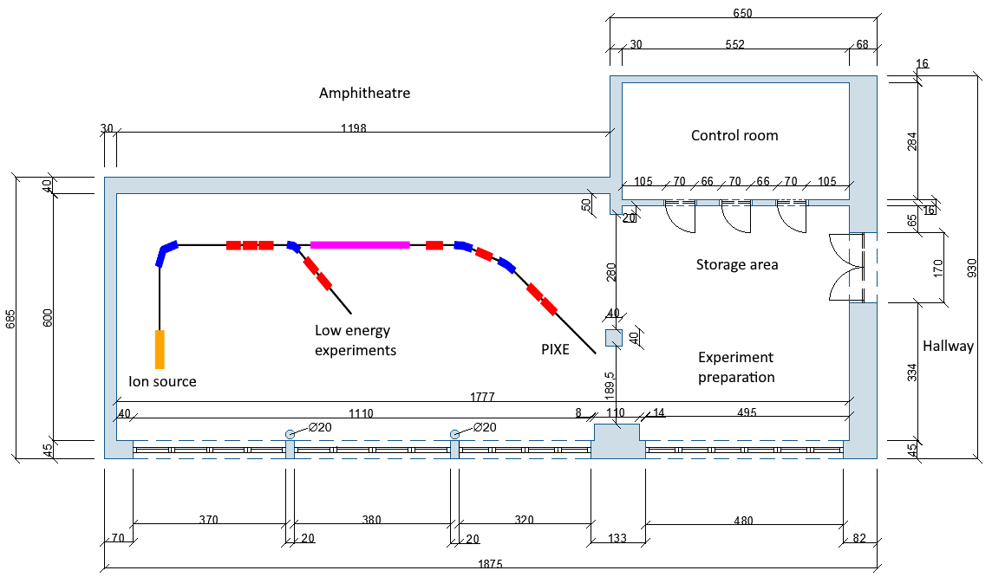
Towards a new lab/project at UNSA/Sarajevo
Aim: establish a new lab based on an ion source, evolving to a low energy accelerator for training and basic research
Sponsored by “Three Physicists Foundation”
Towards reality: drawings of “ion-source lab”
Credit: UNSA Fehima Ugarak
supported by “Three Physicists” Foundation
in collaboration with CERN/NIMMS
Group leader position
Training of students
Source to arrive at CERN
  Testing
  Training
  Moving to UNSA
Strengthening collaboration
  UNSA (academia)
  CERN (research)
  Cosylab (industry)
  Uni of Ljubljana

Slide 24
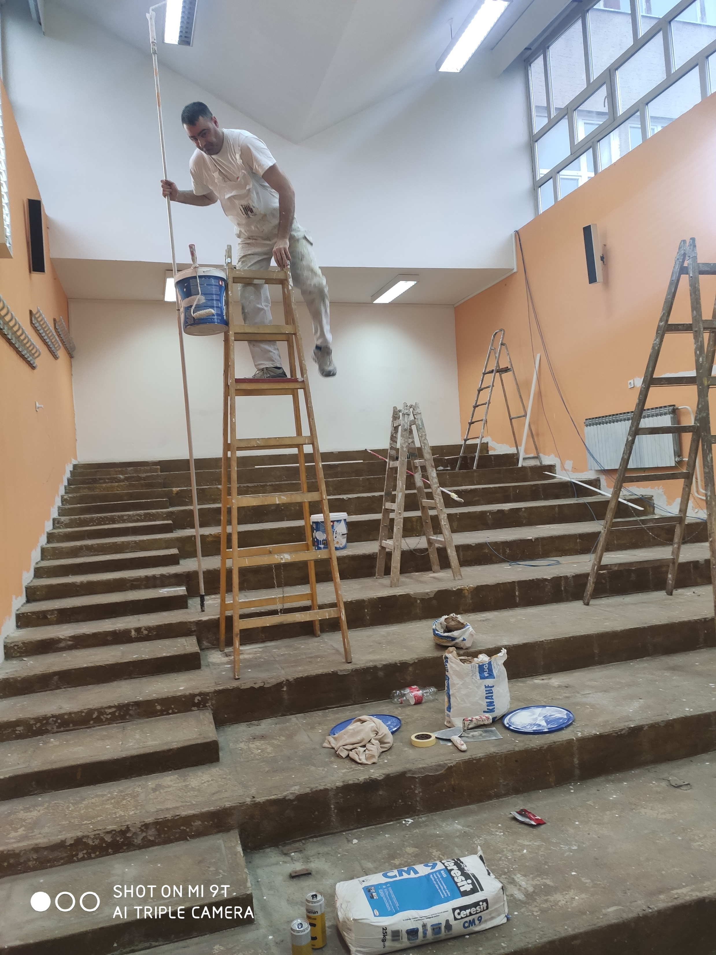
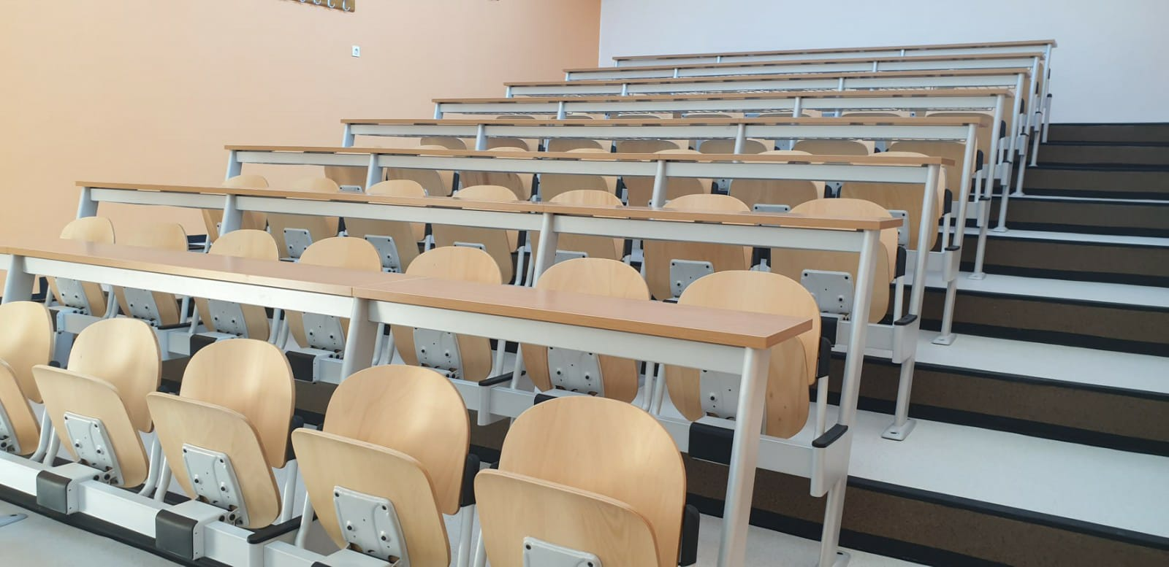
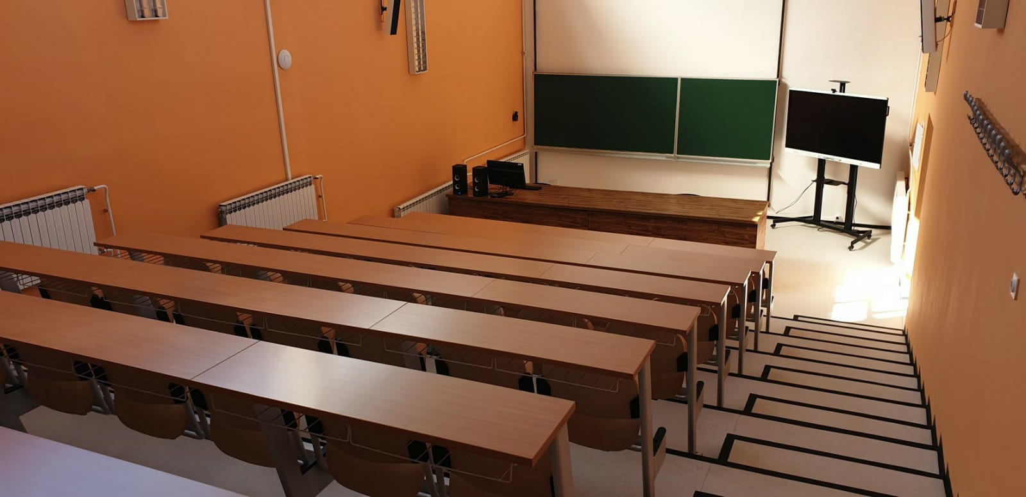
Refurbishing UNSA labs and infrastructures
In addition to the “ion source lab”
complete refurbishing of all infrastructures and existing laboratories
with modern equipment
Complement:
top-down: through hi-tech projects
bottom-up: starting from basics, pushing up
Sponsored by “Three Physicists Foundation”
An example to follow !

Slide 25
Training supporting capacity building
At CERN/NIMMS group
- 3 UNSA masters, 6 months trainees at CERN in-person
2 UNSA masters , 6 months trainees at CERN remotely
12 CERN summer students remotely from SEE region
Masters Students: from UNSA
Results in ESFRI report and other SEEIIST documents
Feasibility and preparation of the ion source project
Supervisors: Elena Benedetto, Mariusz Sapinski (SEEIIST, TERA, NIMMS/CERN)
CERN Summer Students 2021: from SEE region
Topics: from ion therapy simulation studies, to RI, AI….
Sponsored by “Three Physicists foundation”
Main concern:
  after training, provide an attractive project
  so that they come back to home institutes
Summer 2022:
at Slovenia, Ljubljana Uni, Cosylab, i-Tech

Slide 26
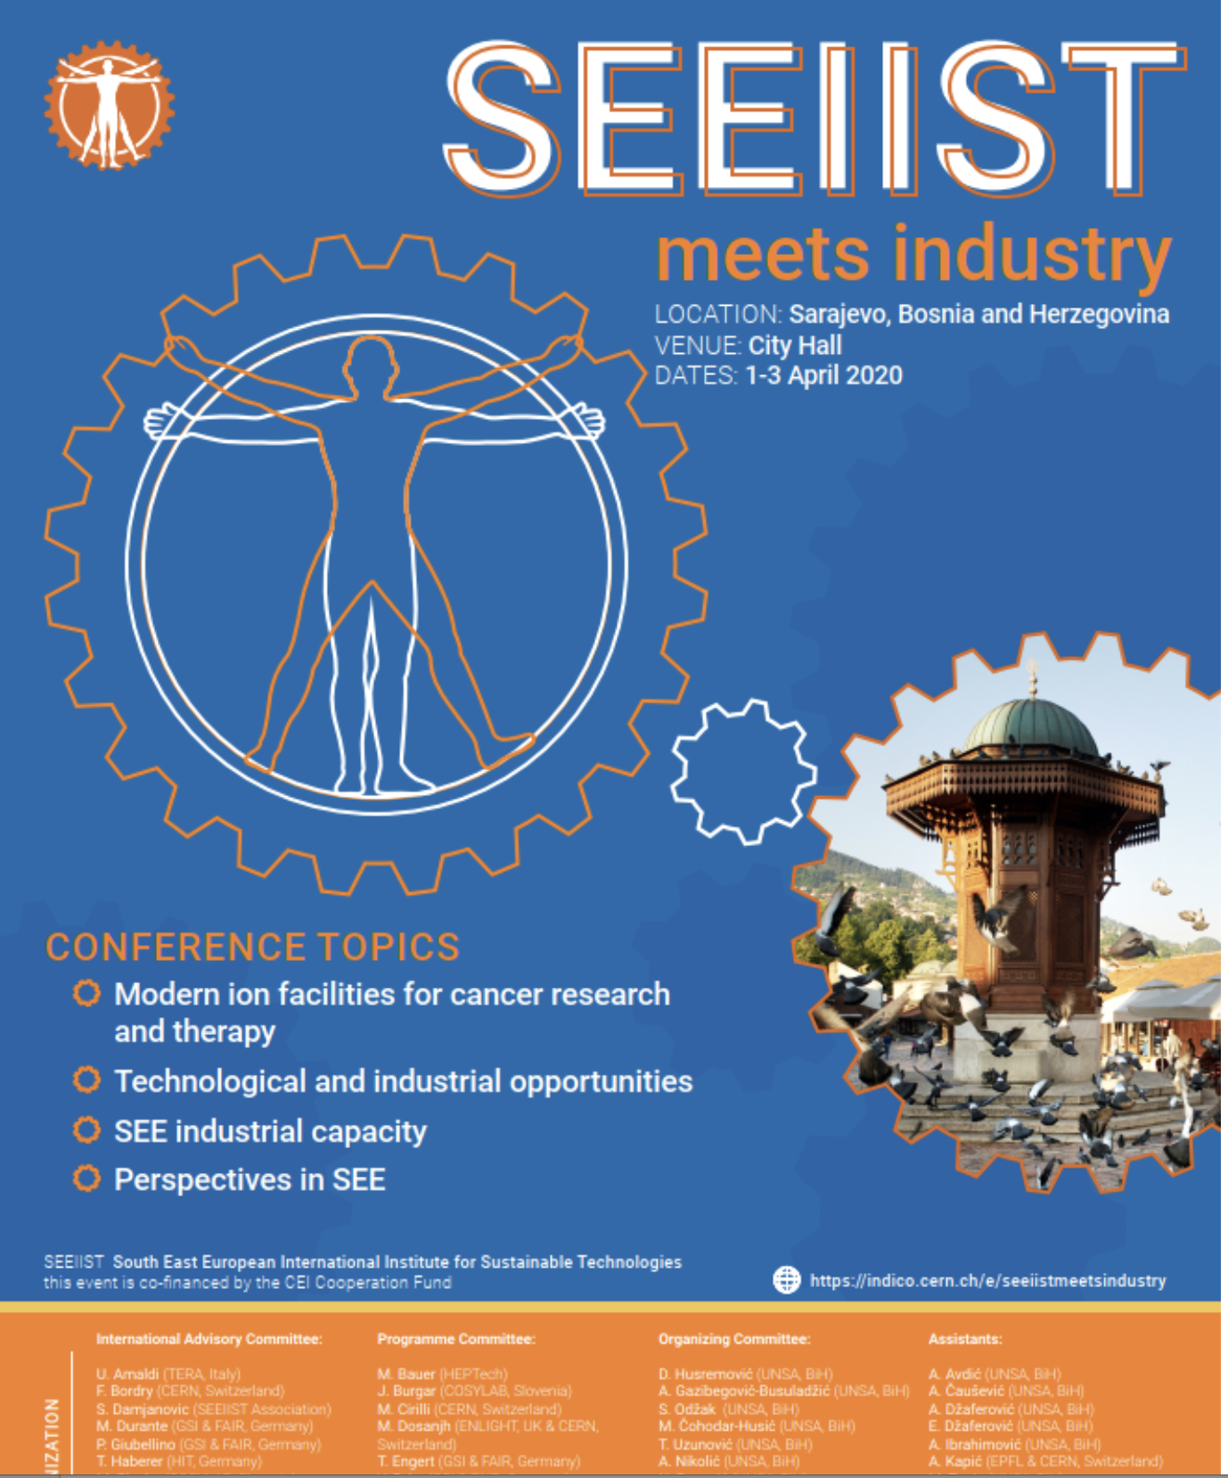
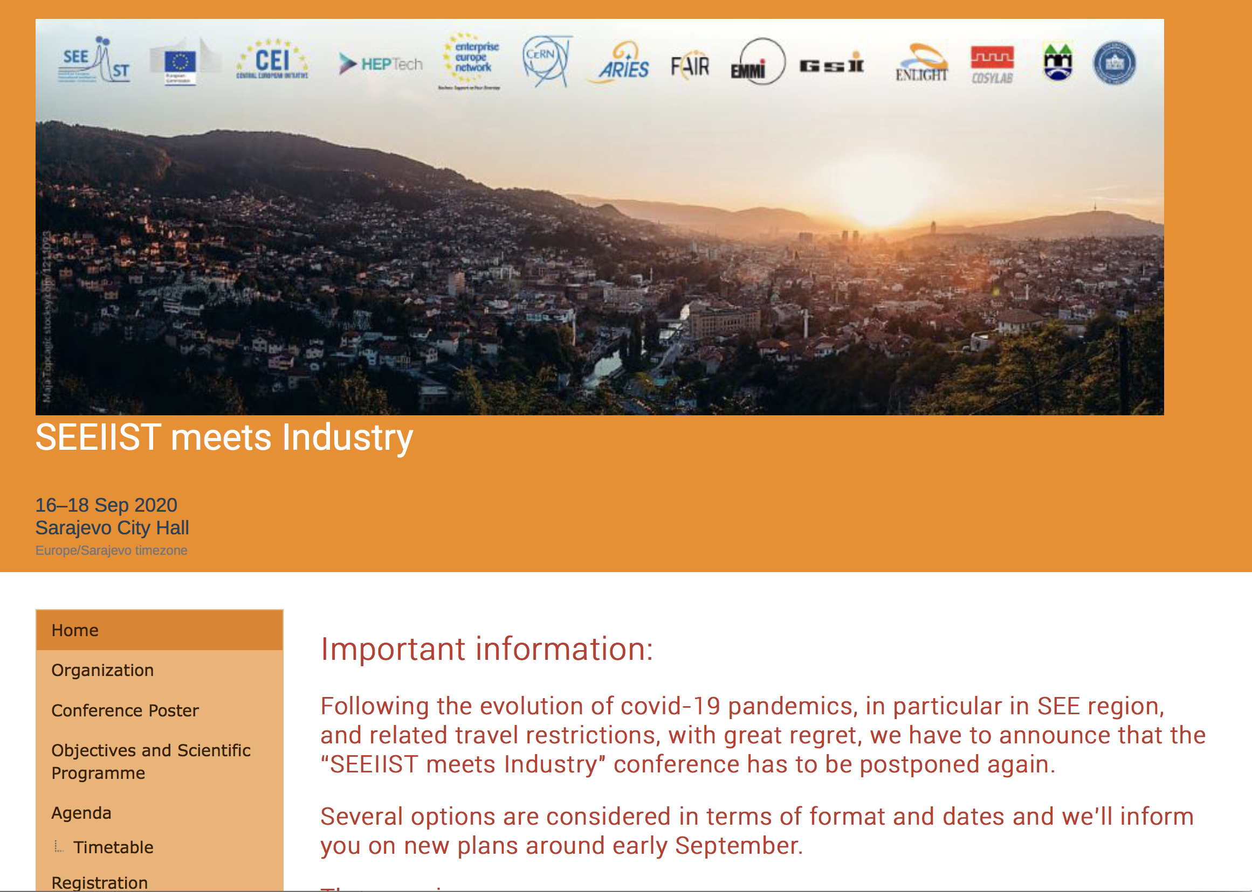
Workshop in Sarajevo
Sponsored by:
Central European Initiative (CEI)
“Three Physicists” Foundation
Attract SEE and WE companies, initiate collaborations
New Proposed Dates: 1st week of October 2022

Slide 27
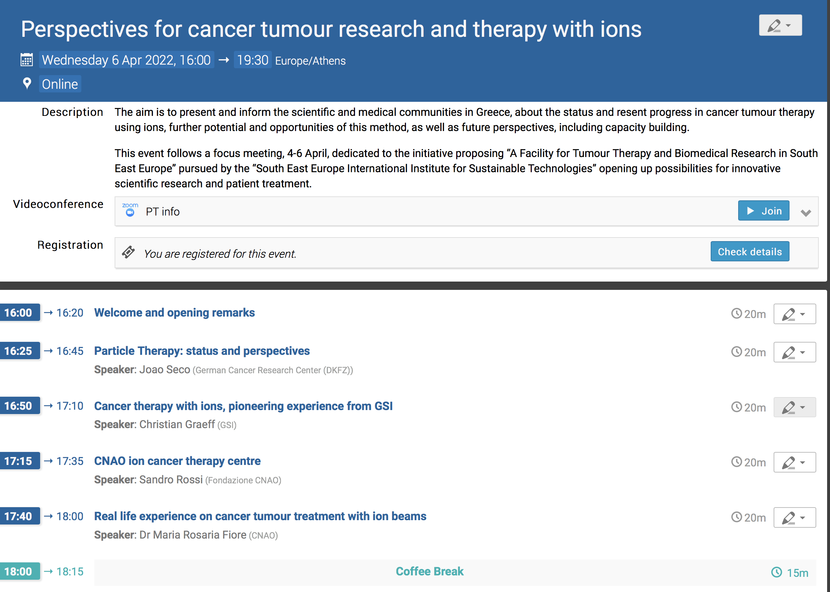
Online information event on Particle Therapy
For scientific/medical communities in Greece
6 April 2022 at 16:00
https://indico.cern.ch/event/1138945/
Under the auspices of AUTH
Speakers:
DKFZ German Cancer Research Center
CNAO therapy centre
GSI, CERN, IAEA
and AUTH
Similar to introductory event
6 November 2020
First introduction of SEEIIST

Slide 28
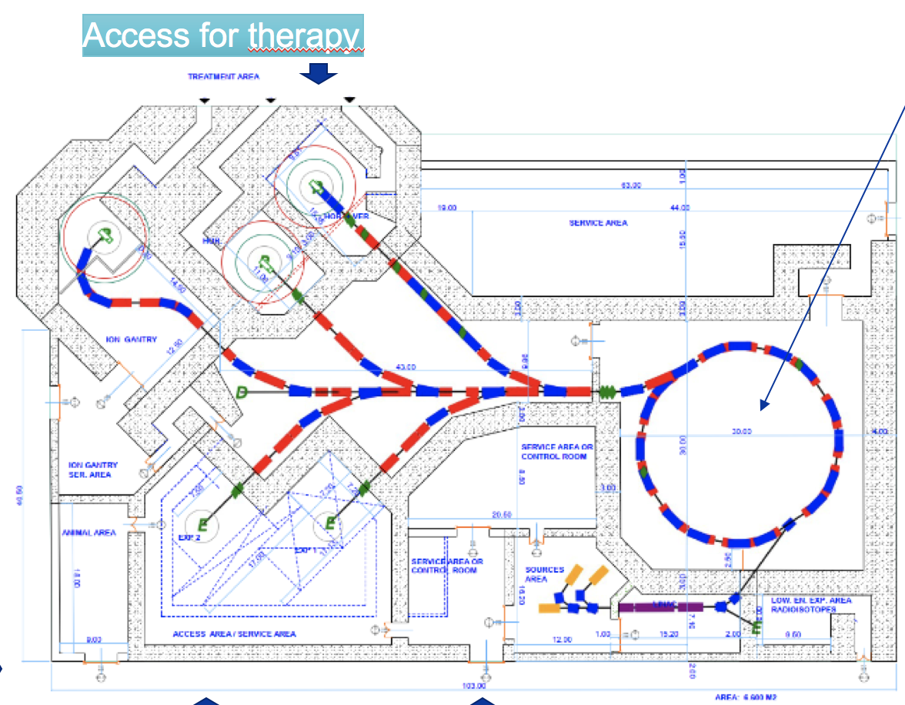
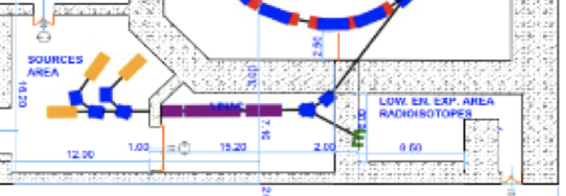
Online information event and RI production
One of the speakers from AUTH young generation: Aris Mamaras
Diploma and Masters Thesis at AUTH
Technical Student at CERN supported by NIMMS
Radio-isotope production exploiting linear accelerators
On details of the project exploring
the use of linear accelerators for radioisotope productions
the use of the linac injector for radioisotope production
For both projects submission of EU proposals
  forming tight groups
  continuing collaborations

Slide 29
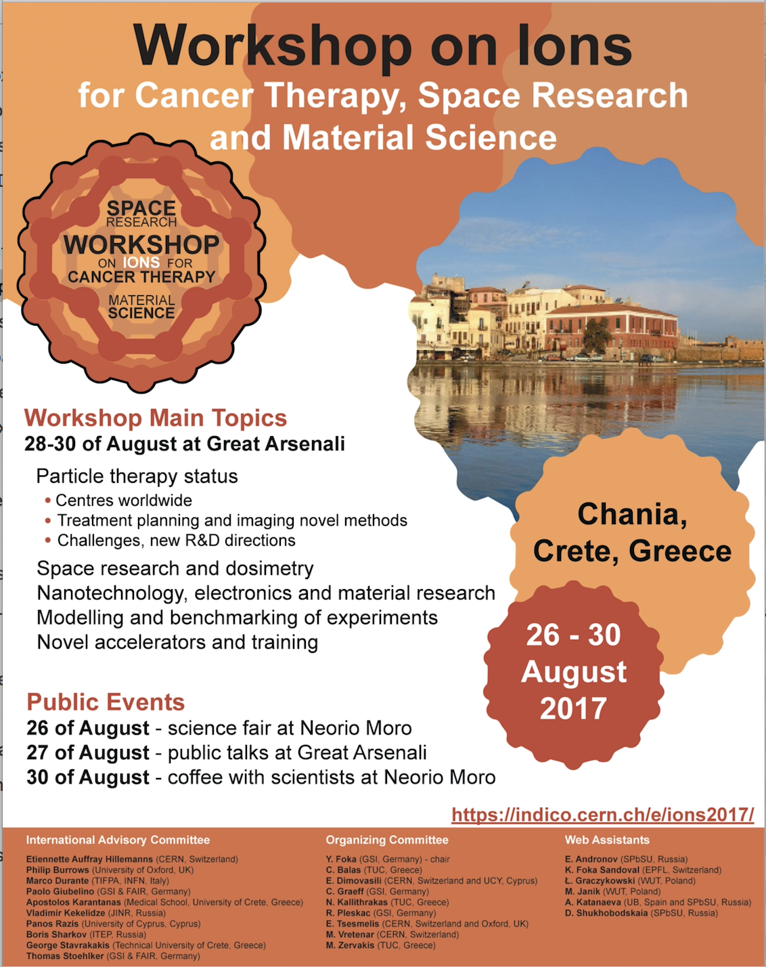
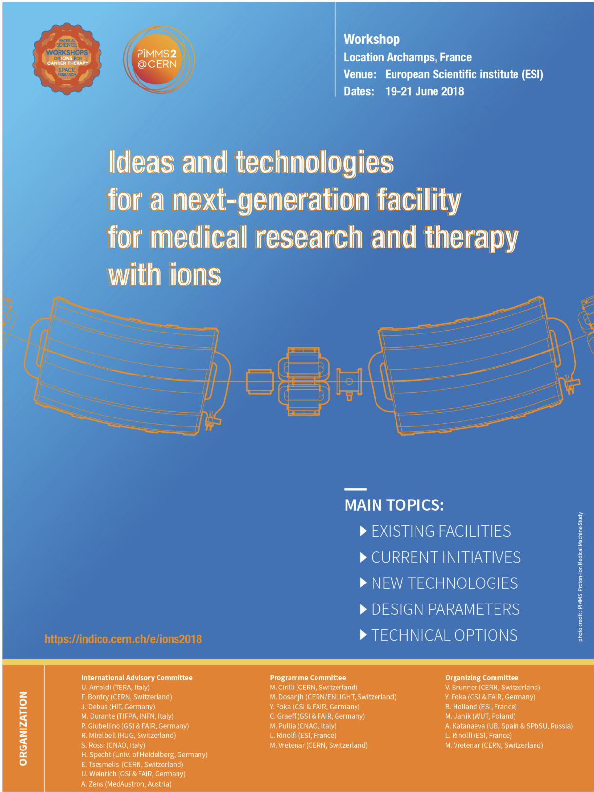
Looking forward to exiting projects and collaborations !

Slide 30
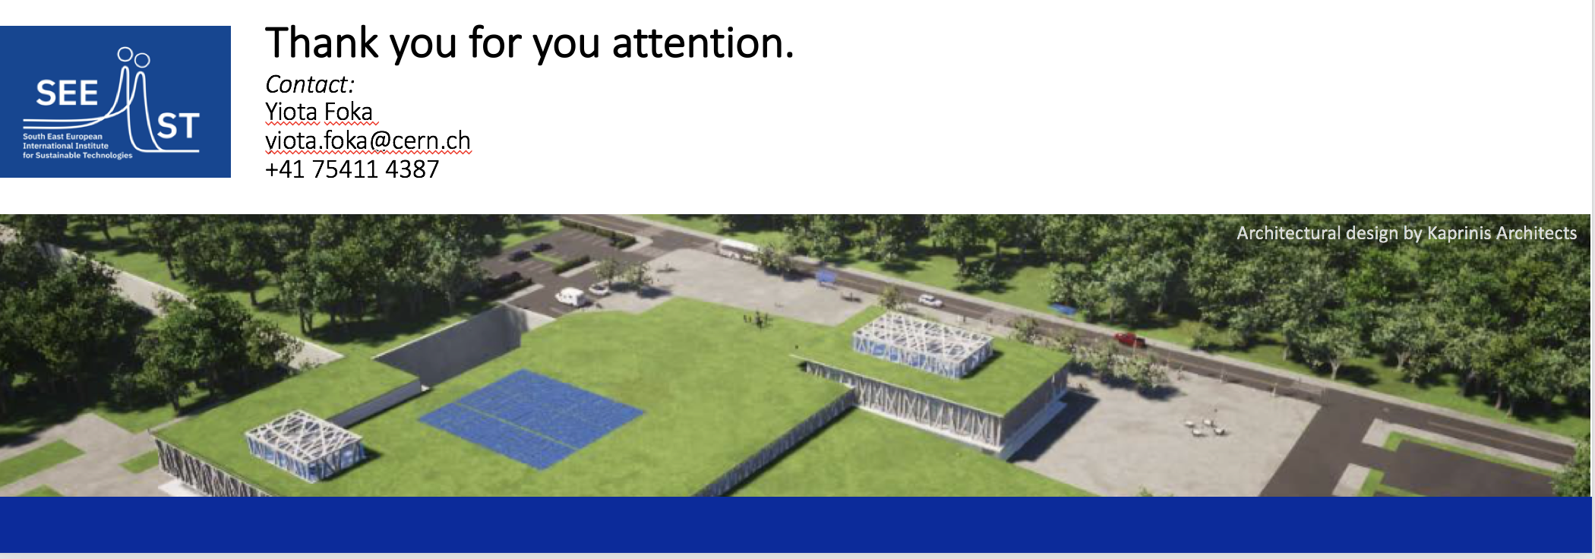
Capacity building pursuing common projects
in the fight against cancer

