Slide 1
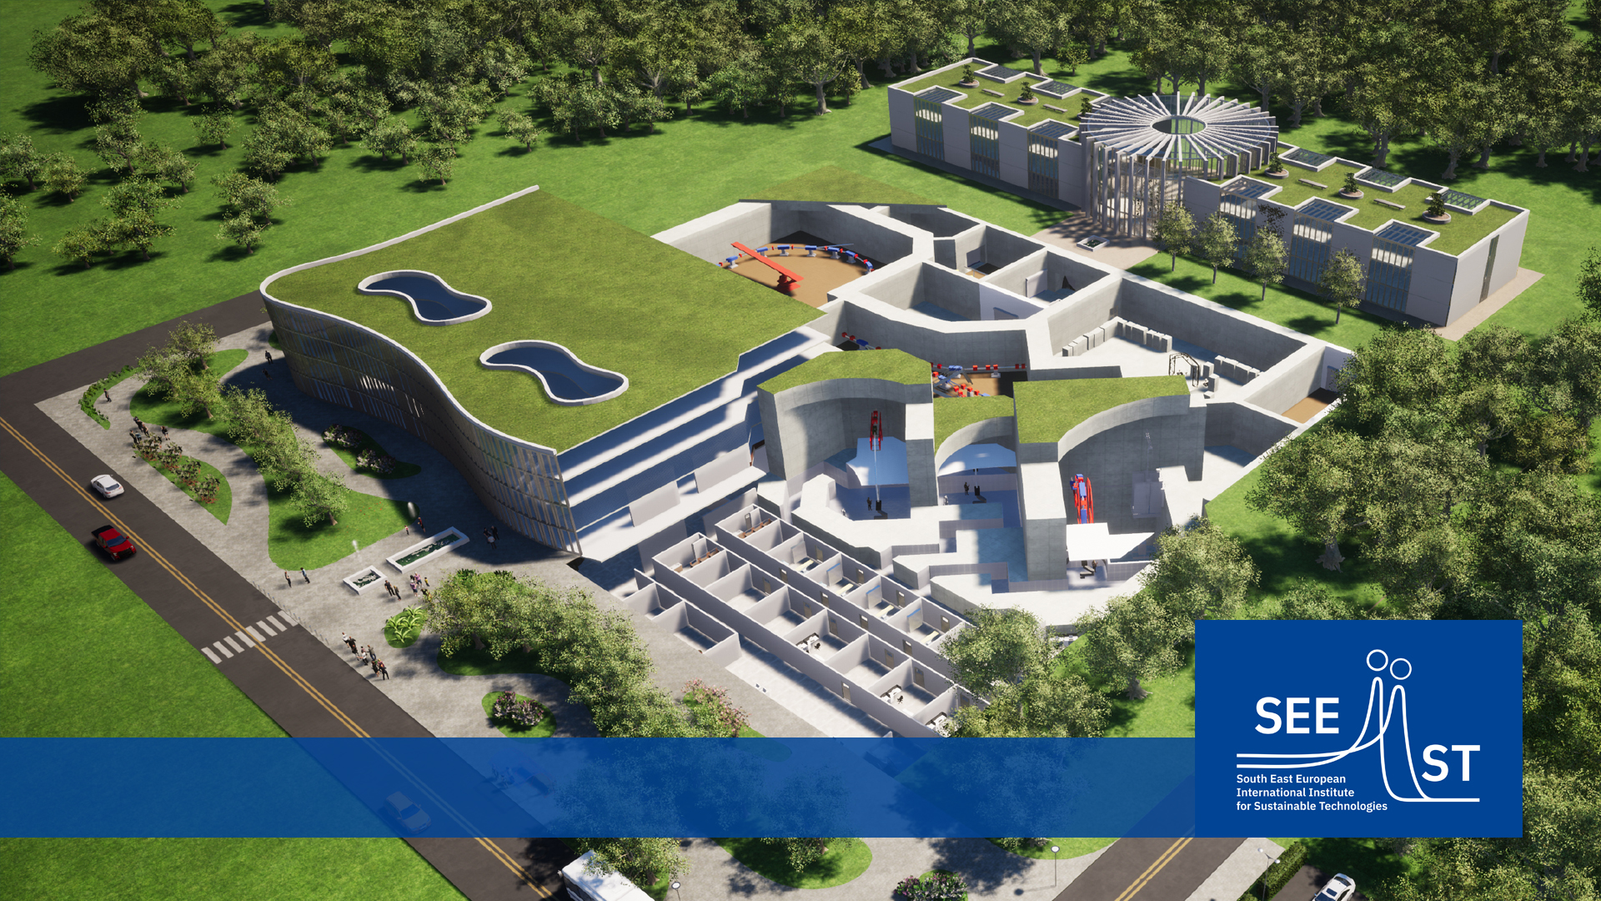
Architectural design by Kaprinis Architects
TITLE FOR PRESENTATION
Dr. Luka B. Uskokovic / March 2021
SEEIIST Association Report to Steering Committee
Adnan Beganović, chair of the AB (04/03/2022)

Slide 2
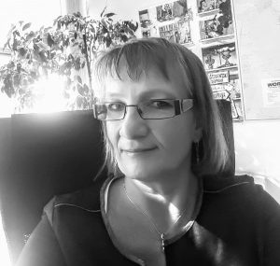
Report SEEIIST Association: Period 01/2022 – 03/2022
Personal Changes
Tea Glazar, Co-Chair of the Association Board,
passed away on January 25th
  Active member in the SEEIIST SC representing Slovenia
  since the SC was established.
  Co-Chair of the Association Board since 2019
  Chair of the Association Board 06/2021 – 09/2021
  Vice-President of the COST Association
  Delegate of Slovenia to the CERN Financial Committee and
  advisor for Slovenia to the CERN Council.

Slide 3
Report SEEIIST Association: Period 01/2022 – 03/2022
Further Personal Changes
Vesna Gershan resigned due to potential conflict of interest with her
employment at IAEA

Slide 4

Report SEEIIST Association: Period 01/2022 – 03/2022
Activities of the Board
  23th-BM-2022.02.07
  Discussion and approval of the SEEIIST PR plan 2022
  Report and discussion of the SC meeting Jan 19th
  24th-BM-2022.02.28
  WG on Clinical concept and WG on Research Concept
  User community development
  25th-BM-2022.03.21
  Preparation SC meeting April 4th
  Continued: WGs Medical / Science

Slide 5
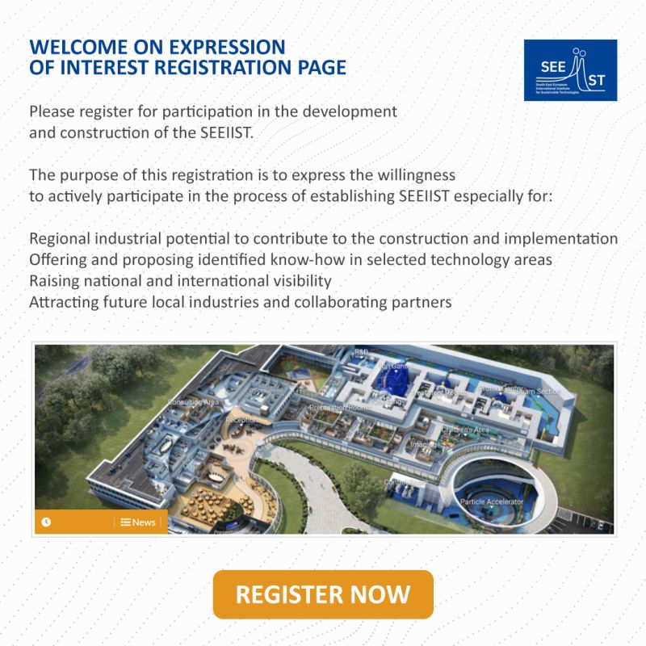


Report SEEIIST Association: Period 01/2022 – 03/2022
Work of the Association in accordance to the Working Plan
  SEEIIST PR plan 2022
  PR Communication: interviews, newsletter, press release
  Campaigns: e.g. World Cancer Day
  Promoting of Events: e.g. SEEIIST meets industry
  Projects: e.g. Website redesign
  In total more than 30 activities planned
  Please provide SEEIIST related information for distribution
  via SEEIIST PR channels.
✓

Slide 6
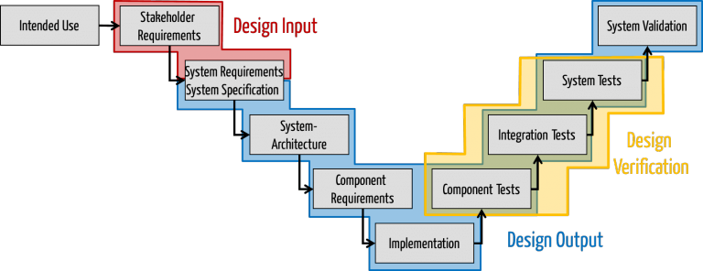
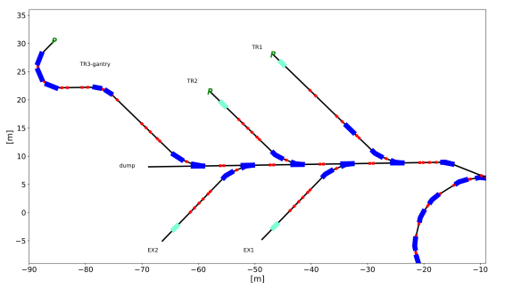
Report SEEIIST Association: Period 01/2022 – 03/2022
Work of the Association in accordance to the Working Plan
  Planning of Accelerator Design Phase started
  HITRIplus contribution in accordance to project schedule
    Design study for beam transport system
    Contracting of partners
    Planning of courses on ion therapy
    Networking and outreach
    Preparation of General Assembly and annual meeting
  Drafts for Framework agreements with PSI and ICTP prepared
✓

Slide 7
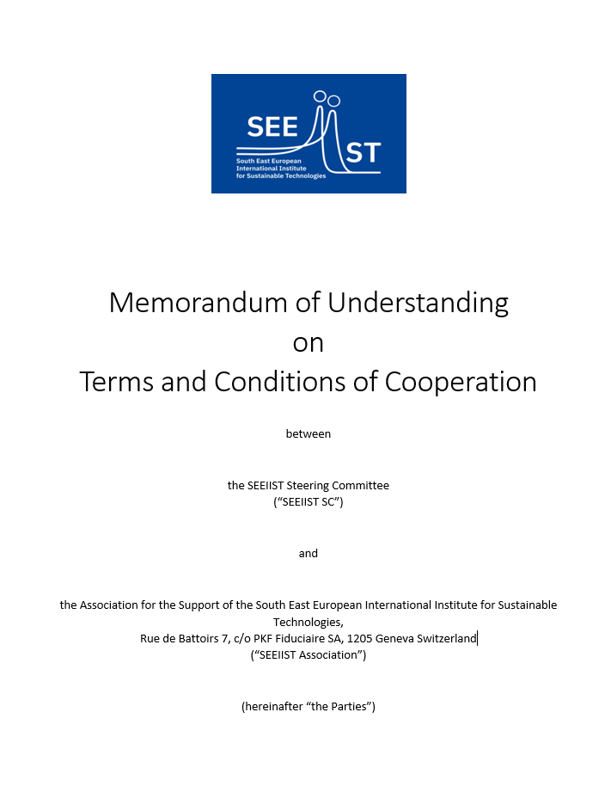
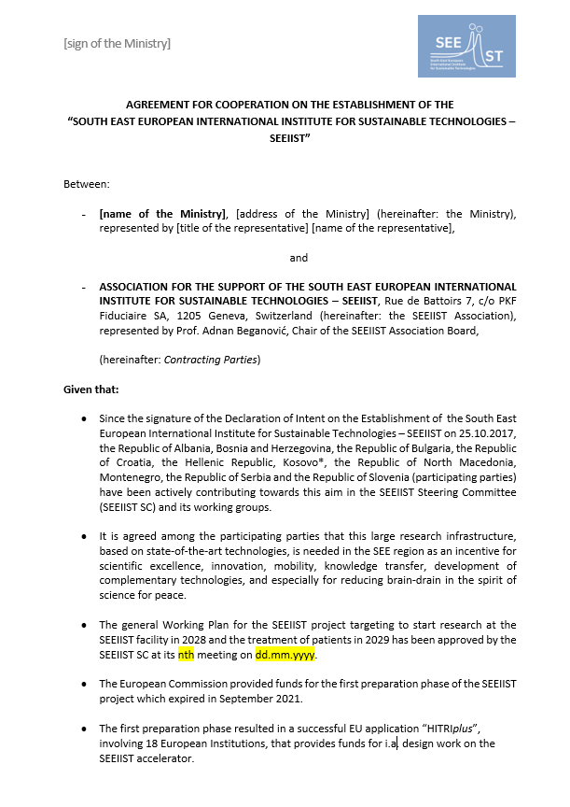
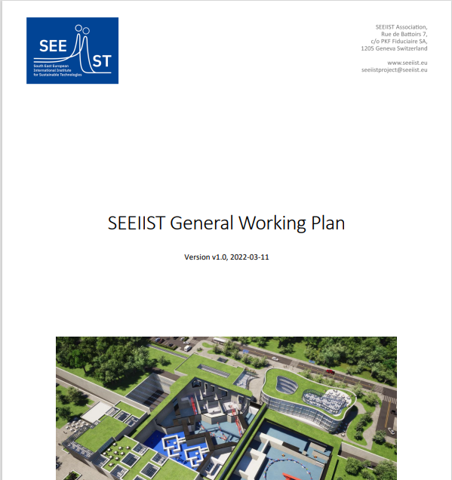
Report SEEIIST Association: Period 01/2022 – 03/2022
Work of the Association in accordance to the Working Plan
  Joint General Working Plan ready for approval by SC
  Memorandum of Understanding SC – Association
  ready for signature
  Template for Cooperation Agreements with SC ministries
  prepared
✓

Slide 8
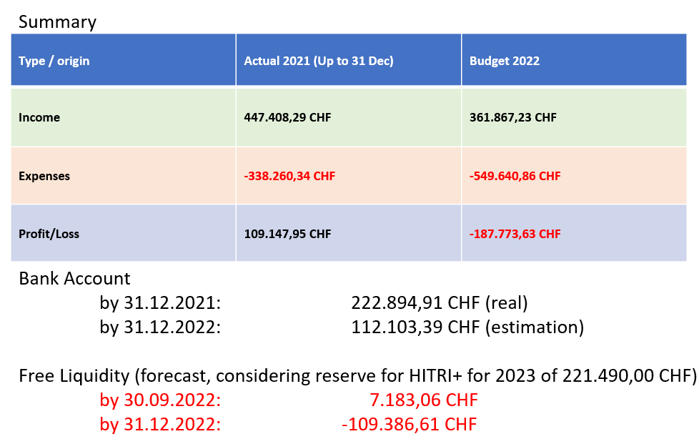
Report SEEIIST Association: Period 01/2022 – 03/2022
Financial Report
  Situation unchanged – liquidity allows work until Q3/2022
  The minimum total amount of money required per year
  is in the order of 300 to 350 kEuro.
  Association counts on the commitments of the countries given
  in Bern and will approach the ministries with the proposal for
  Cooperation Agreements
  General Assembly will prove the situation by 05/2022
  Association is legible to receive funds from the
  Swiss State Secretariat for Education, Research and Innovation (SERI)
  for a Horizon Europe collaborative projects

Slide 9
Report SEEIIST Association: Period 01/2022 – 03/2022
Next Steps – Project Preparation
  Conclusion on a Conceptual Design Report
  → base for detailed design
  → base for project budget estimation with sufficient confidence for project approval
  → base for application for project funding
  Setup of WG on Clinical Concept
  Setup of WG on Research Concept
  Continuation of design studies within HITRIplus
  → Depends substantially on the strategic decisions to be taken by the Steering Committee

Slide 10
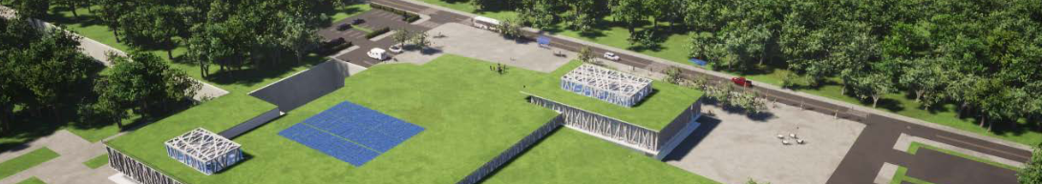
Thank you for you attention.
Contact:
Adnan Beganović
adnanbeg@gmail.com
+387 61 825519
Architectural design by Kaprinis Architects

