Slide 1
Ongoing BPM studies at AWAKE
E. Senes

Slide 2
Outline
Goal of today: make the point on ongoing BPM studies at AWAKE
1
1x HF-BPM
40 GHz buttons by OMC
2x ChDR BPM
Alumina inserts
TRIUMF electronics
2

Slide 3
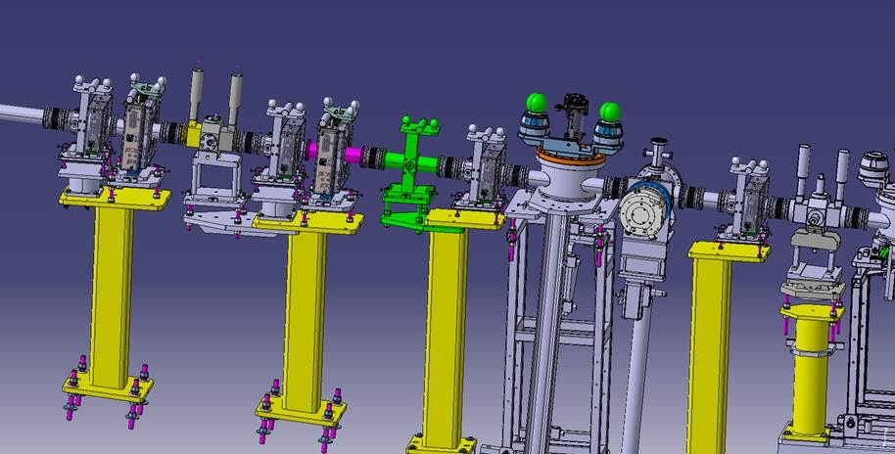
View
eBPM
eBPM
eBPM
eBPM
ELECTRON
MERGE
PLASMA
CELL
ChDR BPM
HF BPM
ChDR BPM
e+p BPM
BTV350

Slide 4
Purpose
Goal agreed with AWAKE: develop an e-BPM capable to measure the position unbiased by the protons.
Timeline agreed with AWAKE: run 2a, possibly not at the end of the run. Run 2a ends in October 2022.

Slide 5
Long story short
10 Sep 2019
Acknowledged the need for a BPM working > 10 GHz (AWAKE Collab. Meeting Sept. 2019)
22 Jan 2020
PTFE results presented
(6th AWAKE Instrument Meeting)
6 Oct 2020
Detailed analysis of proton bunch presented
(9th AWAKE Instrument Meeting)
- Alumina test results presented
- Proposal for 40 GHz buttons upon AWAKE request
(12th AWAKE Instrument Meeting)
22 Jun 2021

Slide 6
40 GHz buttons BPM

Slide 7
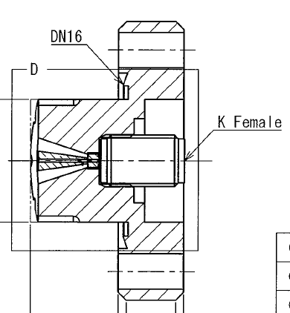
The HF-BPM
40 GHz buttons from OMC
Michal obtained DESY permission to adapt and produce the buttons
The design is conical
Purchased 6x buttons mid-August
Lead time 5 months (January)

Slide 8
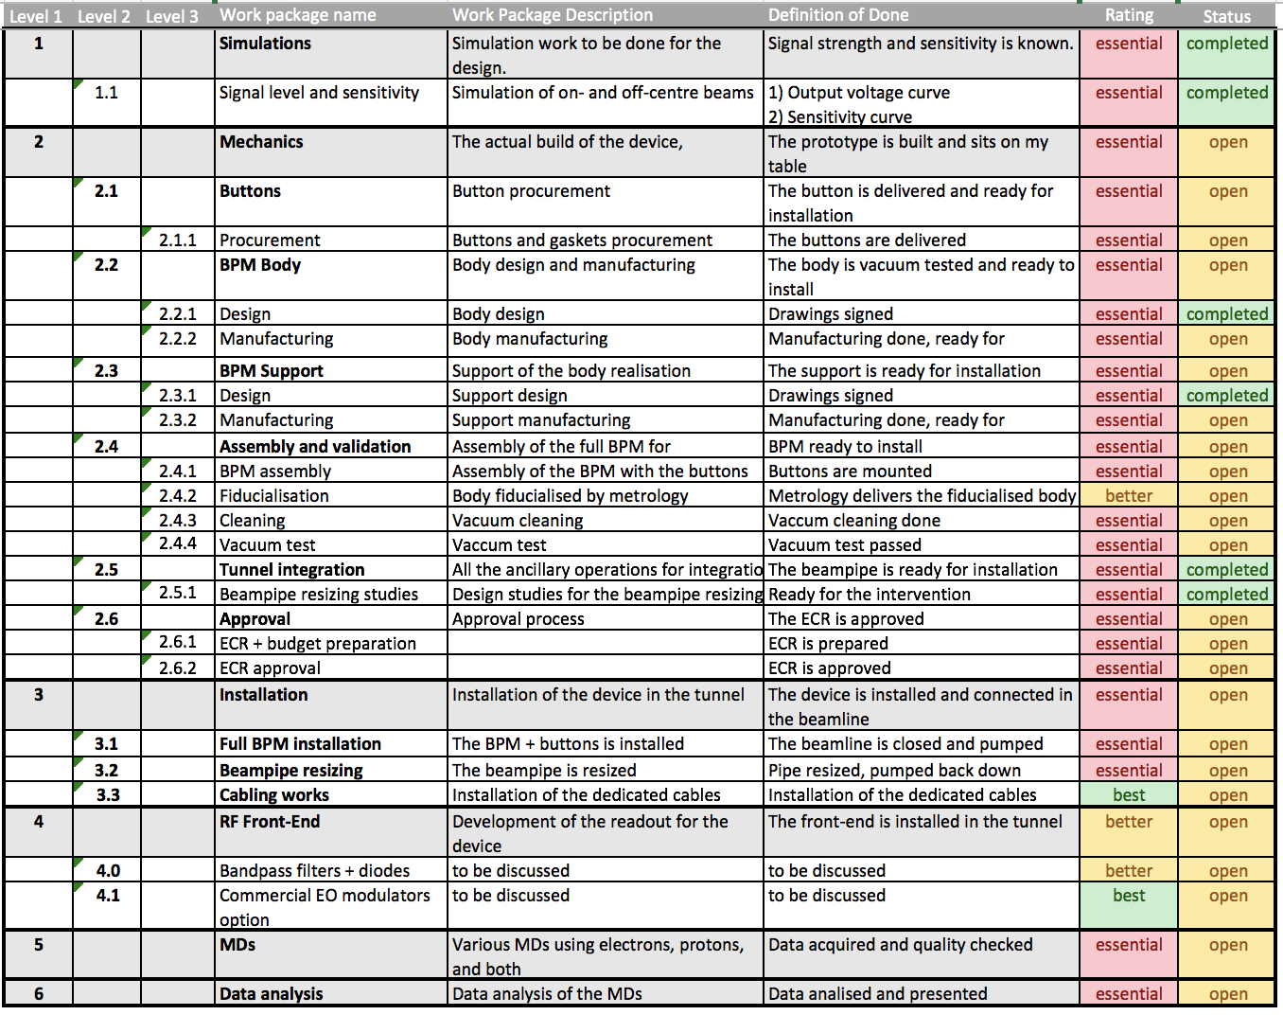
WBS

Slide 9
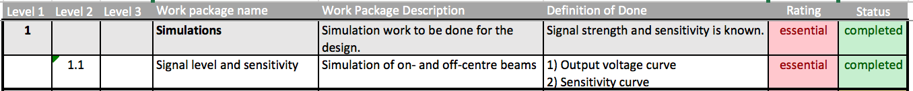
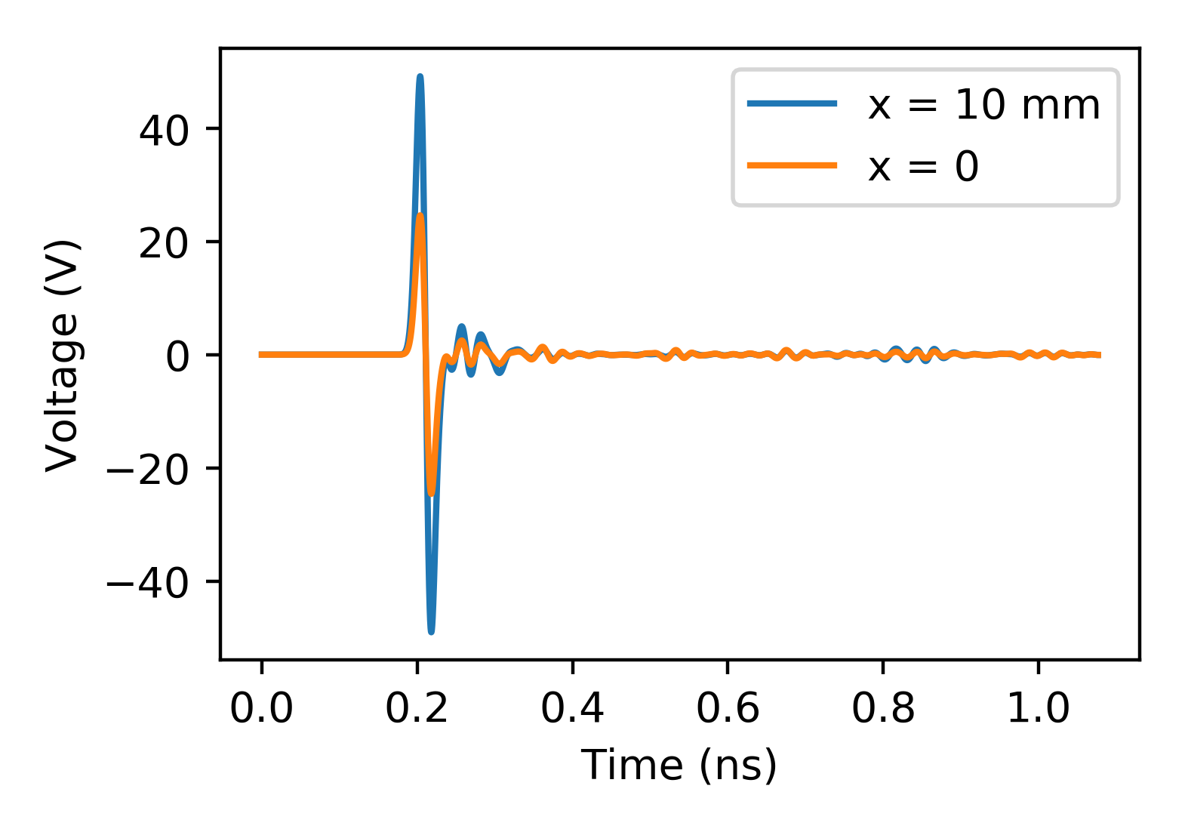
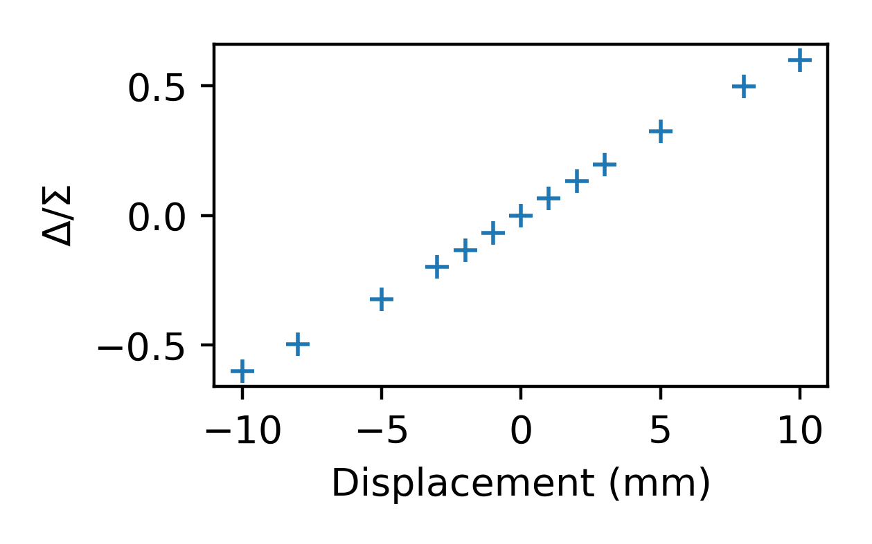
WBS
Simulations DONE
CST model based on OMC mechanical design (based on Manfred’s)
Results with both CLEAR and AWAKE parameters
AWAKE beam

Slide 10
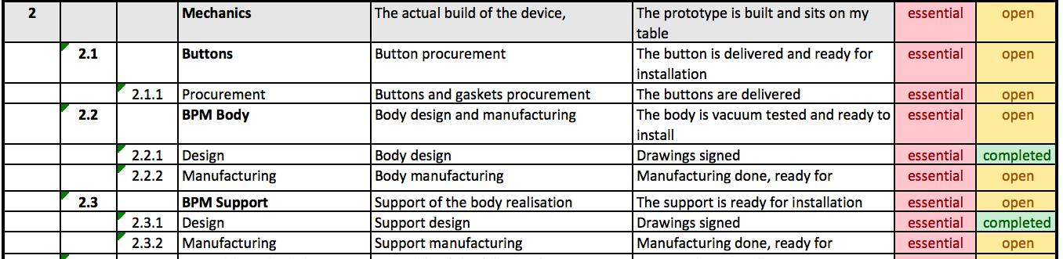
WBS
Mechanics production
Buttons ordered in August, delivery end of Jan
Body drawings signed on 19 November
Body + support production at CERN main workshop
Same length of ChDR BPMs

Slide 11
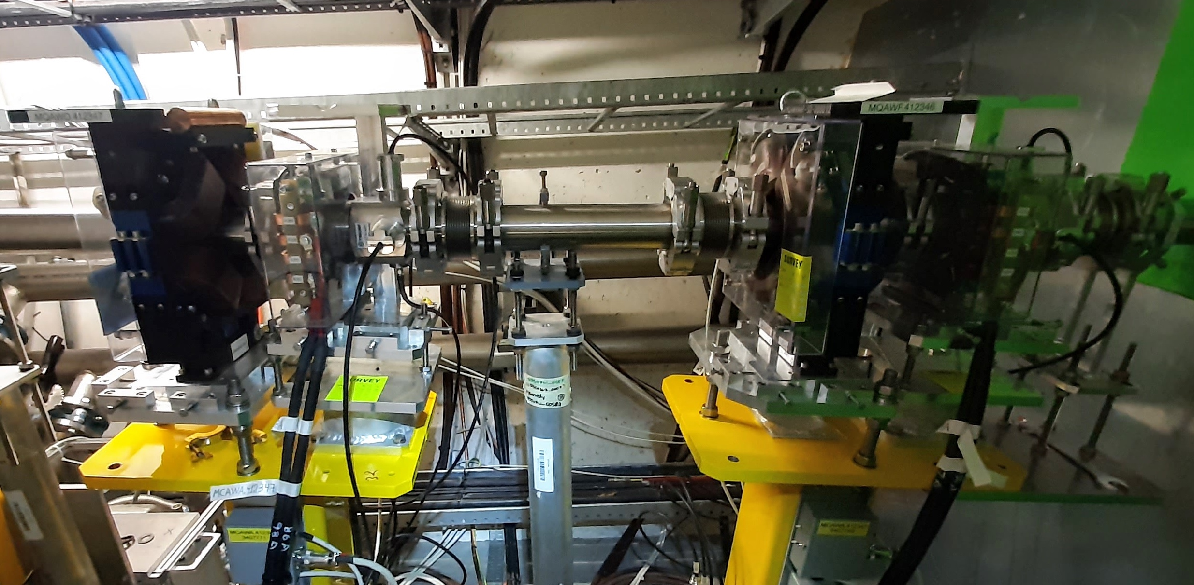
WBS
Tunnel integration
As for ChDR BPM, beampipe resizing is necessary
Intervention agreed for end of YETS 2021/22

Slide 12
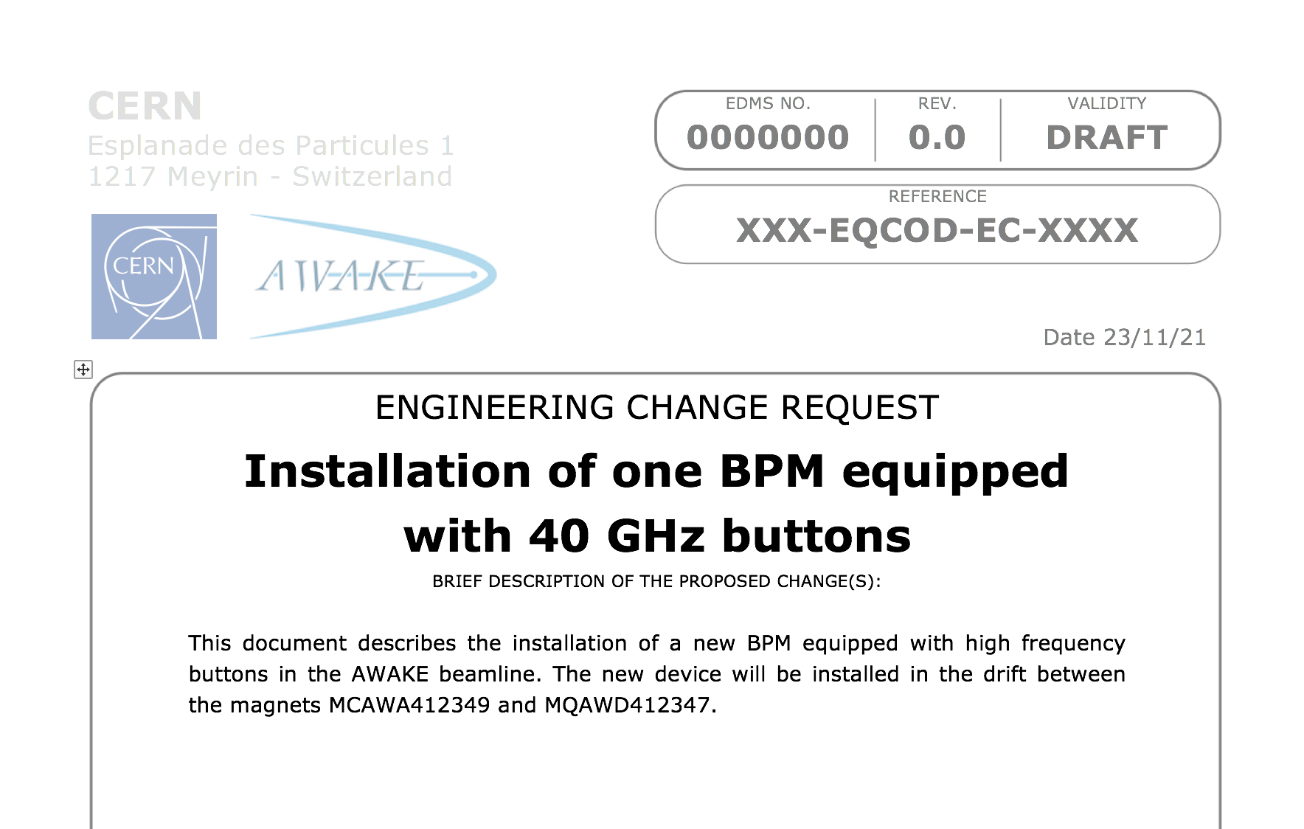
WBS
ECR
A preliminary draft exists
Needs completion, waiting for the inputs on the two that are already ongoing
Budget was discussed with AWAKE, 60k split AWAKE/BI (email June 24)

Slide 13
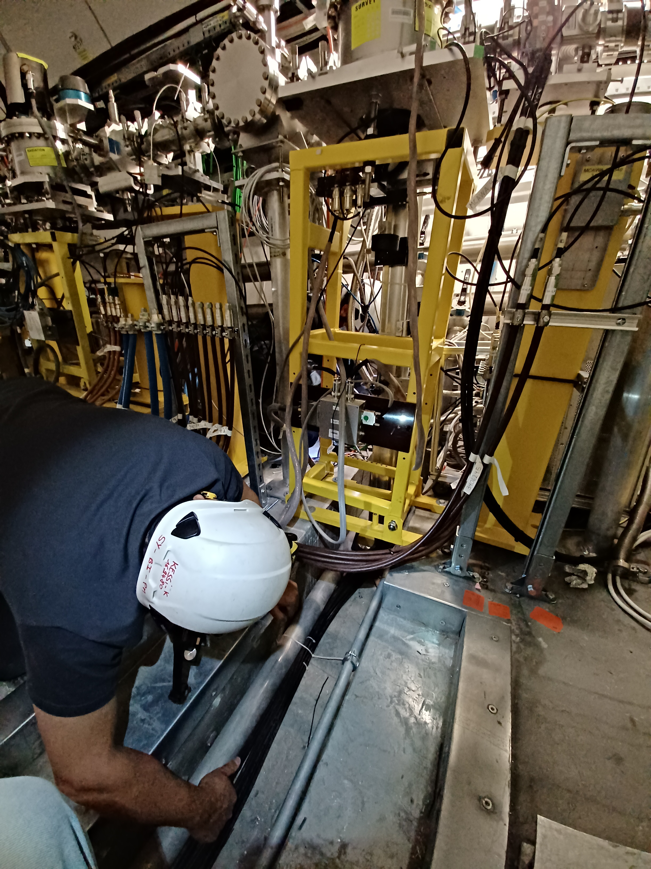
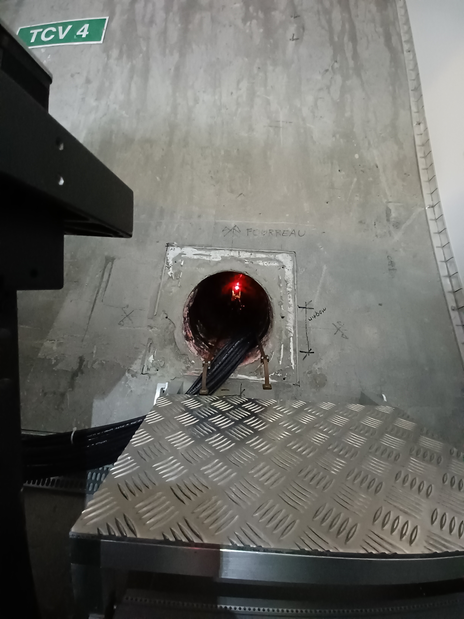
WBS
Cabling
OPTICAL LINE
WAVEGUIDES
4x corrugated cables pulled before end of 2021 (joint intervention with ChDR BPM IF cables)
Saved 10k CHF from EN-EL quote
CABLES
TODAY !!
Many thanks to:
Joel, Karim and Laurent !!

Slide 14
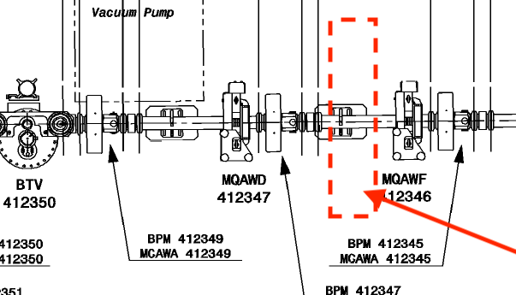
WBS
eBPM
eBPM
eBPM
Test
In a ‘drift’ we have
  3x eBPM
  1x ChDR BPM
  1x HF BPM
I asked SY/ABT (Vittorio) to compute a ballistic optic where we degauss the magnets in the middle
HF BPM
ChDR BPM
Quad + corrector

Slide 15
Upcoming actions – HF BPM
Mechanics
Body + support ready for installation end of YETS
Installation + beampipe resizing end of YETS
Installation with 2x blank flanges + 2x buttons
Detection
Basic: bandpass filters + Schottky diodes + scope
Need to procure now to arrive in time
Before the protons come, it is easier to test directly in AWAKE unless we foresee to break the vacuum often

Slide 16
Summary – HF BPM
Mechanics
We can have 1 plane installed for test by (say) March
4x buttons left for possible testing at CLEAR
Detection
I can work out the basic setup, if I get a bit of supervision by a staff of SY/BI/BP

Slide 17
Cherenkov Diffraction BPM

Slide 18
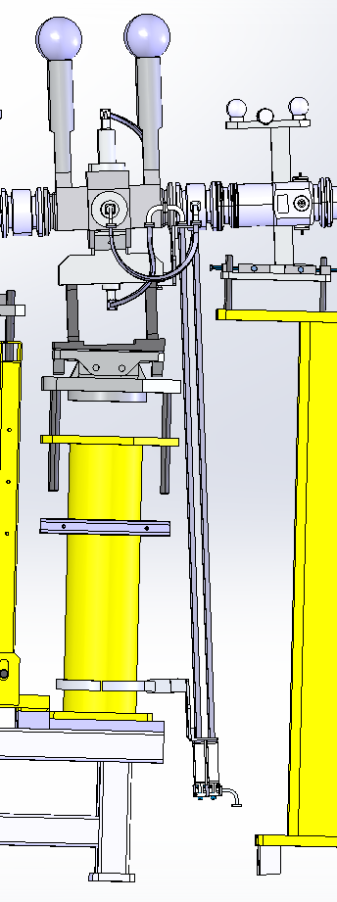
A (much) more complicated system
ChDR BPM
ChDR BPM
HF
HF
LO 30 GHz
Front-end
electronics box
IF ~2 GHz
Front-end
electronics box
Front-end
electronics box
TRIUMF design
TO STREAK ROOM

Slide 19
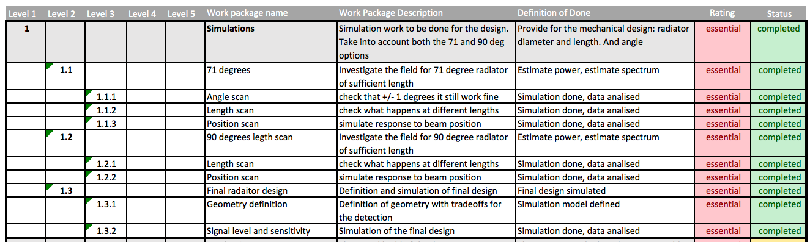
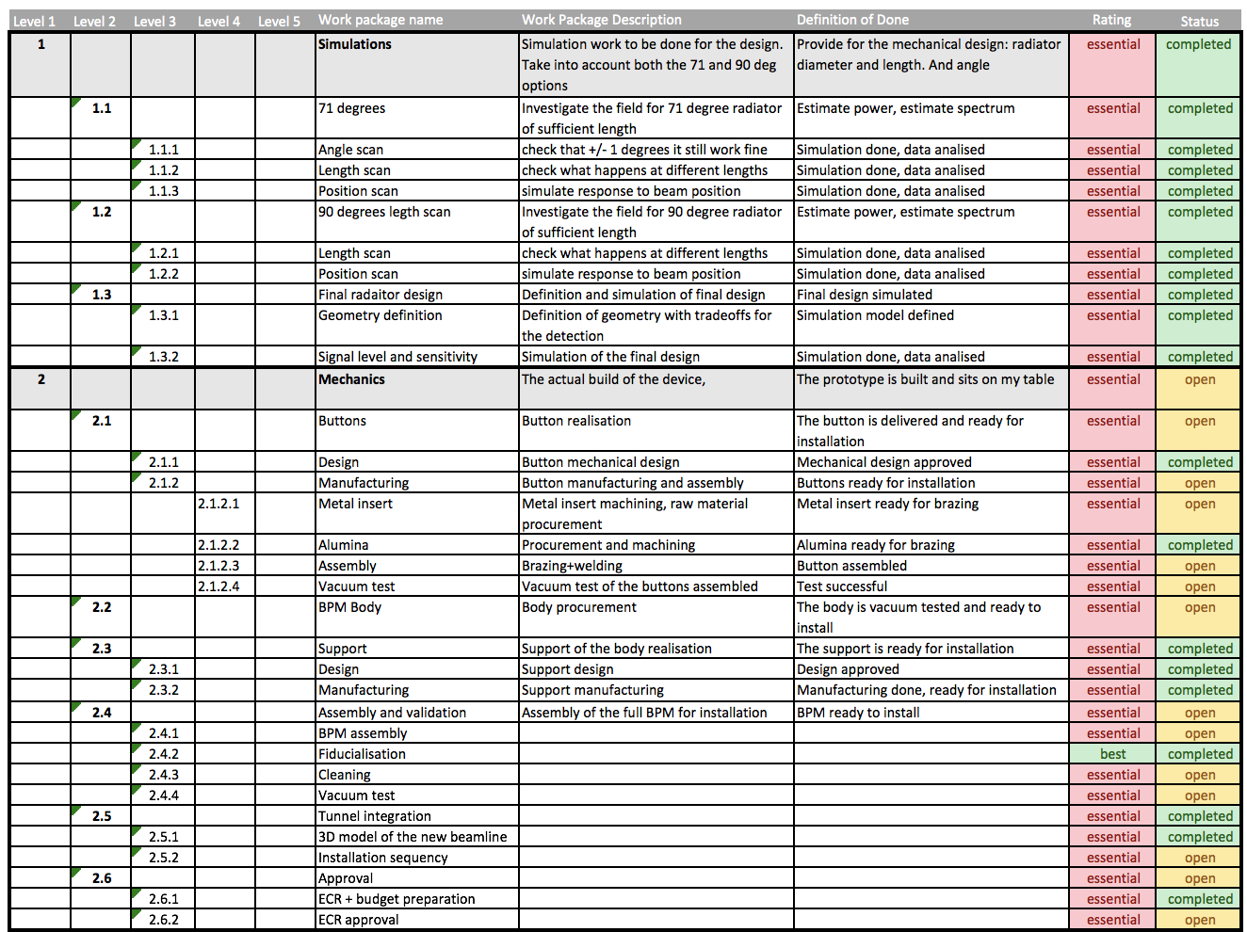
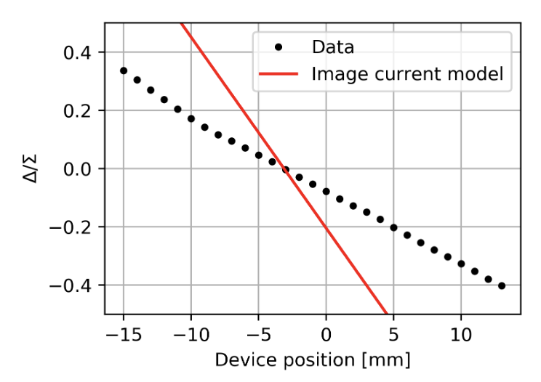
Outline
Simulations + prototype test DONE
Simulations mostly from Collette up to 50 Ohm coax
Prototype in air tested last spring at CLEAR
See IBIC2021 paper MOPP17

Slide 20
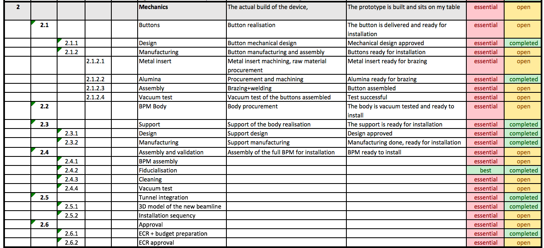
Outline
Buttons ready by end of February
Body + support manufactured and fiducialised
ECR under approval
AWK-BPM-EC-0002
Mechanics production

Slide 21
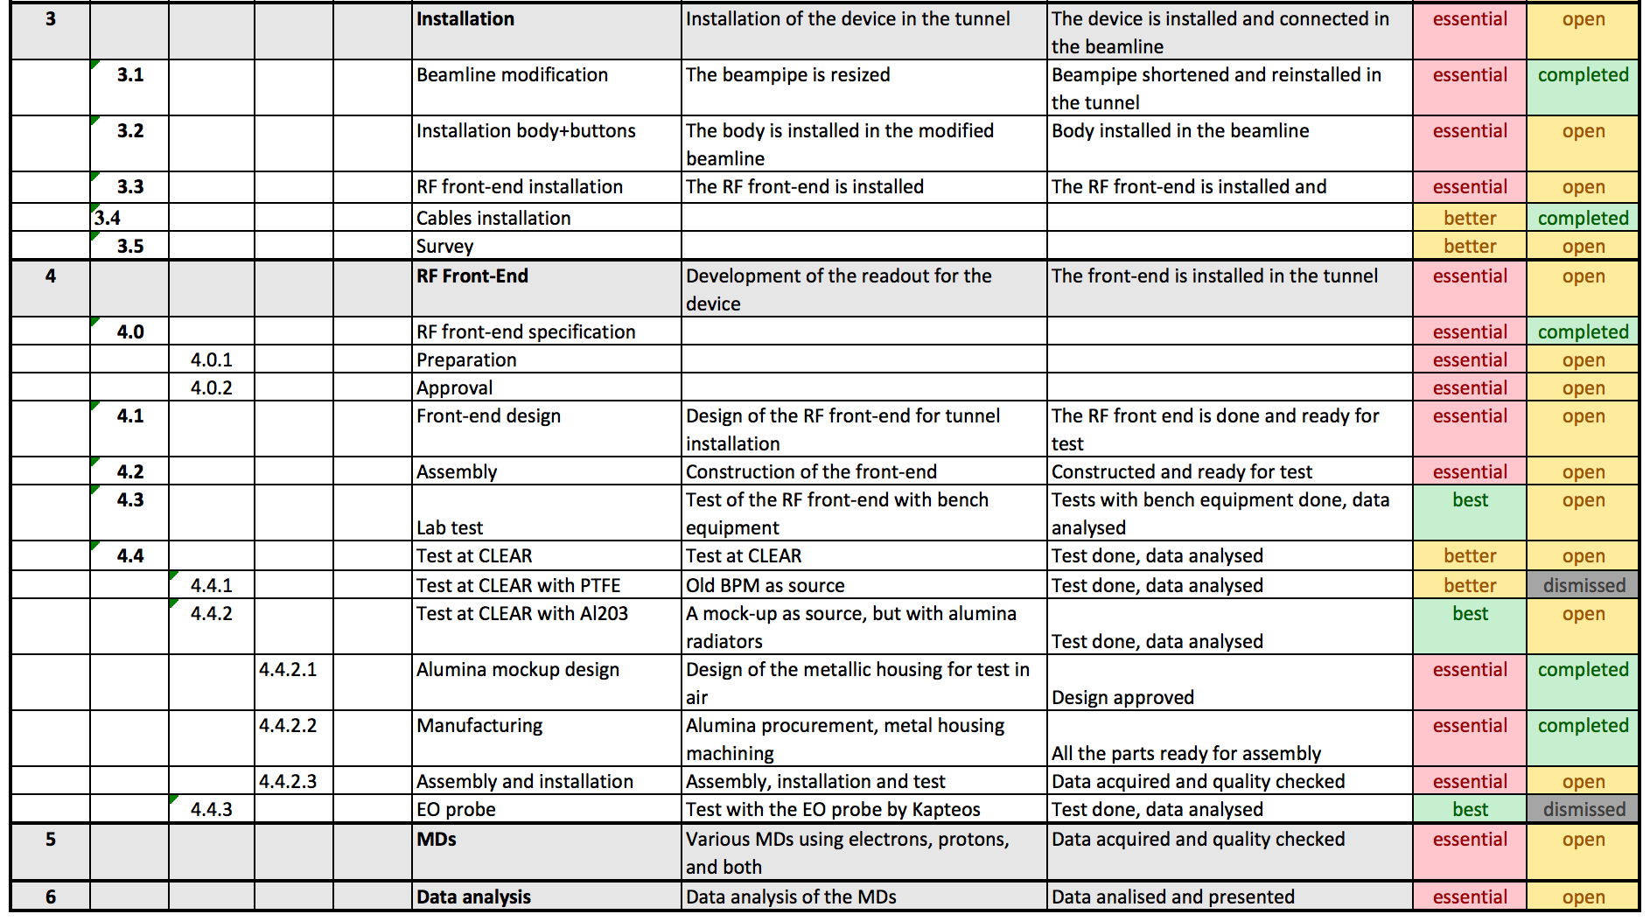
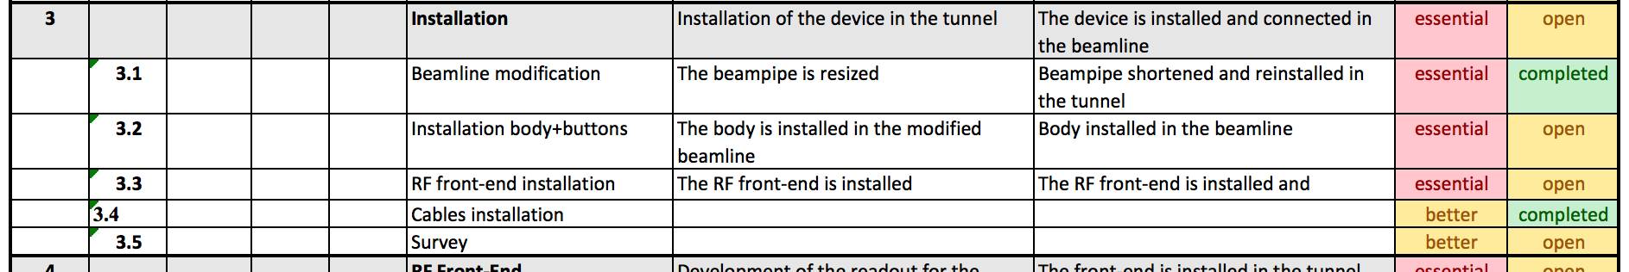
Outline
Installation
ChDR BPM1
ChDR BPM2
Modular approach
  Beampipe resized for BPM#1
  Buttons to be swapped with pBPM for BPM#2
Cables installed
Waveguides partially installed

Slide 22
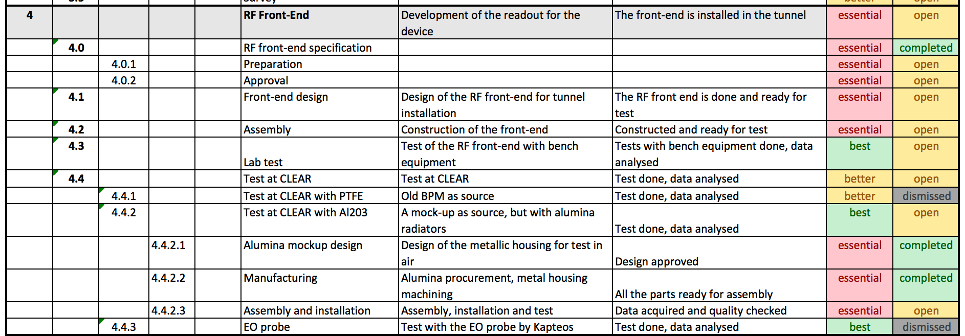
Outline
TRIUMF working on operational electronics
Bandpass filter+diode for our tests
Possible test at CLEAR in parallel with the installation in AWAKE
RF Front-end

Slide 23
Outline
Test
Same test platform of HF-BPM
Possible in AWAKE, at least with demodulation + scope
Detailed plan is now premature

Slide 24
Upcoming actions – ChDR BPM
Mechanics
Body + support ready for installation end of YETS
Buttons + body assembled and tested prior installation
Installation with 4x buttons
Detection
Basic test: bandpass filters + attenuator + Schottky diodes + scope (basically CLEAR test revival)
TRIUMF electronics when available
Transitions
To be discussed with Nicolas

Slide 25
Summary – ChDR BPM – In short
Mechanics
Install the upstream body and play with it
We are ready for then turning the pBPM into a ChDR BPM quickly (not before TRIUMF electronics)
Detection
Same as CLEAR in spring
… waiting for TRIUMF electronics

Slide 26
Summary

Slide 27
My proposal
HF-BPM
Installation of the body in AWAKE equipped with one plane of buttons (2x buttons + 2x blanks) in March
Initial test with bandpass filters + RF diodes
Parallel R&D in CLEAR with remaining 4x buttons is possible (depending on available workforce)
Before May

Slide 28
My proposal
ChDR-BPM
Installation of one complete body in AWAKE in March
Basic test at AWAKE similar to last year’s CLEAR test
Parallel R&D in CLEAR with remaining 6x buttons (→Collette’s thesis, when ready)
TRIUMF electronics delivery time to be assessed
Before May

Slide 29
Thanks for your attention !

