Slide 1
WP12: Software for Future Detectors
Frank Gaede (DESY) and Graeme A Stewart (CERN)
AIDAinnova 1st Annual Meeting, 2022-03-31

Slide 2
Work Package Structure
Simulation
  Fast simulation of calorimeters
  Adopt and develop the latest techniques in parametric and machine learning approaches
Track Reconstruction
  Advanced tracking tools for speed and physics performance, ACTS
  ML based track reconstruction toolkit for triple-GEM and u-RWELL detectors
Particle Flow
  Continue to develop state of the art algorithms for neutrino and linear colliders: PandoraPFA, APRIL
  Develop PF for dual readout calorimeters
Turnkey Software
  Integrate software into a working and validated stack
  Flexibility to rapidly prototype different detector options
  Management of heterogeneous resources
12.3 Simulation
12.2 Turnkey Software
12.4 Track Reco
12.5 Particle Flow

Slide 3
Partners and task leaders
12.1 Coordination and Communication
  CERN, DESY
  G.A.Stewart, F.Gaede
12.2 Turnkey Software Stack
  DESY, CERN, INFN-PI, INFN- PD, INFN-BA, INFN-BO, (IHEP, SDU)
  T.Madlener, A.Sailer
12.3 Simulation
  CERN, DESY, CNRS-IJCLab, UNIMAN
  A.Zaborowska, W.Pokorski
12.4 Track Reconstruction
  CNRS-IJCLab, CERN, DESY, INFN-FE, INFN-BO
  H.Grasland
12.5 Particle Flow Algorithms
  UWAR, UCAM, CERN, INFN-RM3, CNRS-LLR, CNRS-IP2I, UOS
  J.Marshall, J.Back

Slide 4
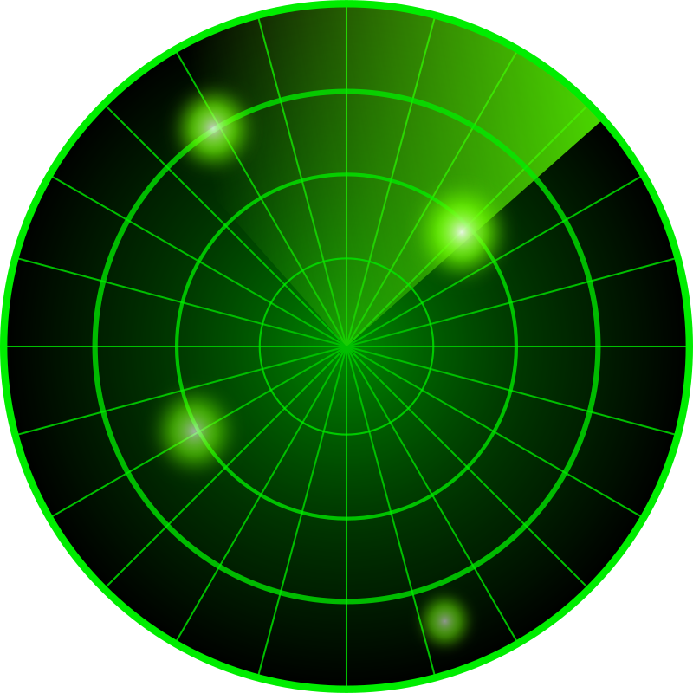
Milestones & Deliverables
Milestone | Title | Description | Due Date
MS48 | LC reconstruction prototype in Key4hep | Reproduce similar detector performance as achieved with the current framework | 21
MS49 | Prototype of ML based shower simulation | Runnable example code that simulates part of the showers with ML algorithms | 22
MS50 | ACTS tracking algorithm prototypes | Runnable test cases which demonstrate algorithm functionality on benchmark data from TrackML | 23
MS51 | New PFS prototypes | Runnable test cases which demonstrate algorithm functionality on benchmark data | 23
Deliverable | Title | Due Date
D12.1 | Turnkey Software Stack (Key4hep) | 46
D12.2 | Fast shower simulation in Geant4 | 45
D12.3 | ACTS tracking algorithms | 43
D12.4 | PFA reconstruction | 45
Lightweight approach, one milestone and deliverable per project
Milestones are on the radar now…

Slide 5
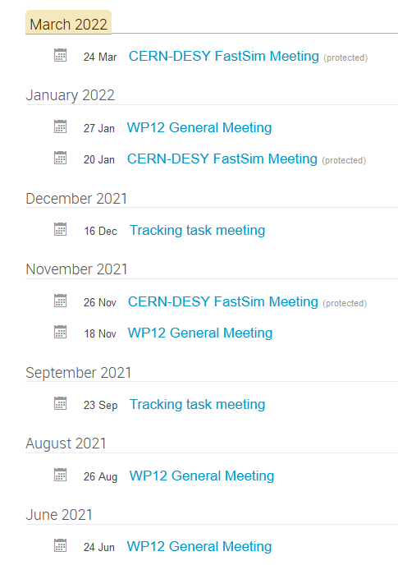
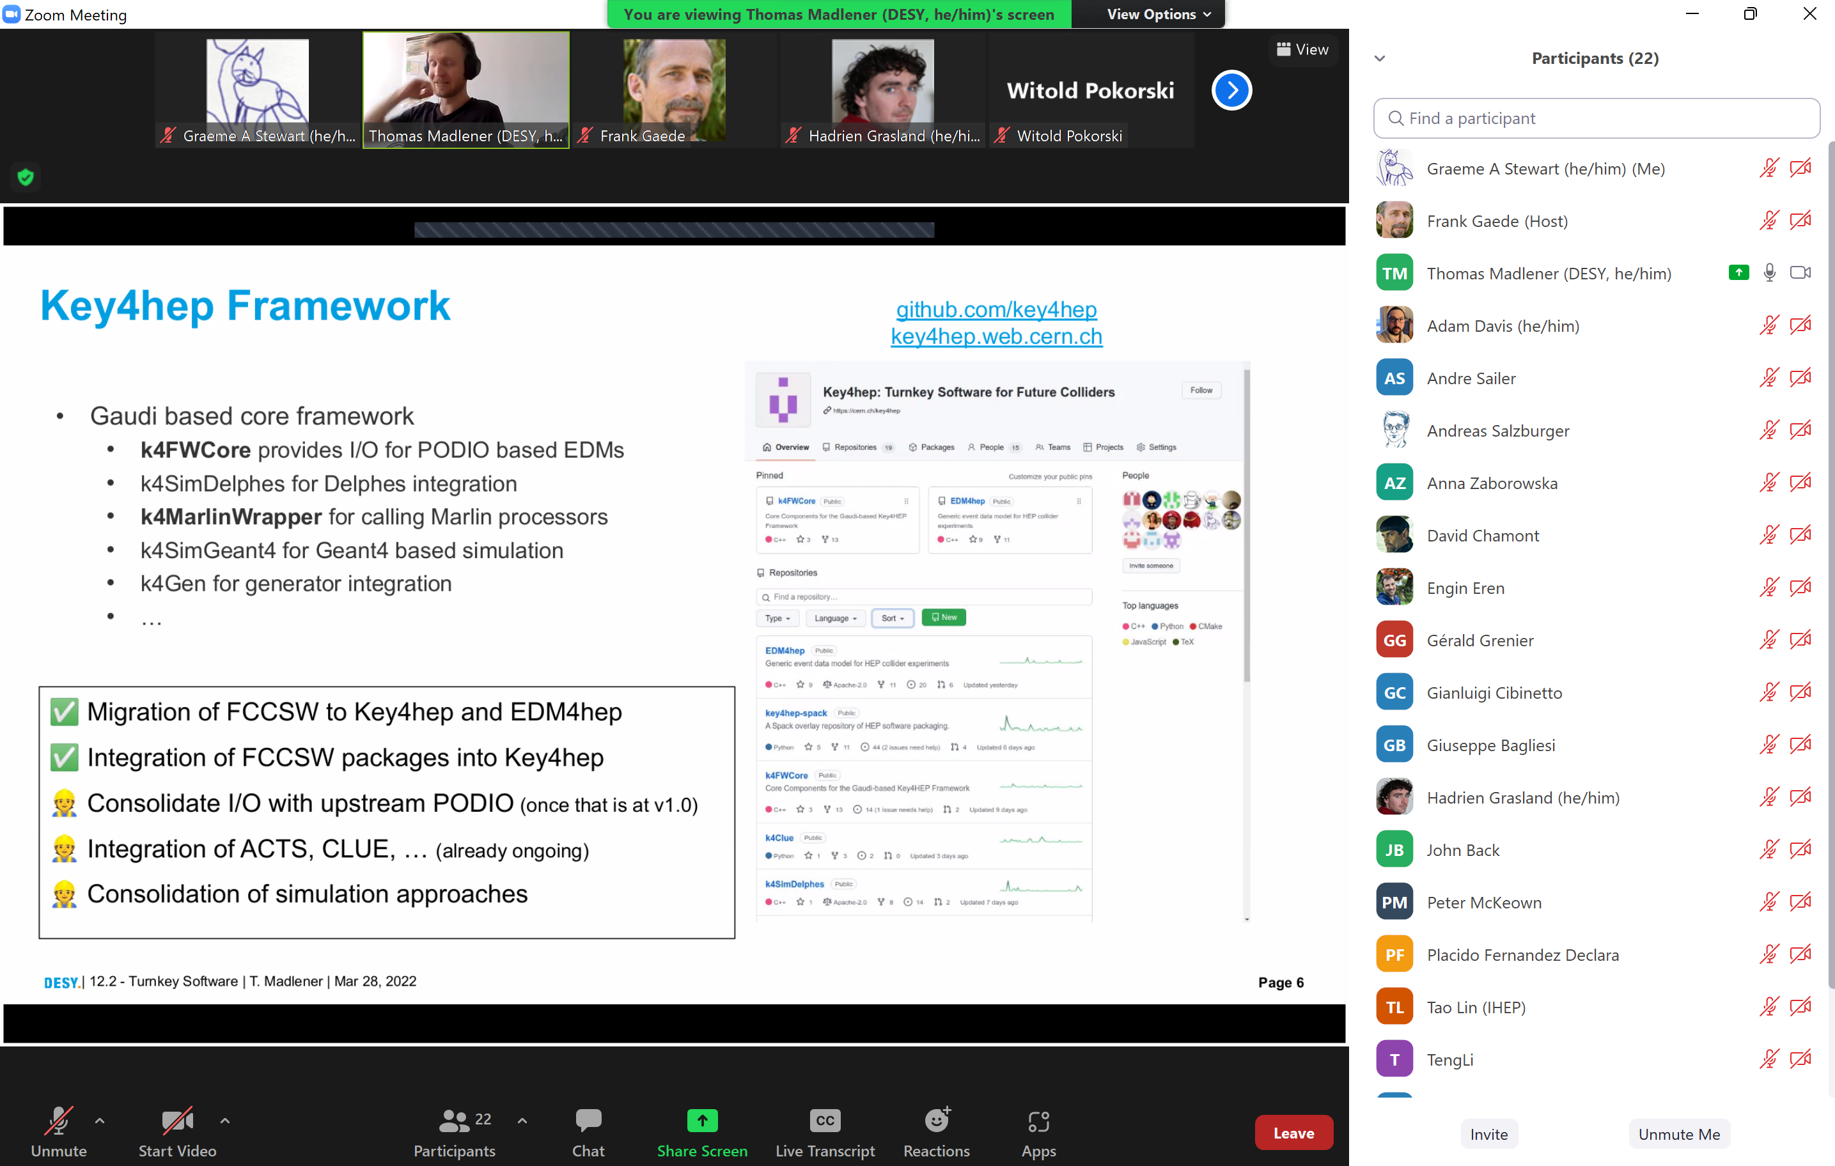
WP Meetings
WP12 up and running
  Regular series of whole WP meetings
  Updates from all of the tasks and sub-tasks
Many tasks have its own meetings as well
  Usually these are integrated into wider projects, e.g., ACTS developer meetings, Key4hep HSF group
  Exploiting links to these projects and amplifying AIDAinnova impact
Good turnout at our session this week, about 25 participants – mostly on Zoom this time

Slide 6
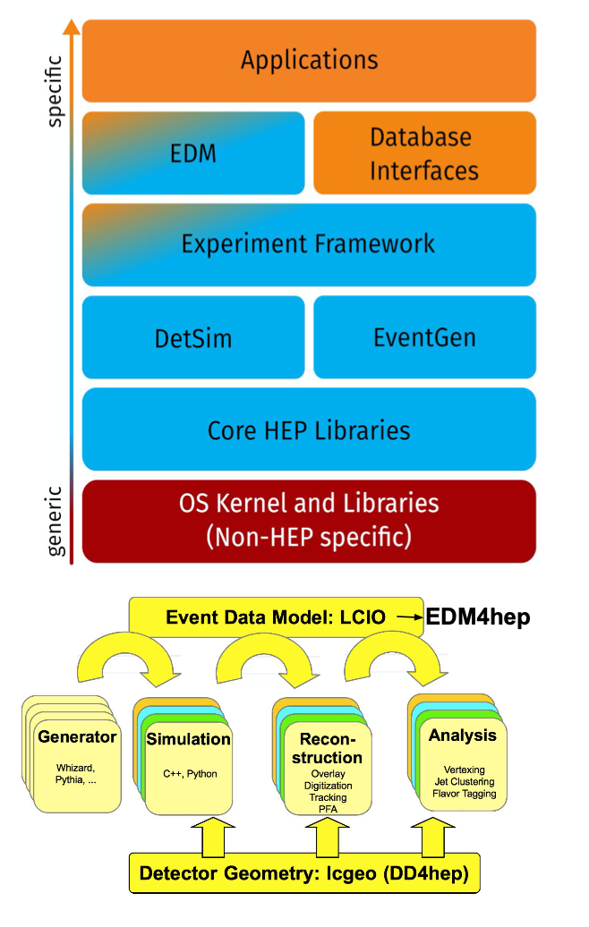
WP12.2 – Turnkey Software
Key4HEP: turnkey software stack for all future collider projects
Take existing tools where possible
  A lot of existing software from the shared iLCSoft developed by ILC and CLIC
All major players involved: CEPC, CLIC, FCC, ILC, EIC
Provide a complete data processing framework
  Shared components reduce overhead for all users
Supported by HSF, CERN EP R&D and AIDAinnova

Slide 7
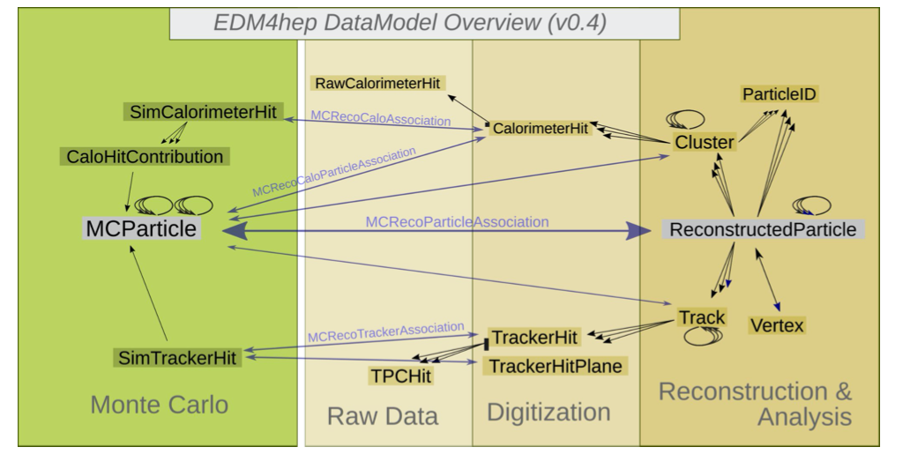
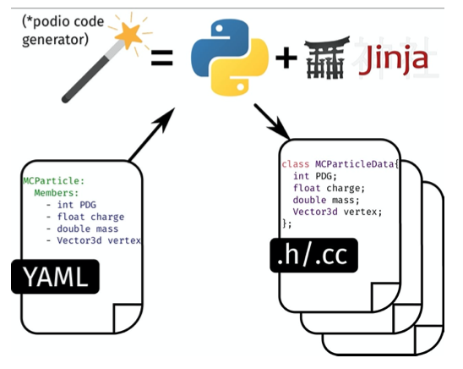
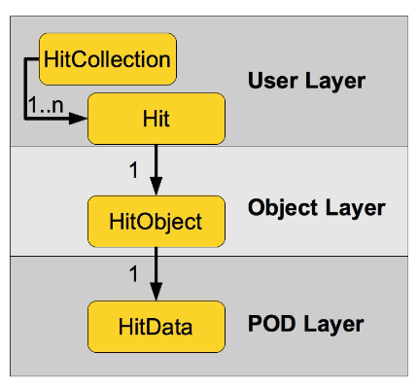
WP12.2 – Turnkey Software
EDM4hep defines the common language for all Key4hep components to communicate
  Heavily inspired by LCIO successfully shared by ILC and CLIC
  Additional novel ideas from fcc-edm
Generated by the PODIO EDM toolkit
  Main functionality exists
  Aiming for prod. Release v1.0
  Need schema evolution, event frames and thread safety ....

Slide 8
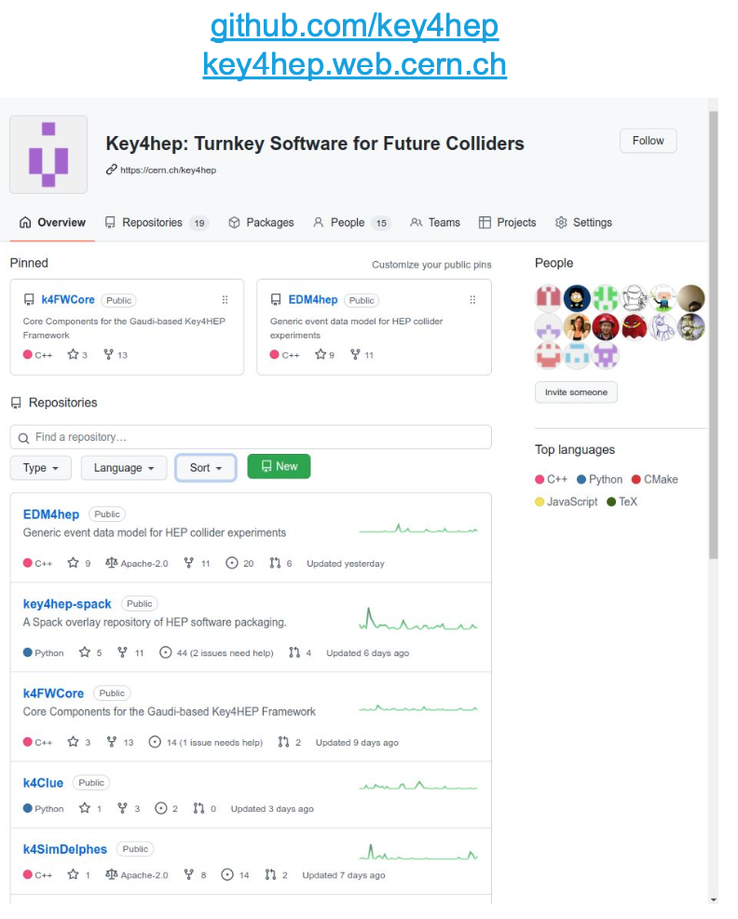
WP12.2 – Turnkey Software
Gaudi based core framework tools:
  k4FWCore, k4SimDelphes, k4MarlinWrapper, k4SimGeant4, k4Gen,...
Migration of FCCSW to Key4HEP done
Development of new reconstruction code (ACTS, CLUE) ongoing
Spack based installations in /cvmfs available
Many contributions from IHEP/SDU: PandoraPFA port, GaudiHive (MT), CI server,...
Overall very good progress on Key4Hep

Slide 9
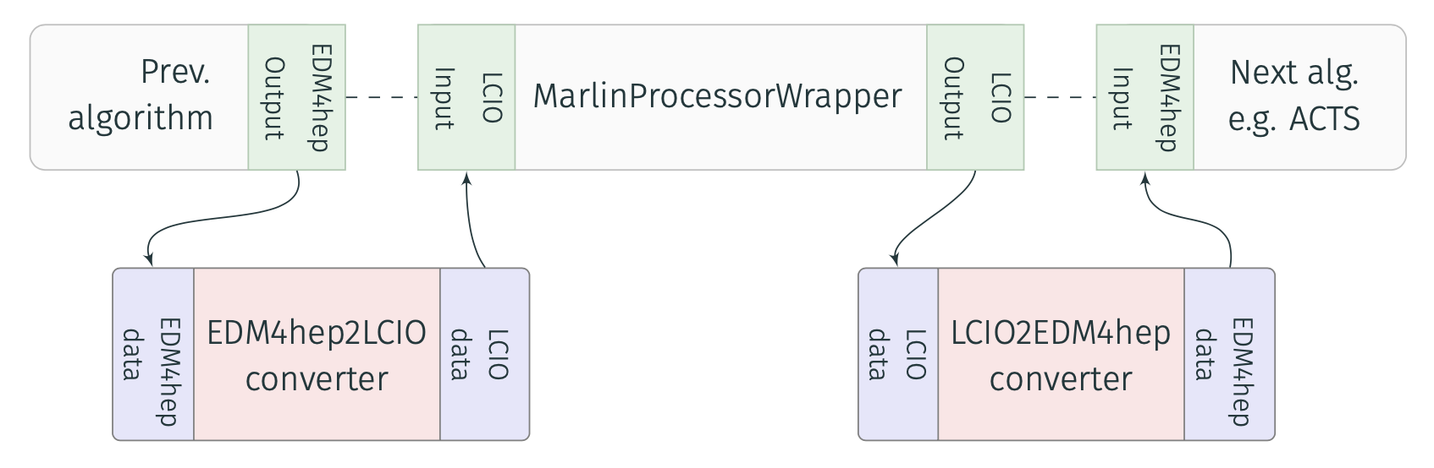
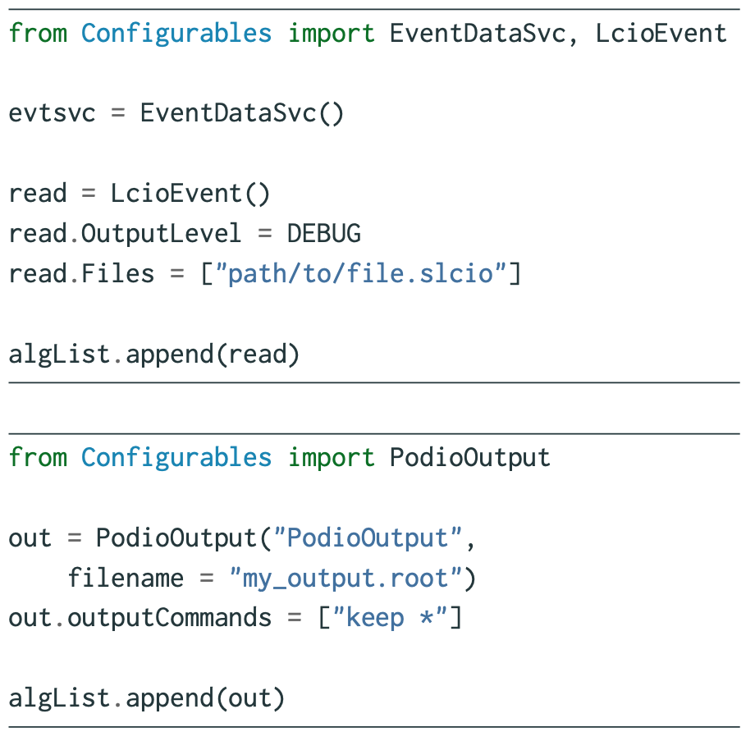
WP12.2 – Turnkey Software
Key4hep chosen to use Gaudi framework – yet lots of battle proven code exists in iLCSoft/Marlin
MarlinWrapper allows to seamlessly call these modules in Key4HEP
  In-memory on-the-fly conversion for LCIO ↔ EDM4hep
  Implemented as Gaudi Tools, can be attached to any MarlinProcessorWrapper
  LCIO → EDM4hep conversion achieved through k4LCIOReader
Marlin XML steering files automatically converted to Gaudi Python scripts

Slide 10
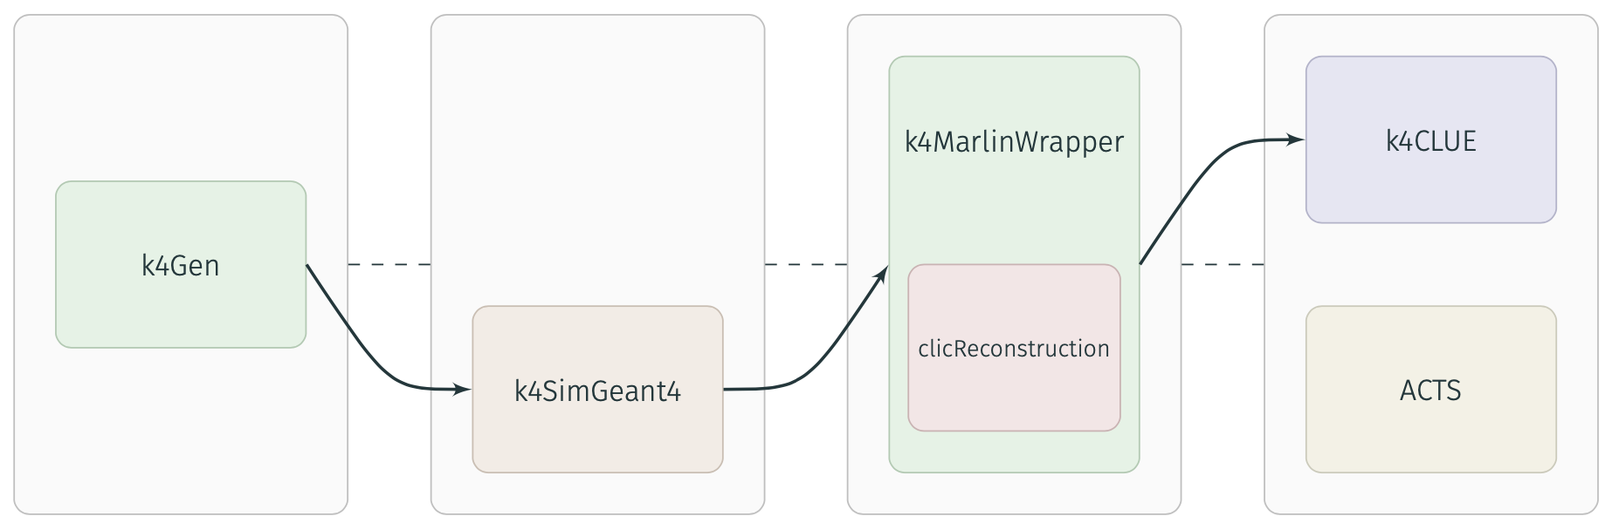
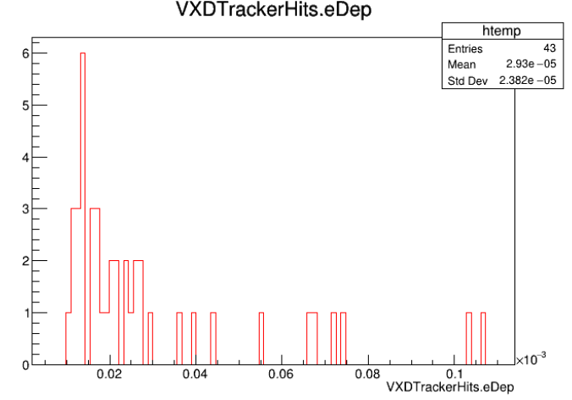
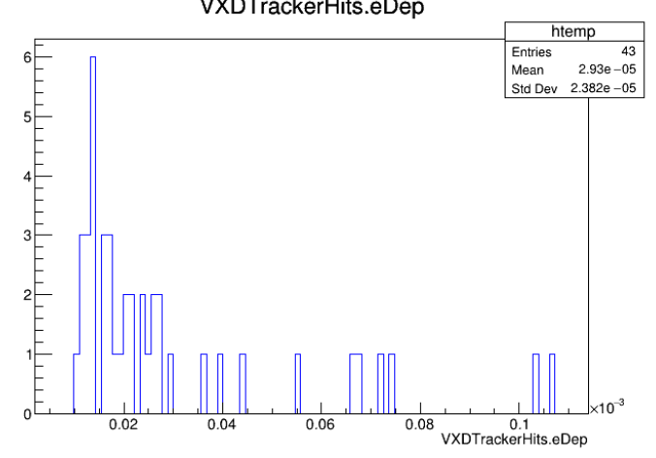
WP12.2 – Turnkey Software
Modular approach in MarlinWrapper allows to seamlessly combine genuine key4hep modules and Marlin processors
Demonstrated to be able to run the full CLIC reconstruction in MarlinWrapper w/ consistent results
Demonstrated identical output for selected processors (digitization)
Milestone MS47 almost complete (ahead of time, 😁)

Slide 11
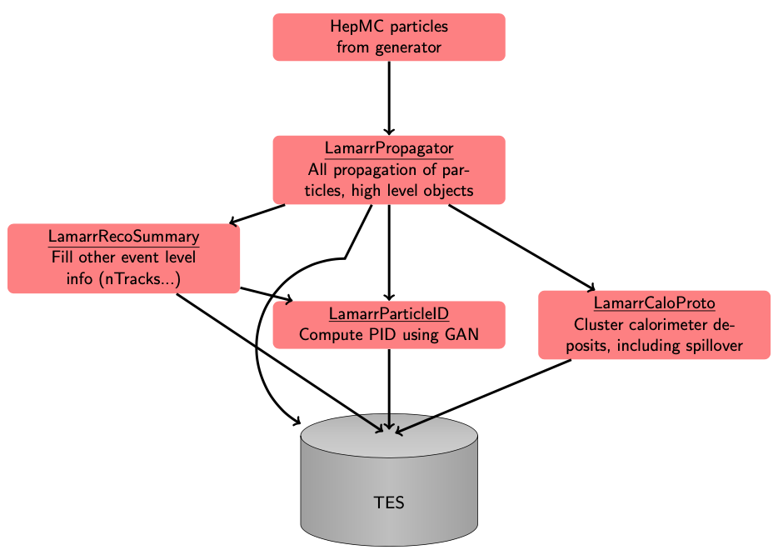
WP12.3 – Simulation (UMAN)
Lamarr fast simulation:
Replace entirety of detector simulation with either ML based models or simple parameterizations
Aim at 1000x faster than Geant4
Write analysis level quantities directly from Lamarr
First focus: calorimeter simulation:
Combining parametrization and GANs

Slide 12
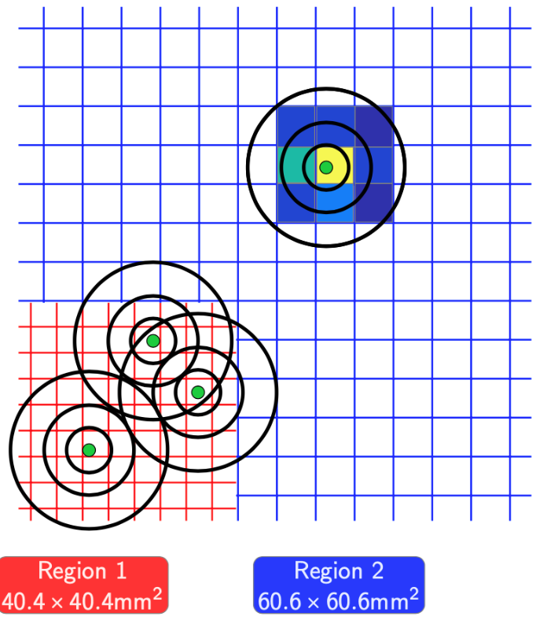
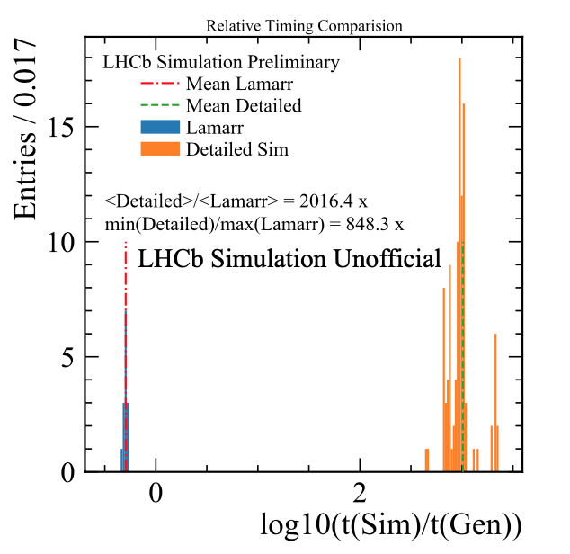
WP12.3 – Simulation (UMAN)
Lamarr fast simulation:
Find on average >1000x speedup, (800x in most pessimistic case)
For LHCb minimum bias events
Integration in Key4HEP:
Should be possible, given that Gaudi is used as framework
Details to be worked out, using LHCb developed Gaussino package

Slide 13
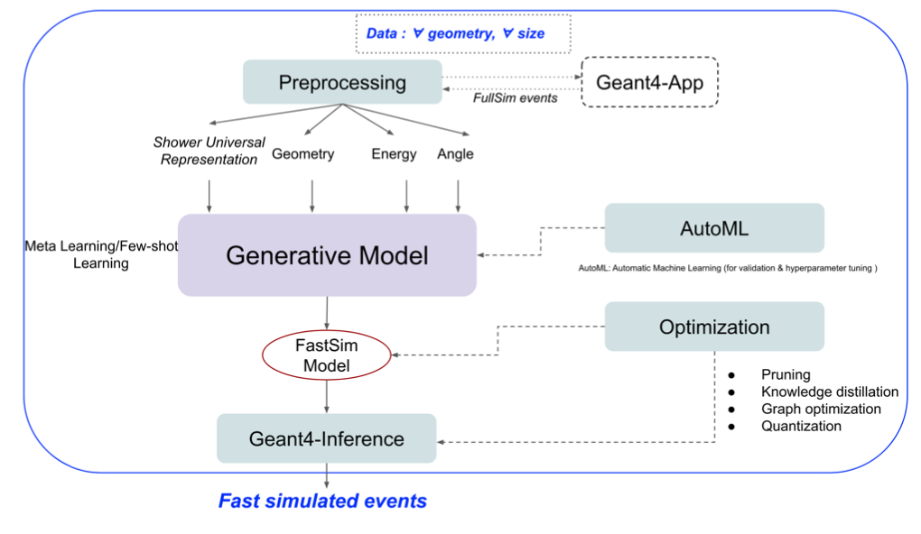
WP12.3 – Simulation (CERN)
Focus on all aspects related to the fast-sim, systematic studies, reusable tools or methodology & systematic studies for HEP calo fast-sim.
Strong ties with CERN EP R&D program
  Data for the studies on different calorimeters (Par04 example, Open Data Detector) and metrics to access quality
  Meta-learning with few-shot-learning
  Hyperparameter tuning methods
  Inference within C++ framework (Geant4 with Par04 example)
  Optimisation - training, inference

Slide 14
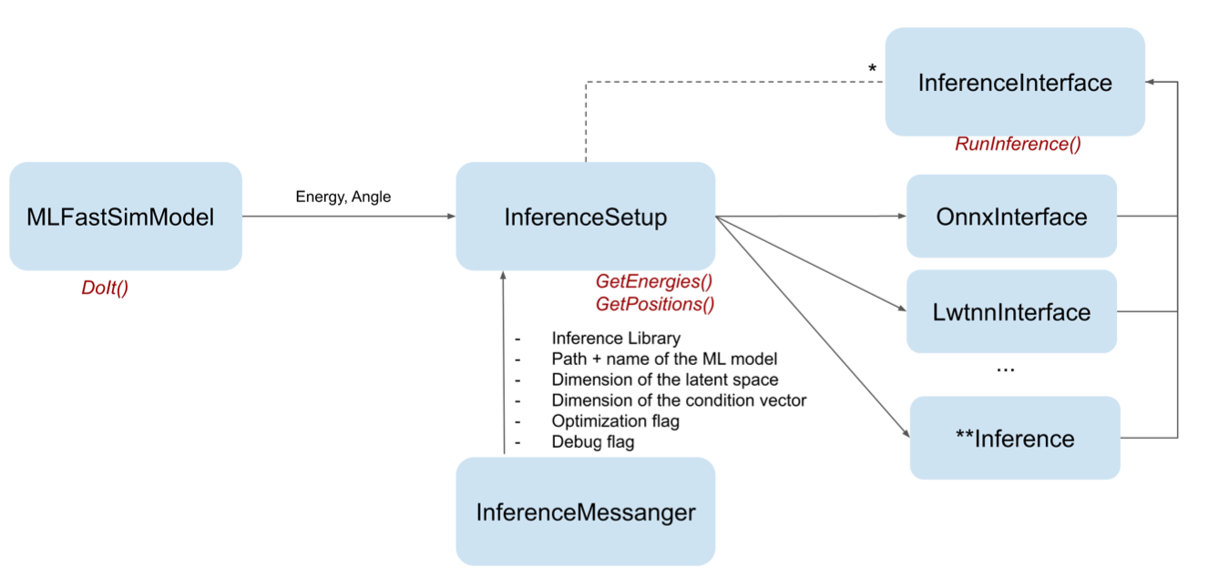
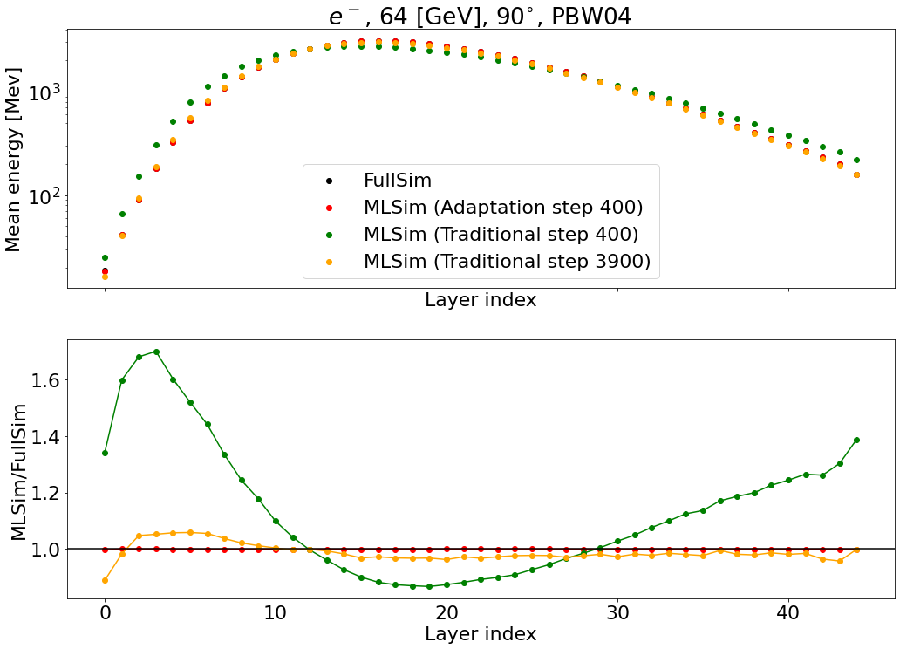
WP12.3 – Simulation (CERN)
Fast simulation with ML within Geant4
  Demonstrates how to incorporate inference libraries (ONNX Runtime, LWTNN)
Focus on ML Meta Learning:
Pre-train model on various geometries
  Allows to find an optimal initial conditions
Fast adaptation to new geometry (100 steps)
  Far superior to ab initio training of a new model

Slide 15
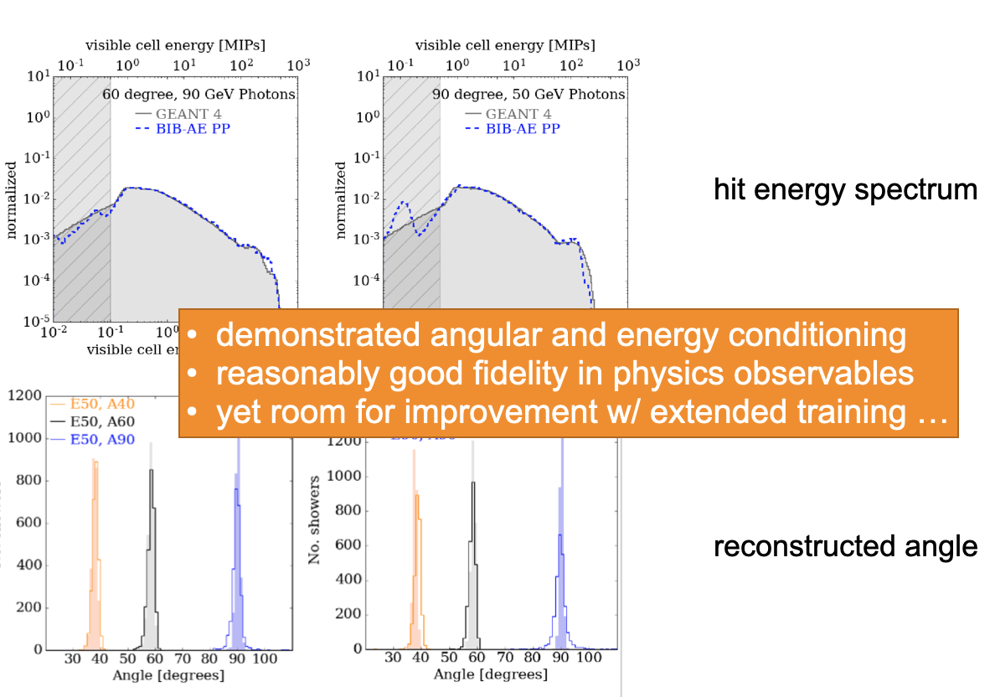
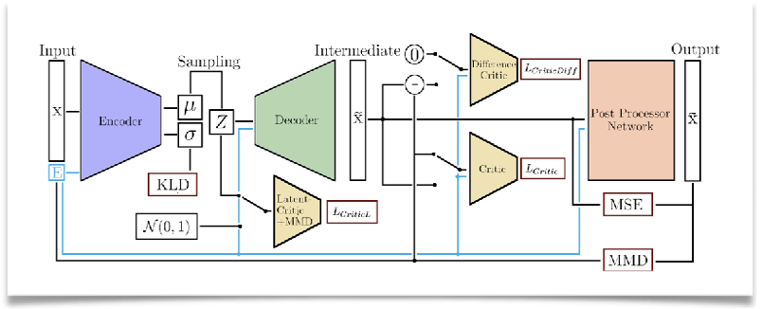
WP12.3 – Simulation (DESY)
Focus on ML Methods for fast generation of showers in highly granular calorimeters with high fidelity:
  GANs, WGANs and BIB-AE (w/ PP)
Working group w/ UHH, QU, AIDAinnova and other funding
Recent activitiy:
  Angular and energy conditioning for photons in ILD ECal

Slide 16
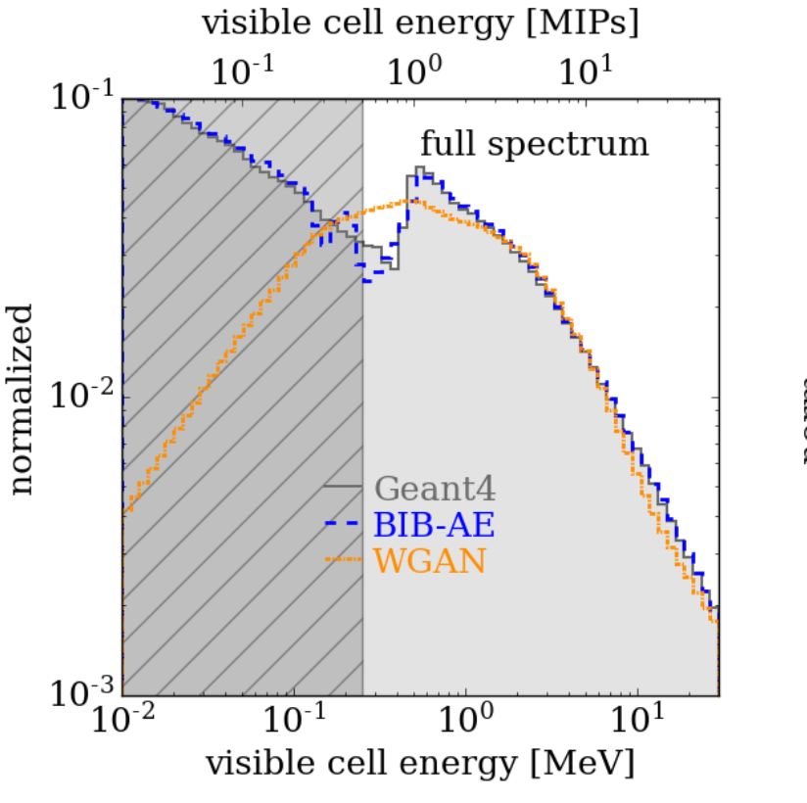
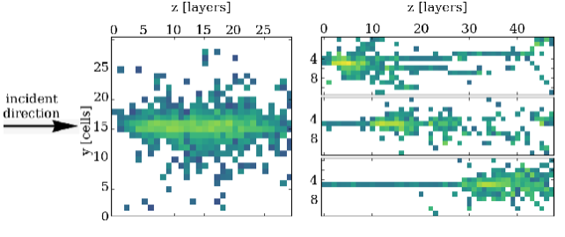
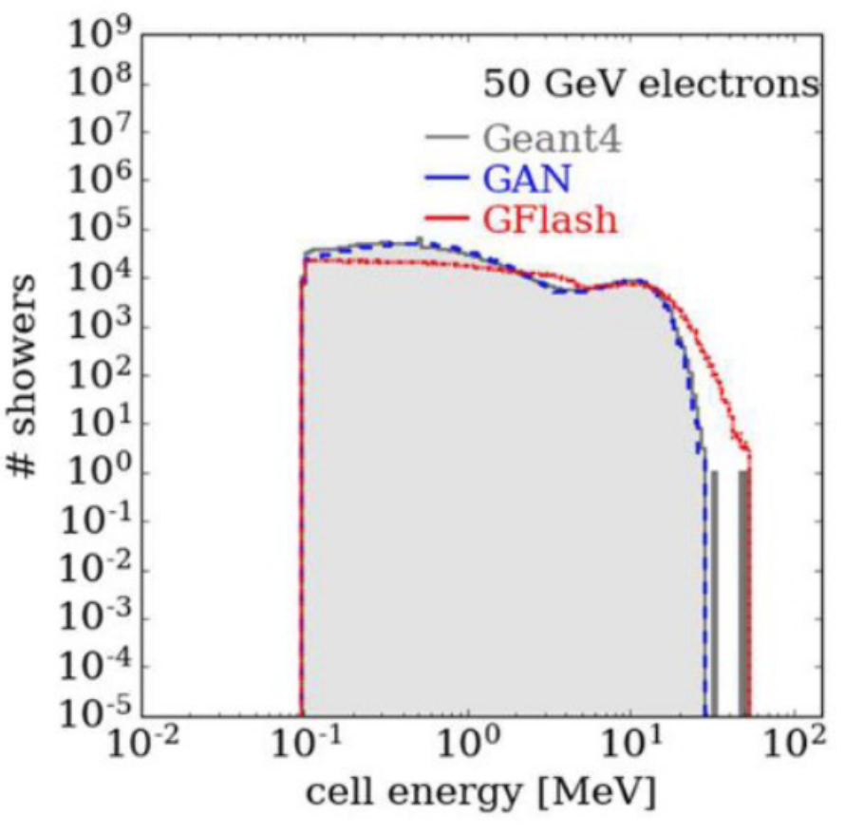
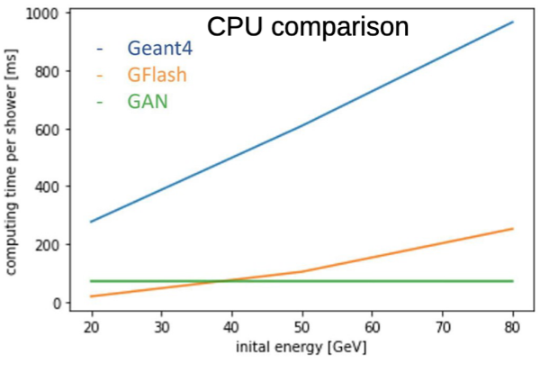
WP12.3 – Simulation (DESY)
Recent activities:
First high fidelity generation of pion showers in highly granular HCal
  BIB-AE and WGAN
  Including reconstruction of ML showers
First comparison of GFlash vs GAN performance in simple calo model
Plan:
Continue to work towards application of ML fast simulation in realistic physics simulation
Hadrons, Better, Faster, Stronger
E. Buhmann, S. Diefenbacher, E. Eren, F. Gaede et al
arXiv:2112.09709 submitted to MLST

Slide 17

WP12.4 – Track Reconstruction
Main work in track reconstruction task is framed inside the ACTS project
  A Common Tracking Software
  Project was spawned from ATLAS’s tracking code
  Make this state-of-the-art track reconstruction experiment independent
    Significant technical challenges!
Additional sub-task on Machine Learning for MPGDs/μ-RWELL detectors

Slide 18
WP12.4 – Track Reconstruction
Fundamentals
  Geometry generalization ongoing
    DD4hep re-integration without the need for plugins (will help Key4hep)
  Calo/Muon navigation support ongoing
  C++ examples → Python bindings
  Build CPU/RAM consumption tracking & improvements
  Keep Spack package up to date (also good for Key4hep)

Slide 19
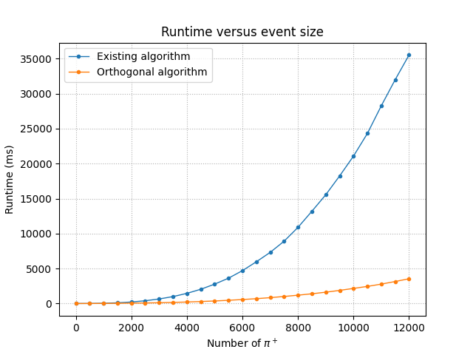
WP12.4 – Track Reconstruction
Algorithms
  ATLAS ITk KF integration enabled, currently doing validation & debugging
  New algorithms developed, pending review/integration/validation
    Gaussian Sum Filter
    Global χ² fitter
    Alternative seeder based on k-d tree
    (~6x faster for HL-LHC)
    Graph neural net seeding & filtering
    (from Exa.TrkX)
New seed finding strategy on based of KD-trees,
achieving very similar tracking performance

Slide 20
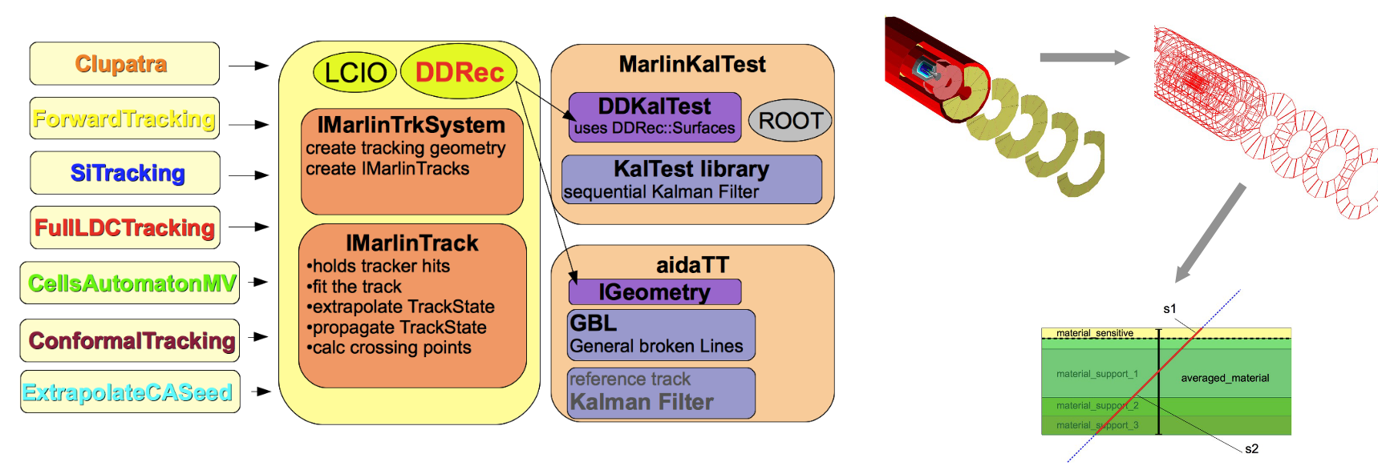
WP12.4 – Track Reconstruction
ILC / CLIC
  Integrating Acts as an IMarlinTrk fitter, but currently blocked on DD4hep integration, contributing to it

Slide 21
WP12.4 – Track Reconstruction
Looking to a future of heterogeneous computing (CPU + GPU + FPGA + …)
vecmem – common memory management between CPU and GPU
  Jagged (nested) vector support
  Much improved SYCL build support
  Profiling/debugging features
  Arena allocator
detray – geometry description that is GPU-friendly
  Mostly usable except for local navigation
  Adding more detectors
traccc – end-to-end test of tracking on GPUs
  New algorithms close to merging
    CUDA & SYCL clustering
    SYCL seeding (based on CUDA version from Berkeley)
  Much work from DESY on profiling & optimization

Slide 22
WP12.4 – Track Reconstruction
MPGDs have high spatial resolution, good radiation tolerance, ideal for tracking in a large-background environment
  Proposed for LHCb muon upgrade, EIC inner tracker, IDEA@FCC-ee pre-shower and muon system
Traditional algorithms limited by high backgrounds
  Use machine learning to overcome this and improve results
Work to date focussing on μ-RWELL simulation (synergy with Task 7.3 and 11.2)
  Started from a parametric simulation of BESIII GEM detector
  Implemented resistive layer
  Tuning to test beam data (taken at CERN, October 2021) is ongoing

Slide 23
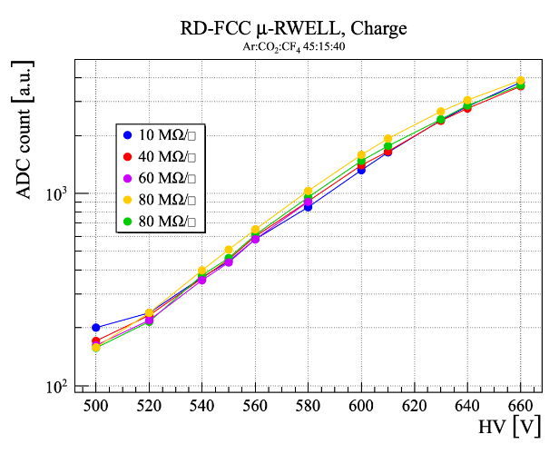
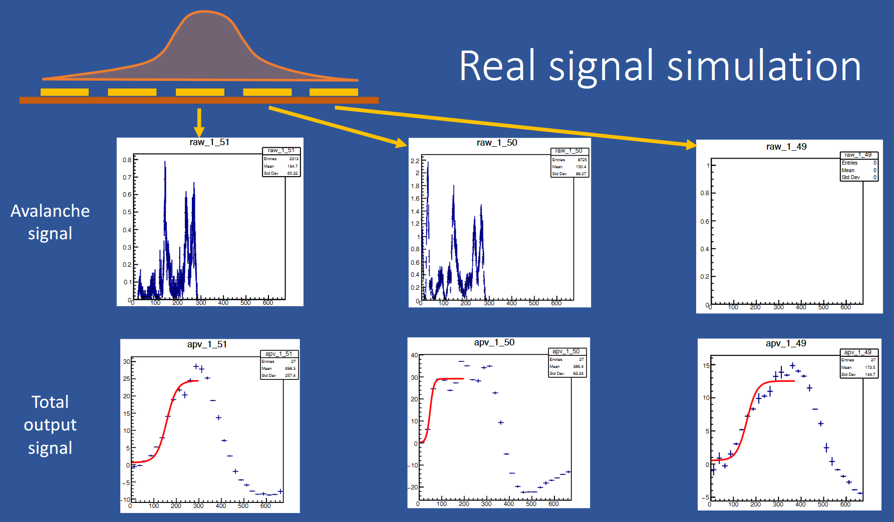
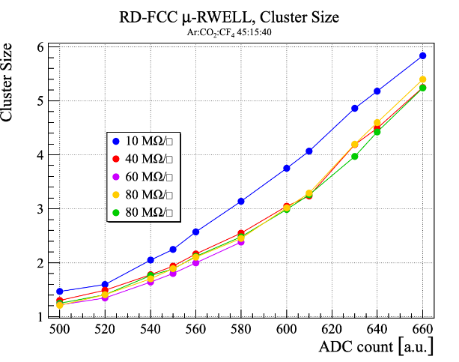
WP12.4 – Track Reconstruction
Tune simulation (left) with test beam results (right)
Covid has slowed down some of the detector characterisation activity
  A few months behind original schedule

Slide 24
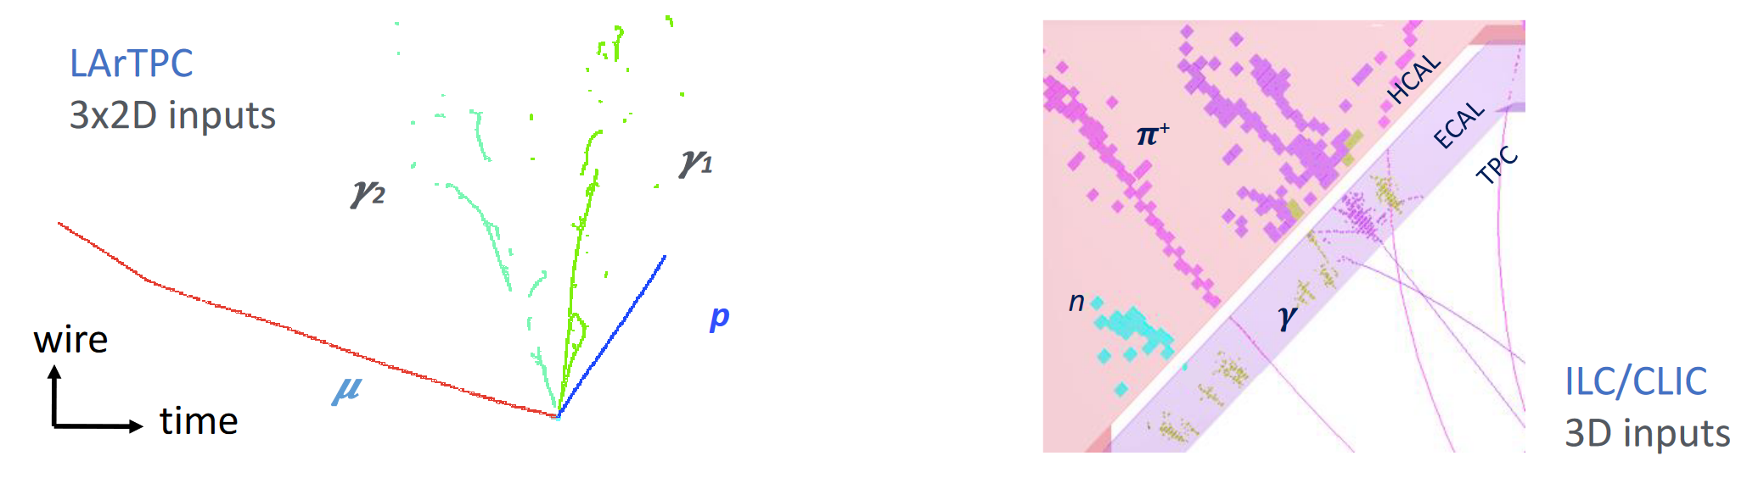
WP12.5 – Particle Flow Reconstruction
Development of state-of-the-art particle flow algorithms for HEP calorimeters and neutrino detectors
Three main activities
  Dual Readout Calorimeters
  APRIL, Algorithm for Particle Reconstruction @ILC
  DUNE Near Detector Reconstruction
Aim to integrate everything into the existing Pandora PFA toolkit
  Then super-integration into Key4hep!
Pandora takes an incremental, multi-algorithm approach
      Mix track-like and shower-like clusters
Deploy more sophisticated algorithms as the reconstruction develops

Slide 25
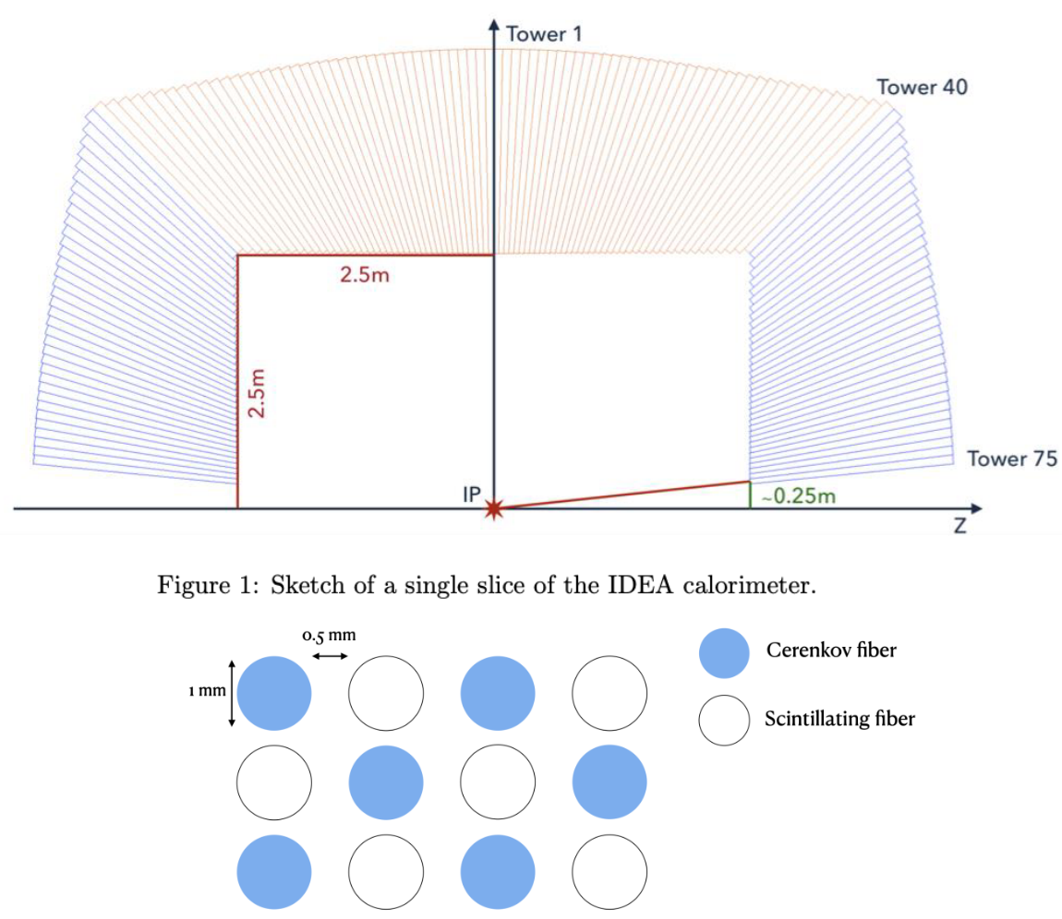
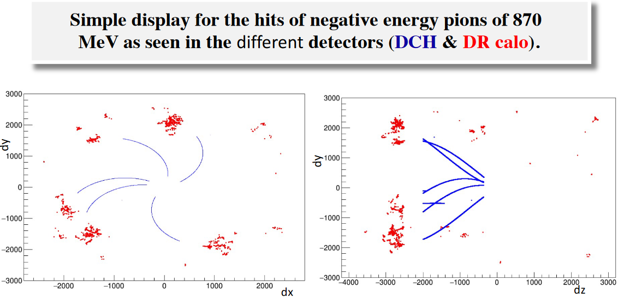
WP12.5 – Particle Flow Reconstruction
Dual Readout Calorimeters
  Improved energy resolution by measuring the EM fraction with mixed scintillation and Cerenkov fibers – part of the IDEA detector
Input preparation needs full simulation of the detector, with tracking and calorimetry
  This is now largely achieved, with Geant4 for the simulation DD4hep for the geometry
  SimCalirometerHit (with individual CaloHitContributions) using EDM4hep in the Key4hep framework
Dual readout calo hits
Drift chamber tracks

Slide 26
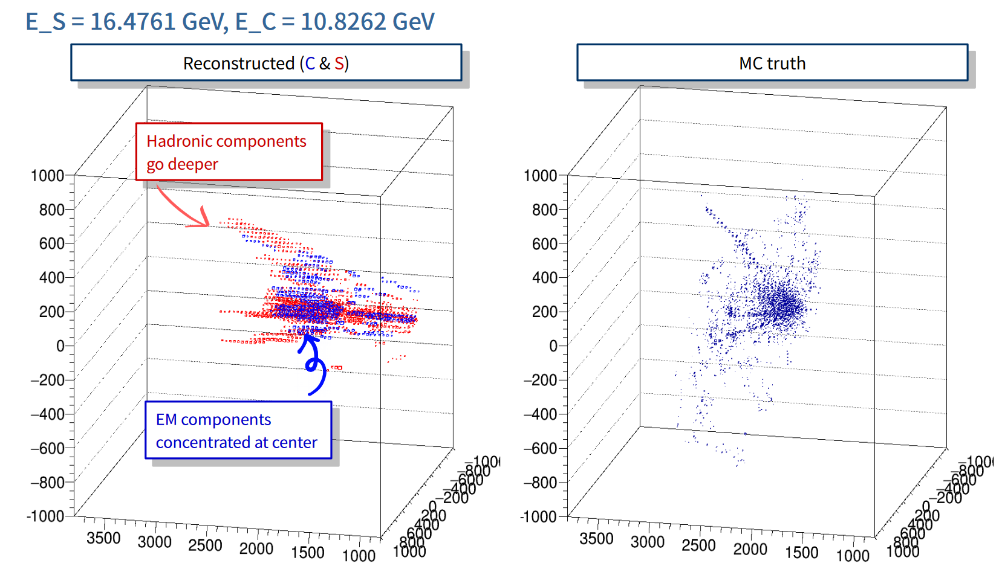
WP12.5 – Particle Flow Reconstruction
Looking into using time as a handle on radial location of the hits
  First results look promising
  Utilising fully the waveform allows probe of the shower depth and length simultaneously
  Unlock potential as a particle flow calorimeter
Calorimeter clustering development has begun
20 GeV π+ (3D)
From Sanghyun Kho, https://indico.cern.ch/event/1086651

Slide 27
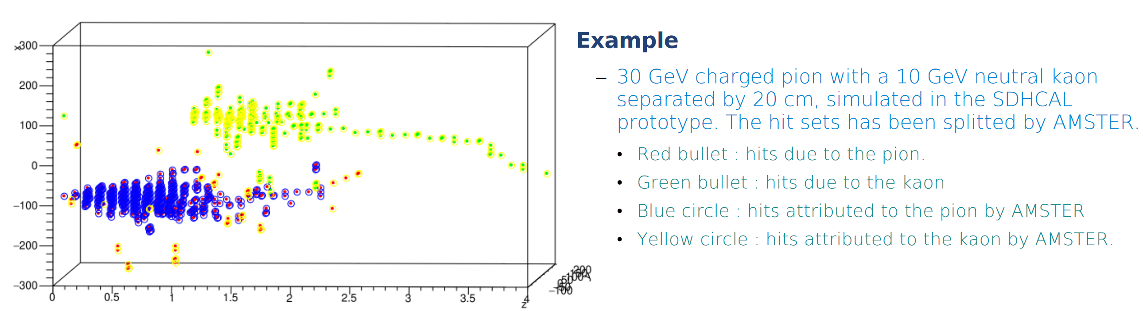
WP12.5 – Particle Flow Reconstruction
APRIL Particle Flow for hadronic jets
  APRIL is based on the ARBOR concept, reimplemented in PandoraSDK
  AMSTER cluster splitting algorithm can re-cluster from APRIL
4D calorimetry under discussion, including timing information
  This fits naturally into both APRIL and AMSTER – initial studies look promising

Slide 28
WP12.5 – Particle Flow Reconstruction
To understand APRIL performance a large set of input events are being prepared
  ILD SDHCAL Videau geometry 300k test samples, 5-100 GeV k_{long}
  Tools for reconstruction very close to release
  Will also include the ability to re-run PFA without redoing entire reco

Slide 29
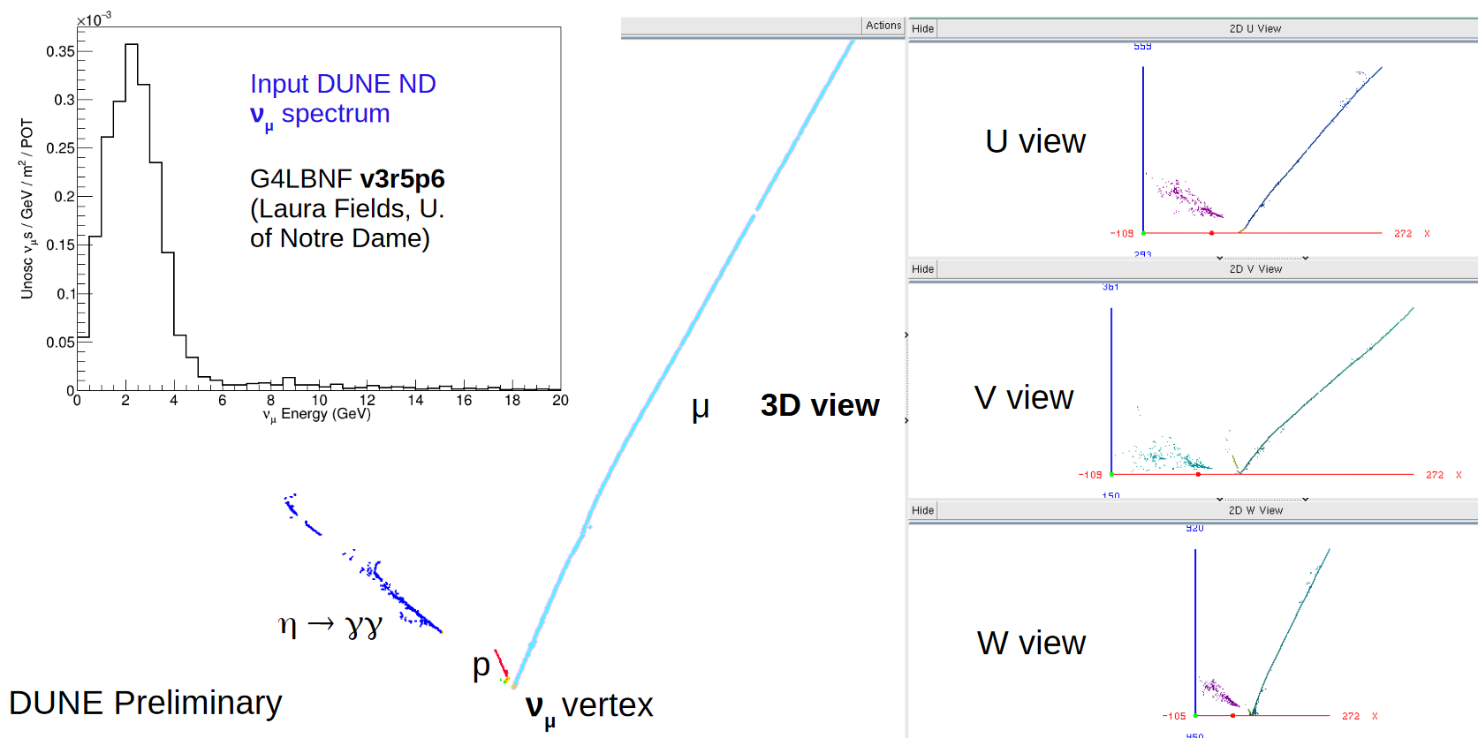
WP12.5 – Particle Flow Reconstruction
DUNE near detector will consist of ND-LAr, ND-GAr, SAND sub-detectors
Initial studies to use Pandora reconstruction for LArTPC and ILC algorithms
  Adapt 2D-view algorithms to work with native 3D hits
  10k events generated with GENIE and passed through edep-sim
    ArgonCube geometry, hits voxelised to 4mm cubes (mimic detector response)

Slide 30
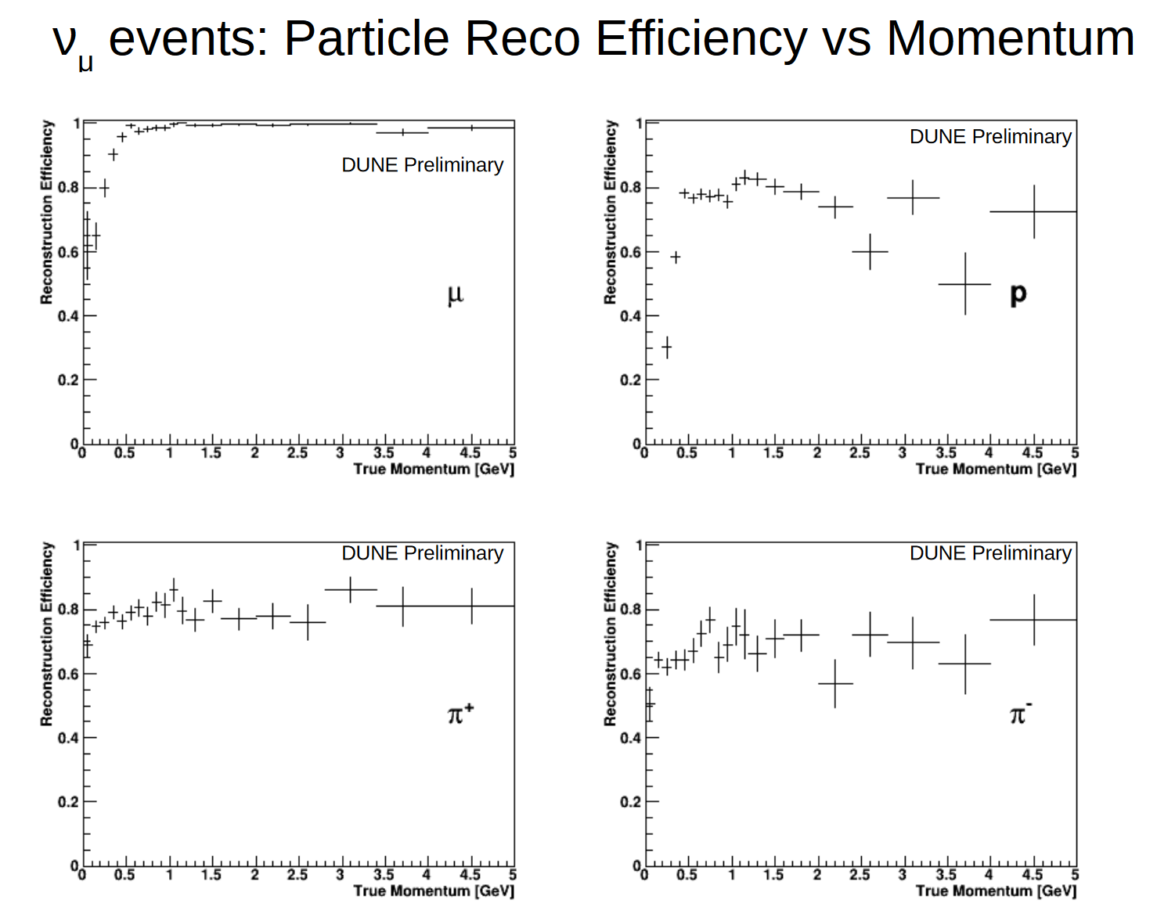
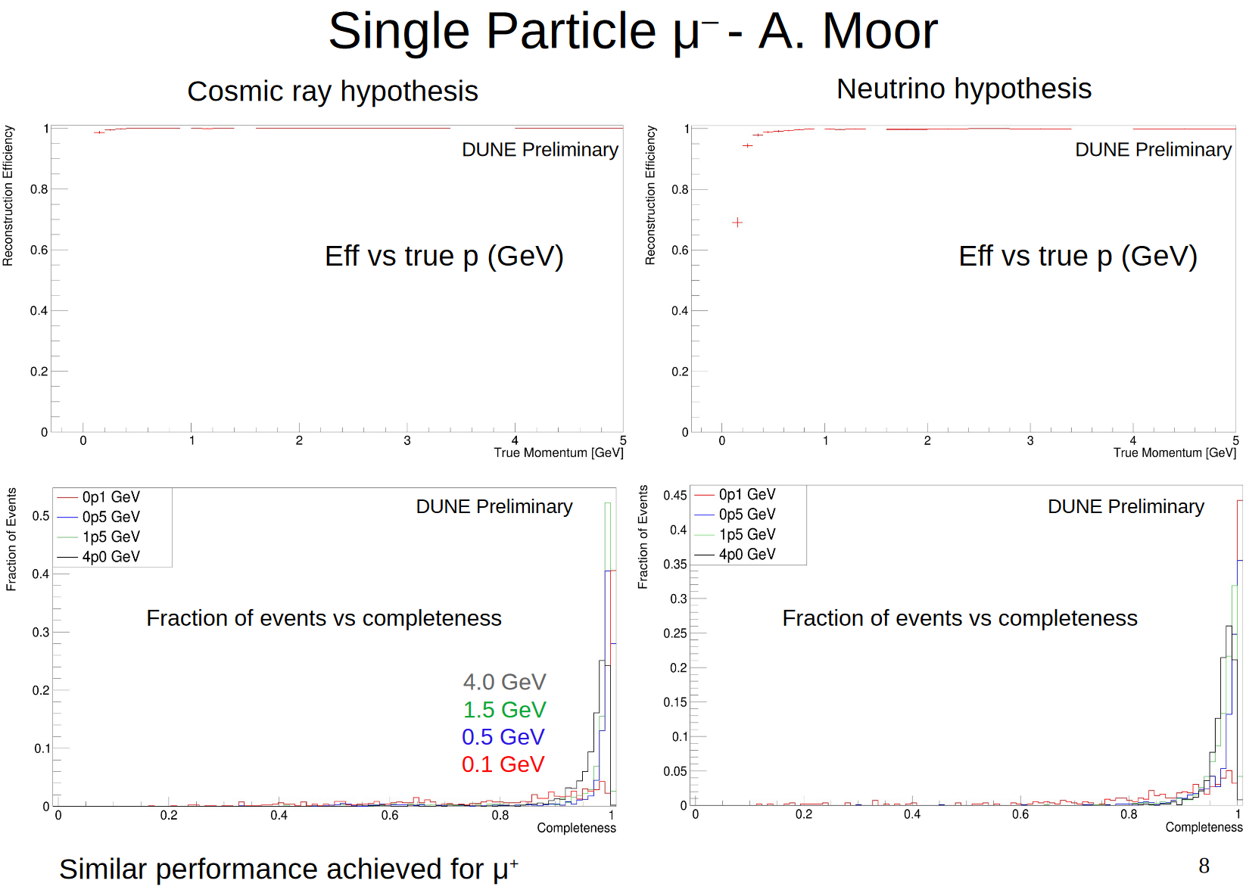
WP12.5 – Particle Flow Reconstruction
Just a few of the initial performance plots obtained

Slide 31
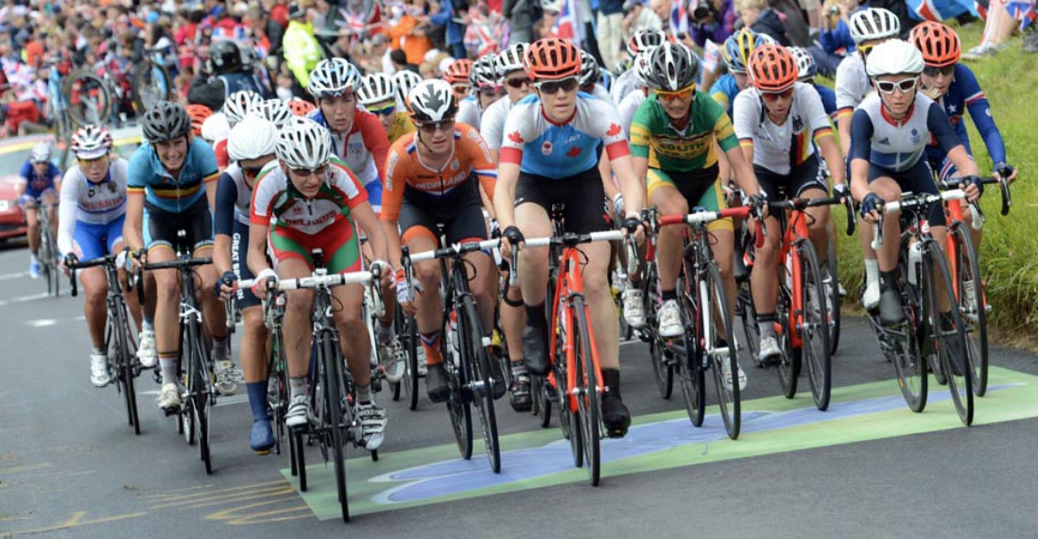
Summary
WP12 is up and running
  We have to thank everyone a lot for their forbearance during the very complicated preparation and start to the project during the pandemic
A few delays have been incurred, mostly for recruitment, but we don’t see any critical issues so far
We want to take advantage of the improving pandemic situation to have a WP12 Hackathon, 20-24 June
  Sub-task cooperation
  Integration into Key4hep

