Slide 1
WP4 Session
Upgrade of Irradiation and Characterization Facilities
Fernando Arteche (ITAINNOVA), Federico Ravotti (CERN)
AIDAinnova 1st Annual Meeting – CERN / Zoom, 28 March 2022

Slide 2
WP4 Goal
Irradiation and characterization tests required for the next generation of particle detectors demand more accurate and reliable procedures, as well as a higher efficiency in their execution
The main goal of WP4 is to develop & standardize common tools for testing infrastructure to better support the next detector generation
  Improve facilities and systems
The activities are covered by different partners:
  Academia
  Industry
  Research and Technology Organizations (RTO)
This good combination of partners will ensure the readiness of the detector support infrastructure for high TRL levels

Slide 3
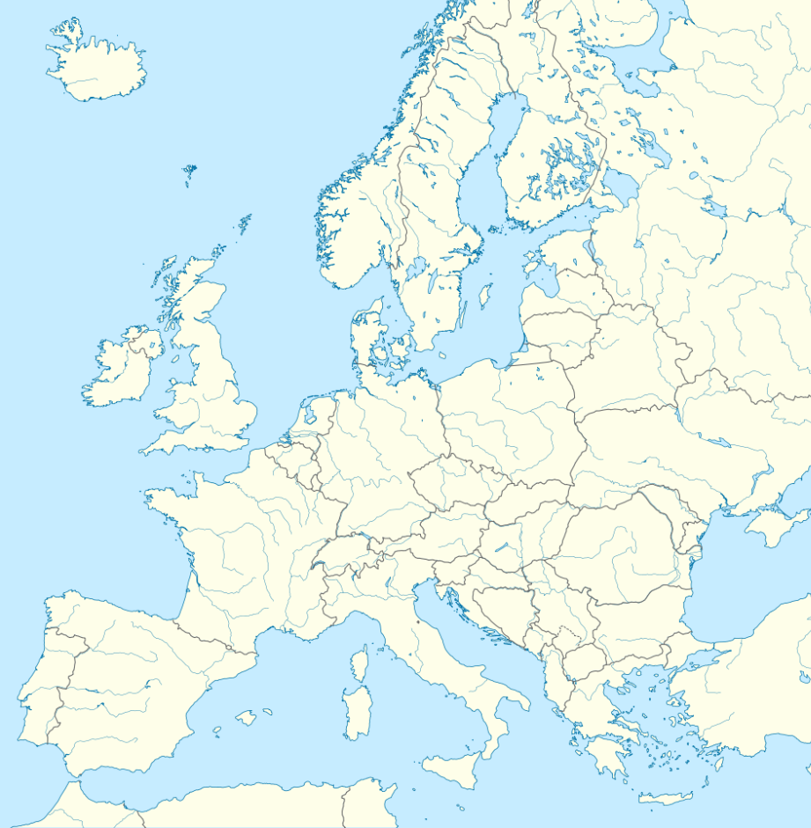


WP4 Structure & Partners
Task 4.1: Task Coordination (CERN, ITAINNOVA)
Task 4.2: Micro-beam Upgrade at RBI Accelerator Facility (RBI)
Task 4.3: Common Tools for Irradiation Facilities QC: Data Management, Traceability, Dosimetry and Activation Measurements (CERN, MINES^{(*)}, INFN, ENEA^{(*)}, CAEN)
Task 4.4: Design & Development of a New Sensor Characterization System based on TPA-TCT Technique (CERN, CSIC-IFCA, FYLA)
Task 4.5: Design & Development of a New Electronics Characterization System for EMC Control (ITAINNOVA⁽⁺⁾, CNRS-IPHC)
IRRAD/GIF⁺⁺
CERN Switzerland
Partner
Company Facility
MINES
ParisTech
France
CNRS-IPHC
France
CSIC-IFCA
Spain
CAEN
Italy
RBI-AF
Croatia
ENEA-FNG
INFN
Italy
FYLA
Spain
ITAINNOVA
Spain
^{(*)} Collaborating Institute
⁽⁺⁾ RTO

Slide 4
WP4 Deliverables/Milestones
5 Tasks
6 Milestones (MS): M18 – M42 → MS13 in September 2022!
5 Deliverables (D): M40 – M46
Y1 WP report will be sent to coordination office → 25th April 2022
  Task leaders should provide the task report to WP leaders → 15th April 2022

Slide 5
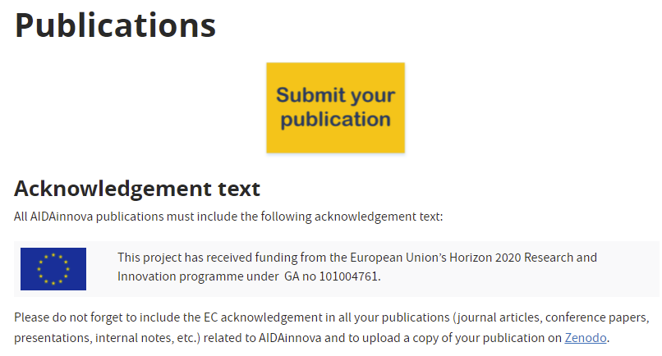
Task 4.1: WP Coordination
https://aidainnova.web.cern.ch/publications
1 publication (Technical Note) for WP4
e-groups to communicate with TLs and WP4 members
INDICO category to host WP- and Task-related meetings:
  https://indico.cern.ch/category/13502/
  TLs can manage this category
This afternoon WP4 session agenda:
  https://indico.cern.ch/event/1104064/sessions/429367/#20220328

Slide 6
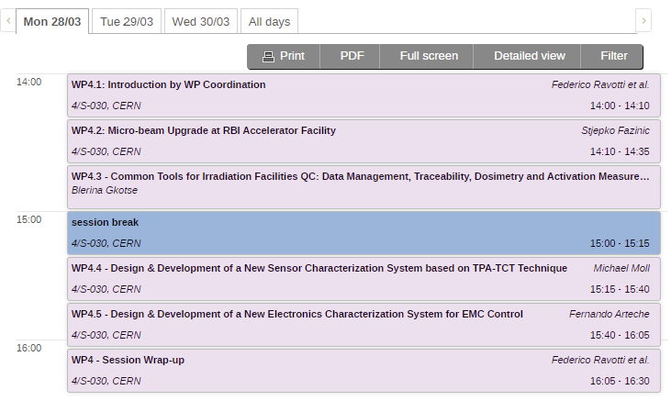


WP4 Session Agenda
WP4 Session:
  One (20min + 5min discussion) report per task
  Wrap-up session at the end (for further discussions, if needed)
WP4 Plenary:
  Wednesday @ 14:20
  WP4 Plenary Talk

