Slide 1
Task 4.2: Micro-beam upgrade at RBI accelerator facility
    Task 4.2: Micro-beam upgrade at RBI accelerator facility
    Stjepko Fazinić, task coordinator
    Rudjer Bošković Institute (RBI), Zagreb, Croatia
1

Slide 2


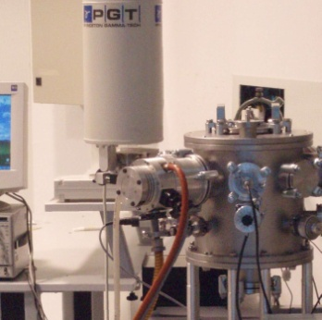
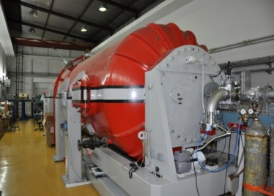
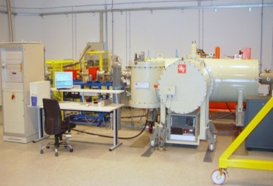
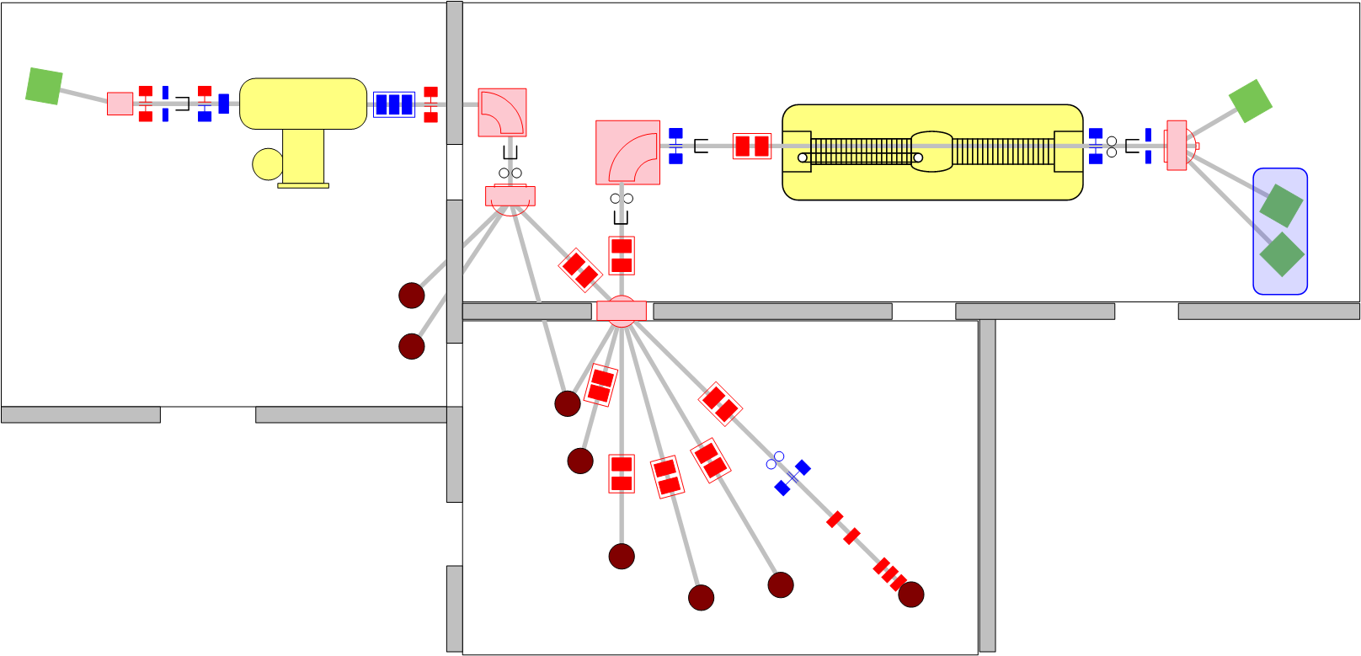
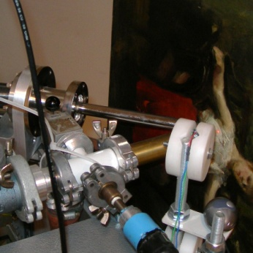
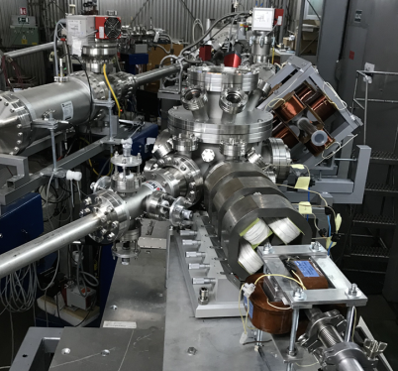
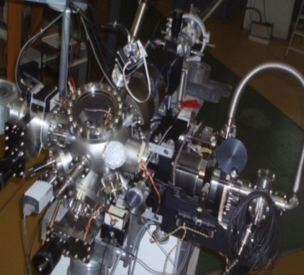
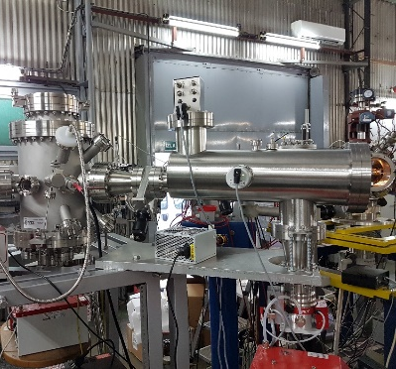
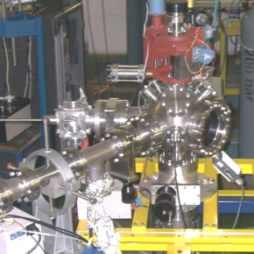
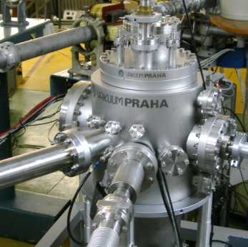
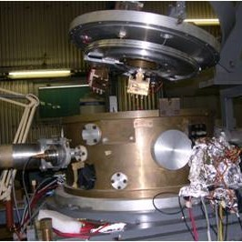
RBI Tandem Accelerator Facility
Managed by the Laboratory for Ion Beam Interactions
Division of Experimental Physics, RBI
PIXE-PIGE/RBS
1.0 MV HVE Tandetron accelerator
6.0 MV EN Tandem Van de Graaff accelerator
In-air PIXE
NEW Ion Microprobe
Old Ion Microprobe
Capillary MeV TOF-SIMS
TOF-ERDA
Channeling
Nuclear reactions
Dual beam,DiFu

Slide 3
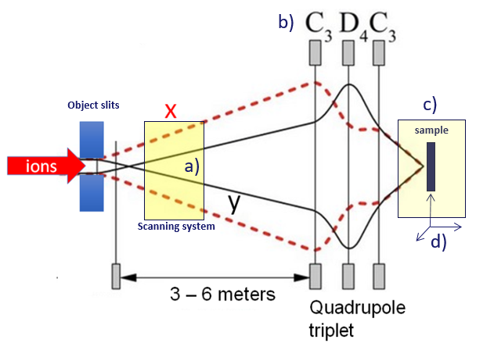
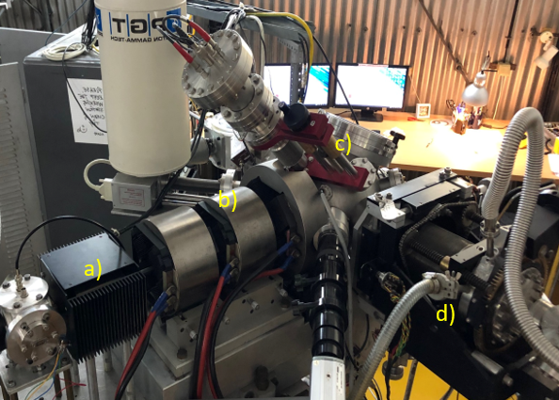
Task 4.2: Micro-beam upgrade at RBI accelerator facility
Old Ion microprobe
Ion beam scanning system
Focusing triplet,
Sample vacuum chamber,
Sample positioning system
3

Slide 4
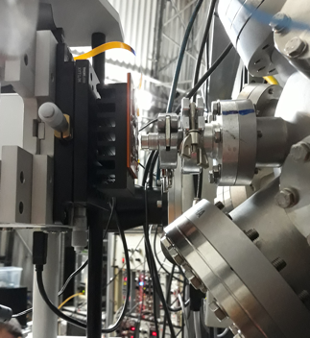
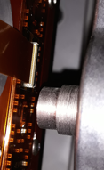
Task 4.2: Micro-beam upgrade at RBI accelerator facility
Old Ion microprobe
e)
Extension for in-air measurements or irradiations
e) sample positioning
4

Slide 5
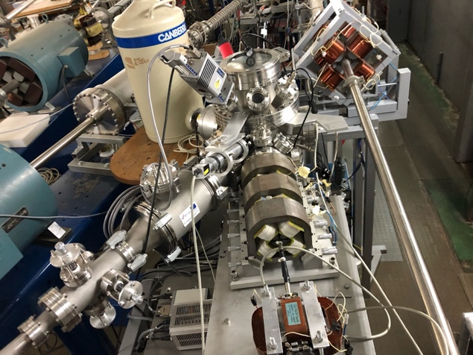
Task 4.2: Micro-beam upgrade at RBI accelerator facility
New Ion microprobe
Sample vacuum chamber
Sample positioning system
(inside the chamber)
Focusing triplet
Ion beam scanning system
5

Slide 6
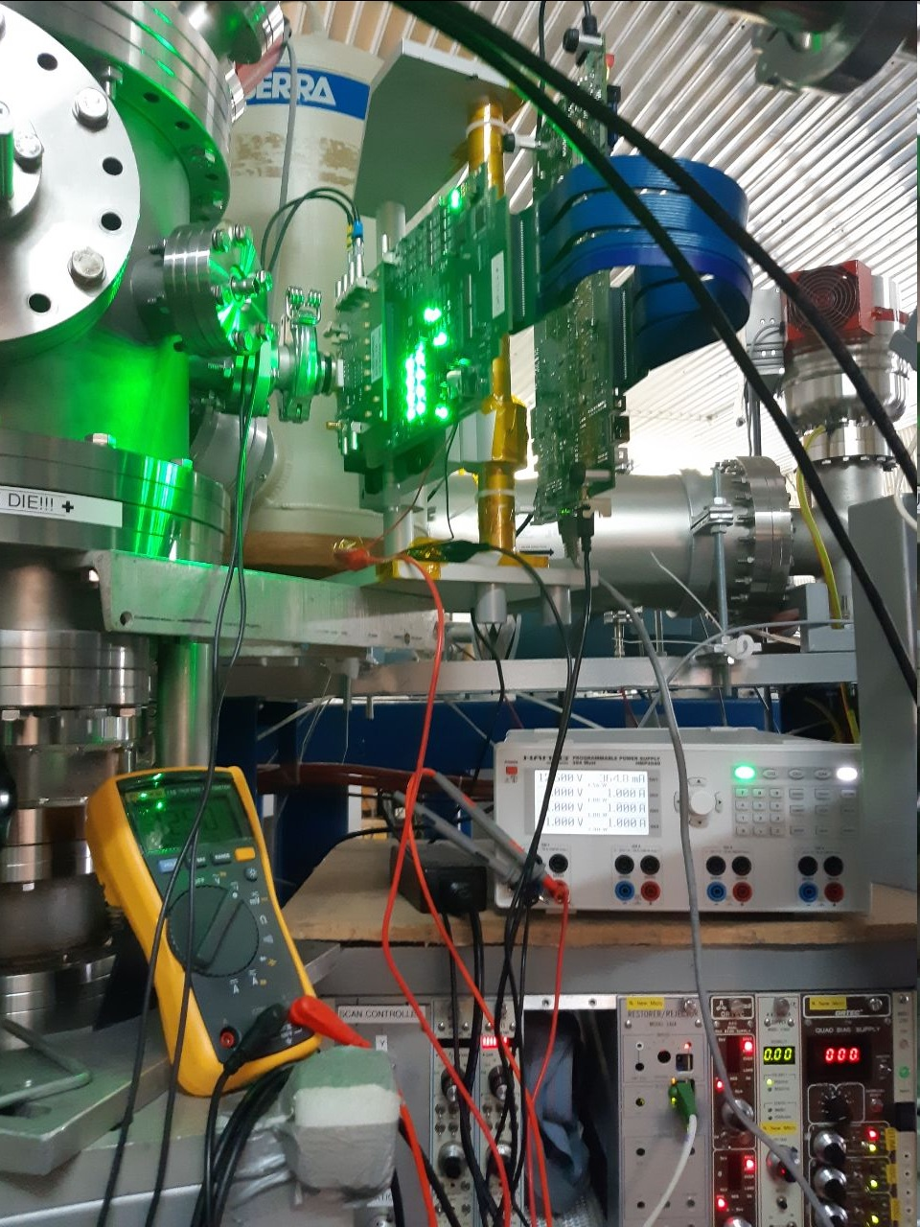
Task 4.2: Micro-beam upgrade at RBI accelerator facility
New Ion microprobe
Extension for in-air measurements or irradiations
6

Slide 7
Task 4.2: Micro-beam upgrade at RBI accelerator facility
    During AIDA-2020 RBI-AF was used for Transnational Access (TA) for:
in vacuum and in-air IBIC imaging of charge collection efficiency (CCE) using protons of up to 10 MeV with ≈ 1 μm resolution and heavier ions on demand
TRIBIC: time resolved imaging of current signal induced by probing beams
Real-time controlled damaging of small detector areas using protons or heavier ions
Studies of radiation-induced Single Event Effects (SEE) on complex electronics and detector systems
IBIC = Ion Beam Induced Charge
TRIBIC = Time Resolved IBIC
16 experiments, most on CCE imaging
7

Slide 8
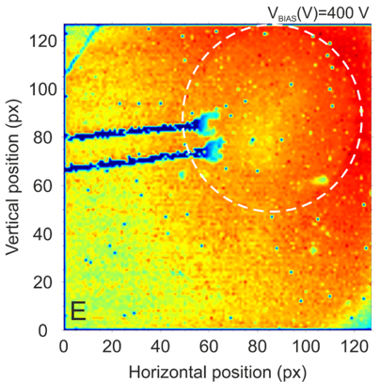
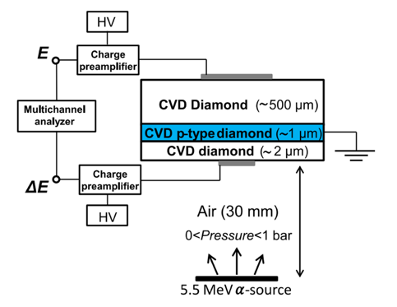
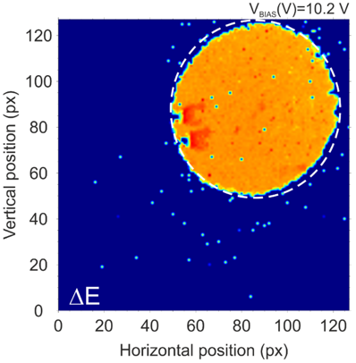
Task 4.2: Micro-beam upgrade at RBI accelerator facility
    Between 2020 – 2022 we continued to suppor TA projects
    related to detector developments through RADIATE project:
    - 7 user projects have been supported, including studies of:
    monolithic particle detector and associated electronics for the RD50 collaboration
    hexagonal and cubic caged 3D diamond and LGAD test detectors
    Single diamond and diamond based telescope for microdosimetry
    Silicon Carbide sensors for harsh environment
    Silicon pin diodes
Ion microbeam
6.0 MeV C³⁺
10.7 MeV C⁴⁺
16.7 MeV C⁵⁺
24.0 MeV C⁶⁺
8

Slide 9
Task 4.2: Micro-beam upgrade at RBI accelerator facility
    The objective of Task 4.2:
    Upgrade of the RBI Tandem Accelerator Facility (RBI-AF) infrastructure for detector characterization and radiation hardness studies at micron-scales,
    At present testing of samples (devices) can be performed in vacuum or in air but
in both cases sample positioning is manual, not reproducible at the sub-micron scale
room temeprature measurements, heating posible, no cooling possible
9

Slide 10
Task 4.2: Micro-beam upgrade at RBI accelerator facility
Within AIDAInnova: Activities of Task 4.2:
New precise motorised sample positioning will be provided
2. Related software for sample and ion beam position controls and
data acqusition will be upgraded
3. Sample cooling capability will be introduced (at first for in vacuum work)
    One deliverable is expected at Month 40:
    D4.1: Integrate the data acqusition and control system at RBI-AF
    Improved data acquisition and control system to optimise the operation and improve the quality of results
10

Slide 11
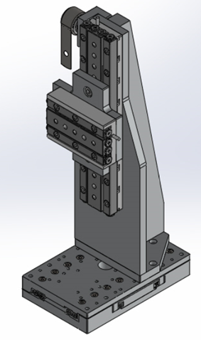
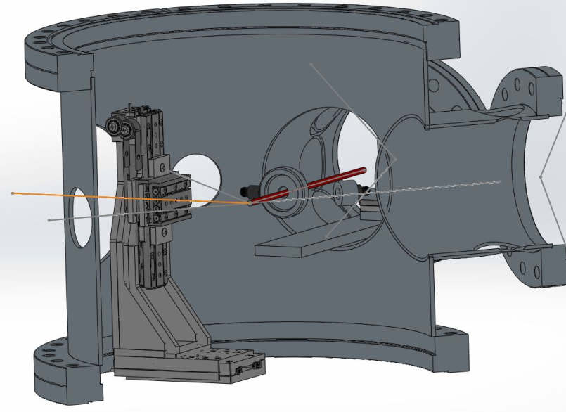
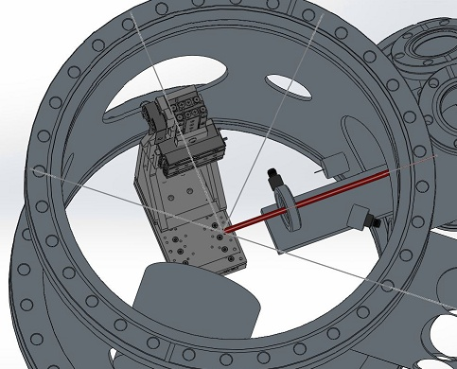
Task 4.2: Micro-beam upgrade at RBI accelerator facility
1. New precise motorised sample positioning
for both microprobes
For new microprobe we selected
SmarAct Linear Piezo 3D
with closed-loop positioning resolution
of 1 nm with tens of nm positioning
repeatability even over longer travel
ranges:
X axis: 51 mm
Y axis: 83 mm
Z axis: 29 mm
New Ion microprobe

Slide 12
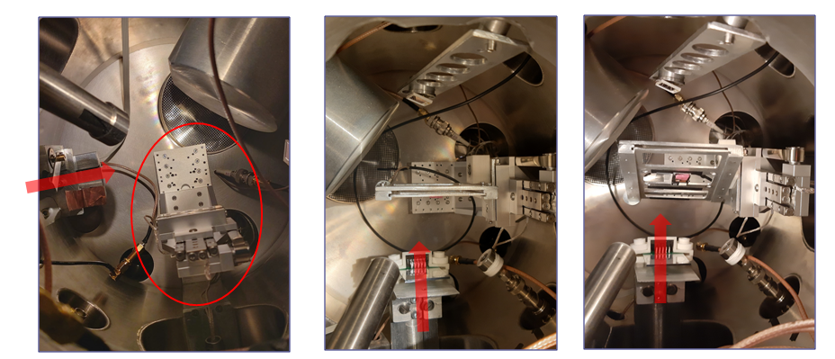
Task 4.2: Micro-beam upgrade at RBI accelerator facility
New Ion microprobe
Sample holder is attached on the piezostage inside the vacuum chamber.
The samples can be positioned at 90º and 60º with respect to the beam.
With the new holder, the working range is extended to 100 x 100 x 50 mm.
12

Slide 13
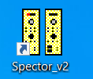
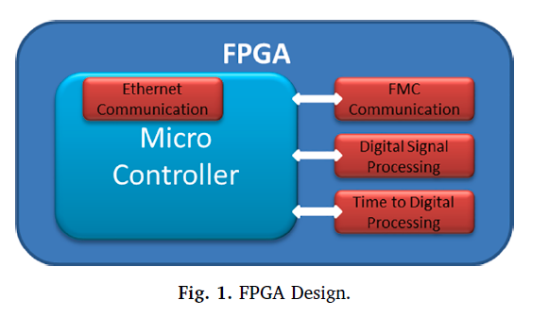
Task 4.2: Micro-beam upgrade at RBI accelerator facility
2. Upgrade of related software for sample and ion beam position controls and data acqusition – integration with SPECTOR
- SPECTOR: D. Cosic et al., Data acquisition and control system for an evolving nuclear microprobe, Nucl. Instr. And Meth. B451 (2019) 122
New Ion microprobe
and
Old Ion microprobe
13

Slide 14
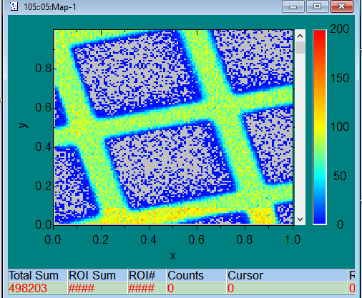
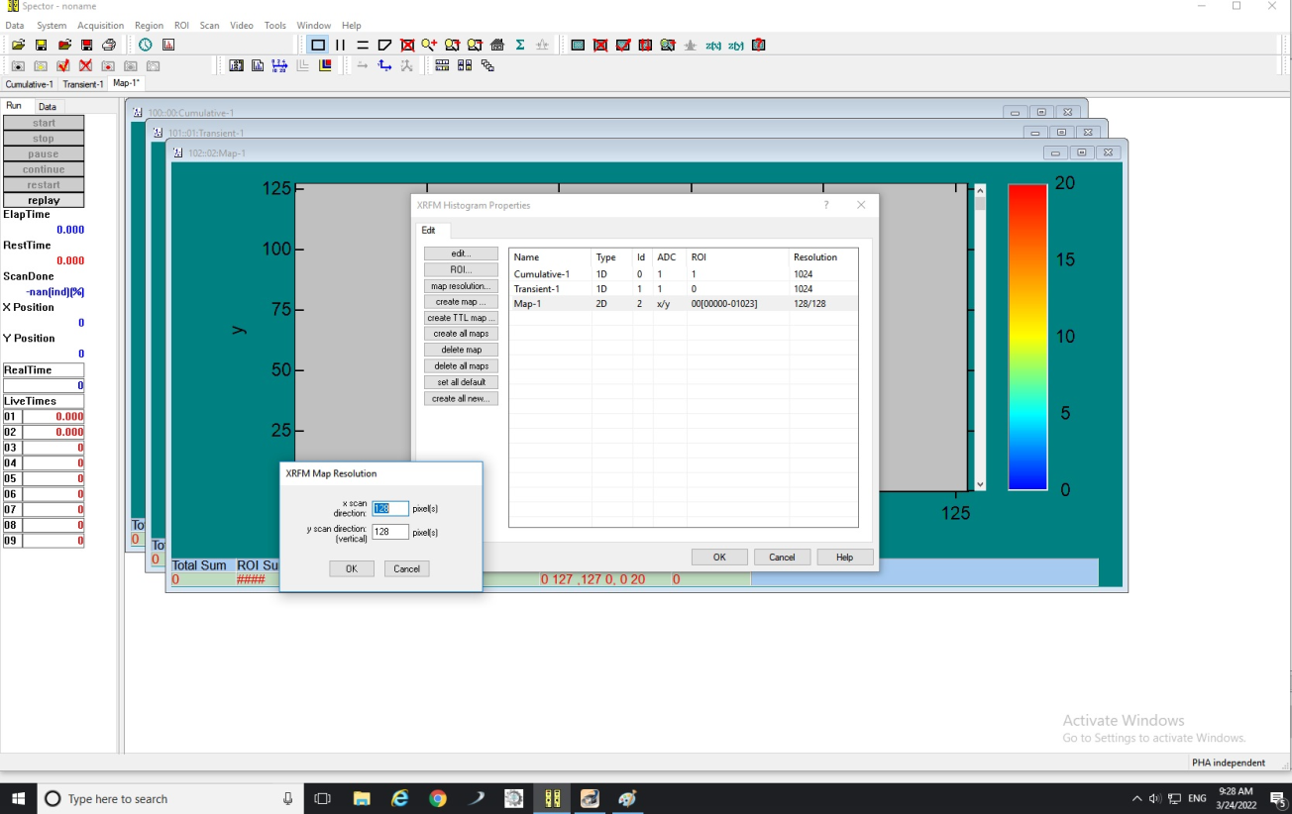
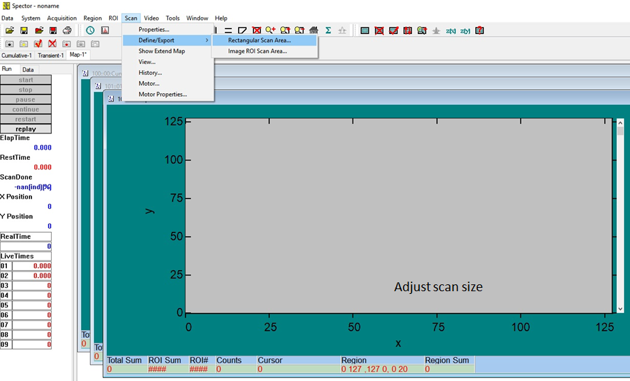
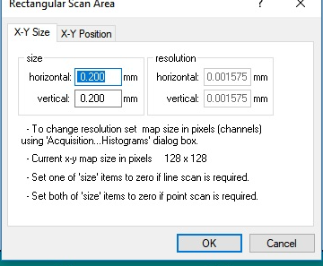
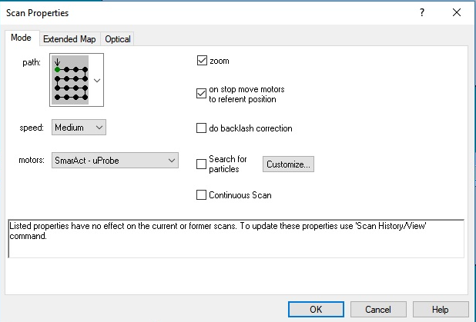
Task 4.2: Micro-beam upgrade at RBI accelerator facility
NEW option to scan the sample in XY plane was added in SPECTOR
2D mapping
Adjust number of pixels/steps
Adjust scan size
Select SmarAct - uProbe
14

Slide 15
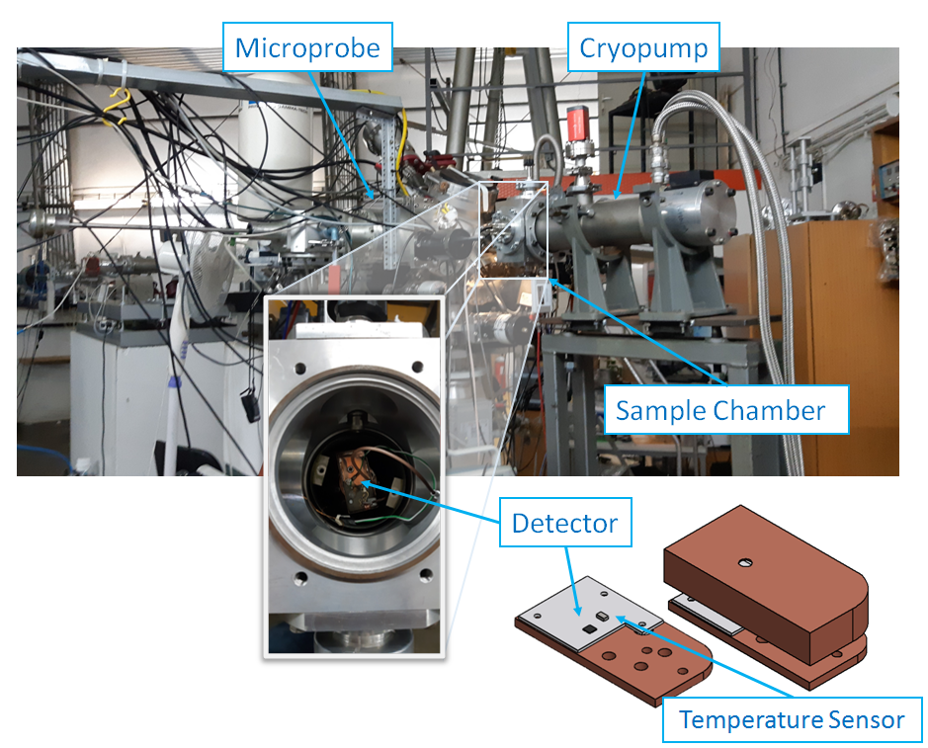
Task 4.2: Micro-beam upgrade at RBI accelerator facility
3. Sample cooling (in progress)
  Sample cooling is considered only for the old microprobe. Several solutions proposed.
a) Cryogenic temperatures
Microbeam scanning over samples at cryogenic temperatures
Temperatures down to 38 K
Integrated heater for intermediate temperature control
Old Ion microprobe
15

Slide 16
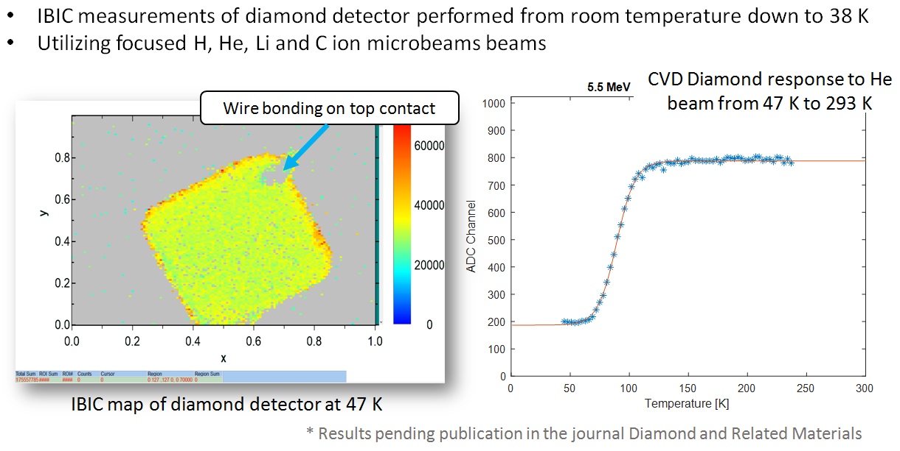
Task 4.2: Micro-beam upgrade at RBI accelerator facility
Old Ion microprobe
a) Cryogenic temperatures
2 experiments performed to test useability
16

Slide 17
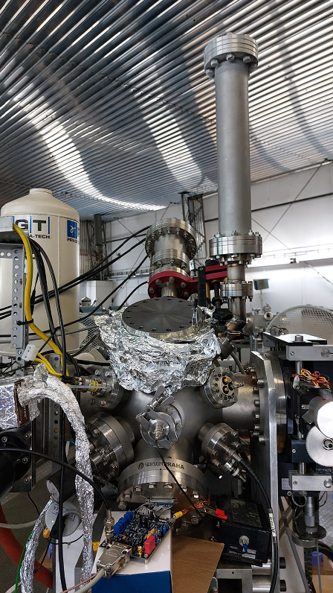
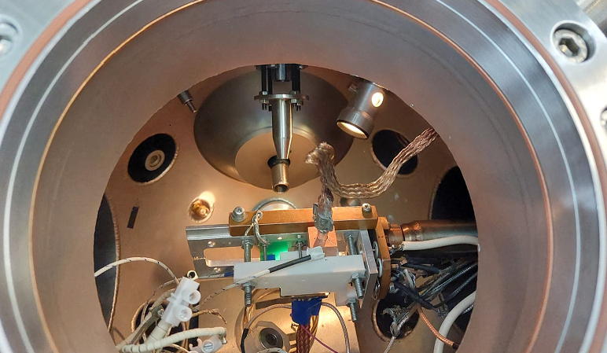
Task 4.2: Micro-beam upgrade at RBI accelerator facility
3. Sample cooling (in progress)
Old Ion microprobe
b) LN2 cooling
Passive LN2 cooling – tested but not appropriate for majority of cases!
LN2 cooling with temperature control – in planning phase
Experiment:
Detector cooled down to -4 ºC
with LN2
17

Slide 18
Task 4.2: Micro-beam upgrade at RBI accelerator facility
Summary
1. precise motorised sample positioning
- Precise motorised sample positioning stage is installed
in the new ion microprobe vacuum chamber
- Design of the new sample positioning stage for the
old microprobe is in progress
18

Slide 19
Task 4.2: Micro-beam upgrade at RBI accelerator facility
Summary
2. Upgrade of related software
- First upgrade of related software for sample and ion beam
position controls and data acqusition on the new ion
microprobe has been done
- this includes integration with the home made SPECTOR data
acqusition
- NEW option to scan the sample in XY plane was added in
SPECTOR, extending considerably 2D mapping capabilities
19

Slide 20
Task 4.2: Micro-beam upgrade at RBI accelerator facility
Summary
3. Sample cooling
- Two different sample cooling options have been tested
on the old ion microprobe:
  - cooling to cryogenic temperatures
  - LN2 cooling
- Discussions on further options and improvements are in
progress.
During the first 12 months we spent in total about 12 PM of
which part will be EC eligible.
20

Slide 21
Task 4.2: Micro-beam upgrade at RBI accelerator facility
On behalf of the RBI participants from the
Division of Experimental Physics
Laboratory for Ion Beam Interactions
M. Jakšić, G. Provatas, I. Božičević Mihalić,
M. Vicentijević, D. D. Cosic, S. Fazinić
Thank you

