Slide 1

Timepix4 timing layers status and plans
AIDAinnova 1st annual meeting
30/3/2022
Martin van Beuzekom

Slide 2
Timepix4 timing layers and telescope
Two parallel projects: timing layers for AIDAinnova, and (LHCb) Timepix4 telescope
Based on same hardware: Timepix4 ASIC and SPIDR4 readout
Deliverable of AIDAinnova WP3: ‘single’ Timepix4 timing layers for EUDET style telescopes
  Aim for time resolution of order 100 ps
  Sensors from WP6, initially PiN, faster sensors when available
  Embedding in EUDAQ / EUDET telescope (software, mechanics)
An 8-layer Timepix4 telescope built by the LHCb Vertex Locator (VELO) group
  Upgrade of the Timepix3 telescope, more focused on timing
  Use this to gain experience with Timepix4 and SPIDR4
  Aim for 20 ps, when reference timing layers are implemented
Timepix4 has large area and is fast, but is not the ultimate chip to test 20-50 ps sensors
  Discrete electronics, Timespot

Slide 3
Timepix4 specifications
65 nm CMOS
Matrix of 512 x 448 pixels, 55 um pixels
Active area 6.94 cm²
4-side buttable, using redistribution layer
Suited for electron and for hole collecting devices
General purpose chip with many acquisition modes
For telescope: simultaneous Time-Of-Arrival and Time-Over-Threshold
195 ps time bins
Data driven readout
64 bits / packet
Sustained average pixel rate: 10.8 kHz
Readout bandwidth: 16 x 10.24 Gbps
Min. threshold: ~500 e-
24.64 mm
Pixel electronics
Peripheral circuits
Wire bond extenders
(can be diced off)
28.16 mm
Designed by CERN, Nikhef, IFAE
For much for info see Xavi Llopart’s seminar: https://indico.cern.ch/event/1121147/

Slide 4
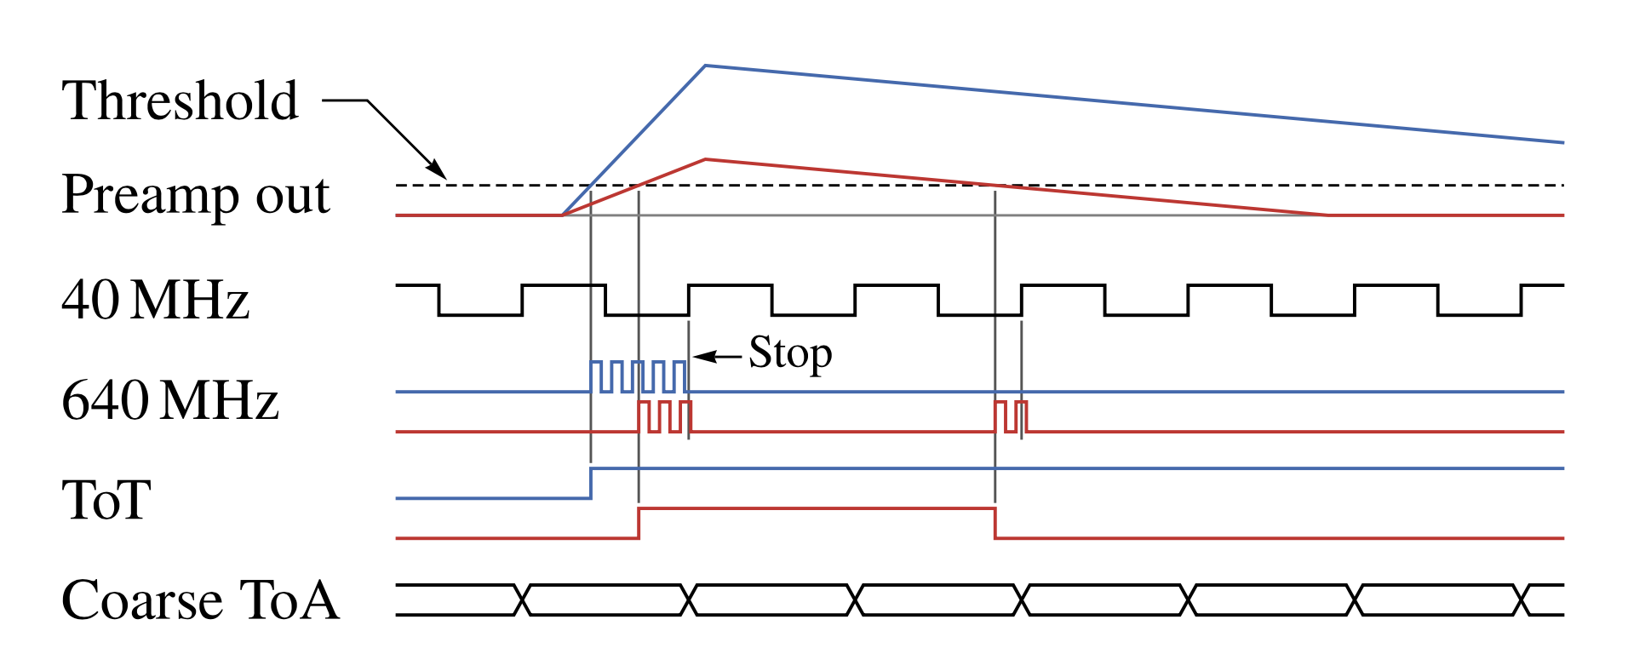
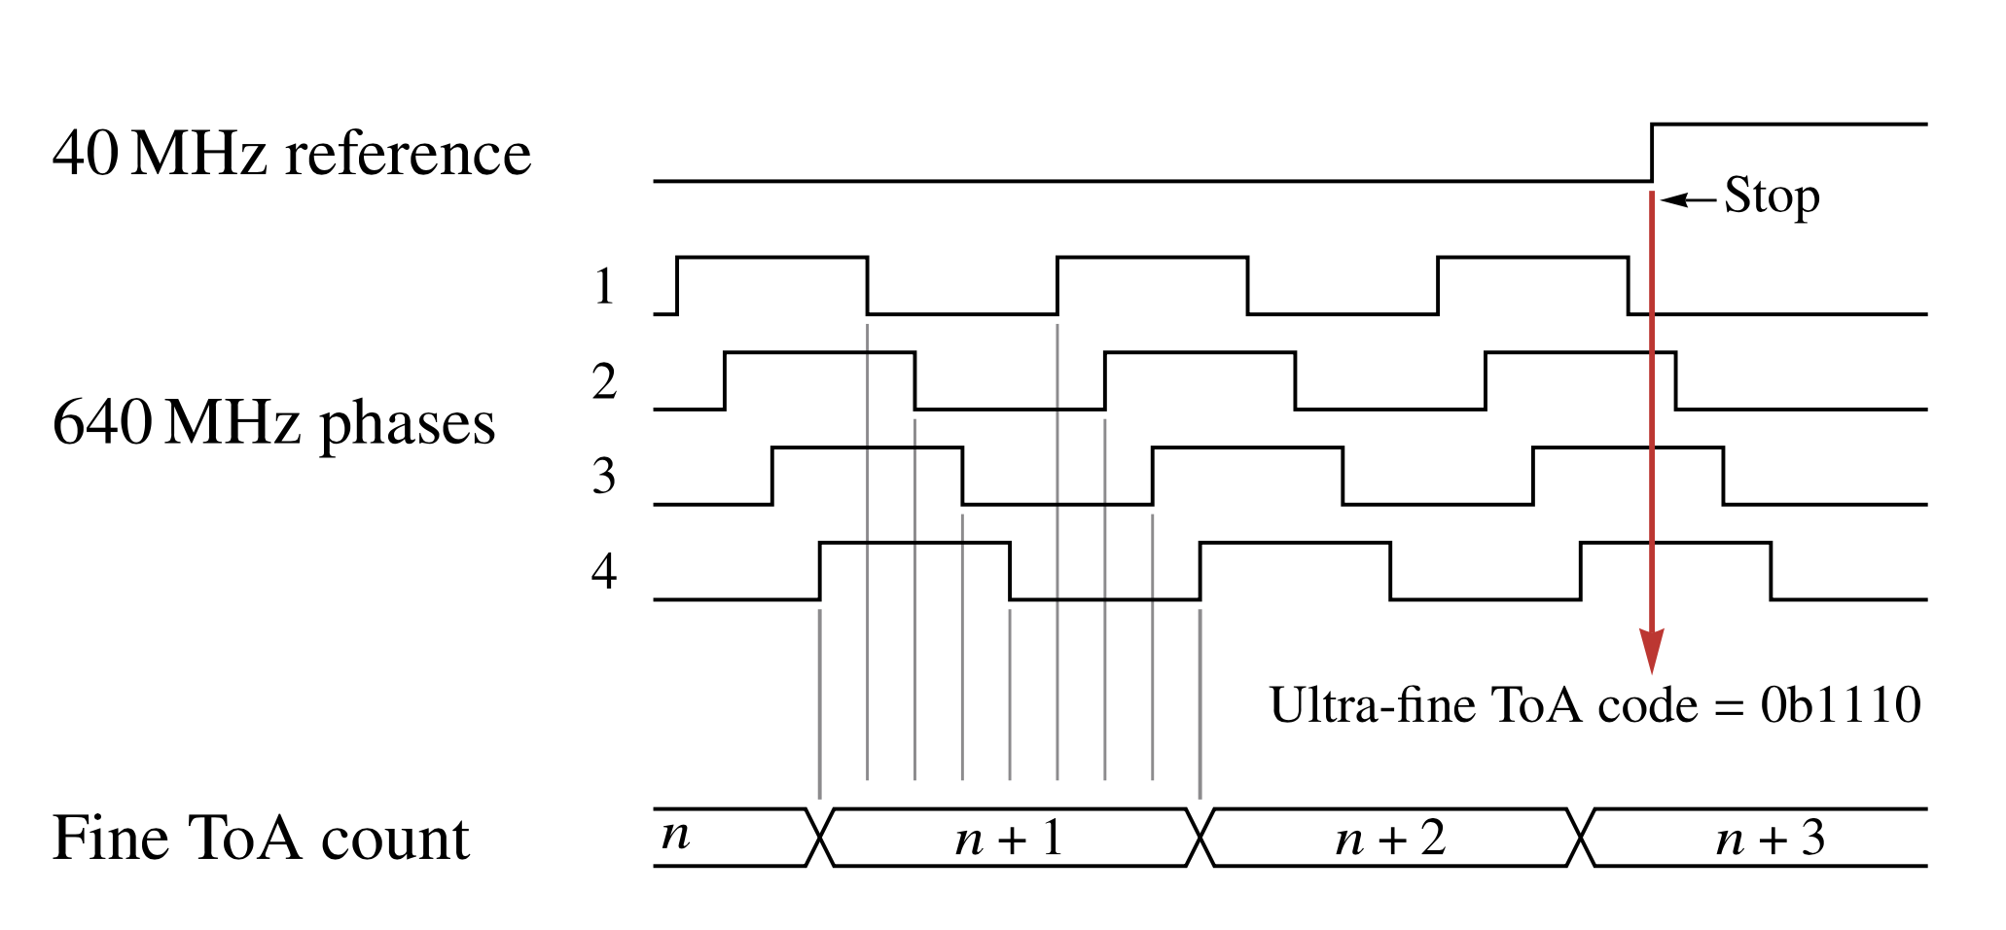
Time measurement with Timepix4
Base clock of 40 MHz
Hit starts 640 MHz oscillator (VCO)
  1.56 ns bins
  Count # clock cycles (like in Tpx3)
  Oscillator shared by 8 pixels in superpixel
Oscillator is stopped by first rising edge of 40 MHz clock
In addition the internal state of ring oscillator is captured –> 195 ps bins
Also the back edge of Time-over-Threshold signal is measured with a high time resolution
  Improved ToT measurement

Slide 5
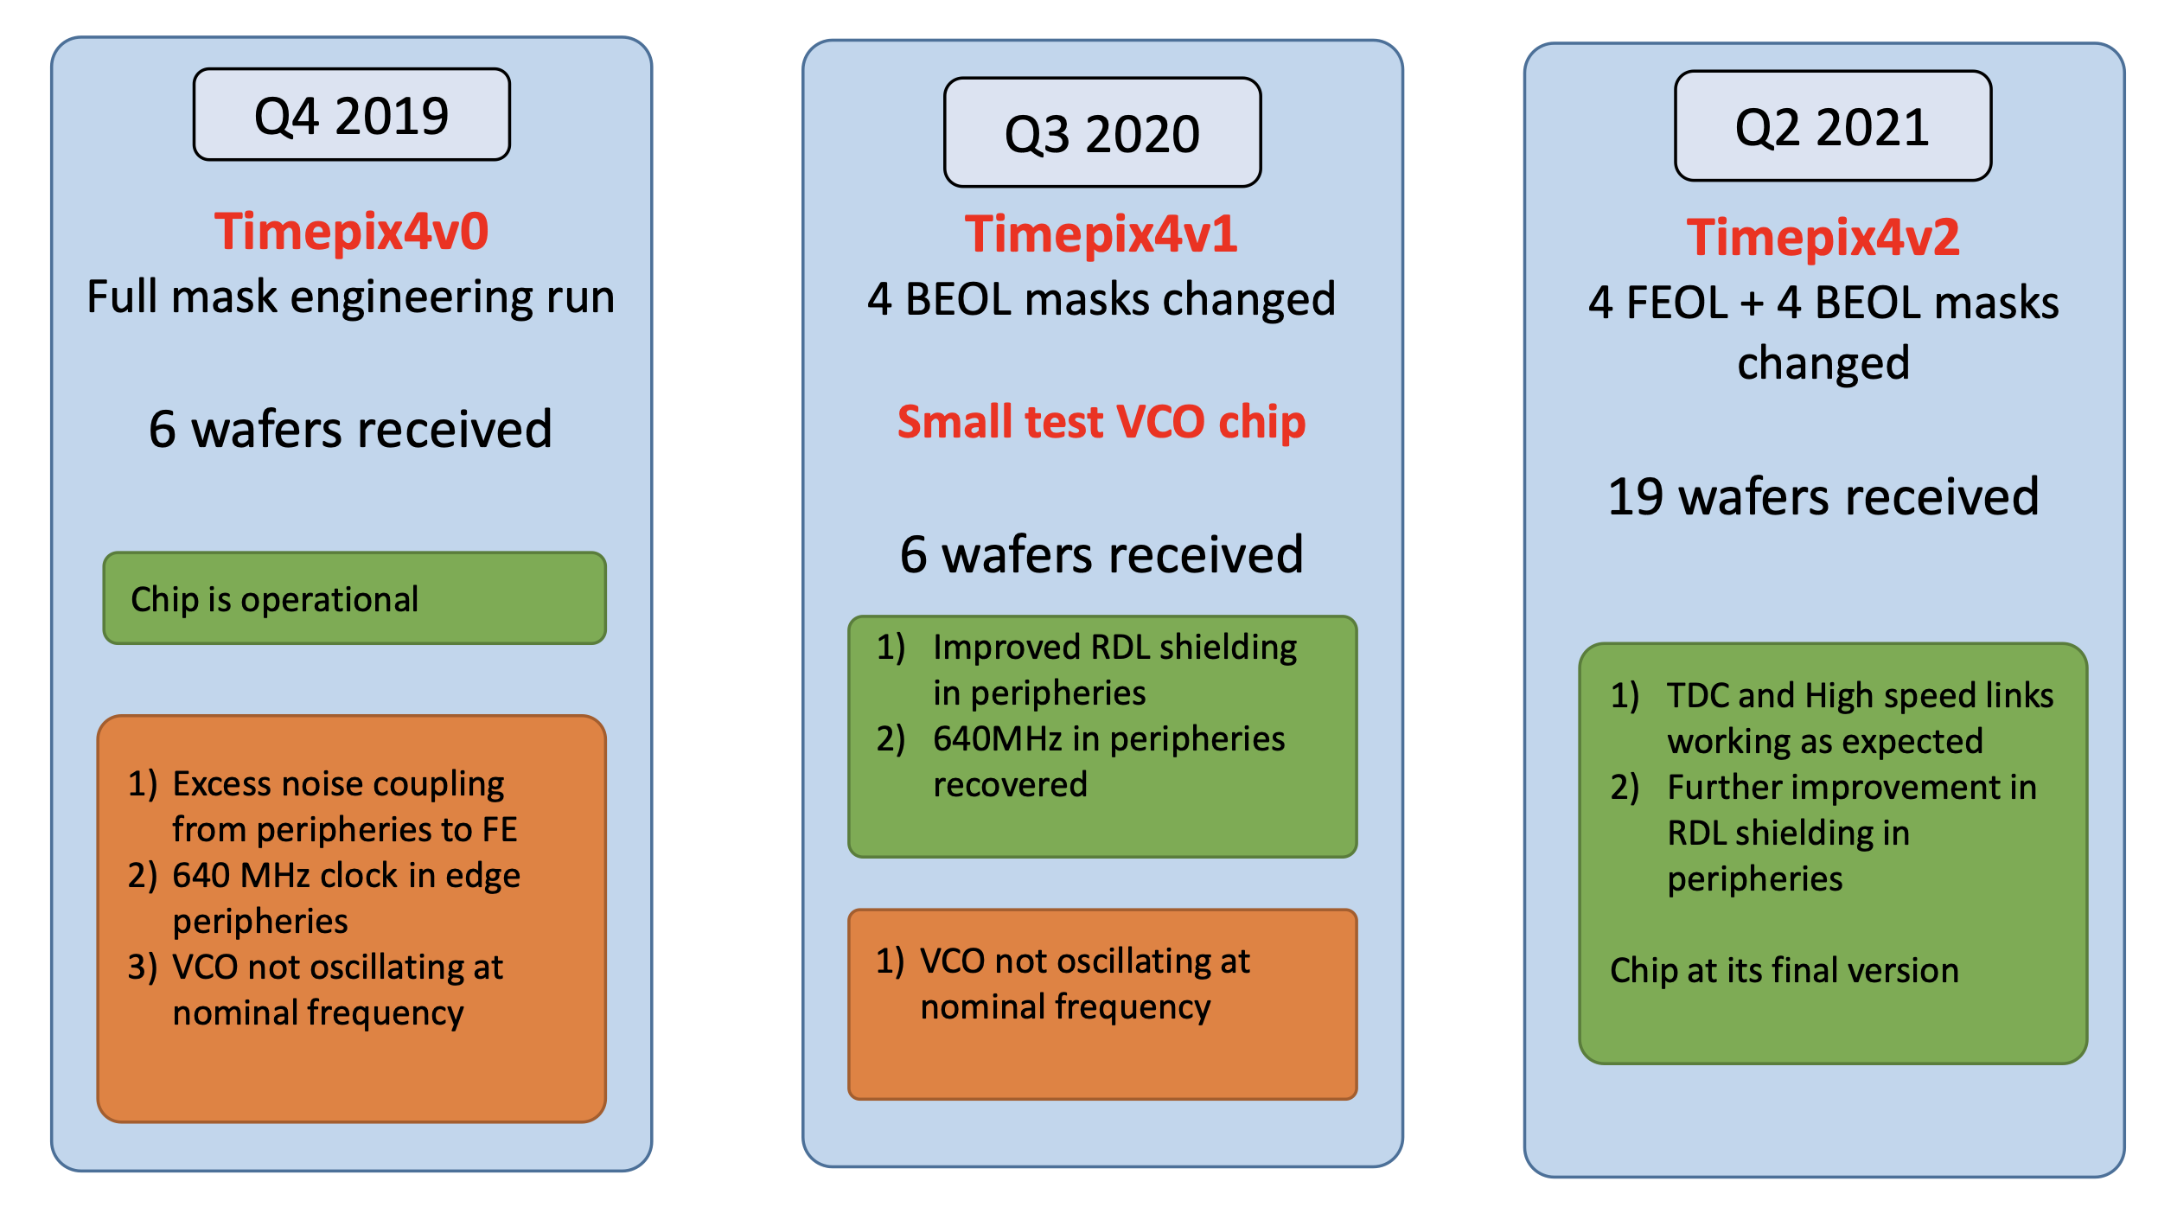
Timepix4 versions
Version1 with sensor used in Nov 2021 testbeam
  With Voltage Controlled Oscillator issue
Version2 (still) without sensor used for lab measurements

Slide 6
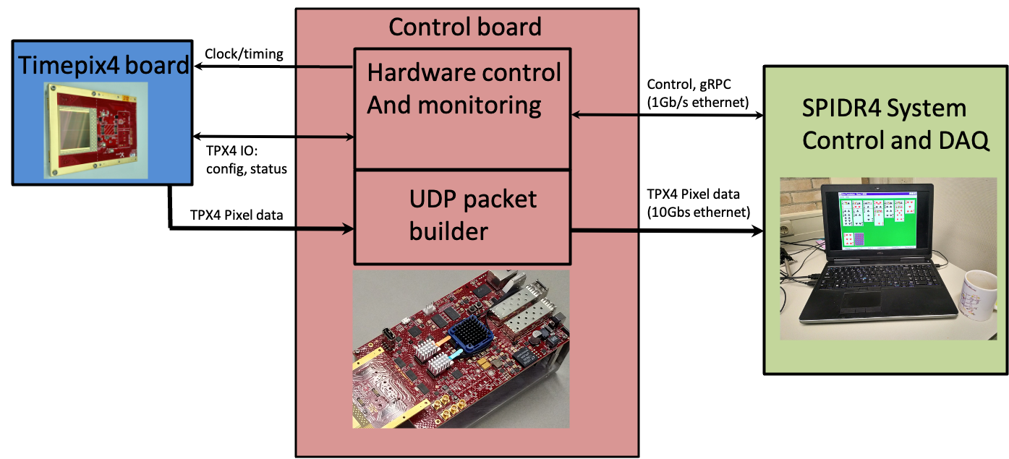
SPIDR4 readout, “low” rate version for testbeam
Readout via one 10 Gbit ethernet link
Up to ~150M pixel hits/s
Is only ~6% of max rate
But is enough for typical testbeam

Slide 7
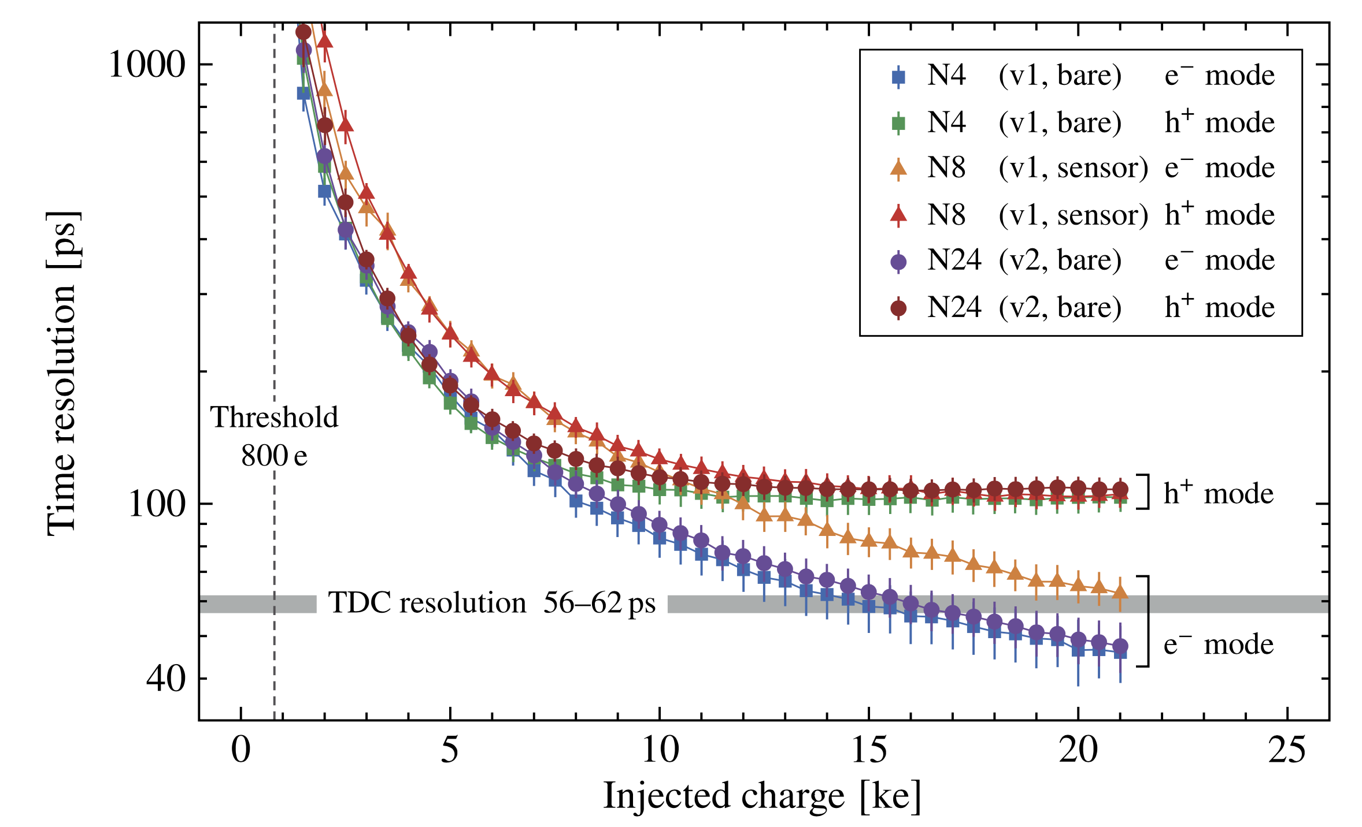
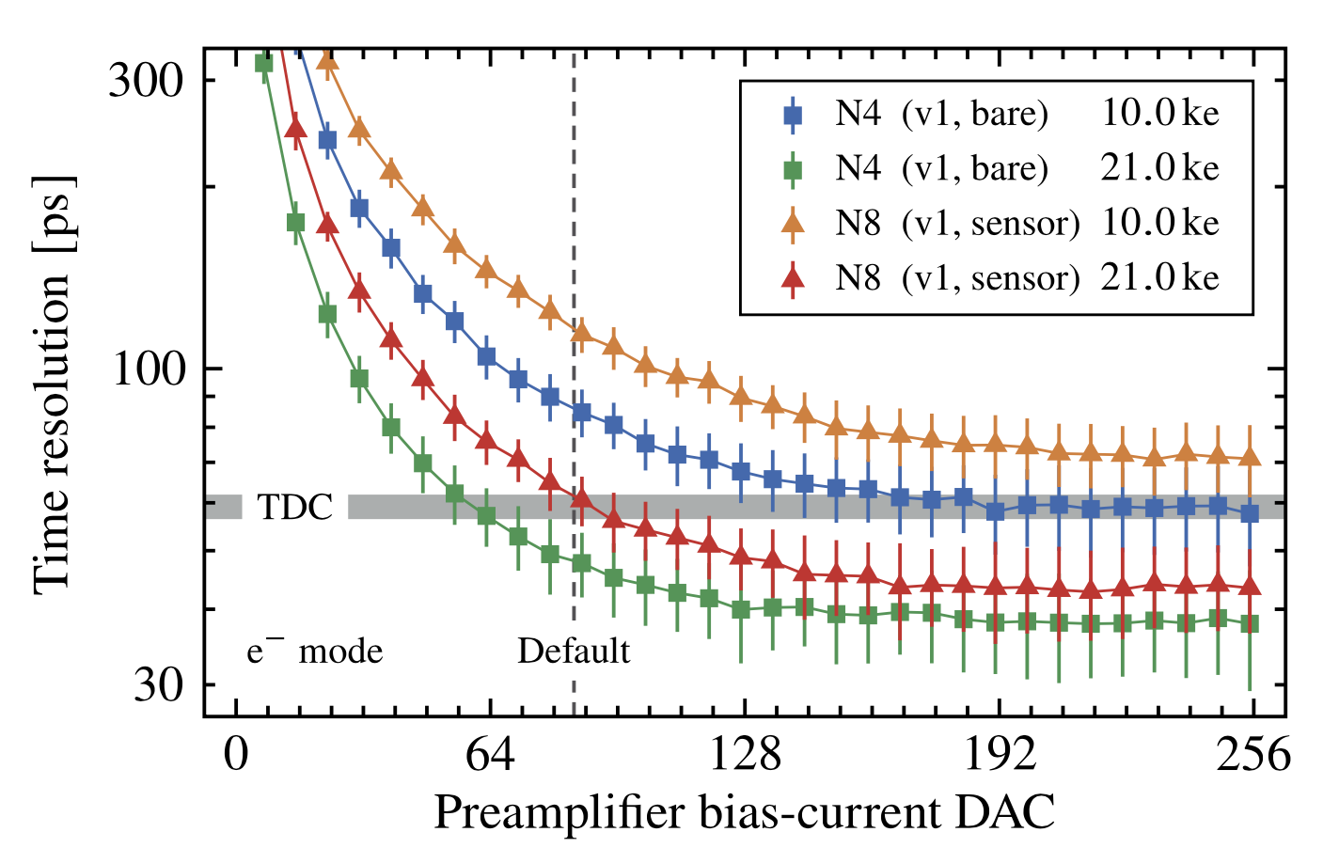
Time resolution of TPX4 analog front-end, lab measurement
Testpulse data
Timepix4 suited for electron and hole collecting sensors
Optimized for electron-collecting mode
Electron mode
Front-end time resolution depends on settings
(Somewhat) better time resolution can be achieved at the cost of power
Results by Kevin Heijhoff, paper submitted to JINST

Slide 8
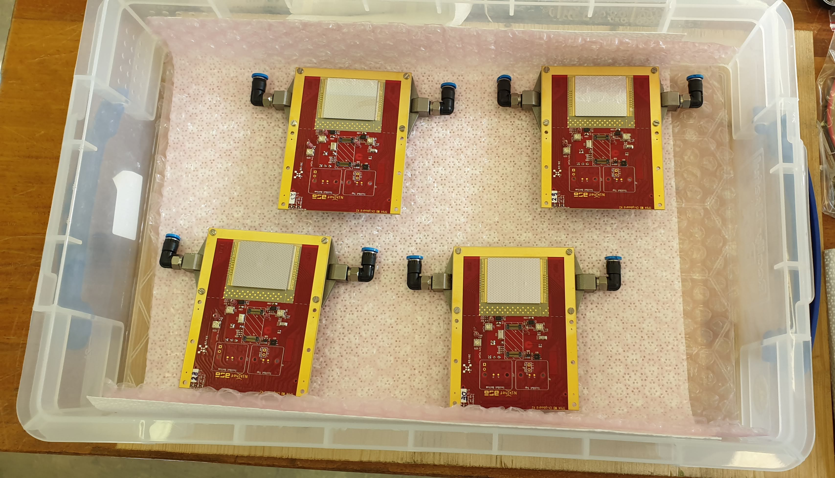
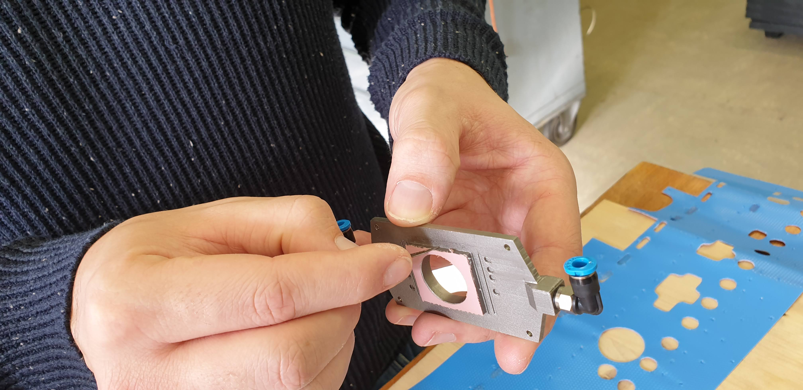
First test with telescope in 2021
Beam test in H8 beam at CERN in Oct/Nov 2021 with half a telescope
  Limited availability of components
  Using Timepix4v1 (so with VCO issue)
Dress rehearsal for 2022 telescope
  Gain knowledge on Timepix4 chip and its data acquisition, and test cooling
  Took data for spatial alignment and track reconstruction
  Test of software (slow control, run control, DAQ, analysis)
  Though we looked at time resolution, it was not the main goal
Four devices ready to be installed
3D printed Titanium cooling block (Raphael Dumps, CERN)

Slide 9
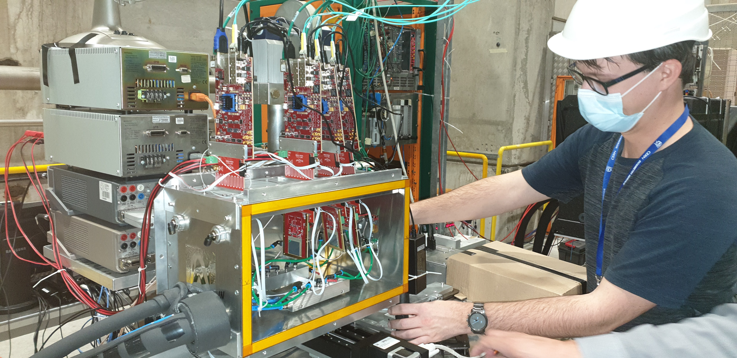
2021 Telescope configuration
4 tracking layers with Timepix4v1 ASICs
  2x 300 μm n-on-p sensors (Advacam, EP R&D WP1.1), at 9’ pitch/yaw angle for better spatial resolution
  2x 100 μm n-on-p sensors (Advacam, EP R&D WP1.1), at 0’ angle for better time resolution
  3 Scintillators + constant fraction discriminators as reference timing
Read out by 4 SPIDR4 systems (half of the ”world stock”)
10 Gbit ethernet via fibre
Timepix4 assemblies in gas-tight and light-tight enclosure
Allows operation at low(er) temperatures (better time resolution)
Feedthrough board

Slide 10
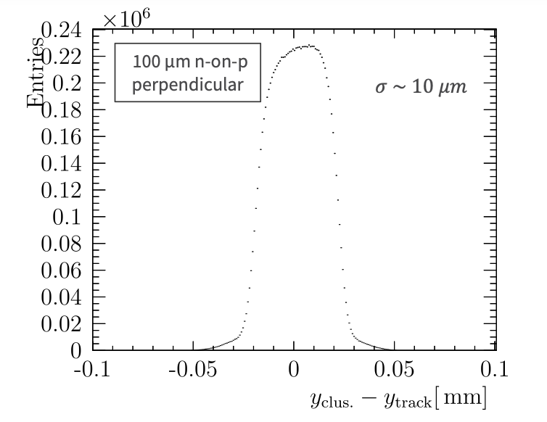
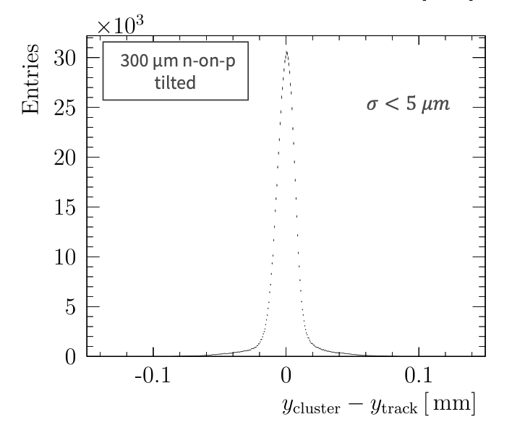
Landau and (spatial) residual distribution
Unbiased residual distributions are in line with expectations
Note that only 3 planes are used to define a track,
hence track pointing resolution is limited
Cluster ToT
100 um sensor
Thin sensor
Thick sensor
Cluster ToT
300 um sensor

Slide 11
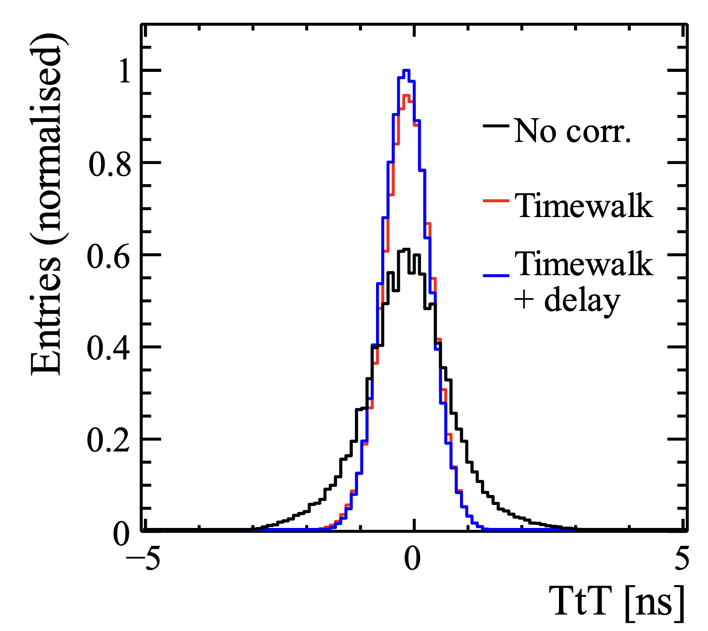
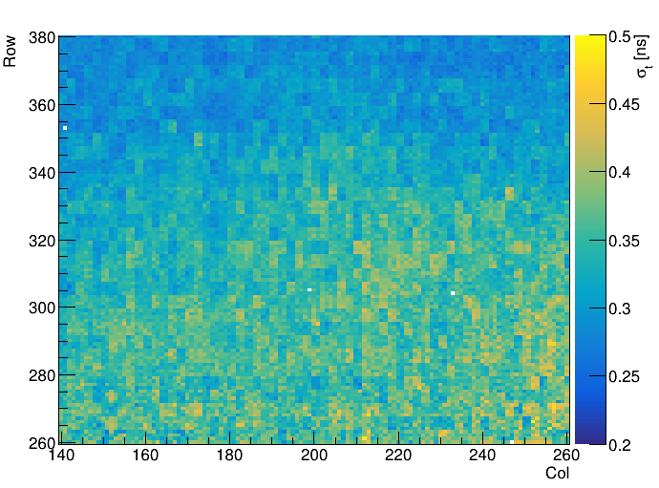
First look at time resolution
After first order corrections
Achieving good time resolution in a system with many pixels is far from trivial
Must apply many corrections
  Per pixel time offsets
  Fine tuning of timewalk corrections
  Geometrical dependence for thick, angled, sensors
Time resolution seems to depend on row number
Expected to be due to VCO issue
Improves for Timepix4v2
And, contribution from scintillator reference timing is not negligible
Time resolution as function of row number

Slide 12
Outlook: Timepix4 telescope & timing layer plans
General:
Planning a test with a full, 8-layer, telescope during summer
  Provided components for SPIDR4 systems are delivered in time
Timepix4v2 expected to perform significantly better
  No more row dependent time resolution
Hopefully also first attempt to run with MCP based reference timing layer(s)
Will use better reference clock system
AIDAinnova specific:
Bond PiN sensors from WP6 to Timepix4
Make a start with integration of timing layer into EUDAQ
Longer term: if faster sensors become available we should upgrade

Slide 13
Thank you for your attention
Test beam crew:
Nikhef: Robbert Geertsema, Kazu Akiba, Kevin Heijhoff, Martin van Beuzekom
CERN: Victor Coco, Raphael Dumps, Edgar Lemos Cid, Wiktor Byczynski, Paula Collins, Marius Halvorsen
Dortmund university: Elena Dall’Occo, David Rolf
Manchester University/CERN: Tim Evans
Oxford University: Tommaso Pajero
And people from the Timepix4 and SPIDR4 design teams in general
and especially: Xavi Llopart, Vladimir Gromov, Bas van der Heijden, Vincent van Beveren, Henk Boterenbrood, Martin Fransen.

Slide 14
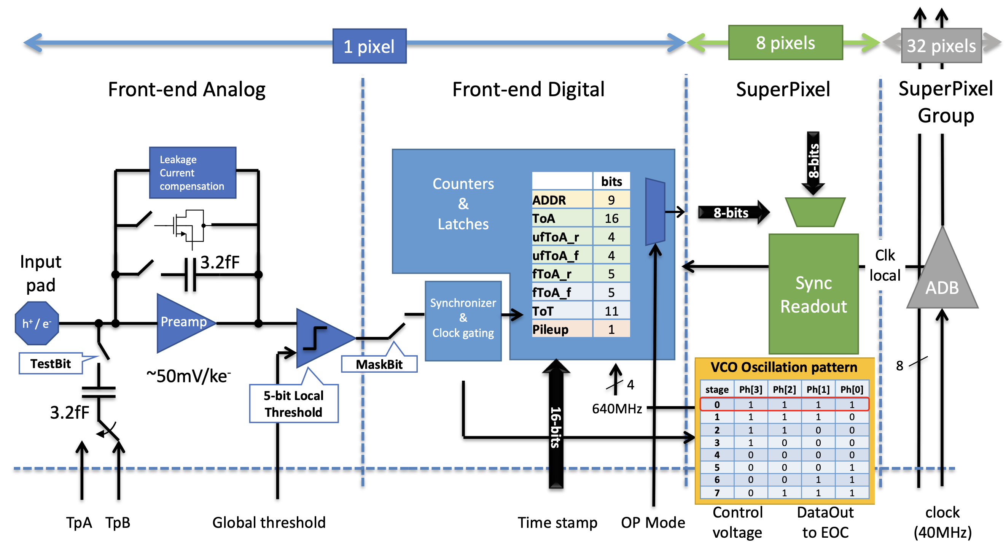
Timepix4 pixel architecture

Slide 15
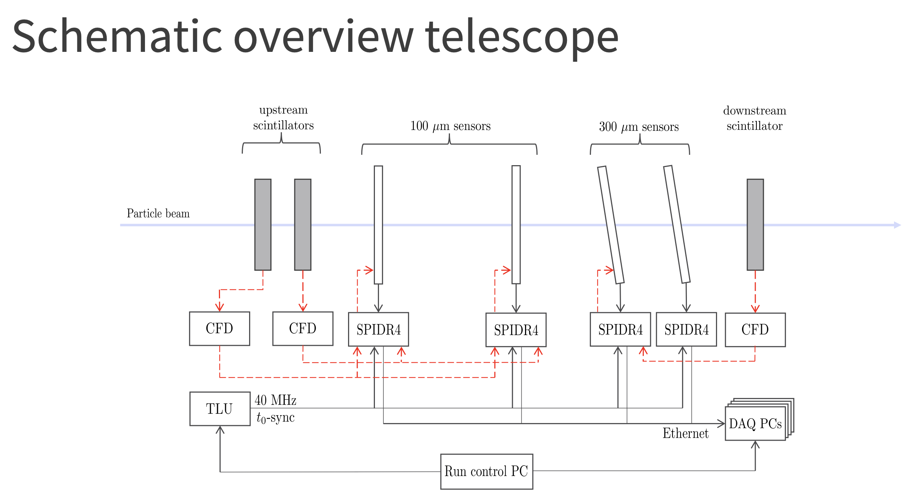

Slide 16
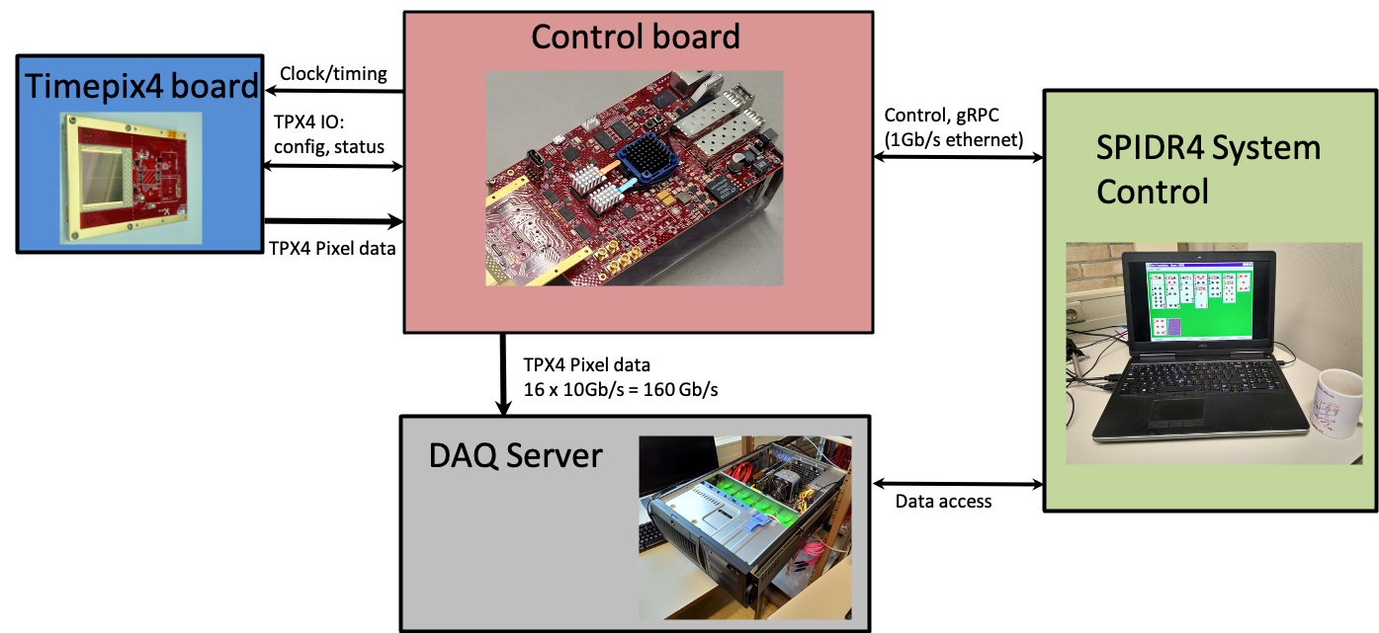
SPIDR4 full rate
Full timepix4 rate requires a powerful DAQ server, per chip
Fills a 1 TB disk in < 1 minute …

