Slide 1



Task 7.2: Eco-friendly gas mixtures for RPCs
Davide Piccolo and Beatrice Mandelli
on behalf of the EcoGas@GIF++ Collaboration
CERN
AIDAinnova Annual Meeting
29 March 2022

Slide 2
GHG emissions at CERN and EU regulation
CERN GHG emissions from particle detectors
Main contributor is C2H2F4 used for ALICE, ATLAS and CMS RPC systems
Emissions mainly due to leaks at detector level (fragile connectors) in ATLAS and CMS.
Campaign for leaks reparation in LS2
Leaks at detector level
Reparation during LS2
RPC gas mixture
~95%C2H2F4 - ~5%iC4H10 - 0.3%SF6
European Union “F-gas regulation”:
Limiting the total amount of the most important F-gases that can be sold in the EU from 2015 onwards and phasing them down in steps to one-fifth of 2014 sales in 2030.
Banning the use of F-gases where less harmful alternatives are widely available.
Preventing emissions of F-gases from existing equipment by requiring checks, proper servicing and recovery
EU HFC Phase down
LHC RUN 2
LHC RUN 3
LHC RUN 4
Prices are increasing in EU and availability in the future is not known.
Reduction of use of C2H2F4 is fundamental for next LHC Runs and future applications
Beatrice Mandelli
29 Mar 2022

Slide 3
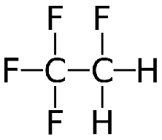
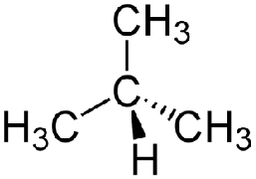
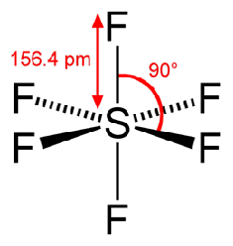

The RPC gas mixture
~95%
4-5%
0.3%
+
+
C2H2F4: GWP 1430
SF6: GWP 22800
iC4H10: GWP 3.3
RPC gas mixture used in ATLAS and CMS experiments (very similar for ALICE)
GWP of the gas mixture: 1430
It is fundamental to search for new eco-gases for RPC detectors
for LHC and not-LHC experiments as well as for future experiments
Hydro-Fluoro-Olefin (HFO)
C=C double bond
R134a
(C2H2F4)
GWP 1430
HFO-1234ze
(C3H2F4)
GWP 6
fluorine-containing
hydrogen-containing
New eco-friendly liquids/gases have been developed for industry as refrigerants… not straightforward for RPC operation
Beatrice Mandelli
29 Mar 2022

Slide 4
AIDA WP 7.2 eco-gas studies
Deliverable:
Report on performance studies of several eco-friendly gas mixtures
for RPCs operated at different background conditions
Motivation
Studies in the AIDainnova Task WP 7.2
Different RPC communities testing eco-friendly gases
Up to now no eco gas mixture was found to fulfil requirements for already installed RPCs at LHC
    Layout is fixed, not possible to change FEB and HV cables
It is fundamental to search for new eco-gases for RPC detectors for LHC and not-LHC experiments as well as for future applications
Identification if suitable eco-friendly gas mixture for RPC operation under gamma irradiation
Long term performance studies on RPC detectors operated under gamma irradiation
Detector performance with muon beam and gamma background
F-based impurities production measurements
The ECOGAS@GIF++ collaboration is a joint effort between
CERN Gas Team, ATLAS-RPC, CMS-RPC, LHCb-SHIP communities
Beatrice Mandelli
29 Mar 2022

Slide 5
Institutes involved in the task
Institute | Main contact person
CERN * | Beatrice Mandelli
INFN LNF * | Davide Piccolo
INFN Bari | Alessandra Pastore
INFN Bologna | Davide Boscherini
INFN Roma | Barbara Liberti
INFN Torino | Alessandro Ferretti
Ghent University | Michael Tytgat
*Beneficiaries
Beatrice Mandelli
29 Mar 2022

Slide 6
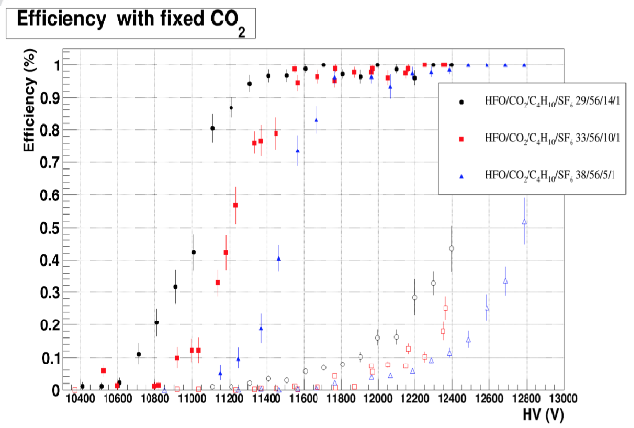
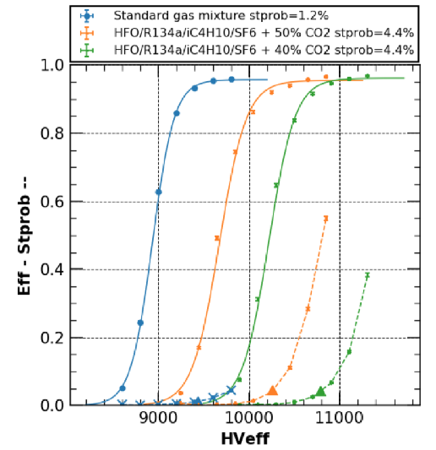
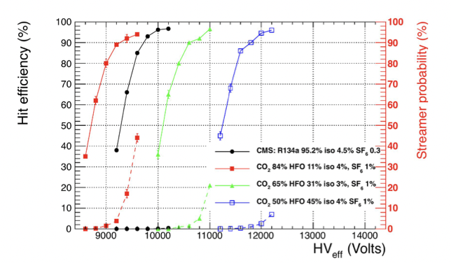
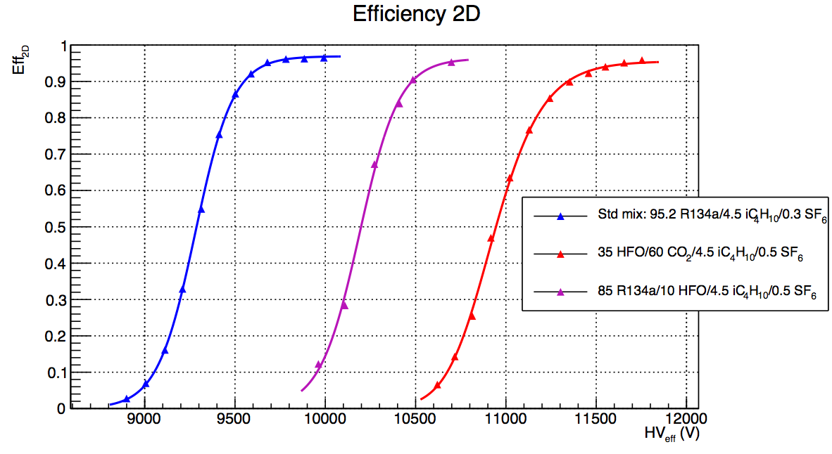
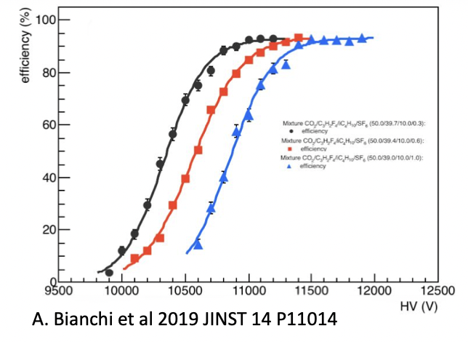
Laboratory results from RPC community
RPC community is testing eco-friendly gas mixtures since several years
Until now no eco-friendly gas mixtures have been found to fulfil the requirements for already installed RPCs at LHC experiments
Good alternatives have been found with a HFO-CO2 based gas mixture
Studies are still on-going in the different institutes
    Each laboratory is working independently
D. Piccolo (INFN Frascati) for CMS group
L. Congedo (Univ. Bari) for LHCb/SHIP group
G. Proto (Univ. Roma) for ATLAS group
G. Rigoletti (CERN) for CERN group
RPC long-term operation with eco-friendly gas mixtures under high background radiation and possible ageing effects must be investigated
AIDAinnova WP 7.2 eco-gas studies
Beatrice Mandelli
A. Bianchi (Univ. Torino) for ALICE group
29 Mar 2022

Slide 7
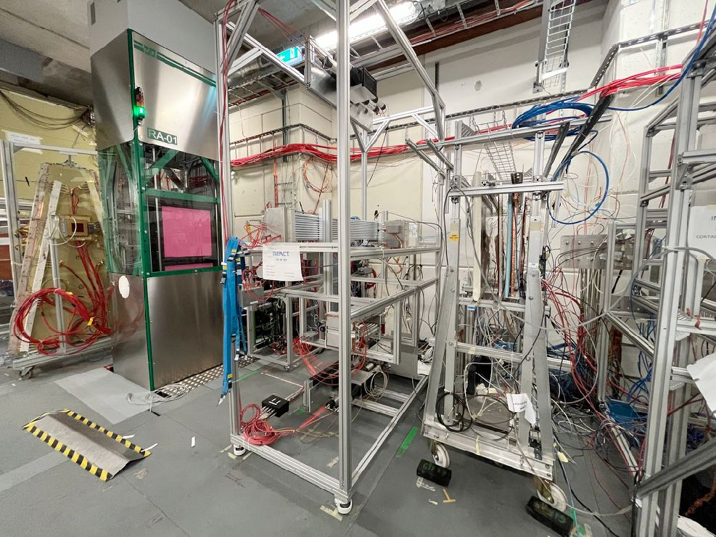
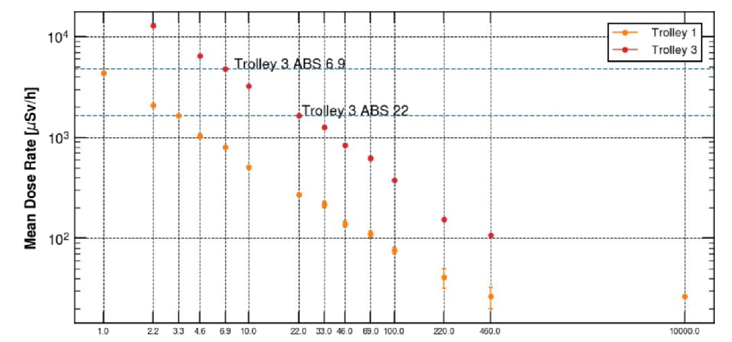
Set-up at GIF++
Set-up installed at GIF++
    12.2 TBq ¹³⁷Cs + H4 SPS beam line
Gas mixer unit to provide up to 4 component gas mixture (humidified)
    C2H2F4, iC4H10, SF6, CO2, Ar, HFO
ECO1: CO2 50%, HFO 45%, iC4H10 4%, SF6 1%
ECO2: CO2 60%, HFO 35%, iC4H10 4%, SF6 1%
ECO3: CO2 69%, HFO 25%, iC4H10 5%, SF6 1%
RPCs under test: Alice (2mm), EP-DT (2mm), CMS (2mm), CMS-KodelC (1.4mm), LHCb/SHIP (1.6mm), ATLAS (2mm)
Aging studies
    Monitoring of currents
Detector performance (test-beam)
    CMS FEB for CMS RPC
    ALICE FEB FEERIC for ALICE and LHCb/SHIP RPCs
    Dedicated digitizer for EP-DT and ATLAS RPCs
trolley 1 at 6 m
trolley 3 at 3 m
Beatrice Mandelli
29 Mar 2022

Slide 8
AIDAinnova activities of the first year
Aging studies
Several months under irradiation with ECO1
Chambers under test: Alice (2mm), EPDT (2mm), CMS (2mm), CMS-KodelC (1.4mm)
Test-beam
Participation in 3 test-beam periods (July, September, October 2021)
Tested STD, ECO2 and ECO3 gas mixtures
Chambers under test: Alice (2mm), EPDT (2mm), CMS (2mm), CMS-KodelC (1.4mm), LHCb/SHIP (1.6mm), ATLAS (2mm)
Fluoride measurements
Tested STD, ECO2 and ECO3 gas mixtures
Chamber under test: EPDT (2mm)
Beatrice Mandelli
29 Mar 2022

Slide 9
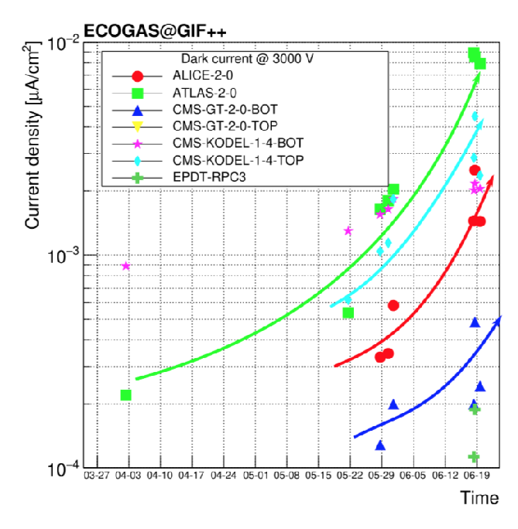
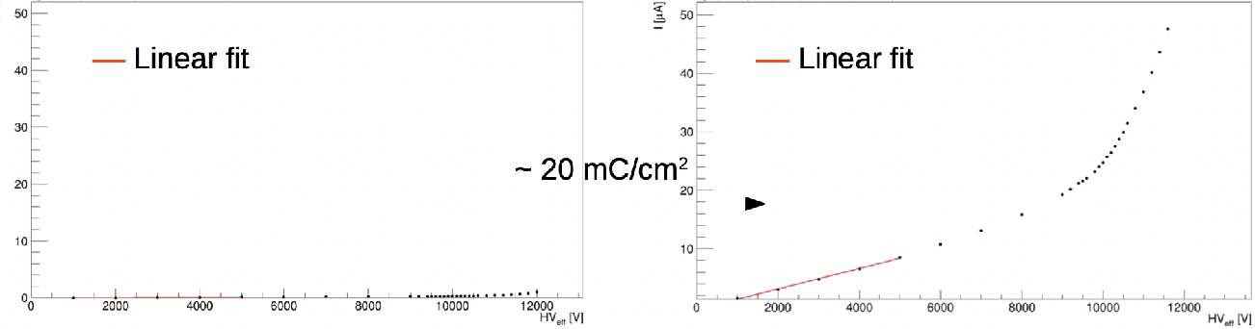
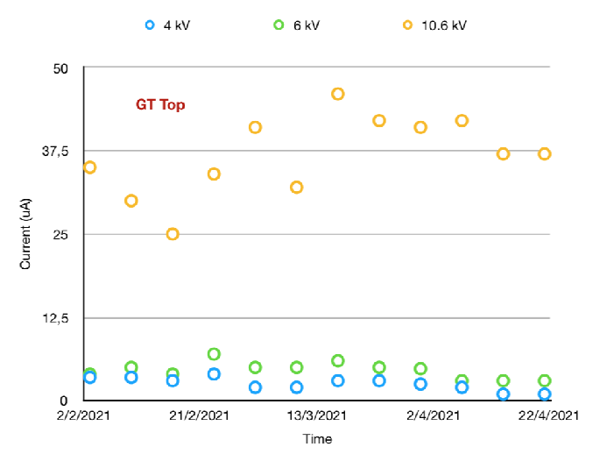
Aging studies with ECO1
Long-term detector performance (ageing test) at GIF++
Monitoring of physics currents,
dark and ohmic currents
Integrated ~ 20 mC/cm²: increase in dark current is visible (both ohmic and physics)
PoS(EPS-HEP2019)164
ALICE RPC 2mm
ALICE RPC 2mm
Before irradiation
After irradiation
CMS RPC 2mm
ECO1 discarded and moved to ECO2 (less HFO)
Monitoring of currents during irradiation periods with ECO2 for a brief period before moving to test-beam studies
Beatrice Mandelli
29 Mar 2022

Slide 10
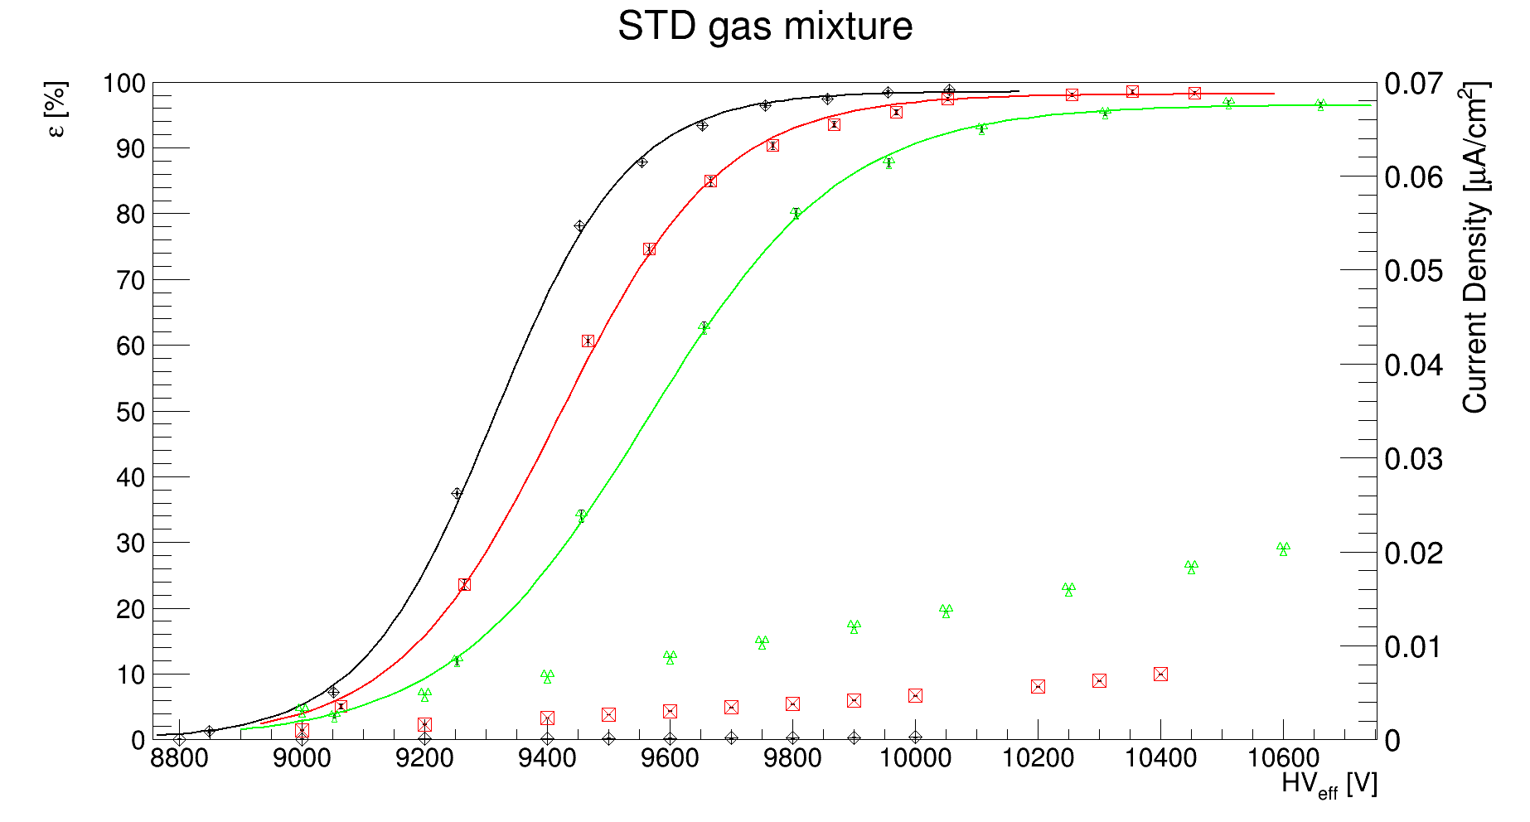
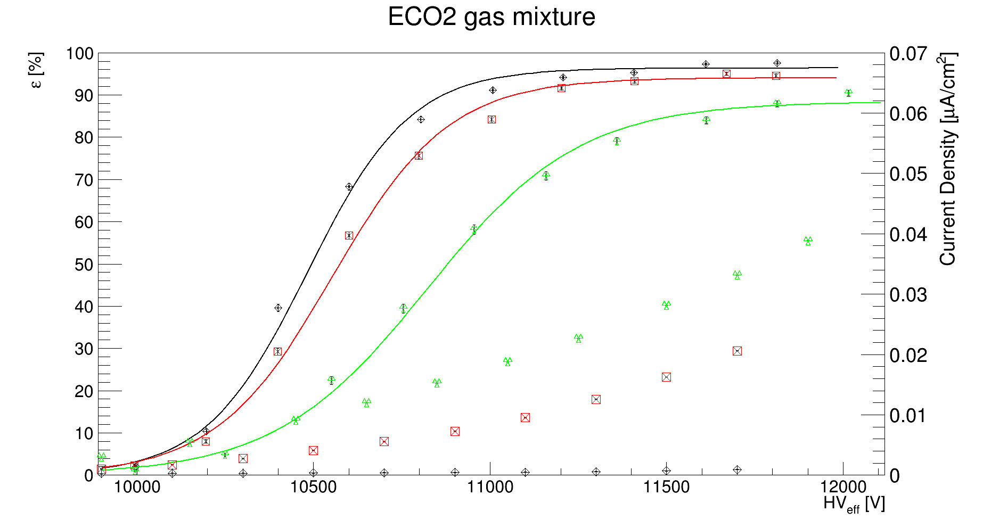
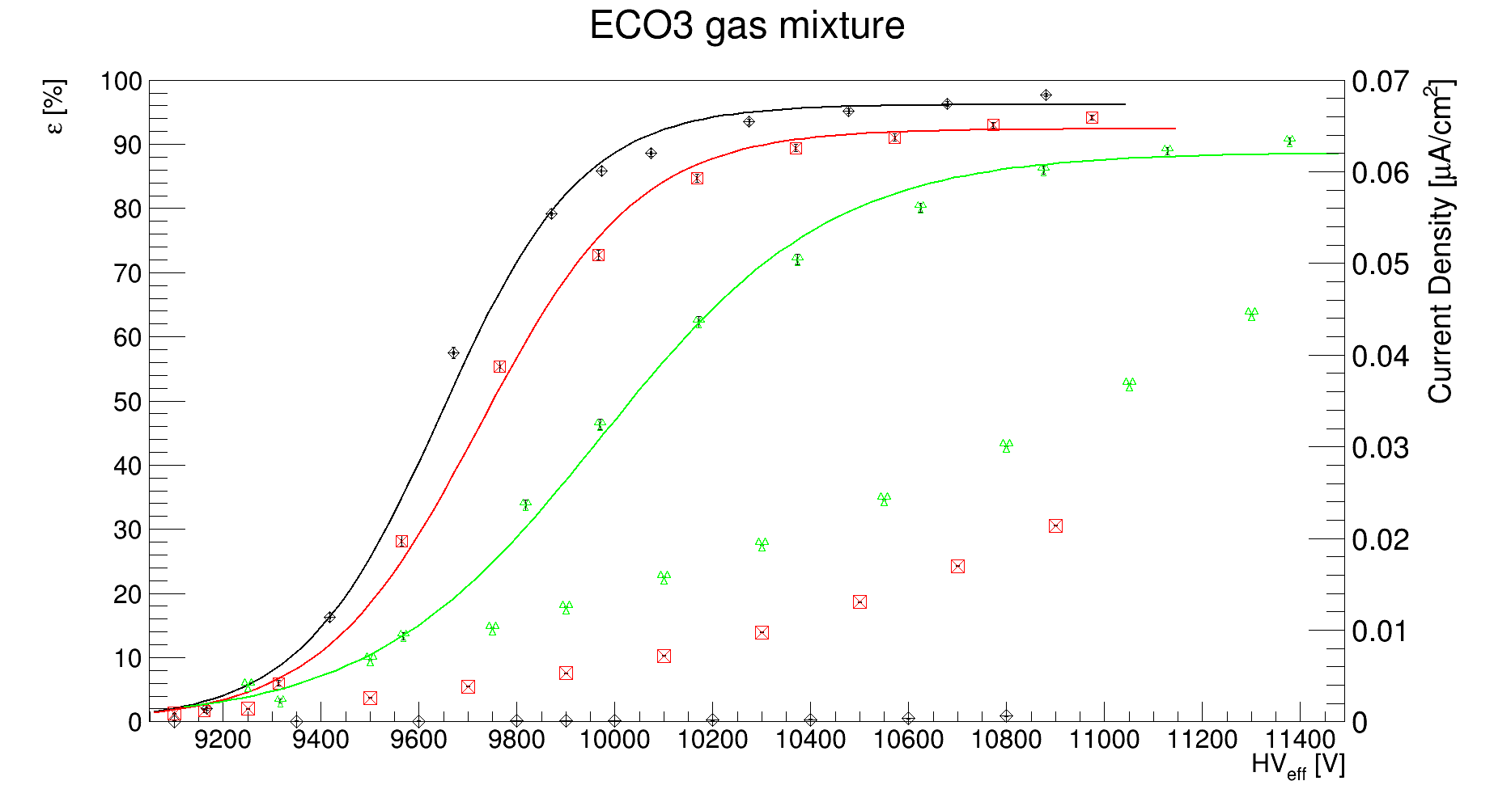
Preliminary results of test-beam studies
RPC performance characterisation at different gamma rates for STD, ECO2 and ECO3
ALICE chamber
c
Data taken at different ABSs
    ABS 10 is equivalent to ALICE running conditions
Higher plateau drop wrt STD with ECO2 and ECO3
For ECO2 and ECO3 the increase of current is a factor 2 wrt STD gas mixture for both ABS
c
- Source off
- ABS 10 (~100 Hz/cm²)
- ABS 2.2 (~350 Hz/cm²)
Beatrice Mandelli
29 Mar 2022

Slide 11
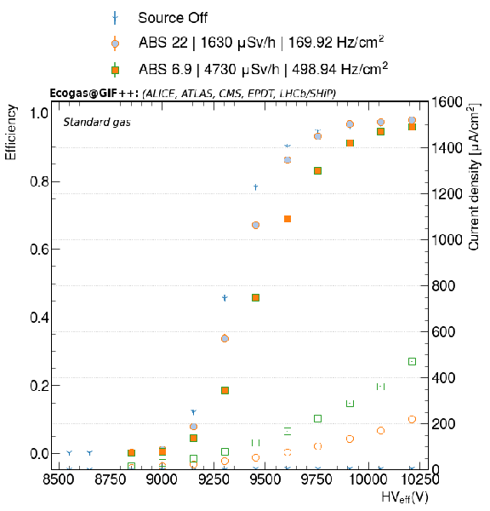
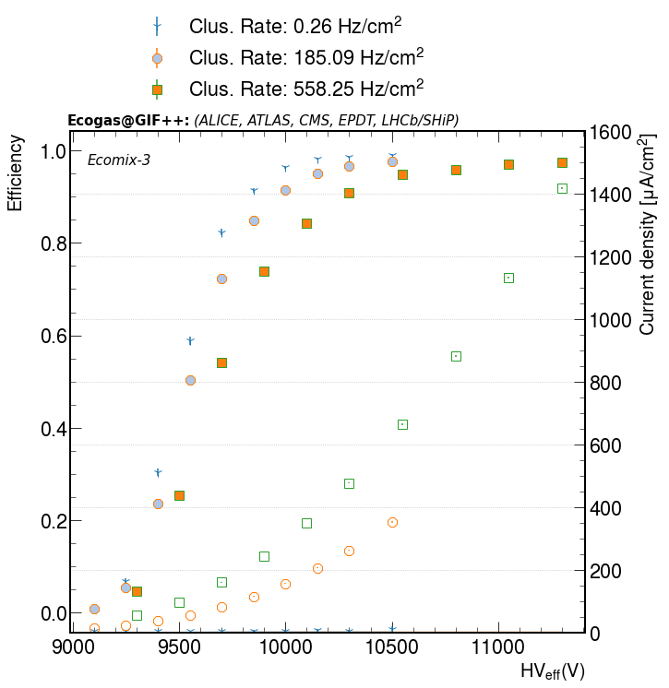
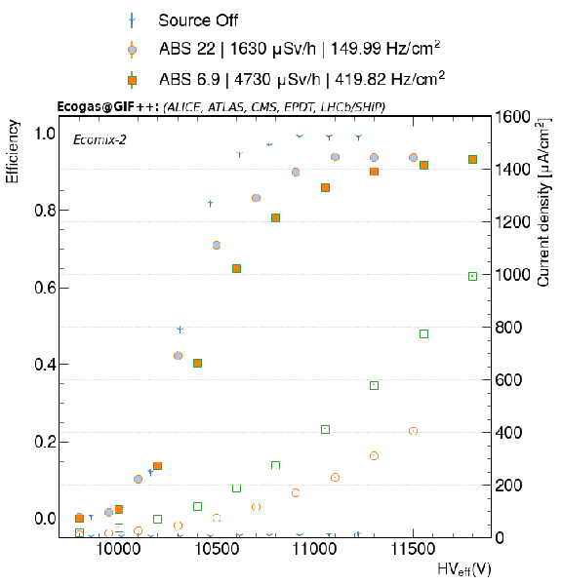
Preliminary results of test-beam studies
RPC performance characterisation at different gamma rates for STD, ECO2 and ECO3
CMS chamber
Data taken at different ABSs
    Up to ~ 600 Hz/cm²
Higher plateau drop wrt STD with ECO2 and ECO3
Higher currents wrt STD gas mixtures
Std:
Eco2
Eco3:
Beatrice Mandelli
29 Mar 2022

Slide 12
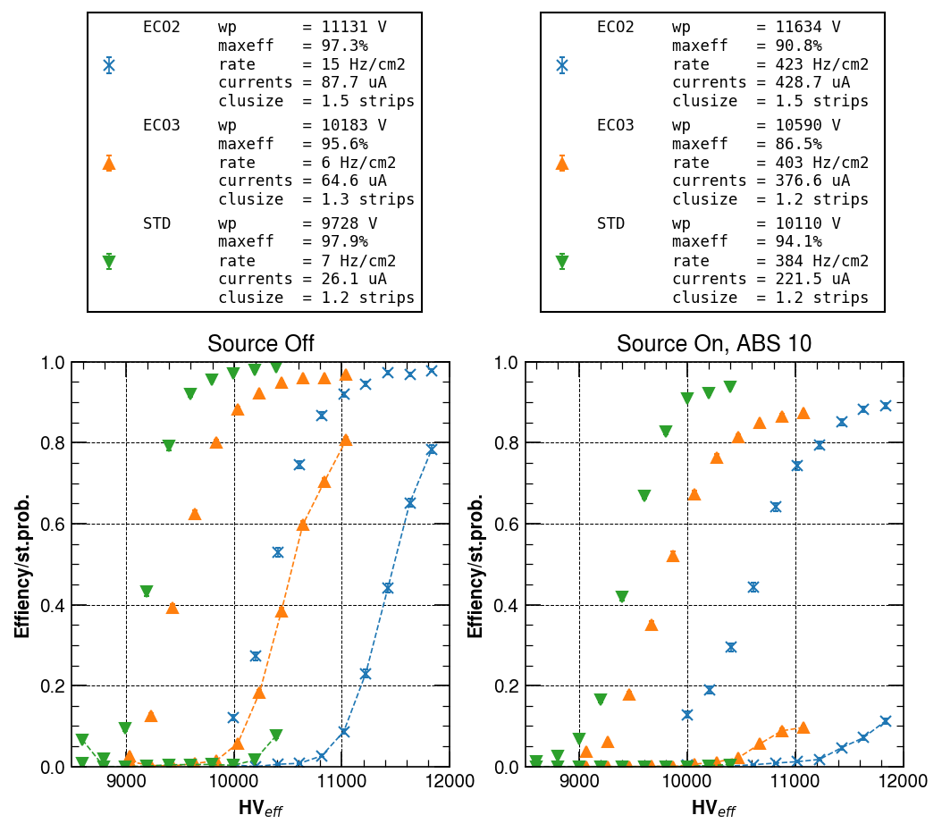
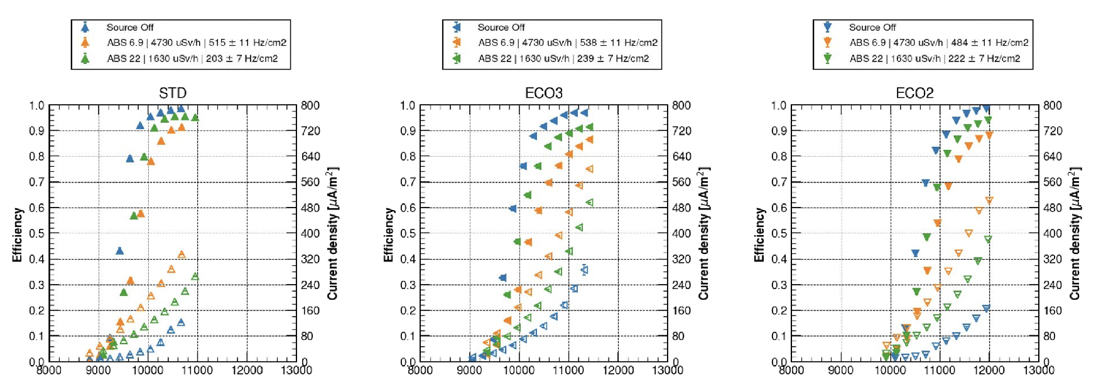
Preliminary results of test-beam studies
RPC performance characterisation at different gamma rates for STD, ECO2 and ECO3
EP-DT chamber
Data taken at different ABSs
    Up to ~ 600 Hz/cm²
Higher plateau drop wrt STD with ECO2 and ECO3
Higher currents wrt STD gas mixture: about a factor 2
Higher streamer probability with ECO2 and ECO3
Beatrice Mandelli
29 Mar 2022

Slide 13
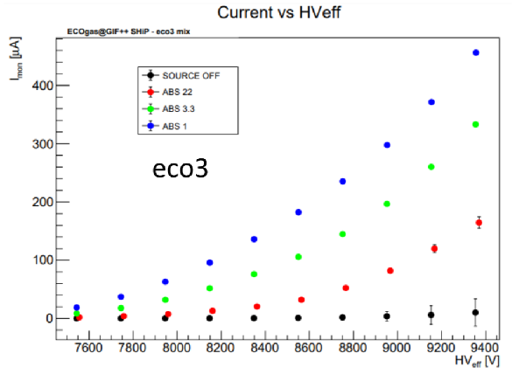
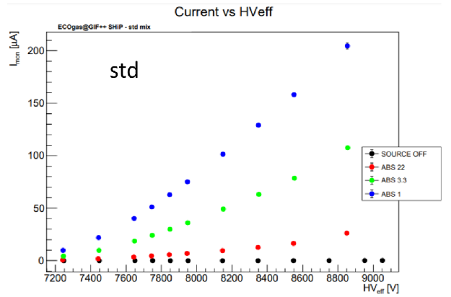
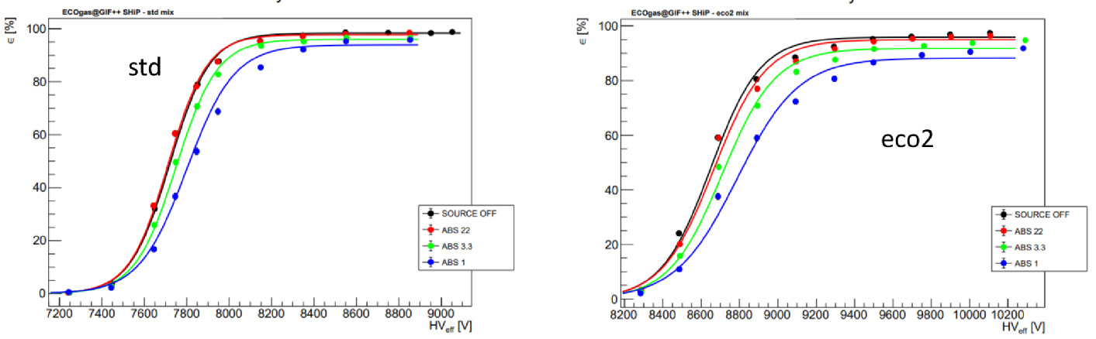
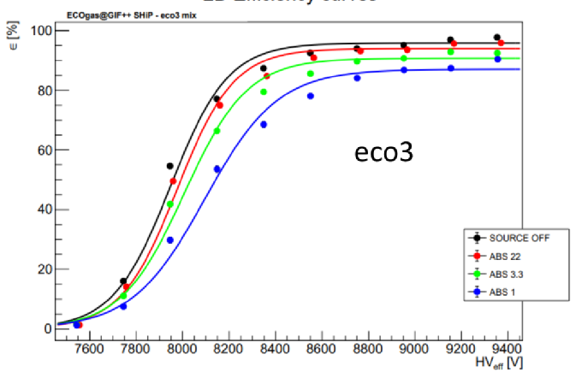
Preliminary results of test-beam studies
RPC performance characterisation at different gamma rates for STD, ECO2 and ECO3
LHCb/SHIP chamber
Data taken at different ABSs
Higher currents with ECO2 and ECO3 gas mixtures (comparable)
    With lower ABS, current ratio ECO/STD decreases
Increase of efficiency drop with ECO2 and ECO3, more visible for ECO3
Beatrice Mandelli
29 Mar 2022

Slide 14
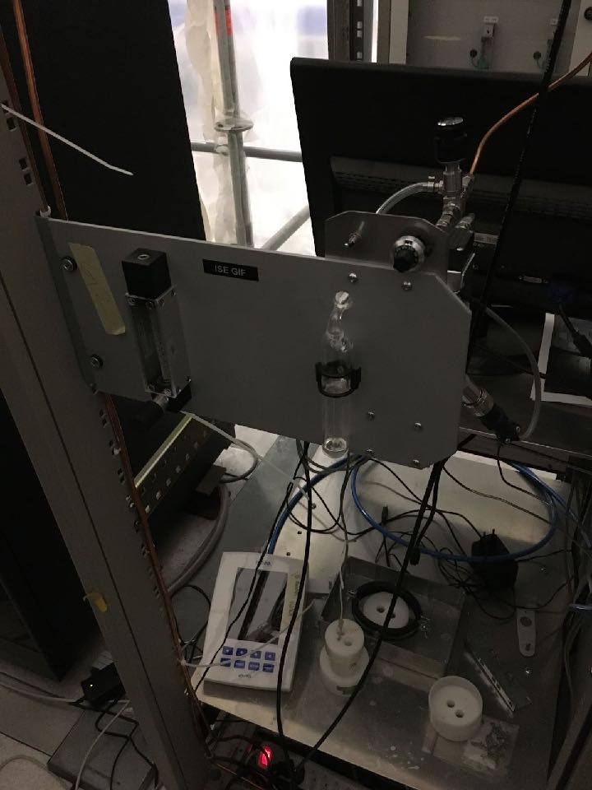
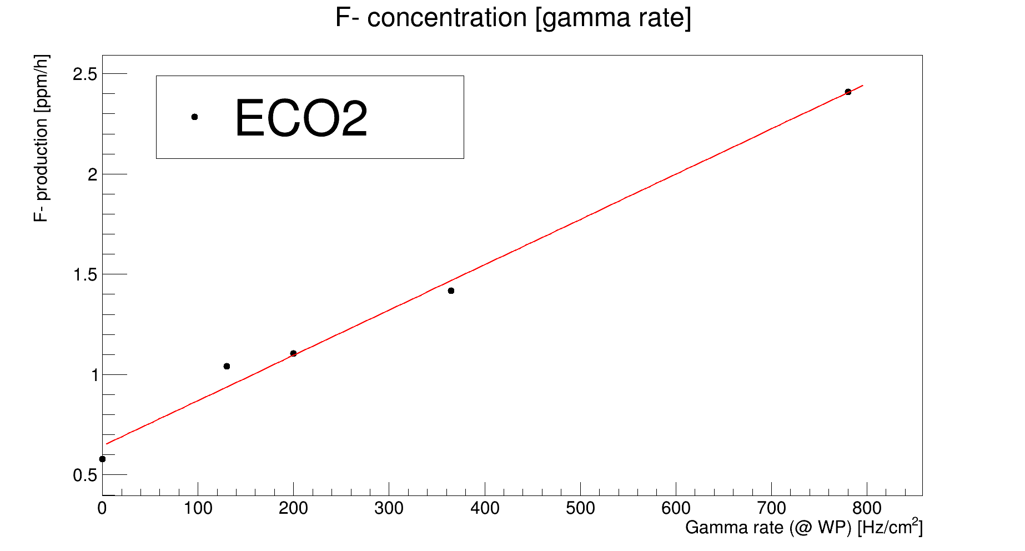
HF measurements
Under the effects of high background radiation and electric field,
freon molecules break into fluorine radicals
Gas module for extraction of gas mixture from irradiated RPC
Compare HF production between Standard and ECO-friendly gas mixtures
Data taken at different ABS and for different gas mixtures
Interpretation of results not straightforward
Work in progress to understand calibration of the setup and to compare results
ISE station for HF measurements
Bottle for the accumulation of HF
Beatrice Mandelli
29 Mar 2022

Slide 15
Conclusions and plans for 2022
Conclusions
At least one RPC chamber for each group
Aging studies of ECO1 show increase of currents for all RPC chambers tested
Two more gas mixtures (ECO2 and ECO3) selected for irradiation campaign
    RPC performance already studied in test-beam
Preliminary HF measurements for STD, ECO2 and ECO3 mixtures
    Results under study
Plans for 2022
Upgrade of the set-up
    New mixer and humidifier
    New trolley (now RPC installed in two different trolleys)
Test-beam campaign
    In July and October 2022
Aging test for ECO2 and/or ECO3
    To start
More systematic HF measurements
Paper in preparation for test-beam results
Beatrice Mandelli
29 Mar 2022

Slide 16
Spares
Beatrice Mandelli
29 Mar 2022

Slide 17
AIDA WP 7.2 eco-gas studies: timeline
Deliverable:
Report on performance studies of several eco-friendly gas mixtures
for RPCs operated at different background conditions
12 months
24 months
36 months
45 months
0. Selection of possible eco-friendly gas mixtures*
1a. Long term operation at GIF++ with different eco-friendly gas mixtures
1b. Detector performance at GIF++ (test-beam)
2. Studies on formation of impurities at GIF++ and impact on RPC operation
on-going
already started
preliminary tests performed
upgrade of set-up necessary
*tests performed in home institute laboratory (not part of WP 7.2)
Beatrice Mandelli
29 Mar 2022

Slide 18
Status of budget
Allocated AIDA Budget: 44 kCHF (CERN) + 30 kEURO (INFN)
12 months
24 months
36 months
45 months
0. Selection of possible eco-friendly gas mixtures
Hiring of PostDoc
1a. Long term operation at GIF++ with different eco-friendly gas mixtures
1b. Detector performance at GIF++ (test-beam)
2. Studies on formation of impurities at GIF++ and impact on RPC operation
In 2022
Upgrade of mixer to study the different eco-friendly mixture selected and allowing to test simultaneously at least 5 chambers (at least one from each experiment/institute): ~20 kCHF
Humidifier (necessary for the operation of RPC detectors): ~10 kCHF
In 2022-25
GC provided by GIF++ infrastructure
F⁻ measurements:~2 kCHF/year
In 2021-25
Expenses in rental of epool material for electronics
Spent ~1 kCHF for minor upgrades
Beatrice Mandelli
29 Mar 2022

