Slide 1
Development of Resistive Electrodes for MPGDs
Task 7.3a
Piet Verwilligen
INFN Bari

Slide 2
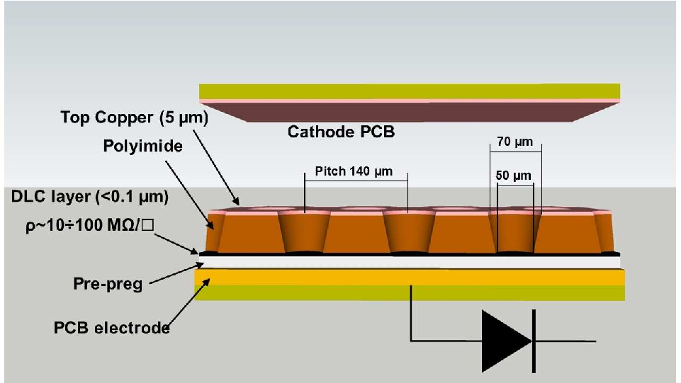
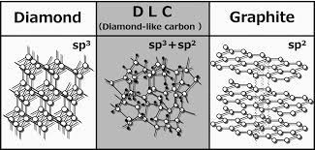
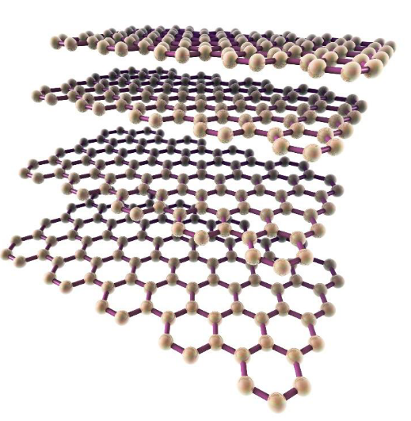
Introduction
  Resistive electrodes improve detector stability of single amplification stage MPGDs (micromegas, μRWELL) and might be the bridge to higher gains (reach wire-chambers gain of ~10⁵) and stable operation
  Resistive electrodes can be used for:
  Discharge quenching: well established
  Signal charge smearing: being studied
  Creation amplification structures: hard, R&D ongoing
  Diamond Like Carbon (DLC) coating techniques are currently explored by several groups to develop new structures and new detectors profiting from coating properties (e.g. robustness, resistivity,…) and on the possibility of controlling them.
  Explore innovative resistive coatings such as
  Multi-Layer Graphene (ML-Graphene) that are very strong, have high conductance and low material budget

Slide 3
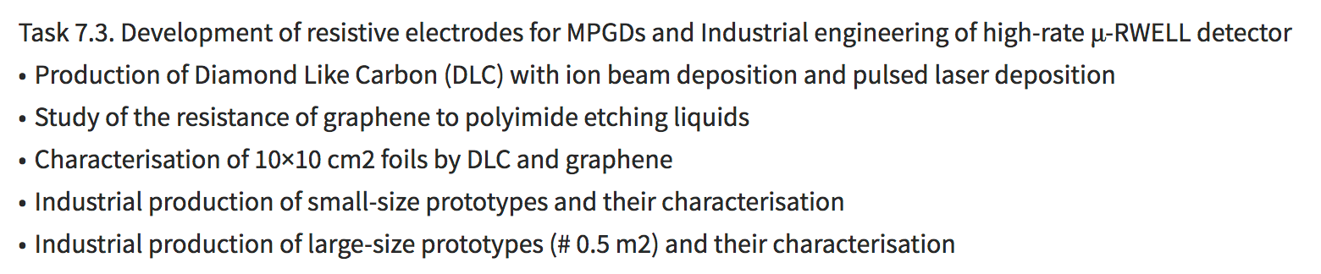

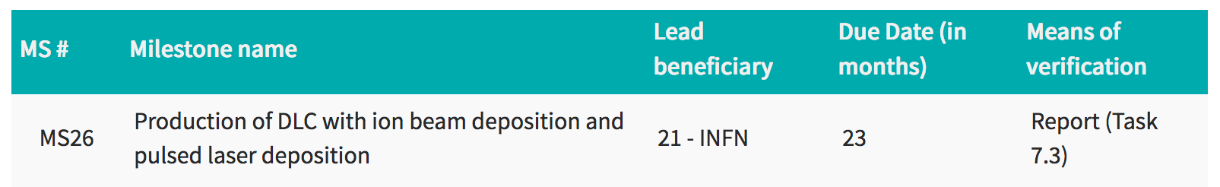
Work within AIDAinnova

Slide 4
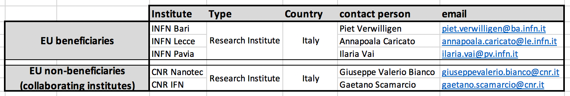
Partners
Benificiaries:
INFN Bari: Ion Beam Deposition DLC, Detector Design & Testing, Task Leader
INFN Lecce: Pulsed Laser Deposition DLC
INFN Pavia: Detector Testing
AIDA innova collaborators (not included in Proposal, but essential contributors):
CERN: Micro-Pattern Technology (MPT) Workshop: Rui De Oliveira
Collaborating Institutes:
CNR Nanotec (Bari) ML-Graphene Deposition, ML-Graphene Etching
CNR IFN (Bari) Photo-Lithography, Patterning
Futher possibilities (already ongoing collaboration within INFN R&D activities)
CNR Nanotec (Lecce) Photo-Lithography, Patterning, DLC Etching
Non-EU close contacts: USTC (Hefei, CN) – Magnetron Sputtering - Resistive DLC collab RD51

Slide 5
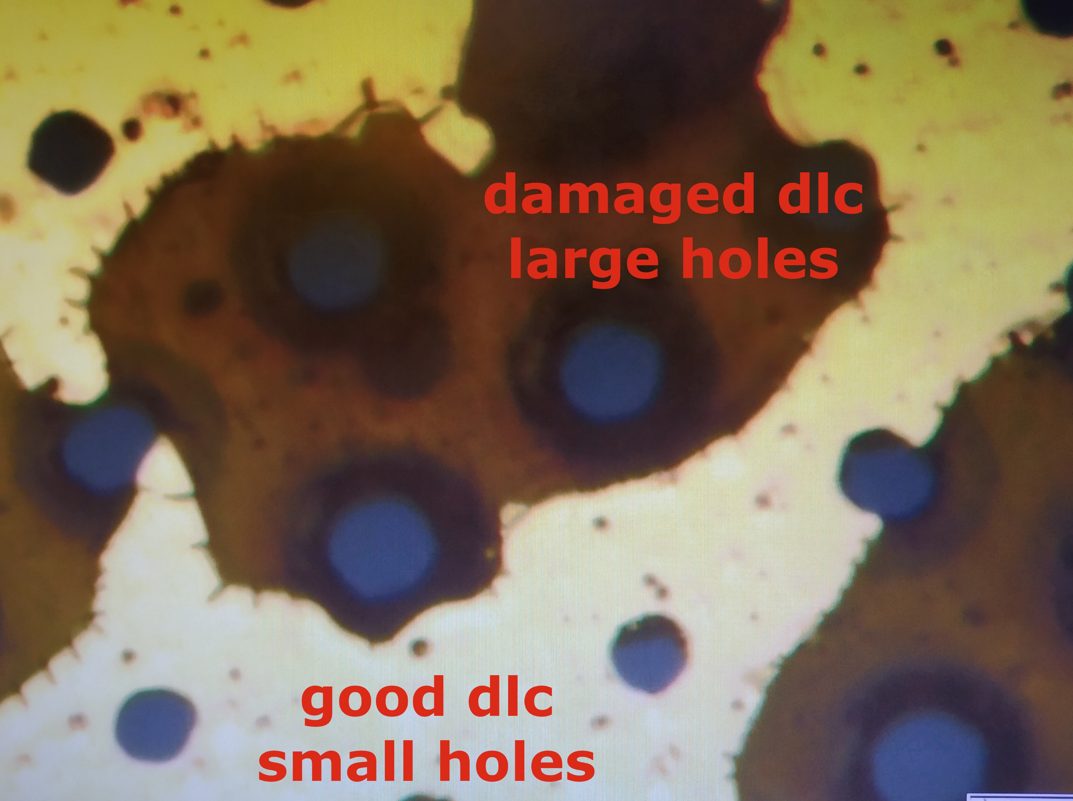
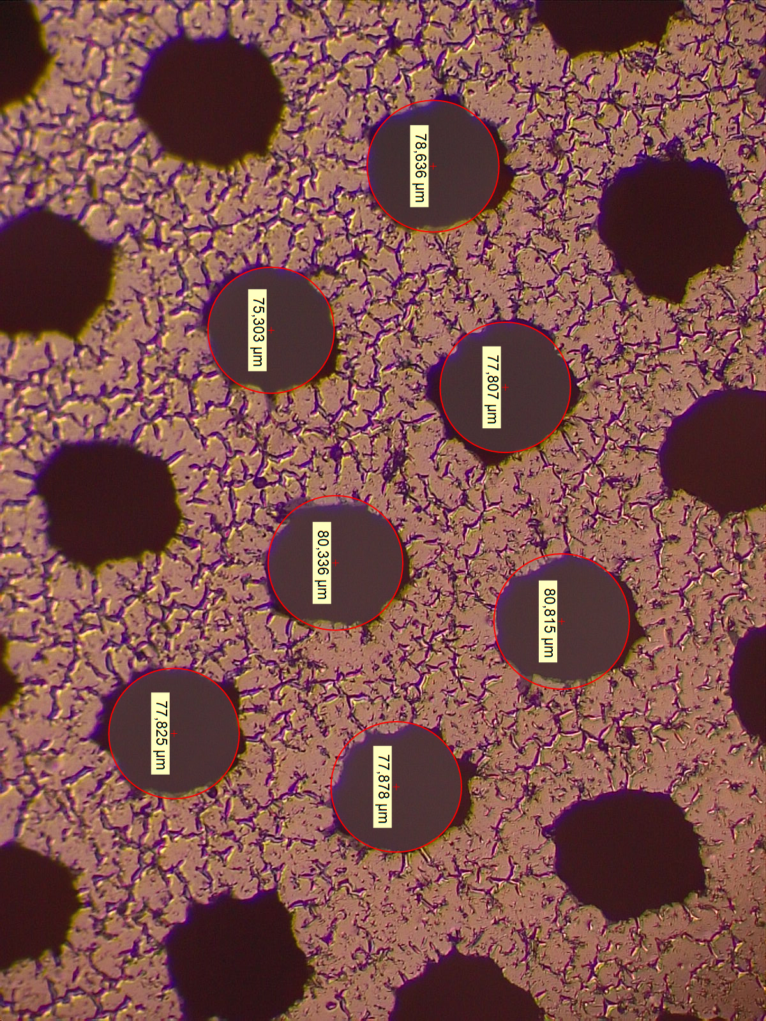
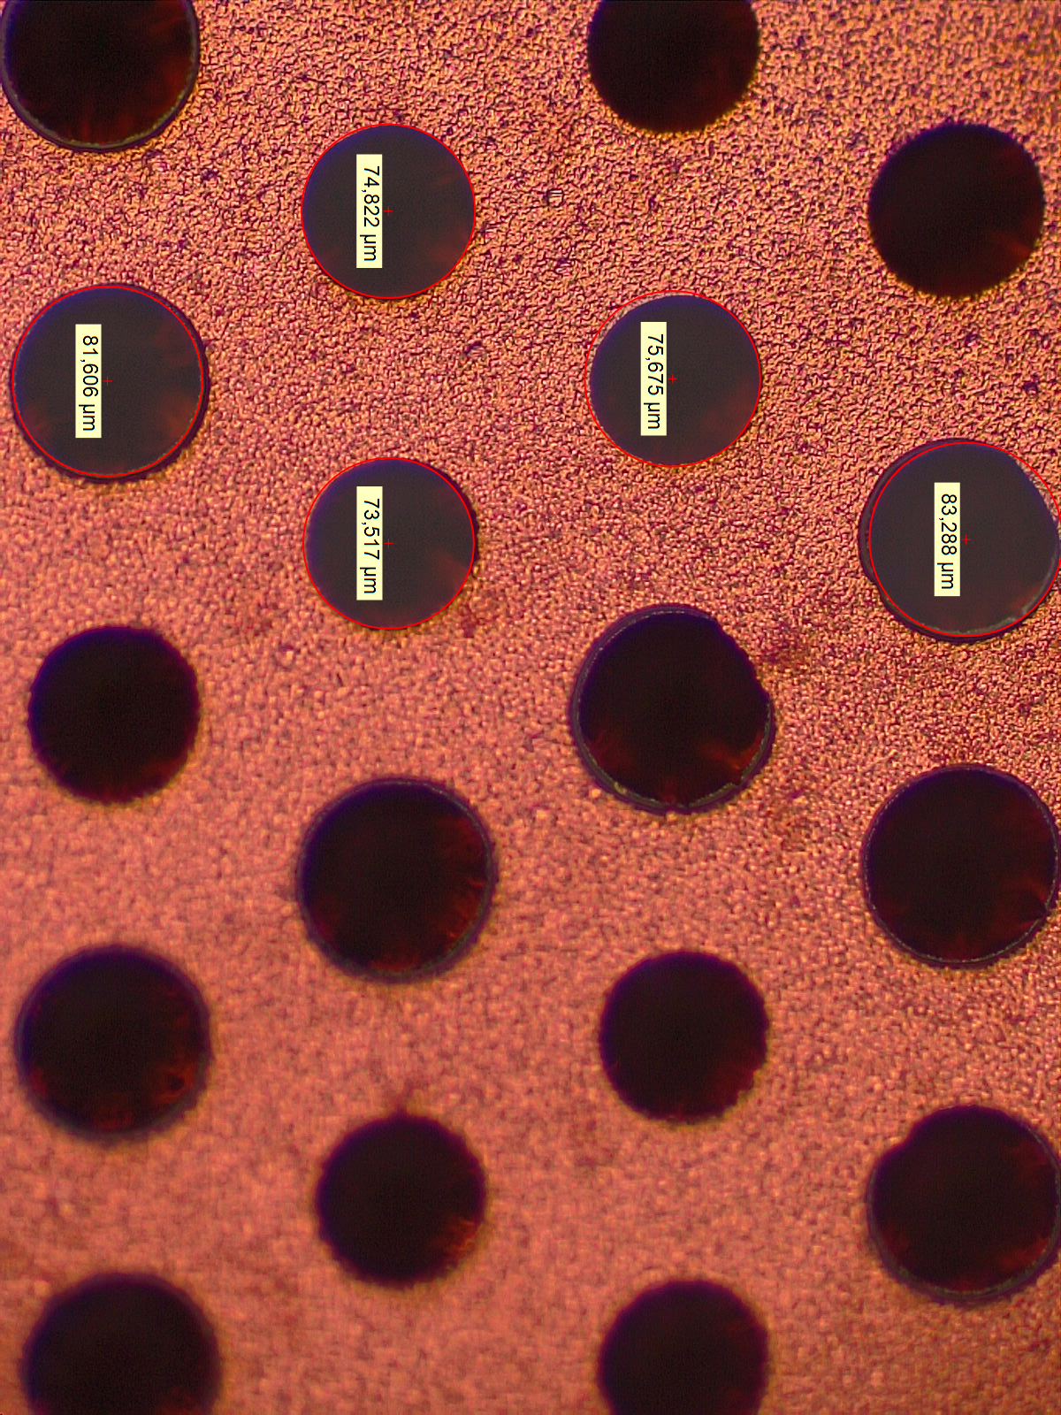
Resistive Challenges
Challenging to make good Amplification structures out of Flexible Cu Clad Laminates (FCCLs) with DLC coating
  Standard Production: Magnetron sputter
  First problem: DLC delaminates
  Solved: Good adhesion found with Ion Beam & Pulsed Laser Deposition
  Solved: for Magnetron: Plasma treatment
  Second problem: Cu delaminates
  Solved: 10nm Cr / Ti layer glues Cu to DLC
  Third problem: DLC (magnetron sputter)
  is not smooth around holes, limits Gain
  Will verify with Ion Beam / Pulsed Laser
  Will investigate “DLC-breaking” methods
  Will investigate alt. production schemes
Latest-gen DLC GEM
Regular
Cu GEM

Slide 6
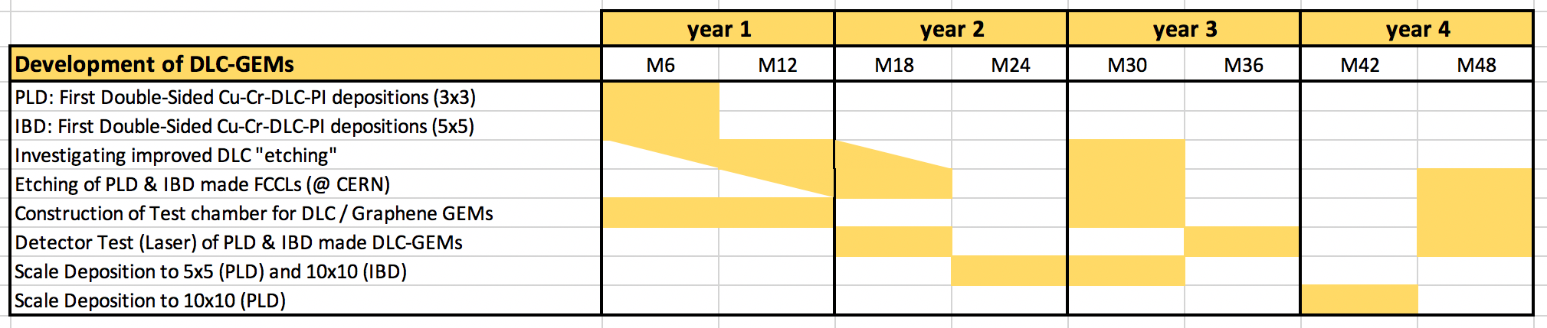
R&D on DLC Electrodes
First Task: High-Resistive GEM with DLC electrodes
Pulsed Laser Deposition (PLD) and Ion Beam Deposition (IBD) of DLC on Polyimide has already started within INFN project framework
    However work so-far concentrated only on single-layer depositions
    Aim in this task is to make a double sandwich layer to produce GEM-foils
    First concentrate on small size foils (3 x 3 cm²) and (5 x 5 cm²) before moving to final 10 x 10 cm² foils. R&D required to go to cover uniformly large surface
    Test setup to verify Gain of Detector with UV Laser
    Milestones: Report expected at month 23
    Deliverables: none

Slide 7
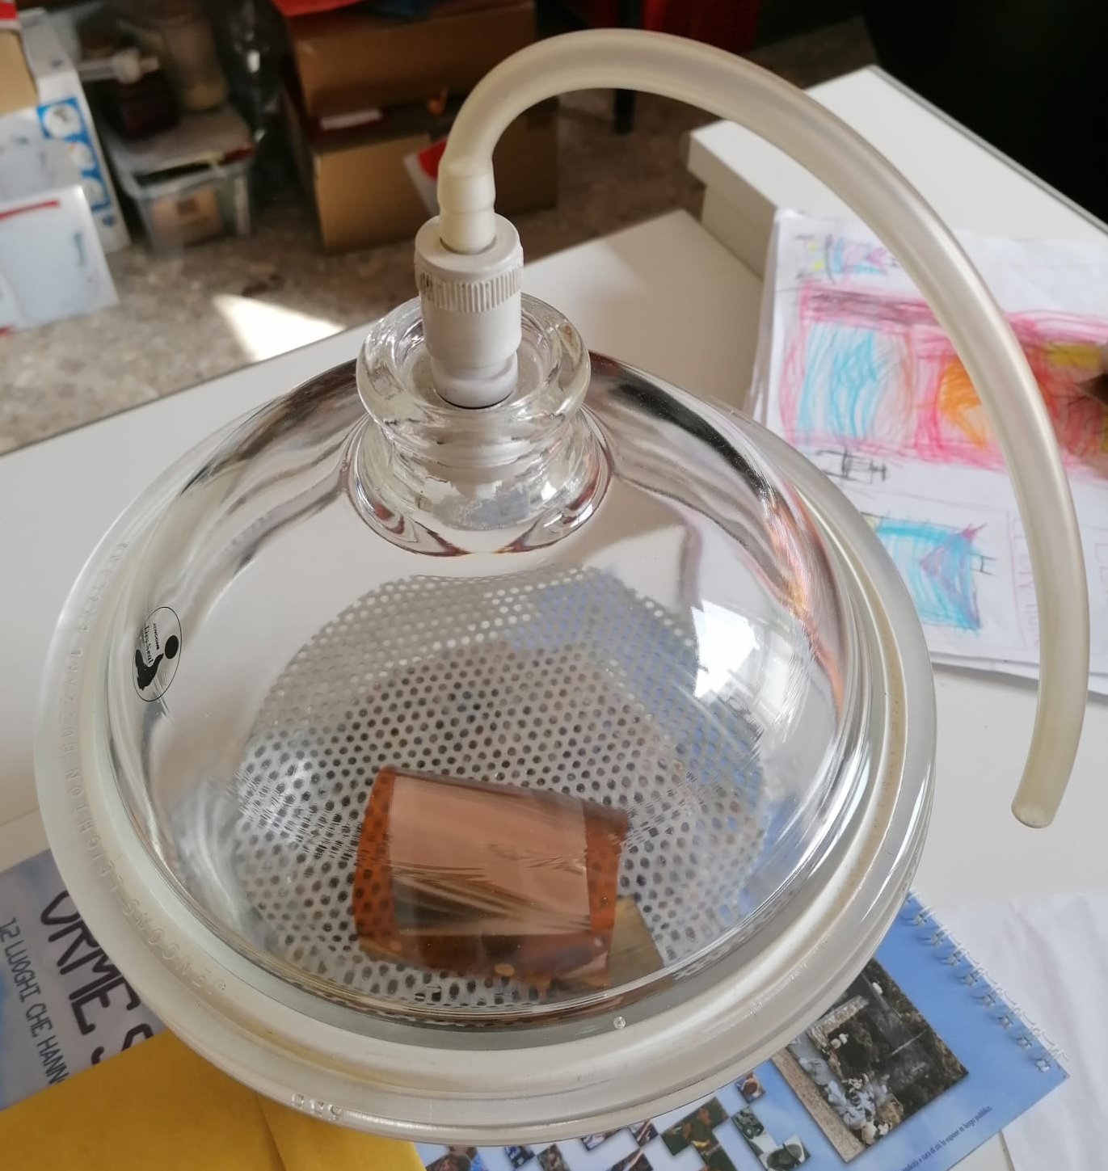
R&D on DLC Electrodes
First Task: High-Resistive GEM with DLC electrodes
Test chamber ready
Test setup ready
PLD foils up to 5x5 cm² produced
IBD mask produced for 10x10 cm2
– first test ongoing
Etching tests at CERN:
- crucial point … sometimes long time of feedback between expedition of foil and actual test in CERN MPT lab. Covid: difficulty to travel/discuss
- previously the electroplating on 100nm Cu failed (Cu-Oxide formation)
- first small break through in Jan ‘22: PI-DLC-Cr-Cu (500nm): electroplating ok: 9um of Cu thickness obtained – waiting for etching test
- will ship future samples under vacuum
PLD 5x5
IBD 7x7
done
ongoing
done
ongoing

Slide 8
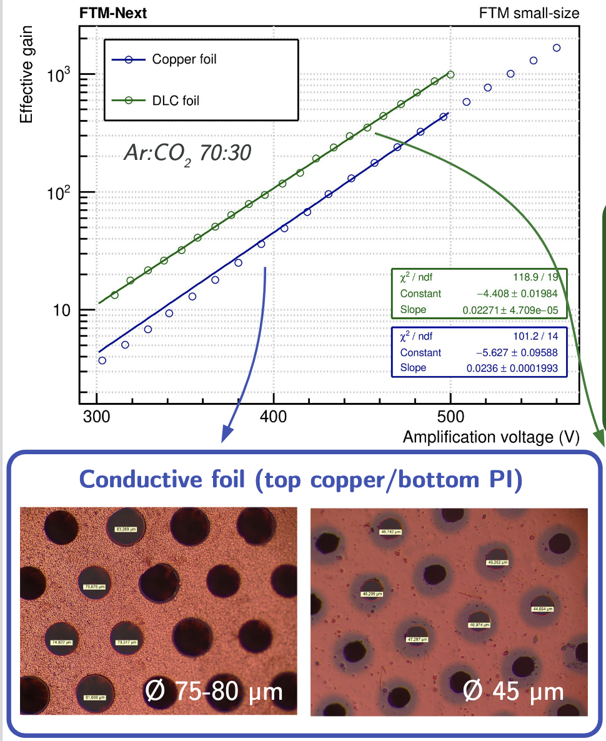
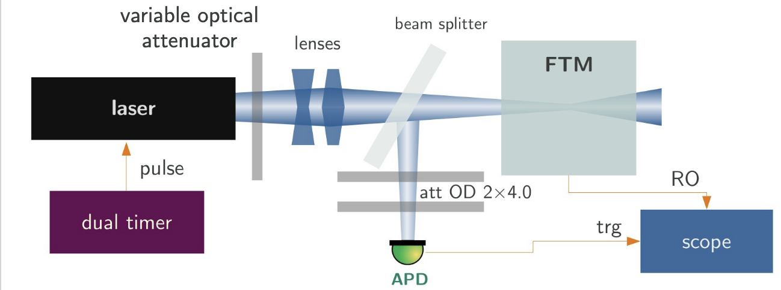
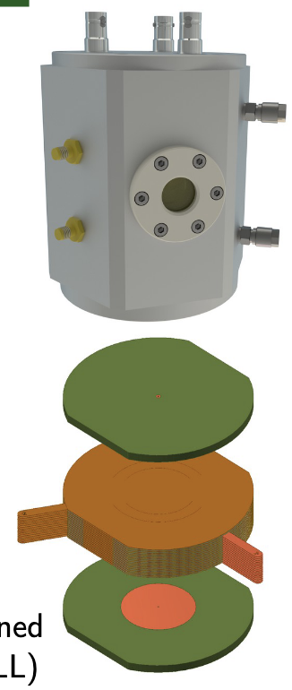
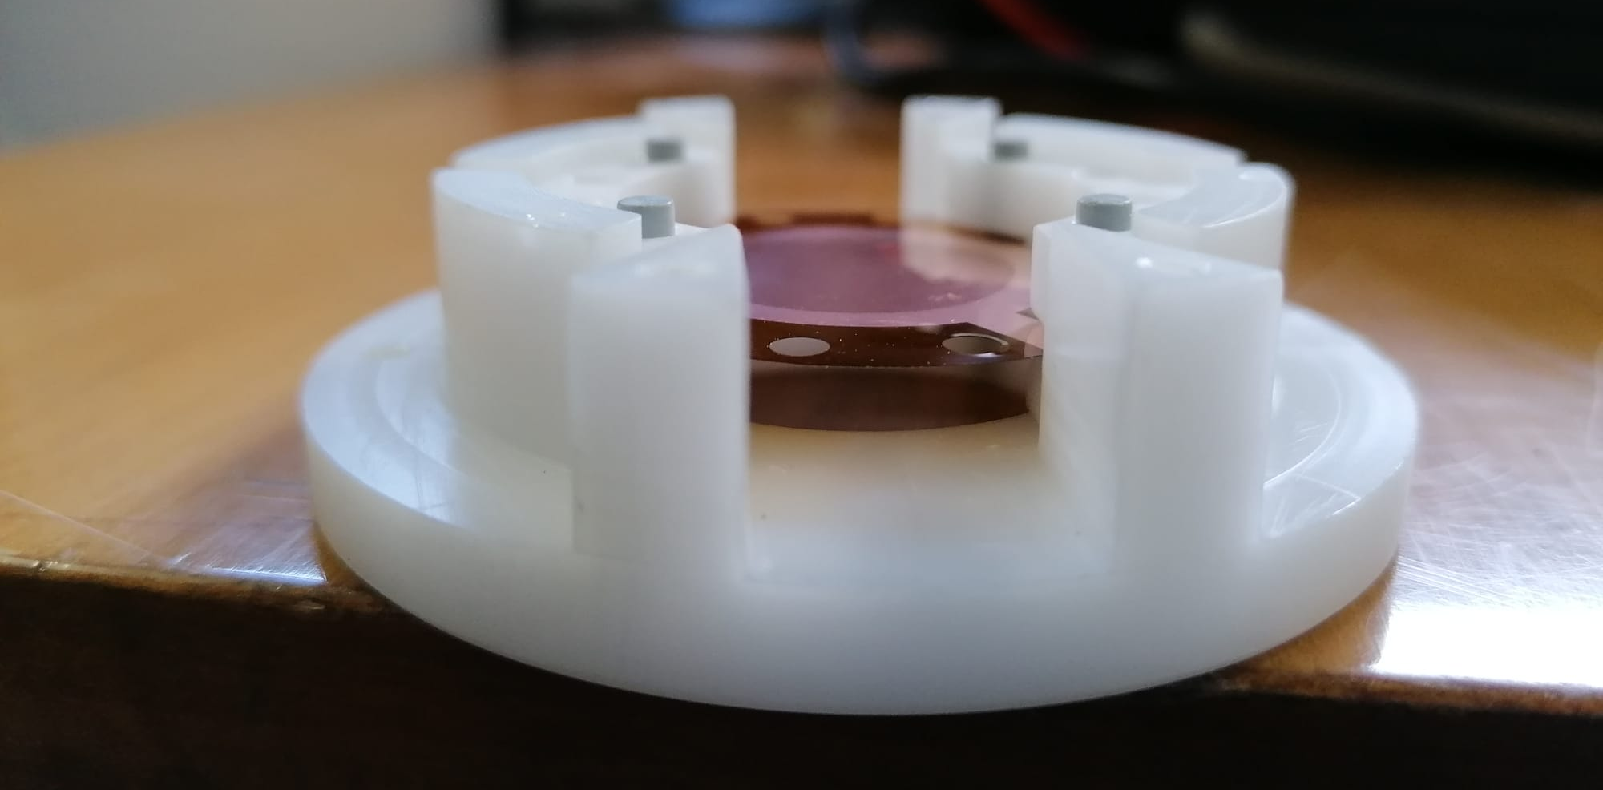
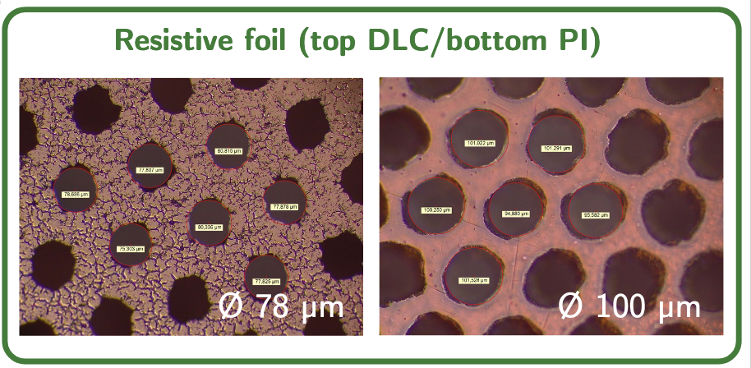
R&D on DLC Electrodes
First Task: High-Resistive GEM with DLC electrodes
Test chamber ready (with Magnetron Sputter DLC test foil inside)
Test setup with UV-laser ready and intesively tested in 2021

Slide 9

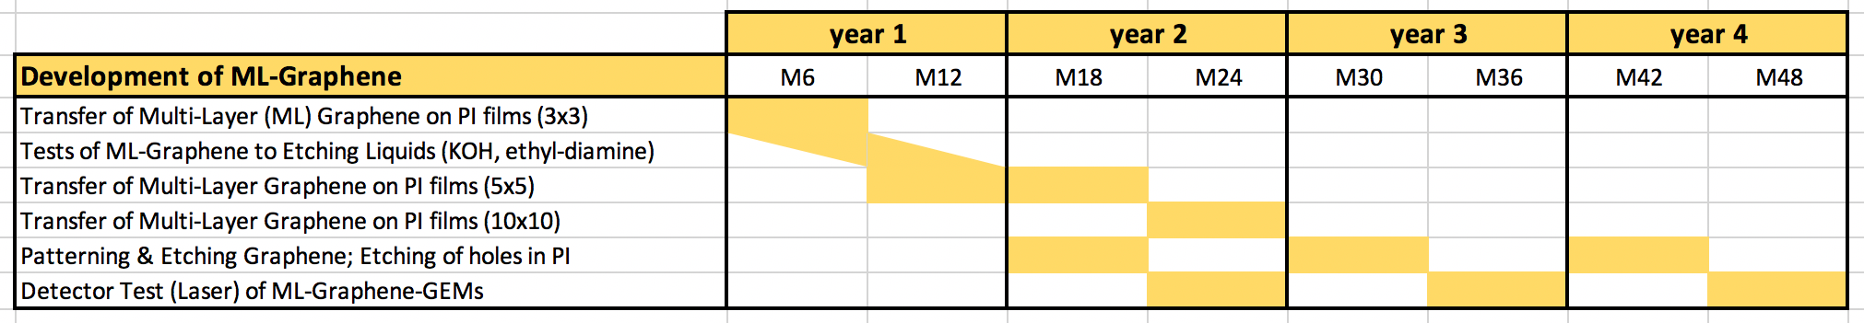
Multi Layer Graphene R&D
Second Task: Low-Resistive GEM (Graphene electrodes)
    Transer of Multi-Layer (ML) Graphene to Polyimide Films
    (specific experience in house of CNR Nanotec (Graphene Factory)
              Verify resistance of ML-Graphene to commonly used Etching Liquids in CERN MPT Workshop (KOH, ethyl-diamine) on small size foils (3 x 3 cm²)
    Transfer ML-Graphene to PI on medium-size (5 x 5 cm²) and experiment Photo-Lithography and ML-Graphene removal through Plasma-etching
    Chemical Etching of ML-Graphene patterned PI
    Test setup to verify Gain of Detector with UV Laser, Xray, Alpha, …
    Thereafter move to large-size (10 x 10 cm²) and repeat entire procedure …
    Milestones: none (but would like to write anyway report on experience)
    Deliverables: none
Activity not ramped up during first year because of need to finish other projects with covid19 delay in ’21
discussing to restart activities this spring

