Slide 1
AIDAinnova first annual meeting
Introductory talk
P. Giacomelli
INFN Bologna

Slide 2
AIDAinnova 1st annual meeting
It is fantastic to be able to see many of you in person!
  It has been a long time since we could meet
  This Annual meeting in person was difficult to foresee only a month ago…
  I do hope that the people who cannot be present here are doing fine in these still rather complicated times
    The pandemic situation has improved but it’s by no means over yet
    The tragic events in Ukraine have had major implications on all of us, but especially on our Ukraine colleagues
It is good to see that many AIDAinnova activities have been up and running in 2021 when the pandemic conditions were pretty bad almost everywhere
  However I believe that one, if not the most, important aspect of AIDAinnova is the Networking and only by meeting in person this can be effectively achieved

Slide 3
AIDAinnova 1st annual meeting
Fortunately the pandemic situation has indeed improved and CERN for example is back to green conditions:
  Effective capacity of meeting rooms is up to 1/2 of the normal capacity
  Cafeteria is open at normal working hours
  No need of special tests to enter Switzerland or France
  No need for masks inside buildings (maybe still a bit early...)
  224 people registered for the AIDAinnova annual meeting
    ~50 in person, rather good number considering the ongoing pandemic and the still present travel restrictions
I remind you that tonight we have the social dinner!

Slide 4
WP13: Blue sky projects
Thin Silicon Sensors for Extreme Fluences
The Silicon Electron Multiplier, a new approach to charge multiplication in solid state detectors
Development of fine-sampling calorimeters with nanocomposite scintillating materials
Wireless Data Transfer for High-Energy Physics Applications
Amendment has been prepared to include new AIDAinnova beneficiaries and partners

Slide 5
Year 1 Scientific/technical reporting
Action | Deadline
Coordination Office to send the reporting templates to the WP Coordinators (+ Y1 S&T report of AIDA-2020) | 1 April 2022
Task Leaders to provide Y1 Task Reports to the WP Leaders | 15 April 2022
WP Leaders to send Y1 WP Reports to the Coordination Office | 25 April 2022
Review by MGT Team and revisions of WP reports if needed | 5 May 2022
Consolidated Y1 S&T Report send to GB for approval | 15 May 2022
Note that AIDAinnova will not have a midterm review

Slide 6
Reporting use of resources in Year 1
Action | Deadline
Coordination Office to send the Y1 IRUS * templates to the financial contacts of all beneficiaries and associate partners | 15 March 2022
Financial contacts to complete and send the Y1 IRUS summaries to the Coordination Office | 15 April 2022
Coordination Office to prepare the consolidated Y1 summary of use of resources by WP and by beneficiary, and send it to the MGT Team for information | 20 April 2022
Coordination Office to send the summary of use of resources to the Governing Board for information, and request approval of the release of the 2nd instalment of the EC pre-financing to the beneficiaries with EC funding exceeding 100 keur | 25 April 2022
* IRUS = Internal Resources Utilisation Summary

Slide 7
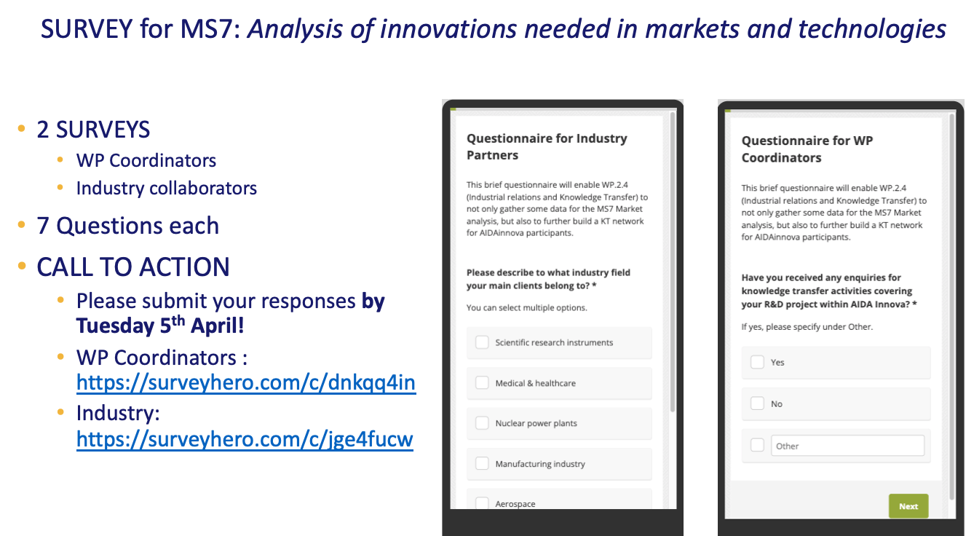
Task 2.4 Industrial relations and KT
Margherita Marini (CERN)

Slide 8
AIDAinnova associated EU projects
We are keeping a close connection with the 2 other Innovation Pilots, LEAPS-INNOV and I.FAST
  We have recently wrote a common document to the EU
  Today we will have presentations by the respective coordinators
  We will give a presentation on AIDAinnova's status and progress at their respective Annual meetings

Slide 9

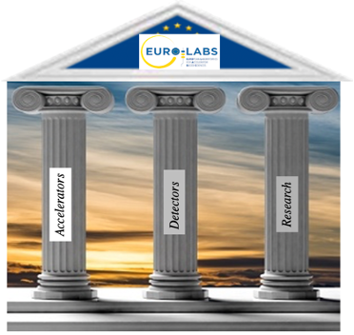
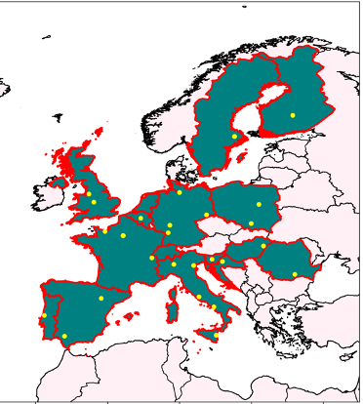
AIDAinnova associated EU projects
Horizon Europe call for Research Infrastructure (RI) services
HORIZON-INFRA-2021-SERV-01-07
EURO-LABS is a consortium of thirty-nine Research Infrastructures (RIs) from twelve countries in Europe
Finland in the north and Italy to south to Romania in the east and Portugal in the west
First joint EU proposal between Nuclear Physics, HEP accelerators and HEP detectors!

Slide 10
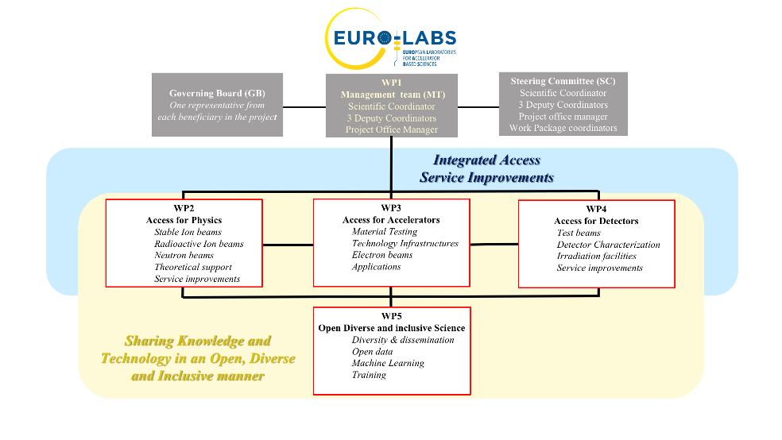
EURO-LABS structure
EURO-LABS is a project that mostly provides funding for Transnational Access (TA) to Research Infrastructures (RI).
For us this means test beams and irradiation facilities.
Total EURO-LABS EU funding: 14.5 M€

Slide 11
WP4: Access for detectors
  CERN
    PS, SPS, IRRAD, GIF++
  DESY
    Testbeam
  PSI
    PiM1, UCN
  RBI
    RBI-AF
  ITAINNOVA
    EMC-Lab
  JSI
    Triga
  IFJ PAN
    AIC-144
  UCL
    HIF-LIF-NIF
  UoB
    MC40
INFN is the coordinating institute of EURO-LABS.
The Project Office (PO) of EURO-LABS will be at INFN Bologna.
P.G. is the Project coordinator and Project Office manager.

Slide 12
EURO-LABS timeline
Deadline of the call: 23/09/2021
Results of the evaluation: 18/01/2022
Grant agreement: 31/03/2022?
Beginning of the Project: 01/09/2022
Duration: 01/09/2022 - 31/08/2026
Budget for WP4: ~2.8 M€ (+25% overheads)

Slide 13

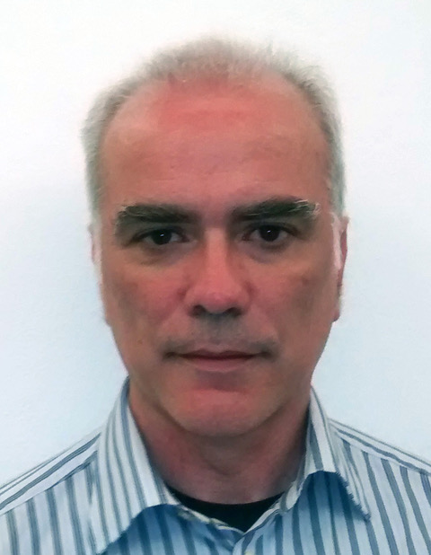
AIDAinnova new Management Team
Daniela Bortoletto
Deputy Scientific Coordinator
Giovanni Calderini
Deputy Scientific Coordinator
To be endorsed by the GB!

Slide 14
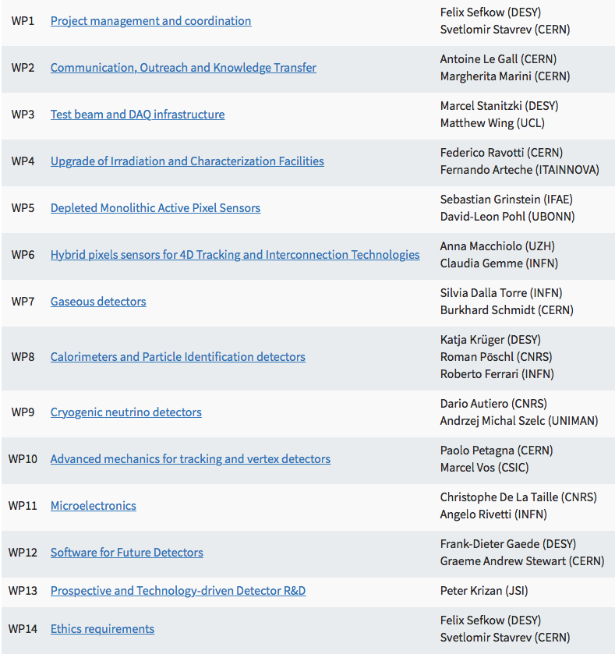
AIDAinnova work packages assignments
Paolo
Paolo
Daniela
Giovanni
Daniela
Giovanni
Paolo
Giovanni
Paolo
Giovanni
Daniela
Paolo
Daniela

Slide 15
Outgoing Scientific Coordinator: Felix Sefkow
Felix steered and coordinated AIDA-2020 from 2015 to 2020
Shaped AIDAinnova and coordinated it from 2021 till now
He certainly deserves a big round of applause from all of us!!
Felix will remain actively involved in AIDAinnova

