Slide 1
The I.FAST Project and its interaction with other Innovation Pilots
M. Vretenar, CERN ATS/DO
Project Coordinator
AIDA Innova Meeting, 30.03.2022

Slide 2
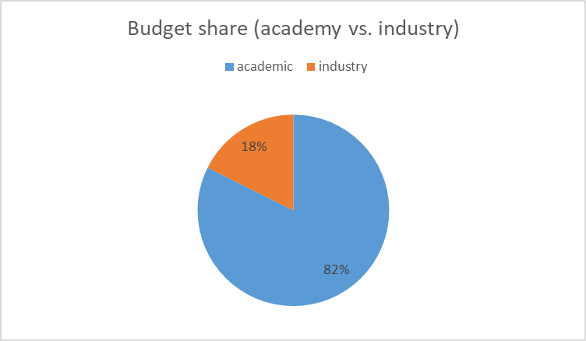

What is I.FAST
Innovation Fostering in Accelerator Science and Technology
An innovation Pilot to support innovation in particle accelerator science and technology
48 beneficiaries from 15 European Countries:
8 large RI operators,
12 national research centres,
12 universities,
16 industrial partners (1/3, including 11 SMEs)
+ 12 partner organisations and >20 collaborating institutions.
Timeline: 4 years, starting 1 May 2021.
Resources: 10 M€ EC contribution, out of a total project cost of about 19 M€ (47% co-funding).
Particle accelerator community entering the age of open innovation:
Sharing of ideas between scientific institutions and companies, to improve high technology products and to identify new products and markets.
Creation of an innovation ecosystem (Keywords: community, trust, openness, creativity, connection to industry)

Slide 3
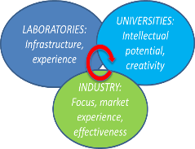
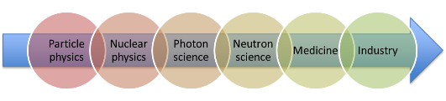
I.FAST Strategic Goals
core made of “co-innovation” R&D activities with industry, at different Technology Readiness Levels (TRL).
Same strategic goals of the old IA’s:
  Transverse approach based on synergies between accelerators for different users: particle and nuclear physics, photon and neutron science, medicine and industry.
  Collaborative schemes involving laboratories, university and industry.
  Priority to long-term R&D topics, beyond the specific needs of approved projects and developments, starting from low TRL activities.

Slide 4
Genesis and structure of I.FAST
Bottom-up call in 2019 analysed by a Committee set up by TIARA and ARIES (13 members nominated by Directors of TIARA partners, 4 from industry).
101 proposals submitted for 3 types of activities:
  Strategies: study groups to define “roadmaps” for specific technologies.
  Prototypes: construction with industry of prototypes at high TRL, with EC contribution ~ 500 k€.
  Developments: development, often with industry, of technologies at lower TRL, with EC contribution ~ 100 k€.
37 proposals selected on the basis of scientific excellence and coherence with the priorities of the accelerator community.
Proposals grouped in 9 “thematic areas” (Work Packages), each made of a strategy with one or more prototypes and developments. 4 additional “transverse” WPs (Coordination, Training, Industry, Innovation).
1 M€ for a second internal call for proposals in 2023-25.
WP
1 | Coordination, dissemination
2 | Training, communication, outreach
3 | Industry engagement
4 | Managing Innovation, new Materials
5 | New concepts, performance improvements
6 | Novel particle accelerators concepts and technologies
7 | High brightness synchrotron light sources
8 | Innovative superconducting magnets
9 | Innovative superconducting cavities
10 | Advanced accelerator technologies
11 | Sustainable concepts and technologies
12 | Societal applications
13 | Technology Infrastructure
14 | Ethics Requirements
9 thematic areas

Slide 5
The I.FAST Consortium
Partner organisations
Industrial Partners:
RHP Technologies
Bergoz Instrumentation
Sigmaphi (magnets)
Thales
BNG (magnets)
Barthel HF-Technik
ILK
XILNIX
COMEB
KYMA
VDL-ETG
CYCLOMED
Elytt (magnets)
NNK
GE
Scanditronix
TMD
48 beneficiaries (16 industry, 33%)
20 associated partners
3 collaborating institutes

Slide 6
The I.FAST 9 thematic areas (WP5-13)

Slide 7
Areas for technical collaboration I.FAST-AIDAinnova
Diagnostics – synergies but also possible overlaps, require definition of boundaries (I.FAST: priority to detectors on the beam line, for high accelerator-type intensities).
Applications to medicine: accelerators have specific challenges that require dedicate innovative detectors.

Slide 8
Areas for general collaboration between Innovation Pilots
Feedback to the EC, definition of future calls and initiatives.
Collaboration on industry events and definition of strategies and methodologies for collaboration with industry.

Slide 9
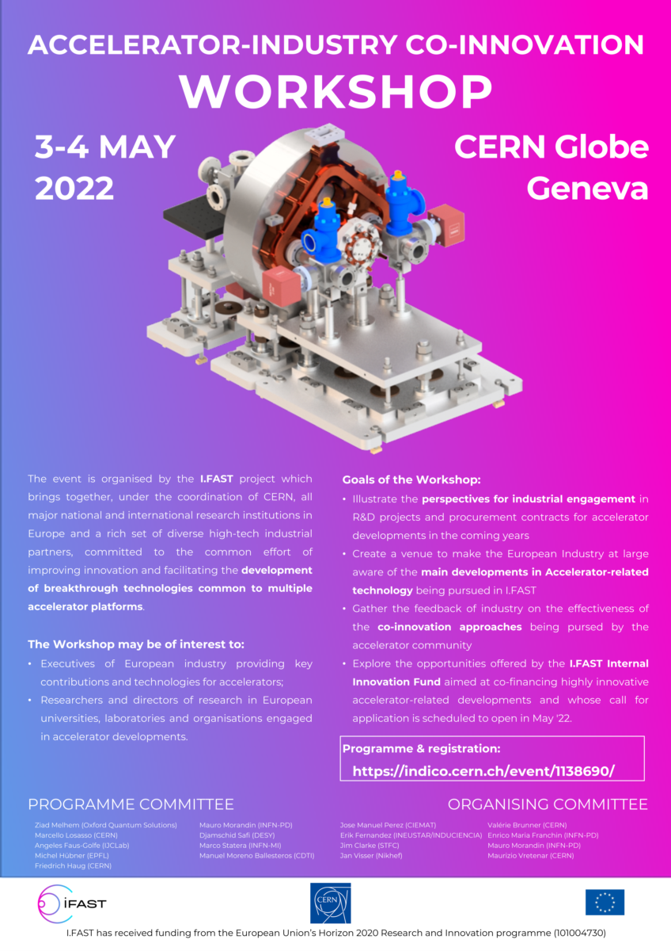
I.FAST Accelerator-Industry Co-innovation Workshop
Organiser: M. Morandin (INFN)

Slide 10
You are welcome to the I.FAST Meeting – Day 1

Slide 11
You are welcome to the I.FAST Meeting – Day 2 and 3

Slide 12
Thank you for your attention!

