Slide 1
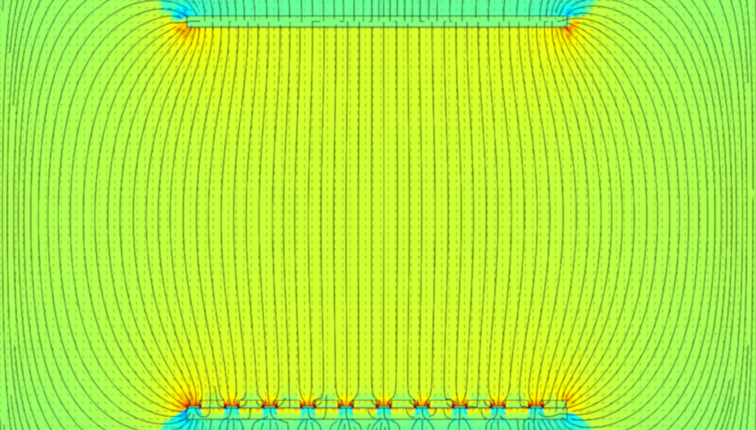

1 March 2022
SoLAr: an overview
Solar Neutrinos in Liquid Argon
Guilherme Ruiz Ferreira
PhD Student
The University of Manchester

Slide 2
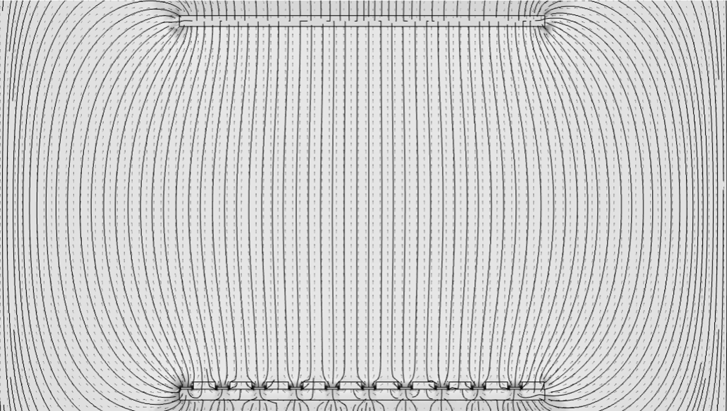
Presentation Outline
Detector Geometry
Motivation
Detector Readout
Conclusion

Slide 3
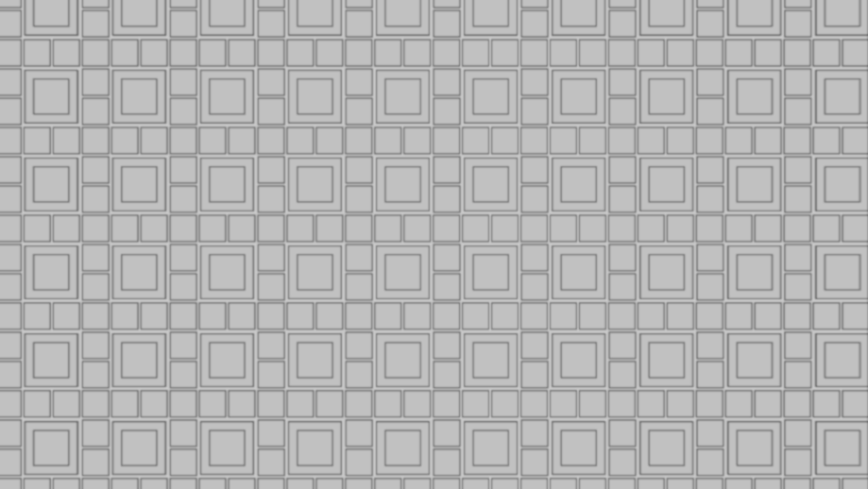
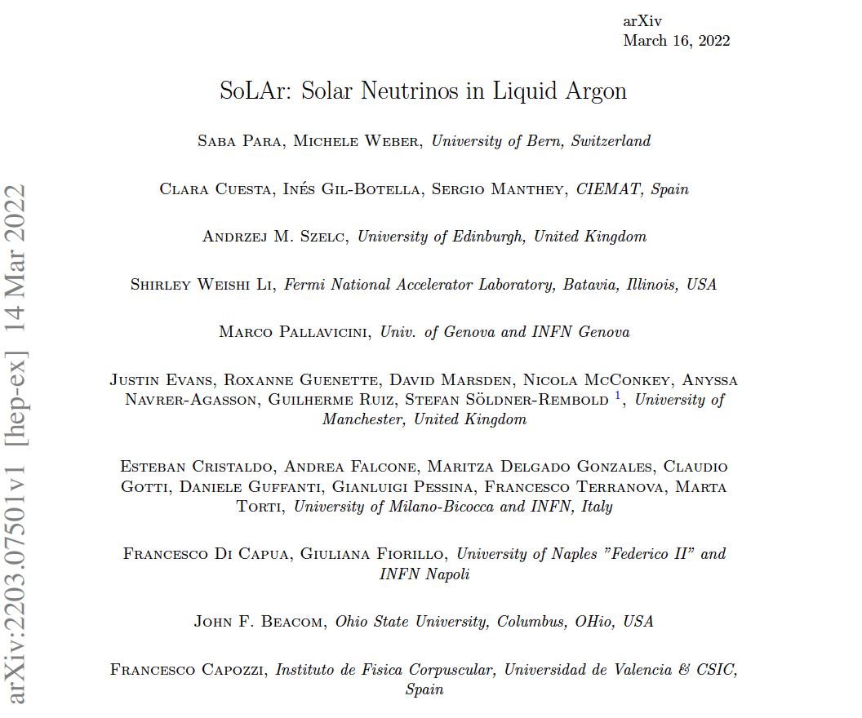
What is SoLAr?
SoLAr is a new concept for a liquid-argon neutrino detector.
The goal: extend the sensitivities to the MeV energy range by combining charge and light readout on one plane
The concept is also a possible technology choice for the DUNE “Module of Opportunity“.
SoLAr collaboration established March 2022
arXiv:2203.07501

Slide 4

SoLAr Novelty
The traditional wire planes used for LArTPCs are replaced by a modular pixel design
The readout unit will be a pixel tile that embeds charge readout pads and Silicon Photon Multipliers (SiPM).
Each tile produces signals corresponding to the charge of the electrons collected in each pixel and to the photons collected in the pixel frame, respectively.

Slide 5
Presentation Outline
Motivation
Detector Geometry
Detector Readout
Conclusion

Slide 6
Prototyping
Initial concept:
100mm x 100mm x 3mm square board
100 6mm x 6mm x 2mm SiPMs
500 3mm x 3mm x 0.5mm charge pixels
500V per cm drift field
Cathode at -5000V
SiPM negatively biased with ΔV=53V
How does the electric field behave?
Pixel
SiPM

Slide 7
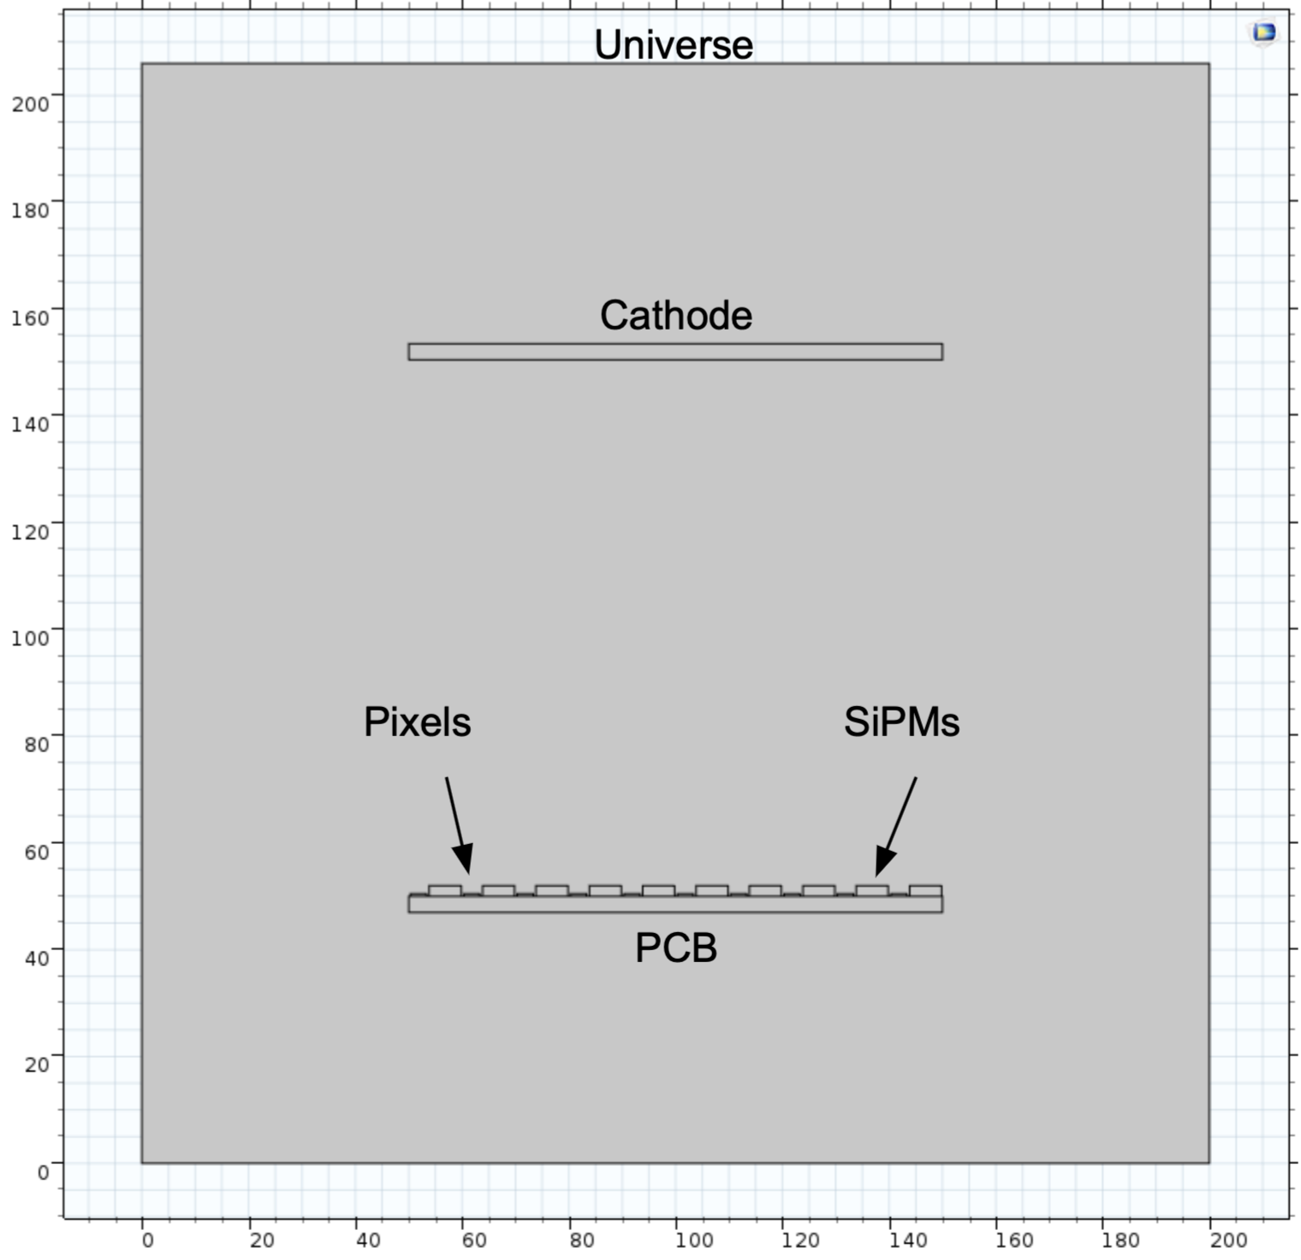
Electric Field Modelling
Using the Finite Element Analysis (FEA) software “COMSOL Multiphysics”, we modelled the electrostatic field in the TPC.
We started with a simple 2D model, then evolved to 3D with different variations of the charge pixel geometry and SiPM bias.
Which combination of geometry and bias yield the most efficient electric field?
10cm

Slide 8
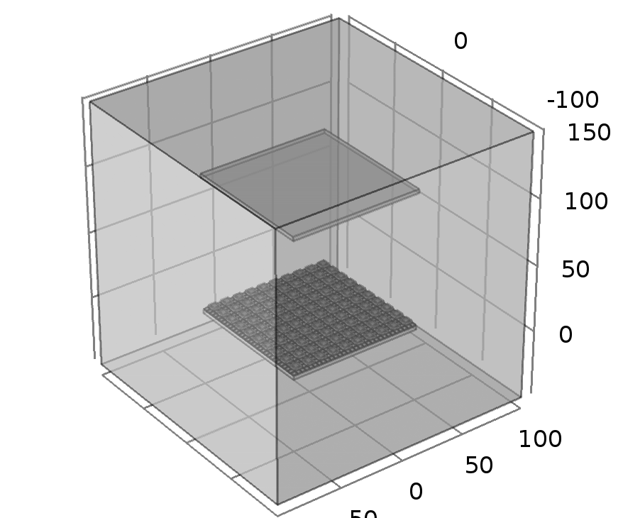
Electric Field Modelling
Using the Finite Element Analysis (FEA) software “COMSOL Multiphysics”, we modelled the electrostatic field in the TPC.
We started with a simple 2D model, then evolved to 3D with different variations of the charge pixel geometry and SiPM bias.
Which combination of geometry and bias yield the most efficient electric field?

Slide 9
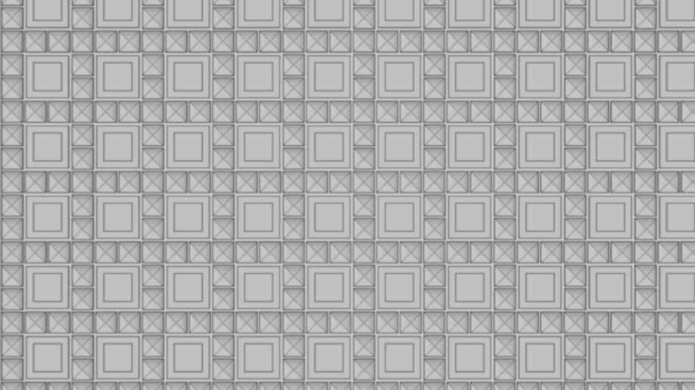
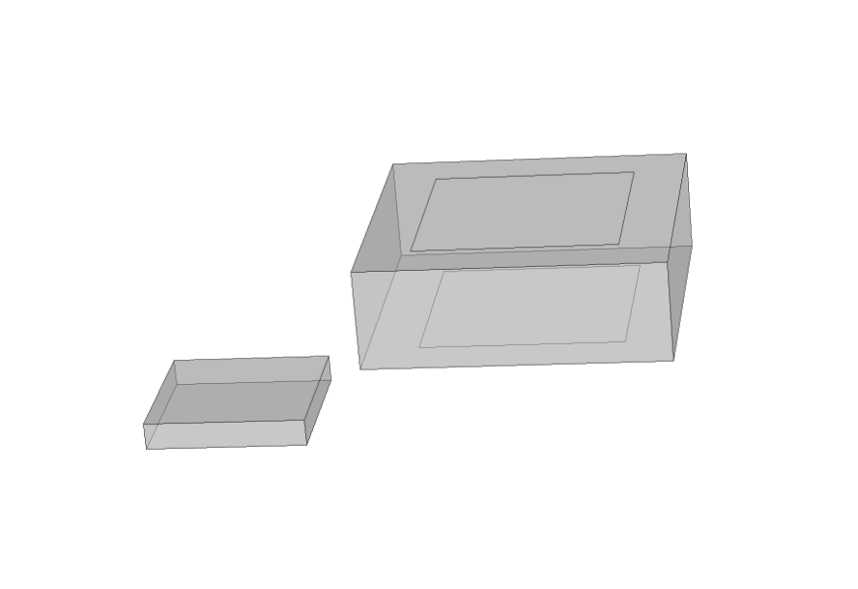
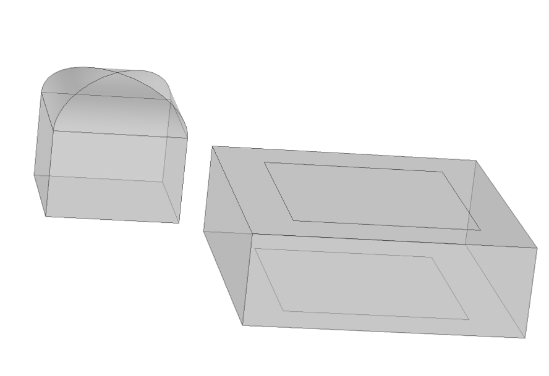
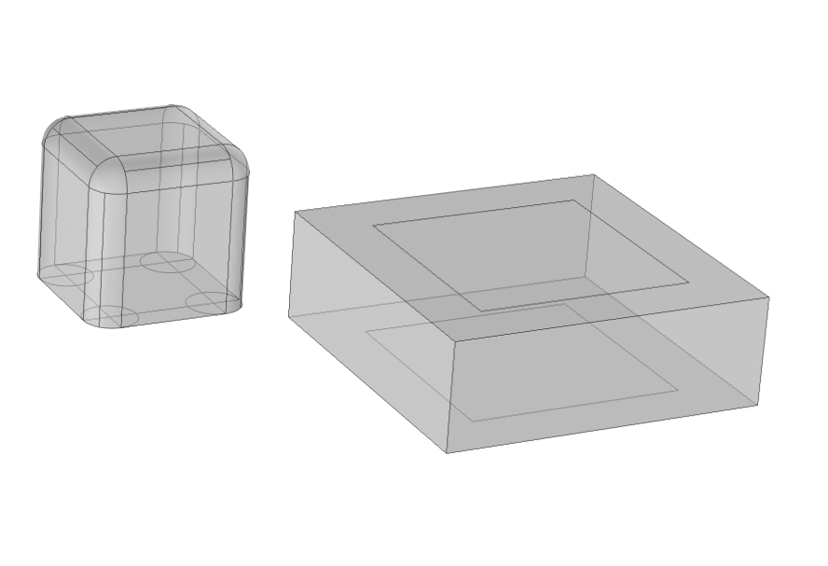
Pixel Geometry Concepts
Version 1
Version 2
Version 3
3mm x 3mm x 0.5 mm rectangular charge pixel
3mm x 3mm x 3 mm charge pixel with rounded top (1.5mm x 1.5mm x 1.0mm dome)
3mm x 3mm x 3 mm square charge pixel with rounded corners (0.5mm radius)
SiPM
Pixel
Pixel
Pixel
SiPM
SiPM

Slide 10
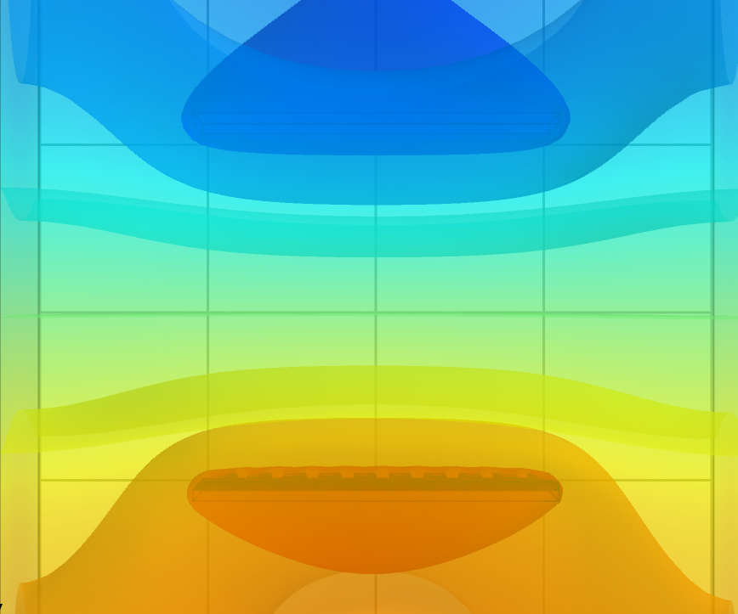
Electric Field Visualization
3D visualization of the electric field is extremely hard
We made a number of cuts in the 3D object in different axis and coordinates to obtain 2D cross section plots
Each cut allows us to explore a different aspect of the TPC

Slide 11
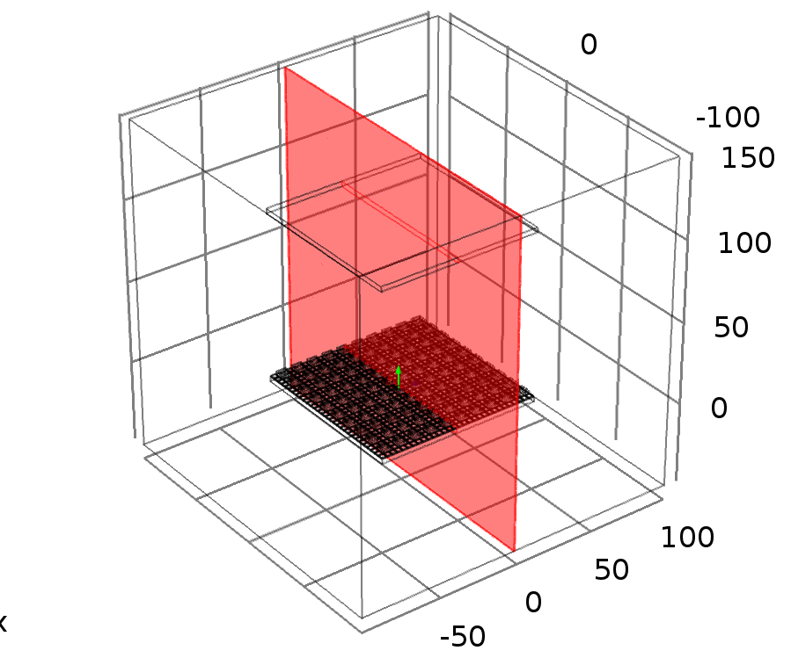
Electric Field Visualization
3D visualization of the electric field is extremely hard
We made a number of cuts in the 3D object in different axis and coordinates to obtain 2D cross section plots
Each cut allows us to explore a different aspect of the TPC
We focused on a plane through the centre of the pixels and SiPMs near the TPC centre

Slide 12
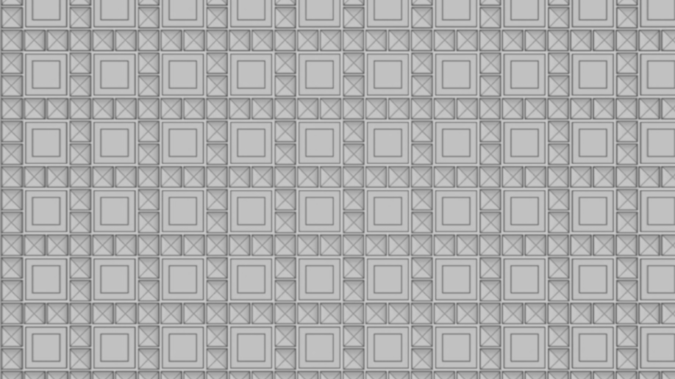
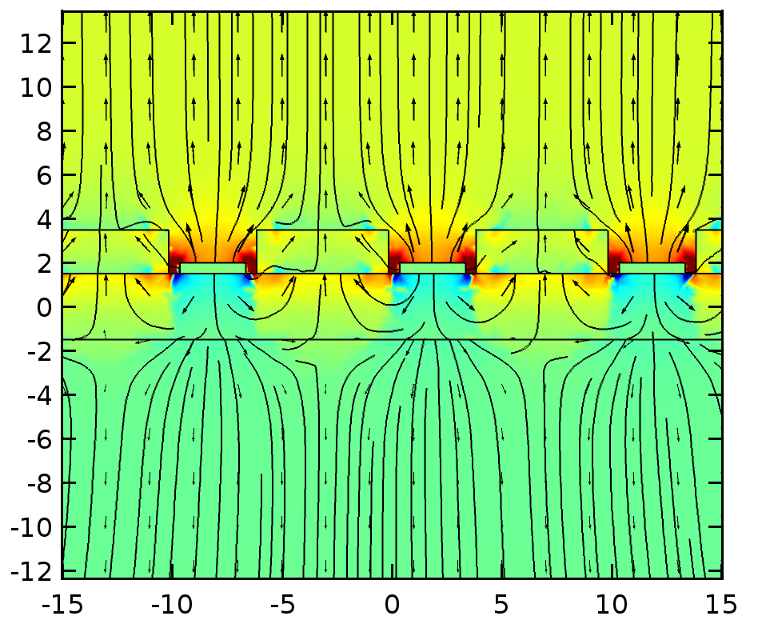
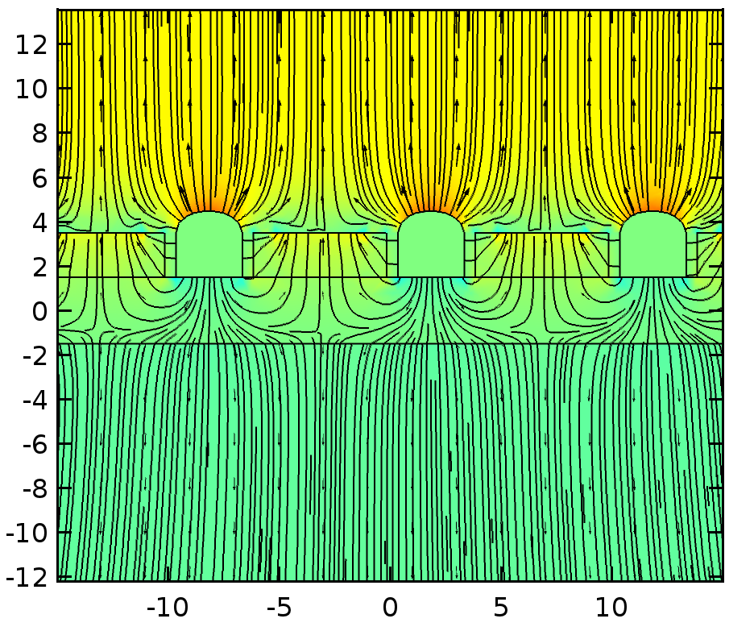
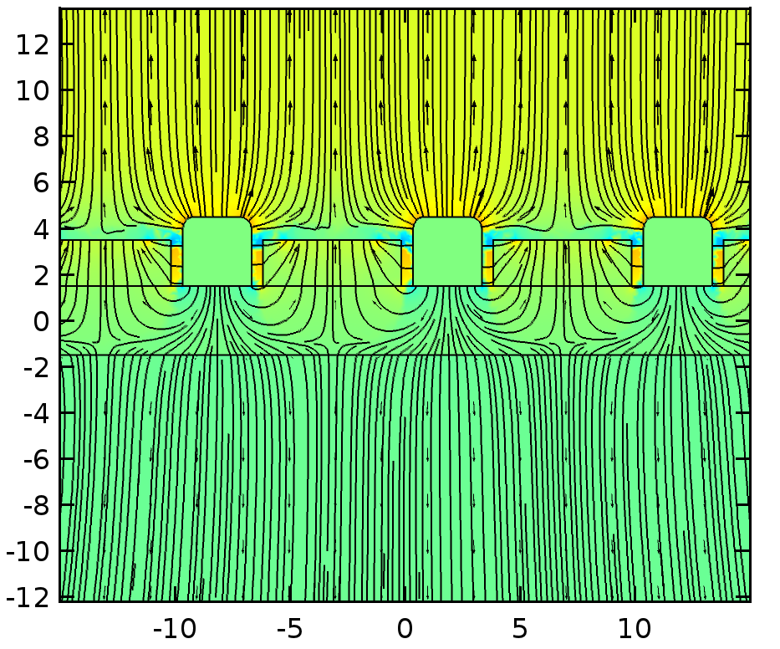
Best SiPM Bias Configuration (so far)
Version 1
Version 2
Version 3
SiPM biased -300V on top and -247 on bottom
SiPM biased -100V on top and -47 on bottom
SiPM biased -100V on top and -47 on bottom

Slide 13
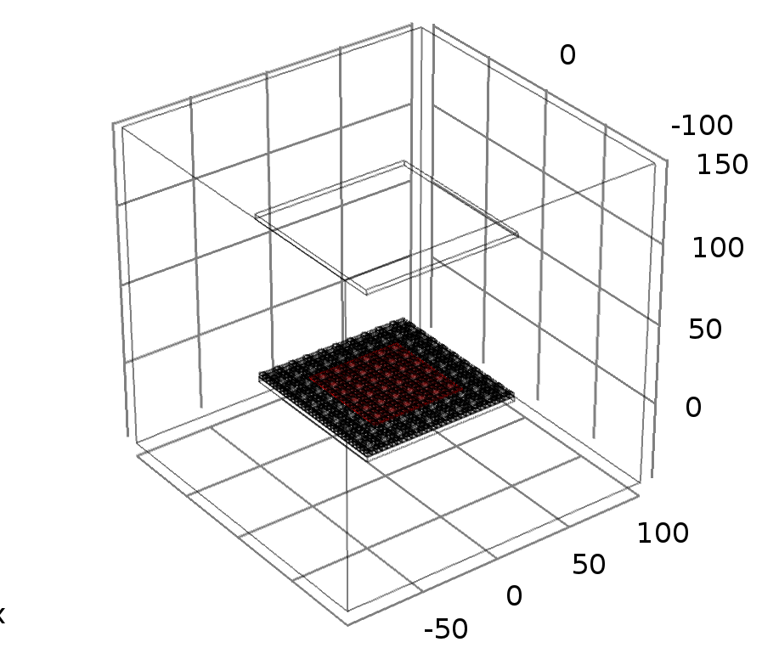
Charge Collection Efficacy (?)
COMSOL does not simulate drifting electrons.
As a proxy, we use the fraction of electric field lines passing through the SiPM top surface to calculate the loss of charge, and hence calculate the expected charge collection efficacy.
1) we define a surface cutting the anode slightly above the SiPM top but below the charge pixel top (2.05mm from PCB surface) and excluding the anode edges.

Slide 14
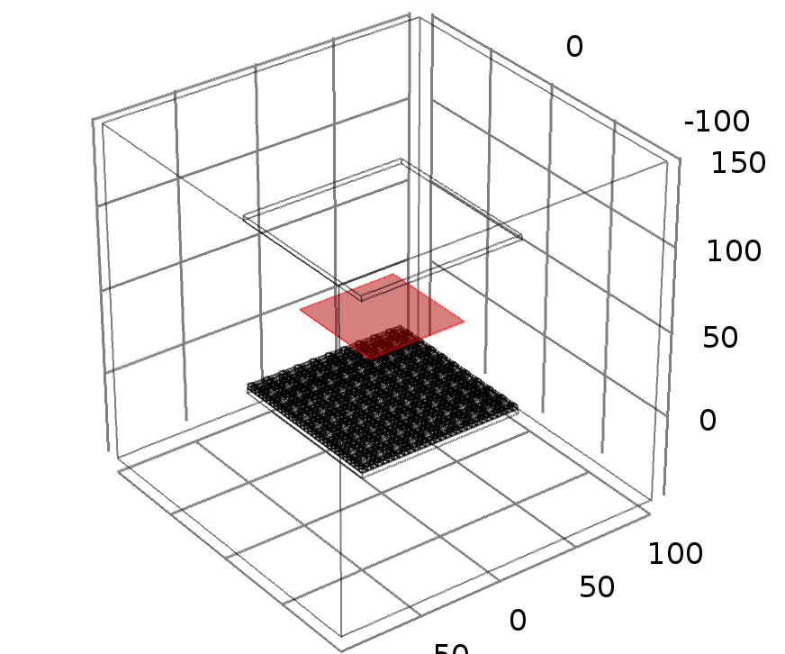
Charge Collection Efficacy (?)
2) We define a surface the same size but at the centre of the TPC (50mm from the PCB and Cathode)
By integrating the Z-component of the electric field where Z ≥ 0 over each surface and calculating their ratio, we obtain the fraction of the electric field lines ending in the SiPM surface.
These would be the lines where electrons are not captured by the charge pixels.

Slide 15
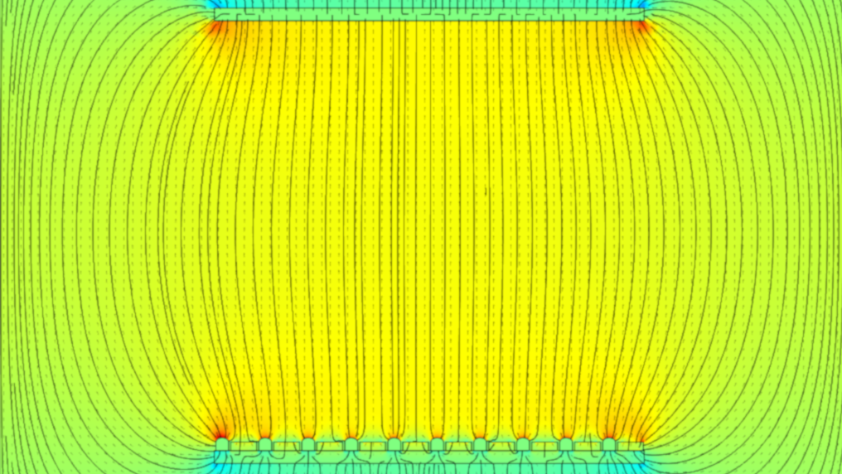
Charge Collection Efficacy Proxy
Version 2
Version 1
Version 3
Efficacy ?%
Even though we are unable to use our proxy method to obtain an efficacy value, it is clear from the plots that this is the least efficient geometry and requires a larger SiPM bias.
Efficacy 96%
This version has the advantage over version 3 of having a simple geometry for real life production.
It also allows the SiPM to operate in a lower bias than version 1
Efficacy 99%
Despite of having a more complicated geometry for real life production, this version yields the best efficacy we obtained so far.

Slide 16
Presentation Outline
Motivation
Detector Readout
Detector Geometry
Conclusion

Slide 17
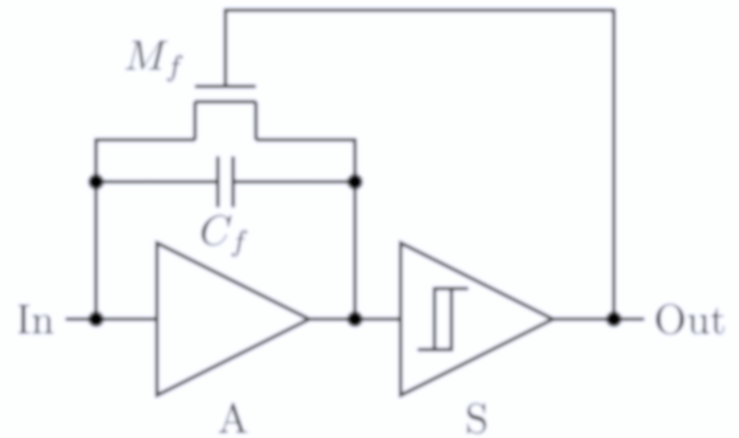
Q-Pix Readout Novelty
Q-Pix offers an innovation in signal capture with a new approach and measures time-to-charge (ΔQ), which Keeps the detailed waveform information from the LArTPC.
The readout follows the “electronic principle of least action”, i.e. don’t do anything unless there is something to do.
Total charge for any RTD = ΔQ
What is RTD?
The difference between sequential pixel resets, i.e. Reset Time Difference = RTD
RTD’s measure the instantaneous current and captures the waveform.
Small average current = Large RTD
Large average current (signal) = Small RTD

Slide 18
Q-Pix RTD Simulations
The Q-Pix RTD simulation is comprised of 3 “layers”:
Event generation – MARLEY (Model of Argon Reaction Low Energy Yields)
  Creates the neutrino events for both Charged Current (CC) and Elastic Scattering (ES) processes
Particle propagation and interaction through the LArTPC – Geant4
  Produces the hits the detector is expected to detect
Pixel triggering simulation (RTD) – Custom made code
  Takes the Geant4 hits and converts into charge deposit into the pixels which then reset when their ∆Q threshold is reached.

Slide 19
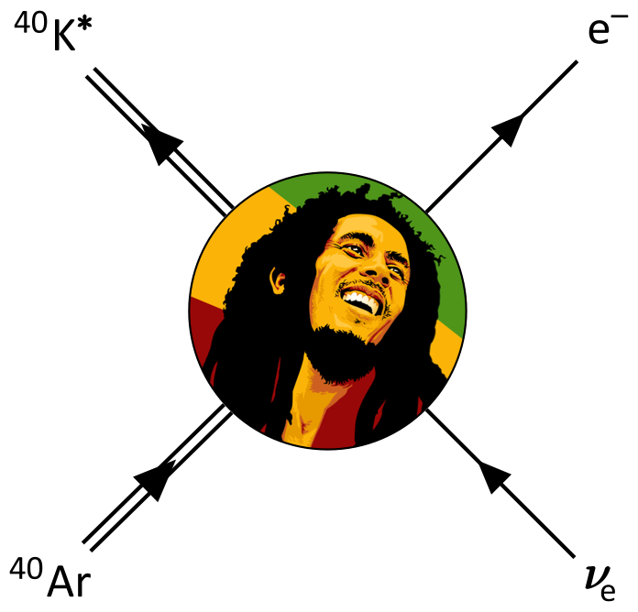
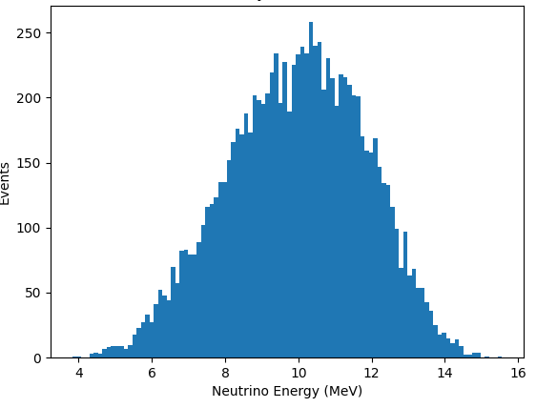
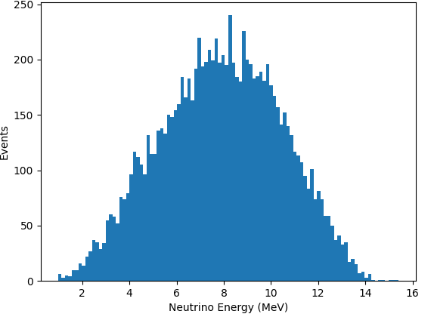


B8 Reaction Event Simulations
Neutrino Initial Energy - CC
Neutrino Initial Energy - ES
$$ν_{e}+40Ar→{40K}^{∗}+e^{−}$$
$$ν_{e}+e^{−}→ν_{e}+e^{−}$$

Slide 20
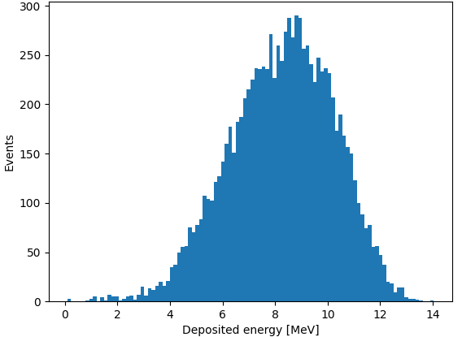
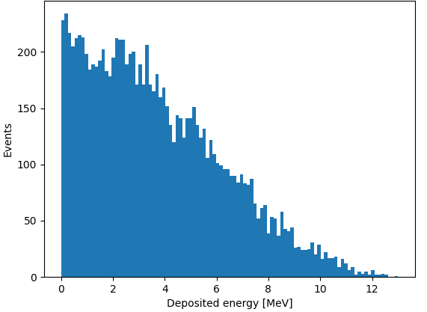


B8 Reaction Event Simulations
Deposited Energy - CC
Deposited Energy - ES
$$ν_{e}+40Ar→{40K}^{∗}+e^{−}$$
$$ν_{e}+e^{−}→ν_{e}+e^{−}$$

Slide 21
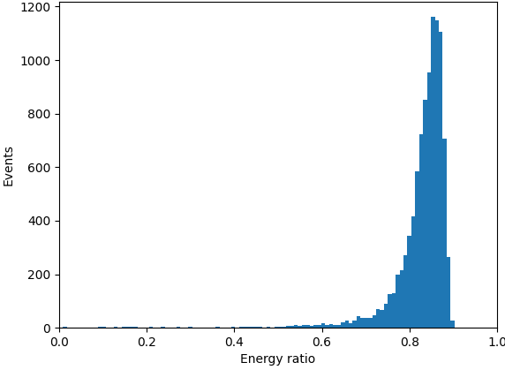
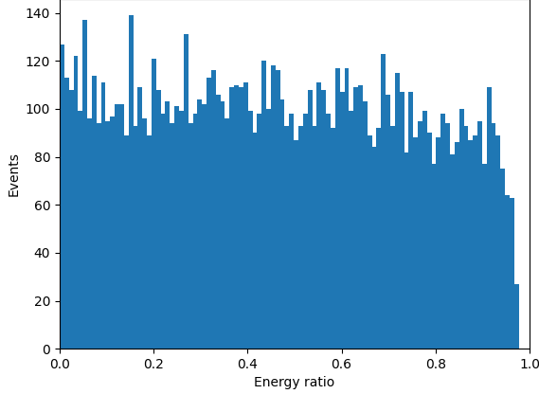


B8 Reaction Event Simulations
Deposited Energy Ratio - CC
Deposited Energy Ratio - ES
$$ν_{e}+40Ar→{40K}^{∗}+e^{−}$$
$$ν_{e}+e^{−}→ν_{e}+e^{−}$$
Charged current “mostly” preserves the incoming neutrino energy spectrum

Slide 22
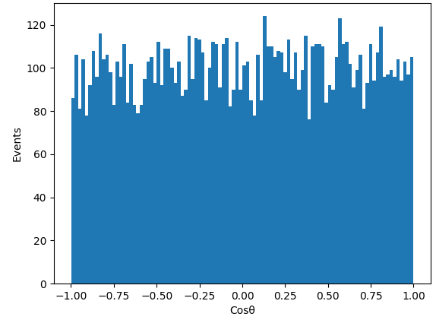
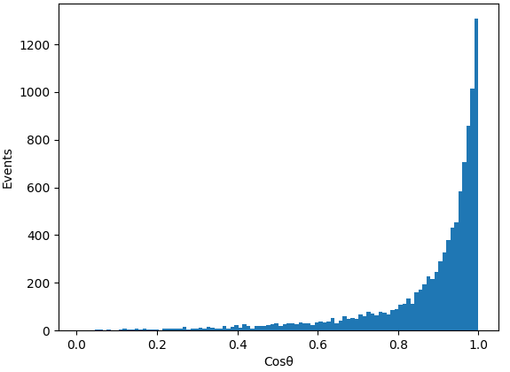
B8 Reaction Event Simulations
Electron Scatter Angle- CC
Electron Scatter Angle- ES
$$ν_{e}+40Ar→{40K}^{∗}+e^{−}$$
$$ν_{e}+e^{−}→ν_{e}+e^{−}$$
Elastic scattering preserves the incoming neutrino direction

Slide 23
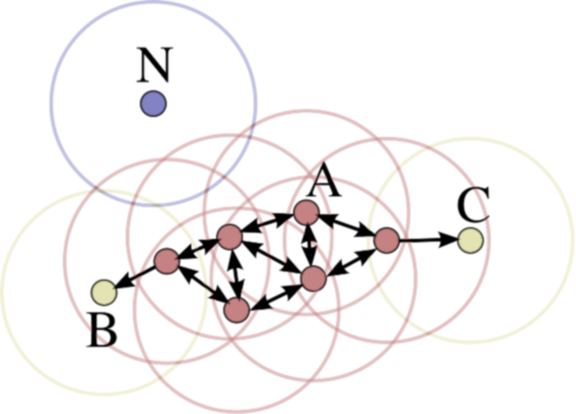
Q-Pix RTD simulations
How well can the detector identify signal events from RTDs?
We begin by defining 2 parameters:
  Completeness: Out of all signal events, how many are we able to detect?
  Cleanliness: Out of all the events detected, how many are signal?
Then we use a simple DBSCAN algorithm to cluster the pixel resets and compute the Completeness and Cleanliness for varied combinations of input parameters
  Density-based spatial clustering of applications with noise (DBSCAN) is one of the most common data clustering algorithm in the scientific literature.
  Input parameters: Minimum number of samples (resets) and maximum distance (ε) between them to consider part of the same cluster

Slide 24

B8 Reaction Completeness & Cleanliness
Completeness & Cleanliness - CC
Energy spectrum after data cuts - CC
Weighted histogram of completeness and cleanliness logical association*
Optimum values:
Min samples = 14
ε = 3.2
Repeating pattern due to anode geometry with
Equal sized repeating pixels
Energy spectrum mostly preserved after cuts
Arbitrarily normalized for better visualization.
All
Valid
Optimum
* Completeness multiplied by cleanliness term by term
Valid cut excludes DBSCAN clustering failures

Slide 25
B8 Reaction Completeness & Cleanliness
Completeness & Cleanliness - ES
Energy spectrum after data cuts - ES
Weighted histogram of completeness and cleanliness logical association*
Optimum values:
Min samples = 14
ε = 3.2
Optimum parameters seem to depend on the geometry of the detector but not on the scattering process
Events below 6 MeV are lost as the produce few resets
Arbitrarily normalized for better visualization.
All
Valid
Optimum
* Completeness multiplied by cleanliness term by term
Valid cut excludes DBSCAN clustering failures

Slide 26
Presentation outline
Motivation
Conclusion
Detector Readout
Detector Geometry

Slide 27
Conclusions
Geometry
The detector geometry is still being studied and optimized based on the electric field simulations and production practicality
We have found potential configurations which maximize charge collection on pixels and protects the SiPMs from strong fields
Readout
Based on preliminary simulations, we are able to determine the energy spectrum of the incoming neutrinos from CC events and their incoming direction from ES events.
Using a simple DBSCAN algorithm we managed to cluster resets on signal events above 6 MeV with good completeness and cleanliness values.
Next steps
Continue our studies of the detector geometry for the first prototype
Proceed into calibrating the Q-Pix detector dE/dX using the RTD simulations

