Slide 1
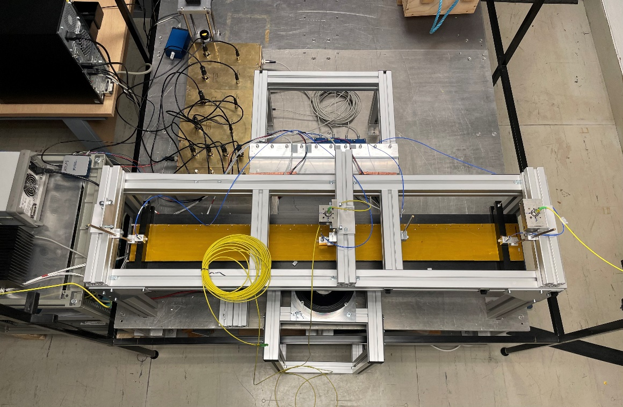
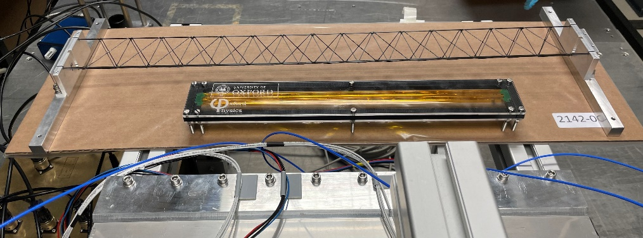
FSI system current status
FSI system received from manufacturer & upgraded from 4 to 16 channels
  Move to different lab due Laser safety & Equipment availability
  Purchased 11x glass ball retroreflectors to use with additional channels on vibration table – currently being gold coated
  Capacitive sensors and accelerometer functional
  Next steps:
    Rest of FSI lines functional
    Use for mode shape measurements
    Use on truss structure
    Use in air flow setup (move pending)
Structures to be tested
Vibration Table

