Slide 1
Supercritical refrigerants for detector applications
Camila Rocio Pedano Medina
30-03-2022

Slide 2
Target and framework
Main target: performance of supercritical fluids in detector cooling
Focus on sc-CO2: good candidate for warm applications + literature available
For future warm detectors, sc-CO2 is a good option for thermal management of the electronics (~31°C)
sc-CO2:
  Extremely effective single phase-like cooling in very small pipes and micro heat exchangers
  Values of heat transfer coefficient comparable to those typical of two-phase flows
  Lower pressure drops
  Much more controllable flow conditions
Interesting intention: using findings on sc-carbon dioxide to cooperate with Luca Contiero on his PhD project, transporting them to Krypton at much lower temperature
Notes:
My name is Camila Pedano. I am currently starting a PhD project in supercritical refrigerants for detector applications. The main target is to study how supercritical fluids in general would perform as refrigerants for detector cooling. However, at this first stage focus is put on scCO2 because it is a good candidate for warm applications and there is literature available.
In this context, for future warm detectors, particularly used in lepton colliders, supercritical carbon dioxide is an option for thermal management of the electronics, which need to be maintained at temperatures somewhat above 31 °C. In principle, scCO2 can provide extremely effective single-phase-like cooling in very small pipes and micro-heat exchangers, with values of the heat transfer coefficient comparable to those typical of two-phase flows, but with much lower pressure drops and much more controllable flow conditions.

Slide 3
Fundamental objectives and preliminary studies
Fundamental objectives
  Theoretical and experimental study of thermal and fluidic behavior of carbon dioxide flowing in small pipes passing over its critical conditions
  Optimization of the use of sc-CO2 as a refrigerant and characterization of the HTC attainable at conditions between 31 and 45 °C
  Study of design indications for new sc-heat exchangers for optimal energy recovery in CO2 refrigeration plants
Preliminary studies
  Literature survey
    Summarizing main findings from literature in sc-CO2 heating
    Defining range of experimental conditions explored in literature
    Finding open points deserving attention
  Conceptual study to design test rig at CERN
Notes:
The three fundamental objectives of this project are:
Firstly, the theoretical and experimental study of the thermal and fluidic behavior of carbon dioxide flowing in small pipes passing over its critical conditions.
Secondly, the optimization of the use of supercritical carbon dioxide as a refrigerant and characterization of the heat transfer coefficient attainable at conditions between 31 and 45 °C.
Finally, studying the design indications for new supercritical heat exchangers for optimal energy recovery in co2 refrigeration plants.
For this, two preliminary studies need to be performed and are planned to be done in parallel during the initial stage of the project <> now:
1. Literature survey: gathering available resources, classifying them and finding common problems or open questions found in the different fields.
2. Conceptual study to design a test rig at CERN, for which different options available need to be explored.

Slide 4
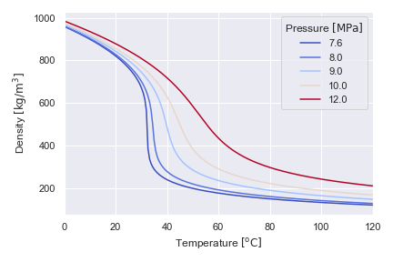
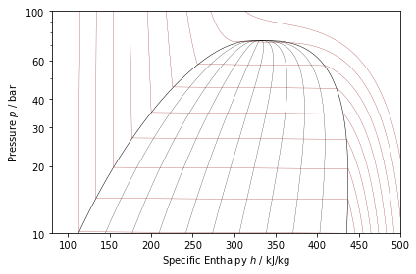
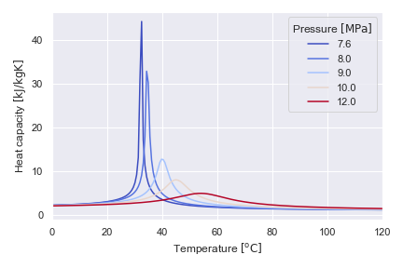
The supercritical condition
At subcritical: discontinuities
Above critical value: change is continuous
  T<Tc liquid-like fluid
  T>Tc vapor-like fluid
Temperature of interest for room temperature detector cooling (+31 to +45 °C)
Tm = Pseudo-critical temperature
Critical point of carbon dioxide: 74 bar, 31 °C
Notes:
At temperatures below the critical value, the variation of pressure with enthalpy along an isotherm exhibits discontinuities where it intersects the saturation line: where phase change takes place. The horizontal constant pressure segments represent the presence of two distinct phases. Above the critical point, these discontinuities are not found. Macroscopically speaking, there is a continuous variation from a liquid-like condition to a vapor-like one. This means, above the critical pressure, at temperatures lower than the critical the liquid-like fluid (with higher density) is found. At temperatures higher than that, the gas-like fluid is present.
In this region, standard techniques of correlating data fail: Dittus-Boelter equation does not correlate near-critical forced convection phenomena, boiling equations exhibit discontinuities and oscillations are commonplace. The similarities in heat transfer, pressure drop, wall temperatures and pressure oscillation between subcritical and near-critical regimes are significant.
The supercritical point of carbon dioxide corresponds to pressures above 7.4 MPa. Its corresponding critical temperature is 31 °C. In the supercritical region, the thermophysical properties of CO2 change dramatically with temperature and pressure.
For a given pressure, thermal conductivity, dynamic viscosity and density (seen in figure on the right top) strongly decrease with an increase in temperature. At the same time, the specific heat capacity reaches a sharp peak which is reduced as the pressure increases, as seen on the right bottom. This temperature, at which the heat capacity reaches its maximum value, is defined as the pseudo-critical temperature.
As can be seen from both figures, these changes are less steep when increasing the operating pressure. However, these sharp variations make its heat transfer performance different from conventional fluids, especially in the determination of the convective heat transfer coefficient from a heat transfer surface.
Finally, coming back to the point in the slide shown before, the temperature of interest for room temperature detector cooling is shown in the plots on the right. (+31 to +45 °C)

Slide 5
Mechanisms and phenomena
Mechanisms
  Normal heat transfer: heat transfer coefficients similar to sub-critical far from critical region when calculated with established correlations (e.g. Dittus Boelter)
  Enhanced heat transfer: higher than at normal conditions
  Deteriorated heat transfer: lower than at normal conditions
One approach (analogy to sub-critical boiling):
  Pseudo-boiling
Tbulk < Tm
Bubble-like volumes of fluid
Tm
Tbulk
Tbulk
Twall
heat
  Pseudo-film boiling
Tbulk < Tm
Twall
Tbulk
Twall
Continuous “vapor blanket”
heat
Notes:
Since the 1950s, authors have obtained heat transfer coefficients experimentally, mainly in water and carbon dioxide. They have defined three mechanisms of heat transfer:
Normal
Enhanced
Deteriorated
Some approaches to study the heat transfer mechanisms have to do with similarities between boiling heat transfer. Some authors approached the problem by defining two different phenomena, relating it to sub-critical boiling:
Pseudo-boiling: similar to nucleate boiling in sub-critical pressures. When heating a fluid with a bulk temperature lower than the pseudo-critical temperature, some layers near the heating surface might achieve temperatures above the pseudo-critical. This lower density part of the fluid can leave the heating surface in the form of bubble-like volumes of fluid. Generally, it leads to higher heat transfer coefficients.
Pseudo-film boiling is similar to film boiling mechanism in sub-critical pressures. In this case, the low-density part of the fluid forms a layer and prevents the high-density part from contacting the heated surface. It leads to lower heat transfer coefficients, since the heat transfer performance of the vapor-like fluid is poor compared to that of the liquid-like fluid in the bulk flow
Another approach to explain phenomena has to do with the effect of buoyancy force and thermal velocity and how the fluid structure can enhance or impair heat transfer.

Slide 6
Findings from literature
Range of experimental conditions explored in literature
  9 sc-heating articles:
    Diameters range from 0.5 to 22 mm, however big majority between 0.5 and 8 mm
    Configurations found cover horizontal, vertical up and down flows
    Range of mass flux: from 50 to 3000 kg/m2s
    Range of heat flux: 2 to 450 kW/m2
    Pressures range from 7.5 to 12 MPa
    Temperatures going from 0 to 110 °C

Slide 7
Findings from literature
Important parameters to evaluate:
  Mass flux
  Heat flux
  Diameter
  Configuration
  Pressure: only significant at temperatures close to pseudo-critical. Higher values of pressure decreased HTC in all cases due to change in physical properties.
Important questions to think about
  Effect of operating parameters on heat transfer coefficient AND pressure drop?
  Mechanism of heat transfer deterioration? Onset?
  Influence of buoyancy on the flow regime… Threshold? Based on what?
  Are pseudo-boiling and pseudo-film boiling good models?
  Correlations?
  To which extent can knowledge on one fluid be extrapolated to another?
Notes:
Important parameters to study and current status:
Mass flux: its influence on the heat transfer coefficient is not clear yet. Opposite trend as the one commonly observed has been reported (higher mass fluxes leading to lower heat transfer coefficient). Some authors have defined a threshold starting from which heat transfer deterioration can occur and below which it does not take place.
q: not clear if higher heat fluxes lead to heat transfer deterioration or not.
ID: opposite conclusions reached in literature. Effect on heat transfer coefficient not clear yet.
Configuration: no clear conclusion. Important for buoyancy effect assessment.
P: significant only at temperatures close to the pseudo-critical. Higher values of pressure decrease heat transfer coefficient.
Some open questions found in literature are the following:
What is the effect of different operating parameters on the HTC and pressure drops
What is the mechanism of heat transfer deterioration? Under which conditions does it take place? Is there an onset?
What is the role of buoyancy force on the flow regime? Is there a threshold?
Are pseudo-boiling and pseudo-film boiling good models for studying supercritical heat transfer?
Which correlations model the process better?

Slide 8
Outlook
Completion of literature analysis on sc-CO2 + study of other fluids
Study of fluid-to-fluid scaling: reliable?
Definition of main questions and important parameters to study
Design of test rig
Perform tests
Use of findings on sc-CO2 for Luca Contiero’s work on Krypton

