Slide 1

Progress on Hydraulic interface at INFN-Pisa
F. Bosi
on behalf of the INFN Pisa mechanical studies group
30 March 2022

Slide 2
OUTLOOK
First prototype in peek material (Roboze company)
First prototype in PerForm “simil ceramic” material (ProtoLab company)
Next company to try to produce Hydraulic interface
Conclusions

Slide 3
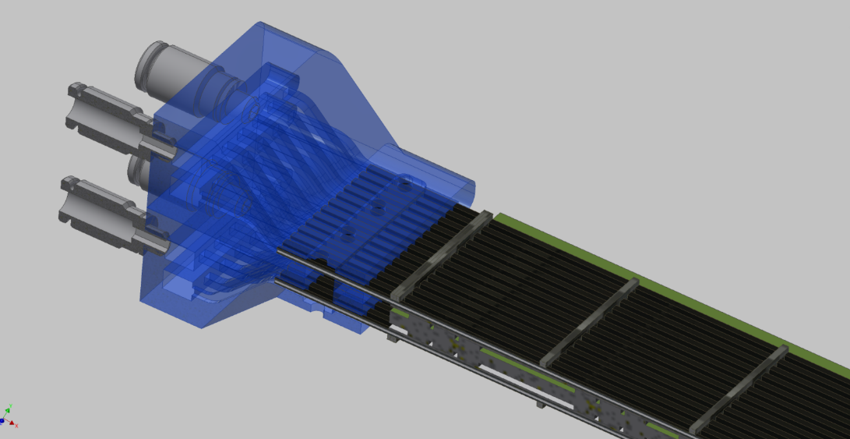
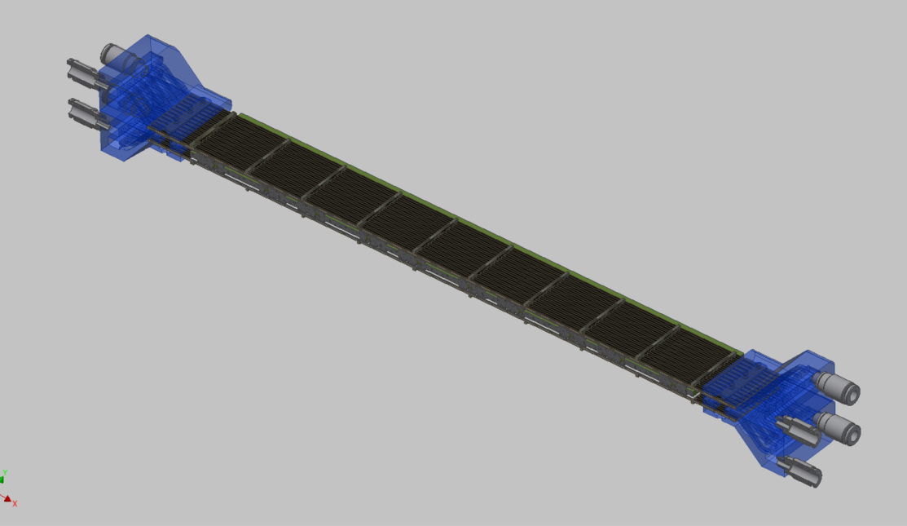
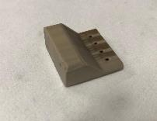
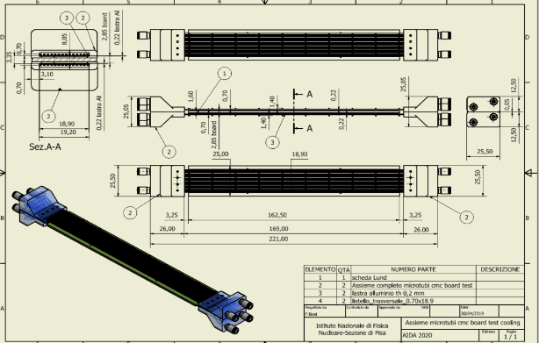
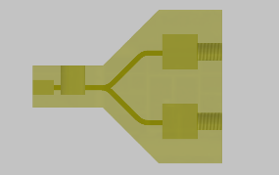
No temperature gradient along the module (Δt<1°C)
Microchannel cooling top/bottom for mockup board
IN
Final experimental setup
OUT
MCM Board
IN
OUT
IN
OUT
Opposite cooling flow by each side
To have same temperature long the module
Inlet/Outlet connector
3D printing technology
Material: Peek
OUT
Opposite cooling flow by each side
IN
‹#›

Slide 4

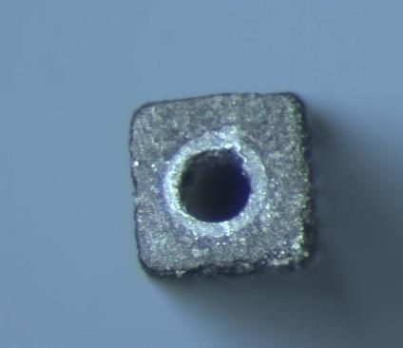
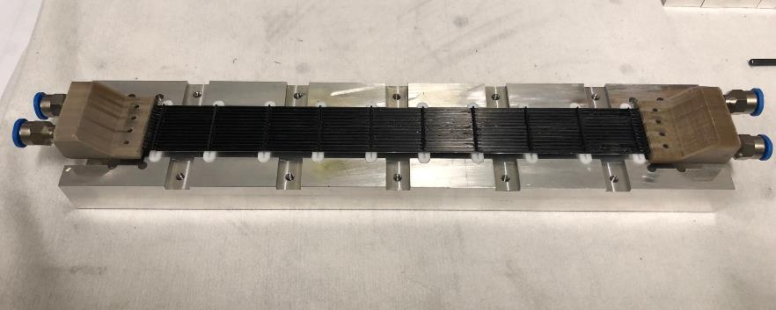
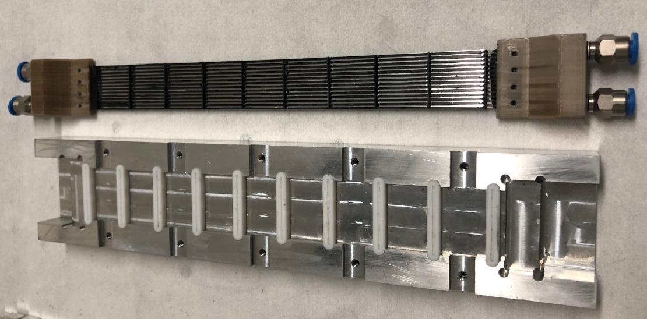
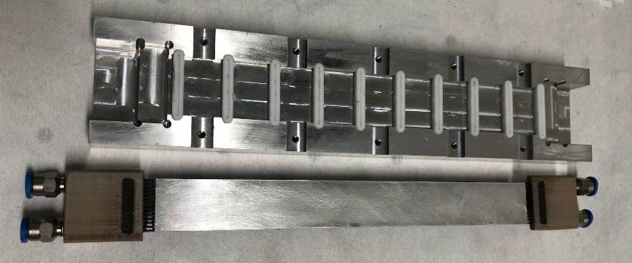
First Module prototype
Peek pipe
Dh=300 μm
Top support prototype on the gluing mask
700 μm
Top prototype
Gluing Mask
Plate in Aluminum for heath diffusion glued on the bottom side of the module support
‹#›

Slide 5
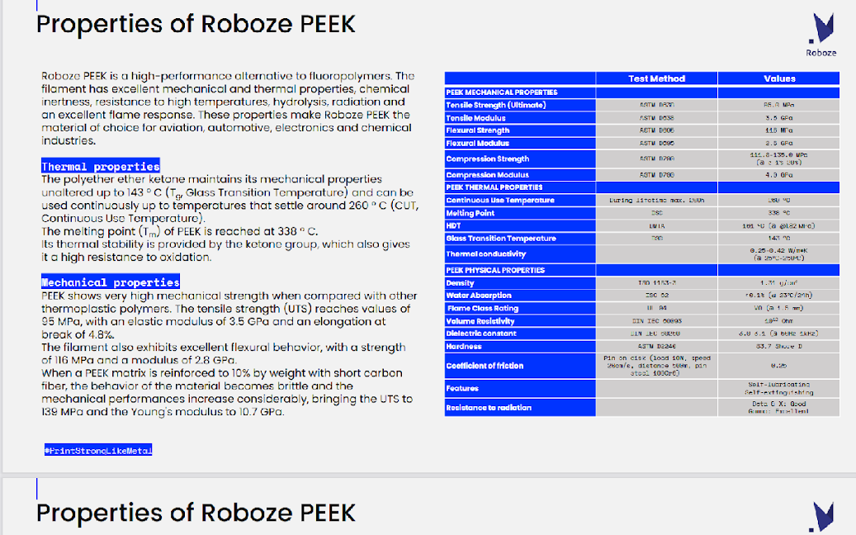
Peek Roboze material

Slide 6
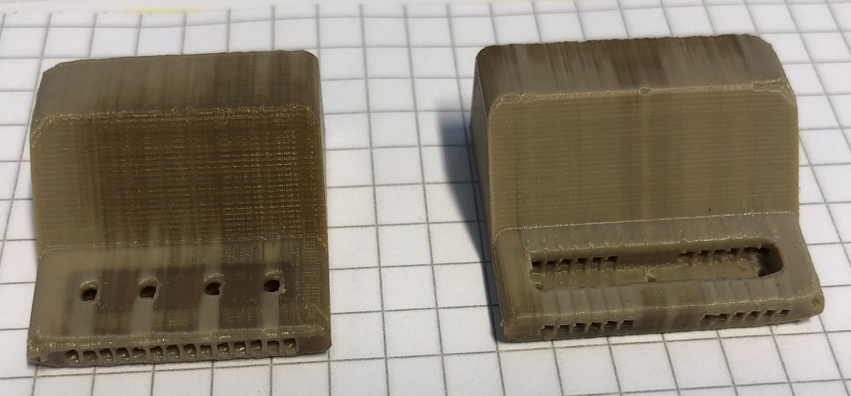
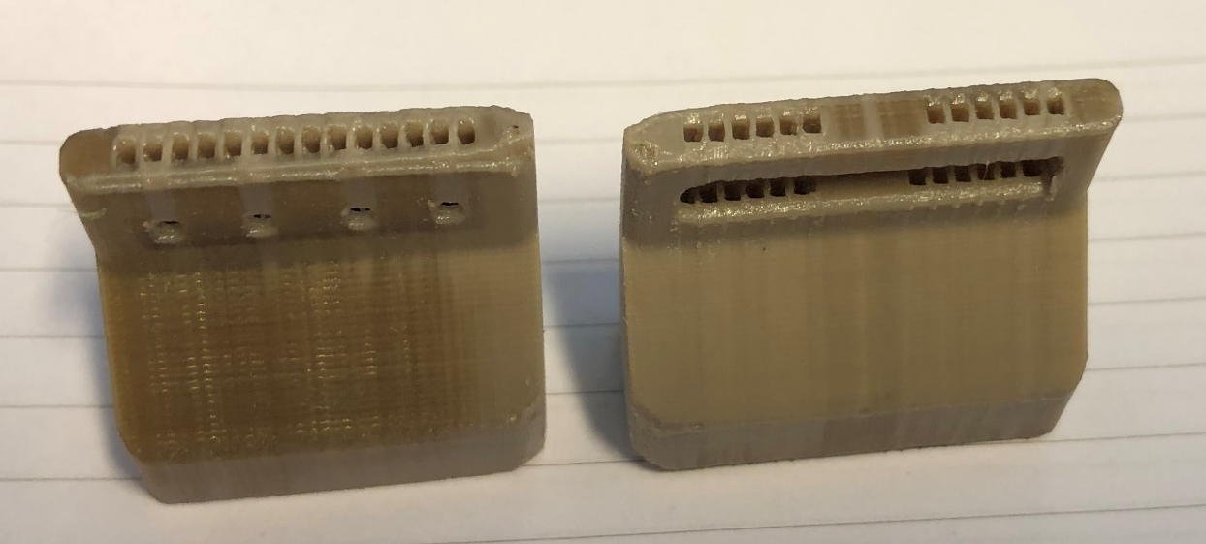
PEEK Hydraulic Interface
Roboze manufacturing
Thank to financing of IN2P3 Paris by AIDA 2020
Visible layer of 3D printing manufacturing
Visible definition of the layer of the 3D printing
Not perfect definition of the square holes
Not perfect definition of the entire geometry

Slide 7
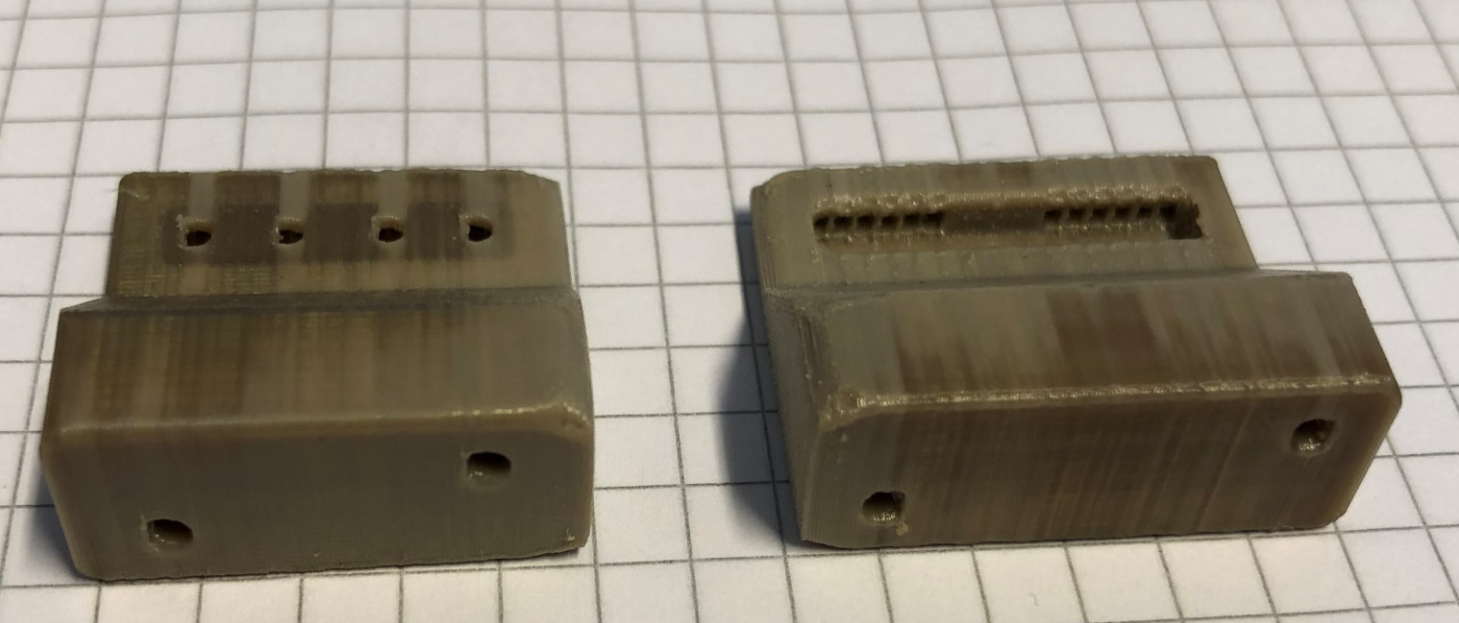
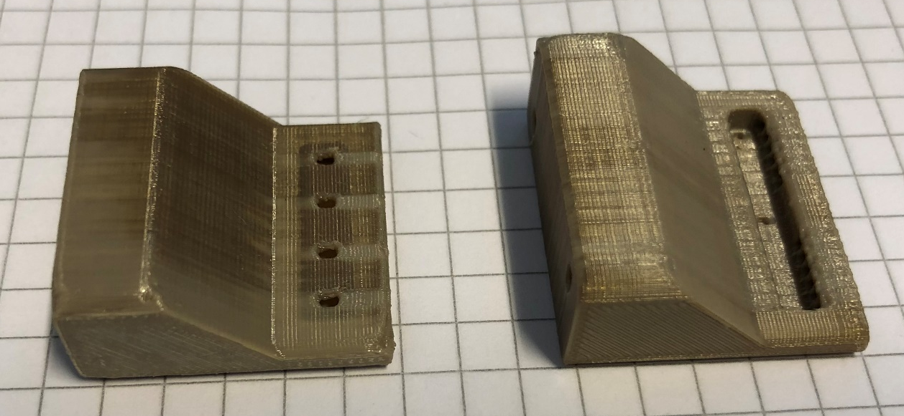
PEEK Hydraulic Interface
Roboze Manufacturing
Volume of the sealing with Araldite 2011
Hole for hydraulic connection
Hole for ejecting the glue and the eventually air bubble
Volume of the sealing with Araldite 2011

Slide 8
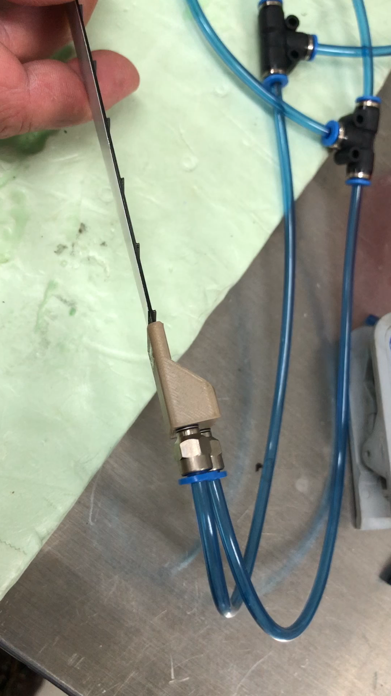

First Test in the Lab
Test of sealing of the Roboze Peek Hydraulic Interface
The pressure was about 2 atm
Test failed !

Slide 9
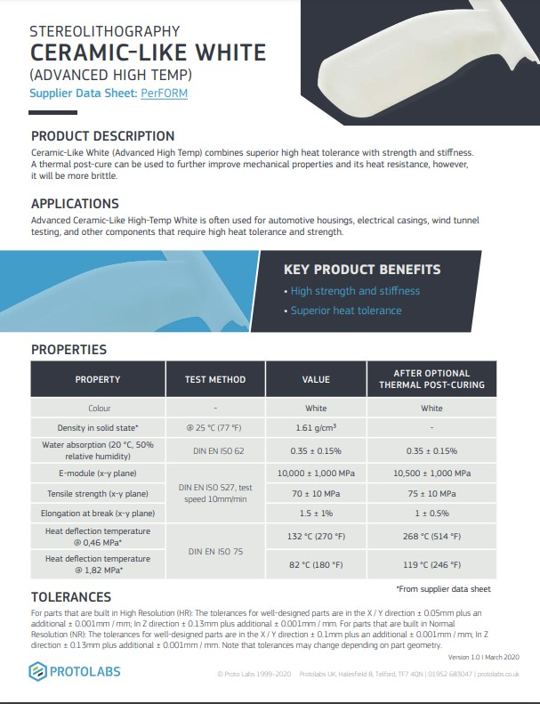
Material Characteristic of PerForm material
- Characteristics of the simil-Ceramic material
- Material PerForm of the Proto lab Company
High definition: about 50 micron
Stereolithography process

Slide 10
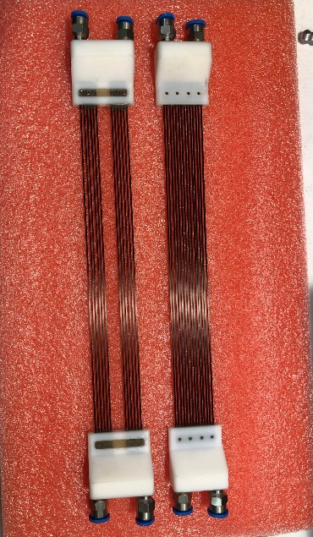
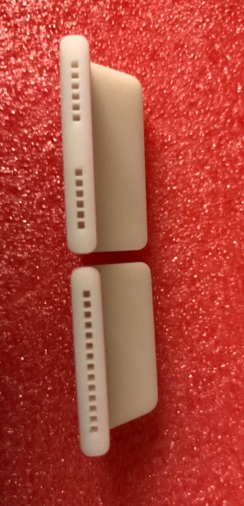
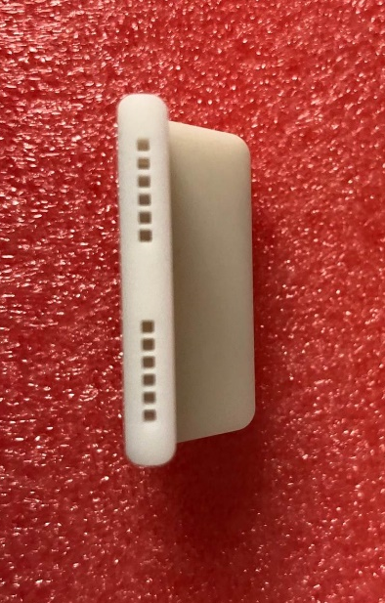
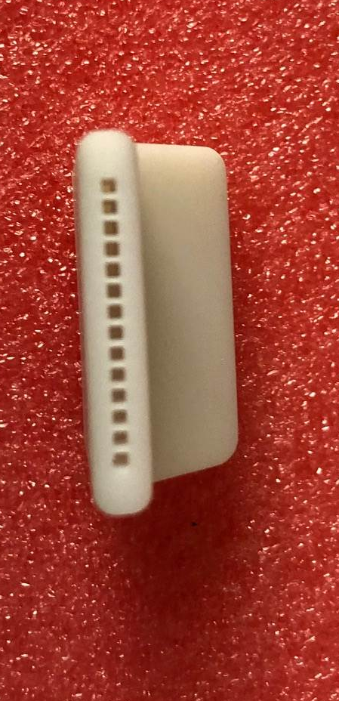
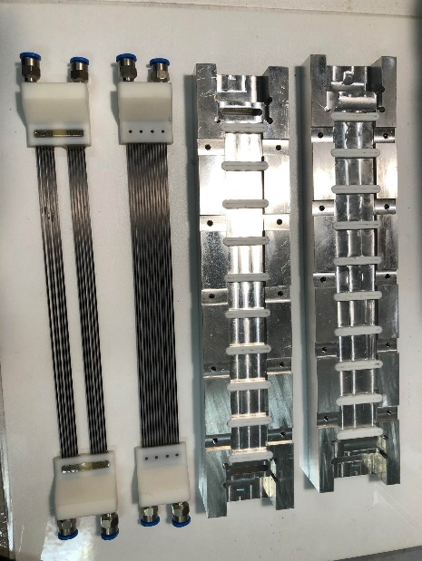

Before the thermal test problems with the 3D Peek printing interface.
Some leakage for poor adhesion of the layer of the peek 3d printing.
Stop of the progress for the absence of founding.
At the beginning of 2022 found new money and ordered a new 3D printing interface with a new process more precise (stereolithography) in PerForm material (ceramic-like).
Status of the project
We will start soon with the new experimental activity

Slide 11
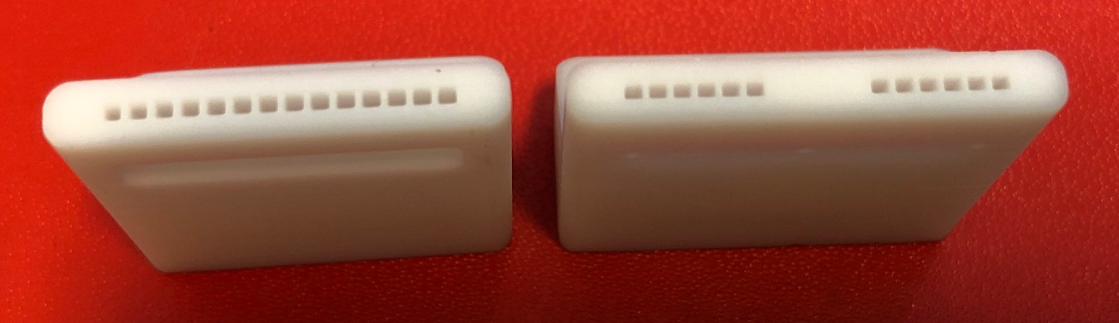
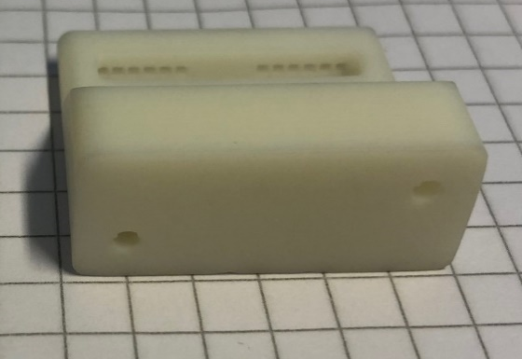
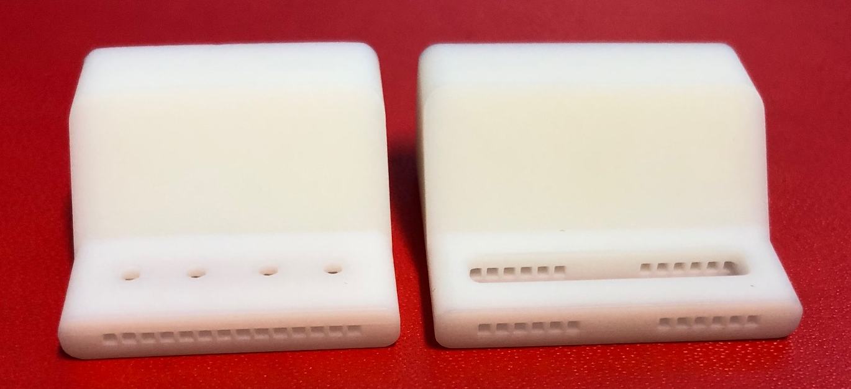

Hydraulic Interface in PerForm Material
Square geometry for carbon fiber microchannel
Holes for hydraulic connection
Hole for ejecting the glue and the eventually air bubble
Volume of the sealing with Araldite 2011

Slide 12
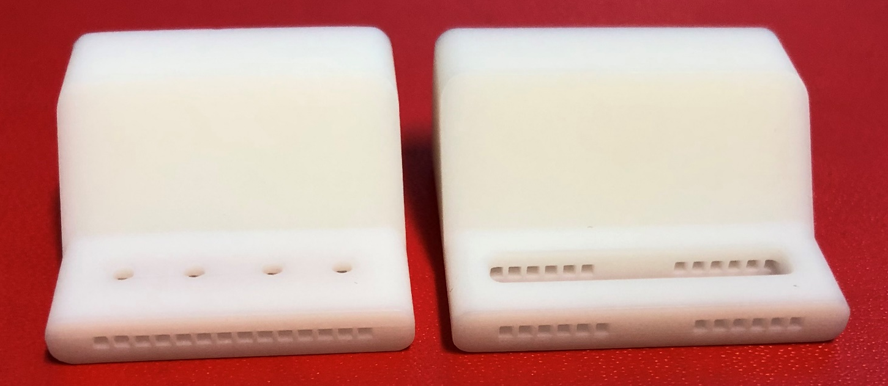
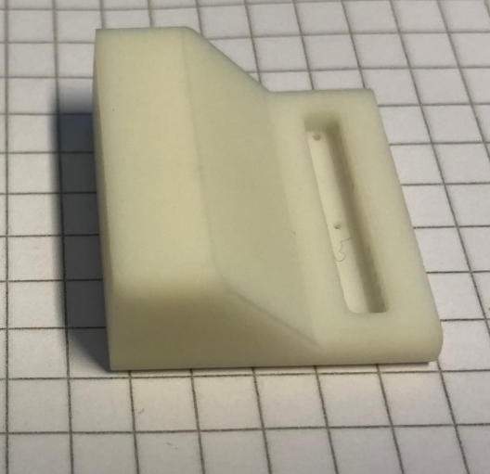
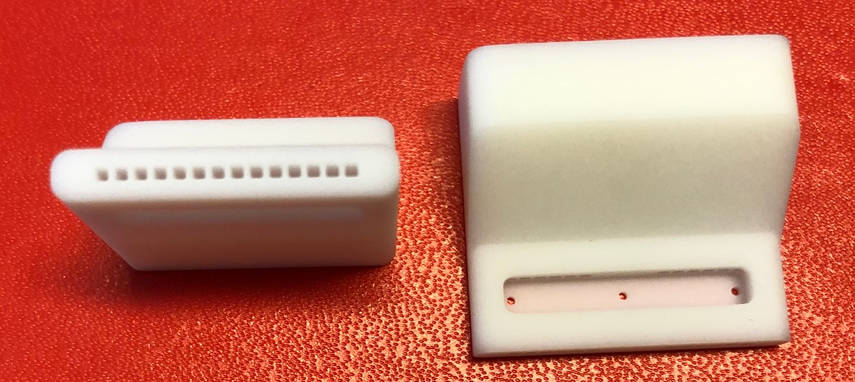
Hydraulic Interface in PerForm Material
Hole for ejecting the glue and the eventually air bubble
Volume of the sealing with Araldite 2011
Square geometry for carbon fiber microchannel
Volume of the sealing with Araldite 2011

Slide 13
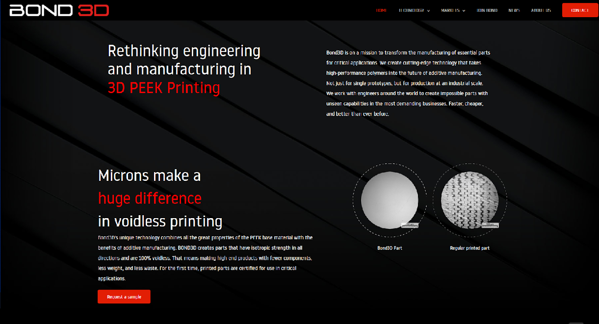
BOND 3D Company
Promising High definition

Slide 14
CONCLUSION
We have produced a peek Hydraulic interface in Peek Material in standard 3d Printing Technology (fusion of material)
- Not good manufacturing with evident sealing losses
We have produced a PerForm Hydraulic interface in 3d Printing Technology in Stereolithography technology
- Good manufacturing - Good definition of the geometry
- Eventually test of the sealing with the carbon fiber microchannel tube
- Eventually test of particle flux with the CERN facilities
We are looking for other Company to manufacture the Hydraulic Interface in peek material
  - In contact with Bond 3D Company in order to have a quotation

Slide 15
Backup

