Slide 1
Cooling systems by AM
Samuel Unterhofer, Olha Sereda CSEM
March 30th, 2022

Slide 2
AIDAINNOVA
Define the optimal geometrical features attainable for 3D printed ultra-thin cold plates in metal alloys
  Select materials
  Parts production
  Post processing
  Characterization

Slide 3
AIDAINNOVA
  Select materials
  Parts production
  Post processing
  Characterization
  First project part
  Second project part
AlSi12 | INVAR/COVAR
AM experience | No AM experience
Better thermal conductivity | Worse thermal conductivity
Worse CTE | Better CTE

Slide 4
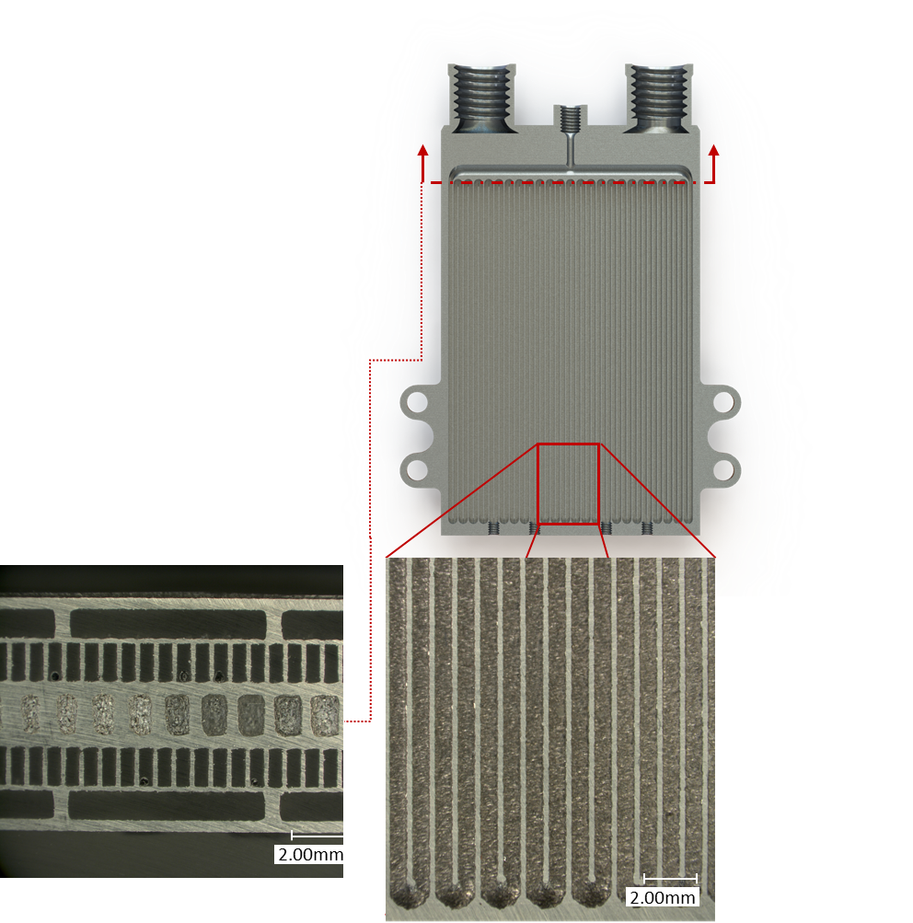
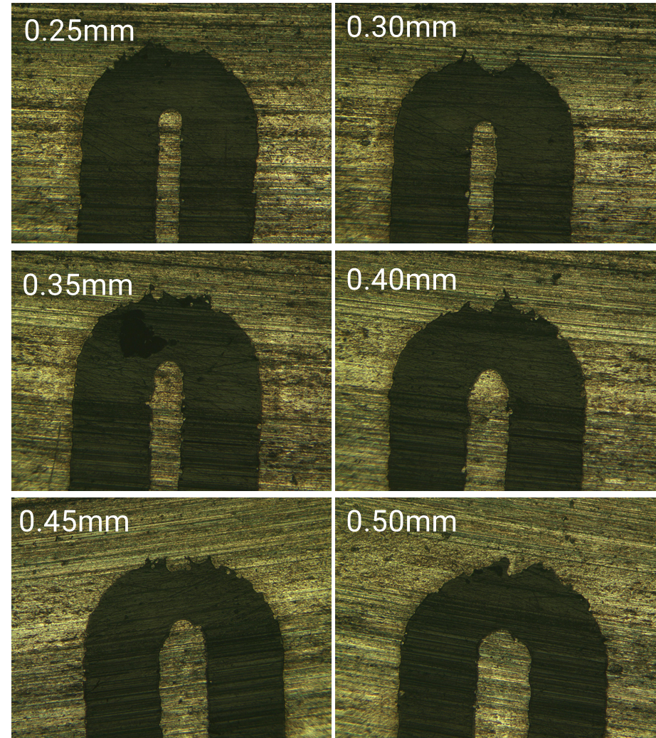
AIDAINNOVA
    First printing is planned for 02-04.05.2022
  Select materials
  Parts production
  Post processing
  Characterization
0.8mm x 1.8mm channels
0.25 mm wall thickness
No. channels 48
Condenser section 24mm
    Geometrical features
    Powder removal
Notes:
Straight & 180° bent, minimum wall thickness, single pipe & multi-microchannel

Slide 5
AIDAINNOVA
  Select materials
  Parts production
  Post processing
  Characterization
    Heat treatments
    HIP
    Chemical etching (to assure particle removal)

Slide 6
AIDAINNOVA
  Select materials
  Parts production
  Post processing
  Characterization
    Dimensional measurements
    Pressure leakage
    Roughness & flatness
    Thermal tests
Notes:
Diameter to length ratio
Minimum wall thickness

