Slide 1

Work Package 10
Task10.2: Ultra-light and 3D-printed structures with integrated cooling
AIDAInnova 1st Annual meeting
Activities at CERN
Massimo Angeletti
https://indico.cern.ch/event/1104064/
Collaboration with CERN EP R&D Work Package 4

Slide 2


WP10.2: Ultra-light and 3D-printed structures with integrated cooling
Synergy between CERN EP R&D WP4 and AIDA Innova WP10 Task10.2
  AIDA Innova Task10.2 programme focus on the Characterization of Ultra-light and 3D printed structures with integrated cooling for HEP experiments.
  Some studies started during the first year of the CERN EP R&D WP4 programme and they will be shared and further developed within AIDA Innova Task10.2 framework.
  The knowledge acquired with the AIDA Innova Task10.2 characterization studies will be then transferred to the prototype activities of the CERN EP R&D WP4
2020
2021
2022
…..

Slide 3
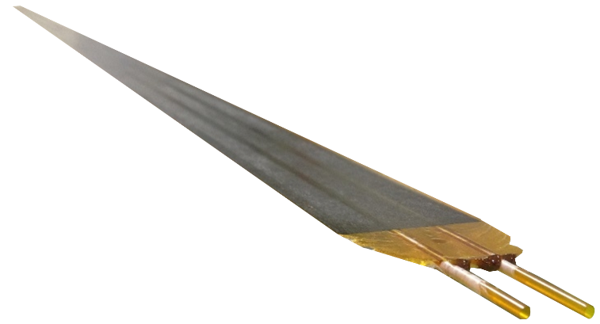
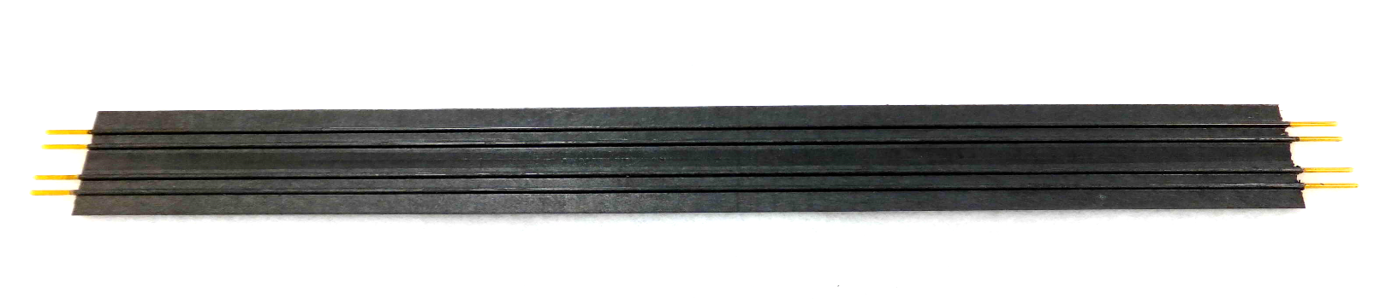
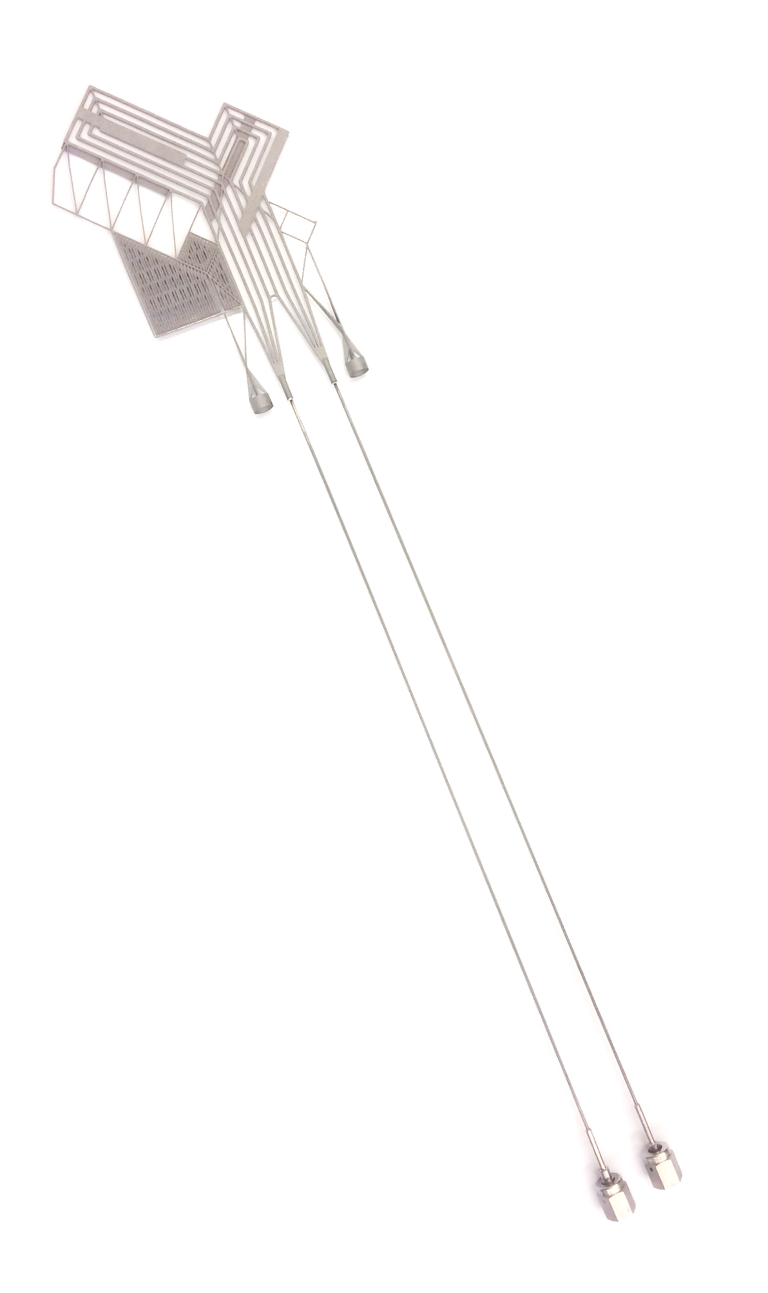
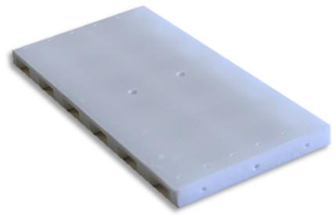
WP10.2: Ultra-light and 3D-printed structures with integrated cooling
Outline:
  Ultra-light structures with integrated cooling
  Carbon cold plate with embedded Kapton pipe
    Purpose,
    2021 Highlights on characterization studies,
    Next and Planning
  3D-printed structures with integrated cooling
  AM Ceramic & Metal cold plates
    Purpose,
    2021 Highlights on characterization studies,
    Next and Planning
Sensor
Sensor
Sensor
Sensor

Slide 4
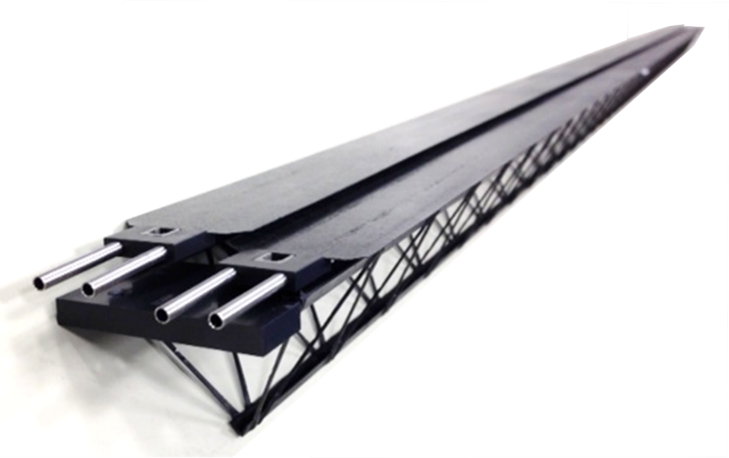





Ultra-light structures with integrated cooling
Carbon Cold Plate (CP)
with embedded Kapton pipes
Up to 1.5m
Developed by
ALICE ITS2 OB Stave configuration
Used in ALICE in 2 detectors:
ITS and MFT (LS2)
2 x cold plate
Also used by
DI water,
Leak-less mode,
T ambient
MPD, IT (JINR)
NA61
Spaceframe
~1.5m long
Purpose:
Compatible with high-pressure liquid coolants: Two-phase CO₂ refrigerant and new coolants (Krypton,…).
Produce extended Carbon CP to cover large surfaces: understand their potentialities and limitations (considering minimum bending radius, pressure drop and pressure resistance limitations).
Collaboration between CERN and Workshape (composite company).

Slide 5
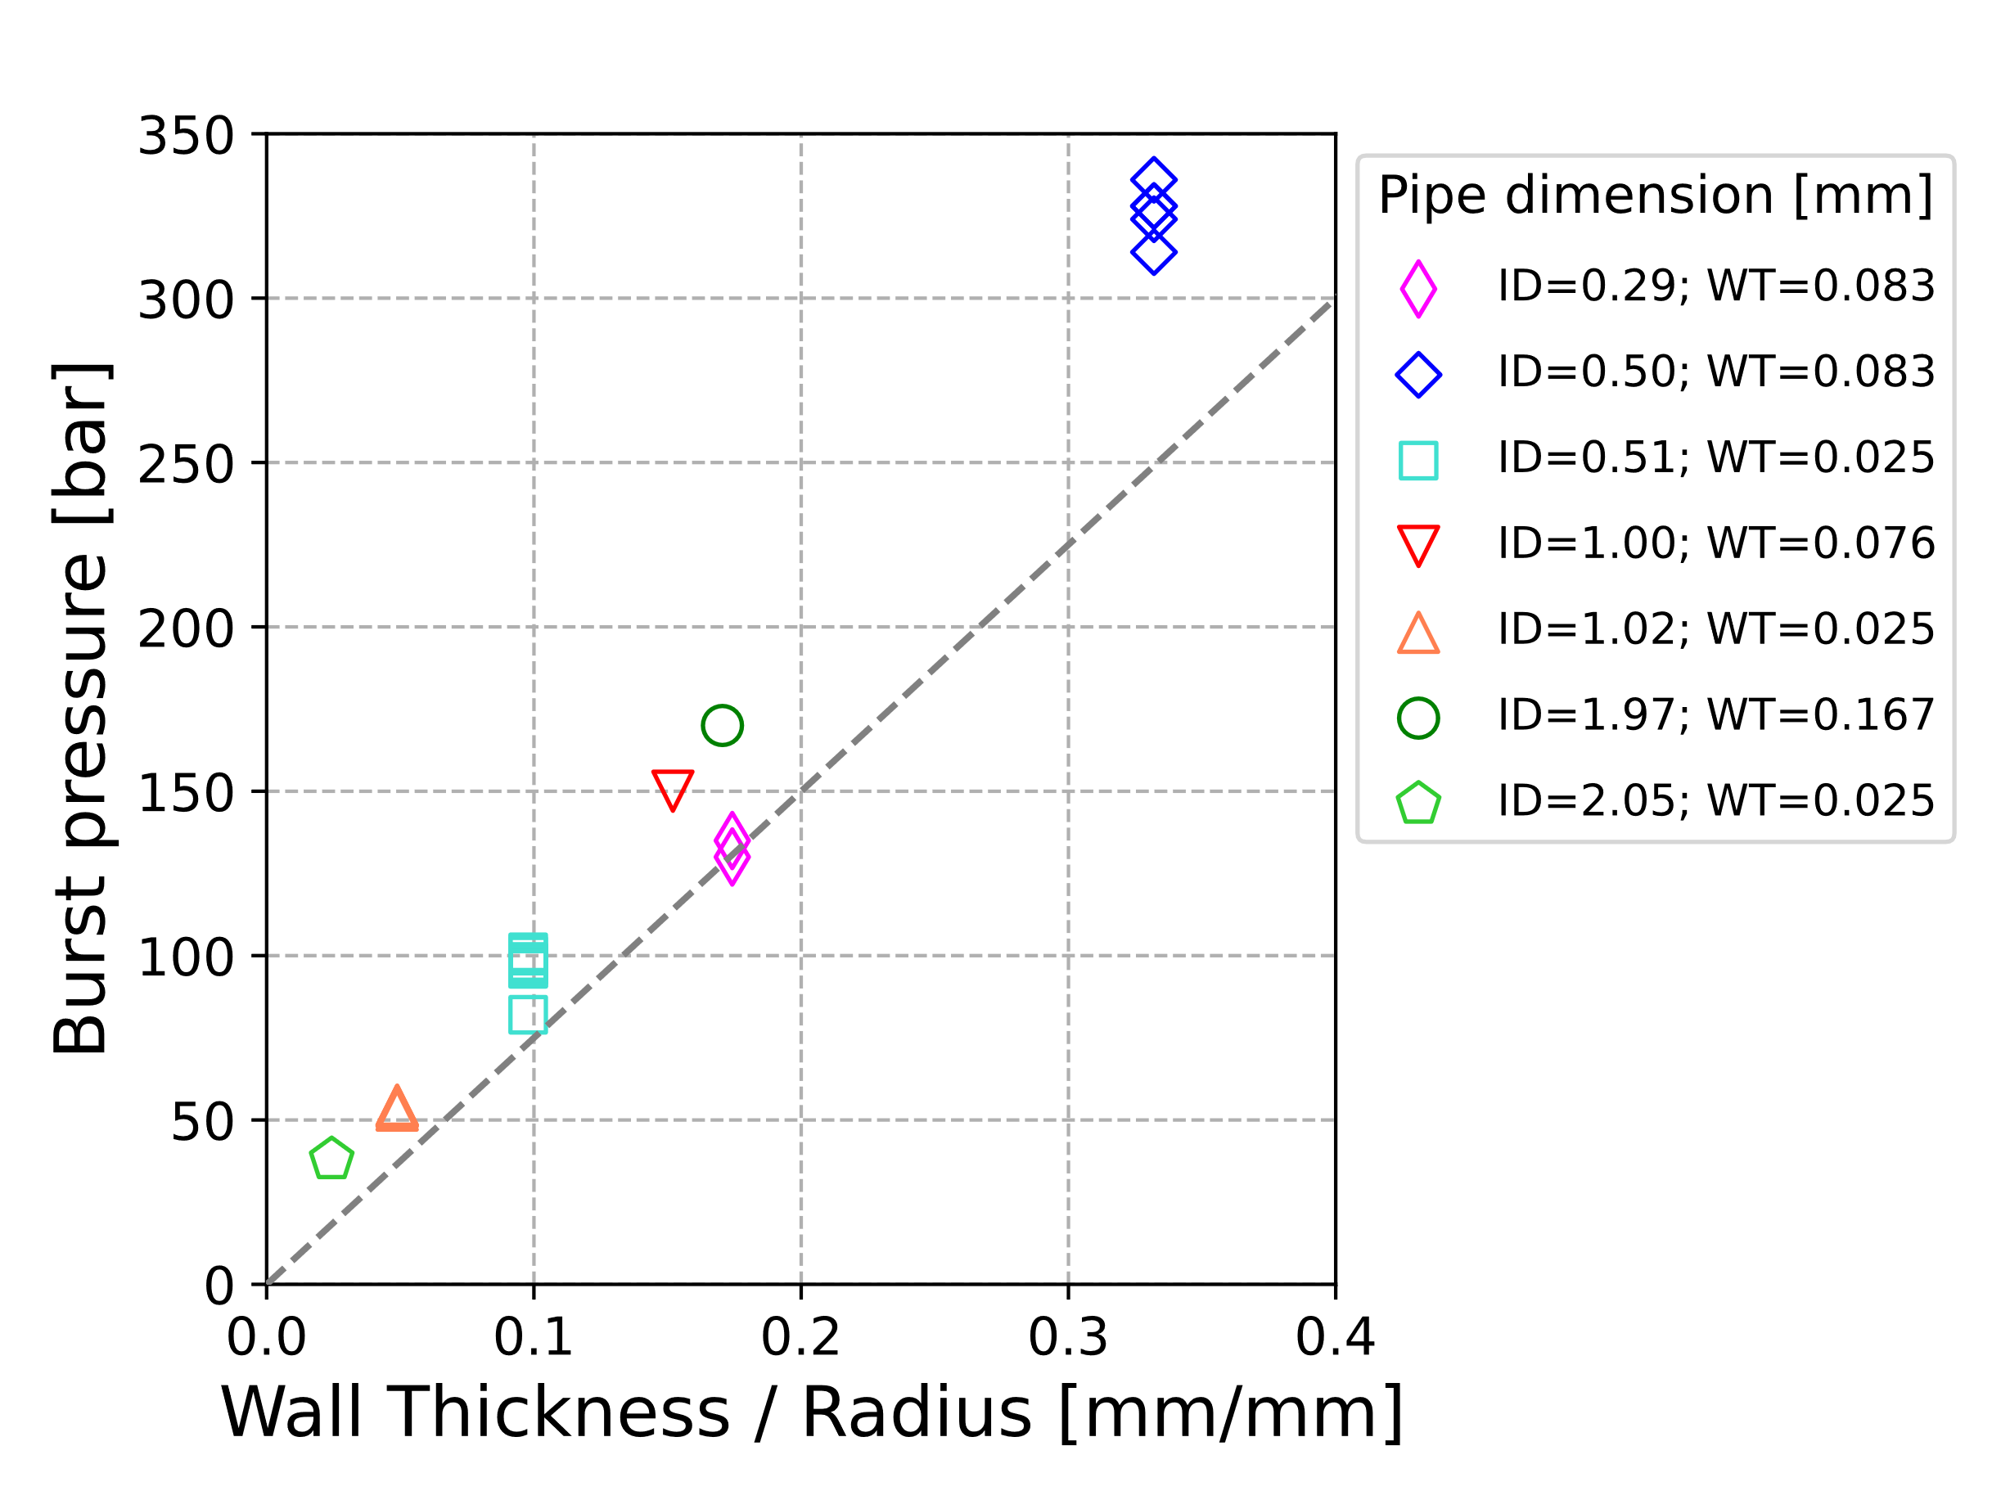
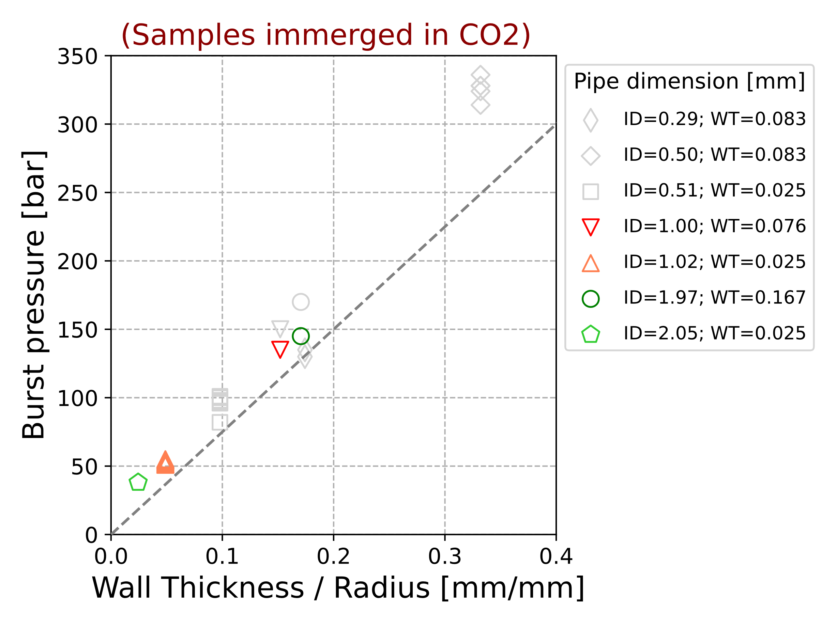
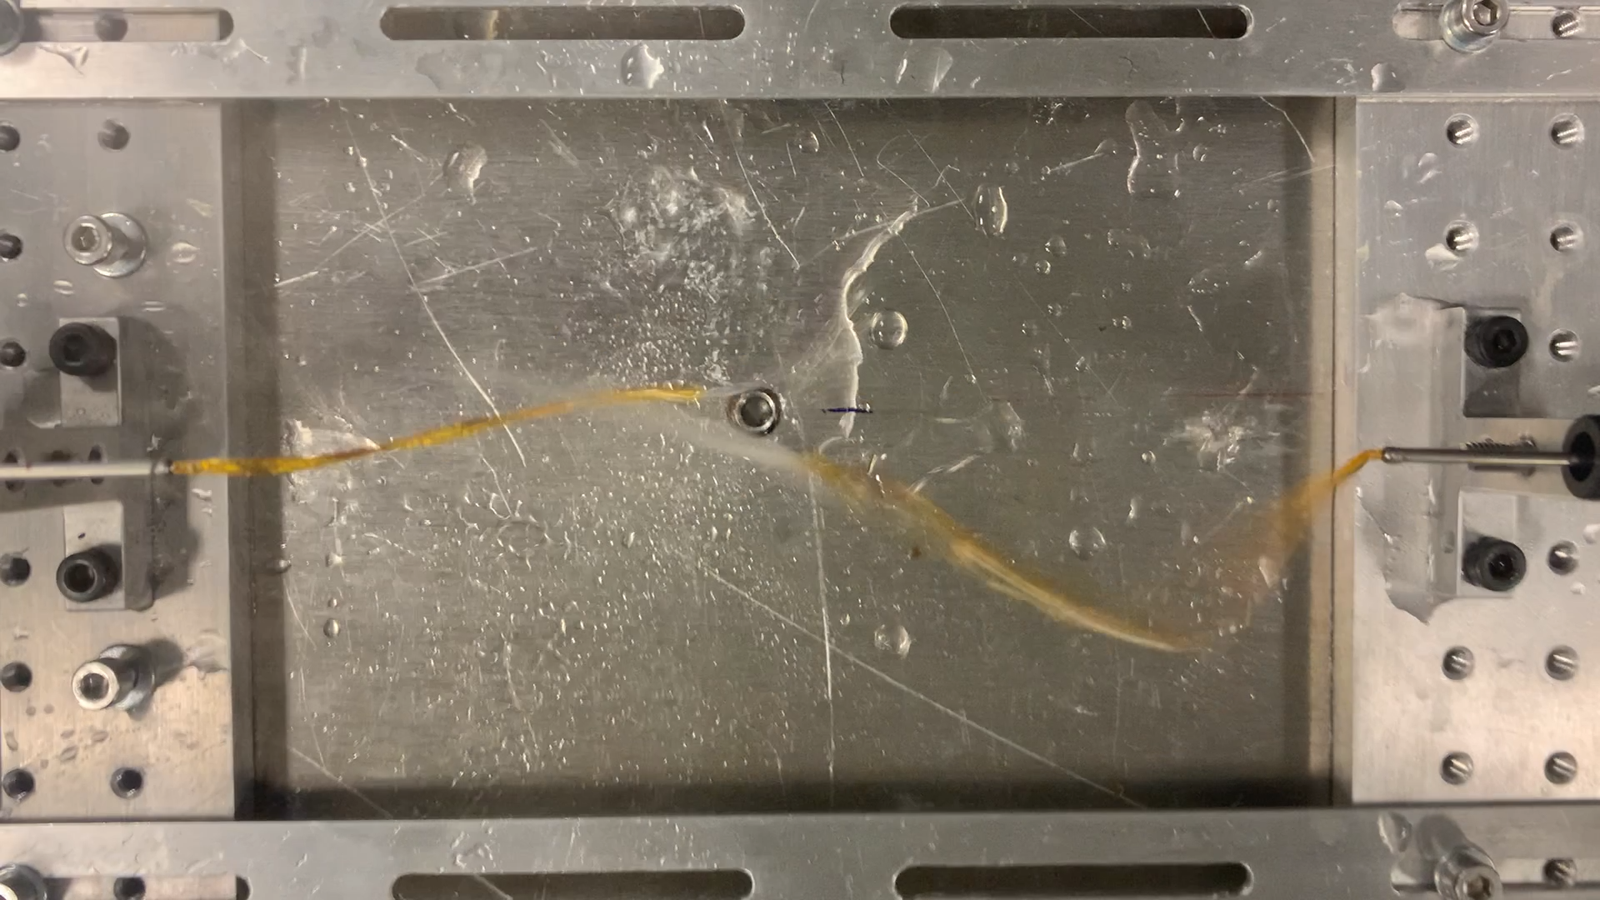


Ultra-light structures with integrated cooling
CERN EP R&D WP4
2021 Highlights
Kapton pipe characterization:
  Pressure test:
(Samples immerged in CO2* prior the test)
$${Theoretic P}_{burst}$$
$$P_{burst}=\frac{{σ_{hoop} t}_{wall}}{r}$$
Burst Pressure & Pressure drop test
$$σ_{hoop}>75 MPa$$
(Demineralized water)
*3 weeks (2 weeks at T=22°C, p=45 bar; 1 week at T=-28°C, p=15bar, v.quality=0.3)
  Permeation test with CO₂
(Preliminary)
Samples: Kapton foils (DuPont Kapton HN) of 25 um, 50 um, 75 um and 125 um thickness, glued to CuOFE gaskets (Polymerlab, Scotchweld 2216)
Sample | CO₂ Permeation from series fit [l cm/cm² s]
Kapton 25 um run 1 | 3.20e-12
…..
Kapton 125 um run 1 | 2.85e-12
@CERN TE-VSC-SCC

Slide 6
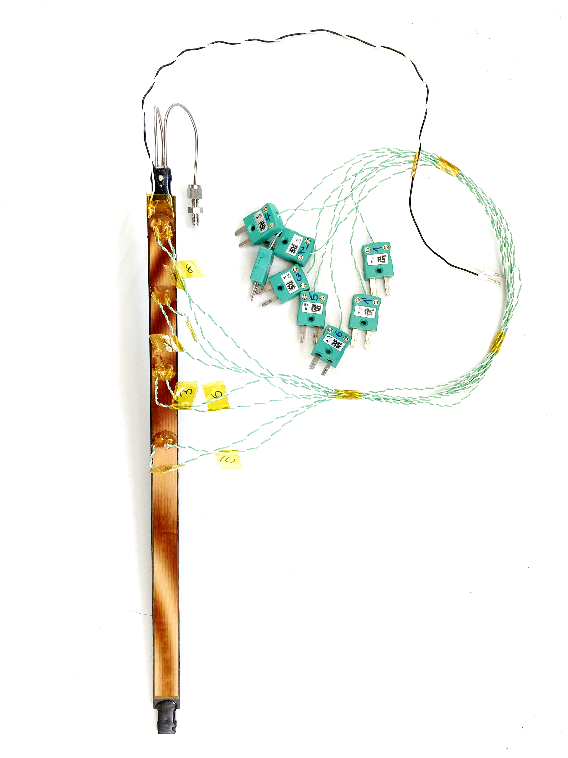
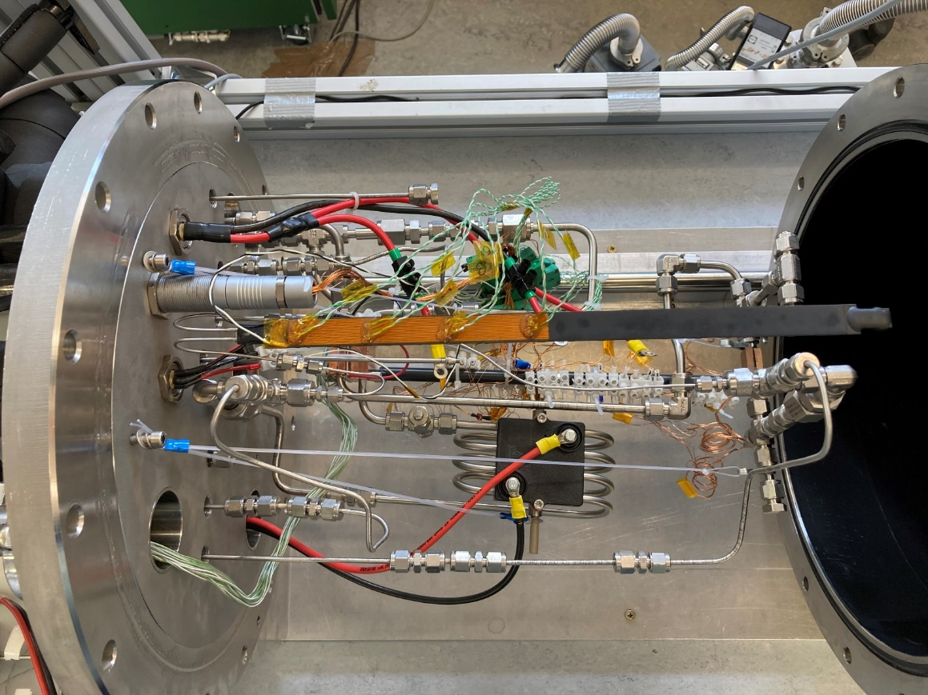
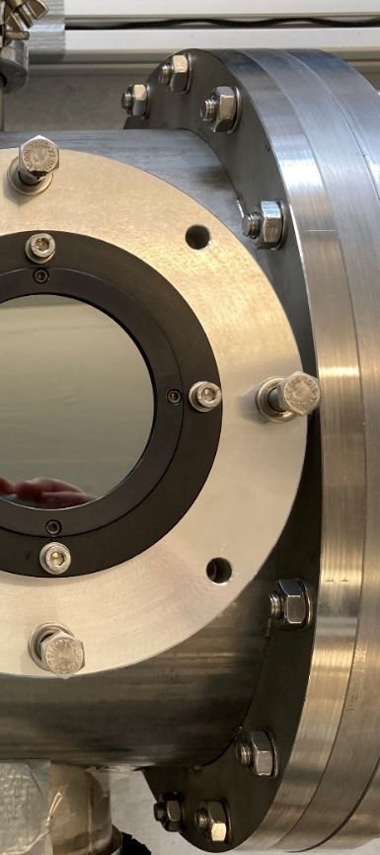
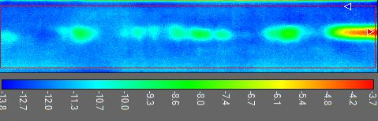
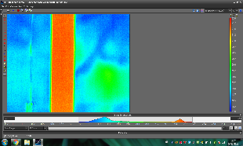
Ultra-light structures with integrated cooling
CERN EP R&D WP4
2021 Highlights
ALICE ITS2 IB Cold plate test with two-phase CO₂
D. Hellenschmidt (CERN EP R&D Fellow)
Thermal-fluidic test set-up
Proof of concept
ALICE ITS2 IB Cold plate
Spray coating
IR Camera
T_{sat} -20°C
q 0.5 W cm⁻²
G 300 kg m⁻² s⁻¹
T _{mean chip} -12°
ΔT _{across chip} 10°C
ΔT _{fluid-sensor} ~ 8°C
Vacuum Chamber
Kapton tubes withstand the high pressure (~20 bar) & circulation of CO2 is possible
CERN CO2 test facility for mini- and micro-channels

Slide 7

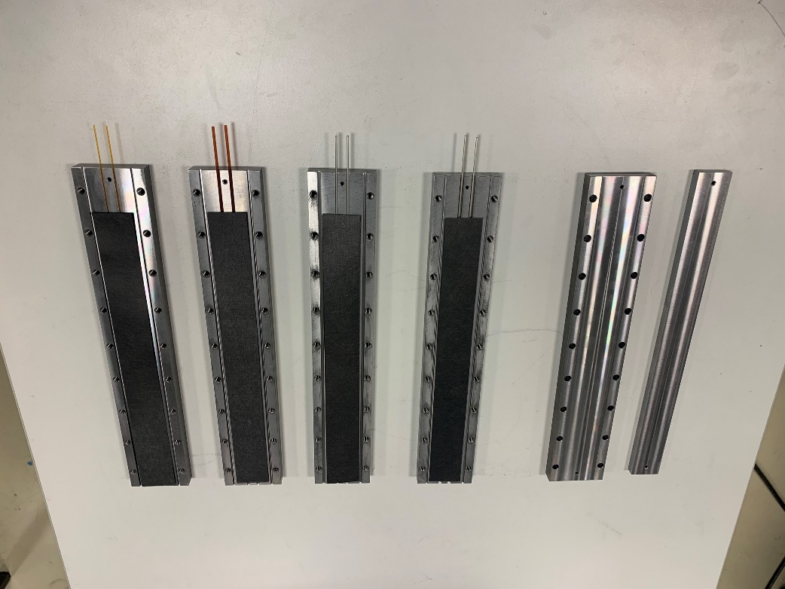
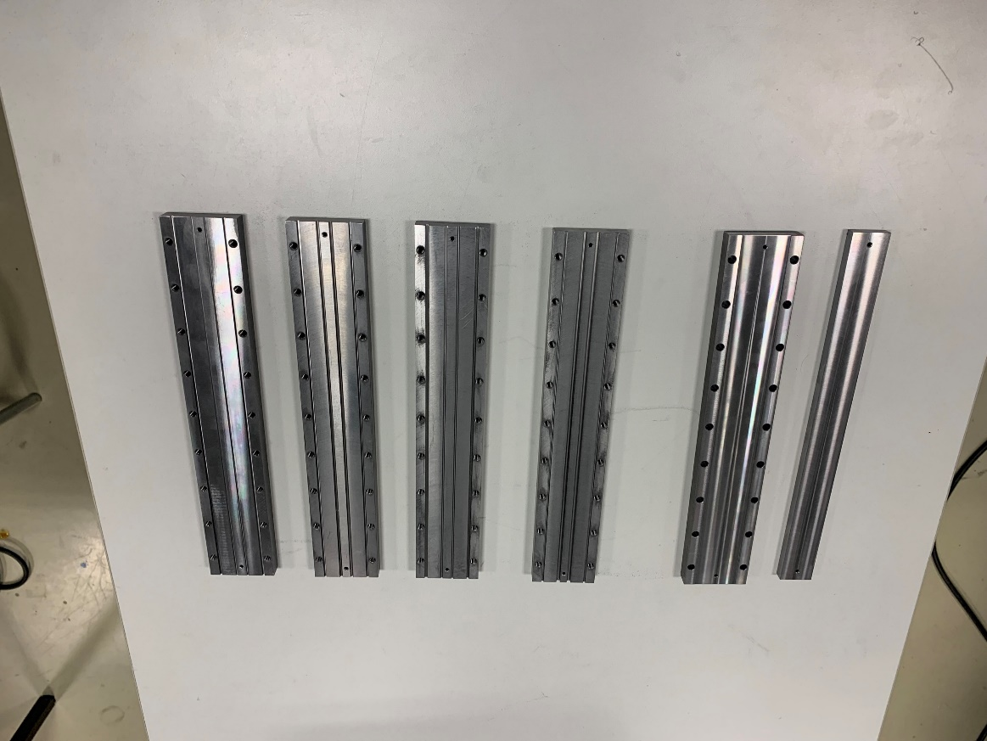

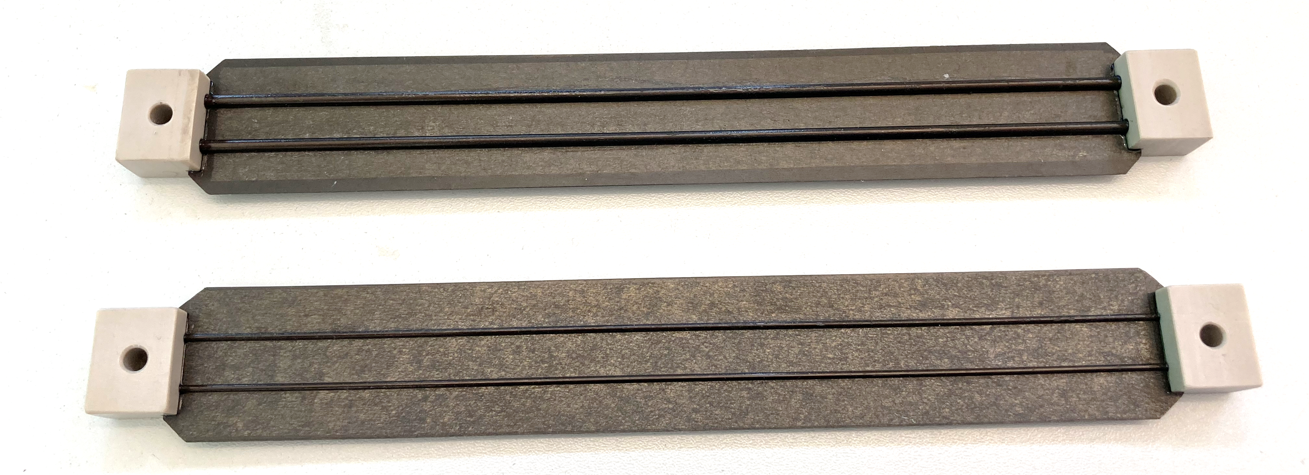

Ultra-light structures with integrated cooling
CERN EP R&D WP4
NEXT: High Pressure CPs production
for CO₂ comparison test
D. Hellenschmidt
Steel
VS
Kapton
(ATLAS,CMS like configuration)
(ALICE like configuration)
HP CPs ready for test
(with Kapton pipes)
200mm
NEXT: WORKSHAPE Collaboration
Transfer Know-how for CPs production
Support future samples production
 | Steel | Steel | Kapton | Kapton
ID [mm] | 2.15 | 1 | 1.97 | 1.024
WT [mm] | 0.51 | 0.29 | 0.167 | 0.076
2022
Jan | Feb | Mar | Apr | May | June |  | July | Aug | Sept | Oct | Nov | Dec
… Kapton pipe characterization
CPs Production |  |  | CO₂ comparison test
 |  |  |  |  |  | CPs production at WORKSHAPE
Planning:

Slide 8
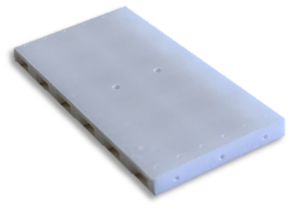
3D Printed structures with integrated cooling
Purpose:
Focus on the best attainable features respectively in terms of geometrical features, thermal-fluidic performances and mass minimization; and on the technological processes required to achieve them.
CERAMIC
The studies will be supported by Lithoz company, leader in additive manufacturing in ceramic materials (production of 3D print machines and component manufacturing).
Within CERN EP R&D alternative ceramic AM technologies are being investigated (Xjet, Fabrica Group, Kyocera, Adamant, …).
METAL
The studies will be supported by CERN EN-MME (3D printers) and CSEM (Experience with SWaP** - ATTRACT project ).
Within CERN EP R&D, different metal AM technologies are being investigated (3D systems, Microfabrica, …).
Material: Aluminum oxide (Al2O3), Aluminum
nitride (AlN), polymeric-ceramic composite*
Material: Al alloys (AlSi12, EN AC-44300),
nickel-iron alloys (Invar and Kovar)
*Polymerised light-sensitive organic matrix in which high-purity ceramic powder is dispersed. (Green part, before de-binding and sintering)
**Smart wall pipes and ducts, link

Slide 9
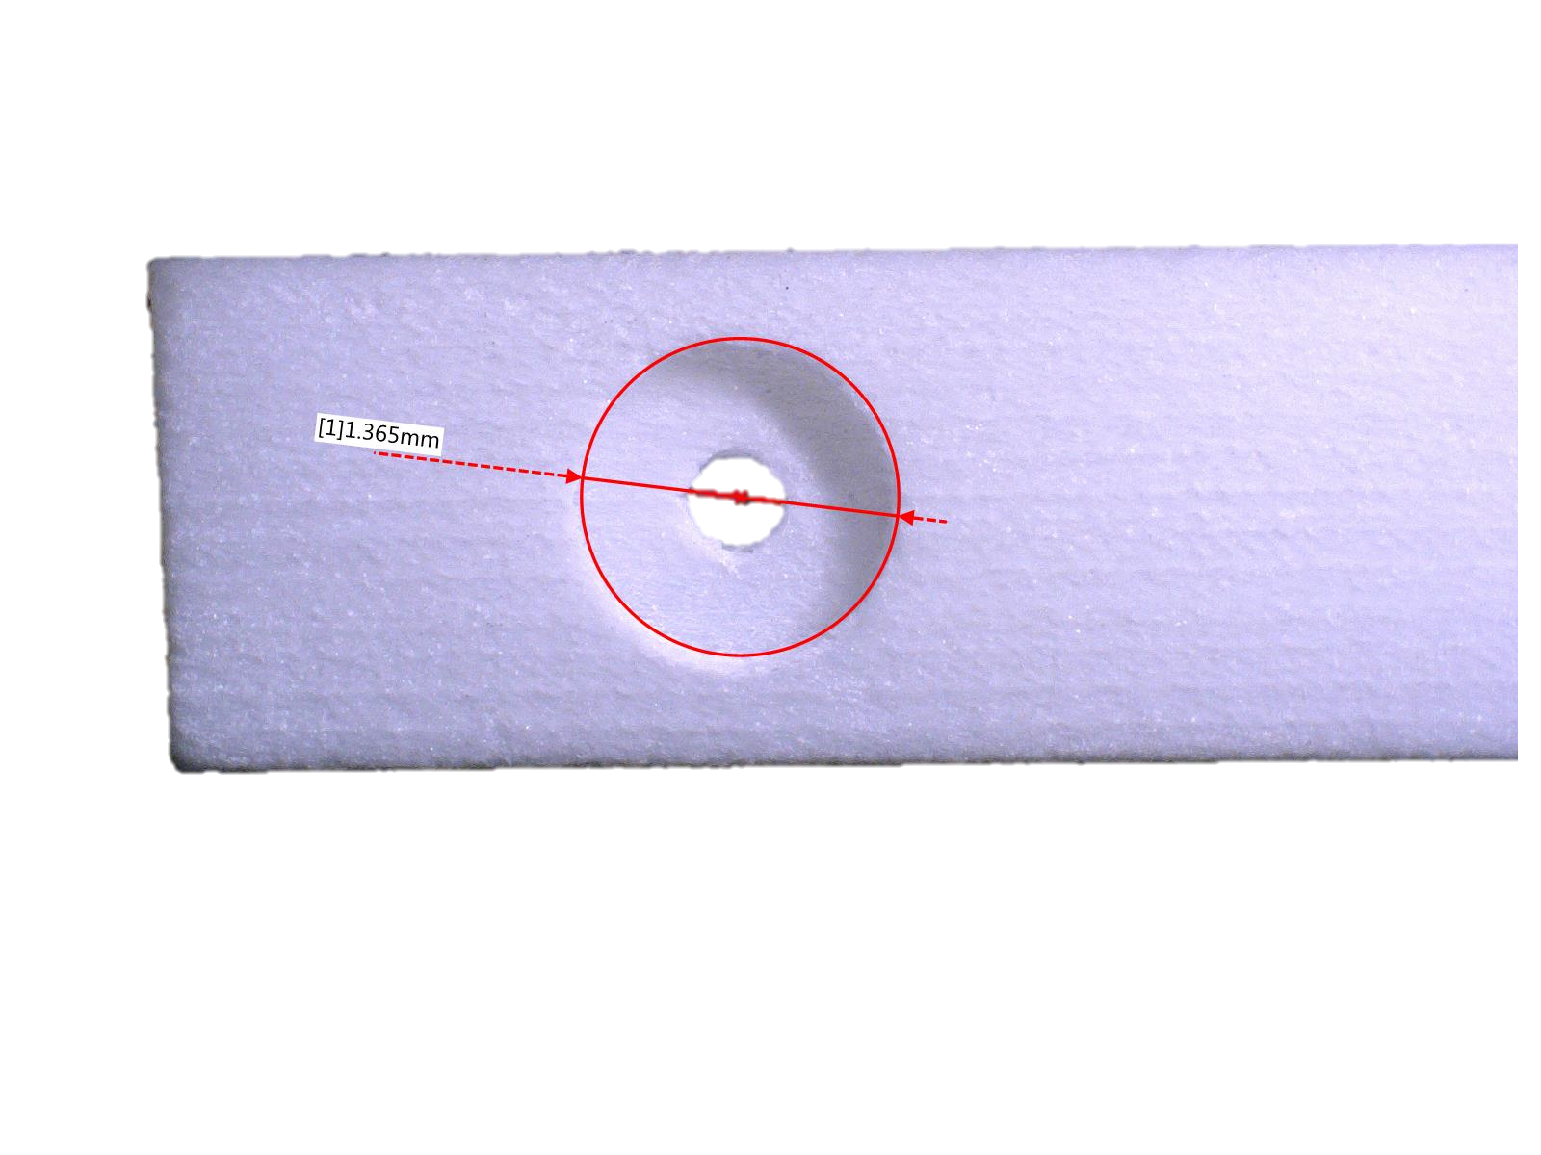
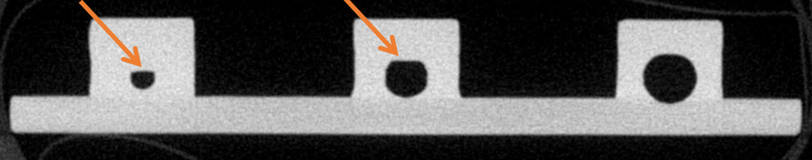
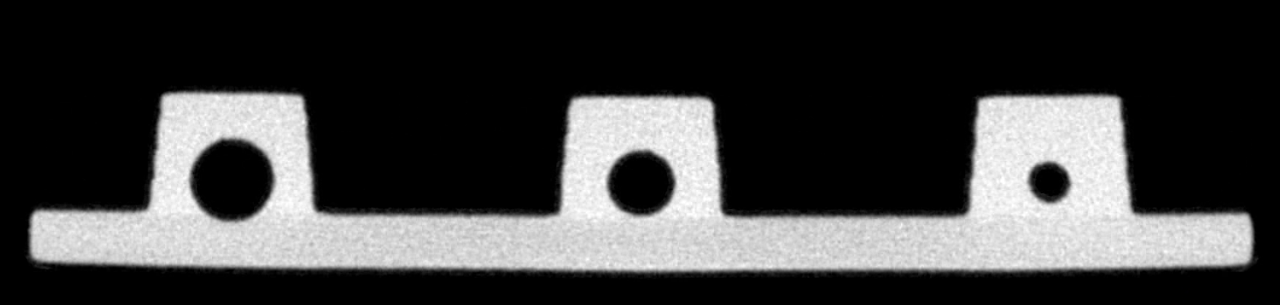
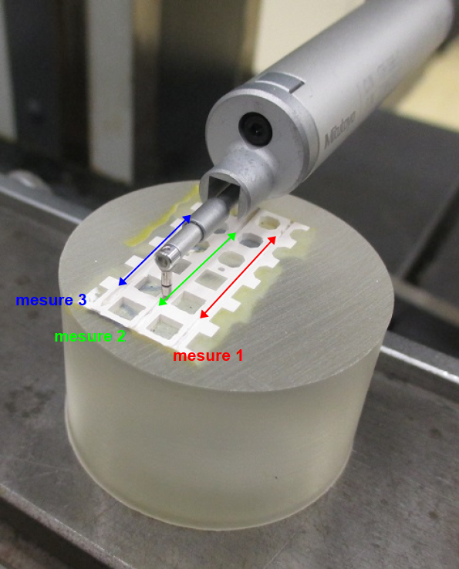
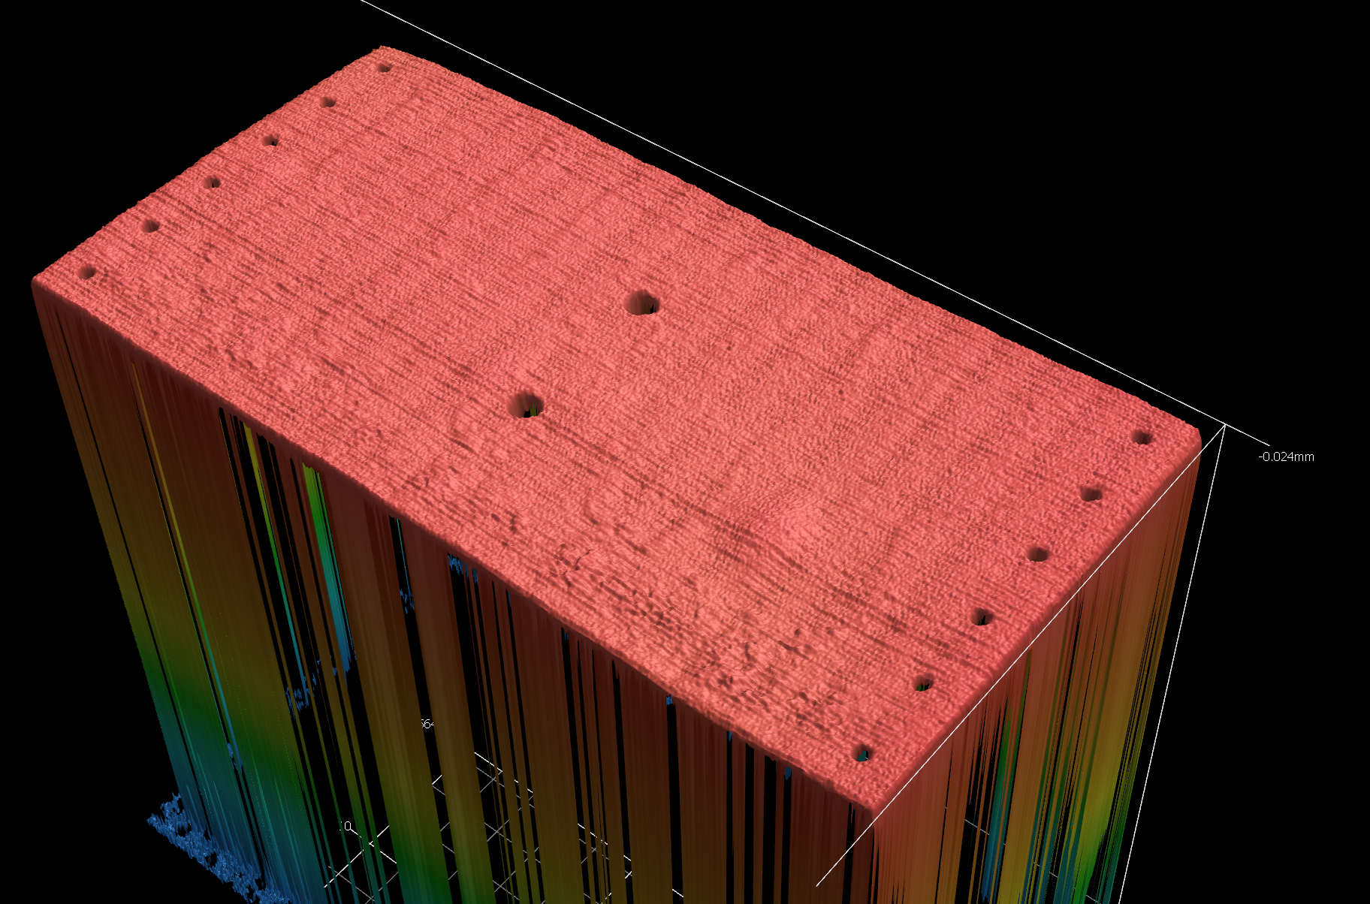
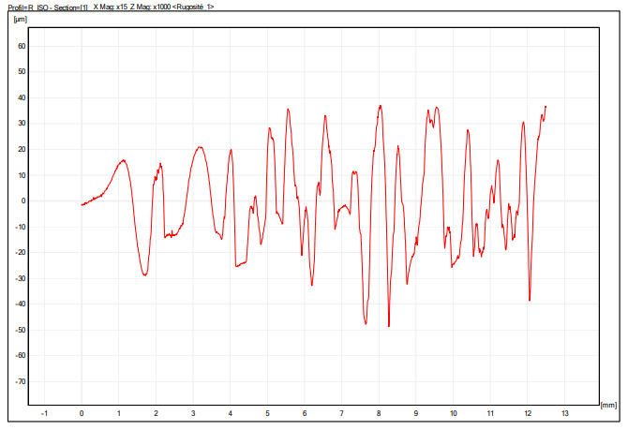
3D-printed structures with integrated cooling
CERN EP R&D WP4
2021 Highlights
Preliminary ceramic AM process characterization
  Performed in the framework of a modular cooling substrate investigation (EP R&D subject)
Substrate defects and channel obstructions (x-ray computed tomography)
Zeiss METROTOM 1500 CT scanner
Tomography resolution 7 um
15x30mm2
Different sample orientation
>90°
D 0.4mm
Printable ceramic
(Al2O3, Zr, SiC, AlN)
D=0.5 mm
D=0.7mm
D=1 mm
@CERN EN MME-MA
Channel roughness measurements (Profilometer)
Substrate roughness, flatness (3D scan)
LCM, Alumina, flat orientation D=0.7mm
Wide-Area 3D measurement system
R_{a}=14.6 µm
Keyence VR5200
S_{a} (arithmetical mean height) = 6 µm
Height magnification 1200%
Height measurement accuracy of +- 3 um and a repeatability of 0.4 um
@CERN EN MME-MA

Slide 10
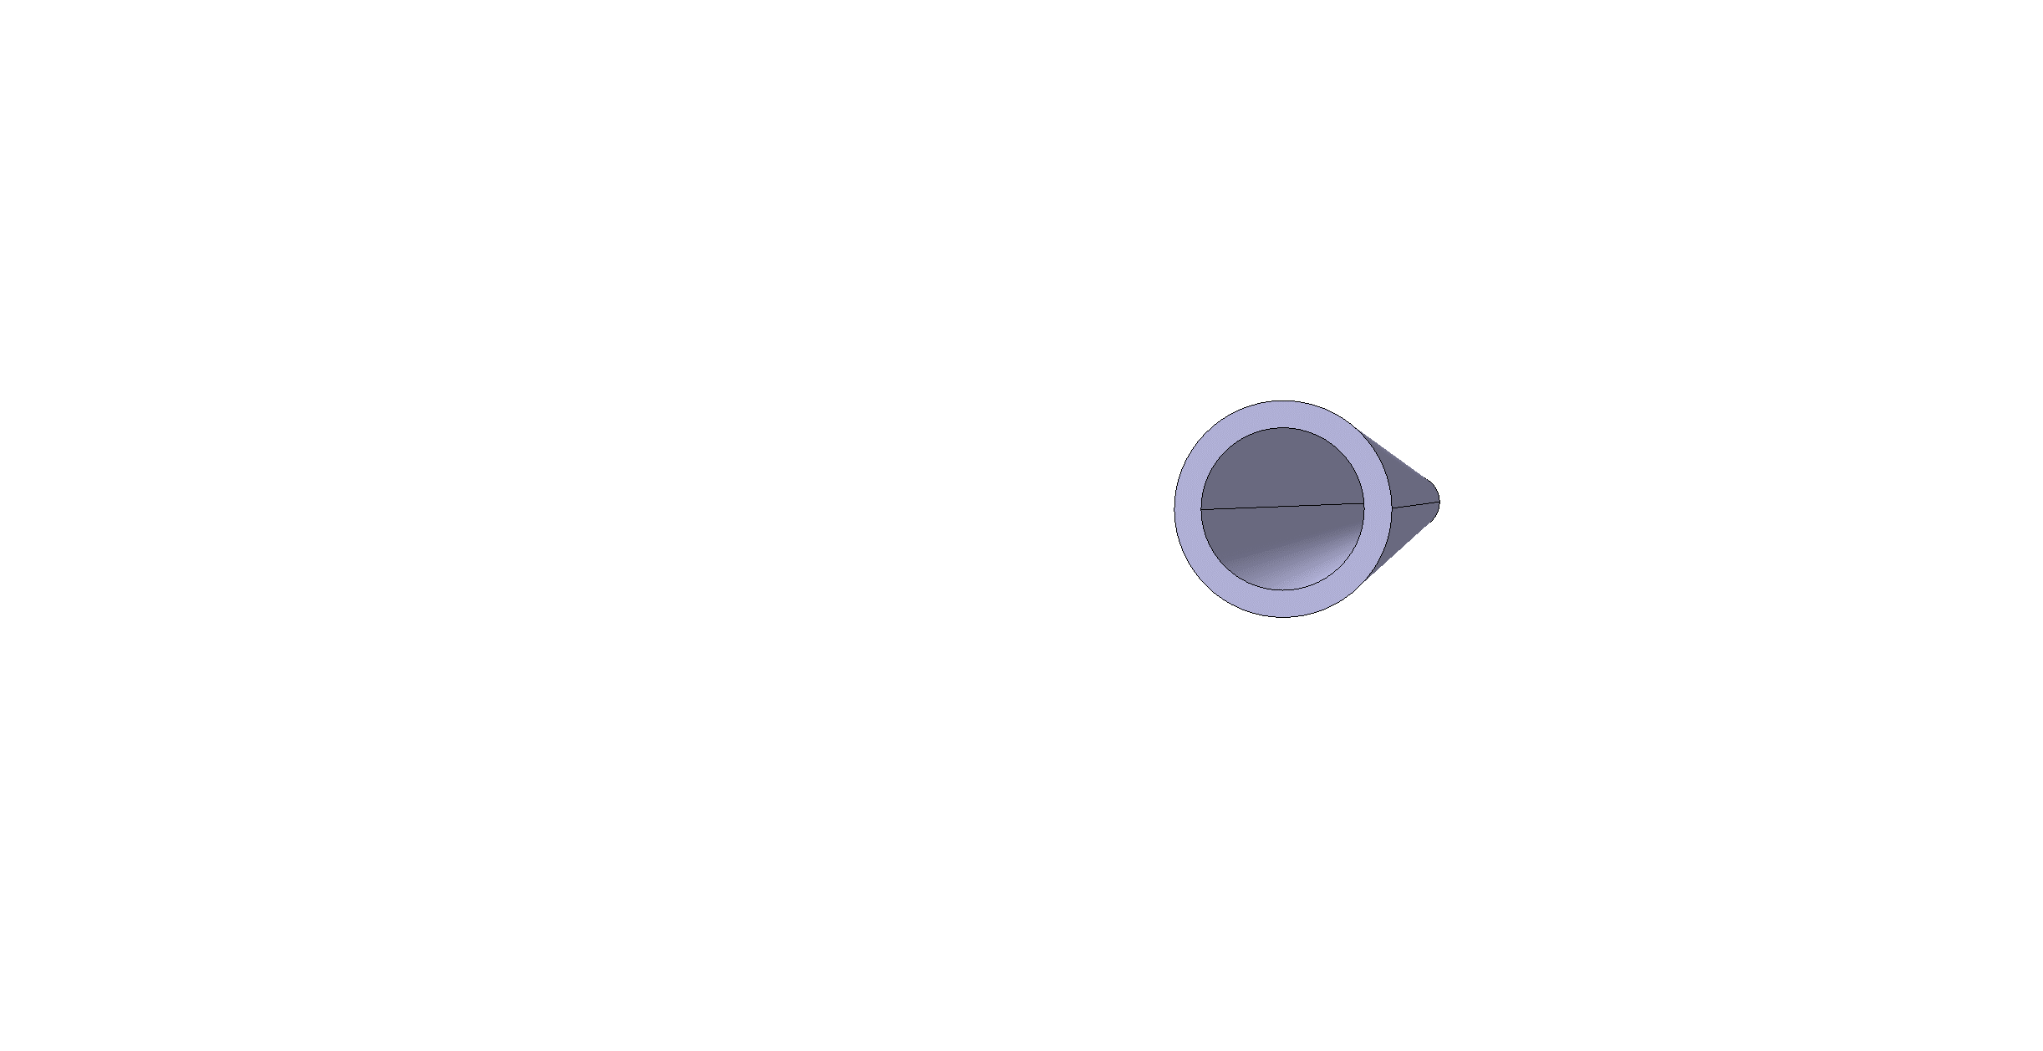






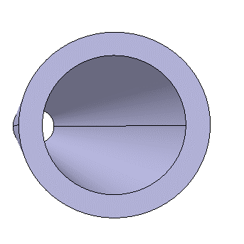
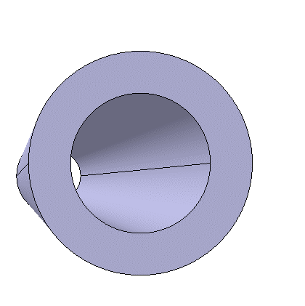


3D-printed structures with integrated cooling
NEXT: CERN, CSEM and Lithoz will work to explore
Geometrical limits (substrate flatness, minimum wall thickness, channel leak-tightness, inner wall roughness, dimensional manufact accuracy…)
For polymeric-ceramic composite: Define and optimise polymeric matrix (acrylate-based or epoxy based) producing parts with good mechanical properties and investigation of tolerance to the ionizing radiations
WT= 0.2 – 0.6 mm
Planning:
2022
Mar | Apr | May | June | July | Aug | Sept | Oct | Nov | Dec
 |  | Samples production (Ceramic & Metal)
 |  |  | Characterization test at CERN and INFN
Future collaboration TASK 10.3 (CNRS-LNPHE Paris and INFN) substrate-substrate interconnection.
Interconnection solution developed in EP R&D WP4: https://indico.cern.ch/event/1063927/ ,
Publication: https://doi.org/10.1016/j.mee.2022.111707

Slide 11
THIS IS THE END…
Thank you
for your attention

