Slide 1

The PIN structured Si sensor for the ALICE FoCal / APD structure into the pixels for the LS3 upgrade
YOUNG HOON HAN

Slide 2
The PIN structured Si sensor for the ALICE FoCal

Slide 3
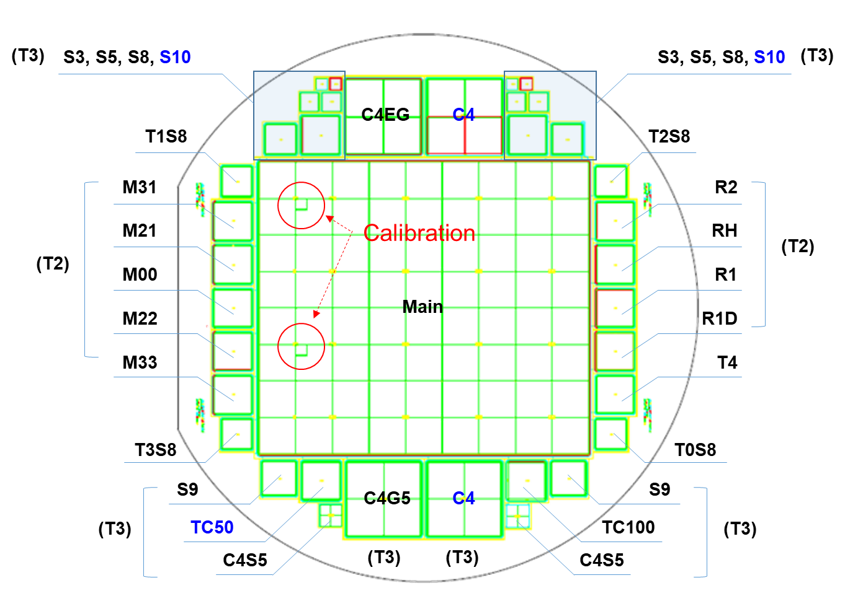
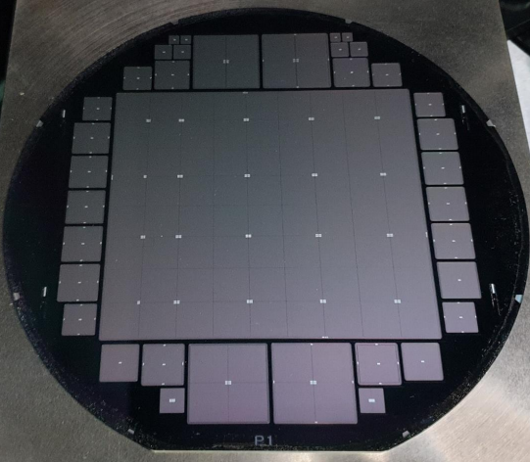
Processed Submission
As a plan we announced at previous workshop, we proceed submission with design considered
Fixed version of Mask design
Fabricated sensor
With various types of test patterns

Slide 4
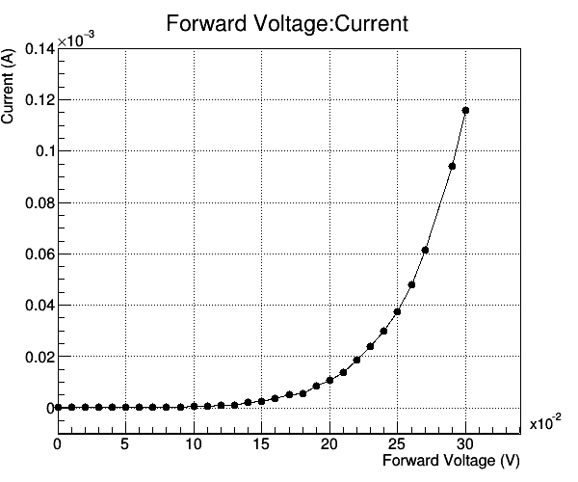
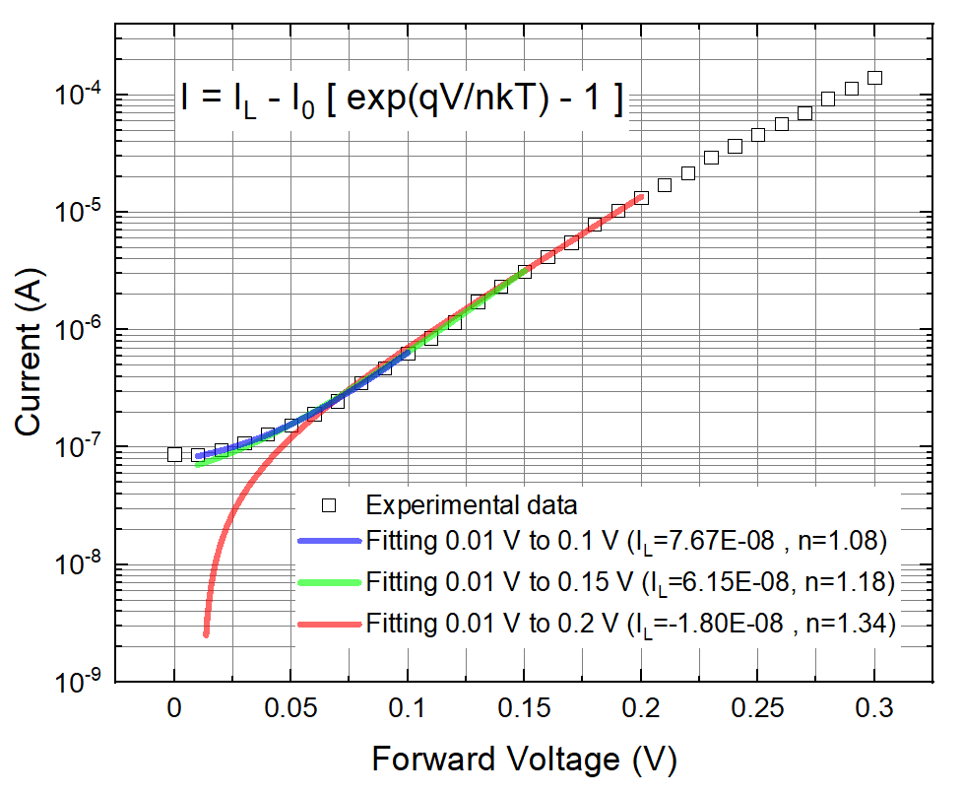
Characteristic of fabricated sensor
Device show turn on at 0.2V, general forward characteristic of diode
Device’s ideality factor was measured as 1.21, so we could confirm device show enough quality of being diode

Slide 5
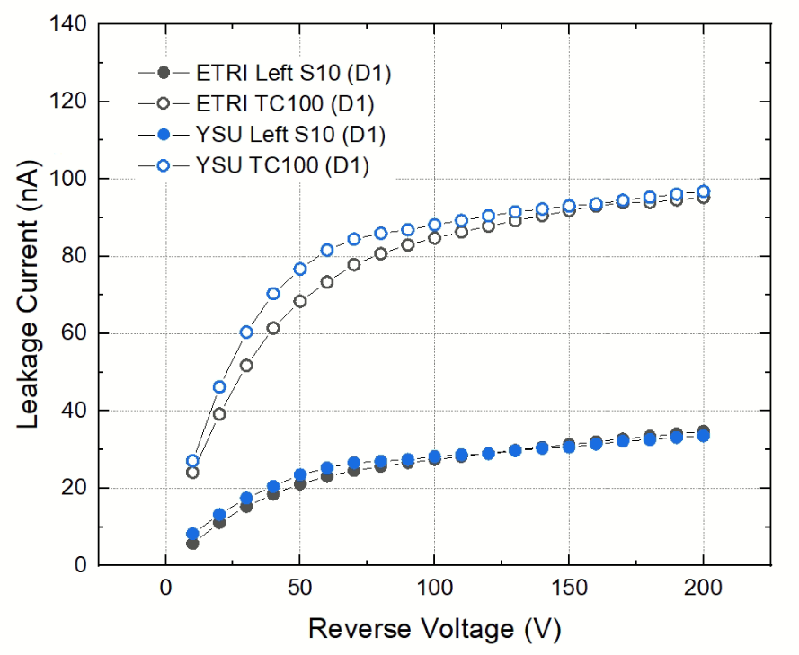
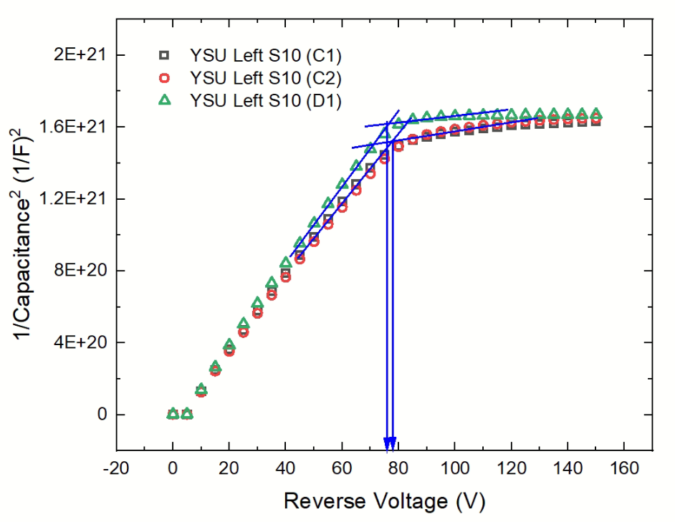
Characteristic of fabricated sensor
There exist some variation at leakage level, but nearly all pattern show leakage level under 1$μ$A, which was our limitation to use for detector
By measuring capacitance, we find that full depletion is achieved at under the half of breakdown voltage, so we concluded it can be operated for ALICE E-FoCal

Slide 6
GR structure study using test pattern
GR structure
Patterns
Main guardring
Tertiary guardrings
Oxide
N⁺
N⁺
N⁺
N⁺
N⁺
P⁺
Intrinsic P⁻ Wafer
P⁺
Give some variances at GR
structures using test pattern
GR numbers, width, rounding.. etc

Slide 7


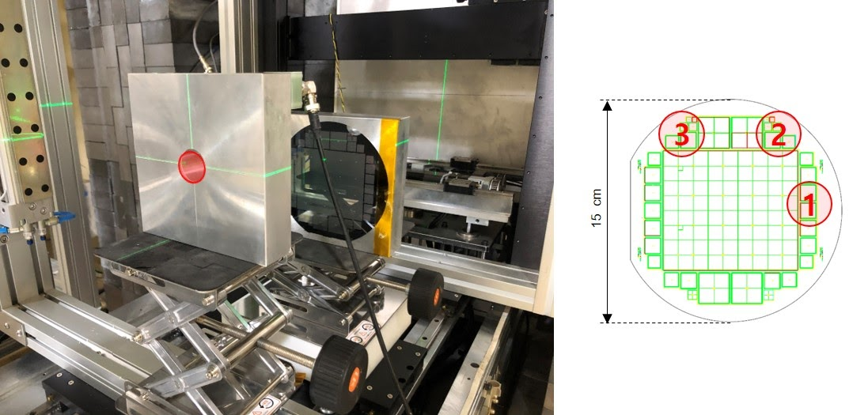
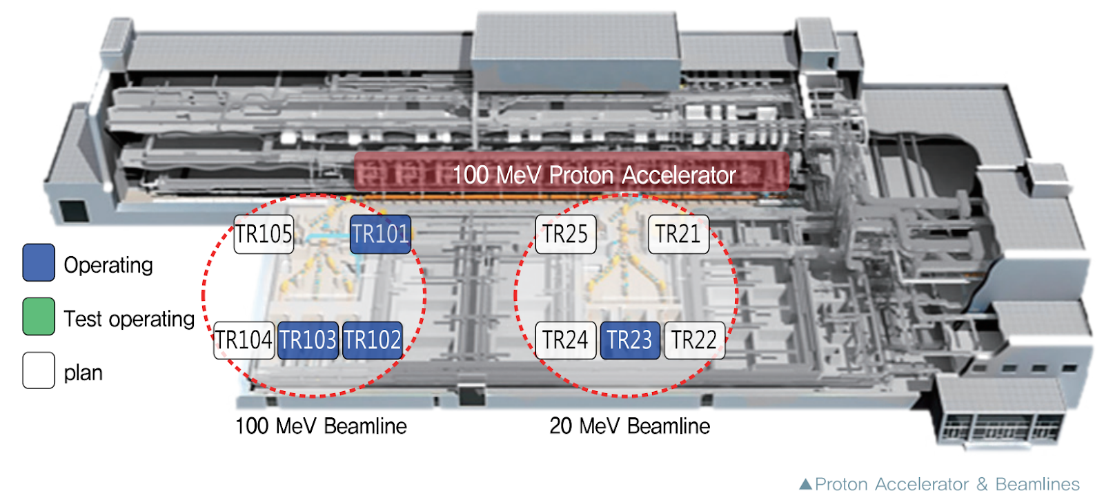
Radiation test
In order to study radiation hardness issues, we perform experiments at KOMAC.
We use two beam line to do research about type-inversion
and leakage current variations due to irradiation

Slide 8
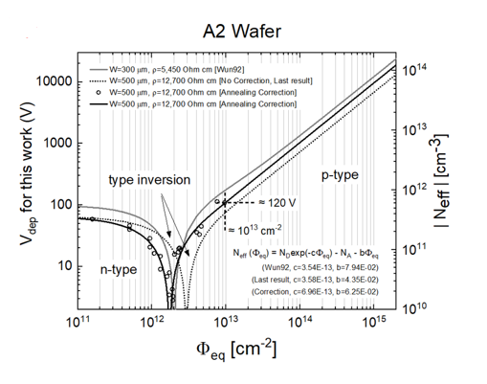
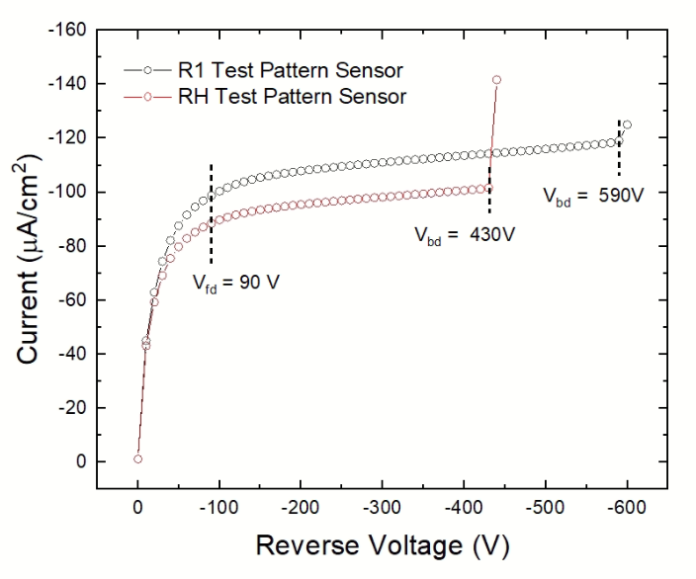
Radiation test
IV Plot
1E+13 n_{eq}/cm²
Proton flux injected was choosed by ALICE FoCal radiation criteria
We check type inversion and increased leakage current

Slide 9
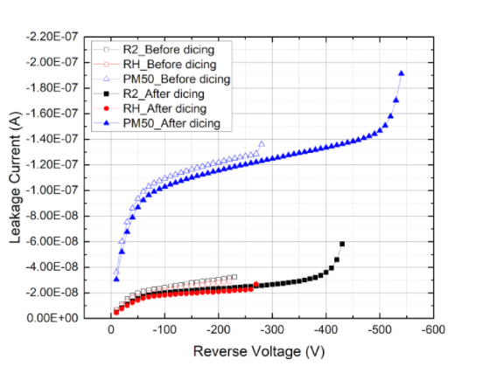
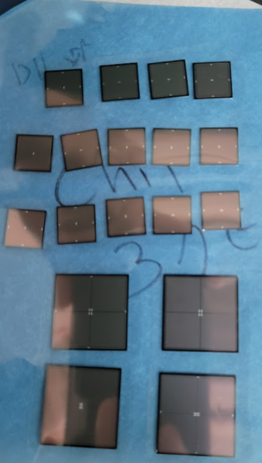
Dicing study
Dicing improved leakage current of sensor

Slide 10
APD structure into the pixels for the LS3 upgrade

Slide 11










Considered APD structure
$$18um$$
$$N node$$
$N$ blancket
$N$ gain layer
Avalanche region ~ 1um
$P$ gain layer
$$30um$$
$P−epi$layer
$$P+substrate$$

Slide 12
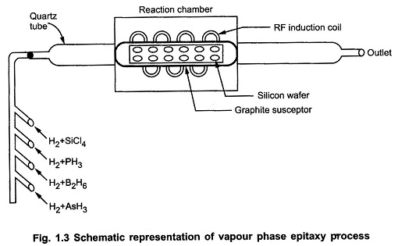
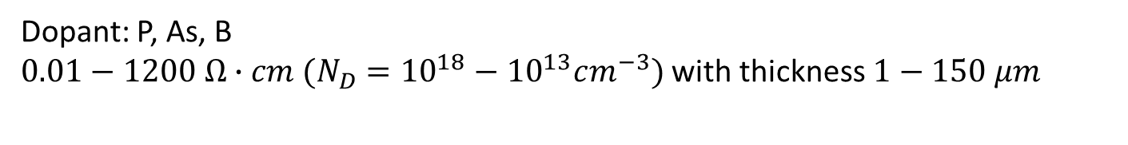

Considered technology of ‘Epitaxial growth’
Typical growth rate: $1 μm/hour$
Dopant: P, As, B
$0.01−1200 Ω∙cm (N_{D}={10}^{18}−{10}^{13}cm^{−3})$ with thickness $1−150 μm$
Claim for commercial service: https://svmi.com/service/epitaxial-wafer-service/

Slide 13
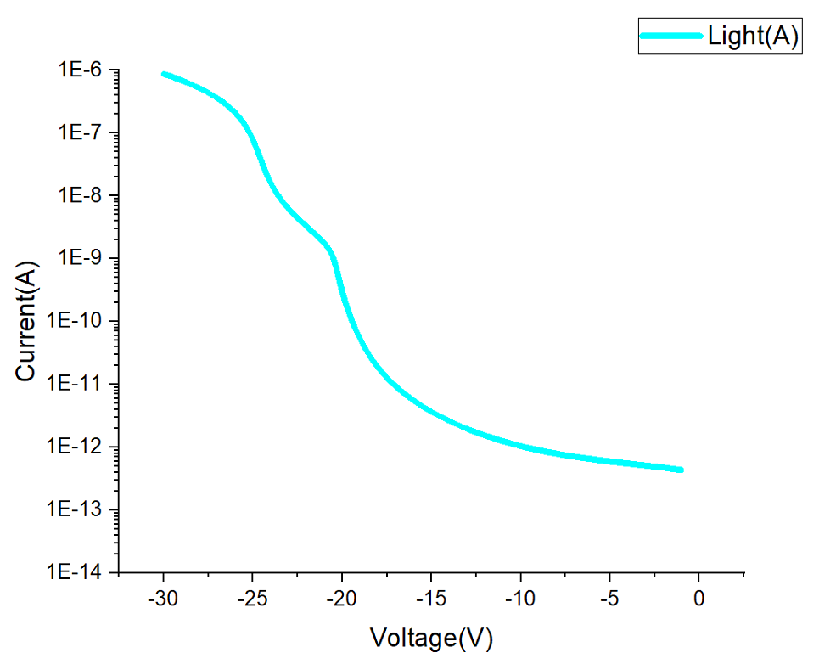
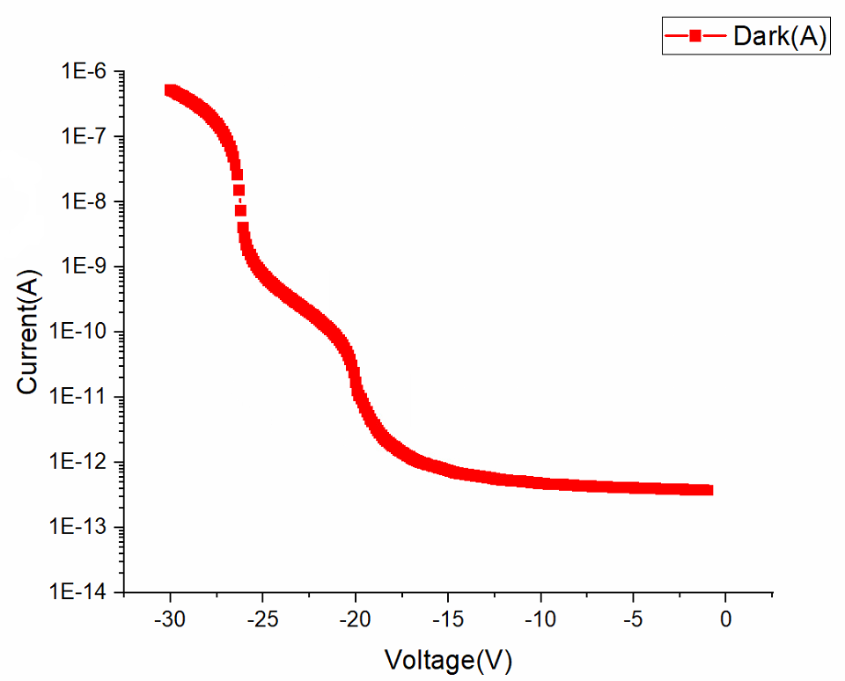
Key features of design
As a reverse bias is applied to P sub, avalanche PN junction region start to be depleted
Full depletion is achieved at 23V with gain of near 93 and we have margin about 3V
As shown at Dark current feature, Light current characteristic follow avalanche behavior due to depletion at junction

Slide 14
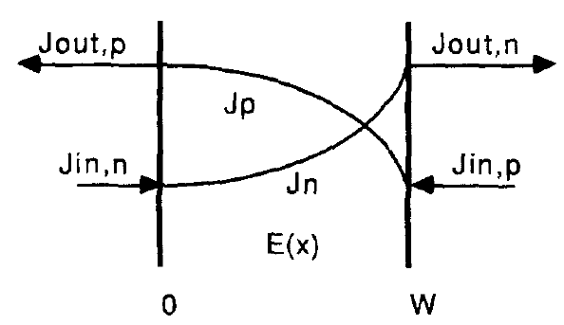
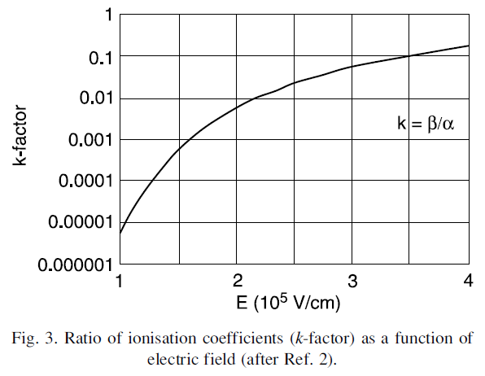
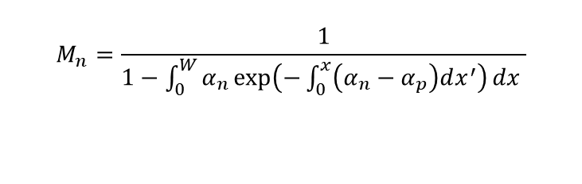



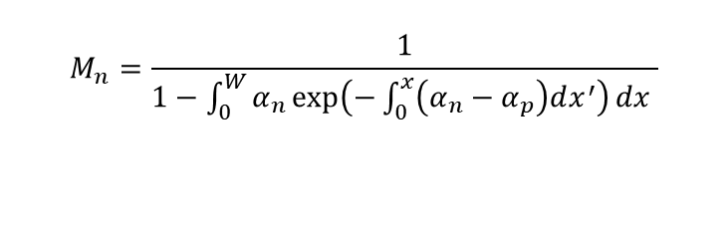
Hands estimation of APD gain
REF: IMPACT IONIZATION IN SILICON: A REVIEW AND UPDATE W. MAES, K. DE MEYER* and R. VAN OVERSTRAETEN IMEC vzw, Kapeldreef 75, 3030 Hevedee, Belgium Solid-State Electronics Vol. 33, No. 6, pp. 705-718, 1990
$${∇J}_{n,p}=±q(G_{n,p}−R_{n,p})$$
$$M_{n,p}=\frac{J_{out n,p}}{J_{in n,p}}$$
$$M_{n}=\frac{1}{1−\int_{0}^{W}{α_{n}\exp\left(−\int_{0}^{x}{\left(α_{n}−α_{p}\right)dx^{′}}\right)dx }}$$
Avalanche region
Use k-factor (ratio between electron and hole ionization coefficients) to estimate formula
$$M_{n}=\frac{1}{1−\int_{0}^{W}{α_{n}\exp\left(−\int_{0}^{x}{\left(α_{n}−α_{p}\right)dx^{′}}\right)dx }}$$
$$≈\frac{k−1}{k−\exp\left(\left(k−1\right)\int_{0}^{W}{α_{n}dx^{′}}\right)}=M_{n}(N_{a0},c_{a})$$

Slide 15








APD into the pixel
$$−1.2V$$
$$N node$$
$$−1.2V$$
$$Pwell circuit area$$
$$Pwell circuit area$$
$$pwell opening 5um$$
$$5um$$
$$N blancket$$
$$Gain region$$
$$30um$$
$$P−epi layer$$
$$P substrate$$
Insert previous APD structure into ALPIDE pixel
Reverse bias of 1.2V is applied at each deep P-well region

Slide 16
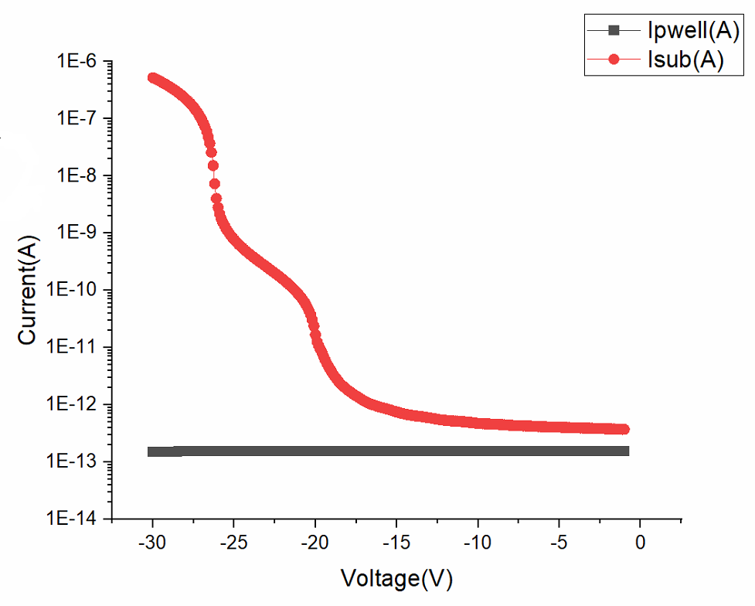
Key features persist!
$$Pwell −N_{a}=2E16 gauss$$
There were no big differences at current feature when we implant APD structure into the ALPIDE pixel structure
No punch through until system breakdown occur

Slide 17
17
Summary
As a plan, We processed submission and check characteristics of sensor
  Sensor’s characteristic was concluded enough to be used for ALICE E-FoCal
  Guardring structure study through test pattern
  Radiation hardness test was processed
APD structure study using Tcad was processed
  Inserting APD structure into the pixel doesn’t make change at avalanche behavior

Slide 18
Thank you for attention

