Slide 1
Design activities towards stitched sensor
Geunhee Hong
Yonsei University

Slide 2
Outline
Introduction
  ITS3 detector concept
  ITS3 timeline
MLR1
  Chip production
  TTS Measurement
ER1
  MOSS Monolithic Stitched Sensor
  Digital pixel implementation
Next generation sensor design for LS3

Slide 3
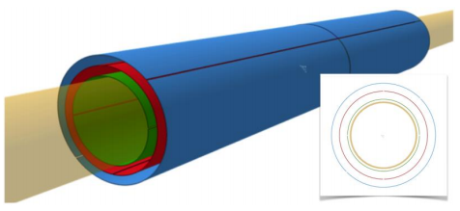
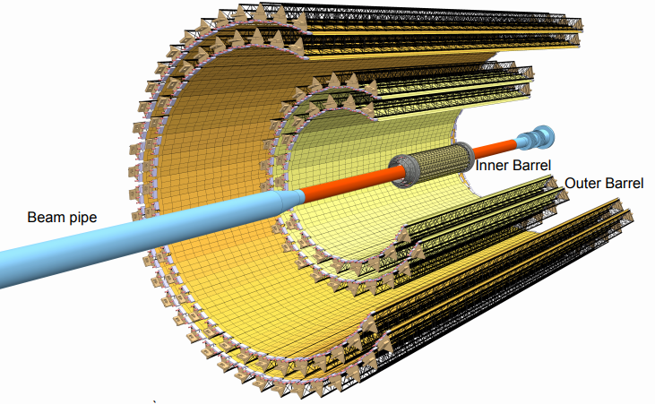
Introduction
Inner Barrel
“Technical Design Report for the Upgrade of the ALICE Inner Tracking”. ALICE Collaboration, B. Abelev et al. System. J. Phys. G 41, 087002 (2014).
https://indico.ph.liv.ac.uk/event/2/contributions/144/attachments/94/125/MBuckland_ALICE_HEPXmasMeeting.pdf
ITS3 detector concept
  The inner barrel in ITS2 is ultra-light but rather packed and irregular
  circuit board (power&data) / mechanical support / water cooling
  → Integrating on chip / Rolling Si Wafer / power consumption below 20mW/cm²
https://indico.cern.ch/event/932973/contributions/4073514/attachments/2141373/3608219/2020-11-12_FCC_ALICE_MAPS.pdf

Slide 4
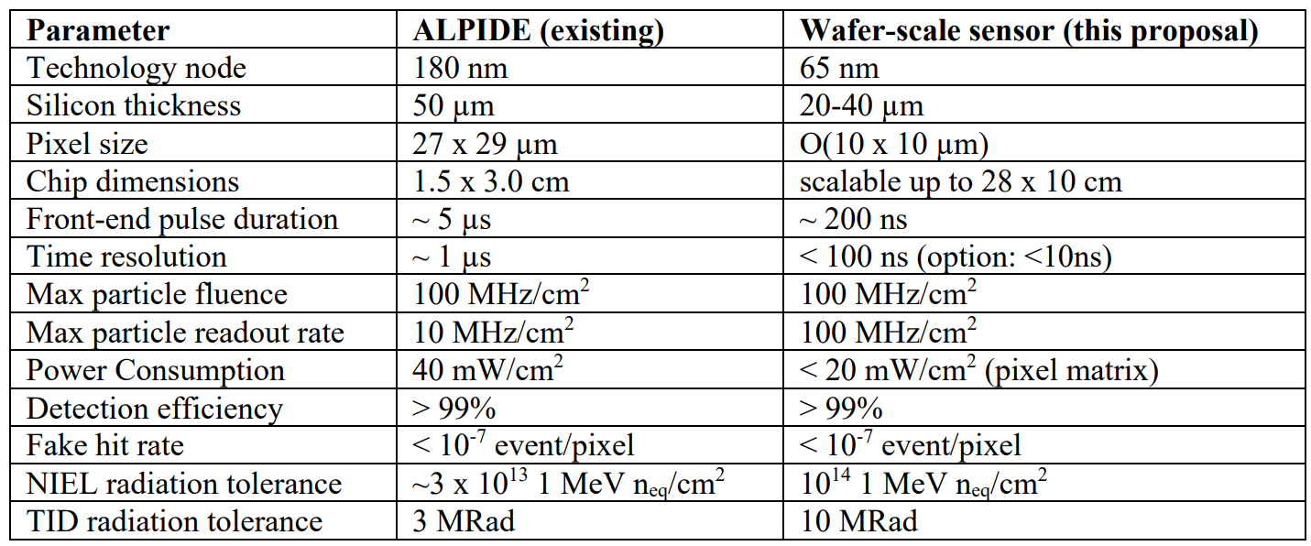
ITS3 detector concept
https://indico.cern.ch/event/813597/contributions/3727803/attachments/1989307/3315951/2020-02-18_Trento2020_ITS3.pdf
Chip size is traditionally limited by CMOS manufacturing (“reticle size”)
  typical sizes of few cm²
  modules are tiled with chips connected to a flexible printed circuit board
New option: stitching, i.e. aligned exposures of a reticle to produce larger circuits
  actively used in industry
  a 300 mm wafer can house a chip to equip a full half-layer
https://indico.cern.ch/event/813597/contributions/3727803/attachments/1989307/3315951/2020-02-18_Trento2020_ITS3.pdf

Slide 5
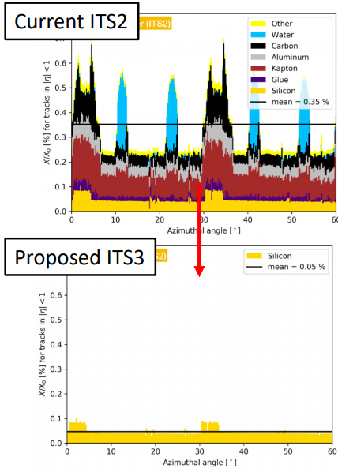
ITS3 detector concept
Inner Barrel
“Technical Design Report for the Upgrade of the ALICE Inner Tracking”. ALICE Collaboration, B. Abelev et al. System. J. Phys. G 41, 087002 (2014).
https://indico.ph.liv.ac.uk/event/2/contributions/144/attachments/94/125/MBuckland_ALICE_HEPXmasMeeting.pdf
Key ingredients:
  300 mm wafer-scale chips, fabricated using stitching
  thinned down to 20-40 μm (0.02-0.04% X0), making them flexible
  bent to the target radii
  mechanically hold in place by carbon foam ribs
Key benefits:
  extremely low material budget: 0.02-0.04% X0 (beampipe: 500 μm Be: 0.14% X0)
  homogeneous material distribution: essentially zero systematic error from material distribution
https://indico.cern.ch/event/974424/contributions/4158313/attachments/2185864/3693273/2021-02-08_DAQFEET-ITS3sensor.pdf

Slide 6
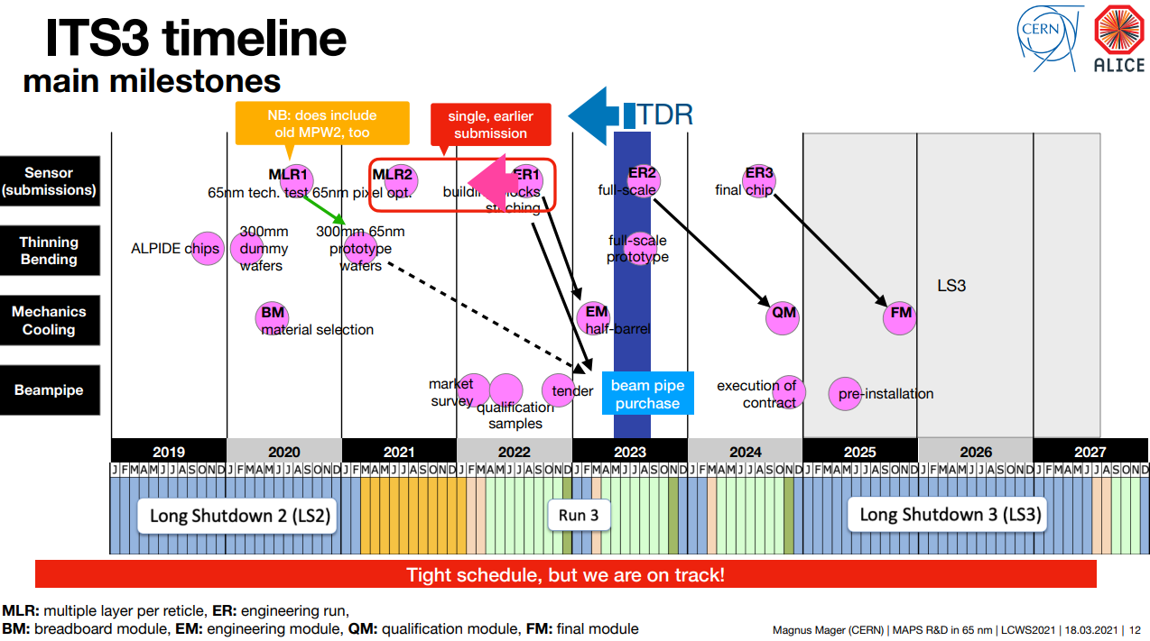
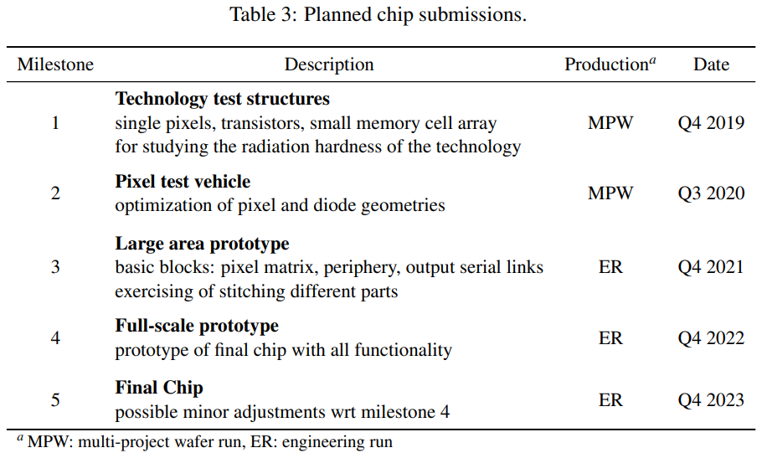

Slide 7
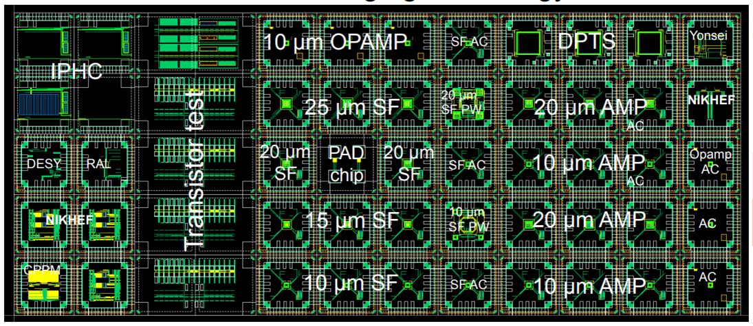
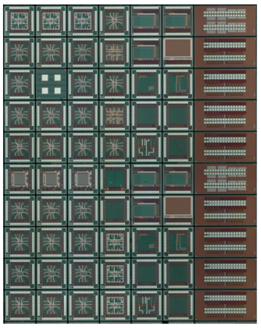
MLR1 production
GDS submission in Dec 2020
Chip delivery in July 2021

Slide 8
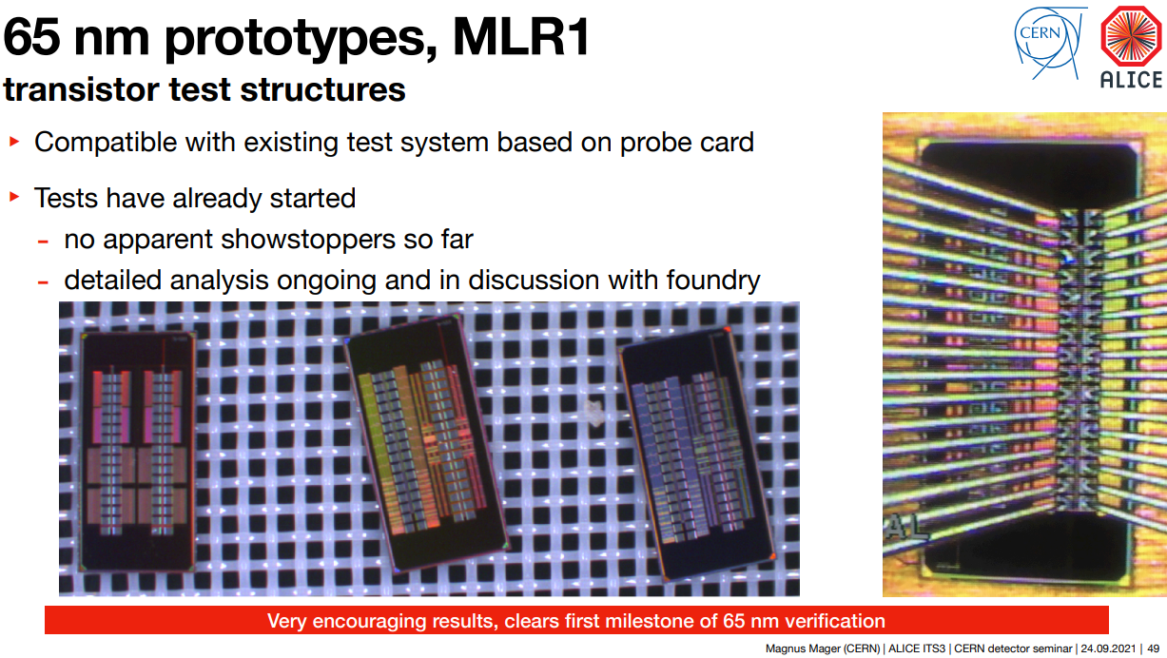
https://indico.cern.ch/event/1071914/

Slide 9
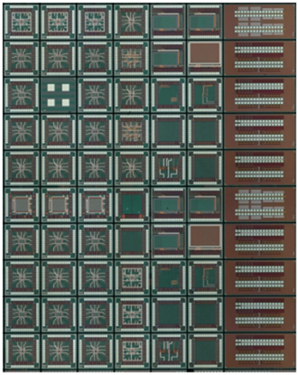
Stitched sensor development
MLR1
~16mm
← 70 chips inside
~12mm
ER1
~14mm
x10
1-D stitching
25.5mm
~260mm
ER2
~100mm
Full-scale Prototype
~280mm

Slide 10
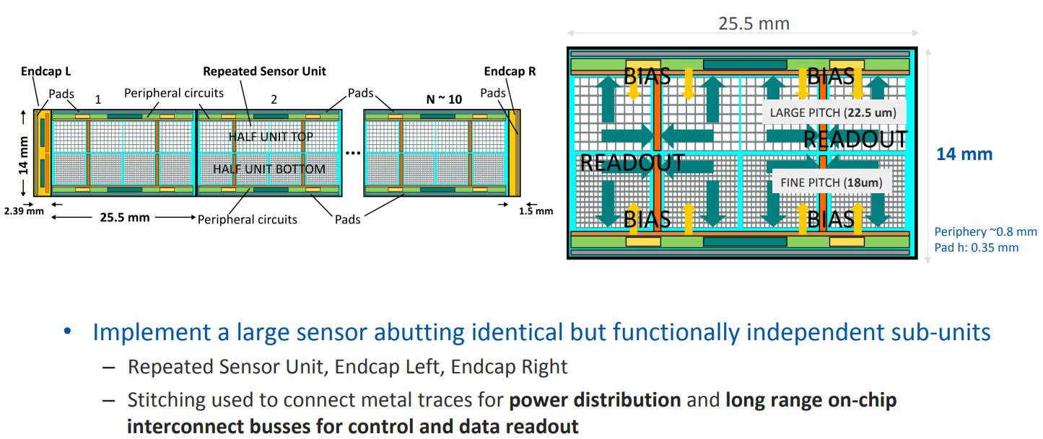
MOSS Monolithic Stitched Sensor Prototype
https://indico.cern.ch/event/1091910/

Slide 11
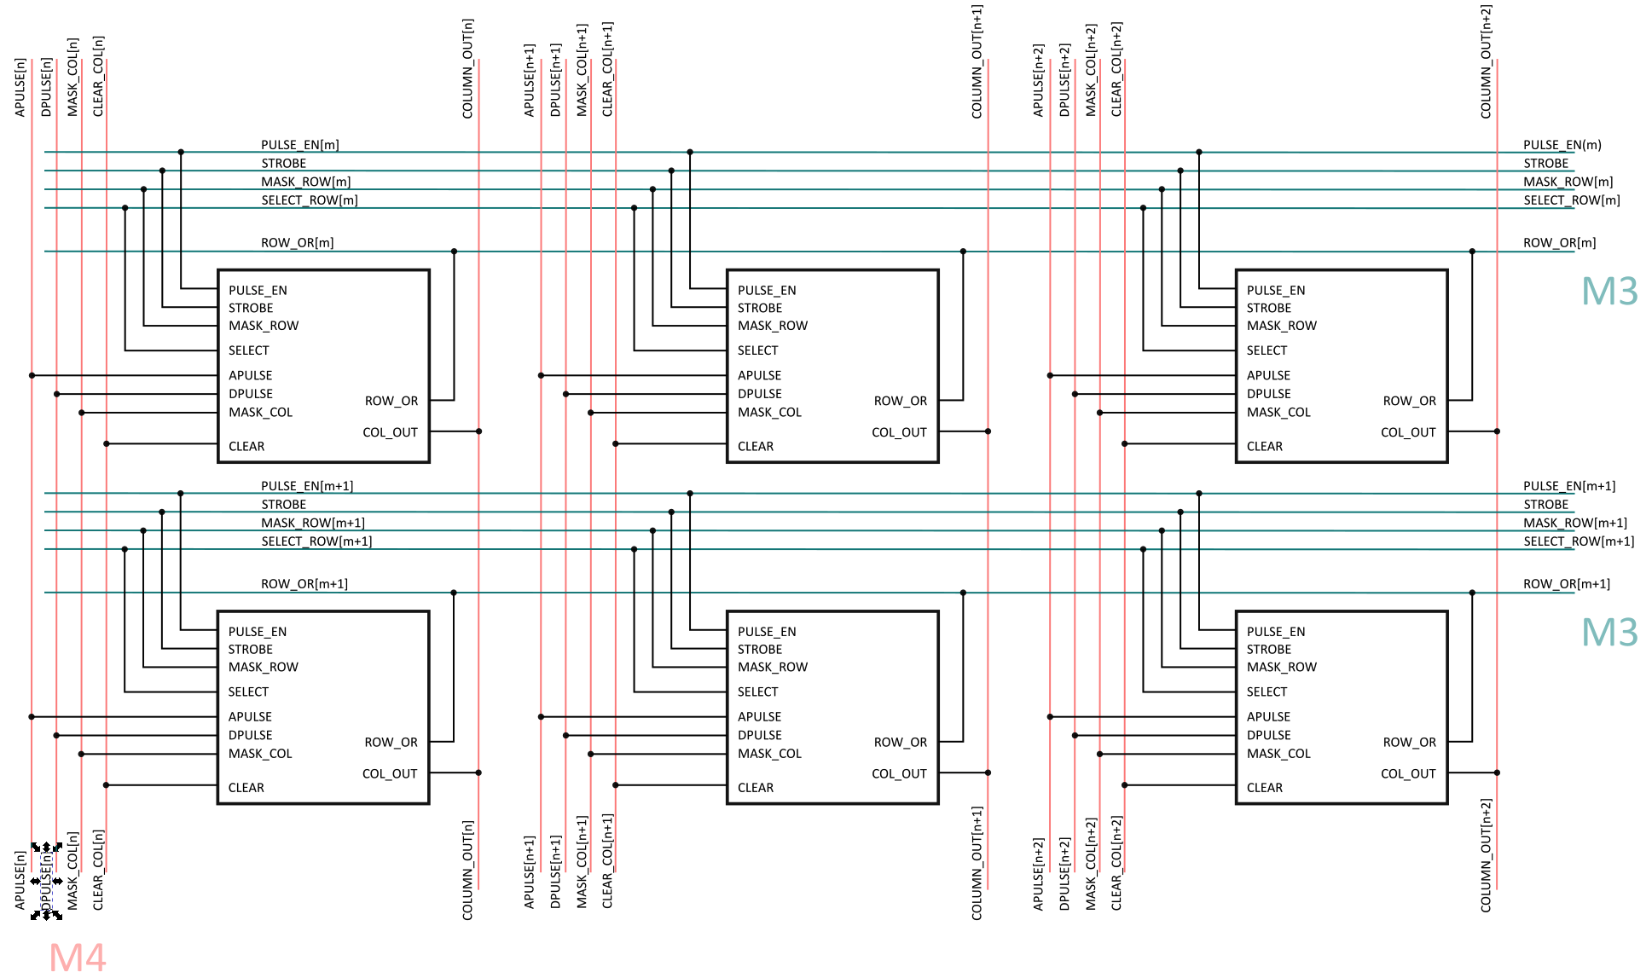
Concept for Pixels Readout in a Region
Global Strobe
In-Pixel Latch
Row OR output line
Selection of row (token)
  Skip rows with no hits
Column out line
  Pixels of the selected row drive the column line

Slide 12
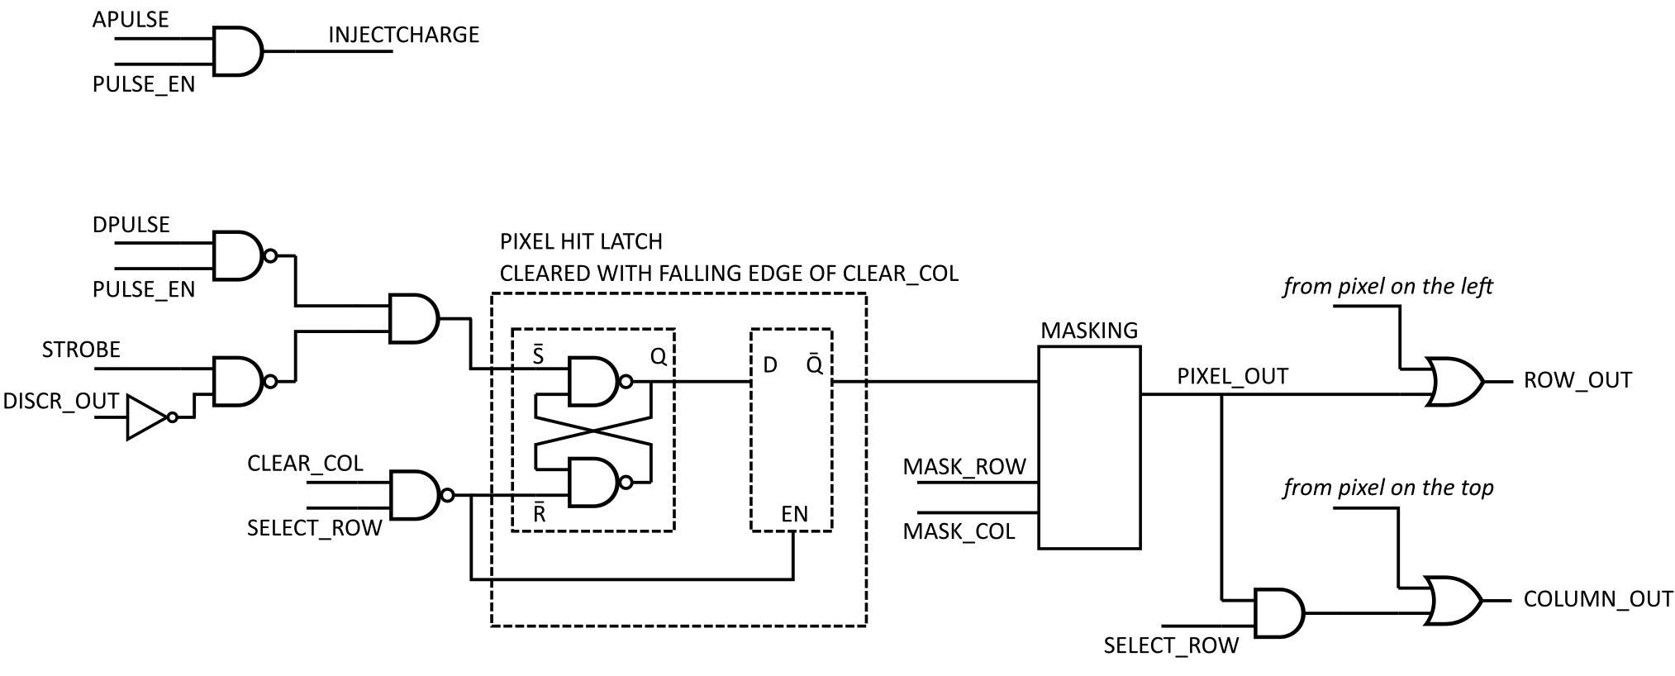
Digital pixel logic

Slide 13
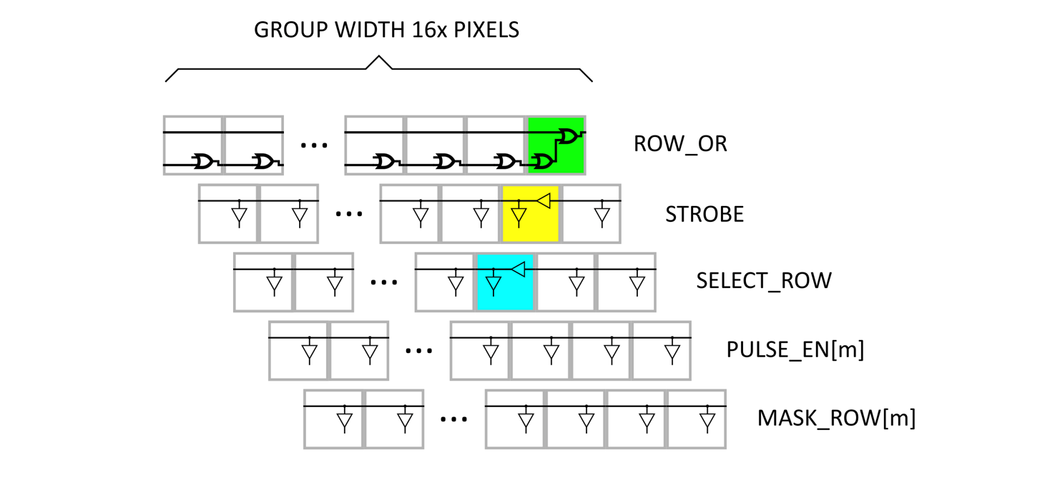
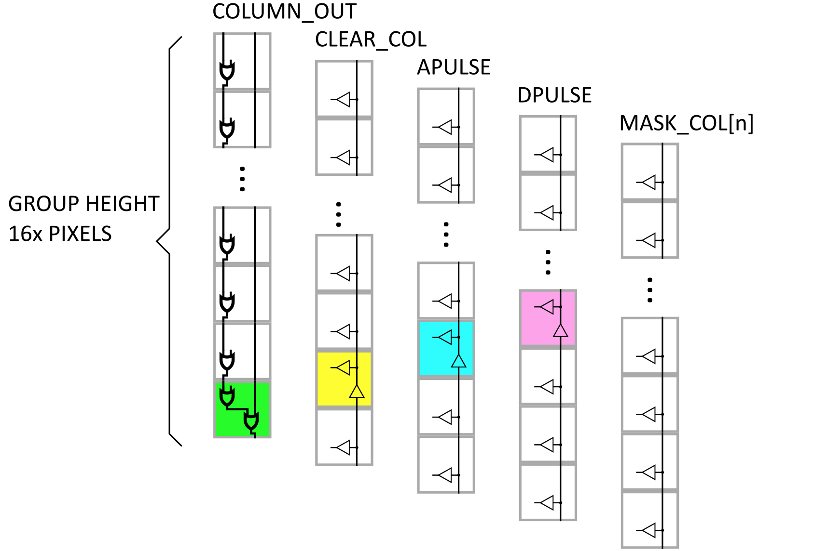
Signal Regeneration

Slide 14
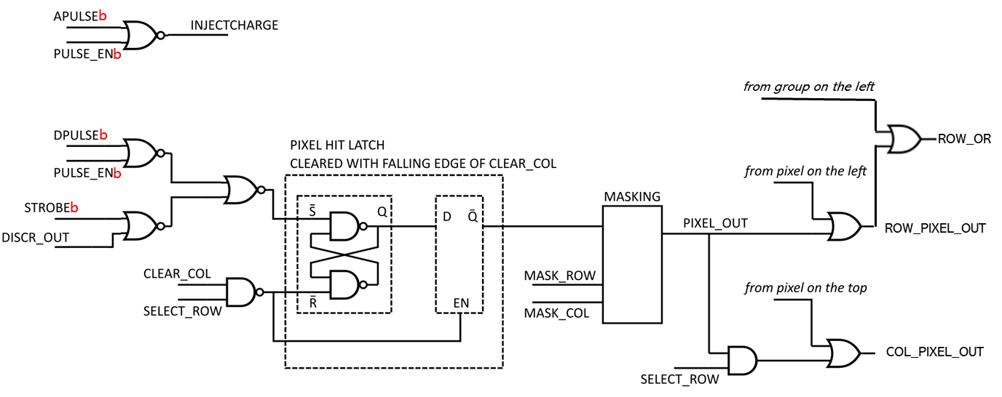
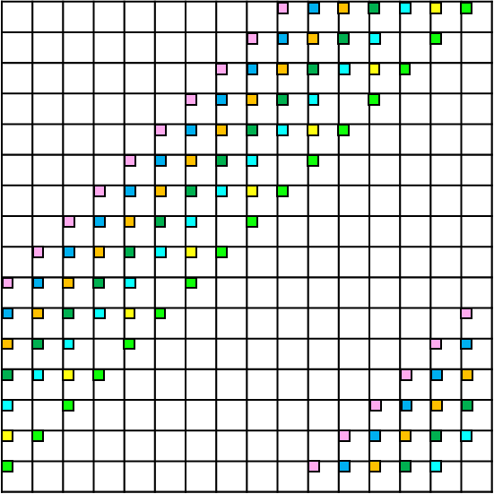
Post-layout extraction simulation results
PWELL=0 V
Typical corner (1.2V, typical process, 27degrees)
Output delay
(FE output over Vth 0.6V → ROW_PIXEL_OUT) : 24 ns
(ROW_PIXEL_OUT → ROW_OR) : 1.022ns
(ROW_OR → ROW_OR) : 0.612ns
STROBE group-to-group delay 0.719ns
STROBE regeneration dynamic energy 84.1 fJ
SELECT_ROW group-to-group delay 1.21ns
Pixel digital
Dynamic energy 2.32pJ
Static energy 16.2fJ for 5us
Static leakage current 2.71nA
Group digital
Static energy 3.65pJ for 5us
Static leakage current 608nA
delay
Power, leakage
Group extraction
Group extraction
Group extraction
delay
risetime

Slide 15
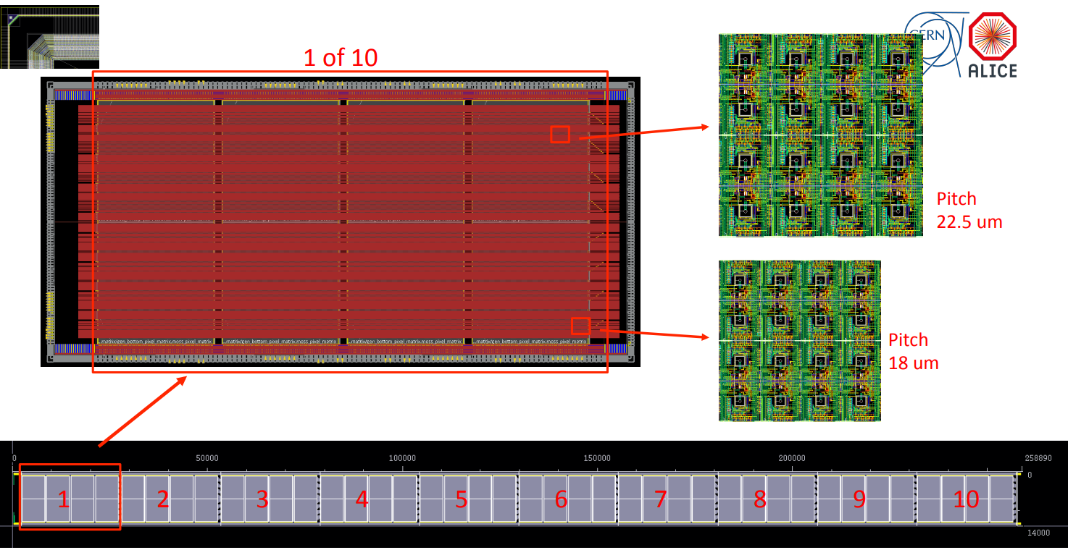
Pre-mock submission – Dec 2021
https://indico.cern.ch/event/1104620/

Slide 16
Next generation sensor design for LS3
Good timing (10’s of 𝑝𝑠?)
  Avalanche photodiode
  Digital operation without the analog front end
High spatial resolution
  Pixel detector
Low power consumption
  Low digital activity (~ low occupancy)
  Digital periphery with the sparcified readout
Simple operation
  Built-in tolerance in the APD operation

Slide 17
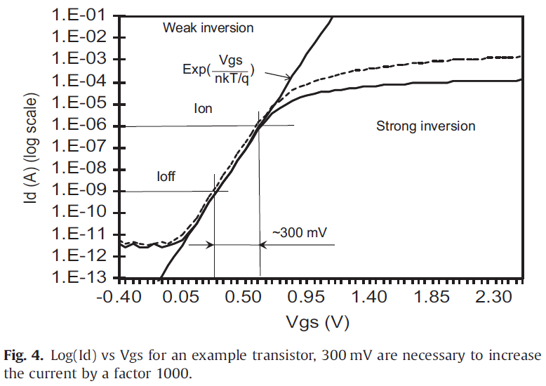
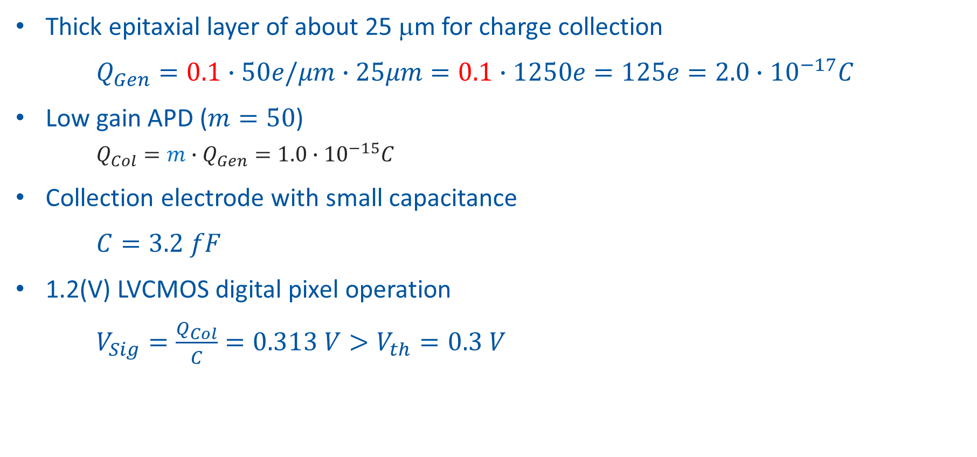
Digital pixel coupled with low gain APD
Thick epitaxial layer of about 25 μm for charge collection
$Q_{Gen}=0.1∙50e/μm∙25μm=0.1∙1250e=125e=2.0∙{10}^{−17}C$
Low gain APD ($m=50$)
  $Q_{Col}=m∙Q_{Gen}=1.0∙{10}^{−15}C$
Collection electrode with small capacitance
$C=3.2 fF$
1.2(V) LVCMOS digital pixel operation
$V_{Sig}=\frac{Q_{Col}}{C}=0.313 V>V_{th}=0.3 V$
Snoeys, W. "CMOS monolithic active pixel sensors for high energy physics." Nuclear Instruments and Methods in Physics Research Section A 2014

Slide 18
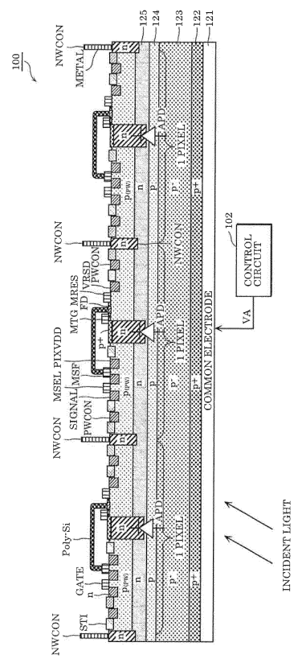
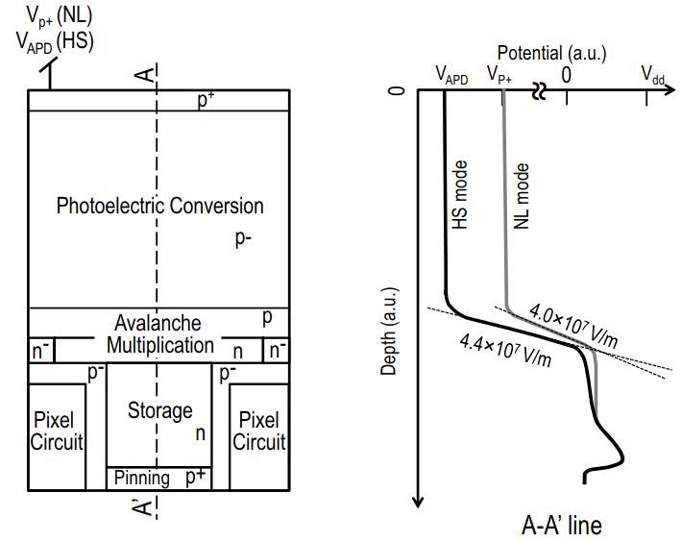
Publications of interest
3.8um pixel
Normal mode / High-sensitivity mode
Abrupt p-n junction between a p- region and n region
Vertical field strength is controlled by the potential of a surface p+ layer (either V_{p+} or V_{APD})
Mori, Mitsuyoshi, et al. "6.6 A 1280× 720 single-photon-detecting image sensor with 100dB dynamic range using a sensitivity-boosting technique." 2016 IEEE ISSCC
Patent EP 3448018A1 - PANASONIC 2019

Slide 19

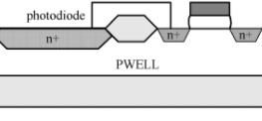






APD into the pixel
Junction Termination Edge
$$N node$$
$$Pwell circuit area$$
$$Pwell circuit area$$
$$pwell opening 5um$$
Defects caused by the wafer sawing
$$N blancket$$
$$Gain region$$
$$30um$$
Noise current through
shared bulk
$$P−epi layer$$
$$P substrate$$
Younghoon Han
Kiwon seo

