Slide 2
Measurement Collection Update
Gonzalo Menéndez Borge
IT-SC-POF

Slide 3
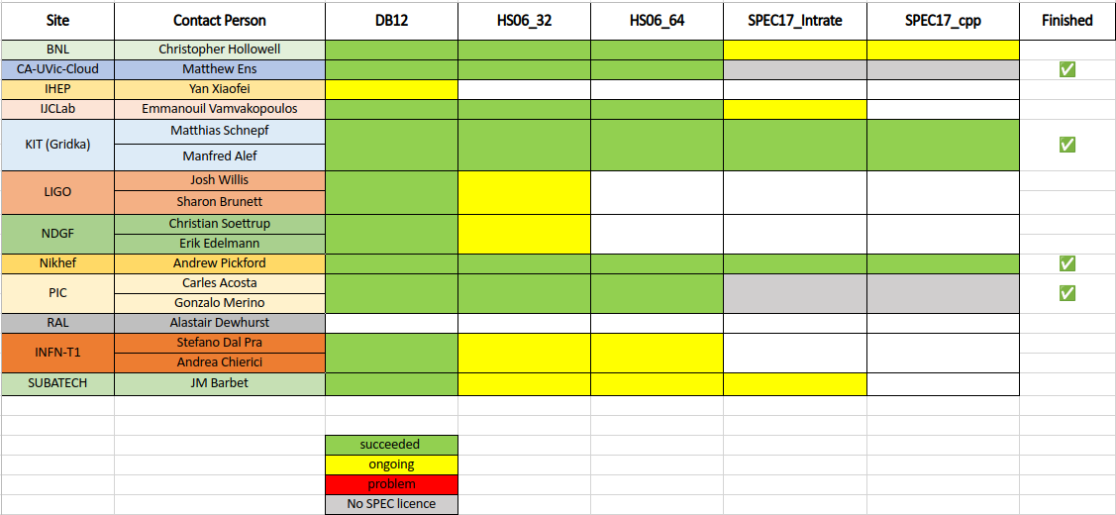
Benchmark Progress (Last)

Slide 4
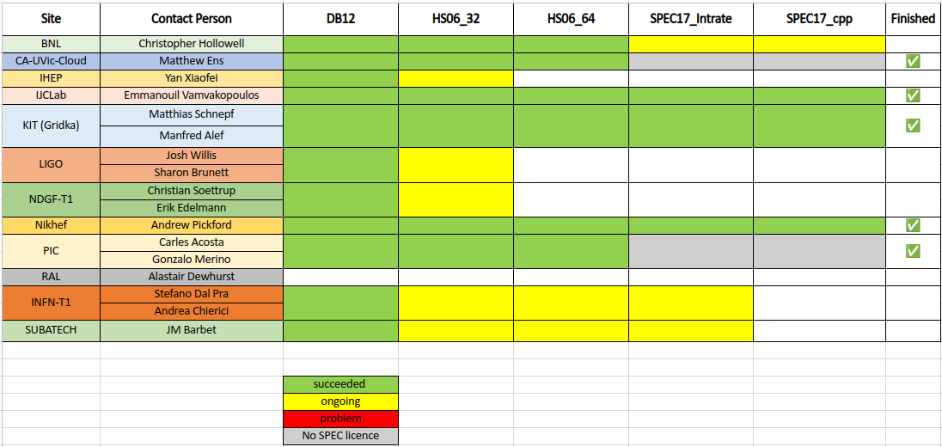
Benchmark Progress (Now)

Slide 5
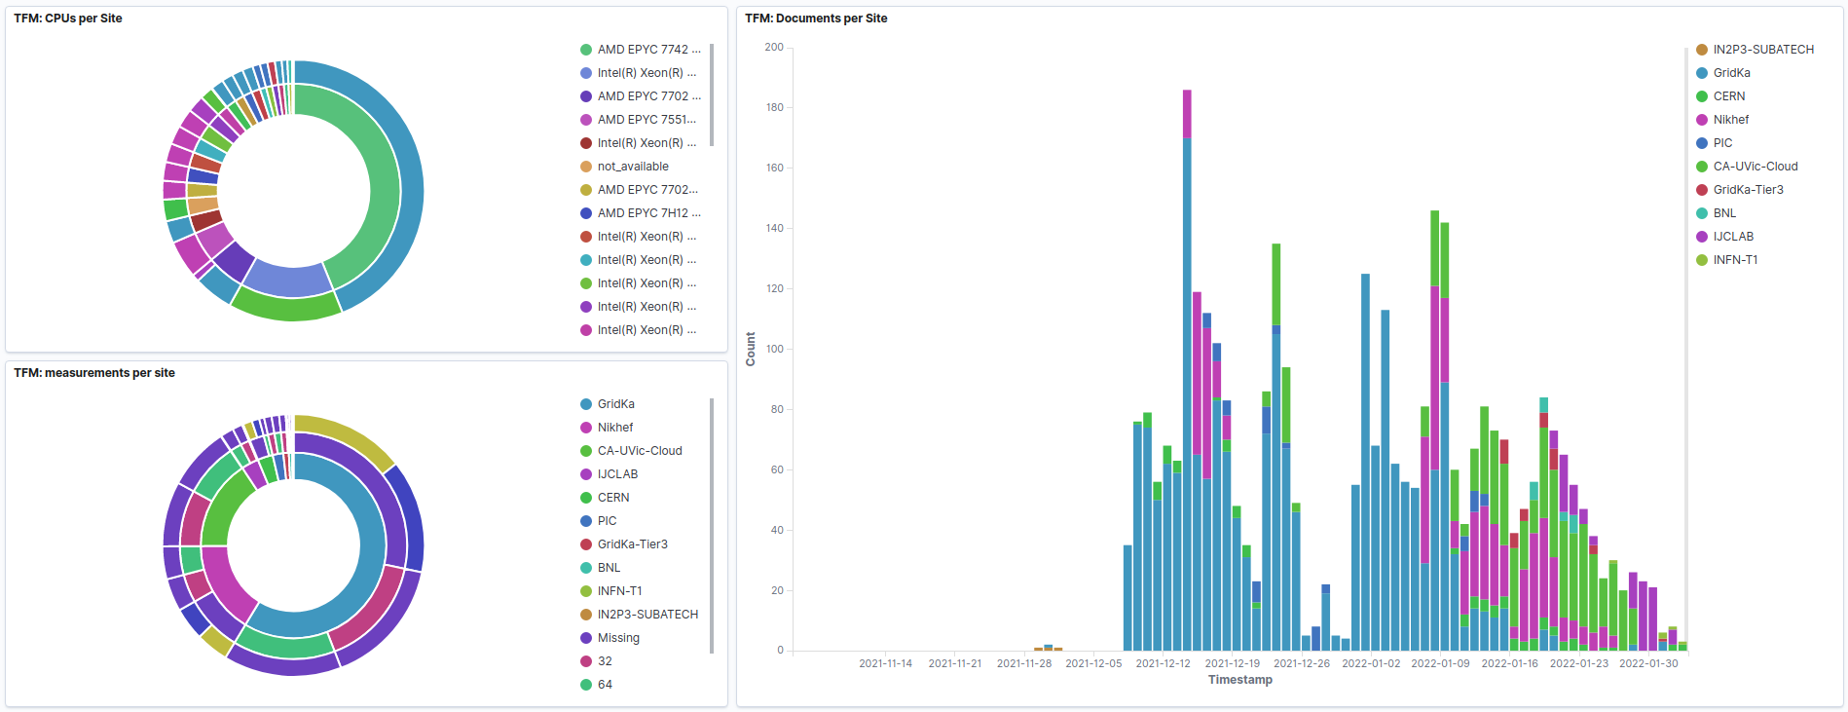
Contributions (Last)

Slide 6
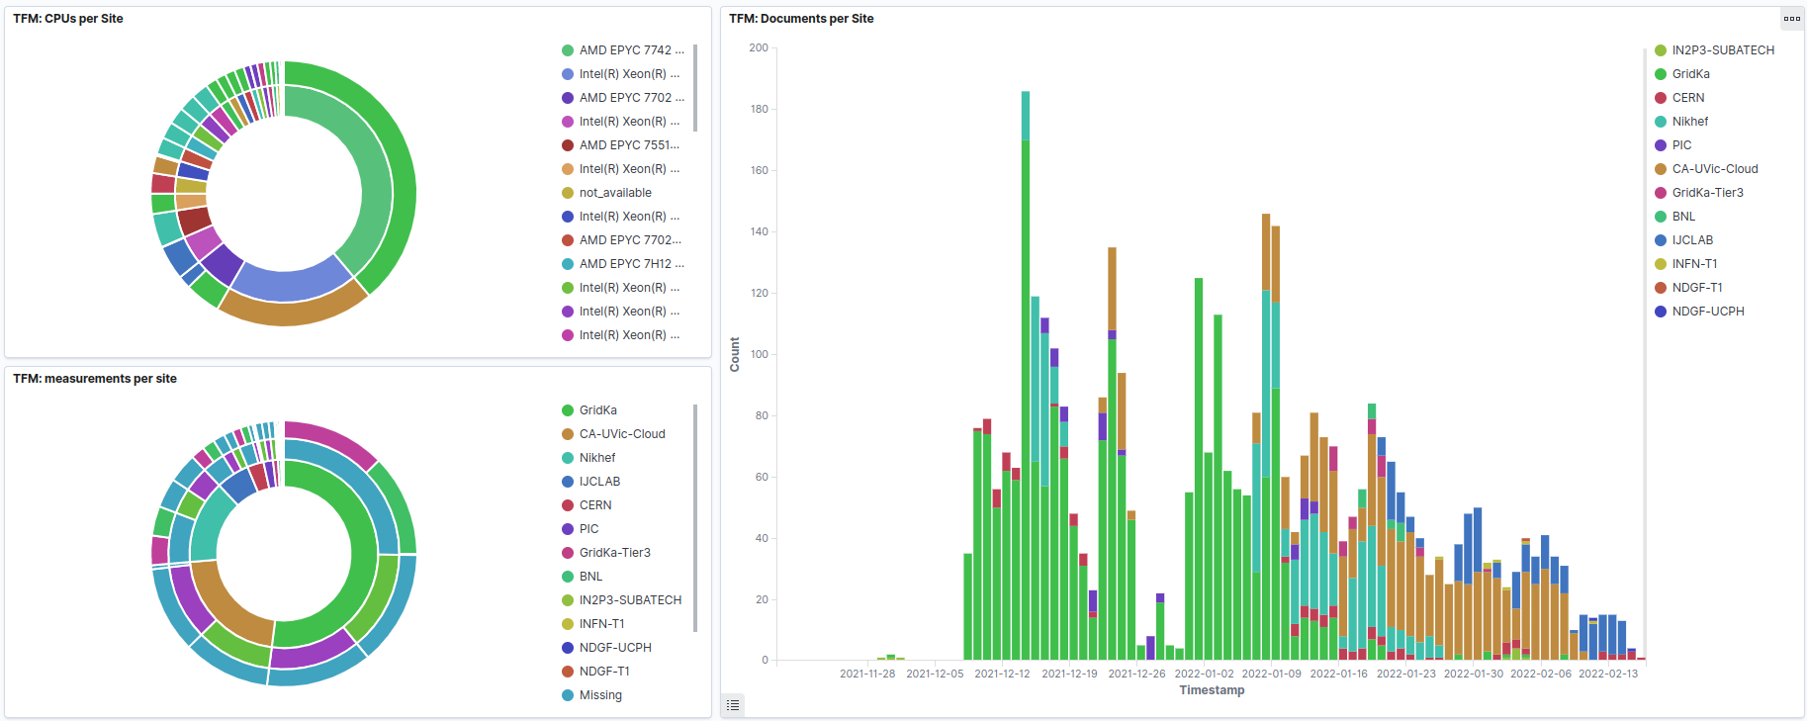
Contributions (Now)

Slide 7
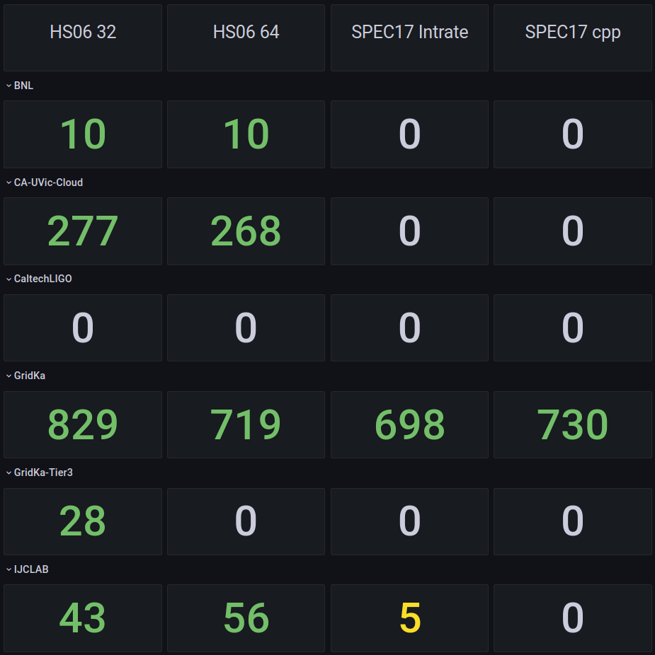
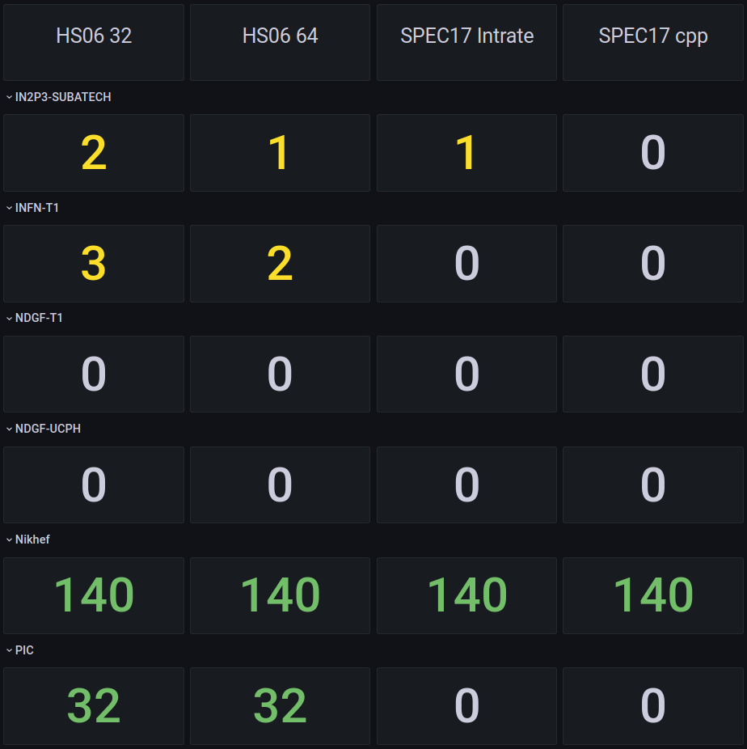
# Contributions (Last)

Slide 8
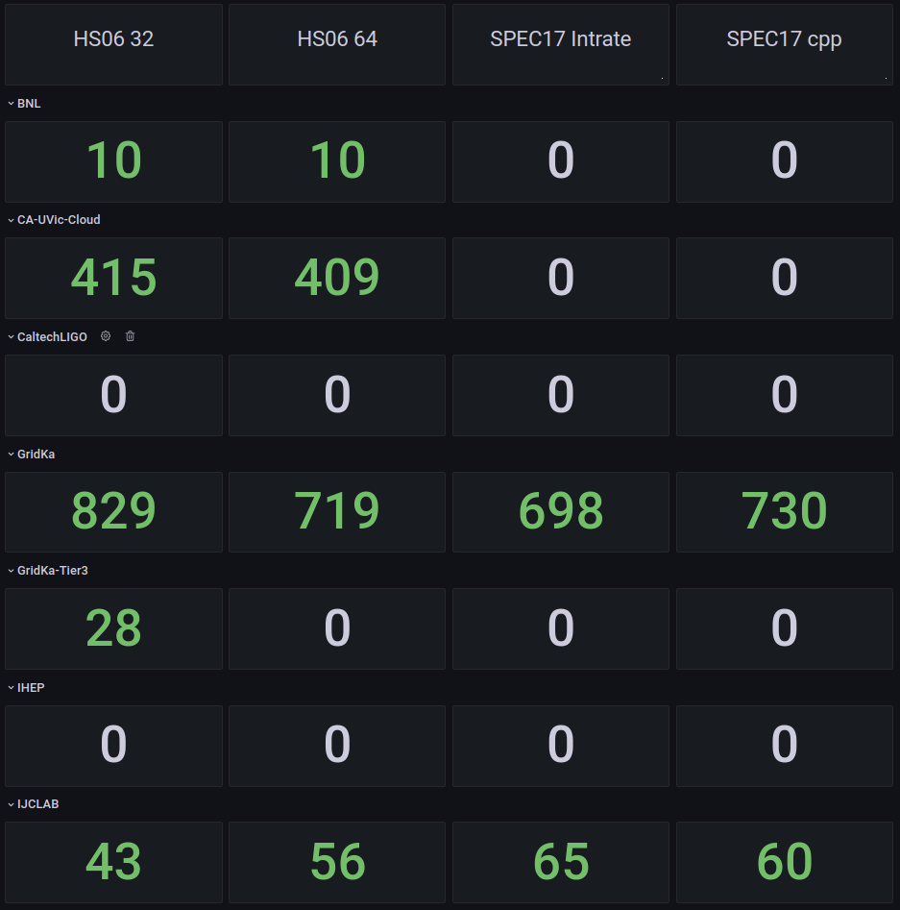
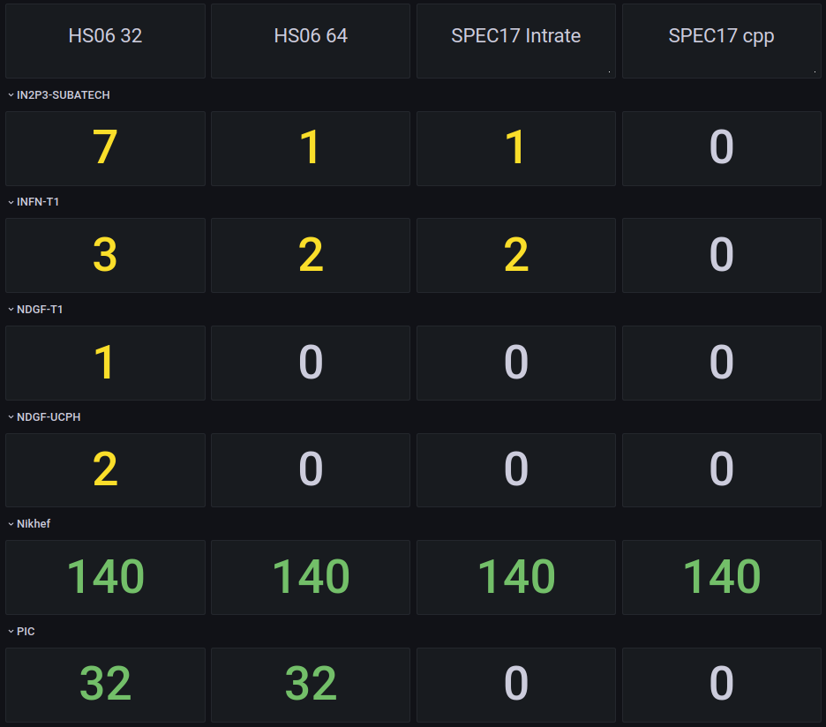
# Contributions (Now)

Slide 9
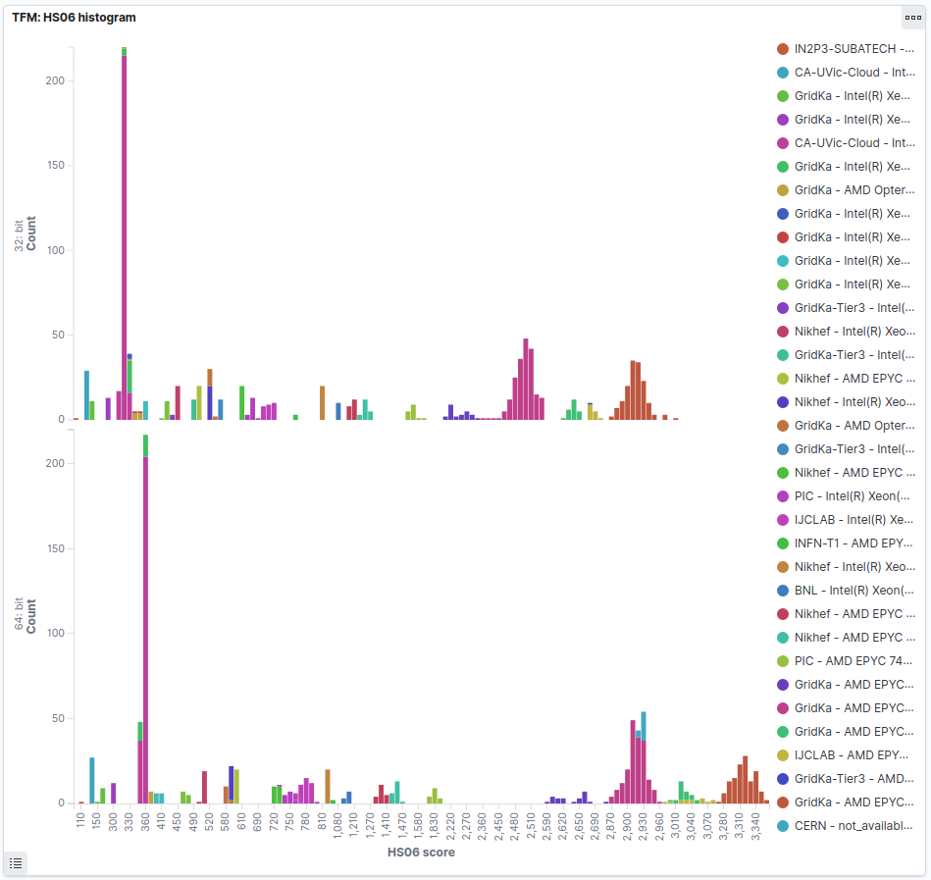
HS06 (Last)

Slide 10
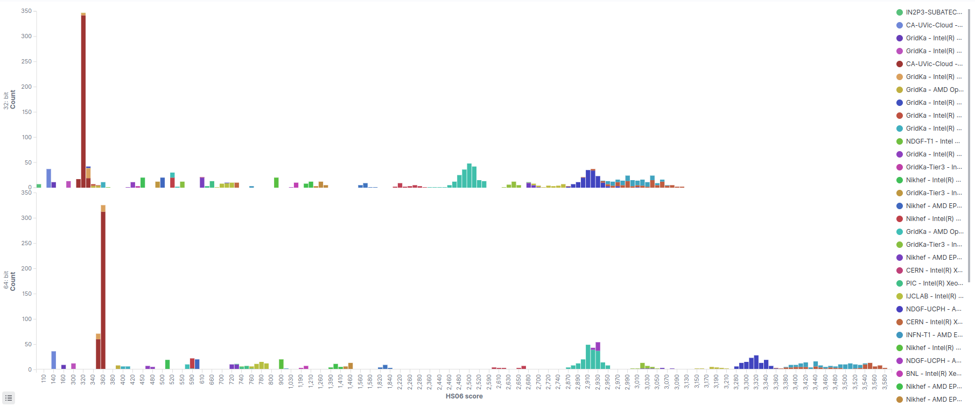
HS06 (Now)

Slide 11
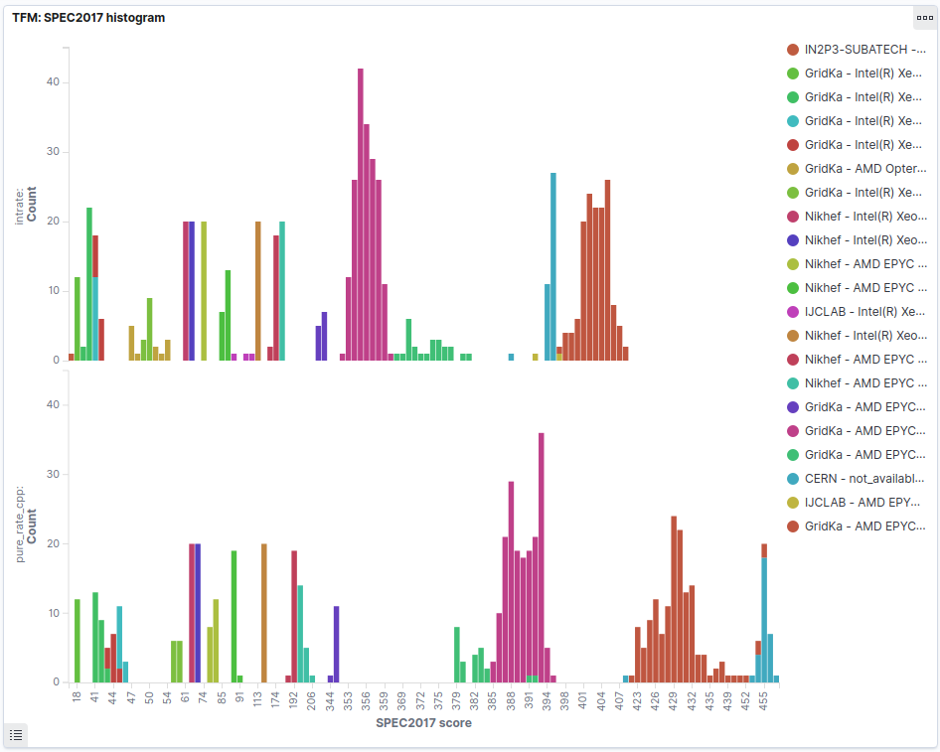
SPEC17 (Last)

Slide 12
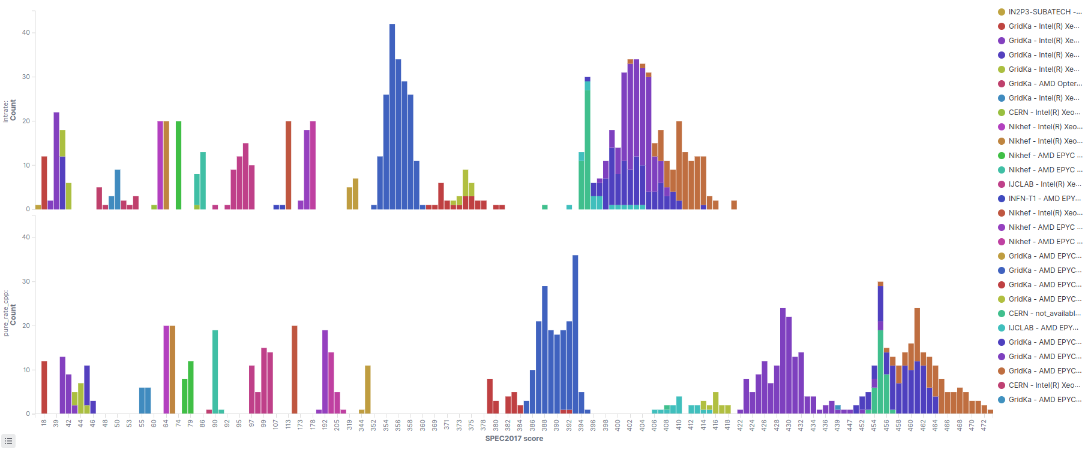
SPEC17 (Now)

Slide 13
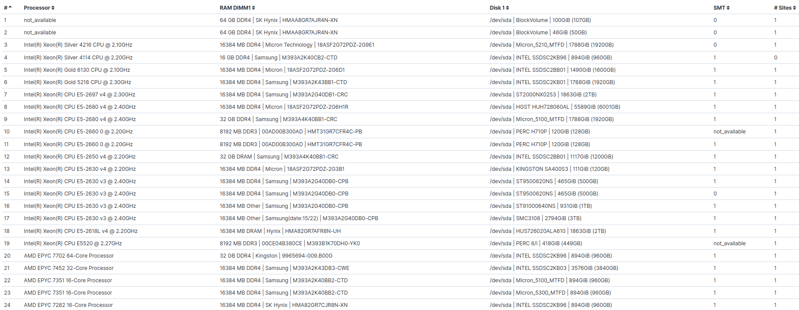
Configurations (Last)

Slide 14
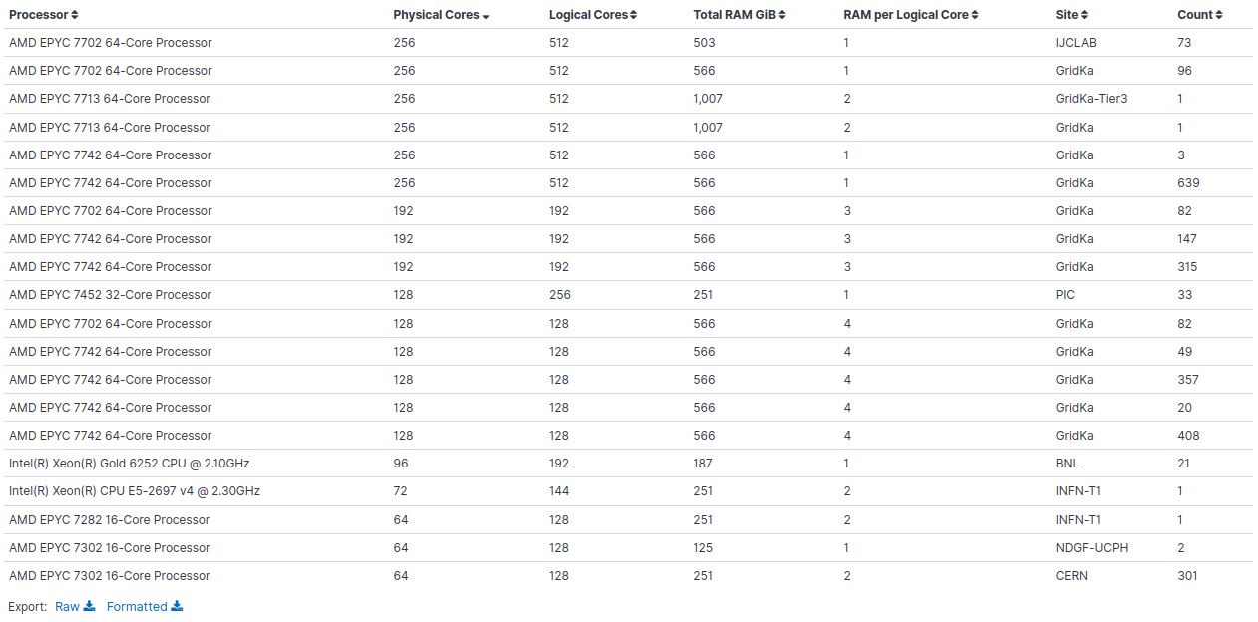
Configurations (New)

Slide 15
Contributing
Follow the instructions from Dec 1, 2021
Check the benchmark configurations available
  Table added to the end of the dashboard
  Benchmark any machine configuration missing here!
  If the number of sites per configuration is low,
  more runs are also helpful
Working on fixing scripts 🛠️
  Thanks to everyone who reported errors (e.g. cryptography)
  Fix expected in the upcoming days

Slide 16
Q&A

