Slide 2
Measurement Collection Update
Gonzalo Menéndez Borge
IT-SC-POF

Slide 3
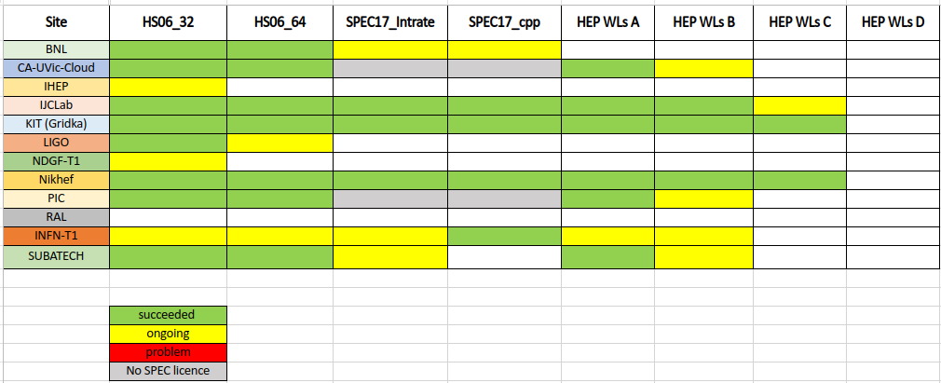
Benchmark Progress

Slide 4
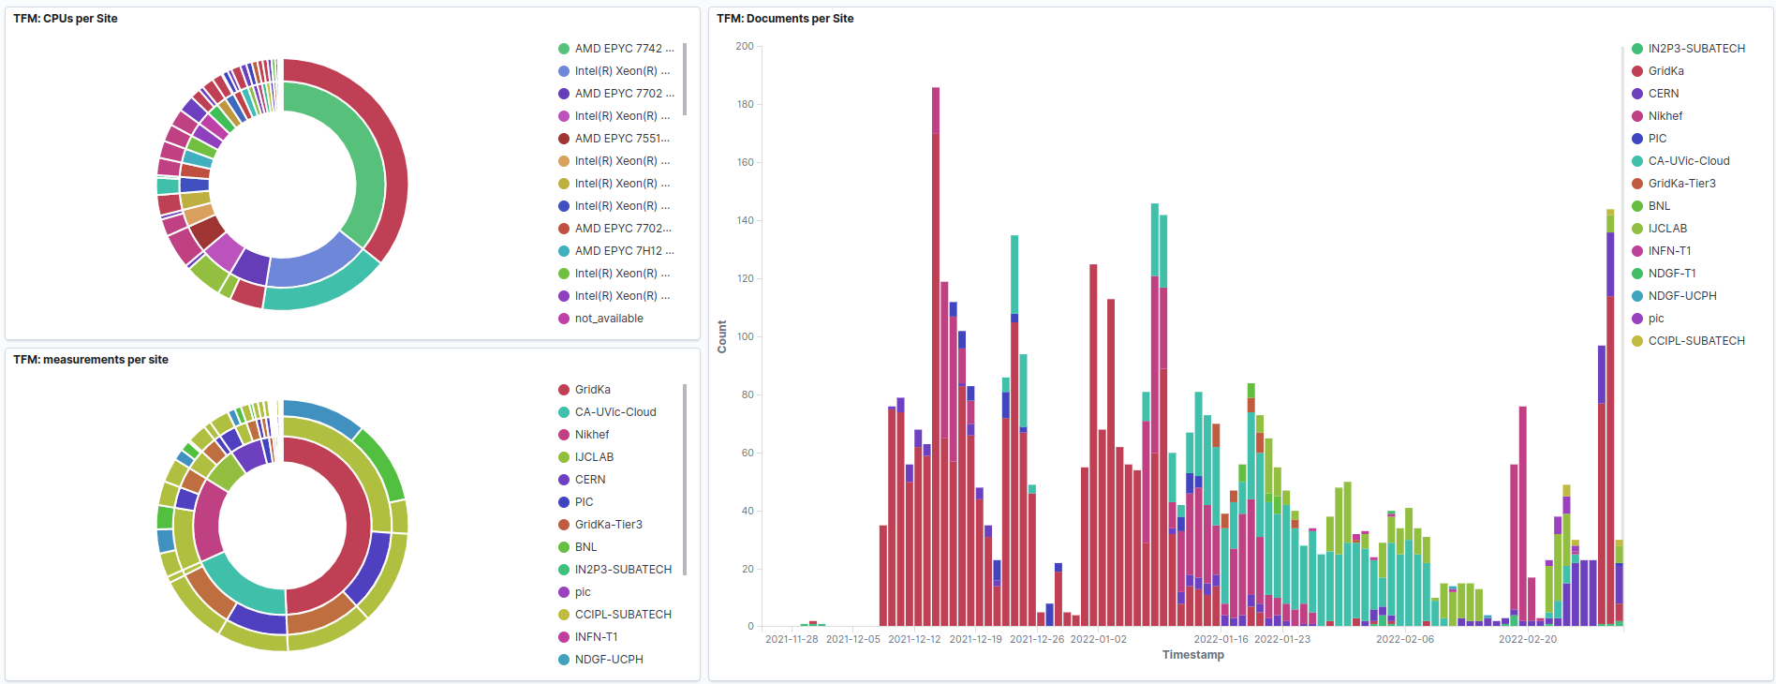
Contributions (Last)

Slide 5
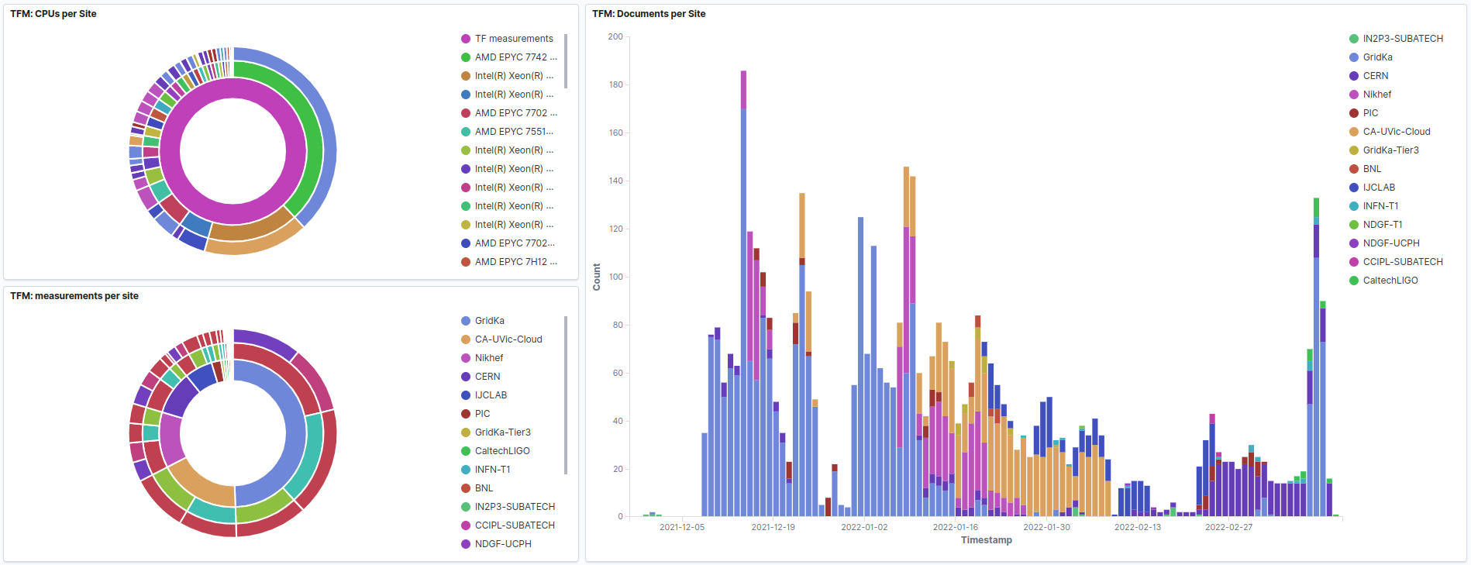
Contributions (New)

Slide 6
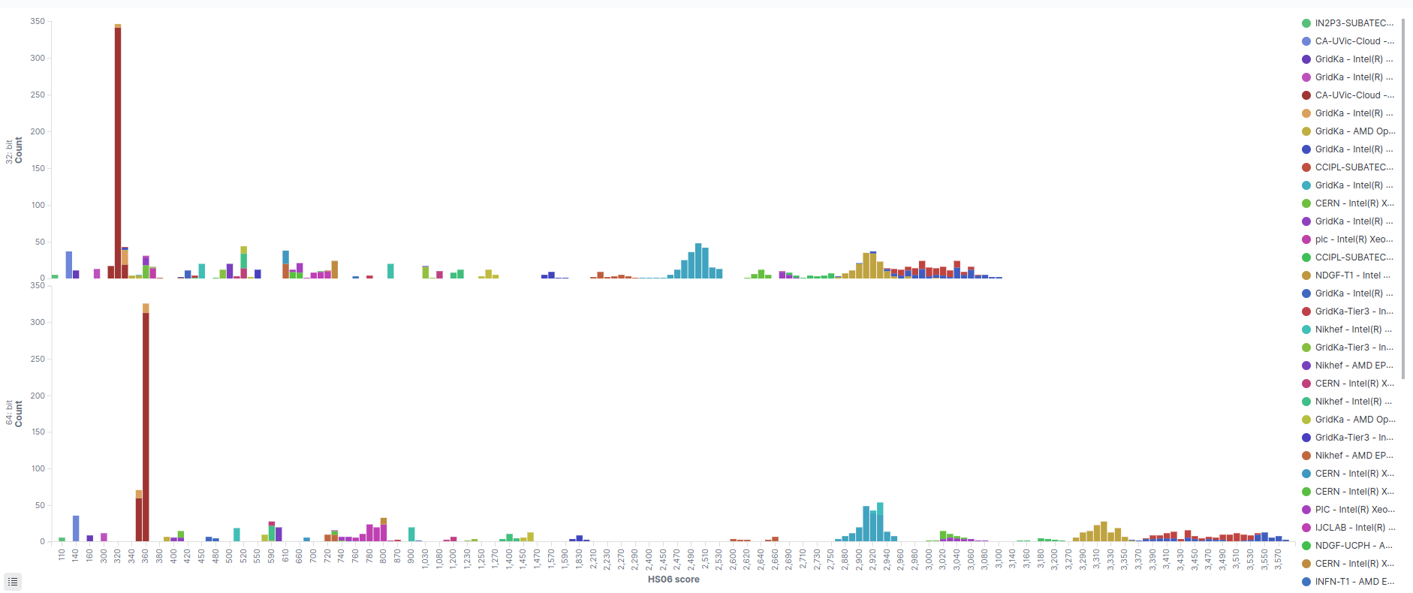
HS06 (Last)

Slide 7
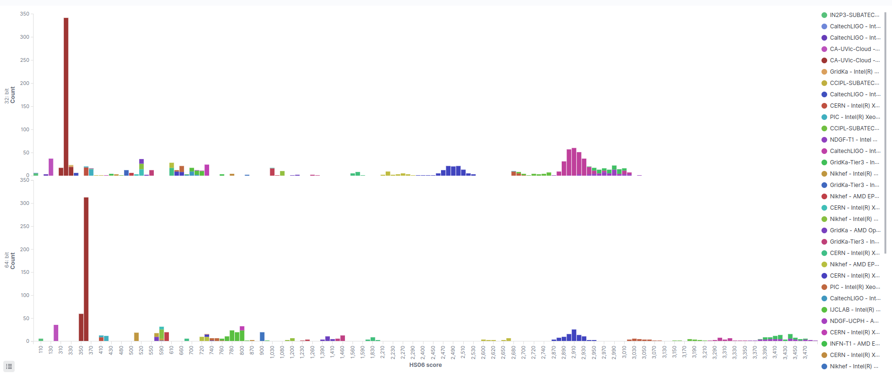
HS06 (Now)

Slide 8
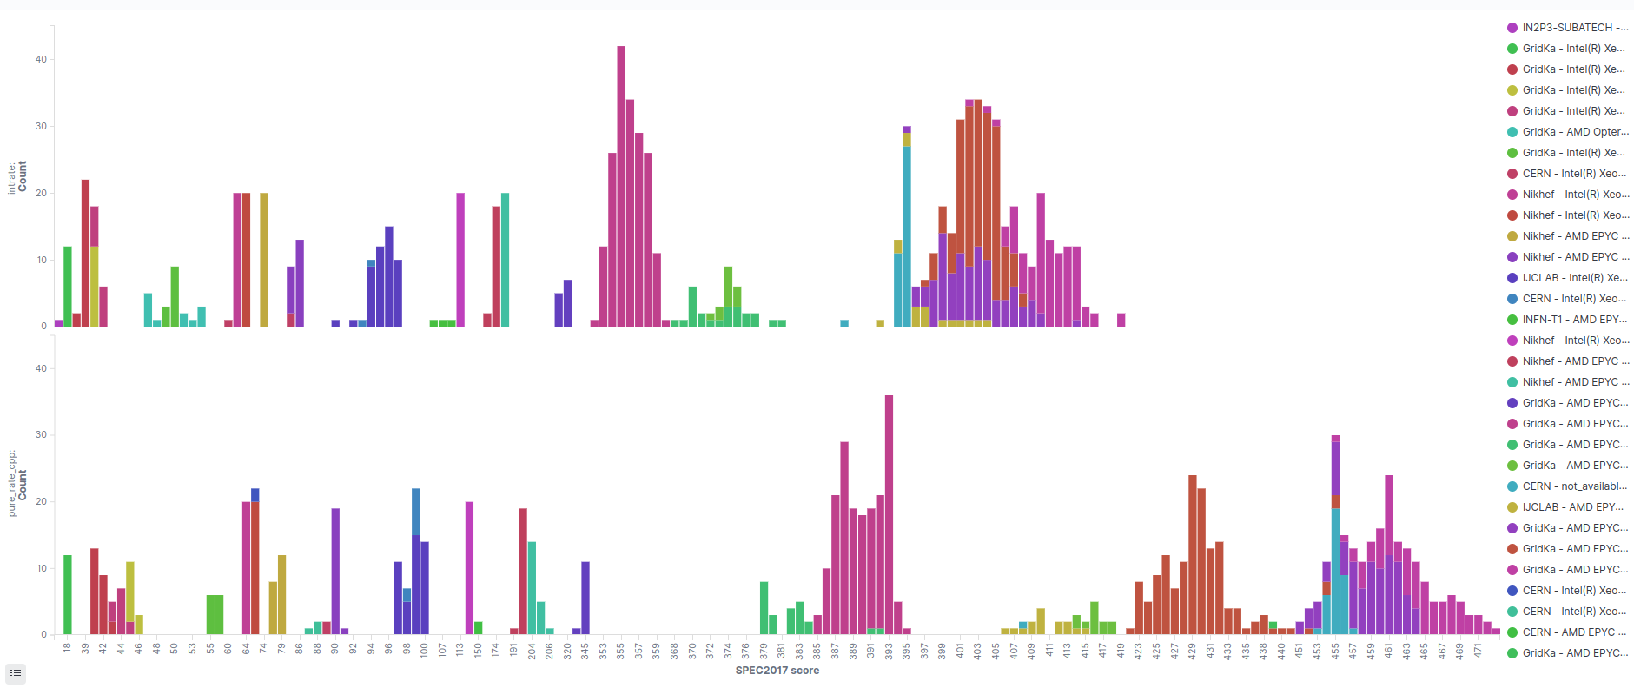
SPEC17 (Last)

Slide 9
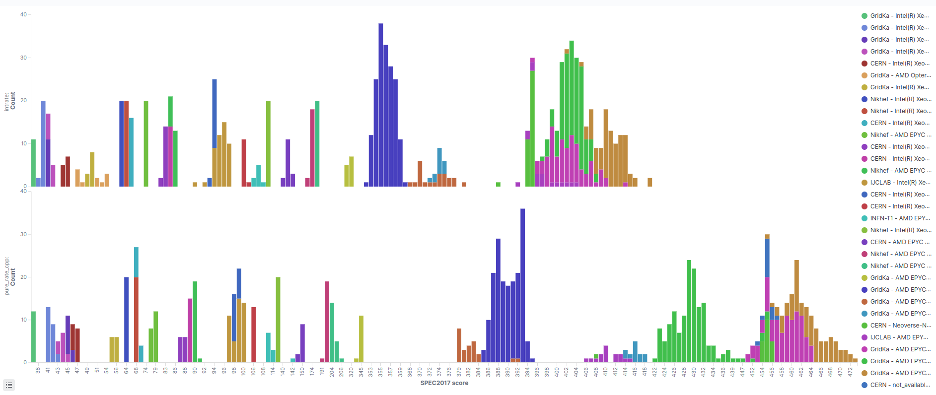
SPEC17 (Now)

Slide 10
Contributing
Follow the instructions from Dec 1, 2021
Check the benchmark configurations available
  Table added to the end of the dashboard
  Runs are especially appreciated on
    Missing machine configuration
    Configurations with low number of runs
Machine models available will be cross-checked
  HW information from monitoring activities (ATLAS & CMS)
Contact email: hep-benchmarks-support@cern.ch

Slide 11
Q&A

