Slide 2
Measurement Collection Update
Gonzalo Menéndez Borge
IT-SC-POF

Slide 3
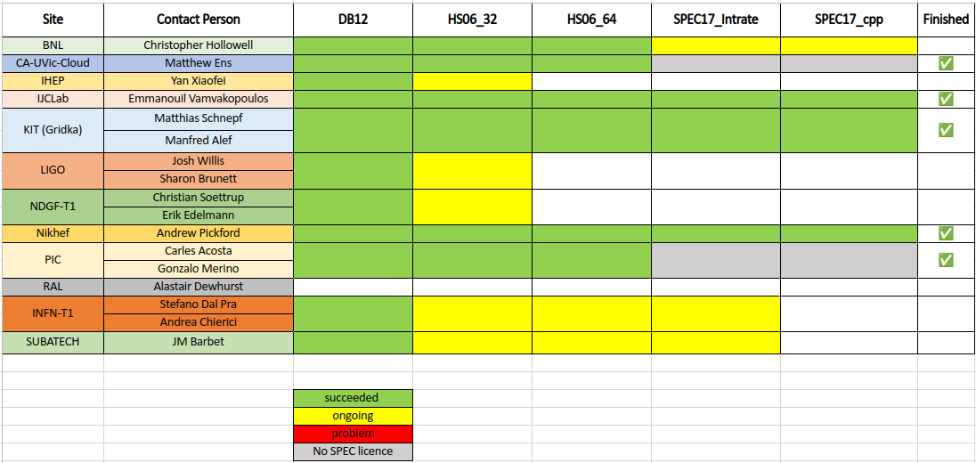
Benchmark Progress

Slide 4
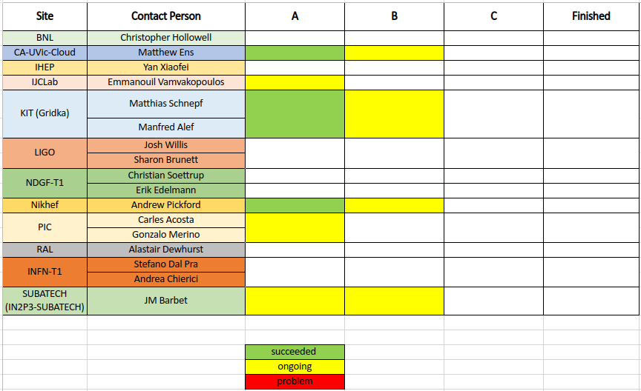
WL Validation Progress

Slide 5
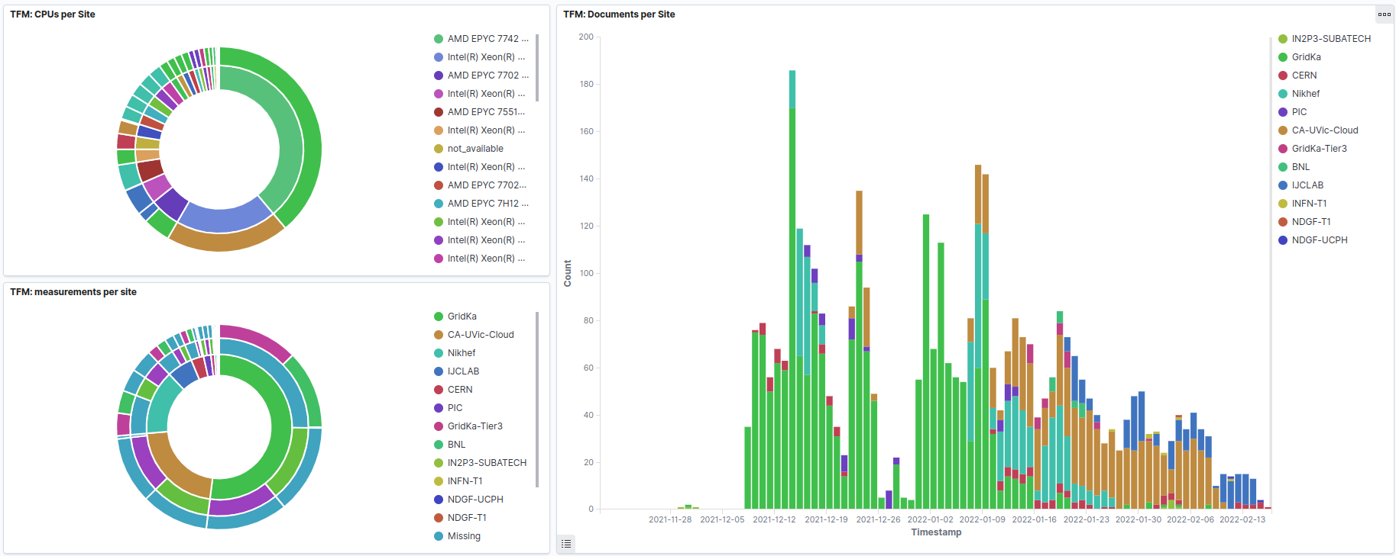
Contributions (Last)

Slide 6
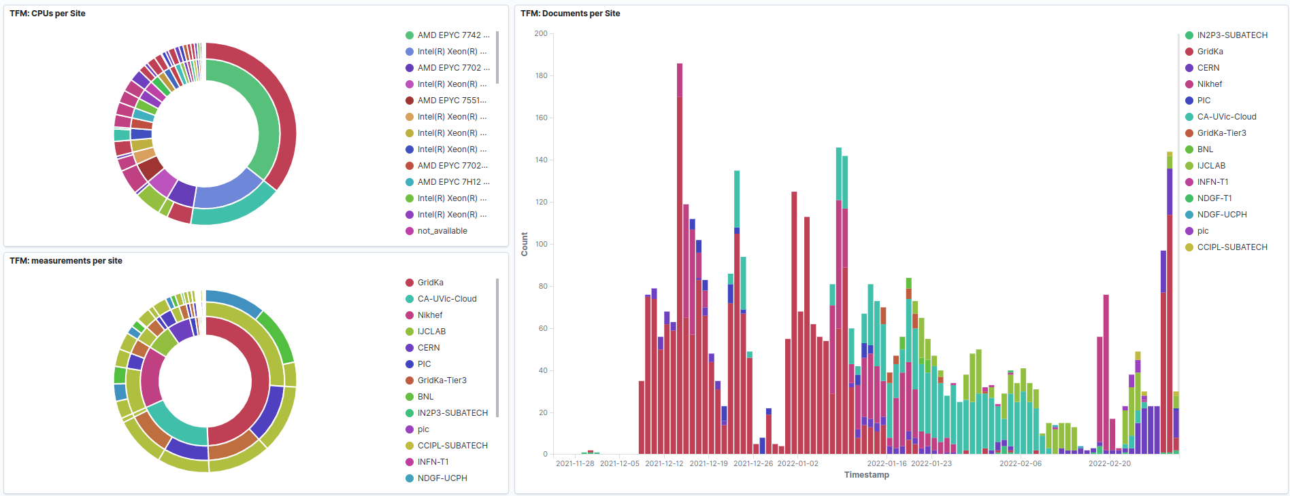
Contributions (Now)

Slide 7
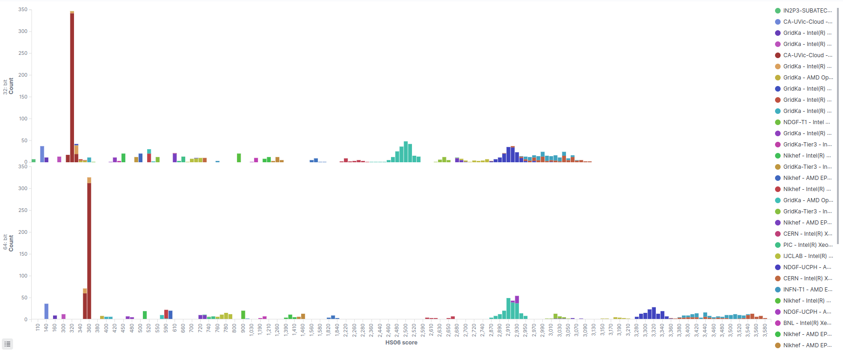
HS06 (Last)

Slide 8
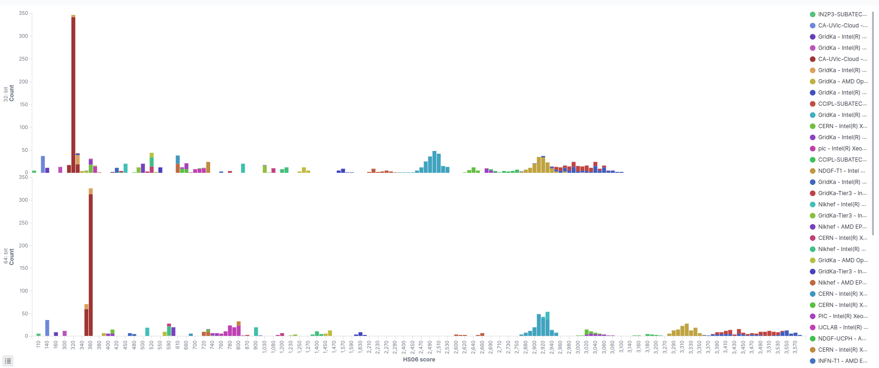
HS06 (Now)

Slide 9
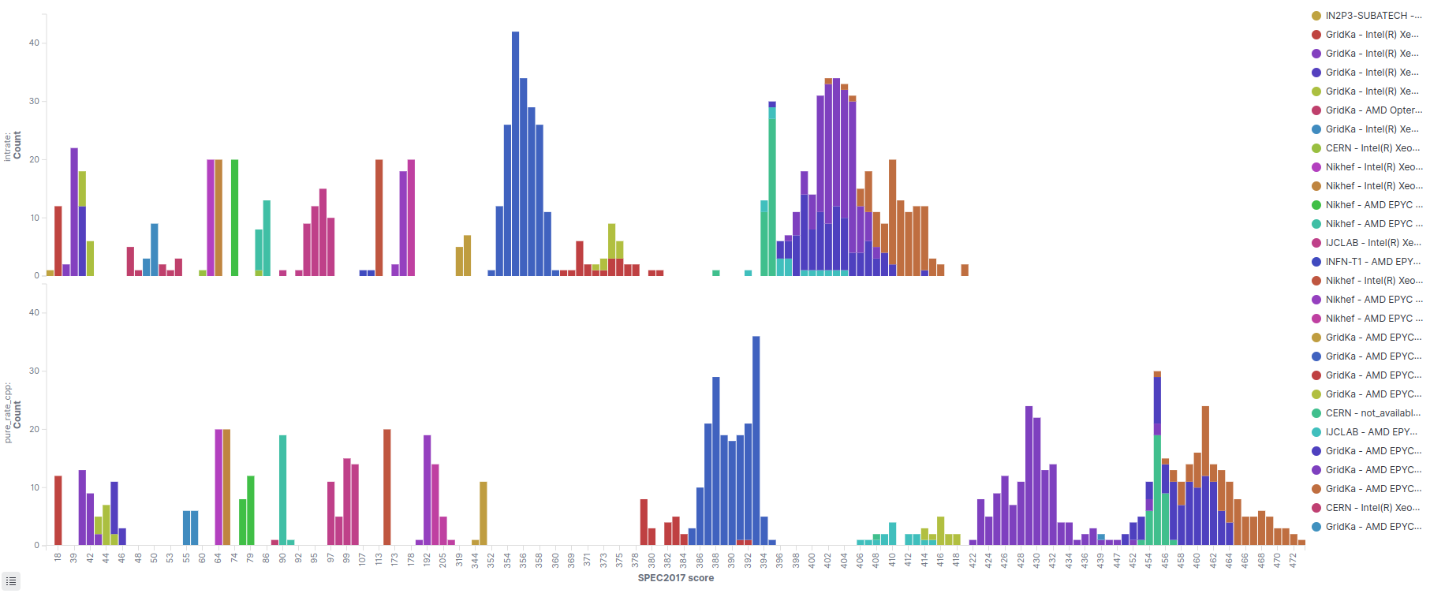
SPEC17 (Last)

Slide 10
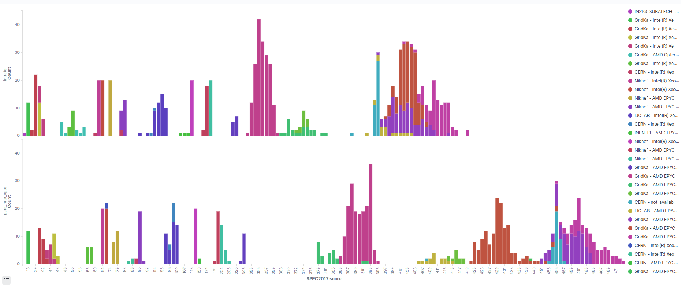
SPEC17 (Now)

Slide 11
Contributing
Follow the instructions from Dec 1, 2021
Check the benchmark configurations available
  Table added to the end of the dashboard
  Benchmark any machine configuration missing here!
  If the number of sites per configuration is low,
  more runs are also helpful
Scripts fixed last week (cryptography) 🛠️✅
  Remove the venv/workdir
  Ensure stomp.py's version is ≤ 7.0.0

Slide 12
Q&A

