Slide 1
CPU models in WLCG
Andrea Sciabà
HEP-SCORE Deployment Task Force Meeting
7 April 2022

Slide 2
Introduction
Benchmarking effort should be focused on the most relevant CPUs
Determine the most used CPU models and architectures in WLCG
  ATLAS and CMS record CPU model in their job monitoring
Within a given CPU architecture, find out if HEPSCORE scales well with number of cores and frequency
  Identify the most common CPUs for each architecture
Involve sites in benchmarking effort
  E.g. ask the site(s) running the most jobs for an architecture
The next slides try to address these points
  Caveat: only ATLAS and CMS jobs are considered

Slide 3
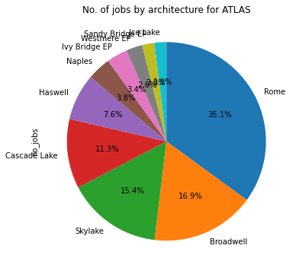
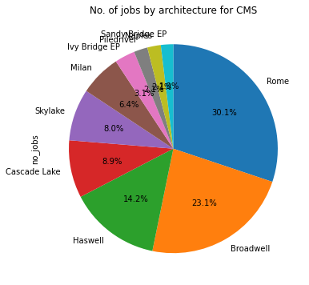
Most common CPU architectures (1/2)
CPU architecture extracted by pattern matching from the CPU name
Statistics based on jobs from the last three months
Ranking metric is the number of jobs run by a given architecture
BOINC jobs excluded
  Lots of consumer CPUs…
HPC jobs included!

Slide 4
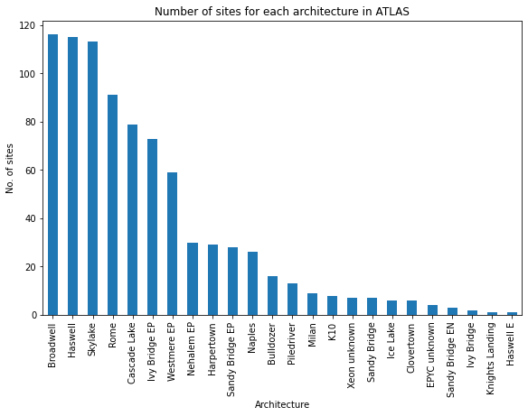
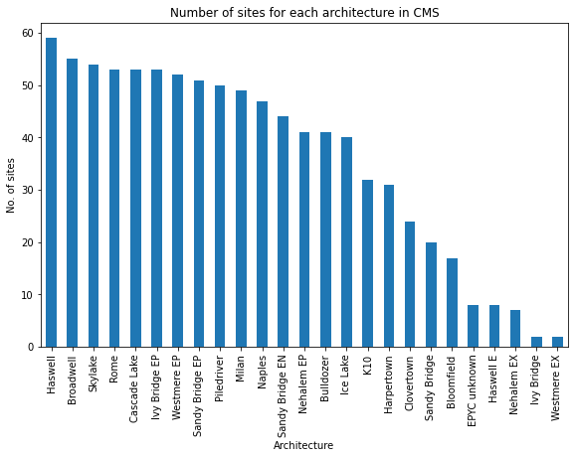
Most common CPU architectures (2/2)
Five architectures are responsible for about 85% of the jobs
  Rome, Broadwell, Haswell, Cascade Lake, Skylake
  Proportions remarkably similar between ATLAS and CMS
  All already tested by the HEPiX benchmarking WG
Many architectures (most for CMS) are present at a large number of sites

Slide 5
Leading sites for each architecture
Arch | Site
Broadwell | BNL
 | INFN-CNAF
Cascade Lake | CERN-T0
 | CERN
Haswell | RRC-KI-T1
 | SWT2_CPB
Ice Lake | TOKYO
 | IL-TAU
Ivy Bridge EP | IN2P3-CC
 | UKI-NORTHGRID-LANCS-HEP
Naples | BNL
 | INFN-FRASCATI
Nehalem EP | TW-FTT
 | EELA-UTFSM
Piledriver | INFN-COSENZA-RECAS
 | SiGNET
Rome | Vega_MCORE
 | FZK-LCG2
Sandy Bridge EP | RRC-KI-T1
 | UNIBE-LHEP
Skylake | IN2P3-CC
 | TRIUMF
Westmere EP | IHEP
 | AGLT2
Arch | Site
Broadwell | T2_CH_CERN
 | T1_DE_KIT
Cascade Lake | T2_CH_CERN
 | T1_RU_JINR
Haswell | T1_US_FNAL
 | T2_US_Purdue
Ice Lake | T2_US_MIT
 | T1_DE_KIT
Ivy Bridge EP | T3_US_OSG
 | T2_US_Wisconsin
Milan | T2_US_Florida
 | T1_US_FNAL
Naples | T1_US_FNAL
 | T2_DE_DESY
Piledriver | T1_US_FNAL
 | T2_IT_Bari
Rome | T2_CH_CERN
 | T1_US_FNAL
Sandy Bridge EP | T2_EE_Estonia
 | T2_US_Nebraska
Skylake | T2_CH_CERN
 | T1_FR_CCIN2P3
Westmere EP | T2_US_MIT
 | T2_US_Vanderbilt
Use this as a list of sites to ask to run HEPSCORE
  The top 12 architectures are listed
  Sorting is alphabetical, not by importance!
Priorities depend on context
  For accounting, the CPU architectures currently available at sites matter
  For procurement, the most recent CPU architectures are more relevant
ATLAS
CMS

Slide 6
Architectures tested by the HEPiX Benchmarking Working Group
AMD
  Milan, Rome, Naples, Piledriver, K10
Intel
  Cascade Lake, Skylake, Broadwell, Haswell, Sandy Bridge EP, Westmere EP, Nehalem EP
ARM
  Neoverse-N1

Slide 7
Conclusions
The most popular CPUs can be easily extracted from the experiment monitoring (namely ElasticSearch)
Five architectures are responsible for 85% of the jobs in the last three months
  Relatively old: Haswell is from 2013, the newest is Cascade Lake from 2020
It should be clearer which CPUs should be benchmarked (and where)
Suggest to look for scaling of HEPSCORE w.r.t. number of cores and frequency, hoping to easily predict CPU power from (architecture, no. cores, clock)
  Knowing though that it might not work with sufficient precision, as there may be bottlenecks in a system not related to the CPU core performance (e.g. memory, interconnects, etc.)
Check backup slides for more detailed information!

Slide 8
Backup slides

Slide 9
All architectures ranked by number of jobs
Arch | no_jobs | top_site | no_sites | Tested
Rome | 24711151 | Vega_MCORE | 91 | TRUE
Broadwell | 11885751 | BNL | 116 | TRUE
Skylake | 10861322 | IN2P3-CC | 113 | TRUE
Cascade Lake | 7966369 | CERN-T0 | 79 | TRUE
Haswell | 5351931 | RRC-KI-T1 | 115 | TRUE
Naples | 2691210 | BNL | 26 | TRUE
Ivy Bridge EP | 2397624 | IN2P3-CC | 73 | FALSE
Westmere EP | 1856192 | IHEP | 59 | TRUE
Sandy Bridge EP | 1416848 | RRC-KI-T1 | 28 | TRUE
Ice Lake | 1360424 | TOKYO | 6 | FALSE
Piledriver | 930382 | INFN-COSENZA-RECAS | 13 | TRUE
Nehalem EP | 650853 | TW-FTT | 30 | TRUE
Bulldozer | 464319 | CYFRONET | 16 | FALSE
Harpertown | 420420 | IFIC | 29 | FALSE
EPYC unknown | 304597 | UIO_CLOUD | 4 | FALSE
Milan | 289275 | DESY-HH | 9 | TRUE
K10 | 251918 | IN2P3-LPC-MUC2A | 8 | TRUE
Sandy Bridge EN | 132952 | DESY-HH | 3 | FALSE
Xeon unknown | 125182 | GOOGLE_BULK | 7 | FALSE
Knights Landing | 37756 | NERSC_Cori_p2_mcore | 1 | FALSE
Sandy Bridge | 37297 | praguelcg2 | 7 | FALSE
Haswell E | 22229 | UKI-NORTHGRID-SHEF-HEP | 1 | FALSE
Clovertown | 13807 | IN2P3-LPC | 6 | FALSE
Ivy Bridge | 11023 | CA-IAAS-T3 | 2 | FALSE
Arch | no_jobs | top_site | no_sites | Tested
Rome | 5480428 | T2_CH_CERN | 53 | TRUE
Broadwell | 4196743 | T2_CH_CERN | 55 | TRUE
Haswell | 2574882 | T1_US_FNAL | 59 | TRUE
Cascade Lake | 1619378 | T2_CH_CERN | 53 | TRUE
Skylake | 1461653 | T2_CH_CERN | 54 | TRUE
Milan | 1165636 | T2_US_Florida | 49 | TRUE
Ivy Bridge EP | 572011 | T3_US_OSG | 53 | FALSE
Piledriver | 385422 | T1_US_FNAL | 50 | TRUE
Naples | 378553 | T1_US_FNAL | 47 | TRUE
Sandy Bridge EP | 349472 | T2_EE_Estonia | 51 | TRUE
Westmere EP | 271261 | T2_US_MIT | 52 | TRUE
Ice Lake | 209439 | T2_US_MIT | 40 | FALSE
Sandy Bridge EN | 96800 | T2_US_Vanderbilt | 44 | FALSE
Nehalem EP | 71175 | T2_ES_CIEMAT | 41 | TRUE
K10 | 50627 | T2_US_Nebraska | 32 | TRUE
Bulldozer | 47314 | T2_DE_RWTH | 41 | FALSE
Harpertown | 23293 | T2_DE_RWTH | 31 | FALSE
Clovertown | 11831 | T2_DE_RWTH | 24 | FALSE
Sandy Bridge | 11792 | T3_US_Colorado | 20 | FALSE
EPYC unknown | 10549 | T2_UK_SGrid_RALPP | 8 | FALSE
Bloomfield | 9770 | T3_US_Colorado | 17 | FALSE
Haswell E | 2451 | T3_US_Colorado | 8 | FALSE
Nehalem EX | 1365 | T3_US_OSG | 7 | FALSE
Ivy Bridge | 287 | T2_HU_Budapest | 2 | FALSE
Westmere EX | 187 | T2_US_Wisconsin | 2 | FALSE
ATLAS
CMS

Slide 10
Top 10 CPUs by architecture: Rome
CPU | no_jobs
s+AMD EPYC 7302 16-Core Processor 512 KB+AVX2 | 6978956
s+AMD EPYC 7H12 64-Core Processor 512 KB+AVX2 | 5844077
s+AMD EPYC 7452 32-Core Processor 512 KB+AVX2 | 3944800
s+AMD EPYC 7702P 64-Core Processor 512 KB+AVX2 | 2090805
s+AMD EPYC 7742 64-Core Processor 512 KB+AVX2 | 1829571
s+AMD EPYC 7402 24-Core Processor 512 KB+AVX2 | 1763392
s+AMD EPYC 7702 64-Core Processor 512 KB+AVX2 | 1435482
s+AMD EPYC 7282 16-Core Processor 512 KB+AVX2 | 327847
s+AMD EPYC 7352 24-Core Processor 512 KB+AVX2 | 204250
s+AMD EPYC 7542 32-Core Processor 512 KB+AVX2 | 177211
CPU | no_jobs
AMD EPYC 7302 16-Core Processor | 1579721
AMD EPYC 7742 64-Core Processor | 1234158
AMD EPYC 7452 32-Core Processor | 717585
AMD EPYC 7542 32-Core Processor | 472942
AMD EPYC 7702P 64-Core Processor | 403153
AMD EPYC 7702 64-Core Processor | 351435
AMD EPYC 7402 24-Core Processor | 245473
AMD EPYC 7662 64-Core Processor | 161399
AMD EPYC 7282 16-Core Processor | 154393
AMD EPYC 7402P 24-Core Processor | 48271
ATLAS
CMS
(CPUs in green have been tested by the working group)

Slide 11
Broadwell
CPU | no_jobs
s+Intel(R) Xeon(R) CPU E5-2640 v4 @ 2.40GHz 25600 KB+AVX2 | 2606447
s+Intel(R) Xeon(R) CPU E5-2630 v4 @ 2.20GHz 25600 KB+AVX2 | 2026849
s+Intel(R) Xeon(R) CPU E5-2690 v4 @ 2.60GHz 35840 KB+AVX2 | 1583308
s+Intel(R) Xeon(R) CPU E5-2680 v4 @ 2.40GHz 35840 KB+AVX2 | 1213929
s+Intel(R) Xeon(R) CPU E5-2683 v4 @ 2.10GHz 40960 KB+AVX2 | 1103603
s+Intel(R) Xeon(R) CPU E5-2650 v4 @ 2.20GHz 30720 KB+AVX2 | 544118
s+Intel(R) Xeon(R) CPU E5-2618L v4 @ 2.20GHz 25600 KB+AVX2 | 403616
s+Intel(R) Xeon(R) CPU E5-2697 v4 @ 2.30GHz 46080 KB+AVX2 | 351032
s+Intel(R) Xeon(R) CPU E5-2695 v4 @ 2.10GHz 46080 KB+AVX2 | 346139
s+Intel(R) Xeon(R) CPU E5-2683 v4 @ 2.10GHz 20480 KB+AVX2 | 268931
CPU | no_jobs
Intel(R) Xeon(R) CPU E5-2650 v4 @ 2.20GHz | 1174157
Intel(R) Xeon(R) CPU E5-2630 v4 @ 2.20GHz | 839788
Intel(R) Xeon(R) CPU E5-2680 v4 @ 2.40GHz | 563440
Intel(R) Xeon(R) CPU E5-2697 v4 @ 2.30GHz | 507896
Intel(R) Xeon(R) CPU E5-2683 v4 @ 2.10GHz | 414601
Intel(R) Xeon(R) CPU E5-2640 v4 @ 2.40GHz | 320156
Intel(R) Xeon(R) CPU E5-2695 v4 @ 2.10GHz | 203106
Intel(R) Xeon(R) CPU E5-2620 v4 @ 2.10GHz | 71204
Intel(R) Xeon(R) CPU E5-2660 v4 @ 2.00GHz | 46677
Intel(R) Xeon(R) CPU E5-2650L v4 @ 1.70GHz | 40222
ATLAS
CMS

Slide 12
Skylake
CPU | no_jobs
s+Intel(R) Xeon(R) Silver 4114 CPU @ 2.20GHz 14080 KB+AVX2 | 1834028
s+Intel(R) Xeon(R) Platinum 8160 CPU @ 2.10GHz 33792 KB+AVX2 | 1750127
s+Intel(R) Xeon(R) Gold 6130 CPU @ 2.10GHz 22528 KB+AVX2 | 1603280
s+Intel(R) Xeon(R) Gold 6148 CPU @ 2.40GHz 28160 KB+AVX2 | 1497573
s+Intel(R) Xeon(R) Gold 6150 CPU @ 2.70GHz 25344 KB+AVX2 | 1254348
s+Intel(R) Xeon(R) Gold 5120 CPU @ 2.20GHz 19712 KB+AVX2 | 794061
s+Intel Xeon Processor (Skylake, IBRS) 16384 KB+AVX2 | 706428
s+Intel(R) Xeon(R) Gold 6132 CPU @ 2.60GHz 19712 KB+AVX2 | 629063
s+Intel(R) Xeon(R) Gold 5118 CPU @ 2.30GHz 16896 KB+AVX2 | 247065
s+Intel(R) Xeon(R) Gold 6140 CPU @ 2.30GHz 25344 KB+AVX2 | 123675
CPU | no_jobs
Intel(R) Xeon(R) Gold 6130 CPU @ 2.10GHz | 512690
Intel(R) Xeon(R) Silver 4114 CPU @ 2.20GHz | 243731
Intel(R) Xeon(R) Gold 6126 CPU @ 2.60GHz | 199620
Intel(R) Xeon(R) Silver 4116 CPU @ 2.10GHz | 178827
Intel(R) Xeon(R) Gold 5120 CPU @ 2.20GHz | 93543
Intel(R) Xeon(R) Gold 5118 CPU @ 2.30GHz | 66321
Intel(R) Xeon(R) Gold 6138 CPU @ 2.00GHz | 49383
Intel(R) Xeon(R) Platinum 8160 CPU @ 2.10GHz | 27422
Intel(R) Xeon(R) Gold 6148 CPU @ 2.40GHz | 13855
Intel Xeon Processor (Skylake, IBRS) | 12608
ATLAS
CMS

Slide 13
Haswell
CPU | no_jobs
s+Intel(R) Xeon(R) CPU E5-2680 v3 @ 2.50GHz 30720 KB+AVX2 | 1158193
s+Intel(R) Xeon(R) CPU E5-2640 v3 @ 2.60GHz 20480 KB+AVX2 | 1149251
s+Intel(R) Xeon(R) CPU E5-2650 v3 @ 2.30GHz 25600 KB+AVX2 | 611201
s+Intel(R) Xeon(R) CPU E5-2630 v3 @ 2.40GHz 20480 KB+AVX2 | 541178
s+Intel(R) Xeon(R) CPU E5-2670 v3 @ 2.30GHz 30720 KB+AVX2 | 363534
s+Intel(R) Xeon(R) CPU E5-2680 v3 @ 2.50GHz 4096 KB+AVX2 | 309570
s+Intel(R) Xeon(R) CPU E5-2660 v3 @ 2.60GHz 25600 KB+AVX2 | 305888
s+Intel(R) Xeon(R) CPU E5-2650L v3 @ 1.80GHz 30720 KB+AVX2 | 235325
s+Intel(R) Xeon(R) CPU E5-2697 v3 @ 2.60GHz 17920 KB+AVX2 | 146414
s+Intel(R) Xeon(R) CPU E5-2697 v3 @ 2.60GHz 35840 KB+AVX2 | 143706
CPU | no_jobs
Intel(R) Xeon(R) CPU E5-2670 v3 @ 2.30GHz | 826613
Intel(R) Xeon(R) CPU E5-2630 v3 @ 2.40GHz | 381117
Intel(R) Xeon(R) CPU E5-2660 v3 @ 2.60GHz | 350472
Intel(R) Xeon(R) CPU E5-2698 v3 @ 2.30GHz | 317071
Intel(R) Xeon(R) CPU E5-2650 v3 @ 2.30GHz | 225466
Intel(R) Xeon(R) CPU E5-2640 v3 @ 2.60GHz | 217418
Intel(R) Xeon(R) CPU E5-2680 v3 @ 2.50GHz | 157489
Intel(R) Xeon(R) CPU E5-2678 v3 @ 2.50GHz | 43445
Intel(R) Xeon(R) CPU E5-2650L v3 @ 1.80GHz | 30872
Intel(R) Xeon(R) CPU E5-2620 v3 @ 2.40GHz | 11226
ATLAS
CMS

Slide 14
Cascade Lake
CPU | no_jobs
s+Intel(R) Xeon(R) Silver 4216 CPU @ 2.10GHz 22528 KB+AVX2 | 2483590
s+Intel(R) Xeon(R) Gold 5218 CPU @ 2.30GHz 22528 KB+AVX2 | 1534250
s+Intel(R) Xeon(R) Gold 6252 CPU @ 2.10GHz 36608 KB+AVX2 | 1050756
s+Intel(R) Xeon(R) Gold 6240R CPU @ 2.40GHz 36608 KB+AVX2 | 504990
s+Intel(R) Xeon(R) Gold 6248 CPU @ 2.50GHz 28160 KB+AVX2 | 336360
s+Intel(R) Xeon(R) Gold 6230 CPU @ 2.10GHz 28160 KB+AVX2 | 279960
s+Intel(R) Xeon(R) Gold 6242 CPU @ 2.80GHz 22528 KB+AVX2 | 263510
s+Intel(R) Xeon(R) Silver 4210 CPU @ 2.20GHz 14080 KB+AVX2 | 222811
s+Intel(R) Xeon(R) Gold 6248R CPU @ 3.00GHz 36608 KB+AVX2 | 198295
s+Intel(R) Xeon(R) Gold 5220 CPU @ 2.20GHz 25344 KB+AVX2 | 182290
CPU | no_jobs
Intel(R) Xeon(R) Silver 4216 CPU @ 2.10GHz | 501172
Intel(R) Xeon(R) Gold 5218 CPU @ 2.30GHz | 497423
Intel(R) Xeon(R) Gold 6226R CPU @ 2.90GHz | 240959
Intel(R) Xeon(R) Gold 6248R CPU @ 3.00GHz | 131069
Intel(R) Xeon(R) Gold 6252 CPU @ 2.10GHz | 47527
Intel(R) Xeon(R) Gold 6238R CPU @ 2.20GHz | 42970
Intel(R) Xeon(R) Gold 6242 CPU @ 2.80GHz | 41243
Intel(R) Xeon(R) Silver 4214 CPU @ 2.20GHz | 39409
Intel(R) Xeon(R) Gold 5220R CPU @ 2.20GHz | 30801
Intel(R) Xeon(R) Gold 6230 CPU @ 2.10GHz | 23861
ATLAS
CMS

Slide 15
Bonus: Ice Lake (latest from Intel)
CPU | no_jobs
Intel(R) Xeon(R) Gold 6326 CPU @ 2.90GHz | 100931
Intel(R) Xeon(R) Platinum 8368 CPU @ 2.40GHz | 90310
Intel(R) Xeon(R) Gold 5318Y CPU @ 2.10GHz | 7701
Intel(R) Xeon(R) Platinum 8358 CPU @ 2.60GHz | 5441
Intel(R) Xeon(R) Gold 6348 CPU @ 2.60GHz | 5018
Intel(R) Xeon(R) Platinum 8370C CPU @ 2.80GHz | 38
CPU | no_jobs
s+Intel(R) Xeon(R) Gold 5320 CPU @ 2.20GHz 39936 KB+AVX2 | 1120828
s+Intel(R) Xeon(R) Gold 6354 CPU @ 3.00GHz 39936 KB+AVX2 | 238899
s+Intel(R) Xeon(R) Platinum 8370C CPU @ 2.80GHz 49152 KB+AVX2 | 697
ATLAS
CMS

Slide 16
Bonus: Milan (latest from AMD)
CPU | no_jobs
s+AMD EPYC 7443 24-Core Processor 512 KB+AVX2 | 166768
s+AMD EPYC 7713P 64-Core Processor 512 KB+AVX2 | 68543
s+AMD EPYC 7513 32-Core Processor 512 KB+AVX2 | 39297
s+AMD EPYC 7443P 24-Core Processor 512 KB+AVX2 | 14584
s+AMD EPYC 7763 64-Core Processor 512 KB+AVX2 | 82
s+AMD EPYC 7763 64-Core Processor 512 KB | 1
CPU | no_jobs
AMD EPYC 75F3 32-Core Processor | 587802
AMD EPYC 7543 32-Core Processor | 416657
AMD EPYC 7443 24-Core Processor | 100830
AMD EPYC 7513 32-Core Processor | 56208
AMD EPYC 7313 16-Core Processor | 2975
AMD EPYC 7763 64-Core Processor | 1164
ATLAS
CMS

