Slide 2
Measurement Collection Update
Gonzalo Menéndez Borge
IT-SC-POF

Slide 3
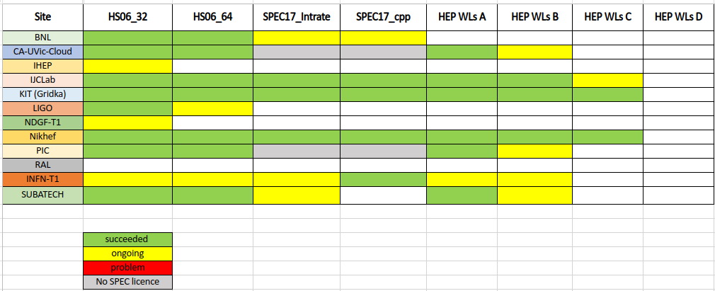
Benchmark Progress (Last)

Slide 4
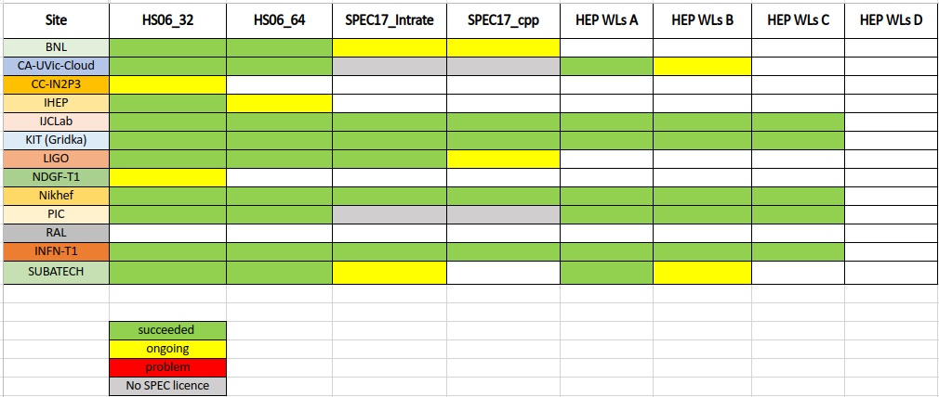
Benchmark Progress (Now)

Slide 5
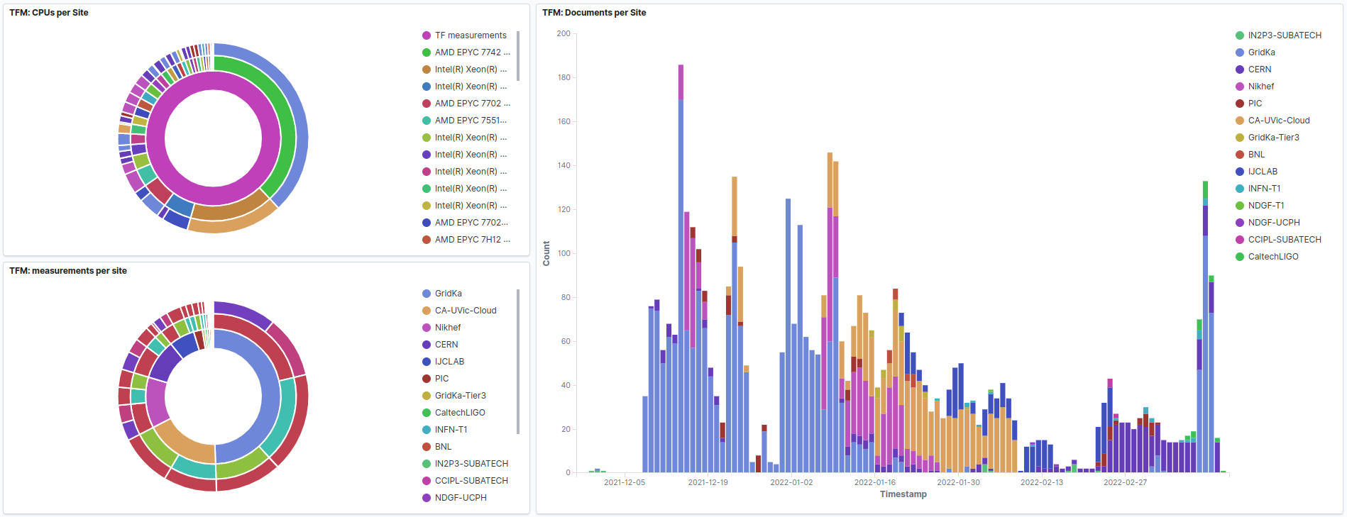
Contributions (Last)

Slide 6
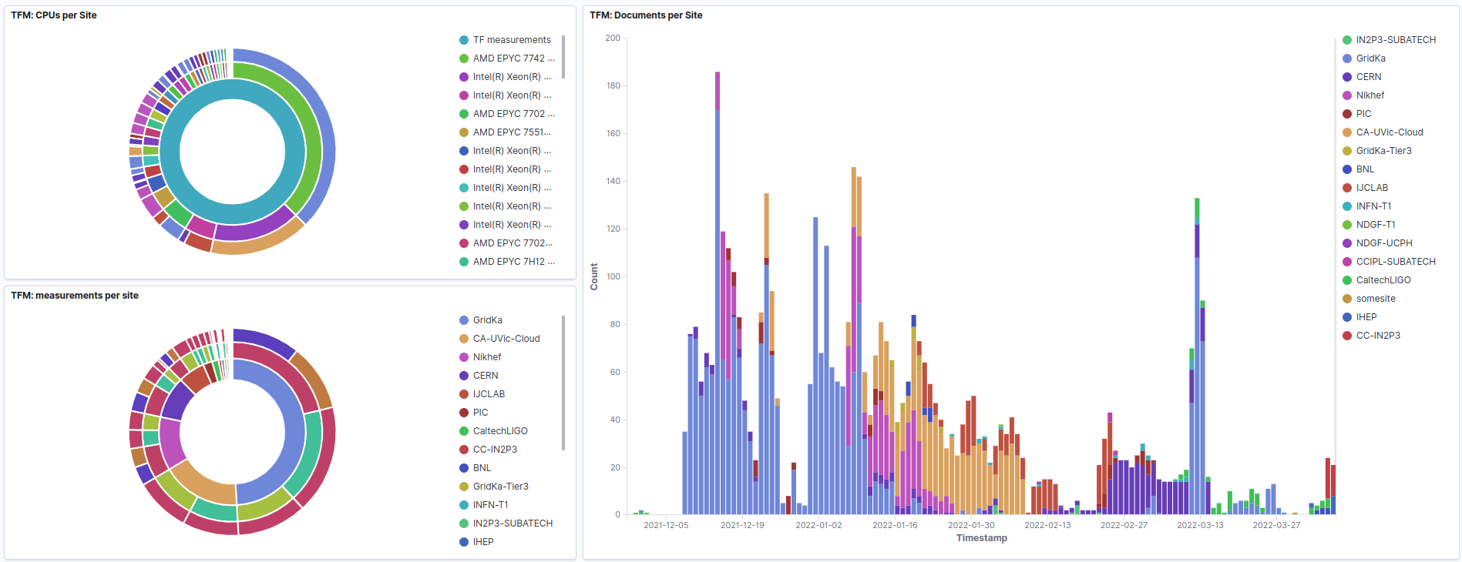
Contributions (New)

Slide 7
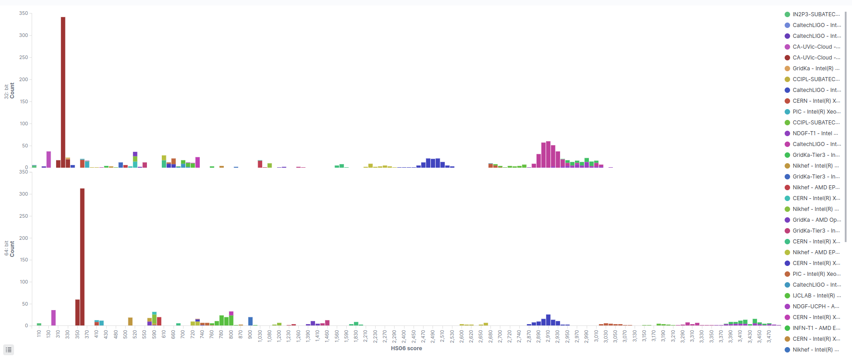
HS06 (Last)

Slide 8
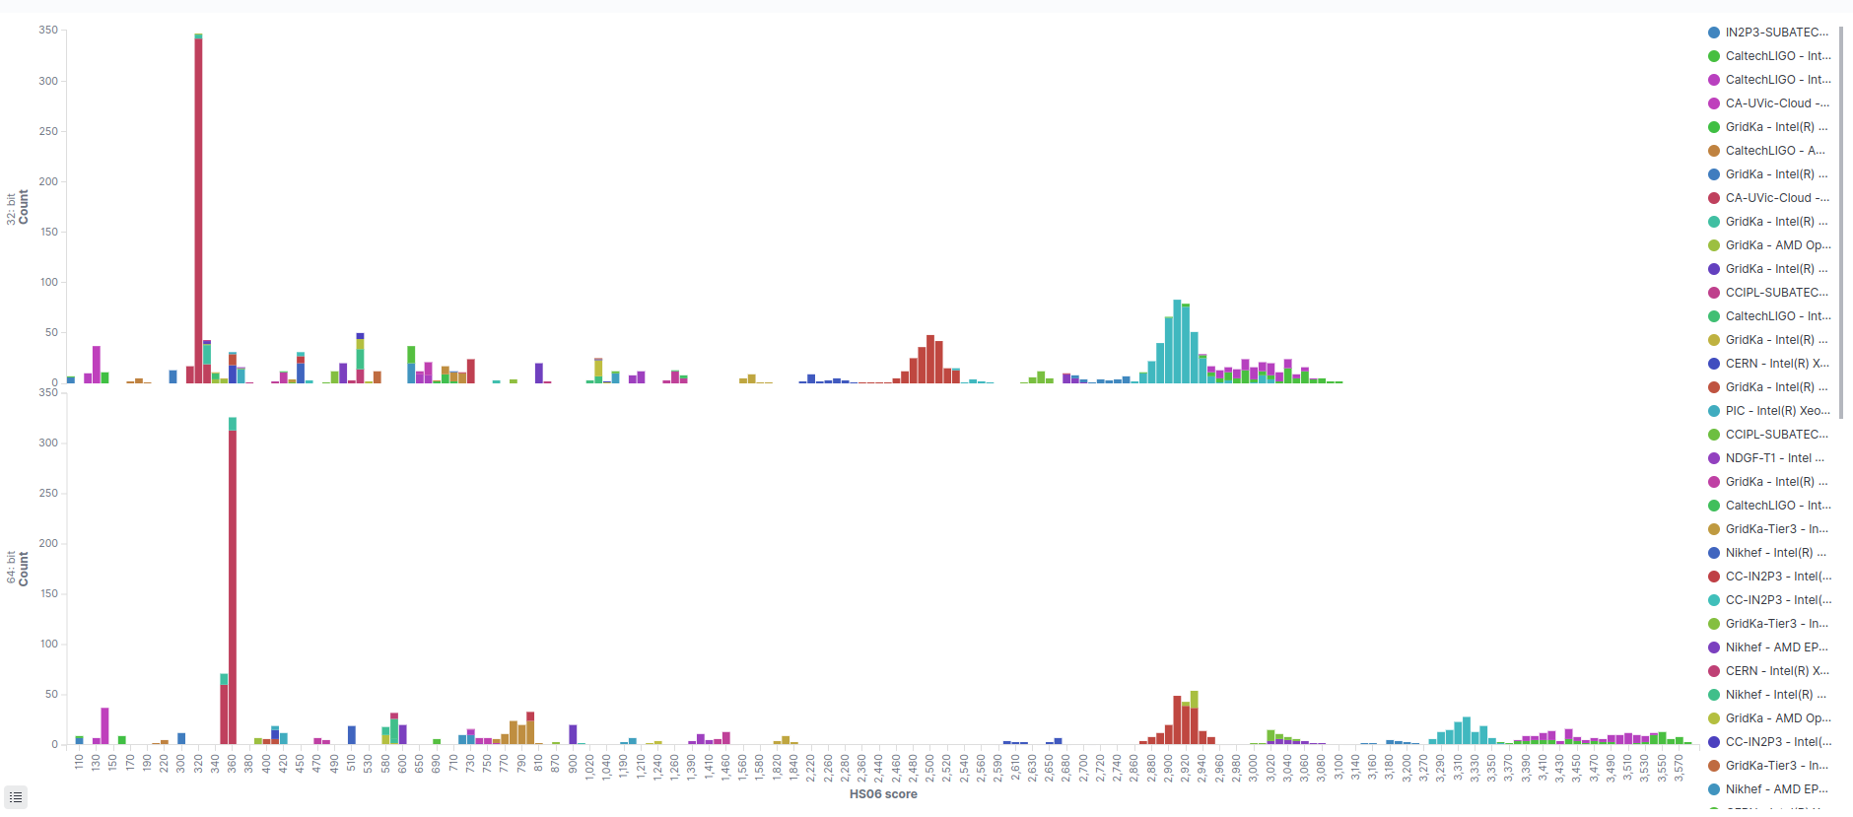
HS06 (Now)

Slide 9
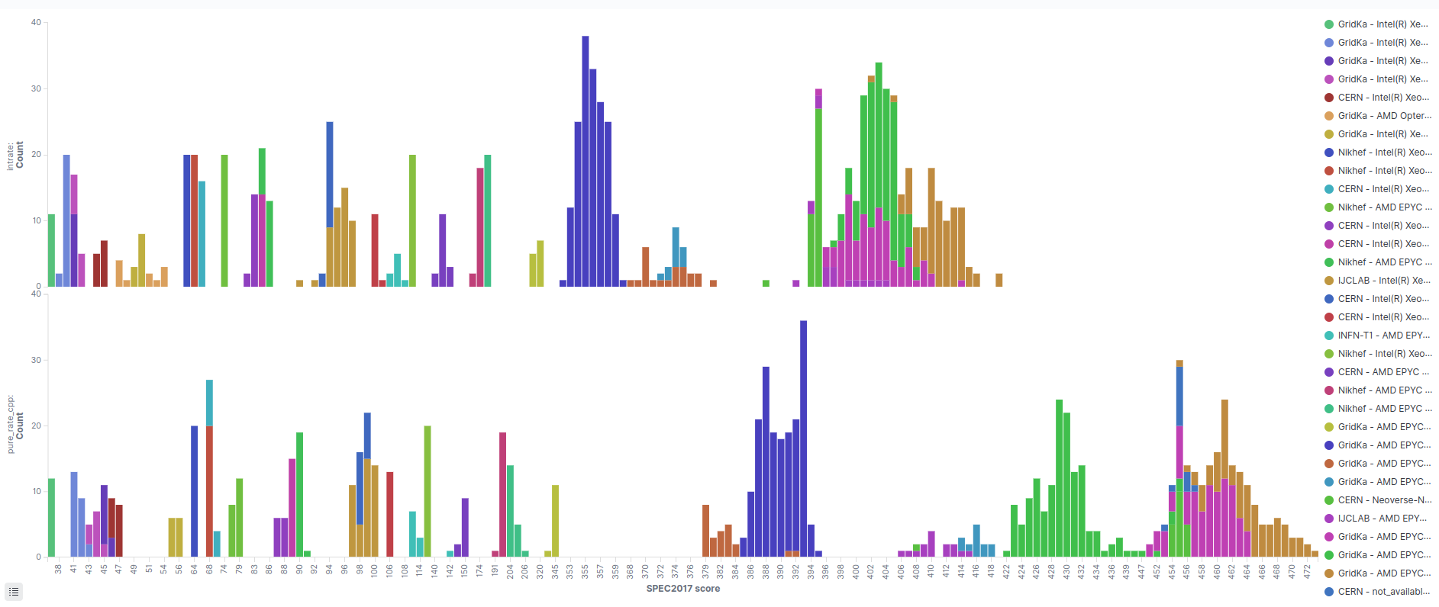
SPEC17 (Last)

Slide 10
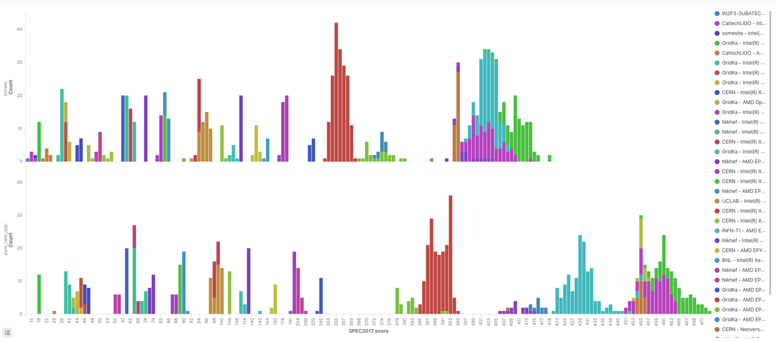
SPEC17 (Now)

Slide 11
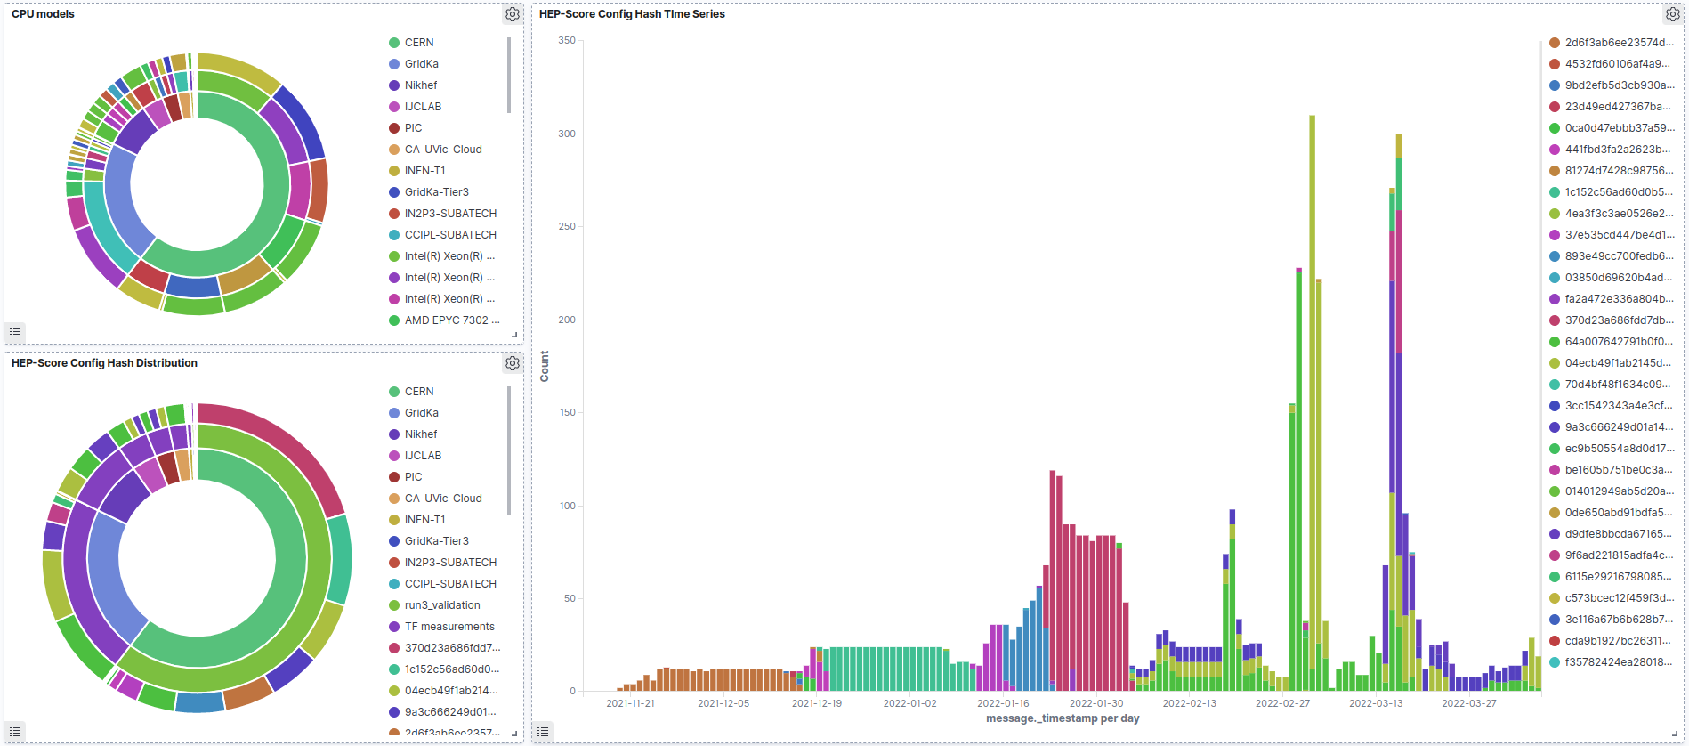
HEPscore

Slide 12
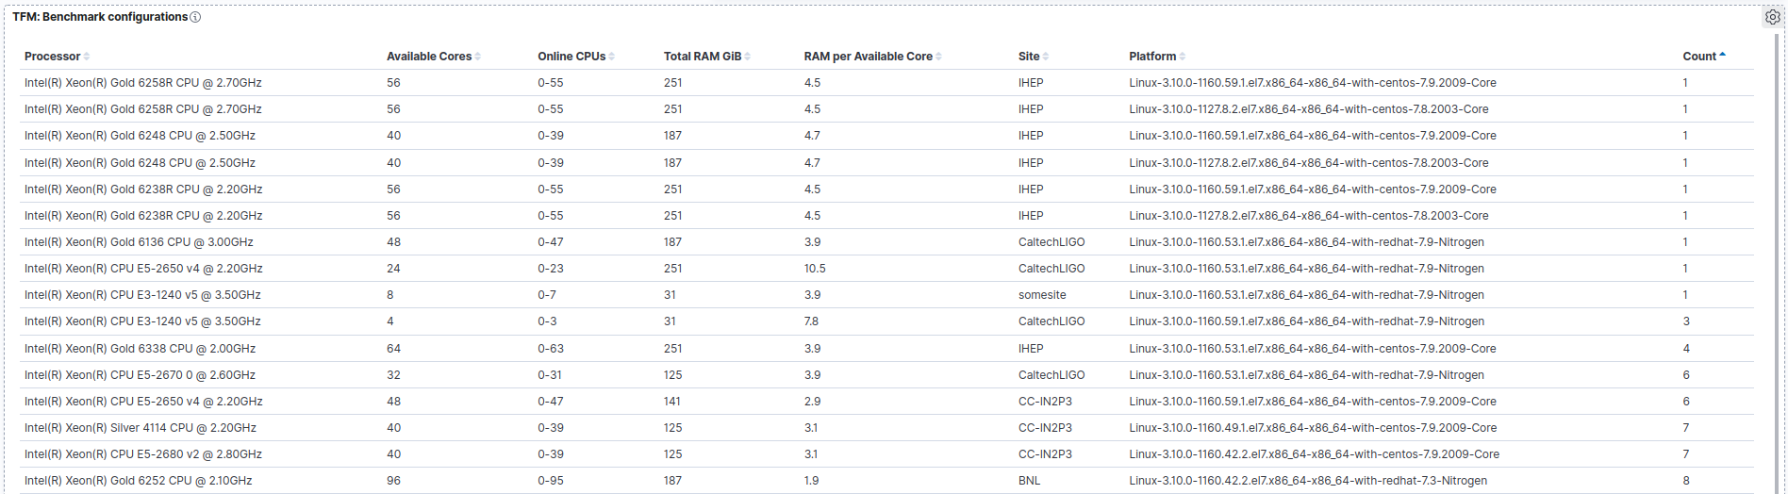
Benchmark Configurations

Slide 13
Contributing
Follow the instructions from Dec 1, 2021
Check the benchmark configurations available
  Table added to the end of the dashboard
  Runs are especially appreciated on
    Missing machine configuration
    Configurations with low number of runs
HEPscore script D still in the works 🛠️
Contact email: hep-benchmarks-support@cern.ch

Slide 14
Q&A

