Slide 1
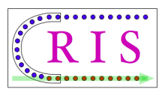
CRIS: collinear resonance ionization spectroscopy physics and progress at ISOLDE
Kieran Flanagan
University of Manchester

Slide 2
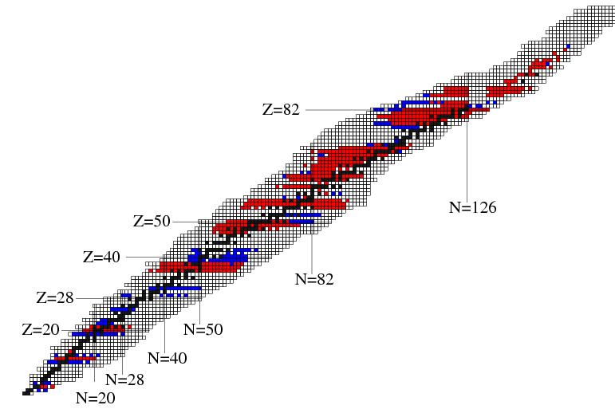
Status of laser spectroscopy
Laser spectroscopy measurements to date
Since 1995
Before 1995
Key questions
Z
What are limits of nuclear existence?
Do new forms of nuclear matter exist?
Are there new forms of collective motion?
77,78
Does the ordering of quantum states change?
N
B. Cheal and K.T. Flanagan, J. Phys. G: Nucl. Part. Phys. 37 1131101 (2010)

Slide 3
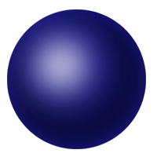
Nuclear moment and radii measurements with laser spectroscopy
Hyperfine Structure
²P_{3/2}
Spin, magnetic and electric
moments , all nuclear
observables are extracted
without model dependence.
3p
F_{j}
²P_{1/2}
3s
F_{i}
²S_{1/2}
Isotope Shift
Changes in nuclear charge
radii and sensitive to changes in dynamic nature and deformation as well as volume.
ppm shift
Δν_{IS} = Δν_{MS} + Δν_{FS}

Slide 4
Production: Isotope Separation
Thick Target
ISOL
Electromagnetic
separator
Ionizer
Primary
Beam
Light ion
(1.4GeV protons)
Ions
Low-energy
High-quality
60keV
Limits
t_{1/2} ~ ms
chemical properties
In-Flight Fragmentation (GSI)
Electromagnetic
Separator
Thin target
Primary
Beam
Low-energy
High-quality
High-energy
Low-quality
All elements
Gas Catcher+ RFQ Cooler Buncher
1 GeV/u
heavy ion
1 GeV/u
t_{1/2} ~ μs
Low intensities
Limits

Slide 5
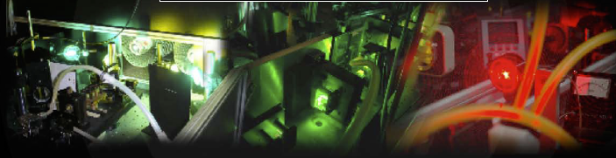
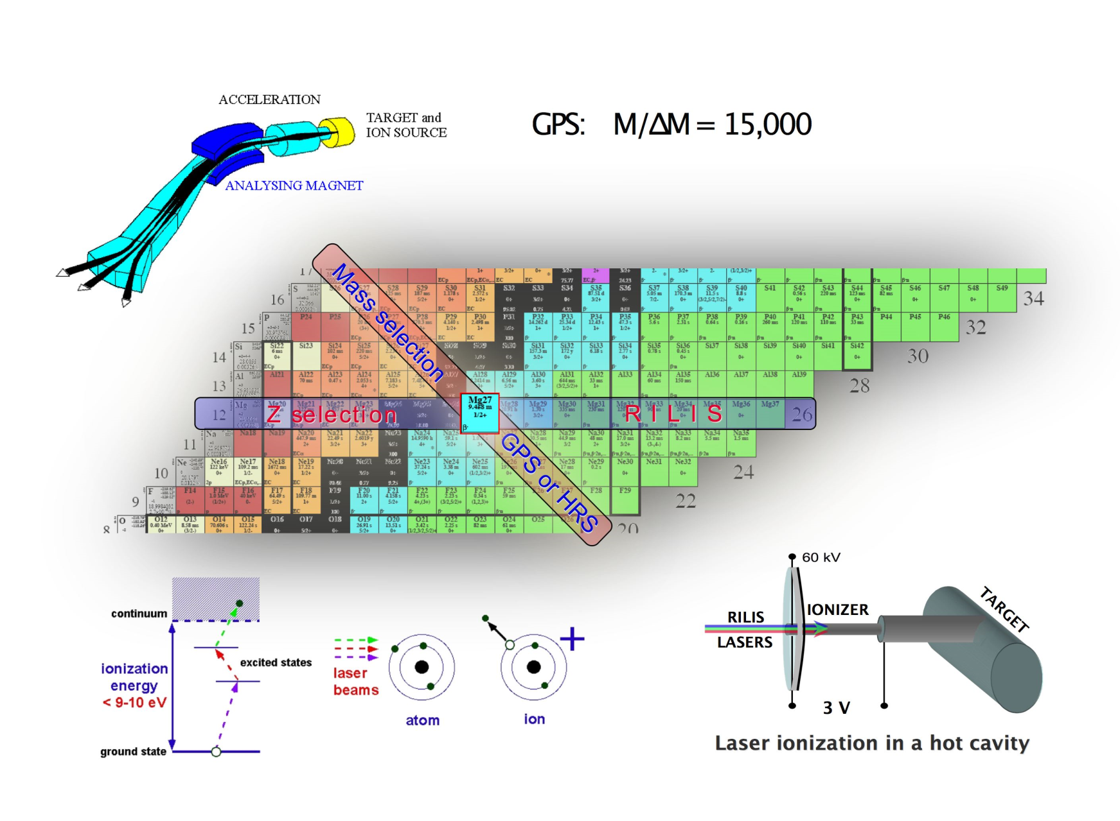
RILIS: The ISOLDE laser ion source
B.A. Marsh (RILIS website)

Slide 6
Considerations for in-source laser spectroscopy
IP
J,ћω_{j}
T=~2000⁰C
E₁
Decay losses
J,ћω_{i}
Length of ionizer
E₀
Evacuation time ~100μs
Therefore a repetition rate of 10kHz
is required for maximum efficiency.
Need to satisfy the Flux and Fluence conditions in order to saturate transitions and maximise efficiency.
Short duration pulsed lasers (10-20ns) with ~1-10mJ per pulse.
CW Laser> 500W (and tight focus) just
to saturate the first step!
~100mW at 10kHz for resonant steps
~1-5W at 10kHz for quasi resonant steps
~10-20W at 10kHz for non-resonant
steps

Slide 7
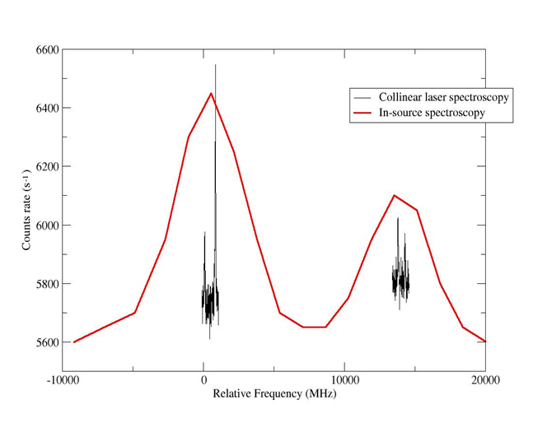
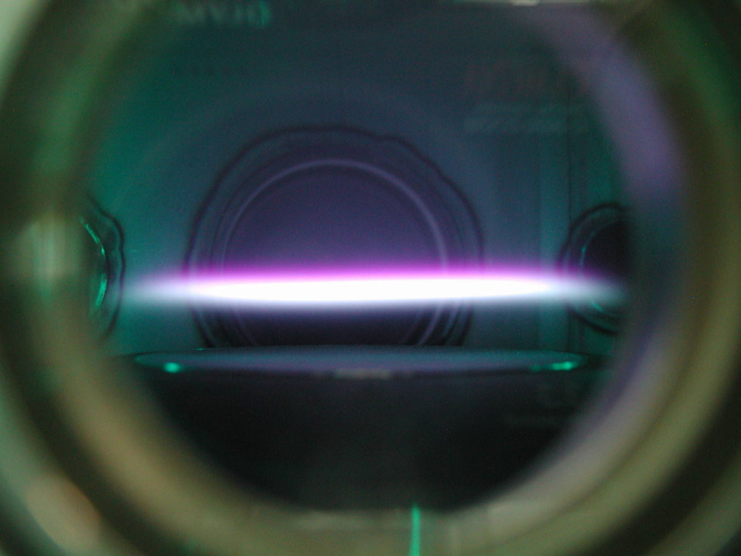
High resolution vs high sensitivity
Cu
Collinear Concept
Energy (eV)
287.9nm
ΔE=const=δ(¹/₂mv²)≈mvδv
5
Charge
exchange
Ion
Source
For ionic spectroscopy
Doppler tuning voltage
applied to light collection
region
327.4nm
0
Separator
electrostatic
acceleration
⁶⁸Cu
Applied Doppler
tuning voltage
PMT
10
0
10
20
Relative Frequency (GHz)

Slide 8
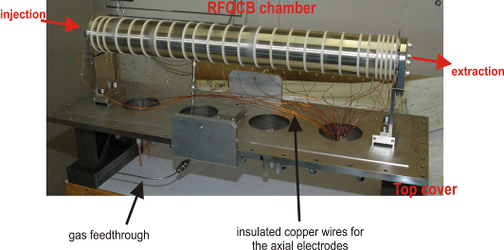
Innovations in fluorescence detection
Charge
exchange
Relatively low detection efficiency ~ 1:1000-10 000
Large background due to scattered light 1000-5000/s
Typical lower limit on yield is 10⁶/s (with a couple of
exceptions)
Background due to
scattered light
ISCOOL
Applied Doppler
tuning voltage
PMT
Accumulate
End plate potential
Release
Background
suppression
eg. 200ms accumulation
=
~10⁴
10µs gate width
Reacceleration
potential
z
500000
With ISCOOL
200
18 min
PMT
Counts
100
490000
⁴⁶K
10µs gate
Tuning Voltage
Tuning Voltage

Slide 9
High resolution vs high sensitivity
Cu
Collinear Concept
Energy (eV)
287.9nm
ΔE=const=δ(¹/₂mv²)≈mvδv
5
Charge
exchange
Ion
Source
For ionic spectroscopy
Doppler tuning voltage
applied to light collection
region
327.4nm
0
Separator
electrostatic
acceleration
⁶⁸Cu
Applied Doppler
tuning voltage
PMT
In-source + collinear will dramatically
reduce the scanning region
and therefore the required time to locate
resonances.
10
0
10
20
Relative Frequency (GHz)

Slide 10

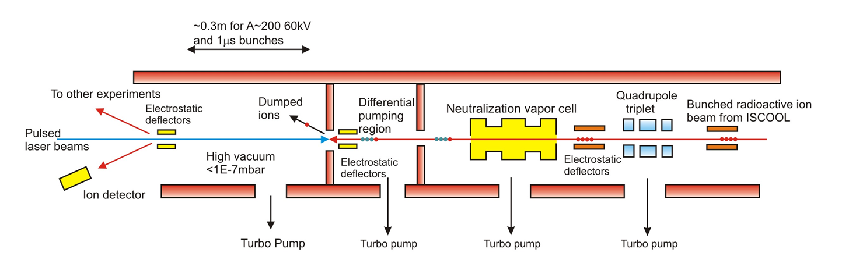
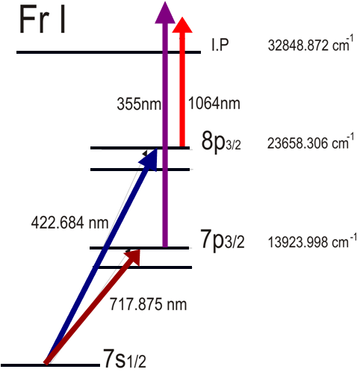
Collinear Resonant Ionization Spectroscopy (CRIS) @ ISOLDE
Combining high resolution
nature of collinear beams
method with high sensitivity
of in-source spectroscopy.
Allowing extraction of
B factors and quadrupole
moments.
⁶⁸Cu
30MHz
4GHz
10
10
0
10
20
Yu. A. Kudriavtsev and V. S. Letokhov,
Appl. Phys. B29 219 (1982)
Relative Frequency (GHz)

Slide 11
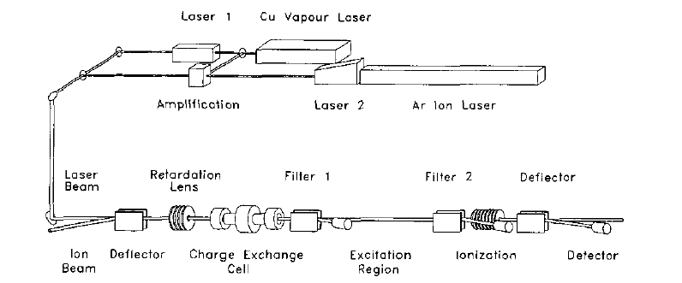
Previous CRIS of Yb at ISOLDE
Ch. Schulz et al., J. Phys. B, 24 (1991) 4831
Charge exchange efficiency into meta stable states
Below saturation on second step
Duty cycle losses due to lasers
Total efficiency
1:100 000

Slide 12
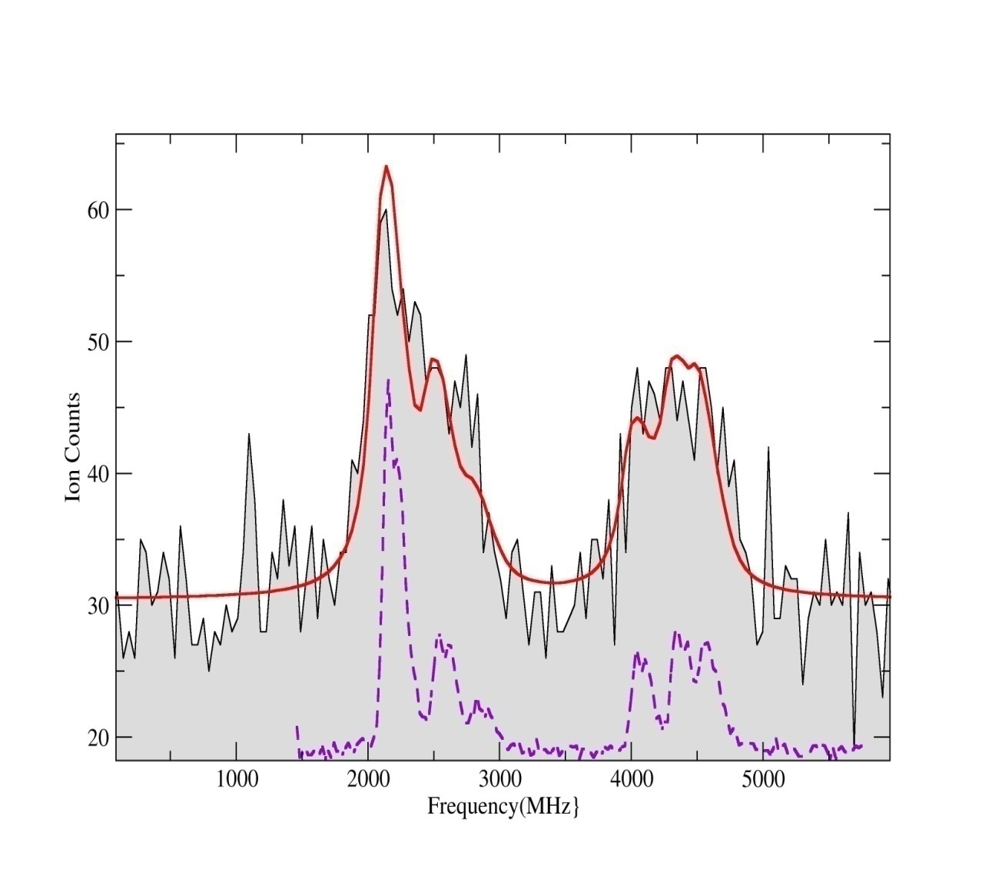
Off-line CRIS test at the IGISOL
200 ions per bunch
6 scans
1:30 efficiency
Factor of 1000 increase in detection efficiency.
50
Ion Counts
Background due to non-resonant collisional ionization in poor vacuum (10⁻⁵ mbar)
~5 non-resonant ions per bunch
30
2000
4000
Relative frequency (MHz)

Slide 13
Collinear resonant ionization laser spectroscopy (CRIS)
RIS performed on a fast atomic bunched beam.
Pulsed Amplified CW laser has a resolution which is Fourier limited.
Background events are due to non-resonant collisonal ionization, which is directly related to the vacuum
Very high total experimental efficiency
  Neutralization (element dependent)
  Ionization efficiency 50-100% (no HFS)
  Detection efficiency almost 100%
  Transport through ISCOOL 70%
  Transport to experiment 80-90%
1:30 From Jyvaskyla off-line tests
( K. Flanagan, PhD)

Slide 14
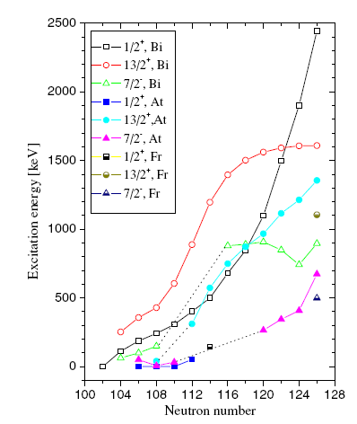
Re-ordering of quantum states in Francium
Systematic reduction in energy of the
deformed π(1/2+) in isotopes in this
region of the chart
7/2⁻
1/2⁺
1/2⁺
7/2⁻
π(1/2+) proton intruder state becomes the ground state in 195At and 185Bi
9/2⁻
9/2⁻
²⁰¹Fr
²⁰³Fr
The isomer shifts of ^{201,203}Fr
and their magnetic moments
will provide important
information to better
understand the evolution of
nuclear structure in this region.
Suggestion that ¹⁹⁹Fr has
I=1/2⁺ ground state spin
with an associated large
oblate deformation.

Slide 15
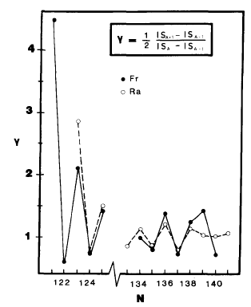
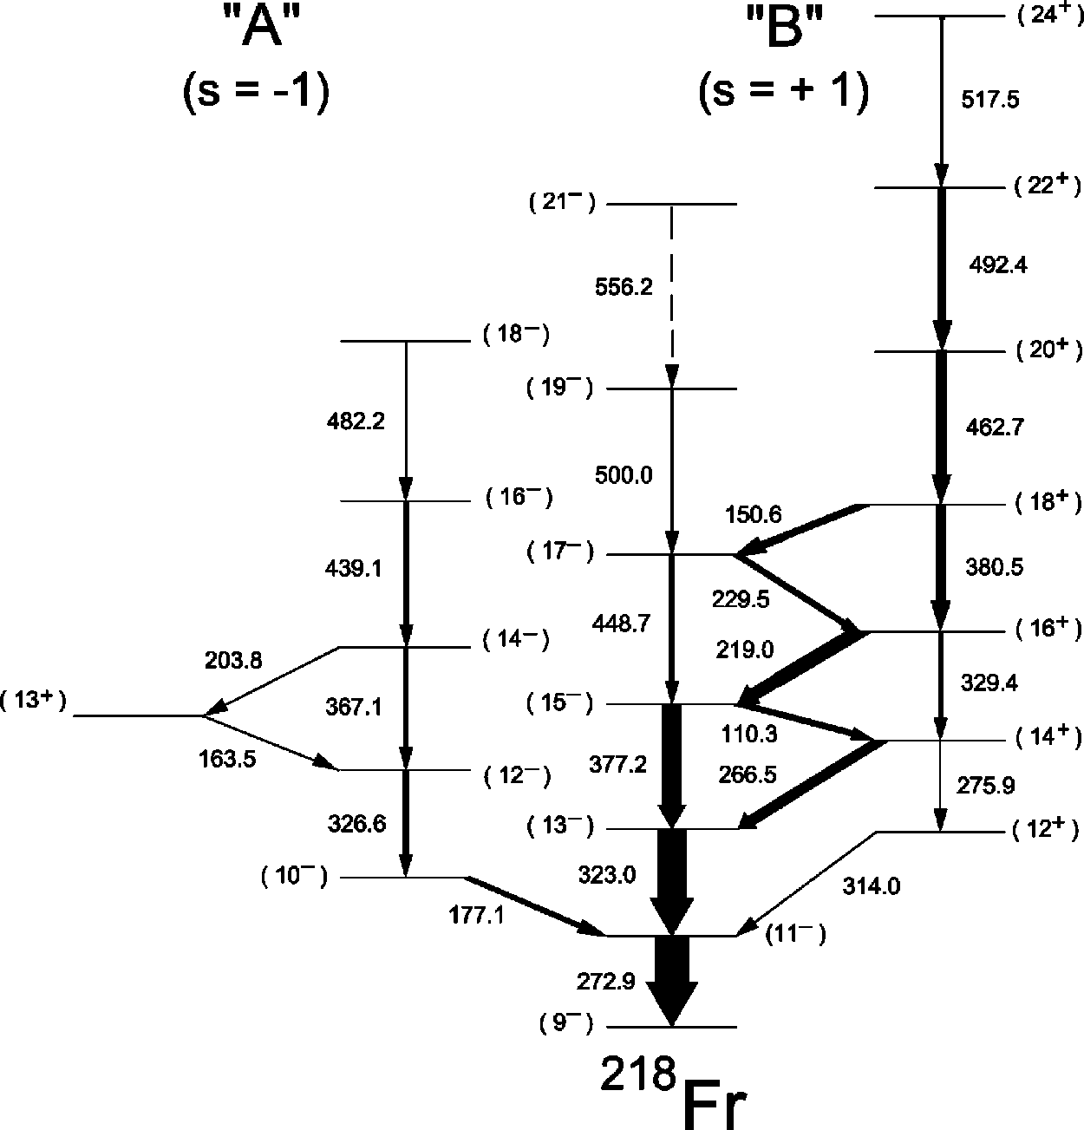
Border of the region of reflection asymmetry
Region characterised by reversal in odd-even staggering, which is attributed to presence of octupole-quadrupole deformation.
Also characterised in the interleaving alternating band structure connected by enhance E1 transitions

Slide 16
Previous and proposed isotopes
1
10²
10⁵
10⁶
10⁷
10⁶
10³
201
202
203
204
205
206
207
208
209
210
211
212
213
214
intruder 1/2+
isomer
Previous measurements
10³
10⁴
10⁴
10³
218
219
220
221
222
223
224
225
226
227
228
229
230
Region of reflection asymmetry

Slide 17
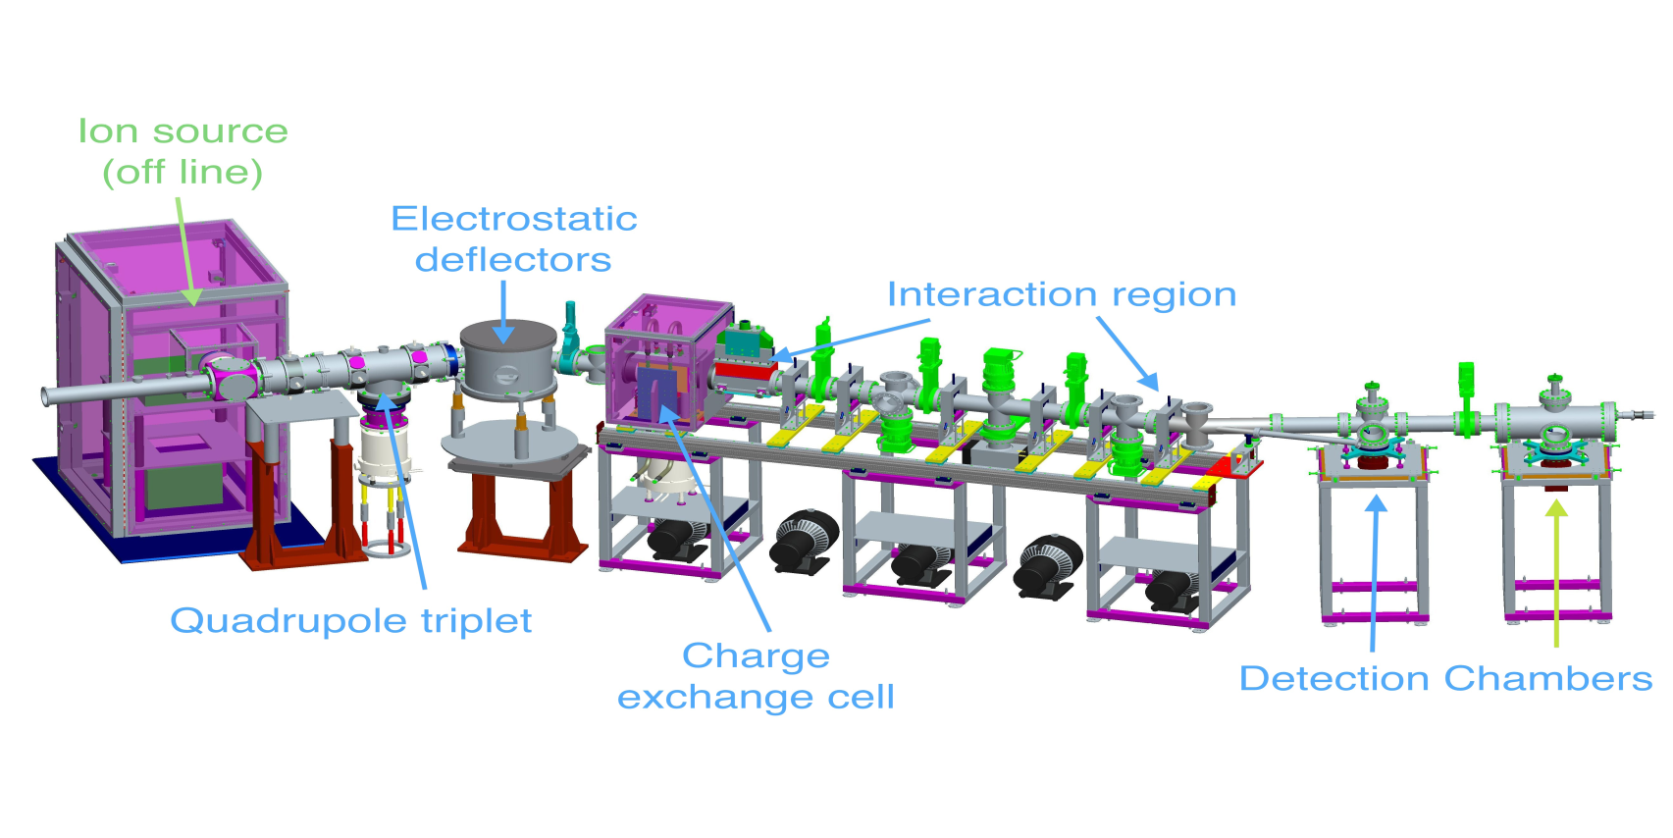
CRIS Beam optics
Bunched, accelerated ions focused and steered
Ions accelerated to scanned velocity and neutralized
  Remaining ions deflected
Pulsed lasers ionize studied atom
Resulting ions steered and focused to detector

Slide 18
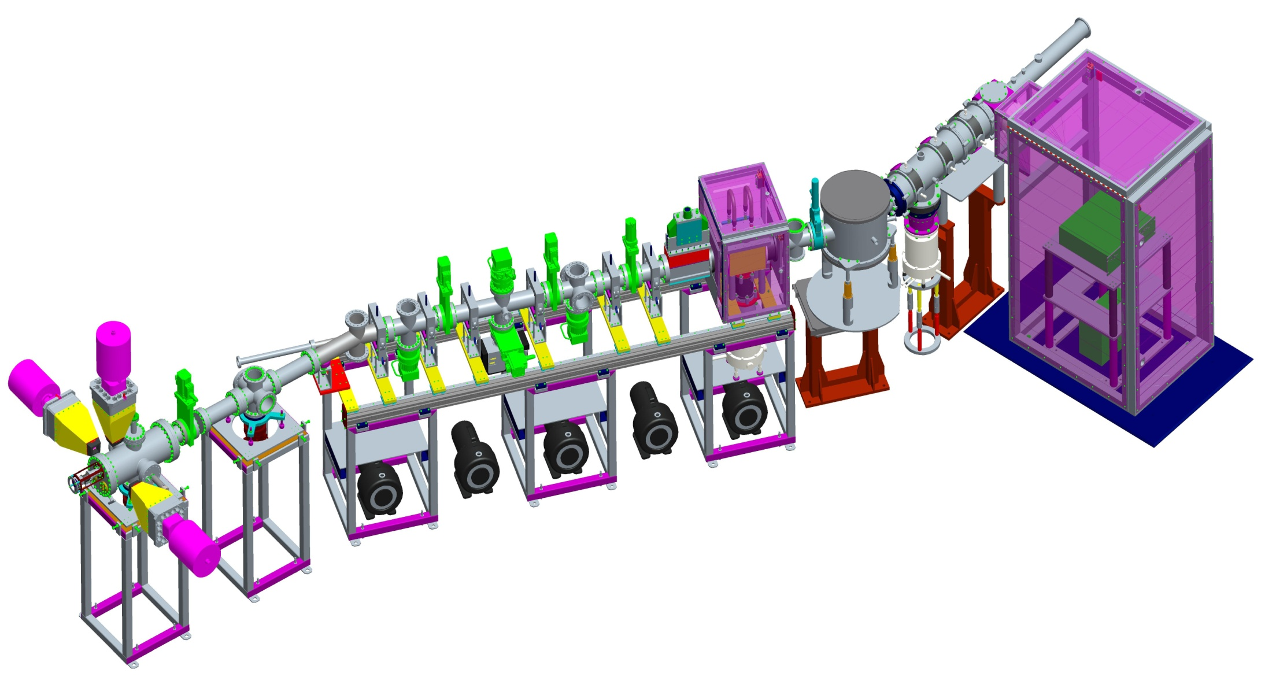
Collinear Resonant Ionization Spectroscopy (CRIS)

Slide 19
Limiting factors:Efficiency and isobaric contamination
From the ISCOOL tests a limit of 10⁷ per bunch were trapped and measured on an MCP.
Conservative efficiency of 1:30 (number from Jyvaskyla work) and a pressure of 10⁻⁹ mbar and a high isobaric contamination of 10⁷ (expect much lower).
Background suppression:
Pressure 10⁻⁹ mbar = 1:200 000
Detection of secondary electrons by MCP
Alpha decay detection allows discrimination
of isobaric contamination (50-100cts/s)
Limited to ~ 100pps
Limited ~5pps
With 50% efficiency and signal limited noise regime = 0.3pps

Slide 20
Isomer Selection
Hyperfine Structure
²P_{3/2}
Spin, magnetic and electric
moments can dramatically
change for the isomeric state.
3p
F_{j}
²P_{1/2}
3s
F_{i}
²S_{1/2}
Isotope Shift
large shift in the transition frequency for the isomeric state compared to the ground state
ppm shift
Δν_{IS} = Δν_{MS} + Δν_{FS}

Slide 21
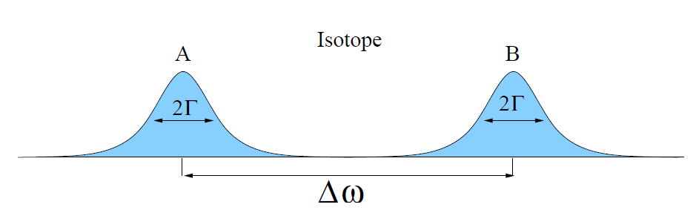
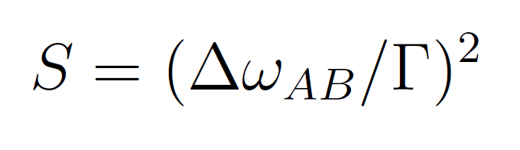
Selectivity
IP
IP
S=ΠS_{i} = S₁*S₂
E₂
E₂
S₂
S_{i} of 10⁴ is possible
E₁
E₁
With more than three steps
S can reach 10¹⁴
S₁
A
E₀
B
E₀

Slide 22
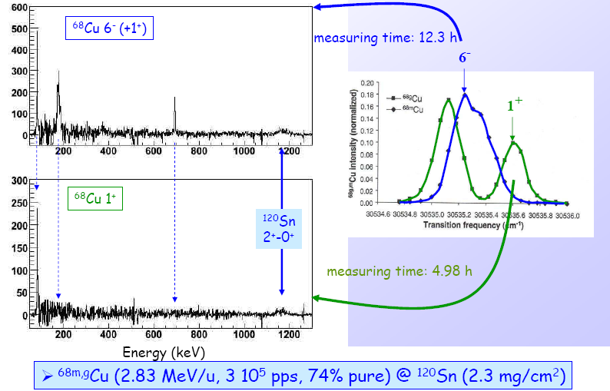
Post accelerated Isomeric Beams at ISOLDE: ⁶⁸Cu

Slide 23
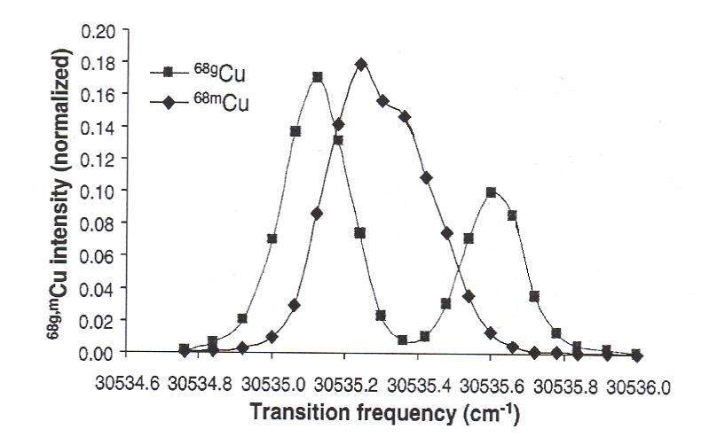
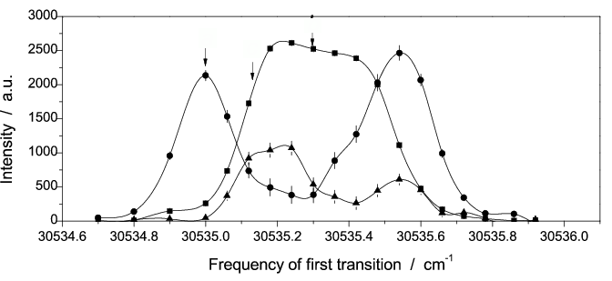
Isomeric beams (^{68,70}Cu) from REX-Isolde
⁷⁰Cu/⁷⁰Ga = 50%/50% → lasers ON vs. lasers OFF
⁷⁰Cu:
6⁻ → 65%
3⁻ → 23% →~12% of the total beam
1⁺ →12%
6⁻
6⁻ (g.s.)
6⁻
722
3⁻
1⁺
β
⁷⁰Cu
242
β
⁶⁸Cu
0
3⁻
101
1⁺
β
β
6⁻
0
1⁺
β
1⁺ (g.s.)
(Ü. Köster et al., NIM B, 160, 528(2000); L. Weissman et al., PRC65, 024315(2000)), I. Stefanescu PRL 98, 122701 (2007))

Slide 24
Collinear ⁶⁸Cu and ⁷⁰Cu (2008 data)
⁷⁰Cu
⁶⁸Cu
6⁻
6⁻
1⁺
1⁺
3⁻
P. Vingerhoets in preparation

Slide 25
Limiting factors:yield and isobaric contamination
From the ISCOOL tests limit of 10⁷ per bunch were trapped and measured on an MCP.
Conservative efficiency of 1:30 (number from Jyvaskyla work) and a pressure of 10⁻⁹ mbar and a high isobaric contamination of 10⁷ (expect much lower).
Isobar suppression:
Pressure 10⁻⁹ mbar = 1:200 000
10⁷ pps reduces to
less than 100pps
Typical selection per transition:
S_{i} =10³-10⁴
For two resonant
steps S_{i} ~10⁷

Slide 26
Collinear Ion Resonant Ionization Spectroscopy
455.4029
Ba²⁺
Second IP 10.1eV
680 nm
No need to neutralise and therefore more
efficient.
Non-resonant 2+ production rate should
be very low
Many step schemes possible (2 step
scheme shown here would have S_{i} ~10⁷
⁶⁸Cu
223 nm
455 nm
Ba⁺
B. Cheal

Slide 27
Ion resonance ionization cases
H
Possible Scheme exists
He
Li
Be
Accessible Ground state transitions
B
C
N
O
F
Ne
Na
Mg
No Scheme possible
Al
Si
P
S
Cl
Ar
K
Ca
Sc
Ti
V
Cr
Mn
Fe
Co
Ni
Cu
Zn
Ga
Ge
As
Se
Br
Kr
Rb
Sr
Y
Zr
Nb
Mo
Tc
Ru
Rh
Pd
Ag
Cd
In
Sn
Sb
Te
I
Xe
Cs
Ba
Lu
Hf
Ta
W
Re
Os
Ir
Pt
Au
Hg
Tl
Pb
Bi
Po
As
Rn
Fr
Ra
La
Ce
Pr
Nd
Pm
Sm
Eu
Gd
Tb
Dy
Ho
Er
Tm
Yb
Ac
Th
Pa
U

Slide 28
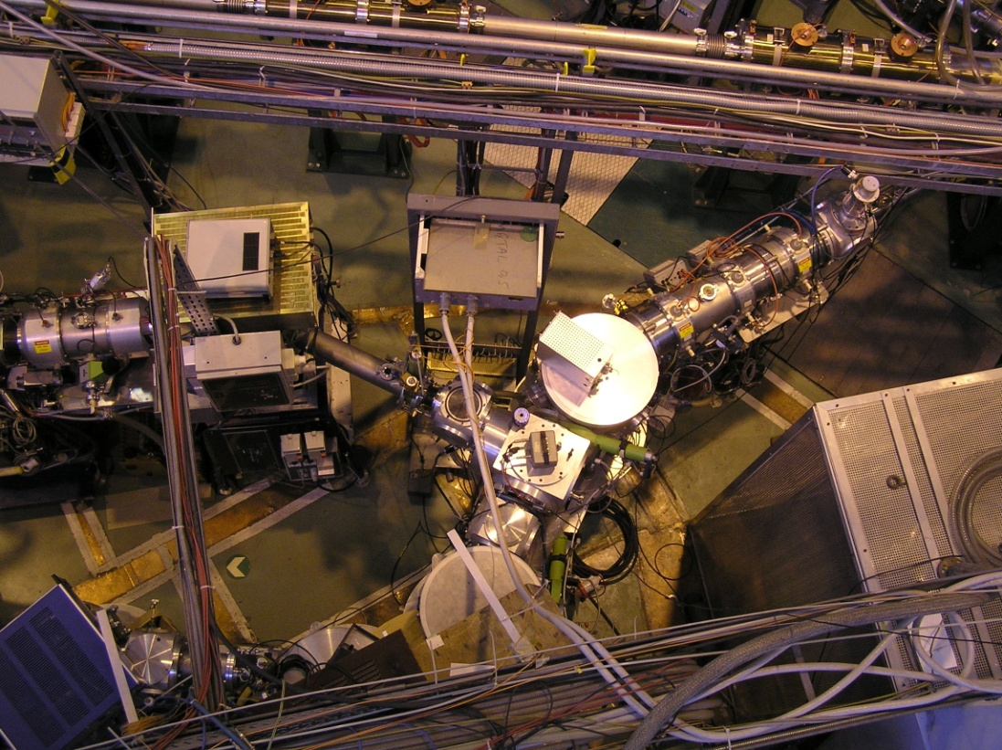
Status in Spring 2008
COMPLIS experiment
beam line.
Quadrupole Triplet and
34 degree bend retained for CRIS

Slide 29
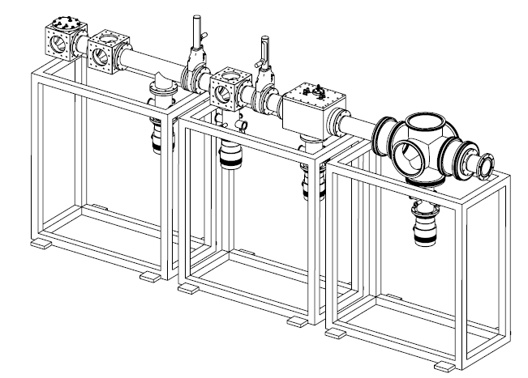
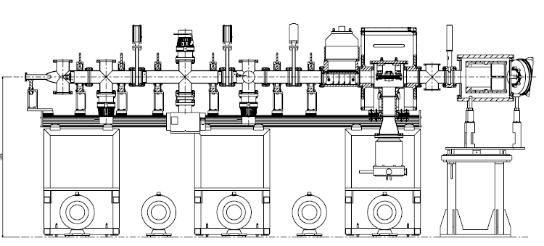
Evolution of design during 2008
Basic scheme went through several iterations before converging on the final design.
UHV requirements constrained the design and forced the beam line to be ~3m in length

Slide 30
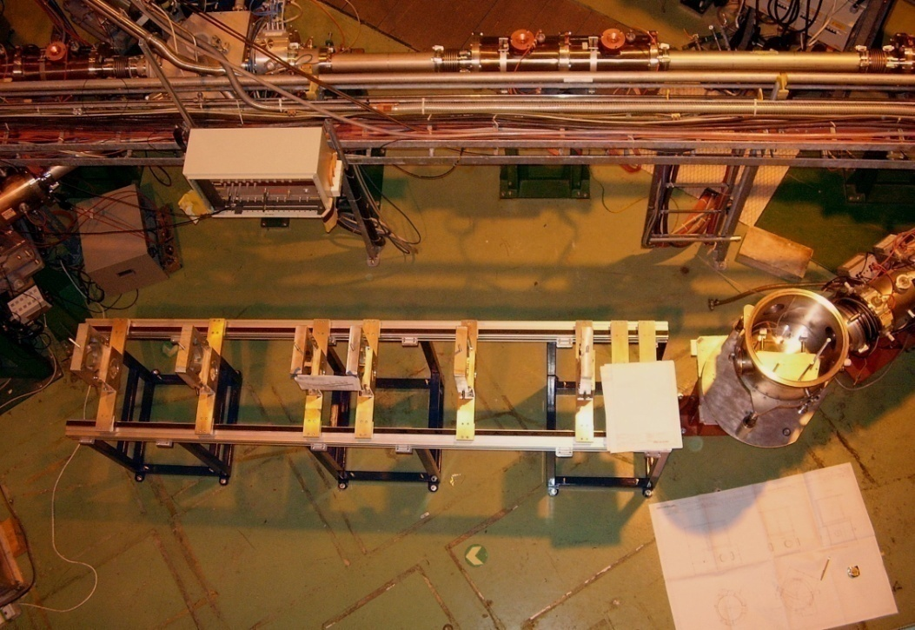
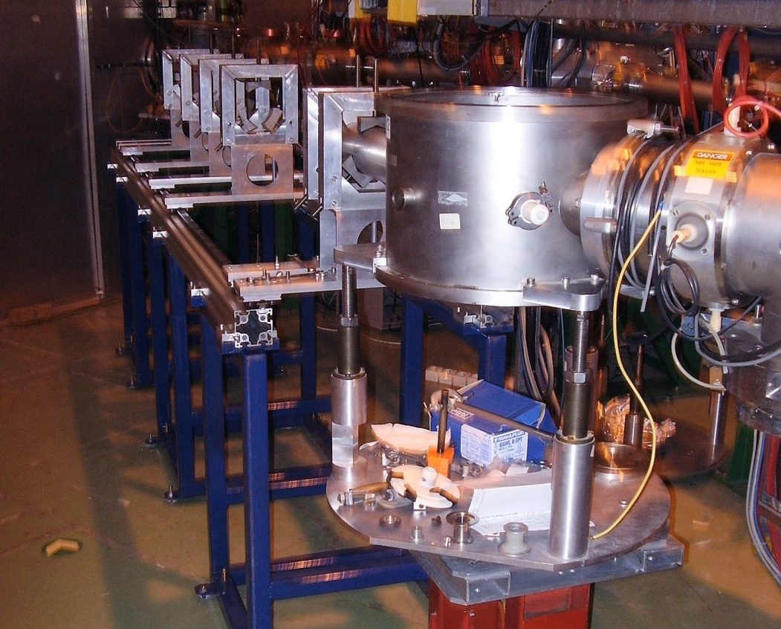
November 2008
“Railway track” installation
Allows one person to open the vacuum system and move chambers.

Slide 31
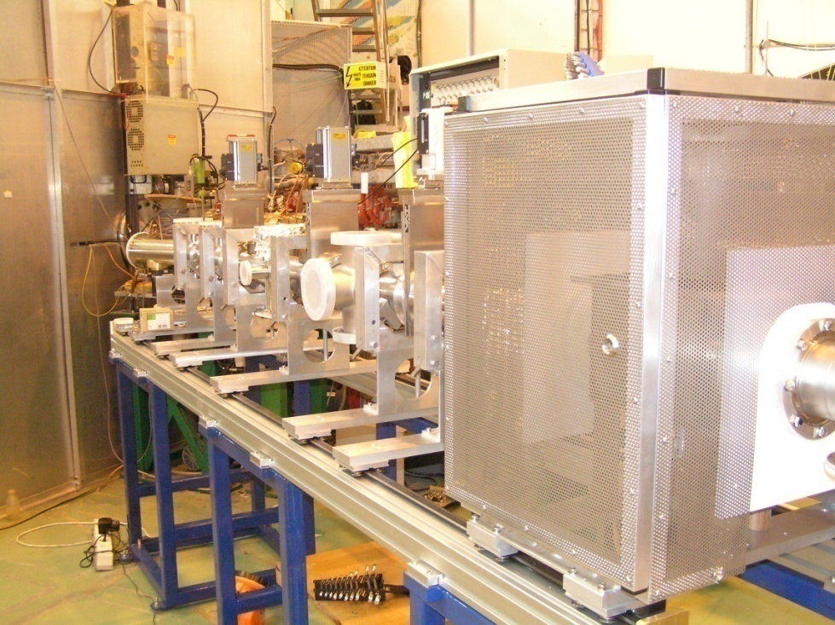
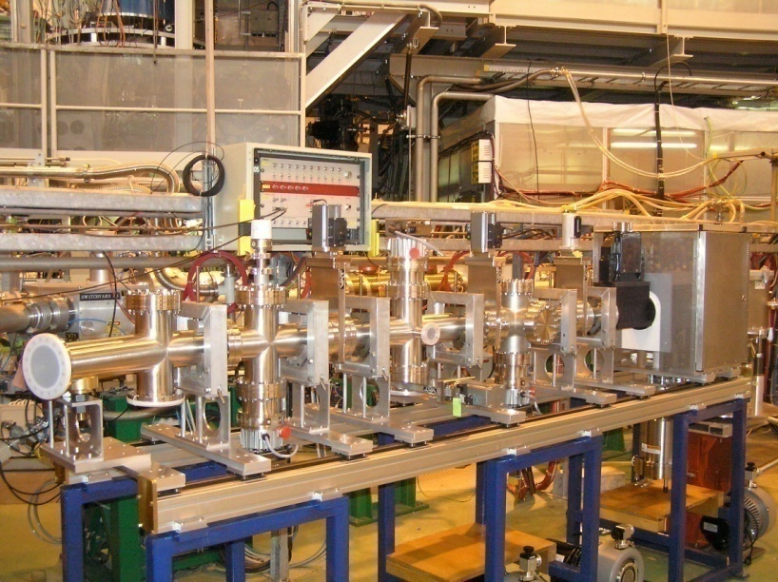
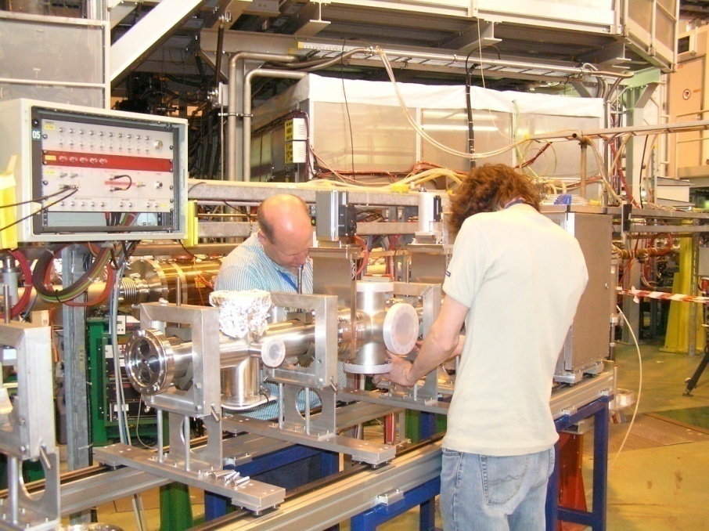
April 2009
Delivery of vacuum chambers, Faraday cage, charge exchange cell and installation of pumps.

Slide 32
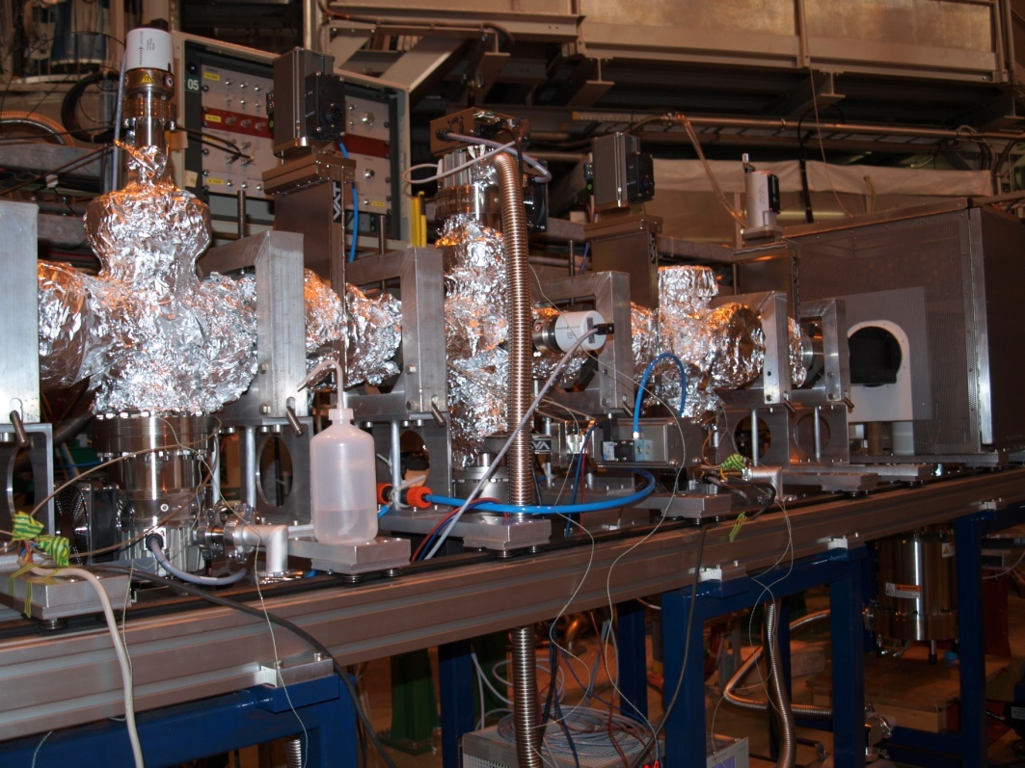
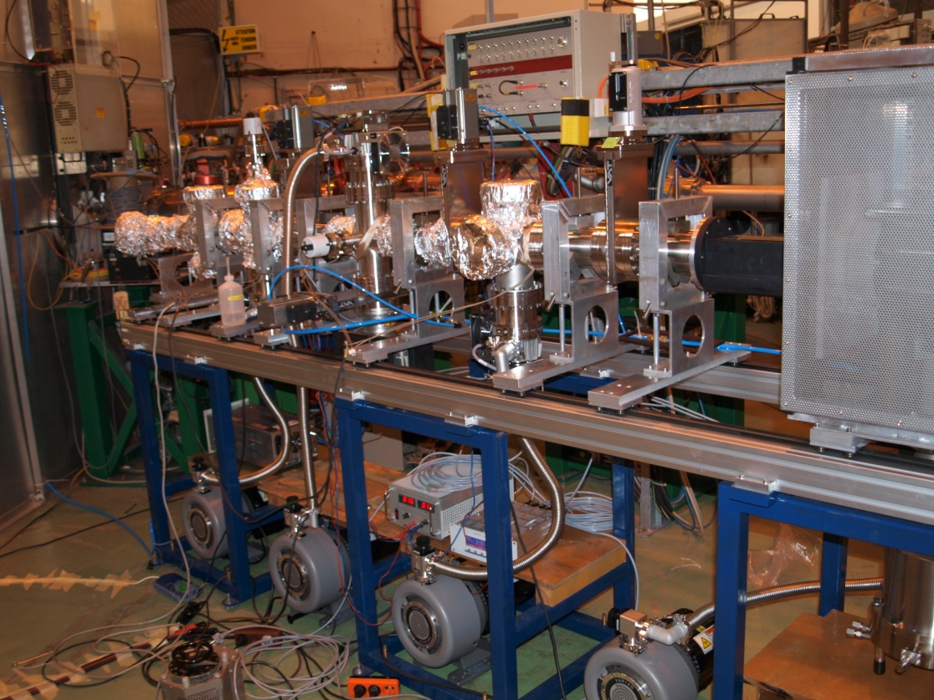
July 2009
Vacuum testing, initial bake-out of UHV section reached <5e-9mbar (limit of the gauge) in the interaction region.

Slide 33
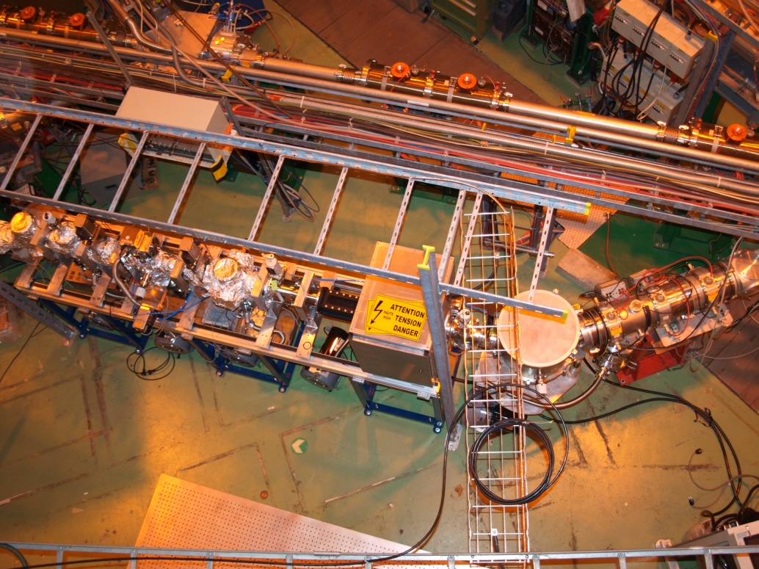
November 2009
ISOLDE beam from HRS
Laser launch direction into the beam line

Slide 34
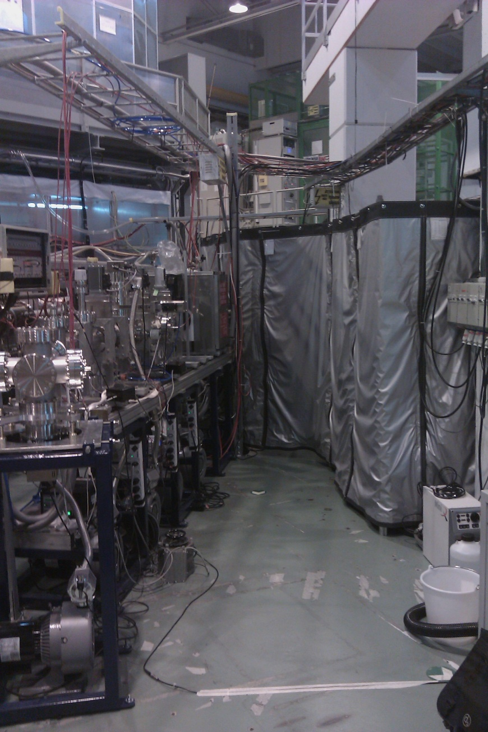
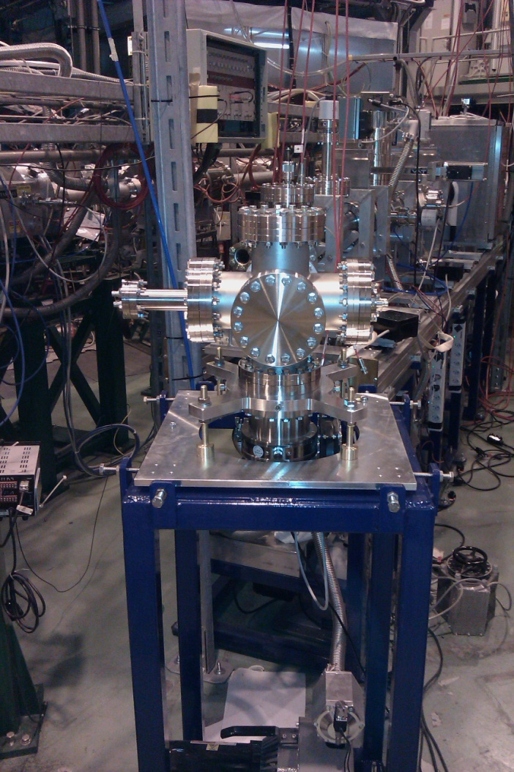
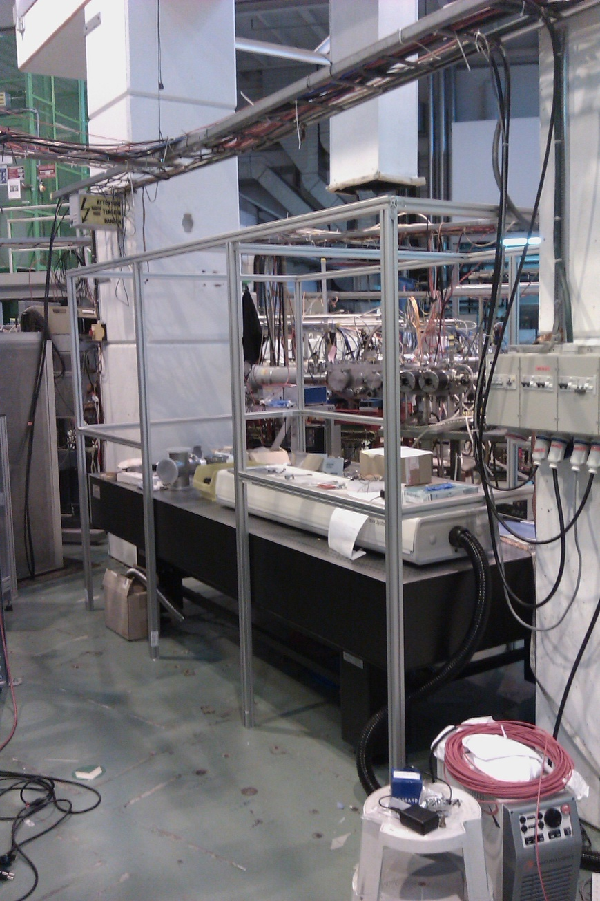
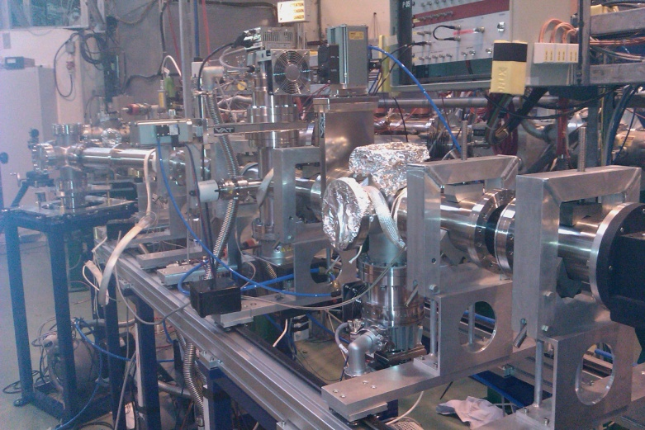
Summer 2010

Slide 35
Pulse width from Be tests
~20cm spatial bunch length at A~200
Peak width
0,8μs
Andreas Krieger, Institute of Nuclear Chemistry - University of Mainz

Slide 36
Vacuum tests
9.11e-9 mbar
<5e-9 mbar
7.24e-8mbar
9.64e-7mbar
7.5e-7mbar
Results from ISOLDE

Slide 37
CRIS Beam optics - Results
100%
100%
>70%
30%
30%

Slide 38
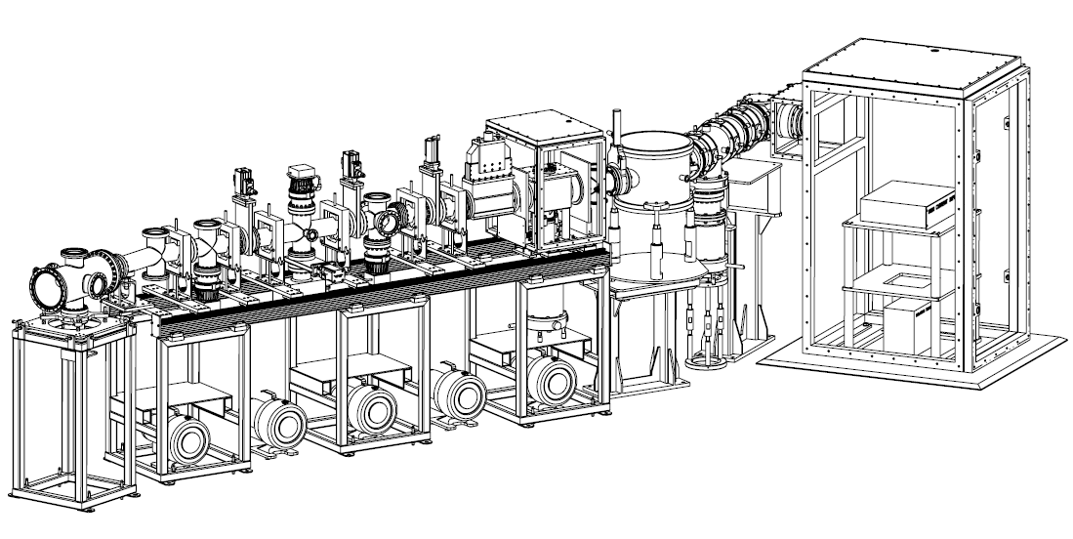
2010-2011
Alpha detection chamber
Windmill design for UHV application
Off-line ion source, HV platform and site for future off-line RFQ trap for technique development
~3m
~2m

Slide 39
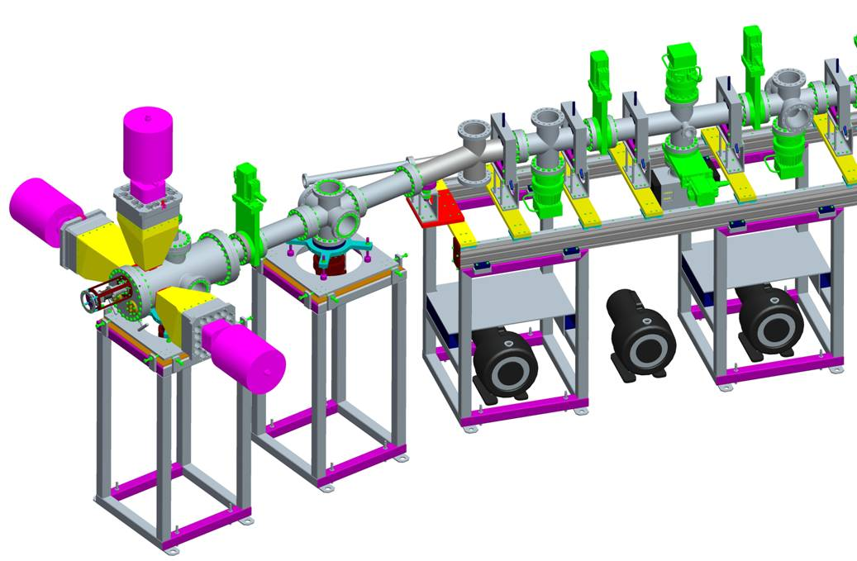
Laser Assisted Decay Spectroscopy:LADS
Possible option: 3 EUROGAM / EUROBALL detectors
Fast timing measurement of isomeric
states
Kara Lynch, PhD Project
Starting 2010
~2m

Slide 40
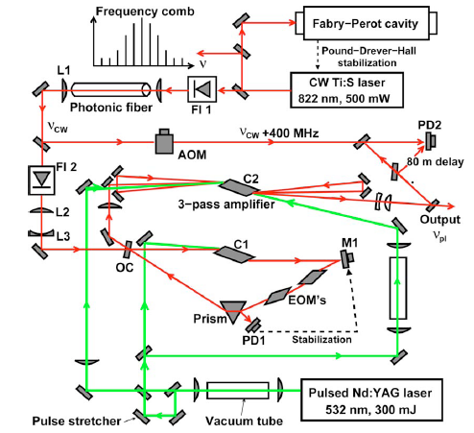
2011:Novel Laser System for on-line radioactive beam research.
M. Hori and A. Dax OPTICS LETTERS 34, 1273 (2009)
Tested tuning range 726–941 nm
Line width ~6MHz
E=50–100 mJ
Replacing CW TiSa with a diode laser system (845nm, 300mW)
Turn key table top system with minimal interventions during operation.
Novel laser system for radioactive ion beam facilities

Slide 41
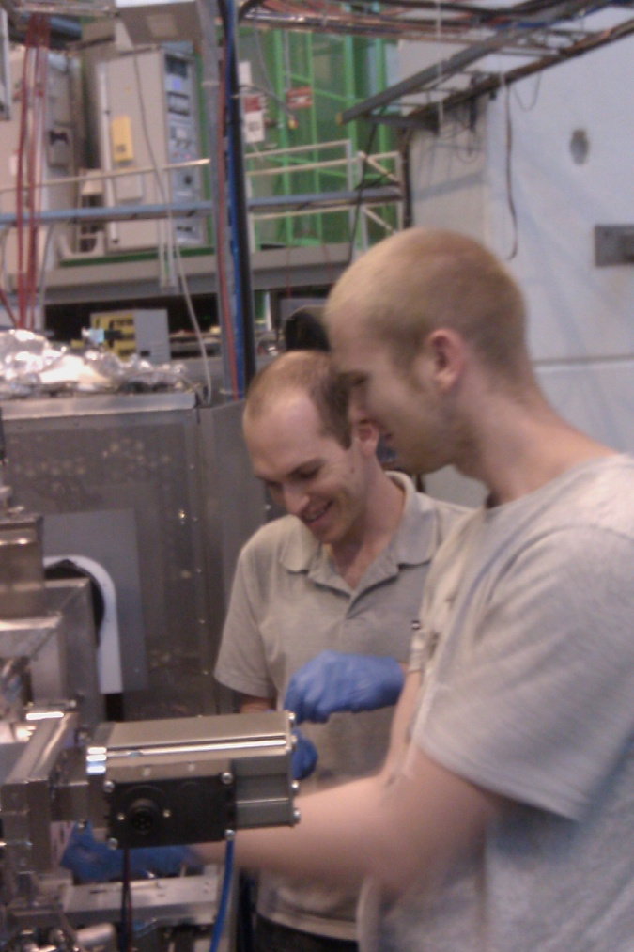
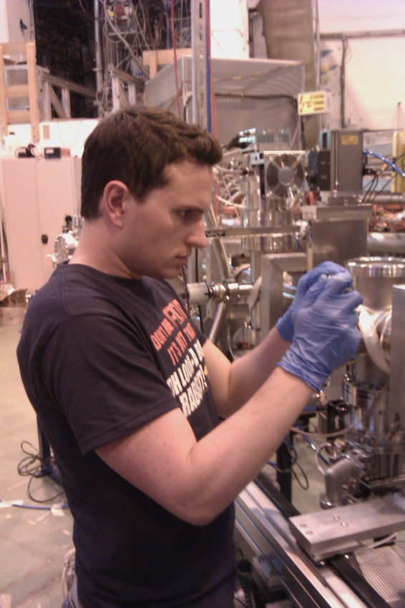
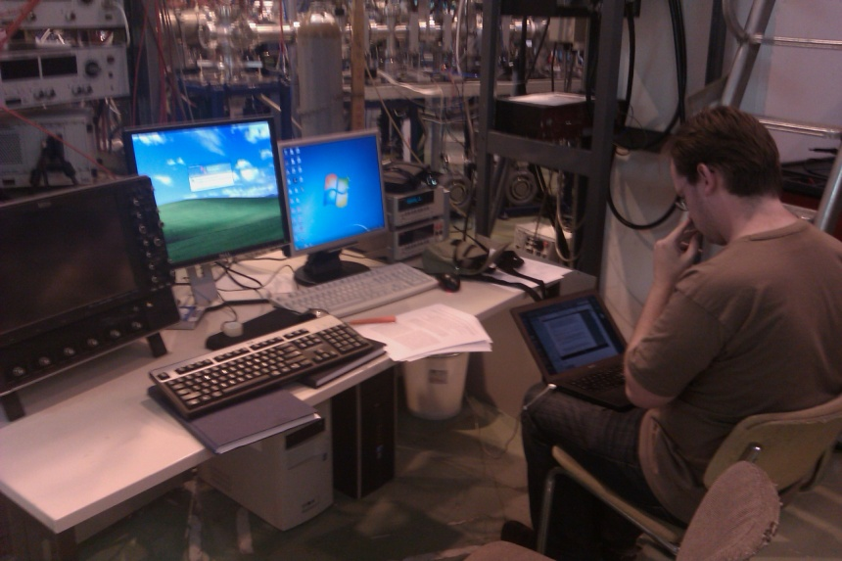
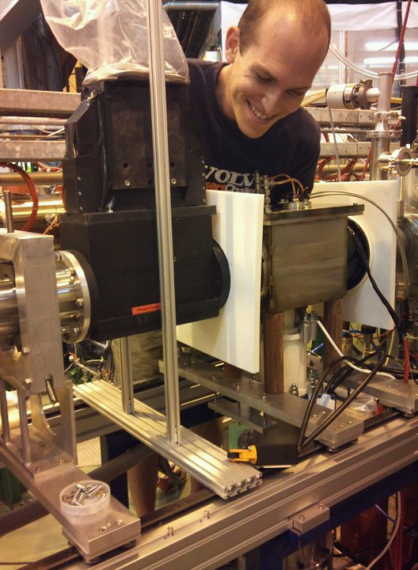
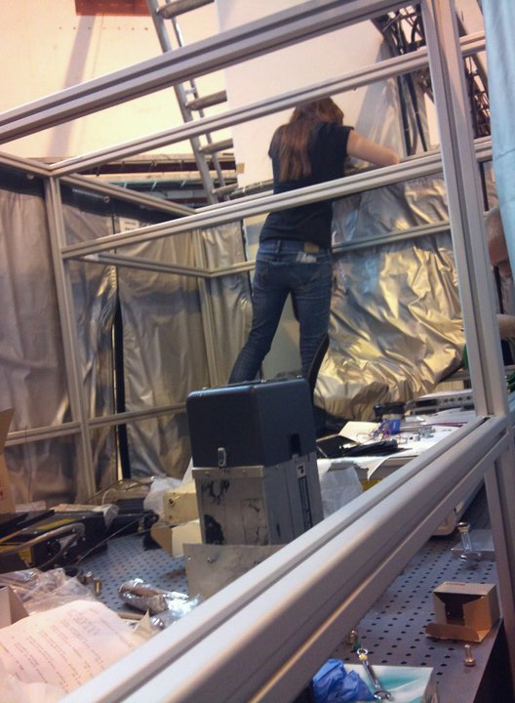
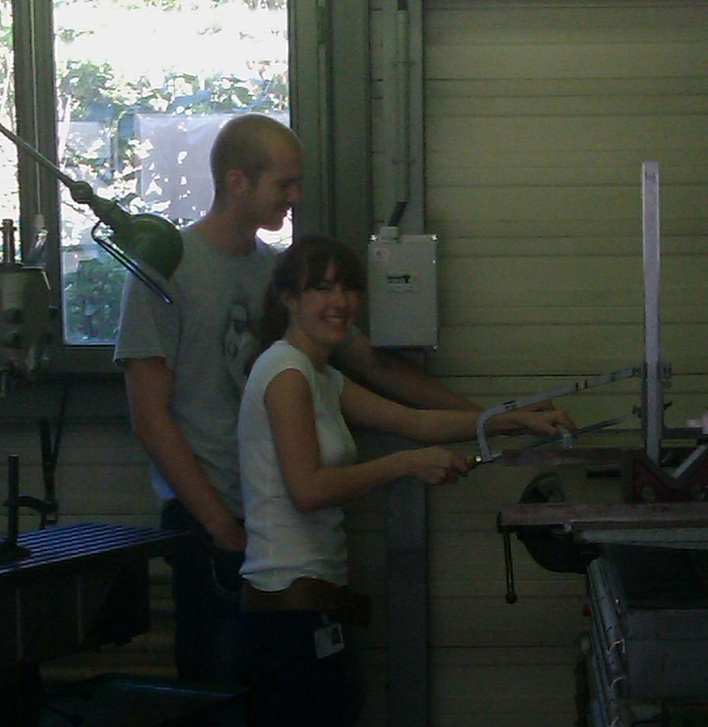
The CRIS team at ISOLDE

Slide 42

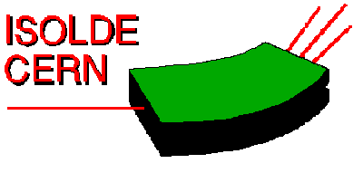










Thank you for your attention
Collaboration
J. Billowes, B. Cheal, T.E. Cocolios, K.T. Flanagan, D.H. Forest, R. Hayano, M. Hori, T. Kobayashi, F. Le Blanc, O. Levinkron, D. Lunney, K.M. Lynch, G. Neyens, T. Procter, M. Rajabali, S. Rothe, A.J. Smith, H.H Stroke, G. Tungate, W. Vanderheijden, P. Vingerhoets, K. Wendt.

