Slide 1

Time-of-flight methods in ion beam analysis
MARKO BRAJKOVIĆ, ZDRAVKO SIKETIĆ, MARKO BARAC, IVANČICA BOGDANOVIĆ RADOVIĆ
RUĐER BOŠKOVIĆ INSTITUTE, ZAGReB, CROATIA
EUnpc22, SANTIAGO DE COMPOSTELA, OCTOBER 2022

Slide 2
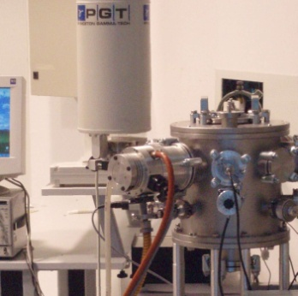
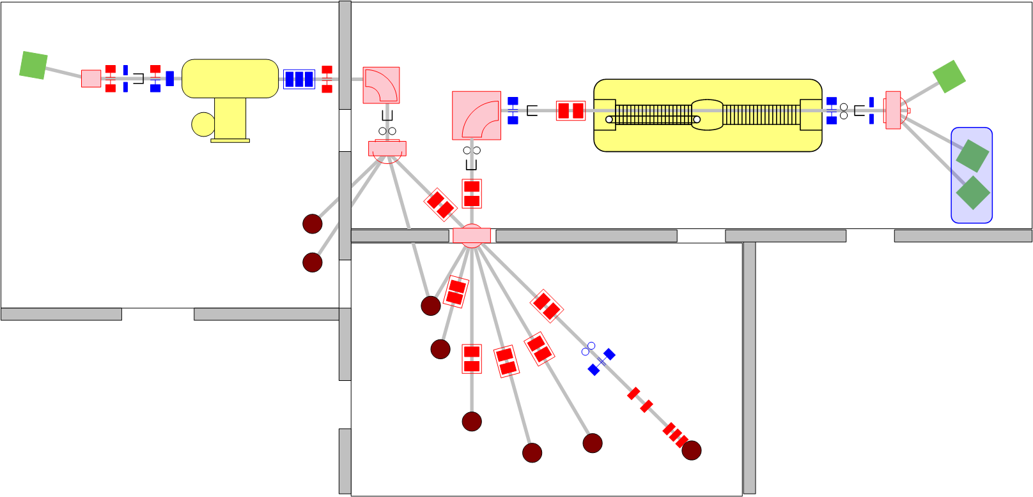
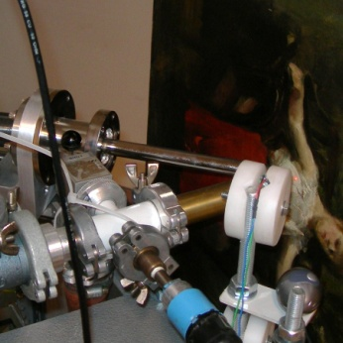
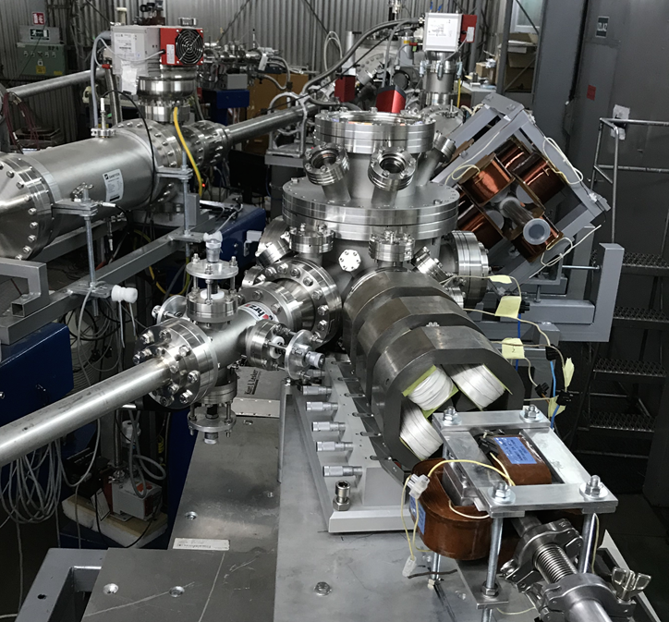
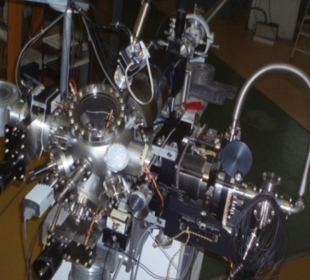
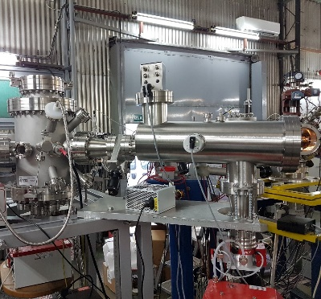
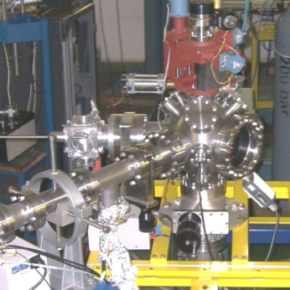
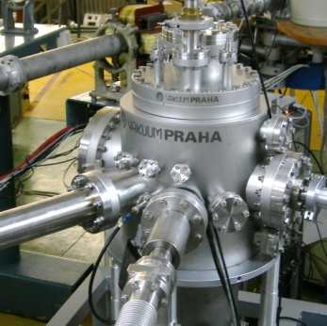
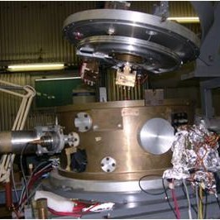
PIXE/RBS
RBI ACCELERATOR FACILITY
1.0 MV HVE Tandetron accelerator
6.0 MV EN Tandem Van de Graaff accelerator
In-air PIXE
Currenty: protons up to 8 MeV, and heavy ions up to 30 MeV from the VDG accelerator
Dual µ-beam
Ion microprobe
Collimated beam MeV TOF-SIMS
TOF-ERDA
Channeling
Nuclear reactions
Dual beam,DiFu

Slide 3
HEAVY ION BEAM TECHNIQUES
Most IBA techniques use protons: PIXE, RBS, PIGE, IBIC.
Heavy ions vs protons:
Production of recoils and secondary particles
High stopping power
MeV TOF SIMS
Time-of-Flight Secondary Ion Mass Spectrometry
TOF ERDA
Time-of-Flight Elastic Recoil Detection Analysis
organic samples
inorganic films

Slide 4
TOF ERDA
Time-of-Flight Elastic Recoil Detection Analysis

Slide 5
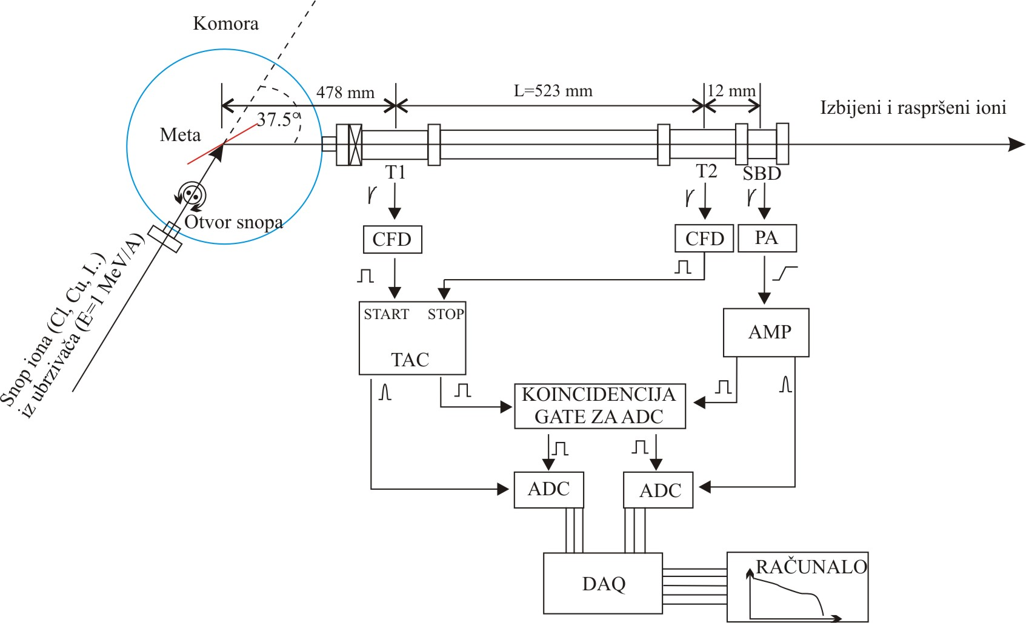
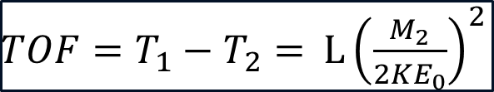
SEPARATION OF ELEMENTS BY MASS
Chamber
Target
Recoiled atoms
Heavy ion beam – e.g. 23 MeV Iodine ions
sensitivity 10¹⁵ /cm²
2 nm depth resolution, up to 500 nm probe depth
all elements are resolved
Resolution < 1 amu for m < 40 amu
Collimator
Ion beam (Cl, I, Au.., E~0.2 MeV/A)
E and TOF measured
cross sections, stopping powers known
$TOF=T_{1}−T_{2}=$ $L{\left(\frac{M_{2}}{2KE_{0}}\right)}^{2}$
Depth profiling of few 100 nm thick samples
Depth resolution up to ~1 nm at the surface

Slide 6
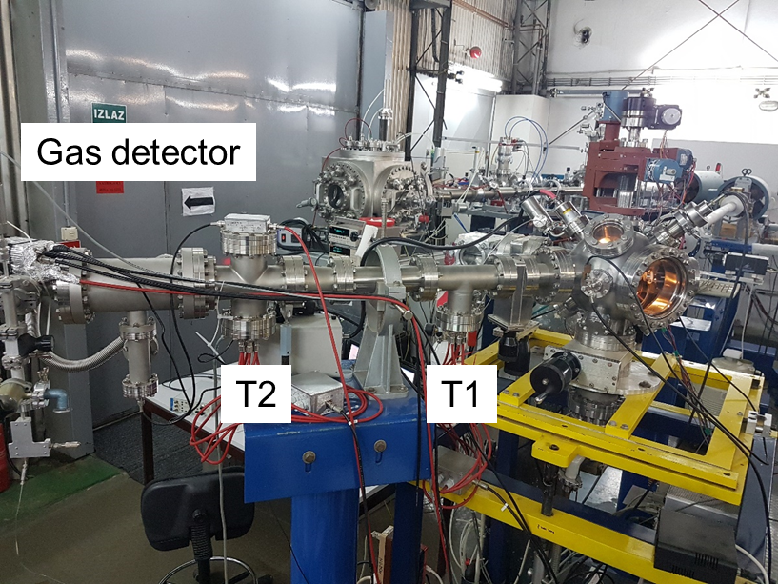
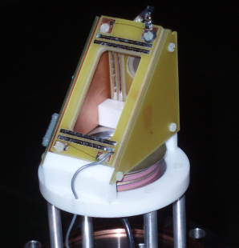
TOF ERDA: SETUP
x,y,z,θ
manipulator
GID: better energy resolution than particle silicon detectors + radiation hardness
L=523.4 mm
Chamber
Z. Siketić, N. Skukan and I. Bogdanović Radović "A gas ionisation detector in the axial (Bragg) geometry used for the time-of-flight elastic recoil detection analysis", Review of Scientific Instruments 86, 083301 (2015)

Slide 7
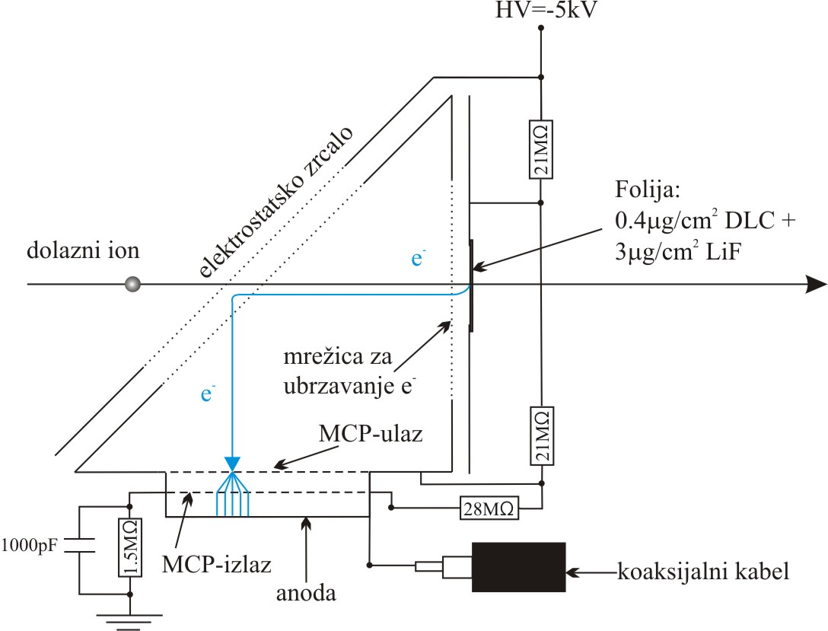
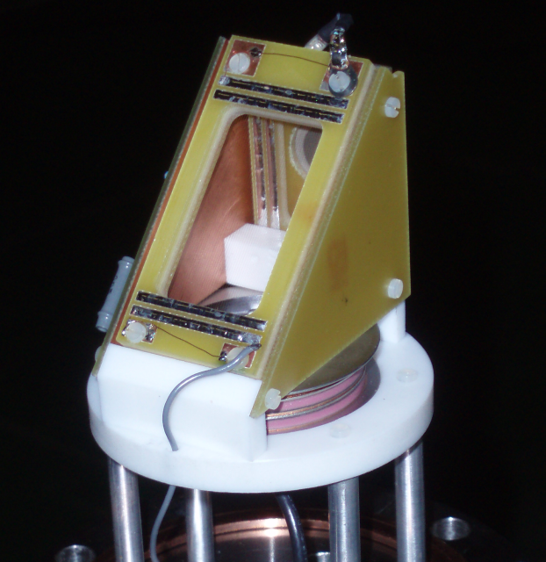
TOF ERDA: SETUP – TIMING GATES
Electrostatic mirror
Foil:
Incoming ion
Accelerating grid
Timing signal: detection of secondary electrons from the diamond-like carbon foil coated with LiF
MCP-in
MCP-out
Coaxial cable
Anode
T1
TAC
CFD
T2

Slide 8
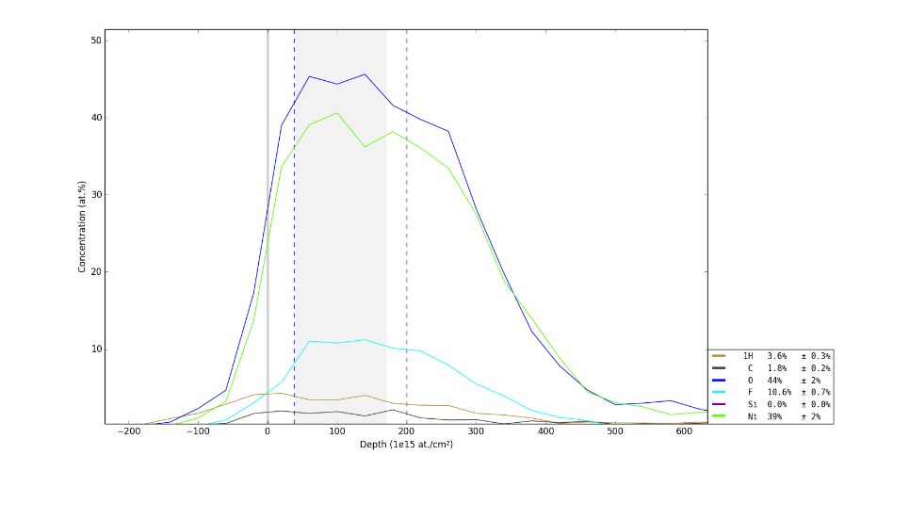
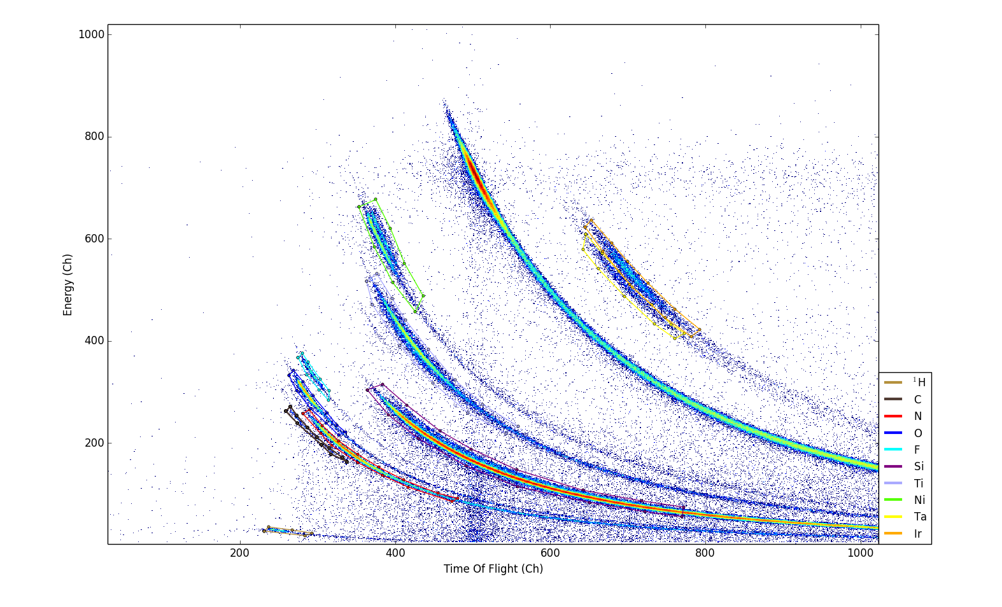
TOF-ERDA applications – industrial partners
TOF ERDA APPLICATION – Quality control of production proces
NiO film
Ni
Ir
Ta
Element | Total Number of 10¹⁵ at/cm²
H | 15.2
C | 6.6
O | 158.7
F | 33.5
Ni | 141.8
Ti
F
O
N
Si
C
H
Flourine contamination found

Slide 9
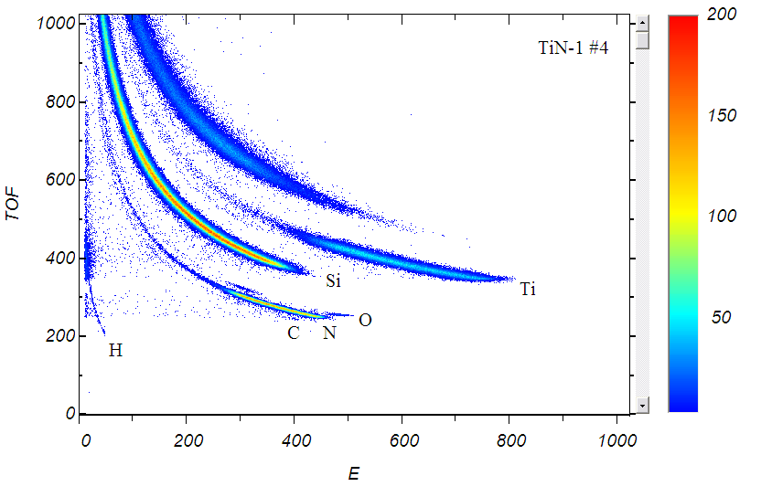
TOF ERDA APPLICATION – Thin film analysis
Sample: TiN
Beam: 20 MeV ⁸¹Br⁵⁺

Slide 10
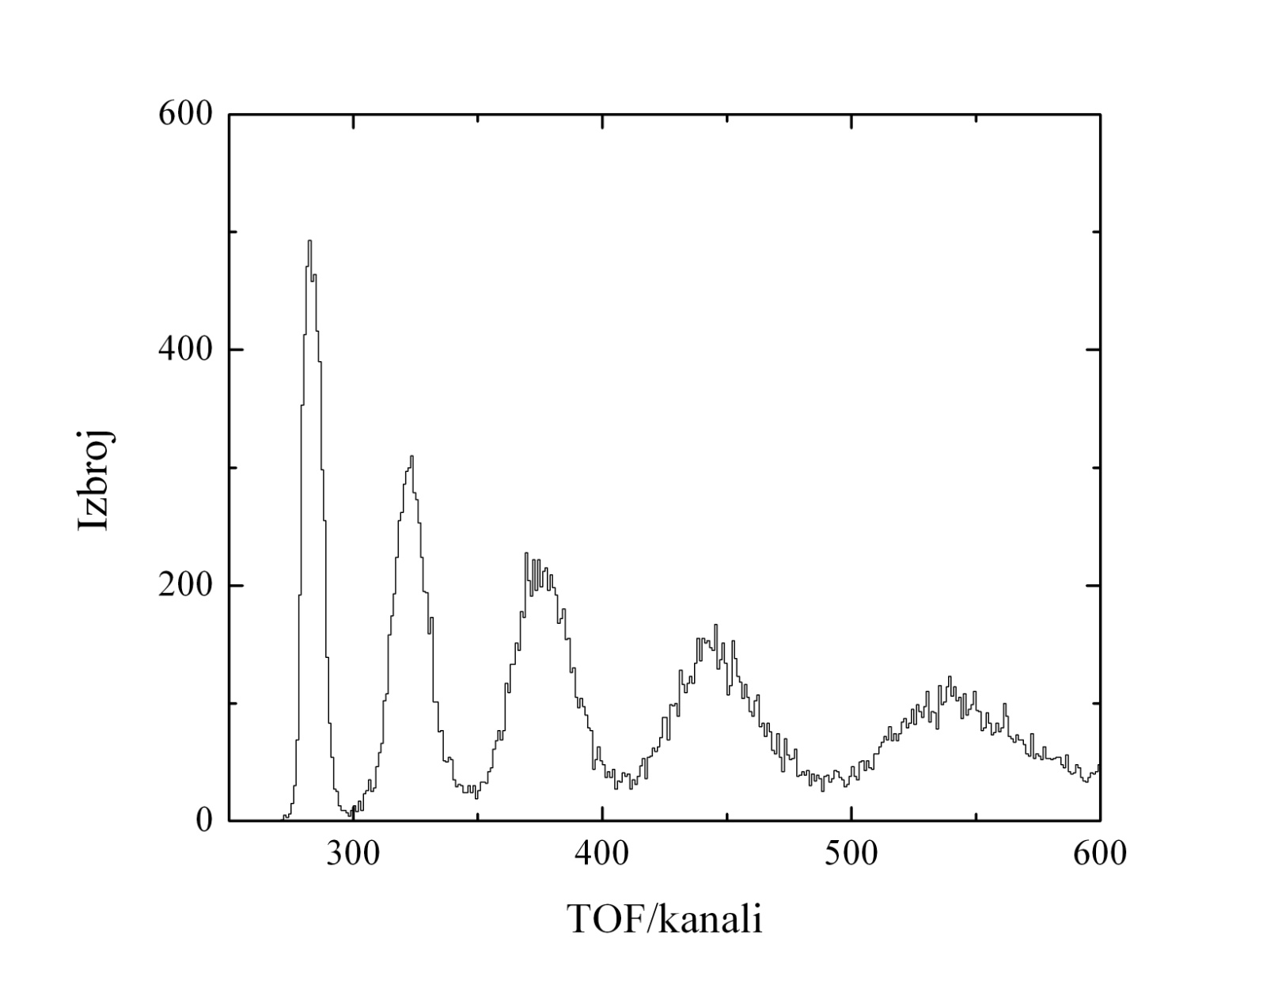
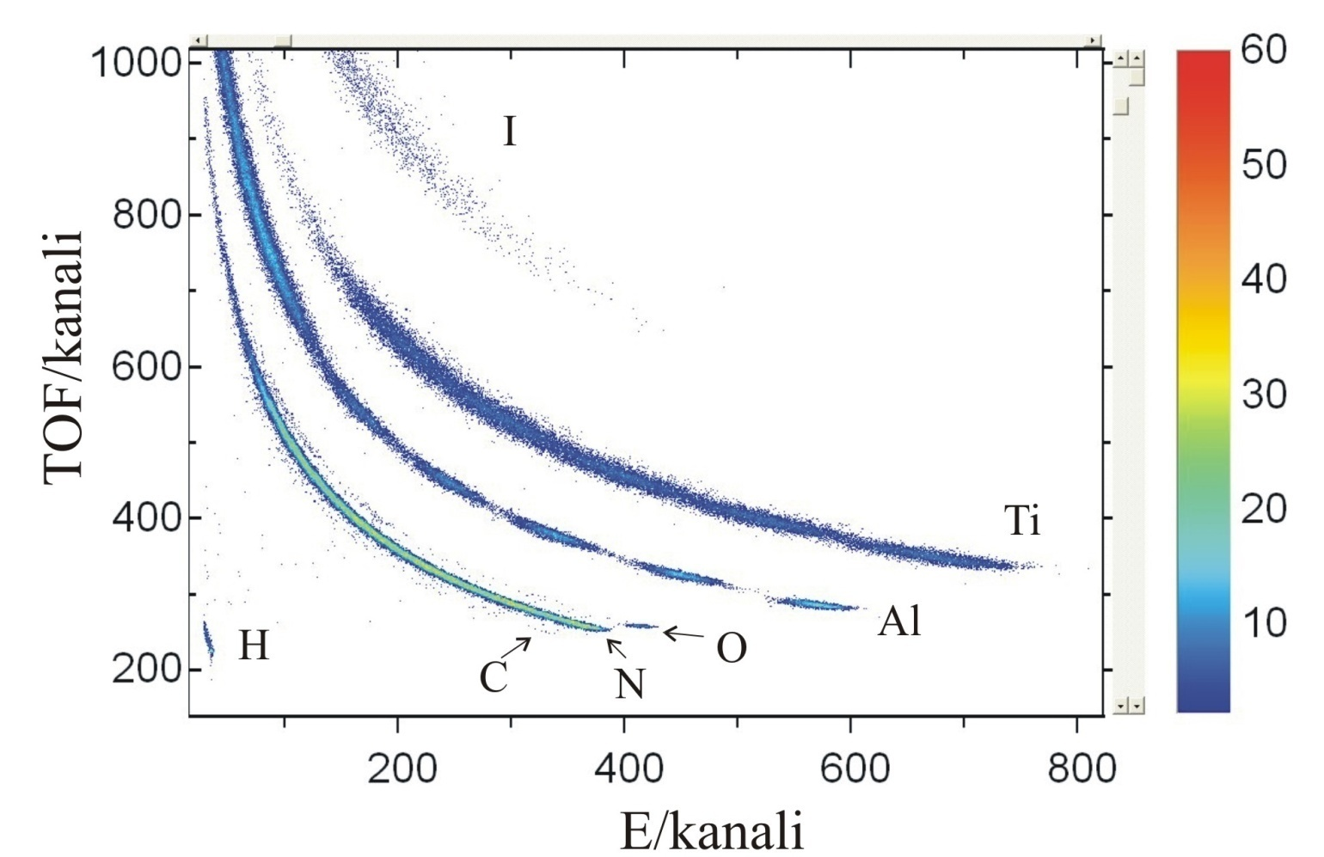
TOF ERDA APPLICATION – Multilayer samples
Result of the analysis:
Al:N=1:1, d = 24 nm
Ti:N=1:1, d = 40 nm
Time spectra of the Al events
Beam: 25 MeV ¹²⁷I, θ_{in} = 5°, θ_{scatt.} = 37.5°
Target: 5x AlN/TiN 20 nm layers
Resolution detoriaties with a depth!
Al layers
Counts
TOF (Channel)
E (Channel)
TOF (Channel)

Slide 11
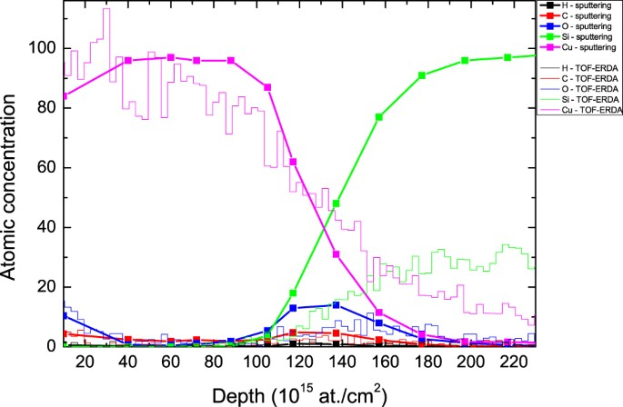
TOF ERDA + Ar SPUTTERING
TOF-ERDA used to measure the surface elemental composition, Ar sputtering to extract the depth information
best achievable (surface) resolution of 2 nm for the entire layer
TOF ERDA promoted by argon sputtering (lines + symbols) and TOF-ERDA (lines) depth profile for a 15-nm-thick Cu layer evaporated onto the Si substrate.
Siketić, Z., Bogdanović Radović, I., Sudić, I. et al. Surface analysis and depth profiling using time-of-flight elastic recoil detection analysis with argon sputtering. Sci Rep 8, 10392 (2018).

Slide 12
MeV TOF-SIMS
Time-of-Flight Secondary Ion Mass Spectrometry

Slide 13
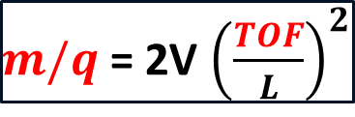

= mass spectrometry technique used for identification of atomic and molecular species by measuring time-of-flight of the secondary ions sputtered from the sample surface
MeV SIMS
$$E=qV= \frac{m}{2}v^{2}=\frac{m}{2}{\left(\frac{L}{TOF}\right)}^{2}→$$
$m/q$ = 2V ${\left(\frac{TOF}{L}\right)}^{2}$
(E₀ few eV)
TOF spectrum
Mass spectrum
TOF analyzer
Primary
ion beam
Spektar pozitivnih iona
Extractor
Secondary ions
Target
Scanning over the sample
Imaging (2D spatial molecular distribution)

Slide 14
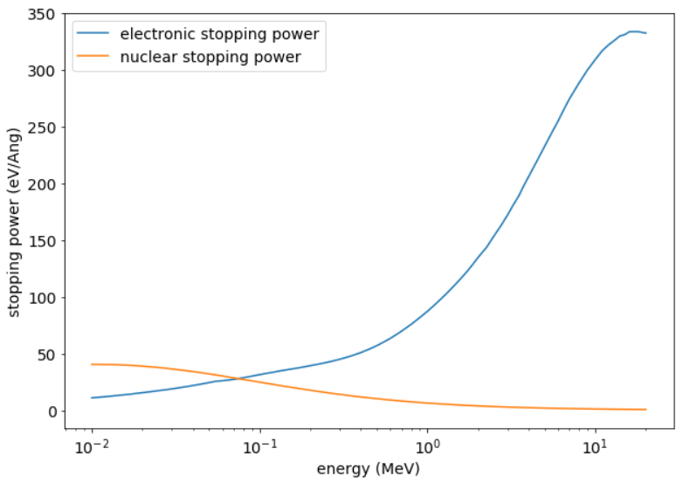
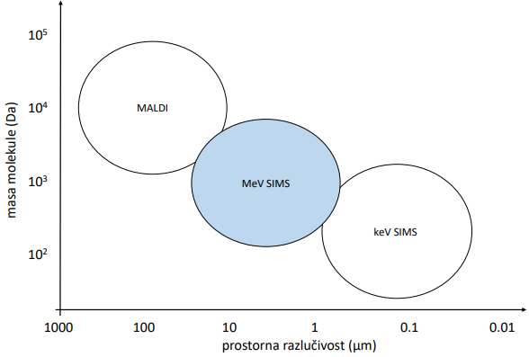
Higher SI yield for heavier molecules, and less fragmentation, than for keV counterpart
MV accelerators required,
organic samples
mass resolution (Da)
commercially available,
mostly inorganic samples
lateral resolution (µm)
TOF mass spectrometry techniques comparison
Silicon beam on a leucine target:
electronic stopping dominates for MeV energies

Slide 15
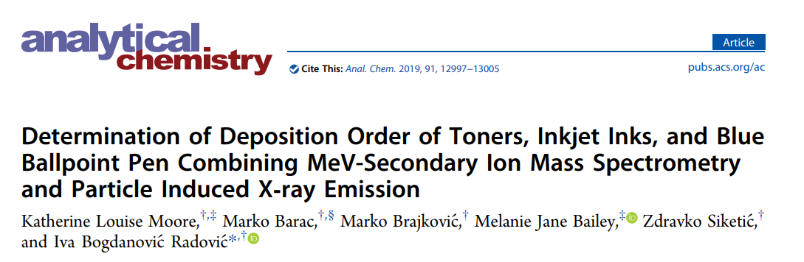

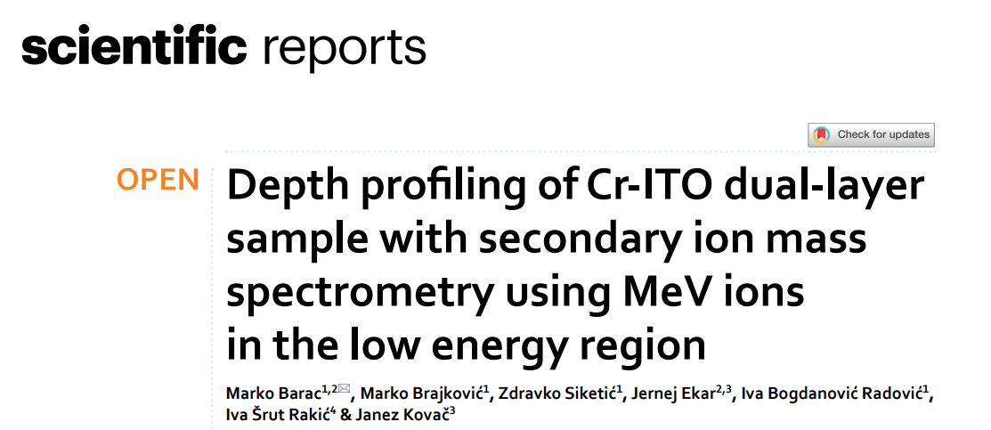
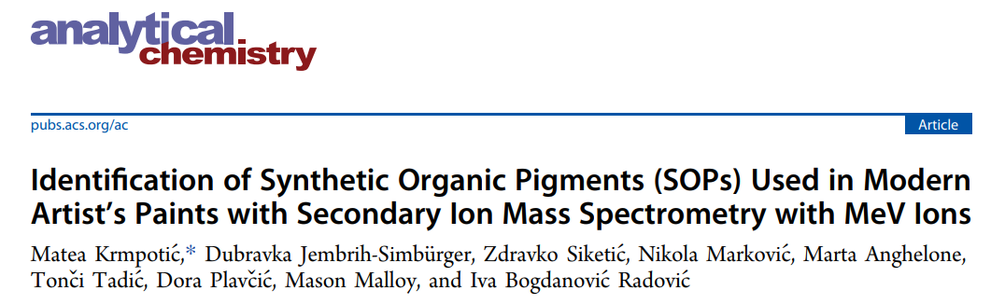
MeV SIMS APPLICATIONS @ RBI
Since 2014 we published 16 papers in high IF journals on application of MeV SIMS analysis:
  Biology (identification of lipids and fatty acids in various tissues and single cells, 2 papers published)
  Cultural heritage (identification of pigments and binders of modern paint materials, 3 papers published)
  Forensics (study of deposition order of crossing lines of different writing tools, 3 papers published)
  Simultaneously analysis of organic and inorganic materials (2 papers published)
  Development of MeV SIMS and measurements of fundamental parameters (6 papers published)

Slide 16
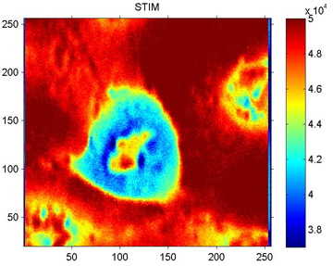
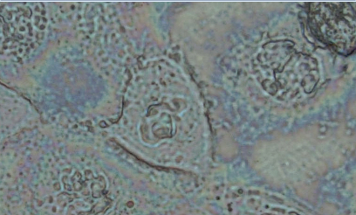
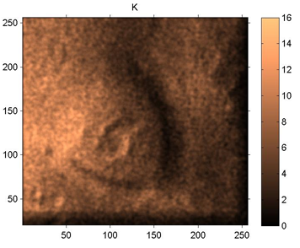
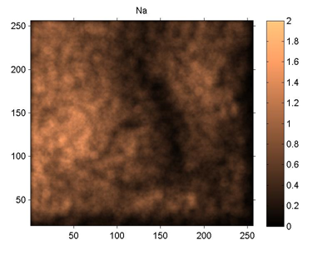
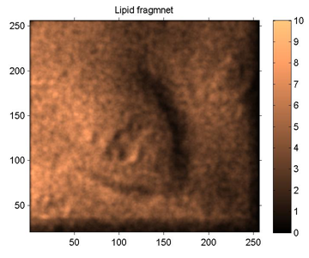
MeV SIMS: APPLICATIONS
STIM
Optical photo
Example #1: Molecular imaging of single CaCo-2 cancer cell
Siketić, Z., Bogdanović Radović, I., Jakšić, M., Popović Hadžija, M., & Hadžija, M. (2015) Applied Physics Letters, 107(9), 093702.
Beam: 9 MeV O⁴⁺
Scan size: 85x85 µm² (≈300 nm/pixel)
Positive ion spectrum
K⁺
Na⁺
Lipid

Slide 17
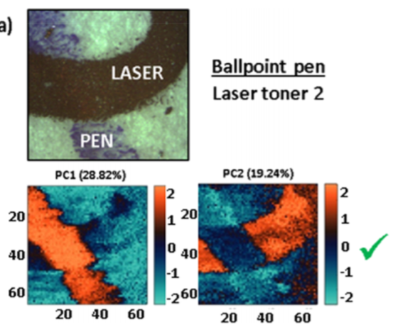
MeV SIMS: APPLICATIONS
Exampple #2: Forensics: determination of depositioning order of inks/toners
Moore, K. L., Barac, M., Brajković, M., Bailey, M. J., Siketić, Z., & Bogdanović Radović, I. (2019) Analytical chemistry, 91(20), 12997-13005.
Ink crossing imaging + PCA analysis

Slide 18
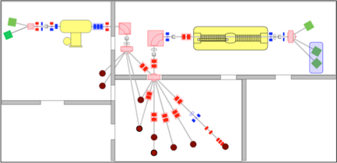
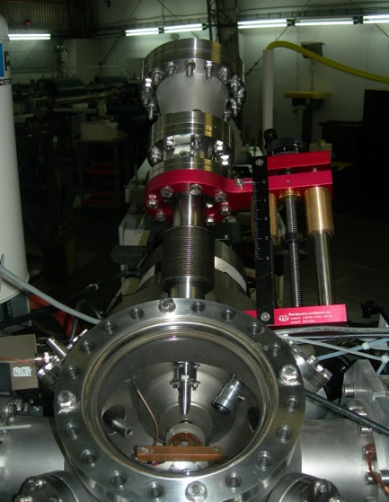
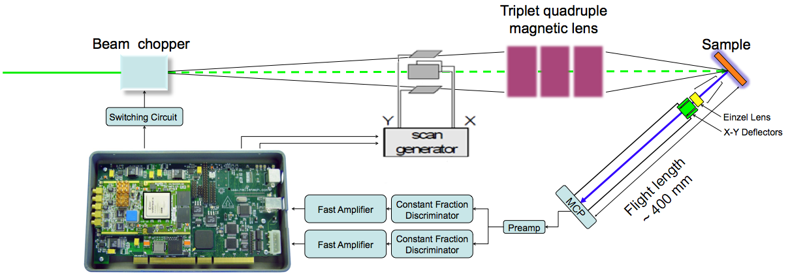
MeV SIMS: OLD SETUP
TOF START: Primary beam pulsing
TOF STOP: MCP detector
FOCUSING: magnetic lenses
IMAGING: Primary beam scanning over the sample
Timing filter amplifier
Timing filter amplifier
Cannot use ions heavier than Silicon!
upper limit: m·E/q² < 14 MeV amu

Slide 19
ALTERNATIVE: COLLIMATED BEAM
cheap alternative for magnetic focusing for small current (fA) application
collimation independent on ion mass and energy = heavy, high energy ion can be used
in principle, in-air extraction possible
COLLIMATED BEAM:
TOF START: Primary beam pulsing ?
TOF STOP: MCP detector (upgraded with 10 kV postacceleration)
FOCUSING: COLLIMATION with micro-capillary/micro-aperture
IMAGING: sample placed on piezo-stage in front of fixed collimator

Slide 20
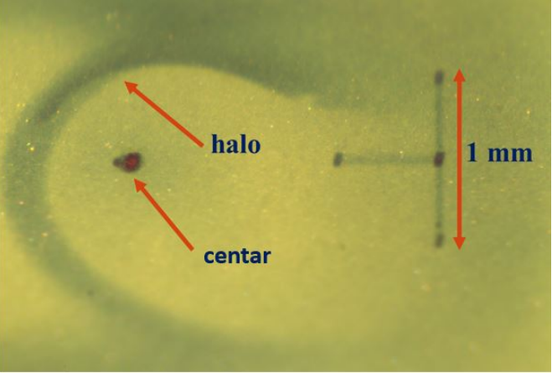
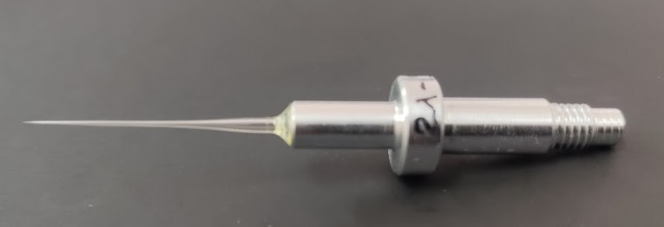
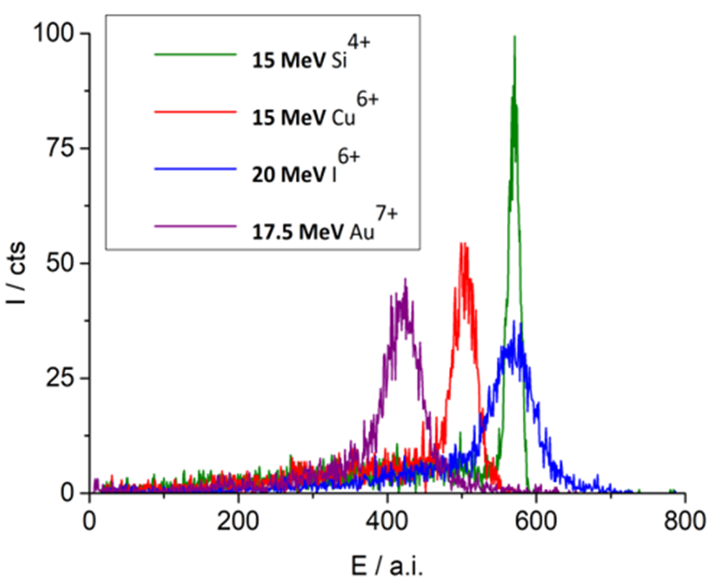
MICROCAPILLARY: TRANSMISSION
conically-shaped glass capillary
(5 µm exit diameter)
spatial distribution of transmitted beam
energy spectra of transmitted beams
M. Brajković, M. Barac, D. Cosic, I. Bogdanović Radović, Z. Siketić, Development of MeV TOF-SIMS capillary microprobe at the Ruđer Bošković Institute in Zagreb, Nucl. Instr. and Meth. B 461 (2019) 237-242.

Slide 21
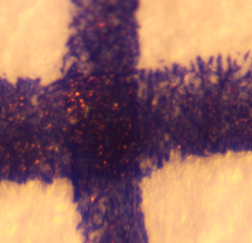
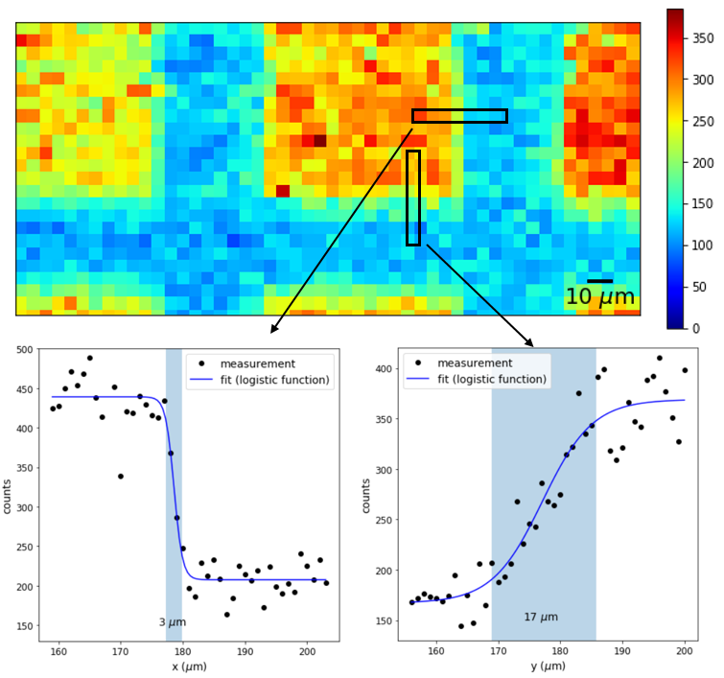
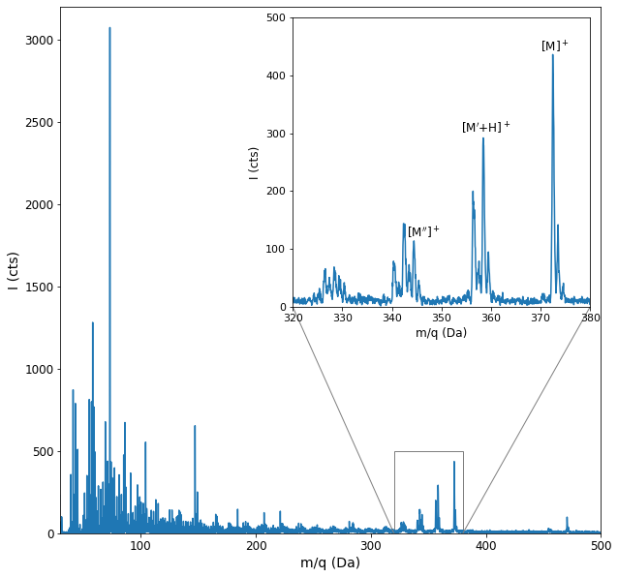
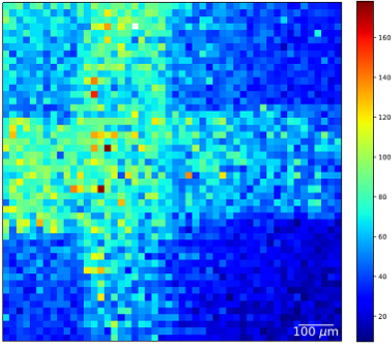
M. Brajković, I. Bogdanović Radović, M. Barac, D. D. Cosic, Z. Siketić, Imaging of Organic Samples with Megaelectron Volt Time-of-Flight Secondary Ion Mass Spectrometry Capillary Microprobe, J. Am. Soc. Mass Spectrom. 2021, 32, 10, 2567–2572.
MICROCAPILLARY: IMAGING
lateral resolution: leucine-evaporated copper mesh
Imaging: ink crossing on a paper
CONS: halo and low contrast

Slide 22
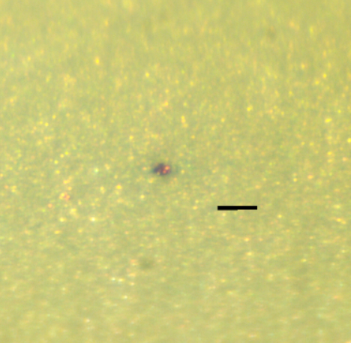
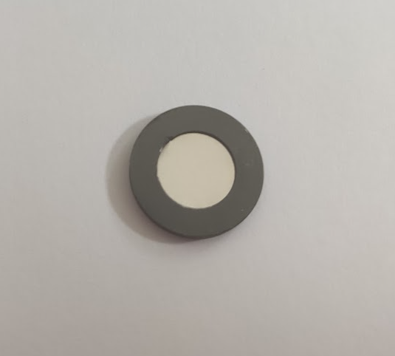
5 µm APERTURE
5, 10 µm aperture opening
0.1 mm
steel, thickness 12.7 µm, aluminum frame
beam through the aperture on Gafchromic EBT3 film

Slide 23
MUCH BETTER CONTRAST COMPARED TO THE CAPILLARY!
IMAGING #1: MESH
Leucine map, 250 x 250 µm²
Phthalocyanine map, 1 x 0.9 mm²
transmission: mesh with 127 µm pitch
electron start: mesh with 440 µm pitch
lateral resolution ≈ 10 µm (for 5 µm aperture)

Slide 24
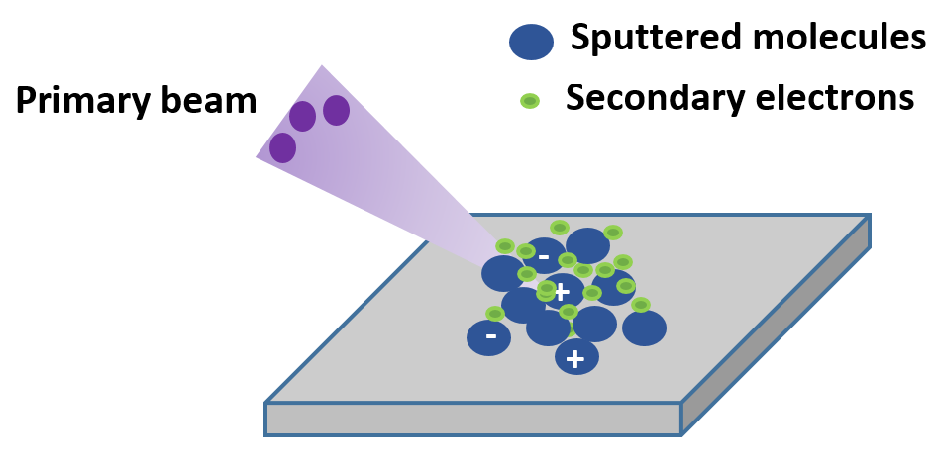
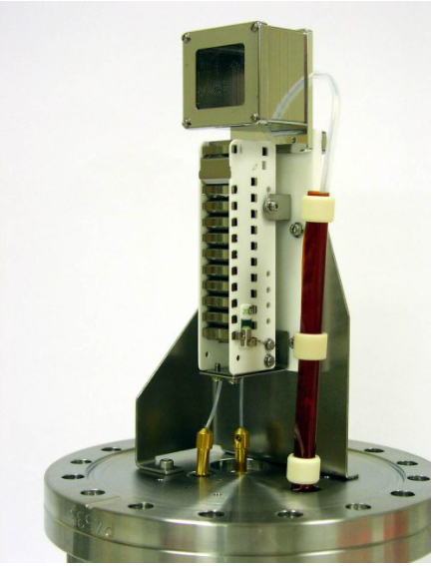
?
TWO TOF START TRIGGER OPTIONS
STOP signal
Kore detector with 10 kV postacceleration
Primary ion detection (by a PIN diode)
simple setup, good mass resolution
thin targets only, radiation damage
Detection of secondary electrons
thick targets, radiation hard
complicated setup

Slide 25
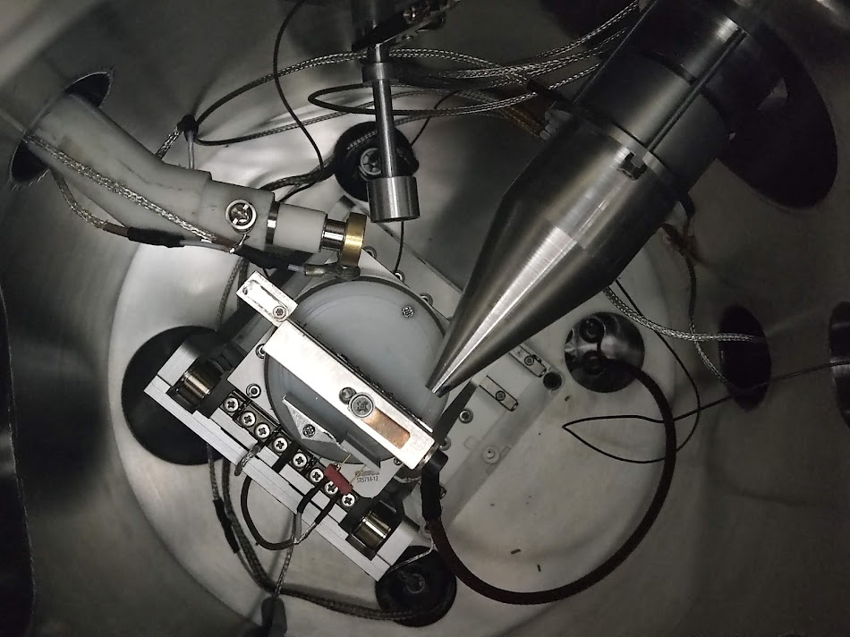
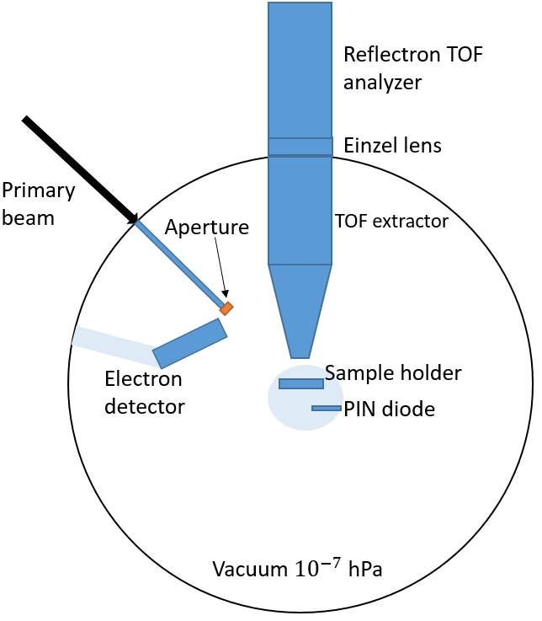
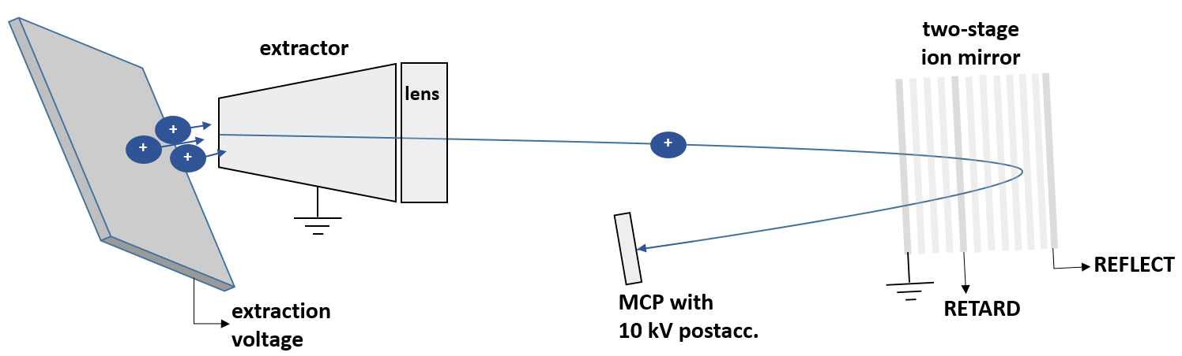
thin carbon foil (5 nm thickness) over the aperture = the production of secondary electrons sample-independent (for example, 7 kHz from a silicon plate but only 1 kHz from a paper
THE SETUP
schematics of secondary ion detection

Slide 26


THICK TARGET SETUP:
DETECTION OF ELECTRONS
COMSOL simulations
electric potential and electron trajectories with the target at the extraction potential
TARGET CANNOT BE HELD AT CONSTANT (EXTRACTION) VOLTAGE!
electric potential distribution and electron detection with the target at zero potential

Slide 27

M. Brajković, I. Bogdanović Radović, M. Barac, D. D. Cosic, Z. Siketić, Imaging of Organic Samples with Megaelectron Volt Time-of-Flight Secondary Ion Mass Spectrometry Capillary Microprobe, J. Am. Soc. Mass Spectrom. 2021, 32, 10, 2567–2572.
SHEMATIC OVERVIEW OF THE THICK-TARGET SETUP: DETECTION OF SECONDARY ELECTRONS
Trigger
C foil over aperture
extractor
target voltage switch
+HV
+HV
+
electron
multiplier
+
+
+
+
+
+
+
$$∆t\sim 100 ns$$
+target voltage
target voltage applied only for 2 µs
delayed extraction
extraction blocked for the remaining part of the acquisiton window(98 µs)

Slide 28


Comparison of two modes of operation
MASS SPECTRUM: TWO MODES
leucine, +3 kV extraction
Mass resolution (for m = 576.1 Da):
2500 in the transmission mode
1400 in the electron start mode
but S/N ration 2 – 5 times better in electron start mode
(random coincidences minimized)
Phthalocyanine blue (m = 576.1 Da) mass spectrum with 10 kV postacc. detector

Slide 29
IMAGING #2: INK CROSSING ON A PAPER
mass spectrum from the ink crossing area
optical photo of ink crossing on a paper
map of signature ink molecules (358-372 Da),
ink crossing on a paper, 1 x 1 mm²

Slide 30


IMAGING #3: FINGERMARK
fingermark on a silicon plate under optical microscope
total map, fingermark on a silicon plate, 5 x 5 mm²

Slide 31

IMAGING #4: MOUSE TISSUE
2 x 2 mm² scan, t = 3.5 hours
cholesterol 369.4 Da
lipid fragment
184.1 Da
medium 228.4 Da
primary beam 14 MeV Cu⁴⁺

Slide 32

IMAGING #4: MOUSE TISSUE
sample photo on an optical microscope
total map
lipid fragment (m = 184.1 Da)
cholesterol (m = 369.4 Da)
medium (m = 228.4 Da)

Slide 33



CONCLUSIONS
Two techniques (heavy MeV ions + TOF measurements): inorganic films and organic samples
Different applications: thin film analysis, biomedicine, forensics, ...
THANK YOU FOR LISTENING!
Acknowledgments

