Slide 1
Experimental tests of a scanner prototype for imaging with protons developed at IEM-CSIC
A.N. Nerio
Instituto de Estructura de la Materia (CSIC)
J.A. Briz^{a,b}, M.J.G. Borgeª, E. Nácher^{c}, O. Tengbladª, A. Pereaª, V.G. Távoraª
ªInstituto de Estructura de la Materia, CSIC, Madrid, Spain
^{b}Facultad de CCias Físicas, Universidad Complutense de Madrid, Madrid, Spain
^{c}Instituto de Física Corpuscular, CSIC-Universidad de Valencia, Valencia, Spain

Slide 2
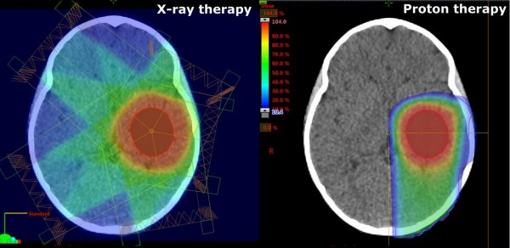
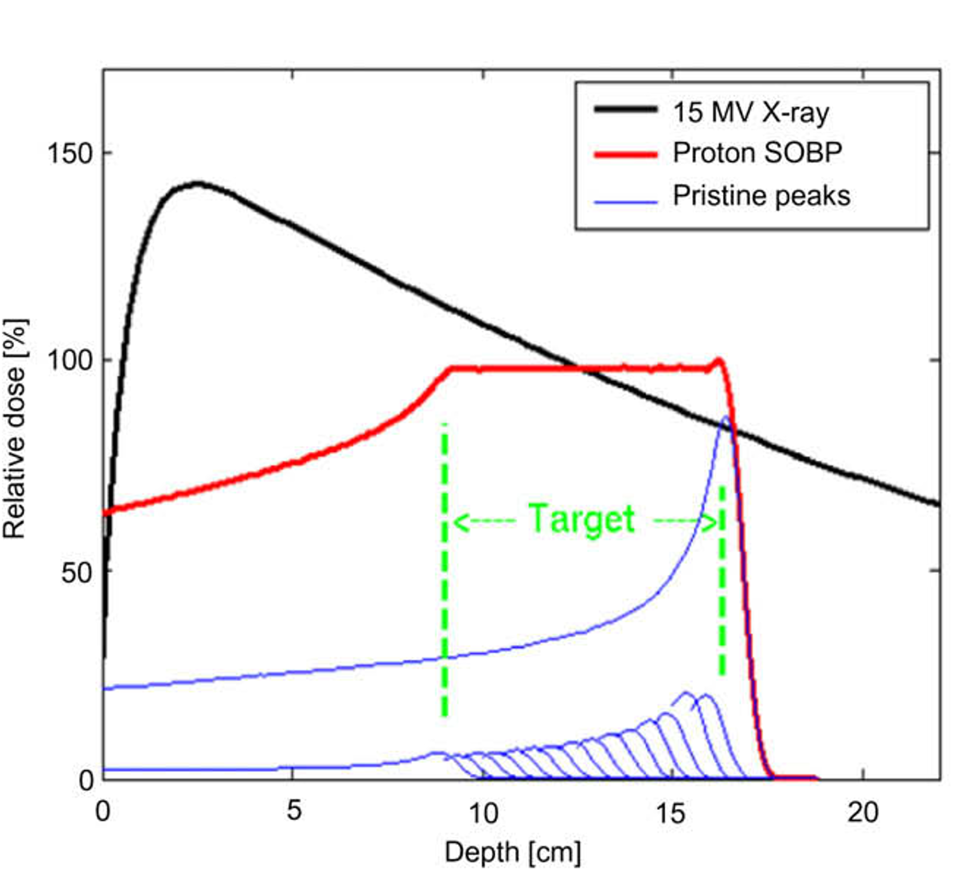
Protontherapy
Proton beams with energy between 70-250 MeV
Better tumor control
  Less toxicity
  Minimal exit dose
  Less dose to healthy cells
Treatment plans use X-ray CT (in HU) to generate the RSP maps
The conversion process induces large uncertainties on the proton range (up to 11%!!)¹
¹ Robert P. Johnson et al. Rep. Prog. Phys. 81 (2018) 016701
Images from: https://www.newswise.com/articles/media-article/741601
H. Suit et al., Radiother. Oncol. (2010) 95, 3–22

Slide 3
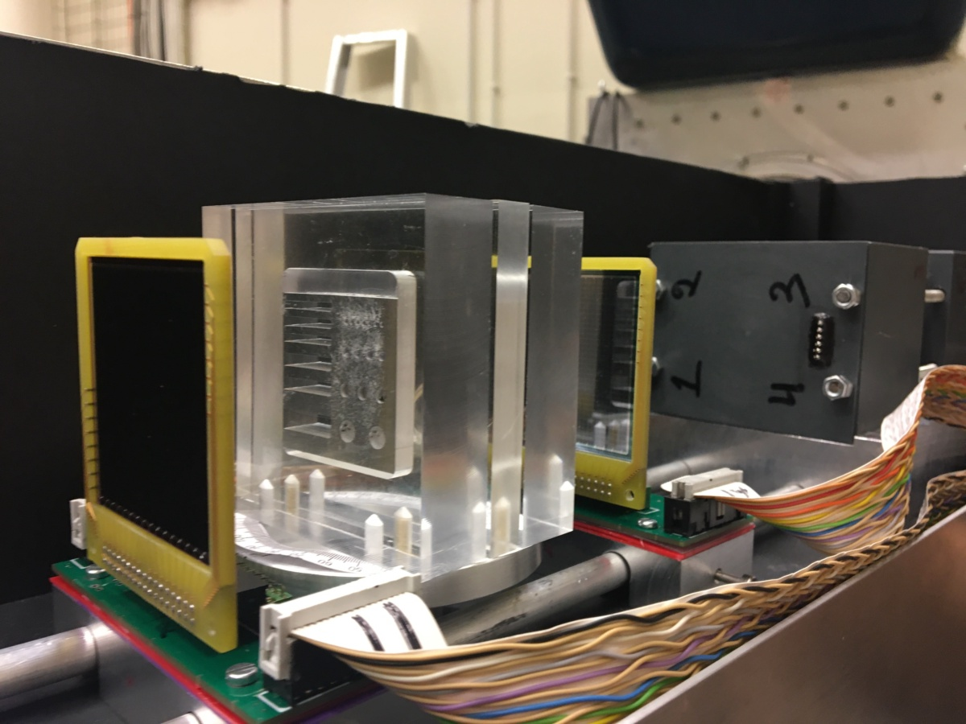
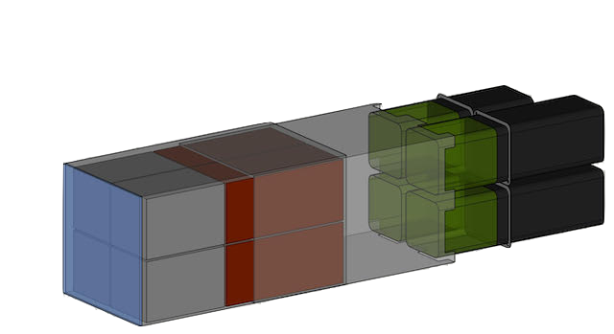
Experimental setup
DSSSDs:
Area: 50x50 mm²
16x16 pixels
CEPA4:
4 phoswich detectors
  LaBr₃: 4 cm
  LaCl₃: 6 cm
Area: 54x54 mm²
Phantom
DSSSD2
DSSSD1
CEPA4
PROTON BEAM

Slide 4
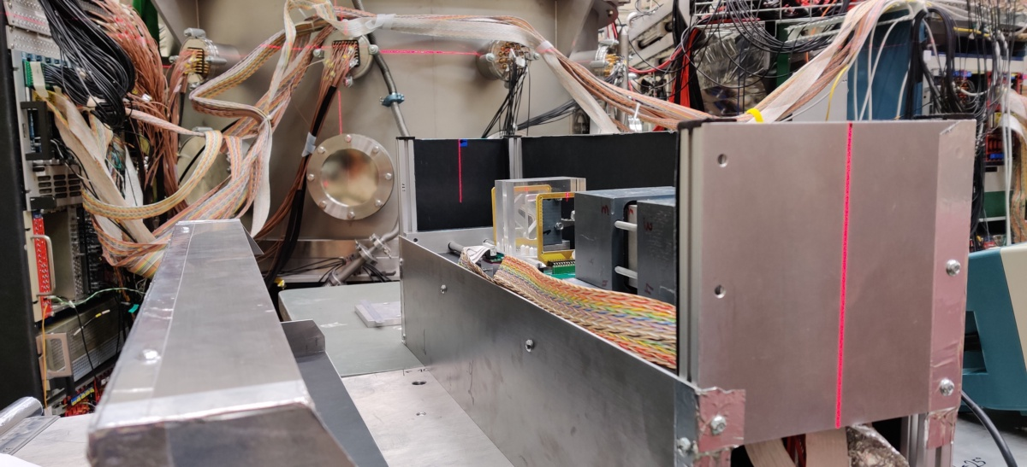


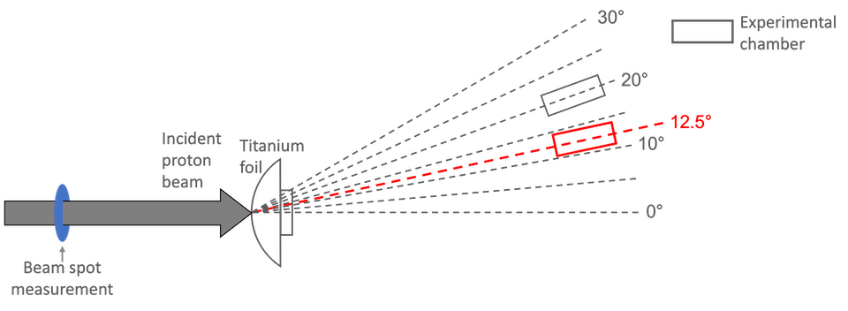
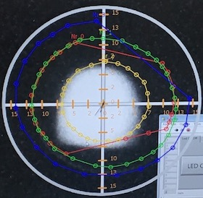
Experimental setup
Ti foil
Scattered beam
Non-scattered beam
0º
Experimental chamber

Slide 5
Study of uniform thickness phantoms

Slide 6
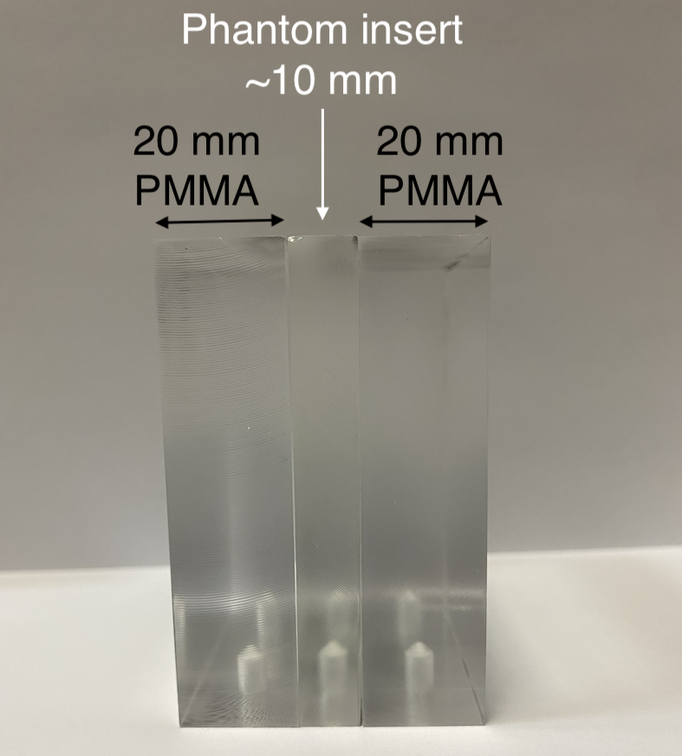
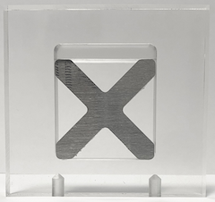
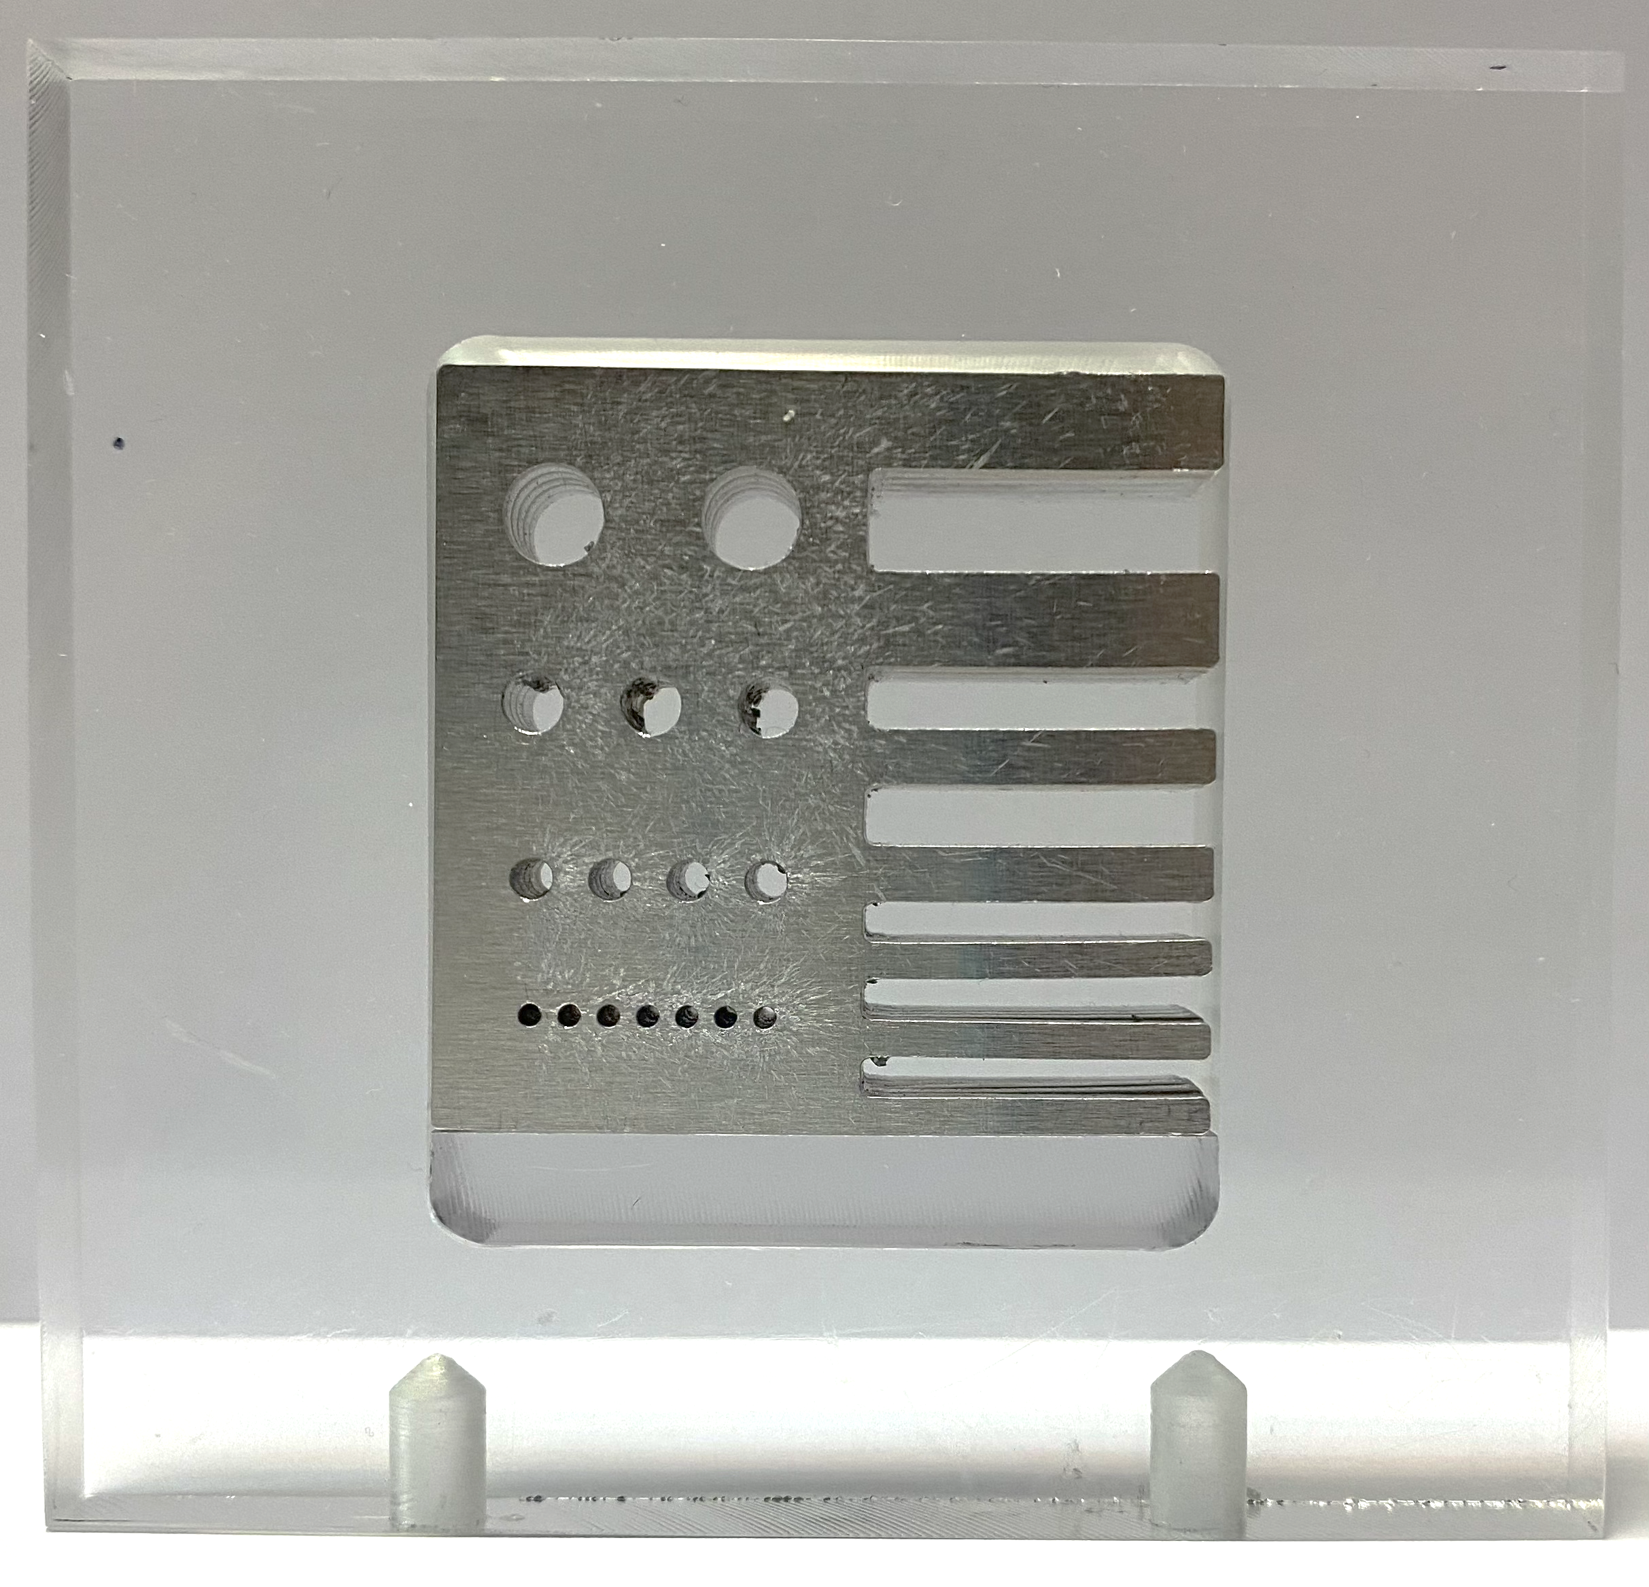
Imaged phantoms
PMMA: Poly(Methyl MethAcrylate)
Aluminum
Derenzo-type phantom
Cross phantom
Uniform phantom

Slide 7
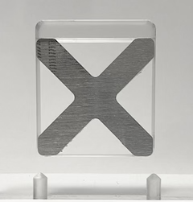
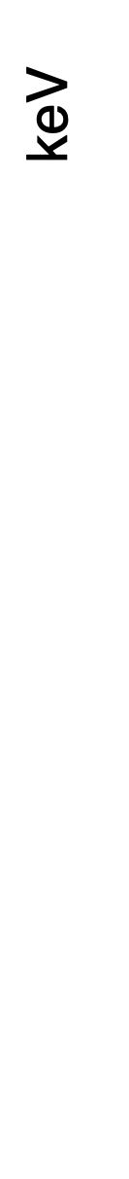
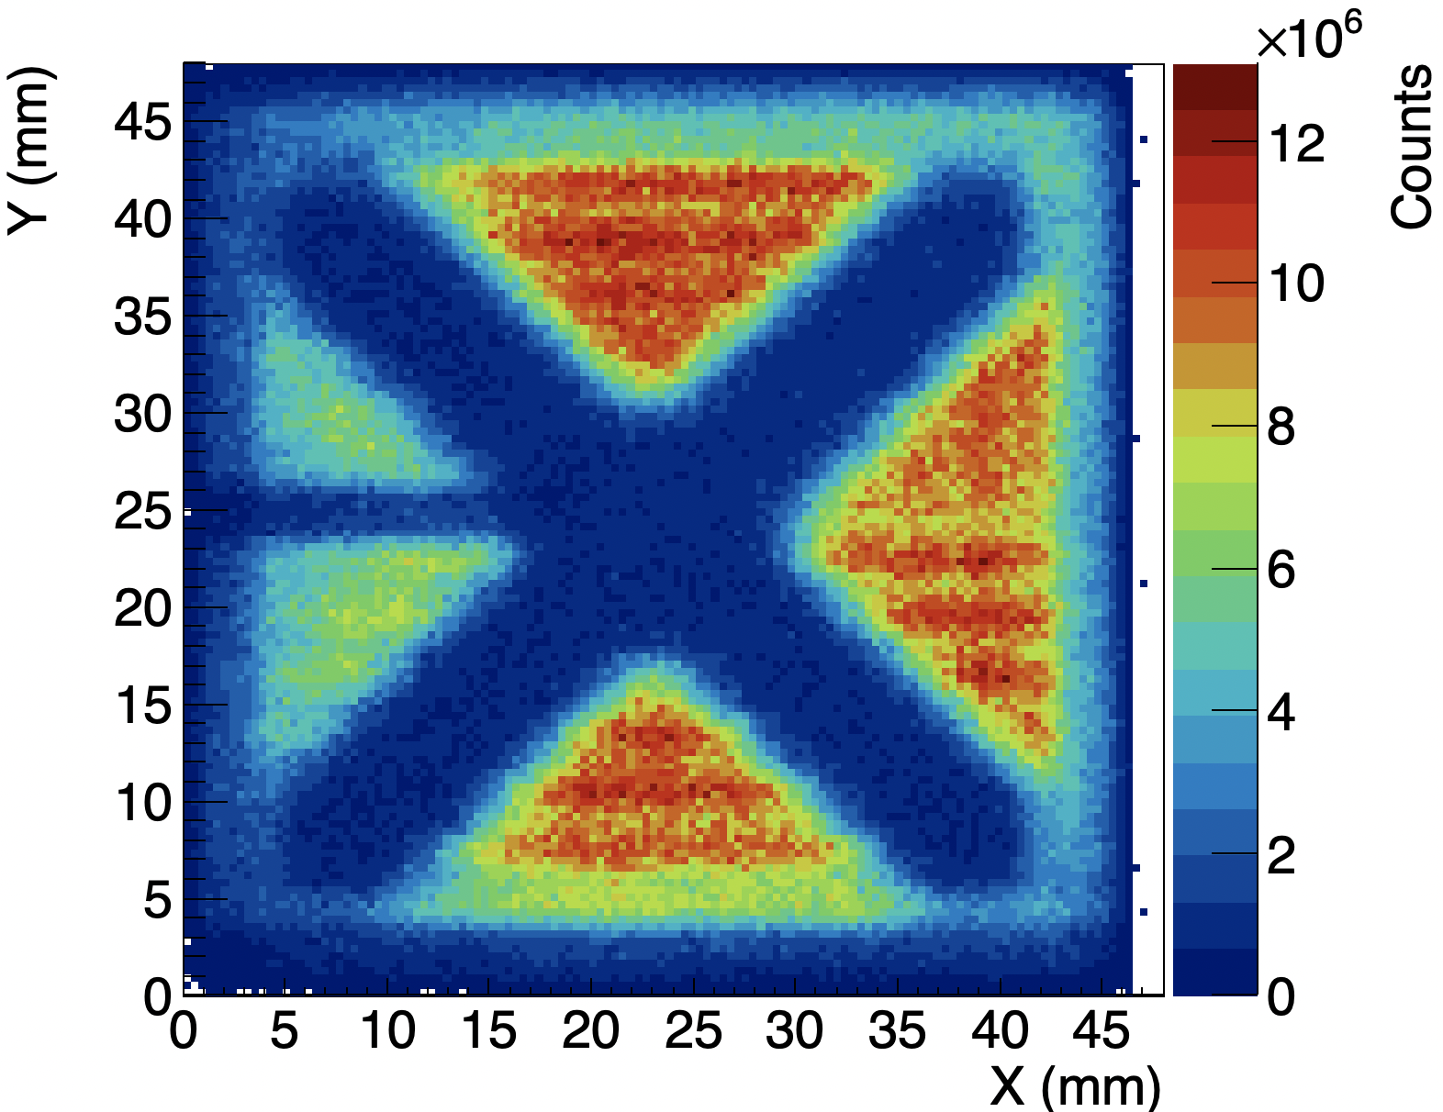
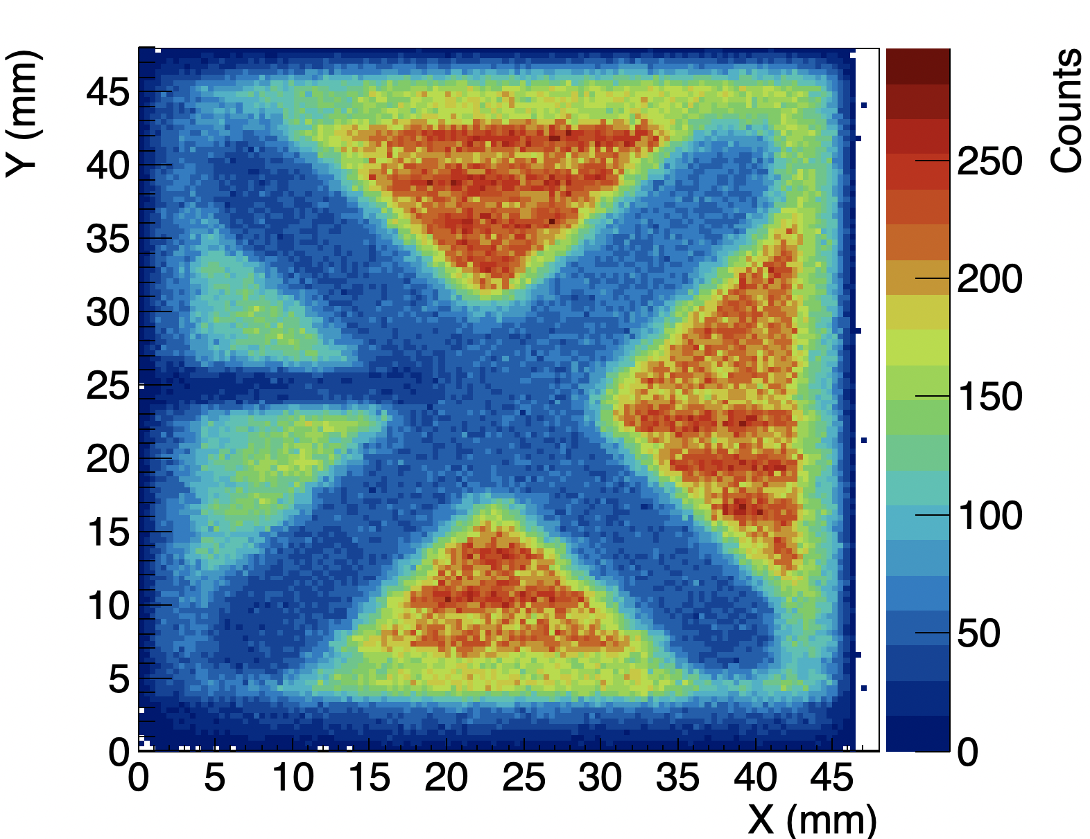
pRads: Cross-shaped phantom
The shape of the phantoms were reproduced.
39.85(5) mm
39.70(5) mm
Process to get the energy per hit on the scanner detectors (E=E_{D1}+E_{D2}+E_{CEPA4})
Sum of the energy deposited
Number of hits
Energy deposited per proton

Slide 8
pRads: Cross-shaped phantom
1-hour measurement (~1.6x10⁶counts)
30-min measurement (~8x10⁵counts)
PMMA
Air
Aluminum
Three well-differentiated zones are observed: PMMA, air, and aluminum.
As expected, higher statistics increased the uniformity of the images.
Average energy deposited per hit on each material was consistent.

Slide 9
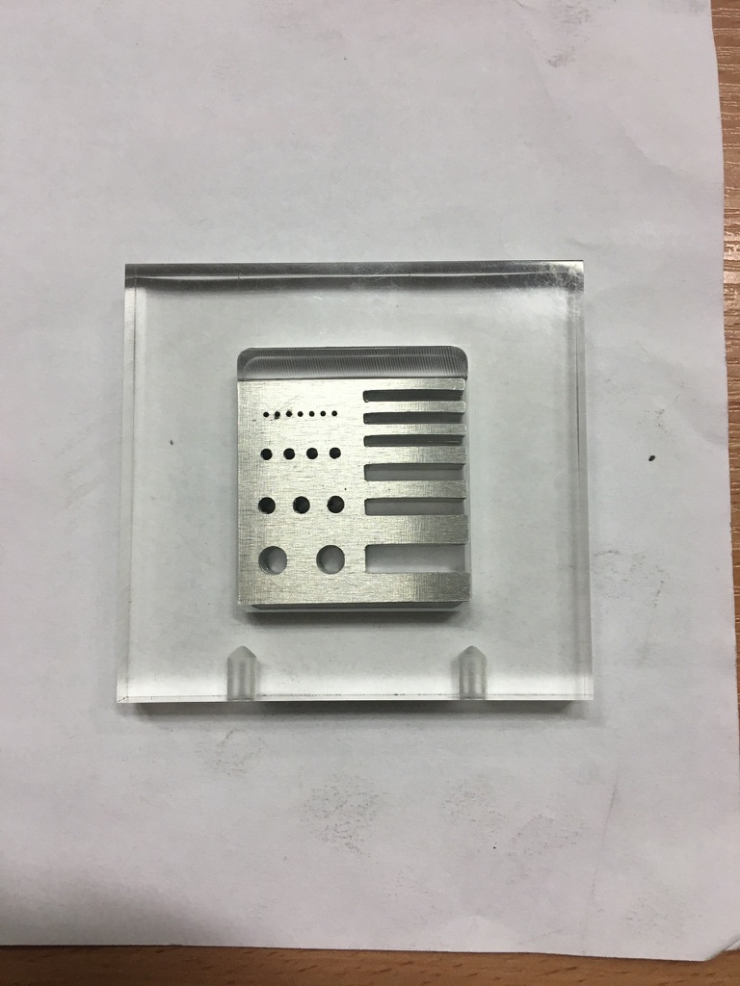
pRads: Derenzo phantom
Experimental image
Simulated image
2 mm
φ=s=1 mm
φ=s=2 mm
3 mm
φ=s=3 mm
φ=s=5 mm
5 mm
The different structures of the phantom are observed.
Simulated results displayed more intense red and blue zones.
Circles of d=2mm are less defined in the experimental image but they are still distinguished.

Slide 10
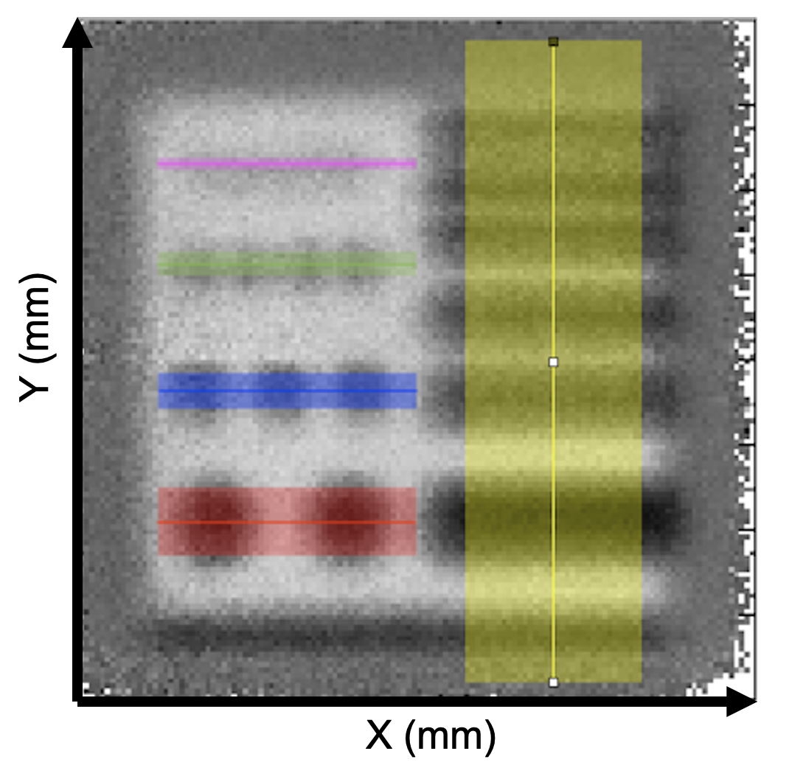
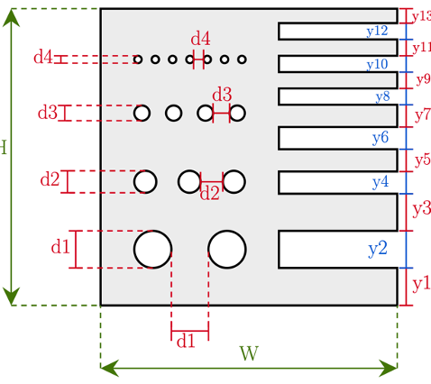
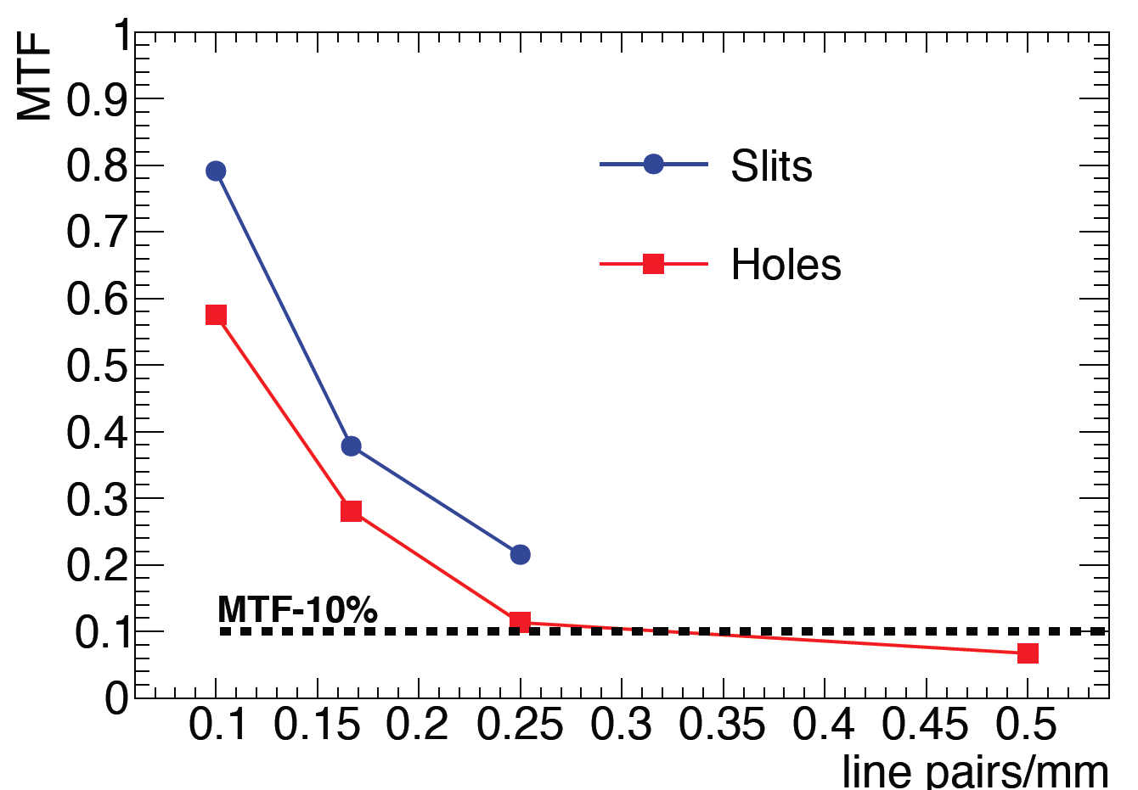
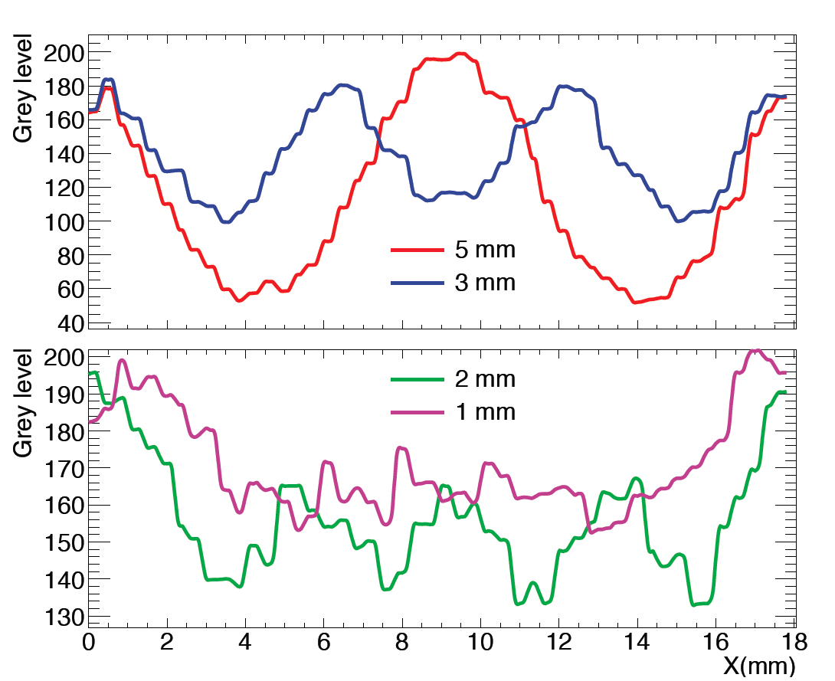
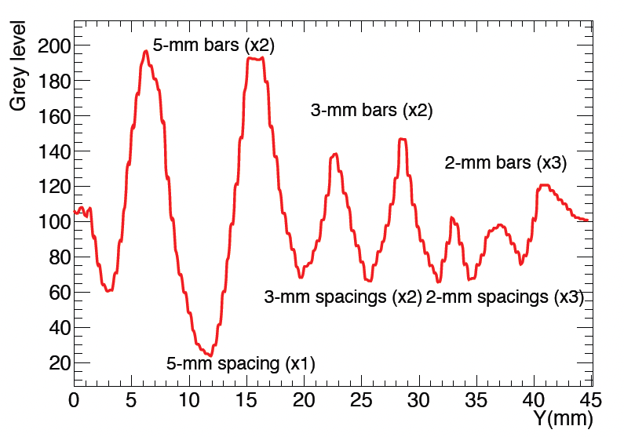
Derenzo measurements
¹ Briz, J. A., et al., IEEE Transactions on Nuclear Science 69.4 (2022): 696-702.

Slide 11
Conclusions
An experimental system that has been used to take radiograph images was designed.
Data has been taken with different beam energies.
Different phantoms were studied
Experimental results were compared with the simulated results, obtaining a good agreement.

Slide 12
Study of cylindrical phantoms

Slide 13
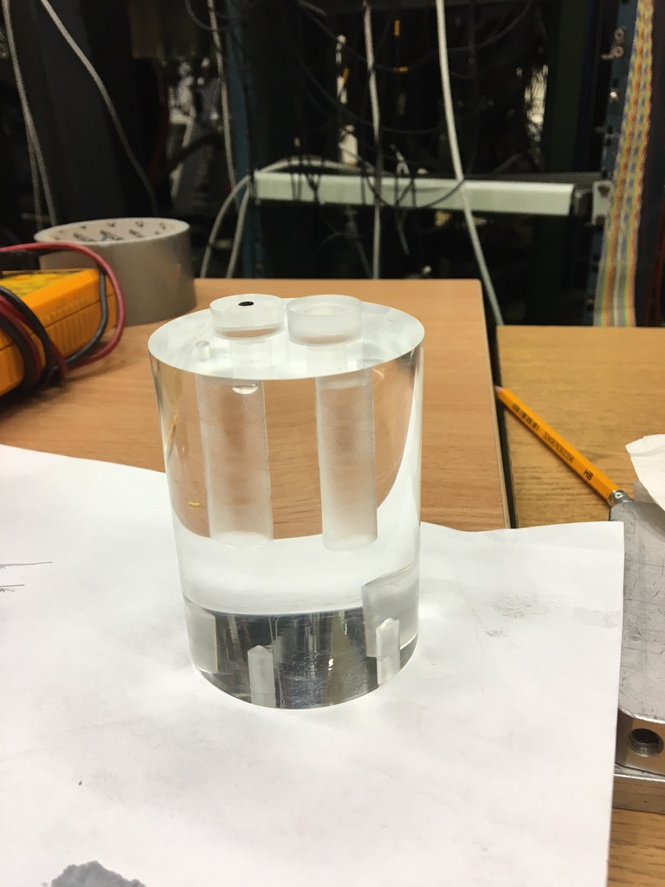
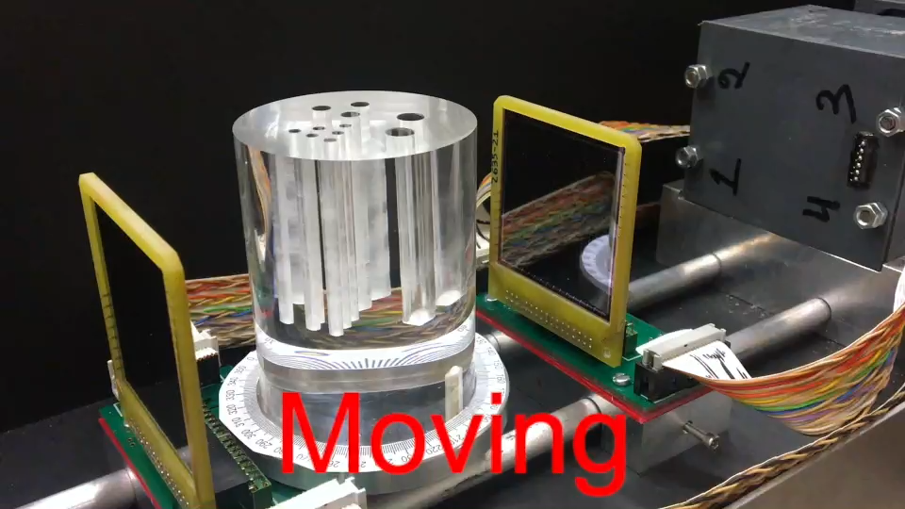
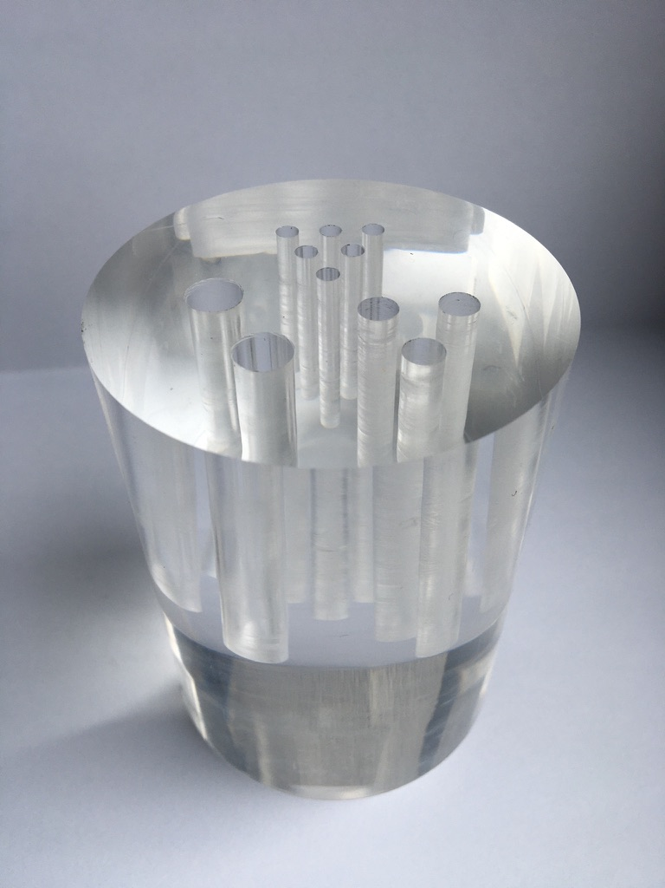
Measurements
Beam energy: 110 MeV
Ethanol-Water:
- 0-180º in 18º steps
3D Derenzo pattern:
- 0-360º in 18º steps
- 0-180º in 9º steps
- 0-180º in 1.8º steps
Tomography:
Ethanol-Water inserts
(Scan recording images
at multiple positions)
ethanol
water
3D Derenzo pattern

Slide 14
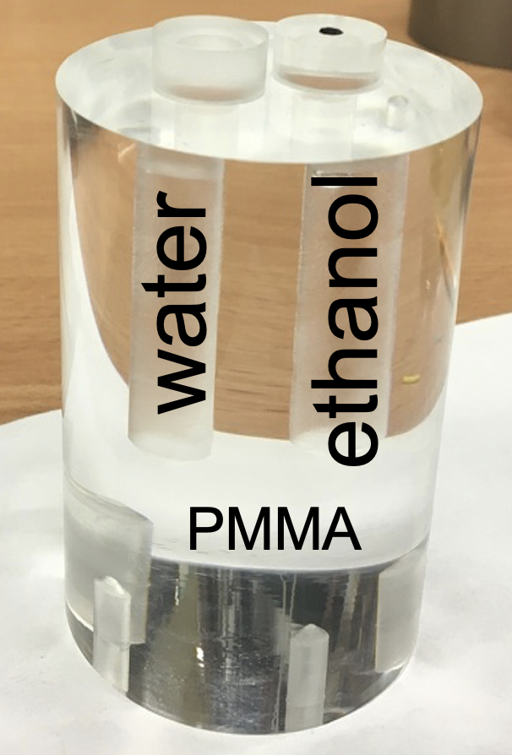
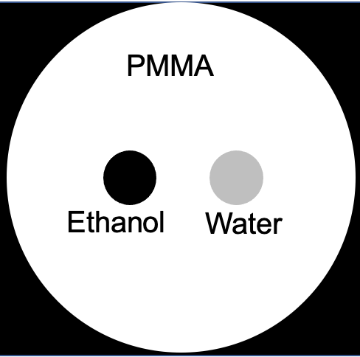
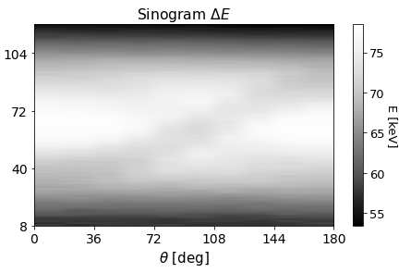
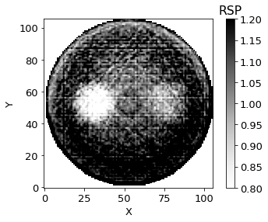
Ethanol and water phantom
Ethanol
Water
Region | RSP ^{[2]} | RSP exp
Water | 1.000 | 1.00(4)
Ethanol | 0.815 | 0.81(3)
PMMA | 1.153 | 1.15(1)
PMMA
[2] NIM B 436 (2018) 99-106

Slide 15
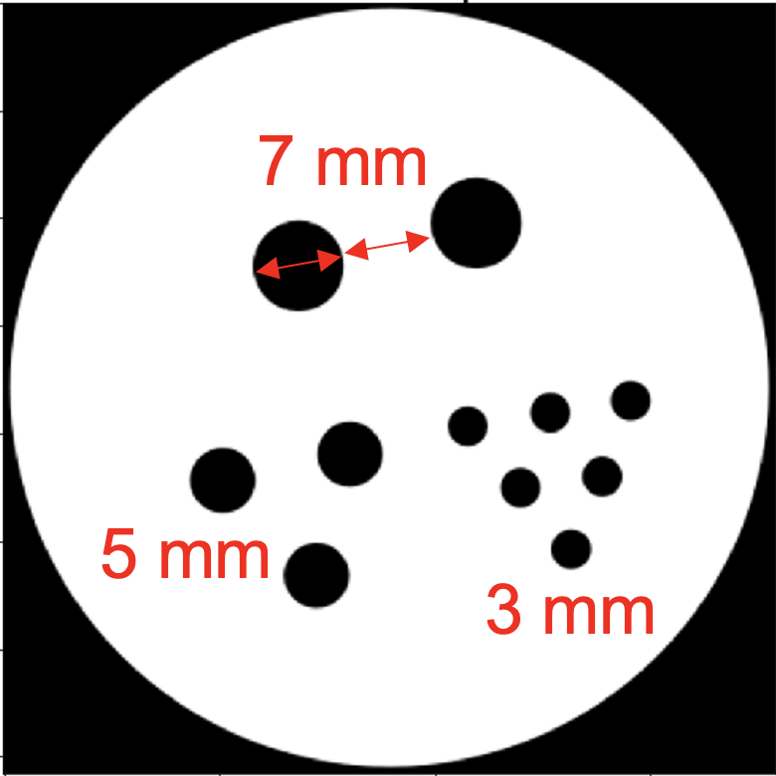
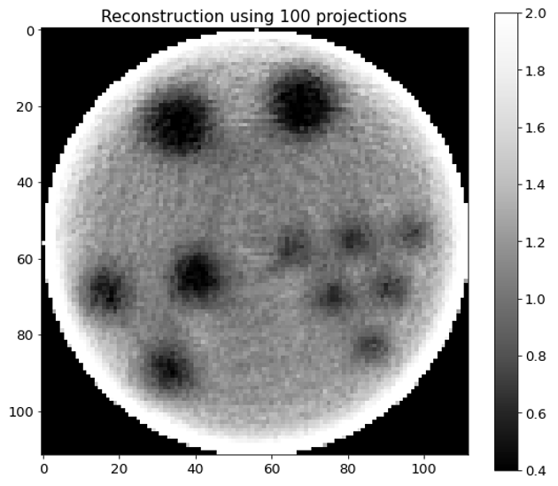
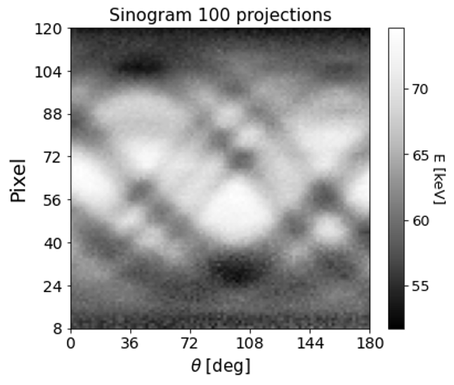
Derenzo 3/5/7

Slide 16
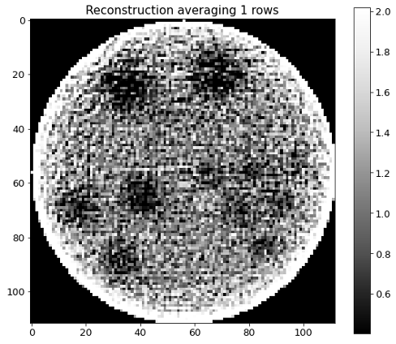
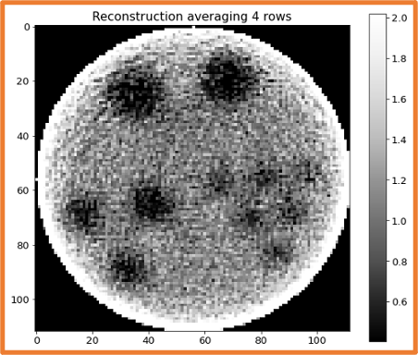
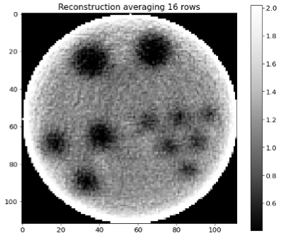
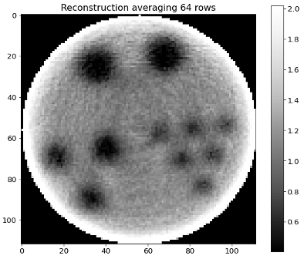
Comparison: lowest statistics reconstructions
Sinograms obtained taking 80, 320, 1280 and 5120 protons/mm² per projection.
All structures are observed, even with the lowest statistics achieved.
The structures are better observed and defined at least 320 protons/mm² per pRad.

Slide 17
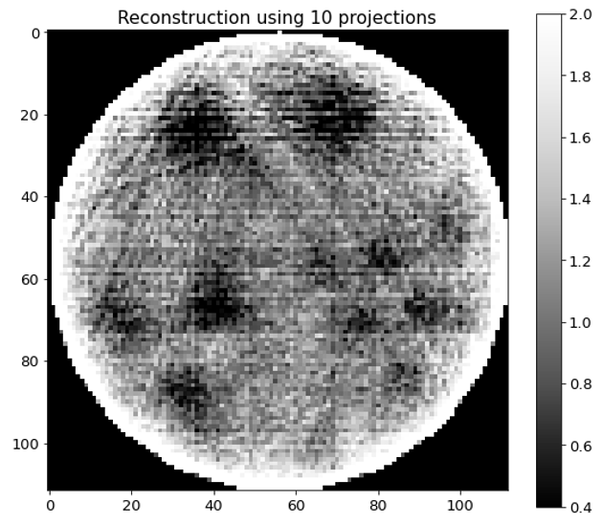
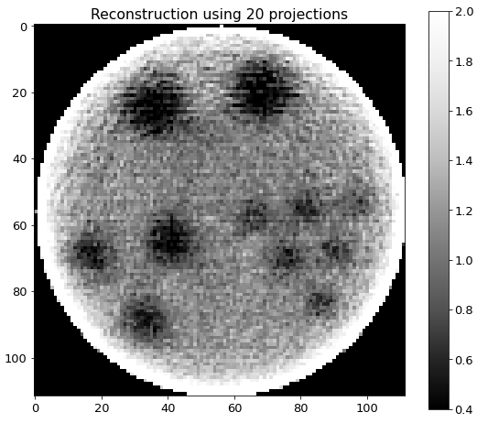
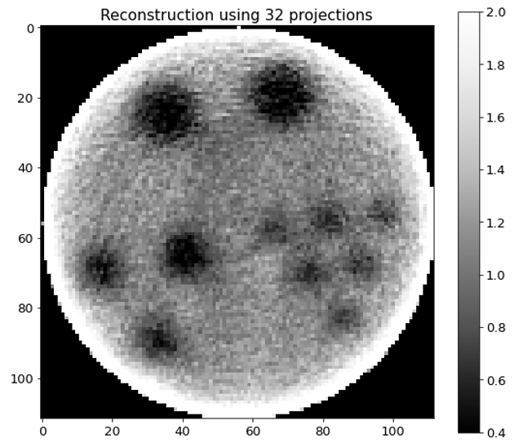


Comparison: varying the angular step
Conclusion:
It was possible to reproduce well the structures of the phantom using at least 20 projections (one each 9 degrees) with 3600 protons/mm² each.
Image quality improves as we take more projections with smaller angular steps.

Slide 18
Conclusions
Our experimental system has been used for pCT imaging.
Different phantoms were studied
Outlook
Data analysis of the experiment performed in June 2022.
Third experiment expected for December 2022.

Slide 19
Thanks for your attention

