Slide 1

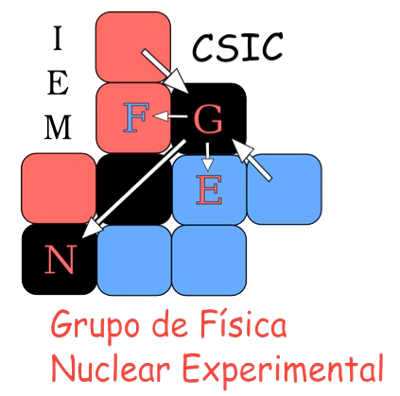


Scattering of ¹⁵C on ²⁰⁸Pb at energies near the coulomb barrier
Instituto de Estructura de la Materia (IEM-CSIC)
Madrid, Spain
Vicente García Távora (vicente.garcia@csic.es)
Supervisor: María José García Borge
Notes:
Hello everyone, my name is Vicente García Távora and im going to present the results of the experiment where we studied the elastic scattering of 15C on 208Pb at energies near the coulomb barrier.

Slide 2
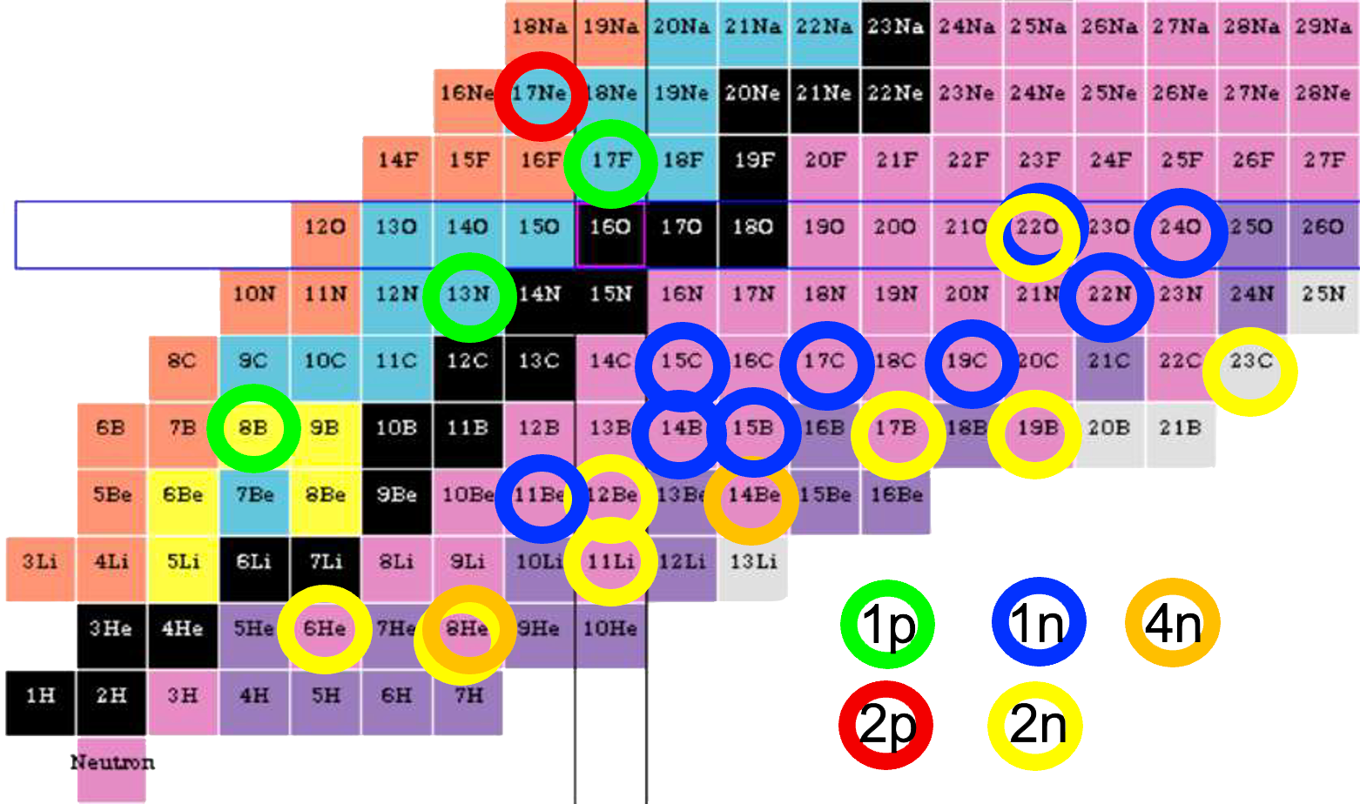
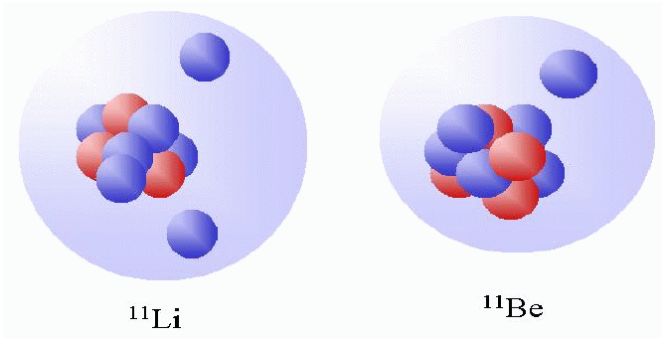
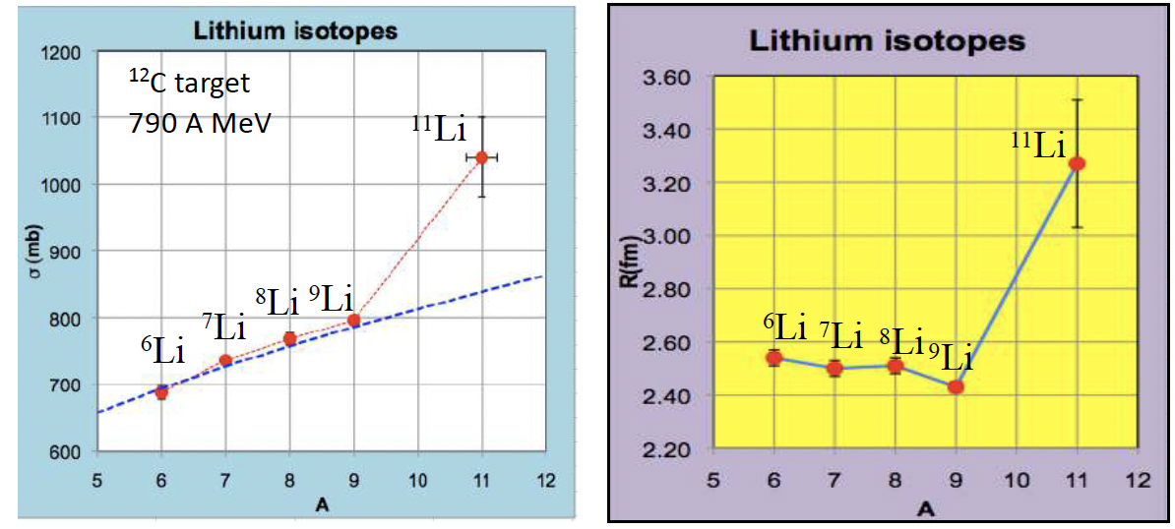
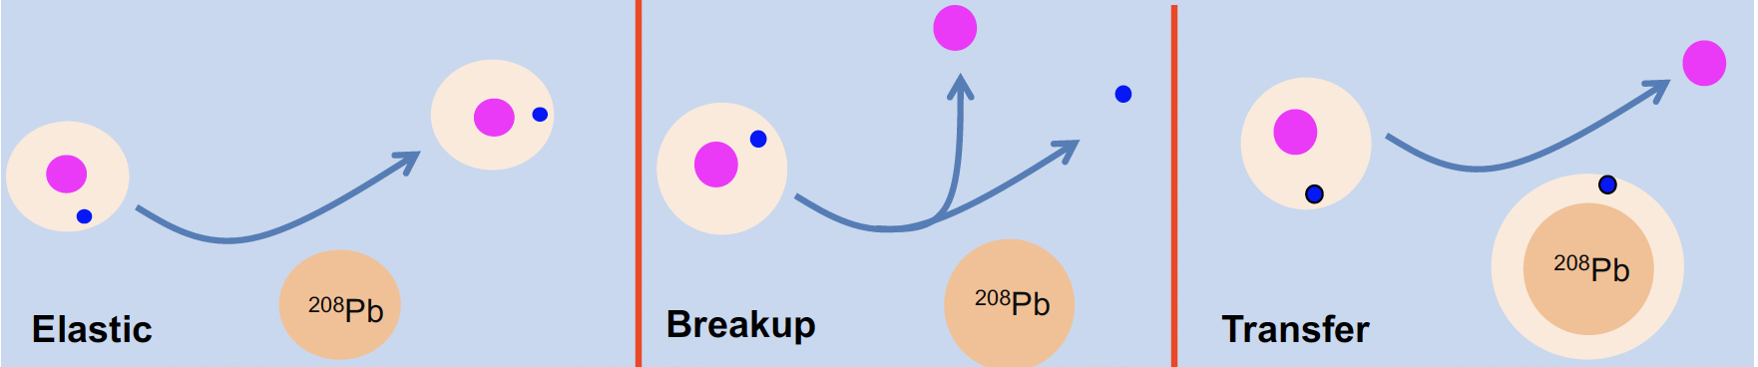

Halo Nuclei
The nuclear halo is a threshold effect arising from the very weak binding energy (0.1-1 MeV) of the outer nucleon(s)
2
Extended mass distribution
Large reaction cross section
Large rms radius
Narrow momentum distribution of the fragments following breakup
Concentration of B(E1) close to Breakup threshold
G. Sawhney et al, J. Phys G Nuc part Phys 41 (2014) 055101
Tanihata, PRL 55 (1985)2676
Neutron Haloes
Provide an ideal test bench to study few-body correlations by measuring elastic, nucleon transfer and breakup
Vicente García Távora Instituto de Estructura de la Materia - CSIC
Notes:
First of all I‘m goin to introduce what is a halo nuclei, we can define the nuclear halo as a threshold effect arising from the very weak binding energy of the outer nucleons.
There are a lot of known halo nuclei, some of the most studied are 11Li which is a 2 neutron halo, and 11Be with 1 neutron halo.
Some of the characteristics of those nuclei are: the extended mass distribution, large radius as we can see in 11Li figure, large reaction cross section as we can see in the other figure, narrow momentum distribution, following fast fragmentation and a high concentration of B(E1) close to Break-Up threshold.
So due to those characteristics, neutron haloes provide an ideal test bench to study few-body correlations by measuring elastic, nucleon transfer and break-up reactions.

Slide 3
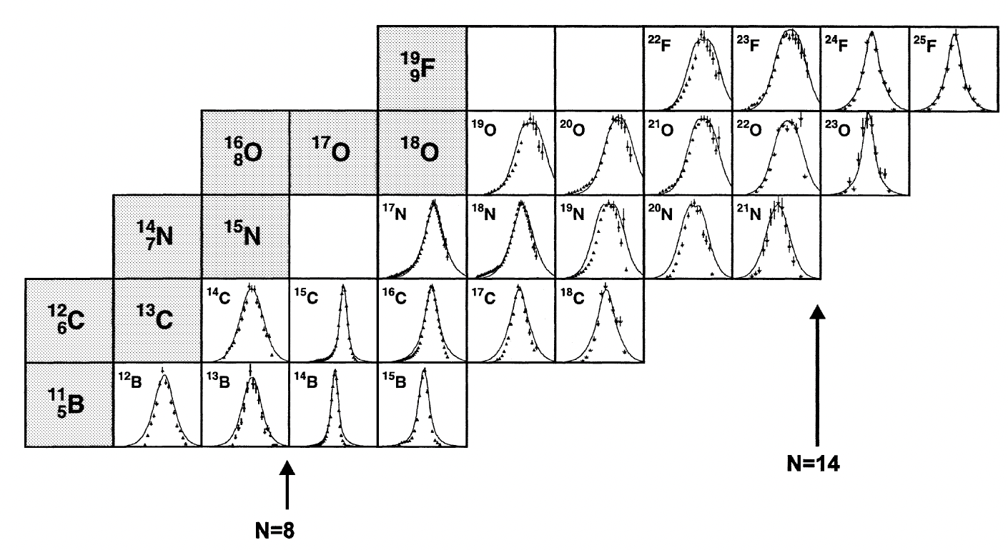
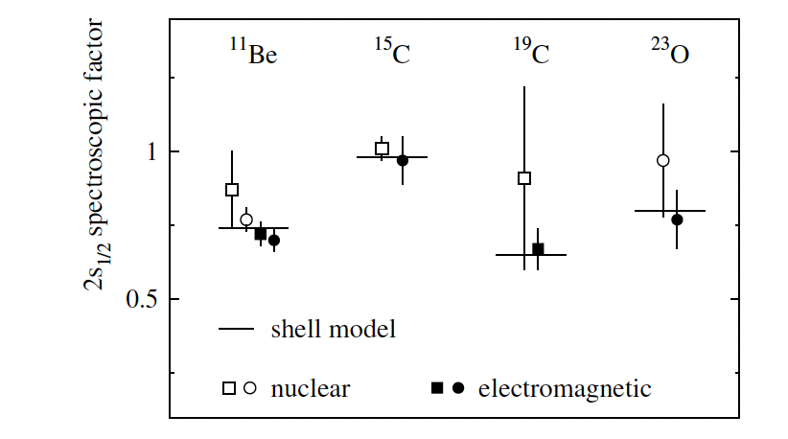
What makes ¹⁵C (T_{1/2} = 2.45s) Interesting ?
3
Realively weakly bound:
S_{n} = 1.2 MeV; S_{2n} = 9.4 MeV
Relatively narrow longitudinal momentum distribution.
First excited state (E = 740 keV)
Ground state mainly 2s_{1/2}
62 MeV/c
Spectroscopic Factor
1d_{5/2}
2s_{1/2}
S-wave 1n-halo coupled to ¹⁴C
could explains these features
1p_{1/2}
1p_{3/2}
1s_{1/2}
Aumann et al., EPJA 26 (2005) 446
Vicente García Távora Instituto de Estructura de la Materia - CSIC
Notes:
The case of 15C is special since some high energy experiments have showed a large total interaction cross section and a very narrow distribution of the longitudinal component of the momentum of the fragments following breakup. This was reported by Ozawa in 2004 and this paper says that all these features would be consistent with a structure consisting of a 14C core plus a 1n in halo configuration with a pure s-wave as ground state, despite of having a relatively large separation energy above 1 MeV. Still the difference with the separation energy of 2 neutrons, which is closer to 10 MeV, is considerable.
Los nucleos típicos tienen unos 40 MeV/c.
Spectroscopic factor esta en 1, and that confirm that is mainly 2s1/2.

Slide 4
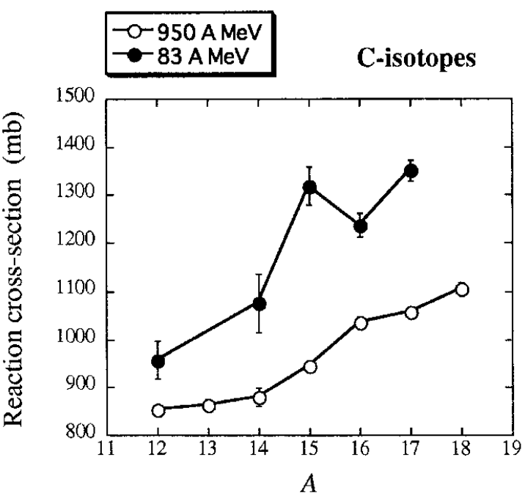
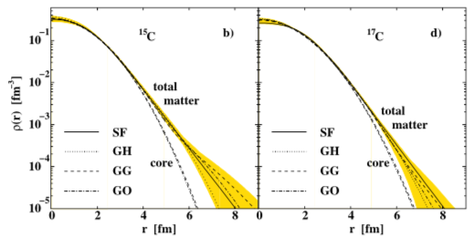
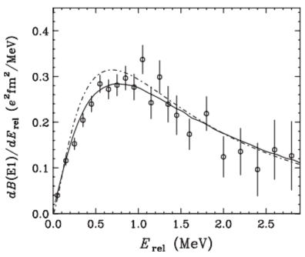
¹⁵C: Controversial 1n-halo
4
Reaction cross section larger than ^{14,16}C at intermediate energies, but not at higher energies
  It seems that coupling increases when energy decreases
B(E1) deduced from coulomb breakup of ¹⁵C on Pb longer tail than ¹¹Be and smaller value of mean square radius.
Nuclear matter radii and density recently revisited
R_{m} = 2.59(5) fm ; R_{p} = 2,37(3) fm R_{n} = 2,73(8) fm→ δ_{np} = 0.36(9) fm
R_{c} = 2,41(5) fm ; R_{ν} = 4.36 (38) fm → κ = R_{ν} /R_{c} = 1.81 (halo κ > 2)
Ozawa et al.,
NP A738 (2004) 38
¹⁵C
Dobrovolsky et al., NP A 1008 (2021) 122154
Nakamura et al., PRC 79 (2009) 035805
Vicente García Távora Instituto de Estructura de la Materia - CSIC
Notes:
This 15C could be even more interesting if we focus now on the parameters that shoud determine if we are facing a halo nuclei we find some discrepancies.
So first, the reaction cross section of 15C is larger than 14 and 16C, at intermediate energies, but not at higher energies. So it seems that the coupling increases when the energy decreases.
Then, the B(E1) deduced from the coulomb break up has a longer tail than 11Be which is a 1-n halo and a smaller value of mean square radius.
Then, the difference between proton and neutron radius is quite small for a 1-neutron halo core and also the ratio between valence and core radious is smaller than the expected.
So for all of this we can’t really determine if 15C is or not a halo nuclei
Rv = Valence radious
Rc = Core radious

Slide 5
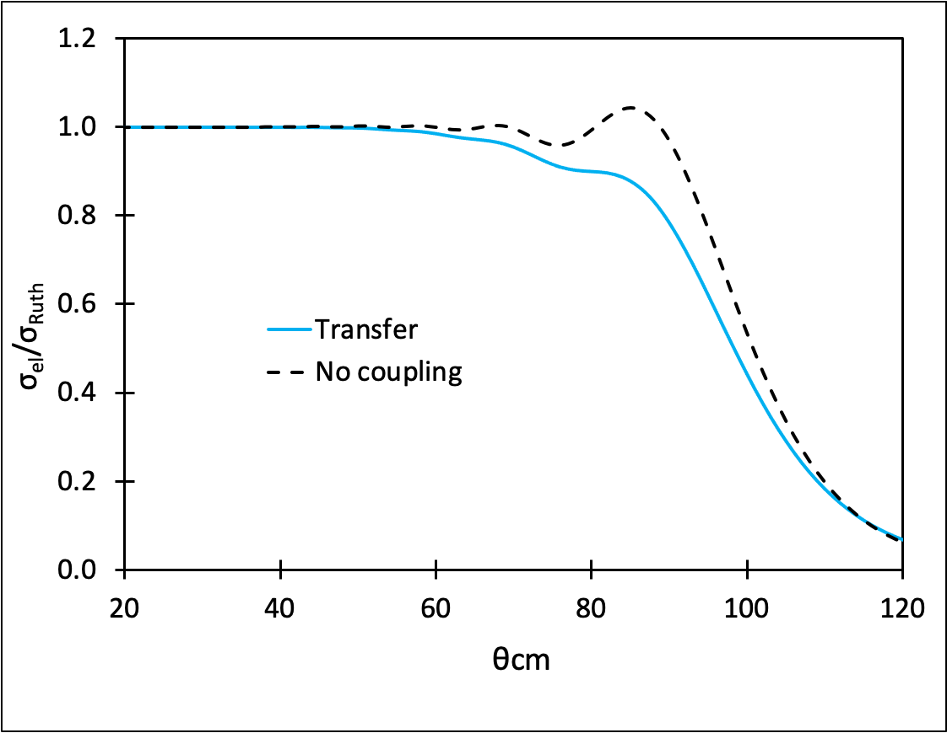
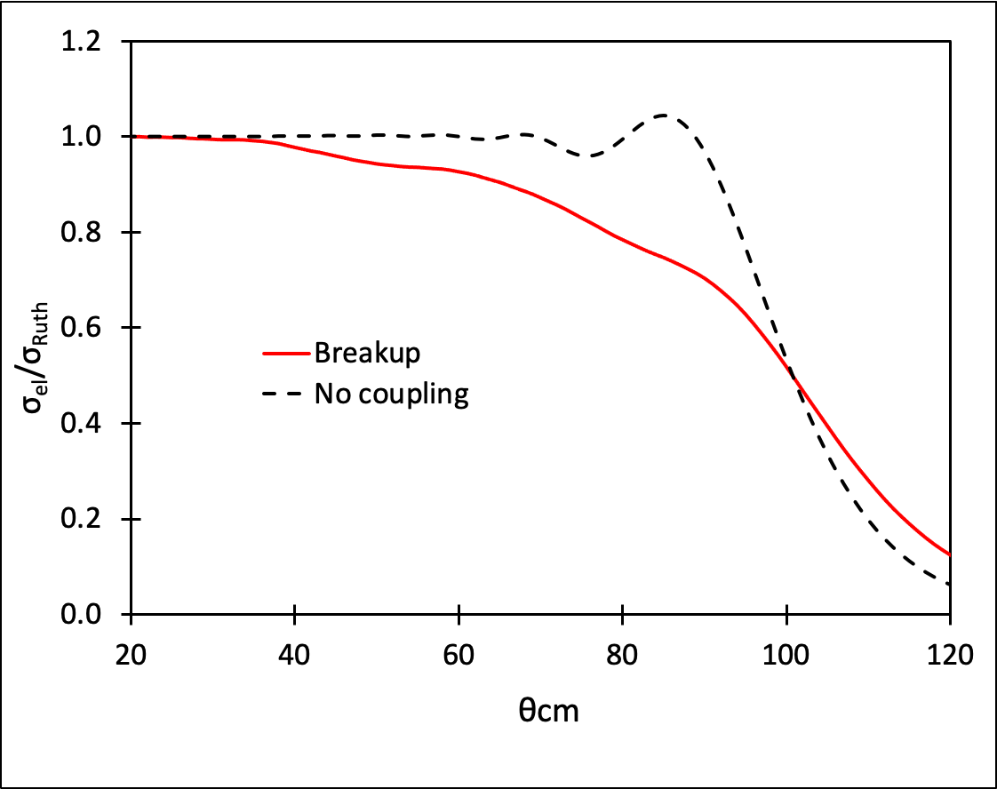
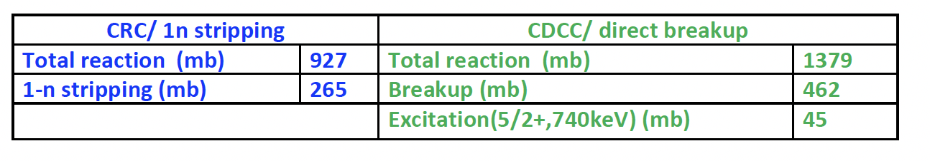
Coulomb Barrier Scattering of ¹⁵C + ²⁰⁸Pb
5
Reaction studies done at high energies all agree with a moderate halo structure for ¹⁵C
→ ¿Which is the diferential elastic cross section near Coulomb Barrier (E= 65 MeV)?
Predictions on the elastic scattering of ¹⁵C + ²⁰⁸Pb @ 65 MeV were done by Keenley et al. in the framework of CRC including 1n-stripping and CDCC including breakup
¹⁵C + ²⁰⁸Pb @ 65 MeV
¹⁵C + ²⁰⁸Pb @ 65 MeV
N. Keenley et al., PRC 75 (2007) 056610; EPJA 50 (2014) 145
Scattering dominated by the competition of 1n-stripping and breakup
Vicente García Távora Instituto de Estructura de la Materia - CSIC
Notes:
What else could be studied to confirm or not the halo structure?
All the studies done at high energies agree with a modetare halo structure, so we wanted to study the elastric cross section at energies near the coulomb barrier, that exist for an energy of 65 MeV.
In this energy region we can find theoretical studies that predict that scattering is dominated by the competition of 1n-stripping and breakup with the cross section that we can see in the table.

Slide 6
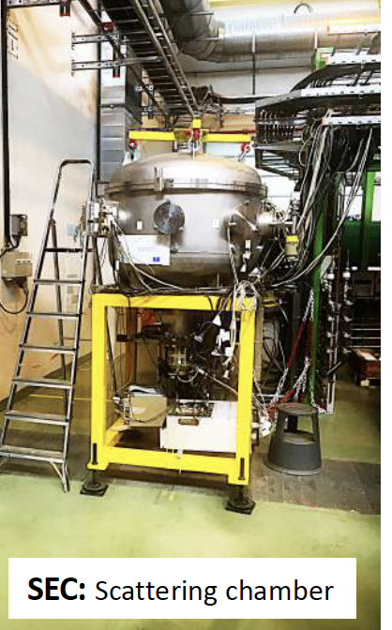
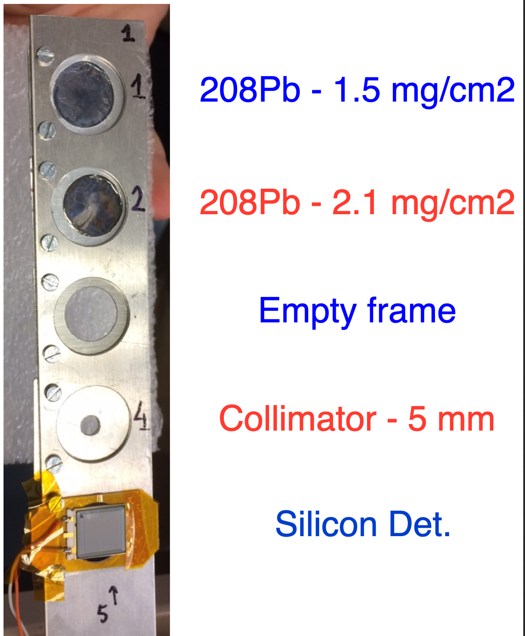
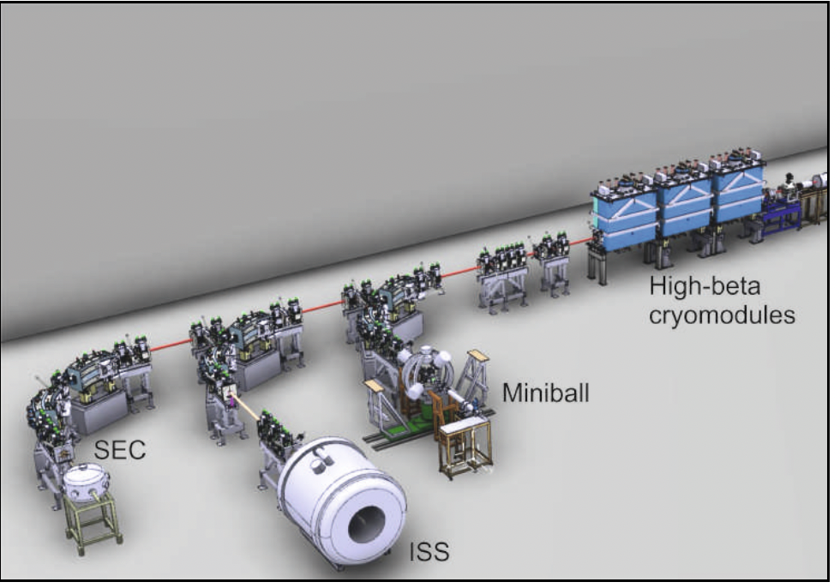
Coulomb Barrier Scattering of ¹⁵C + ²⁰⁸Pb
6
Experiment IS699 @ HIE-ISOLDE (CERN)
1 x 10³ pps average ¹⁵C at reaction point
E = 4.37 MeV/u (65.5 MeV) incoming ¹⁵C (FWHM = 225 keV)
  65,43 MeV, after 75 μg/cm² stripping C-foil
  64,56(23) MeV in the middle of the ²⁰⁸Pb-foil
Cocktail beam of ¹⁵N + ¹⁵C: ¹⁵C/¹⁵N ≈ 1-3%
  ¹⁵N tightly bound @ this energy → use for monitoring and normalization
Purity > 98%
Vicente García Távora Instituto de Estructura de la Materia - CSIC
Notes:
The radioactive beam was produced from the impact of 1.4GeV proton pulses coming from the Psbooster on a CaO primary or production target, extracted, mass-separated and post-accelerated with A/q=3 up to 4.37 MeV/u; the coulomb barrier of the system 15C + 208 Pb.
15N was present as the unique contaminant after the 75ug/cm2 carbon stripping foil. This is a stable nucleus and at this energy is far from the Coulomb barrier, then it would follow a pure classic Rutherford scattering. The ratio between these two components in time fluctuated a little but was between 1 and 3%, meaning that the radioactive yield was one order of magnitude lower than requested.
We also could run with and stable cocktail beam made of 12C+15N+18º at the same energy per nucleon.
As reaction targets we had two available thicknesses of 208 Pb with a purity higher than 98%: 2.1 and 1.2 mg/cm2.
With the thicker target the energy losses are enhanced but it also favors a higher reaction rate and more statistics. However, with the thin target we lose reaction rate but we avoid straggling and get a better energy resolution.
For beam tuning we also prepared an empty frame, a collimator and a silicon detector.

Slide 7
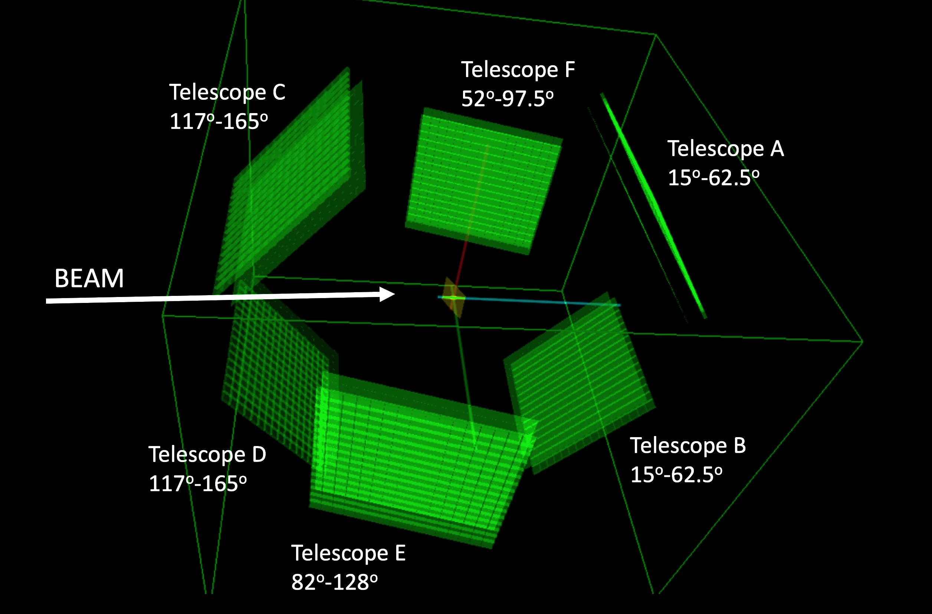
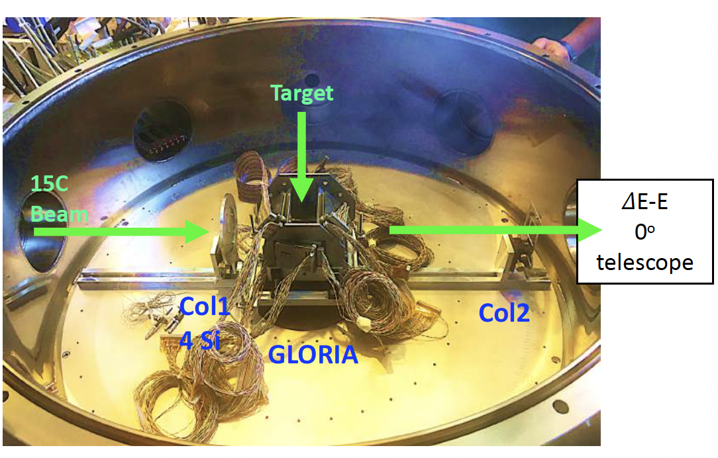
Experimental Setup
7
Gobal Reaction Array GLORIA
  (NIM A 755 69-77 [2014]).
6 Si telescopes tangent to a 6 cm radius sphere.
40 µm (ΔE) + 1 mm (E) DSSDs in 256 pixels of 3x3 mm²
  2-3º angular ressolution
25% geometric eff.
Full angular coverage 𝛉_{LAB} =15º -165º
²⁰⁸Pb targets 2.1 and 1.5 mg/cm².
Vicente García Távora Instituto de Estructura de la Materia - CSIC
Notes:
For this purpose, the used experimental set-up was the global reaction array, also called GLORIA, which is an array of silicon detectors specially designed for scattering measurements. It consist of 6 silicon telescopes, all of them tangent to a 6 cm radius sphere in which center the reaction target is placed. All of the telescopes are made of a 40 um Delta E stage and a thicker 1 mm E stage. Both stages have 16x16 strips, which means they work as a set of 256 pixels each with an angular resolution between 2 and 3º. Dynamic ranges were adjusted to around 50 MeV to catch up the scattered 15C ions at ≈65 MeV lab. energy and the system has an angular coverage from 15 to 165º in a continous way with some overlapped intervals between pairs of telescopes. The geometric efficiency is 25%.
They were placed on a target ladder with a 30º tilt respect to the beam direction, this avoids shadowing at 90º but also introduces an asymmetry in the energy losses through the phi azimutal angle.

Slide 8
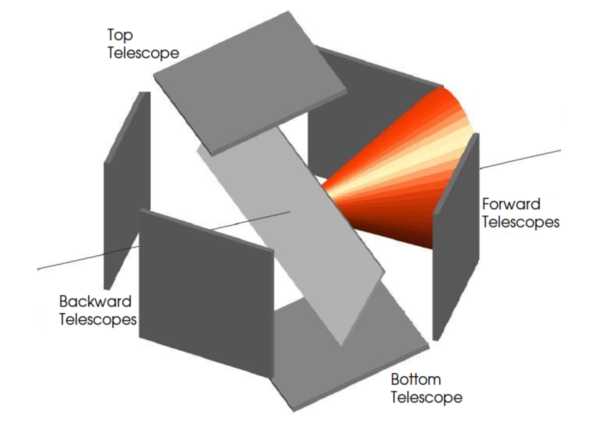
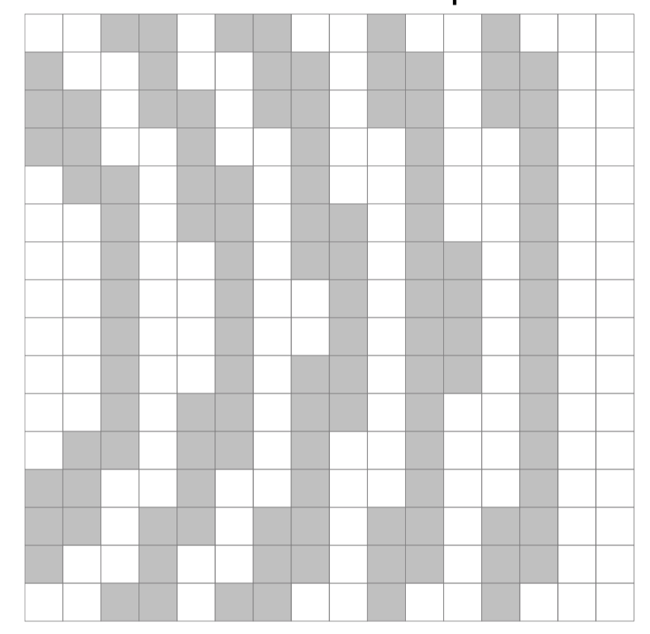
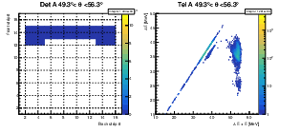
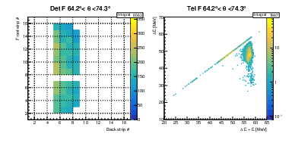
Data Analysis
8
Telescope configuration allows for particle identification from 2D (ΔE-E_{TOT}) plots.
High granularity of DSSDs allows for grouping together pixels within a Δ𝛉 range.
In the Δ𝛉 sectors the same physics are expected (non-polarized beam) and minor effects of different energy losses happen, maximizing the statistics and reducing the errorbars.
Tel A 49º < θ < 56º
Tel A 49º < θ < 56º
¹⁵N
Tel F 64º < θ < 74º
¹⁵C
Tel F 64º < θ < 74º
Back strip number
ΔE + E (MeV)
Back strip number
ΔE + E (MeV)
Vicente García Távora Instituto de Estructura de la Materia - CSIC
Notes:
Regarding the analysis:
As for a non-polarised beam the reaction fragments follow axial symmetry, we expect the same physics to happen in the same scattering angle #theta, and this is a cone like the one shown, we divide our detectors angular intervals limited by the intersection between two cones of different angle and the detectors surfaces., This way, and despite of having an asymmetry in the energy losses, we can sum statistics keeping a reasonable resolution.
In the 2D/mass spectra plots from this angular sectors, we can appreciate several effects.
the two elastic scattered ions with some characteristic features such as the stragglin in the reaction target (that shows up as a long tail towards the left side), the channeling through the channels of the silicon lattice (as a tail downwards) or some charge charing events (hits in between strips).
On one hand, the presence of 15N is an advantage since it follows pure Rutherford scattering for being far from the Coulomb barrier and dividing the integral of the carbon elastic peak by the nitrogen one, one gets a point proportional to the carbon elastic cross-section normalized by Rutherford indpendent of the pixel angle and solid angle, since both are the exactly the same for the two isotoped. Apart of this one needs to know which angle is this so you put the corresponding cross section in the proper position of the angular distribution.

Slide 9
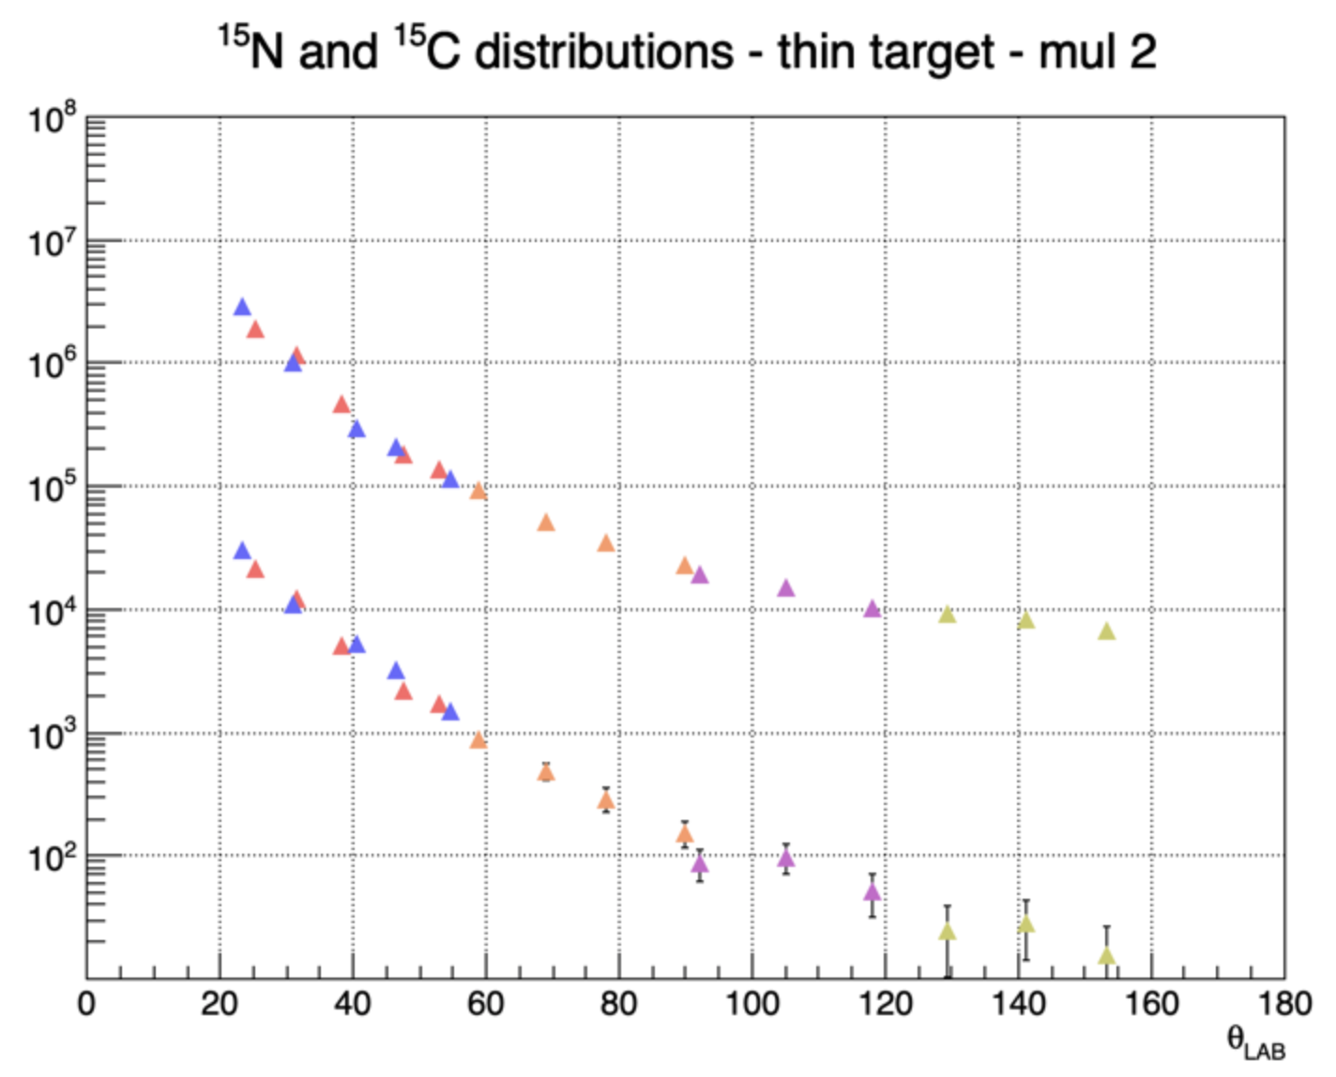
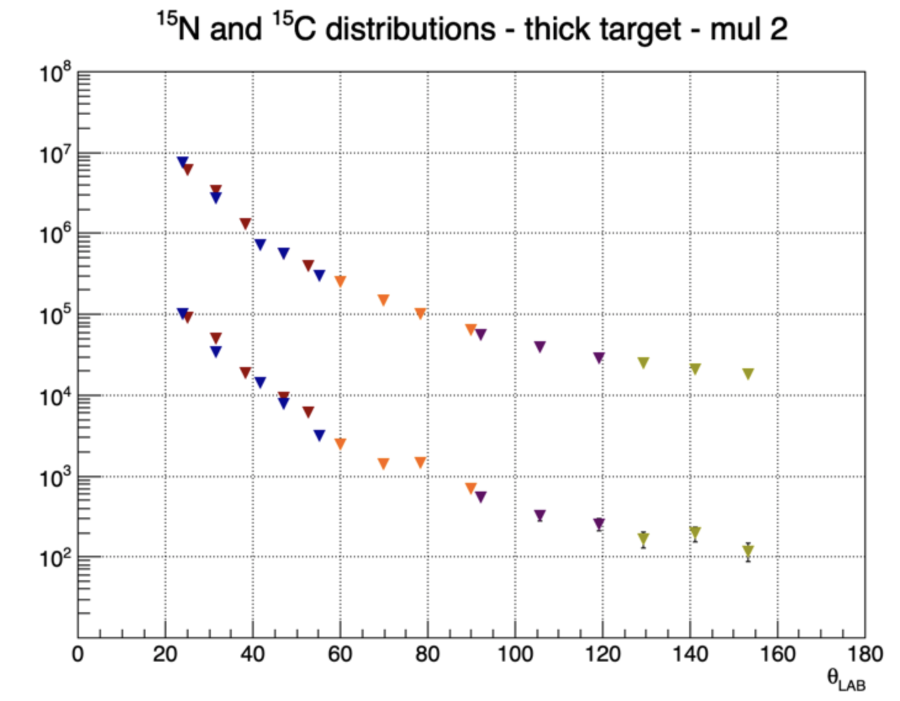
¹⁵N / ¹⁵C Distributions
9
counts/msr
counts/msr
Vicente García Távora Instituto de Estructura de la Materia - CSIC

Slide 10
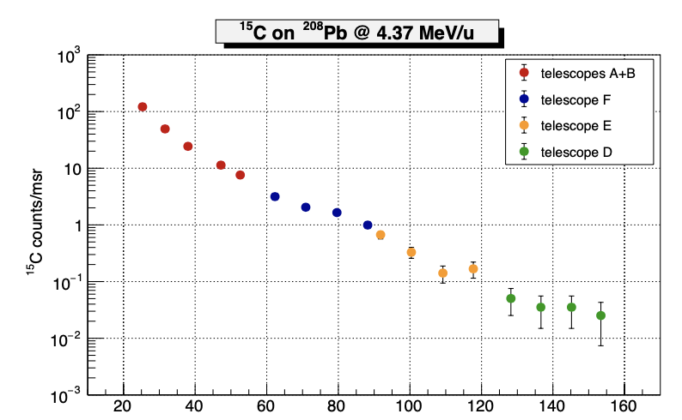
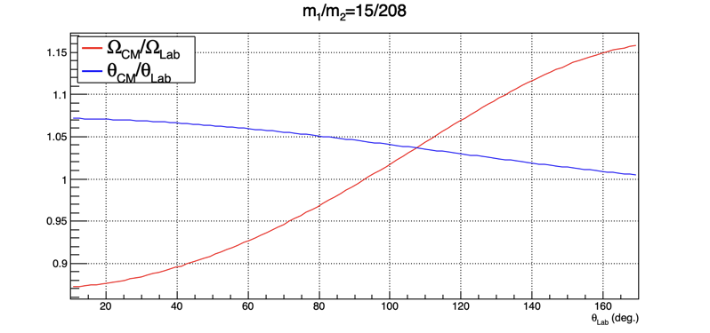
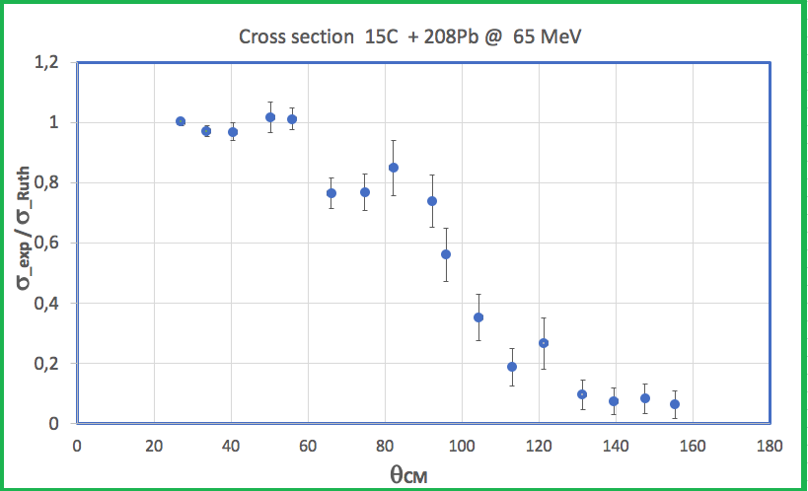
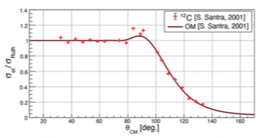
¹⁵C + ²⁰⁸Pb Cross Section
10
θ_{Lab}
θ_{Lab}
Santra et al., PRC 64 (2001) 024602
¹²C+ ²⁰⁸Pb @ 65 MeV
Vicente García Távora Instituto de Estructura de la Materia - CSIC

Slide 11
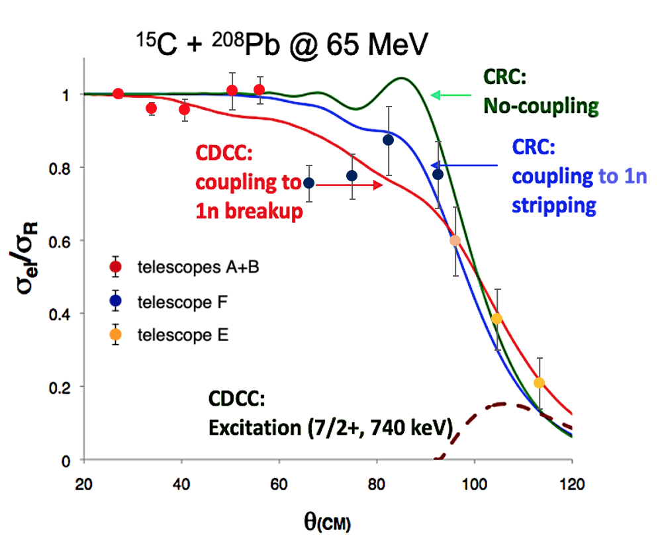
Comparison of Experimental results with Theory
11
The experimental angular distribution cross section of ¹⁵C + ²⁰⁸Pb @ 65 MeV are compared with the calculations done by Keenley et al., for the extreme case of no coupling and 1n-stripping within the coupled reaction channel and CDCC for no coupling and 1n breakup.
The experimental angular distribution of the elastic scattering near the Coulomb Barrier (~ 65 MeV) shows strong couplings.
The distribution favours the presence of 1n-stripping channel.
N. Keenley et al., PRC 75 (2007) 056610; EPJA 50 (2014) 145
Vicente García Távora Instituto de Estructura de la Materia - CSIC

Slide 12
Summary & Outlook
12
We have performed the first study of the angular distribution of the elastic cross section of ¹⁵C + ²⁰⁸Pb @ 65 MeV at HIE-ISOLDE (CERN).
¹⁵C nucleus is a border line halo case with relatively low binding energy, a moderate halo case.
It constitutes a unique case where the last neutron sits mainly in a 1S_{1/2}–wave state.
Predictions on the scattering of ¹⁵C + ²⁰⁸Pb @ 65 MeV were done by Keenley, Alamanos and Rusek in the framework of CRC including 1n-stripping and CDCC including breakup. 1n-stripping contribution was expected to be prominent as well as 1n-breakup
The experimental angular distribution of the elastic scattering near the Coulomb Barrier (~ 60 MeV ) shows strong couplings. The distribution favours the presence of 1n-stripping channel.
Vicente García Távora Instituto de Estructura de la Materia - CSIC

Slide 13
The IS699 collaboration
13
J.D. Ovejas , V.G. Tavora, O. Tengblad
Instituto de Estructura de la Materia, CSIC, Serrano 113-bis, E-28006 Madrid, Spain
I. Martel, A.M. Sánchez-Bení­tez
Departamento de Física Aplicada, Universidad de Huelva, E-21071, Huelva, Spain
Di Pietro, P. Figuera
INFN, Laboratori Nazionali del Sud, via S. Sofia 62, 1-95123, Catania, Italy
N. Keeley, K. Rusek
National Center for Nuclear Research, ul Andrzeja Soltana 7, 05-400 Otwock, Poland
L. Acosta
Dpto Física Experimental, Instituto de Física , UNAM (Mexico)
J. P. Fernández
Departamento de FAMN, Universidad de Sevilla, Seville, Spain
D. Galaviz
Faculty of Sciences, LIP, Lisbonne, Portugal
Thanks for Your Attention
Vicente García Távora Instituto de Estructura de la Materia - CSIC

Slide 14
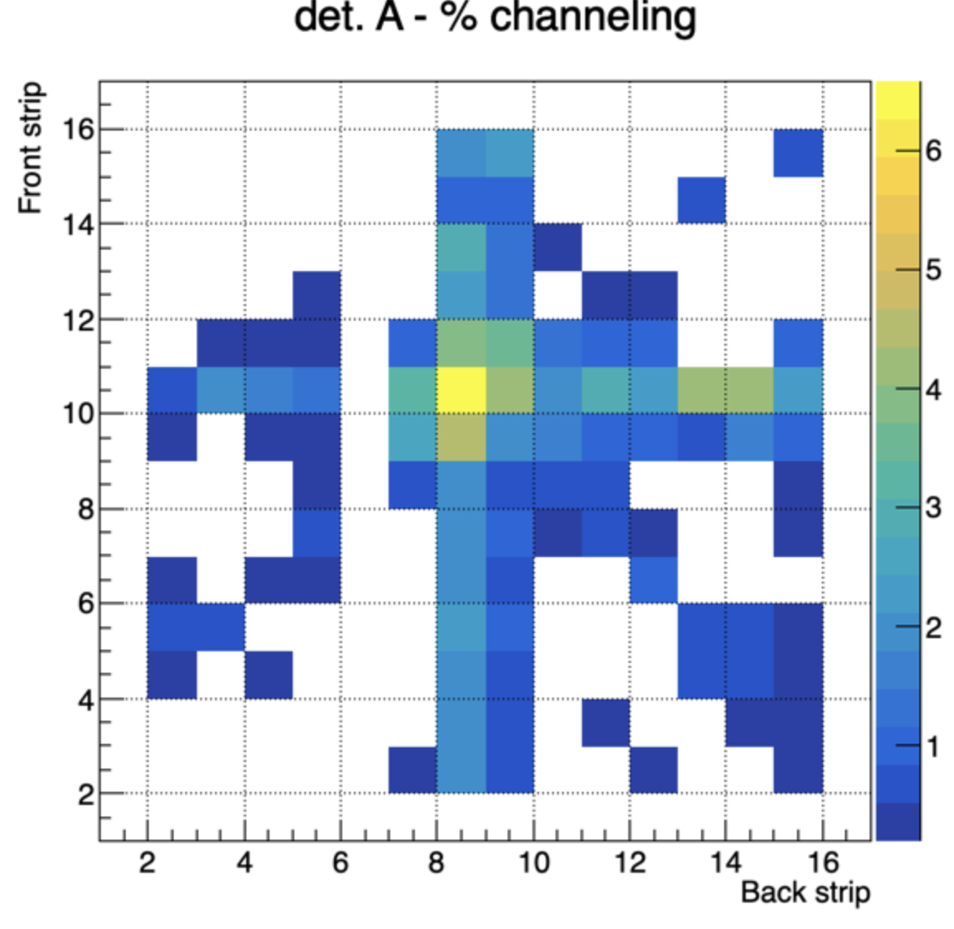
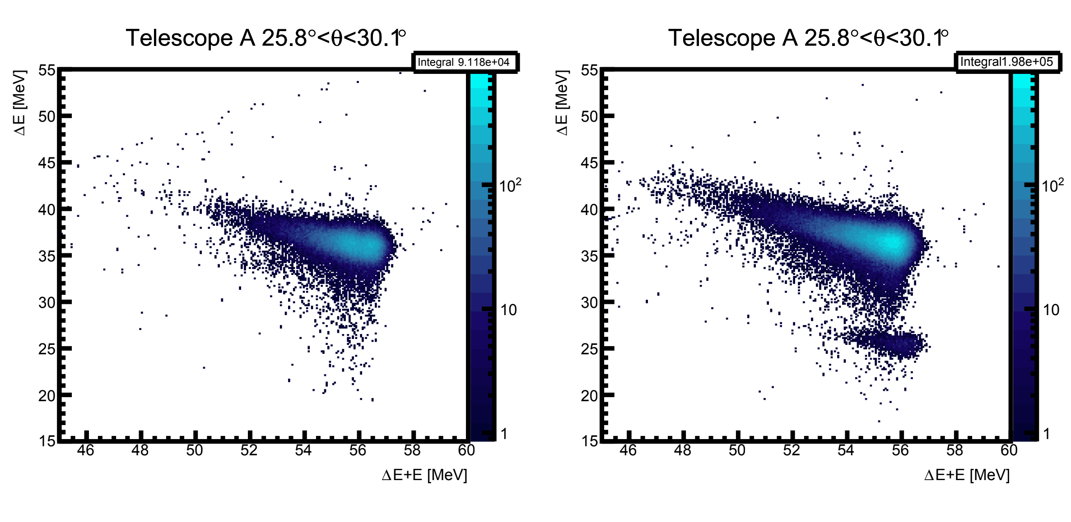
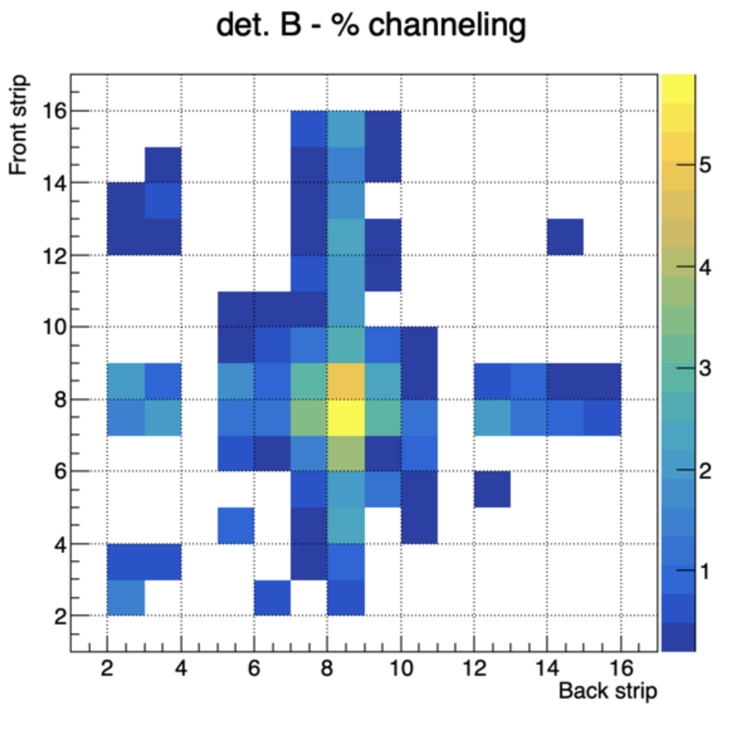
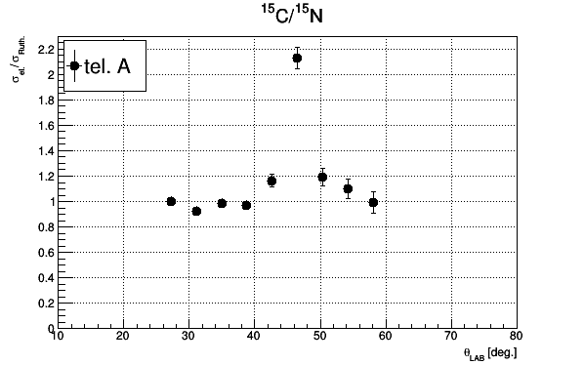
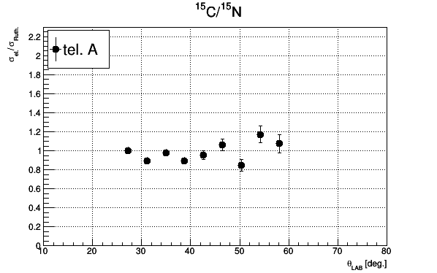
Channeling Effects
Channeling through Si lattice in ΔE detectors leads to a smaller energy deposition.
It happens in specific regions where the trajectory of the incident particle coincides with a channel of the detector wafer.
The channeling of ¹⁵N overlap with elastic of site of ¹⁵C
Channeling corrected
Vicente García Távora Instituto de Estructura de la Materia - CSIC
Notes:
On the other hand, one sees in the mass spectra that the channeling tail of 15N overlaps the carbon region, so this effect has to be corrected by using files with only nitrogen and estimating the amount of channeling overlapping on every pixel and substracting it to the counts of 15C one integrates in the elastic cut.
We observe in the right side plots how if you do not consider this substraction, the ratio between the isotopes skyrockets at the points where the channeling is favored. This effect starts to be important in the moment where the amount of channeling is comparable to the amount of good C elastic events and we can see than at some points, we can even double the amount of carbon.
After substraction however the resulting trend is smoother and more realistic. Still the error introduced by this estimation needs to be calculated since in some regions the number of channeling counts is very small and, doing it pixel by pixel we can even get negative counts of carbon, which is clearly not possible, and by now, have been rejected.
The ffect is máximum in F10B8 reaching 6% of 15N events. Out of these two strips the effects is minor.. When reaches 6% is well above the 2% percentage of 15C versus 15N

