Slide 1




Highly-sensitive photodetachment spectroscopy in an MR-ToF device
Franziska Maria Maier
CERN PhD Student

Slide 2
Determination of the rms charge radius
Charge Radii:
Convey information about nuclear structure
Benchmark nuclear models
Notes:
Field shift: change in the neutron number leads to a different nuclear charge density
distribution which results in a shift in the energy of the fine structure state
Mass shift:, when adding or removing a neutron the mass of the nuclide changes and the energy of the fine structure state changes
due to the different motion of the nucleus in the center-of-mass system
N: accounts for differences in reduced mass of the 2 isotopes, only describes single valence electron systems accurately
S: additional shift due to electron correlations in multi-electrons systems, pure atomic effect caused by a correlated motion of the electron
Electron scattering and muonic X-ray spectroscopy: measure charge radii of stable nuclides, determine field and mass shift from King plot analysis
isomer: metastable state in which one or more nuclei occupy higher energy level than in the ground state

Slide 3
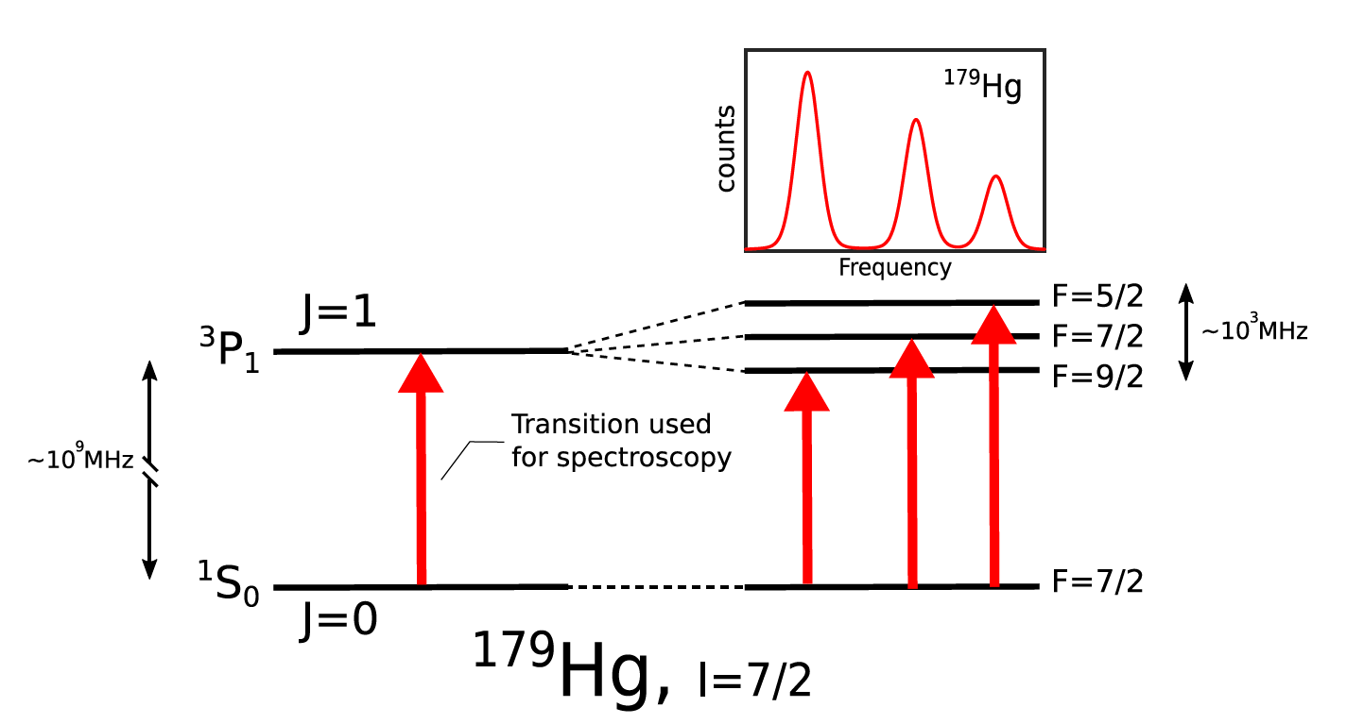
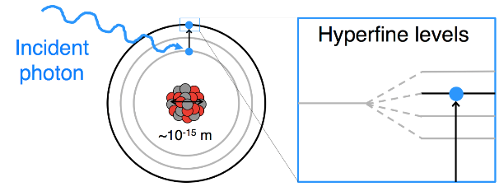
Determination of the rms charge radius
Charge Radii:
Convey information about nuclear structure
Benchmark nuclear models
Optical Laser Spectroscopy:
→ Measure isotope shifts in optical transitions
→ extract changes in nuclear rms charge radii
A
A’
Notes:
Field shift: change in the neutron number leads to a different nuclear charge density
distribution which results in a shift in the energy of the fine structure state
Mass shift:, when adding or removing a neutron the mass of the nuclide changes and the energy of the fine structure state changes
due to the different motion of the nucleus in the center-of-mass system
N: accounts for differences in reduced mass of the 2 isotopes, only describes single valence electron systems accurately
S: additional shift due to electron correlations in multi-electrons systems, pure atomic effect caused by a correlated motion of the electron
Electron scattering and muonic X-ray spectroscopy: measure charge radii of stable nuclides, determine field and mass shift from King plot analysis
isomer: metastable state in which one or more nuclei occupy higher energy level than in the ground state

Slide 4
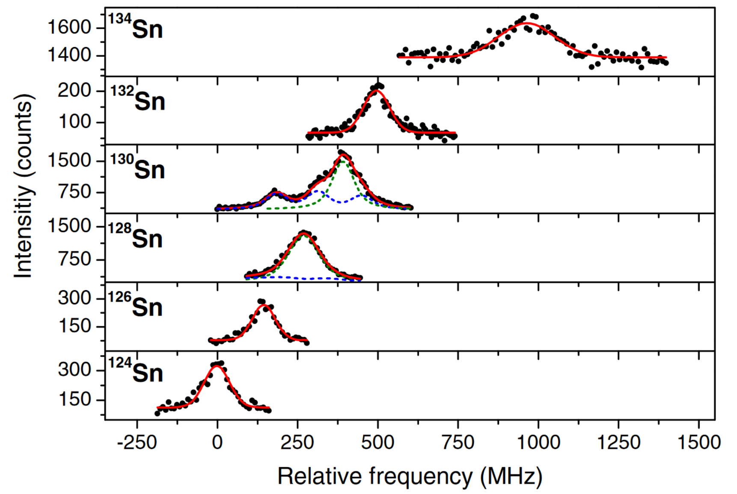
Determination of the rms charge radius
Charge Radii:
Convey information about nuclear structure
Benchmark nuclear models
Optical Laser Spectroscopy:
→ Measure isotope shifts in optical transitions
→ extract changes in nuclear rms charge radii
A
A’
C. Gorges et al, 122, 192502 (2019)
Notes:
Field shift: change in the neutron number leads to a different nuclear charge density
distribution which results in a shift in the energy of the fine structure state
Mass shift:, when adding or removing a neutron the mass of the nuclide changes and the energy of the fine structure state changes
due to the different motion of the nucleus in the center-of-mass system
N: accounts for differences in reduced mass of the 2 isotopes, only describes single valence electron systems accurately
S: additional shift due to electron correlations in multi-electrons systems, pure atomic effect caused by a correlated motion of the electron
Electron scattering and muonic X-ray spectroscopy: measure charge radii of stable nuclides, determine field and mass shift from King plot analysis
isomer: metastable state in which one or more nuclei occupy higher energy level than in the ground state

Slide 5
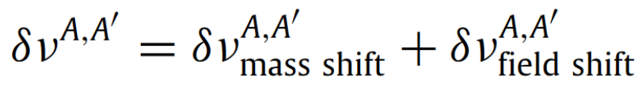
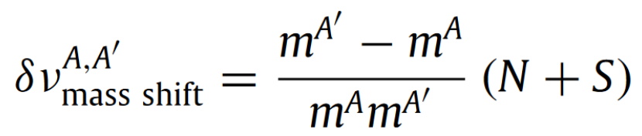
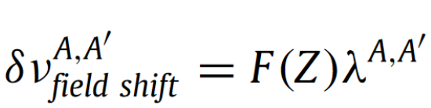

Determination of the rms charge radius
measured
Exactly calculable
Theoretically predicted, often a challenge for atomic theory
C. Gorges et al, 122, 192502 (2019)
P. Campbell et al., Progress in Particle and Nuclear Physics 86 (2016)
Notes:
Field shift: change in the neutron number leads to a different nuclear charge density
distribution which results in a shift in the energy of the fine structure state
Mass shift:, when adding or removing a neutron the mass of the nuclide changes and the energy of the fine structure state changes
due to the different motion of the nucleus in the center-of-mass system
N: accounts for differences in reduced mass of the 2 isotopes, only describes single valence electron systems accurately
S: additional shift due to electron correlations in multi-electrons systems, pure atomic effect caused by a correlated motion of the electron
Electron scattering and muonic X-ray spectroscopy: measure charge radii of stable nuclides, determine field and mass shift from King plot analysis
isomer: metastable state in which one or more nuclei occupy higher energy level than in the ground state

Slide 6
Precise knowledge of specific mass shift S is important for nuclear structure studies.
Accurate calculations of S are required to extract nuclear charge radii from measurable total optical isotope shifts
S is caused by a correlated motion of the electrons
→ pure atomic effect
Negative ions:
  Sensitive probes for electron-electron correlation studies
Notes:
If one wants to study e-e corr to benchmark atomic models, one needs to find a system where they are dominant.
So let us now talk about neg. ions.

Slide 7
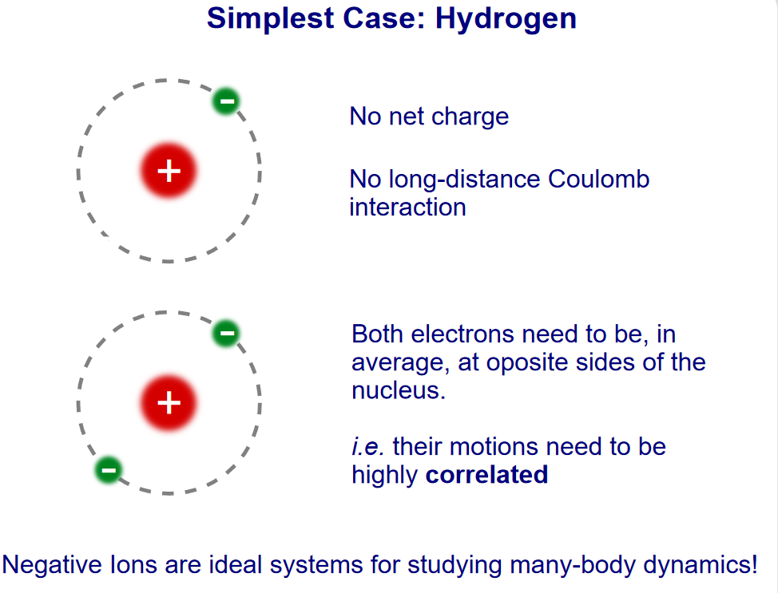
Negative ions are sensitive probes for electron-electron correlation studies.
Coulomb potential of nucleus almost fully screened
Prone to electron-electron correlations
Validation of atomic theory beyond single particle model

Slide 8
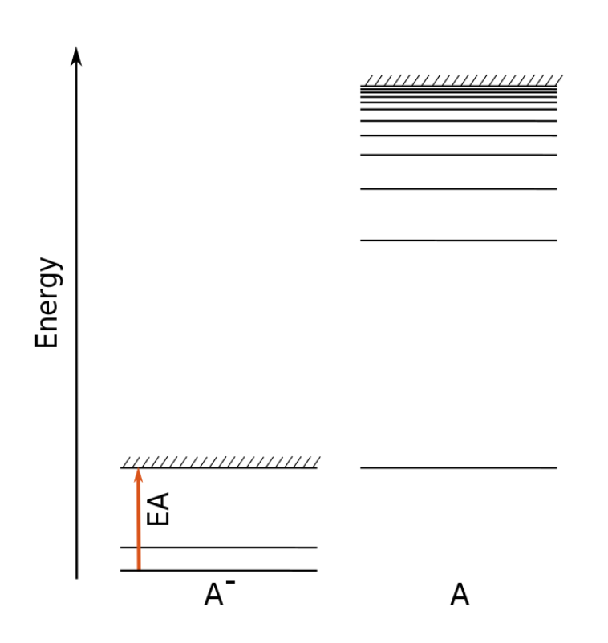
Negative ions are sensitive probes for electron-electron correlation studies.
Coulomb potential of nucleus almost fully screened
Prone to electron-electron correlations
Validation of atomic theory beyond single particle model
Very few or no bound electronic states
Optically allowed transitions only observed in very few atoms
Often only observable:
Electron Affinity EA:
Binding energy of additional electron of a negative ion (around 1 eV)
Notes:
Atomic spectrum of neutral atom: several bound states, many optical transitions possible
Typical atomic spectrum of neg. ion: few or no excited states, only ground state

Slide 9
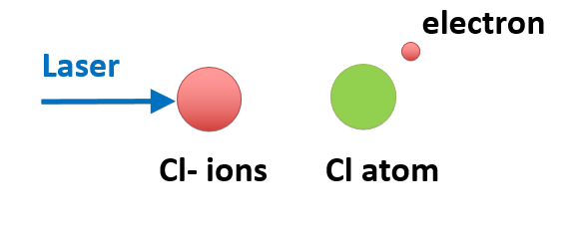
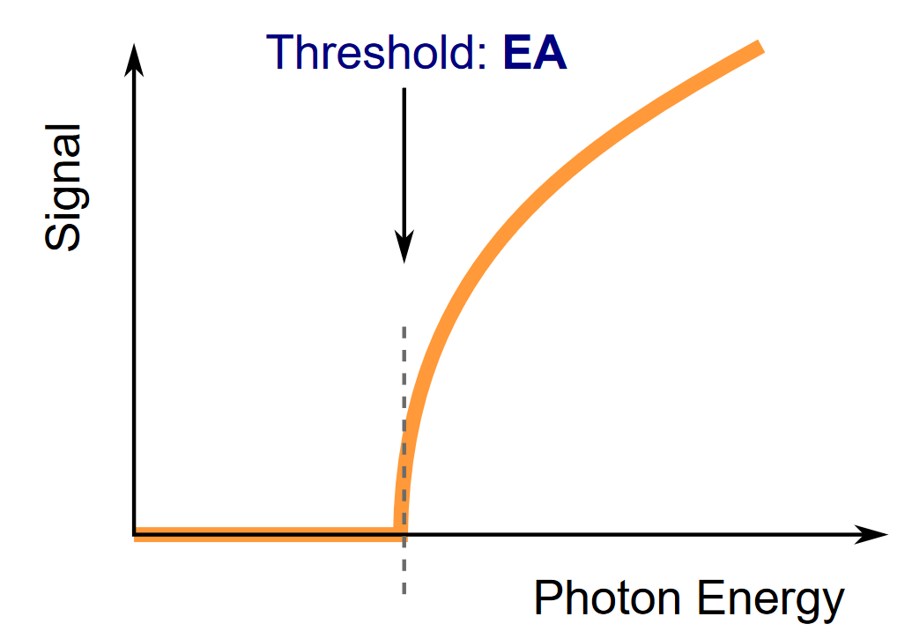
Laser Photodetachment Threshold Spectroscopy allows to measure the EA.
Cross section σ follows Wigner threshold law
Doppler corrected threshold yields the EA

Slide 10
Laser Photodetachment Threshold Spectroscopy allows to measure the EA.
Cross section σ follows Wigner threshold law
Doppler corrected threshold yields the EA
But: very low photodetachment probability around threshold

Slide 11
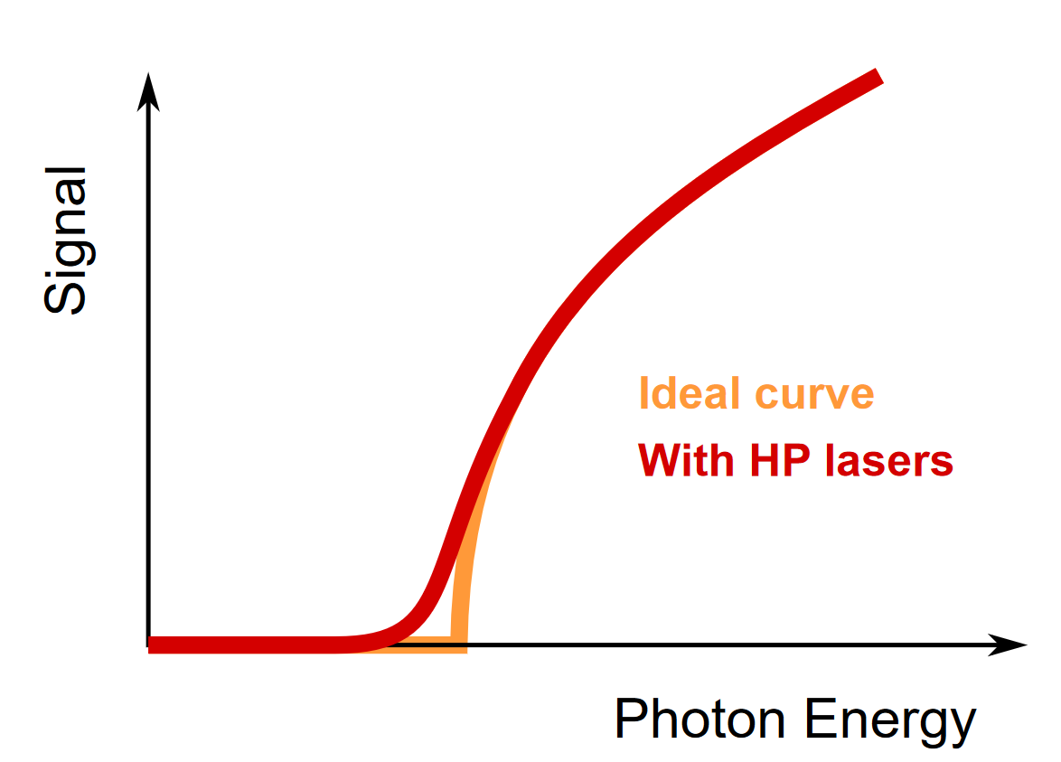
Pulsed high power lasers limit precision.
Very low photodetachment probability around threshold
High photon density needed
Pulsed high-power lasers
Broad-band
Limited precision

Slide 12
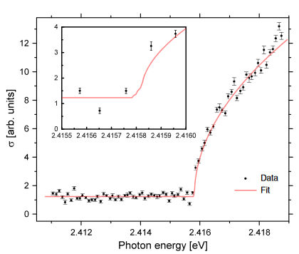
Pulsed high power lasers limit precision.
Very low photodetachment probability around threshold
High photon density needed
Pulsed high-power lasers
Broad-band
Limited precision
GANDALPH @ ISOLDE/CERN:
Successful EA measurements of At & I
radionuclide therapy of cancer
²¹¹At
Generally, rich multi-threshold structure from hyperfine splitting cannot be seen
D. Leimbach et al., Nat Commun 11, 3824 (2020).
S. Rothe et al., Journal of Physics G 44(10): 104003 (2017).

Slide 13
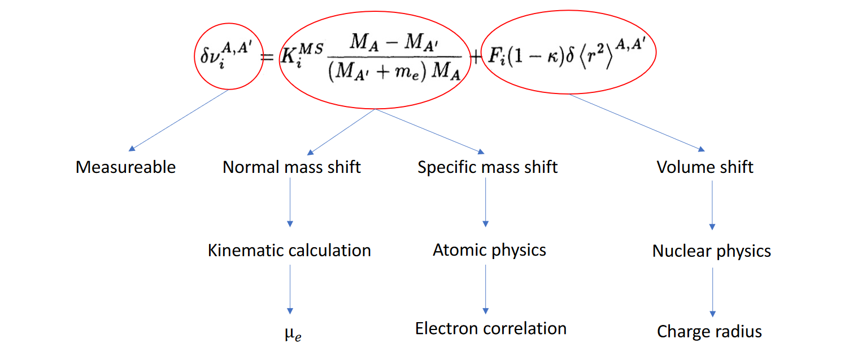
Pulsed high power lasers limit precision.
Isotope Shifts in the EA → benchmark atomic models
U. Berzinsh, et al. Phys. Rev. A 51, 231 (1995)
Carette & Godefroid J. Phys. B: 46 (2013)
Notes:
Look at things we can barely do.

Slide 14
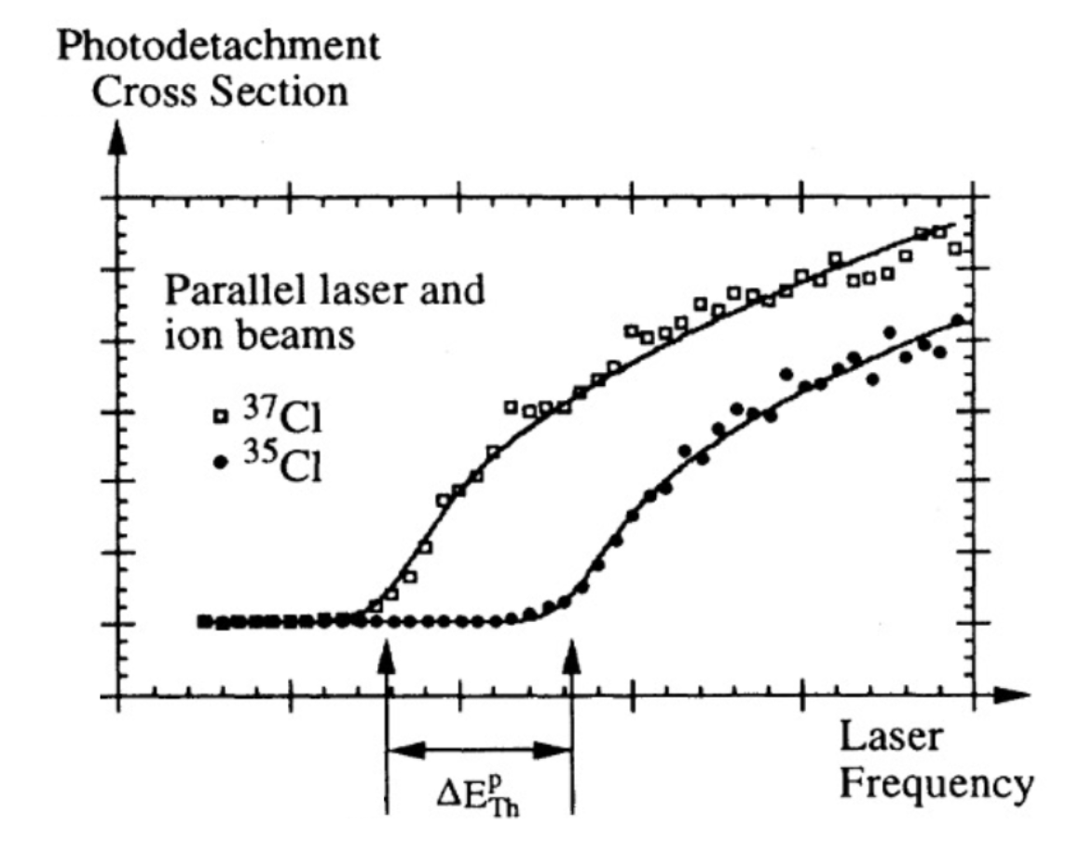
Pulsed high power lasers limit precision.
Isotope Shifts in the EA of ^{35,37}Cl:
Most bound negative ion
0.22(14) GHz
Laser-bandwidth: 4.3 GHz
U. Berzinsh, et al. Phys. Rev. A 51, 231 (1995)
Carette & Godefroid J. Phys. B: 46 (2013)

Slide 15
Pulsed high power lasers limit precision.
Isotope Shifts in the EA of ^{35,37}Cl:
Most bound negative ion
0.22(14) GHz = 0.74 GHz – 0.51(14) GHz + 0.014(14) GHz
Laser-bandwidth: 4.3 GHz
U. Berzinsh, et al. Phys. Rev. A 51, 231 (1995)
Carette & Godefroid J. Phys. B: 46 (2013)
Notes:
Very few cases in which theory claims to be more accurate than experiment. Higher precision needed to benchmark theory.

Slide 16
Pulsed high power lasers limit precision.
Isotope Shifts in the EA of ^{35,37}Cl:
Most bound negative ion
0.22(14) GHz = 0.74 GHz – 0.51(14) GHz + 0.014(14) GHz
Laser-bandwidth: 4.3 GHz
Theory: - 0.535(51) GHz
More precisely predicted in theory than experimentally measured
U. Berzinsh, et al. Phys. Rev. A 51, 231 (1995)
Carette & Godefroid J. Phys. B: 46 (2013)
Notes:
Very few cases in which theory claims to be more accurate than experiment. Higher precision needed to benchmark theory.

Slide 17
Electron affinity (EA) and isotope shift measurements of the EA:
Further constrain atomic models for accurate calculations of S needed for nuclear structure studies
  Demand for better precision as e.g. achievable with narrow-band continuous-wave lasers (with lower laser power)
→ Sensitivity boost is required
Notes:
100 kHz linewidth

Slide 18
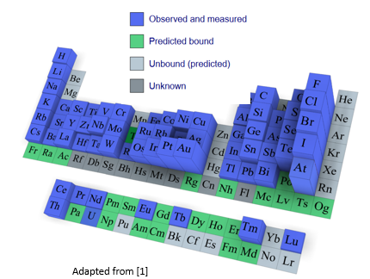
Electron affinity (EA) and isotope shift measurements of the EA:
Further constrain atomic models for accurate calculations of S needed for nuclear structure studies
  Demand for better precision as e.g. achievable with narrow-band continuous-wave lasers (with lower laser power)
Important benchmark for atomic models describing electron-correlation effects for chemistry and atomic physics
  Demand for measurement of scarcely produced (radioactive) elements and isotopes
→ Sensitivity boost is required
[1] D. Leimbach et al. Nat Commun 11, 3824 (2020).
Notes:
We can additionally serve community in a broader way by measuring EA of elements that have not been measured at all so far.

Slide 19

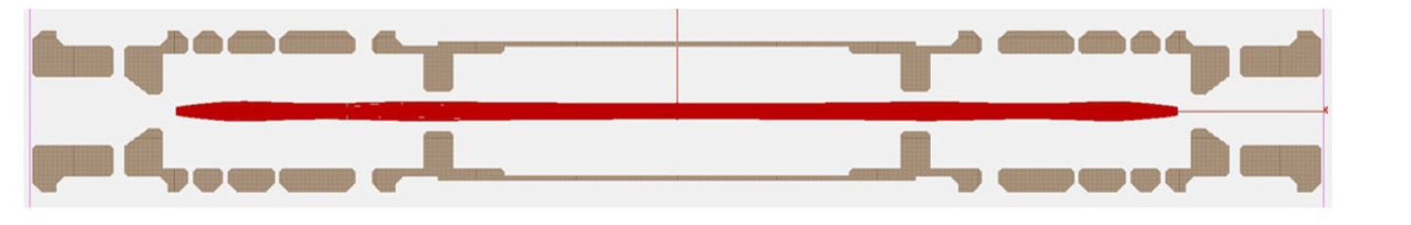
Laser Photodetachment Threshold Spectroscopy in an MR-ToF device
... Increase observation time
... sensitivity boost by reprobing same ion bunch
... CW lasers to increase precision
Electrostatic Mirror
Central Drift Tube
Electrostatic Mirror
ions
neutrals
neutrals

Slide 20
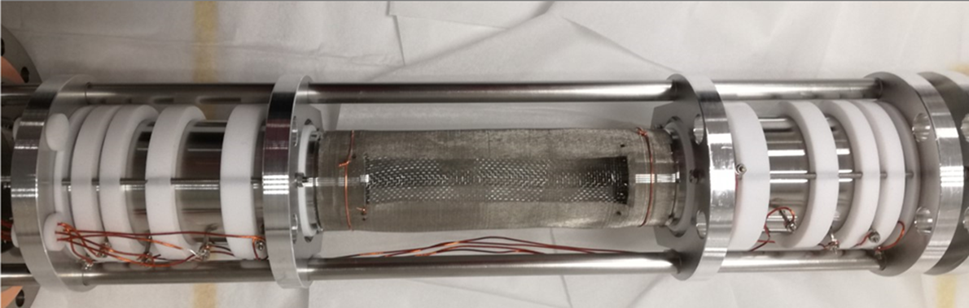
MR-ToF Device
Electrostatic Mirror
Central Drift Tube
Electrostatic Mirror
ions
neutrals
neutrals
Electrostatic mirror
Central Drift tube
Electrostatic mirror

Slide 21
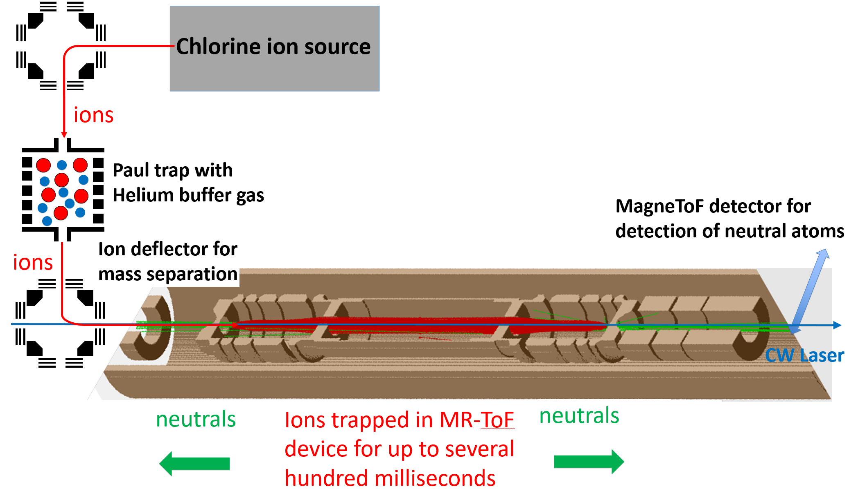
Laser Photodetachment Threshold Spectroscopy in an MR-ToF device
sensitivity boost by reprobing same ion bunch
CW laser to increase precision
Chlorine ion source: PhD Thesis D. Leimbach (2021).
Remaining setup: modified MIRACLS low-energy setup, see e.g.
F. Maier et al., Hyperfine Interact. 240, 54 (2019).
S. Sels et al., Nucl. Instr. Meth. Phys. Res. B 463, 310 (2020).
V. Lagaki et al., Nucl. Instr. Meth. Phys. Res. A 1014, 165663 (2021).

Slide 22
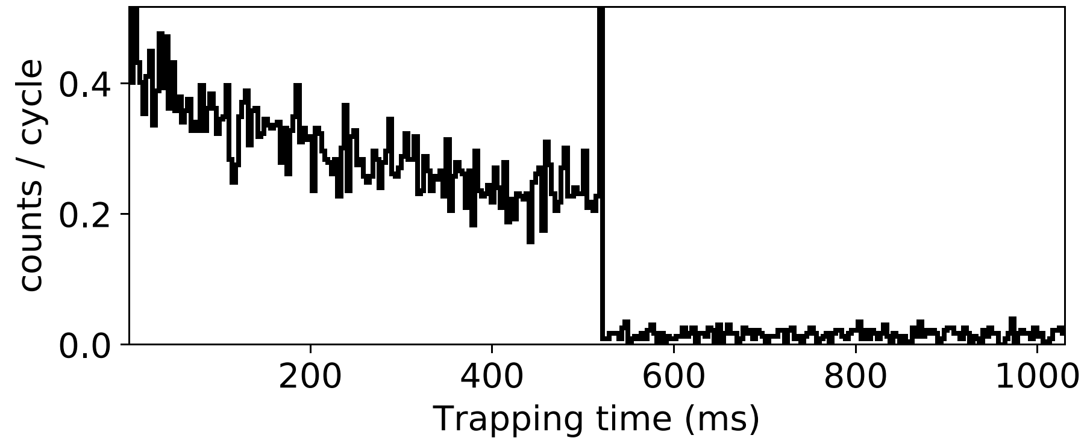
Measurement Scheme
Trap opened:
Ions released
Observation time (ms)
Trap full and closed:
Neutrals + background
Trap empty:
Background only

Slide 23
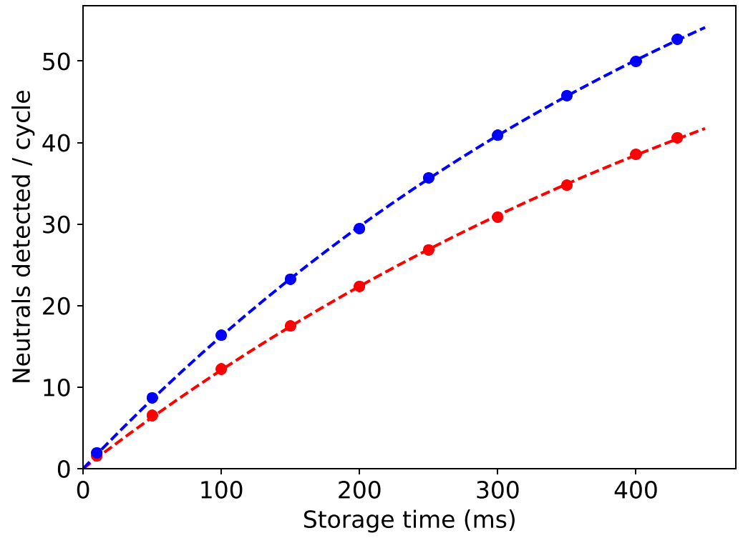
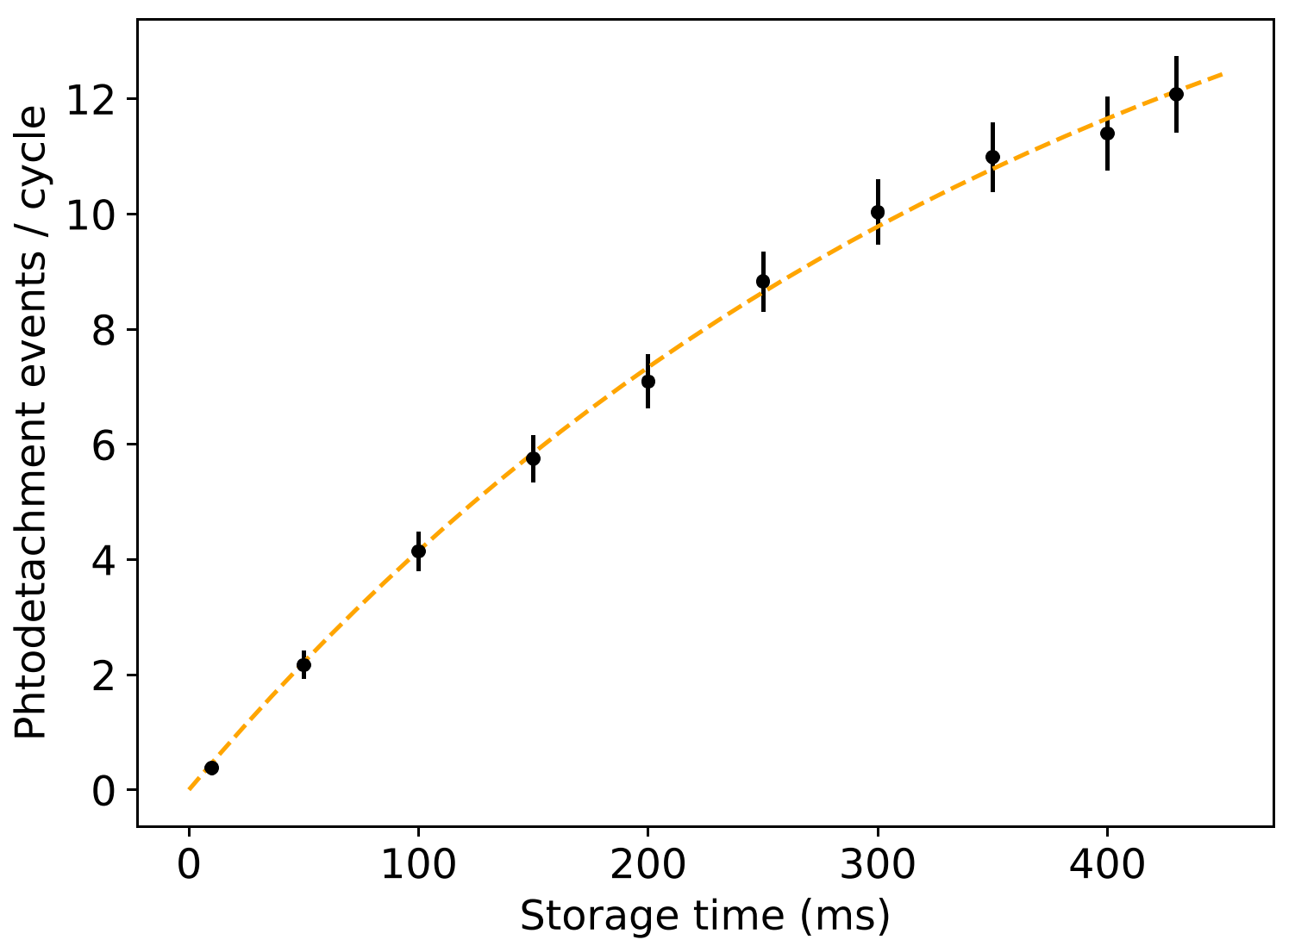
Signal Growth over Trapping Time
338.445 nm, 4.45 mW
Laser on
Additional neutralization due to photodetachment
Laser off
Neutralization through residual gas collisions
Trap half-life: 400 ms,
to be increased by improving vacuum quality
Boost in signal sensitivity by > 1000 compared to conventional single-pass experiments

Slide 24
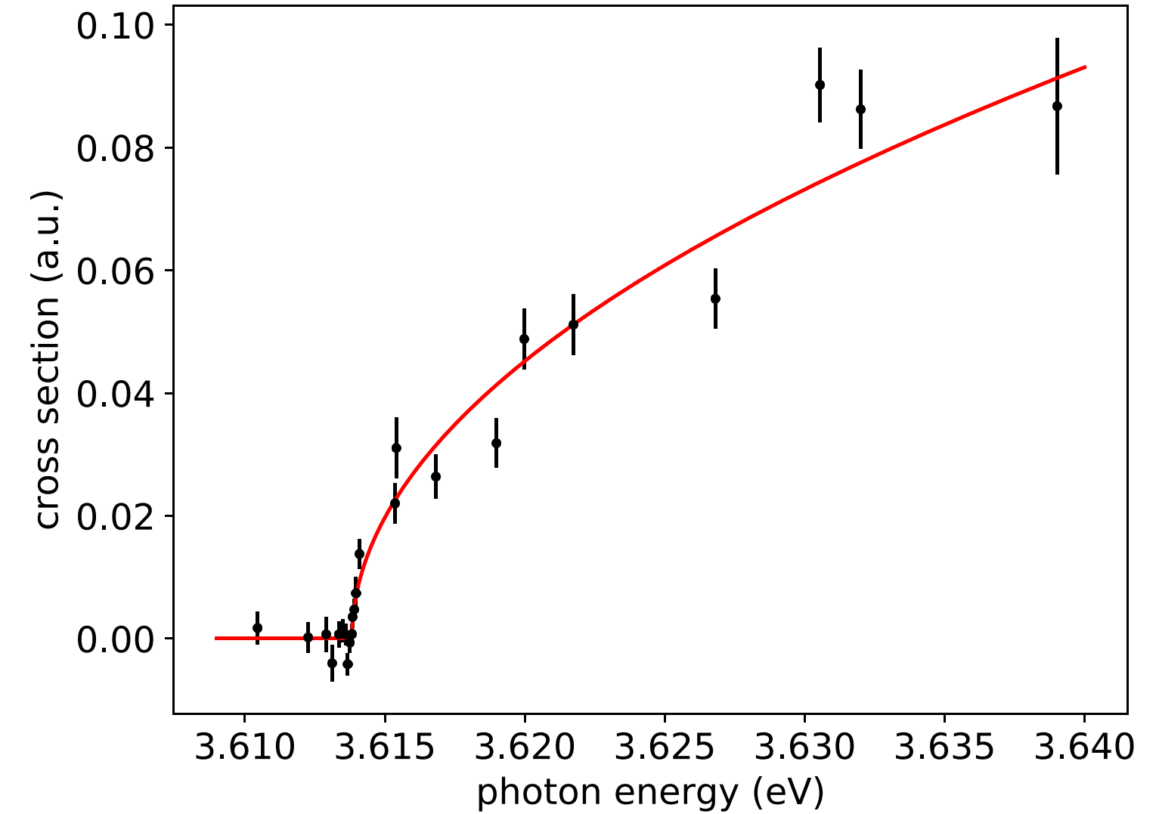
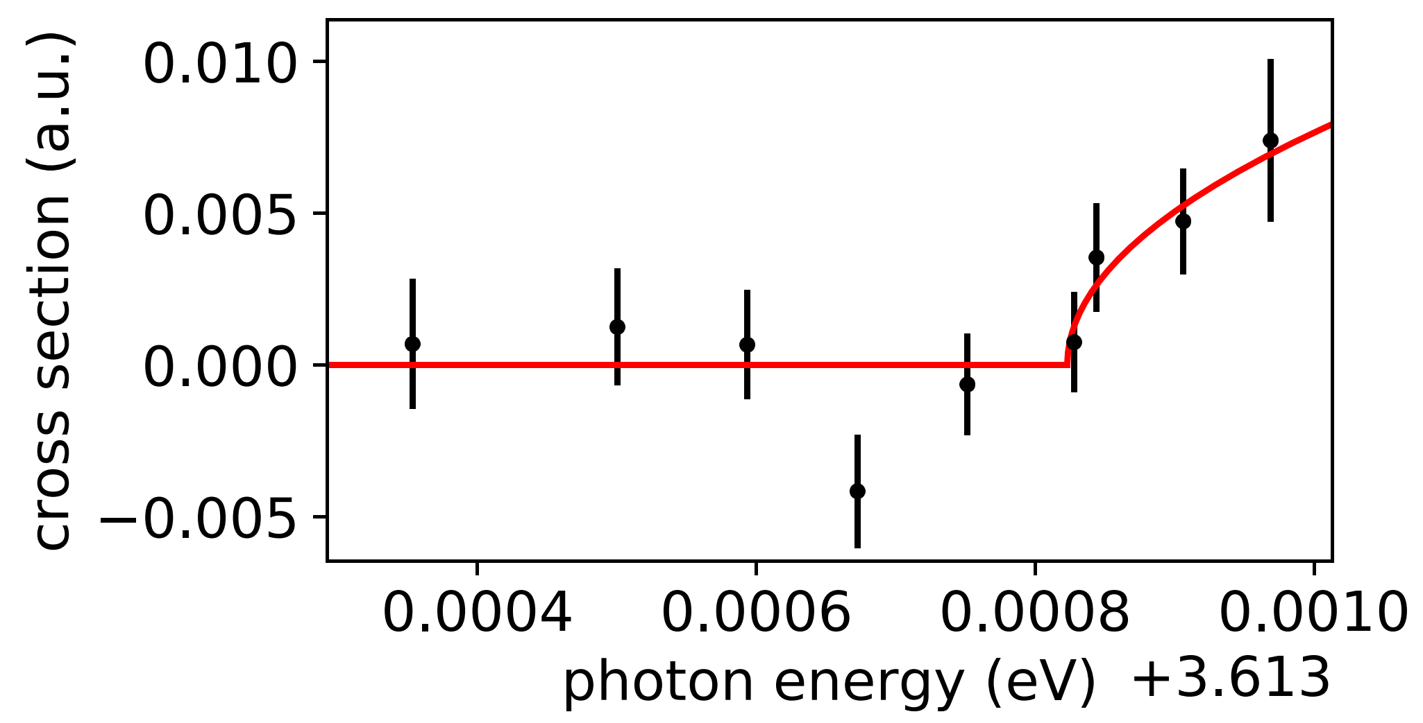
First photodetachment threshold curve in an MR-ToF device
³⁵Cl
~2 mW laser power,
520 ms storage time
Preliminary
Threshold value in perfect agreement with literature [1], eventually exceeding its precision(*)
(*) Measurements completed early August 2022, systematic effects not yet fully characterized
[1] U. Berzinsh et al., Phys. Rev. A 51, 231(1995).

Slide 25
Summary and Outlook Photodetachment
Show boost in signal sensitivity
Obtain laser photodetachment curve for ³⁵Cl
Measure EA isotope shift between ^{35,37}Cl more precisely
Measure EA isotope shift to long-lived ³⁶Cl for the very first time
Online measurements of a variety of radioactive samples in a dedicated MR-ToF setup coupled to a radioactive ion beam facility such as ISOLDE

Slide 26
Summary and Outlook Photodetachment
Show boost in signal sensitivity
Obtain laser photodetachment curve for ³⁵Cl
Measure EA isotope shift between ^{35,37}Cl more precisely
Measure EA isotope shift to long-lived ³⁶Cl for the very first time
Online measurements of a variety of radioactive samples in a dedicated MR-ToF setup coupled to a radioactive ion beam facility such as ISOLDE
Further constrain atomic models for accurate calculations of S needed for nuclear structure studies
Benchmark for atomic models describing electron-correlation effects for chemistry and atomic physics

Slide 27
Conclusions & Outlook
Negative ions are sensitive probes to study electron-electron correlation effects.
… same ion bunch can be probed for 10,000s of times
... increased observation time
... increased experimental signal sensitivity
… increased precision when combined with CW lasers
Highly sensitive/high-precision measurements of the electron affinity and isotope shifts in the EA of various radioactive negative ions for the very first time
Important benchmark for theoretical models to e.g. decrease the uncertainty on the specific mass shift

Slide 28
Conclusions & Outlook
Negative ions are sensitive probes to study electron-electron correlation effects.
… same ion bunch can be probed for 10,000s of times
... increased observation time
... increased experimental signal sensitivity
… increased precision when combined with CW lasers
Highly sensitive/high-precision measurements of the electron affinity and isotope shifts in the EA of various (radioactive) negative ions, often for the very first time
Important benchmark for theoretical models to e.g. decrease the uncertainty on the specific mass shift
Other programs @ MIRACLS:
Fluorescence-based collinear laser spectroscopy for the study of rms charge radii of the most exotic radionuclides
Novel 30-keV MR-ToF device
Highly selective and high flux mass separation
Laser Cooling at Radioactive Ion Beam Facilities
F. Maier et al., Hyperfine Interact. 240, 54 (2019)
S. Lechner et al., Hyperfine Interact. 240, 95 (2019)
S. Sels et al., NIMB 463, 310 (2020)
V. Lagaki et al., Acta Physica Polonica Series B 51, 571 (2020)
V. Lagaki, H.Heylen et al., NIMA, 1014, 165663 (2021)
S. Sels, F. Maier et al., Phys. Rev. Research 4, 033229 (2022)
F. Maier, M.Vilen et al., submitted to NIMA (2022)

Slide 29
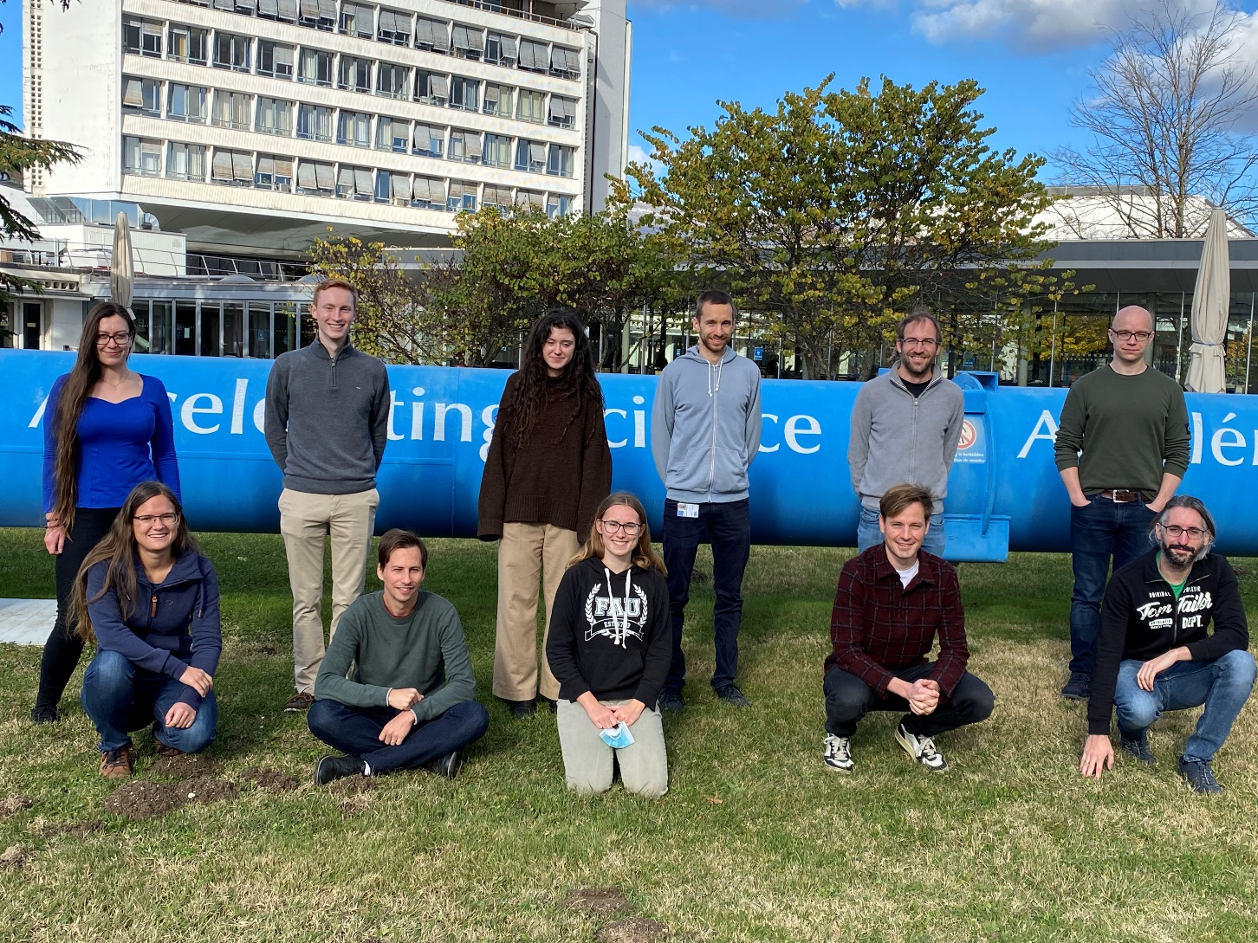
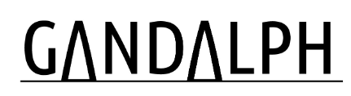


Thanks!
F.M. Maier (CERN, U. Greifswald)
E. Leistenschneider (CERN)
M. Au (CERN)
U. Berzinsh (U. Latvia)
D. Hanstorp (U. Gothenburg)
E. Ganzke (CERN)
V. Lagaki (CERN)
S. Lechner (CERN)
D. Leimbach (U. Gothenburg)
M. Nichols (U. Gothenburg)
P. Plattner (CERN)
M. Reponen (JYFL)
S. Rothe (CERN)
L. Schweikhard (U. Greifswald)
M. Vilen (CERN)
J. Warbinek (GSI)
S. Malbrunot-Ettenauer (CERN, TRIUMF)
https://miracls.web.cern.ch/

Slide 30
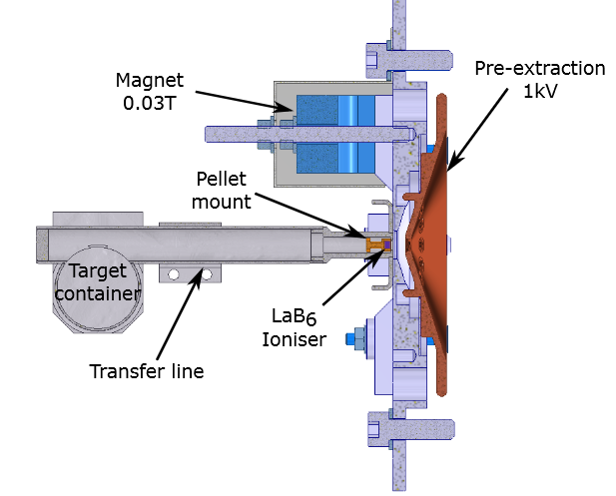
Chlorine Ion source
Pellet source
To deflect thermally emitted electrons onto electron catcher
^{35,37}Cl⁻
KCl salt is evaporated by resistive heating
Atoms diffusing out of target onto pellet can be surface ionized and are extracted as negatively charged ions.
PhD Thesis D. Leimbach (2021).
Notes:
lanthanum hexaboride

Slide 31
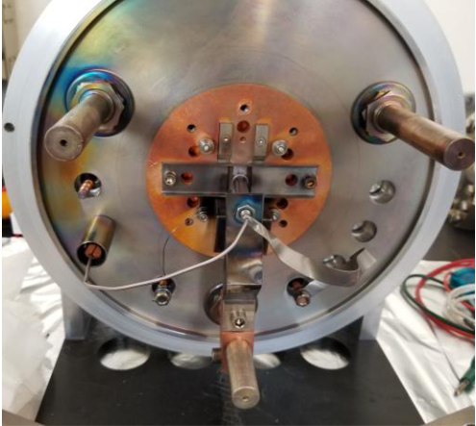
Chlorine Ion source
Pellet source
Tubular source
^{35,37}Cl⁻
To deflect thermally emitted electrons onto electron catcher
^{35,37}Cl⁻
Tantalum capillary tube with KCl salt
KCl salt is evaporated by resistive heating
Atoms diffusing out of target onto pellet can be surface ionized and are extracted as negatively charged ions.
Higher geometrical likelihood of neutral atoms interacting with LAB₆ ionizer
PhD Thesis D. Leimbach (2021).
Notes:
lanthanum hexaboride

Slide 32
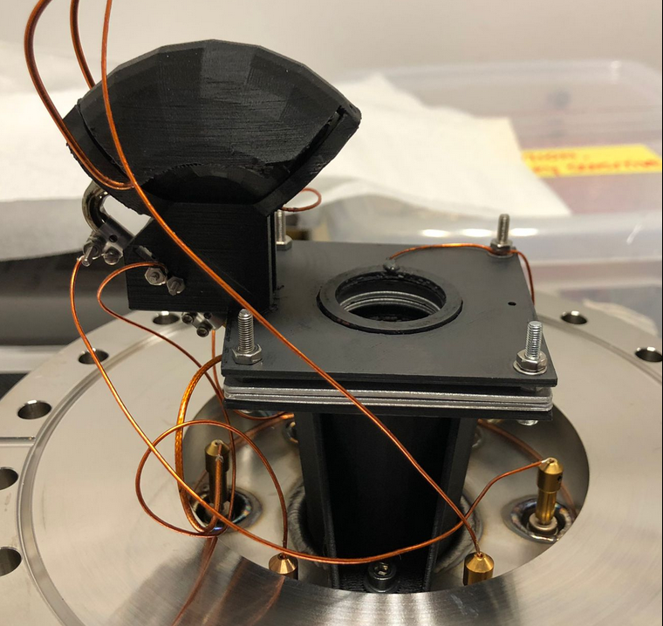
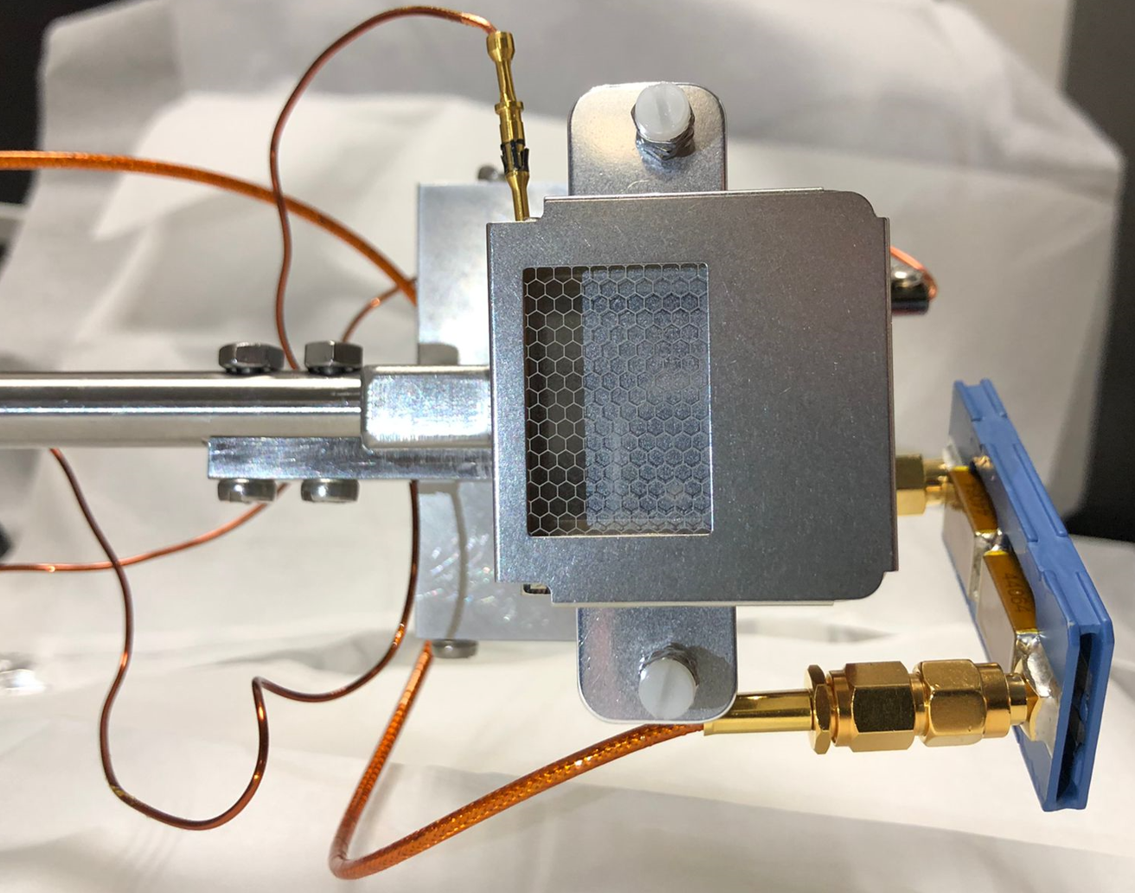
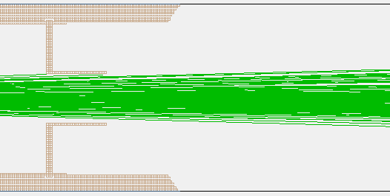
Neutral particle detection
Graphene-based neutral particle detector:
Slightly off-centered MagneToF detector:
MR-ToF device
modified to [1], e.g. coated with Graphite paint
laser
neutrals
not to scale
Retractable MagneToF detector
34% neutral detection efficiency
Advantage: much reduced laser-induced background
Disadvantage: No anticollinear measurements possible
Advantage: transparent for laser →
collinear& anticollinear measurements possible
Disadvantage: laser-induced background > 300 times larger compared to MagneToF detector
Used for measurements discussed here.
[1] J. Warbinek et al. Appl. Phys. Lett. 114, 061902 (2019)

Slide 33
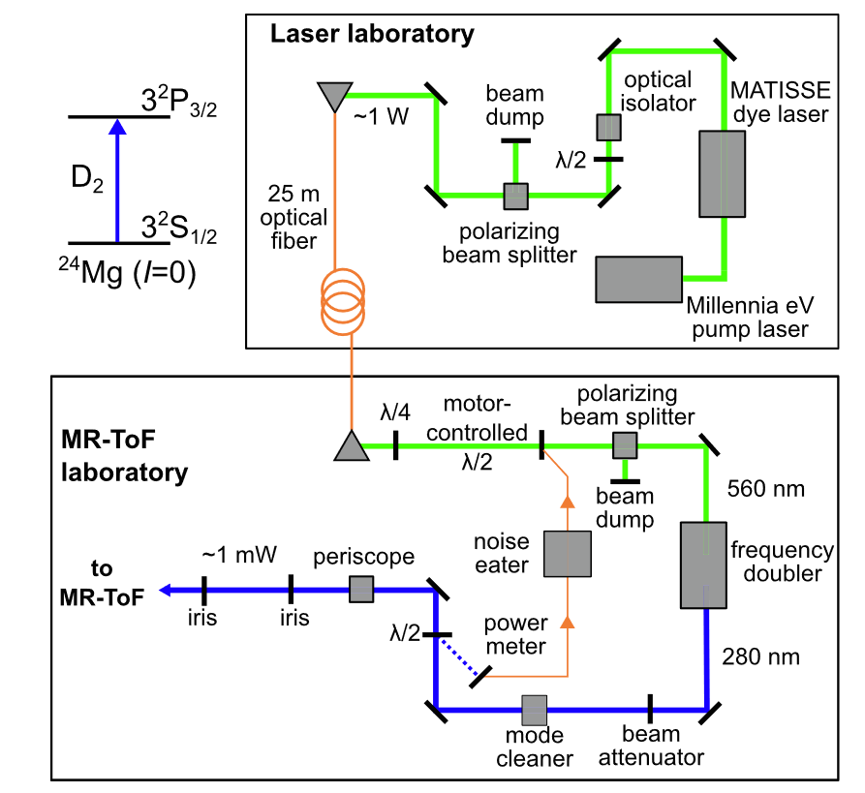
CW Laser Setup
Matisse dye laser with DCM dye: ~686 nm, ~1.5 W
Transport to MIRACLS low-energy lab by 25 m fibre with ca. 30% transmission efficiency
Frequency doubling by non-linear BBO crystal
~2 mW of ~343 nm CW sent into MR-ToF apparatus
S. Sels et al., Nucl. Instr. Meth. Phys. Res. B 463, 310 (2020)

Slide 34
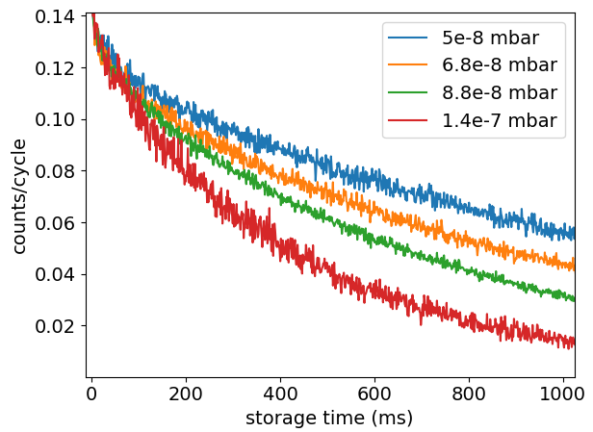
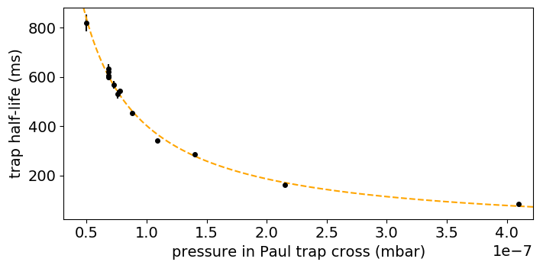
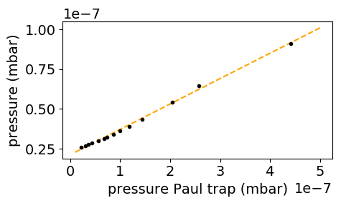
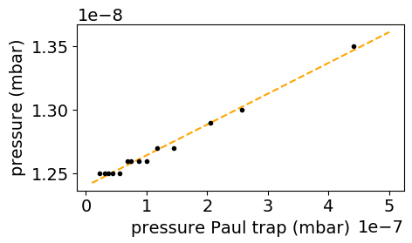
Neutralization due to residual gas collisions in MR-ToF device
… limit trap-half life
He pressure in Paul trap cross:
Before
MR-ToF device
After
MR-ToF device
Residual gas collisions will be reduced by installing more turbo pumps and a dedicated differential pumping section.

