Slide 1
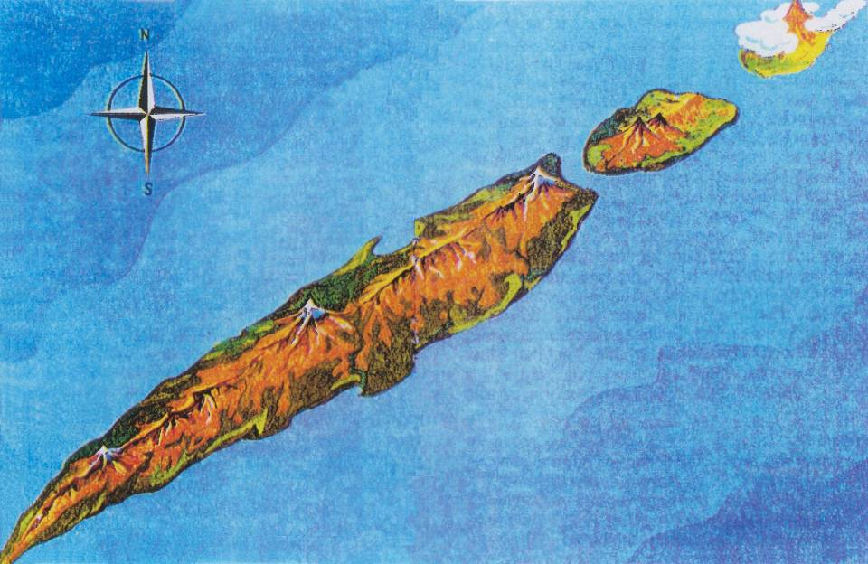
Fission Hindrances in transfermium nuclei
Introduction & motivation
Experimental details & results
Summary & perspectives
Flerov & Ilyinov (1986)

Slide 2
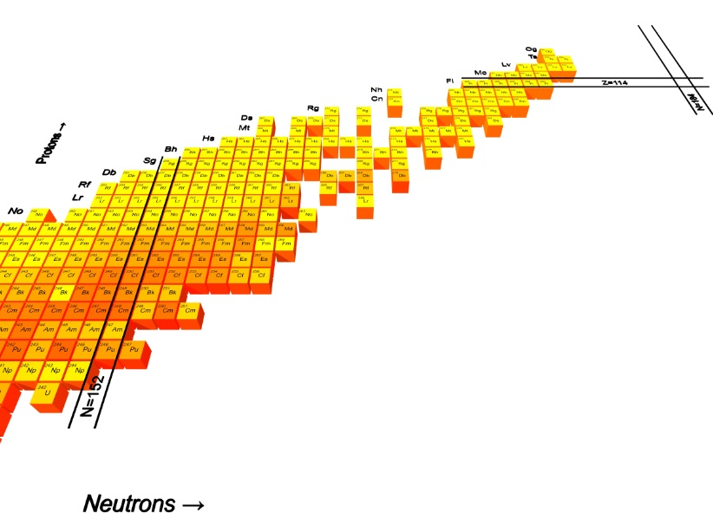
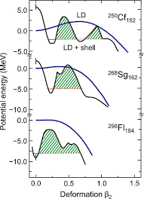
Super Heavy Nuclei
S. Hofmann, Radiochimica Acta 107 (2019) 879

Slide 3
Super Heavy Nuclei
S. Hofmann, Radiochimica Acta 107 (2019) 879
W. Ryssens & M. Bender private comm.

Slide 4
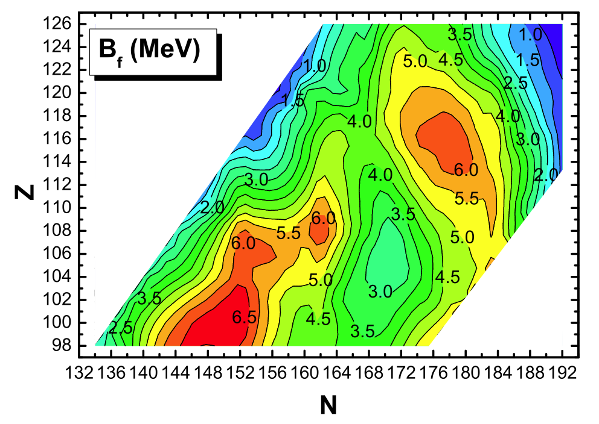
Systematics of Fission half-lives
Mic-Mac model calculations
A. Baran et al., Nucl. Phys. A. 944 (2015) 442
Notes:
MM model based on the single particle (SP) spectrum of a deformed Woods-Saxon potential
Macroscopic part: Yukawa + exponential model

Slide 5
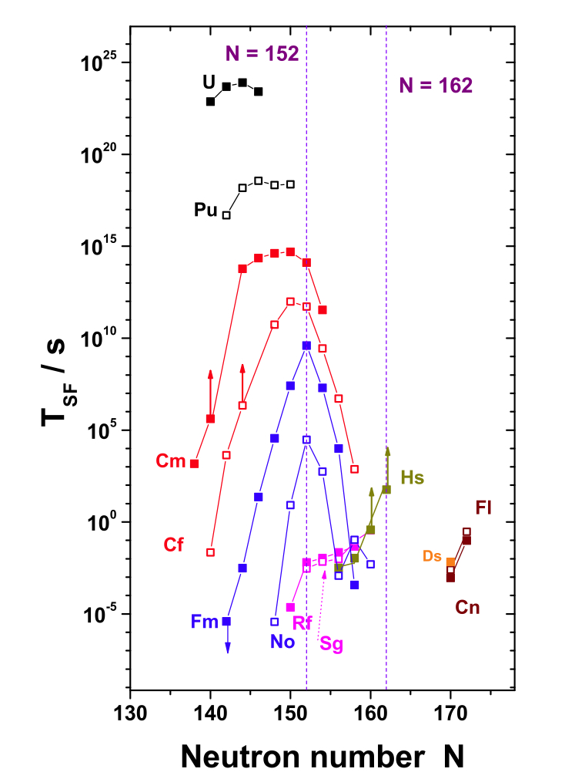
Systematics of Fission half-lives
Mic-Mac model calculations
A. Baran et al., Nucl. Phys. A. 944 (2015) 442
10 orders of magnitude drop from ²⁵⁴No to ²⁵⁰No
Shorter fission times in Rf because of the disappearance of the outer fission barrier
F.P. Hessberger, Eur. Phys. J. A (2017) 53: 75
Notes:
MM model based on the single particle (SP) spectrum of a deformed Woods-Saxon potential
Macroscopic part: Yukawa + exponential model

Slide 6
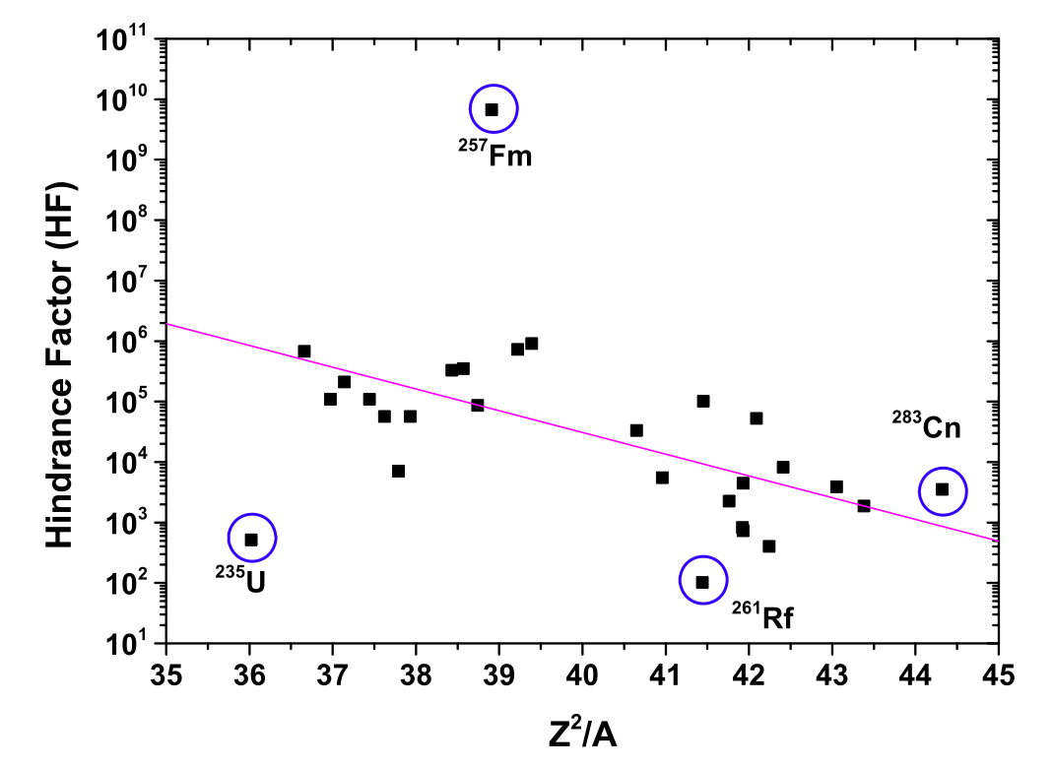
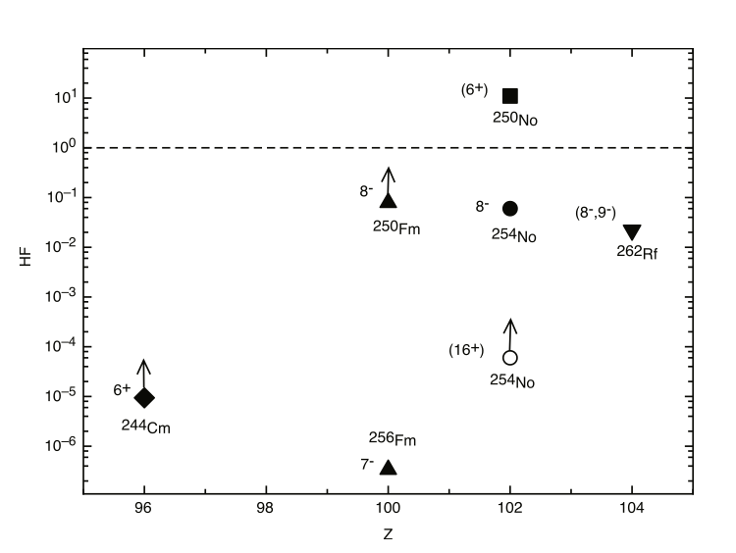
Fission hindrance
F. Kondev, G. Dracoulis and T. Kibedi, At. Dat. And Nucl. Dat. Tables 103-104 (2015) 50
HF(Z,N)= T_{oe}(Z,N)/T_{ee}(Z,N)
T_{ee}=(T(Z,N+1)xT(Z,N-1))^{1/2}
T_{ee}=(T(Z+1,N)x T(Z-1,N))^{1/2}
HF(Z,N)= T_{iso}(Z,N)/T_{gs}(Z,N)

Slide 7
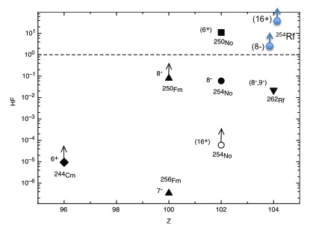
Fission hindrance
J. Khuyagbaatar et al., Phys. Rev. C106 (2022) 024309 : HF(²⁵⁰No) > 286
H. David et al., Phys. Rev. Lett. 115 (2015) 132502
J. Kallunkathariyil et al. Phys. Rev. C 101 (2020) 011301(R)
HF(Z,N)= T_{oe}(Z,N)/T_{ee}(Z,N)
T_{ee}=(T(Z,N+1)xT(Z,N-1))^{1/2}
T_{ee}=(T(Z+1,N)x T(Z-1,N))^{1/2}
HF(Z,N)= T_{iso}(Z,N)/T_{gs}(Z,N)

Slide 8
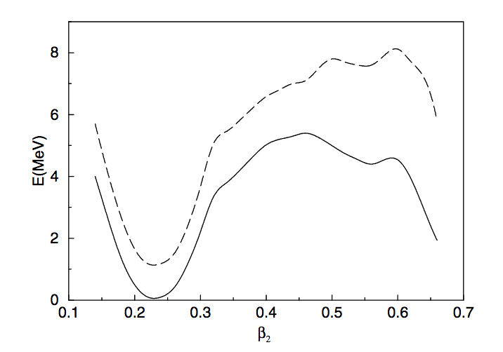
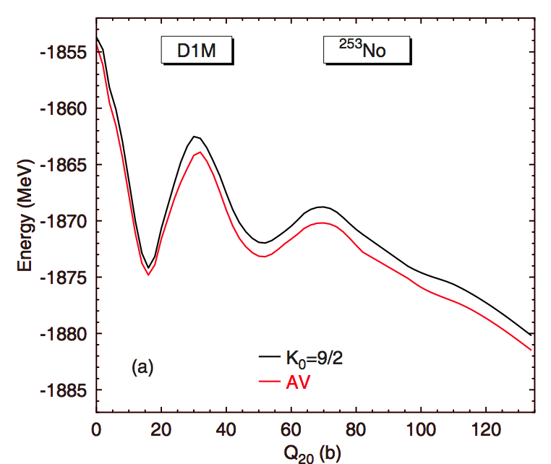
Qualitative theoretical understanding
Configuration-constrained PES calculation
F.R. Xu et al., Phys. Rev. Lett. 92 (2004) 252501
²⁵⁶Fm
7⁻
gs
HFB + blocking with D1M
R. Rodrıguez-Guzman and L.M. Robledo , Eur. Phys. J. A 52 (2016) 348

Slide 9
Qualitative theoretical understanding
Configuration-constrained PES calculation
F.R. Xu et al., Phys. Rev. Lett. 92 (2004) 252501
²⁵⁶Fm
7⁻
gs
Specialization energy
HFB + blocking with D1M
R. Rodrıguez-Guzman and L.M. Robledo , Eur. Phys. J. A 52 (2016) 348

Slide 10
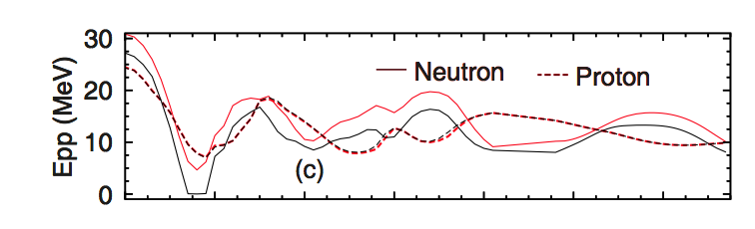
Qualitative theoretical understanding
Configuration-constrained PES calculation
F.R. Xu et al., Phys. Rev. Lett. 92 (2004) 252501
²⁵⁶Fm
7⁻
gs
Specialization energy
HFB + blocking with D1M
Reduced pairing
R. Rodrıguez-Guzman and L.M. Robledo , Eur. Phys. J. A 52 (2016) 348

Slide 11
Questions
Limits of the nuclear chart for neutron deficient Rf isotopes ?
Fission hindrance of the 8⁻ isomer in ²⁵⁴No ?

Slide 12
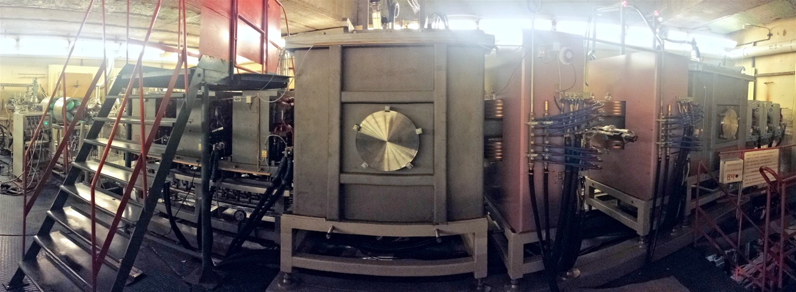
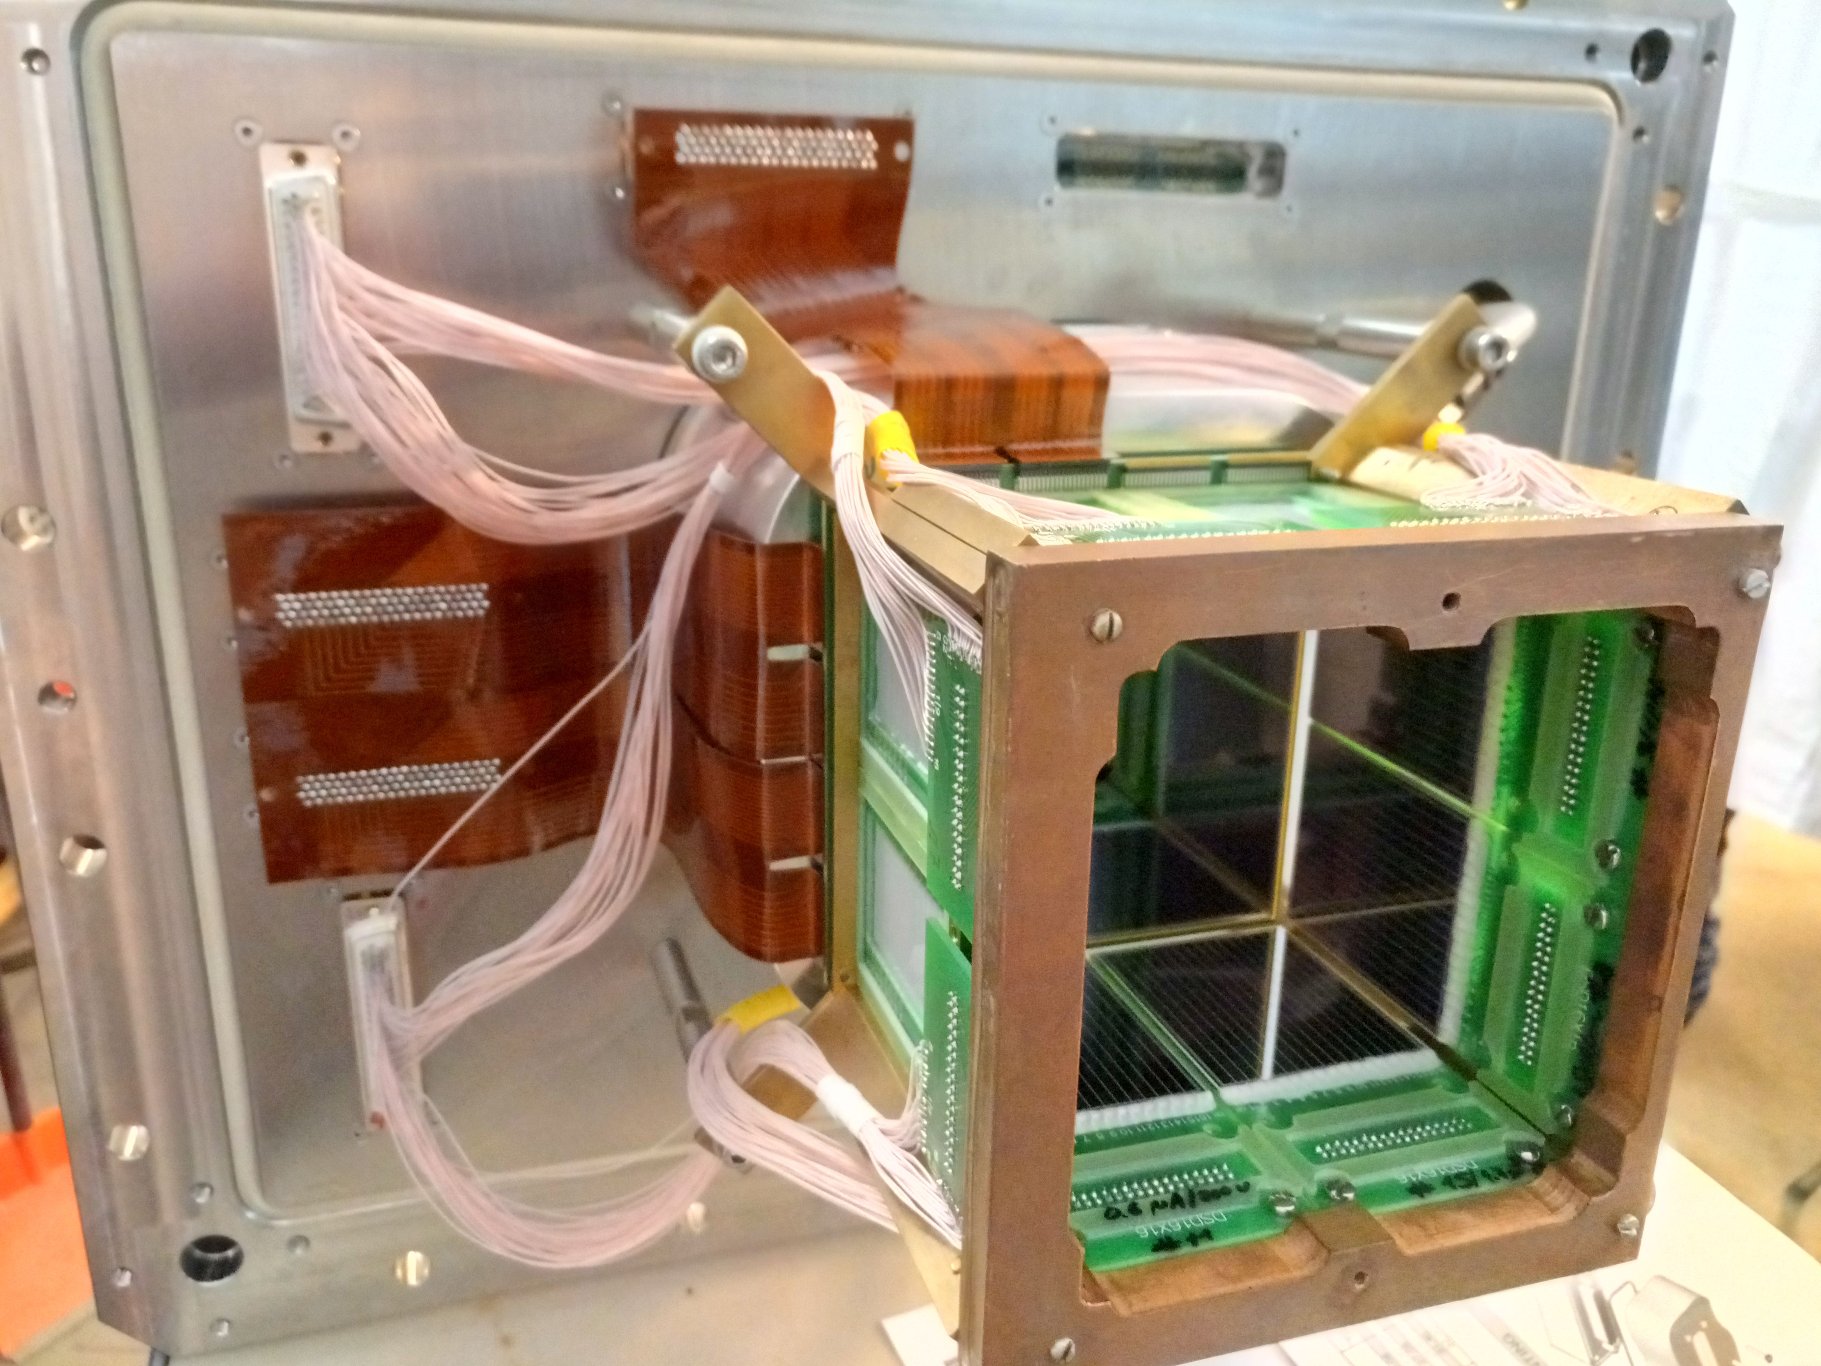
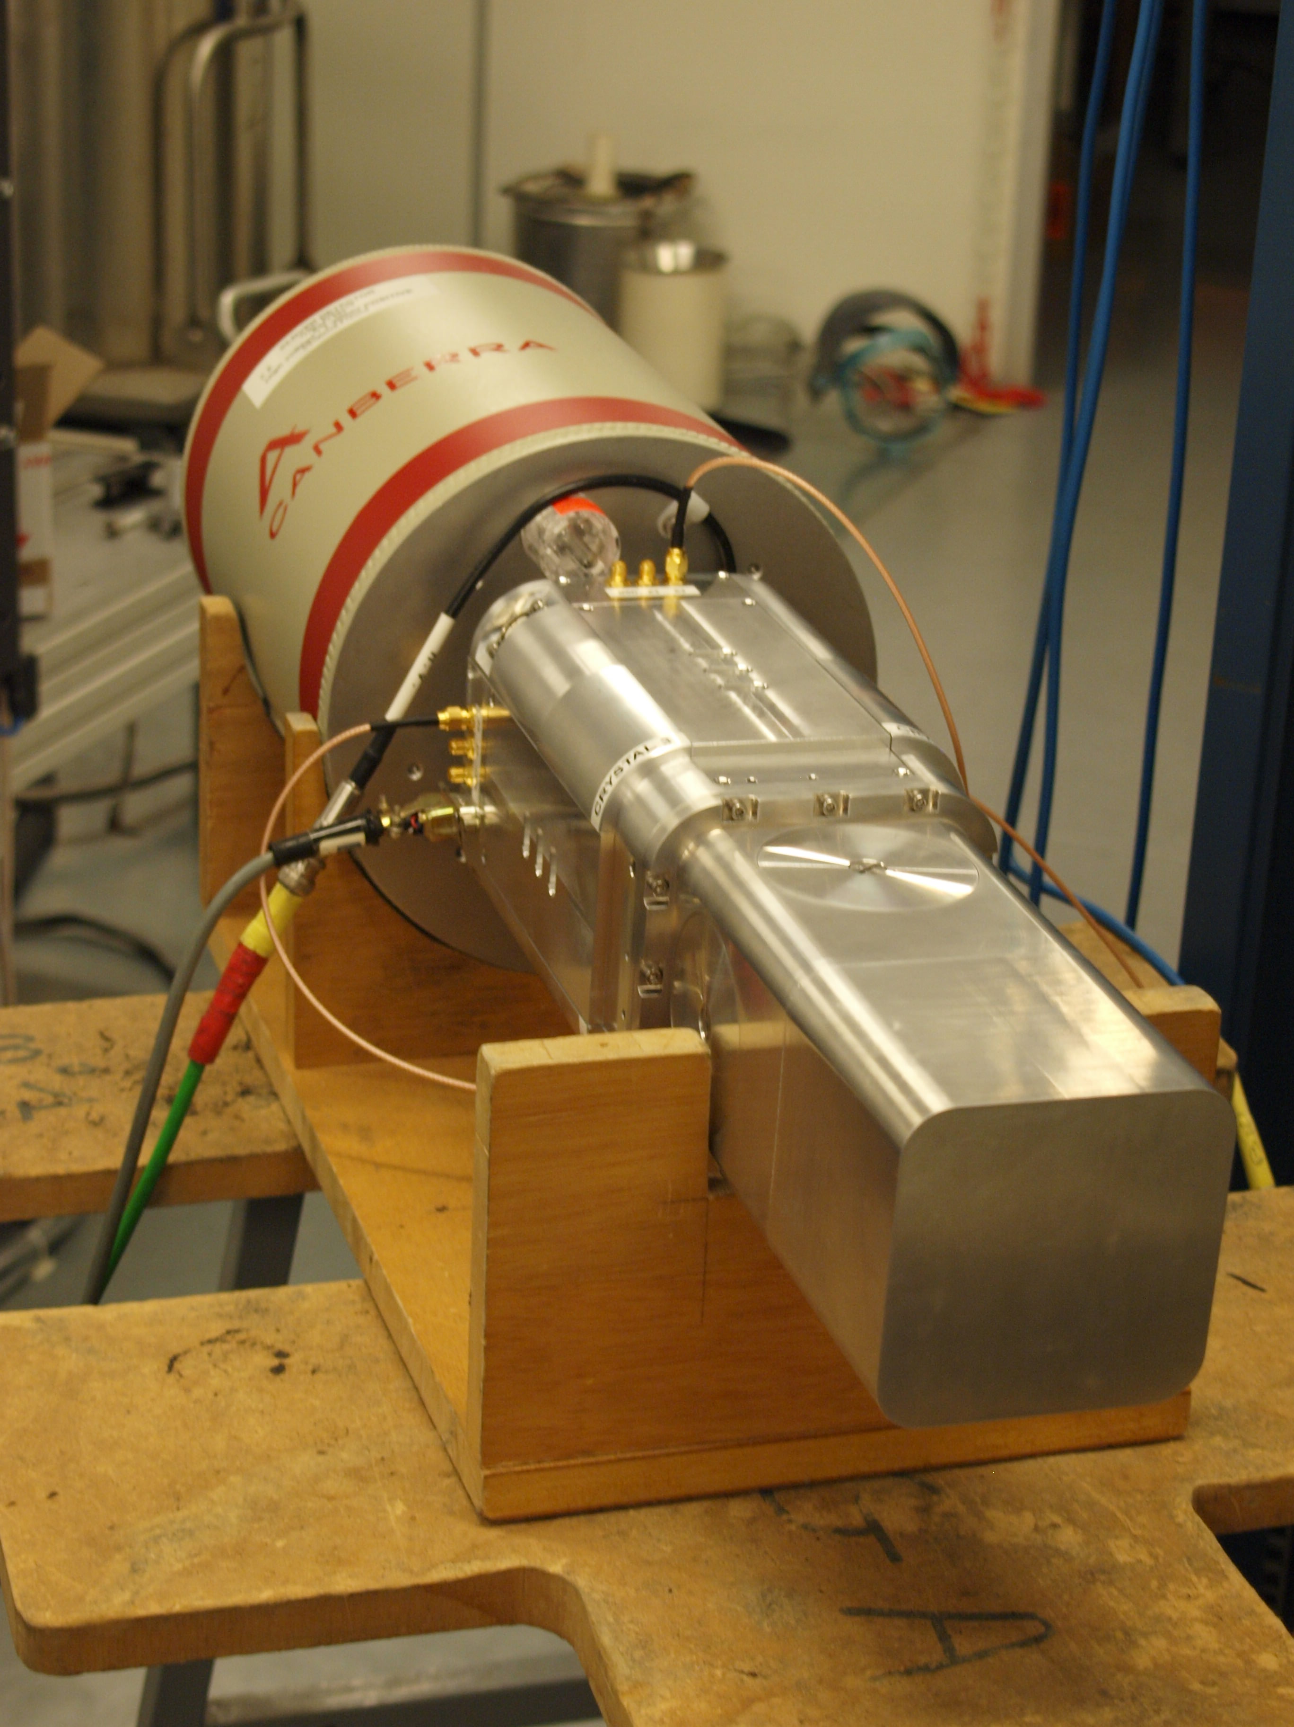
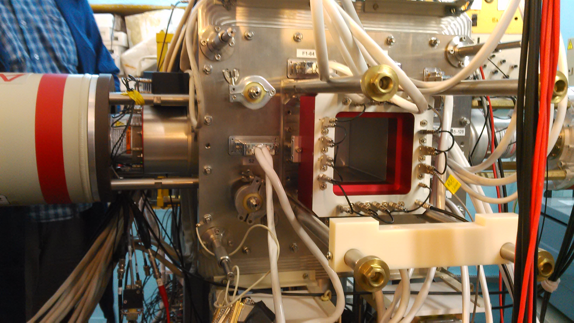
GABRIELA @ SHELS
SHELS
Rotating
target
concrete
wall
Focal plane
R. Chakma et al., Eur. Phys. J. A 56 (2020) 245
ToF
fission
γ
SHELS
α
Intense
beam
ICE
8º
magnet
Triggerless
detector array
GABRIELA

Slide 13
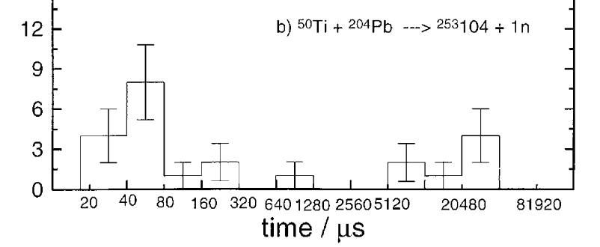
Most neutron-deficient known Rf: ²⁵³Rf
One 48 μs (and possibly another 11 ms ?) fission activity was identified
F.P. Hessberger et al., Z. Phys. A 359 (1997) 415
8
Notes:
Earlier GSI: 14 evts
21 decays observed at GSI
Candidate isomeric decay: Er-Fission 185 micros
Dubna target purity: 99.94% purity
(0.01% ²⁰⁸Pb)

Slide 14
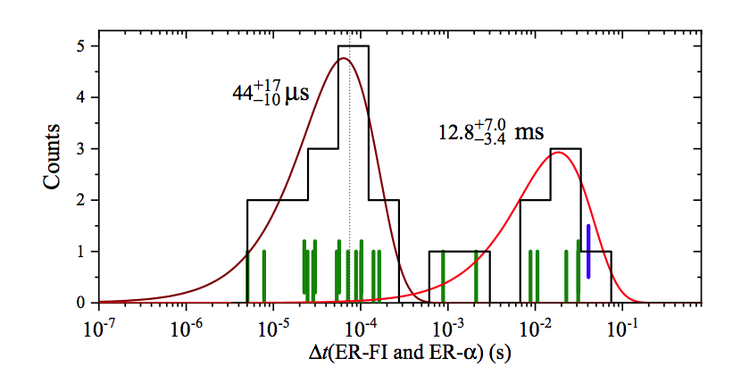
Most neutron-deficient known Rf: ²⁵³Rf
J. Khuyagbaatar et al., Phys. Rev. C 104 (2021) L031303
21 fission events
1 alpha decay
1 candidate for a fast isomeric decay
8
Notes:
Earlier GSI: 14 evts
21 decays observed at GSI
Candidate isomeric decay: Er-Fission 185 micros
Dubna target purity: 99.94% purity
(0.01% ²⁰⁸Pb)

Slide 15
Most neutron-deficient known Rf: ²⁵³Rf
J. Khuyagbaatar et al., Phys. Rev. C 104 (2021) L031303
21 fission events
1 alpha decay
1 candidate for a fast isomeric decay
8 full-energy alpha decays
240 fission events
7 isomeric decays
0.66(+40/−18) ms
52.8(4.4) μs
9.9(1.2) ms
8
Notes:
Earlier GSI: 14 evts
21 decays observed at GSI
Candidate isomeric decay: Er-Fission 185 micros
Dubna target purity: 99.94% purity
(0.01% ²⁰⁸Pb)

Slide 16
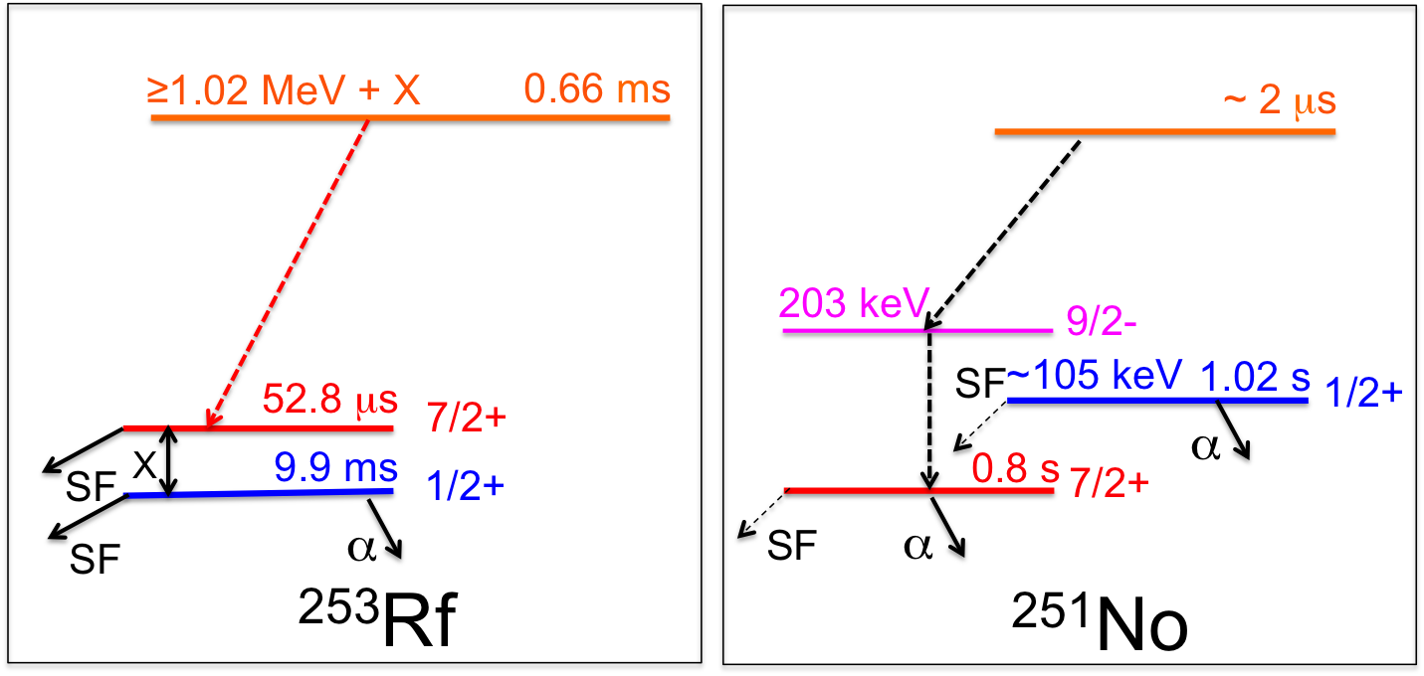
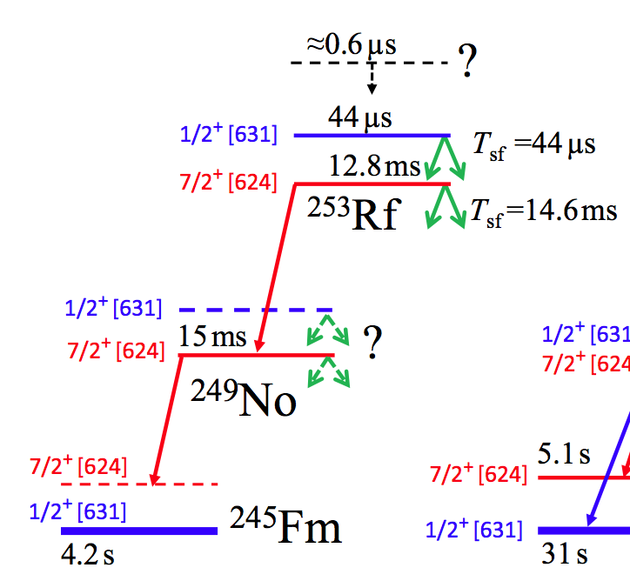
²⁵³Rf – Decay scheme
A. Lopez-Martens et al., Phys. Rev. C 105, L021306 (2022)
X<15 keV
J. Khuyagbaatar et al., Phys. Rev. C 104 (2021) L031303
Notes:
Inversion of states
3 neutron configurations with very dfferent fission properties

Slide 17
²⁵³Rf – Decay scheme
A. Lopez-Martens et al., Phys. Rev. C 105, L021306 (2022)
X<15 keV
Notes:
Inversion of states
3 neutron configurations with very dfferent fission properties

Slide 18
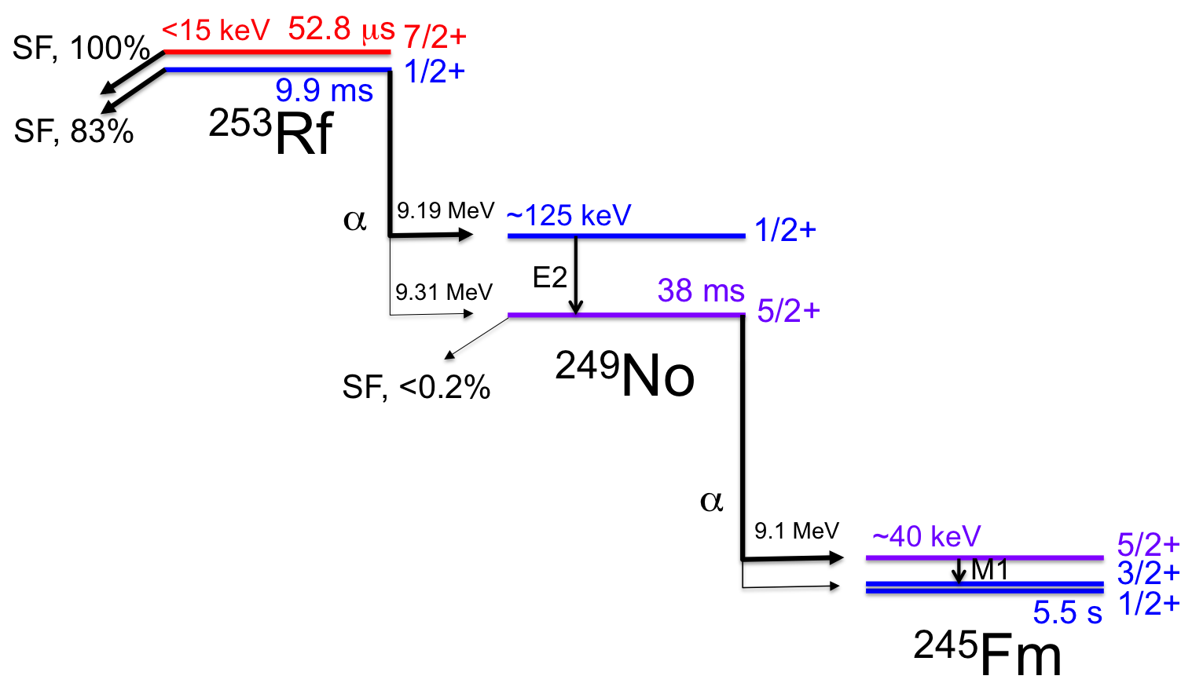
²⁵³Rf – Decay scheme
Geant4-assisted analysis
²⁵³Rf
²⁴⁹No
[622]
M. S. Tezekbayeva, Eur. Phys. J. A 58 (2022) 52

Slide 19
Stability against fission of Rf isotopes

Slide 20
Stability against fission of Rf isotopes

Slide 21
Stability against fission of Rf isotopes
T_{sf}(7/2+)/T_{sf}(1/2+) = 0.004
BSkG2 (axial)
W. Ryssens & M. Bender private comm.

Slide 22
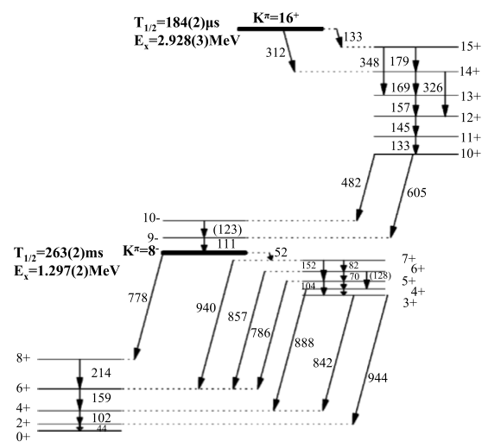
K^{π}=8⁻ isomer in ²⁵⁴No
b_{SF}(8⁻) = (2.0 ± 1.2) 10⁻⁴, “ corrected for the expected contributions of ^{252,254g}No”
b_{SF}(16⁺?) < 1.3 10⁻⁴
F.P. Hessberger et al., Eur. Phys. J. A 43, 55–66 (2010)
²⁰⁸Pb(⁴⁸Ca,2n)²⁵⁴No
~ 1 million ^{254,255}No alphas detected
²⁵⁴No
²⁵⁰Fm
²⁴⁶Cf
²⁵⁴Fm
²⁵⁵No
R. Clark et al., Phys. Lett. B 690, 19 (2010)

Slide 23
K^{π}=8⁻ isomer in ²⁵⁴No
b_{SF}(8⁻) = (2.0 ± 1.2) 10⁻⁴, “ corrected for the expected contributions of ^{252,254g}No”
b_{SF}(16⁺?) < 1.3 10⁻⁴
F.P. Hessberger et al., Eur. Phys. J. A 43, 55–66 (2010)
52
~141 000 slow isomeric decays
944
842
~44 000 fast isomeric decays
605
R. Clark et al., Phys. Lett. B 690, 19 (2010)

Slide 24
Clean selection of the fission events of interest
slow isomer – gs decay
R. Clark et al., Phys. Lett. B 690, 19 (2010)
Notes:
Max. low res range in this experiment: ~100 MeV

Slide 25
Clean selection of the fission events of interest
slow isomer – gs decay
fast isomer- slow-isomer decay
R. Clark et al., Phys. Lett. B 690, 19 (2010)

Slide 26
Clean selection of the fission events of interest
slow isomer – gs decay
fast isomer- slow-isomer decay
HF (8⁻) > 0.37
R. Clark et al., Phys. Lett. B 690, 19 (2010)

Slide 27
Conclusions & perspectives
The HF of the 8⁻ isomer of ²⁵⁴No has been revised: it is now a lower limit (~8 times higher than the previously established value)
It would seem all the HFs of high-K isomers are moving upwards when remeasured: this gives hope to extend the nuclear chart beyond the « fission dripline »
Neutron deficient transfermium nuclei are a unique laboratory to study the fission properties of different nucleonic configurations (in the same nucleus)
The gs of the next even-even Rf isotope (²⁵²Rf) will probably be at the limit of stability of an atom
There may be hope to observe ²⁵¹Rf
Need for « proper » microscopic modelling of the fission from odd Z/odd N nuclei and high K states

Slide 28
Gabriela Collaboration
France
A. Lopez-Martens, K. Hauschild
Z. Asfari, O. Dorvaux, M. Forge, B. Gall, K. Kessaci
D. Ackermann, R. Chakma, J. Piot
Russia
A.I. Svirikhin, M.L. Chelnokov , V.I. Chepigin, A.V. Isaev, I.N. Izosimov, A.A. Kuznetsova, O.N. Malyshev, R.S Mukhin, A.G. Popeko, Yu.A. Popov, B. Sailaubekov, E.A. Sokol, M.S. Tezekbayeva and A.V. Yeremin
Slovakia
P. Mosat, B. Andel
China
B. Ding, Z. Liu, F. Zhang

Slide 29
N=147 isotopes

