Slide 1




Nuclear Physics Capabilities of the IFMIF-DONES Neutron Source
A. Ibarra
IFMIF-DONES España
with significant contributions from D. Cano (CIEMAT, Spain) A. Letourneau (CEA, France) A. Maj (IFJ-PAN, Poland) W. Krolas (IFJ-PAN, Poland)

Slide 2
Outline
What is IFMIF-DONES
IFMIF-DONES for Nuclear Physics

Slide 3
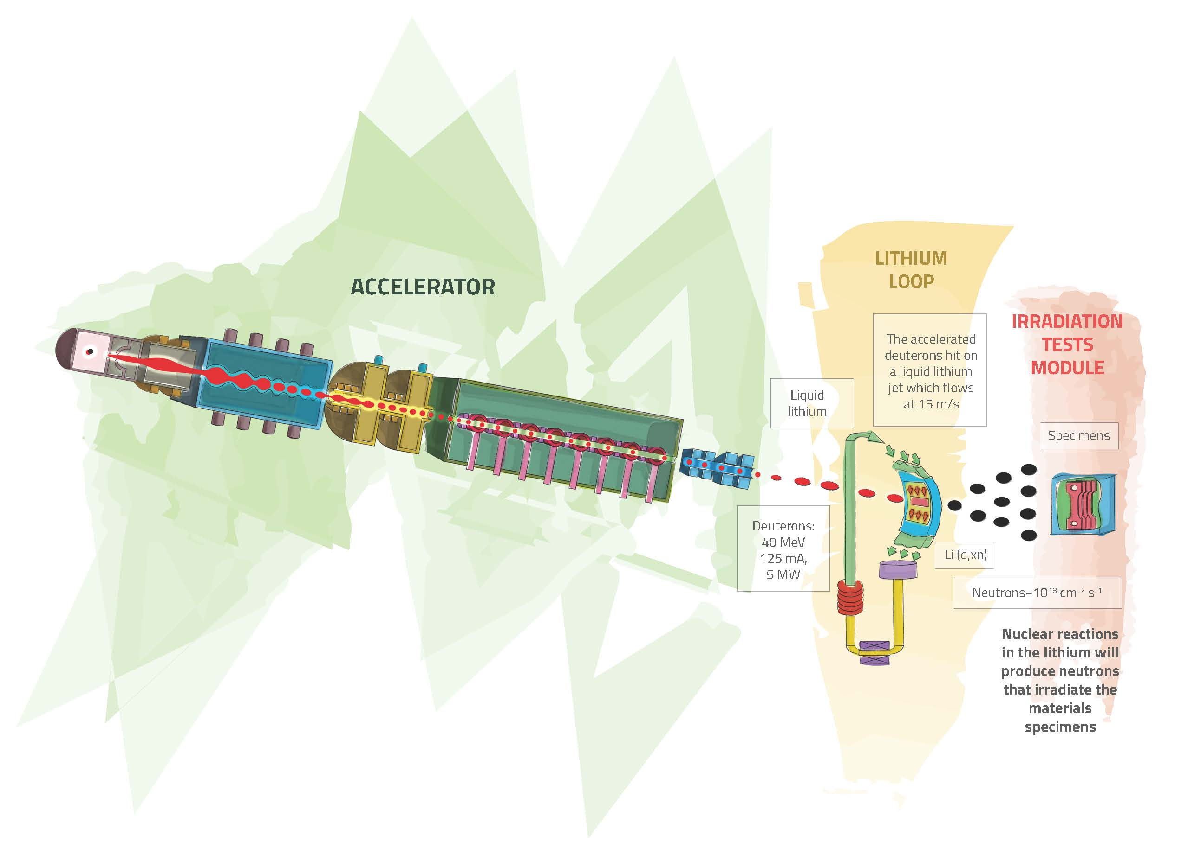
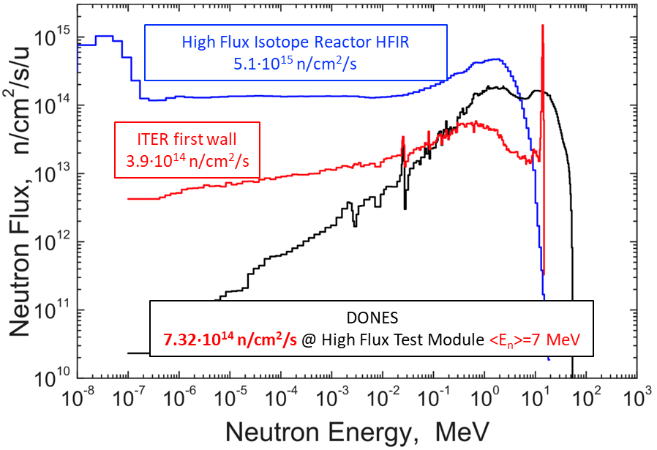
What is IFMIF-DONES?
An accelerator based fusion-like neutron source to be used for
the qualification of the materials to be used in the DEMO Reactor
High Flux Test Module:
20 dpa/fpy in 130 cm³
10 dpa/fpy in 400 cm³
Controlled Temperature:
250 < T < 550 ºC
Stripping reaction
A neutron flux of ~ 10¹⁵ n/cm²/s is generated with a neutron spectrum up to 55 MeV energy
15
Heat removal by high velocity Li flux

Slide 4
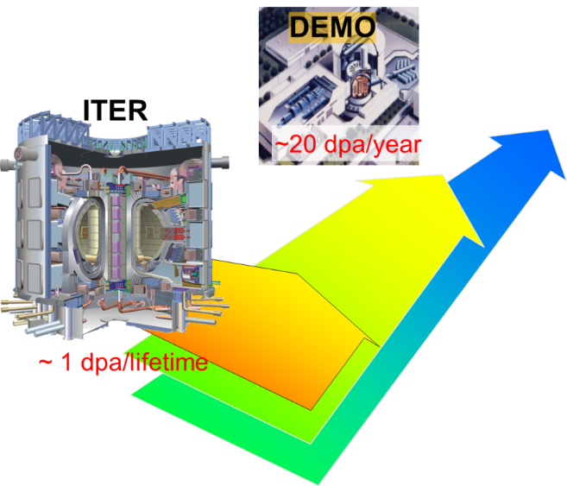
Why DONES ?
Selection and qualification of candidate materials for fusion reactors
Generation of engineering data for design, licensing and safe operation of DEMO up to end-of-life
Completion, calibration and validation of databases (mainly generated from fission reactors research)
Material testing and simulation carried out simultaneously to correlated fundamental understanding of radiation response of materials
One of the main differences between ITER and DEMO is the radiation dose: at DEMO more than two orders of magnitude higher
But also of interest in other scientific areas (nuclear physics, medical and industrial applications,…) due to its unique characteristics
Identified as high priority in the EU Fusion Roadmap
Included in the ESFRI Roadmap as a EU strategic facility

Slide 5
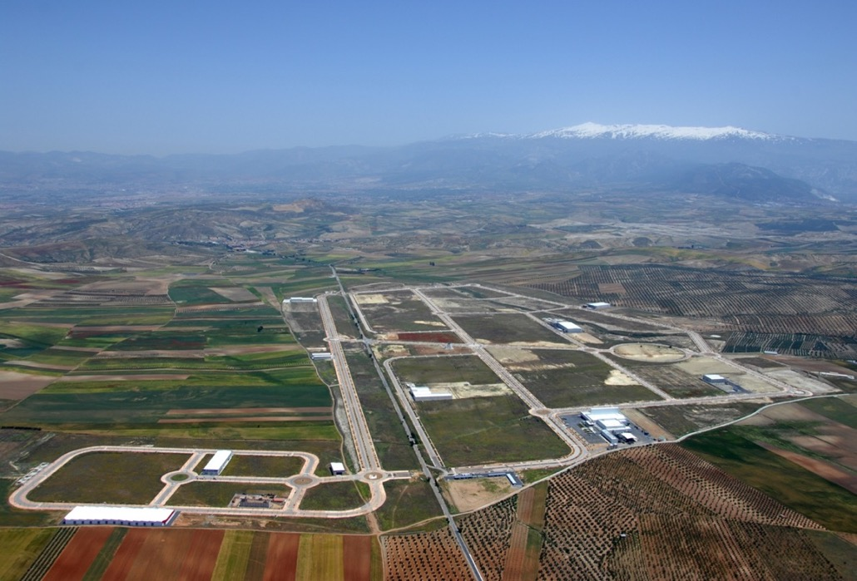
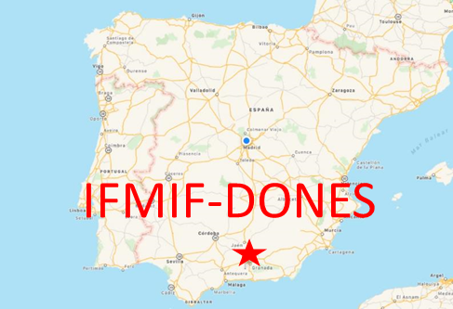
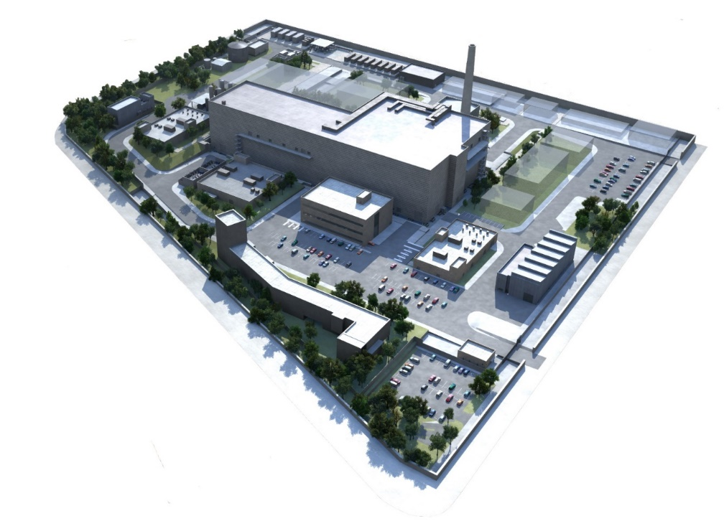
IFMIF-DONES Facility
The site is located at Escúzar -18 km southwest from Granada city- Spain

Slide 6
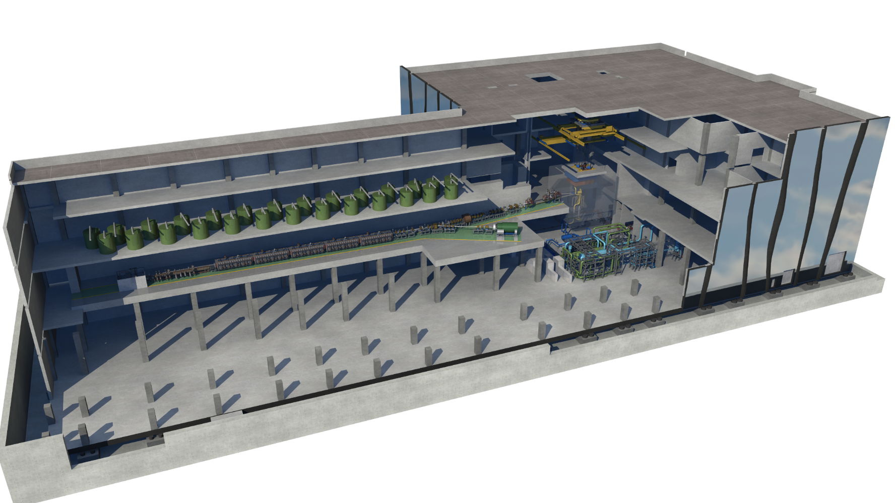
IFMIF-DONES Plant
Test System
Accelerator System
Lithium System

Slide 7
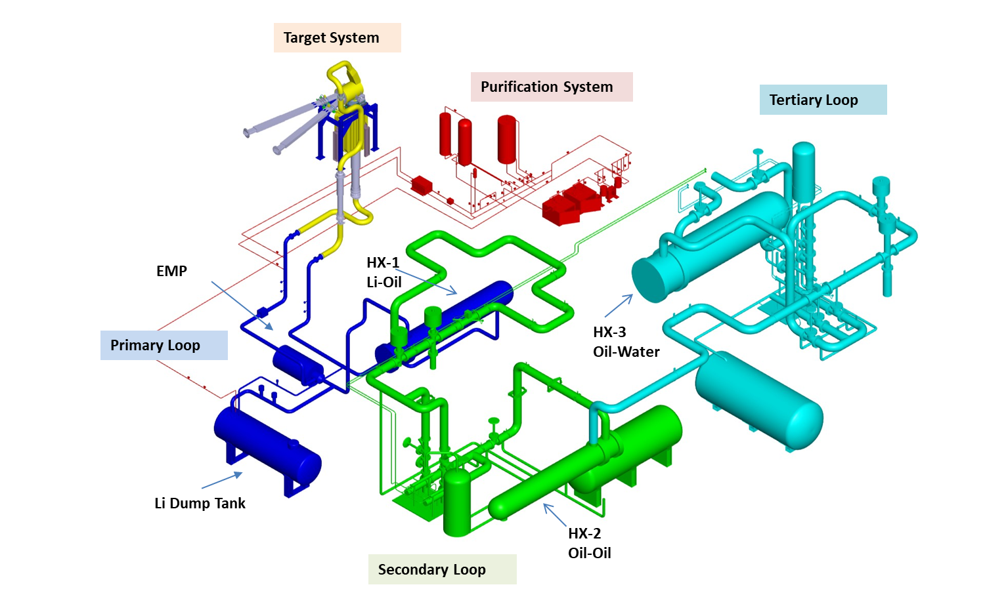
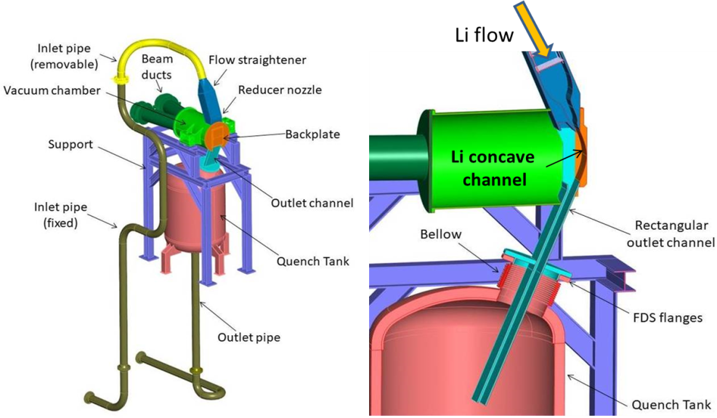
Lithium System
5 MW power handling, 15 m/s Li velocity, remote handling
Main requirements: Li flow stability and Li impurities control
Lithium target
Li volume ~14 m³
Li flow rate ~100 l/s
Li temperature (cold side) ~300 °C
Jet thickness: 25±1 mm Li flow velocity: 15 m/s
Chamber pressure: 10⁻³ Pa Heat flux: 500 MW/m²

Slide 8
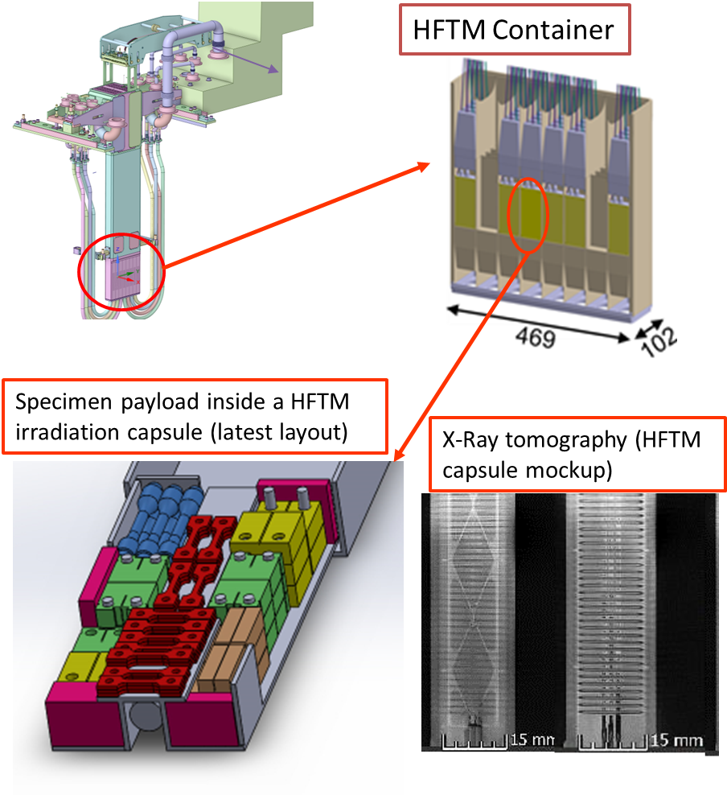
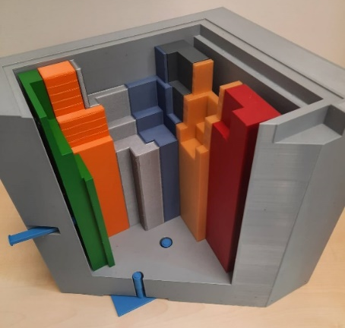
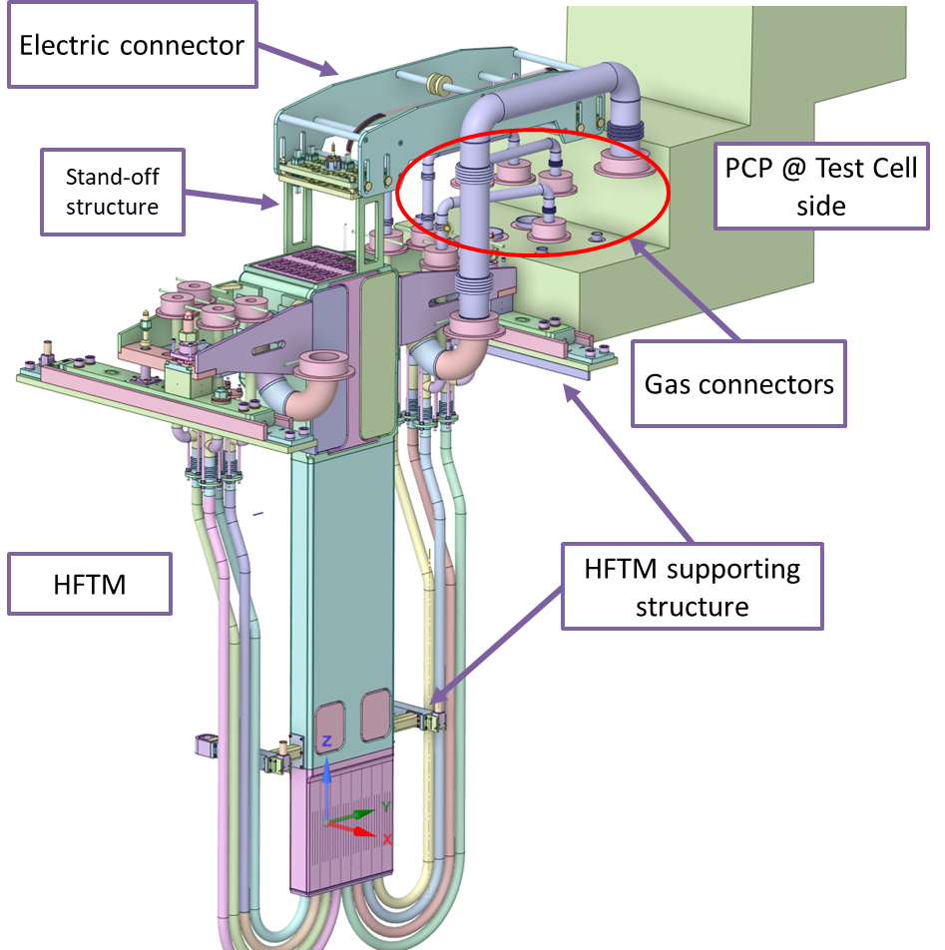
Test Systems
Main characteristics driven by the presence of neutrons and Li
Internal components cooling by He
Remote Maintenance required
HFTM upper part
Test Cell Removable Shielding Blocks (Maintainability and minimizing neutron streaming)
More than 850 specimens can be hold in the HFTM !!

Slide 9
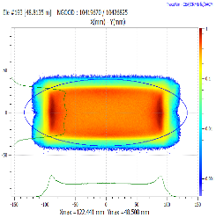
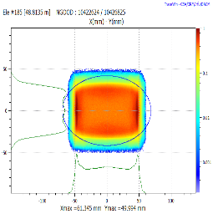
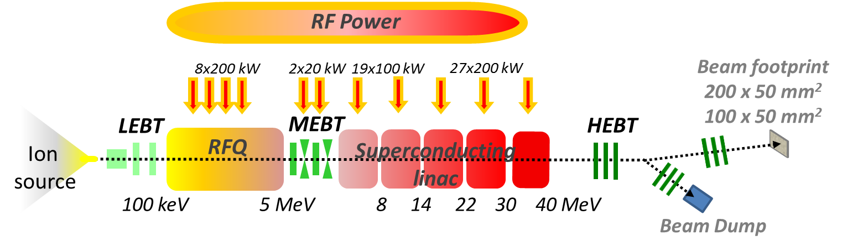
IFMIF-DONES: Accelerator
Beam footprint @ target
175 MHz Solid State RF source
20x5 cm² footprint
(reference)
10x5 cm² footprint
(optional)
Auxiliaries
Vacuum, Cryogenics, Water cooling, Gas and electric distribution…
D+ CW 175 MHz SC LINAC
125 mA / 40 MeV → 5 MW
Total length of ~100 m
Windowless liquid Li target
Hands-on maintenance (<1 W/m)
Staged comissioning in five years (Injector CW / RFQ @10-20%
/SRF LINAC @ 1% / HEBT@ Target)
CW operation with an availability target of 87%

Slide 10
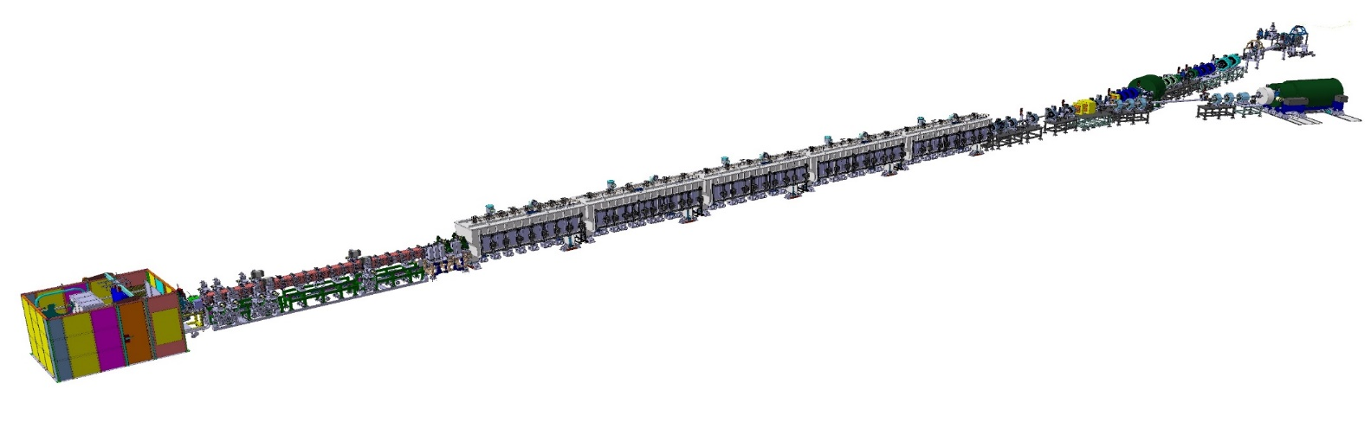
Accelerator systems summary
175 MHz, 5MW, 125 mA, CW, high availability: One of the more powerful accelerators in the world
Waiting for validation results from IFMIF-EVEDA: LIPAc Prototype (Rokkasho)
Injector (ECR) + Low Energy Beam Transport (LEBT)
Output energy | 100 KeV
Medium Energy Beam Transport (MEBT)
Particle energy | 5 MeV
High Energy Beam Transport (HEBT)
Particle energy | 40 MeV
Superconducting Radio Frequency Linear Accelerator (SRF-Linac)
Output energy | 40 MeV
highest current linac D⁺ in CW
top H⁺&D⁺ injector performance
longest RFQ
record of light hadrons current through SC cavities
highest beam perveance
Radio Frequency Quadrupole (RFQ)
Output energy | 5 MeV

Slide 11


The key mission of the facility is linked to the materials issue of the future fusion reactors but it has unique characteristics thatmust be available for other scientific problems
A systematic effort is being developed to analice the posible different ideas and to integrate them in the facility engineering design
Coordinated by D. Cano (CIEMAT) and A.M. Lallena (UGR)
WP8 in the DONES-Prep Project coordinated by A. Maj (IPJ-PAN)

Slide 12
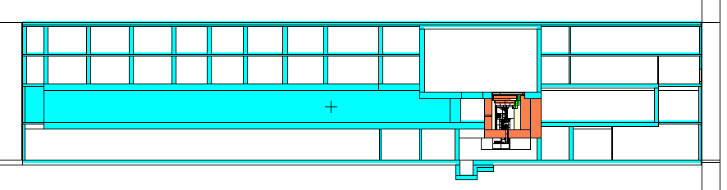
Additional experimental areas
Experiments with
continuous neutron beams
XY plane (Z=0)
(horizontal)
ZY plane (X=0)
(vertical)
Experiments with pulsed neutron + deuteron beams

Slide 13
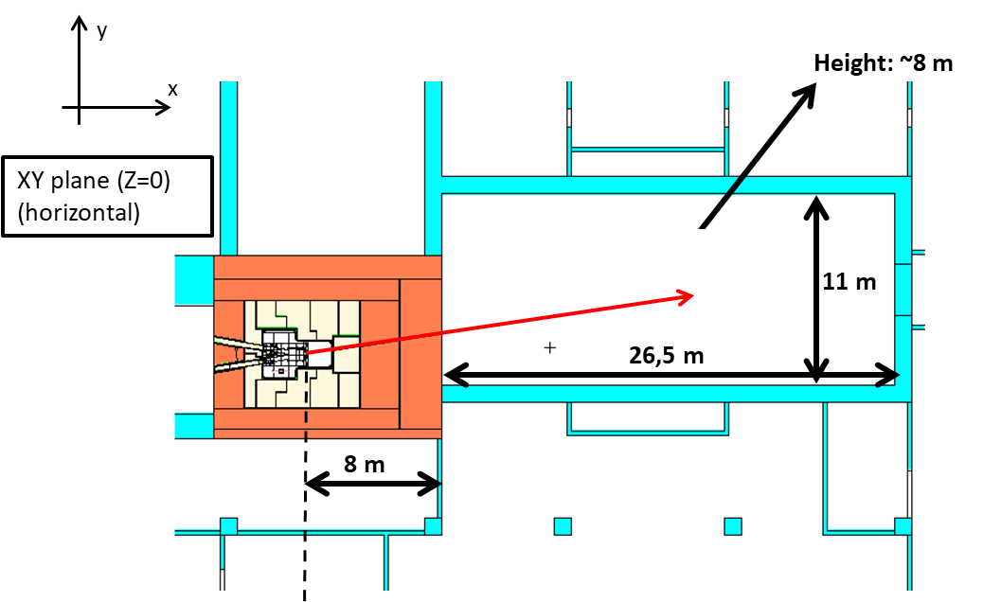
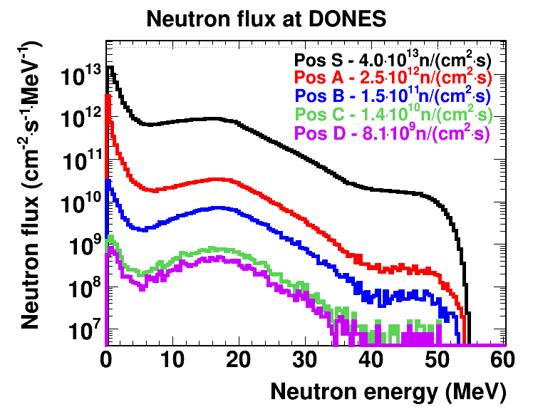
Continuous neutron beam experimental area
Very high neutron flux at very high energies!!!
C
D
S
B
A
E. Mendoza et al., submitted to Nucl. Fusion
High-flux (~2. 10¹⁰ n/cm²/s at nominal operation 125 mA deuteron beam, covering a large energy range
Collimated neutron beam (~98% of the neutrons with θ < 1°)

Slide 14
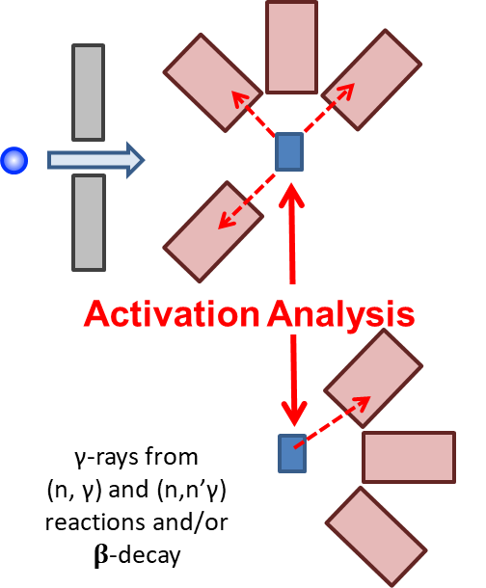
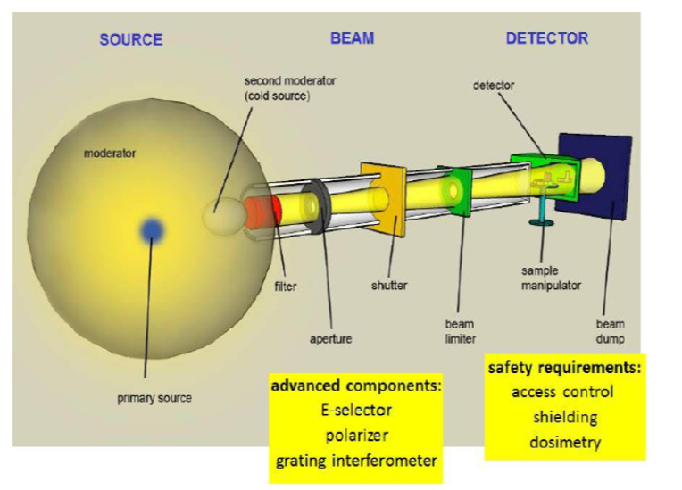
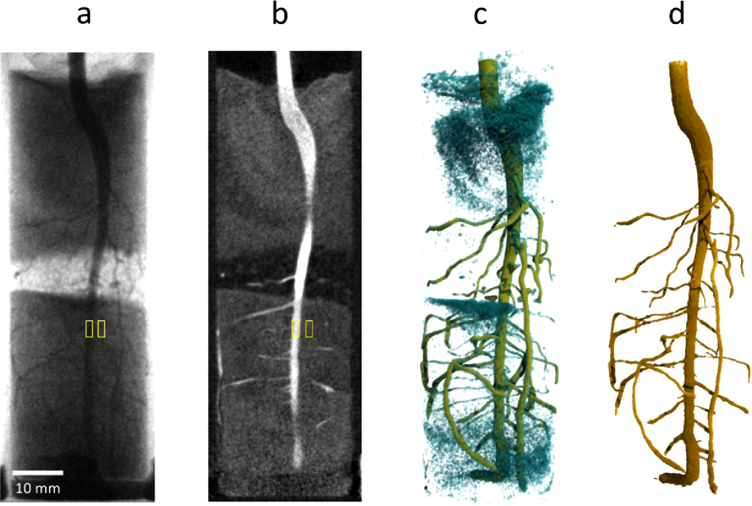
Potential experiments with neutrons
Nuclear physics studies with moderated and unmoderated neutrons
  Analysis of neutron-rich isotopes production by neutron induced fission
  Spectroscopy of very exotic and short lived nuclei
  Maxwellian-averaged capture cross-section for some stellar nuclear reactions by activation techniques with neutrons
  Analysis of radioisotope production routes by nuclear decay induced reactions
Others
  Neutron scatering with moderated neutron beams (biological matter)
  Characterization of materials by radiation analysis (for medicine, chemistry, biology, forensics,…)
  Materials doping
  Imaging techniques with neutrons
  Radioisotope producción for medical applications (e.g. 99Mo)
  Fast neutron irradiation of components, devices or bio-simples
  Superconductive materials under fast neutron irradiation

Slide 15
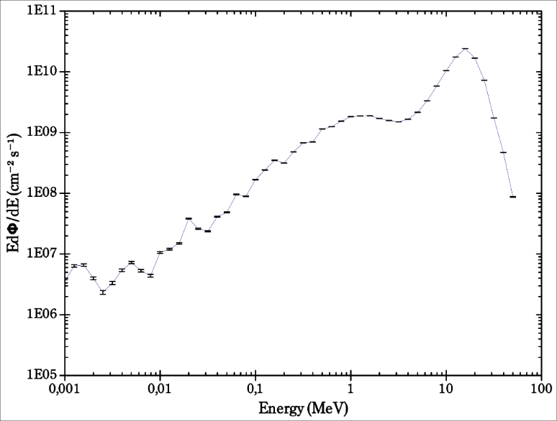
Unmoderated neutron beam
(EAR1/0.25Hz)
IFMIF-DONES
IFMIF-DONES has higher neutron flux than TOF facilities
but, No TOF technique to select neutron energy
High flux for radioisotope production by (n,x) reaction

Slide 16
DOMISOL: DONES Magnetic Isotope Separation On Line
The DOMISOL consists of:
High energy and flux neutron beam.
Production target based on fission reactions and ion source.
Mass separator.
Ion beam transport system.
Similar to the OSIRIS separator in Studsvik.
Hot & thick target
High energy neutrons
10¹² n/cm²/s
Ion source
+
+
+
Spectroscopy of very exotic and short lived nuclei.
+
+
+
Mass separator
+
+
+
+
+
+
+

Slide 17
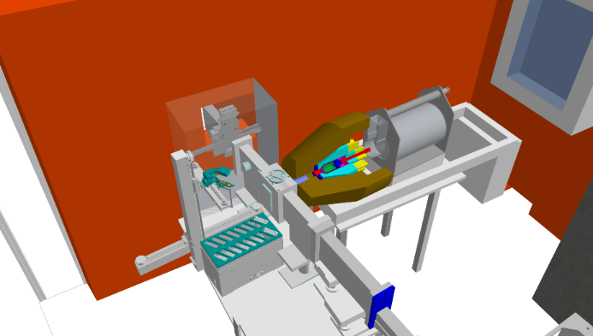
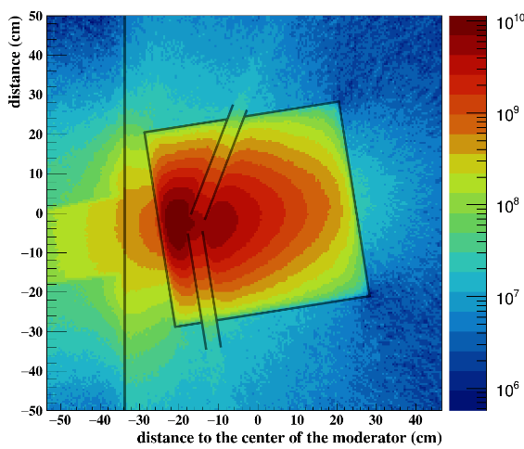
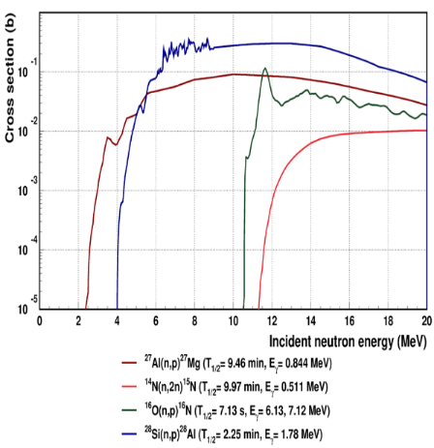
Neutron Activation Analysis
Non-destructive method to determine the elemental composition of materials
  with thermal Neutrons (NAA and Prompt Gamma AA)
  with Fast Neutrons (FNAA and FPGAA).
Neutron flux is a key ingredient:
  ~10¹²⁻¹⁴ n/cm²/s for NAA ; ~10⁸ n/cm²/s for PGAA,
  ~10⁸ n/cm²/s for FNAA
Irradiated sample to be analyzed
PGAA station @Budapest Neutron Center
Fast Neutron Activation Analysis
The IFMIF-DONES has the advantage to provide both thermal and fast neutrons and is competitive for FNAA and PGAA

Slide 18
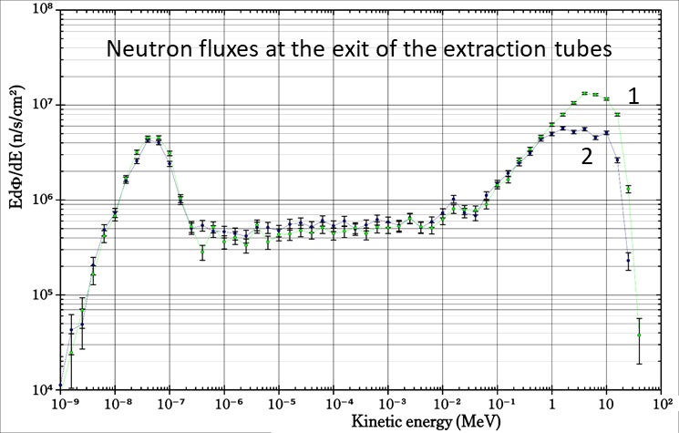
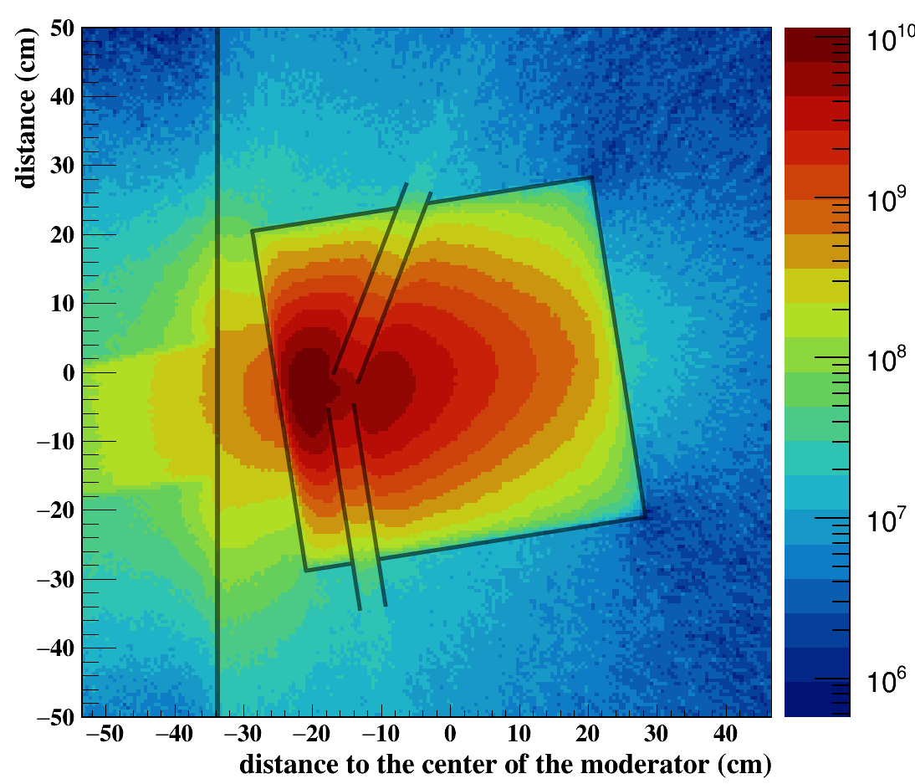
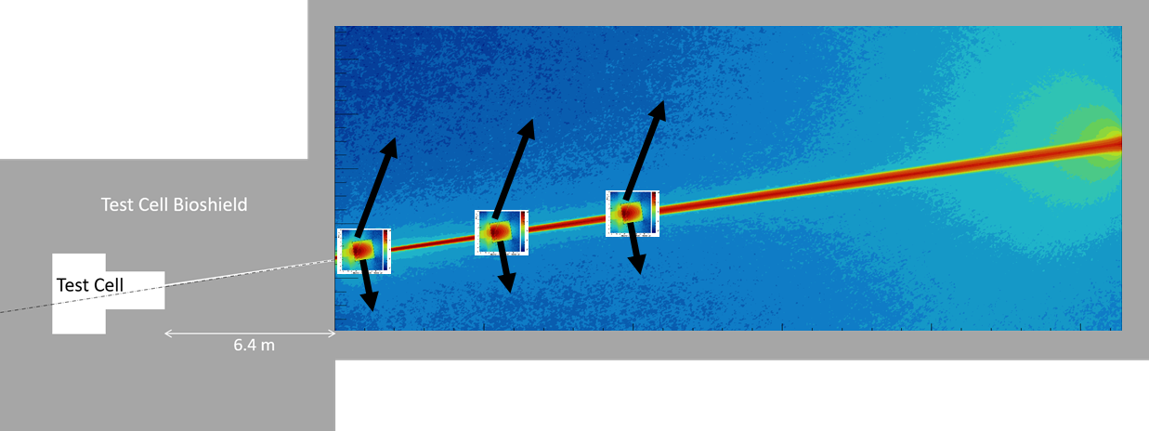
Moderated neutrons
1
2
50x50x50 cm³
At the exit of the tubes, the thermal neutron flux is ~ 10⁷ n/cm²/s below 400 meV but with a large fast neutron contamination (~ 7 10⁷ n/cm²/s)
Offer the possibility to put moderators in cascade (Fishbone configuration)

Slide 19
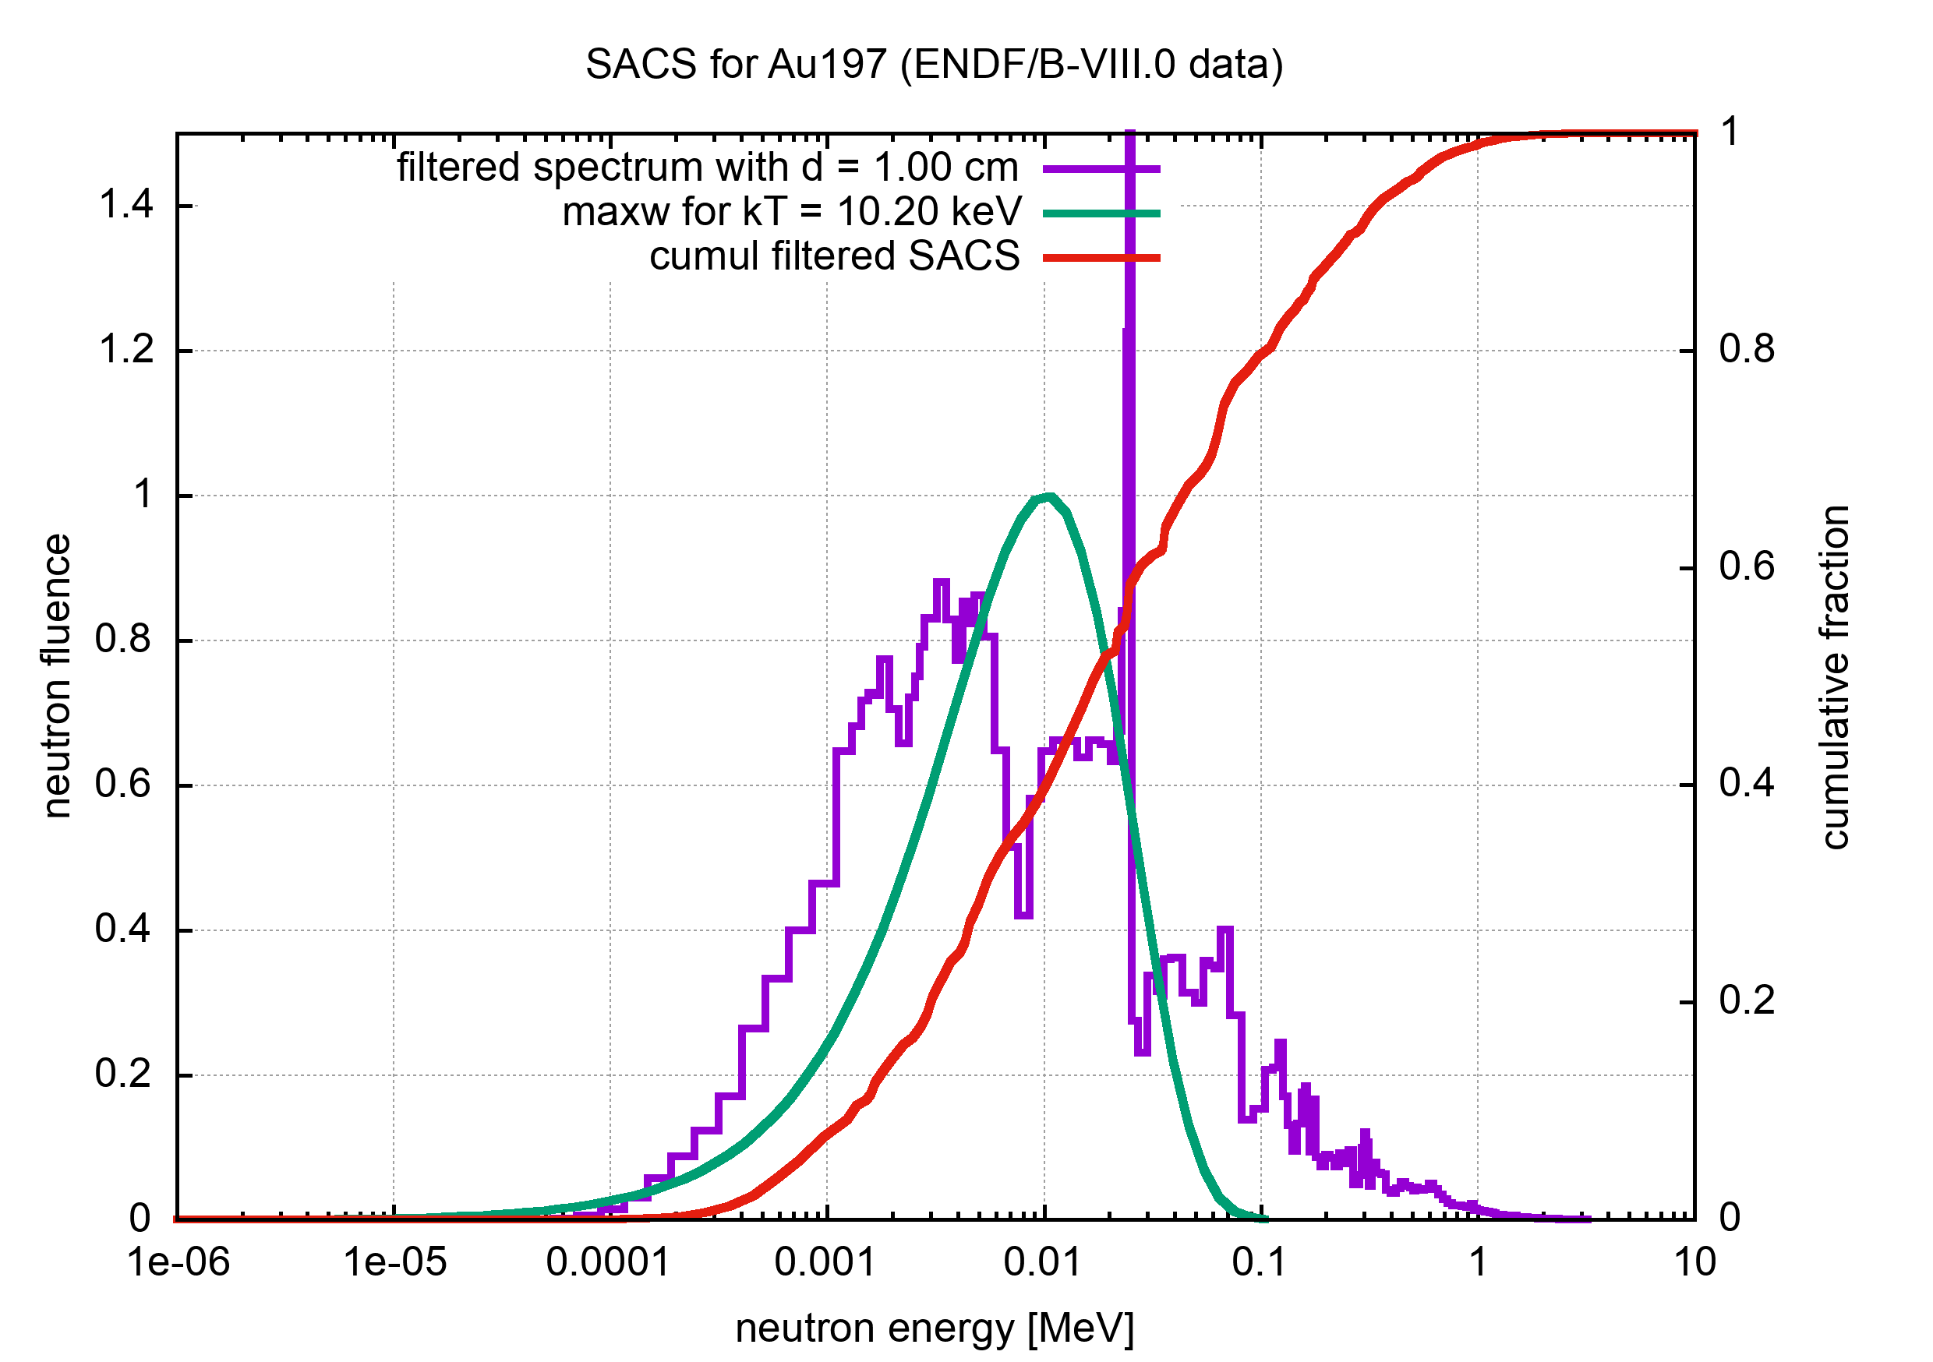
Activation cross section measurements for astrophysics, and other applications
Experience acquired at the new n_TOF NEAR station (6 meters flight path). Produce a neutron flux which mimics Maxwellian spectra:
Activation at high energies: (n,xn), (n,γ)
(n,γ) at stellar temperatures (i.e. kT = 5 to 90 keV)
(n,γ) at energies relevant for fast nuclear reactors.
Unique Maxwellian averaged cross section measurements on very small masses (nanograms) and short half-lives (days) for some isotopes (e.g. ^{134,137}Cs, ⁸⁵Kr, ¹⁵⁴Eu, ... ) of key relevance.

Slide 20
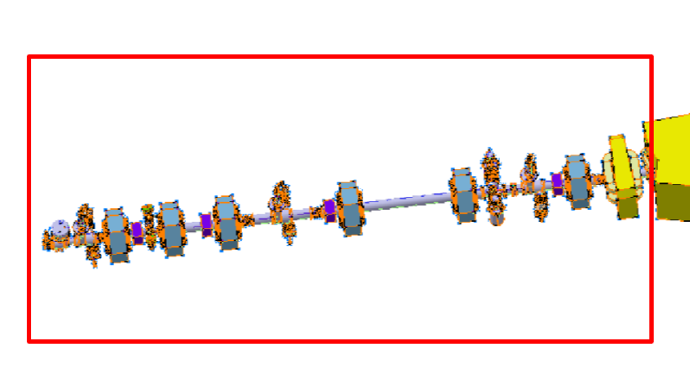
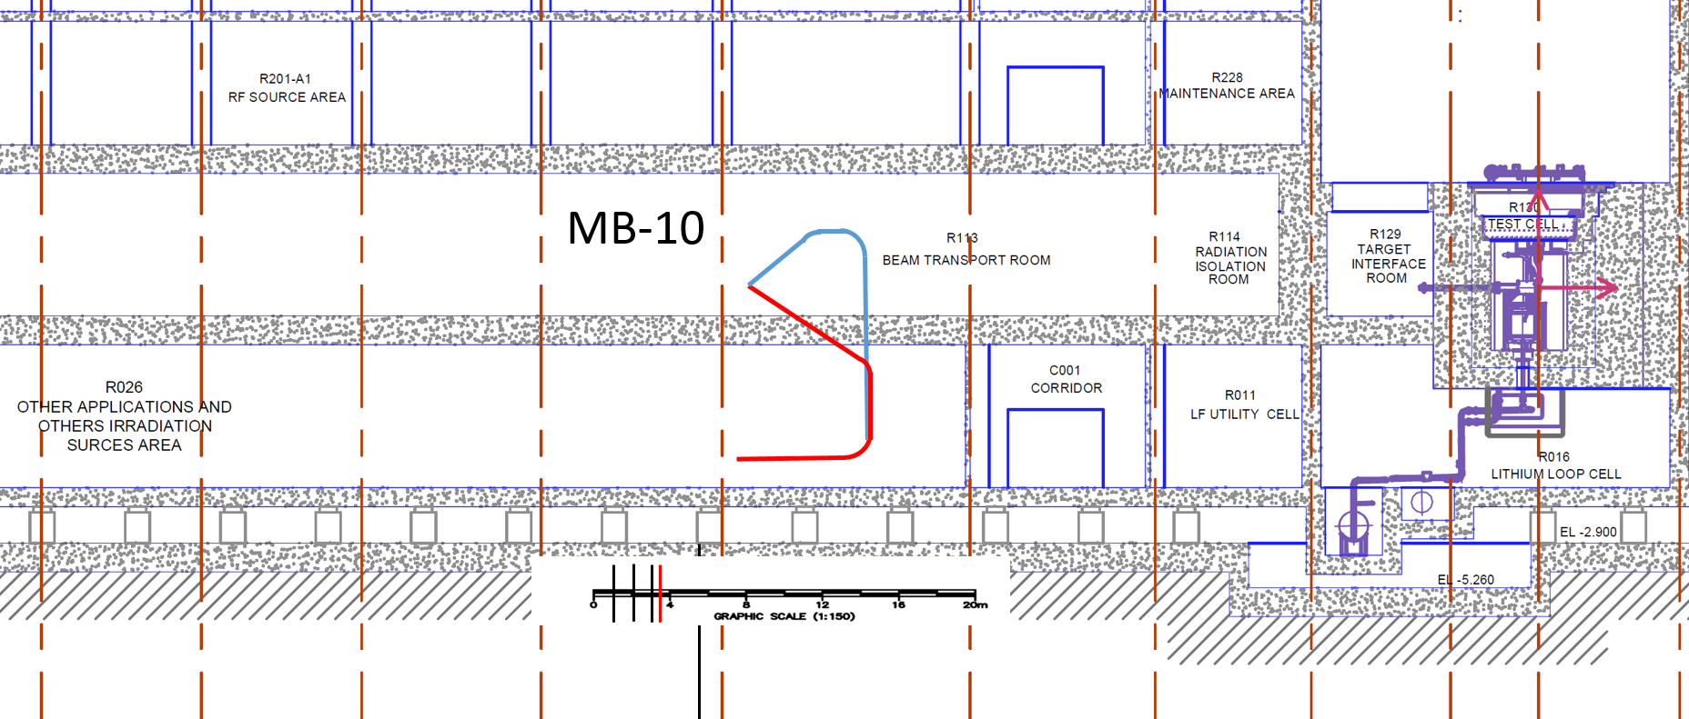
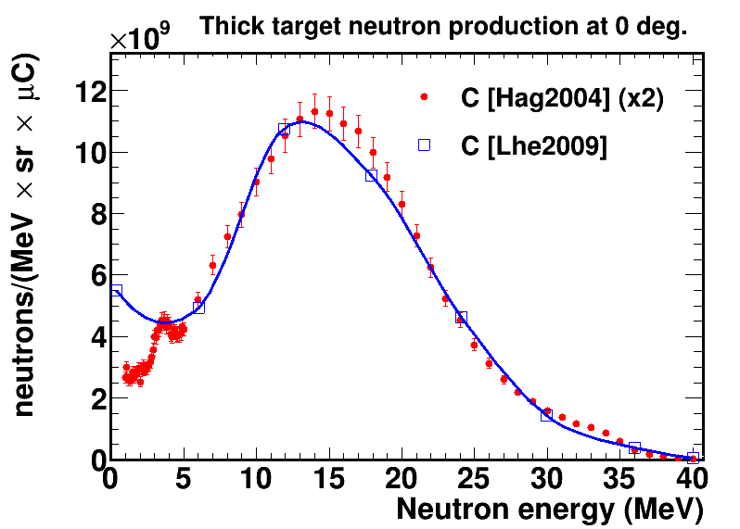
Pulsed beam experimental area
fast chopper at 40 MeV, at the end of the linac, able to extract one single bunch (over 10 000) and deviate it through an electrostatic meander followed by a magnetic septum into a dedicated transfer line
qp1
qp3
13 m
qp2
Deuteron beam
Septa position
R026
Area: >2600 m² / Height: 7.5 - 8.5 m
Extraction of the 40 MeV deuterons with kicker (1/1000 duty cycle or less)

Slide 21
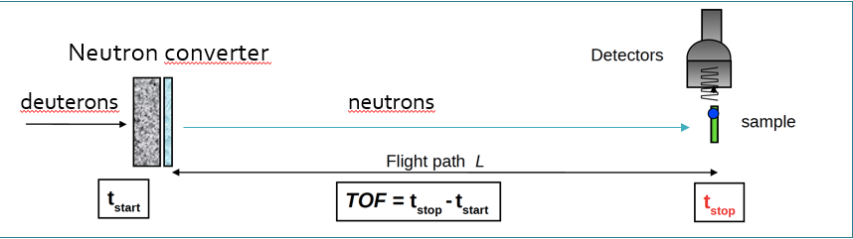
Potential experiments with pulsed beams
With deuterons
  Production of radionuclides with a high intense deuteron beam
  Deuteron induced reactions
    (d,n) reactions
    (d, charged particles) reactions
  Half-life measurements of long-lived (10⁵-10⁷ years) isotopes
With pulsed neutron beam (ToF-DONES facility)→ with a neutron production target
  Neutron cross section measurements
  Gamma-spectroscopy of nuclei produced in fast-neutron-induced fission reaction
  Investigation of pygmy dipole resonances (PDRs) via (n, n’γ) reaction
  Deuteron-induced proton transfer reactions (d,n)
Neutron time-of-flight facility (n_TOF)

Slide 22
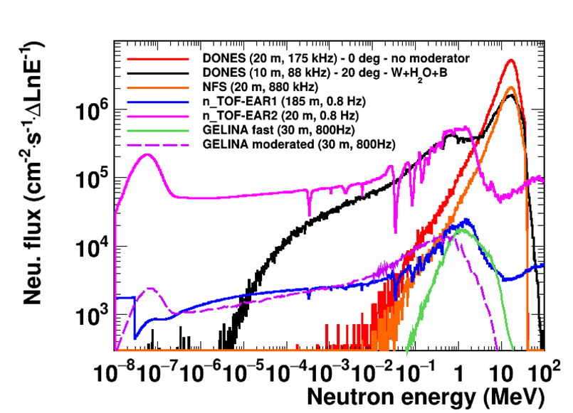
TOF DONES
TOF DONES would be world’s highest intensity TOF neutron source
Broad experimental program on neutron induced reaction cross section measurements for nuclear technologies, astrophysics, fusion, particle and astro-particle physics
(n,el) - elastic
(n,γ) - capture
(n,n’γ) -inelastic
(n,xn) – neutron multiplication
(n,f) - fission
(n,p), (n,d), (n,t), (n,α)… - charged particle production
Reaction studies with pulsed deuteron beam: cross sections, radiobiology, isotope production…
Measurements over several decades:
52 isotopes listed in the High Priority Request List for nuclear technologies.
Over 35 (n,γ) prioritary cross section measurements for astrophysics.

Slide 23
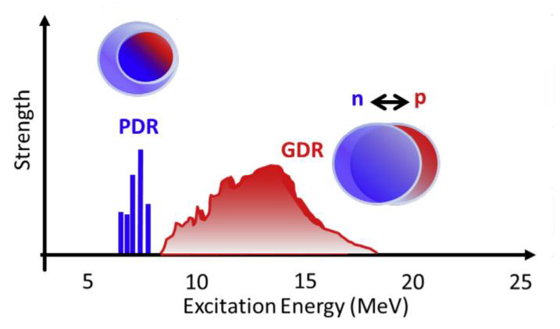
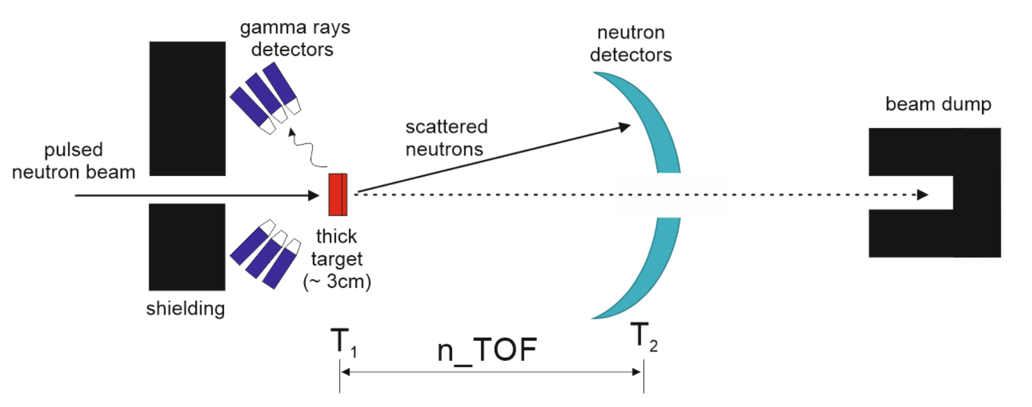
Study of the pygmy dipole resonance with (n,n’γ) or (d,d’γ) reactions
(Such experiments are already performed at NFS@GANIL/SPIRAL2)
or deuteron
pulsed deuteron beam
The DONES facility is an excellent place to systematically study PDR excitations in nuclei from different regions of the nuclear chart using neutrons or deuterons as a probe.
The high intensity of the neutron/deuteron beam and the possible long duration of the experiments will ensure high statistics data which is crucial for obtaining detailed information on the nature of pygmy dipole resonances.

Slide 24
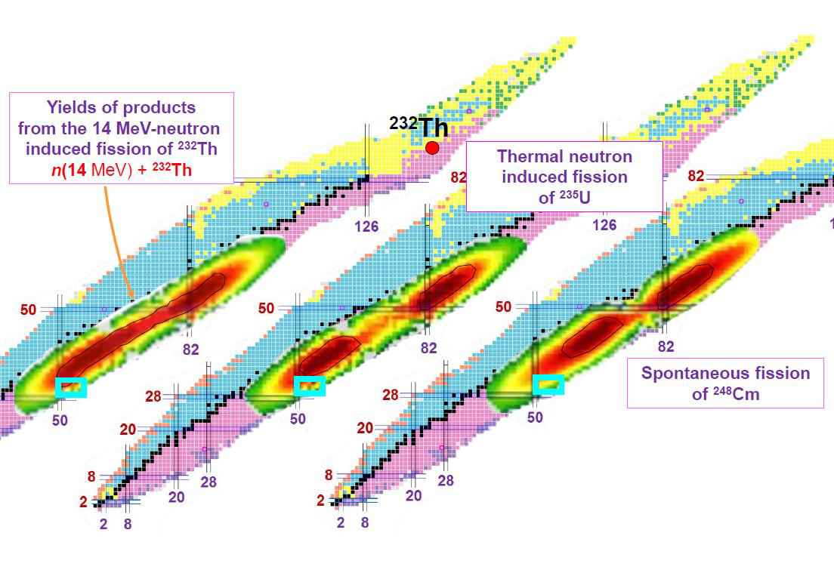
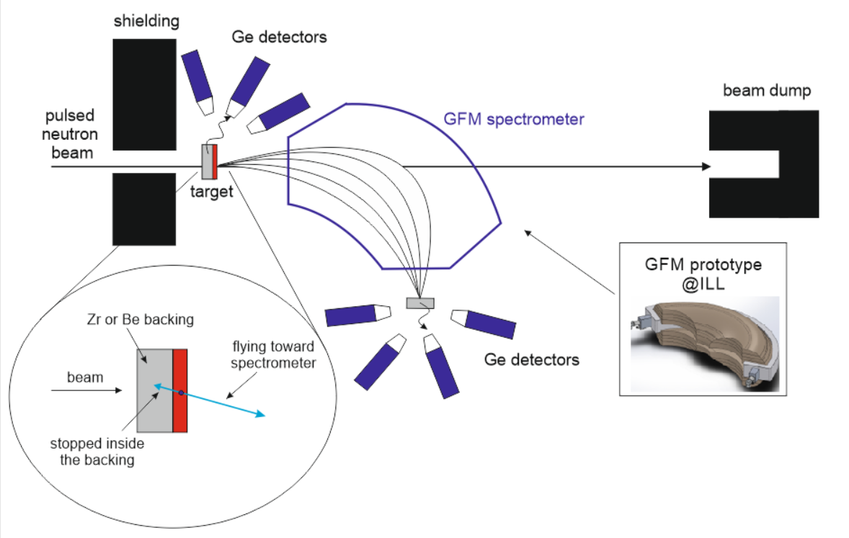
Gamma spectroscopy of the nuclei produced in fast-neutron-induced fission reaction
Distribution of the fission products which correspond to different target materials.
The secondary beam line at DONES offers unprecedented opportunity for gamma spectroscopy studies of neutron-rich nuclei, as it should allow accessing excited states and observing their gamma decay in nuclei which could not be reached for nuclear structure investigations so far.

Slide 25
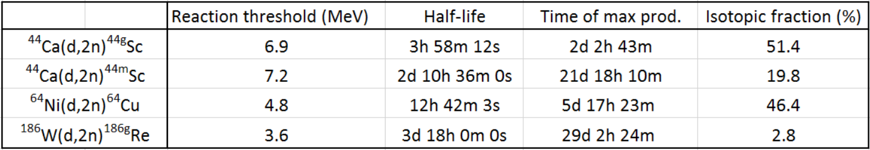
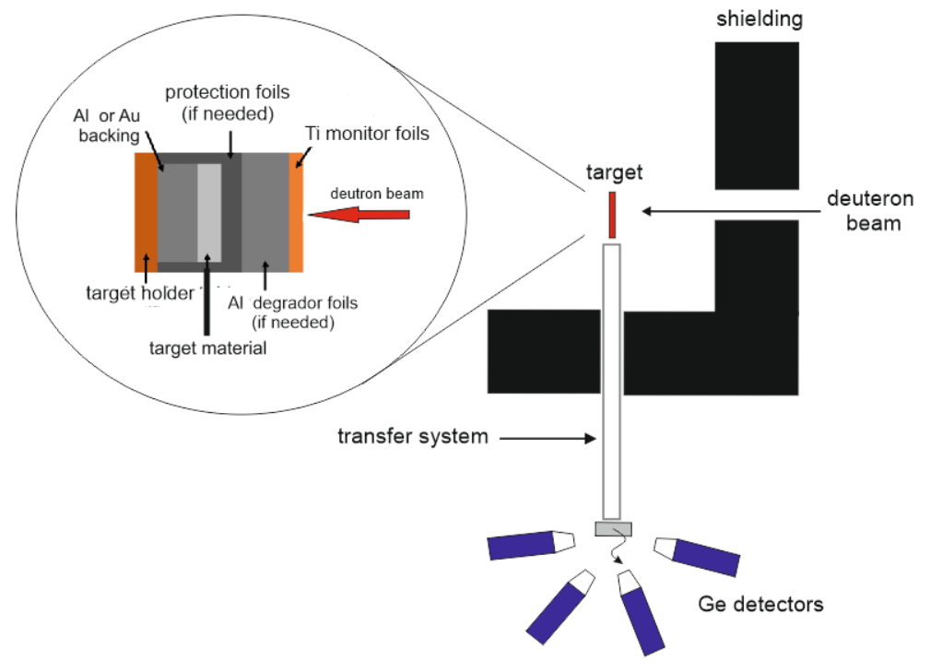
Production of radionuclides (⁴⁴Sc, ⁶⁴Cu, ¹⁸⁶Re) with a high intense deuteron beam
The very intense deuteron beam is ideal for the effective irradiation of samples and leads to the production of radionuclides with high activity.

Slide 26
Summary
The IFMIF-DONES facility, to be built in Granada aimed to the qualification of fusion reactor materials will also allow relevant simultaneous experimental activities in other scientific areas.
In the case of nuclear physics:
The collimated neutron beam allows IFMIF-DONES to be a first class facility for techniques using fast neutrons and a medium flux facility for techniques using thermal neutrons.
The deuteron pulsed beam allows IFMIF-DONES to be a first class TOF facility
Your help in order to further progress with these ideas is welcome and we are open to collaborations!!!

Slide 27

