Slide 1

The ISOLDE Solenoidal Spectrometer
Bruno Olaizola
for the ISS collaboration
EuNPC 2022 – Santiago de Compostela

Slide 2
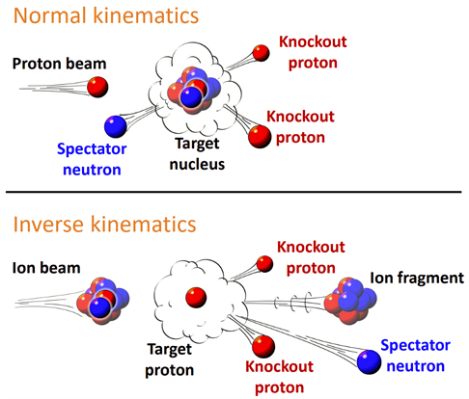
Inverse kinematic
Exotic nuclei have short lifetimes → target not possible
With advent of radioactive beams, they can be studied
Only feasible in inverse kinematics
Kahlbow Journal of Modern Physics, 13, 761-767 (2022)

Slide 3
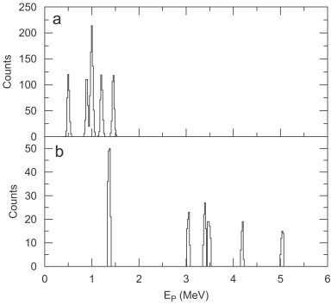
Kinematic compression
v_{lab}
v₀
θ_{cm}
θ_{lab}
V_{cm}
z
Now the CM has a high velocity
The speed v₀ of the small fragment, measured in the LAB, will be compressed by v_{CM}
This effects is speed (energy) dependent
Compresses the energy spectrum, lowering resolving power
A.H. Wuosmaa et al. / NIM A 580 (2007) 1290–1300

Slide 4
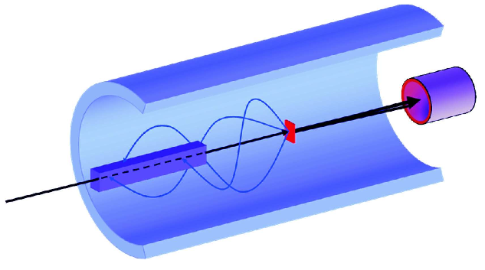
Reactions in a magnetic field
Magnetic field along the beam axis
MEASURED QUANTITIES: position z, cyclotron period T_{cyc} and LAB particle energy E_{p}.
Suffers no kinematic compression

Slide 5
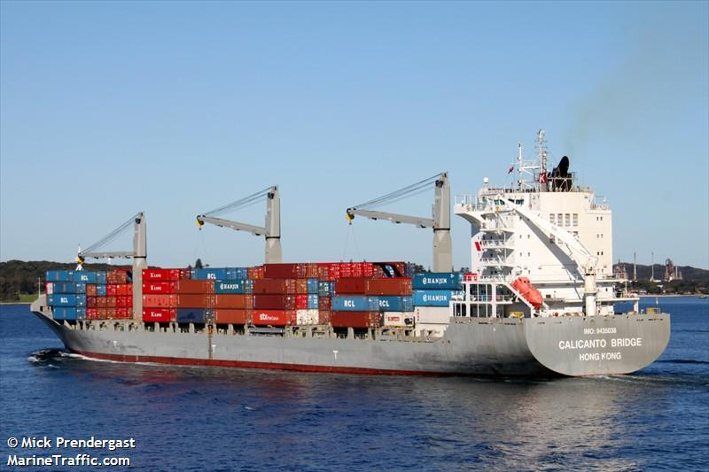
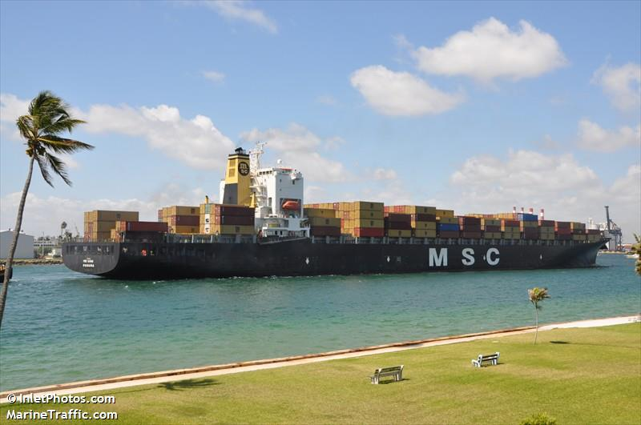
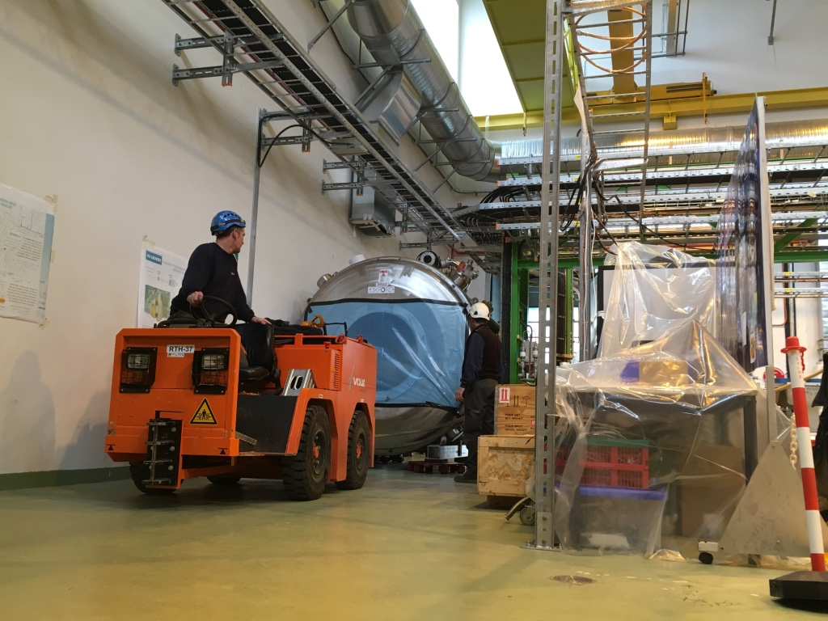

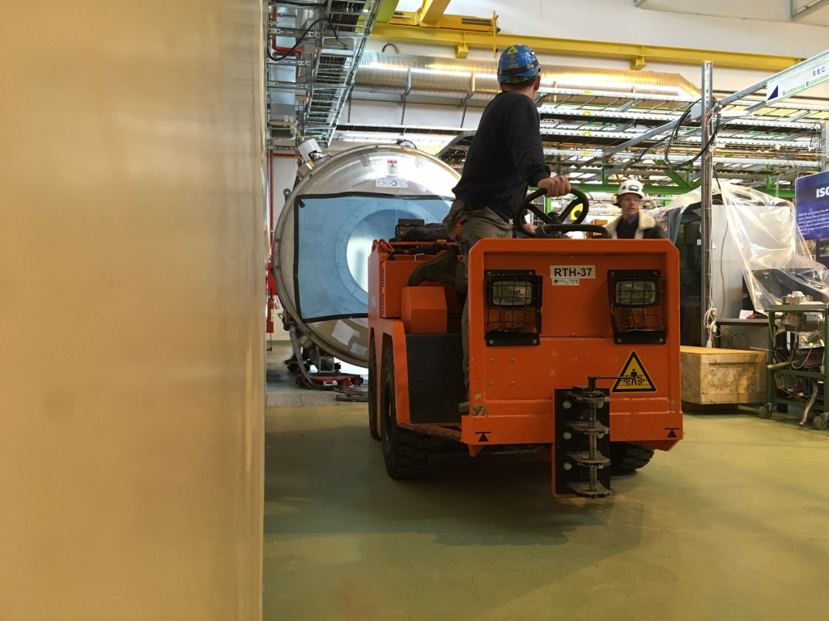
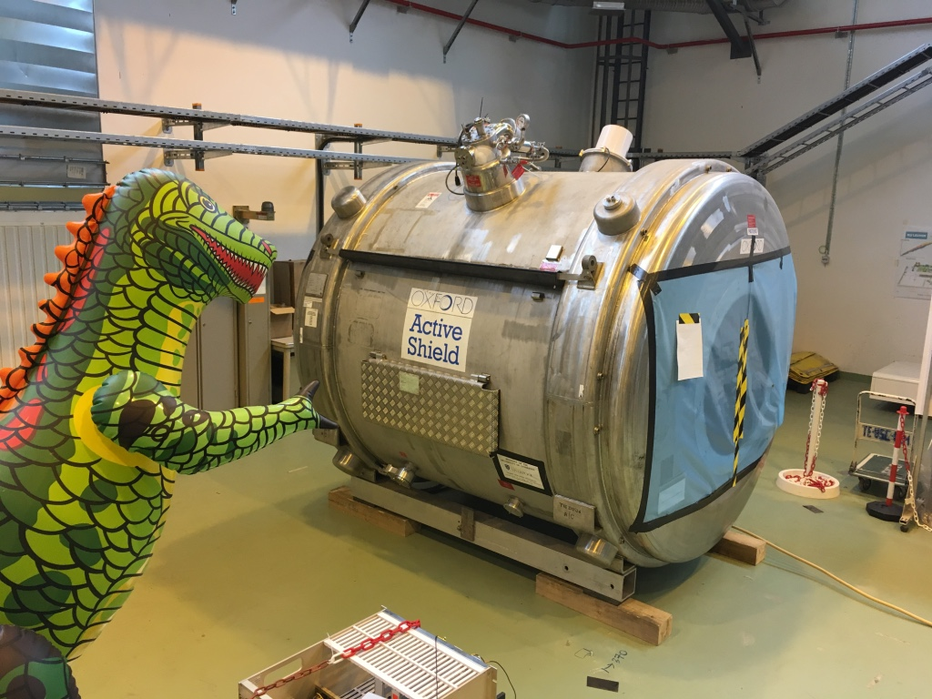
Recycling an MRI magnet
Calicanto Bridge
Australia
Malaysia
Sarah
Netherlands
Switzerland
February 2017
Pictures courtesy of L. Gaffney

Slide 6
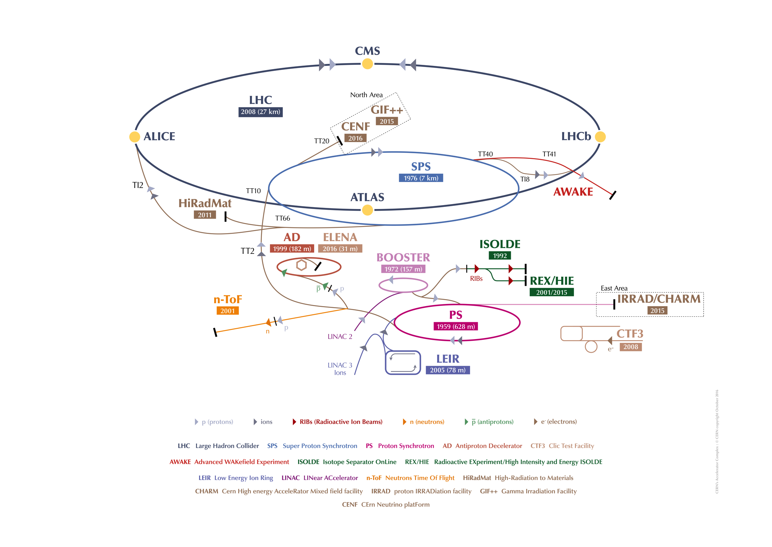
CERN accelarators

Slide 7
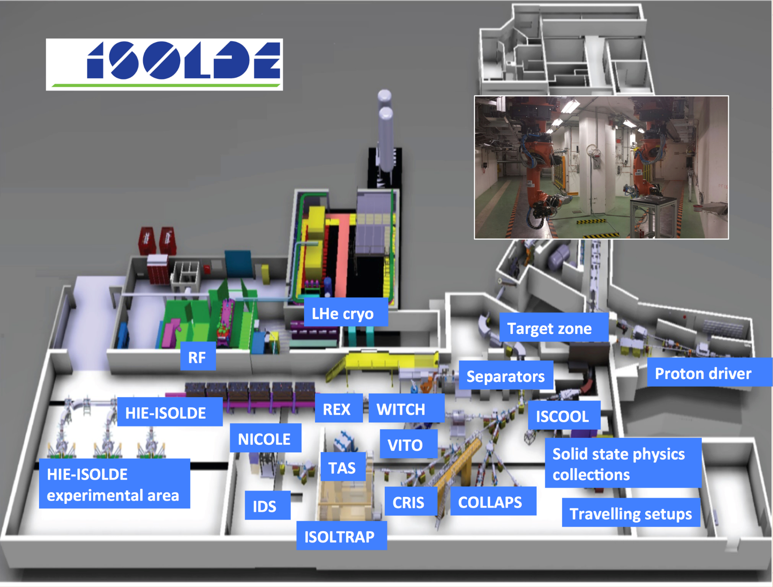
ISOLDE facility

Slide 8
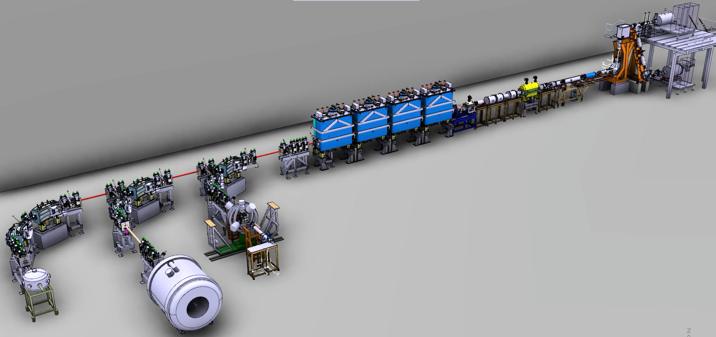

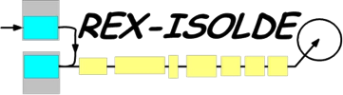

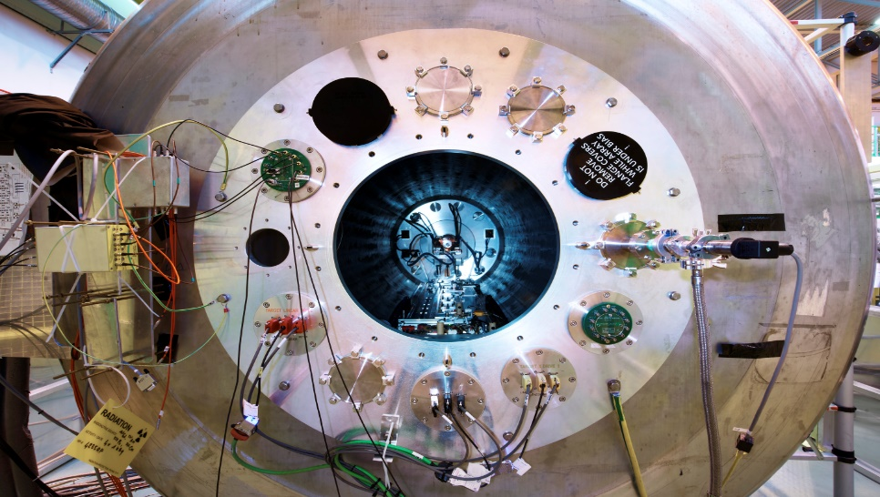


HIE-ISOLDE
>10 MeV/u
Nuclear reactions:
  Inelastic scattering
  Coulomb excitation
  Few-nucleon transfer
  Astrophysical processes
2.83 MeV/u
10.0 MeV/u
1⁺ RIB from ISOLDE
Miniball
Moveable Setups (SEC)

Slide 9
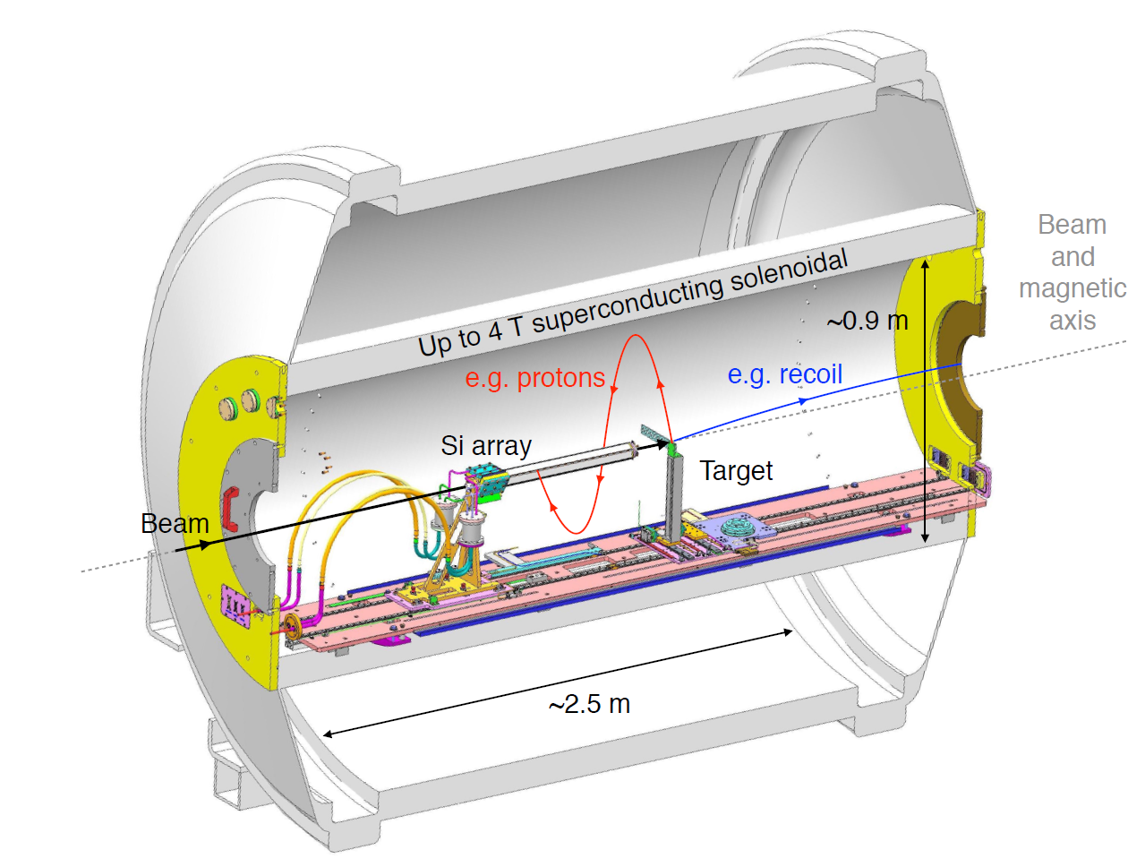
ISOLDE Solenoidal Spectrometer

Slide 10
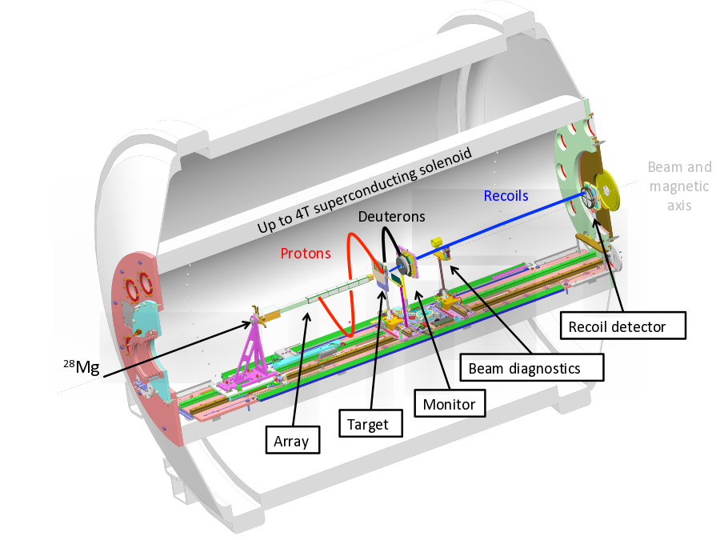
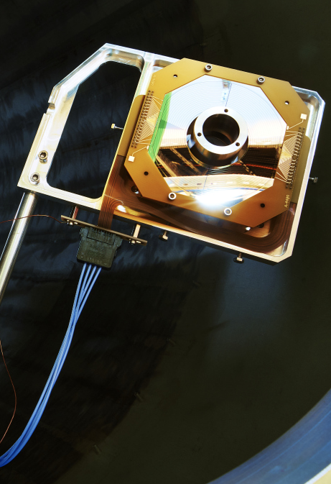
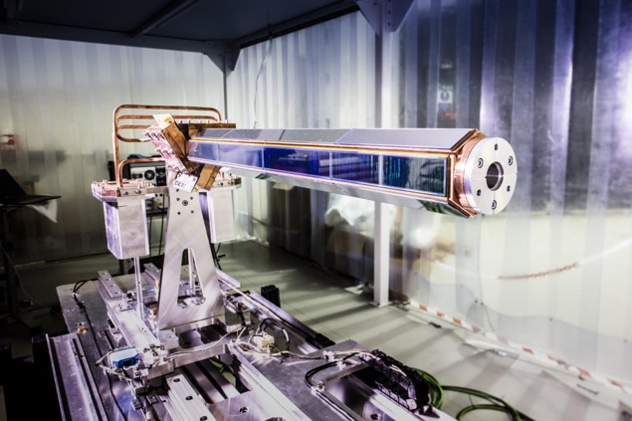
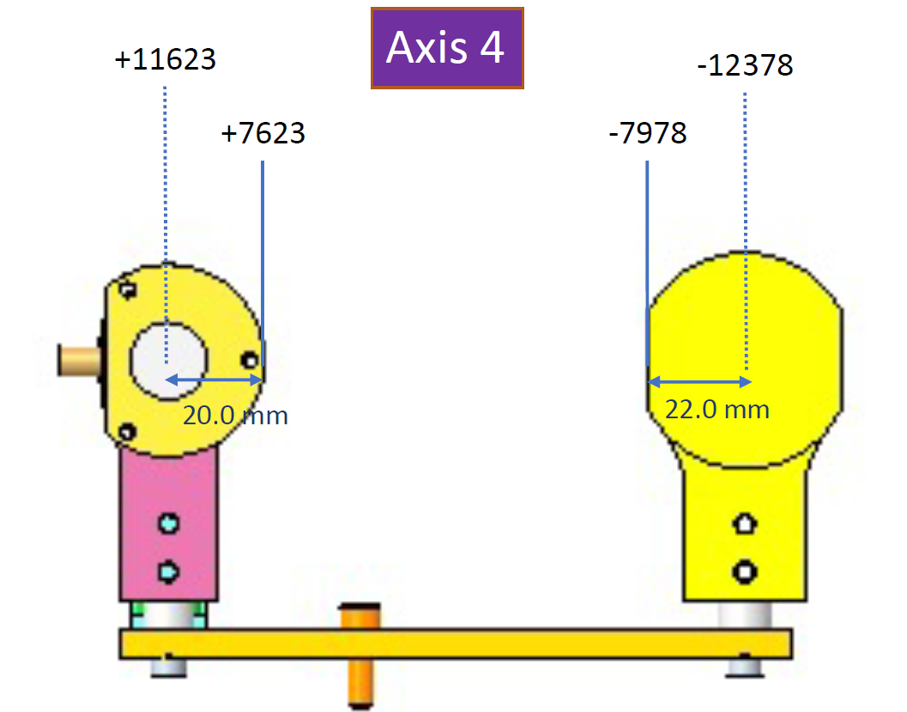
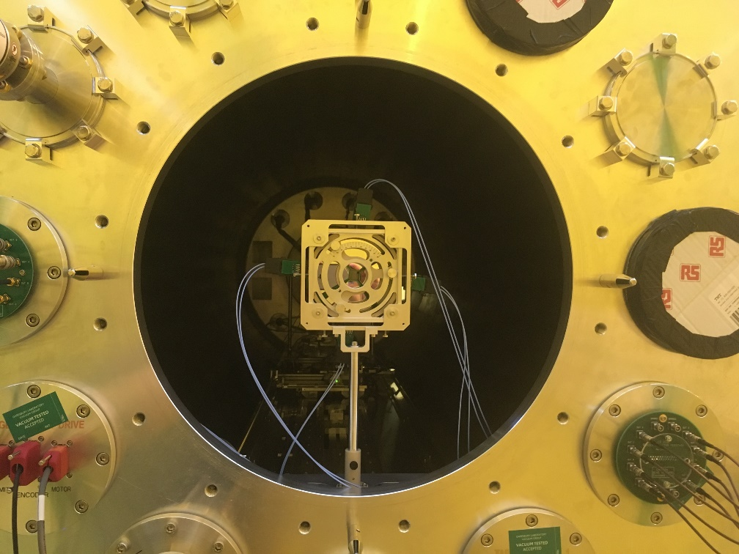
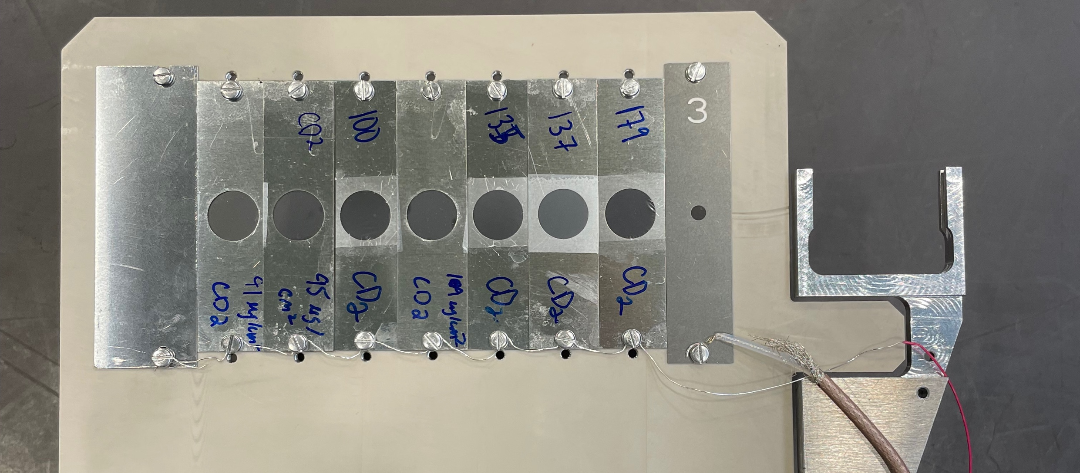
ISS

Slide 11
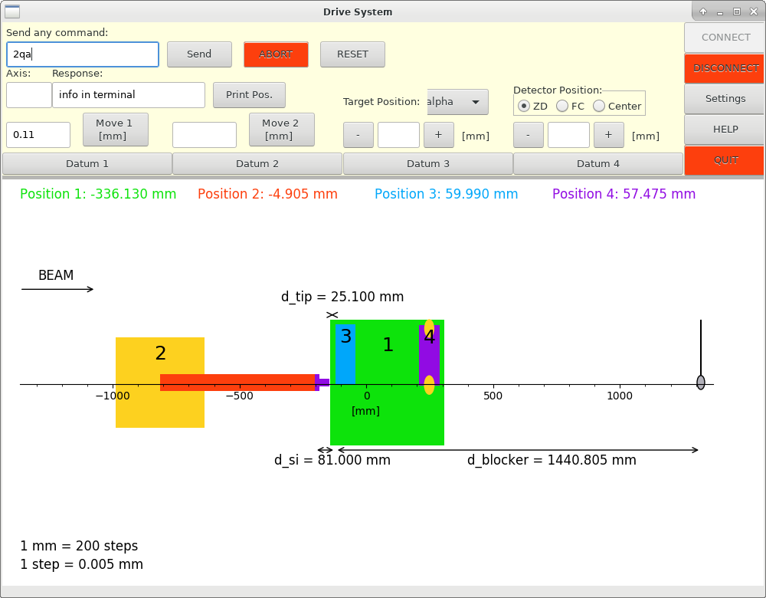
Moving axis
Precision~10μm

Slide 12

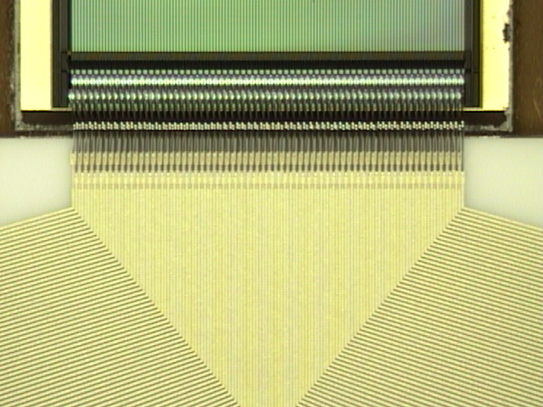
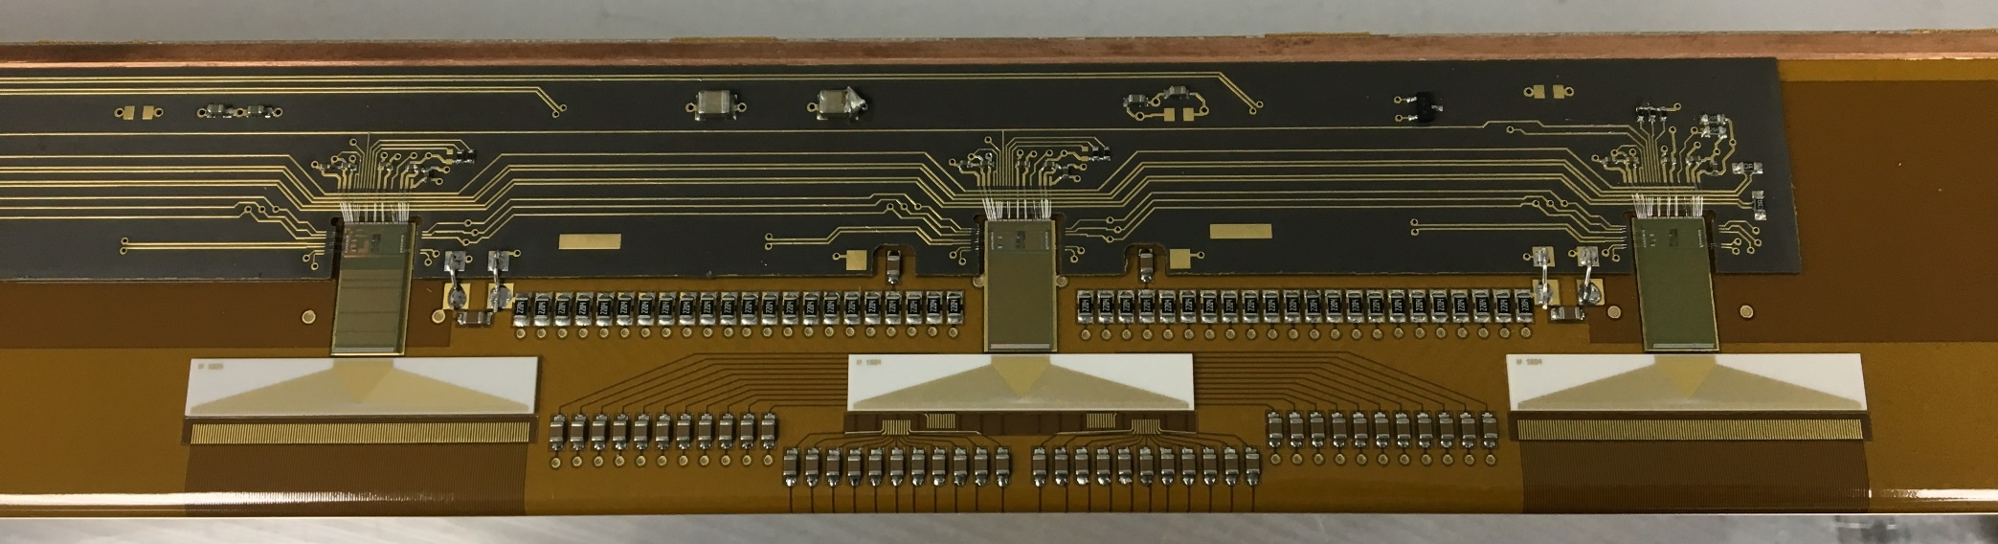
Advanced Liverpool Array
6-sided 4 DSSDs + ASIC readout.
Each detector consists of strips:
  x: 128 x 0.95mm.
  y: 11 x 2mm.
1668 channels readout
Total length of silicon is 510.4mm (486.4mm active)

Slide 13
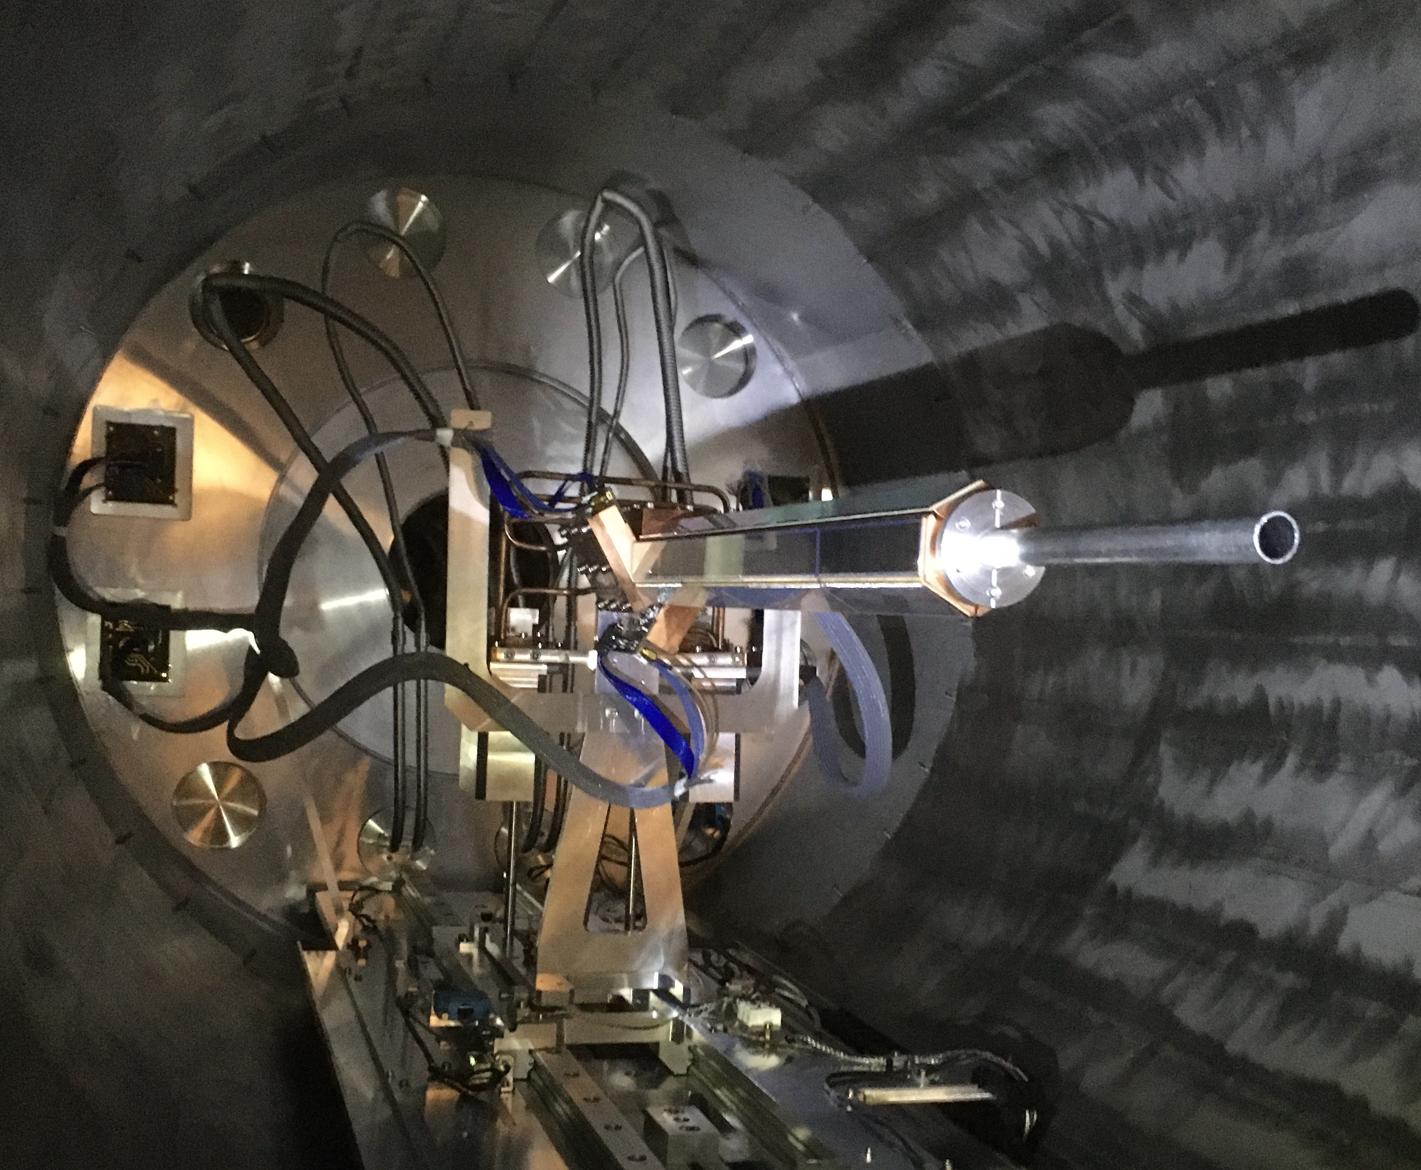
“The Silencer”
Not enough time resolution
Can’t measure cyclotron period
No particle identification
Cannot distinguish between one orbit or 2 or more
Pipe blocks multiple orbit trajectories

Slide 14
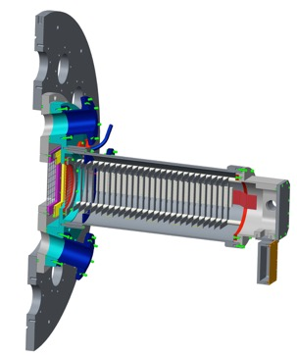
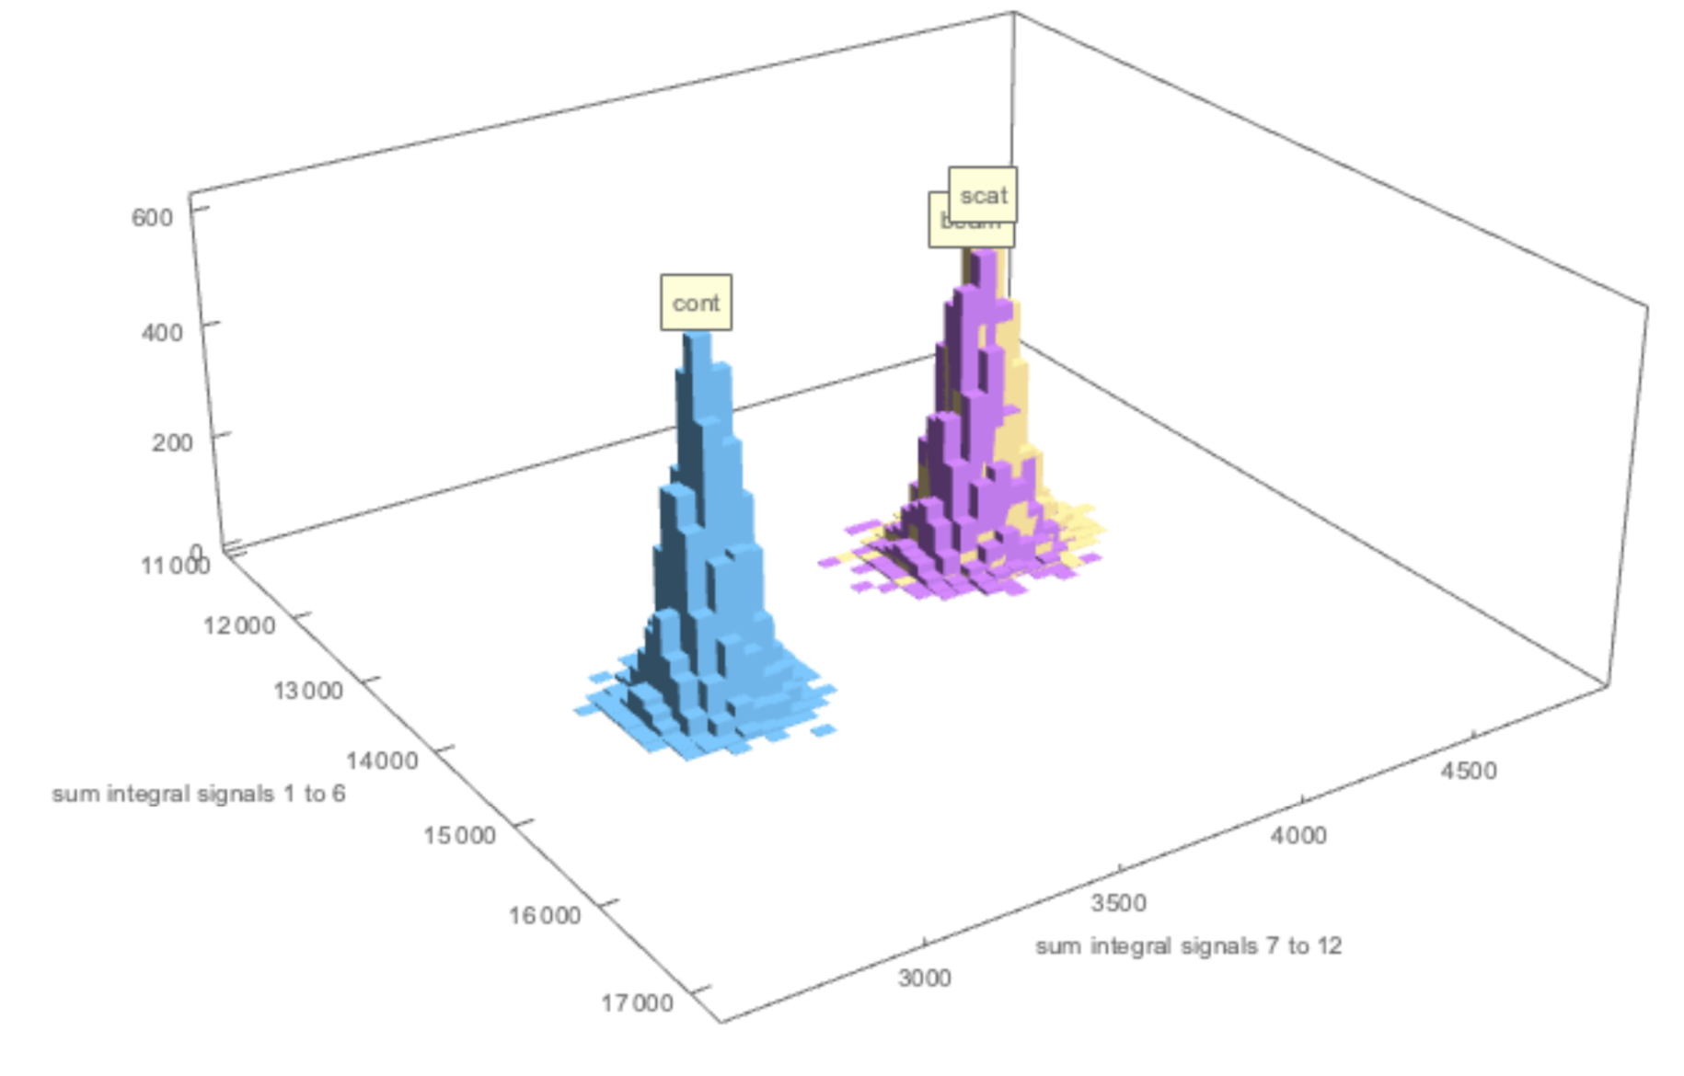
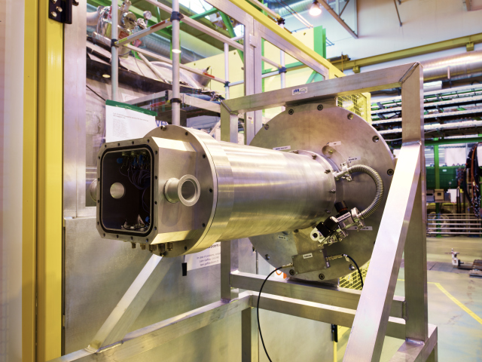
Gas ionization chamber
Up to 100 kHz counting.
Segmented with digital readout
Sample dE/dx along track of recoils
Beam composition identification
MWPC for position sensitivity and time reference
⁹²Kr
⁹³Kr
⁹²Rb

Slide 15
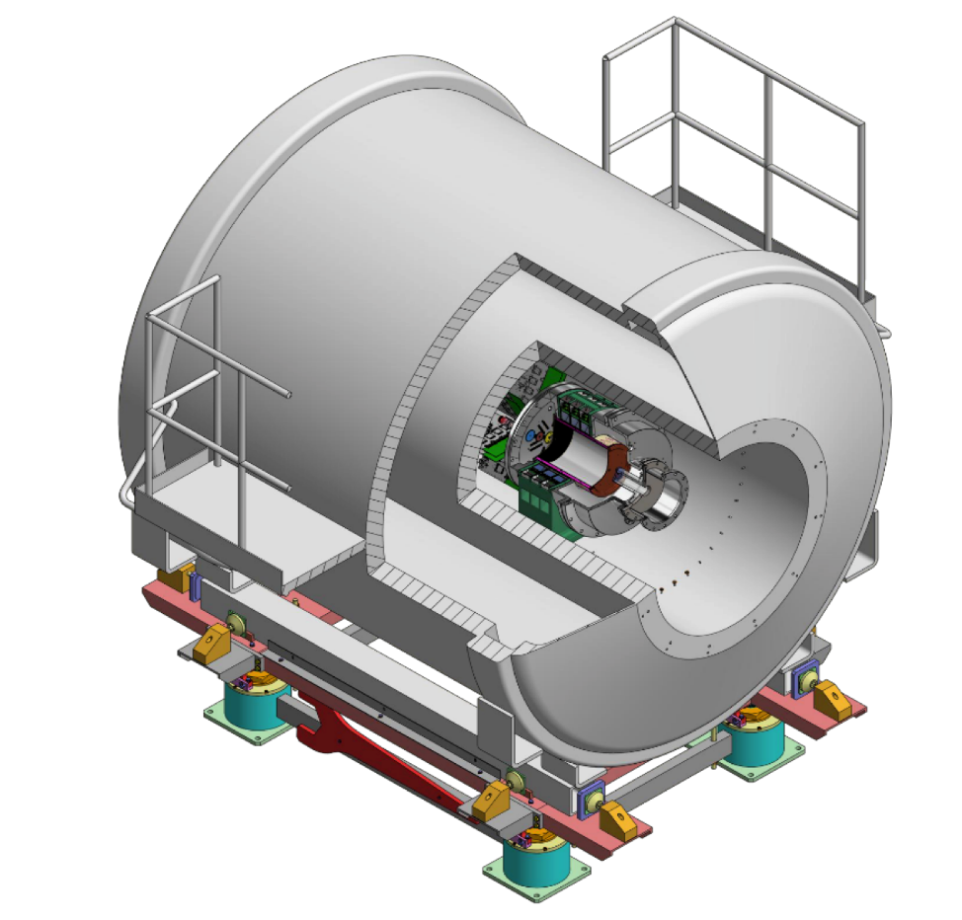
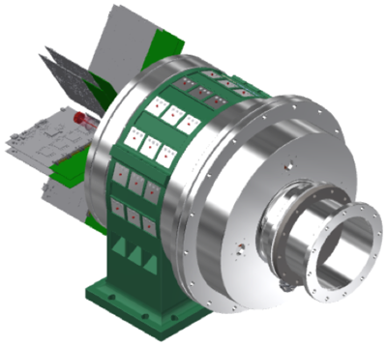


SpecMat
SpecMat – R. Raabe
Time-projection chamber
Active target
Helium or hydrogen species as gas
CeBr₃ detectors array for gamma-ray detection
Figures made by Oleksii Poleschchuk

Slide 16
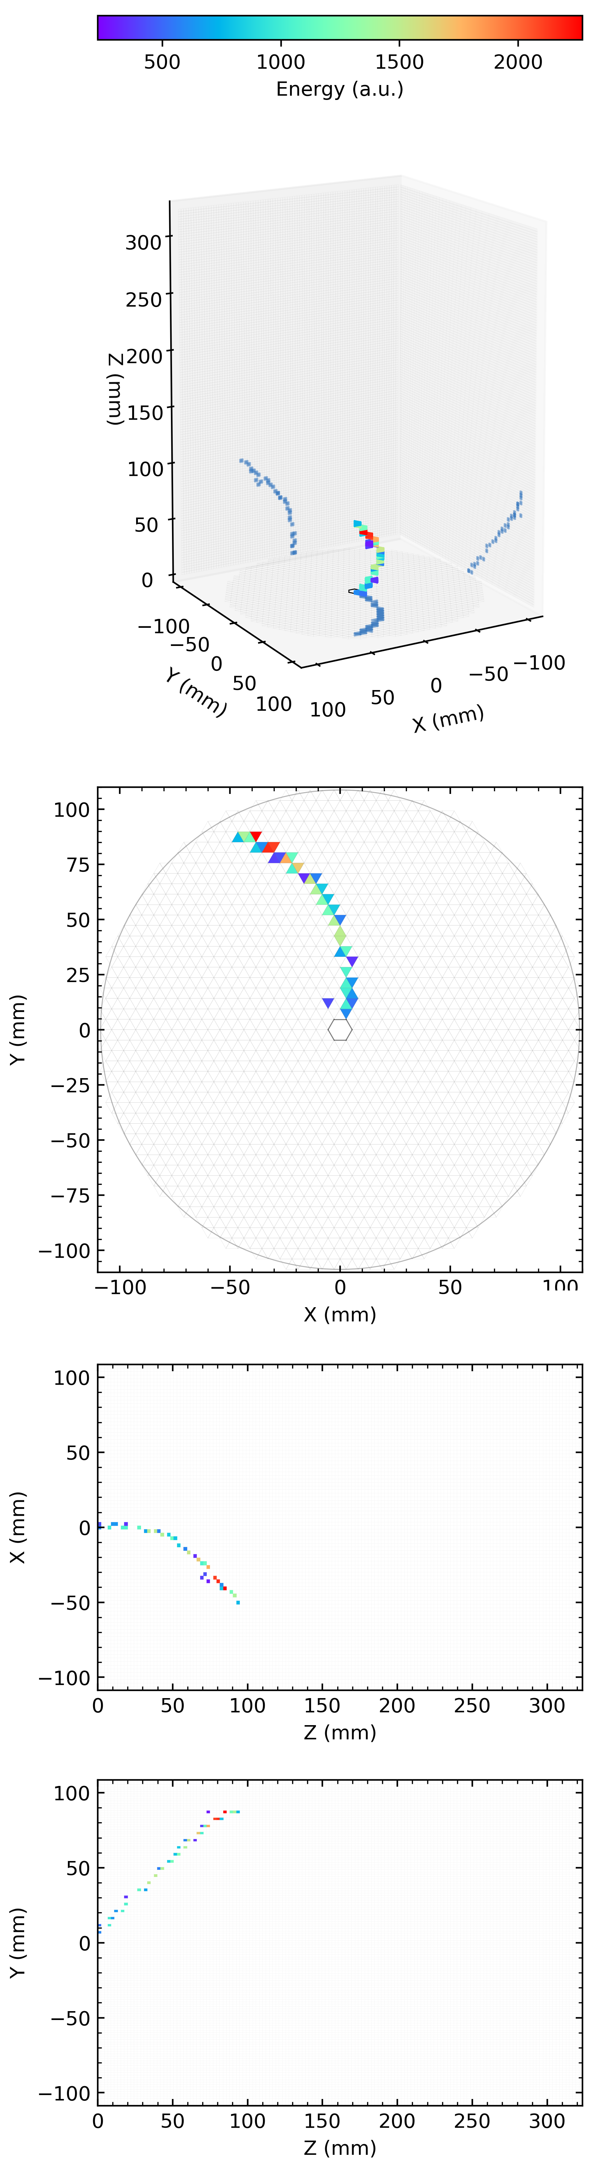
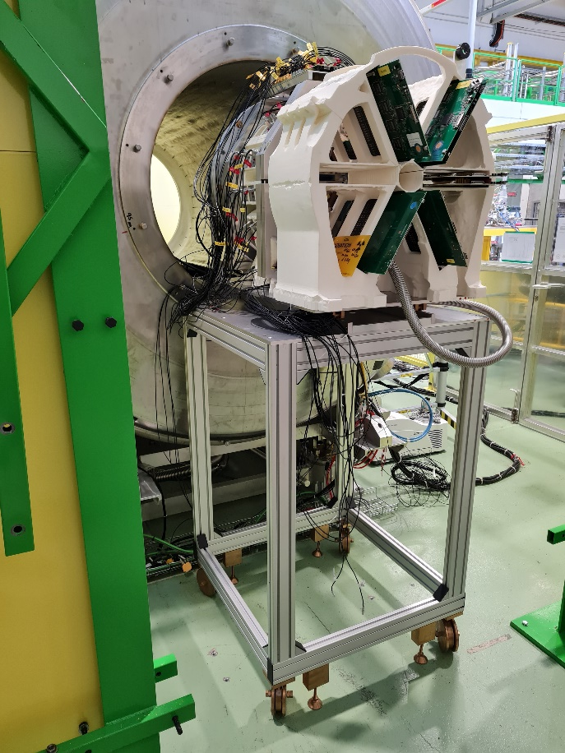
Tests of the SpecMAT active target in ISS
Measured α-particle
track in B=2.5T
SpecMAT installation in the superconducting magnet
Images provided by O. Poleshchuk

Slide 17
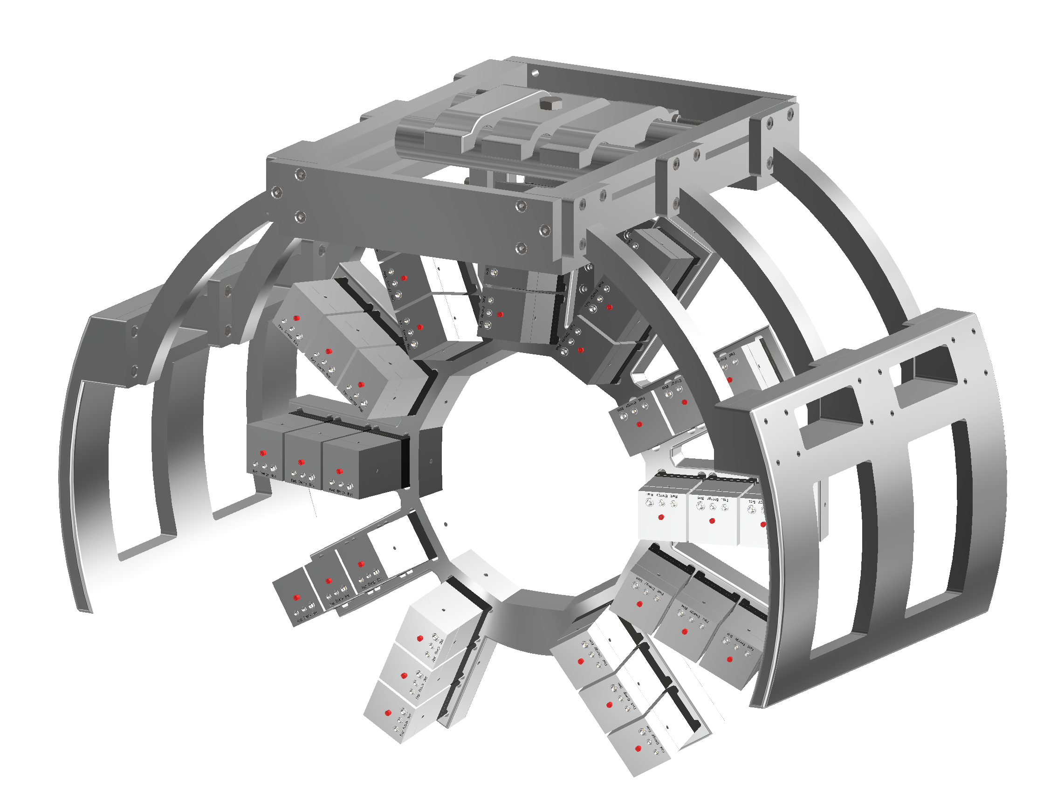
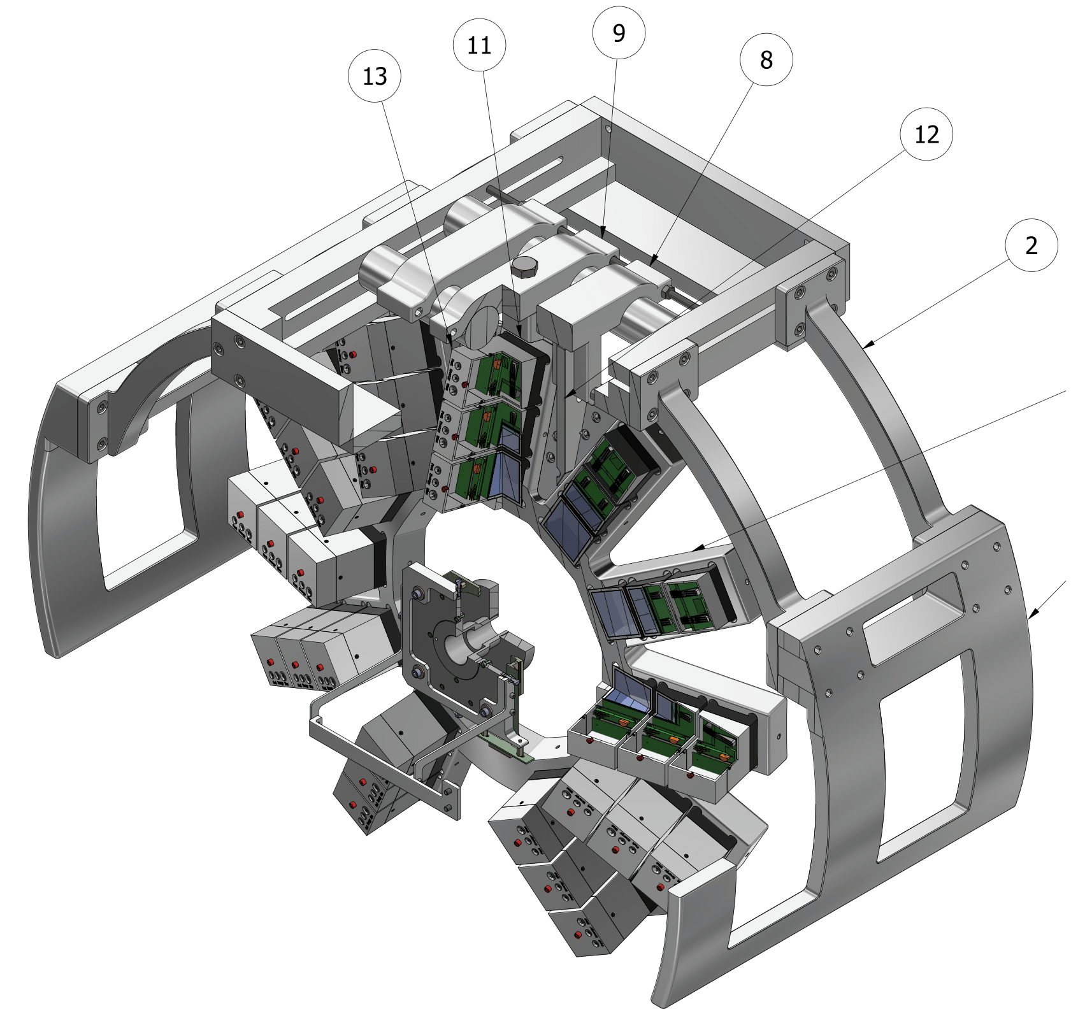
(d,p) reactions with a gamma array
In November we plan to run (d,p) reactions with the SpecMAT CeBr₃ array
Images provided by O. Poleshchuk

Slide 18
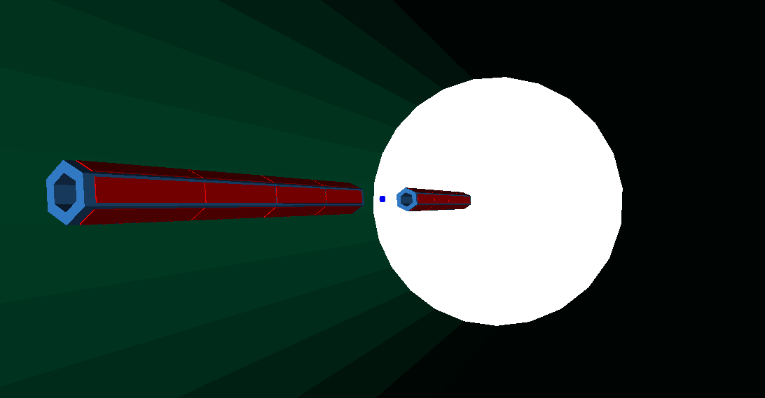
Future
Many reaction channels forward-going in lab. frame:
  Interest shown already in e.g. (d,d’), (d,³He)
  Foreseen to rotate geometry for these measurements.
  Limit for recoil angles passing through (A>120) or around array (A<30) + beam diagnostics, etc.
Physics for free in dual-array mode ← Increasing output
New possibilities e.g. coincidences between arrays.
Courtesy of L. Gaffney U. Liverpool

Slide 19
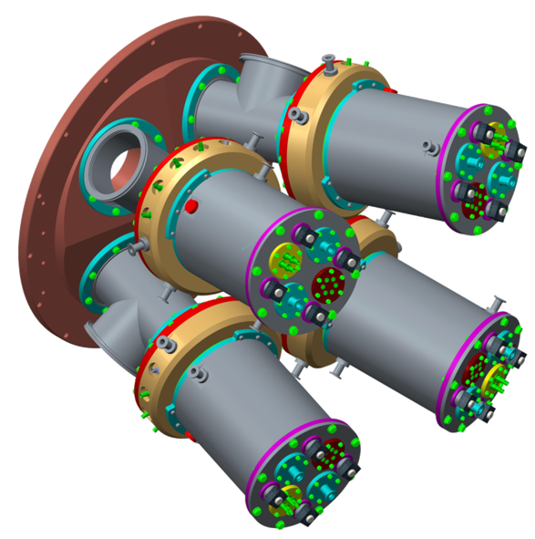
Future
Multi-Bragg chamber to study fissioning
(d,pF) reactions
Direct measurement of fission barriers. Simultaneously probing above and below Sn.
Fragments are boosted into a small solid angle in inverse kinematics. Full Bragg peak spectroscopy possible due to energy of fragments.
Detection of proton in coincidence with fission fragments provides clean event selection. Angular distribution -> l of fissioning state.

Slide 20
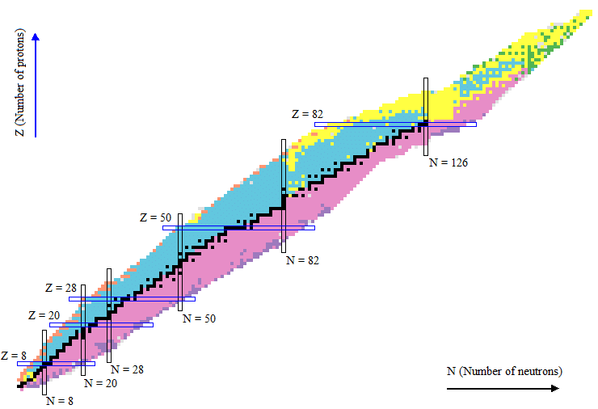
Experiments pre-2020
²⁰⁶Hg(d,p) IS689 Kay
²⁸Mg(d,p) IS680 Sharp

Slide 21
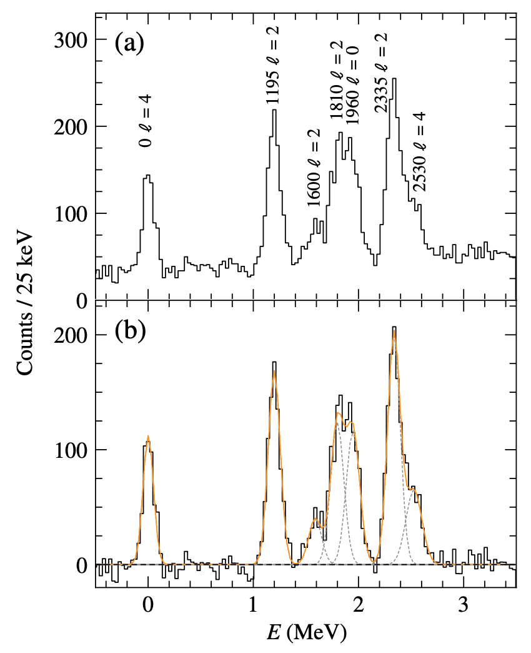

ISS first results – ²⁰⁷Hg
Measurements in 2018 with HELIOS array and DAQ - Argonne
²⁰⁶Hg(d,p) – first step into region south-east of ²⁰⁸Pb
First ²⁰⁷Hg level scheme
T. L. Tang et al., Phys. Rev. Lett 124, 062502 (2020)

Slide 22
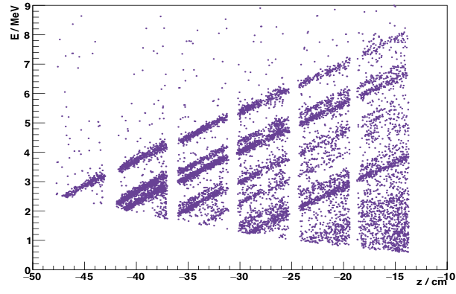
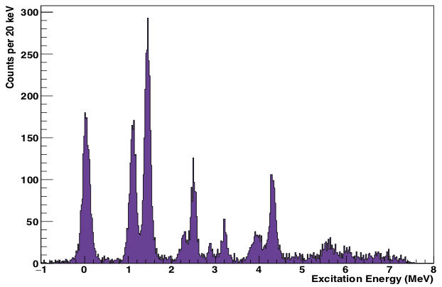
ISS first results – ²⁹Mg
Excitation energy resolution of ~140 keV.
Compared to DWBA calculations to make 𝓁 assignments.
2 days beam time with ~10^6 pps
MacGregor PHYSICAL REVIEW C 104, L051301 (2021)

Slide 23
Experiments 2021-2022
²¹²Rn(d,p) IS689 Sharp
¹¹⁰Sn(d,p) IS686 Park
^{92,94}Kr(d,p) IS711 Gaffney (as we speak)
³⁰Mg(d,p) IS680 Sharp
(twice)
⁶⁸Ni(d,p) IS711 Gaffney (next month)
⁶¹Zn(d,p) IS675 Lotay
And even more in the books…
²⁷Na(d,p) IS710 Sharp
²²Ne(d,p) commissioning
¹¹Be(d,p) IS677 Chen

Slide 24
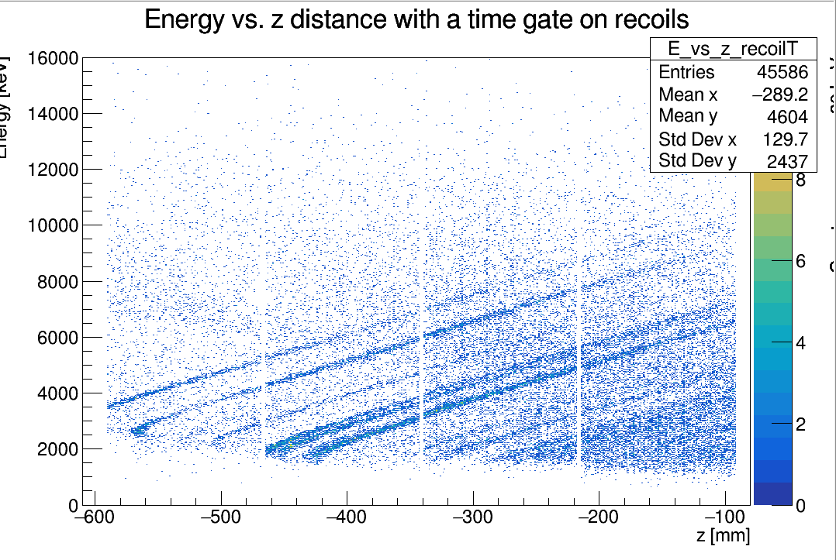
Test with stable ²²Ne
Array commissioned with stable ²²Ne
120 μg/cm² target
Kinematic lines correspond to excited states
“Bend” at the end of lines due to finite size of Si array
Can be corrected
Projection is excitation energy
Energy resolution~140 keV

Slide 25
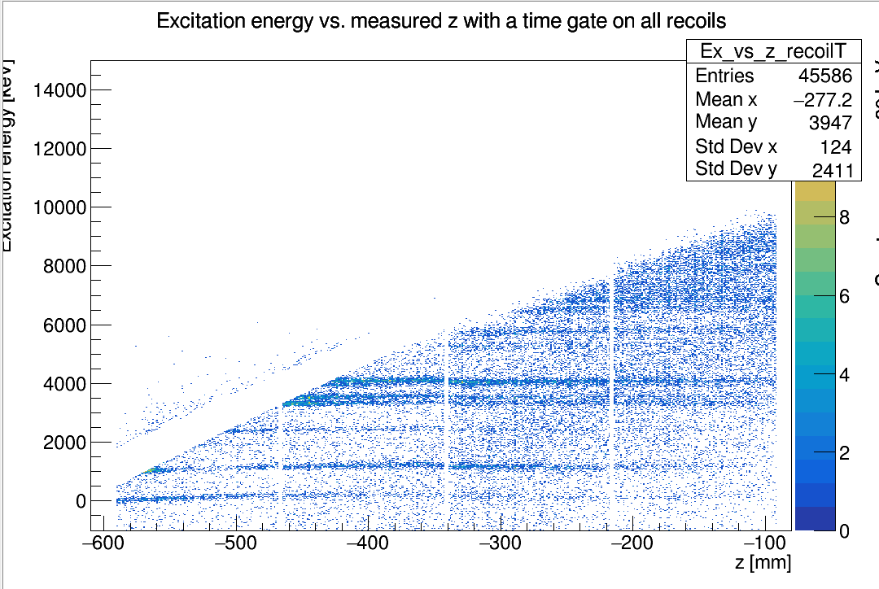

Test with stable ²²Ne
Array commissioned with stable ²²Ne
120 μg/cm² target
Kinematic lines correspond to excited states
“Bend” at the end of lines due to finite size of Si array
Can be corrected
Projection is excitation energy
Energy resolution~140 keV

Slide 26
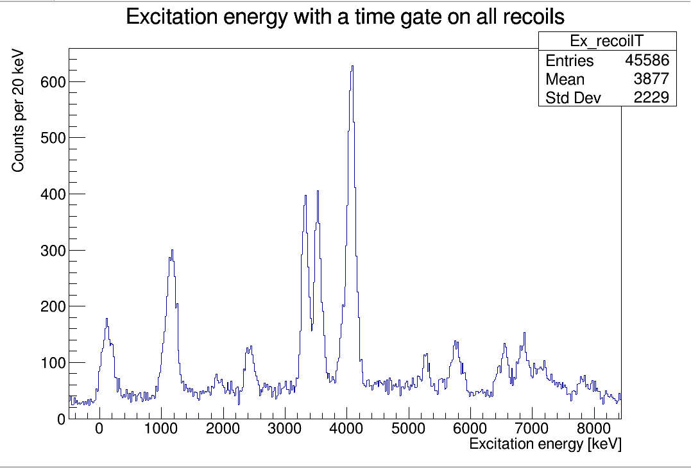
Test with stable ²²Ne
Array commissioned with stable ²²Ne
120 μg/cm² target
Kinematic lines correspond to excited states
“Bend” at the end of lines due to finite size of Si array
Can be corrected
Projection is excitation energy
Energy resolution~140 keV

Slide 27
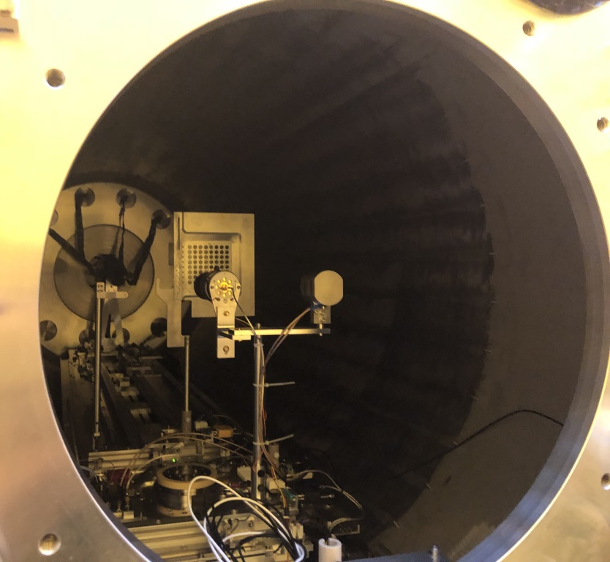
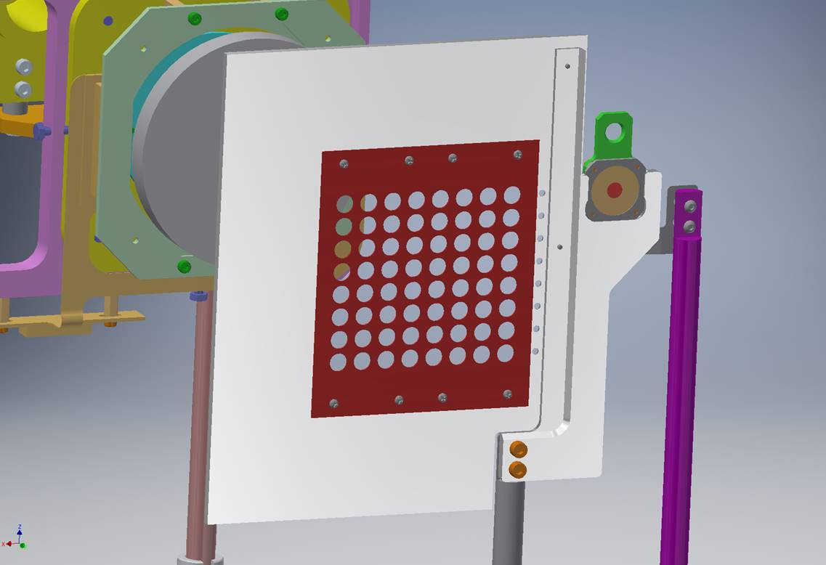
²¹²Rn(d,p)²¹³Rn – SP structure outside N=126
Beam: ~5x10⁶ pps of ²¹²Rn.
Produced using cold transfer line from the target – contaminants condense out of beam
A 7.63 MeV/u – highest total HIE-ISOLDE beam >1.6 GeV
Measured in singles mode
Beam purity >99%.
Using >20 deuterated polyethylene targets of ~125μg/cm2
ISS set to B-field of 2.5 T

Slide 28
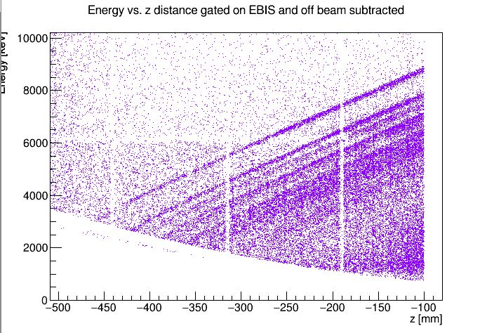
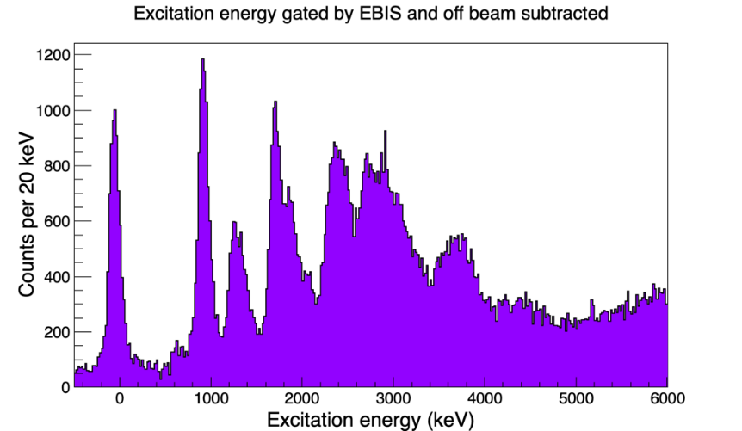
²¹²Rn(d,p)²¹³Rn – SP structure outside N=126
Best case resolution ~100 keV.
Background from alpha decay of beam and fusion-evaporation.
24 states identified up to 5 MeV – predominantly l=2 and 4 strength.
  Hints of i_{11/2} population above g_{9/2}
Slide courtesy of D. Sharp U. Manchester
Notes:
-characterise the neutron single-particle states along N = 127 - one neutron outside the N = 126 shell closure, north of 208Pb.
-

Slide 29
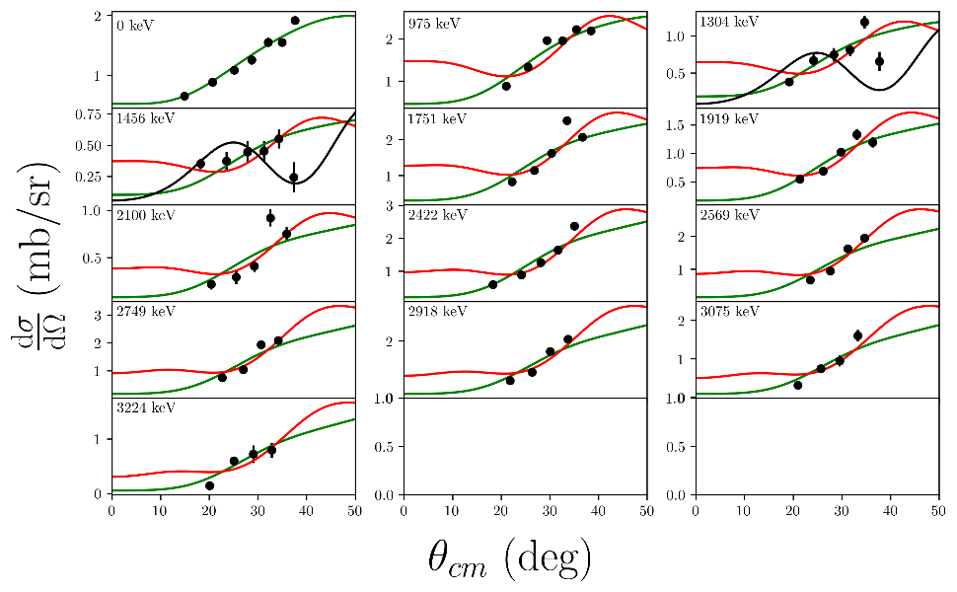
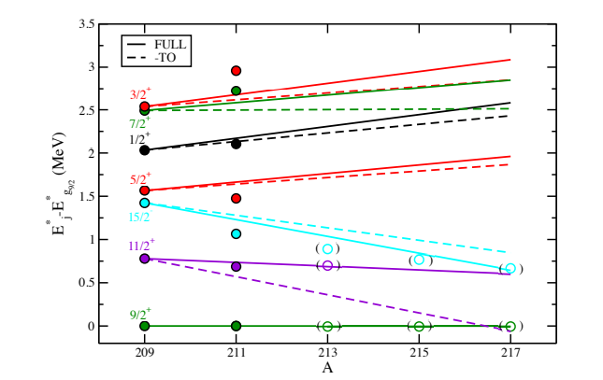
²¹²Rn(d,p)²¹³Rn – SP structure outside N=126
Best case resolution ~100 keV.
Background from alpha decay of beam and fusion-evaporation.
24 states identified up to 5 MeV – predominantly l=2 and 4 strength.
  Hints of i_{11/2} population above g_{9/2}
Preliminary
Slide courtesy of D. Sharp U. Manchester
Notes:
-characterise the neutron single-particle states along N = 127 - one neutron outside the N = 126 shell closure, north of 208Pb.
-

Slide 30
Summary
Reaction in a magnetic field suffer no kinematic compression
High position sensitivity → good angular resolution
Improved energy resolution
Versatile ancillary detectors
Several upgrades planned

Slide 31




















Thanks to collaborators
PT MacGregor, DK Sharp, SJ Freeman,
SA Bennett, D Clarke,BD Cropper, K Garrett, University of Manchester, UK
CR Hoffman, BP Kay, JP Schiffer, TL Tang, J Chen, MD Gott, Argonne National Laboratory, USA
LP Gaffney, PA Butler, RD Page, A Dolan, C Everett, D Judson, M Satrazani, Liverpool, UK
EF Baader, F Browne, J Konki, B Olaizola, ISOLDE, CERN
MJG Borge, Instituto de Estructura de la Materia, CSIC, Spain
WN Catford, D Doherty, C Paxman, D Reed, L Canete, C O’Shea, G Lotay Zs Podolyak, University of Surrey, UK
G de Angelis, ET Gregor, INFN, Legnaro, Italy
Th. Kroll, Technishe Universitat Darmstadt, Germany
M Labiche, IH Lazarus, P Papadakis, Daresbury, UK
RS Lubna, Florida State University, USA
I Martel, Universidad de Huelva, Spain
DG McNeel, University of Connecticut, USA
A. Arokiaraj, A Ceulemans, O Poleshchuk, R Raabe, J Yang, KU Leuven, Belgium
F Recchia, Universita degli Studi di Padova and INFN Padova
MR Mumpower, Los Alamos National Laboratory, USA
F Flavigny, Orsay and LPC Caen, France
Y Ayyad, Universidade de Santiago de Compostela
JF Smith, UWS, UK
SV Szwec, JYFL and University of Helsinki, Finland

Slide 32
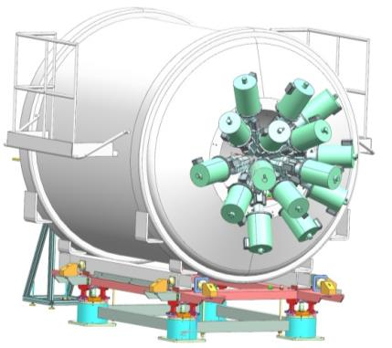
Future
HPGe spectrometer for γ-ray detection.
  Tests in the solenoid field with Padova group.
  Possibility for plunger measurements (Manchester)

