Slide 1




EuNPC22 Conference
Study of ²⁰Ne spectroscopy from new experiments on ¹⁹F(p,α₀) and
¹⁹F(p, α_{π}) reactions at low energies
A New Phenomenological Model for the description of Heavy-Ion Fusion Cross Sections
Ivano Lombardo
Dip. di Fisica e Astronomia - Università di Catania
INFN - Sezione di Catania
Istituto Nazionale di Fisica Nucleare – Sezione di Catania
ivano.lombardo@ct.infn.it
Santiago de Compostela, 27/10/2022
1

Slide 2

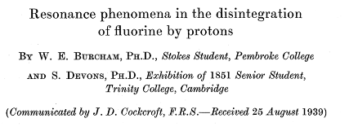
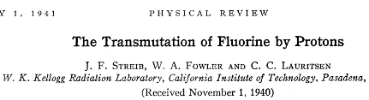

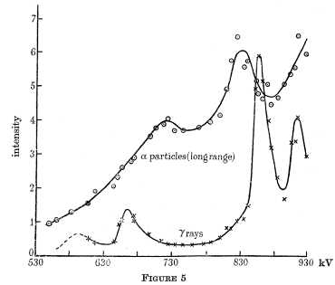
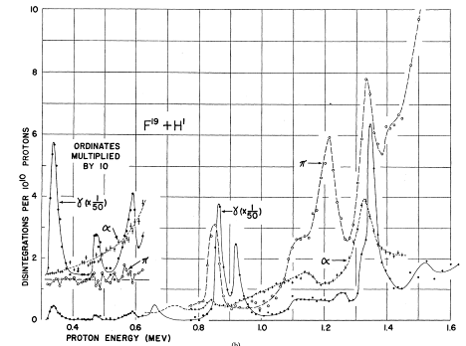
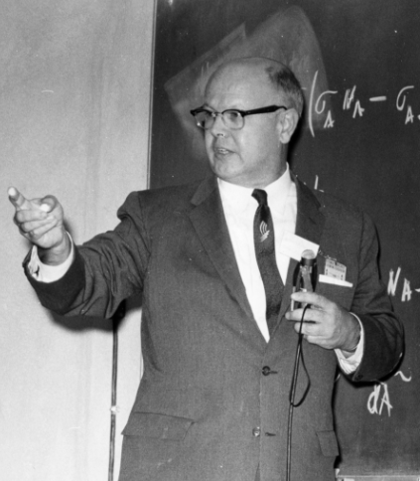

¹⁹F(p,α): a long standing story
Fluorine transmutation by proton bombardment → Cockroft and Walton studies (~1930) → emission of long range α particles
Istituto Nazionale di Fisica Nucleare – Sezione di Catania
Other very old paper on this subject
2
Notes:
2

Slide 3
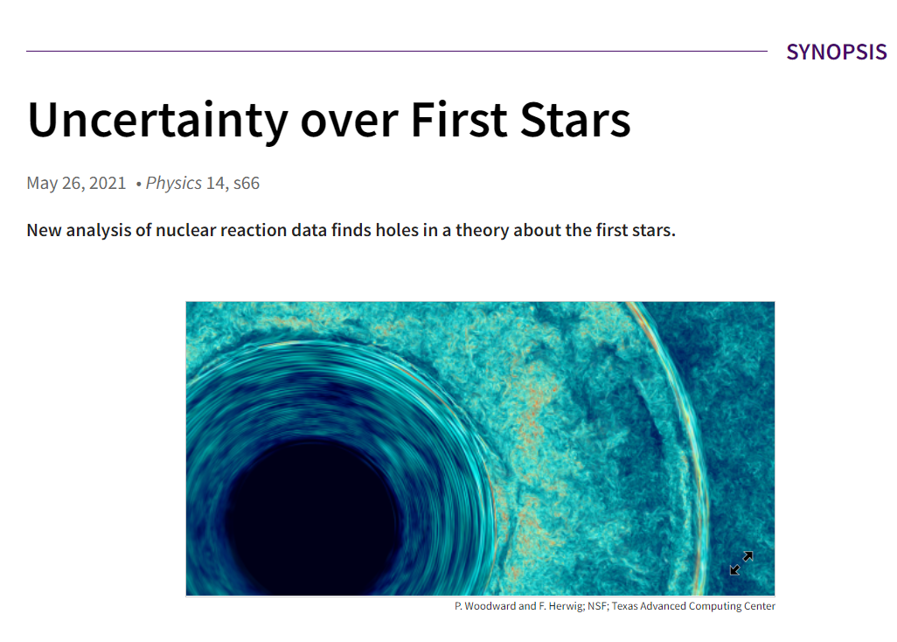
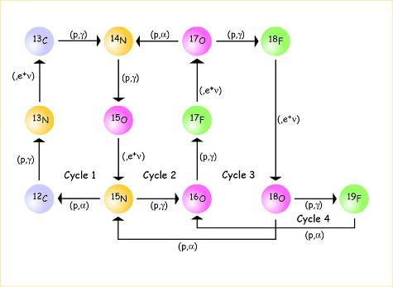
Importance of ¹⁹F(p,α₀) at low energy
¹⁹F(p,α₀) and ¹⁹F(p,α_{π}) at sub-barrier energies → cluster states in ²⁰Ne
(Arima, Gillet, Ginocchio PRL 1970)
Ambiguities of ²⁰Ne spectroscopy near the S_{p} (12.844 MeV) (Tilley et al, NPA 1999)
Low energy S(E) → astrophysical interest (CNO, fluorine nucleosynthesis)
αγ
12.84
α₃
p+¹⁹F
7.12 1⁻
Istituto Nazionale di Fisica Nucleare – Sezione di Catania
α₂
6.92 2⁺
α₁
6.13 3⁻
α_{π}
6.05 0⁺
CNO
cycle
α₀
4.73
GS 0⁺
α+¹⁶O
0
E_{x}
_{(MeV)}
²⁰Ne
R.J. De Boer, …, I.L., et al PRC 103 (2021)
3

Slide 4
¹⁹F(p,α_{0,π}): ambiguities in the literature
Istituto Nazionale di Fisica Nucleare – Sezione di Catania
NACRE
D.R. Tilley et al, Nucl. Phys. A 636 (1998) 249
New experiment in Naples & LNL → α₀
4
Notes:
4

Slide 5
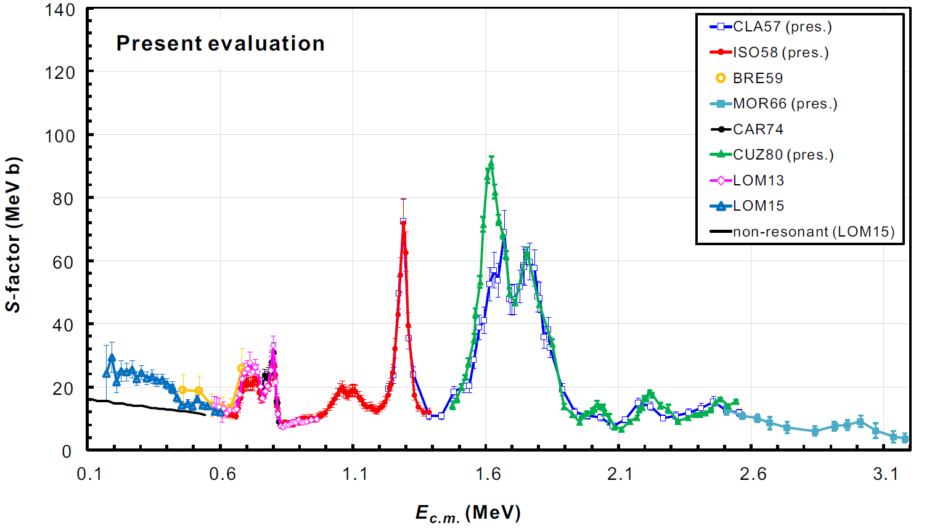
¹⁹F(p,α₀): a general revision of literature data
Naples and LNL experiments → new data in the E_{p} = 0.2-1.0 MeV range
J.J. He, I. Lombardo, D. Dell’Aquila, Y. Xu,
L.Y. Zhang, W.P. Liu, Chinese Phys. C 42 (2018) 015001
Naples
Re-evaluation of all
the literature data
Istituto Nazionale di Fisica Nucleare – Sezione di Catania
LNL
LNL: I. Lombardo, D. Dell’Aquila et al, Phys. Lett. B. 748 (2015)
Naples: I. Lombardo, D. Dell’Aquila et al, J. Phys. G 40 (2013)
Solid database to make spectroscopic studies on ²⁰Ne → Coupled with α_{π} and elastic scattering data!
α_{π} channel → very puzzling!
5

Slide 6
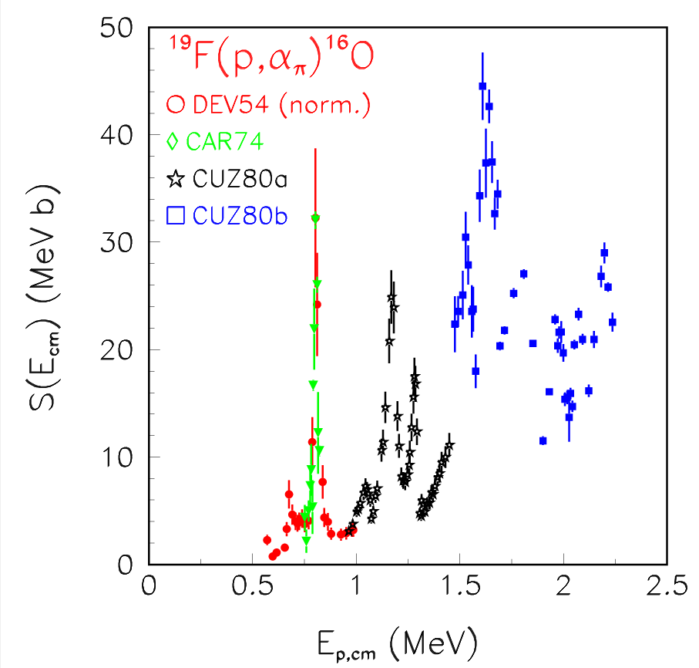
¹⁹F(p,α_{π}): a general revision of literature data
¹⁹F(p,α_{π}) reaction → extremely difficult to measure!
(π emitting state, 6.05 MeV, very close to the 6.13 MeV γ-emitting state)
Istituto Nazionale di Fisica Nucleare – Sezione di Catania
Unpublished data:
P. Cuzzocrea et al, INFN/BE 80/5 (1980)
New measurements → very welcome!
6

Slide 7
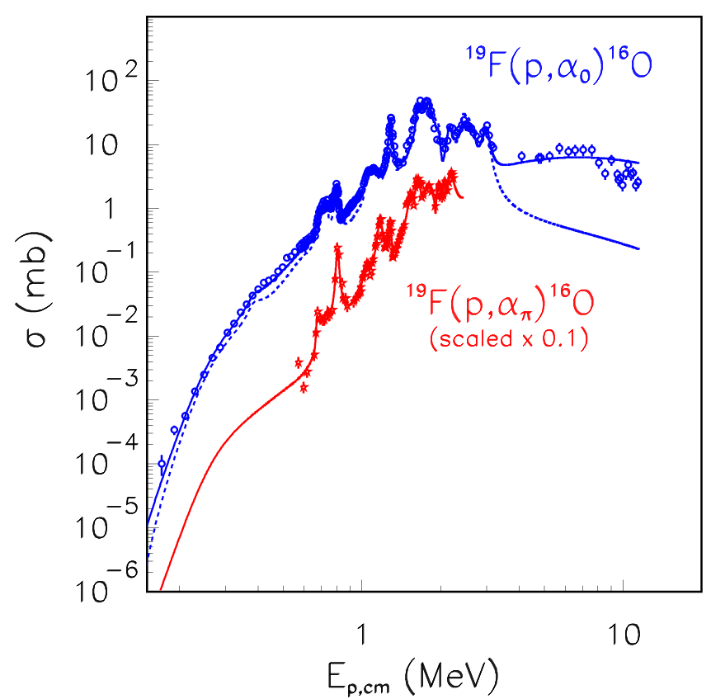
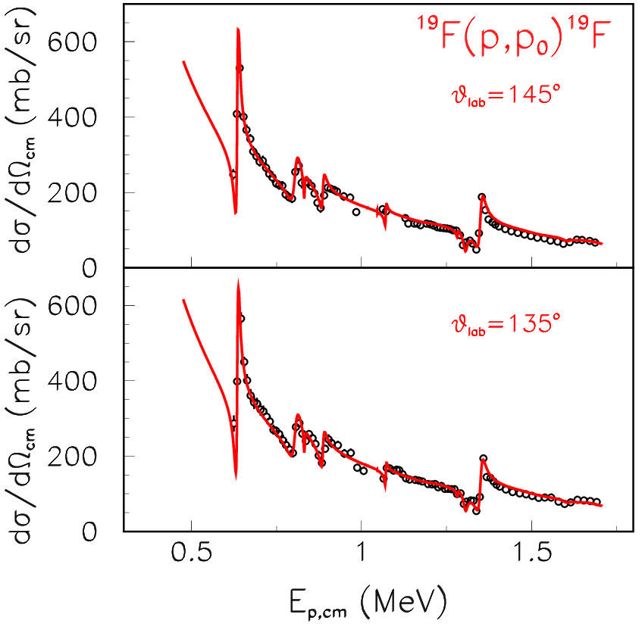
²⁰Ne spectroscopy via R-matrix fit of data
R-matrix approach: Thomas & Lane, Rev. Mod. Phys. 30 (1958) 257
Implemented for many-channels, many-levels in the AZURE2 code
R. Azuma et al, Phys. Rev. C 81 (2010)
Quantum mechanics: only natural parity states!
Quantum mechanics: all J^{π} are possible
with direct
no direct
Istituto Nazionale di Fisica Nucleare – Sezione di Catania
p
t
¹⁶O
For E_{p,cm} ≈ 5.6 – 11.2 MeV → Temmer [PRL 12 (1964)] pointed out, from fluctuation analysis, the major role (90-95%) played by direct effects
s- and p-wave direct contributions → broad high energy poles adjusted to data
High energy data → fixing direct term!
7

Slide 8
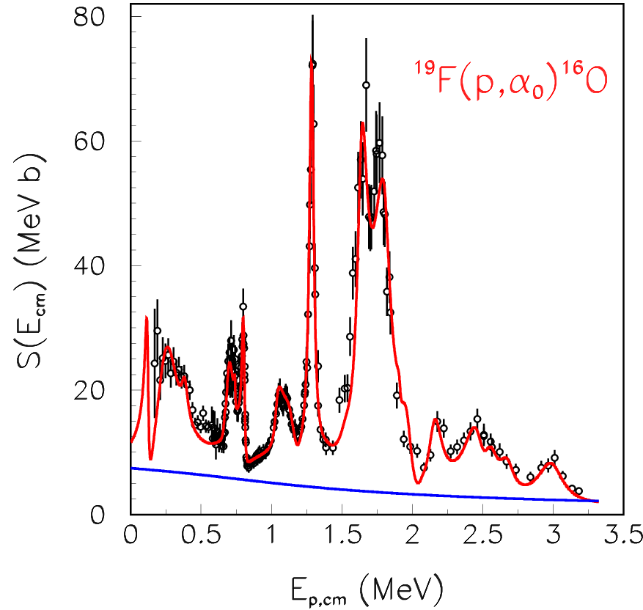
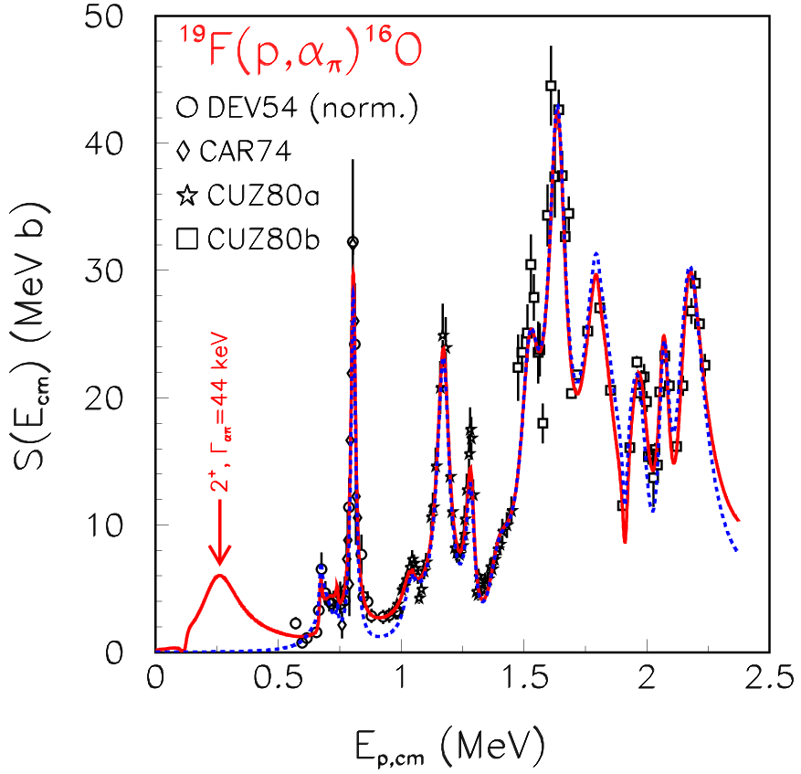
²⁰Ne spectroscopy via R-matrix fit of data
Effect of resonances → 28 natural parity states come into play!
2⁺
Istituto Nazionale di Fisica Nucleare – Sezione di Catania
direct
no 2⁺ state
2⁺ state at 0.262 MeV (E_{x}=13.095 MeV) seen in I.L. et al, Phys. Lett. 748 B (2015)
C.M. Laymon et al, Phys. Rev. C 45 (1992) analyzed the ¹⁶O(α,α_{π}) reaction. The E_{x}=13.095 MeV is seen → it has a large α-cluster structure, with non-vanishing Γ_{απ} partial width (44 keV).
Including such a partial width → big change in the α_{π} S-factor!
Importance of studying data from several channels!
8

Slide 9
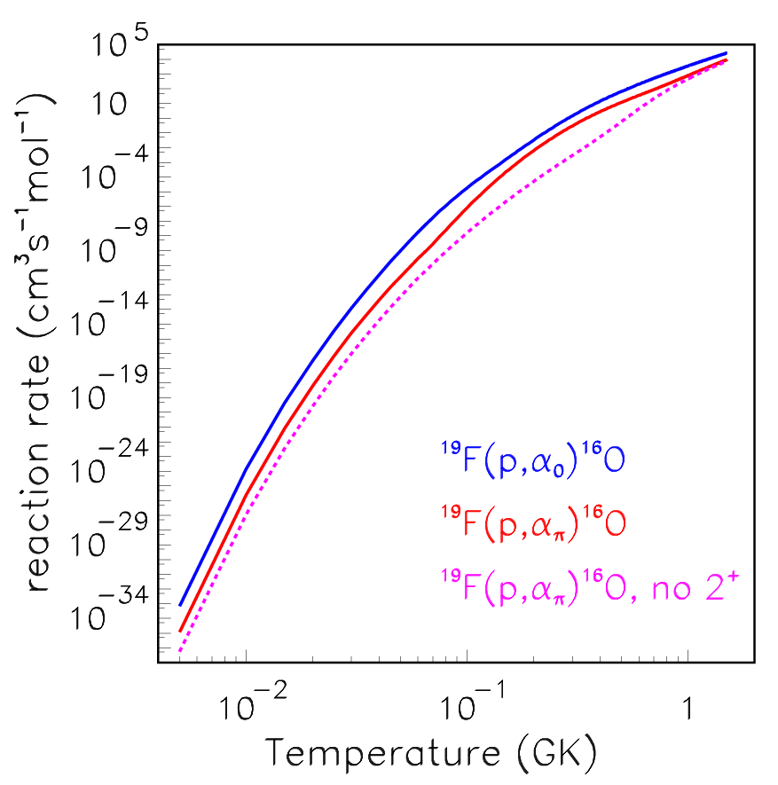
Consequences on the reaction rate
Interesting influence of the low energy 2⁺ state at 13.095 MeV on the α_{π} reaction rate at T ≈ 0.2 – 0.7 GK
Amounts up to 20% of the α₀ reaction rate → non negligible
α₀ is confirmed to dominate at low temeratures (T<0.1 GK), the typical regime of fluorine destruction in the AGB stars
α_{γ} channel → future studies. Needed to constrain definitely the ¹⁹F(p,α)¹⁶O total RR.
Also inelastic scattering data are important → thermalization processes (E_{x}=110, 197 keV)
Help from new high-performances γ-ray detectors
Istituto Nazionale di Fisica Nucleare – Sezione di Catania
I. Lombardo et al, PRC 100 (2019)
9

Slide 10
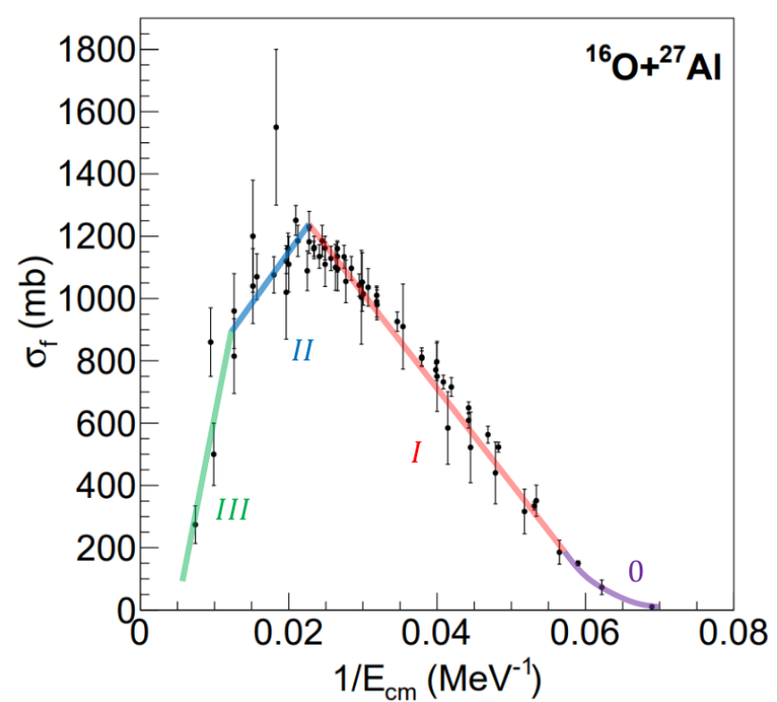
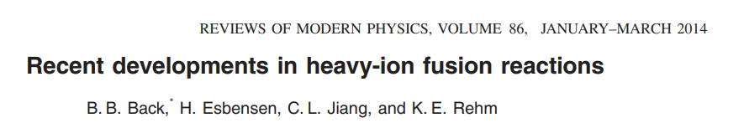
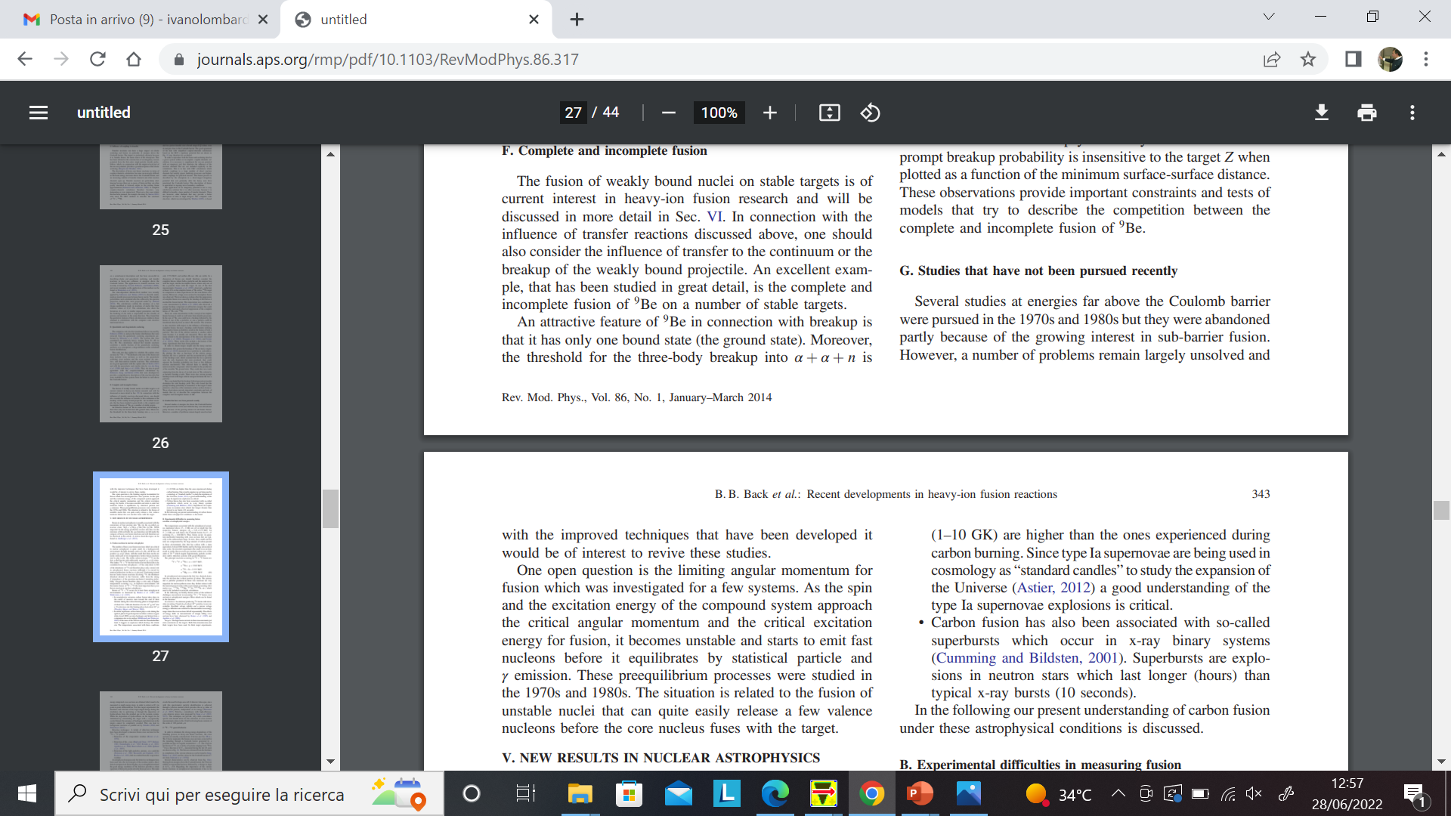
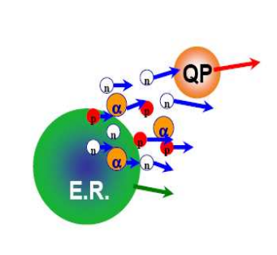

Overbarrier HI fusion
HI fusion→ fundamental for probing the limits of existence of nuclei subject to sizeable centrifugal and thermal stresses
DIC, ICF
CF vs MNT
Istituto Nazionale di Fisica Nucleare – Sezione di Catania
ICF, MF
tunneling & deformations
Regions II & III → $saturation of{ ℓ}_{crit}$
New measurements in regions II – III !
10

Slide 11
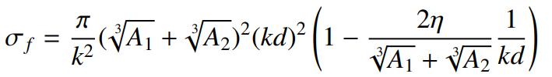



Heavy ion fusion and the SOD method
Heavy ion fusion → cross section estimates with the «sum of difference» (SOD) method
$$σ_{reaz}=2π\int_{θ_{a}}^{π}{\left({\frac{dσ}{dΩ}}_{Ruth}−{\frac{dσ}{dΩ}}_{el}\right)\sin{θ}dθ}$$
$$σ_{el}\left(θ\right)/σ_{Ruth}$$
$$1$$
Conside$ring an angle θ_{f}≥θ_{a}$, we will have:
$$elastic$$
dominant
$$absorption$$
dominant
$$σ_{f}=2π\int_{θ_{f}}^{π}{\left({\frac{dσ}{dΩ}}_{Ruth}−{\frac{dσ}{dΩ}}_{el}\right)\sin{θ}dθ}$$
$$θ_{cm}$$
Istituto Nazionale di Fisica Nucleare – Sezione di Catania
a$nd, being θ≥θ_{f},{\frac{dσ}{dΩ}}_{el}≪{\frac{dσ}{dΩ}}_{Ruth}$, it follows that:
$$σ_{f}≈2π\int_{θ_{f}}^{π}{{\frac{dσ}{dΩ}}_{Ruth}\sin{θ}dθ}=π{\left(\frac{η}{k}\right)}^{2}\cot^{2}{\frac{θ_{f}}{2}}=\frac{π}{k^{2}}{\left(kD\right)}^{2}\left(1−\frac{2η}{kD}\right)$$
Defining now $D≡d\left(\sqrt[3]{A_{1}}+\sqrt[3]{A_{2}}\right)$ we will have:
Arco di Ferdinando e Carolina
monumento FAI
R. Giordano et al, Lett. Nuovo Cim. A 61 (1981) 182
11

Slide 12
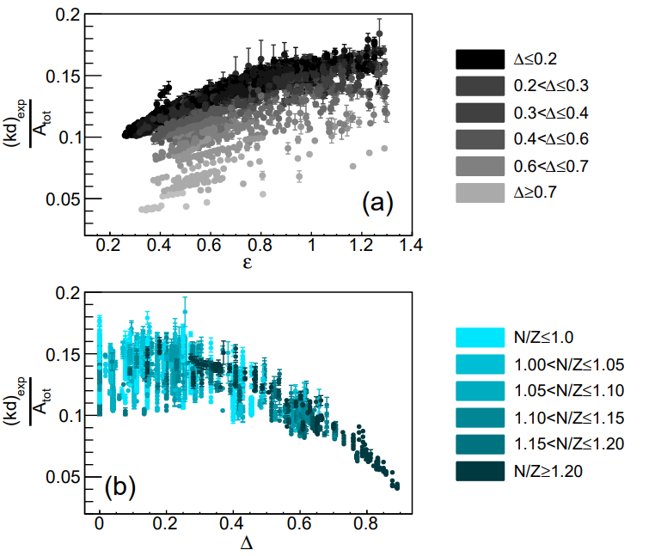
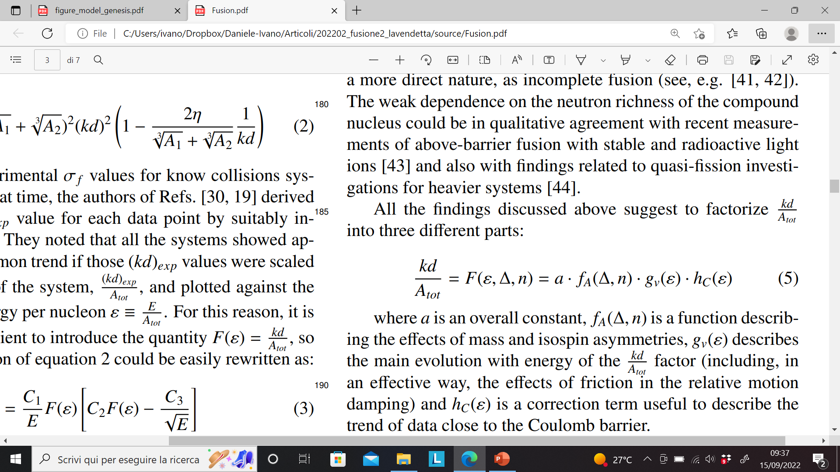
Heavy Ion fusion: the role of the kd value
Experimentally → $σ_{f}$ very different one another… but kd?
$$ε=\frac{E_{cm}}{A_{tot}}$$
Istituto Nazionale di Fisica Nucleare – Sezione di Catania
12

Slide 13
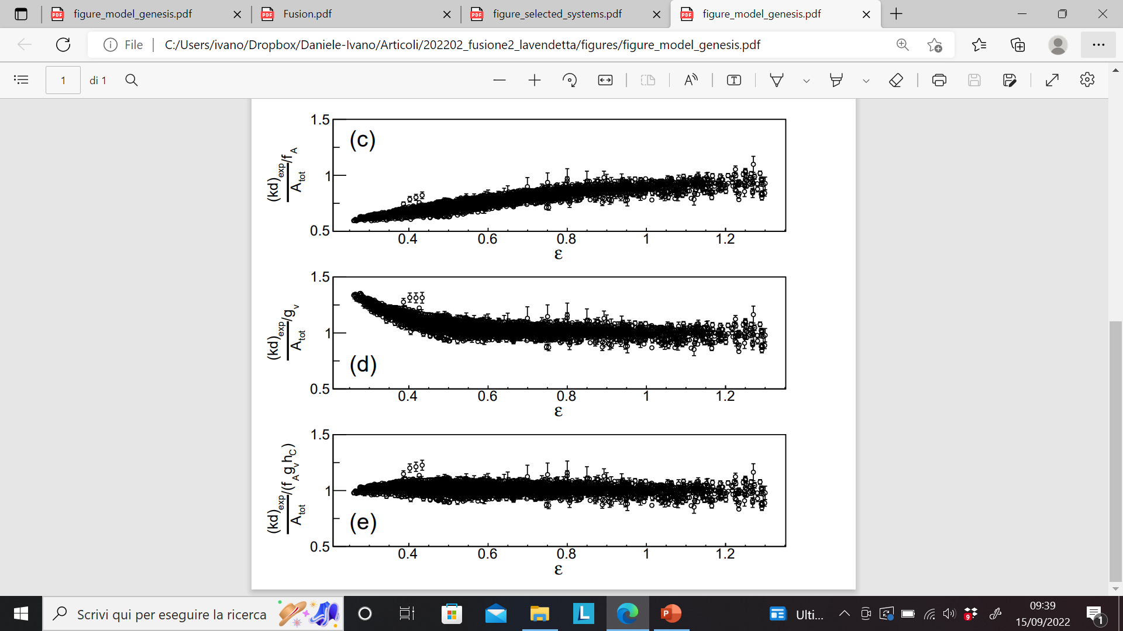
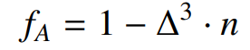
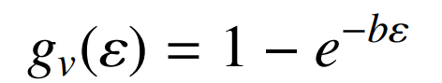
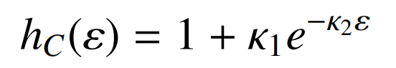
Heavy Ion fusion: the role of the kd value
$$ε=\frac{E_{cm}}{A_{tot}}$$
Istituto Nazionale di Fisica Nucleare – Sezione di Catania
Asimmetry, velocity damping, residual Coulomb effect
13

Slide 14
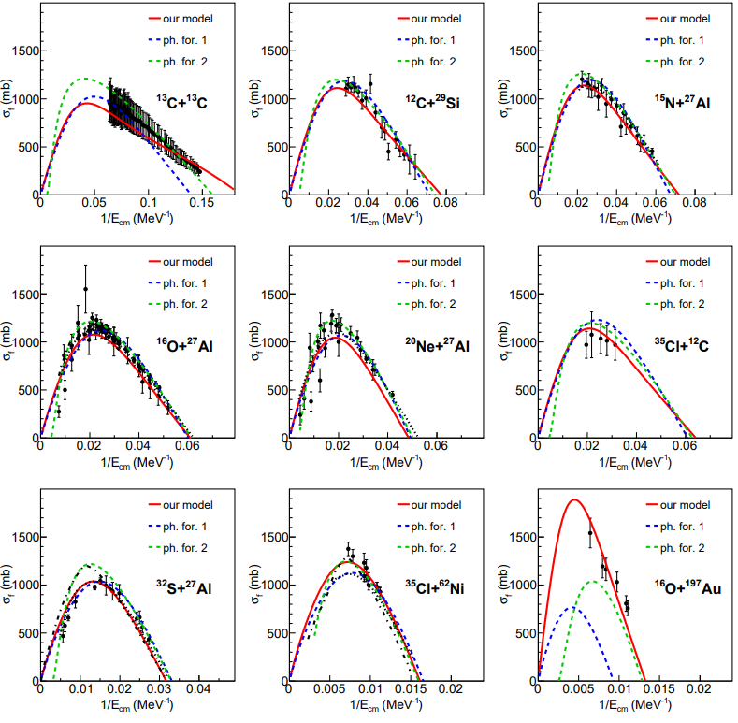
Heavy Ion fusion: cross sections
Porto & Sambataro,
Nuovo Cim. A 83 (1984) 339
Kailas & Gupta,
Zeit. Phys. A 302 (1981) 355
Istituto Nazionale di Fisica Nucleare – Sezione di Catania
Note: estimates of the absolute cross section as a function of E is fundamental in the planning and quantitative analysis of this type of NR!
Excellent reproduction of 250 systems and 4500 data points!
14

Slide 15
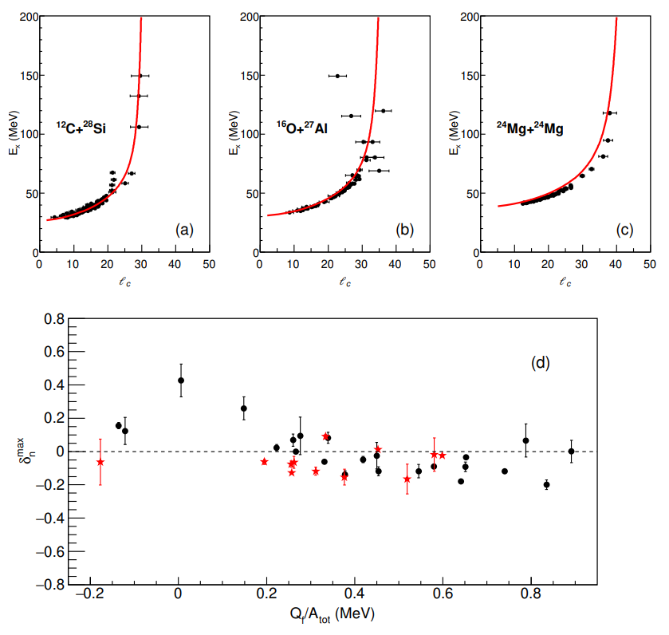
Heavy Ion fusion and nuclear structure effects
Clear saturation of ℓ
Effect of Q-value never shown before on the maximum value ​​of the fusion cross section
No obvious clustering dependency on σ_{max}
Other studies in progress → search for shell effects
Istituto Nazionale di Fisica Nucleare – Sezione di Catania
Thank you for the attention!
15

