Slide 1


Recent results from the DESPEC campaign at GSI
G.Benzoni (INFN Milano)
for the HISPEC/DESPEC collaboration

Slide 2
Recent results from the DESPEC campaign at GSI
HISPEC-DESPEC Scientific Goals
  Short description of equipment and readiness
  Evolution of the campaigns from 2020 ➔ 2022
  Recent results
  Perspectives

Slide 3
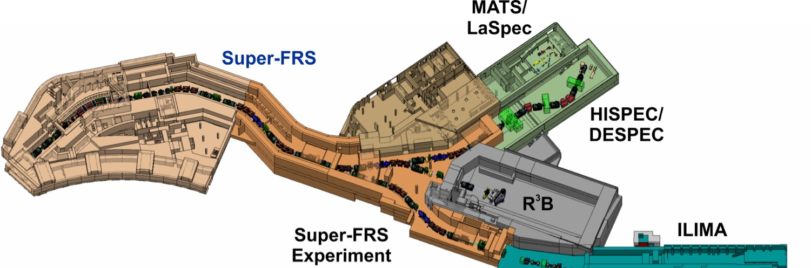
HISPEC-DESPEC Scientific Goals
➔ Spectroscopic studies both in-beam (HISPEC) and with stopped ions (DESPEC)
Key goals using unique GSI-FAIR beams:
Approach the r-process path along N=126: nucleosynthesis of heavy nuclei
Evolution of the shell structure and exotic nuclear shapes in uncharted nuclear territory
Using the strength of HISPEC/DESPEC:
Use combination of unique detectors for complete spectroscopy on secondary beams with yields as low as one ion per hour

Slide 4

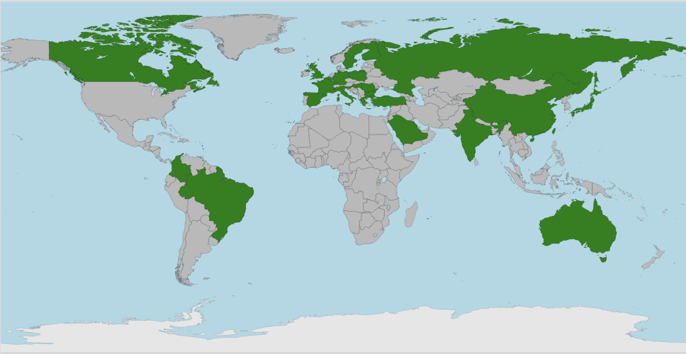
HISPEC-DESPEC Collaboration
~230 members
(PhD holders+ Students)
Management:
G.Benzoni (INFN Mi) Spokesperson
P.Reiter (Uni. Cologne) Deputy
M.Gorska-Ott (GSI) Local Project Manager
J.Gerl (GSI) Liason ad BR

Slide 5
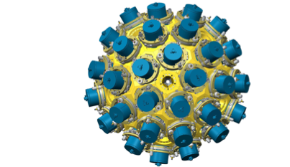
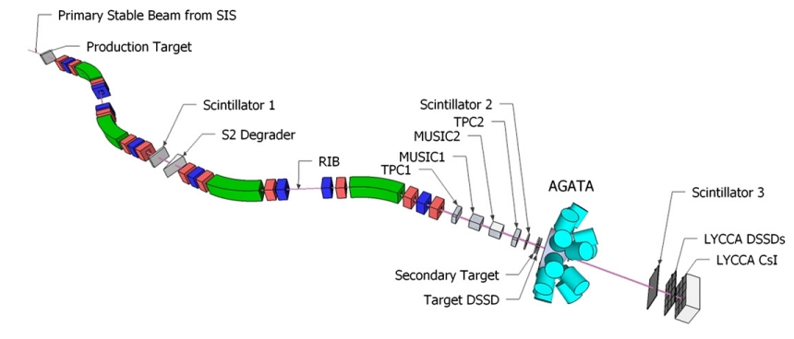
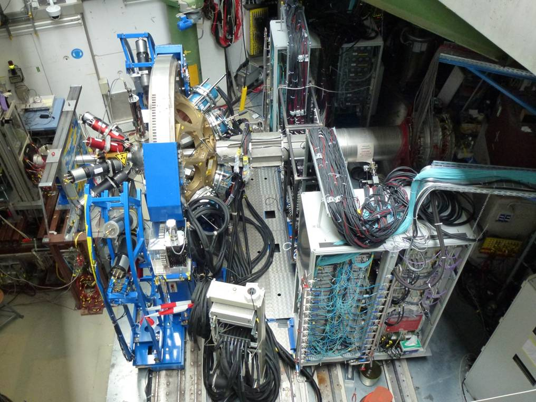

HISPEC revolves around the core instrument AGATA
AGATA: γ-tracking array
very high γ-ray efficiency
excellent peak-to-total ratio
unprecedented position resolution due to γ-ray tracking
Move to GSI > 2026
Physics opportunities with the Advanced Gamma Tracking Array: AGATA
W. Korten et al., Eur. Phys. J. A (2020) 56:137

Slide 6
DESPEC: Decay Spectroscopy
a complete picture of the β-decay process requires both high-resolution, high-efficiency studies and exclusive measurements
high-resolution: aiming at a detailed reconstruction of decay scheme. Exploits combination of AIDA+HPGe detectors, coupled to ancillaries such as FATIMA to enhance the sensitivity to specific observables (levels)
high-efficiency: Total Absorption Spectrometry technique, requires instead the use of highly efficient scintillator detectors aiming at measuring the full decay strength
exclusive measurements: aiming at studying specific quantities, such as delayed neutron emission probability and spectroscopy
✪ unique DESPEC instrumentation allows for:
High-resolution γ spectroscopy
Lifetime measurements
Delayed neutrons detection
B(GT) measurements

Slide 7
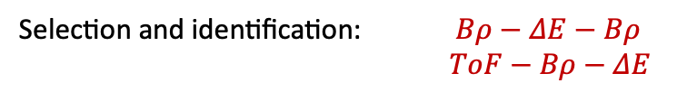
Decay measurements @ FRS/S-FRS – GSI-FAIR
FATIMA
FATIMA
Selection and identification: $Bρ−ΔE−Bρ$
$ToF−Bρ−ΔE$
S4 deg
FATIMA
SC42
AIDA
HPGe
S1
S3
S4
HPGe
S2
β⁻
Ion
γ
HPGe
βPlast
HPGe
FATIMA
FATIMA
FATIMA
Exotic nuclei will be firstly slowed down
• Implanted into multi-plane, highly segmented DSSD array
Ion- isomeric decay studies
• Implant - decay correlations
- Observe subsequent decays
- Measure half lives, branching ratios, decay energies

Slide 8
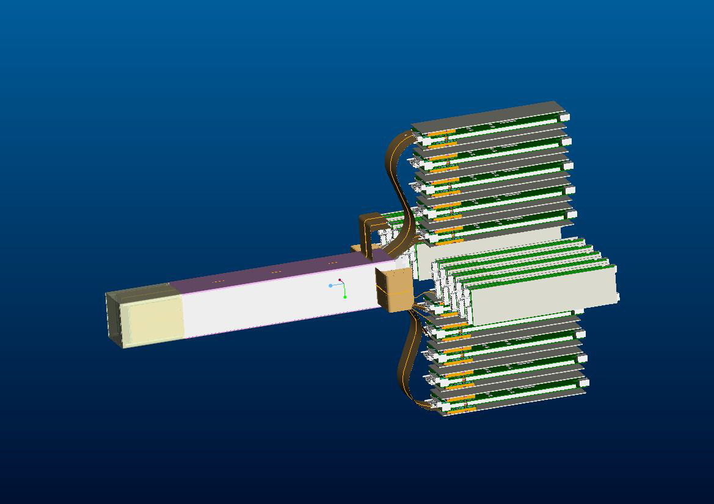
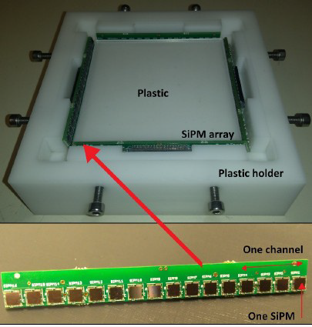
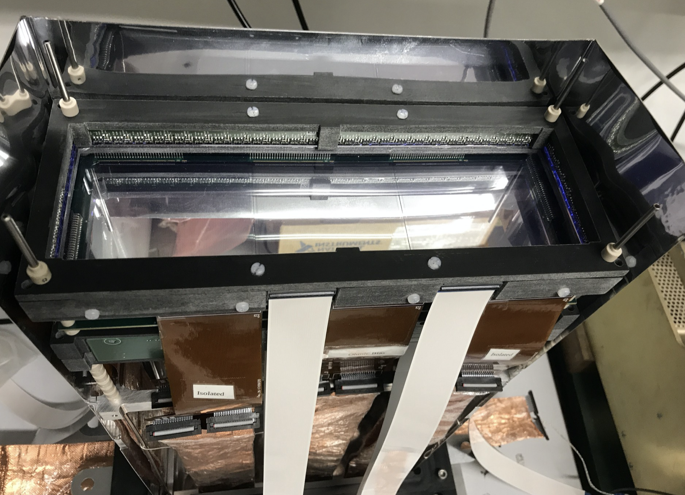
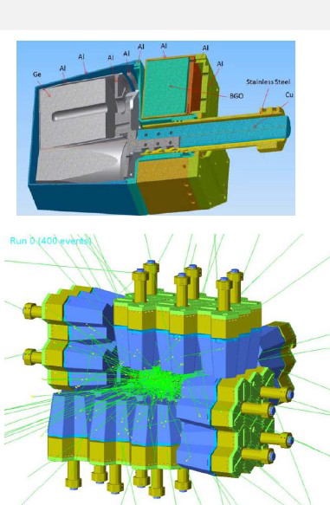
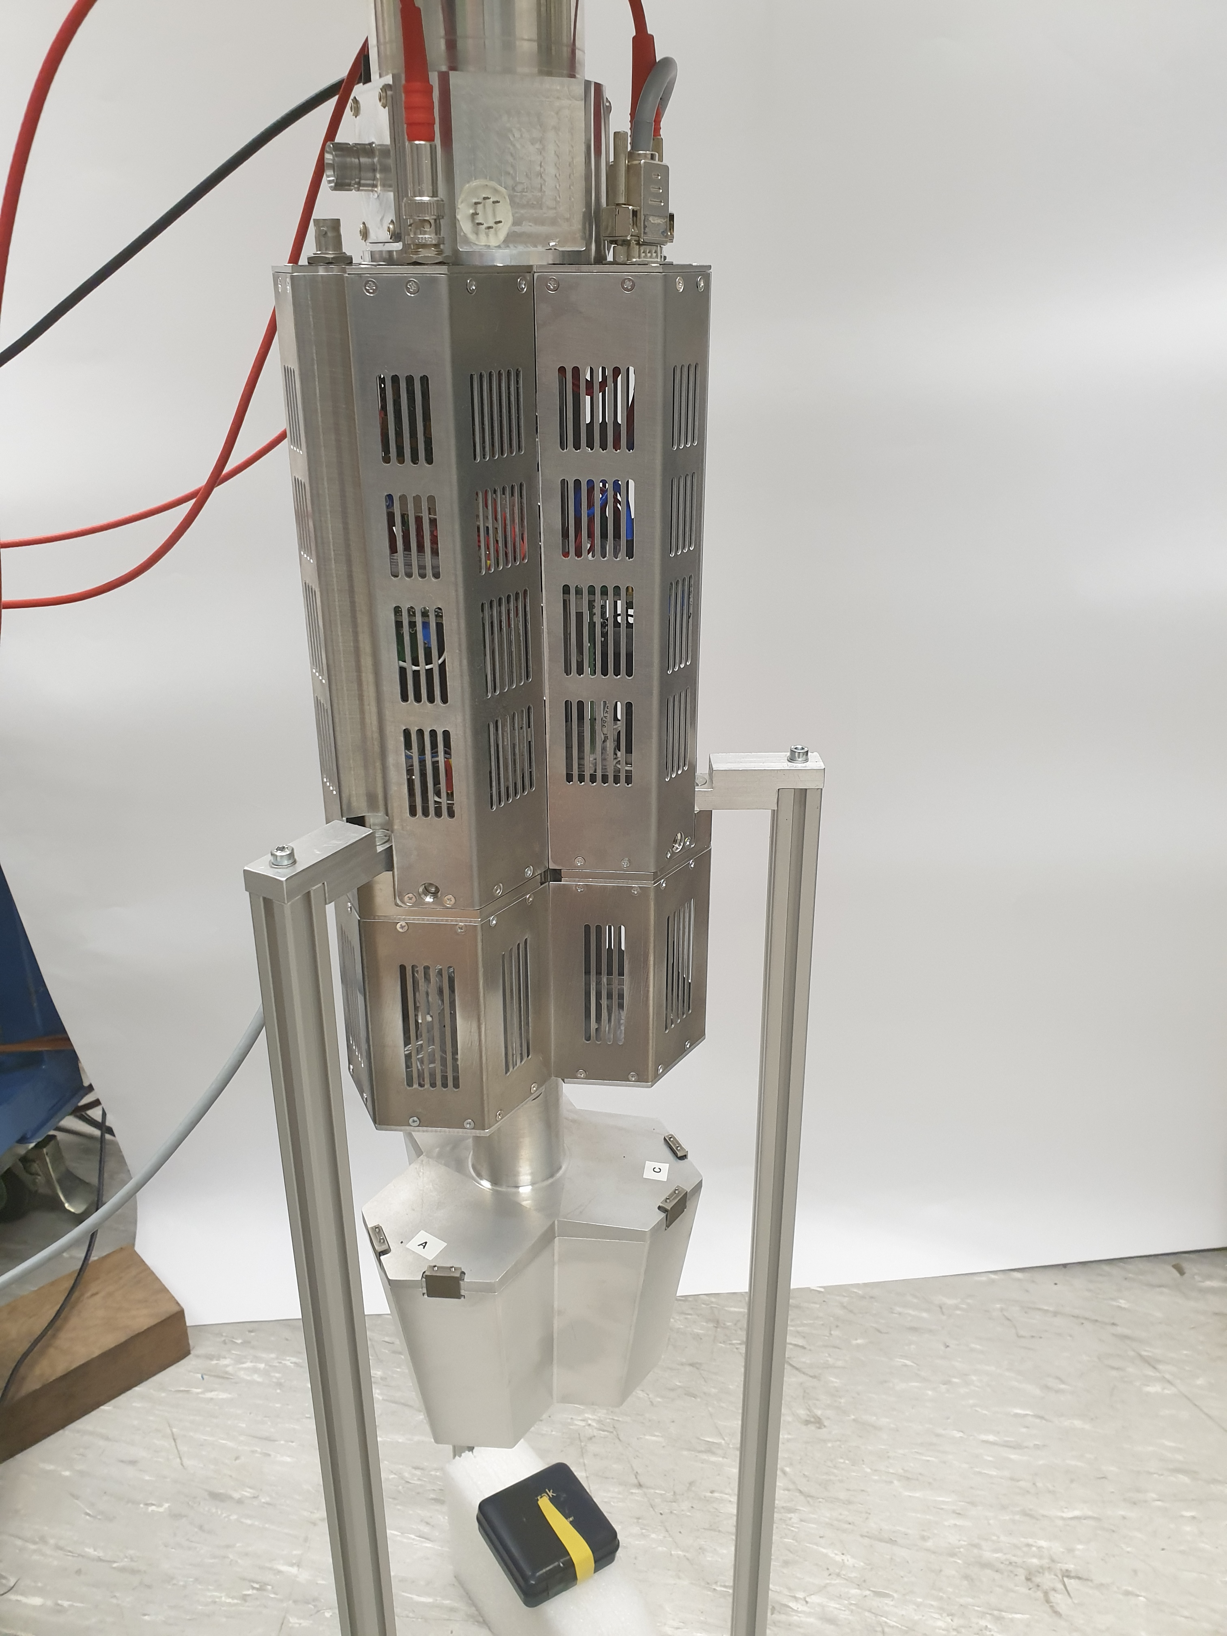
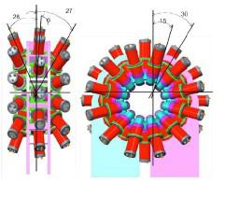
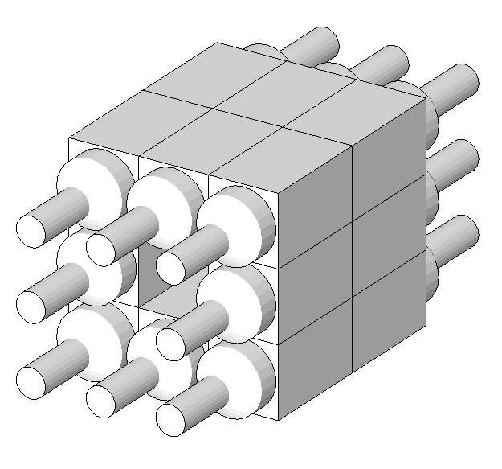
DESPEC instrumentation
AIDA: stack of DSSSD:
8x8 cm² and 24x8 cm² ;128x128 pixels
Wide dynamic range
3 mm thick plastic detector upstream and downstream from AIDA
SiPM readout
DEGAS DEspec Germanium Array Spectrometer
28 triple Clusters of Euroball Ge capsules with
BGO back-catchers and side-shields
Box configuration around 24x8 cm² AIDA
FATIMA – 36 LaBr3(Ce) detectors (of medium
energy resolution) for fast-timing coincidences
to measure excited state lifetimes in the 100
ps–ns regime using γ−γ and fast-β−γ coinc.
DTAS gamma-calorimeter
NaI(Tl) large volume 1515×25 cm³
Central hole accommodating AIDA

Slide 9
DESPEC instrumentation
AIDA: stack of DSSSD:
8x8 cm² and 24x8 cm² ;128x128 pixels
Wide dynamic range
3 mm thick plastic detector upstream and downstream from AIDA
SiPM readout
DEGAS DEspec Germanium Array Spectrometer
28 triple Clusters of Euroball Ge capsules with
BGO back-catchers and side-shields
Box configuration around 24x8 cm² AIDA
➔ See G.Kosir Poster P22
All sub-systems fully commissioned at GSI
(single detectors + coupling into GSI DAQ)
FATIMA – 36 LaBr3(Ce) detectors (of medium
energy resolution) for fast-timing coincidences
to measure excited state lifetimes in the 100
ps–ns regime using γ−γ and fast-β−γ coinc.
DTAS gamma-calorimeter
NaI(Tl) large volume 1515×25 cm³
Central hole accommodating AIDA

Slide 10
DESPEC instrumentation

Slide 11
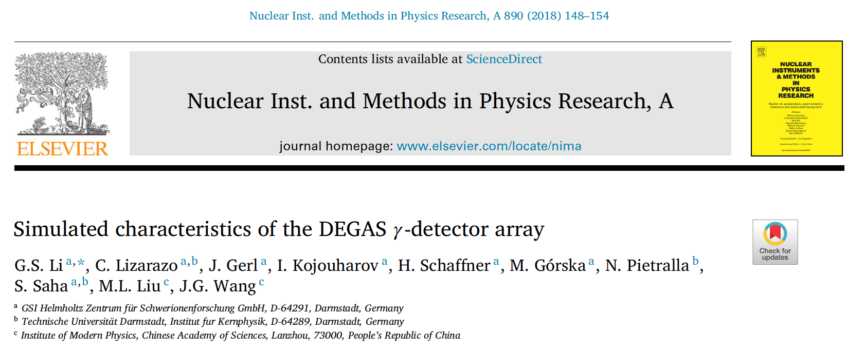
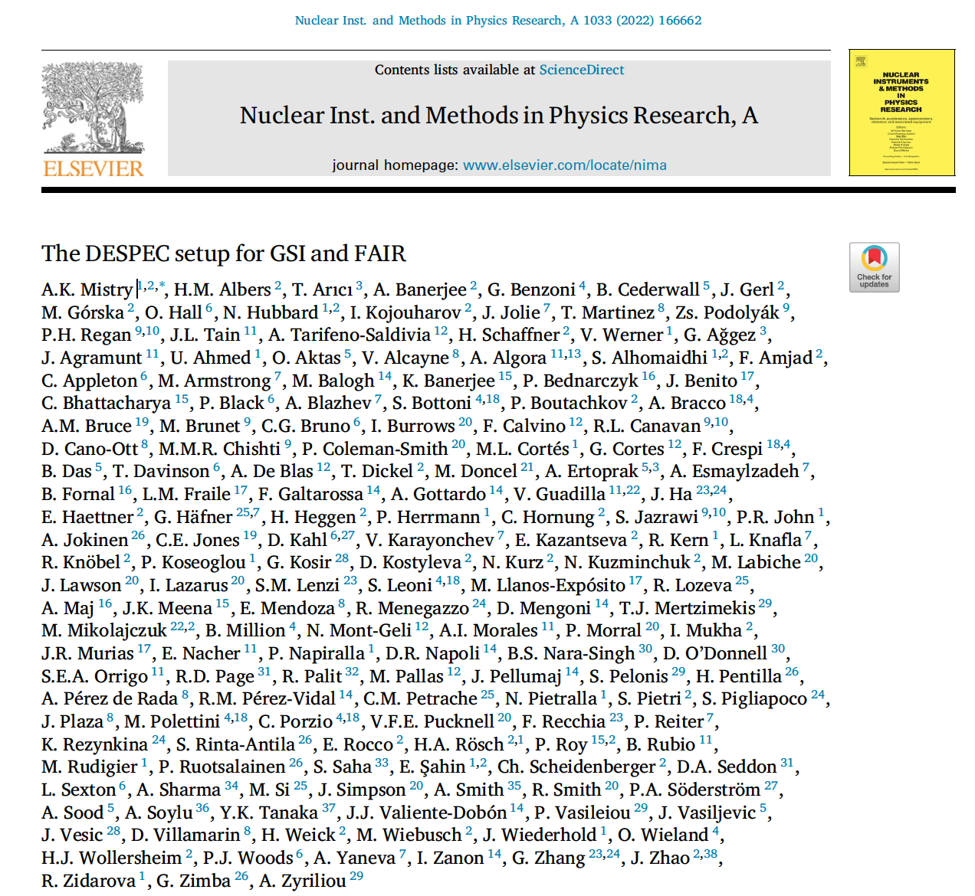
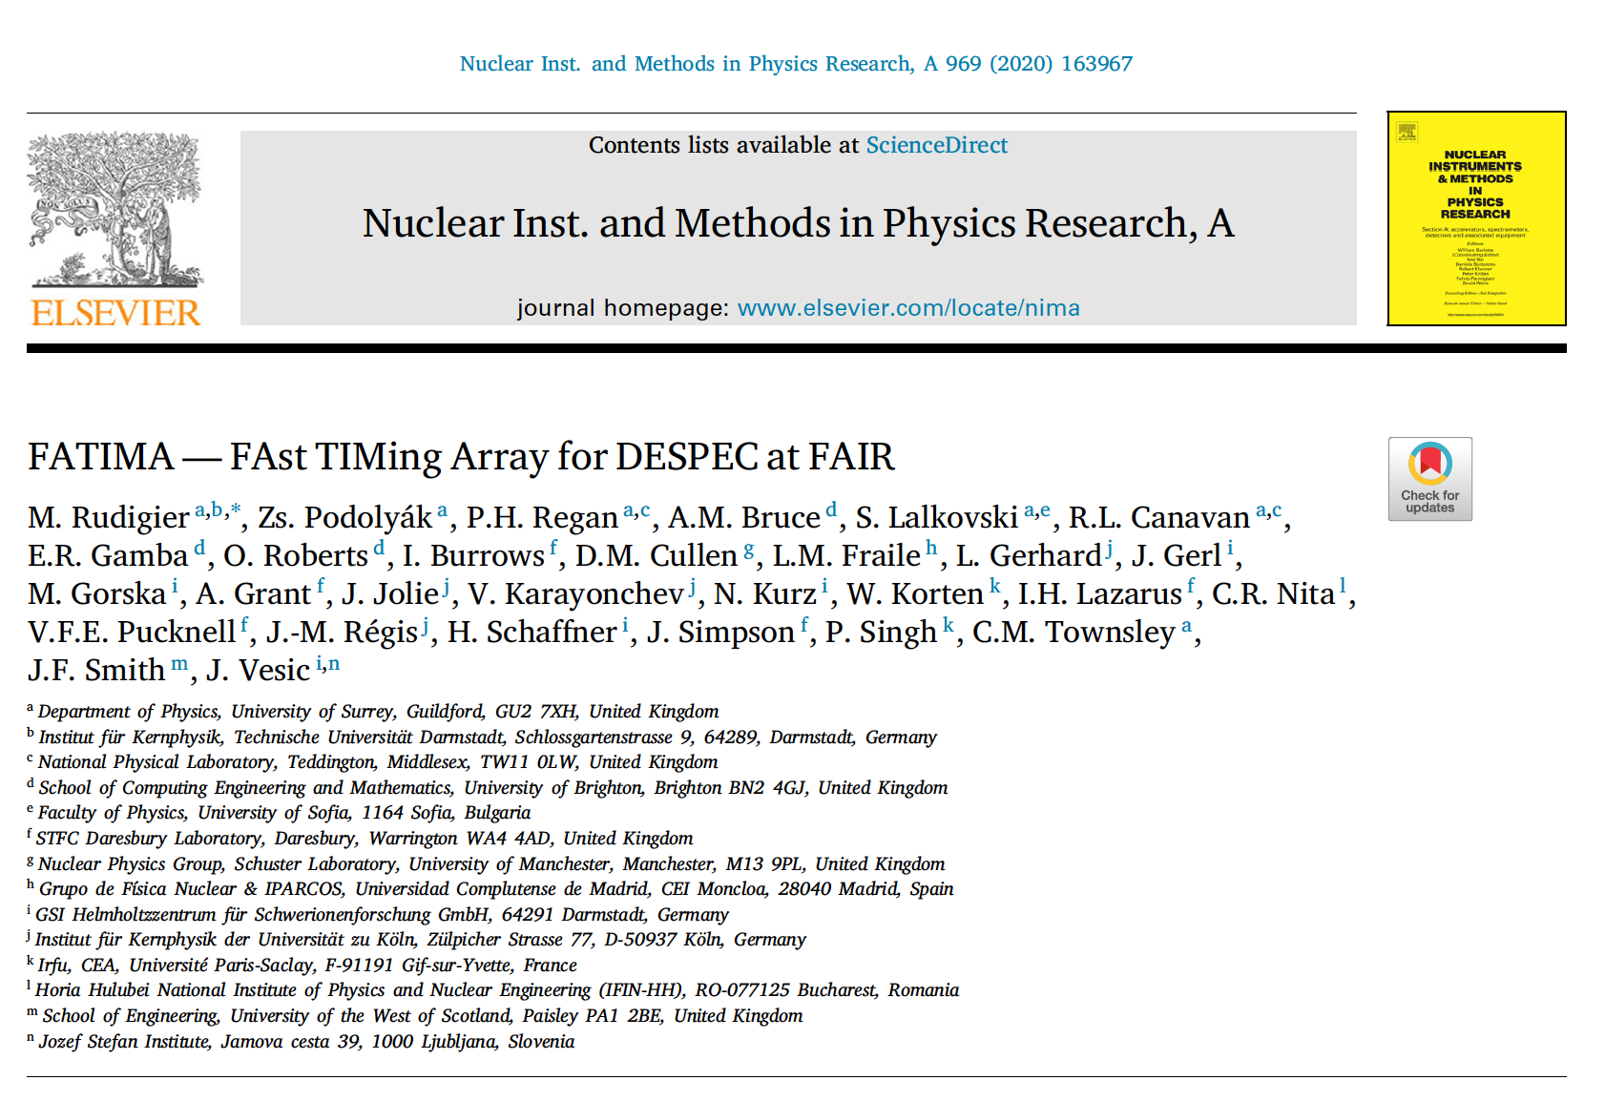
DESPEC instrumentation

Slide 12
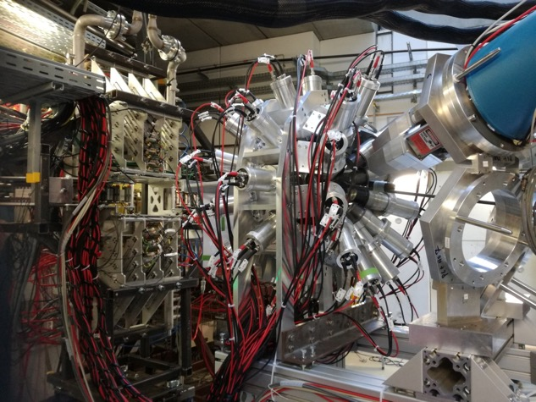
FAIR Phase-0: 2020-2022 campaigns
2020
2021
2022
FATIMA-bPLAST
+AIDA
+HPGe
Fast-timing measurements following isomeric decay and Fast-Timing measurements

Slide 13
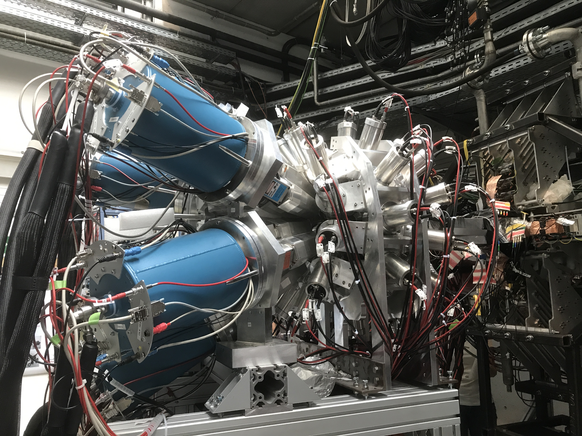
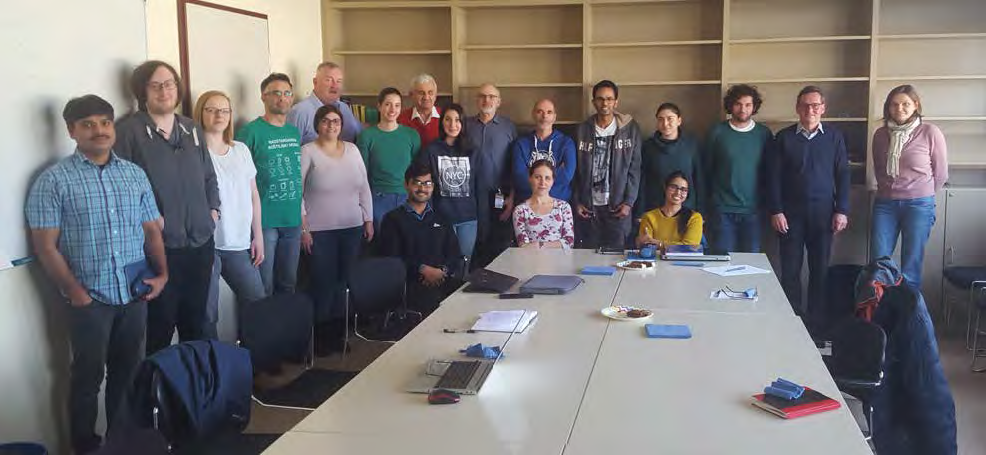
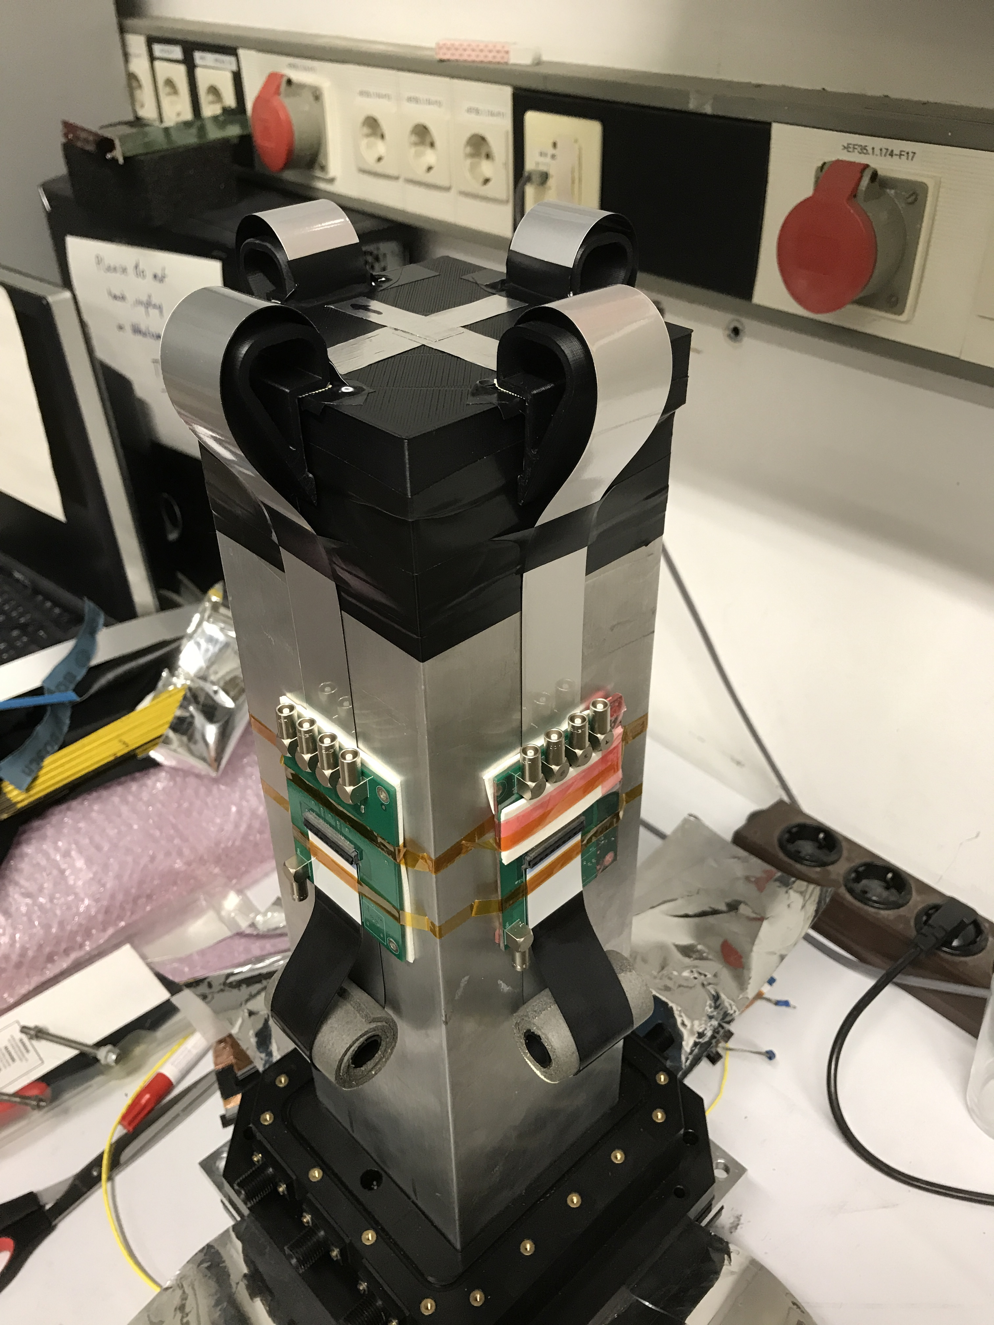
DESPEC campign in 2020
Owing to outburst of COVID-19 Pandemic just one experiment was performed:
S480: “ Structure of the heaviest N=Z nuclei: Seniority Transitions and EM Transition Rates in 94Pd”
➔ Focus on isomeric decays and Fast-Timing measurements
➔ First implementation of the FATIMA+HPGe coupling, with AIDA and bPlastic single layout
Fragmentation of 850 MeV/nucleon ¹²⁴Xe beam impinging on a 4g/cm² ⁹Be target.

Slide 14
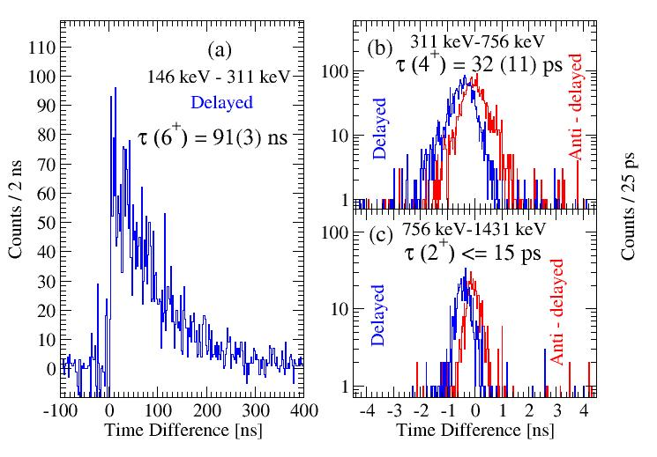
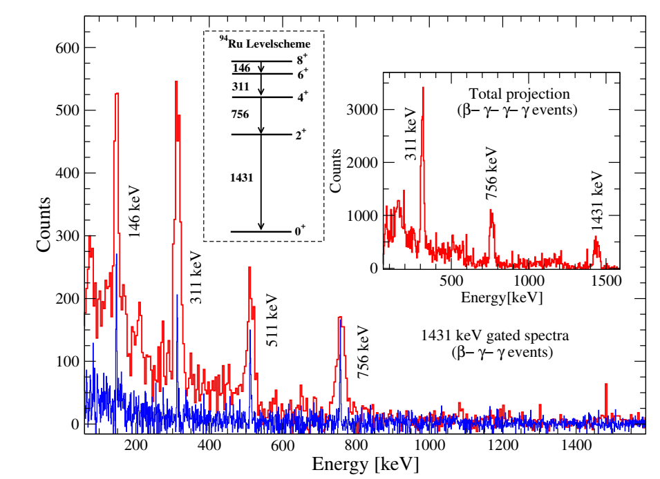
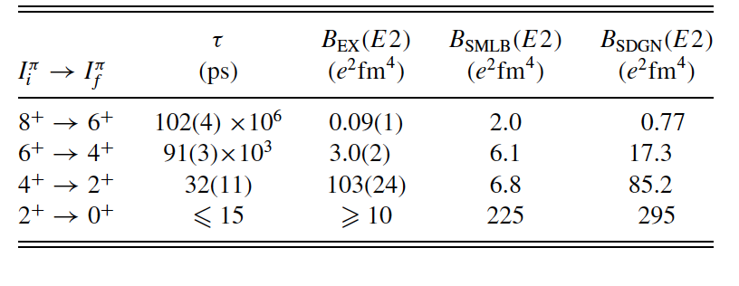
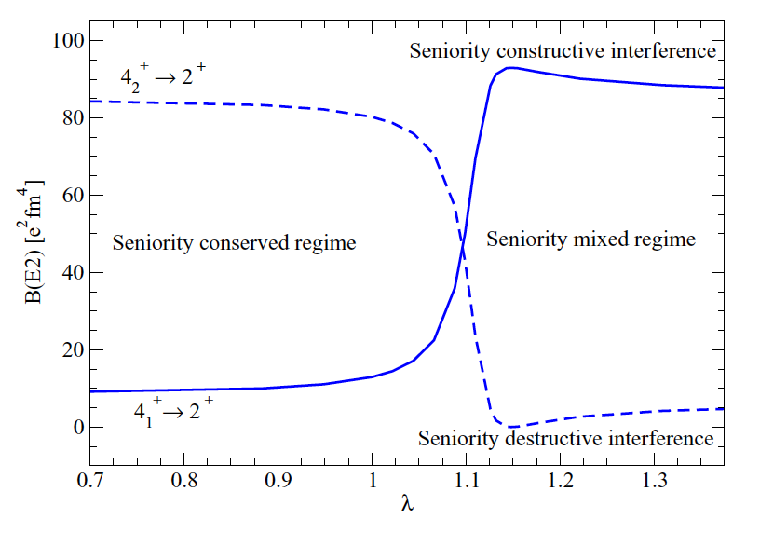
First published results
B. Das, B. Cederwall, C. Qi, M. Gorska, P.H.Regan et al., Phys. Rev. C 105, L031304(2022).
Excited states in ⁹⁴Ru were populated primarily via the β-delayed proton emission of ⁹⁵Pd nuclei
subtle interference between the wave function of the lowest seniority ν = 2, J^{π} = 4⁺ state and that of a close-lying ν=4 state that exhibits partial dynamic symmetry
Notes:
Illustration of the influence of the nondiagonal matrix
elements of the effective interaction on the B(E2) strengths for
transitions from the first (solid line) and second (dashed) 4+ states to
2+ 94Ru in shell model calculations in the f pgspace using the jun45
interaction [44]. The parameter λ is a renormalization factor scaling
the effective interaction. A strong mixture between the ν = 2 and 4
configurations, which can show drastically different constructive or
destructive interferences, is expected when the effective interaction
is slightly enhanced [22]. The result of a similar calculation for the
particle-hole mirror nucleus 96Pd is shown in Fig. 5 of Ref. [22]. See
text for details.

Slide 15
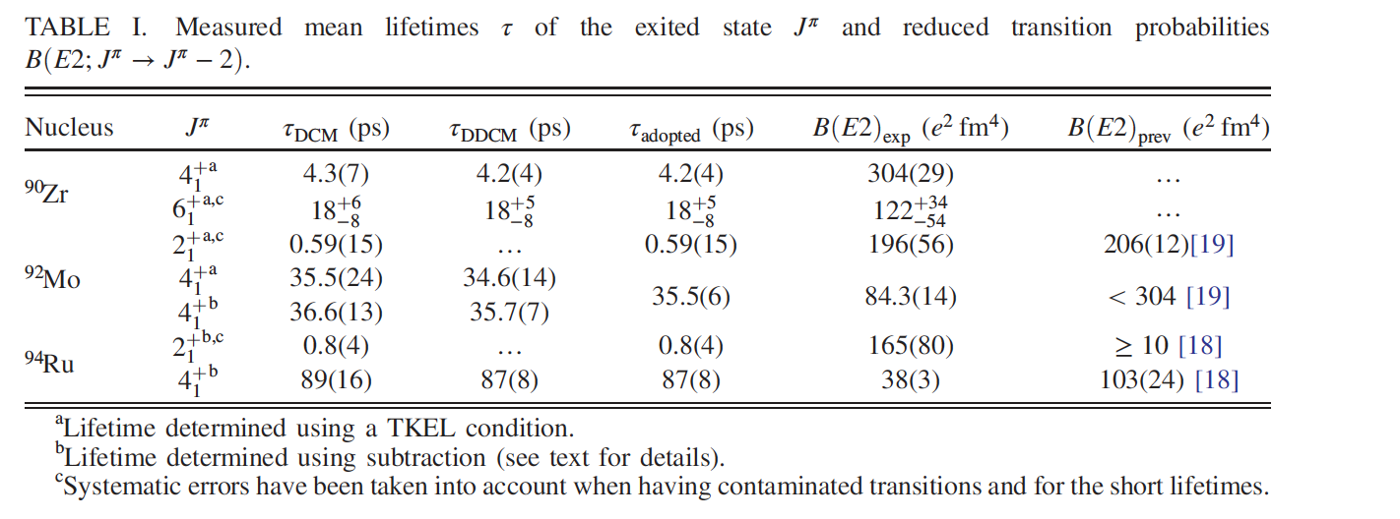
First published results
B. Das, B. Cederwall, C. Qi, M. Gorska, P.H.Regan et al., Phys. Rev. C 105, L031304(2022).
Excited states in ⁹⁴Ru were populated primarily via the β-delayed proton emission of ⁹⁵Pd nuclei
subtle interference between the wave function of the lowest seniority ν = 2, J^{π} = 4⁺ state and that of a close-lying ν=4 state that exhibits partial dynamic symmetry
Evidence of Partial Seniority Conservation in the πg9=2 Shell for the N = 50 Isotones
R. M. Perez-Vidal, PRL129, 112501 (2022)

Slide 16
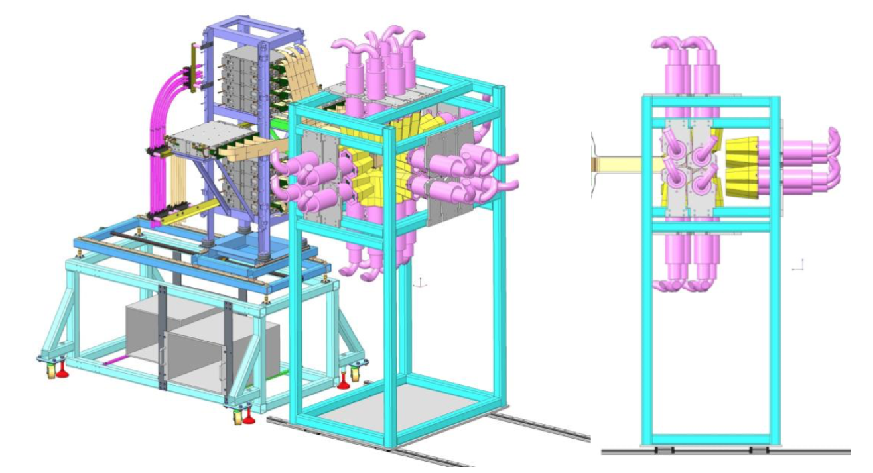
FAIR Phase-0: 2020-2022 campaigns
2020
2021
2022
FATIMA-bPLAST
+AIDA
+HPGe
3x AIDA
+HPGe
+ FATIMA-bPlast
Shifting the focus from isomeric states to β-decay

Slide 17
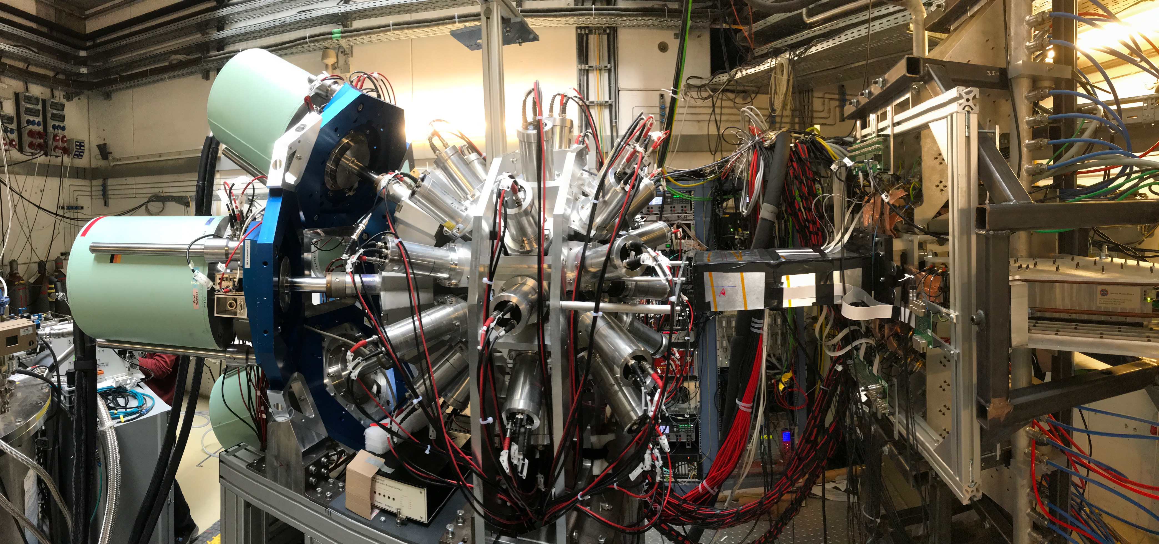
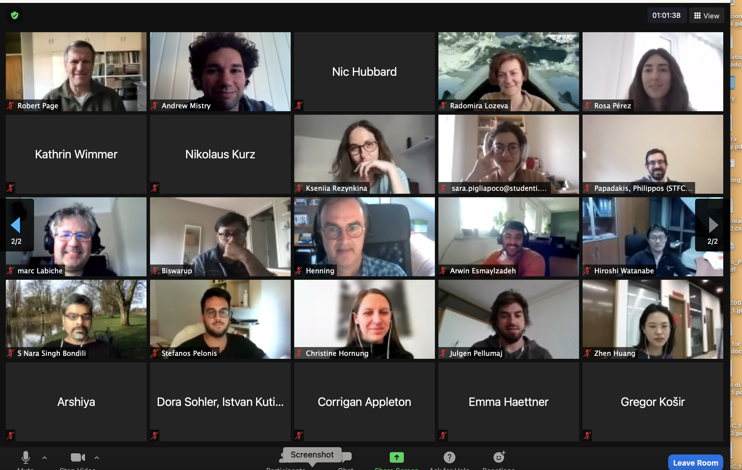
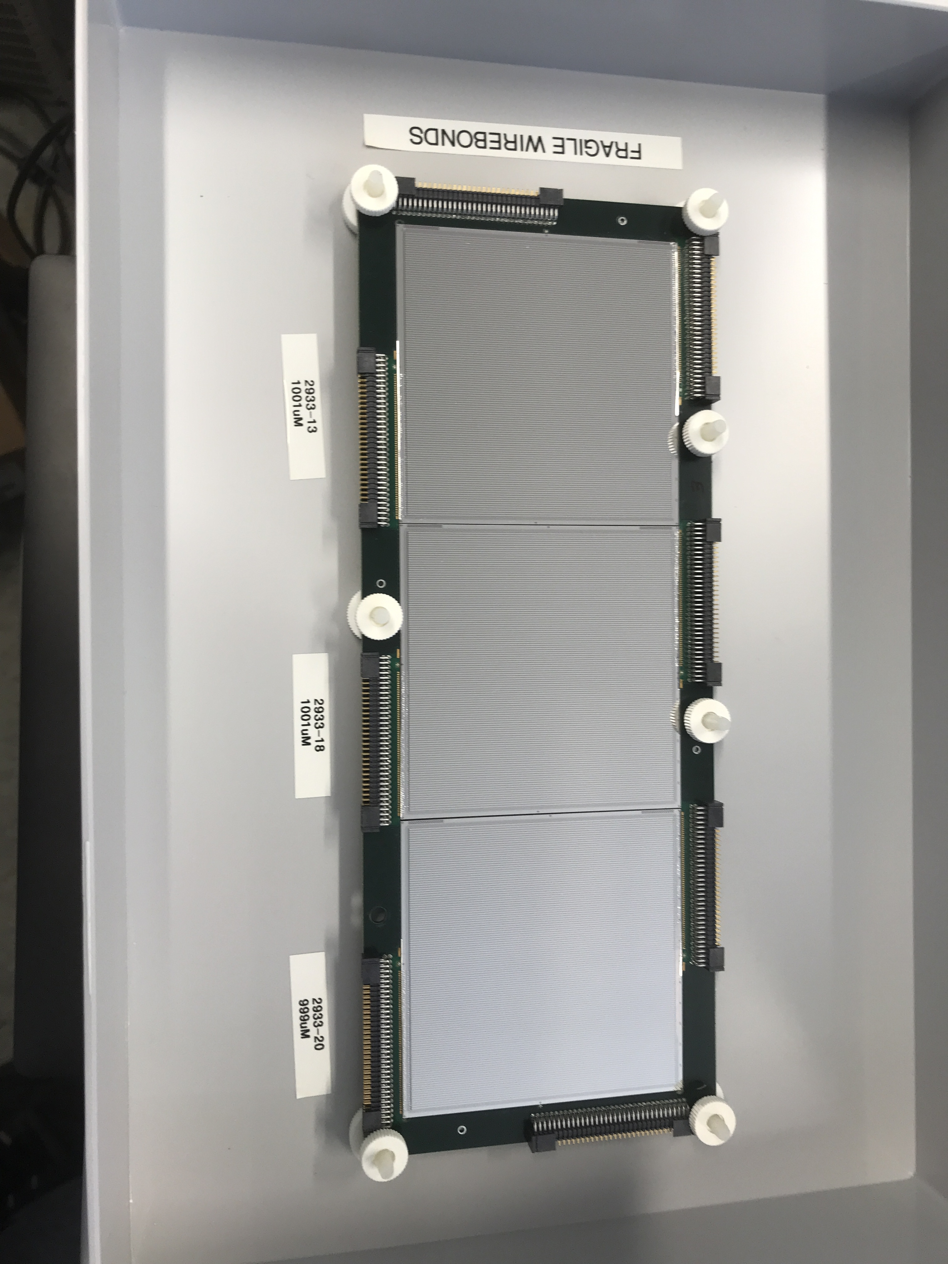
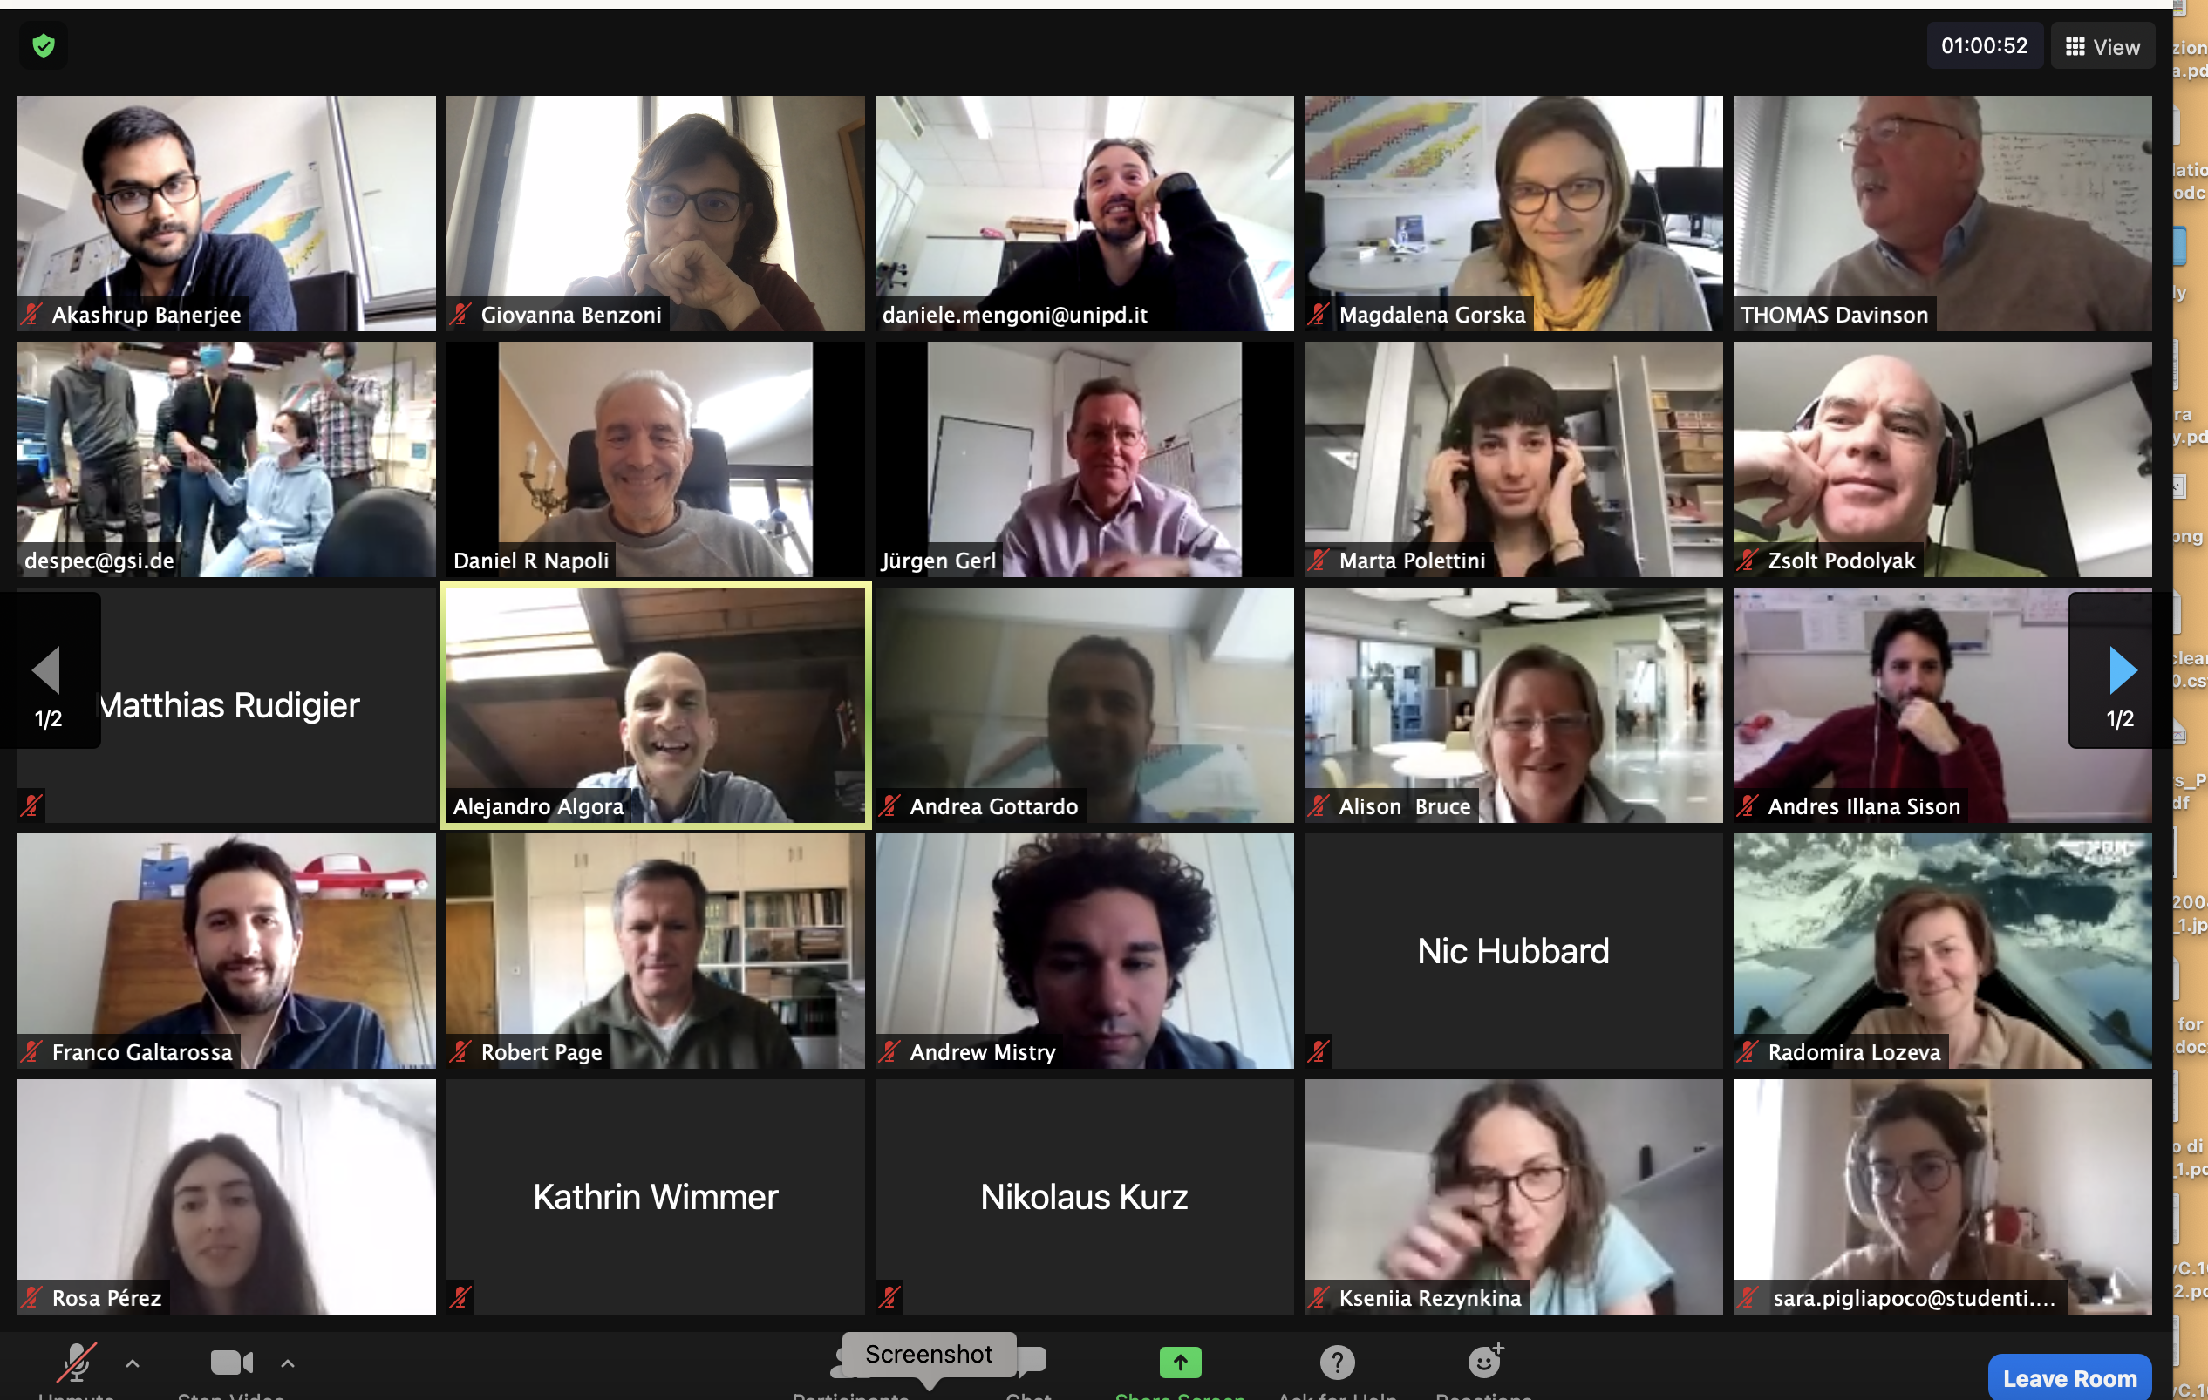
DESPEC campaign in 2021
Expanded array to achieve full covarage of F4 focal plane
Incremented gamma efficiency
New readout for FATIMA and bPlastic
  Established remote participation procedures: ~ 50 people joined shifts on-line
  Successfully completed 3 exp. runs ~25 days data taking

Slide 18
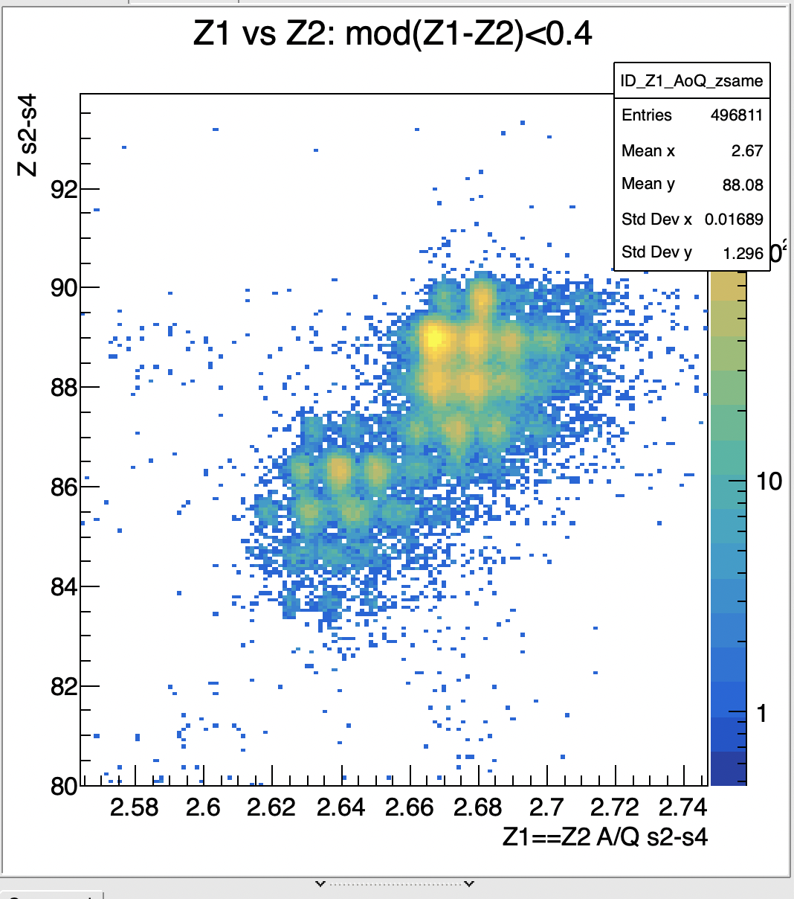
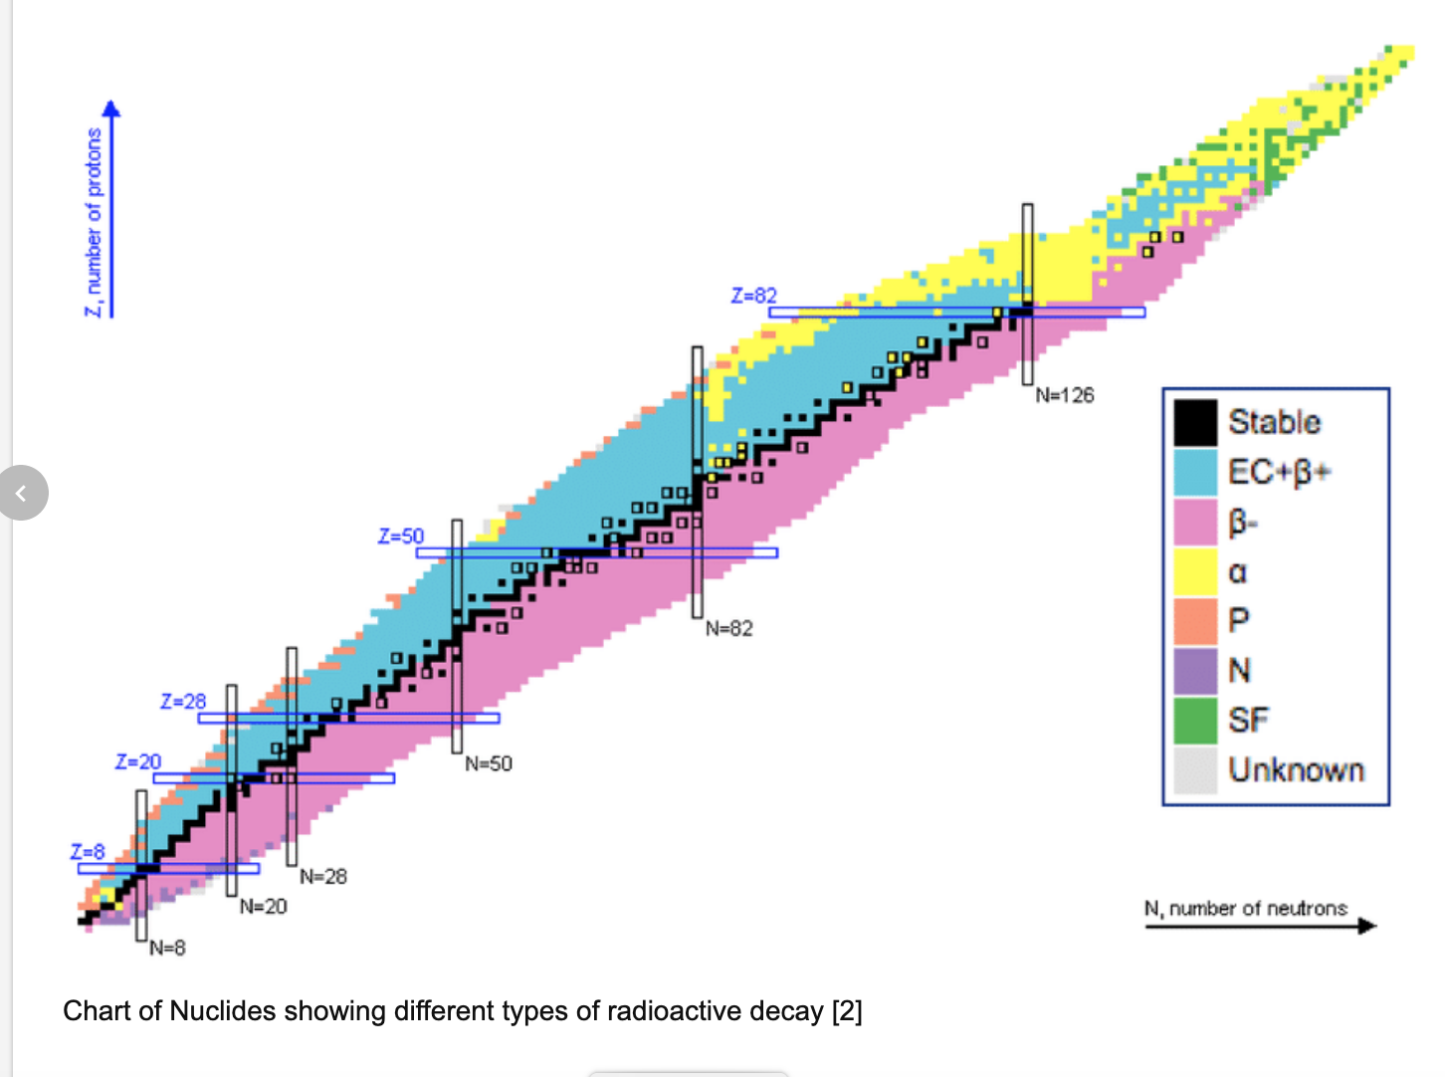
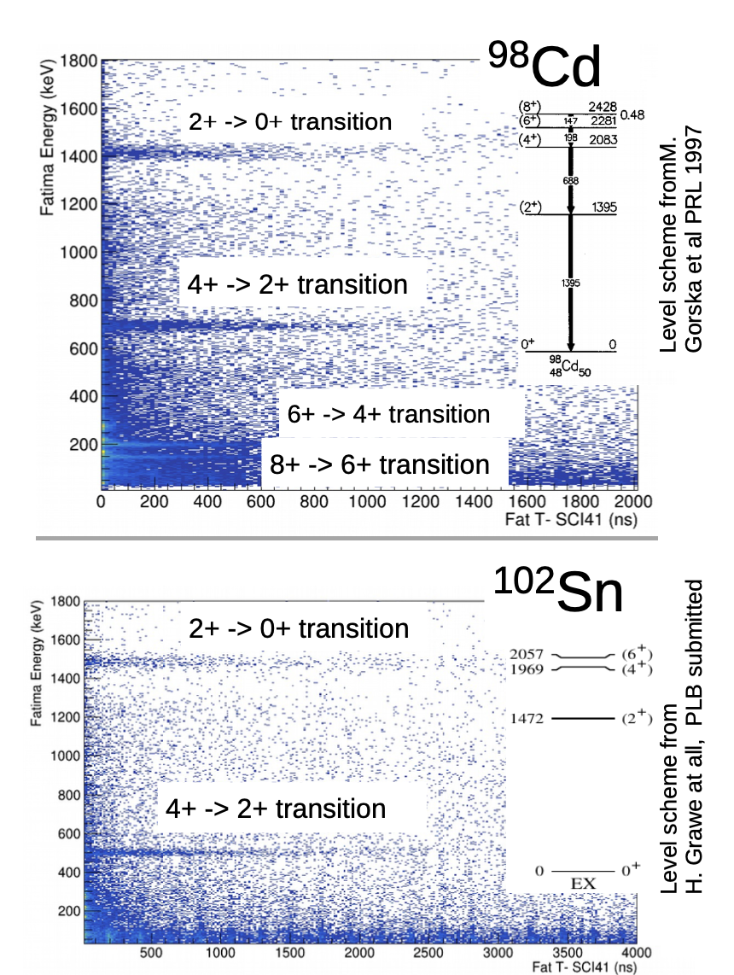
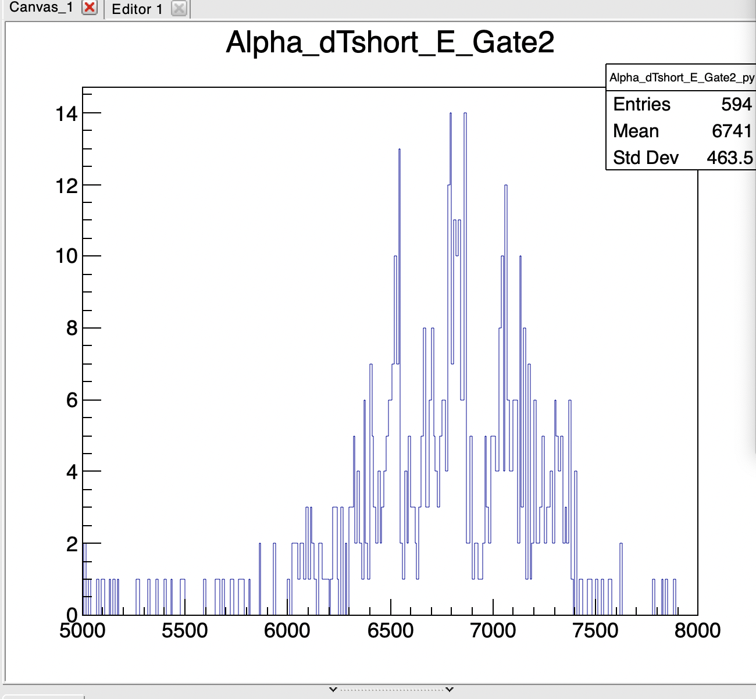
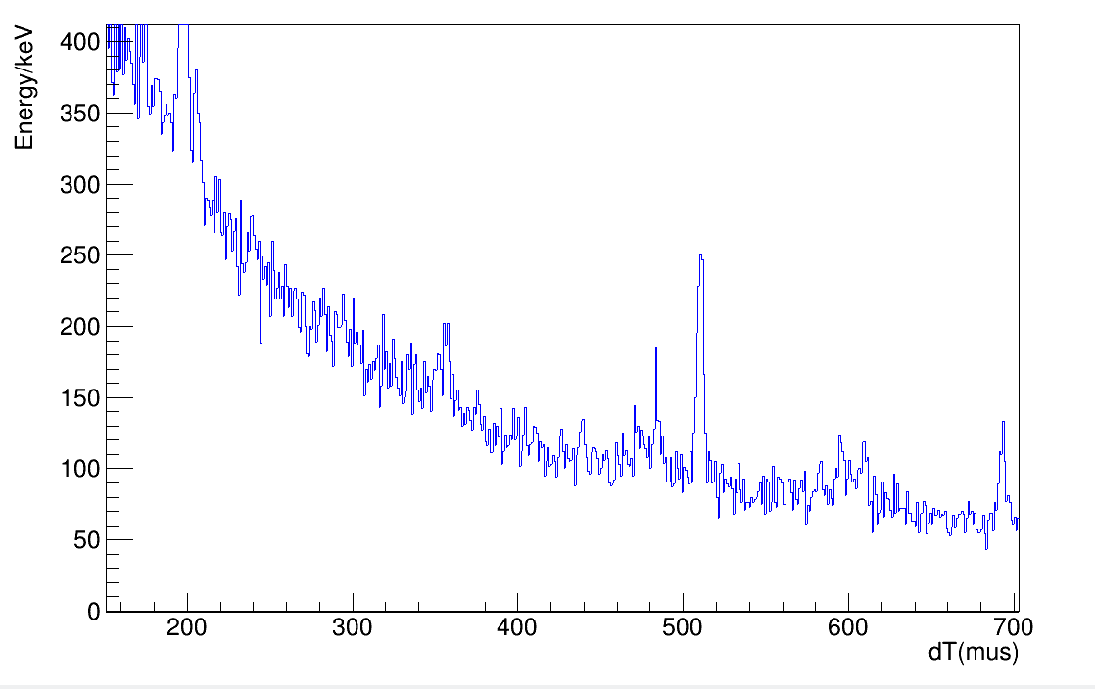
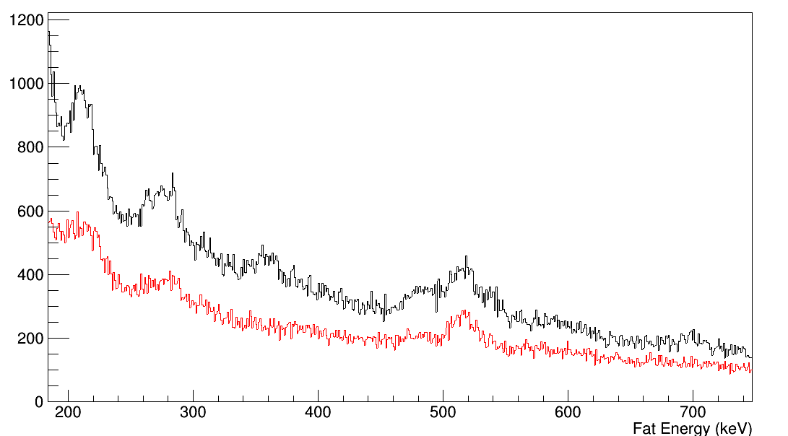
DESPEC campaign in 2021
228-230Fr
S496 Core-breaking in the most neutron-deficient Tin isotopes
226-229Rn
S460: Investigation the south-east frontier of the A~225 island of octupole deformation
224-225At
α decay of 218Rn, calibration nucleus
See talk by. G.Zhang Wed.26th
AIDA
S452 Shape Evolution at A~190
HPGe
206
206
Black 0-300mus
Red: 700-1000mus
358
484
358
484
693
693
FATIMA
0-300mus

Slide 19
DESPEC campaign in 2021
228-230Fr
S496 Core-breaking in the most neutron-deficient Tin isotopes
226-229Rn
S460: Investigation the south-east frontier of the A~225 island of octupole deformation
224-225At
α decay of 218Rn, calibration nucleus
See talk by. G.Zhang Wed.26th
AIDA
S452 Shape Evolution at A~190
HPGe
206
206
Black 0-300mus
Red: 700-1000mus
See talk by. S. Alhomaidhi Tue.25th
358
484
358
484
693
693
FATIMA
0-300mus

Slide 20
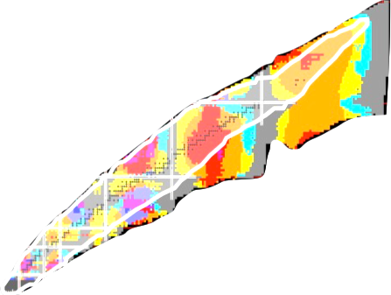
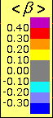

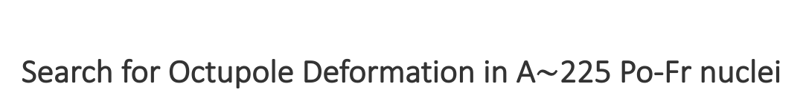
Search for Octupole Deformation in A$\sim$225 Po-Fr nuclei
Z=88
The Rn-Th (Z=88-90) actinide nuclei around A∼225
  region where the strongest octupole correlations are manifested
  dearth of experimental information on the structure of heavy nuclei in the 220<A<230 region
Proton number Z
N=134
N=88
Neutron number N
β
Ion

Slide 21
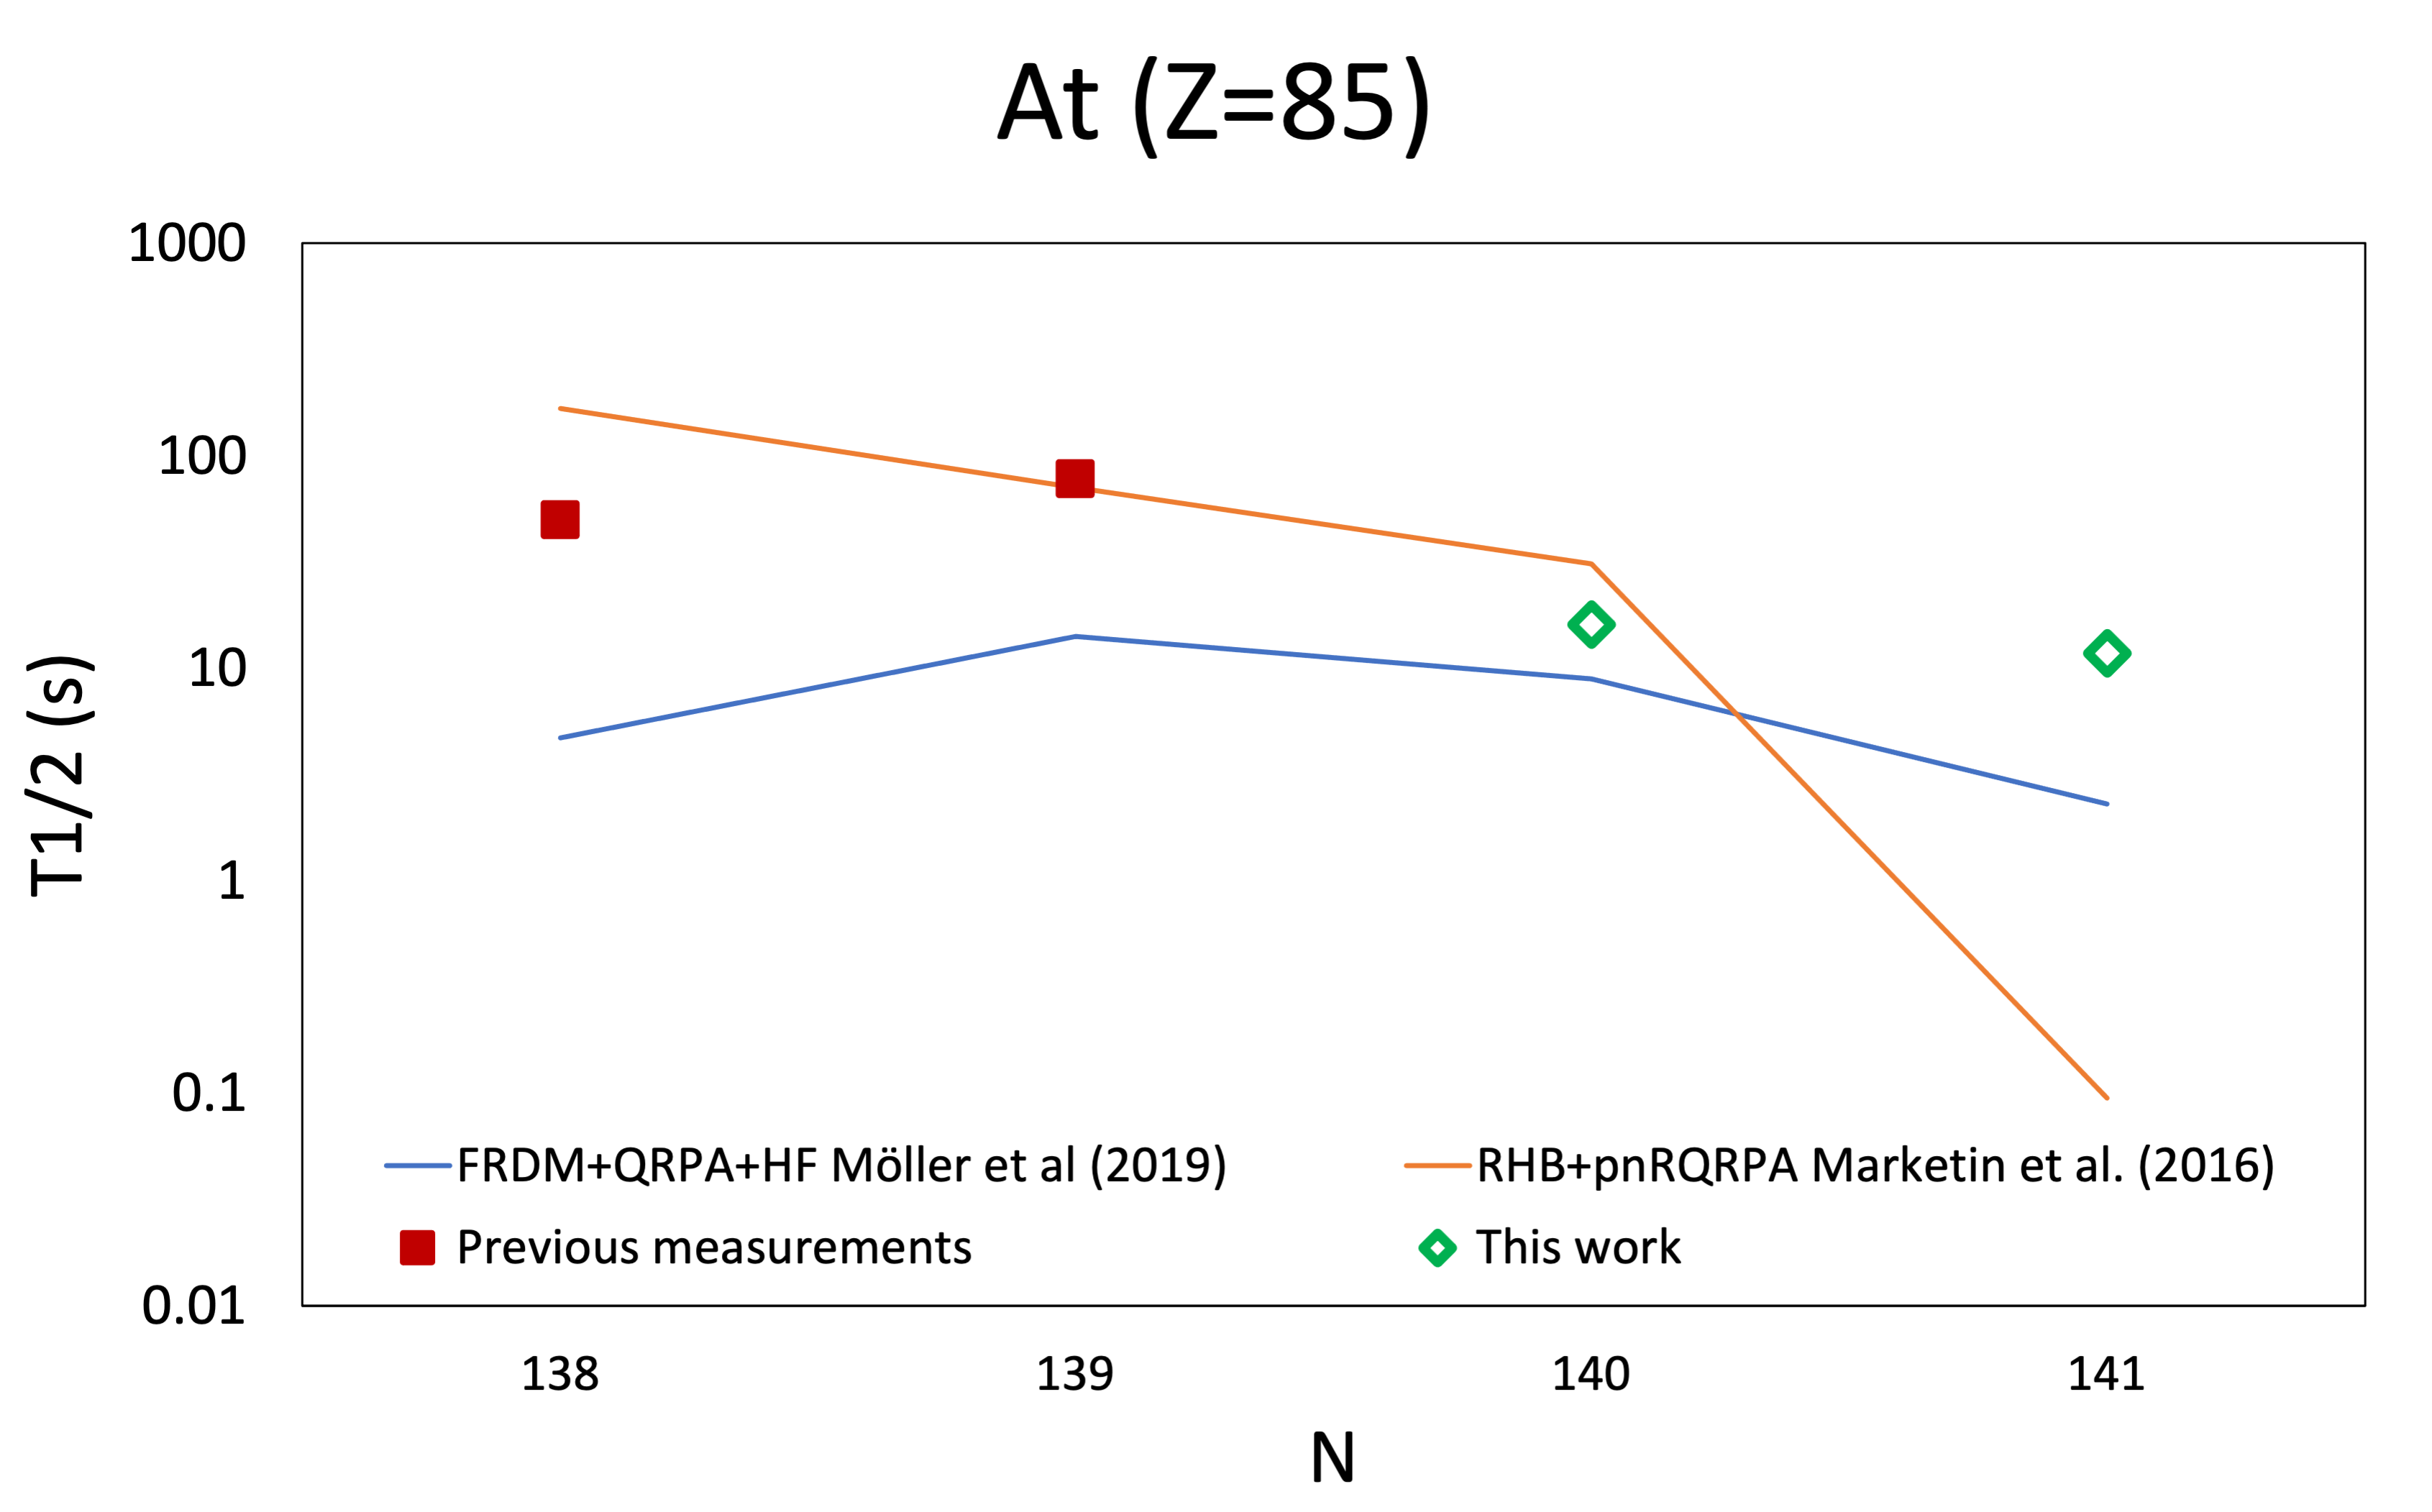


Search for Octupole Deformation in A$\sim$225 Po-Fr nuclei
Z=88
The Rn-Th (Z=88-90) actinide nuclei around A∼225
  region where the strongest octupole correlations are manifested
  dearth of experimental information on the structure of heavy nuclei in the 220<A<230 region
Proton number Z
N=134
N=88
Neutron number N
β
Ion
Newly measured!
²²⁷Rn
$$T_{1/2}=18.4 ±0.8 s$$

Slide 22
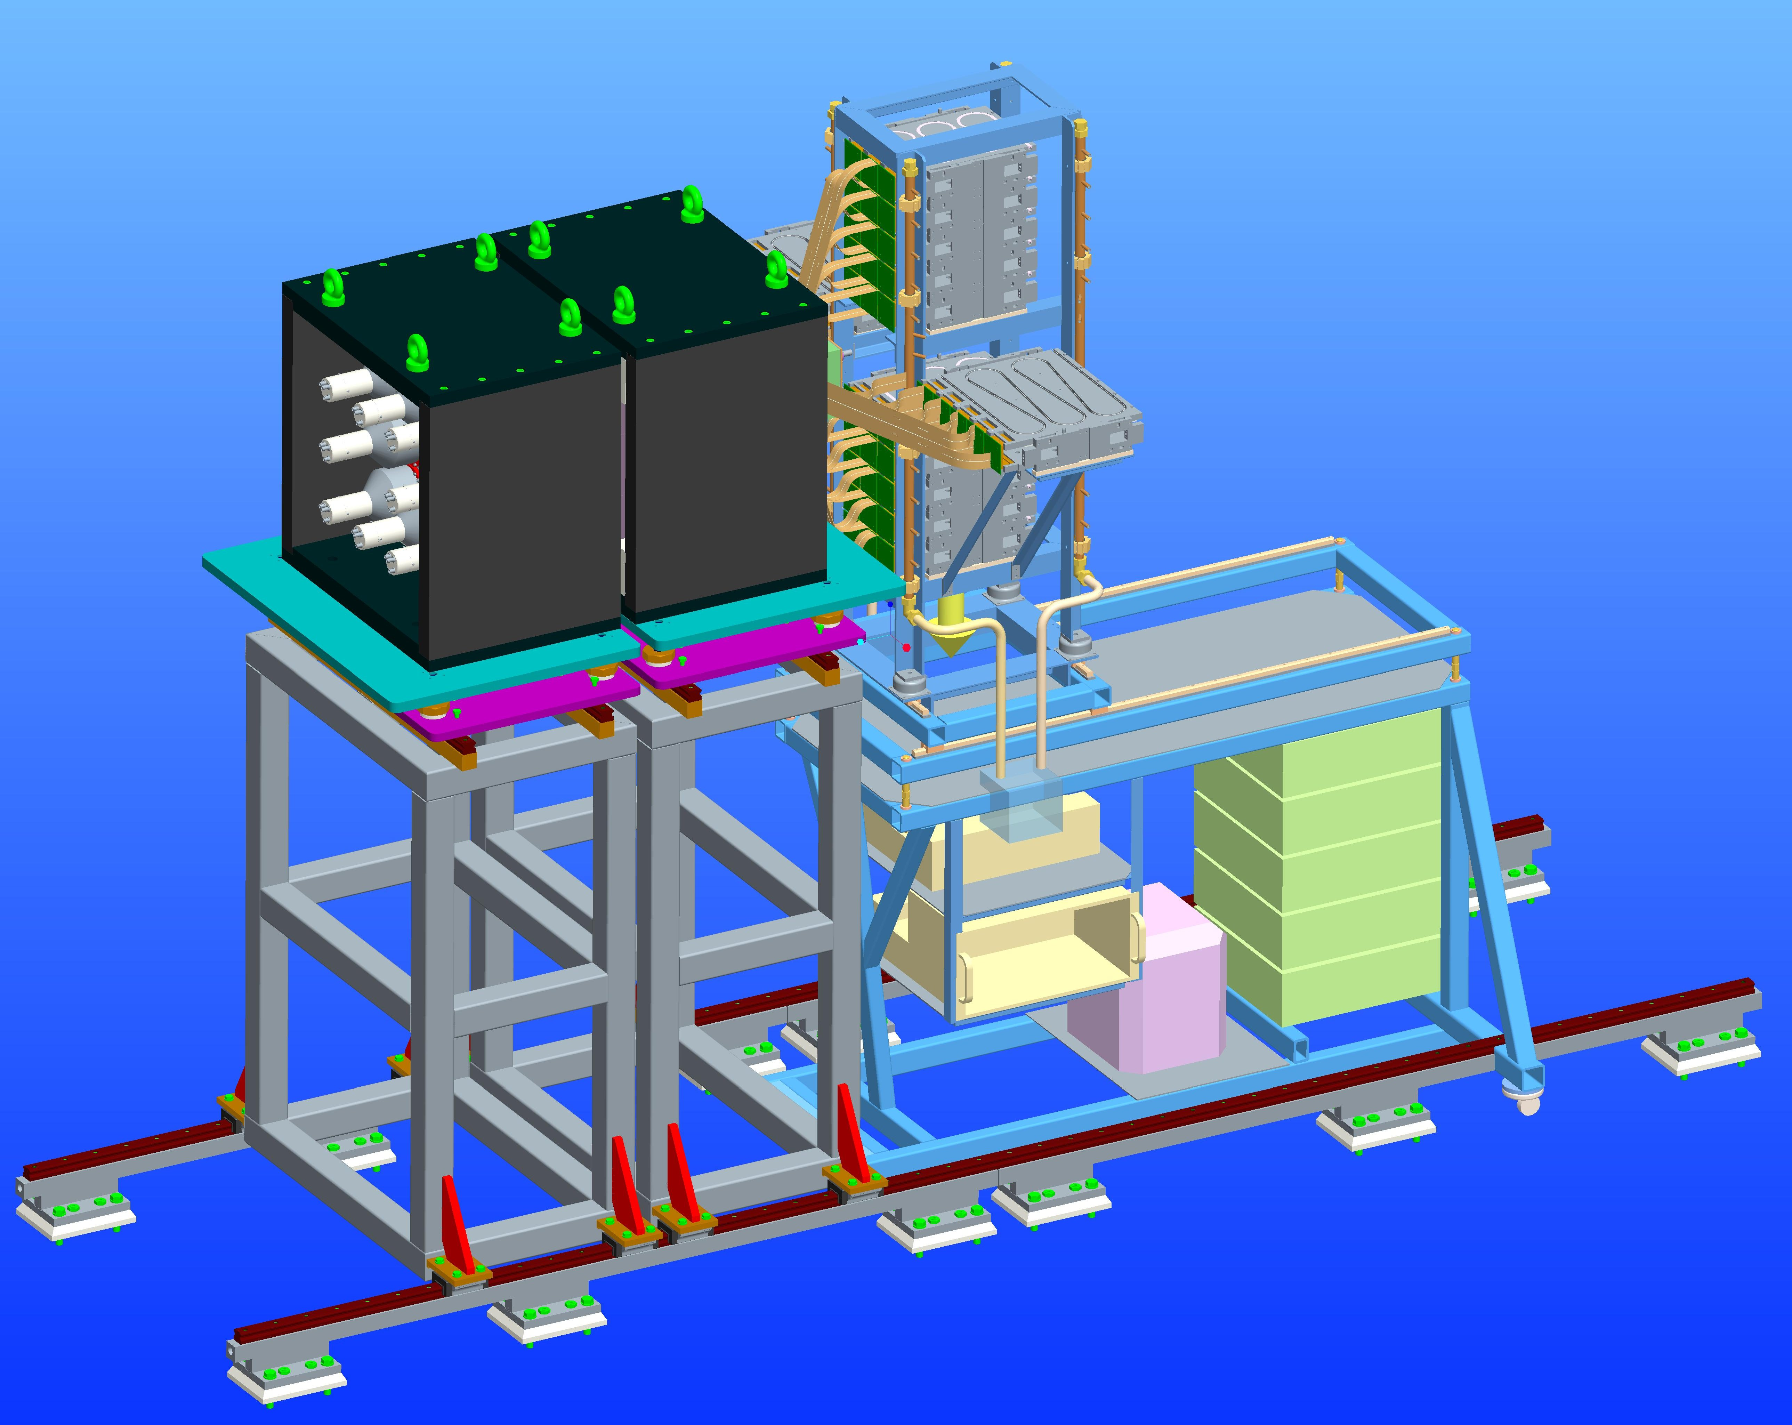
Experiments in 2022
2020
2021
2022
FATIMA-bPLAST
+AIDA
+HPGe
3x AIDA
+HPGe
+ FATIMA-bPlast
AIDA
+DEGAS
+DTAS
Improved efficiency with DEGAS detectors
First experiments with DTAS

Slide 23
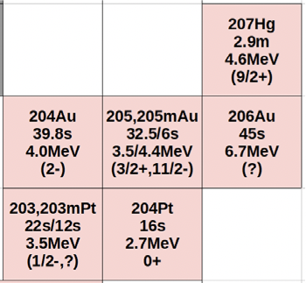
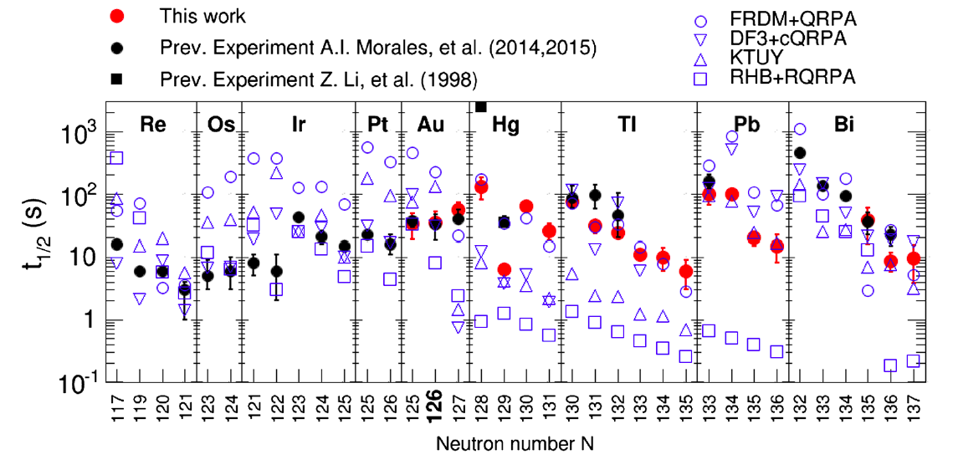
Experimental campaign in 2022
S450: Study of N=126 nuclei: Isomeric and beta decays in ²⁰²Os and ²⁰³Ir
(Zsolt Podolyák (Univ. Surrey))
Structure of N=126,125 nuclei (²⁰³Ir, ²⁰²Os, ²⁰³Pt, ²⁰²Ir) gives info about individual orbitals
=> improved predictions for r-process path
S505: Investigation of the beta-strength crossing N=126 and the formation of the 3rd r-process abundance peak
(Tain, Morales, Nacher)
Large discrepancies, no model consistent with data across N=126 • T1/2 is not univocally related to β-strength: need for measurement

Slide 24
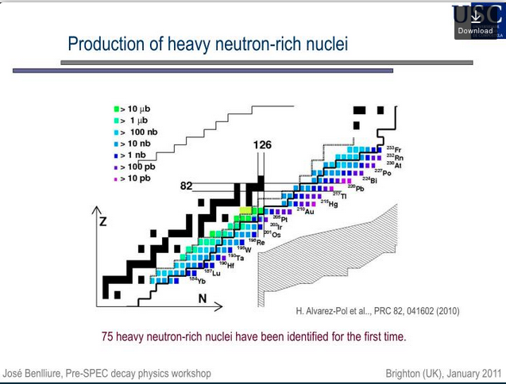
Complete picture of decay mechanism around N=126: multifaceted approach
R-process A~195 abundance peak: fed by N ~126 nuclei
Exact astrophysical location of the r-process path depends on parameters such as number of available neutrons and lifetimes
Inputs to constrain theory:
  Half-lifes and Pn values
  Role of First Forbidden transitions
  Full B(GT)
    Accessible NOW at 1-10 nb level
    FUTURE (FAIR): < 1 nb
N=125-127 isotones are at reach
r-process path
2022
2023
2024
2025
²⁰³Ir, ²⁰²Os, ²⁰³Pt, ²⁰²Ir | ^{203,204}Pt, ²⁰⁴Au, ²⁰⁶Au, ²⁰⁷Hg | Pt, Ir, Os chains up to N=127 | ²⁰⁷Au, ²⁰⁵Pt up to N=127
Full β−γ spectros. | TAS B(GT) measur. | T1/2 and β-delayed n emission | Full β−γ spectros.

Slide 25
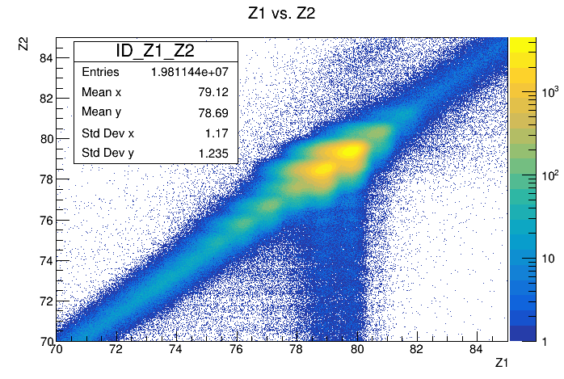
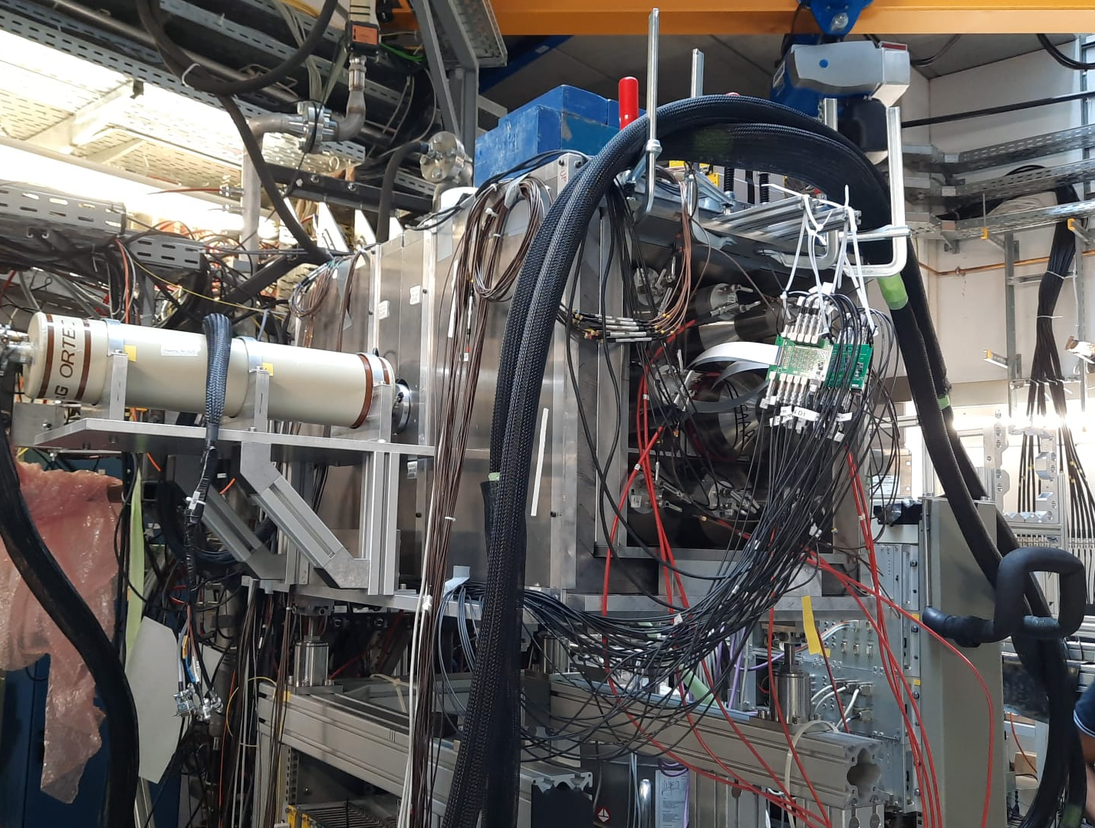
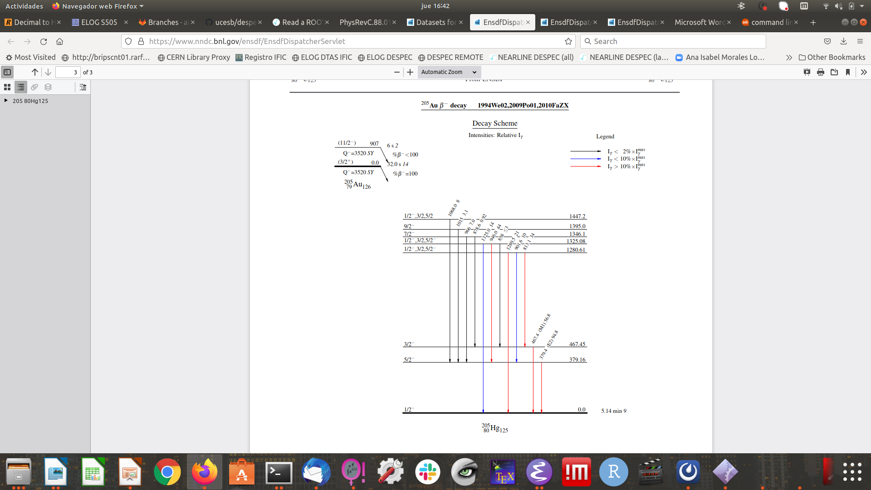
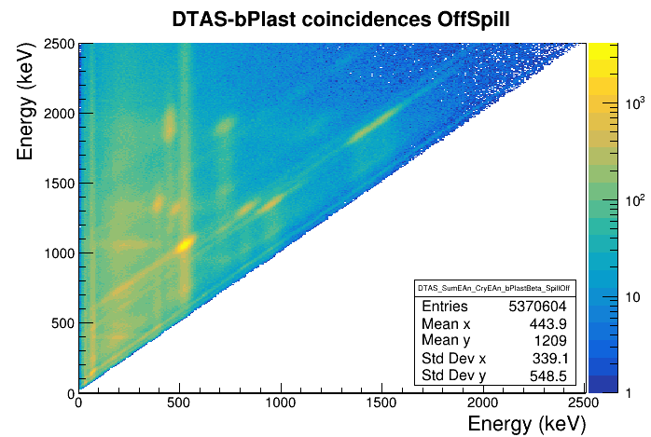
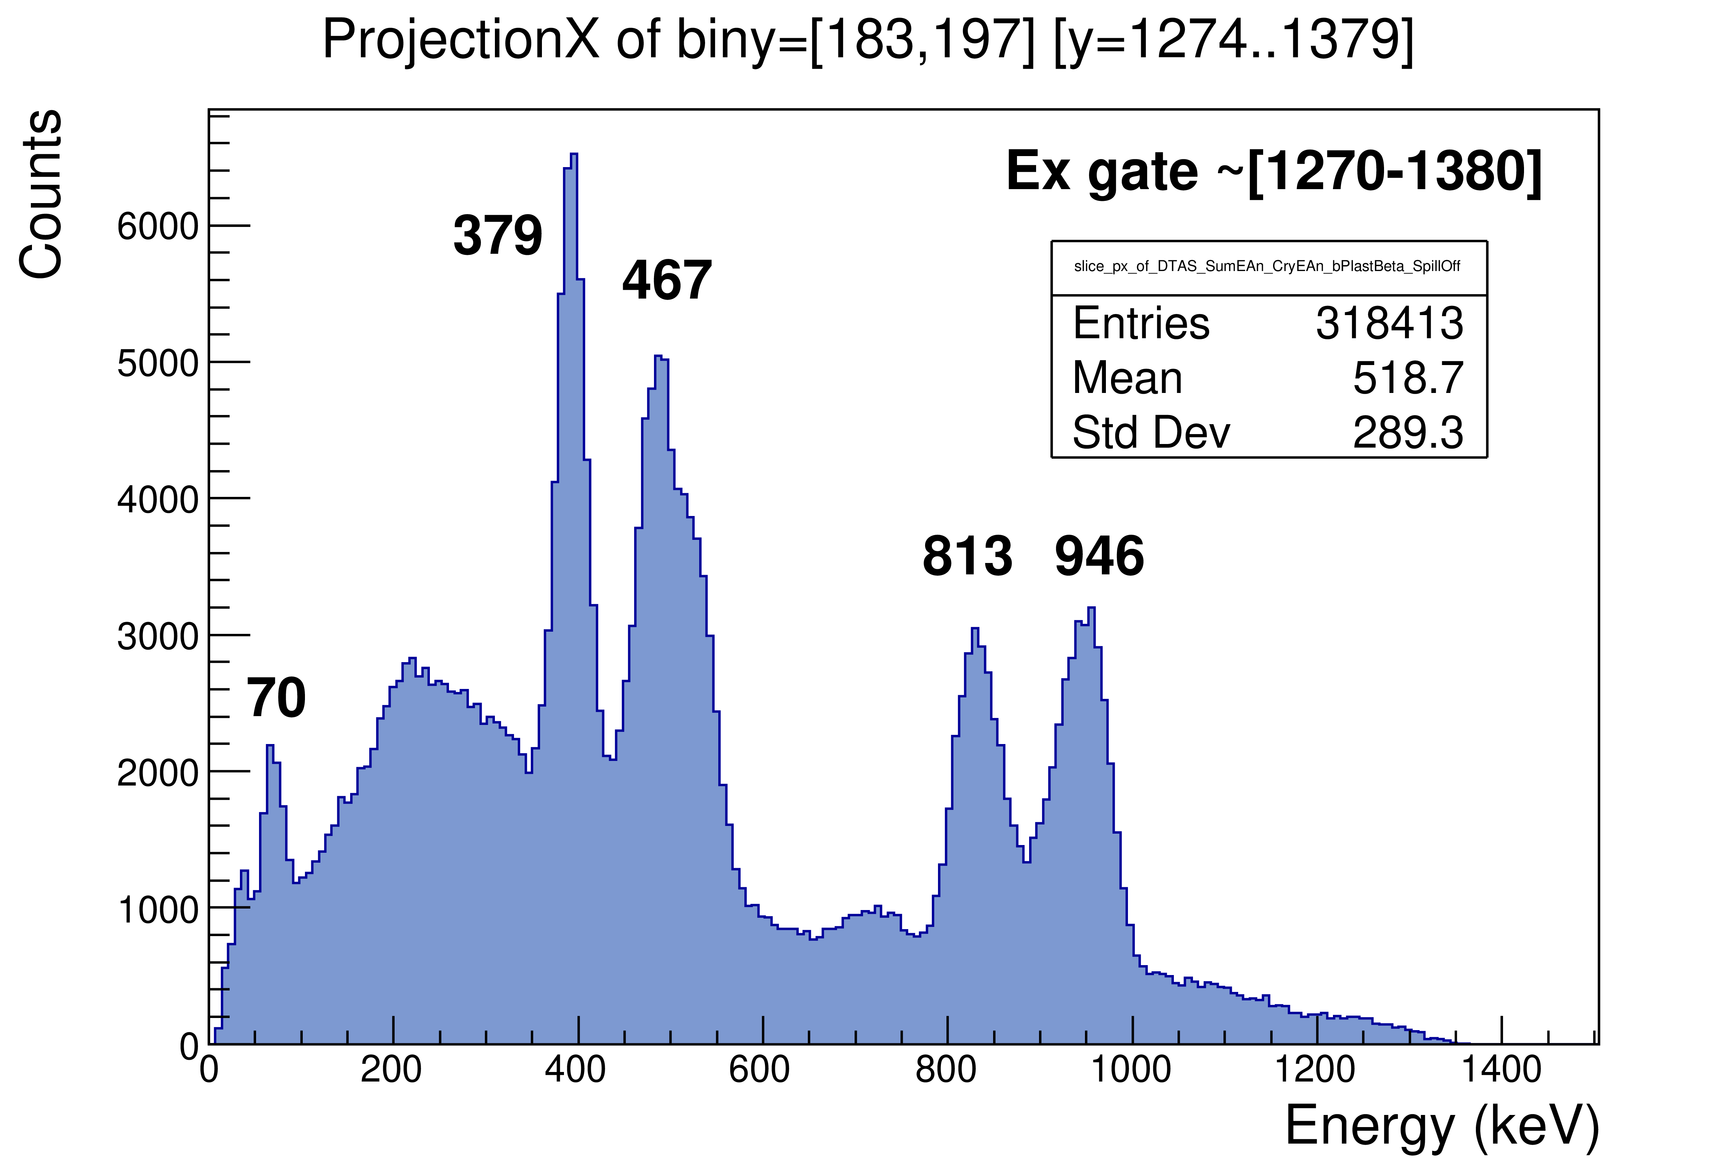
Experimental campaign in 2022
Courtesy A.I.Morales and J.L.Tain (IFIC Valencia)

Slide 26
Conclusion and outlook
HISPEC with AGATA
2020
2021
2022
2023
2025
>2026
Commissioning and first exp
From isomers to beta-decay spect.
From high-res to high-eff studies
DESPEC
Exp program
At S4 area
and in front of HEB using SIS18+superFRS
perform high-resolution (DEGAS/FATIMA), high-efficiency studies (DTAS) and exclusive measurements (BELEN) with the aim of a complete picture of the β-decay process in key regions (e.g. N~126)
2023-2024: further improve detectors, read-out, DAQ towards early start in 2025 using SIS18+superFRS in HEB
➔ Exploit GSI-FAIR beams with unique HISPEC instrumentation and AGATA for High-resolution γ spectroscopy and Lifetime measurements (LISA ERC by K.Wimmer)
Wide scientific program convey key information on nuclear structure
Continuous work to innovate detectors and detecting systems
Notes:
Astrophysics and decay heat studies

Slide 27
DESPEC collaboration
Strong exchange with FRS team
Preparation
Data taking
Data analysis

Slide 28
√

Slide 29
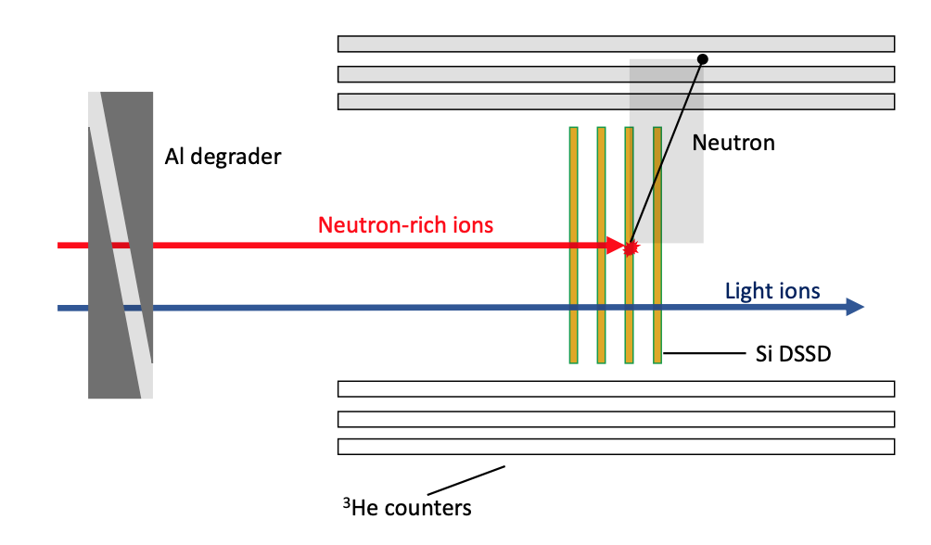

Completing the suite of detectors: n-detection arrays
BEta-deLayEd Neutron detector (BELEN):
48 3He cylindrical counters in Polyethylene moderator
- Successful 5-years BRIKEN campaign to measure β1n and β2n emission
Coupling to AIDA already successfully tested
Detectors soon to return to Europe (2022)
Available for a campaign starting in 2023
Courtesy of A.Tarifeño Saldiva, F.Calvino, I.Dillman,G.Cortes Rossel

Slide 31





Lifetime measurement of 4⁺ state in ¹⁰²Sn
Primary goals:
- ¹⁰³Sn isotope populated via α decay of ¹⁰⁷Te , the lifetime of 7/2⁺ state in ¹⁰³Sn will be obtained by α − γ time coinc.
- Lifetime of 4⁺ state in ¹⁰²Sn Fast-timing
- Lifetime of ⁹⁸⁻¹⁰⁰Cd
840 MeV/u ¹²⁴Xe beam, 2x10⁹ pps
Notes:
B(E2 : 4⁺ → 2⁺) value in ¹⁰²Sn can probe the nature of first 4⁺ and 2⁺ states through the interplay of pairing and quadrupole interactions

Slide 32
Lifetime measurement of 4⁺ state in ¹⁰²Sn
Primary goals:
- ¹⁰³Sn isotope populated via α decay of ¹⁰⁷Te , the lifetime of 7/2⁺ state in ¹⁰³Sn will be obtained by α − γ time coinc.
- lifetime of 4⁺ state in ¹⁰²Sn Fast-timing
- Lifetime of ⁹⁸⁻¹⁰⁰Cd
Data analysis on-going
Courtesy G. Zhang
(Uni and INFN Pd)
840 MeV/u ¹²⁴Xe beam, 2x10⁹ pps
Notes:
B(E2 : 4⁺ → 2⁺) value in ¹⁰²Sn can probe the nature of first 4⁺ and 2⁺ states through the interplay of pairing and quadrupole interactions

